Slide 1



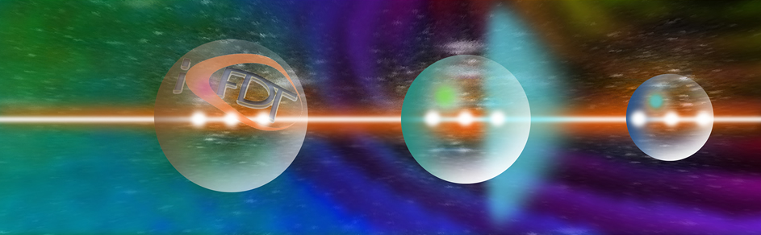




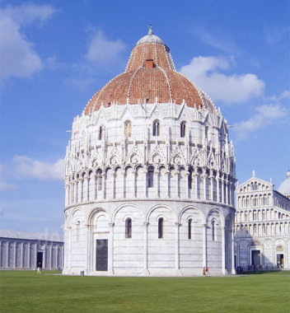
Novel “Octopus” diagnostics for the investigation of side stimulated Raman scattering at ICF laser intensities
Gabriele Cristoforetti
Intense laser irradiation Laboratory
Istituto Nazionale di Ottica
CNR – Pisa, Italy
gabriele.cristoforetti@cnr.it
www.ilil.ino.it
ICFDT7 - 7th International Conference on Frontier in Diagnostic Technologies

Slide 2
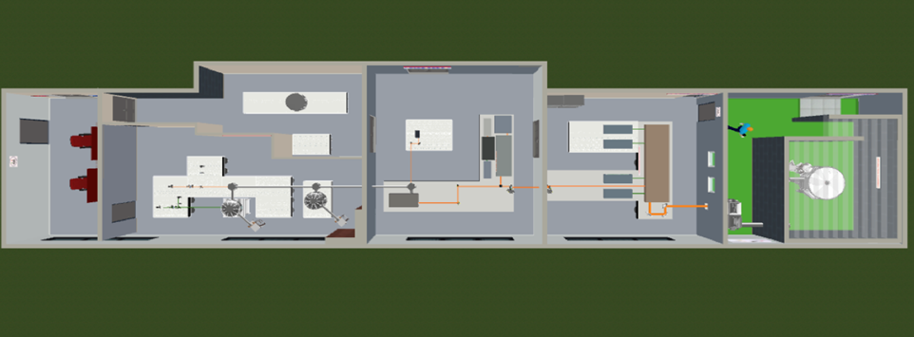
The Intense Laser Irradiation Lab
@ INO-CNR, Istituto Nazionale di Ottica, Pisa (Italy)
PEOPLE
  Leonida A. GIZZI (head)
Gabriele CRISTOFORETTI
Luca LABATE
Fernando BRANDI
Petra KOESTER
Federica BAFFIGI
Lorenzo FULGENTINI
Daniele PALLA
Martina SALVADORI
New laser sources and technology for ultraintense lasers
Laser-plasma acceleration
Flash radiotherapy research
Laser-plasma interaction for direct drive schemes of Inertial Confinement Fusion
TOPICS
Costanza PANAINO
Simona PICCININI
Emma HUME
Alessandro FREGOSI
Federico AVELLA
Davide GREGOCKI
Simon VLACHOS
Gianluca CELLAMARE
Paolo TOMASSINI
Relatore:
Nome relatore
Sub-PW Experimental Laser Facility
Evento:
Room Control
Radiobiology
Laser-Driven
Particles and Radiation
Laser Front End
10 TW, 10 Hz
Power Amplifier
up to 250 TW
Shielded target Area for PW experiments
http://ilil.ino.it

Slide 3
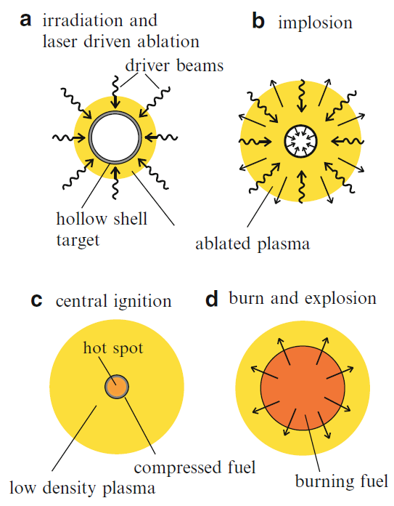
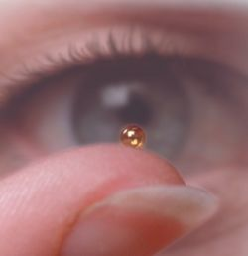
Direct-Drive Inertial Confinement Fusion
Inertial Fusion Energy (IFE) schemes investigated in Europe are based on Direct-Drive approach
Coupling efficiency 4-5% Compared to Indirect-Drive (NIF) we can compress larger mass capsules and we need lower pressures to get ignition 140 Gbar vs. 350 Gbar
simpler targets, more compatible with high-repetition rate operation and requirements of fusion reactors.

Slide 4
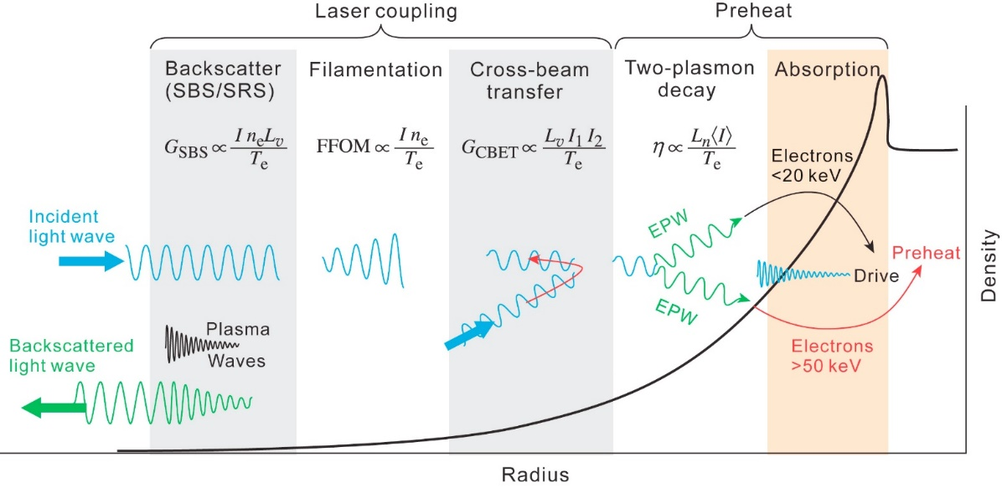
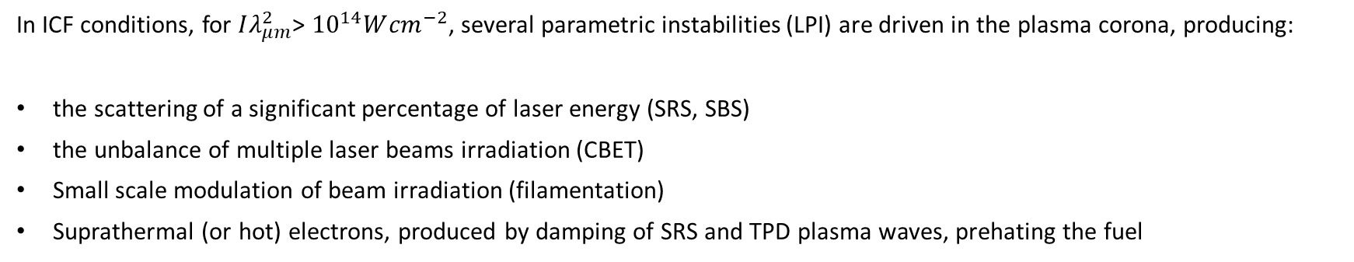

Laser Plasma Interaction
Laser
Froula et al., Plasma Phys. Control. Fusion 54 (2012) 124016
In ICF conditions, for $Iλ_{μm}^{2}$> ${10}^{14}W{cm}^{−2}$, several parametric instabilities (LPI) are driven in the plasma corona, producing:
the scattering of a significant percentage of laser energy (SRS, SBS)
the unbalance of multiple laser beams irradiation (CBET)
Small scale modulation of beam irradiation (filamentation)
Suprathermal (or hot) electrons, produced by damping of SRS and TPD plasma waves, prehating the fuel
$$\text{Effective} \text{collision} \text{frequency} \text{reduced} \text{by} \text{quiver} \text{motion} \text{in} \text{laser}$$
$$\text{field}$$
Our
Job

Slide 5

Side SRS: the most elusive LPI
Back SRS
Side SRS
λ₄(n₄)
λ₃(n₃)
EMW1
EMW0
EMW1
λ₂(n₂)
EMW0
λ₁(n₁)
EPW
Laser
EPW
$$∇n$$
n₁ n₂ n₃ n₄
The exit angle can be large and depends only on the density where SSRS is driven and on the density profile
SSRS grows more strongly along the spot in the S-direction and is preferentially scattered in the S plane
SSRS growth can be limited by the spot size or the density scalelength, depending on interaction conditions
Polarization
direction
P
SSRS growth
S
Laser spot

Slide 6
Side SRS: experiments
Early studies in the 70s:
SSRS can have a dramatic
impact on ICF performance
Very few observations in the 80s
Drake, PRL 53, 1739, 1984; Phy. Fluids, 31, 3130, 1988; Phys. Fluids B 1, 1082, 1989
I = 10¹⁴ – 2x10¹⁶ W/cm² no RPP
E_{SRSS} ≈1/2 E_{BRS}
No more
investigation
Why few observations ?
Recent experiments at Omega and NIF identify SSRS to be relevant and maybe dominant
Observation limited by collisional absorption of scattered light
Intrinsic difficulty to measure and quantify light scattered in the whole solid angle
Michel, Phys. Rev. E 99, 033203 (2019), Rosenberg, Phys. Plasmas 27, 042705 (2020), Hironaka, Phys.Plasmas 30, 022708 (2023)
TODAY
Limited by the beam size → high threshold
SSRS
BSRS
Our experiment at PALS in 2019
λ₀ = 351 nm L = L_{y} = 300 μm n = 0.08 n_{c}
I > 5x10¹⁵ W/cm²
G. Cristoforetti et al., HPLSE, (2019), Vol. 7, e51

Slide 7
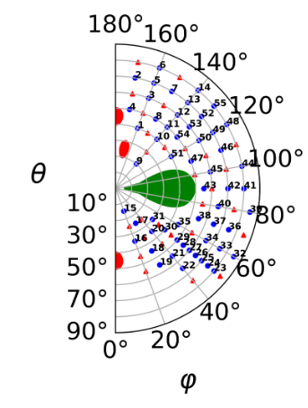
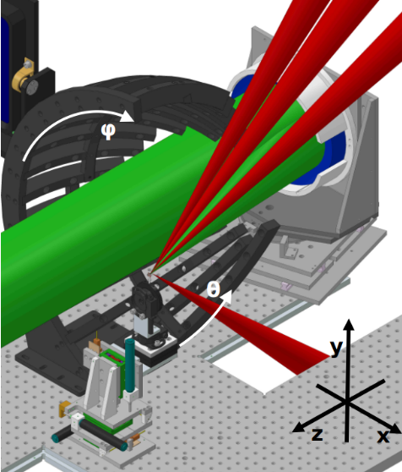
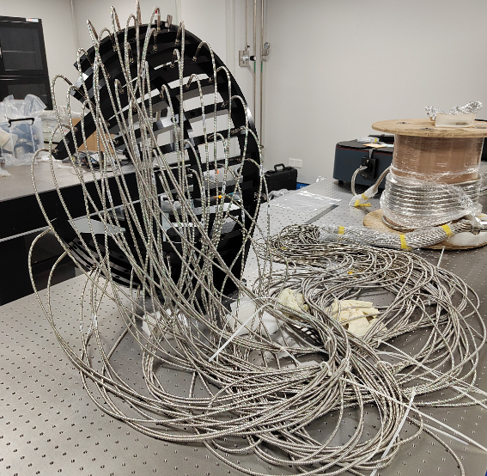
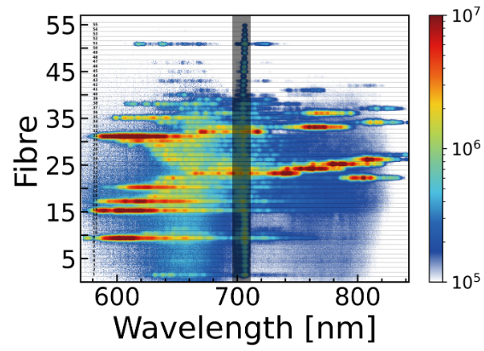
The VULCAN experiment (2023)
K. Glize P.I.
LASER IRRADIATION DESIGN (PLANAR)
4 driver/heating beams (long beams)
E=250 J x 4, λ=1053 nm, 3 ns
FWHM=800 μm, I ≈ 3x10¹³ W/cm²
interaction beam B8 bypassing compressor
E= 100 J, λ=527 nm, 15 ps
FWHM ≈ 300 μm, I ≈ 6x10¹⁵ W/cm² , f/# =3
Distribution of fibers in the solid angle
Conditions of large spots and large density wavelength (long plasmas)
A quarter of a sphere of radius 40 cm
Angular resolved SSRS spectra

Slide 8
The PALS experiment (2023)
Aim : Investigate angular distribution of SSRS light and dependence on laser spot size/shape and density scalelength
G. Cristoforetti¹, E. Hume¹, S. Agarwal^{2,3}, D. Batani⁴, D.E. Carleton², M. Cervenak⁵, P. Devi^{2,3}, R.Dudzak^{2,5}, D. Ettel², P. Gajdos⁵, K. Glize⁶, S. Jelinek^{2,3,5}, L. Juha², P. Koester¹, M. Krupka^{2,5}, M. Krus⁵, H.Larreur^{4,7}, G. Malka⁴, D. Mancelli^{8,9}, P.E. Masson-Laborde¹⁰, A. Morace², J. Myatt¹¹, Ph. Nicolai⁴, O. Renner^{2,5,12}, D. Singapulli⁴, S. Singh^{2,5}, M. Tatarakis⁸, Y. Wang¹³, N. Woolsey¹³, X. Zhao¹⁴, and L.A. Gizzi¹
1 INO-CNR, Pisa, Italy
2 Institute of Physics of the CAS, Prague, Czech Republic
3 Faculty of Mathematics and Physics, Charles University, Prague, Czech Republic
4 Université de Bordeaux, CNRS, CEA, CELIA, Talence, 33405, France
5 Institute of Plasma Physics of the CAS, Prague, Czech Republic
6 Rutherford Appleton Lab, CLF, Didcot, UK
7 University of Salamanca, Salamanca, Spain
8 Institute of Plasma Physics and Lasers, Hellenic Mediterranean University, Rethymnon, Greece
9 Department of Electronic Engineering, Hellenic Mediterranean University, Chania, Greece
10 CEA, DAM, DIF, Arpajon, France
11 University of Alberta, Edmonton, Canada
12 The Extreme Light Infrastructure ERIC, Dolni Brezany, Czech Republic
13 York Plasma Institute, University of York, York, United Kingdom
14 Shanghai Jiao Tong University, Shanghai, China

Slide 9
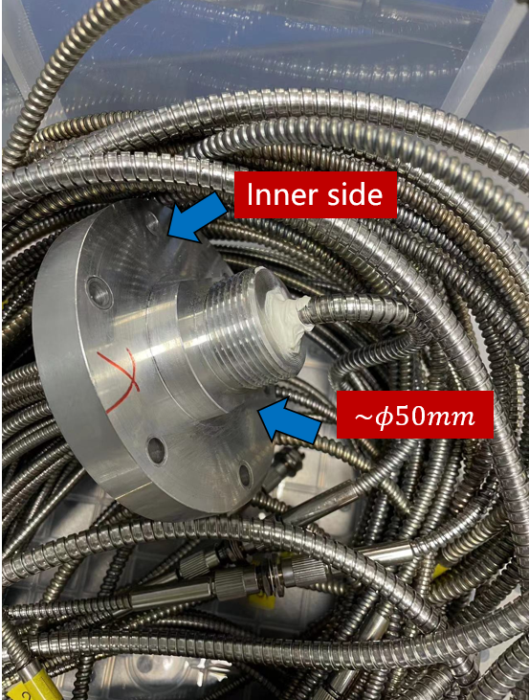
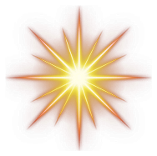
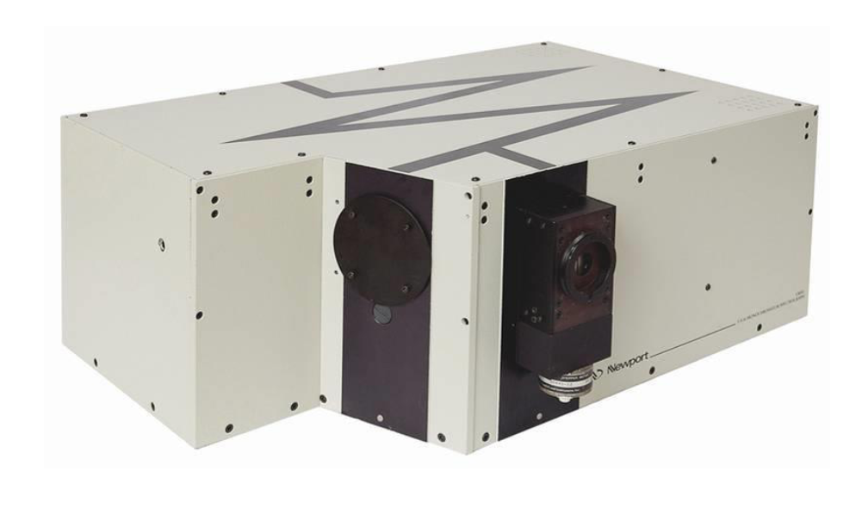
Experimental Setup: the «Octopus»
θ
Polar
angle
Fibers coupled
to Spectrometer
φ
Azimuthal
angle
Arm «S»
Arm «P»
Laser Beam
TCC
slit
Czerny Turner
spectrometer
CCD

Slide 10
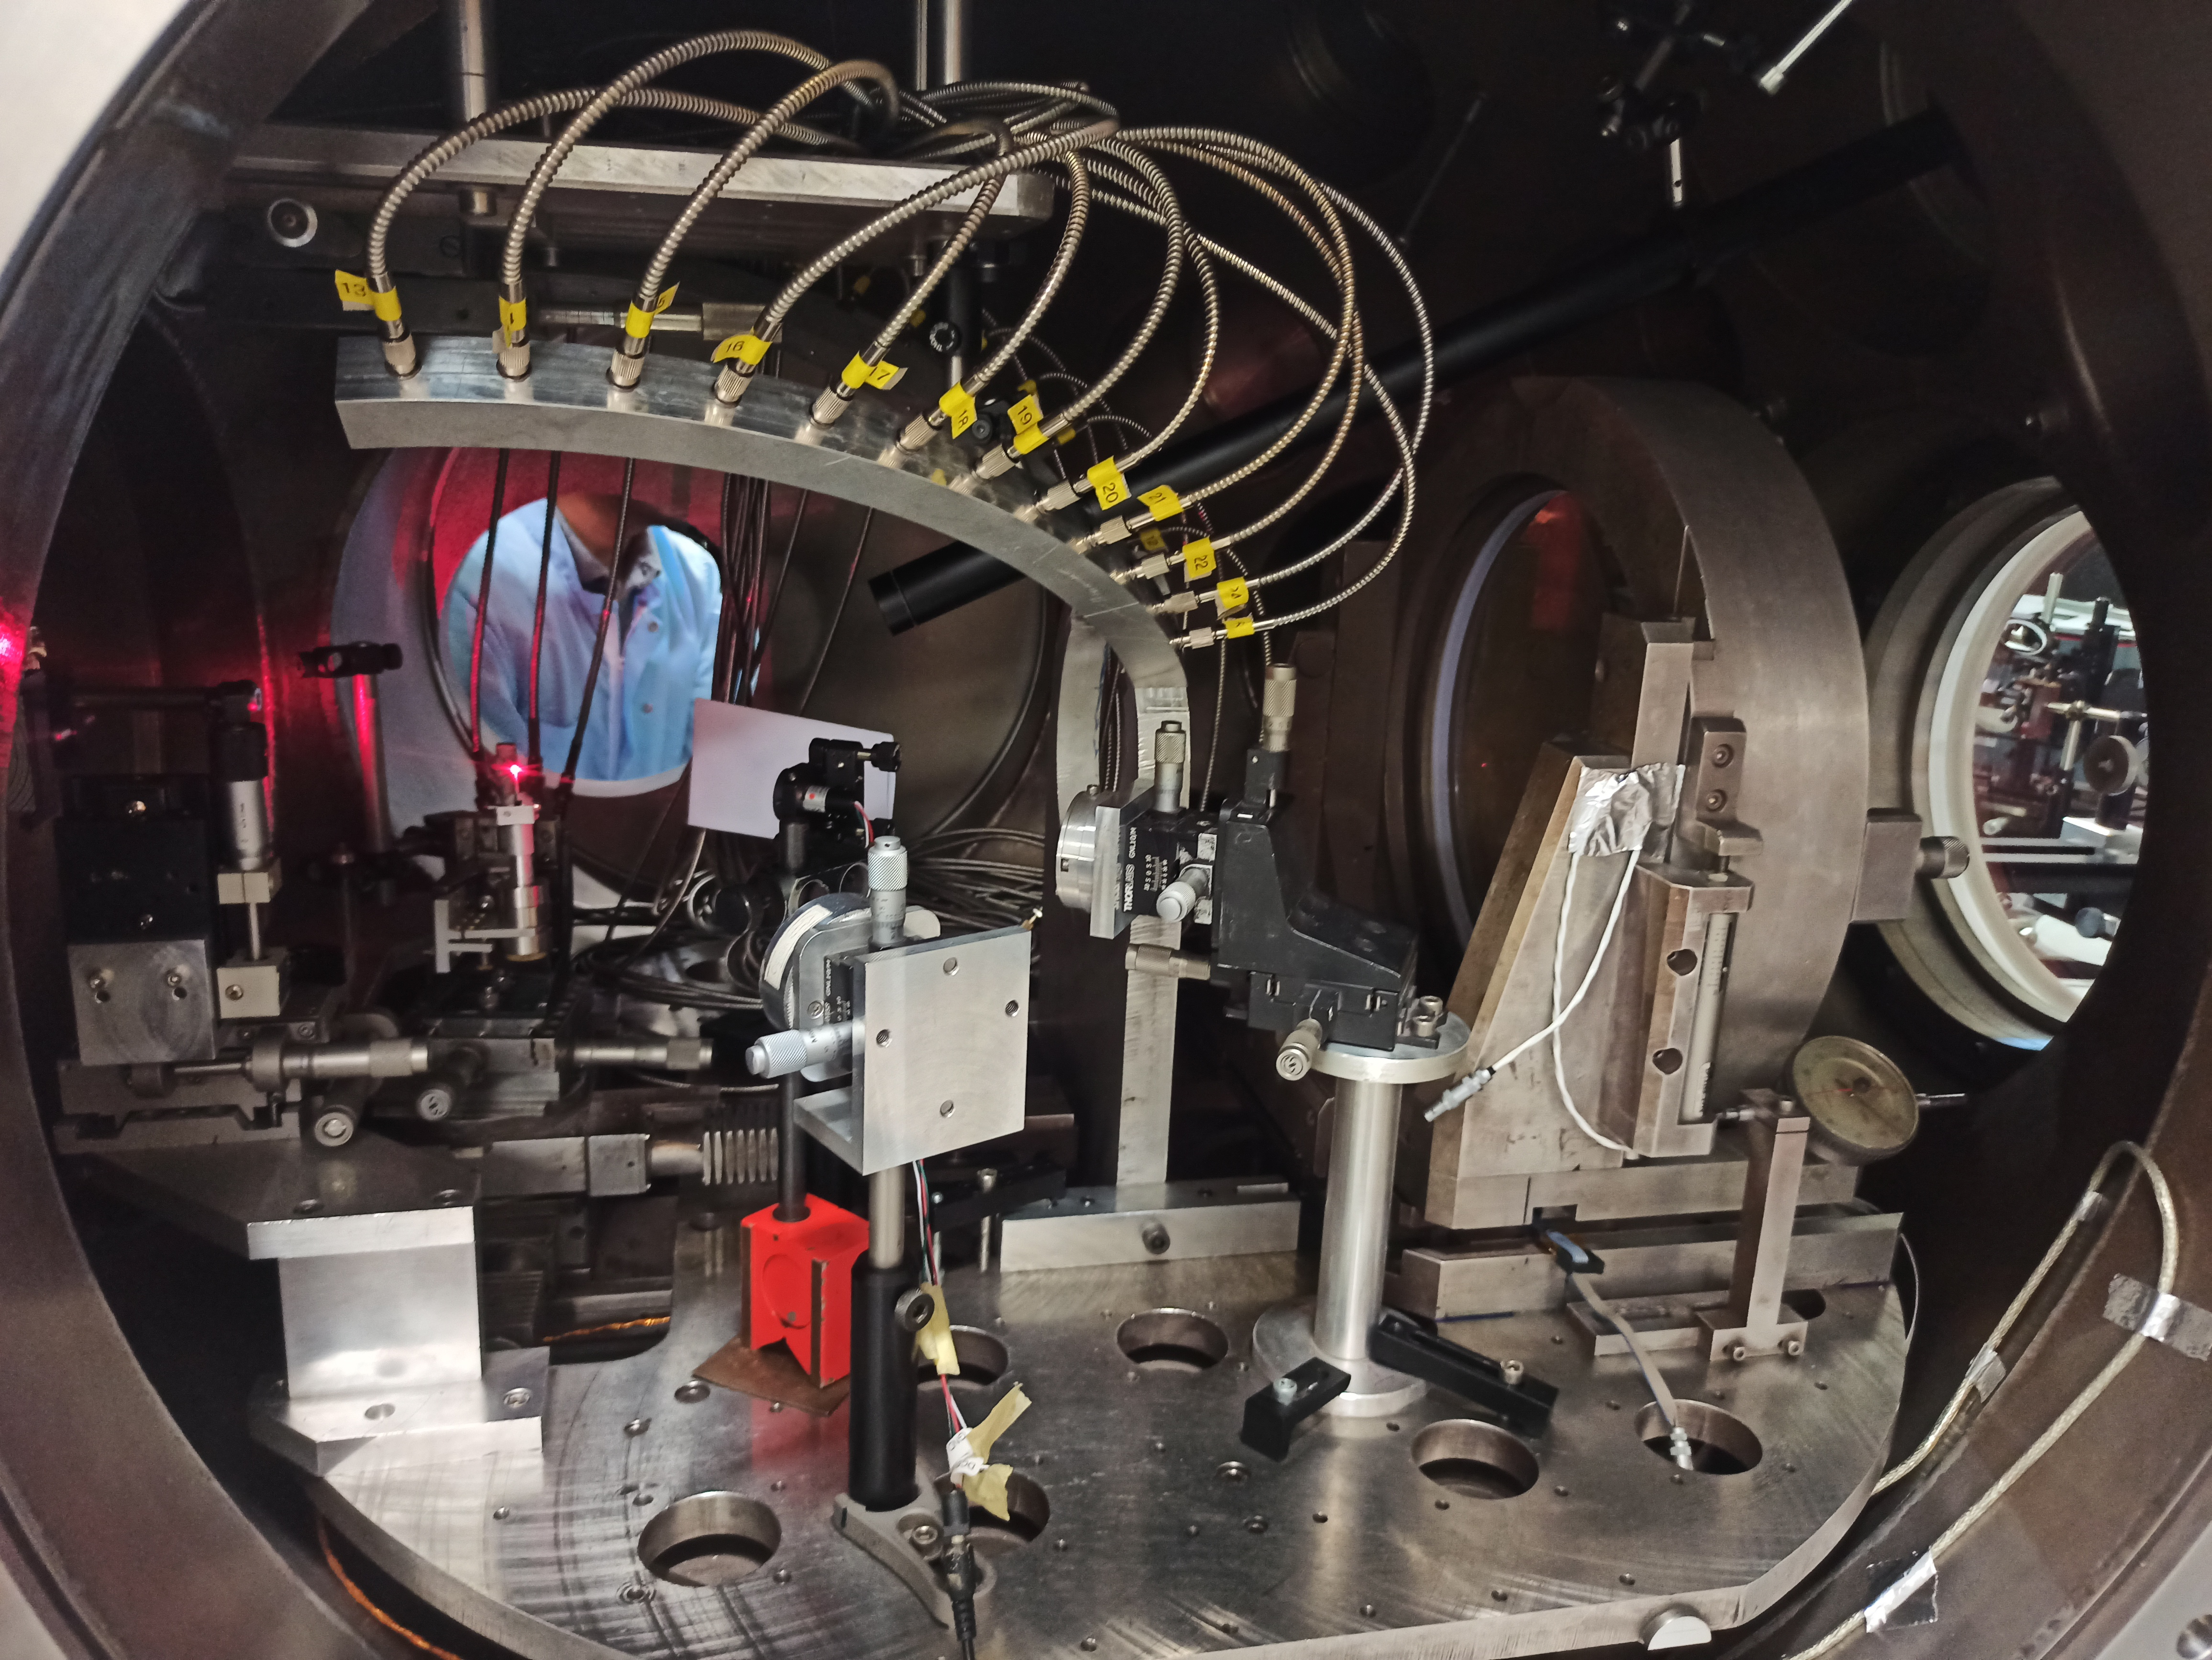
LASER

Slide 11
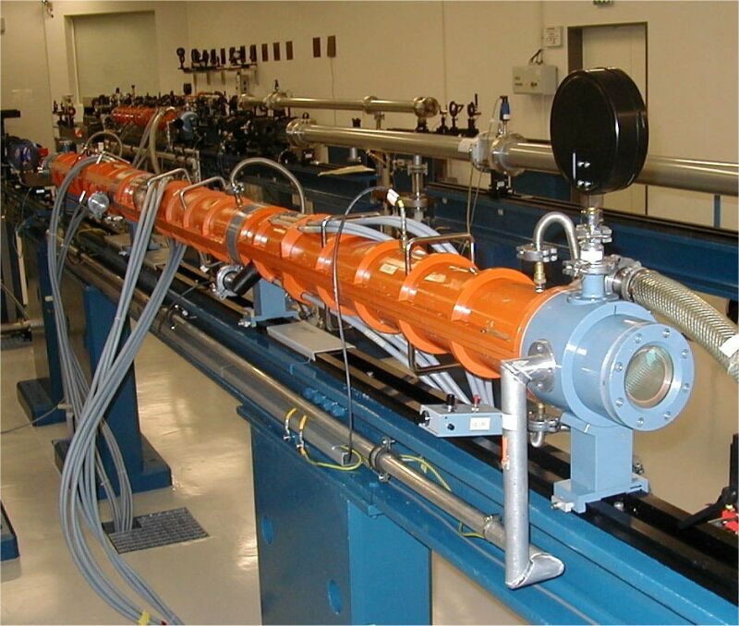
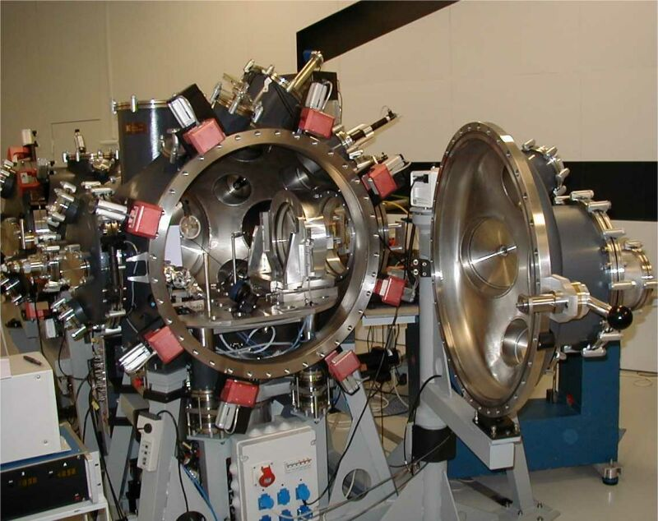
Other diagnostics for characterizing laser-plasma interaction
Shots @ 3ω
λ = 438 nm
Laser Energy : 100 – 230 J
Duration : 270 – 350 ps
Intensity : (0.5-1.5) x 10¹⁶ W/cm²

Slide 12
Interaction Conditions
Dependence on focal spot size and shape
circular
P
elliptical
P
elliptical
P
100 μm
60 μm
S
S
S
40 μm
Focal spot shape is changed by laser phase manipulation
medium SSRS growth
small SSRS growth
large SSRS growth
THICK (multilayer) TARGETs
THIN FOIL TARGETs
Dependence on electron density scalelength
20, 60 or 100
μm
μm
μm
Laser
5
5
3
2
μm
Al coating
CH - PyC
Cu
Al coating
Al coating
Al coating
Density scalelength varies because of the different plasma hydrodynamics
CH - PyN
CH - PyN
CH - PyN
$$L=n/(dn/dx)$$ (at 100 ps after the laser peak) | 63 | 76 | 86 | 115
μm

Slide 13
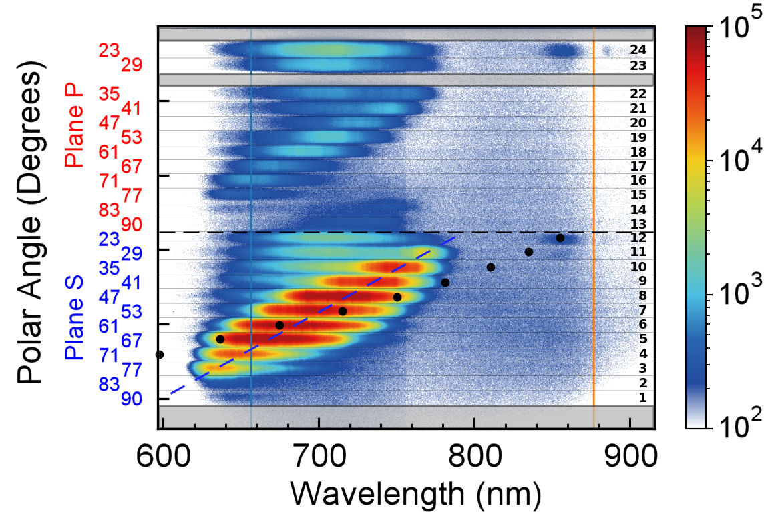
Side SRS spectra
(thick target)
SSRS spectrum is evident
There is a clear relation
λ − θ, i.e. n - θ
The SSRS is much stronger
in S-plane vs. P-plane
S

Slide 14
Side SRS spectra
(thick target)
Near Backward SRS
at small polar angles.
Similar in P and S planes
FABS spectrum
Backward SRS
S
ω/2 (TPD) signal at
small angles as expected

Slide 15
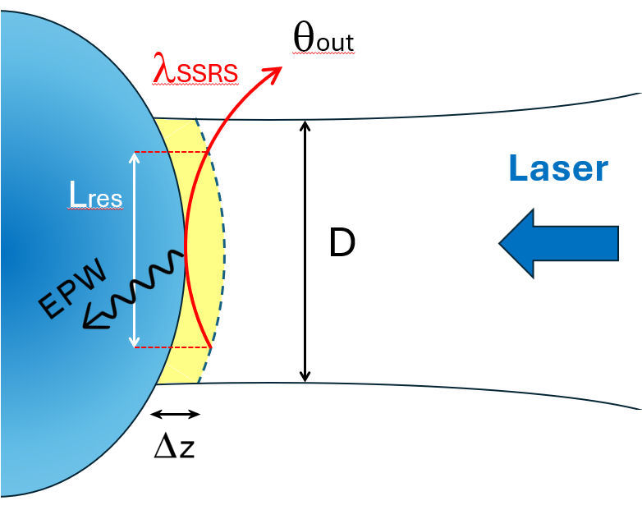
Dependence on spot size
D (μm)
D = 40 μm
RPP2 S
100
SSRS intensity increases with the spot size D in the S direction
RPP1
60
RPP2 P
20
D = 60 μm
From raytracing in 2D density maps we find SSRS resonance length
L_{res} ≈ 70 μm
RPP1, RPP2P
D = 100 μm
D < L_{res}
SSRS growth is limited by D

Slide 16
Thick Target: Al flash + 60 μm CH + 7 μm Cu
Dependence on density scalelength L
(thick vs. thin targets)
Side SRS
BSRS and Near-BSRS is strongly affected by density scalelength
SSRS is not affected by density scalelength
BSRS - FABS calorimeter
SSRS - Octopus
L ≈ 60–80 μm
L
Thin Target: Al flash + 2 μm CH
RPP1
Near BSRS - Octopus
BSRS is limited by L
SSRS is limited by the spot size
L ≈ 80–300 μm
RPP2 S & P

Slide 17
Conclusions
Octopus diagnostics can be easily used in laser-plasma experiments and allows angular-resolved spectroscopy of Side Stimulated Raman Scattering along polar angles in P and S planes
The combination of Octopus with focal spot manipulation by RPP technology allows the investigation of 3D angular emission and its dependence on laser spot geometry and laser polarization
In next step we aim at quantify SSRS efficiency, which implies an upgrade of Octopus diagnostics with more arms/fibers, as in the Vulcan experiment.

Slide 18

THANK YOU FOR YOUR ATTENTION !
References:
G. Cristoforetti et al., Euro Phys. Lett., 117, 35001, 2017
G. Cristoforetti et al., Phys. Plasmas 25, 012702, 2018
D. Batani et al., Nucl. Fusion, 59, 032012, 2019
G. Cristoforetti et al., HPLSE, (2019), Vol. 7, e51
S. Baton et al., High Energy Density Physics 36, 100796, 2020
P. Koester et al., Review of Scientific Instruments 92, 013501, 2021
G. Cristoforetti et al., HPLSE, (2021), Vol. 9, e60
T. Tamagawa et al., Rev. Sci. Instrum., 93, 063505, 2022
G. Cristoforetti et al., HPLSE, Vol. 11, e24, 2023
K Kawasaki, Phys. Rev. Research 5, 033051, 2023
F. Wasser et al., Rev. Sci. Instrum. 94, 093503, 2023
G. Cristoforetti et al, Sci. Rep., 13, 20681, 2023
F. Wasser et al., Phys. Plasmas 31, 022107, 2024
*** papers on SSRS experiments in preparation ***
More info at www.ilil.ino.cnr.it
This work has been carried out within the framework of the EUROfusion Consortium, funded by the European Union via the Euratom Research and Training Programme (Grant Agreement No 101052200 — EUROfusion). Views and opinions expressed are however those of the author(s) only and do not necessarily reflect those of the European Union or the European Commission. Neither the European Union nor the European Commission can be held responsible for them. The involved teams have operated within the framework of the Enabling Research Project: ENR-IFE.01.CEA “Advancing shock ignition for direct-drive inertial fusion"

Slide 19
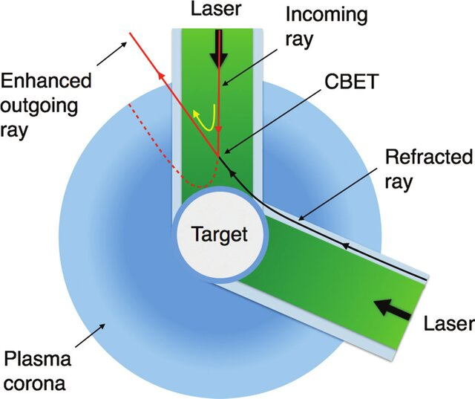

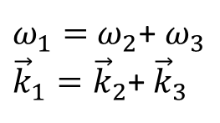
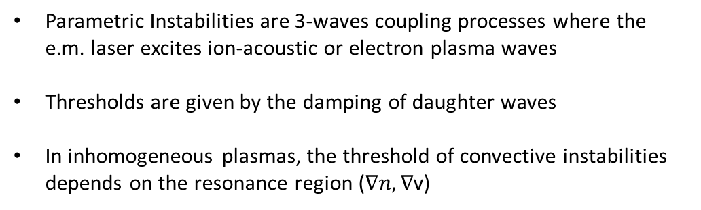
Parametric instabilities
Parametric Instabilities are 3-waves coupling processes where the e.m. laser excites ion-acoustic or electron plasma waves
Thresholds are given by the damping of daughter waves
In inhomogeneous plasmas, the threshold of convective instabilities depends on the resonance region ($∇n, ∇$v)
$ω_{1}=$ $ω_{2}$+ $ω_{3}$
${\vec{k}}_{1}={\vec{k}}_{2}$+ ${\vec{k}}_{3}$
Stimulated Raman Scattering (SRS)
absolute
convective
CBET
~10¹⁴ W/cm²
~10¹⁵ W/cm²
Stimulated Brillouin Scattering (SBS) &
Cross Beam Energy Transfer (CBET)
~10¹⁴ W/cm²
$$\text{Effective} \text{collision} \text{frequency} \text{reduced} \text{by} \text{quiver} \text{motion} \text{in} \text{laser}$$
$$\text{field}$$
Two Plasmon Decay (TPD)
~10¹⁴ W/cm²

Slide 20
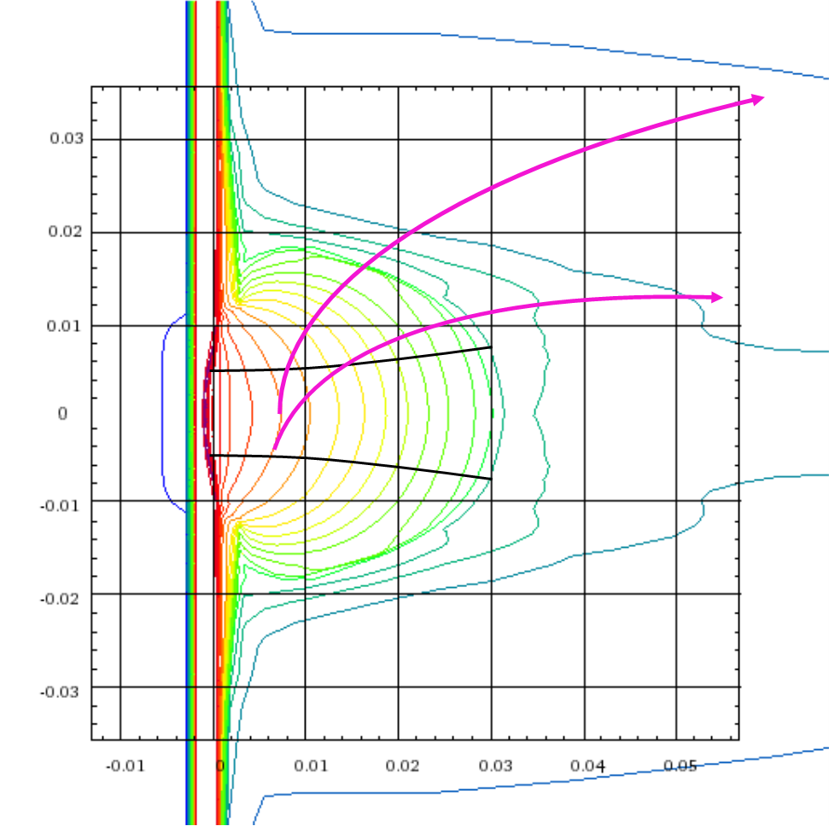
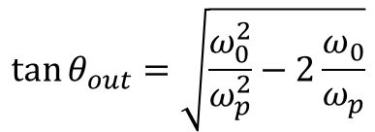
Side SRS spectra
(thick target)
Assuming 1D plasma
$$\tan{θ_{out}=\sqrt{\frac{ω_{0}^{2}}{ω_{p}^{2}}−2\frac{ω_{0}}{ω_{p}}}}$$
Why the angular distribution is different from the expected one ?
Plasma curvature affecting refraction?

