Slide 1

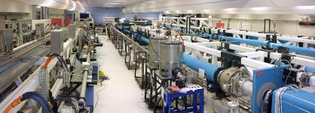
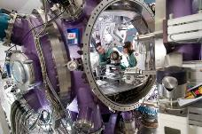
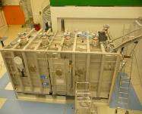





Review of the Ignition campaign on the National Ignition facility
Sébastien Le Pape
hall laser LULI2000
enceinte d'expérience MILKA
compresseur APOLLON

Slide 2
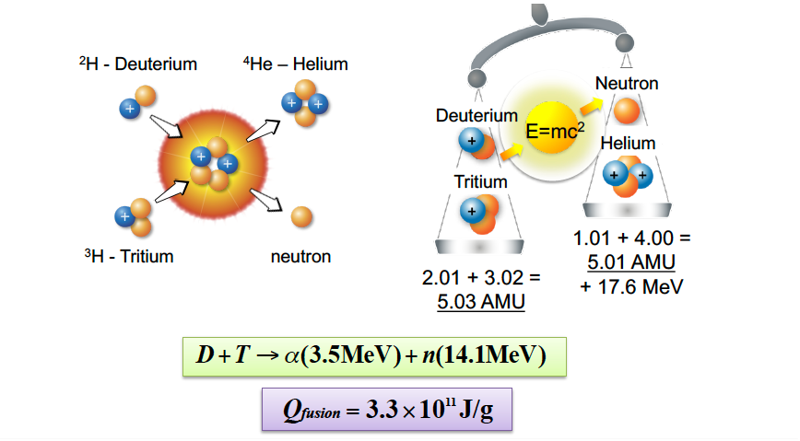
How to produce energy through fusion reaction

Slide 3

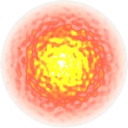
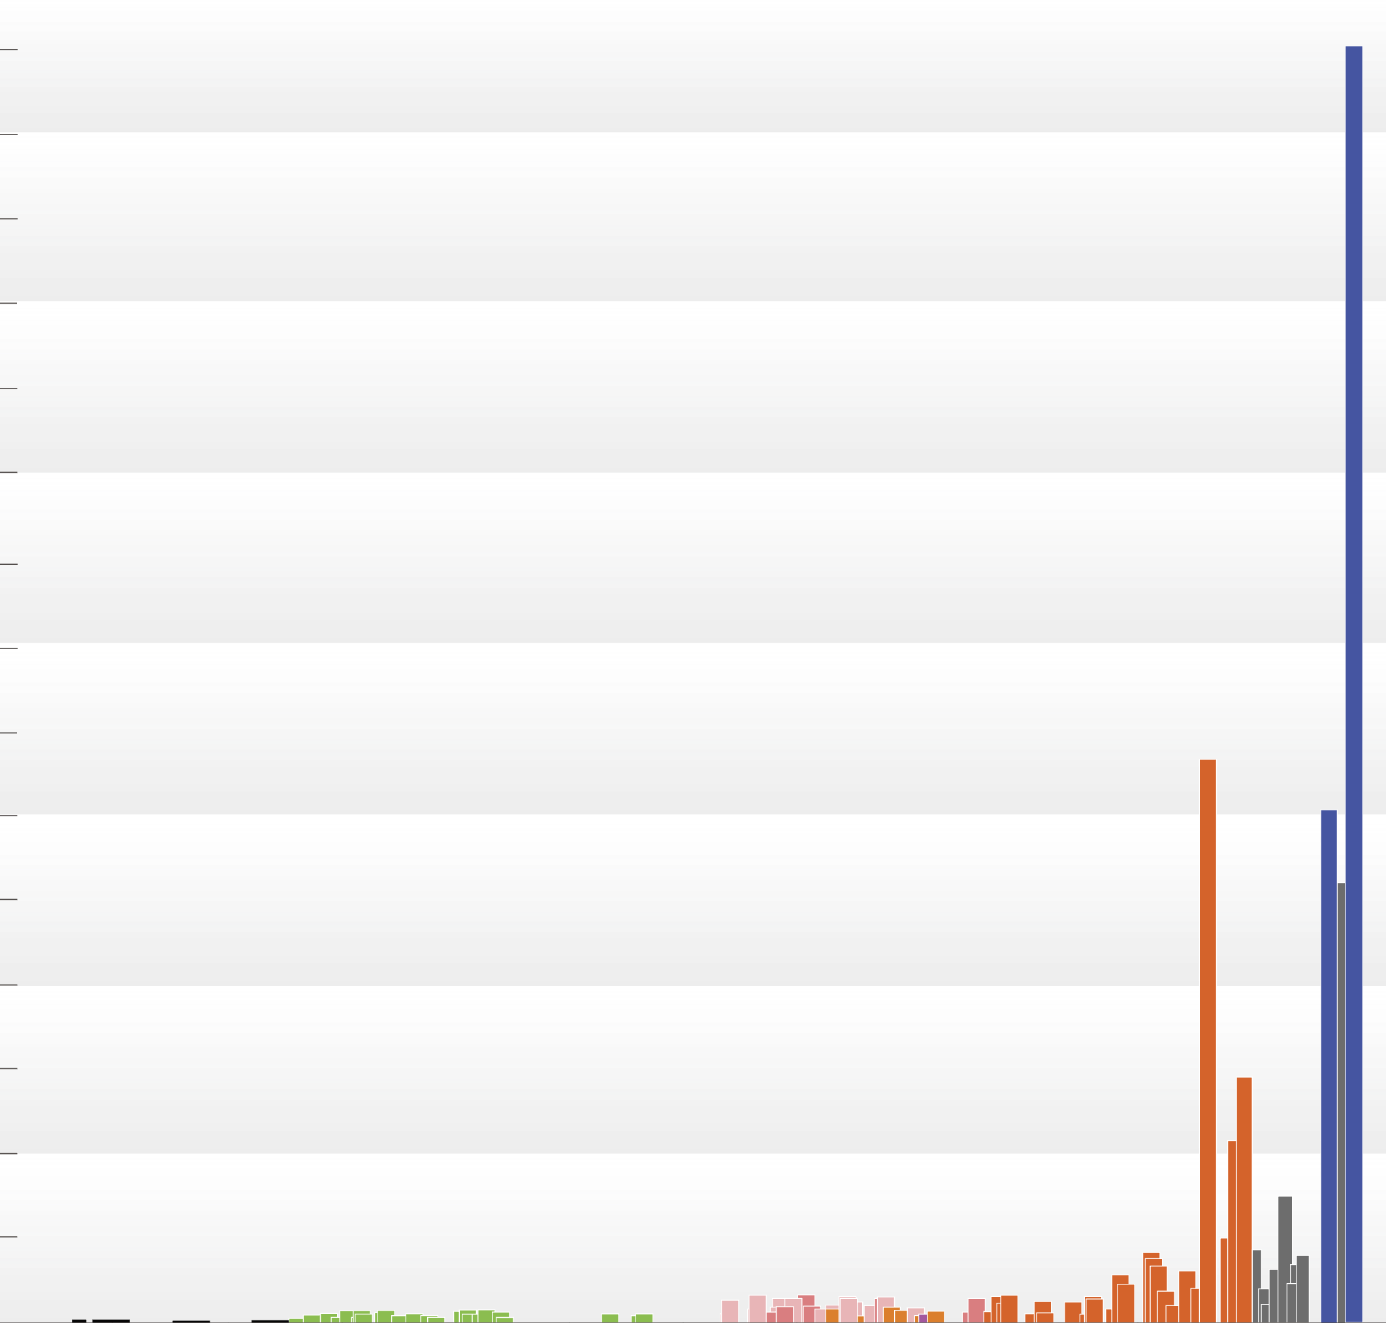
On December 5, 2022, NIF exceeded the threshold* for ignition, with 3.15 MJ of fusion output for 2.05 MJ laser delivered
3
NIF shot N221204 achieved a target gain of 1.5 and a capsule gain of ~12
Preceding experiments quickly progressed from 100’s kJ – 1.35 MJ ^{1,2,3} and built understanding of ignition.
Achieving such yields required effort to improve:
  Target quality
  Laser accuracy and increased energy delivery
  Diagnostic capabilities
  Design
Improved understanding has led to design refinements enabling 5 shots that have exceed a MJ since Fall 2022
2.8
2.6
2.4
2.2
Max laser energy available
2.0
1.8
Fusion yield (MJ)
1.6
1.4
1.2
1.0
0.8
0.6
0.4
0.2
0
2011
2012
2013
2014
2015
2016
2017
2018
2019
2020
2021
2022
Year

Slide 4
There are at least three ways to achieve nuclear fusion
by Laser Implosion
Density
Temperature
Confinement time
10⁴ x solid
1 keV
10⁵ years
solid / 10⁸
10 keV
seconds
10³ x solid
10 keV
10’s ps

Slide 5
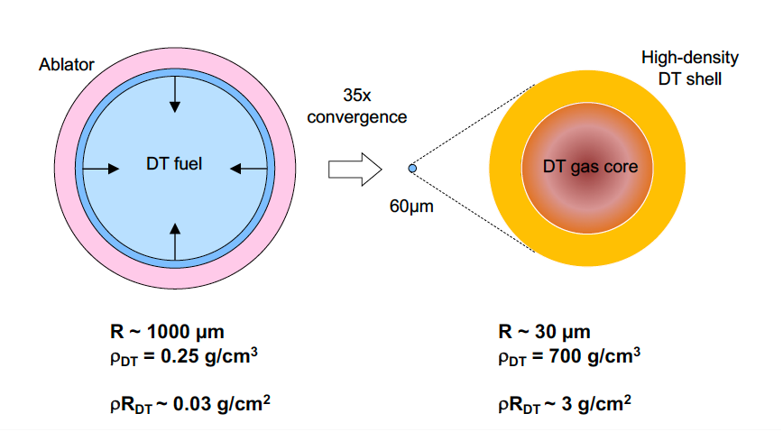
The idea of ICF is to compress fuel to thermonuclear conditions

Slide 6
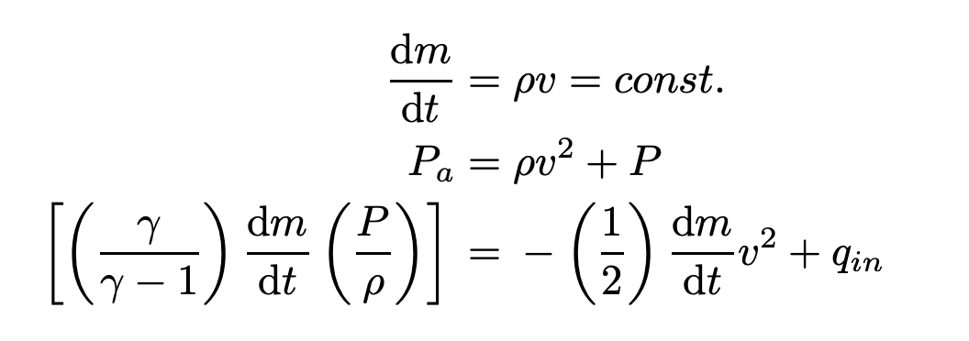
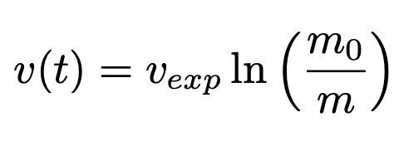
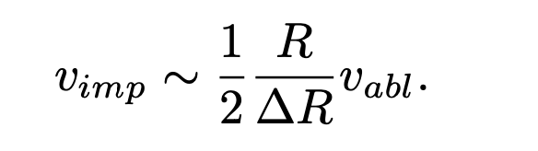
The capsule velocity follows a simple rocket model
Starts with 3 conservation equations
Mass
Momentum
Energy
Where m₀ is the initial mass and m
the initial minus the ablated mass
Vexp = expansion velocity of ablated material
This leads to the rocket equation
You can also write
This means the more you ablated the faster you go but hydro instabilities might kick in

Slide 7
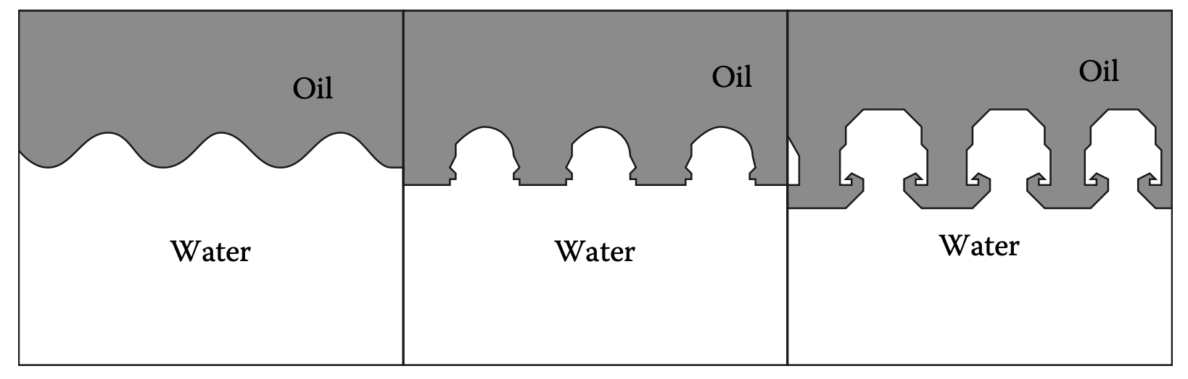
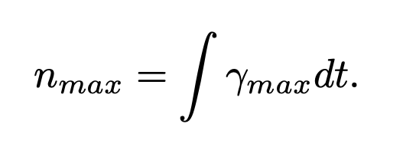
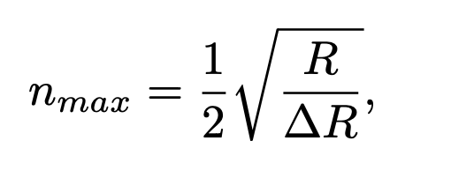
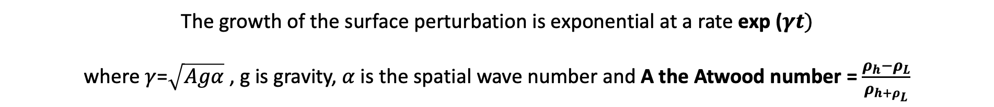


Hydrodynamic instabilites : Rayliegh-Taylor
Dense matter pushes on light matter
$$ρ_{H}$$
g
$$ρ_{L}$$
The growth of the surface perturbation is exponential at a rate exp ($γt)$
where $γ$=$\sqrt{Agα}$ , g is gravity, $α$ is the spatial wave number and A the Atwood number = $\frac{ρ_{h}−ρ_{L}}{ρ_{h+ρ_{L}}}$
So high R/$∆R is need for high velocity but limit is set by hydro stability$

Slide 8
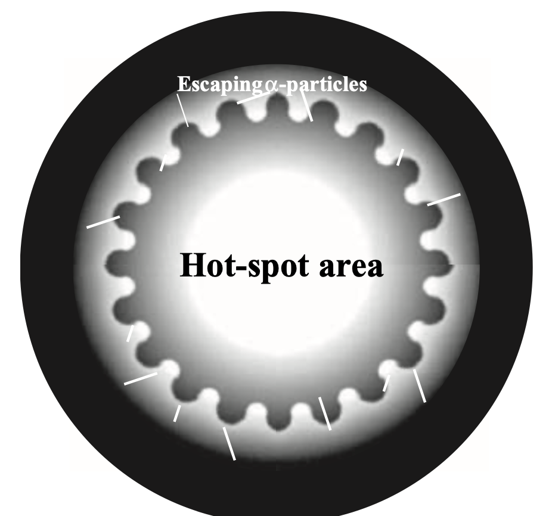
Hydrodynamic instabilites : Rayliegh-Taylor
Why does it matter?
Alter the quality of the piston that compresses the fuel
Increase the losses due to radiation and thermal conductivity
Lead to loss of efficient heating by alpha particles
Caused by
- Defect of the target surface
- Defect in the irradiation homogeneity

Slide 9
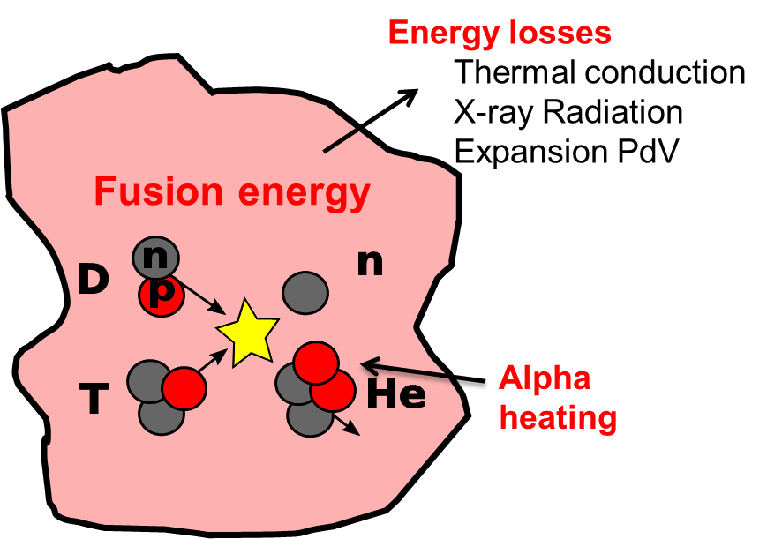
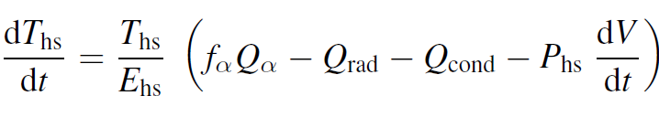
Ignition is about power balance in the hot spot
Fusion energy > losses if Pressure (P) X confinement time (τ) exceeds Lawson’s criterion
pdV provides heat until minimum volume, then becomes a loss
**H. Abu-Shawareb et al., Physical Review Letters 129, 075001 (2022).

Slide 10
Hot spot central ignition
Ablator
(CH, HDC)
Cold fuel
ρR~1 g/cm²
100’s eV
~20-30x convergence
DT ice
Hotspot
T>5 keV
ρR>0.3 g/cm²
DT gas
>380 km/s
~40 µm
~1 mm radius
mass of DT ~200 μg -> 67 MJ
peak velocity ~380 km/s
energy needed to heat 200 µg to 5 keV = 116 kJ
but we only need to heat enough DT for ρR~0.3 g/cm²
if ρ_{hs}~100 g/cm³ ⇒ r_{hs}~30 µm, and m_{hs}~11 μg, so energy required in the hotspot ~6 kJ
(hence, the term central hotspot ignition)
⇒ fuel kinetic energy ~14 kJ

Slide 11
There are at least three ways to achieve nuclear fusion
by Laser Implosion
Density
Temperature
Confinement time
10⁴ x solid
1 keV
10⁵ years
solid / 10⁸
10 keV
seconds
10³ x solid
10 keV
10’s ps

Slide 12
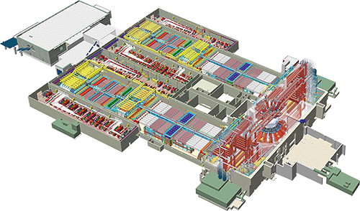
~600 MJ of electricity is used to generate 1.8MJ/480TW
192 Beams
Energy: 1.8 MJ
Power: 500 TW
(1000x the power in the US electrical grid)
Frequency Tripled Nd Glass
Wavelength: 351 nm
Pulselength: ~25 ns

Slide 13
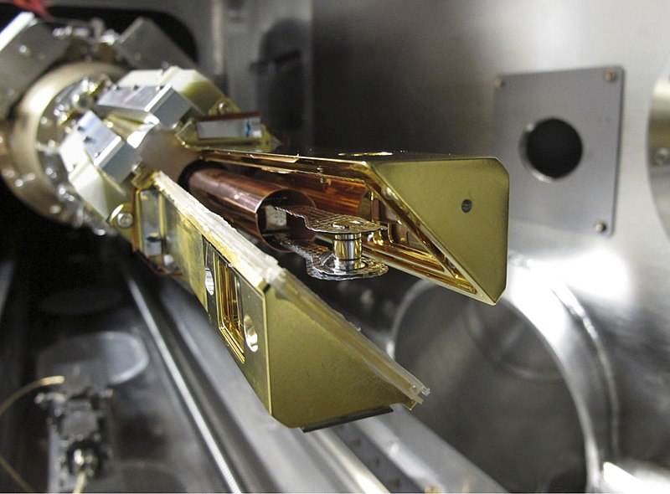
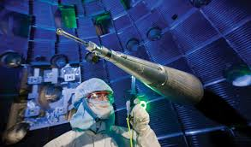

Slide 14
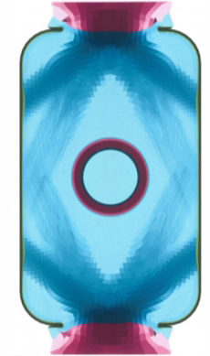
~1.3MJ of X-rays is generated by the interaction of the laser with a high Z cavity
Laser pulse
Radiative temp
Major challenge: laser beam pointing and energy repartition in the hohlraum must be designed to symmetrically drive the capsule

Slide 15

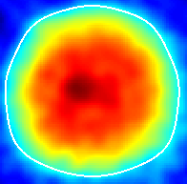
~150 KJ of energy is absorbed by the 2 mm diameter low Z capsule
X-ray self-emission image from a DT implosion at peak compression
Diameter ≈ 50 μm
2 mm

Slide 16
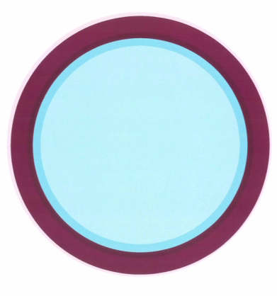
~20 KJ of kinetic energy is reached at peak velocity of the capsule
Major challenge: The capsule must be designed and driven to withstand hydro instabilities

Slide 17
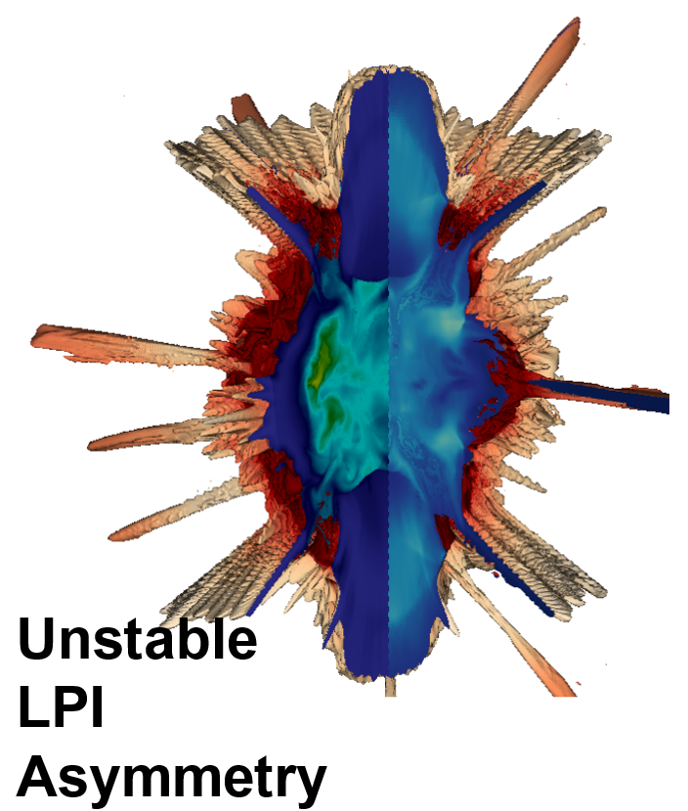
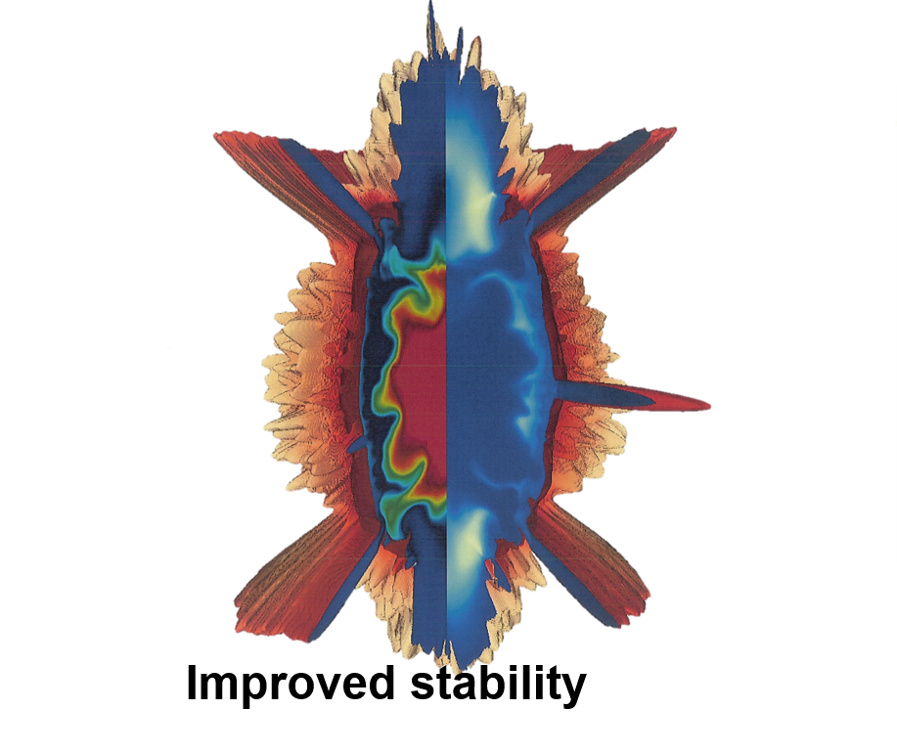
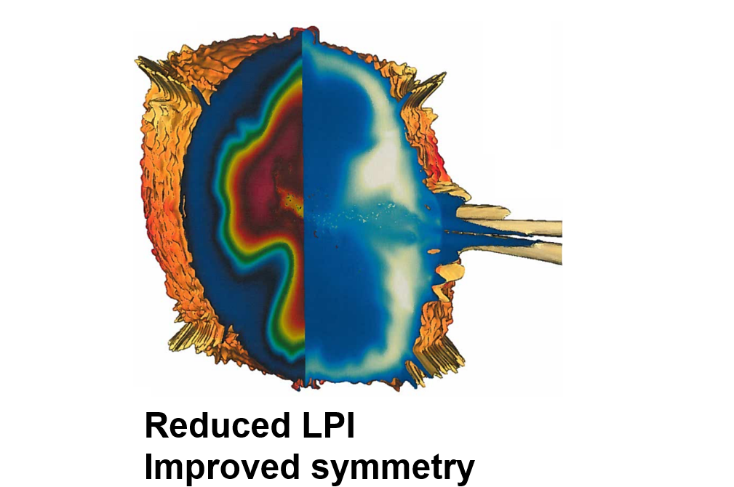
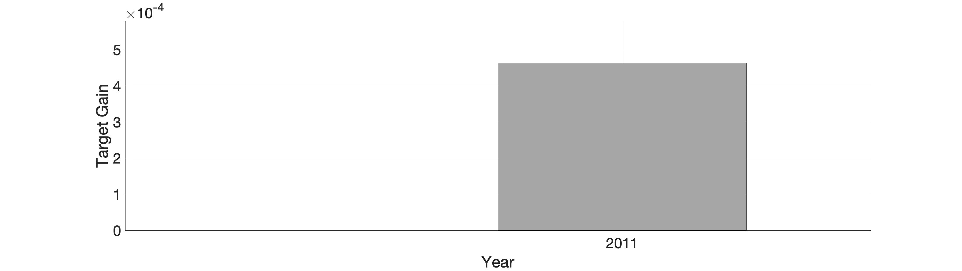
More than 800 experiments conducted over a decade enabled an increase in target gain of >1000X and fusion ignition
Increased energy coupling

Slide 18
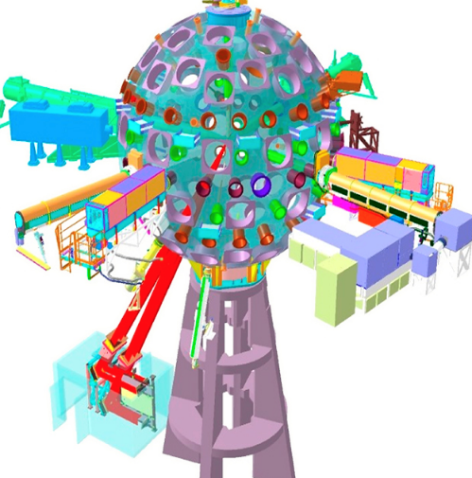


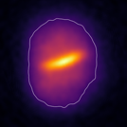
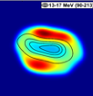

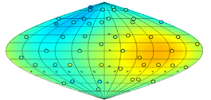

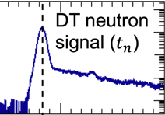
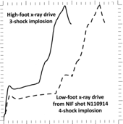

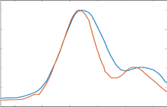
Dozens of diagnostics are applied to each experiment improving understanding
Hot Spot and Fuel Shape
Shock Speeds, Timing
Liquid D₂
t
Hot Spot Electron
Temperature and Impurities
Yield / Fuel Uniformity
Ion Temperature,
Hot Spot Velocity, Fuel Areal Density, Yield
DT* Fuel Uniformity
Hohlraum Radiation Flux
Burn Width, Bang Time
300
Spectrum
250
200
150
Tr source (eV)
100
500
t (ns)
600
50
0
0
5
10
15
20
25
8.8
9.0
t (ns)
Time (ns)
9.2

Slide 19
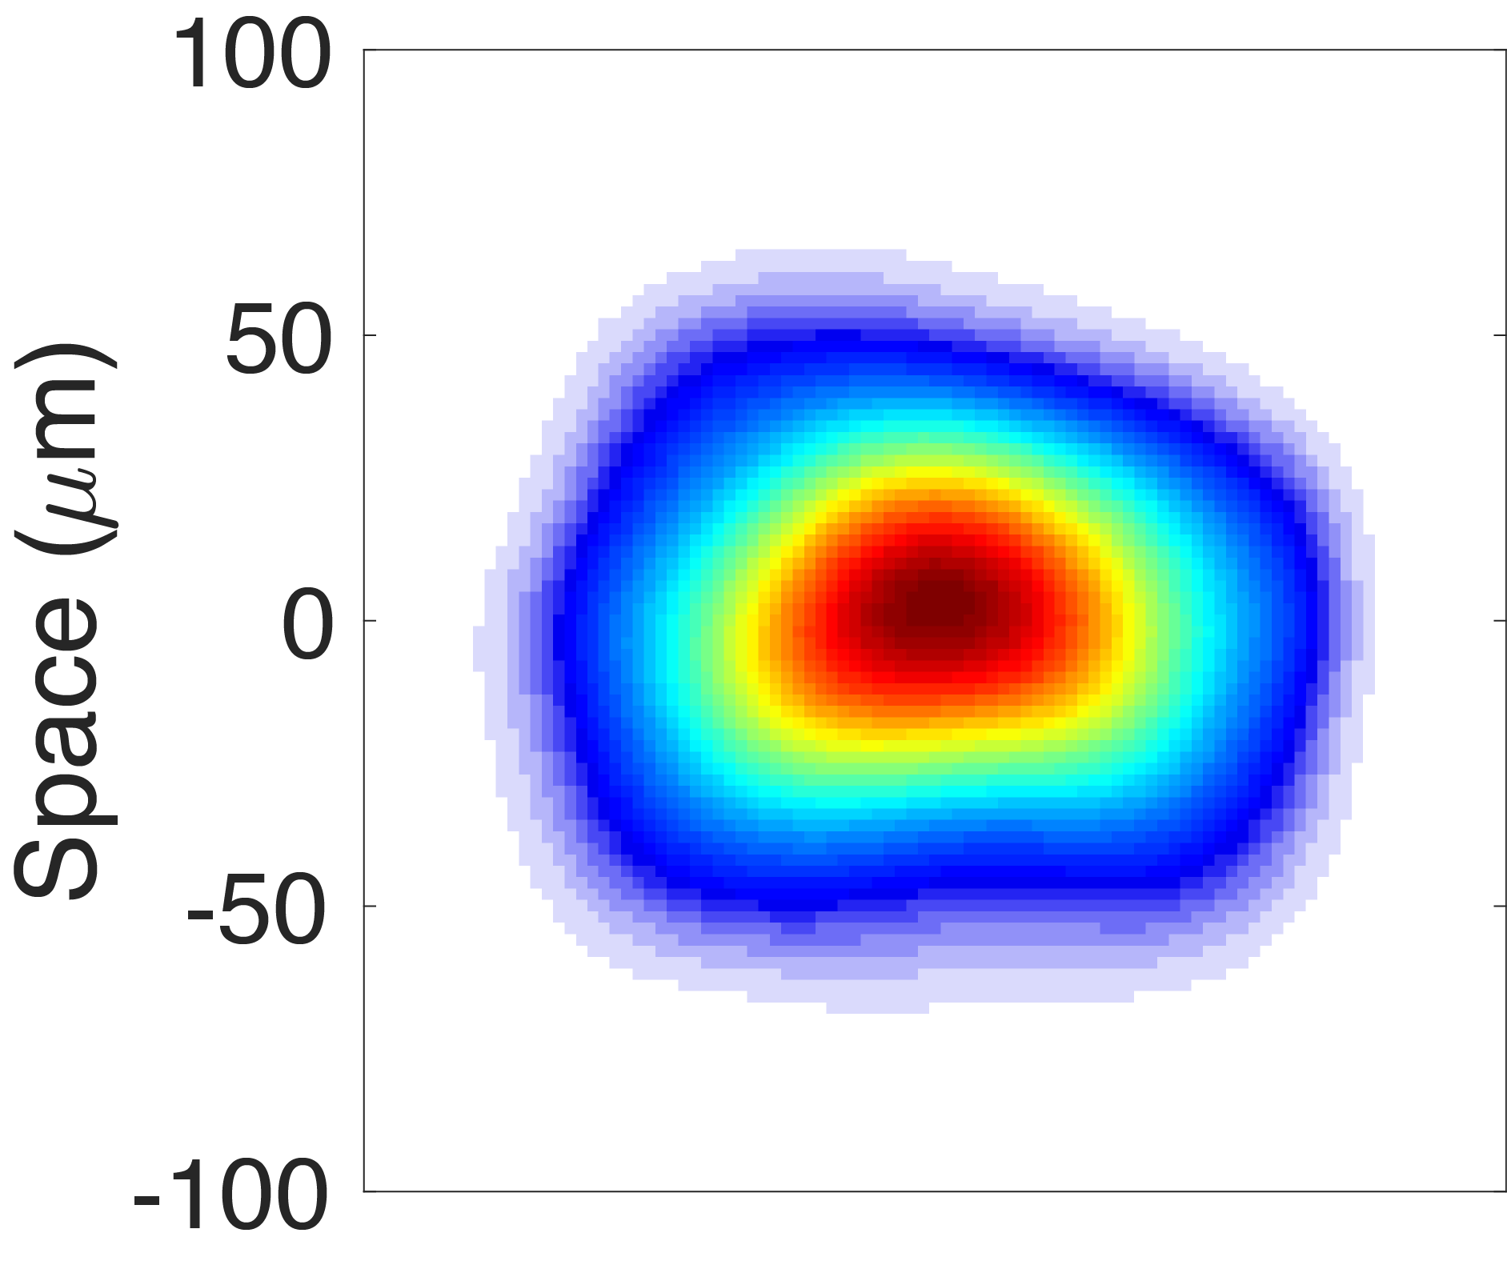
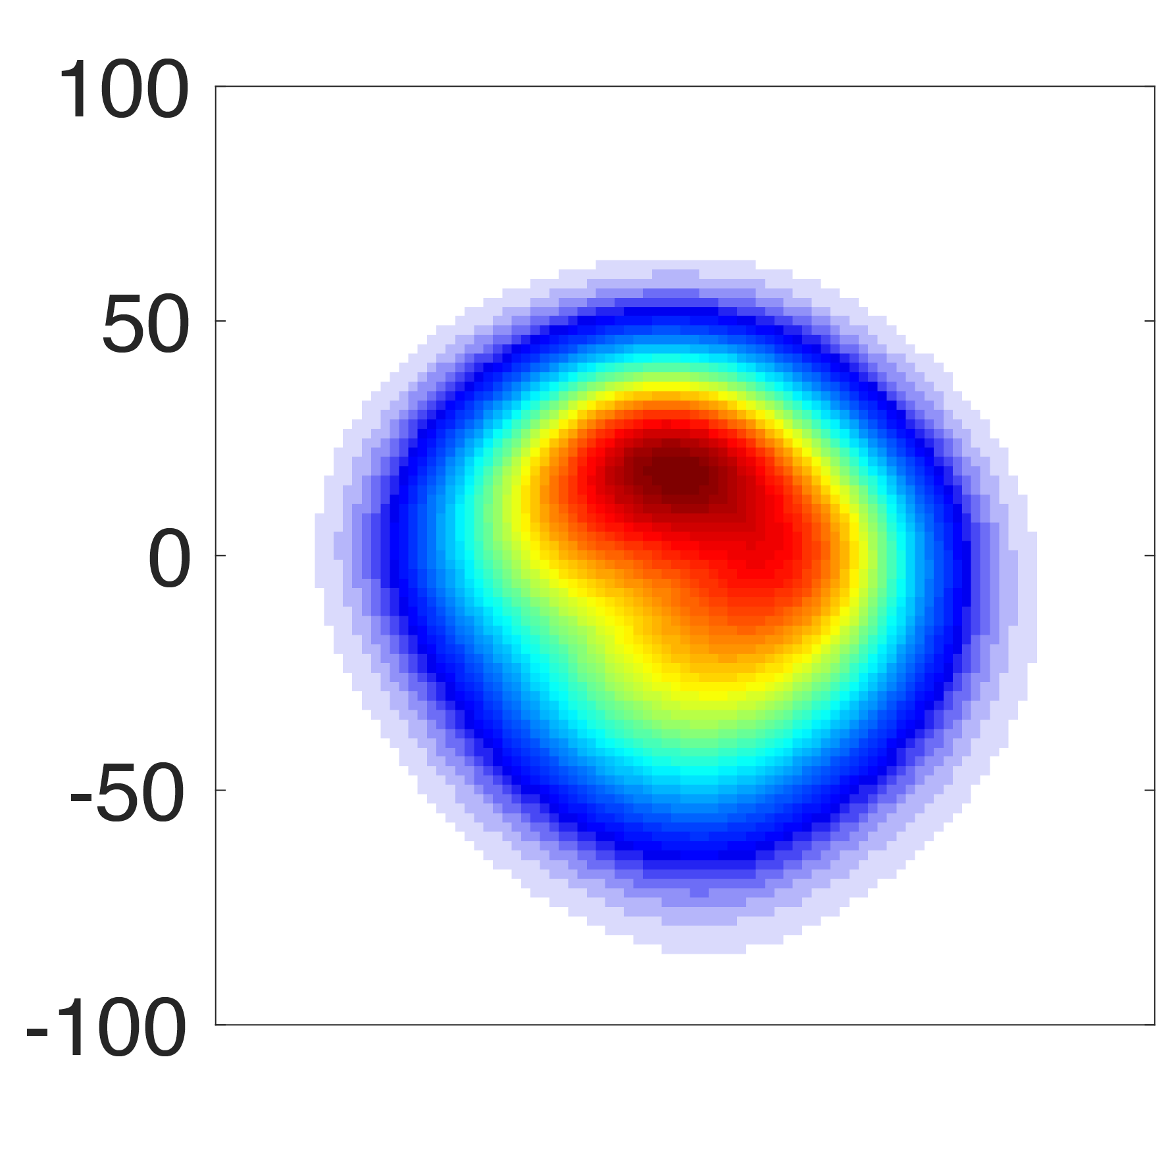
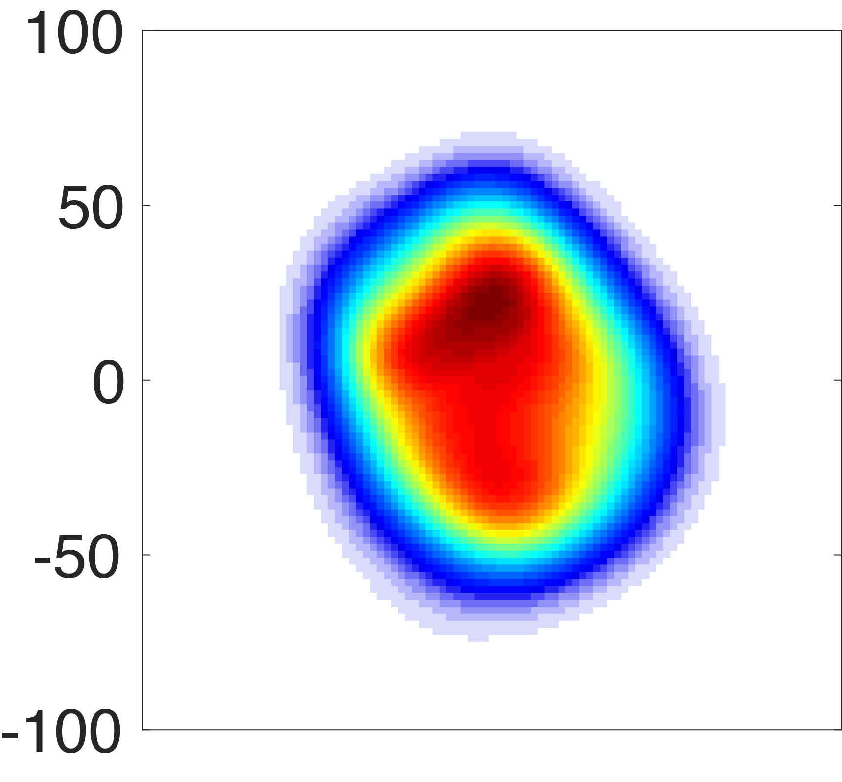
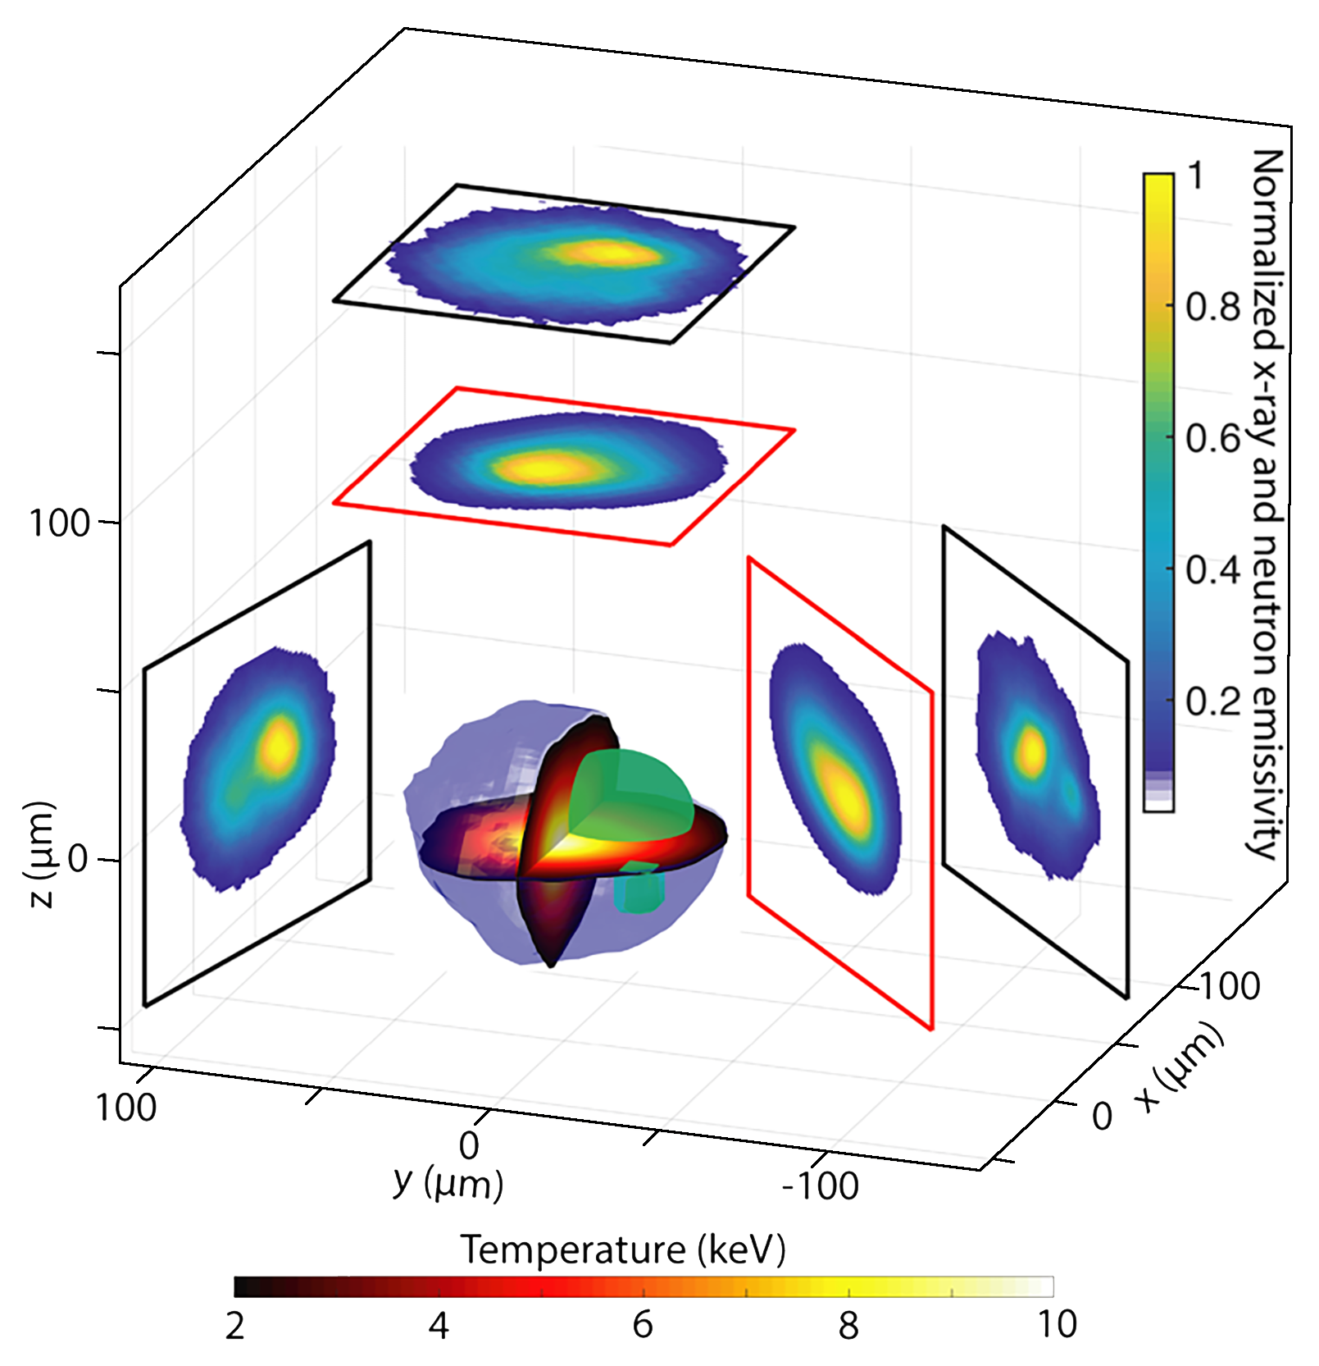
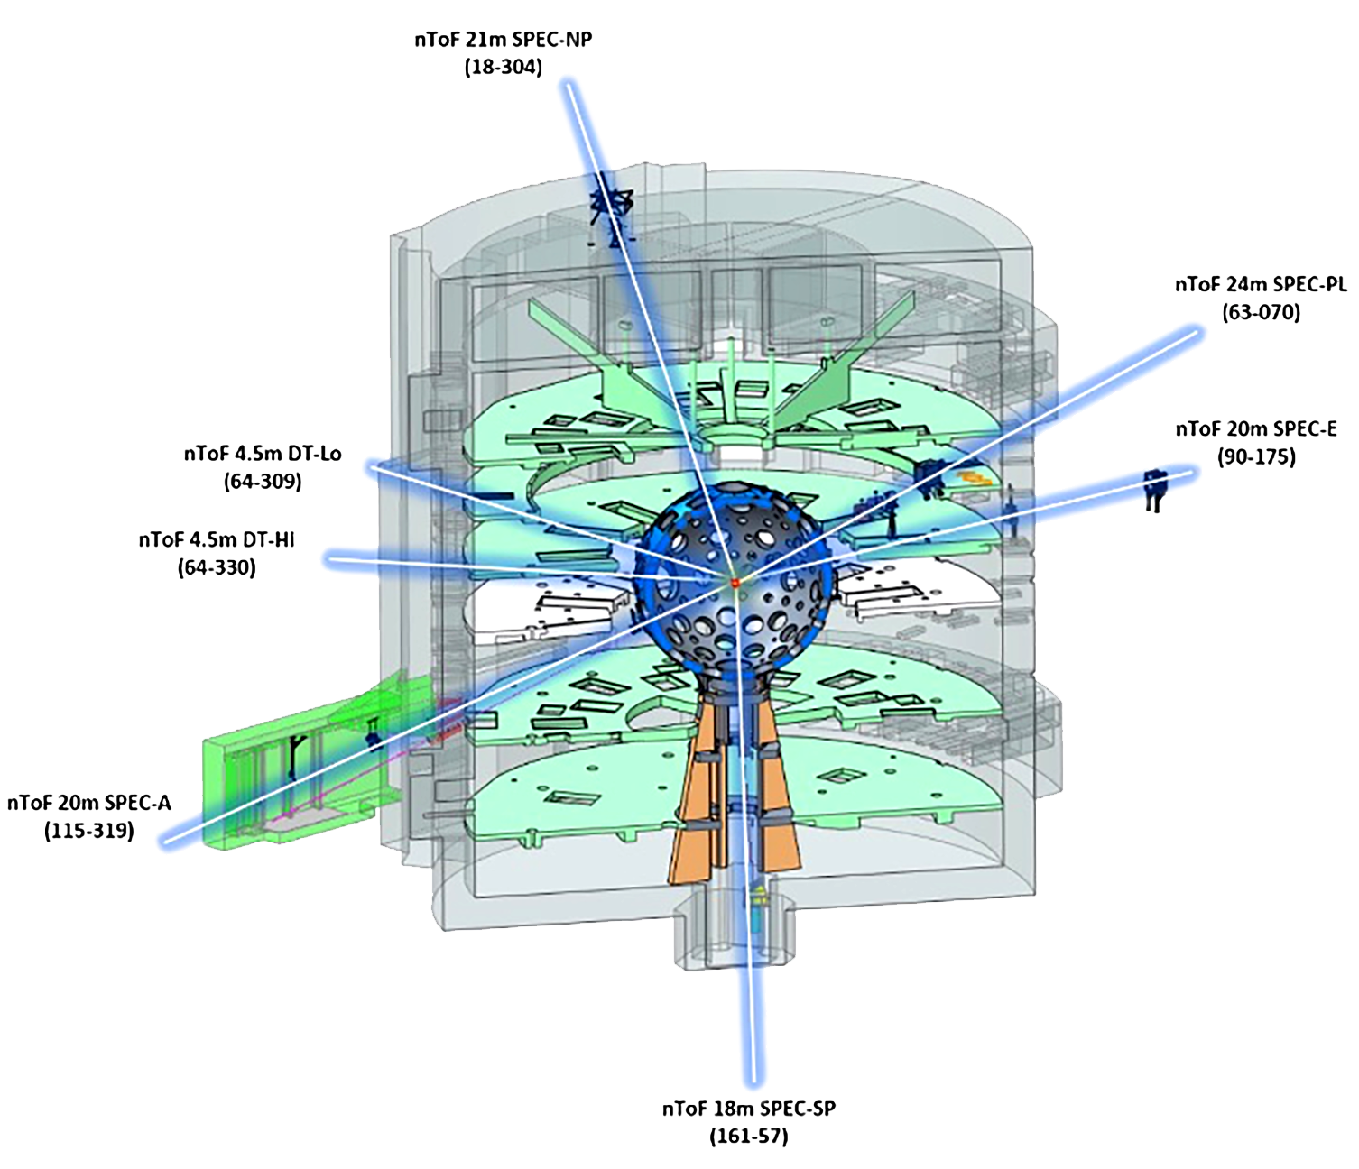
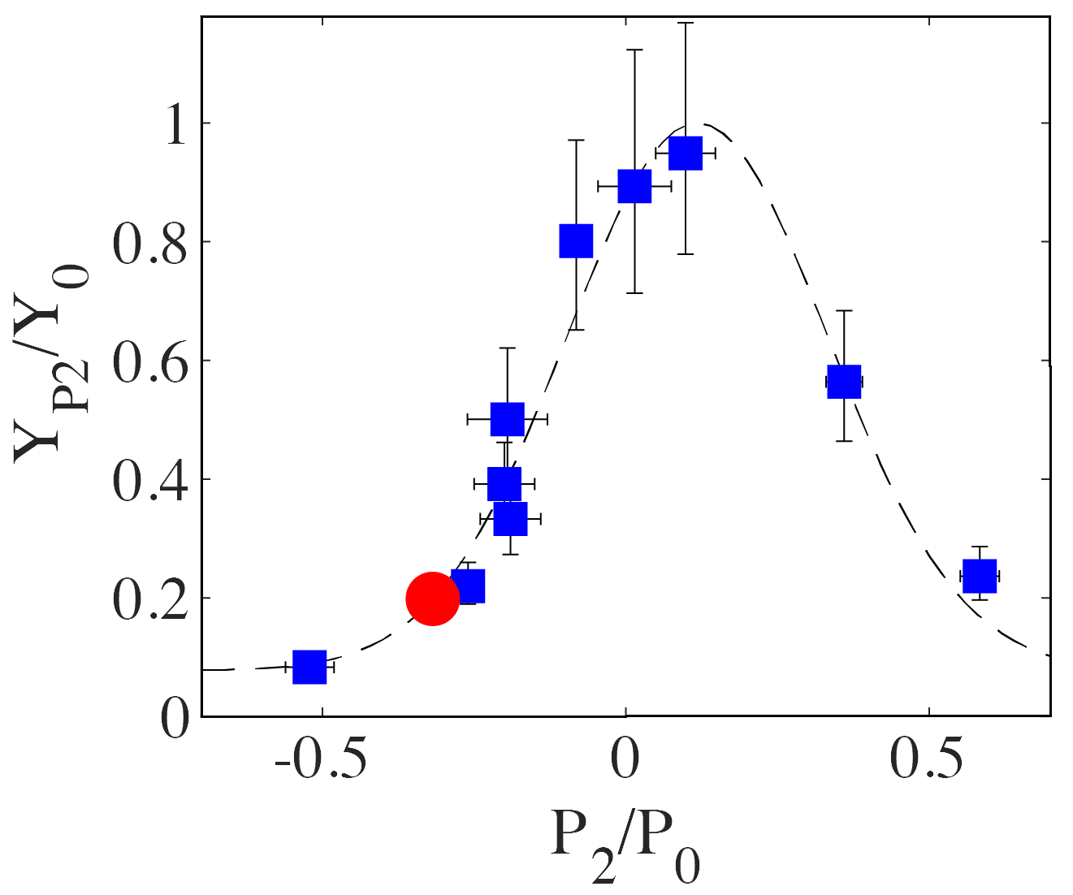
A diagnostics suite to evaluate the degradation mechanisms
Hotspot Drift Velocity
(V_{hs}[km/s])
Hotspot Symmetry
(P2[µm])
Mix Mass
[ng]
X-ray
Neutron
(Plot: J. Ralph)
(Plot: A. Pak)
Hotspot bulk velocity from neutron Doppler Shift (NTOF) along
5 directions
Neutron and X-ray imagers
at peak emission
Synthetic tomographic reconstruction and spectroscopy

Slide 20
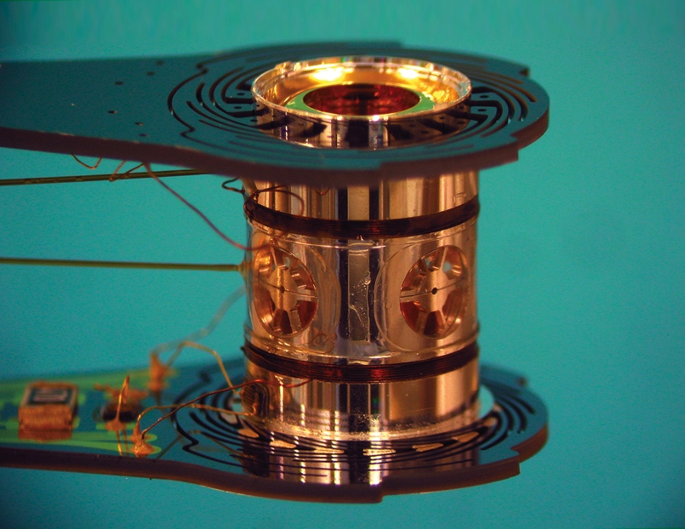
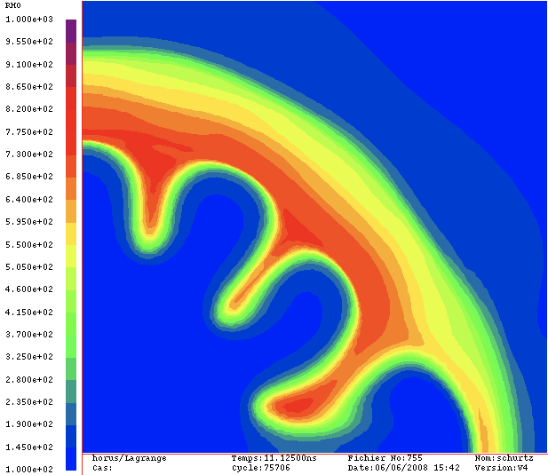
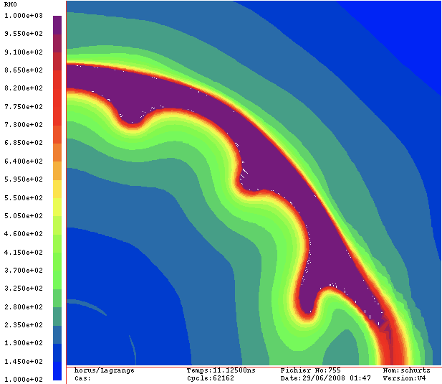
Is this scheme viable a route to clean energy?
1- Indirect drive is not energitically favorable
      1.9 MJ only 200 kJ absorbed by the capsule
2- target are very complex
3- highly non linear regime -> need of a more robust regime
350 km/s
230 km/s
1.35 MJ

Slide 21
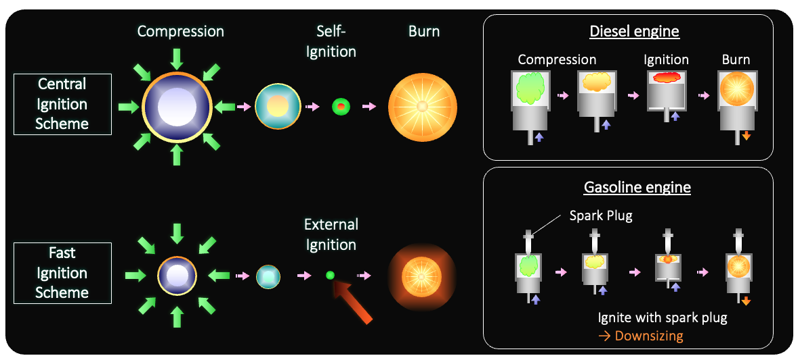
Alternate way: decouple compression from heating

Slide 22
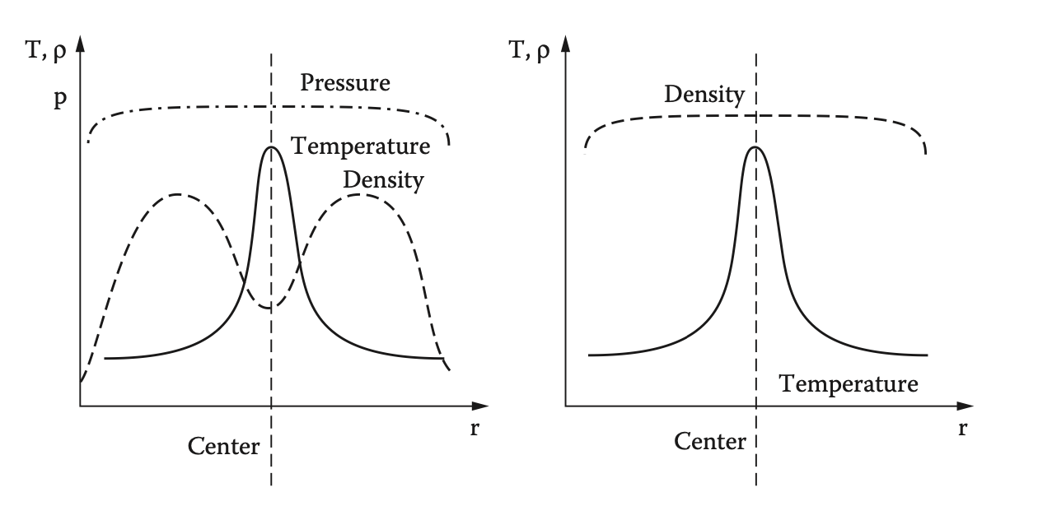


Fast ignition scheme leads to higher mass spot
Higher mass leads to higher yield
Hot spot: Isobaric spot from implosion
F.I.: Isochoric spot from fast electron heating
$$Mass=23 {(ηE)}^{1.2}$$
$$Mass=230 {(ηE)}^{1.3}$$

Slide 23
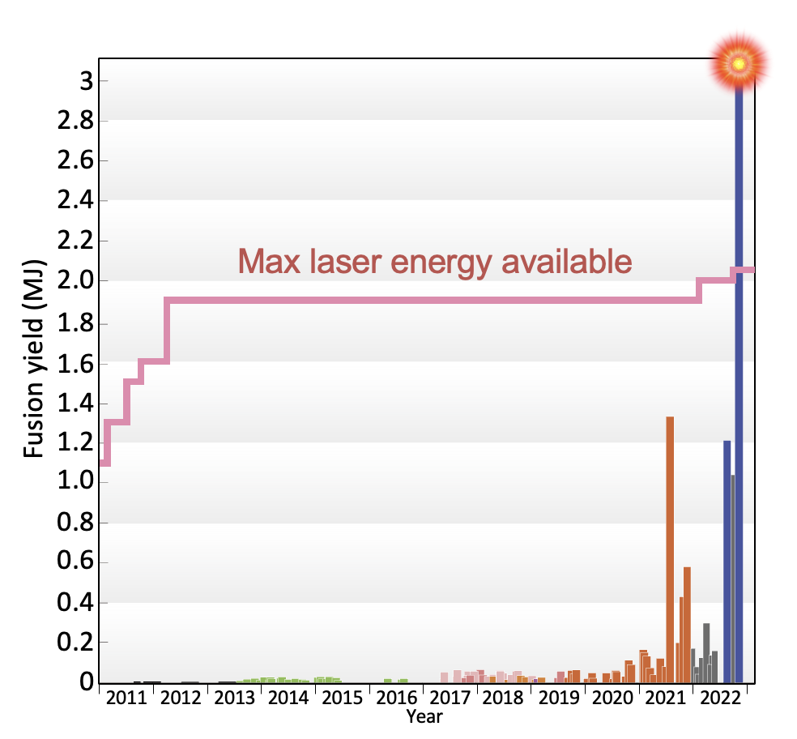
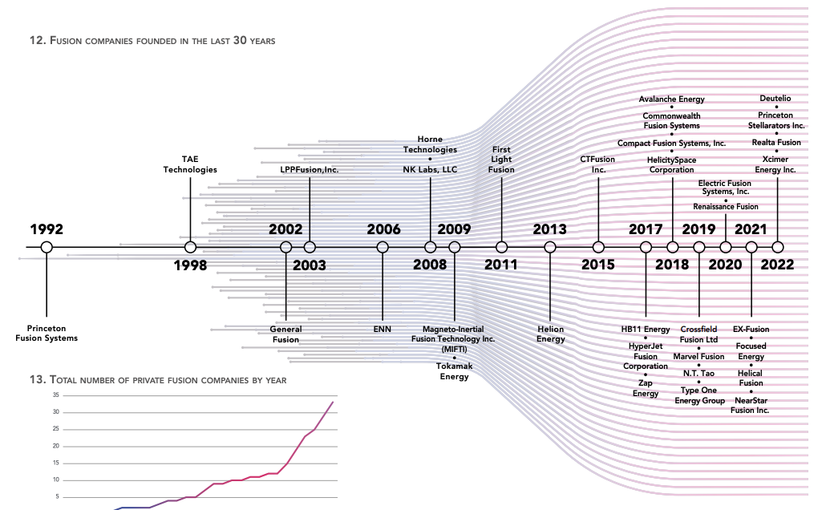
Conclusion
Ignition has been achieved after 13 years of experiments on the NIF
Higher gain up to 10 MJ are envisioned in the near future
Europe has the expertise and is getting organized toward an IFE initiative (Hiper +)
Startups are emerging around the world

