Slide 1
Alexandru Boboc PhD CEng CPhys
Experience on the interferometry and polarimetry for fusion power plants
7th International Conference Frontiers in Diagnostic Technologies (ICFDT7)
ENEA Frascati, 22nd Oct 2024

Slide 2
Outline
Few words on JET Far Infrared Diagnostic(FIR)
Strategy on diagnostics development approach
How to …. ?
Examples
Conclusions

Slide 3
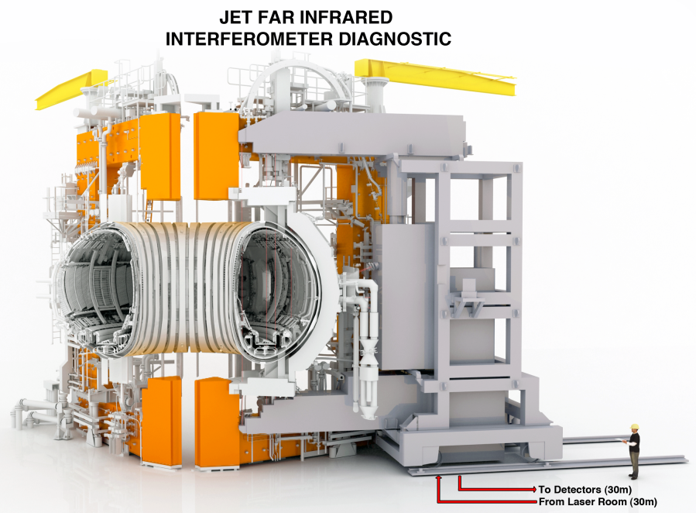
Intro - JET Far InfraRed Interferometer/Polarimeter Diagnostic System
Why Far Infrared (THz) ?
Plasma frequencies (GHz) => plasma is a transparent medium for FIR
Hybrid interferometer and polarimeter
Essential for JET Plasma Operation
Measures electron plasma density and magnetic fields via Faraday Rotation angle
Number of channels 10 (8 probing the plasma)
Four lateral channels have double passage due to in-vessel mirrors
Uses Far Infrared Lasers(FIR) (wavelength 100 microns 200mW power)
Number of optical components ~ 500 over 3 buildings
Optical path length 80 meters x16 branches
Largest single component: Diagnostic tower (14 metres high, 70 tonnes weight)
Operation time: 16 hr/day, mostly unattended
Age: ~40 years old
Note 1: Interferometry is based on plasma optical refractive index
Note 2: Polarimetry is based on plasma optical activity and birefringence

Slide 4
Lessons learned from FIR Interferometry/Polarimetry on JET alone
JET Far Infrared Diagnostic Status before Deuterium-Tritium Experiment Campaigns no. 2 and no. 3(DTE2 & DTE3)
Triple redundancy for laser availability
Triple redundancy on measurements for density control
Double redundancy in signal detection + hot spare
Monitoring from remote designed for non-expert
(e.g. Shift Technicians, Diagnostic co-ordinators, Responsible Diagnostic Experts)
Three Data Acquisition Systems with 100% channel reliability
in terms of signal quality (C40, PowerPC and FPGA architecture)
Spare parts/Ancillary equipment commissioned/checked and ready to use/swap

Slide 5
How to design power-plant diagnostics based on past experience?

Slide 6
Lesson learned
Learn from the mistakes done in last 70 years
Learn from the positives done in last 70 years
Developments were multi-generational

Slide 7
Current development approach*
Systems developed to maximise physics output and not reliability
Prototype, one-off, one measurement - one diagnostic
Long time for developing a system (small team) => “old design” when required
“Comfortable” approach of copying existing validated systems
Care for meeting the minimum requirements only => no built-in resilience
Not an agile approach with not much innovation => risk of obsolescence
No clear direction with respect Human Resources required for developing, commissioning, operating the system
Safety considered mostly locally within the system or close area
Quality control and tracking to various levels not unitary with the entire plan
* The list is not exhaustive

Slide 8
Current machine versus Fusion power plants*
Plasma duration from seconds to non-stop
Neutron fluences higher order of magnitudes (up to 7 !)
No human access to most of the parts of the machine for decades
* The list is not exhaustive

Slide 9
Fusion power plants approach
From day one of development…..
Fully engineering approach
Integrated with other plants and machine design
Strong Safety Systems
Diagnostics are for control and monitoring – Physics is optional
Clear parameters to control and what measurements (sensors) are required
Each measurement will have a functional role for machine control, monitoring and protection

Slide 10
Think how to keep it alive

Slide 11
Think how to keep it alive
Torus(reactor) hall
Access considerations
Diagnostic room
Interspace area
Regular access allowed
MAST-U
EAST
ASDEX-U
WEST
Full access
Day operation
Full access when not in plasma operation
Easy access for manual emergency
Plasma
Bioshield
Bioshield
Vacuum vessel –parts replaceable during shutdown
Full access during long shutdowns
Easy access for people entry in an emergency
Partial access
Day operation
Up to 8 hr shift
Semi-automation
Partial access
JET
ITER
SPARC?
Plasma
Bioshield
Bioshield
Vacuum vessel –parts replaceable during shutdown
Partial access
Non-stop operation
Turn-key devices
Intermediate area
Access every 5-15 years
Very limited manual entry
Zero Manual access
STEP
BEST
DEMO
ARC
Nobody
done it yet !
Plasma
Bioshield
Bioshield
Vacuum vessel - No access Parts embedded in first wall

Slide 12
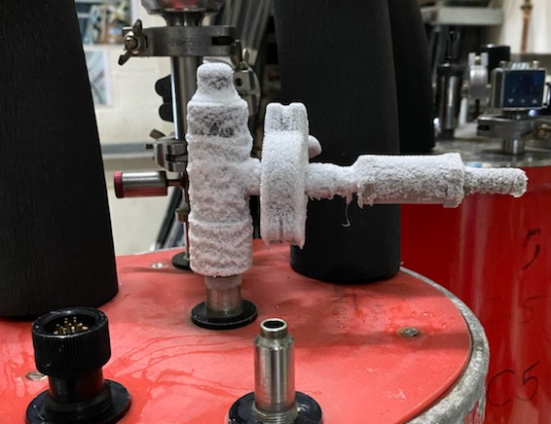
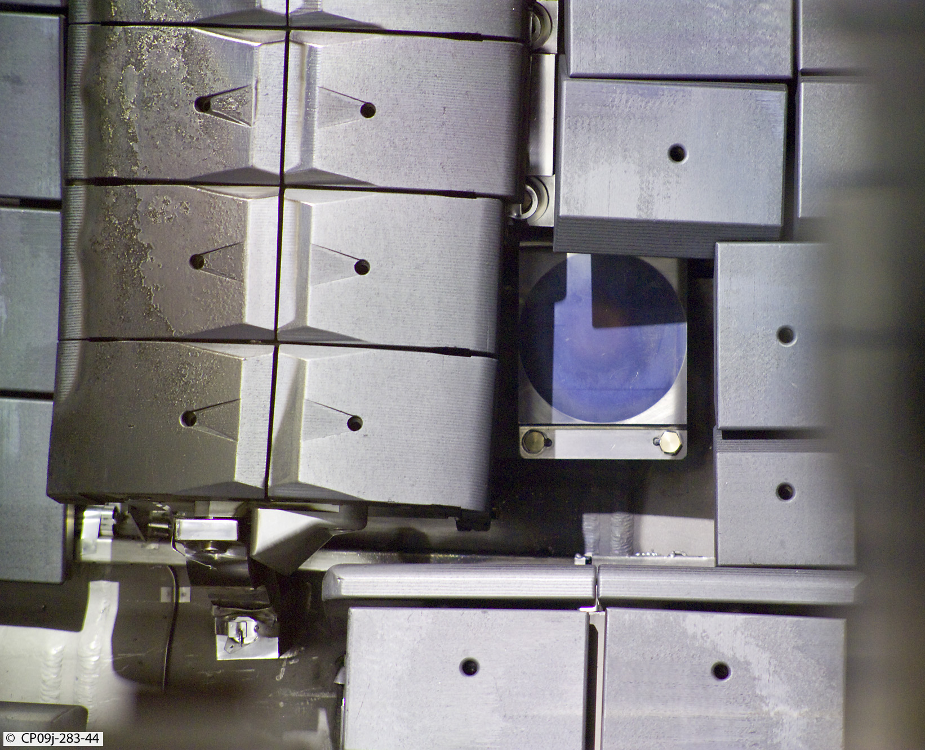
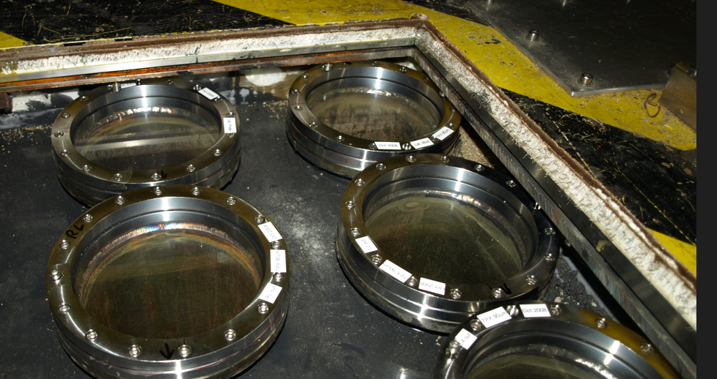
Lessons learned from FIR Interferometry/Polarimetry on JET alone
Think how to keep it alive
Diagnostic room
Tritium barrier
Tritium barrier
Torus(reactor) hall
Interspace area
Diagnostic room
FIR Lasers
Ancillary Equipment
Electronics
HV Power supplies
Cryogenics
Pressure systems
Hot surfaces
Service areas
Access
Basement
Opto-mechanics
Access
Dry air
Torus Hall
In-vessel
Mirrors (not replaceable)
Vacuum-Windows (replaceable once every 10 years or so)
Bioshield
Bioshield
Ex-Vessel
Diagnostic-Tower
Access
Opto-mechanics
Losing dry air requires 3 days for restoring signal power as basement duct account for 50m(80 in total) of the optical path (rate of air 5l/min for a 25mx4mx2m box)
TPX 90μm thick pellicle windows acting as tritium barrier to the basement
Nickel in-vessel mirror hiding
behind limiter 30 years later
A failed cryostat will take minimum one week to recommission

Slide 13
Lessons learned from FIR Interferometry/Polarimetry on JET alone
Think about signal losses and errors

Slide 14
Lessons learned from FIR Interferometry/Polarimetry on JET alone
Think about signal losses and errors
Lasers
Laser power and power stability
Laser pointing stability
Polarisation quality & settings
Risk associated with operation/maintenance
Long term operation cost
Better a low power but stable
Essential for 100m optical path
Unnecessary losses 100% avoidable
High Voltage, heat, pressure, laser
Time required for recovery after fault
Cost of spares, people time, number of people

Slide 15
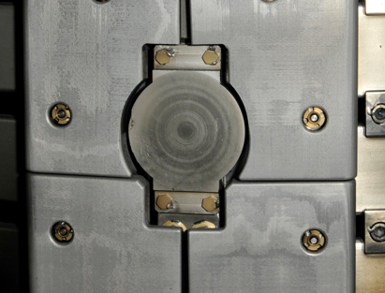
Lessons learned from FIR Interferometry/Polarimetry on JET alone
Think about signal losses and errors
Transmission(T) losses
Vacuum Window transmission
Tritium barrier losses
Waveguides
Environmental controls
In-vessel reflectors
JET FIR system
T of new double vac window: 75%, 56% after 30 years in visible,
T for FIR 24% day one (4cm thick z-cut quartz)
T 50%
T 50%
T difficult to predict let’s assume T 50% here
Reflection 100% when new (Nickel mirrors)
unknown now
Channel 5 (L1) 31-years old in-vessel mirror (Survey from 2024)
(“Tokamakium” deposits)
Total transmission level(24%x50%x50%x50%) = > 3 %T in the ideal case scenario so 97% losses !!!

Slide 16
Lessons learned from FIR Interferometry/Polarimetry on JET alone
Think about signal losses and errors
Phase shift errors -very hard to model and eliminate
Depolarisations due to the transmission lines
Hot air turbulence (3 μm laser – first compensation laser on JET FIR )
Moisture in air (all FIR lasers)
Electronics signal distortion(capacitors dying after 10 years)
Windows under high magnetic field – new thing in ITER and beyond
Bad or degrading alignment

Slide 17
Lessons learned from FIR Interferometry/Polarimetry on JET alone
Think about signal losses and errors
Calibration errors
Wrong wavelength - DCN laser emits in 190 and 195micron leading with 2.5% error if wrongly selected
Polarimetry Torus hall encoders(potentiometers) degradation leading to wrong conversion Voltage-Faraday Angle =>solved by regular offline calibration (remote)
Polarimetry wrong half-wave plate position – Signal-to-noise issue
Mutual interaction of Faraday Angle- Cotton Mouton effects (all papers use cold plasma approximation)
1-D Calibration (Faraday- linear polarisation) for 2-D real problem (Faraday and Cotton-Mouton –elliptical polarisation)

Slide 18
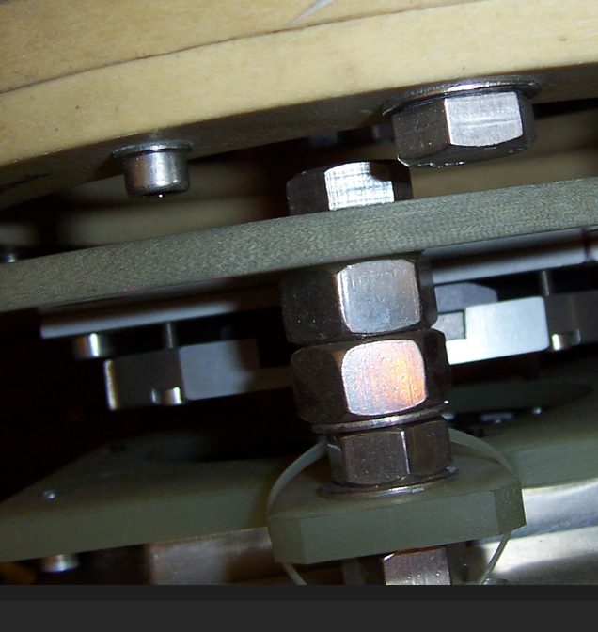
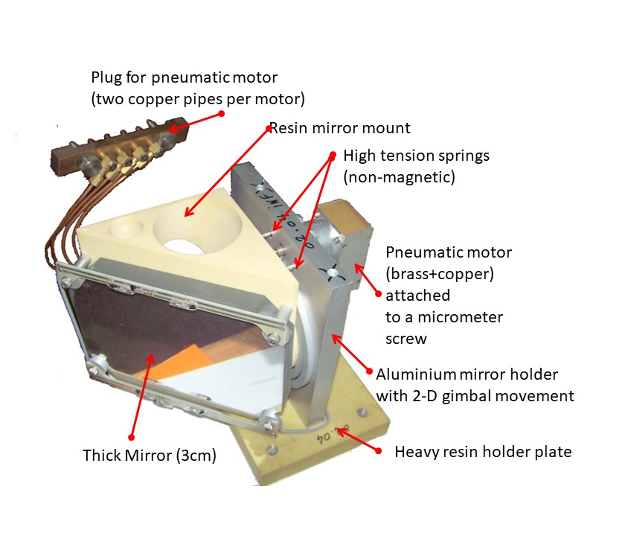
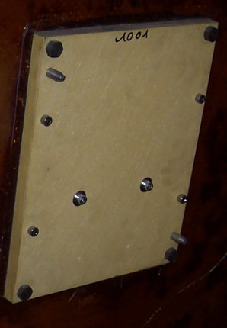
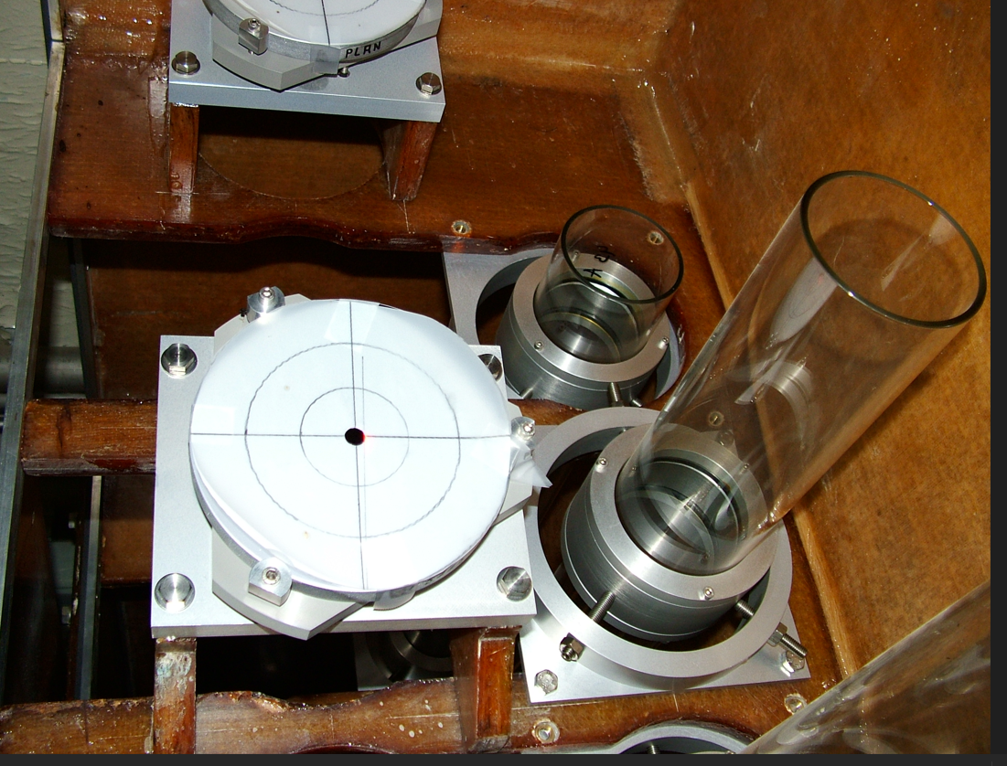
Lessons learned from FIR Interferometry/Polarimetry on JET alone
Think about signal losses and errors
Alignment
All big systems require alignment, in power-plants environment that could be possible only partially every decade - E.g. JET FIR System
Integrating alignment scheme at early design phase is crucial
Integrate alignment requirement with rest of the plant (including shared space with other diagnostics for example)
Choose the most resilient parts where there is no access
Use good practices and good old examples
Choose right components
Bad practice
“Spacer” made of M8 nuts and
washers pointing down
Half-wave plate
assembly
Find new means (some very cheap)
to align
φ12mm location pins
with 50μm clearance
Opto-mechanics
support plate
Torus Hall non-magnetic mirror assembly
25m straight beamline visible laser
(2-3mm => 0.005 degrees error)
Basement optics

Slide 19
Lessons learned from FIR Interferometry/Polarimetry on JET alone
Think for what do you use the measurements
Interferometry
Gas feedback and control of plasma density in real-time
Additional heating-systems safety interlocks in real-time
Reference diagnostic for many systems (E.g. High-Resolution Thomson Scattering)
Physics analysis (80% of Physics Data depends on interferometry)
Polarimetry
Safety Factor control, including real-time (via Equinox)
Gas feedback and control of density (backup)
Additional heating-systems safety interlocks(backup)
Physics analysis (EFIT constrains)
Secondary measurement for density validation

Slide 20
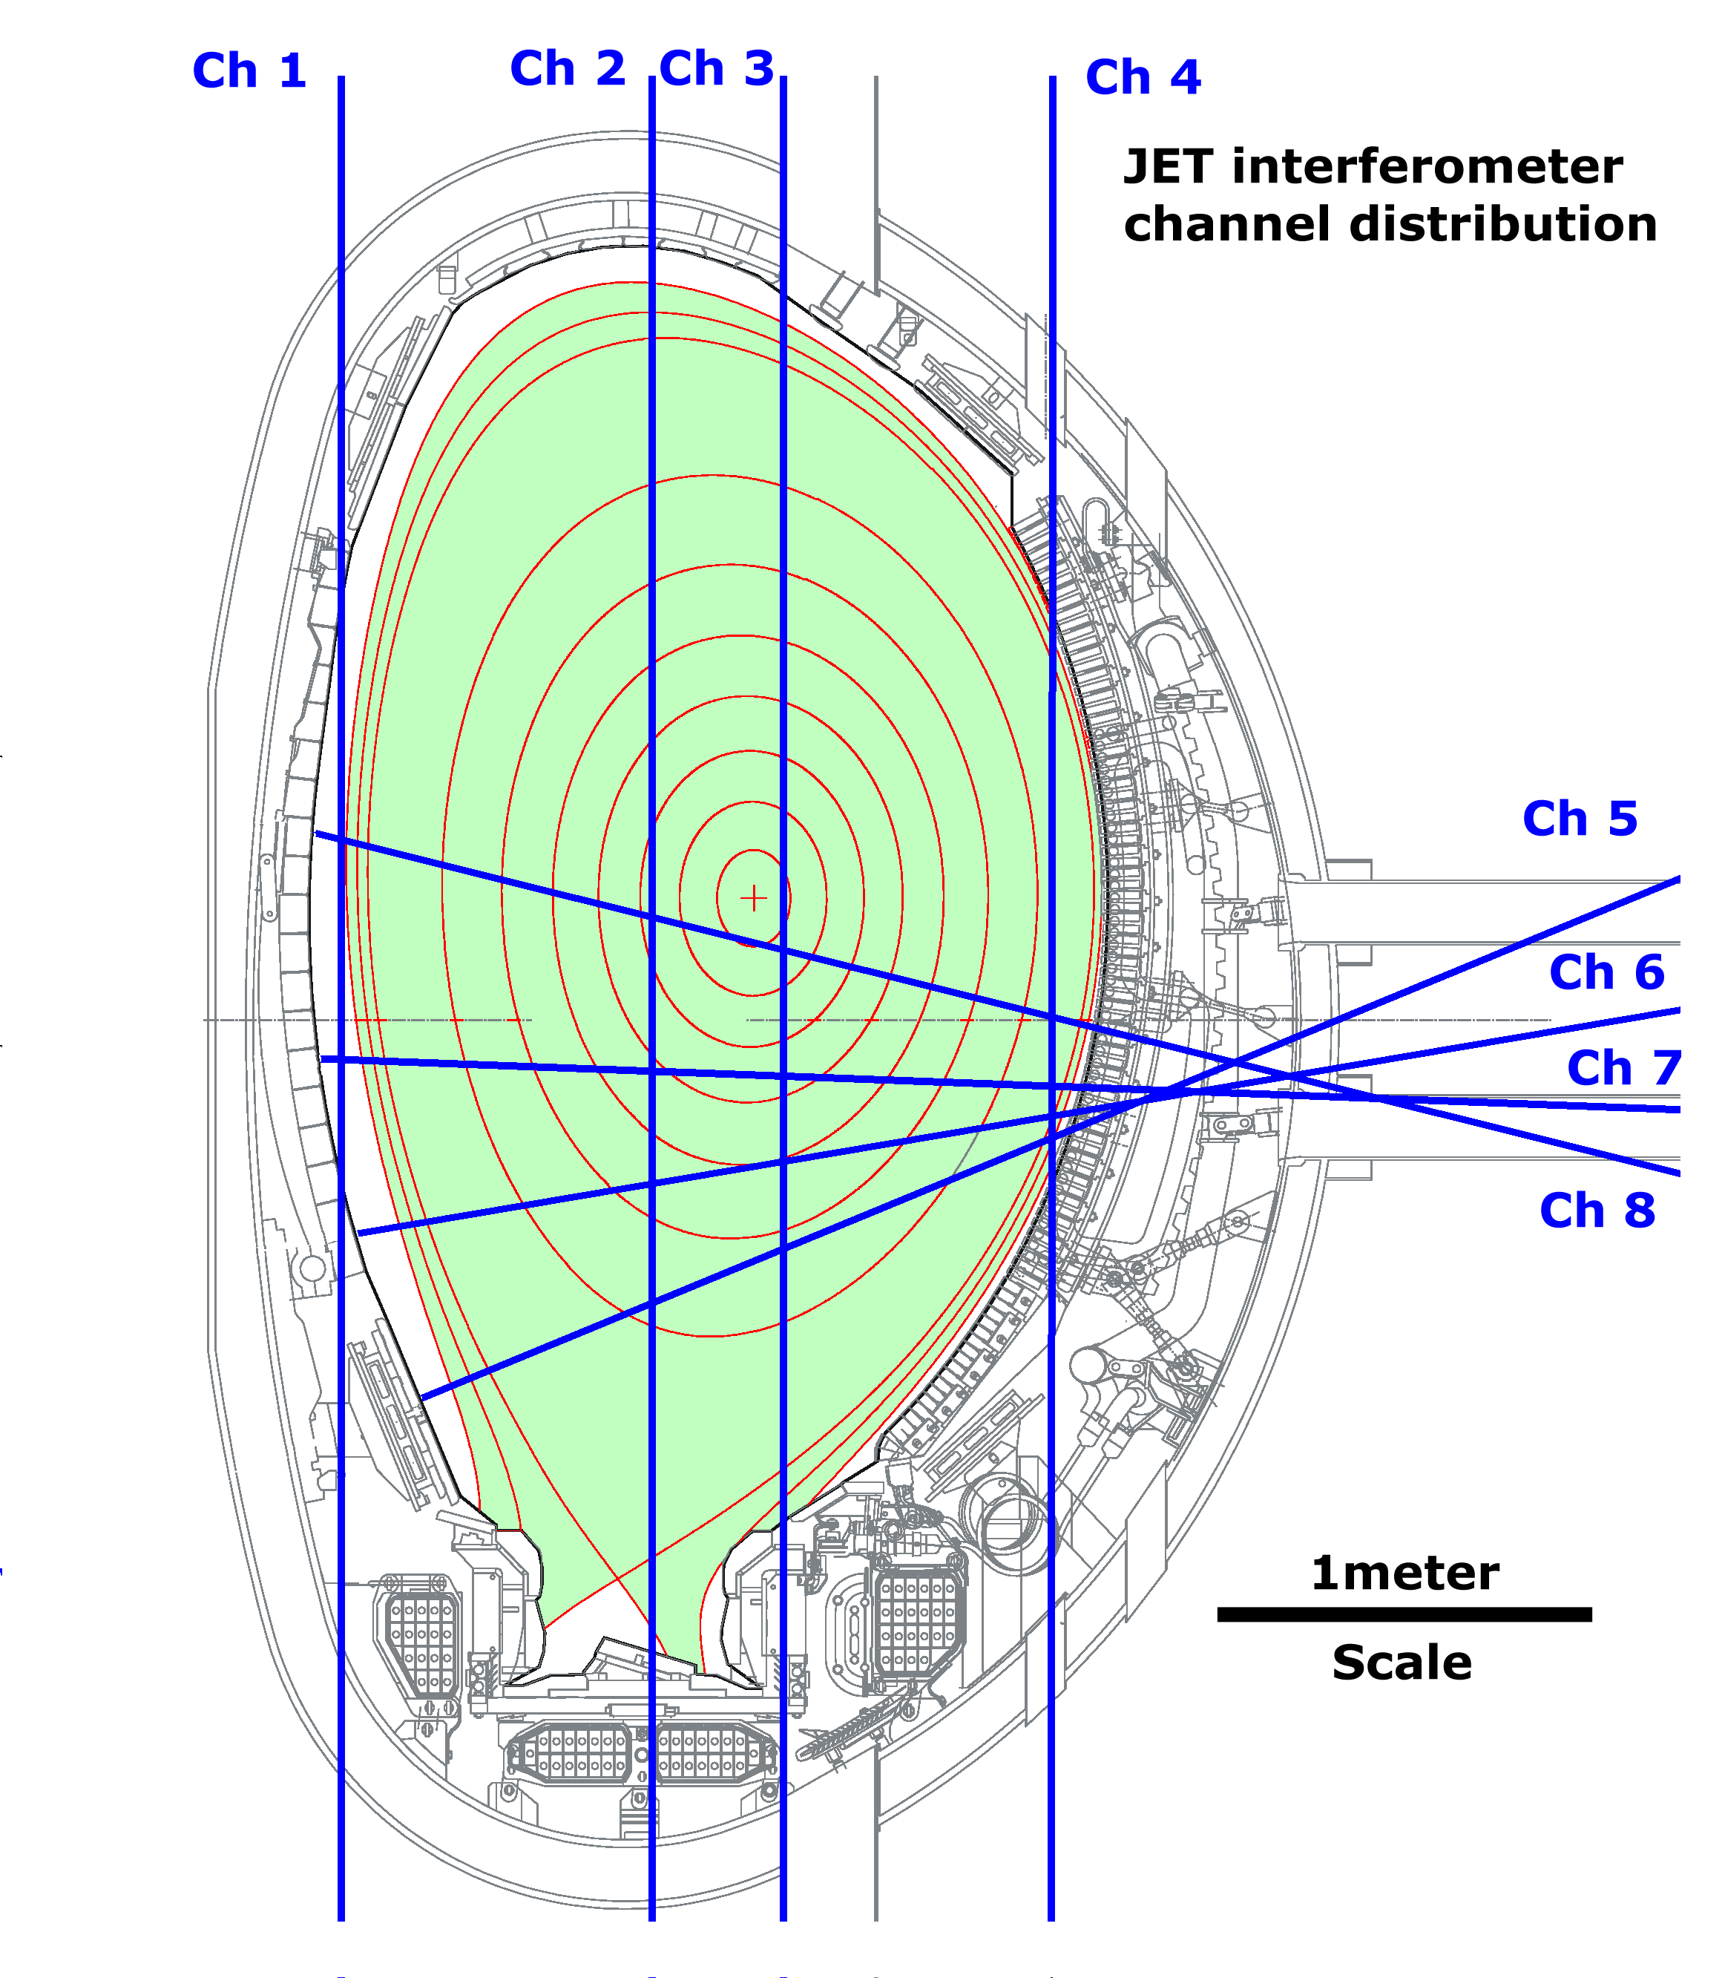
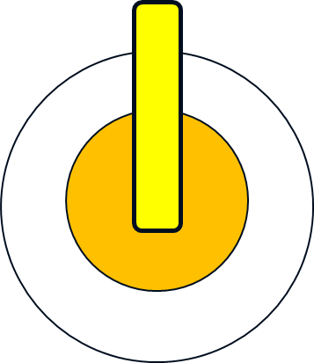
Think what changes to the machine impact to your measurements
Example- Divertor introduction impact to the FIR interferometer:
Ch1 tangent
to plasma
2 channels lost for any H-mode pulse with NBI on
Ch 2 slot in divertor plate
9mmx 44mm x 1 m
FIR Beam
diameter
35mm
Additional Line-integrated density component
in the divertor not included in EFIT
Vacuum window 60mm diameter

Slide 21
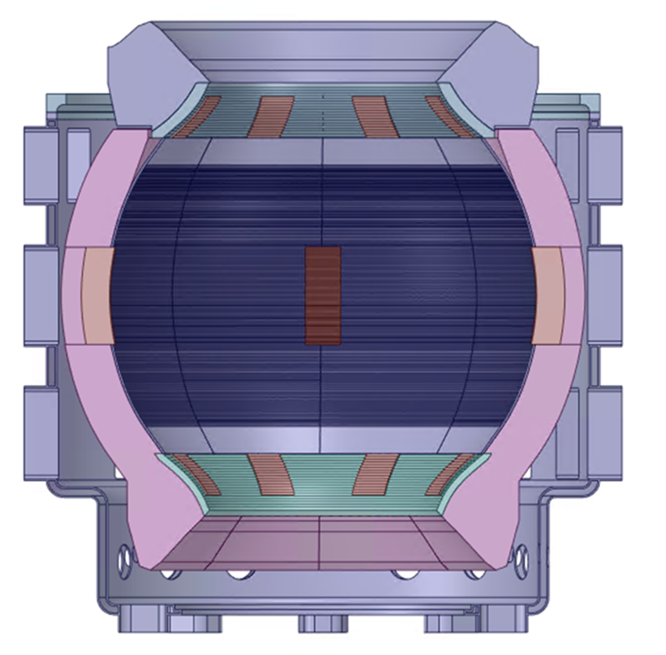
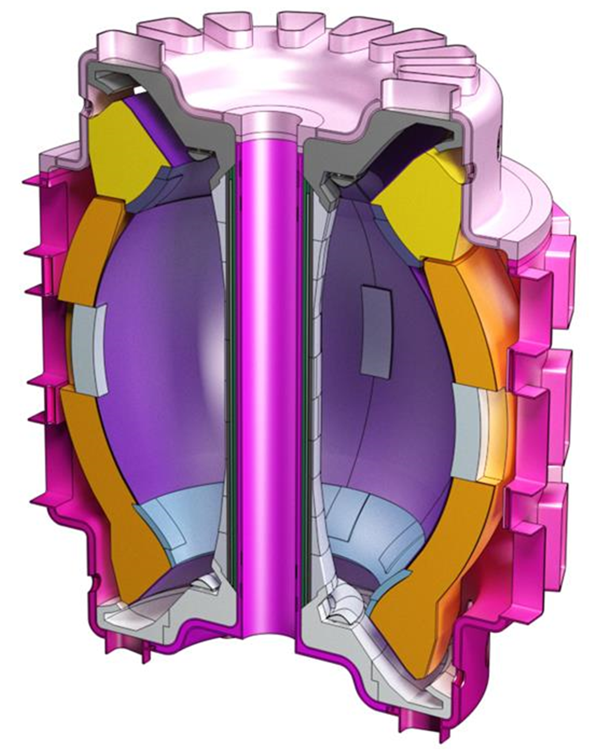
What is the function of your measurement ?
Example: STEP Interferometer Tangential Channel 4 *
Tangential plane (Z=0)
~10m from centre of
machine to exit mirror
Essential for plasma breakdown and ramp-up control for scenario of plasma forming close to inner limiter (very low density, high resolution required)
First external adjustable reflector ~10 meters from plasma
Key problem
1cm of beam displacement due to refraction over 25m requires an angular precision of tracking of 0.001 degrees or 17 microradians
Ch 4 FIR laser beam (RED colour) close to central column (~10cm)
Distance between centre of machine to input mirror ~10 meters
*Extract from STEP Interferometer/polarimeter preliminary study

Slide 22
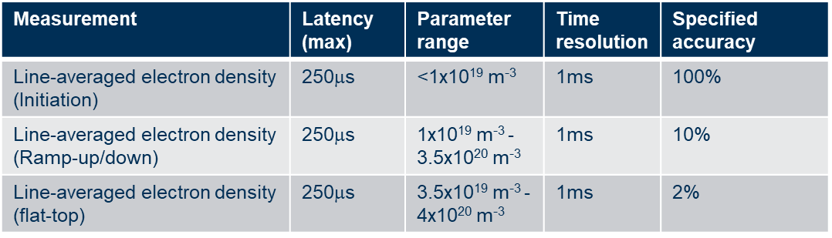
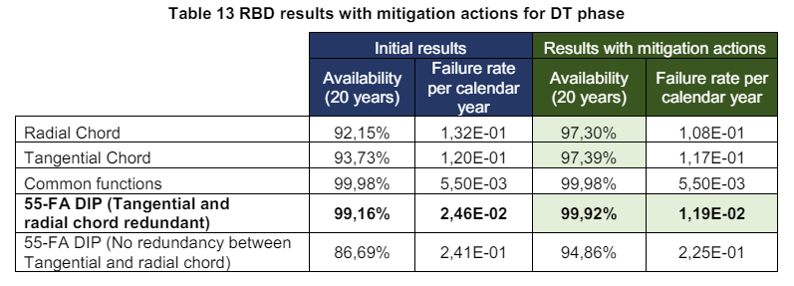
A word about RAMI
RAMI (Reliability, Availability, Maintainability and Inspectability) is one of the most severe challenges of Fusion Technologies, and it is probably the engineering branch where the fusion community is the least competent.
Fusion people know/want this*
What is required is this*
*Extract from ITER Dispersion Interferometer RAMI Analysis Report

Slide 23
Think about measurement (not-diagnostic) redundancy
Magnetic information
Magnetic sensors/coils
Polarimetry
Fiber Optical Current Sensor (FOCS)
Real-time profile controller (AI driven)
Integration with other diagnostics
System requirements
Electron Density
Interferometry
Polarimetry
Microwave diagnostics
Visible spectroscopy
Realtime profile controller (AI driven)
RAMI for measurement ?
Wall protection
Visible and Infrared cameras
Pyrometers
Laser diffusion spectroscopy
Thermocouples
Real-time controller (Machine Learning)
STEP

Slide 24
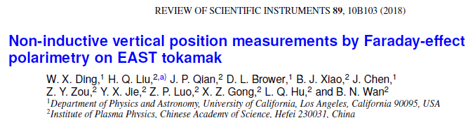
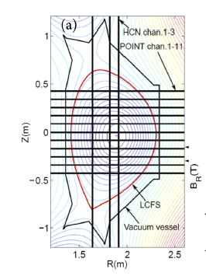
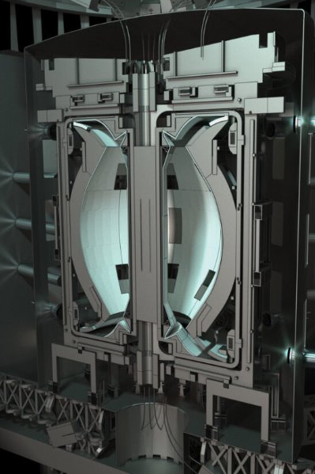
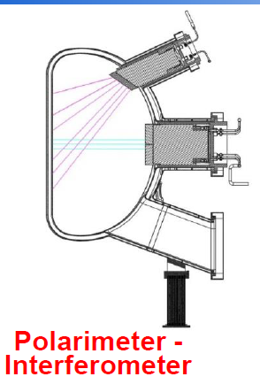
How to survive ? - example #1
Scenario: Catastrophic failure of in-vessel internal magnetic sensors for vertical stability due to radiation damage of cables/coils
Polarimetry is one possible viable alternative
EAST
BEST
STEP
Works
nicely !
Will probably work
(horizontal channels only)
Try again with no in-vessel reflectors and no toroidal symmetry of laser beams !

Slide 25
Conclusions
Suggestions for development for power plants -class diagnostics based on facts and experience
Synthetic diagnostics accounts of substantial development time at first phase ➔ feasible solutions for control
1:1 prototyping for part of the system is a must ➔ risk mitigation
Turn-key laser sources and detectors(for laser-based diagnostics) ➔ needs developments
Zero access for most of parts of the machine ➔ No in-vessel optics (reflectors)/electromechanics
3D-symmetry of sensors(no poloidal symmetry) ➔ very hard physics reconstruction ➔ complicates real-time control
Control mechanisms components must be far away from plasma ➔ μm accuracy beam tracking or cameras views via optical fibres

Slide 26
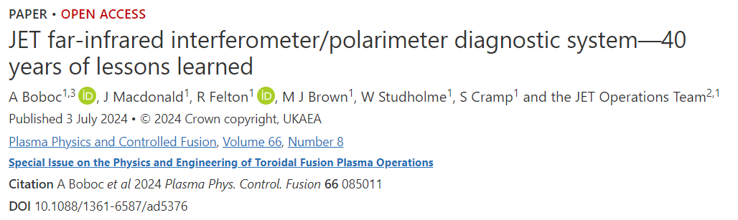
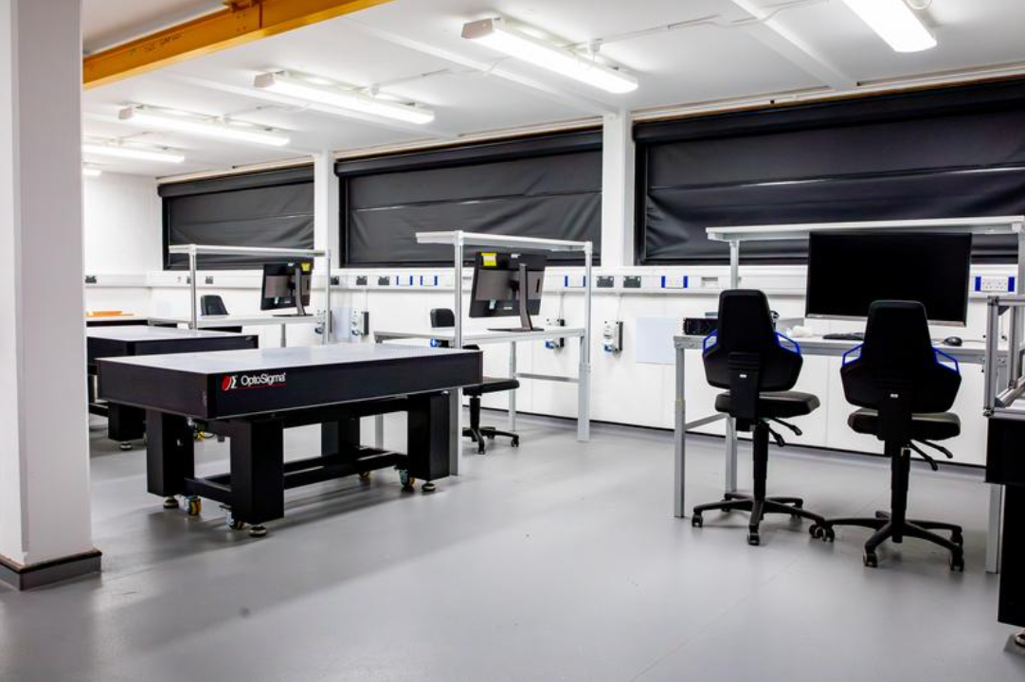
UKAEA supports new diagnostics developments and share lessons learned
Plasma Physics and Controlled Fusion
Special Issue on the Physics and Engineering of Toroidal Fusion Plasma Operations
Plasma Science and Fusion Operations Division new initiative
<< DICE >>
Diagnostics Innovation Centre
of
Excellence
Operational since September 2024
Neutronics and Gamma Lab
Magnetics Lab
Optics Lab with five optical workstations areas
https://iopscience.iop.org/journal/0741-3335/page/Special%20Issue%20on%20the%20Physics%20and%20Engineering%20of%20Toroidal%20Fusion%20Plasma%20Operations
https://iopscience.iop.org/article/10.1088/1361-6587/ad5376

Slide 27
Acknowledgments
Many people have worked with the FIR team, and it has been a tremendous collaborative effort, so I would like to thank to entire JET Team over the years.
I would like to remember here my predecessors and their deputies: Didier Veron, George Magyar, Jan de Hass, Perry Beaumont, Klaus Guenter, Paulo Puglia and the technicians Geoff Braithwaite, Dave Peach, Paul Trimble.
Interferometer/polarimeter operations in the JET DTE3 campaign would not have been possible without my colleagues James Macdonald, Mark J Brown, the electrical engineers Will Studholme and Simon Cramp.
And last, but not least, we would like to thank for our long-term collaborators F.Orsitto, C.Gil, B.Bieg, A.Murari, D.Mazon and M.Gelfusa.
JET, which was previously a European facility, is now a UK facility collectively used by all European fusion laboratories under the EUROfusion consortium. It is operated by the United Kingdom Atomic Energy Authority, supported by DESNZ and its European partners. This work, which has been carried out within the framework of the Contract for the Operation of the JET Facilities up to 31 October 2021, has been funded by the Euratom Research and Training Programme. Since 31 October 2021, UKAEA has continued to work with the EUROfusion Consortium as an Associated Partner of Max-Plank-Gesellschaft zur Förderung der Wissenschaft e.V represented by Max-Plank-Institut fur Plasmaphysik (“IPP”) pursuant to Article 9.1 of the EUROfusion Grant Agreement for Project No 101052200. The views and opinions expressed herein do not necessarily reflect those of the European Commission.

Slide 28
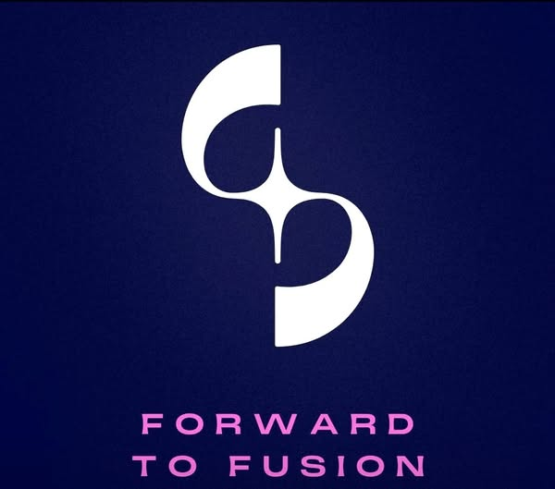
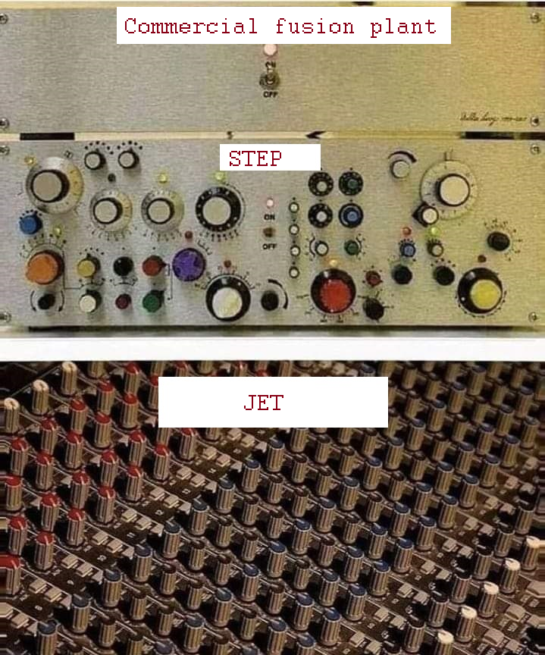
FUSIONICS
Many thanks
Any questions ?
Email: Alexandru.Boboc@ukaea.uk

