Slide 1
Merging Data-Driven and Physics Knowledge for Improved Diagnostics, Interpretation, and Modelling with Physics-Informed Neural Networks
7th International Conference on Frontier in Diagnostic Technologies
Riccardo Rossi¹, Michela Gelfusa¹, Pasquale Gaudio¹, Ivan Wyss¹, and Andrea Murari^{2,3}
on behalf of JET Contributors and the EUROfusion Tokamak Exploitation Team
¹Department of Industrial Engineering, University of Rome “Tor Vergata”, Via del Politecnico 1, 00133, Rome, Italy
²Consorzio RFX (CNR, ENEA, INFN, University of Padova, Acciaierie Venete SpA), C.so Stati Uniti 4, 35127 Padova, Italy
³Istituto per la Scienza e la Tecnologia dei Plasmi, CNR, Padova, Italy
Contact: r.rossi@ing.uniroma2.it

Slide 2
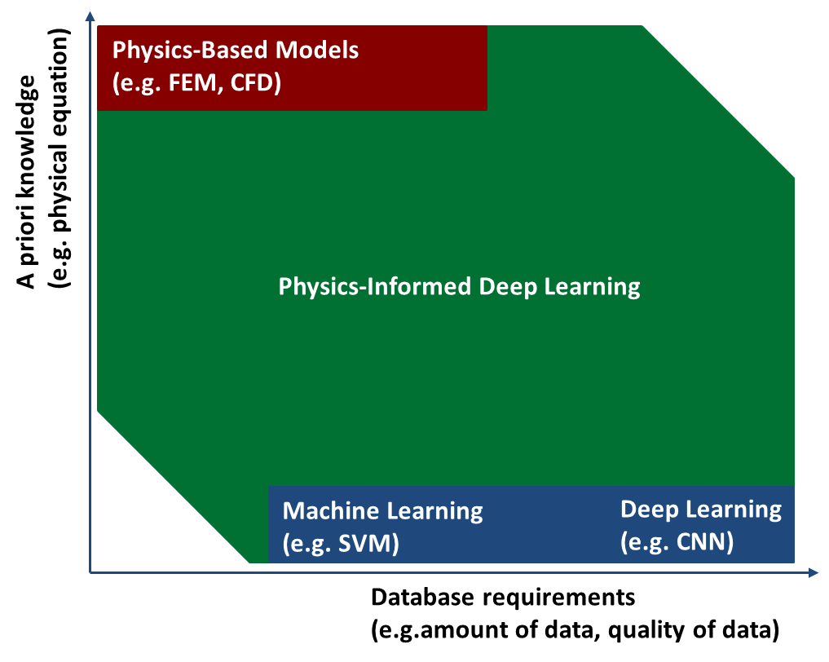
Physics-Informed Neural Networks (PINNs)
Physics-Informed Deep Learning has been developed between 2017 and 2019.
Physics-Informed Neural Networks (PINNs) are deep learning methodologies that allow to combine data-driven methodologies with physics-based model, by compensating the limits of both approaches.
PINNs are very flexible methodologies which can be used for a huge number of applications:
Improved real-time prediction
Numerical simulations (PDE solving)
PDE discovering (Modelling)
Inverse problems
Improved Diagnostics Processing
Much more…
Raissi M. et al. “Physics-informed neural networks: a deep learning framework for solving forward and inverse problems involving nonlinear partial differential equations” J. Comput. Phys. 378 686–707 (2019)

Slide 3
Outline
Introduction to Deep Neural Networks
(Purely) Data-Driven vs Physics Informed Deep Learning
Example Introduction
Supervised Deep Learning
Physics Informed Deep Learning
Results Comparison
PINNs for Diagnostics: Application to Nuclear Fusion
Equilibrium Reconstruction
Data-Integrated Reconstruction
Time-Resolved Tomography
Conclusions

Slide 4
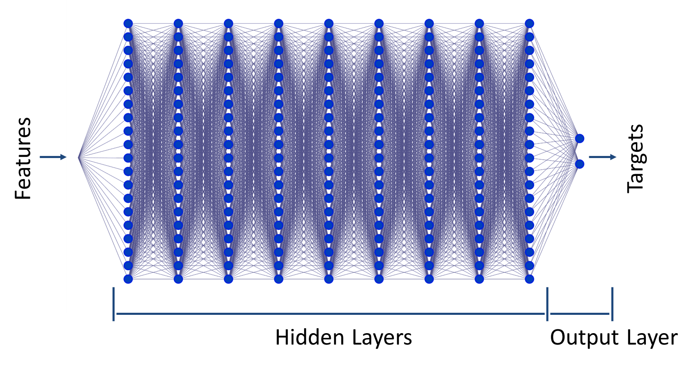
What is a (deep) neural network?
A neural network is a mathematical model $f$ defined by several parameters $θ$ that given the features (or inputs) $X$ returns the targets (or outputs) $Y$:
$Y=f\left(θ,X\right)$
From the universal approximation theorem, we can assert that:
“a sufficiently deep neural network can approximate any function”
The process to tune the parameters $θ$ is known as training
Good Fellow et al. “Deep Learning” MIT Press, (2016)

Slide 5
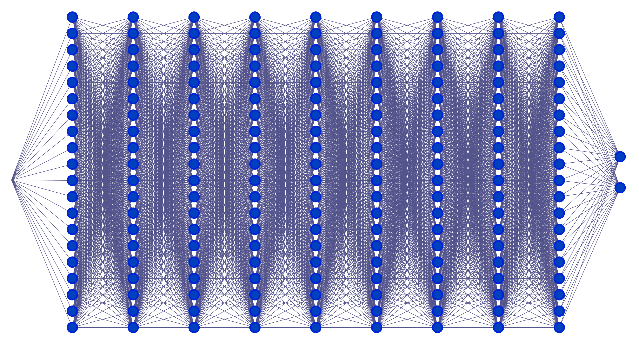
Training a neural network
Training Steps:
Neural Network parameters are (randomly) generated
The neural network is test with the parameters and the outputs are used to compute a loss function
The gradient of the loss function respect with the parameters is calculated
The parameters are updated
Steps 2, 3 and 4 are repeated until a convergence criterium is reached
Inputs
Outputs
No, new iteration
Parameters Update
Gradient Calculation
Loss Function
Convergence Criterium/a met?
Yes, training ends
Good Fellow et al. “Deep Learning” MIT Press, (2016)

Slide 6
Different ways to train a neural network
Supervised Learning
Dataset with labelled data
Loss calculated comparing prediction with dataset labels
Typical applications:
Regression
Classification
Prediction
Unsupervised Learning
Dataset with unlabelled data
Loss is calculated in different manners as a function of the application and a priori knowledge
Typical applications:
Density estimation
Anomaly detection
Data projections
Etc.
Reinforcement Learning
A specific environment is developed to train the model together with an interpreter
Learning is based on maximising reward given by the interpreter when and how the model (the agent) interacts with environment
Typical applications:
Robotics
Bots (for example for videogames)
Support to medical doctors
Etc.
Physics-Informed Learning
Very flexible approach (both labelled and unlabelled datasets)
Learning can be based on physics and boundary conditions (purely physics-guided learning) or hybrid dataset and physics (physics-informed learning)
Typical applications:
Same of supervised, unsupervised and reinforcement learning
Numerical simulations
Inverse problems
Data Driven
Purely Physics Driven or
Hybrid (Physics + Data)

Slide 7
Outline
Introduction to Deep Neural Networks
(Purely) Data-Driven vs Physics Informed Deep Learning
Example Introduction
Supervised Deep Learning
Physics Informed Deep Learning
Results Comparison
PINNs for Diagnostics: Application to Nuclear Fusion
Equilibrium Reconstruction
Data-Integrated Reconstruction
Time-Resolved Tomography
Conclusions

Slide 8
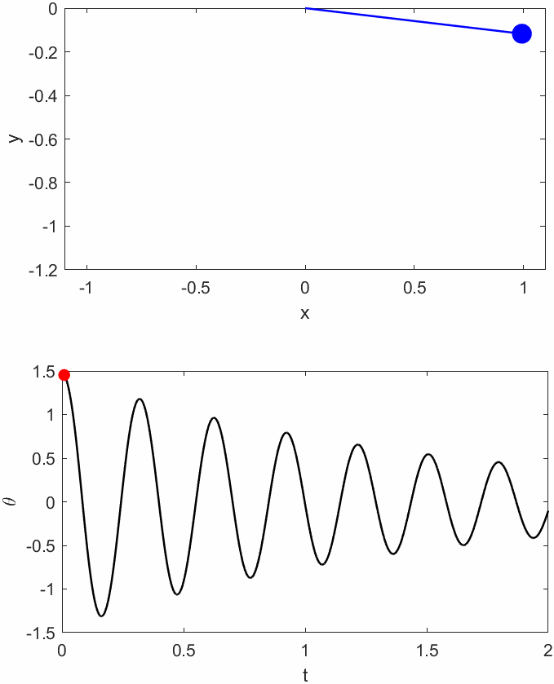
A (simple) example: Problem Definition
Let’s suppose to develop a model to predict the pendulum position as a function of time.
We have just 50 measurements (randomly sampled).
We also know the equation but not its parameters $β$ and $γ$
$$\frac{d^{2}θ}{dt^{2}}+γ\frac{dθ}{dt}+βsin\left(θ\right)=0$$
$$(β=490.5;γ=1.25)$$

Slide 9
Outline
Introduction to Deep Neural Networks
(Purely) Data-Driven vs Physics Informed Deep Learning
Example Introduction
Supervised Deep Learning
Physics Informed Deep Learning
Results Comparison
PINNs for Diagnostics: Application to Nuclear Fusion
Equilibrium Reconstruction
Data-Integrated Reconstruction
Time-Resolved Tomography
Conclusions

Slide 10
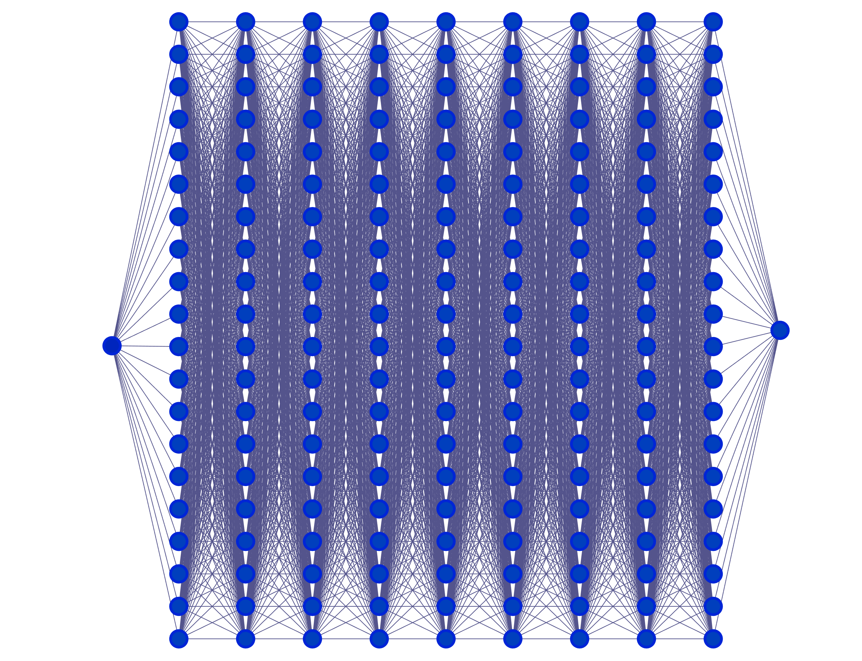
A (simple) example: Purely Data Driven Model
A purely data driven model uses the 50 measurements to train the model (early stopping is used to prevent overfitting)
Loss function is calculated as prediction vs target:
$$Loss=\frac{1}{N_{data}}\sum_{i=1}^{N_{data}}{{\left(θ_{p}−θ_{m}\right)}^{2}}$$
Dataset
$$t$$
$$θ_{p}$$
$$Loss=MSE\left(θ_{p},θ_{m}\right)$$
No, new iteration
Parameters Update
Gradient Calculation
Convergence Criterium/a met?
Yes, training ends

Slide 11
A (simple) example: Purely Data Driven Model
A purely data driven model is based only on measurements:
Good interpolator only in presence of large amount of data
Bad extrapolator (based mostly on network initialisation, that is random)
Overfitting may be a limit
No new information regarding the model or the physics of the phenomenon
Partial overfitting because of data sparsity.
Unreliable extrapolation
Bad predictions in presence of missing data

Slide 12
Outline
Introduction to Deep Neural Networks
(Purely) Data-Driven vs Physics Informed Deep Learning
Example Introduction
Supervised Deep Learning
Physics Informed Deep Learning
Results Comparison
PINNs for Diagnostics: Application to Nuclear Fusion
Equilibrium Reconstruction
Data-Integrated Reconstruction
Time-Resolved Tomography
Conclusions

Slide 13
A (simple) example: Physics-Informed Model
We can ask to the neural network to predict the two coefficients
$$t$$
$$θ_{p}$$
$$β_{p}$$
$$γ_{p}$$
And we can define a new loss term based on the differential equation of the problem:
$$f=\frac{d^{2}θ_{p}}{dt^{2}}+γ_{p}\frac{dθ_{p}}{dt}+β_{p}sin\left(θ_{p}\right)=0$$
$$Loss_{physics}=\frac{1}{N_{physics}}\sum_{i=1}^{N_{physics}}{{\left(f\right)}^{2}}$$

Slide 14
A (simple) example: Physics-Informed Model
$$Loss_{physics}=\frac{1}{N_{physics}}\sum_{i=1}^{N_{physics}}{{\left(f\right)}^{2}}$$
Physics equation must be true in the entire domain:
We define a fine grid of point where to calculate it
One iteration
$$t$$
Collocation points
(one color one iteration)
$$θ_{p}$$
Automatic Differentiaion
$$t$$
$$β_{p}$$
$$t$$
$$γ_{p}$$
$$\frac{dθ_{p}}{dt}$$
$$\frac{d^{2}θ_{p}}{dt^{2} }$$
Collocation points
(Total resolution)
$$f_{i}=\frac{d^{2}θ_{p}}{dt^{2}}+γ_{p}\frac{dθ_{p}}{dt}+β_{p}sin\left(θ_{p}\right)$$
$$t$$

Slide 15
A (simple) example: Physics-Informed Neural Network
A physics-informed neural network combines data and physics knowledge (even incomplete physics)
$$Loss=Loss_{data}+αLoss_{physics}$$
$$Loss_{data}=\frac{1}{N_{data}}\sum_{i=1}^{N_{data}}{{\left(θ_{p}−θ_{m}\right)}^{2}}$$
$$Loss_{physics}=\frac{1}{N_{physics}}\sum_{i=1}^{N_{physics}}{{\left(f\right)}^{2}}$$
$$f=\frac{d^{2}θ}{dt^{2}}+γ\frac{dθ}{dt}+βsin\left(θ\right)$$
Dataset
Physics Grid Points
$$Data=MSE\left(θ_{p},θ_{m}\right)$$
$$t$$
$$θ_{p}$$
$$Physics=MSE(f,0)$$
No, new iteration
$$β_{p}$$
$$γ_{p}$$
Parameters Update
Gradient Calculation
$$Loss$$
Convergence Criterium/a met?
Yes, training ends

Slide 16
A (simple) example: Physics-Informed Model
A purely data driven model is based only on measurements:
Good interpolator even in presence of data sparsity thanks to physics-based regularisation
Good extrapolator (physics-based extrapolation)
No Overfitting thanks to physics-based regularisation
Automatic Modelling: the method search for the best parameters of the physical equation that satisfy both equation and measurements
Reliable extrapolation
Physics regularise the model avoiding overfitting
 | Target | Predicted
$$β$$ | 490.5 | 487.1
$$γ$$ | 1.25 | 1.32
Good predictions in presence of missing data

Slide 17
Outline
Introduction to Deep Neural Networks
(Purely) Data-Driven vs Physics Informed Deep Learning
Example Introduction
Supervised Deep Learning
Physics Informed Deep Learning
Results Comparison
PINNs for Diagnostics: Application to Nuclear Fusion
Equilibrium Reconstruction
Data-Integrated Reconstruction
Time-Resolved Tomography
Conclusions

Slide 18
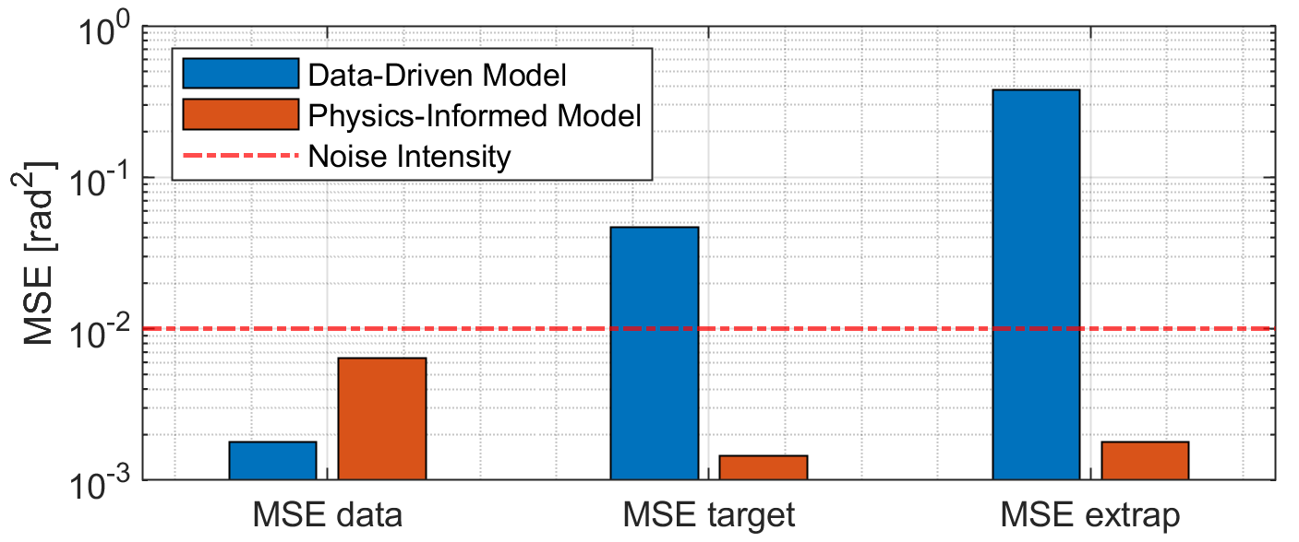
A (simple) example: Pure Data vs Physics-Informed Models
Introducing a physic model (even incomplete) in a deep learning model can be beneficial for different reasons:
The physics acts as a regularisation term that prevents overfitting
Prediction in both sparse data and in extrapolation domains is more reliable
Automatic modelling is enabled with application of deep learning to not only predictions but also physics understanding
Much more… (see next slides)
Note that MSE data is expected to be the noise intensity (otherwise we are partially overfitting data) while MSE on target and extrapolation should be equal to zero (because calculated on the true signal and not noisy data).

Slide 19
Outline
Introduction to Deep Neural Networks
(Purely) Data-Driven vs Physics Informed Deep Learning
Example Introduction
Supervised Deep Learning
Physics Informed Deep Learning
Results Comparison
PINNs for Diagnostics: Application to Nuclear Fusion
Equilibrium Reconstruction
Data-Integrated Reconstruction
Time-Resolved Tomography
Conclusions

Slide 20
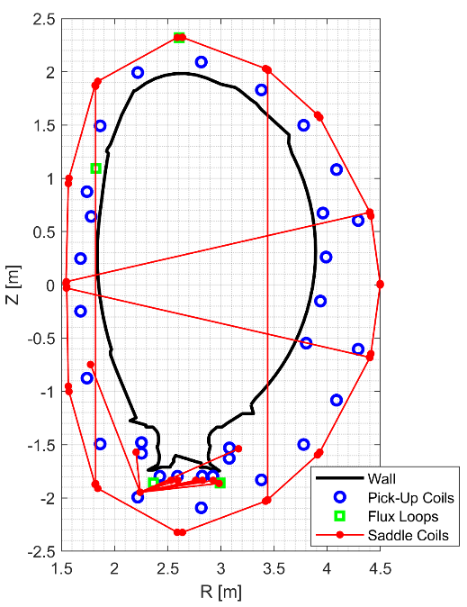
Applications in Nuclear Fusion: Equilibrium Reconstruction
Steady State Ideal Static MHD
$$\left\{\begin{aligned}∇∙B=0 \\ μ_{0}J=∇×B \\ ∇p=J×B\end{aligned}\right.$$
Grad-Shafranov Equation:
$$\frac{∂^{2}ψ}{∂R^{2}}−\frac{1}{R}\frac{∂ψ}{∂R}+\frac{∂^{2}ψ}{∂z^{2}}=−μ_{0}R^{2}\frac{dp}{dψ}−\frac{1}{2}\frac{df^{2}}{dψ}$$
$$p=h\left(ψ\right)$$
$$f=RB_{φ}=g\left(ψ\right)$$
JET Magnetics Coils for Equilibrium:
Toroidal geometry and symmetry

Slide 21
Applications in Nuclear Fusion: Equilibrium Reconstruction
Ad hoc neural network architecture for Grad-Shafranov Equation
It implicitly ensures that:
$$f=g\left(ψ\right)$$
$$p=h\left(ψ\right)$$

Slide 22
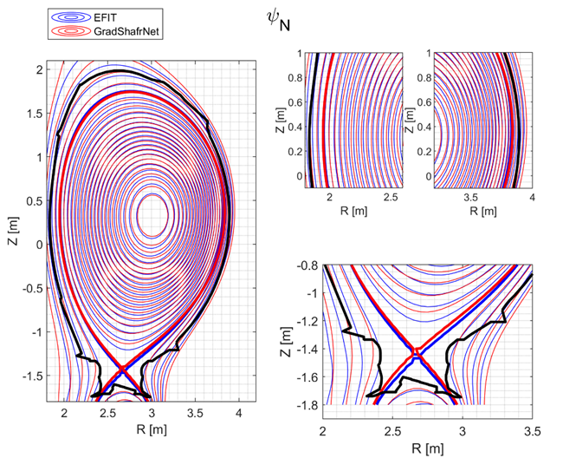
Applications in Nuclear Fusion: Equilibrium Reconstruction
Comparison with standard equilibrium code at JET (EFIT)
PINN has been trained using same boundaries of EFIT (“Magnetics only”) and therefore no improvements in terms of equilibrium quality has to be expected.
Next works:
Multi-diagnostics equilibrium and profile reconstructions.
Rossi R. et al. “On the potential of physics-informed neural networks to solve inverse problems in tokamaks” Nuclear Fusion 63 126059 (2023)

Slide 23
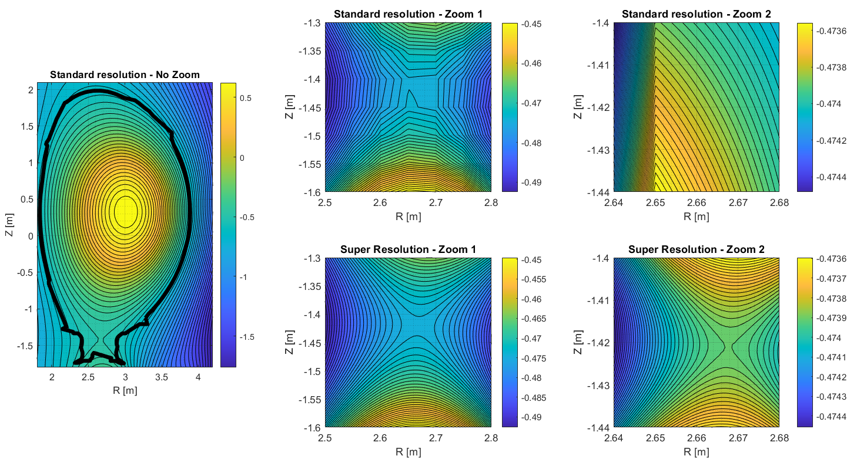
Applications in Nuclear Fusion: Equilibrium Reconstruction
Super-Resolved reconstructions can be achieved thanks the technique of varying collocation points

Slide 24
Outline
Introduction to Deep Neural Networks
(Purely) Data-Driven vs Physics Informed Deep Learning
Example Introduction
Supervised Deep Learning
Physics Informed Deep Learning
Results Comparison
PINNs for Diagnostics: Application to Nuclear Fusion
Equilibrium Reconstruction
Data-Integrated Reconstruction
Time-Resolved Tomography
Conclusions

Slide 25
Data Integrated Reconstructions
Interferometer
HRTS and Lidar
Different diagnostics are used to measure the same quantity in different regions and in different ways. How to combine them?
Electron density at JET is measured by:
Interferometer:
Line-integrated density, 8 line of sight
High Resolution Thomson Scattering (HRTS)
Local measurements limited to low field side and midplane
Lidar
Local measurements, low resolution, mid plane

Slide 26
Application in Nuclear Fusion: Inverse Problem and data integration
$$ℒ=αℒ_{p}+ℒ_{ML,LID}+ℒ_{ML,N_{e}}+ℒ_{wall}$$
$$ℒ_{ML,LID}=\frac{1}{M_{ch}}\frac{1}{M_{k}} \sum_{ch}{\sum_{k}{\left(\log\left(\sqrt{2π}σ_{LID,ch}\right)+\frac{{\left(LID_{ch,k}−LID_{ch,k}^{b}\right)}^{2}}{2σ_{LID,ch}^{2}}\right)}}$$
$$ℒ_{ML,N_{e}}=\frac{1}{M_{b}}\frac{1}{M_{k}}\sum_{i_{b}}{\sum_{k}{\left(\log\left(\sqrt{2π}σ_{N_{e},i_{b},k}\right)+\frac{{\left(N_{e,i_{b},k}−N_{e,i_{b},k}^{b}\right)}^{2}}{2σ_{N_{e},i_{b},k}^{2}}\right)}}$$
$$ℒ_{p,N_{e}}=\frac{1}{M_{p}}\frac{1}{C_{∥}^{2}}\sum_{i_{p}=1}^{M_{p}}{{\left(∇_{∥}N_{e}\left(R_{i_{p}},Z_{i_{p}}\right)\right)}^{2}}+\frac{1}{M_{p}}\frac{1}{C_{⊥}^{2}}\sum_{i_{p}=1}^{M_{p}}{{\left(∇_{⊥}N_{e}\left(R_{i_{p}},Z_{i_{p}}\right)\right)}^{2}}$$
$$ℒ_{p,σ_{Ne}}=\frac{1}{M_{p}}\frac{1}{C_{∥}^{2}}\sum_{i_{p}=1}^{M_{p}}{{\left(∇_{∥}σ_{Ne}\left(R_{i_{p}},Z_{i_{p}}\right)\right)}^{2}}+\frac{1}{M_{p}}\frac{1}{C_{⊥}^{2}}\sum_{i_{p}=1}^{M_{p}}{{\left(∇_{⊥}σ_{Ne}\left(R_{i_{p}},Z_{i_{p}}\right)\right)}^{2}}$$

Slide 27
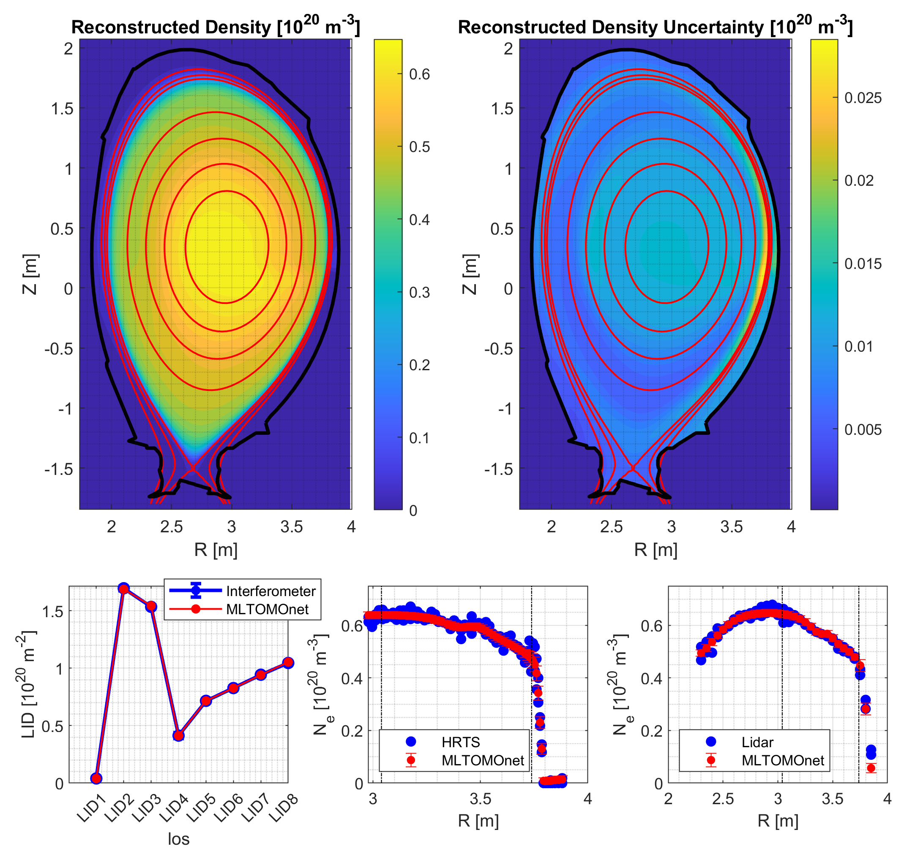
Data Integrated Reconstruction
A unique reconstructed profile that considers both HRTS and interferometric measurements (LIDAR is used for test)
Uncertainty prediction highlights regions where different diagnostics say different things: useful for fault diagnostic detection.
Rossi R. et al. “On the potential of physics-informed neural networks to solve inverse problems in tokamaks” Nuclear Fusion 63 126059 (2023)

Slide 28
Outline
Introduction to Deep Neural Networks
(Purely) Data-Driven vs Physics Informed Deep Learning
Example Introduction
Supervised Deep Learning
Physics Informed Deep Learning
Results Comparison
PINNs for Diagnostics: Application to Nuclear Fusion
Equilibrium Reconstruction
Data-Integrated Reconstruction
Time-Resolved Tomography
Conclusions

Slide 29
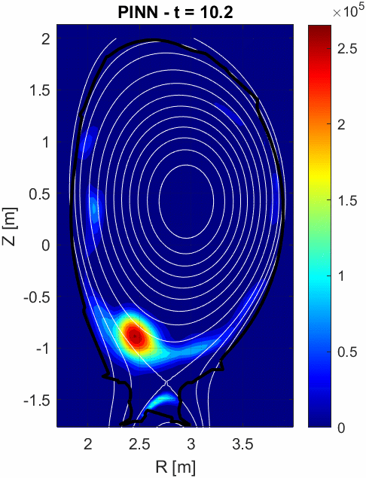
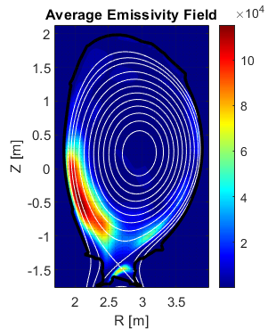
Time-Resolved Inverse Problem
New constrains, models, and diagnostics can be used for improve inverse problem like self-modelling of coefficients for regularisation equation.
We developed a time-constrained self-modelling PINN for emissivity reconstruction from bolometers.
See presentation by Ivan Wyss.
Comparison with visible camera
VIS t = 10.2448 s
VIS t = 10.2848 s

Slide 30
Outline
Introduction to Deep Neural Networks
(Purely) Data-Driven vs Physics Informed Deep Learning
Example Introduction
Supervised Deep Learning
Physics Informed Deep Learning
Results Comparison
PINNs for Diagnostics: Application to Nuclear Fusion
Equilibrium Reconstruction
Data-Integrated Reconstruction
Time-Resolved Tomography
Conclusions

Slide 31
Conclusions
Physics-Informed Deep Learning allows to combine physics-knowledge (even incomplete) with data (both ideal boundaries and noisy measurements).
Only some of the various advantages have been covered in this presentation (mostly related to diagnostic-based applications), but PINNs have a huge amount of features:
Physics
Boundaries
Measurements
Data-integration methods
Outliers and faulty diagnostic detection and identification
Inverse problem solution via hybrid data-driven and physics-informed methods
Physics-based regularised model for better predictions and reliable extrapolation
Meshless and multi-scale PDE solving
Direct Modelling
Super-Resolution
PINN
Meshless PDE Solving
Self-Modelling
Outliers Detection
Inverse Problems
Data Integration
Reliable Extrapolation

Slide 32
References
First works on Physics-Informed Neural Networks
Raissi, Maziar, Paris Perdikaris, and George Em Karniadakis. "Physics Informed Deep Learning (Part I): Data-driven Solutions of Nonlinear Partial Differential Equations." arXiv preprint arXiv:1711.10561 (2017)
Raissi, Maziar, Paris Perdikaris, and George Em Karniadakis. "Physics Informed Deep Learning (Part II): Data-driven Discovery of Nonlinear Partial Differential Equations." arXiv preprint arXiv:1711.10566 (2017)
Raissi M. et al. “Physics-informed neural networks: a deep learning framework for solving forward and inverse problems involving nonlinear partial differential equations” J. Comput. Phys. 378 686–707 (2019)
Reviews
Karniadakis G.E., Kevrekidis I.G., Lu L., Perdikaris P., Wang S. and Yang L. 2021 Physics-informed machine learning Nat. Rev. Phys. 3 422–40
Cai S., Mao Z., Wang Z., Yin M. and Karniadakis G.E. 2021 Physics-informed neural networks (PINNs) for fluid mechanics: a review Acta Mech. Sin. 37 1727–38
Zhao C. et al. “A comprehensive review of advances in physics-informed neural networks and their applications in complex fluid dynamics” Physics of Fluids 36 (2024)
Wu Y. et al. “Physics-informed machine learning: A comprehensive review on applications in anomaly detection and condition monitoring”, Expert Systems with Applications 255 (2024)
References of PINNs in Nuclear Fusion
Rossi R. et al. “On the potential of physics-informed neural networks to solve inverse problems in tokamaks” Nuclear Fusion 63 126059 (2023)
Rossi R. et al. “A hybrid physics/data-driven logic to detect, classify, and predict anomalies and disruptions in tokamak plasmas” Nuclear Fusion 64 046017 (2024)
Murari A. et al. “A control oriented strategy of disruption prediction to avoid the configuration collapse of tokamak reactors” Nature Communications 15 (2024)
Seo J. et al. “Leveraging physics-informed neural computing for transport simulations of nuclear fusion plasmas” Nuclear Engineering and Technology, (2024)
Jang B. et al. “Grad–Shafranov equilibria via data-free physics informed neural networks” Physics of Plasmas 31 (2024)

Slide 33
Merging Data-Driven and Physics Knowledge for Improved Diagnostics, Interpretation, and Modelling with Physics-Informed Neural Networks
7th International Conference on Frontier in Diagnostic Technologies
Riccardo Rossi¹, Michela Gelfusa¹, Pasquale Gaudio¹, Ivan Wyss¹, and Andrea Murari^{2,3}
on behalf of JET Contributors and the EUROfusion Tokamak Exploitation Team
¹Department of Industrial Engineering, University of Rome “Tor Vergata”, Via del Politecnico 1, 00133, Rome, Italy
²Consorzio RFX (CNR, ENEA, INFN, University of Padova, Acciaierie Venete SpA), C.so Stati Uniti 4, 35127 Padova, Italy
³Istituto per la Scienza e la Tecnologia dei Plasmi, CNR, Padova, Italy
Contact: r.rossi@ing.uniroma2.it

Slide 34
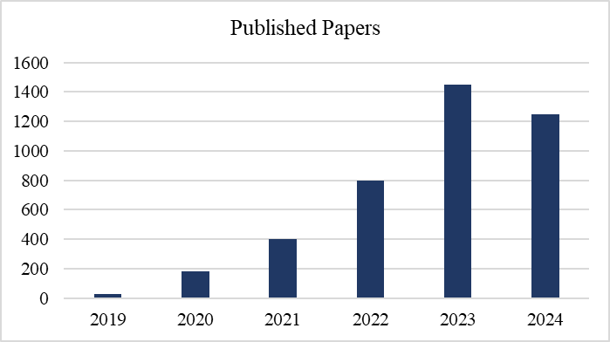
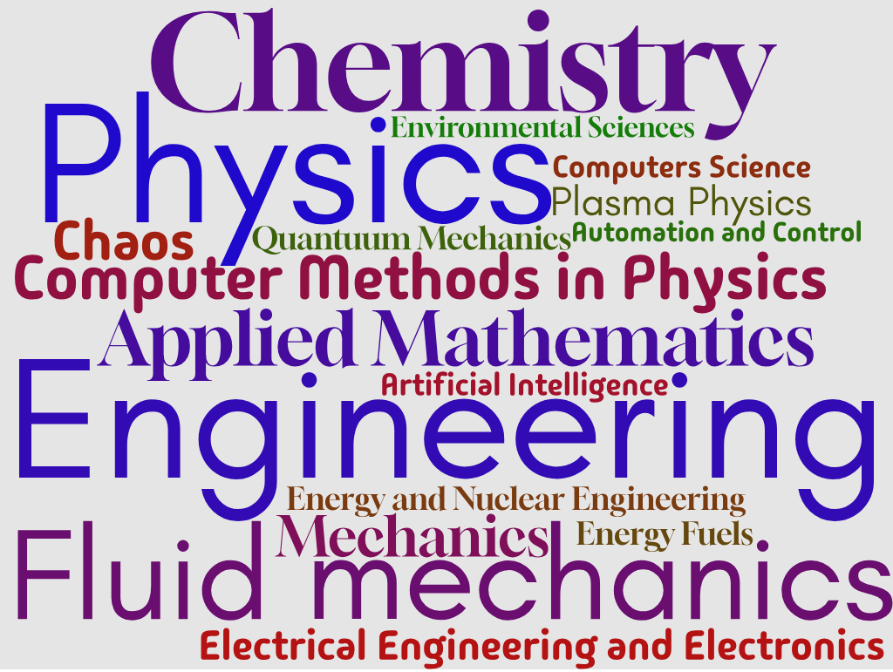
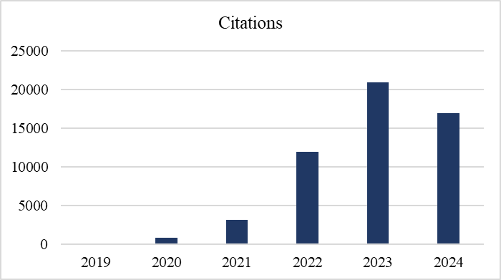
Physics-Informed Neural Networks - Literature
Physics-Informed Deep Learning has been developed between 2017 and 2019 and in few a years it has been studied, improved, and applied to a huge number of work.
PINN: Published papers and citations statistics (WOS)
Word cloud (17 most frequent – WOS)

Slide 35
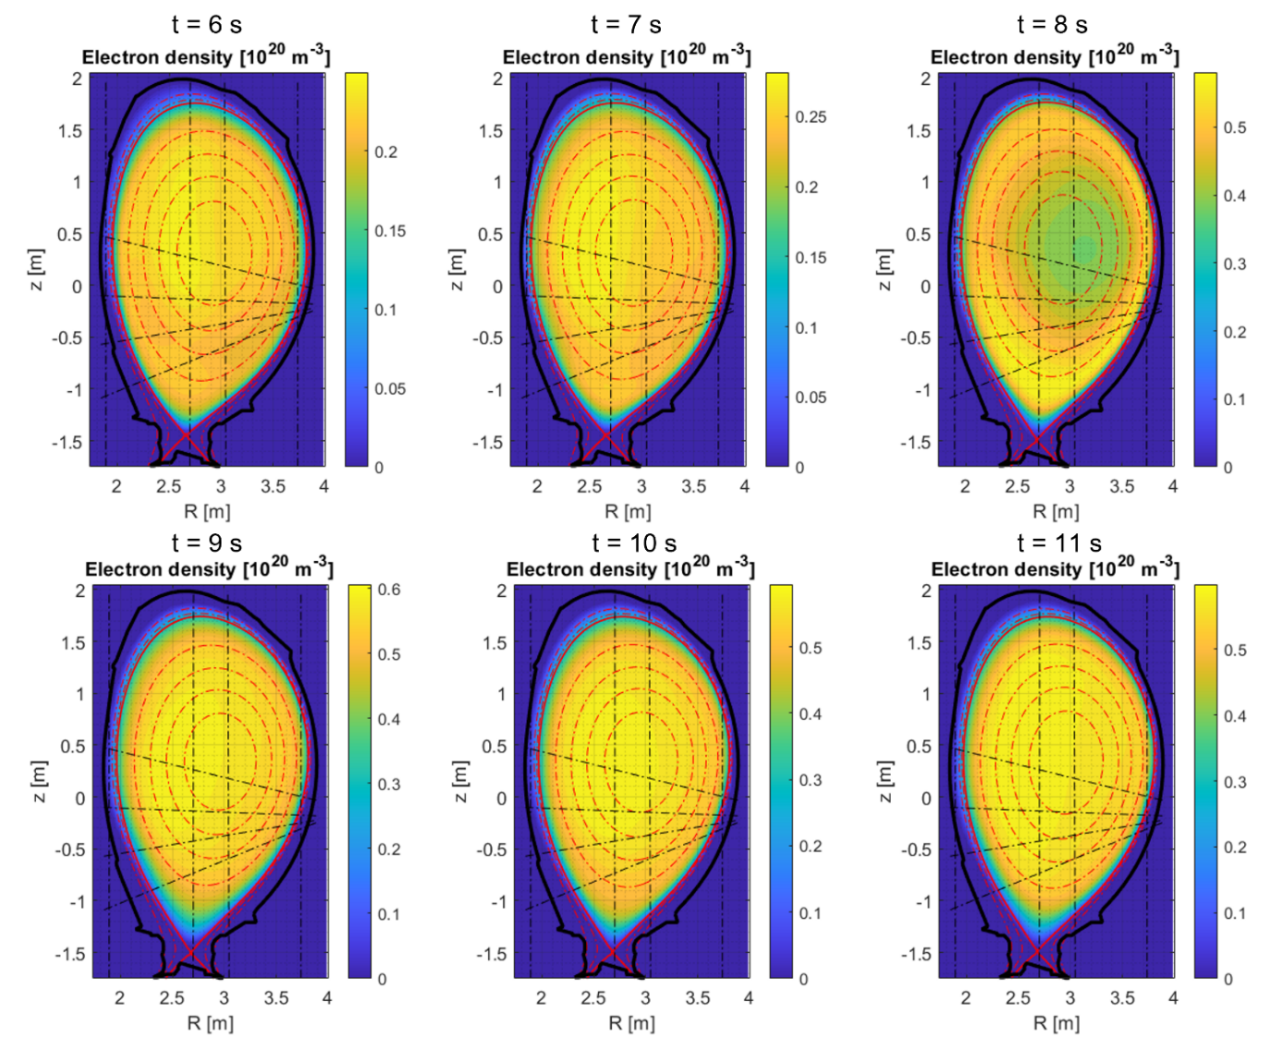
Appendix: Density Reconstruction
Density reconstruction with only interferometer
Different time-slices
Density reconstruction with data integration

Slide 36
Appendix: Standard vs Direct Modelling
Standard Physics-Based Methodology
Physics-Informed Neural Network
Boundaries
and PDE
Measurements
Boundaries
and DE/PDE
Measurements
PDE solver
Results Compared with Measurements
PINN
New Coefficient
Best Coefficients

