Slide 1
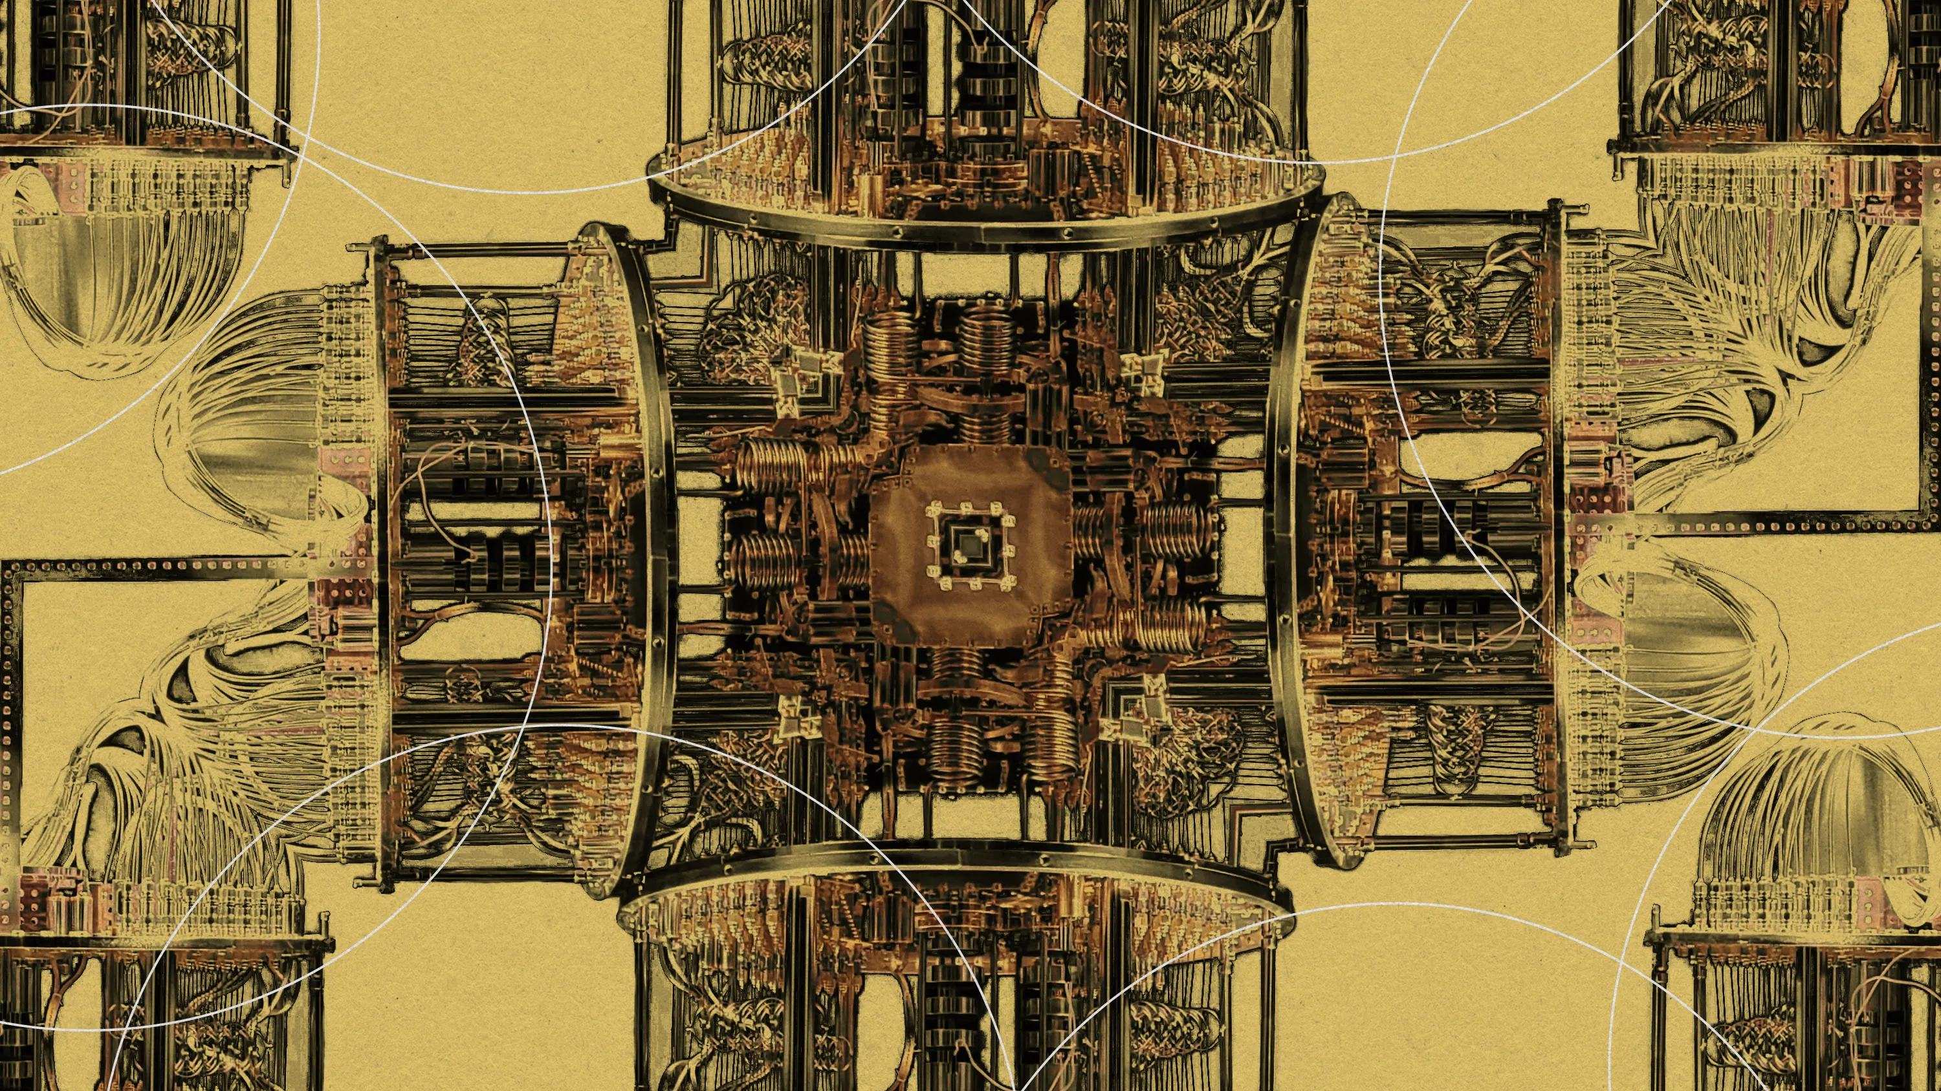
Quantum Architectures for Analogues and Theory Applications
FBK Trento 13/2/2024

Slide 2
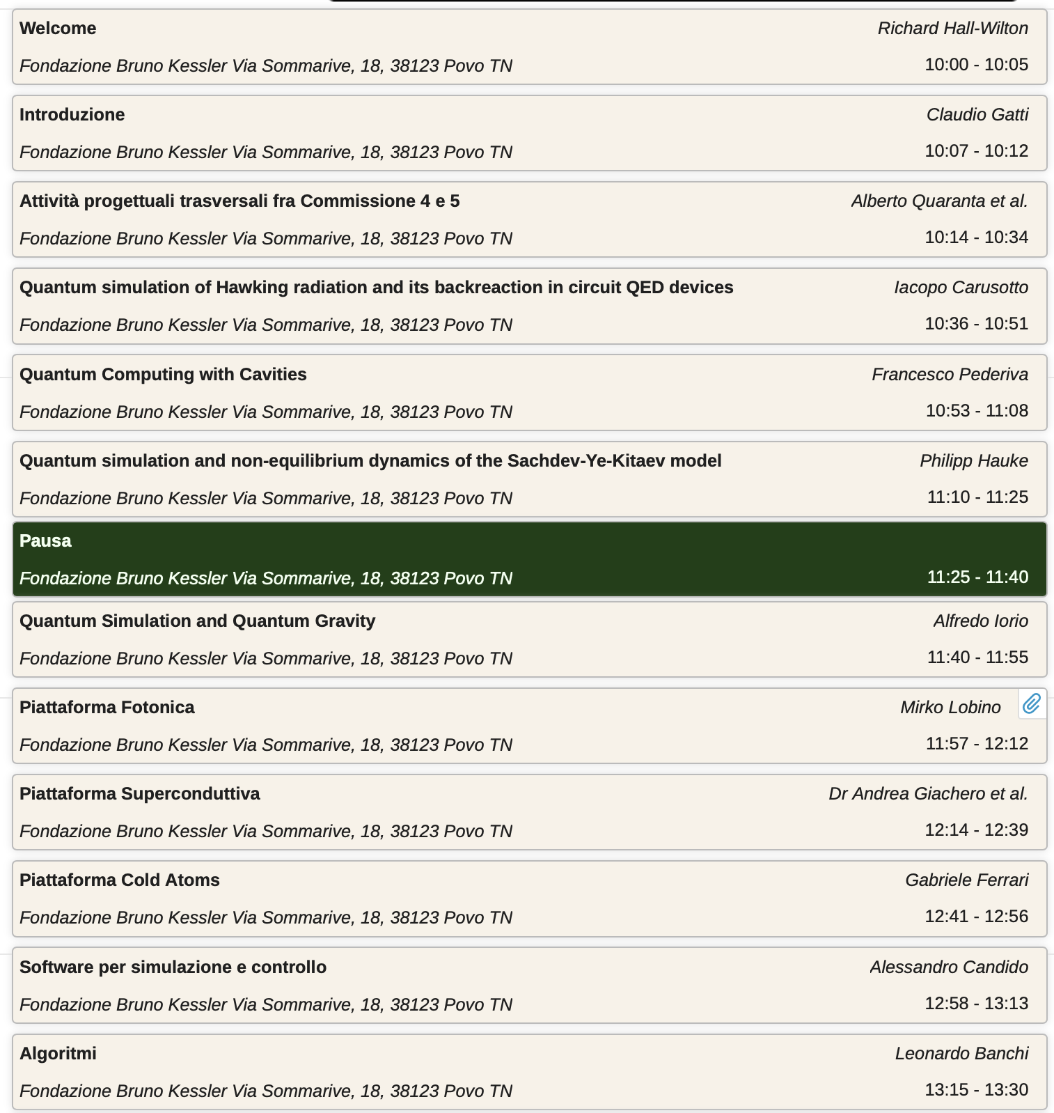
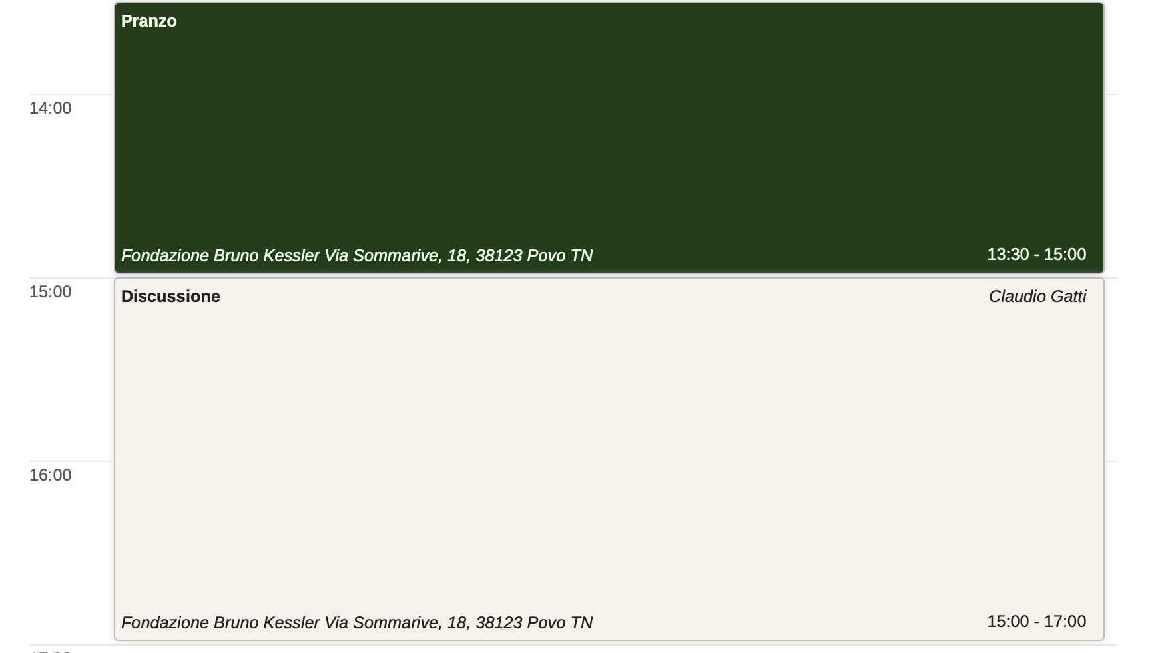
https://agenda.infn.it/event/39248/

Slide 3
https://agenda.infn.it/event/39248/
in the next pages I show an (incomplete) list of topics to be addressed during the meeting

Slide 4
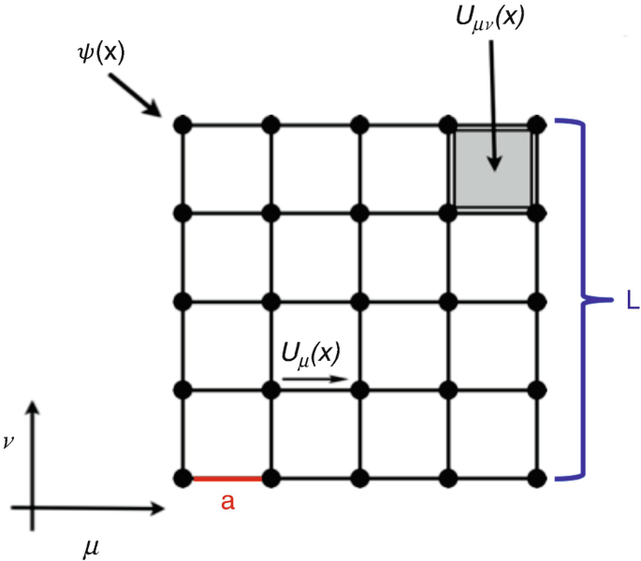
Discussion 1: What can we learn from a (Analogue) Quantum Simulation
What we would like from a simulation:
The example of Lattice QCD
Experiment: measurement of f₀×V_{ab} with 0.1% accuraccy
Lattice QCD: Calculation of f₀ to few 0.1%
Exp+Lattice QCD: determination of V_{ab} to few 0.1% →Precision test of the theory
Build new experiment for a higher precision measurement
Examples: Vus, g-2, B D C mesons decay ratios and constants, alpha strong …

Slide 5
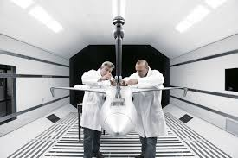
Discussion 1: What can we learn from a (Analogue) Quantum Simulation
Theory or model of some physical phenomena
No experimental access to the phenomena
AQS: Understand properties of the physical system (in particular if model not solvable)
Outputs:
Discrimination btw competing models/solutions; better understanding of theory/solutions; new ideas for theory/models
How does the study of analogue systems provides information for better understanding of the physics phenomenon?

Slide 6
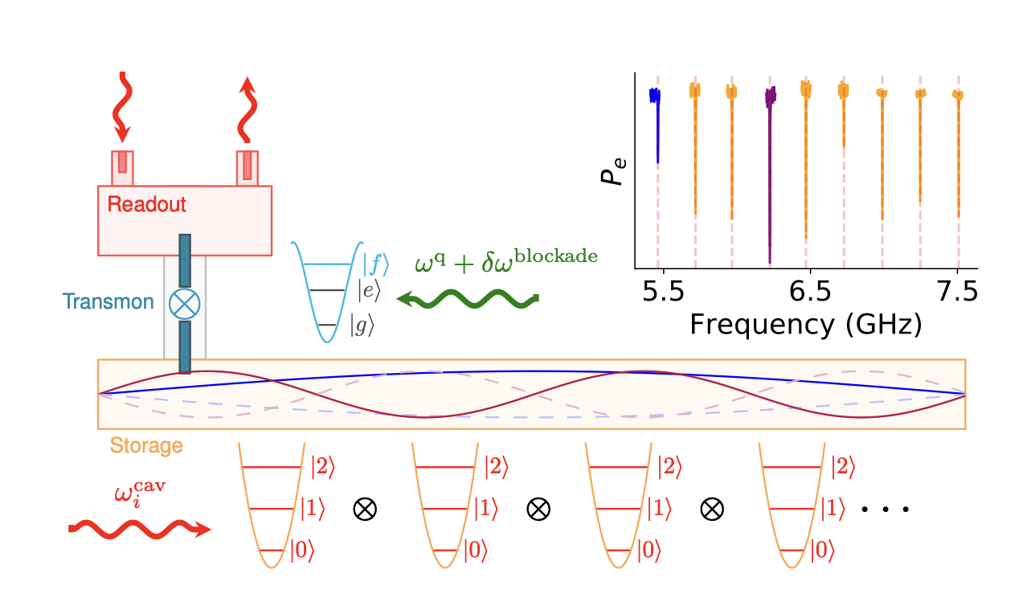
Discussion 2: How to realize the (A)QS?
Theory/model
Qudits and QOC
Mapping
Theory/model in Lab “operator space”
Analogue circuit realization
Metamaterials
Multiple qubits entangling gates
Digital
Analogue
Digital-Analogue

Slide 7
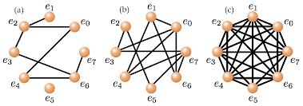
Discussion 3: How big must be N?
How to scale to a large enough system?

Slide 8
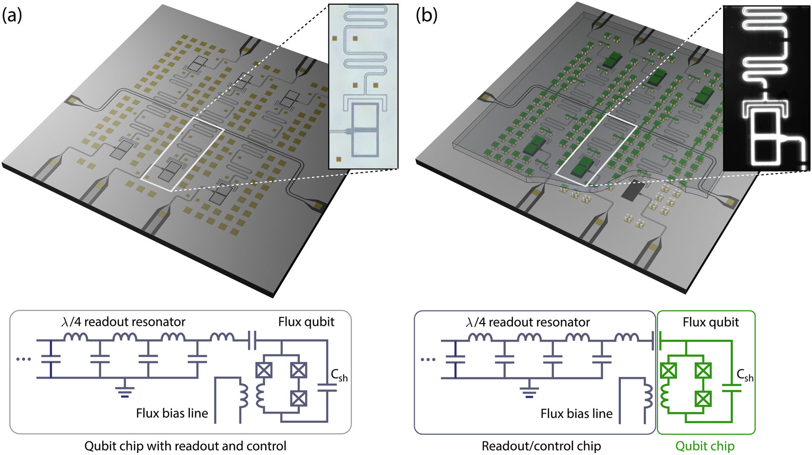
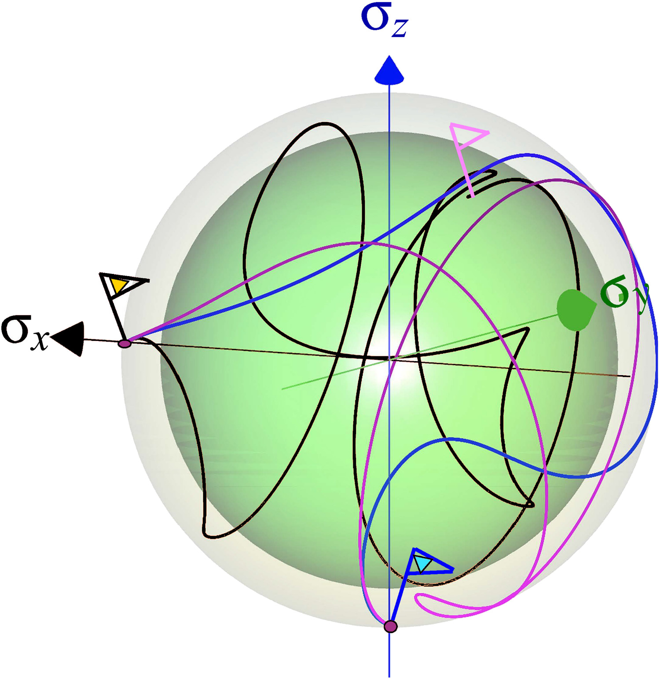
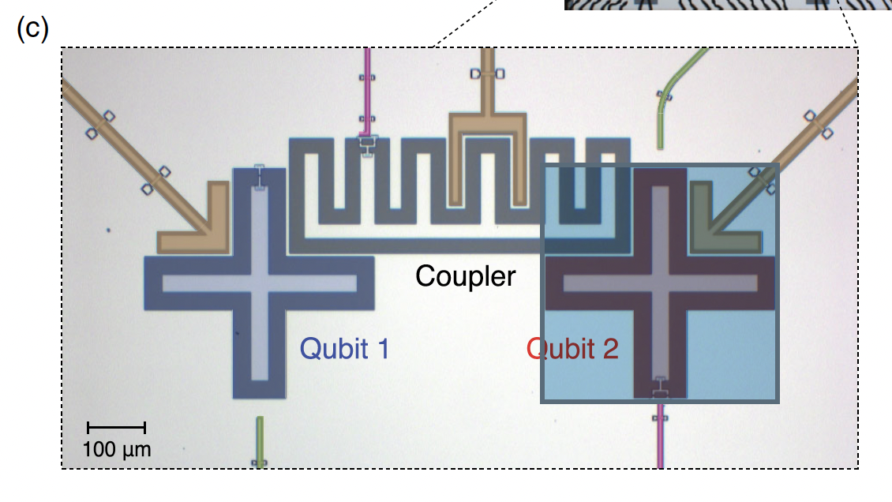
Discussion 4: Key Enabling Technologies for AQS?
Pulse generation for QOC
Flip chip process
Tunable couplers
Multiqubit gates
Qudits
Optimization algorithms

Slide 9
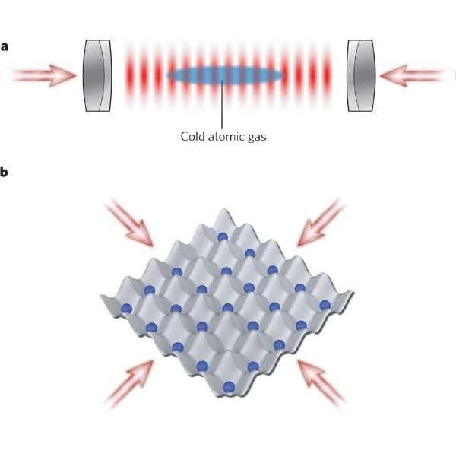
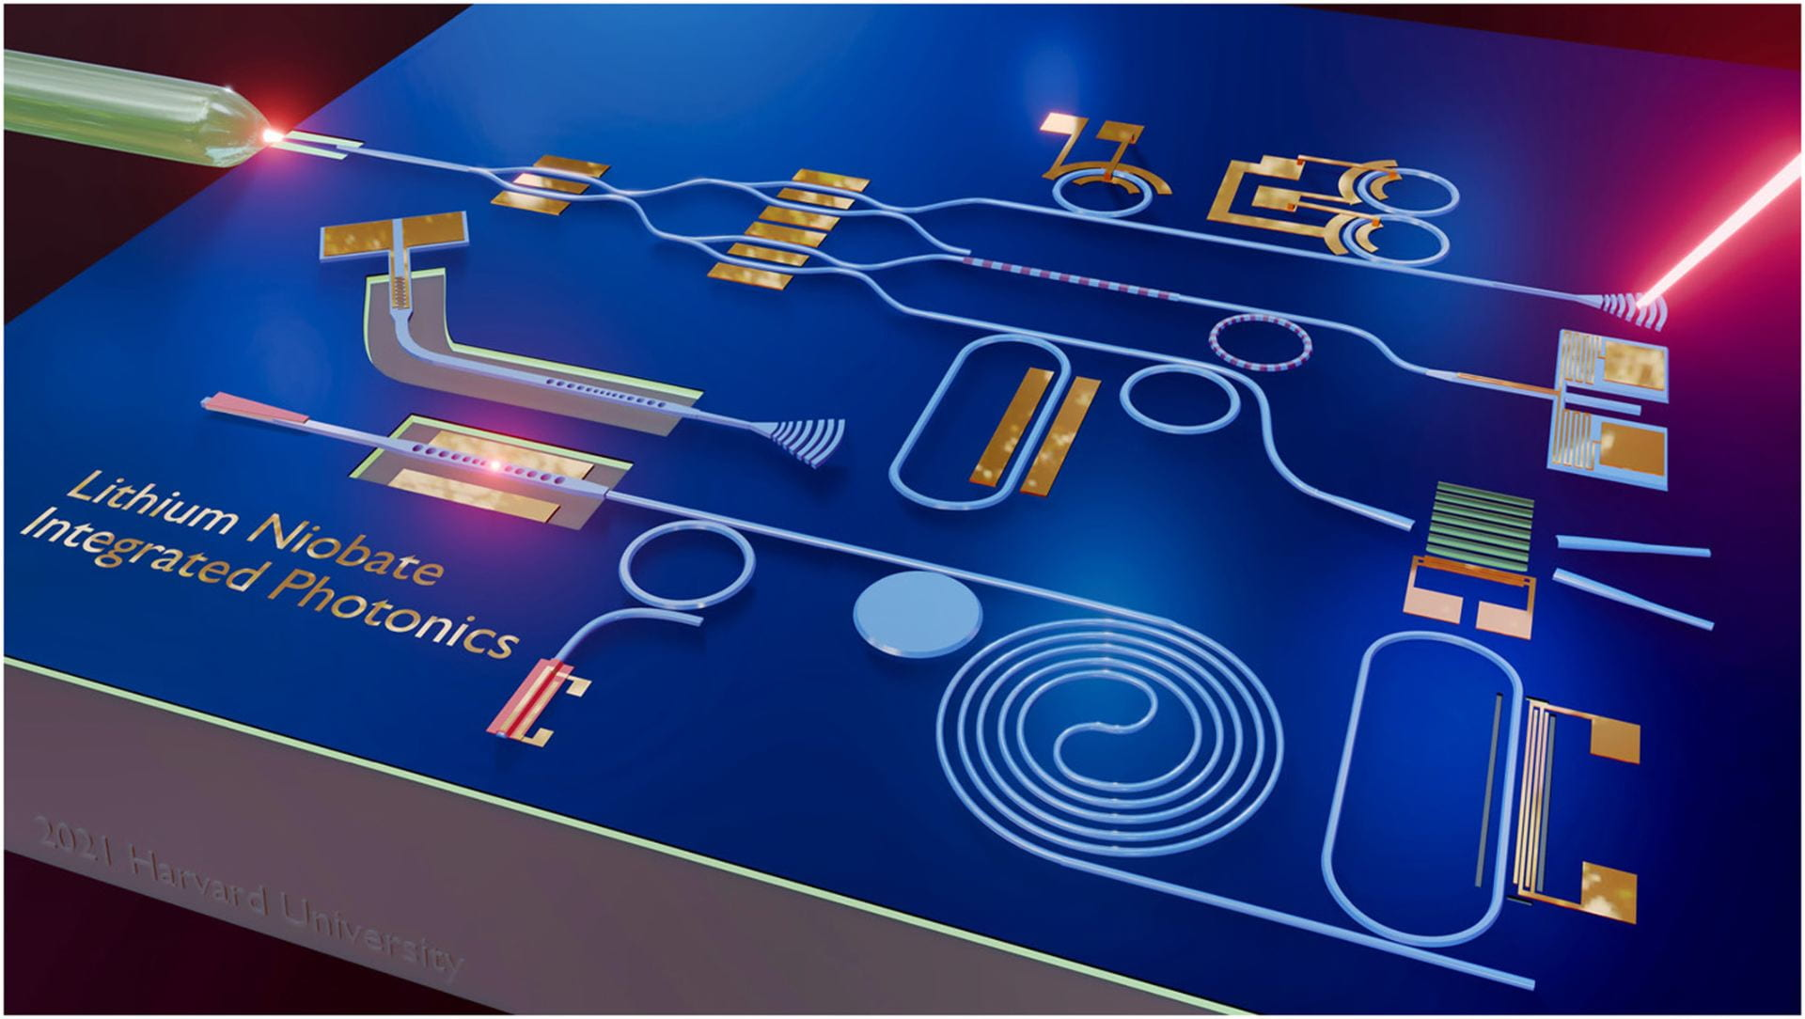
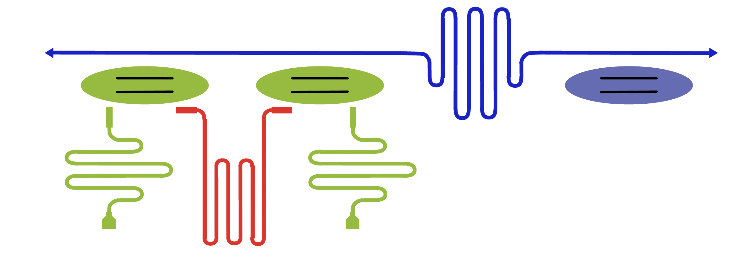
Discussion 5: Platforms, pros and cons.

Slide 10
Discussion 6: Project Organization
Gruppo 4
Model 1
Model 2
Gruppo 5
AQS
Fabrication
…
Control
…
External Collaborations

