Slide 1



Reconfigurable photonic devices in lithium niobate
Mirko Lobino
Università di Trento
Dipartimento di Ingegneria Industriale
Quantum Architectures for Analogues and Theory Applications – Trento 13/02/2024

Slide 2
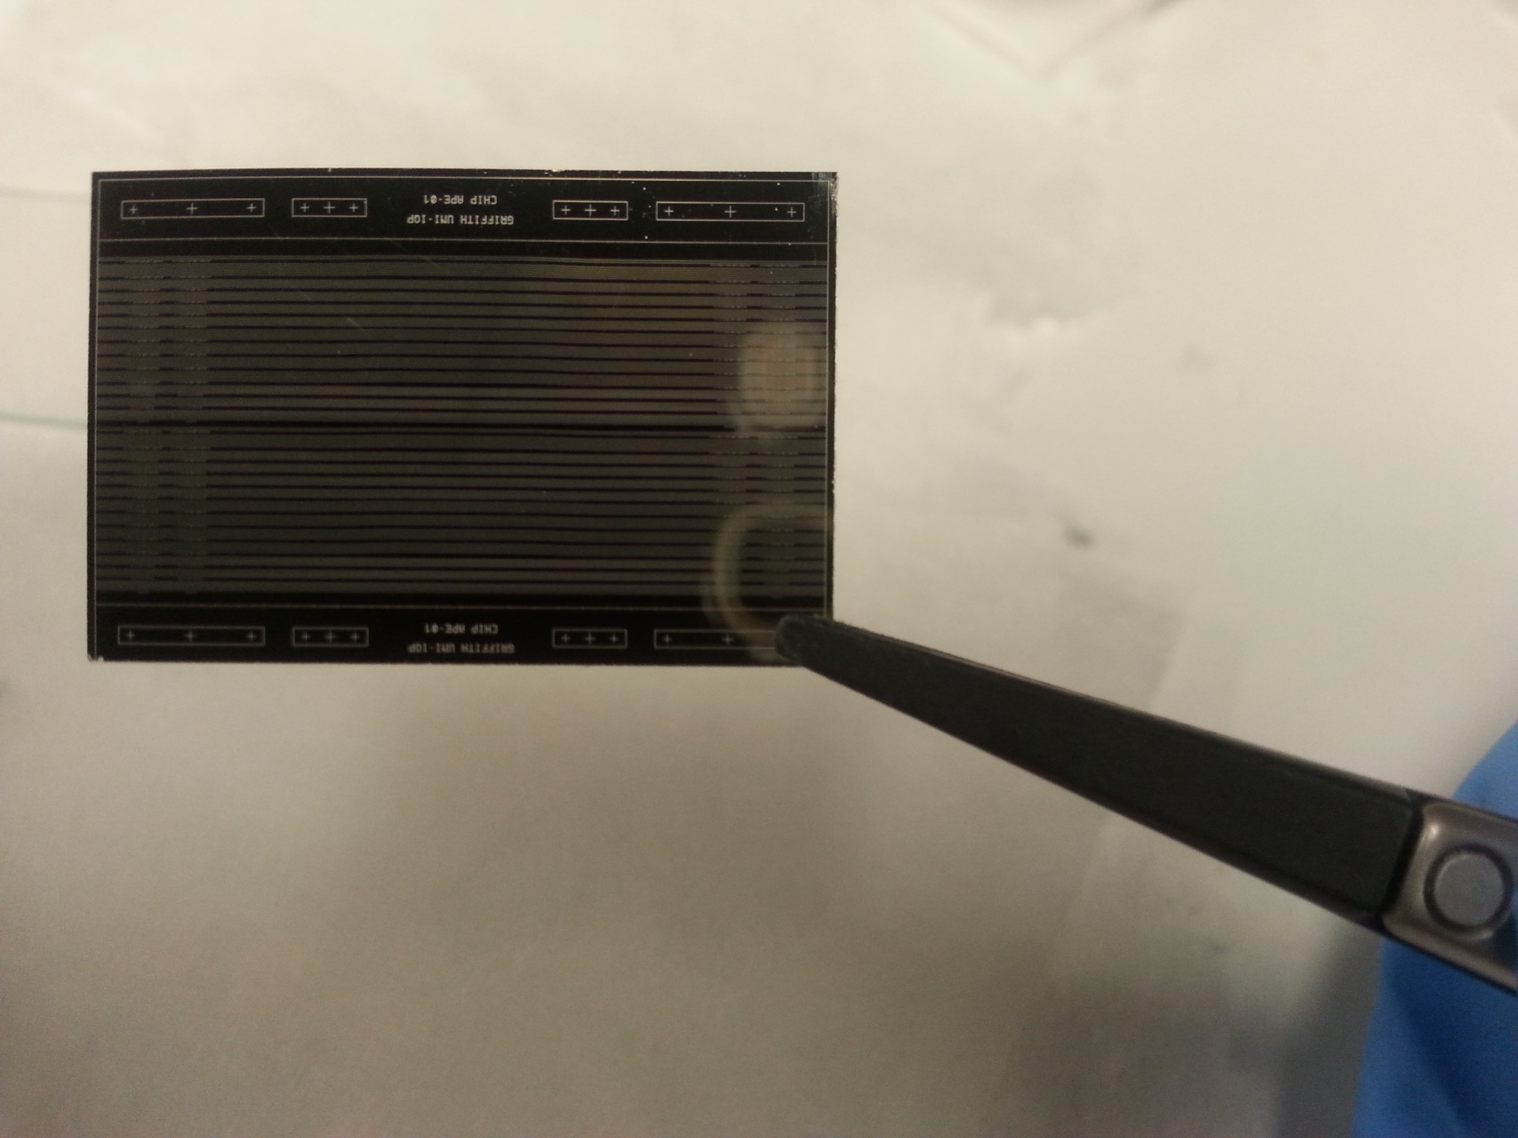
LiNbO₃ Integrated Photonics
Integrated Quantum Photonics:
implementation of photonic quantum circuits in
photolithography patterned waveguides
Image of a waveguide chip fabricated at Griffith University-IQP
PROPERTIES OF LITHIUM NIOBATE:
High transparency range (0.35 μm < λ < 4.5 μm), low propagation losses at 1550 nm
High electro-optic coefficient (30 pm/V) and second order susceptibility (20 pm/V)
Compatibility with periodic poling technique to achieve quasi phase matching
WAVEGUIDE CIRCUITS
+
PERIODIC POLING
+
ELECTRODES DEPOSITION
GENERATION OF QUANTUM STATES VIA SPDC
IN QUASI-PHASE MATCHED PPLN WAVEGUIDES
+
ELECTRO-OPTIC TUNABLE CIRCUITS FOR THE ACTIVE MANIPULATION OF QUANTUM STATES

Slide 3
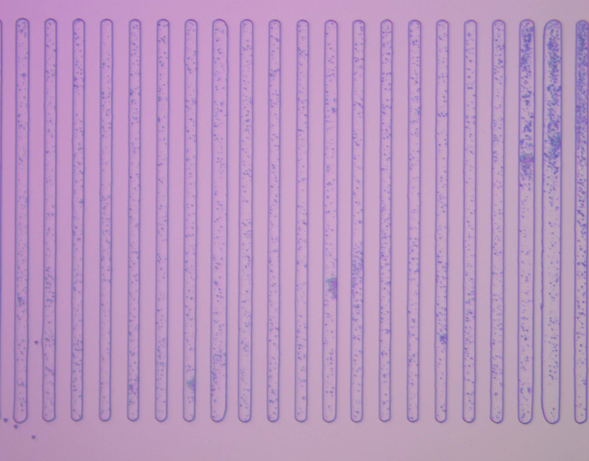
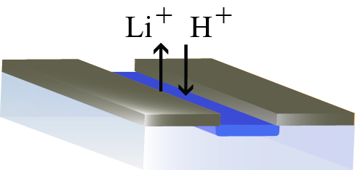
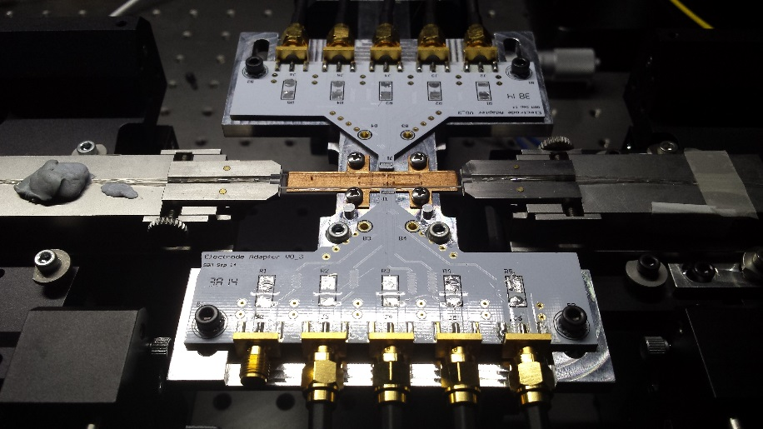
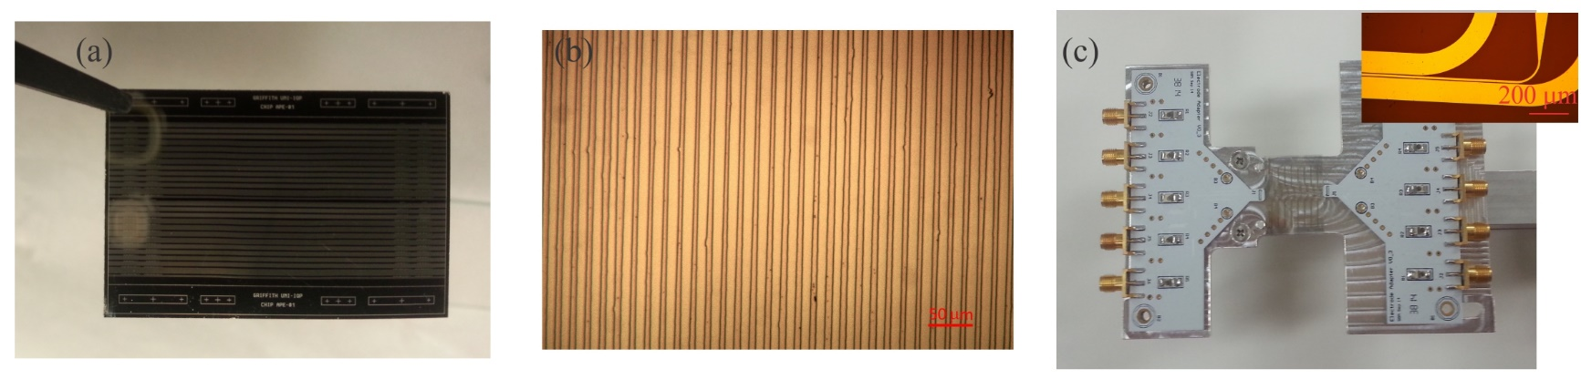
Waveguide Fabrication
Periodically Poling for Quasi Phase Matching
Proton Exchange (benzoic acid, T=170 C)
And Reverse Proton Exchange
Ti
LiNbO₃
Higher refractive index core
Electrodes Fabrication
Notes:
3 phases
Thin high contrast layer with poor optical properties, anneal to diffuse protons into substrate, creates a gradient index profile that is highly asymmetric, to symmetrise we return lithium ions to the surface, burying the waveguide. This gives symmetric, low propagation loss waveguide with nonlinear properties close to that of the substrate. I worked on characterisation of the reverse proton exchange step in planar waveguides.

Slide 4
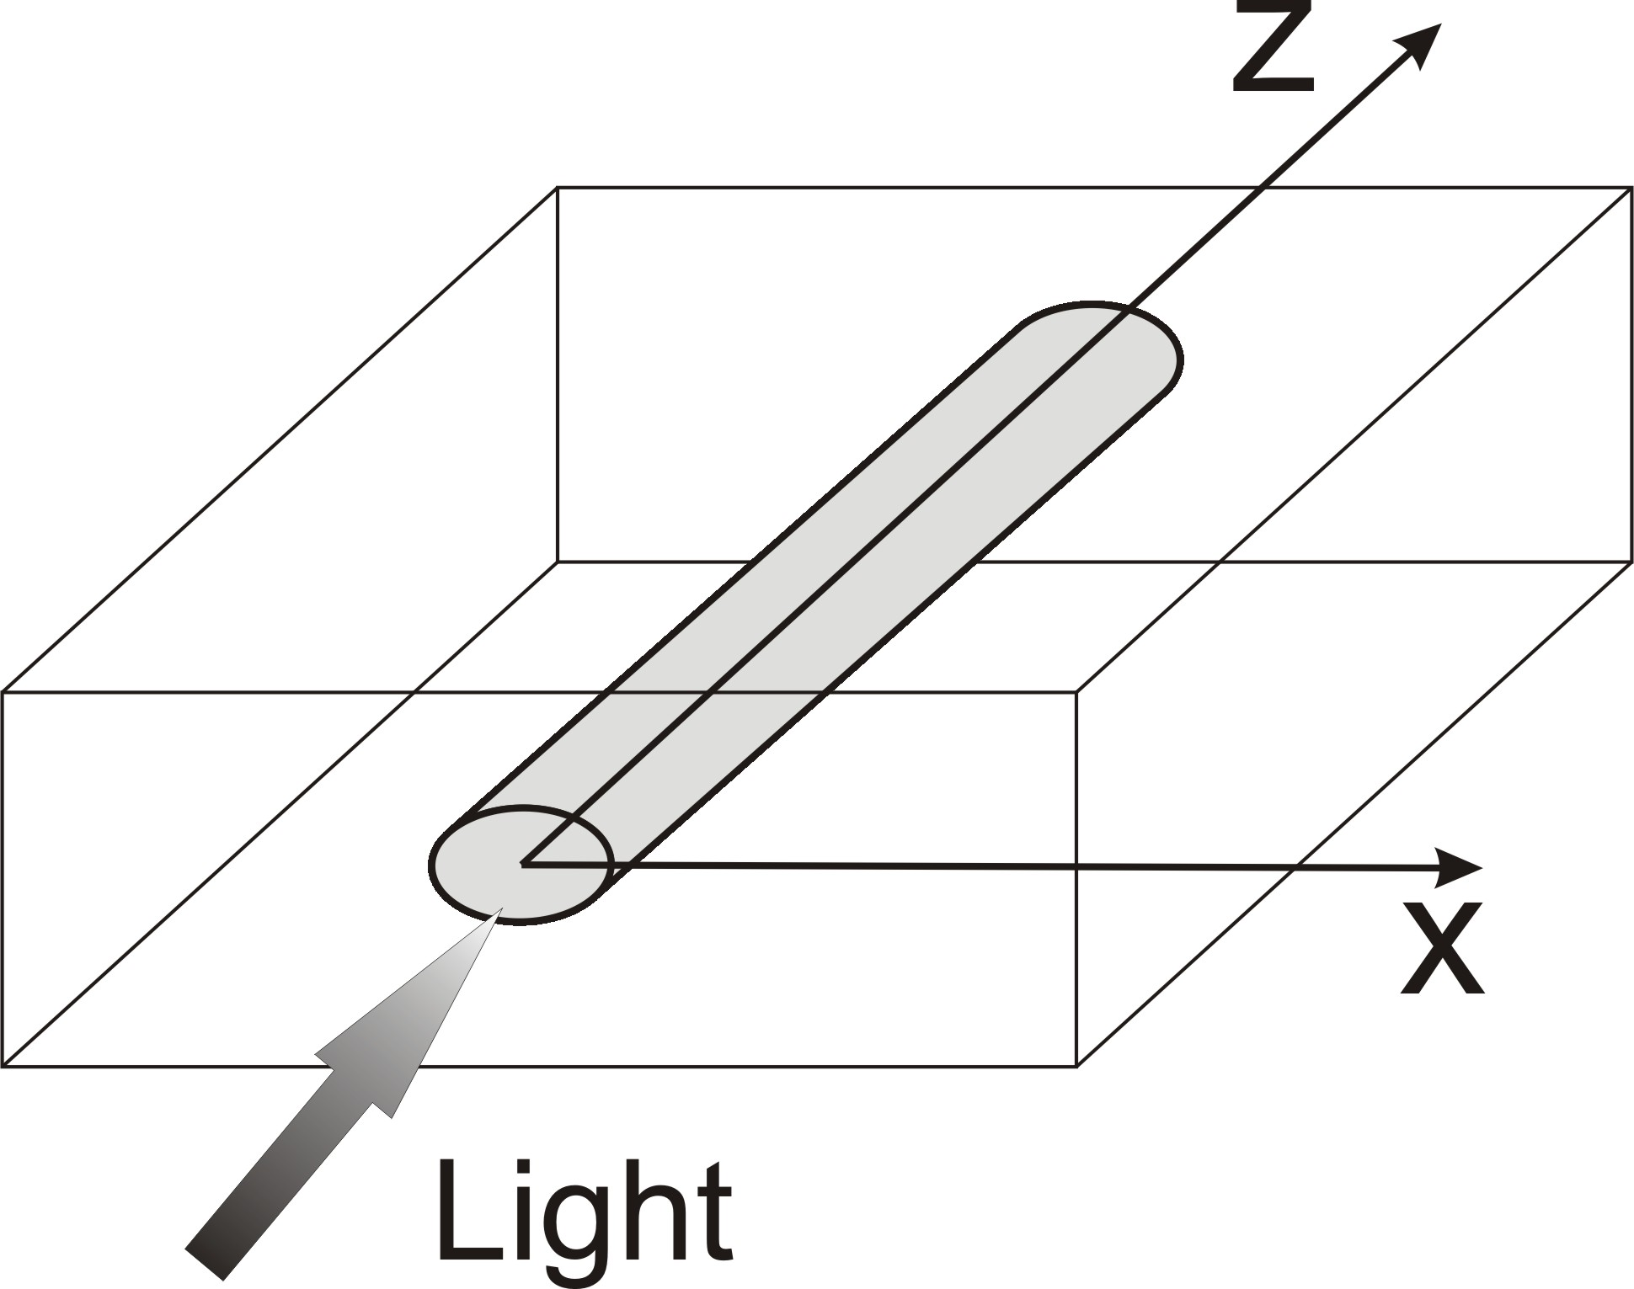
Optical and Particle Wave
2-D Electric field distribution in guided structure propagating in z direction
Paraxial wave equation
With
Changing:
Schrödinger equation

Slide 5
Waveguide Array: Discrete Diffraction
Output pattern for single waveguide
Coupling constant C has been measured by the analysis of diffraction patterns
The points show the waveguide intensity distribution
predicted by the coupled-mode Eqs. for C = 3 cm⁻¹
S. Longhi, et al, Phys. Rev. B 74, 155116 (2006)

Slide 6
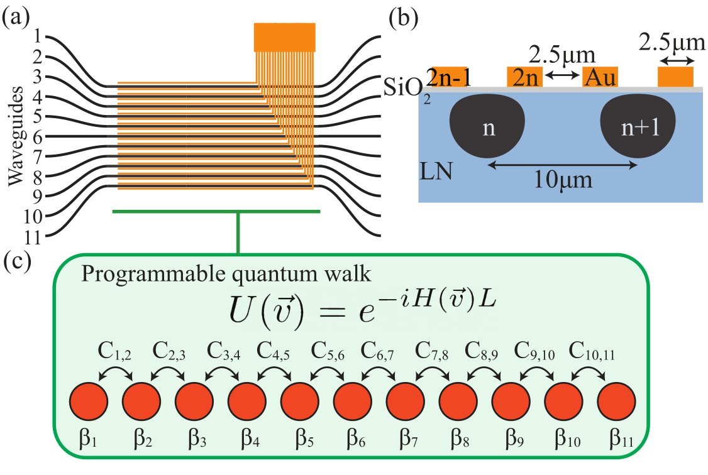



Waveguide array
Periodic potential
Because of the analogy it can behave like a solid
Collaboration with A. Peruzzo
Y. Yang, et al, Nature Comm.15, 5(2024)

Slide 7
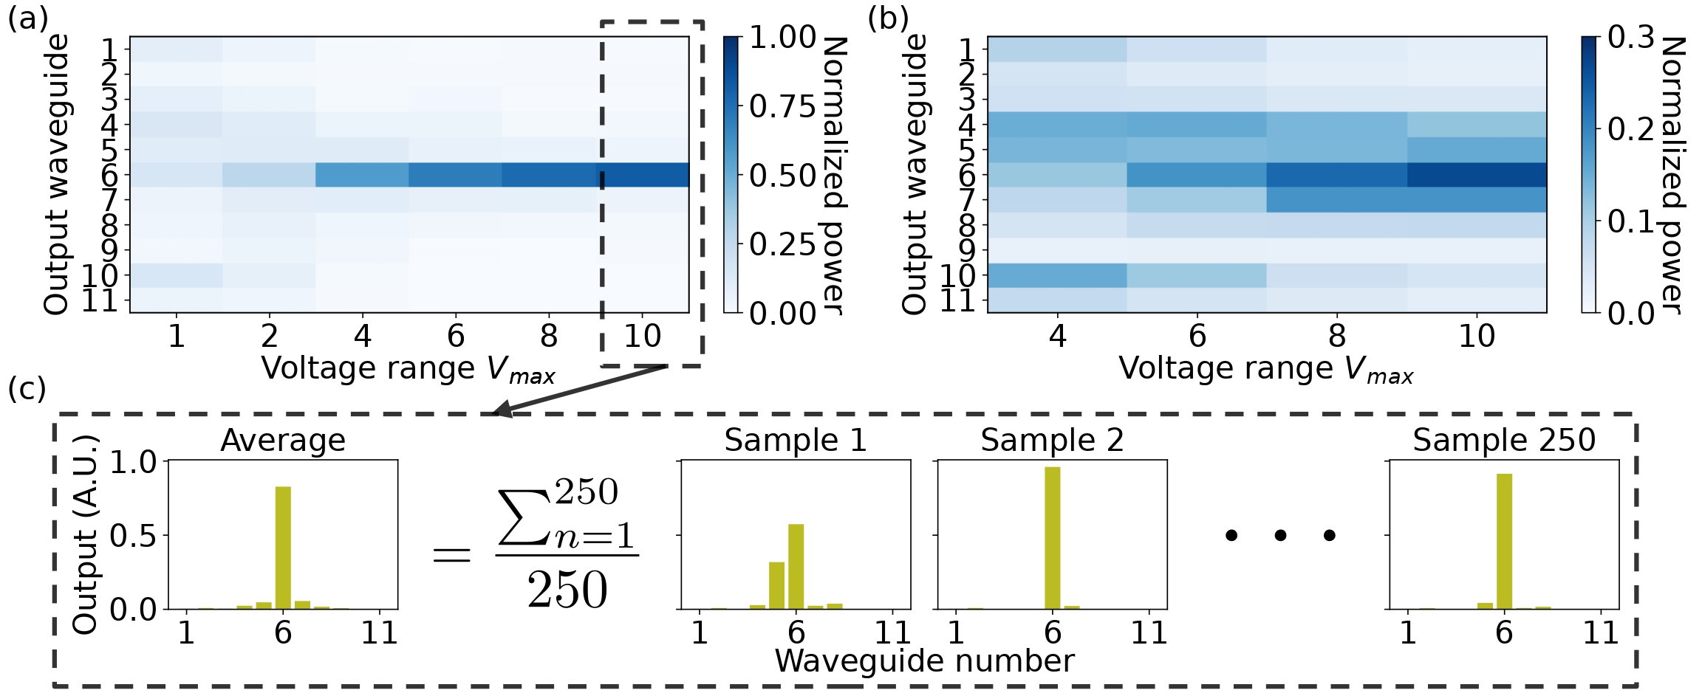
Platform to simulate solid state phenomena: Anderson Localization
arXiv:2311.14951
arXiv:2311.14951
Disorder in the coefficients leads to localization of light
Light injected in waveguide 6 , with C₀ = 84.8 m⁻¹,
Disorder in β_{n}
Disorder in C_{n,n+1}

Slide 8
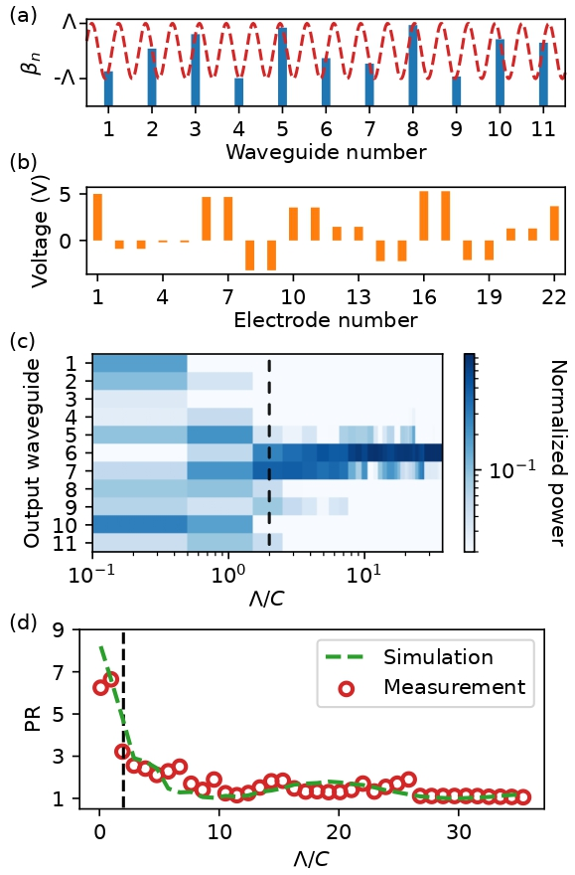
Localization with order: Aubry-Andrè model
condensed matter systems with a quasi-periodic potential β_{n} = β₀ + Λcos(2πnχ), with the condition that Λ/C = 2
The coupling coefficient is constant across the array
Voltage setting for Λ/C = 37.4

Slide 9
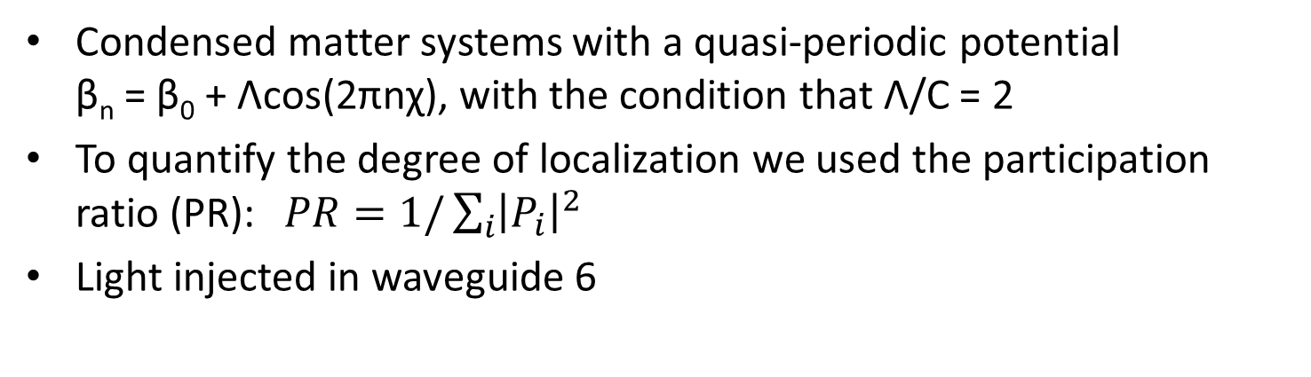
Localization with order: Aubry-Andrè model
Condensed matter systems with a quasi-periodic potential β_{n} = β₀ + Λcos(2πnχ), with the condition that Λ/C = 2
To quantify the degree of localization we used the participation ratio (PR): $PR=1/\sum_{i}{{\left|P_{i}\right|}^{2}}$
Light injected in waveguide 6

Slide 10
Implementing transformations over many modes
Hard to analytically predict what each electrode will do
Problem: how to implement a desired transformation?

Slide 11
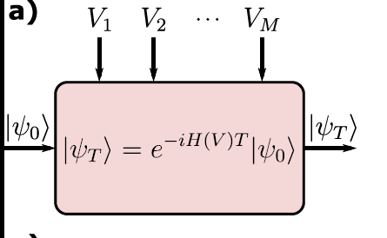
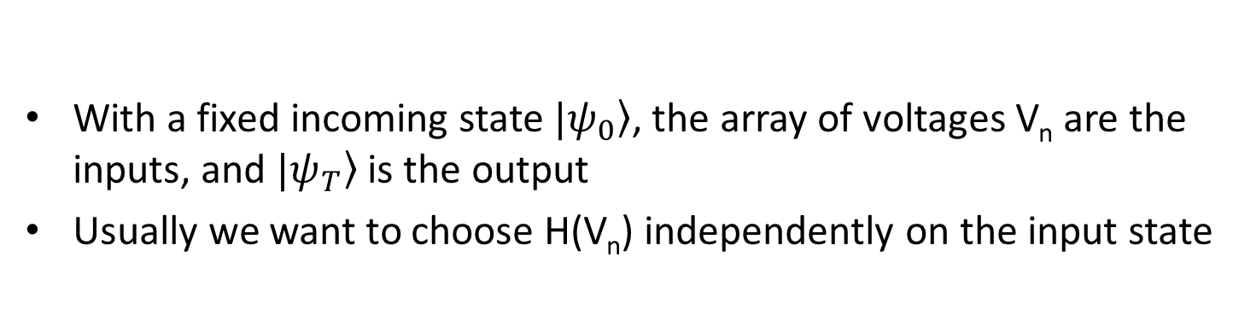
Controlling Electrooptical Circuits
With a fixed incoming state $\left.|ψ_{0}\right\rangle$, the array of voltages V_{n} are the inputs, and $\left.|ψ_{T}\right\rangle$ is the output
Usually we want to choose H(V_{n}) independently on the input state
Device​
Collaboration with A. Peruzzo
A. Youssry, et al, NPJ Q. Inf. 10, 9(2024)
Notes:
Typically people take data and fit a model. But the model is generally incorrect, missing some aspects of the physics of the device

Slide 12
Identification - Blackbox
A highly non-linear function
Ex: Neural network
Universal Approximation Theorem
No Physics
Output control
Device​
Collaboration with A. Peruzzo
A. Youssry, et al, NPJ Q. Inf. 10, 9(2024)
Notes:
Neural networks can help controlling a device but don’t provide a physical insight

Slide 13
Identification - Graybox
Best of the two worlds!
How much Black vs White?
Device​
Collaboration with A. Peruzzo
A. Youssry, et al, NPJ Q. Inf. 10, 9(2024)
Notes:
GB is the best of the two worlds: idetifies a model and uses is for control. This provide solution to other problems such as characterizing the environment

Slide 14
Experimental Graybox Quantum Control
Collaboration with A. Peruzzo
A. Youssry, et al, NPJ Q. Inf. 10, 9(2024)
Notes:
First experimental demonstration of a graybox controller

Slide 15
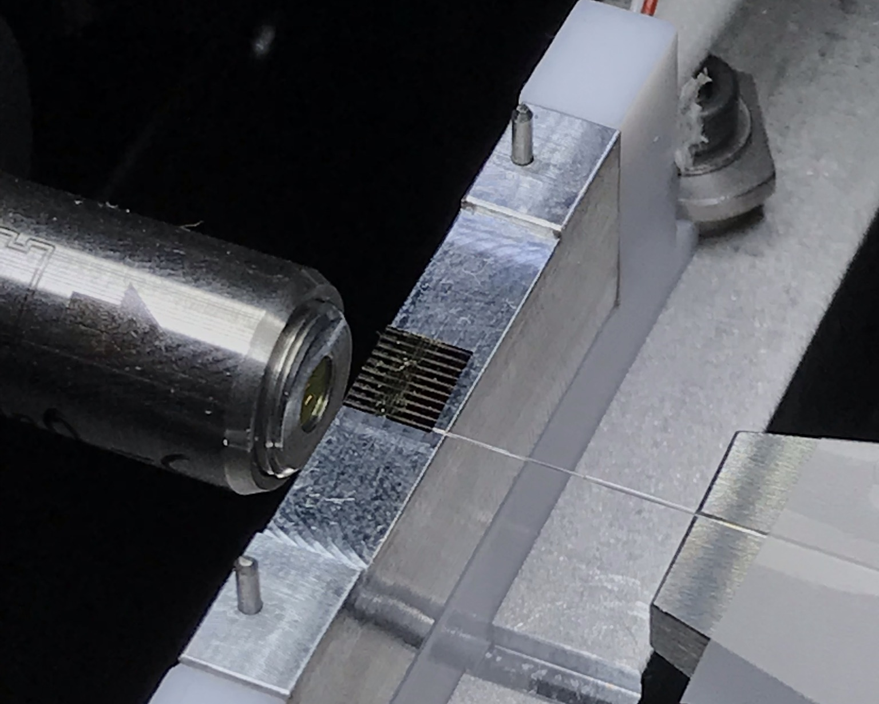


Thin film LN
10um
~5mm
Collaboration with A. Mitchell
Daniel Peace et al 2022 J. Phys. Photonics 4 035002 (2022)

Slide 16
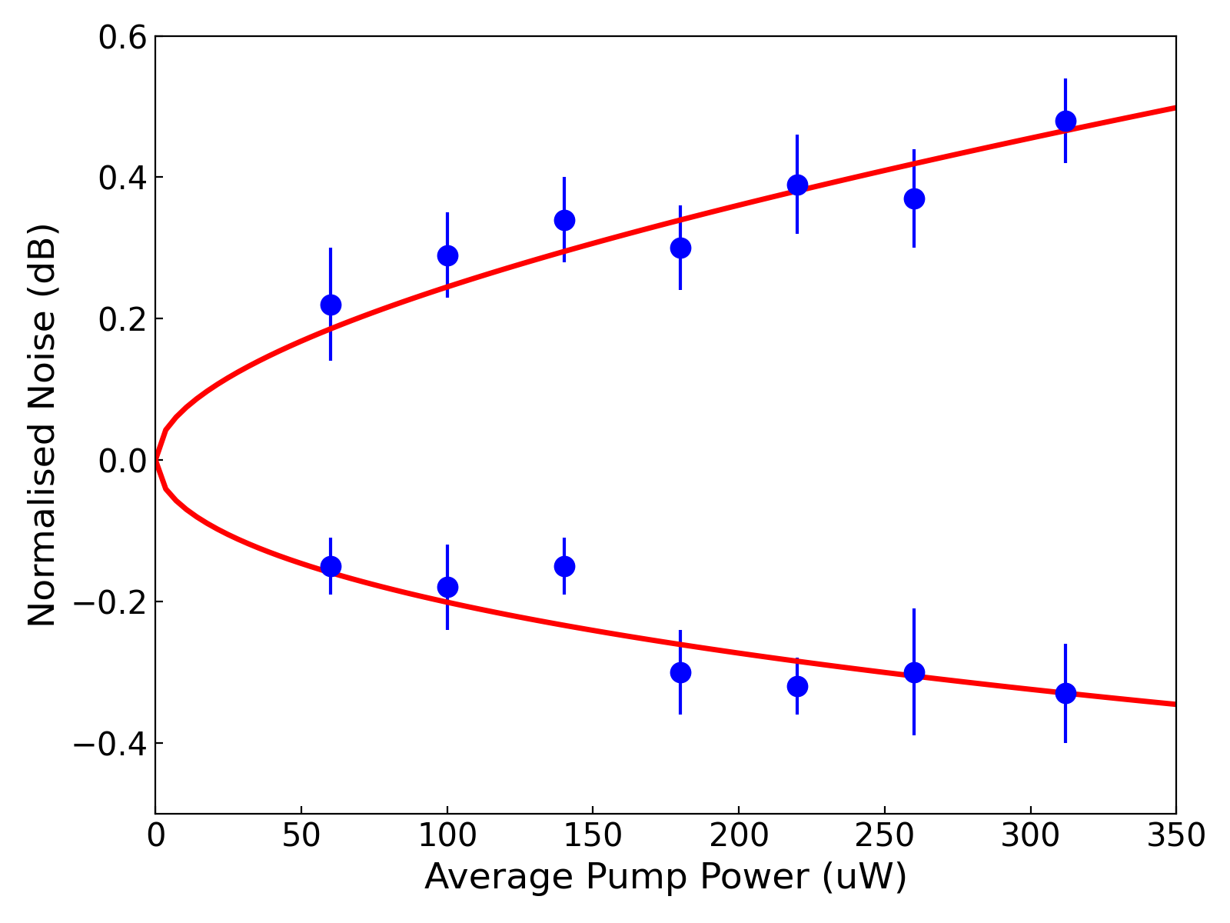
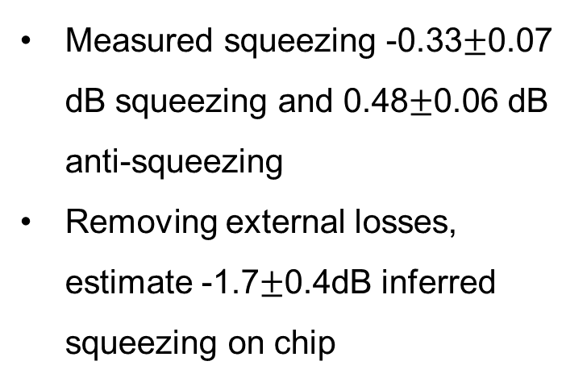


Squeezing Measurement
Estimate total detection efficiency, $η_{det}$ of 23%
$$S_{±}=η_{det}\exp\left(±2r\right)+1−η_{det}$$
Measured squeezing -0.33$±$0.07 dB squeezing and 0.48$±$0.06 dB anti-squeezing
Removing external losses, estimate -1.7$±$0.4dB inferred squeezing on chip
$$η_{SHG}=18\%/W$$
Collaboration with A. Mitchell
Daniel Peace et al 2022 J. Phys. Photonics 4 035002 (2022)

Slide 17


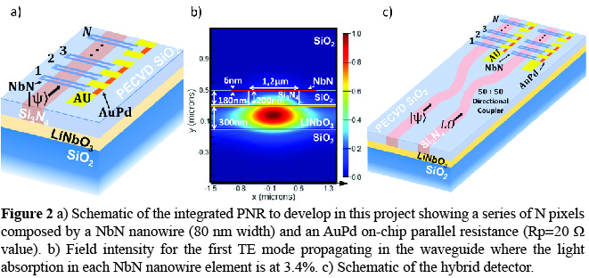
INFN experiment: UNIDET

Slide 18
Summary
Versatility of lithium niobate for photonic devices
Graybox control to multimode circuits
Thin film lithium niobate for nanophotonics devices

Slide 19






Thank You

