Slide 1
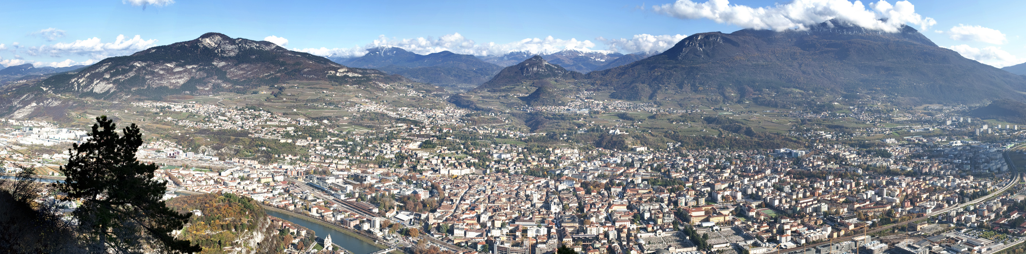
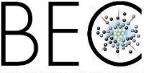
© Franco Visintainer
Quantum simulation and non-equilibrium dynamics of the Sachdev-Ye-Kitaev model
Quantum Architectures for Analogues and Theory Applications, Trento February 13th, 2024
Philipp Hauke
Pitaevskii BEC Center & Department of Physics, University of Trento
INFN-TIFPA, Trento Institute for Fundamental Physics and Applications
SERI project Holograph
Horizon Europe RIA NeQST (101080086)
Quantera II, Horizon 2020, DYNAMITE (101017733)
INFN specific initiative QUANTUM

Slide 2
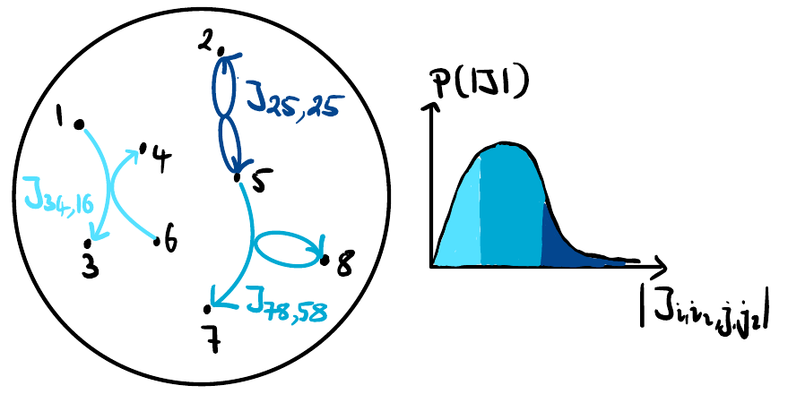
The SYK model —a new frontier for theory and experiment in quantum simulation
$$H_{SYK}^{4}=\sum_{ijkl}{J_{ijkl}c_{i}^{†}c_{j}^{†}c_{k}c_{l}}$$
$$var\left(J_{ijkl}\right)∝J^{2}$$
Kitaev KITP talks “A simple model of quantum holography" 2015
Sachdev, PRX 5 (2015)
Simplification of Sachdev-Ye model Phys. Rev. Lett., 1993

Slide 3
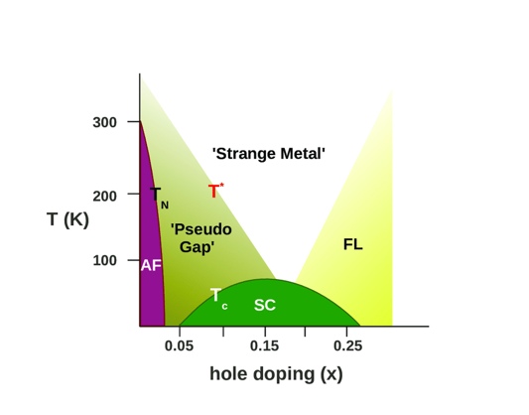
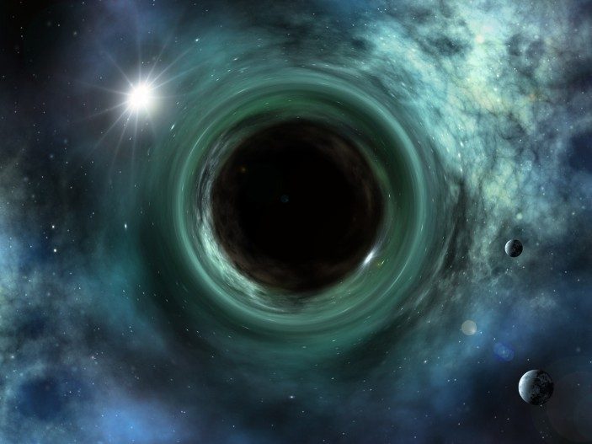
A prototype for holographic quantum matter
Sachdev-Ye-Kitaev model
$$H_{SYK}^{4}=\sum_{ijkl}{J_{ijkl}c_{i}^{†}c_{j}^{†}c_{k}c_{l}}$$
Holographically dual to Jackiw-Teitelboim gravity
no quasiparticles,
emergent conformal symmetry
phenomen. model of strange metals
proxy for quantum critical system
Maximal chaos/operator growth/scrambling
$$W(0)$$
holographic duality
to black holes
$$V$$
at $βJ≫1 (strong coupling)$:
Many-body system
in d dimensions
single scale $κ=1/β$
saturates Lyapunov exp$λ=2π/β$
${\left\langle {\left|\left[W\left(t\right),V\left(0\right)\right]\right|}^{2}\right\rangle }_{β}∼e^{λt}$
Liu, Sonner, arXiv:2004.06159
$$W(0)$$
$$W(t)$$
$$V$$
$$V$$
Gravity in d+1 dimensions
$$1$$
Artist's impression by
Markus Gann/ Shutterstock
OTOC
other models
SYK
Picture: blog condensedconcepts
$$0$$
$$10$$
$$t/β$$
Notes:
Bridges holography/gravity, quantum information, condensed matter
(interesting research question: is just similar to strange metal or can really emerge as an effective description?)
From Liu/Sonner
Holographic systems at a finite density/temperature are described by black holes, a defining feature of which is that they
swallow everything thrown at them as fast as possible. Without fine tuning initial conditions such absorption processes happen with a time scale controlled by the geometric scale of a black hole which in turn determines its temperature. As a result the dissipation time is generically of the same order as the inverse temperature scale.

Slide 4
The main characteristic is also the main challenge:
How to obtain infinite-ranged interactions that are random and uncorrelated ?
$$H_{SYK}^{4}=\sum_{ijkl}{J_{ijkl}c_{i}^{†}c_{j}^{†}c_{k}c_{l}}$$

Slide 5
A series of proposals already exists
Analog devices
Graphene flakes, Majorana wires, optical lattices, molecules, . . .
Pikulin and Franz, PRX 2017; García-Álvarez et al., PRL 2017; Danshita et al., PTEP 2017; Chew et al., PRB 2017; Chen, et al., PRL 2018; Kuhlenkamp, Knap PRL 2020; . . .
Not yet
implemented
Quantum computers
Nuclear Magnetic Resonance, Superconducting qubits
Challenge:
scalability
($N≤7$)
Babbush et al., PRA 99 (2019); Luo et al., npj Q. Inf. 5 (2019); Bentsen et al., PRL 123 (2019); Kim et al., PRB 101 (2020); Wei and Sedrakyan, PRA 103 (2021);
Jafferis et al., Nature 612, 51 (2022); Kobrin et al., arXiv:2302.07897

Slide 6
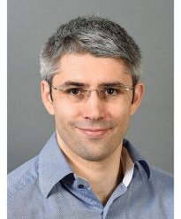
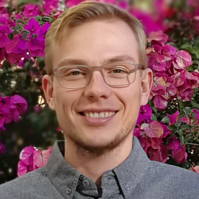
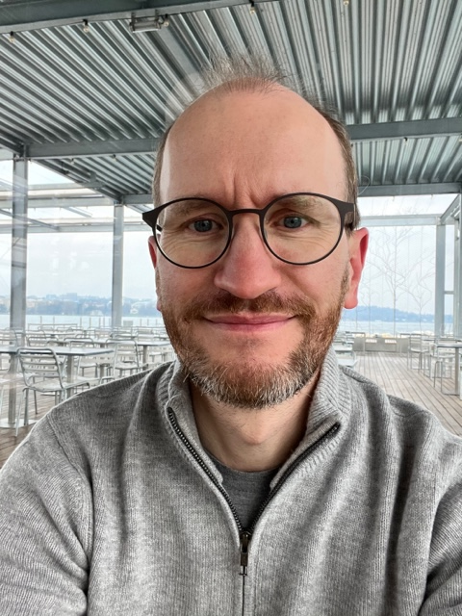
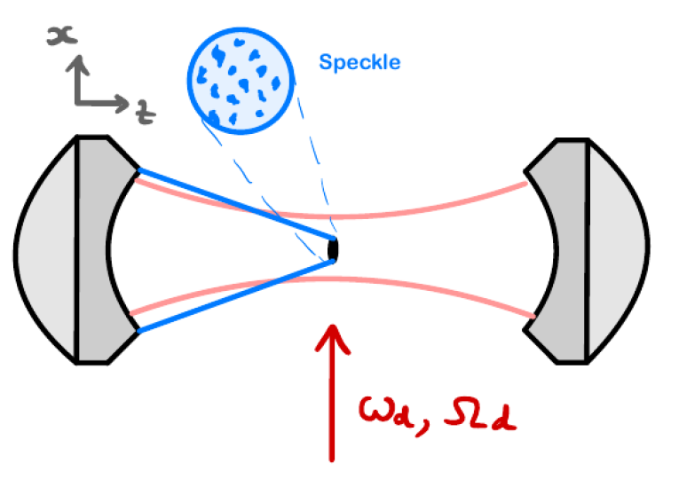
Philipp
Uhrich
Soumik Bandyopadyhay
Nick
Sauerwein
Jean-Philipp Brantut
Julian Sonner
Trento
Lausanne
Geneva
Cavity-QED quantum simulation of SYK model
Uhrich, Bandyopadhyay, Sauerwein, Sonner, Brantut, Hauke
arXiv:2303.11343
atoms
$$H_{eff}^{}=\sum_{ijkl}{J_{ijkl}c_{i}^{†}c_{j}^{†}c_{k}c_{l}}$$
cavity
photon
Notes:
e.g., disorder generates localization instead of scrambling

Slide 7
Cold atoms in optical cavity – an ideal platform for long-ranged system
. . .
atoms
in states
$$e, g$$
$$\left.|e\right\rangle \left.|\left\{1_{m}\right\}\right\rangle$$
$$\left.|e\right\rangle \left.|\left\{0_{m}\right\}\right\rangle$$
$$ω_{at}$$
$$Δ_{d}$$
$$ω_{cav}$$
$$\left.|e\right\rangle \left.|0\right\rangle$$
$$Δ_{ca}$$
$$\left.|g\right\rangle \left.|1\right\rangle$$
$$ω_{d}$$
$$g_{ca}$$
$$\left.|g\right\rangle \left.|\left\{0_{m}\right\}\right\rangle$$
cavity
photon
$$0$$
$$\left.|g\right\rangle \left.|0\right\rangle$$
$$H=∫dr \left(g_{ca}(r)a ψ_{e}^{†}\left(r\right)ψ_{g}^{}\left(r\right)+H.c.\right)$$
$+Δ_{ca}a_{}^{†}a_{}^{}$
talks to all atoms
but much structure,
not random
Experiments in many groups. In context of holographic quantum matter,
Periwal, Cooper, Kunkel, Wienand, Davis, and Schleier-Smith, Nature 600, 630 (2021)

Slide 8
We propose to use a multimode cavity
atoms
in states
$$e, g$$
$$ω_{at}$$
$$\left.|e\right\rangle \left.|\{0_{m}\}\right\rangle$$
$$ω_{m}$$
$$\left.|g\right\rangle \left.|\{1_{m}\}\right\rangle$$
cavity
photon
$$0$$
$$\left.|g\right\rangle \left.|\{0_{m}\}\right\rangle$$
$H=\sum_{m}{∫dr \left(g_{m}\left(r\right)a_{m} ψ_{e}^{†}\left(r\right)ψ_{g}^{}\left(r\right)+H.c.\right)}$
Multimode experiments, e.g., Lev group, PRX 2018
Related theory work in context of fermionic glasses, Müller, Strack, Sachdev PRA 2012

Slide 9
We propose to use a multimode cavity
atoms
in states
$$e, g$$
$$ω_{at}$$
$$\left.|e\right\rangle \left.|\{0_{m}\}\right\rangle$$
$$ω_{m}$$
$$Δ_{d}$$
$$\left.|g\right\rangle \left.|\{1_{m}\}\right\rangle$$
$$ω_{d}$$
$$Δ_{m}$$
$$Ω_{d}$$
cavity
photon
$$0$$
$$\left.|g\right\rangle \left.|\{0_{m}\}\right\rangle$$
$H=\sum_{m}{∫dr \left(g_{m}\left(r\right)a_{m} ψ_{e}^{†}\left(r\right)ψ_{g}^{}\left(r\right)+H.c.\right)}$
$+\sum_{m}{Δ_{m}a_{m}^{†}a_{m}^{}}$
$$+∫dr\left(Ω_{d}ψ_{e}^{†}\left(r\right)ψ_{g}^{}\left(r\right)+H.c.\right)+∫drΔ_{d}\left(r\right)ψ_{e}^{†}\left(r\right)ψ_{e}^{}\left(r\right)$$

Slide 10
We propose to use a multimode cavity
Can you not write all of that stuff
in understandable language
(= Feynman diagrams)?
atoms
in states
$$e, g$$
$$ω_{at}$$
$$\left.|e\right\rangle \left.|\{0_{m}\}\right\rangle$$
$$ω_{m}$$
$$Δ_{d}$$
$$\left.|g\right\rangle \left.|\{1_{m}\}\right\rangle$$
$$Δ_{d}(r)$$
$$ω_{d}$$
$$Δ_{m}$$
$$Ω_{d}$$
$$ψ_{g}$$
cavity
photon
$$0$$
$$\left.|g\right\rangle \left.|\{0_{m}\}\right\rangle$$
$$a_{m}, Δ_{m}$$
$$ψ_{e}, Δ_{d}(r)$$
$H=\sum_{m}{∫dr \left(g_{m}\left(r\right)a_{m} ψ_{e}^{†}\left(r\right)ψ_{g}^{}\left(r\right)+H.c.\right)}$
$+\sum_{m}{Δ_{m}a_{m}^{†}a_{m}^{}}$
$$+∫dr\left(Ω_{d}ψ_{e}^{†}\left(r\right)ψ_{g}^{}\left(r\right)+H.c.\right)+∫drΔ_{d}\left(r\right)ψ_{e}^{†}\left(r\right)ψ_{e}^{}\left(r\right)$$
$$ψ_{e}, Δ_{d}(r)$$
$$ψ_{g}$$
classical drive

Slide 11
Summary of setup – in language of Feynman diagrams
$$ψ_{e}, Δ_{d}(r)$$
$$ψ_{g}$$
Elementary
interactions
$$ψ_{g}$$
$$a_{m}, Δ_{m}$$
$$ψ_{e}, Δ_{d}(r)$$
classical drive
$$ψ_{g}$$
Resonant
process
$$ψ_{g}$$
$$ψ_{g}$$
$$ψ_{g}$$
$$H_{eff}^{}=\sum_{ijkl}{J_{ijkl}c_{i}^{†}c_{j}^{†}c_{k}c_{l}}$$

Slide 12
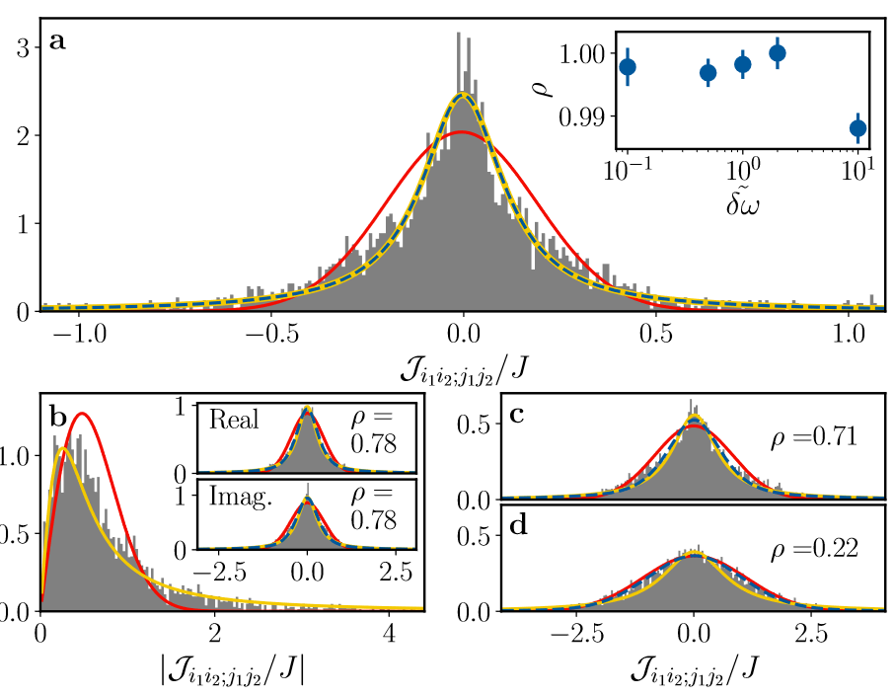
Are the $J_{ijkl}$ really random?
Numerics from “first principles” including speckle pattern etc.
We find, that happens also in
Chen, et al., Phys. Rev. Lett. 2018
Wei and Sedrakyan, Phys. Rev. A 2021
random
but rather Cauchy
Gaussian
Interesting research question: what random distributions are “permissible”?
See, e.g., Krajewski, et al., Phys. Rev. D 2019; Cao, et al., Science Bulletin 2020;
García-García, et al., Phys. Rev. D 2021; Tezuka, et al., Phys. Rev. B 2023
Legramandi, Bandyopadyhay, Uhrich, Hauke, in preparation
And what do such deformations mean on the gravity side?

Slide 13
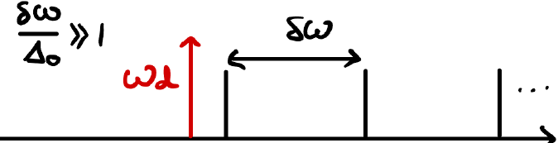
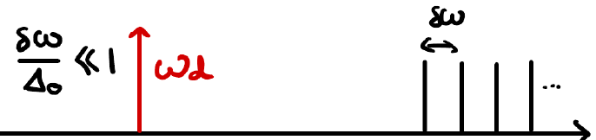
Test physics, e.g., maximal short-time chaos
Fast scrambling as revealed by OTOC
$J_{ijkl}=\frac{I_{ij,0}I_{kl,0}}{Δ_{0}}$
$$Δ_{0}↑$$
$$m$$
SYK
$$m$$
$J_{ijkl}=\sum_{m}{\frac{I_{ij,m}I_{kl,m}}{Δ_{m}} }$
Dynamics approaches that of SYK model!
Note: relevant experimental time scales = few $J$ !

Slide 14
Search for simpler observables reveals interesting physics
Abrupt quench
at $t=0$ into
SYK Hamiltonian
Gaussian (super-exponential) decay
$$𝔼[local observable(t)]$$
simple rescaling
$$𝒢(𝔼[local obs.]$$
Universal
collapse!
Potential experimental signature:
occurs on very short time-scales!
S. Bandyopadyhay, P. Uhrich, A. Paviglianiti, P. Hauke, QUANTUM 2023
A. Paviglianiti, S. Bandyopadyhay, P. Uhrich, P. Hauke, JHEP 2022

Slide 15
It is tough, but

Slide 16
There are lots of fascinating questions for theory and experiment along this road!
Unexpected universal dynamics as signature of maximal randomness
Bandyopadyhay, Uhrich, Paviglianiti, Hauke, QUANTUM 2023
Paviglianiti, Bandyopadyhay, Uhrich, Hauke, JHEP 2022
Eigenstate thermalization of non-Hermitian systems $(H≠H^{†})$
Singha Roy, Bandyopadhyay, Costa de Almeida, Hauke, arXiv:2309.00049
No disorder
disorder
“Simpler” setup leads to disordered systems
Sauerwein, Orsi, Uhrich, Bandyopadhyay, Mattiotti, Cantat-Moltrecht, Pupillo, Hauke, Brantut, Nat. Phys. 2023
probe
“grey states”
cavity detuning
Large engineering challenge: try other models, other platforms. Neutral atoms, trapped ions, solid state
Experiments are not ideal, but show deformations of model
Does nature permit us to realize holographic matter?
What do deformations mean on gravity side?

Slide 17
Collaborators (on this project)
Trento: Philipp Uhrich, Soumik Bandyopadyhay, Andrea Legramandi, Alessio Paviglianiti,
David Pascual, Alex Windey,
Gianluca Rastelli, Iacopo Carusotto
Jean-Philipp Brantut (Lausanne),
Julian Sonner (Geneva),
Tilman Esslinger (Zürich),
Guido Pupillo (Strassburg)
and their groups
Thank you!
hauke-group.physics.unitn.it
Horizon Europe Programme, NeQST (GA101080086)
Quantera II, Horizon 2020, DYNAMITE (101017733)
ICSC – Centro Nazionale di Ricerca in HPC, Big Data and Quantum Computing, NextGenerationEU
bec.science.unitn.it
quantumtrento.eu
SERI Holograph
BMBF MagicApp; Q@TN PhoQuaSDyn, HyClassQSampling
MUR FARE project DAVNE (R20PEX7Y3A)
Provincia Autonoma di Trento
Views and opinions expressed are however those of the author(s) only and do not necessarily reflect those of the European Union or the European Commission. Neither the European Union nor the granting authority can be held responsible for them.

