Slide 1
Project Technical Board meeting
Antonella Sciuto
WP 3 Leader & CNR unit coordinator
SWRIPS PTB first Meeting
Catania 9 January 2024

Slide 2
WP3 aim: our focus is the development of a Spectroscopy apparatus for Online Water Quality Monitoring => an in-line test system for continuous monitoring of the physical and chemical parameters of the purified water to be re-used for irrigation. The system consists of compact UV spectroscopy apparatus and visible sensor systems adopting innovative Silicon Carbide and Silicon Photomultipliers detectors WP3 is organized in 5 tasks

Slide 3
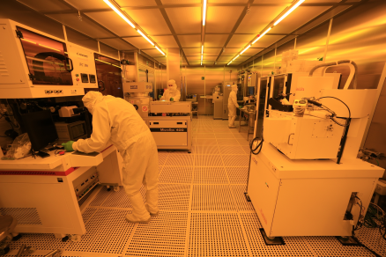
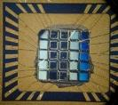
WP3 Task 3.1 Months 3-24
Task 3.1 Development of sensors and electronics (CNR-IT, CSFNSM-IT, UNICT-IT)
Our objectives:
Design and fabrication of innovative SiC sensors operating in deep UV with large area, low noise and high sensitivity
Development of Lecture electronics ensuring biasing of source and detector, low noise, sensing current amplification and digital conversion.
Involved people:
Antonella Sciuto, Domenico Longo, Alessia Tricomi, Nello Abergo, Lucia Calcagno

Slide 4
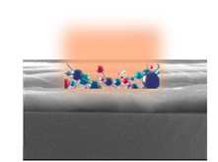
WP3 Task 3.2 Months 12-30
Task 3.2 Optically sensible polymeric substrates for heavy metals and pesticide detection (CNR-IT, ….???????....)
Our objectives:
design and fabrication of Optically sensible polymeric substrates for heavy metals and pesticide detection;
Involved people:
Sabrina Carroccio, Antonella Sciuto, ……..

Slide 5
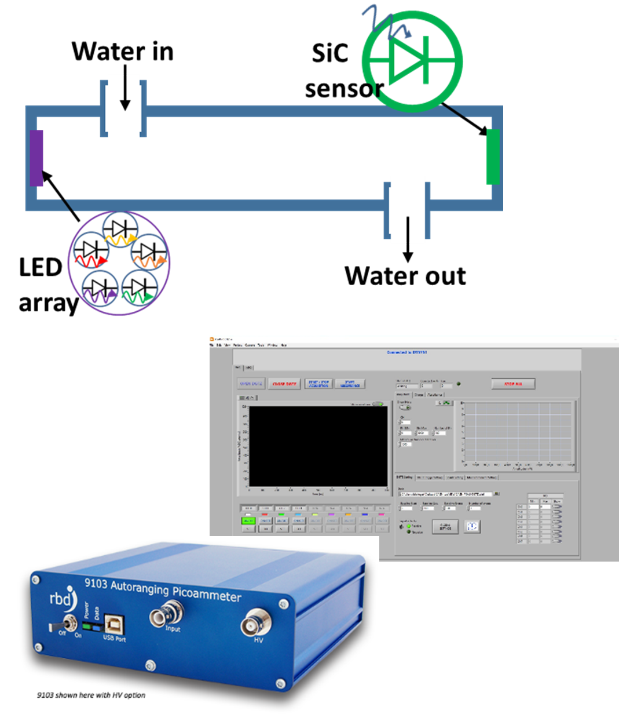
WP3 Task 3.3 Months 12-30
Task 3.3 Detector assembly and readout software development (UNICT-IT, CSFNSM-IT, CNR-IT)
Our objectives:
design and assembly of spectroscopy apparatus operating in the UV range and its complete electro-optical characterization
Involved people:
Domenico Longo, Nello Albergo, Alessia Tricomi, Antonella Sciuto

Slide 6
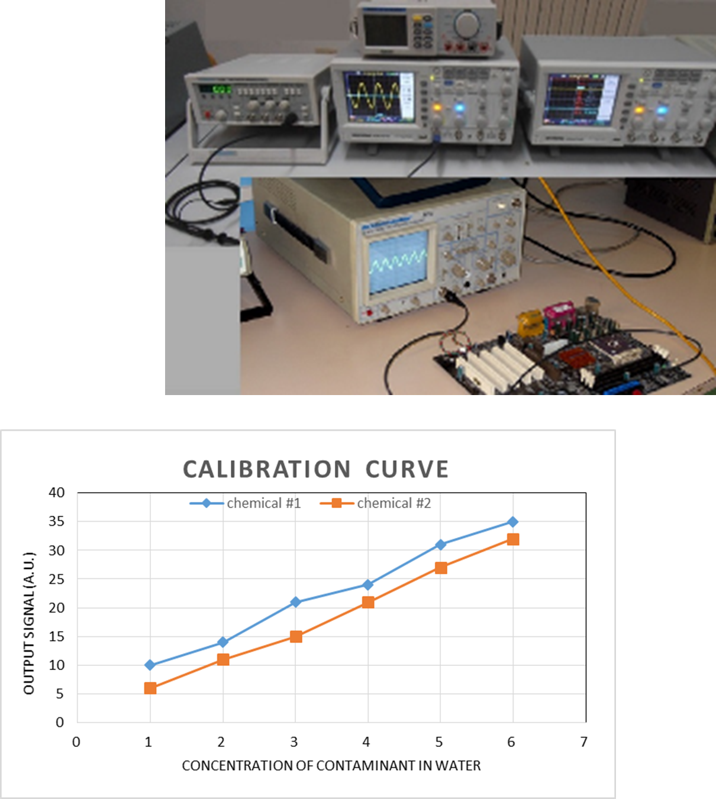
WP3 Task 3.4 Months 12-30
Task 3.4 Detector test and calibration with use cases (CSFNSM-IT, CNR-IT, UNICT-IT, UV-ES)
Our objectives:
Test and calibration of the spectroscopy apparatus
Involved people:
Alessia Tricomi, Antonella Sciuto, Domenico Longo, Nello Albergo, UV-ES

Slide 7
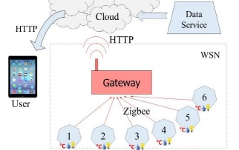
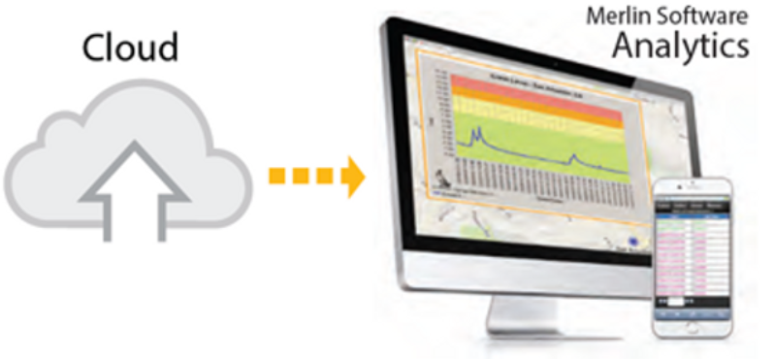
WP3 Task 3.5 Months 6-34
Task 3.5 Development of data network and online monitoring software for remote control (UNICT-IT, CNR-IT, UBOUIRA-DZ, UV-ES)
Our objectives:
Development of data network and of the software for the remote control
Involved people:
Domenico Longo, Antonella Sciuto, UBOUIRA-DZ, UV-ES

Slide 8
WP3 interaction with other WPs
WP1: Analysis of the water/land/agro-ecosystem
WP2: Development of Innovate Integrated Water Purification System
WP4: Quality control on Water, Soil and Crops
WP5: Dissemination and Communication
WP6: Project management
Info on contaminant/chemicals of interest
WP1
for the dissemination of the results and for the Intellectual Properties Rights (patent proposal)
Periodic meetings project management
WP3: SiC Spectroscopy apparatus for inline and online water quality monitoring
WP5
WP6
real purified water samples to perform sensing test
Info on the residual contaminant expected in treated water
WP2

Slide 9
WP3 Milestones
M3.1 - Large area SiC photo-sensor operating in deep-UV (task 3.1)
M3.2 - Spectroscopy apparatus assembled with running readout software (task 3.3)
M3.3 - Data network and remote control software (task 3.5)
=> Month 14 (December 2024)
=> Month 18 (April 2025)
=> Month 32 (June 2025)

Slide 10
WP3 deliverables
D3.1 Design and flow chart preparation for the fabrication of SiC sensors (task 3.1)-M6 (April 2024)
D3.2 Report on sensors fabrication and on their electro-optical characterization (task 3.1)-M14 (December 2024)
D3.3 Large area SiC sensors ready and operating in deep-UV and electro-optical characterised (task 3.1)-M14 (December 2024)
D3.4 Optically sensible polymeric substrates for pollutant detection made and tested (task 3.2)-M16 (February 2025)
D3.5 Spectroscopy apparatus assembled and readout software deployed and running (task 3.3) (M18) (April 2025)
D3.6 Report on the tests and calibration curves of the spectroscopy apparatus (task 3.4) (M25) (November 2025)
D3.7 Data network and remote control software (task 3.5) (M32) (June 2025)

Slide 11
WP3 short term deadline
first deadline is the Deliverable 3.1 => April 2024
Design and flow chart preparation for the fabrication of SiC sensors (task 3.1)-M6

Slide 12
WP3 short report of carried activity (task 3.1 & 3.2)
We studied the literature on optical systems for pollutants monitoring in water
We identified the wavelengths of interest for the detection of chemical pollutants and biological agents
We searched on the market, LEDs operating at the wavelengths of interest: the selected lines are actually in the UV range and in particular 234, 265, 280, 300 and 355 nm

Slide 13
WP3 technical and scientific meeting calendar (every ∼3 months )
coordination meeting 30 January ‘24
deliverable meeting 24 April ’24 => D3.1 Design and flow chart preparation for the fabrication of SiC sensors (task 3.1)-M6 (April 2024)
coordination meeting 21 July ’24
deliverable meeting 22 November ’24=> D3.2 Report on sensors fabrication and on their electro-optical characterization & D3.3 Large area SiC sensors ready and operating in deep-UV and electro-optical characterised (task 3.1)-M14 (December 2024)
deliverable meeting January ‘25=> D3.4 Optically sensible polymeric substrates for pollutant detection made and tested (task 3.2)-M16 (February 2025)
deliverable meeting April ’25 => D3.5 Spectroscopy apparatus assembled and readout software deployed and running (task 3.3) (M18) (April 2025)
coordination meeting July ’25
deliverable meeting November ’25=>D3.6 Report on the tests and calibration curves of the spectroscopy apparatus (task 3.4) (M25) (November 2025)
deliverable meeting June ’25=> D3.7 Data network and remote control software (task 3.5) (M32) (June 2025)
Tasks activity will be discussed and planned during the WP meetings. Further Task meetings will be planned if necessary during the project period.

Slide 14
WP3 short term activity plan
Laboratory measurements with bench top systems to verify the optical detection principle for the pollutants of interest
Identification of the optical powers necessary for sensing systems
Design of Silicon Carbide photo-detectors to be used for the development of portable spectroscopic systems.
Design of polymers for the sensing in water (M12-M30)

Slide 15
WP3 Risk and contingencies
Risk description (Low/Medium/High level) | Mitigation approach
Management of low signal at low concentrations (M) | opportune amplification electronic set-up
System not usable in turbid waters (M) | Pre-sensing water treatment
Absence of cheap LED (M) | Use of lamp and filters
Atmospheric agents interference for in-line on-field measurements (L) | To be tested
faster scientific and technologies innovations competitors (M)

