Slide 1




Radiation Field Simulation in GIF ++
Nicola Ferrara, INFN and Politecnico of Bari
Gabriella Pugliese INFN and Politecnico of Bari
Giuseppe Iaselli, INFN and Politecnico of Bari
Dayron Ramos, INFN and Polytecnic of Bari

Slide 2
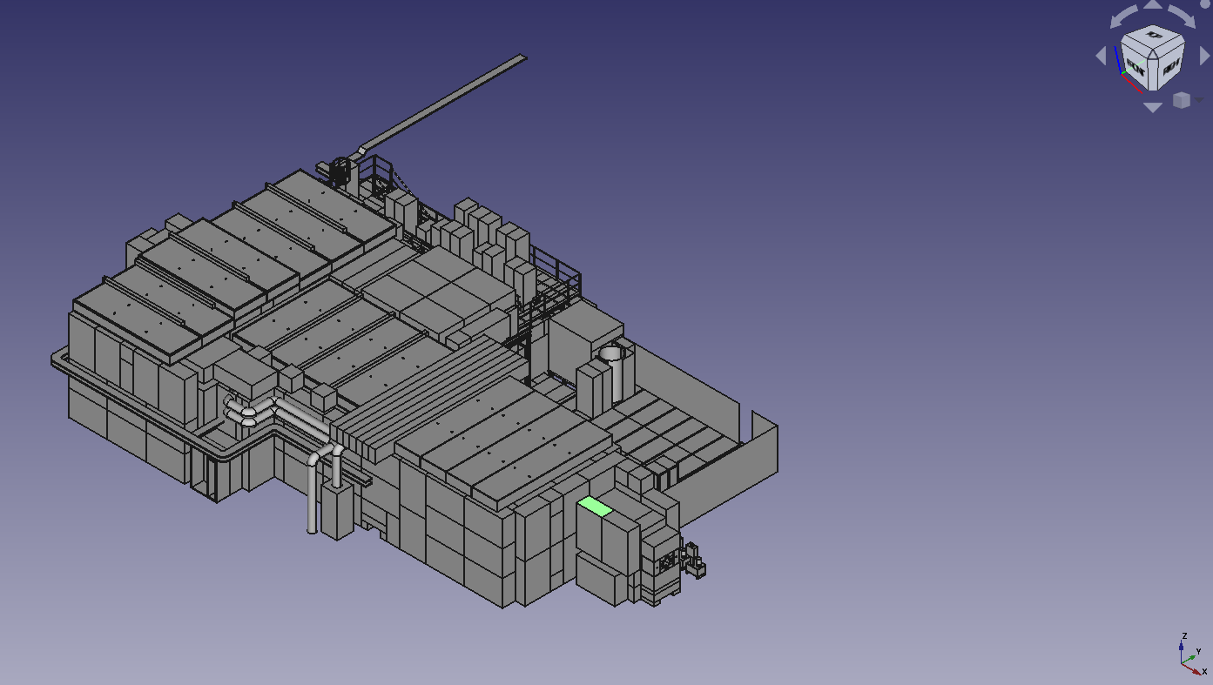
Geant4 GIF++ simulation code Source: Pfeiffer Dorothea Software developed in GEANT4-10.0 to simulate GIF++ radiation background [ref]
Software upgrade in the framework of the new DRD1 «collaboration».
Main steps:
Transition from GEANT4-10.0 to GEANT4-11.0
Description of the new bunker geometry
[ref] https://gif-irrad.web.cern.ch/documents/1-s2.0-S0168900217306113-main.pdf

Slide 3
Transition from GEANT4-10.0 to GEANT4-10.7 (1)
New GEANT4 version: geant4-10-07-patch-03 [MT]
Change of one class in the GIF++ project ()
Issue: in class GIF++UserScoreWriter,
the typedef MeshScoreMap becomes defined in G4VScoringMesh
Solutions: Geant4 upgrades to G4VScoringMesh::MeshScoreMap

Slide 4
Other Changes:
Transition from GEANT4-10.0 to GEANT4-10.7 (2)
MeshScoreMap fSMap = fScoringMesh->GetScoreMap();
G4VScoringMesh::MeshScoreMap fSMap = fScoringMesh->GetScoreMap();
std::map<G4int, G4double*> * score = msMapItr->second->GetMap();
std::map<G4int, G4StatDouble *> &score = *(msMapItr->second->GetMap());
std::map<G4int, G4double*>::iterator value = score->find(idx);
std::map<G4int, G4StatDouble *>::iterator value = score.find(idx);

Slide 5
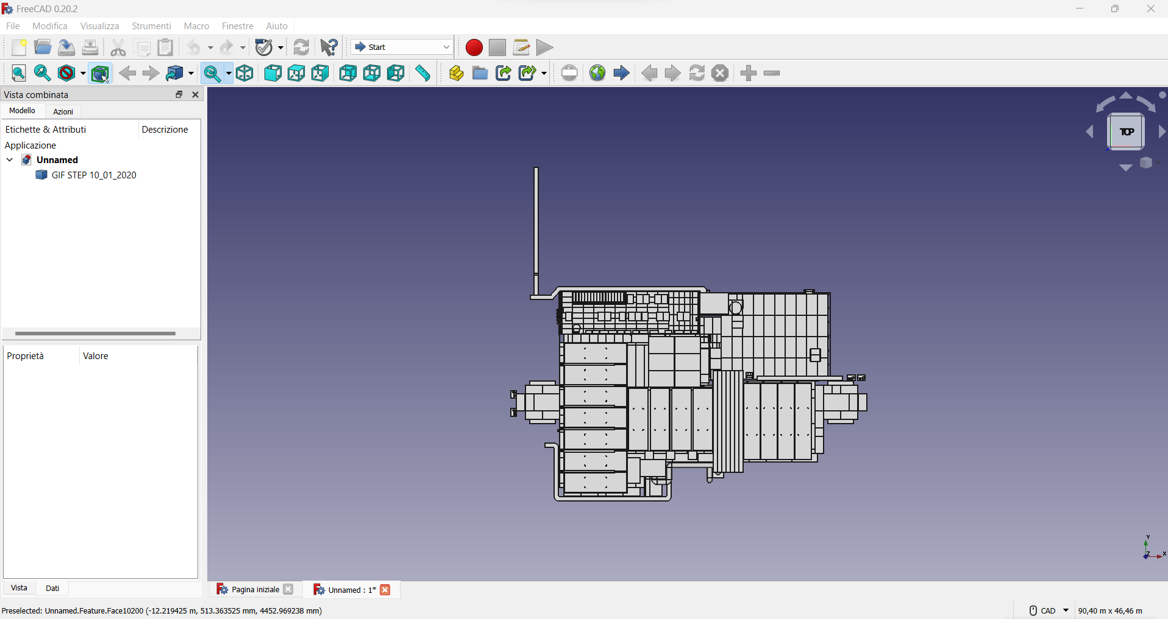
GIF++ geometry UPDATE
STEP file was opened with an open source FreeCAD to obtain the layout of the bunker
A new file GDML with FreeCAD was created and the geometry was described using a box model.
Note: The format of the GDML file is not compatible with the one used by GEANT https://gdml.web.cern.ch/GDML/
Some manipulation needed to solve the issue

Slide 6
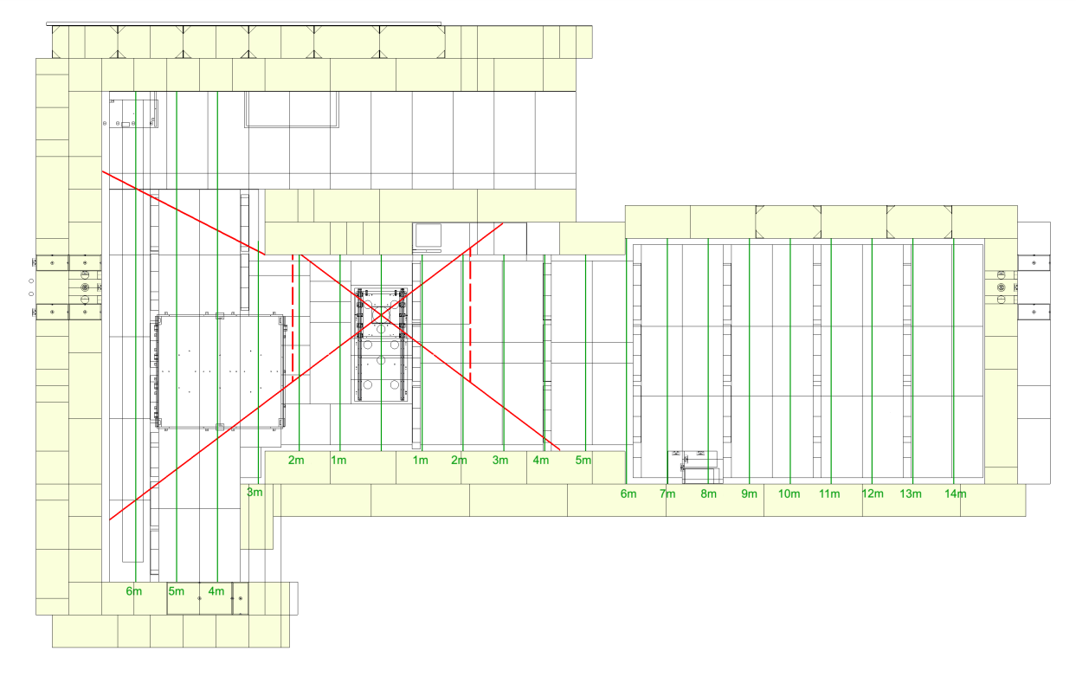
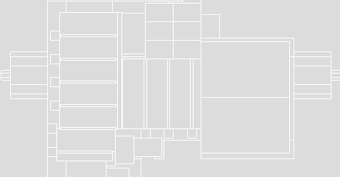
Upgrade geometry: layout
CAD Gif++ layout
GEANT gdml layout

Slide 7
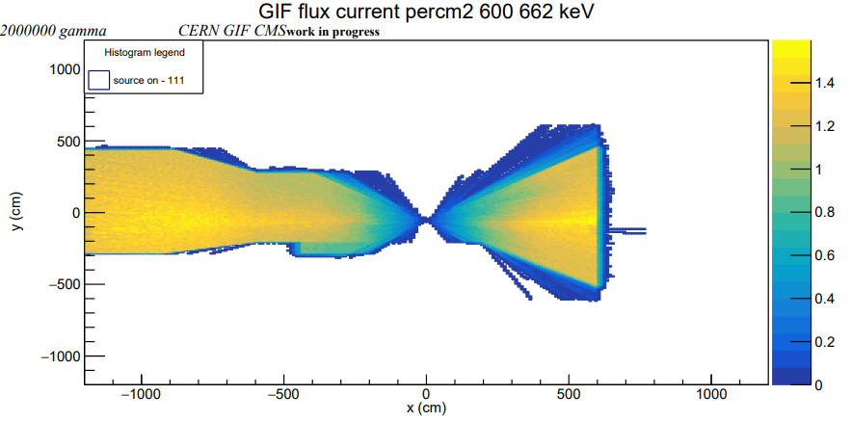
Preliminary Results
Simulated gamma: 2 10⁶
Flux in the range 600-662 keV

Slide 8
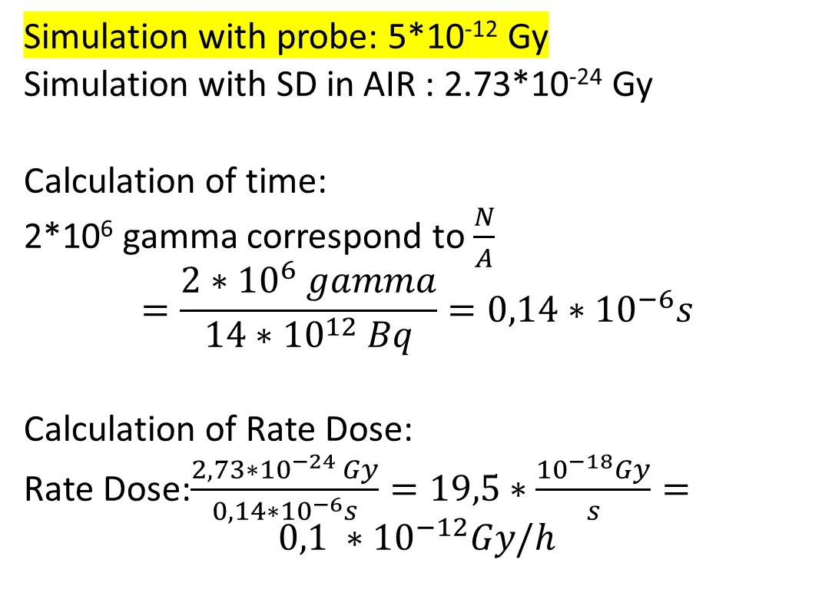
Dose calculation
Simulation with probe: 5*10⁻¹² Gy
Simulation with SD in AIR : 2.73*10⁻²⁴ Gy
Calculation of time:
2*10⁶ gamma correspond to $\frac{N}{A}$
$$=\frac{2∗{10}^{6} gamma}{14∗{10}^{12} Bq}=0,14∗{10}^{−6}s$$
Calculation of Rate Dose:
Rate Dose:$\frac{2,73∗{10}^{−24 }Gy}{0,14∗{10}^{−6}s}=19,5∗\frac{{10}^{−18}Gy}{s}=$
$$0,1 ∗{10}^{−12}Gy/h$$
Cube of air of 10 cm

Slide 9
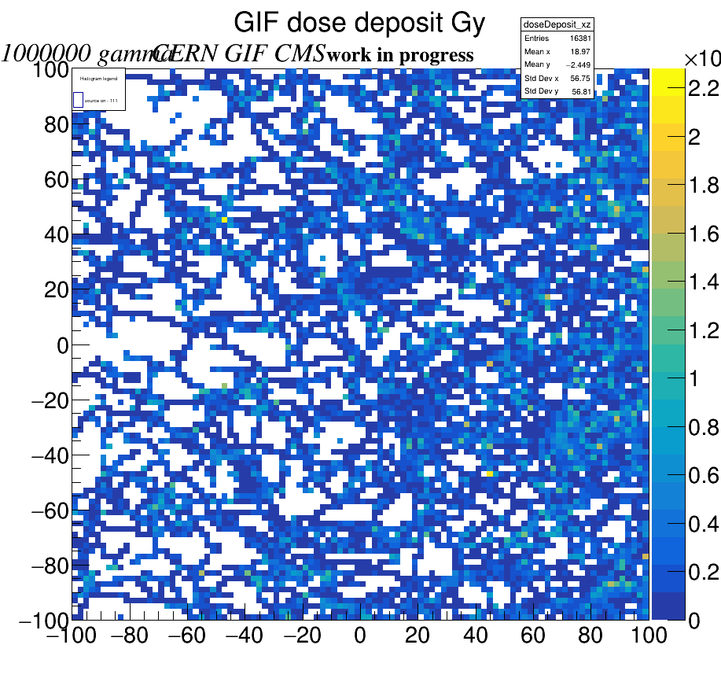
Dose calculation
10⁻⁹
Cube of air of 10 cm

Slide 10
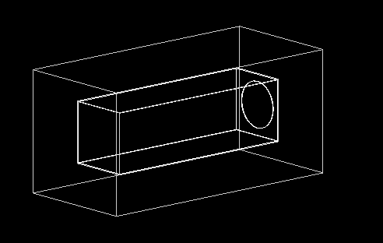
Next steps
Start simulate filters
Simulation of different detectors installed inside the GIF
Validation of the simulation by comparing the estimated dose with some measurements done in several points inside the bunker

Slide 11
Conclusion
A first simulation of the bunker succesfully done.
A simulation of gamma dose with sensitive volume.

Slide 12
Backup

Slide 13
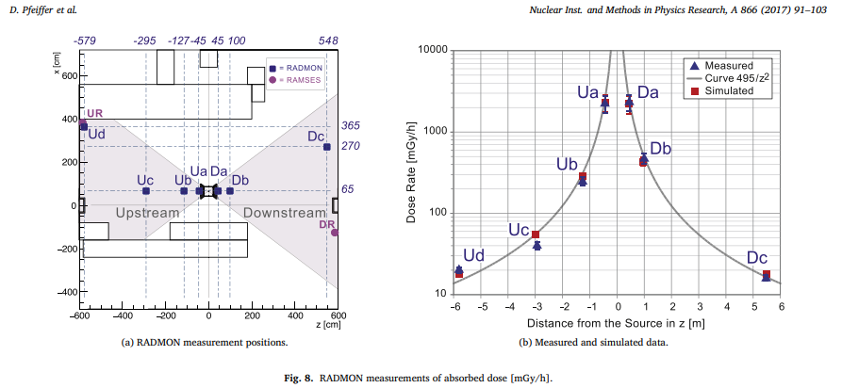
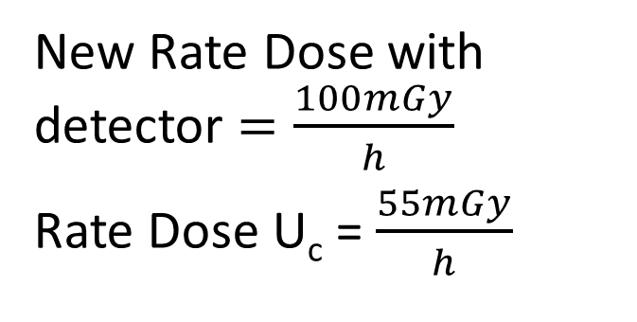
Dose comparison
New Rate Dose with detector $=\frac{100mGy}{h}$
Rate Dose U_{c} = $\frac{55mGy}{h}$

