Slide 1
Development of machine vision algorithms for radiomics
XXXVIII
Novel approach to segment tumor tissue and dose for particle therapy
Ph.D candidate
Nicola Ferrara
Tutors
Filippo Attivissimo (Tutor 1)
Gabriella Maria Incoronata Pugliese (Tutor 2)

Slide 2
Description of the research program
Project aim to develop innovative methods for the recognition of medical images in the field of dosimetry and radiomics using Machine Learning algorithms. First aim is to simulate the entirely neutron and gamma field of an Accelerated-based BNCT, up to simulation of dose released in the tumor area treated with Boron Neutron Capture Therapy (BNCT). Then simulate image of dose, by detection of prompt gamma, and by a reconstruct algorithm for tomography, based on SPECT principle. This algorithm exploits a CNN network that will be trained and tested on the dosimetric image database.
The second phase consists in applying Deep Learning methods to the analysis of cancer medical images for radiomics purpose, obtaining information on dosimetry and tumors features. I will use existing database of medical images of tumor lesions and I will build a Deep Learning algorithm able to segment images and distinguish lesions from healty tissue. The method will be benchmarked with the most up-to-date medical image recognition methods.
During the final part of the project, I will classify tumor images by combining segmentation methods with radiomics extraction methods, in order to extract features like “energy” and “grey-level”.
Insert a short description of the research program.
The list of training activities and relative ECTS must not be included in this presentation.

Slide 3
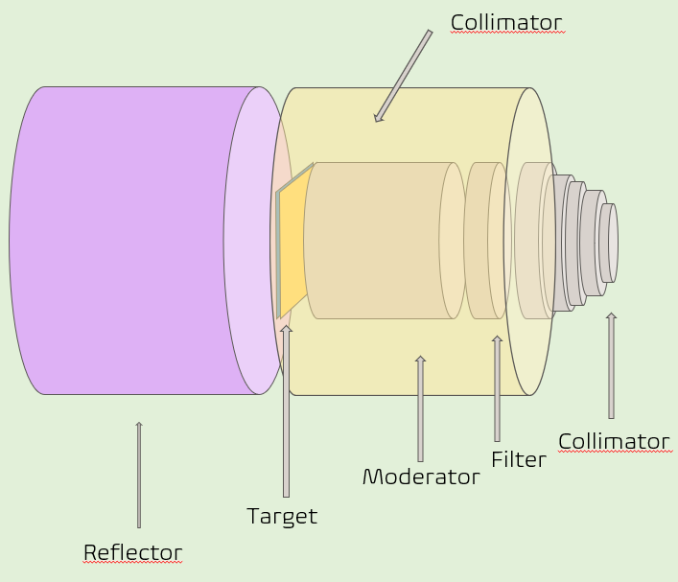
BNCT simulations
Full neutron spectrum simulation of an accelerator based BNCT facility
Different target validation
First prototype of Beam Shaping Assembly
Clinical beam of thermal neutron obtained
Next step:
Build a tomographic reconstruction method for a SPECT system for on-line dose validation.
L. Zaidi (2018), Beam shaping assembly design of ⁷Li(p,n)⁷Be neutron source for boron neutron capture therapy of deep-seated tumor, Elsevier
I. Postuma (2021), A Novel Approach to Design and Evaluate BNCT Neutron Beams Combining Physical, Radiobiological, and Dosimetric Figures of Merit, Biology

Slide 4
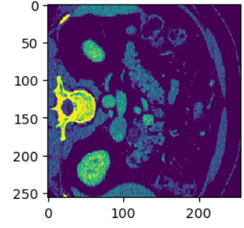
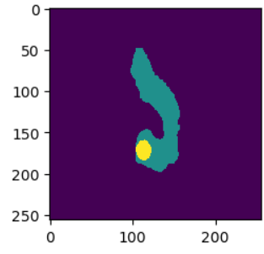
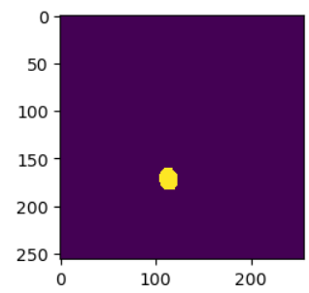
Deep learning for medical images
Development of pipe-line for medical image segmentation
Augmentation technique like 2,5 D
Convolutional neural network:
U-net
Resnet
Multi Dimensional Attention Gate
Radiomics features extraction
L. Cao (2023), Multi-target segmentation of pancreas and pancreatic tumor based on fusion of attention mechanism, Elsevier
Sovanlan Mukherjee (2022) Radiomics-based Machine-learning Models Can Detect Pancreatic Cancer on Prediagnostic Computed Tomography Scans at a Substantial Lead Time Before Clinical Diagnosis, Gastroenterology

Slide 5
Thank you for your attention!

