Slide 1
EuroHPC CoE per HEP?

Slide 2
CoE = Centre of Excellence
Esistono in vari flavour (finanziate direttamente via H2020-INFRA, oppure da sotto progetti come EuroHPC)
In generale, sono aggregazioni di enti / istituti che cercano di fare sistema per creare un centro di eccellenza distribuito su una topic piu’ o meno specifica
Ce ne sono davvero di tanti tipi:
European Centre of Excellence for Civilian Crisis Management
Jean Monnet European Centre of Excellence
https://www.hpccoe.eu/eu-hpc-centres-of-excellence2/ →

Slide 3
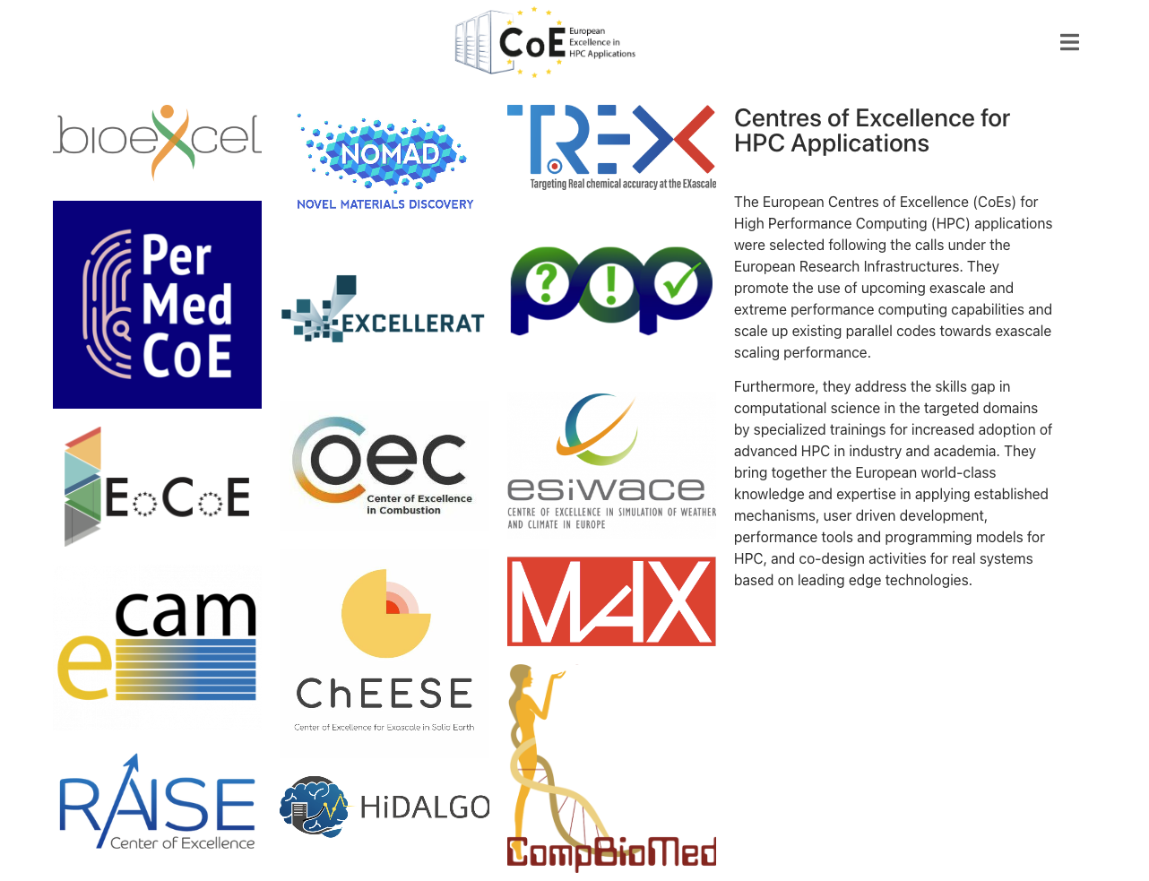
Questi finanziati direttamente da EU su programmi H2020-INFRA

Slide 4
RAISE

Slide 5
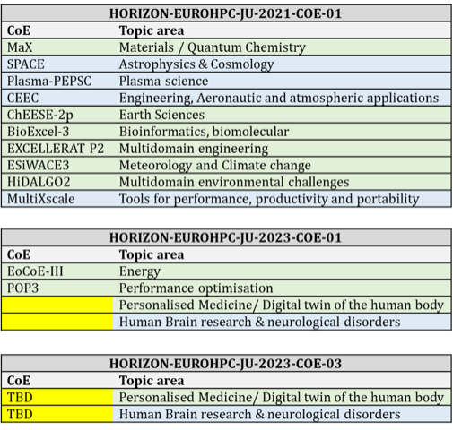
EuroHPC ha i suoi CoE
Finanziati su 3 calls 2021-2023
Tali calls richiedevano:
Advancing the transition towards exascale capabilities by developing or scaling up existing parallel codes, resulting into effective applications to solve scientific, industrial or societal challenges and addressing the needs of the user communities.
All CoEs should be user-driven and inherently committed to co-design activities to ensure that future HPC architectures are well suited for the applications and their users (both from academia and industry), providing a high performance and scalable application base.

Slide 6
Requirements for CoEs (dai vecchi bandi)
…
Enhancing HPC applications and ensembles of coupled applications towards highly scalable, optimised codes.
Provision of codes aimed at capacity pre-exascale systems for ensemble workloads that might not need tight interconnection between runs. Proposals must convincingly demonstrate the ensemble pre-exascale capabilities and needs.
Involvement in co-design activities (hardware, software, codes), including the collaboration with HPC vendors and the identification of suitable applications relevant to the development of European HPC technologies towards exascale.
Enlarging and expanding HPC applications development and use, in particular for new user communities in EU countries and countries associated to Horizon Europe that are members of the EuroHPC Joint Undertaking currently developing and advancing their HPC infrastructure and ecosystem.
Federating capabilities and integrating communities around exascale computing in Europe.
Address the skills gap in the targeted domain by specialised training and capacity building measures to develop the human capital resources for increased adoption of advanced HPC in industry and academia.
Complementarity and synergy with National HPC Competence Centres and EU projects.
…

Slide 7
Adesso: discussione al prossimo governing board EuroHPC
Discussione il 16/1; se a noi interessa mandare proposta entro il 15/1
Richiesta specifica:
CoEs should focus on exascale application development on the basis of existing flagship codes centered around a specific domain of science or technology. Topics should therefore relate to areas where such flagship codes exist in Europe.
CoEs require a critical mass of domain specific communities with advanced HPC skills – the instrument may not be appropriate to build a new community around a domain of HPC applications which is not yet developed in Europe. Topics should therefore address areas where a significant HPC aware community exists in Europe.
Proposed topics should avoid double funding and focus on inclusiveness and collaboration of the European HPC communities in a specific domain where fragmentation is not desirable.

Slide 8
Cosa serve?
GB delegates are invited to send proposed topics to the JU by 16/01/2024 at the latest. Each proposed topic should be supported by a sufficiently detailed justification, an explanation of the strategic importance of the topic in the context of HPC applications, and address the elements listed above (sufficient number of existing European flagship codes, sufficiently large existing community in the domain with advanced HPC skills, no significant overlaps with existing calls and projects).
Nostri GB delegates: Stefano Fabris (CNR) e Paola Inverardi (GSSI)
Members of the EuroHPC GB will be invited to express their preference by distributing 10 points among up to four topics in the consolidated list and communicate their opinion to the JU by 31/01/2024.

Slide 9
CoE gia’ Candidate
Combustion:
Modelling and simulation for current and future combustion systems, promoting and enabling sustainable fuels and efficient new combustion technologies in alignment with the European Green Deal. This CoE should focus on strategic European sectors using energy intensive processes and where decarbonisation is a challenge, such as aviation or the metallurgical industry. The proposed activities should be complementary to existing initiatives such as The Clean Hydrogen JU and The Research Fund for Coal and Steel.
Aeronautical Design:
Modern simulations tools for aeronautical design including aerodynamics, structural design and propulsion. This CoE must enhance the technology available to European aeronautical industry, guaranteeing its competitiveness at a global level. The industrial use of the developed codes/techniques should be prioritized. The commitment of the main European aeronautical industrial stakeholders is strongly recommended. CoEs must be aligned with the decarbonization policies promoted by programs such as Clean Aviation.
Virtual Pre-clinical trials:
Development of tools to design and test new drugs and treatments and models to complement and eventually replace experimentation with animals and humans in pre-clinical trials. The CoE should work with the communities and end-users to develop and deploy the necessary HPC solutions including HPC platforms for drug design and models of cell lines, organoids or human organs.
Foundation Models for Science:
Establish a Trusted Research Environment (TRE) for the secure development, hosting and testing of foundation models LLMs, derived specialised models and multimodal LLMs, with particular emphasis in bias detection and correction. This environment will host seed data and ensure privacy-focused AI operations, and continuous training environments allowing European stakeholders to train their language models in a secure HPC environment. Target communities will include those working in multilingual systems in different domains of science and scientific communities working in integration of different data types, particularly those in the life sciences domain.

Slide 10
Cosa potremmo fare?
Manca chiaramente un CoE di HEP. Non ne vedo ne’ lato TH ne’ lato HEP.
Mi verrebbe da dire che sarebbe opportuno un unico CoE, per un numero di ragioni
Visto che sono richiesti (anche?) codici gia’ paralleli, solo i TH ce li hanno davvero; lato HEP abbiamo dei tentativi (soprattutto con AI), e dei tests
Scrivere 5 righe come per gli altri CoE e’ semplice (per esempio prossima pagina); il punto della questione vero e proprio e’ avere il supporto del maggior numero di membri del GB

Slide 11
Esempio di piccolo testo
High Energy Physics (experimental and theoretical) is one of the scientific domains with larger needs in scientific computing, since decades, and one of the largest scientific communities overall. While the theoretical part is already major driver in the design and utilization of HPC systems, with codes able to scale at 100,000 cores or more, the convergence of the experimental part has started more recently, with a series of PRACE/EuroHPC projects awarded. With the HEP-CoE we will collect experience and ease the transition of existing parallel codes to larger scales and evenrually to the use of GPUs and in general accelerators, and facilitate the transition of experimental codes to an higher level of parallelism, including large scale AI solutions.

Slide 12
Note:
Background EU projects:
INDIGO-Datacloud
Intertwin
ESCAPE
SPECTRUM
OSCARS
EOSC-hub
…
PRACE / EuroHPC projects awarded
Teorici …
LHC@HPC (2018194658)
PowerAtCMS (2021250016)
(roba slovena, Spagnola…)
Codici
Teorici
Generatori (madgraph?)
AI @ LHC

Slide 13
Come procedere?
Ovviamente non stiamo scrivendo un progetto, ma chiedendo di aggiungere un CoE ad un futuro progetto
Quello che servirebbe qui (se vogliamo andare avanti) e’ contattare partners che a loro volta contattino i loro membri del GB per “votare in modo opportuno”
Io ho contattato CERN (ok ma non ha voto GB), Spagna (Merino, mi chiama oggi), Francia (Lamanna, mi chiama oggi), CINECA (Scipione, domani) …
Stamattina ho parlato con Fabris (CNR, membro del GB), serve esattamente per il 15:
5 - 6 righe come quelle fatte vedere (anche multiple copie)
Per fine mese: sentire piu’ membri possibili del GB (tramite nostri contatti) che supportino la cosa
Chi ha contatto TH/EXP scaldi il telefono …

