Slide 1
UPDATES ON COMPARISONS BETWEEN MC AND DATA

Slide 2
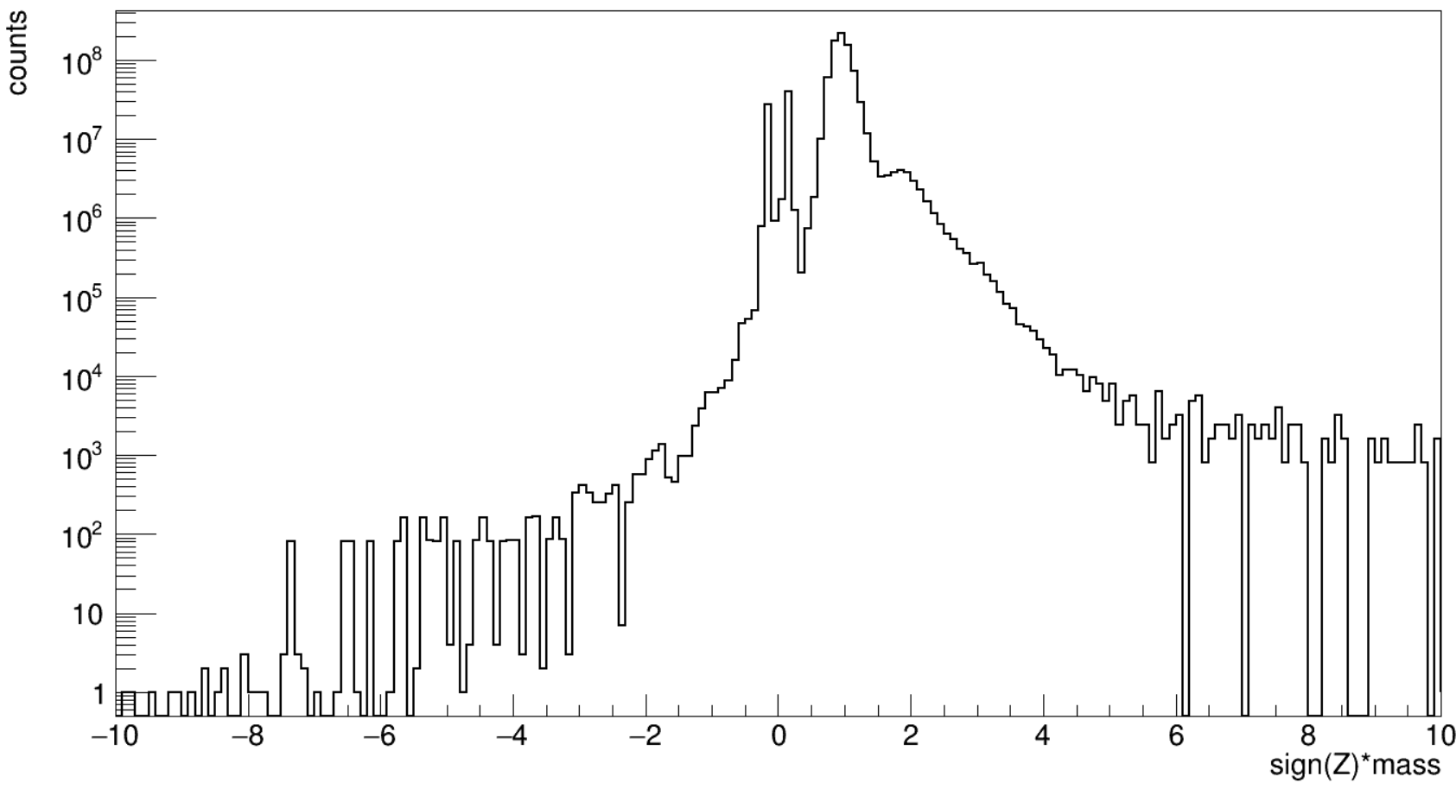
STANDARD SELECTION DEFINITION
A standard selection has been defined:
TOF:
Nhits TOF = 4
$χ_{Coo}^{2}$ < 4
$\frac{\left|Z_{utof}−Z_{ltof}\right|}{Z_{utof}}$ < 0.2
Inner Tracker (L2 to L8):
PATTERN Y L2 & (L3 || L4) & (L5 || L6) & (L7 || L8)
$χ_{Y}^{2}$ < 10
$\frac{σ_{Z}}{Z}$ < 0.1
Physics trigger ON
0. 75 < β < 0.8

Slide 3
MONTECARLO DISTRIBUTIONS
We started to use the MonteCarlo for the protons, trying to quantify the negative particles produced by the interaction between the incoming protons and the detector, and the efficiencies of the selections applied.
The ntuples in the directory /storage/gpfs_ams/ams/groups/AMS-Italy/ntuples/v1.0.0/Pr.B1236/pr.pl1.05100.6_02 have been used.
The MonteCarlo has been weighted to be comparable with the counts obtained processing the data. The flux is defined as:
$$Φ\left(R\right)=\frac{\#_{counts}(R)}{dt dS dΩ dR}$$
so it’s possible to find the number of the counts for every rigidity bin in this way:
$$\#_{counts}(R)=Φ\left(R\right) t\left(R\right) π{ l}^{2} ∆(R)$$
Bin width
Proton flux taken from
Physics Reports 894 (2021)
Helium4 flux taken from
PhysRevLett.123.181102 (2019)
Generation acceptance:
the MC uses a 3.9x3.9 mq generation surface on top of the instrument.
Exposure time calculated looping on the slimmed RTI cutoff info
The number of generated events in the MC for every rigidity bin is:
$\#_{counts_MC}(R)=\frac{\#generated}{\log\left(R_{max,gen}\right)−\log\left(R_{min,gen}\right)}$ $∆(logR)$
Each event has been weighted using the following:
$$w\left(R\right)=\frac{\#_{counts}(R)}{\#_{counts_MC}(R)}$$
MC generation factor

Slide 4
MONTECARLO DISTRIBUTIONS (2)
We are using also the deuteron Montecarlo in the following path:
/storage/gpfs_ams/ams/groups/AMS-Italy/ntuples/v1.0.0/D.B1236/d.pl1.05200/.
We calculated the flux as:
$$Φ_{D}\left(R\right)=Φ_{p}\left(R\right)\frac{D}{p}(R)$$
Ratio interpolated from the deuteron draft and kept fixed outside the boundaries
Flux taken from
Physics Reports 894 (2021)
We are using the proton Montecarlo, switching the rigidity sign, in the following path:
/storage/gpfs_ams/ams/groups/AMS-Italy/ntuples/v1.0.0/Pr.B1236/pr.pl1.05100.6_02 .
We calculated the flux as:
$$Φ_{\overline{p}}\left(R\right)=Φ_{p}\left(R\right)\frac{\overline{p}}{p}(R)$$
Ratio interpolated from the Physics Reports 894 (2021) and kept fixed outside the boundaries
We are using the He4 Montecarlo, L1 focused. To “defocus” it a rigidity dependent scale factor has been applied: this is simply the count ratio between the unfocused MC proton and the L1 focused one.
The MC I have used is the following (only 10000 ntuples):
/storage/gpfs_ams/ams/groups/AMS-Italy/ntuples/v1.0.0/He.B1236/he4.pl1.l1.24000.6_02 .

Slide 5
NTUPLES USED (V 1.0.0)
I have used roughly 200 000 ntuples (skimmed) starting from 1305853512.root to 1668126894.root, spanning from from 20/05/2011 to 11/11/2022 and covering a total of 11.5 years.
TOTAL EXPOSURE TIME
I’ve found an exposure time (for R > 30 GV) of roughly $1.8 {10}^{8} s$ that I think is wrong and I’m missing seconds
TOTAL EXPOSURE TIME WITH DIFFERENT ANGLES
The exposure time to weight the MC has been calculated looping on the RTI files of the skimmed ntuples (NB: skimming has been done on the events loop and not on the RTI info loop), considering the MAX IGRF Cutoff with a 40° field of view, and weighting on the livetime fraction.

Slide 6
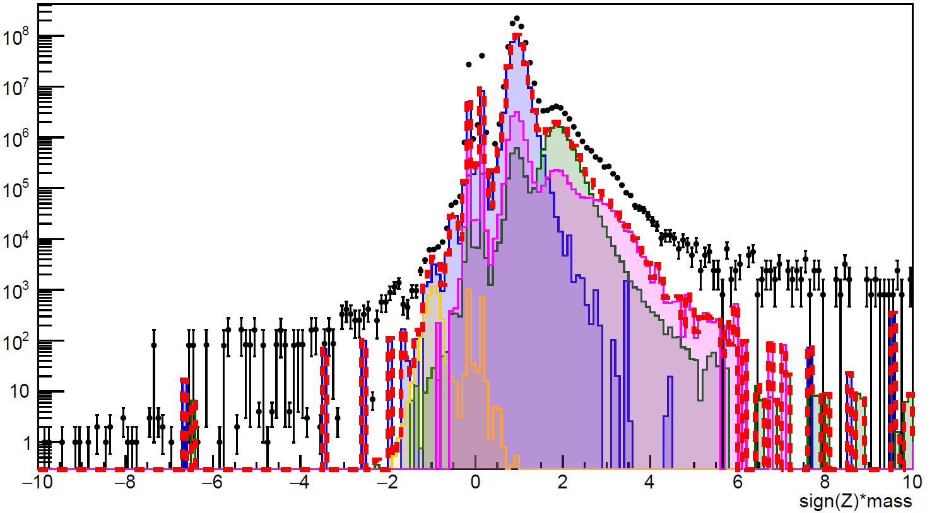
45% of proton peak estimation
Z1: 0.75 < beta < 0.8
Standard selection
42% of pion peaks estimation
DATA without RTI cutoff
MC D without RTI cutoff
*MC p without RTI cutoff
MC pbar without RTI cutoff
MC he4->Z1 without RTI cutoff
MC total without RTI cutoff
*secondary protons have been added from the AMS-01 publication
42% of deuteron peak estimation

Slide 7
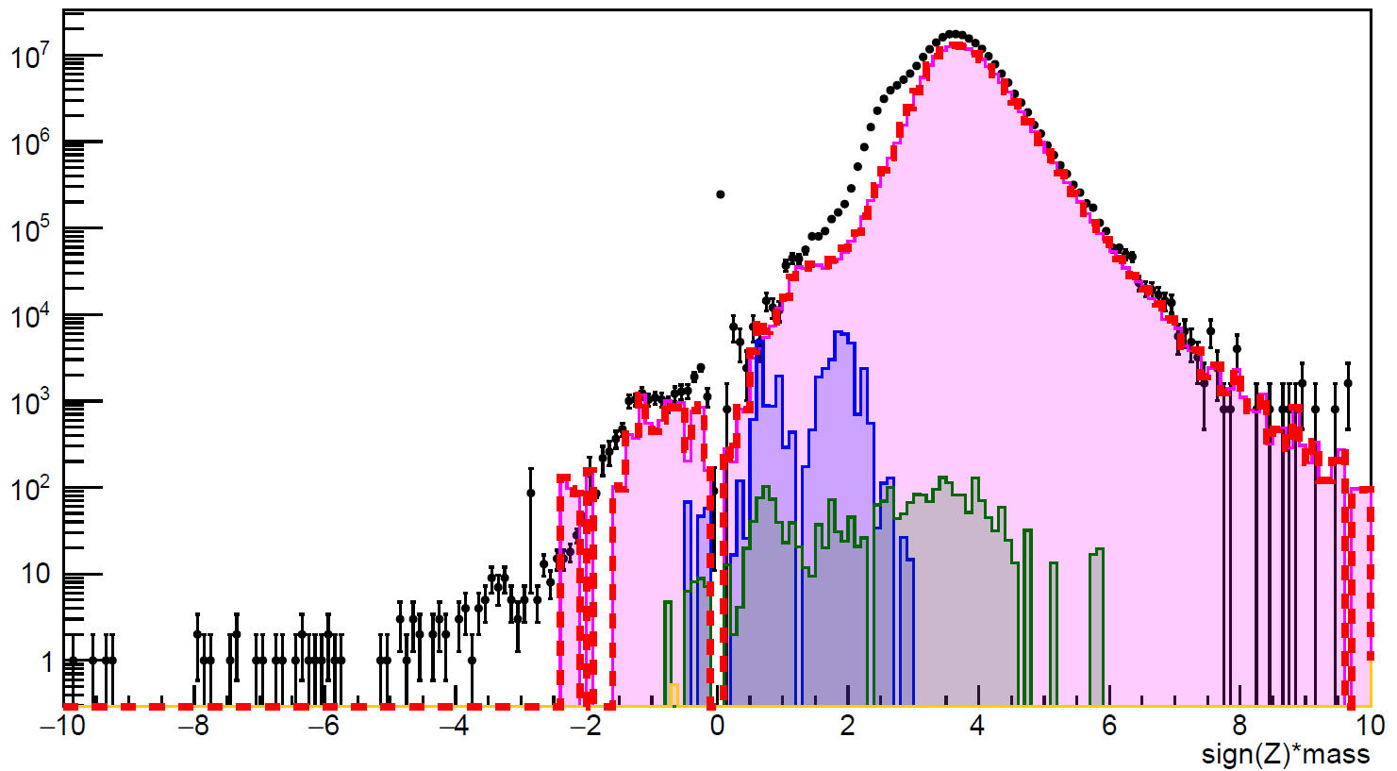
72% of helium4 peak estimation
Z2: 0.75 < beta < 0.8
Standard selection
DATA without RTI cutoff
MC D->Z2 without RTI cutoff
*MC p->Z2 without RTI cutoff
MC pbar->Z2 without RTI cutoff
MC he4 without RTI cutoff
MC total without RTI cutoff
*secondary protons have been added from the AMS-01 publication

Slide 8
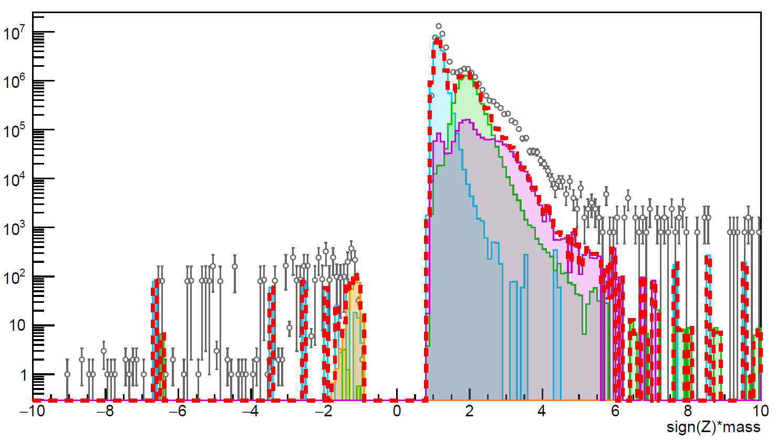
60% of proton peak estimation
Z1: 0.75 < beta < 0.8
Standard selection
72% of deuteron peak estimation
DATA with RTI cutoff
MC D with RTI cutoff
MC p with RTI cutoff
MC pbar with RTI cutoff
MC he4->Z1 with RTI cutoff
MC total with RTI cutoff

Slide 9
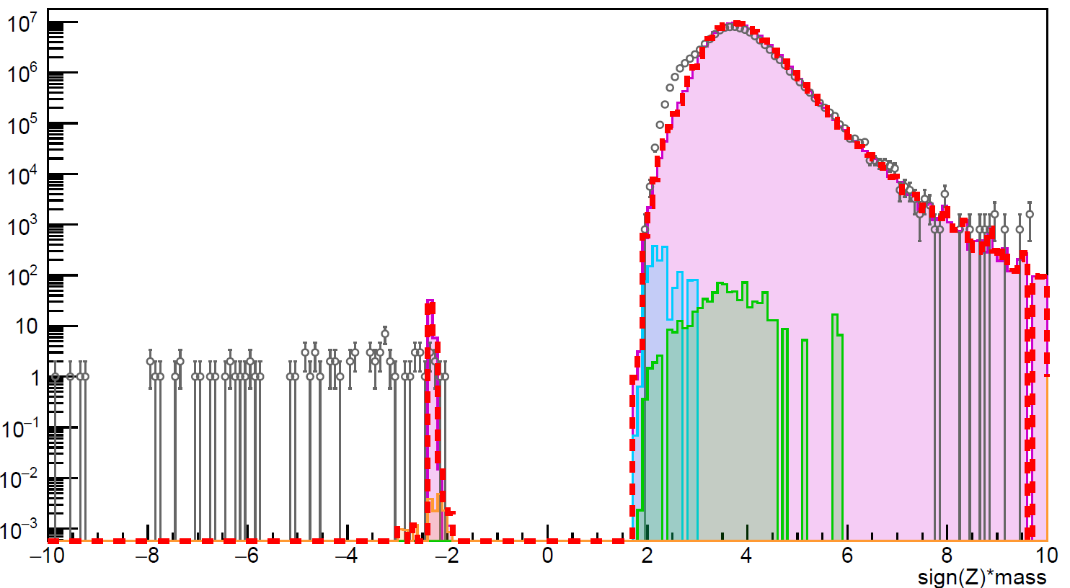
19% of helium4 peak OVERestimation
Z2: 0.75 < beta < 0.8
Standard selection
DATA with RTI cutoff
MC D->Z2 with RTI cutoff
MC p->Z2 with RTI cutoff
MC pbar->Z2 with RTI cutoff
MC he4 with RTI cutoff
MC total with RTI cutoff

Slide 10
BACKUP

Slide 11
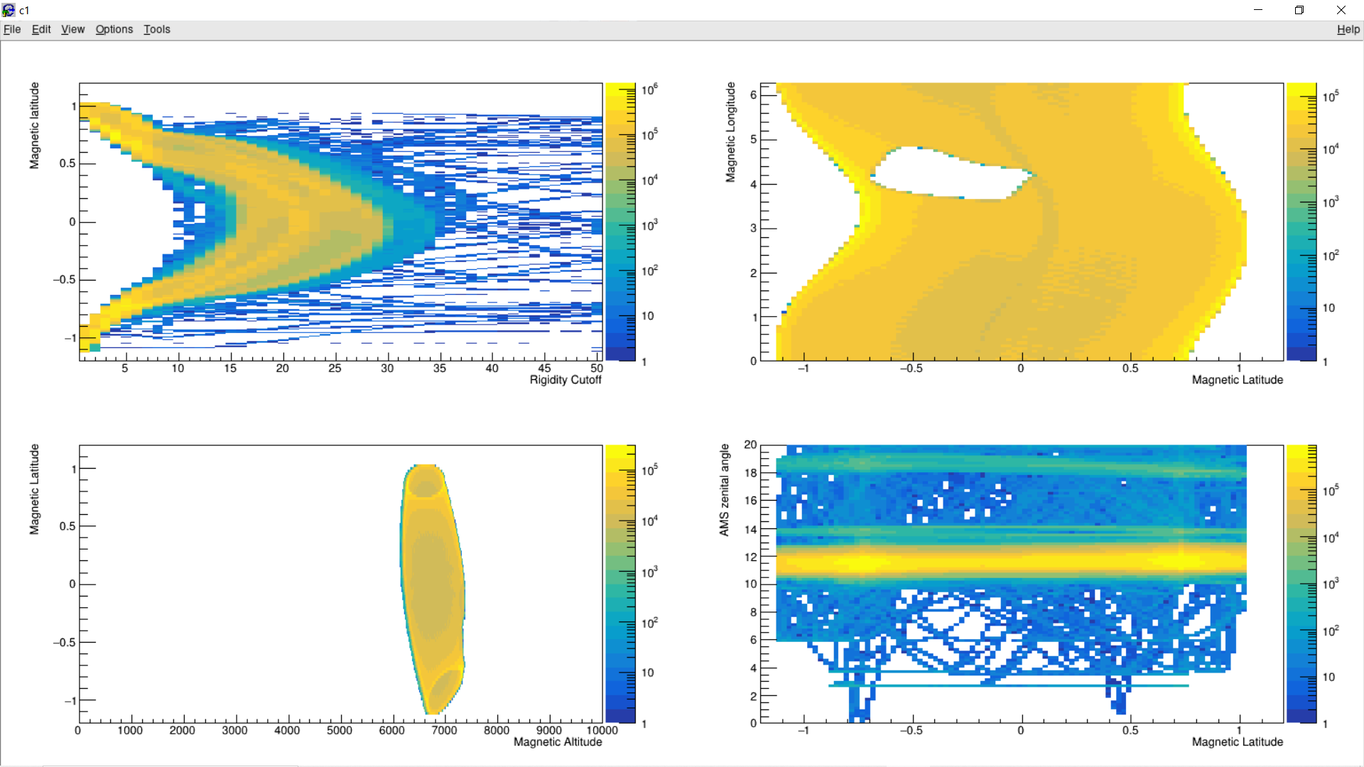

Slide 12
LIVETIME FRACTION
TOTAL EXPOSURE TIME
I’ve found an exposure time (for R > 30 GV) of roughly $1.8 {10}^{8} s$ that I think is wrong and I’m missing seconds
TOTAL EXPOSURE TIME WITH DIFFERENT ANGLES
MAX IGRF AND MIN IGRF

Slide 13
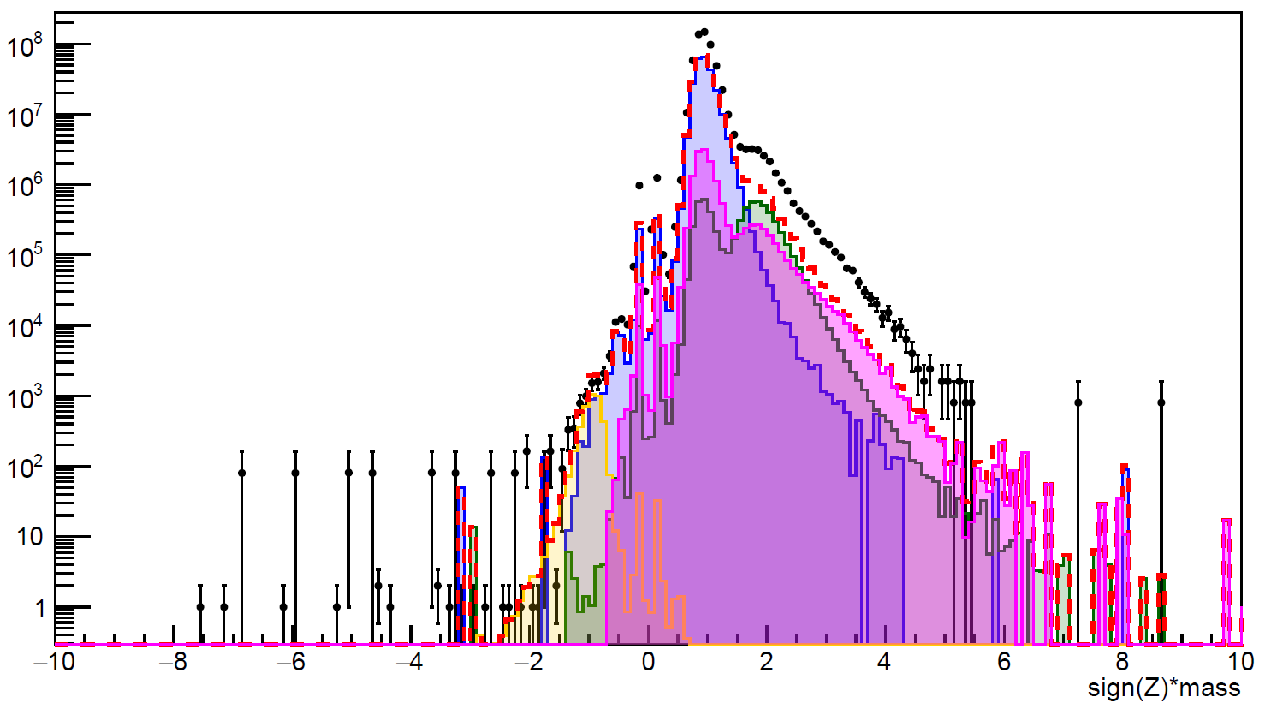
Z1: 0.55 < beta < 0.6
Standard selection
DATA without RTI cutoff
MC D without RTI cutoff
*MC p without RTI cutoff
MC pbar without RTI cutoff
MC he4->Z1 without RTI cutoff
MC total without RTI cutoff
*secondary protons have been added from the AMS-01 publication

Slide 14
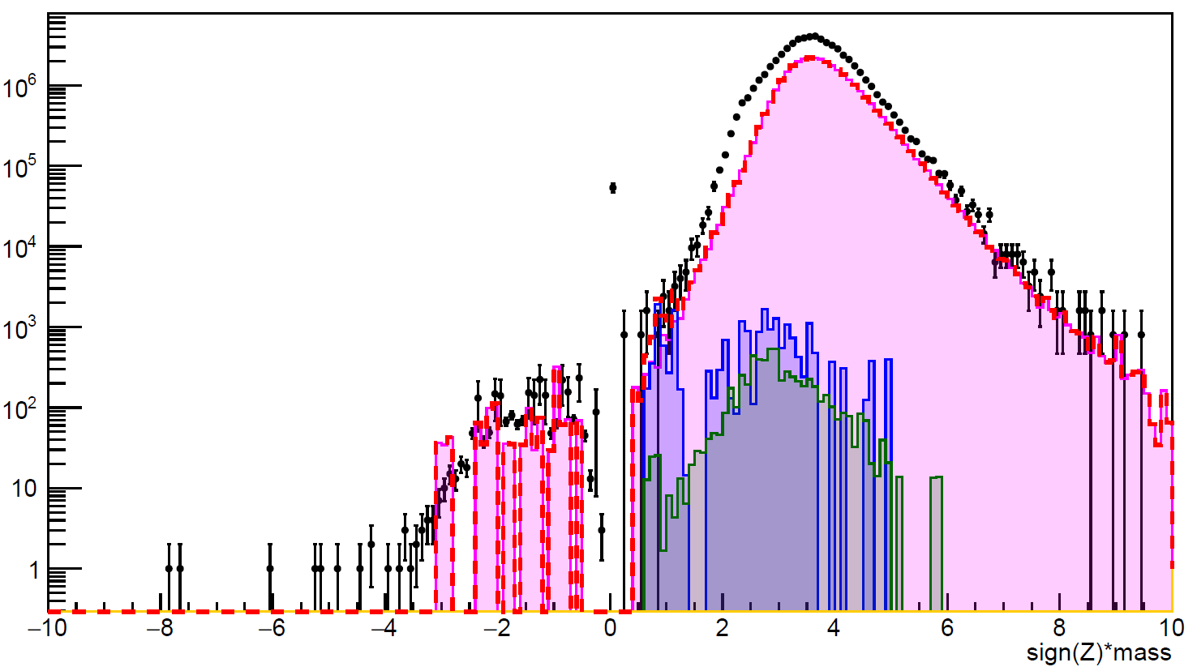
Z2: 0.55 < beta < 0.6
Standard selection
DATA without RTI cutoff
MC D->Z2 without RTI cutoff
*MC p->Z2 without RTI cutoff
MC pbar->Z2 without RTI cutoff
MC he4 without RTI cutoff
MC total without RTI cutoff
*secondary protons have been added from the AMS-01 publication

Slide 15
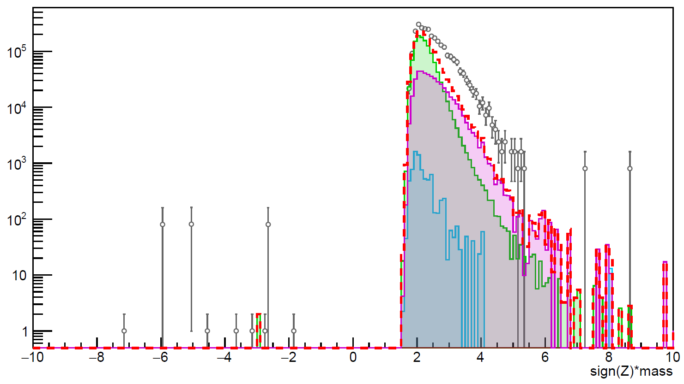
Z1: 0.55 < beta < 0.6
Standard selection
DATA with RTI cutoff
MC D with RTI cutoff
MC p with RTI cutoff
MC pbar with RTI cutoff
MC he4->Z1 with RTI cutoff
MC total with RTI cutoff

Slide 16
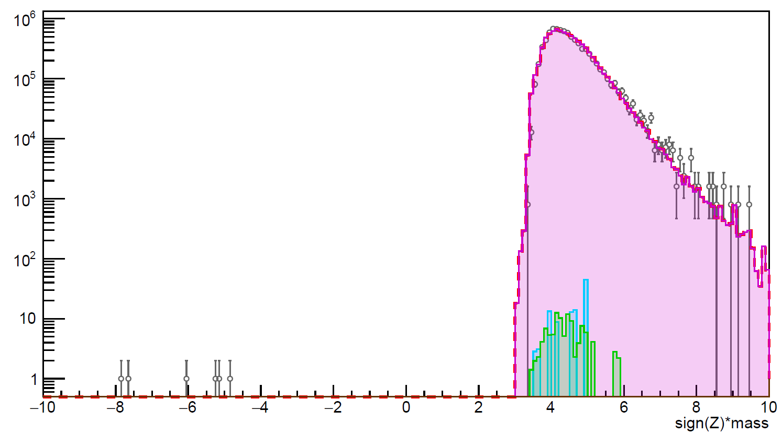
Z2: 0.55 < beta < 0.6
Standard selection
DATA with RTI cutoff
MC D->Z2 with RTI cutoff
MC p->Z2 with RTI cutoff
MC pbar->Z2 with RTI cutoff
MC he4 with RTI cutoff
MC total with RTI cutoff

Slide 17
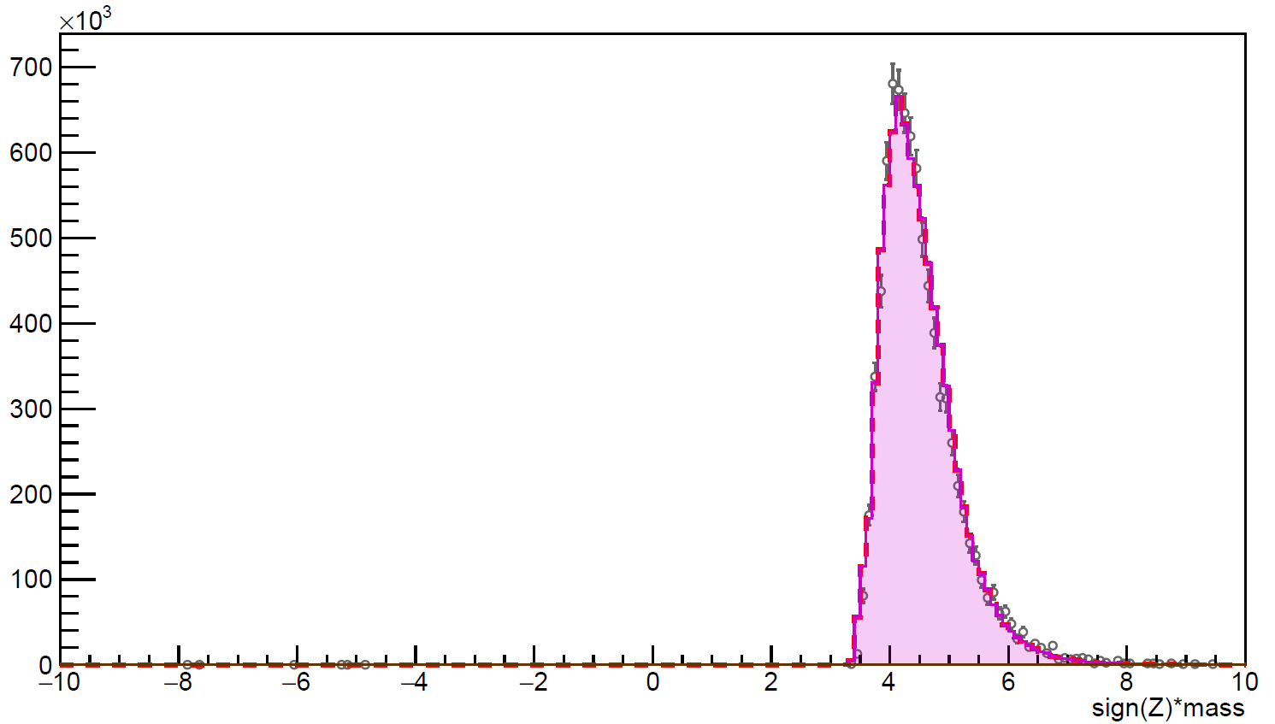
Z2: 0.55 < beta < 0.6
Standard selection
DATA with RTI cutoff
MC D->Z2 with RTI cutoff
MC p->Z2 with RTI cutoff
MC pbar->Z2 with RTI cutoff
MC he4 with RTI cutoff
MC total with RTI cutoff

