Slide 1
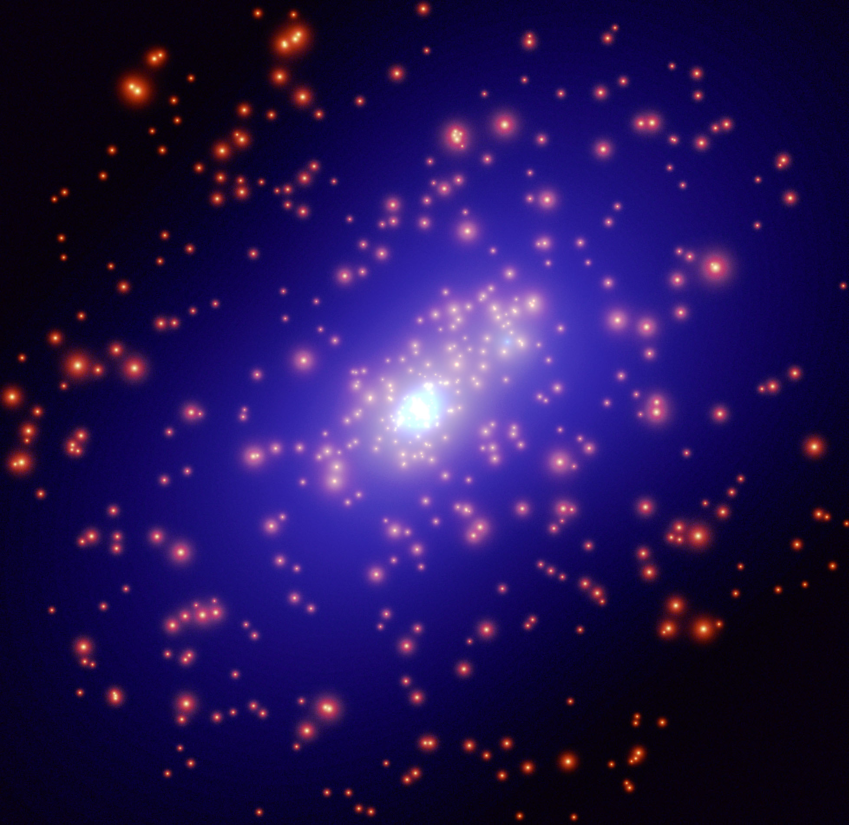
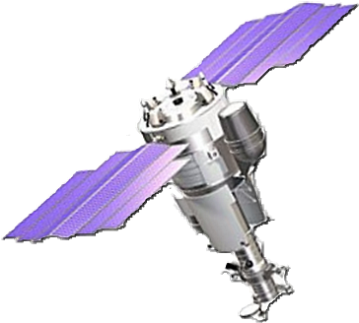
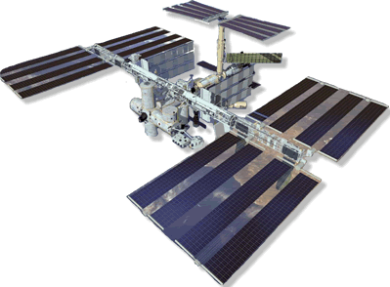
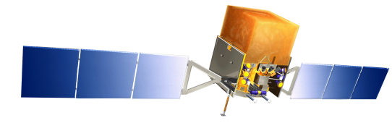
Understanding CRs with Space Experiments
Piergiorgio Picozza
INFN & University of Rome “ Tor Vergata”
ARGO-YBJ and beyond
Roma
July 20, 2011

Slide 2
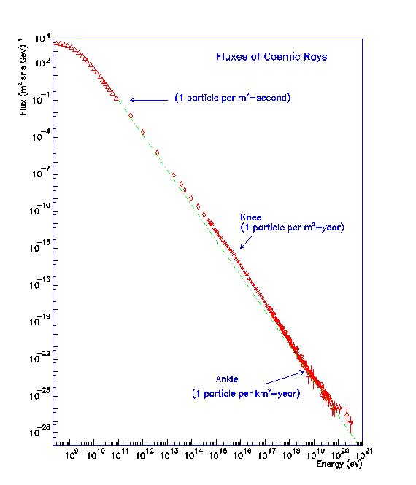
Isotopic composition [ACE]
Solar Modulation
Antimatter
Dark Matter
[BESS, PAMELA, AMS]
Elemental
Composition
[CREAM, ATIC, TRACER, NUCLEON,
CALET, ACCESS?, INCA?,

Slide 3
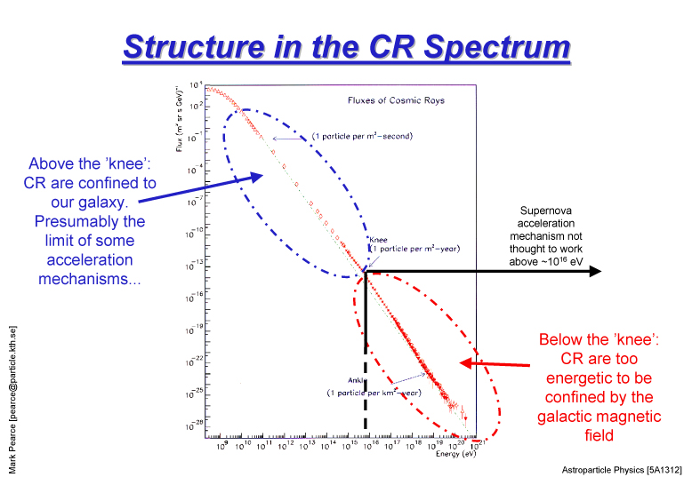

Slide 4
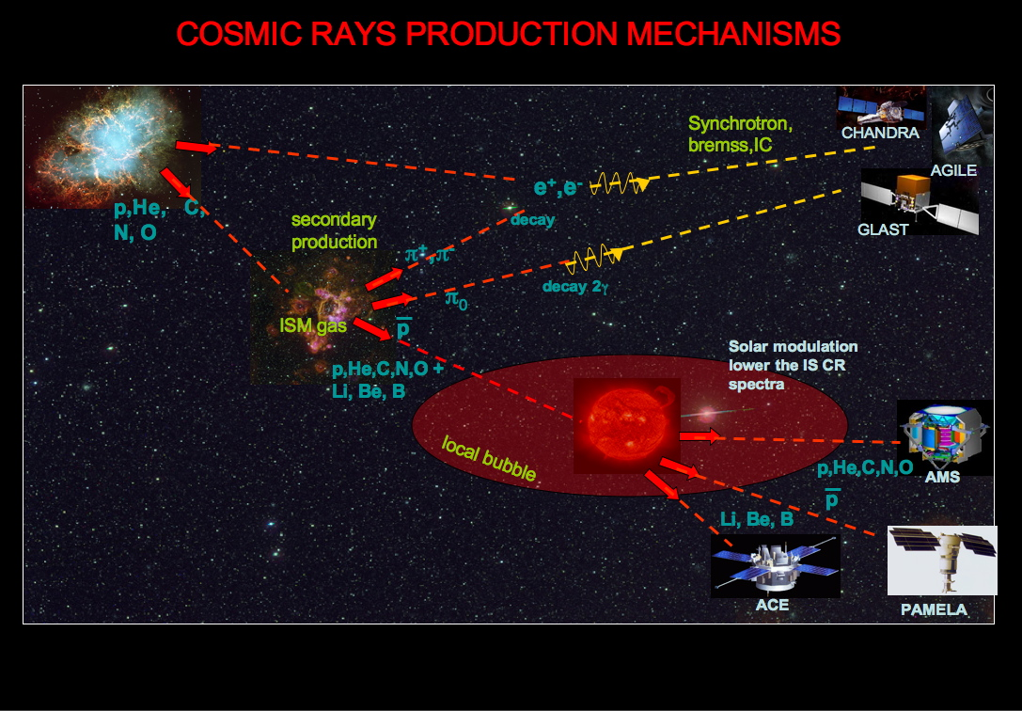
e⁻

Slide 5
Cosmic Ray Sources and Acceleration in
Supernova explosions and Remnants
Fast spinning neutron stars
Exotic Objects

Slide 6
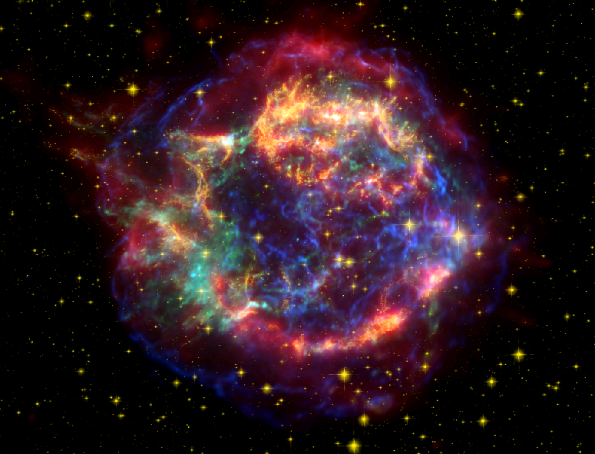
Cas A optical (Hubble), X-rays (Chandra), IR (Spitzer)

Slide 7
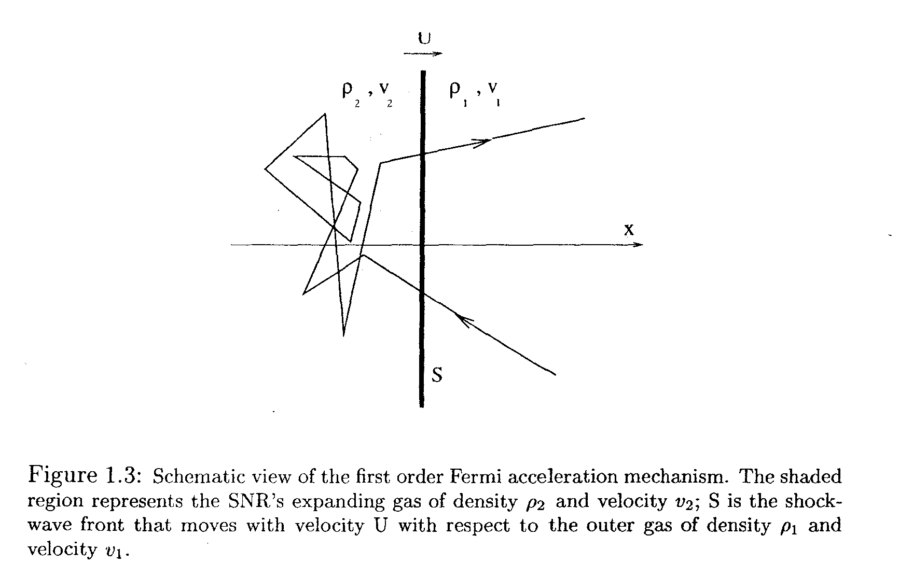
Diffusive shock acceleration (DSA) (first-order Fermi acceleration)

Slide 8
NLDSA
The reaction of accelerated particles onto the accelerator cannot be neglected; it is responsible for spectral features (such as spectral concavity) that may represent potential signatures of CR acceleration.
The standard diffusion coefficient typical of the interstellar medium (ISM) only leads to maximum energies of CRs in the range of ∼ GeV, rather than ∼ 10⁶ GeV (around the knee) required by observations. The only way that the mechanism can play a role for CR acceleration is if the accelerated particles generate the magnetic field structure on which they may scatter, thereby reducing the acceleration time and reach larger values of the maximum energy.
A non linear version of DSA including the dynamical reaction of accelerated particles on the shock was developed and completed with the inclusion of self-generation of magnetic field and acceleration of nuclei other than Hydrogen.

Slide 9
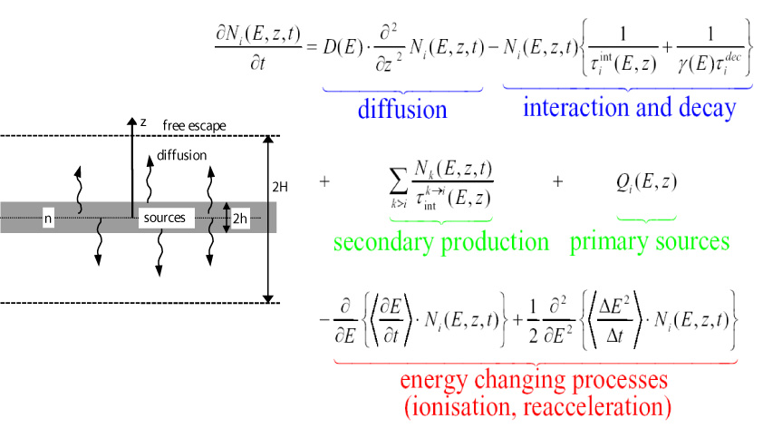
Diffusion Halo Model

Slide 10
Direct measurements
Elemental Composition
Antimatter and Dark Matter Search
Solar Modulation

Slide 11
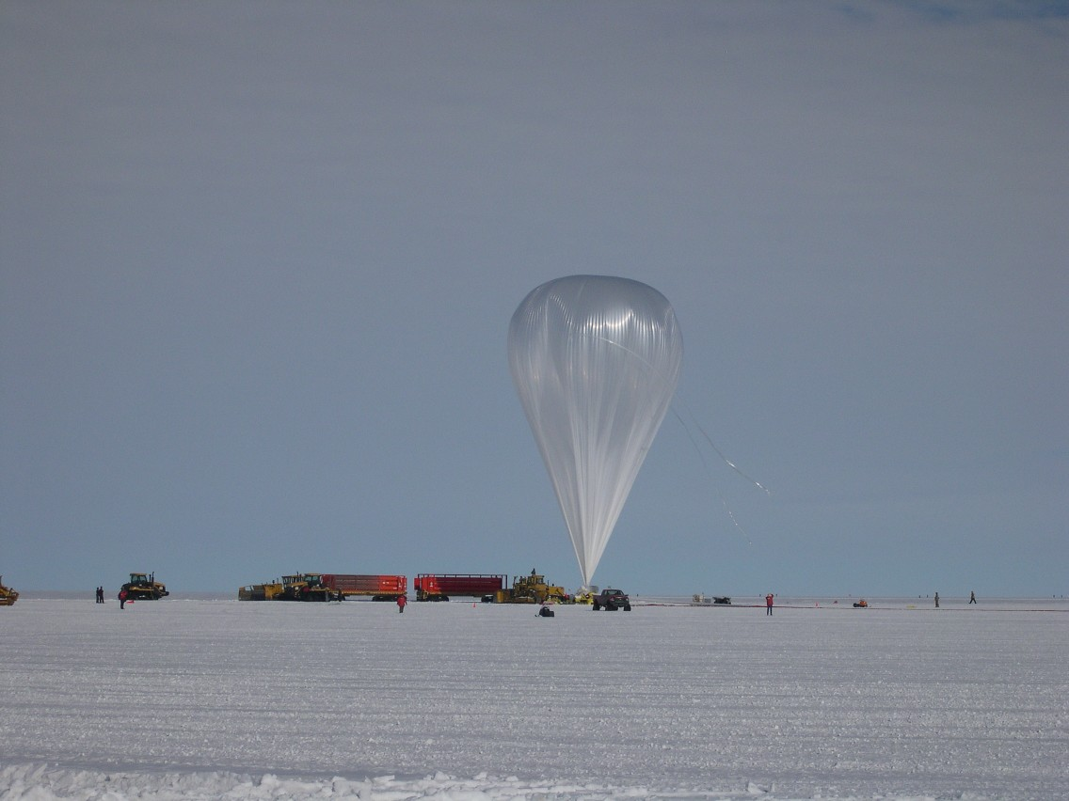
Cosmic Rays Direct Experiments
ACCESS
ACE
AMS-02
ATIC
BESS
CALET
CREAM
HEAO
HIMAX
INCA
JACEE
NUCLEON
PAMELA
PPB-BETS
PROTON sat.
RUNJOB
SOKOL
TIGER
TRACER

Slide 12
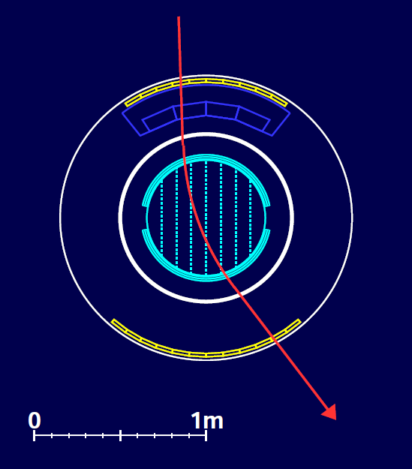
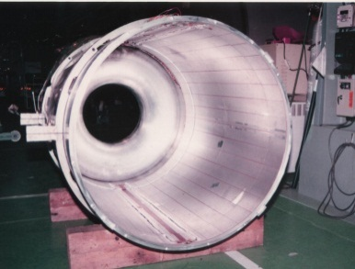
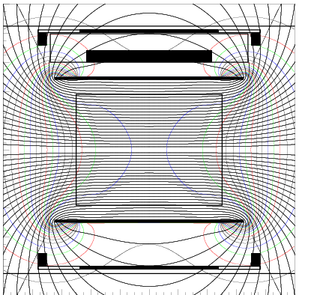
BESS Detector
  JET/IDC
  Rigidity
  Rigidity measurement
  SC Solenoid (L=1m, B=1T)
    Min. material (4.7g/cm²)
    Uniform field
    Large acceptance
  Central tracker
    Drift chambers (Jet/IDC)
    δ ~200 μm
  Z, m measurement
  R,β --> m = ZeR 1/β²-1
  dE/dx --> Z
TOF
β, dE/dx
√

Slide 13
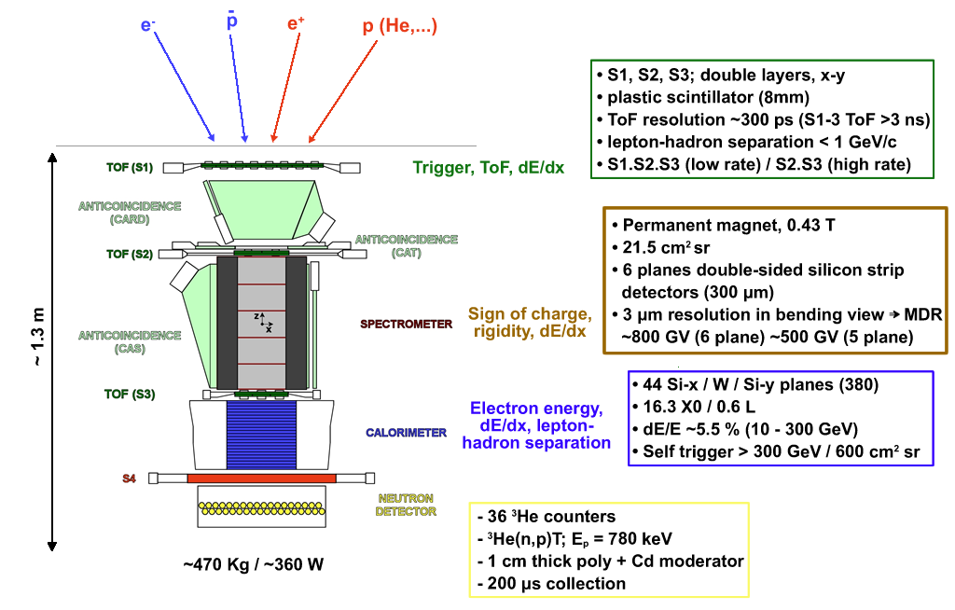
PAMELA

Slide 14
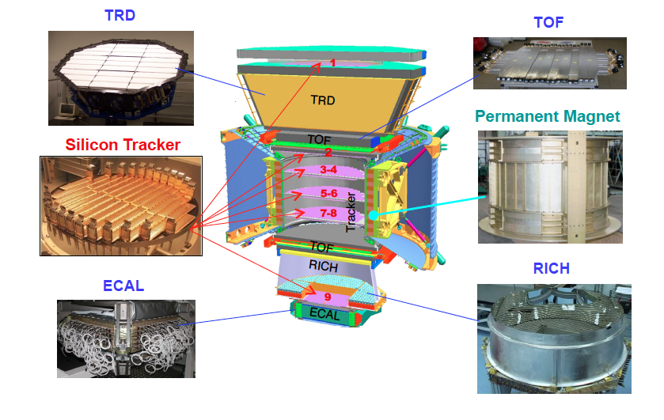
The AMS-02 detector

Slide 16
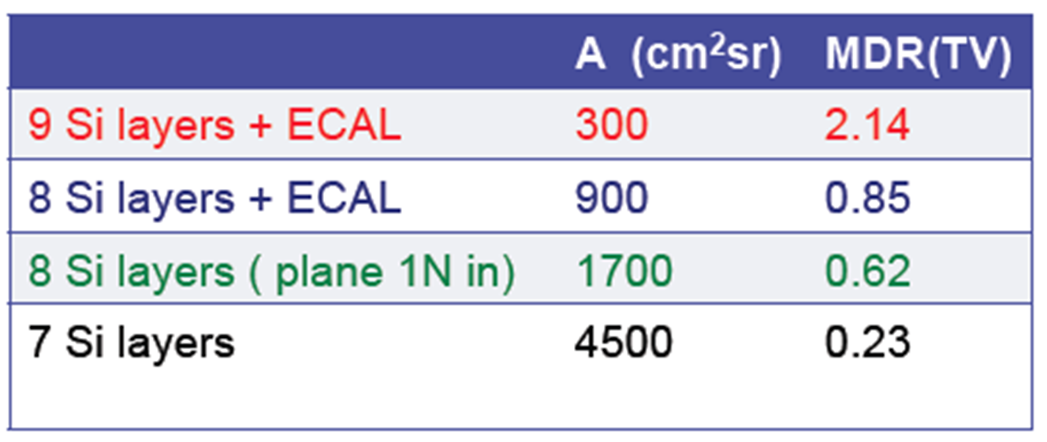
AMS-02

Slide 17
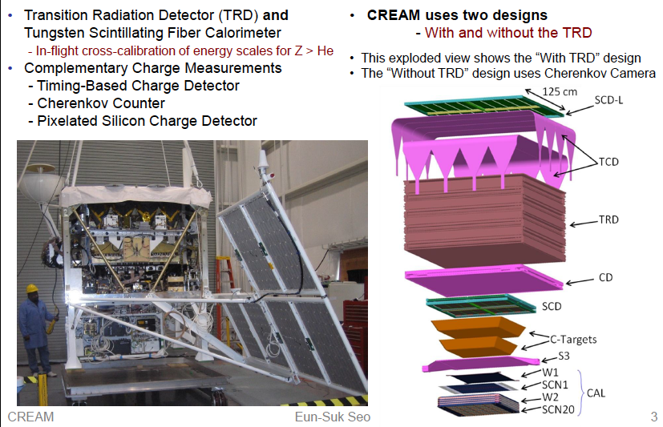
The CREAM instrument
Collecting power: 300 m2-sr-day for proton and helium, 600 m2-sr-day nuclei

Slide 18
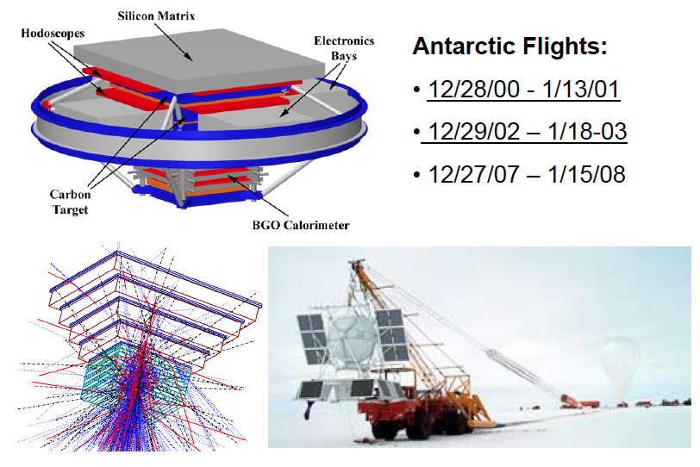
ATIC Instrument Details

Slide 19
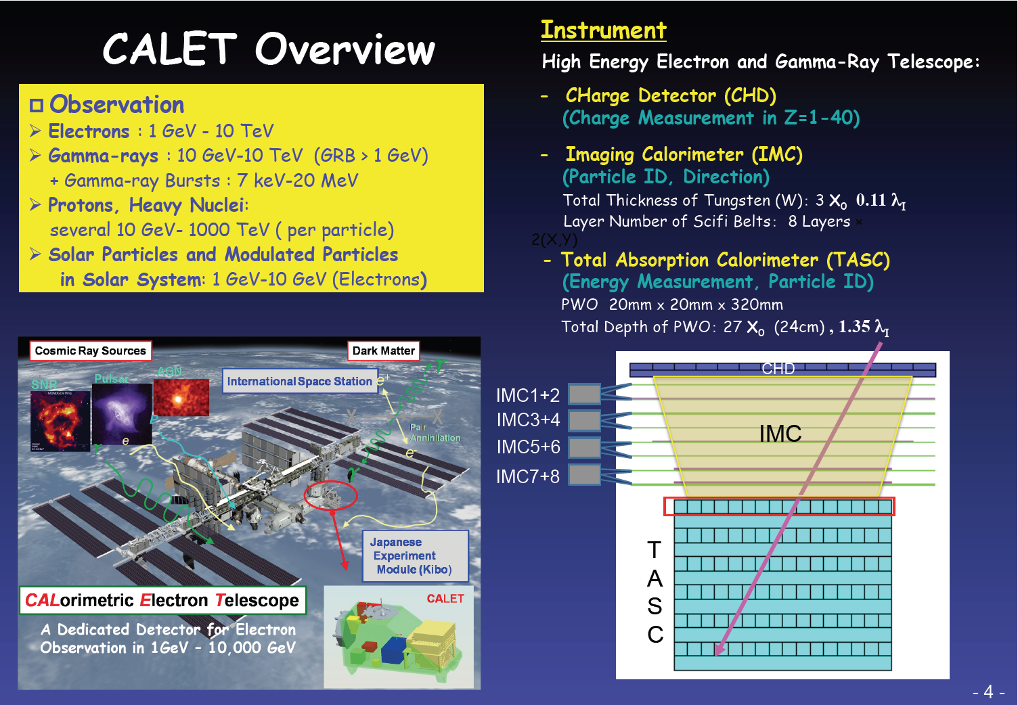

Slide 20
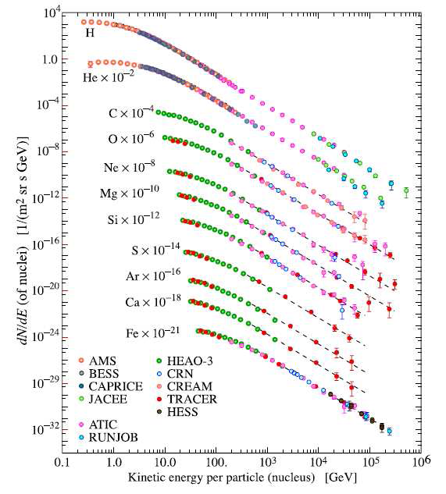
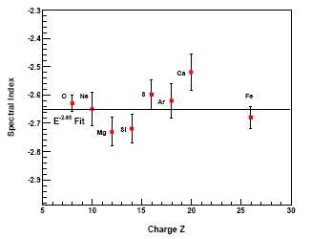
CR ELEMENTAL COMPOSITION BELOW THE KNEE
Measurements of the flux of different chemical elements below the knee have been carried out.
No appreciable difference between the slopes of the spectra of these nuclei was detected, all slopes being around 2.7
Spectral indices of a best power-law t to the combined TRACER data above 20 GeV/amu.
Notes:
20

Slide 21
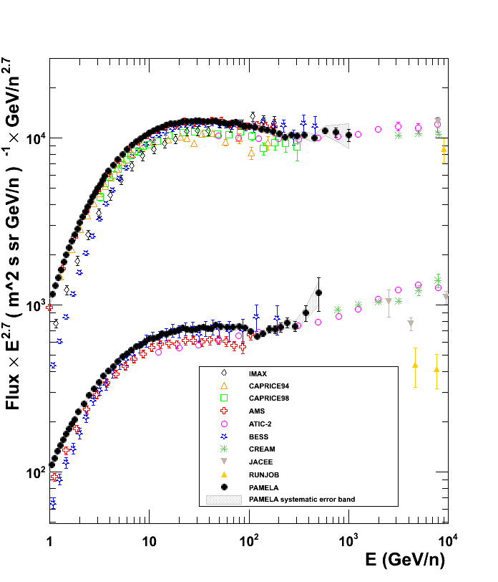
Proton and Helium fluxes
p
He
Science 332,69 (2011)

Slide 22
Proton and Helium fluxes

Slide 23

Proton Flux

Slide 24
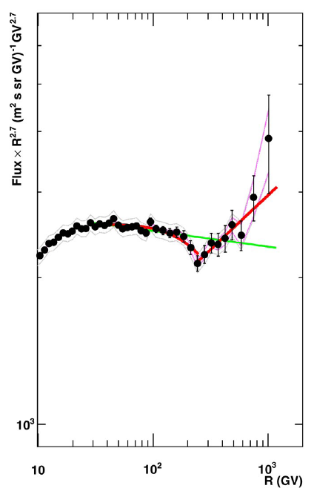


Helium Flux

Slide 25
Proton and Helium fluxes
ApJ, 728, 122 (2011) CREAM

Slide 26
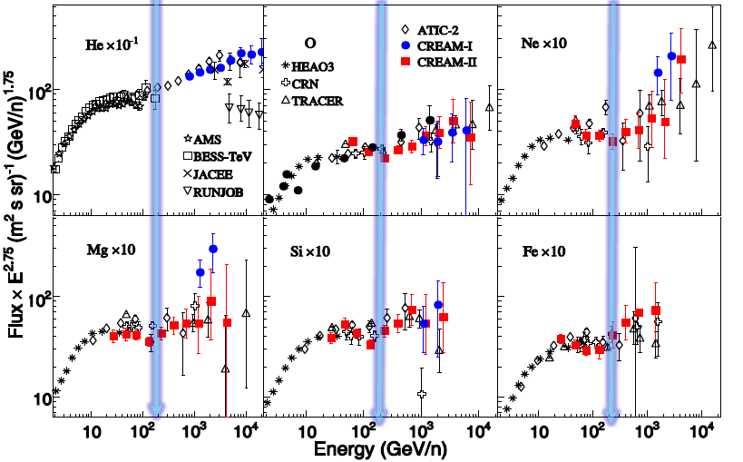
Heavier elements: hardening

Slide 27
Proton to helium ratio

Slide 28
Proton to Helium ratio
ApJ, 728, 122 (2011) CREAM

Slide 29
P. Blasi astro-ph 1105.4521

Slide 30
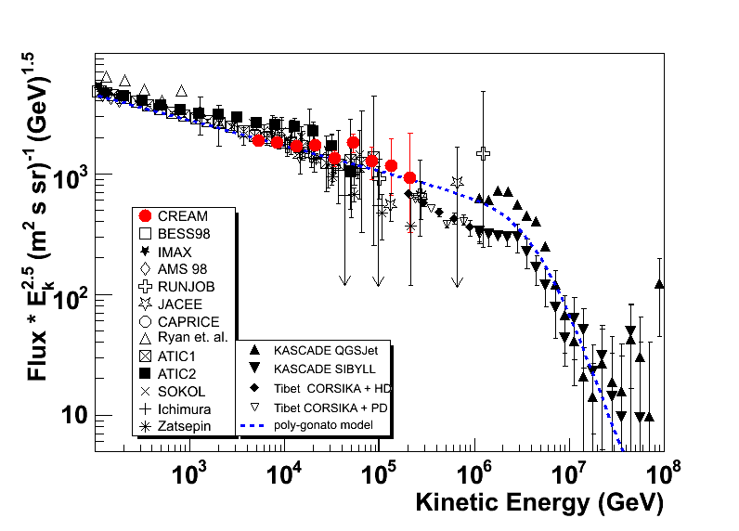
Proton flux
proton

Slide 31
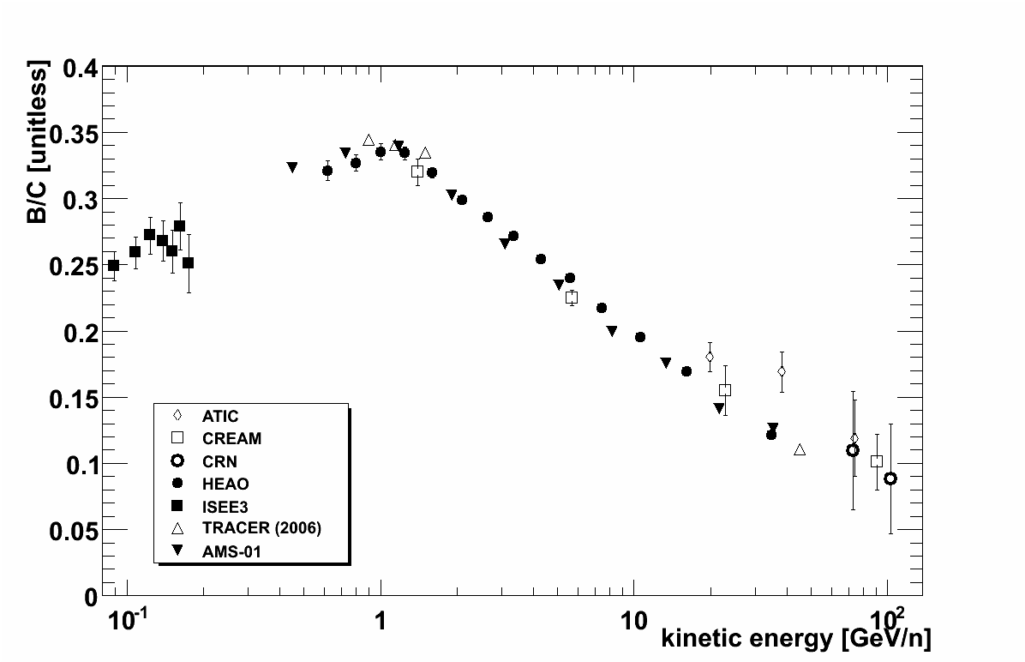


B/C ratio

Slide 32
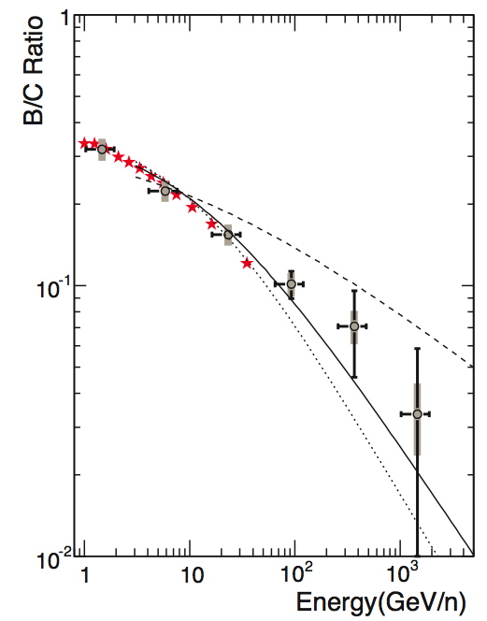
CREAM
astro-ph/0808.1718
δ = 0.33 top
0.6 med.
0.7 bot.

Slide 33
ATIC

Slide 35
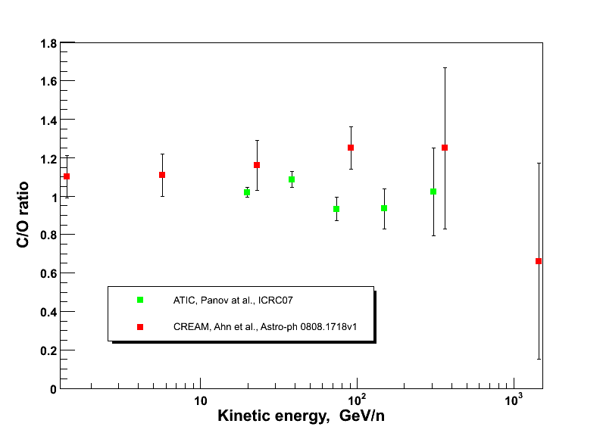

Slide 36
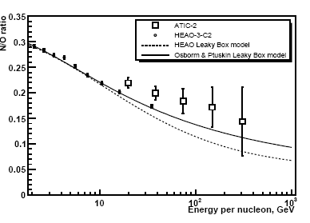
CREAM 2 astro-ph/0808.1718 ATIC

Slide 37
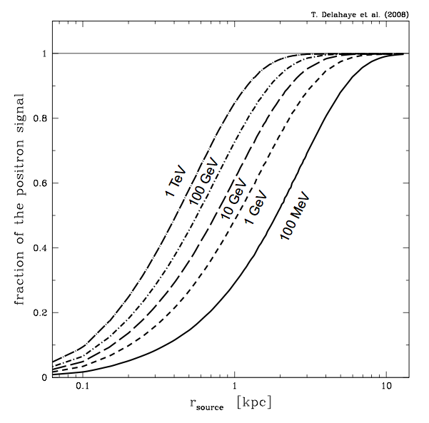

Positrons and Electrons
Where do positrons and electrons come from?
Mostly locally within 1 Kpc, due to the energy losses by Synchrotron Radiation and Inverse Compton scattering
Typical lifetime
Antiprotons within 10 Kpc

Slide 38
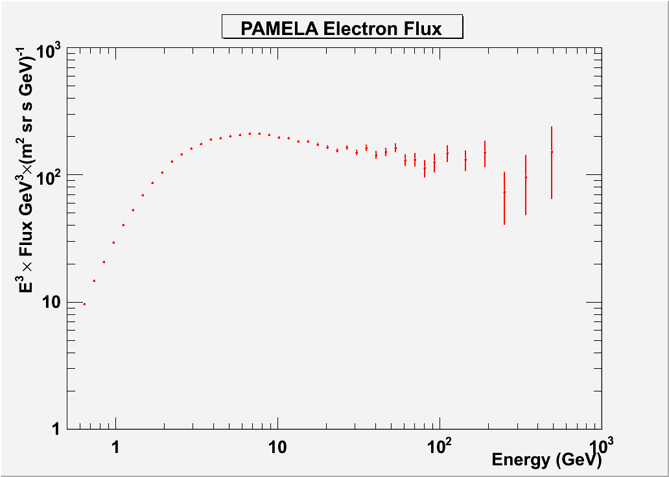
Phys. Rev. Lett. 106, 201101 (2011)

Slide 39
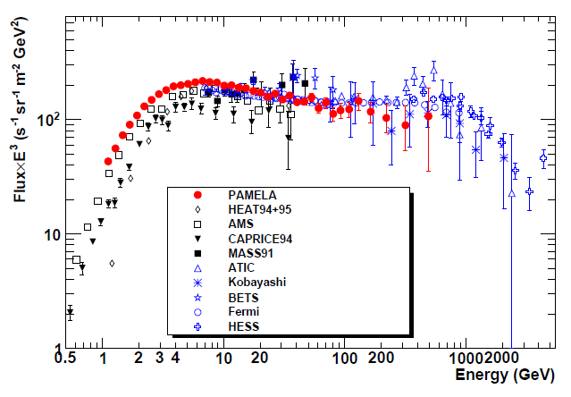
Electron absolute flux
e⁻
e⁺ +e⁻
Adriani et al. , PRL 106, 201101 (2011)
Largest energy range covered in any experiment hitherto with no atmospheric overburden
Low energy
minimum solar activity (φ = 450÷550 GV)
High energy
  No significant disagreement with recent ATIC and Fermi data
  Softer spectrum consistent with both systematics and growing positron component
Spectrometric measurement
Calorimetric measurements

Slide 40
Problematic aspects of the SNR Paradigm
Can we consider the SNR paradigm as proven right?
We are plenty of evidences that at least some of the SNRs we observe are accelerating CRs efficiently.
However other SNRs do not seem to be accelerating (hadronic) CRs to the level required by the paradigm
The general theory makes some very general predictions on a “typical” SNR
The behavior of an individual SNR depends on many physical phenomena which are specific of the environment where the supernova explodes and are much harder to predict

Slide 41
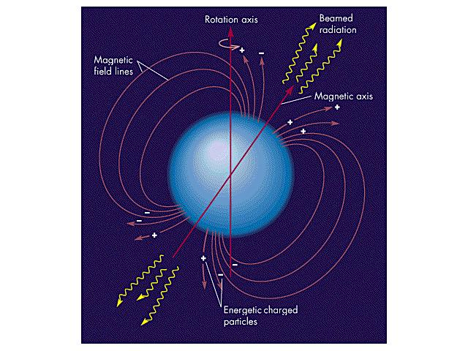
A NEUTRON STAR WITH A STRONG MAGNETIC FIELD:
FAST ROTATING PULSAR (P = 33 msec)
L(spindown) = 5 10³⁸ erg/s

Slide 42
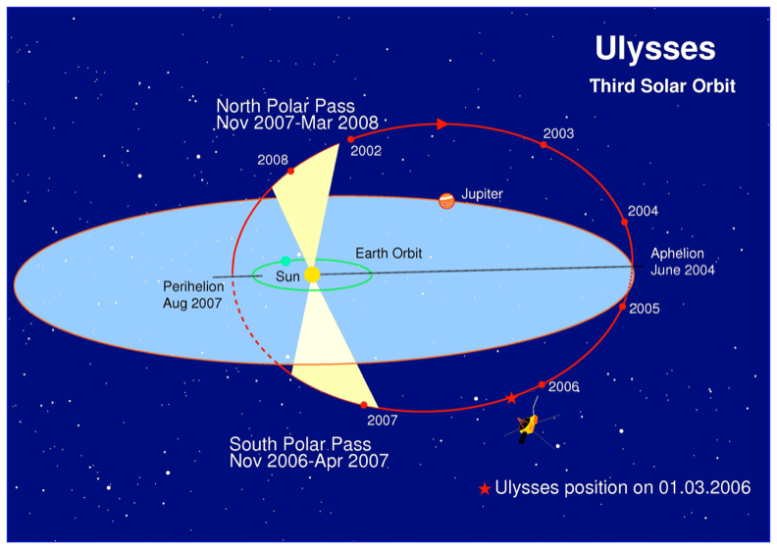
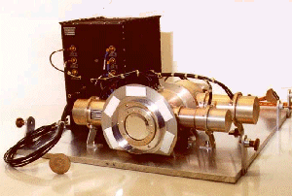
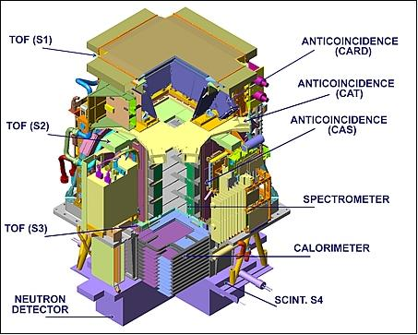
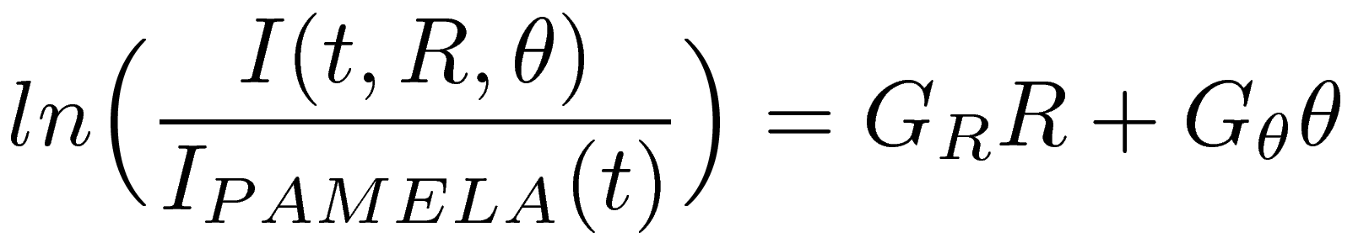
Gradients in the Heliosphere, PAMELA & ULYSSES
Notes:
42
This slide shows the Ulysses orbit together with the trajectory of the Earth project. While PAMELA stays close to Earth the Kiel Electron Telescope moves within the inner heliosphere

Slide 43
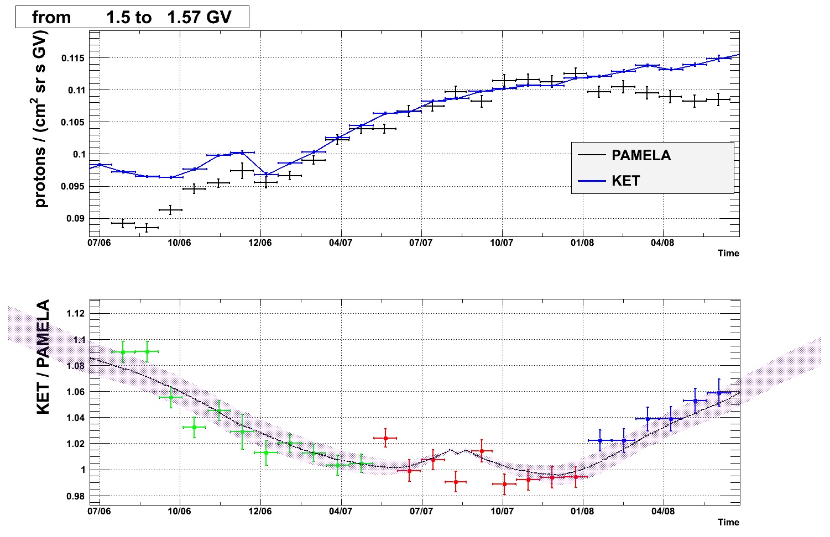

Gradients in the Heliosphere, PAMELA & ULYSSES
Comparison of the proton flux measured between 1.5 and 1.57GV by PAMELA and ULYSSES as a function of time

Slide 44
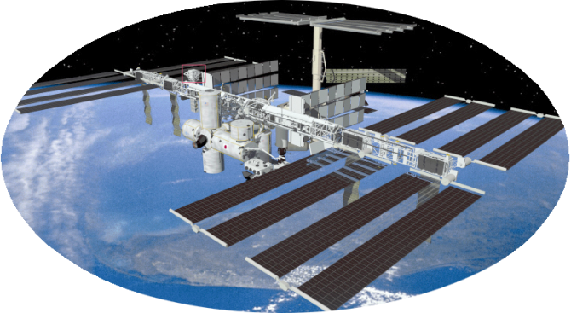
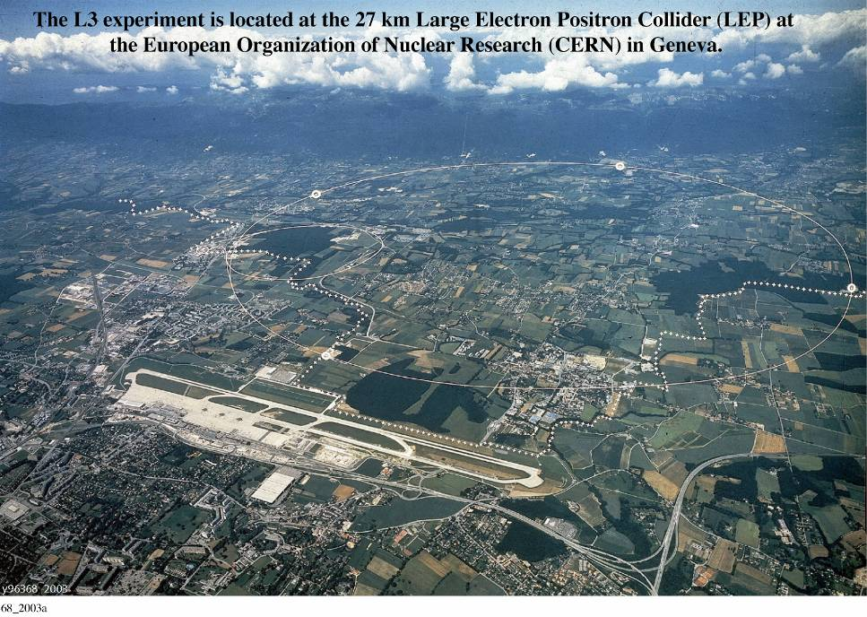
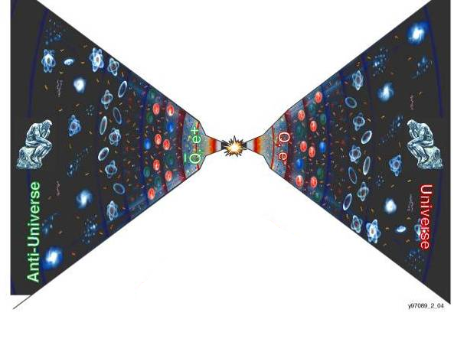
Search for the existence of Antimatter in the Universe
PAMELA AMS
in Space
AMS
Search for the existence of anti Universe
Search for the origin of the Universe
Accelerators
The Big Bang origin of the Universe requires
matter and antimatter
to be equally abundant at the very hot beginning

Slide 45
Antimatter Direct research
Observation of cosmic radiation hold out the possibility of directly observing a particle of antimatter which has escaped as a cosmic ray from a distant antigalaxy, traversed intergalactic space filled by turbulent magnetic field, entered the Milky Way against the galactic wind and found its way to the Earth.
Sreitmatter, R. E., Nuovo Cimento, 19, 835 (1996)
High energy particle or antinuclei

Slide 46
Antimatter

Slide 47
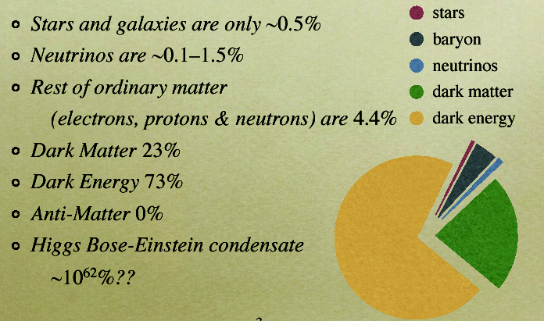
THE UNIVERSE ENERGY BUDGET

Slide 48






DM annihilations
DM particles are stable. They can annihilate in pairs.
Primary annihilation channels
Decay
Final states
σ_{a}= <σv>

Slide 49
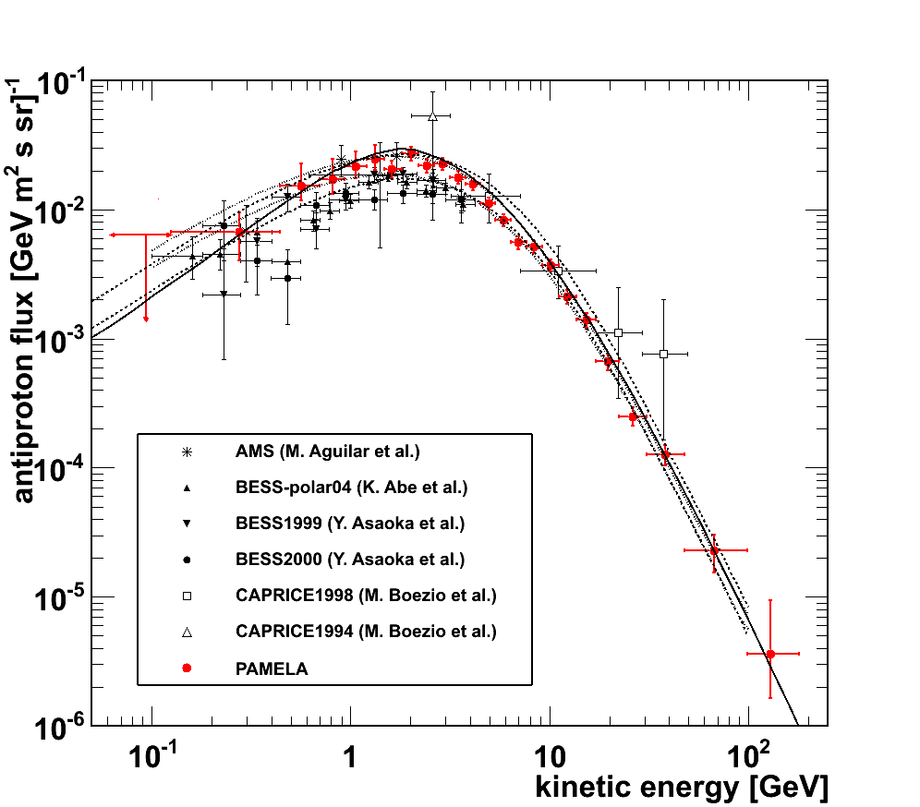
Antiproton Flux
Donato et al. (ApJ 563 (2001) 172)
Ptuskin et al. (ApJ 642 (2006) 902)
PRL. 105, 121101 (2010)

Slide 50
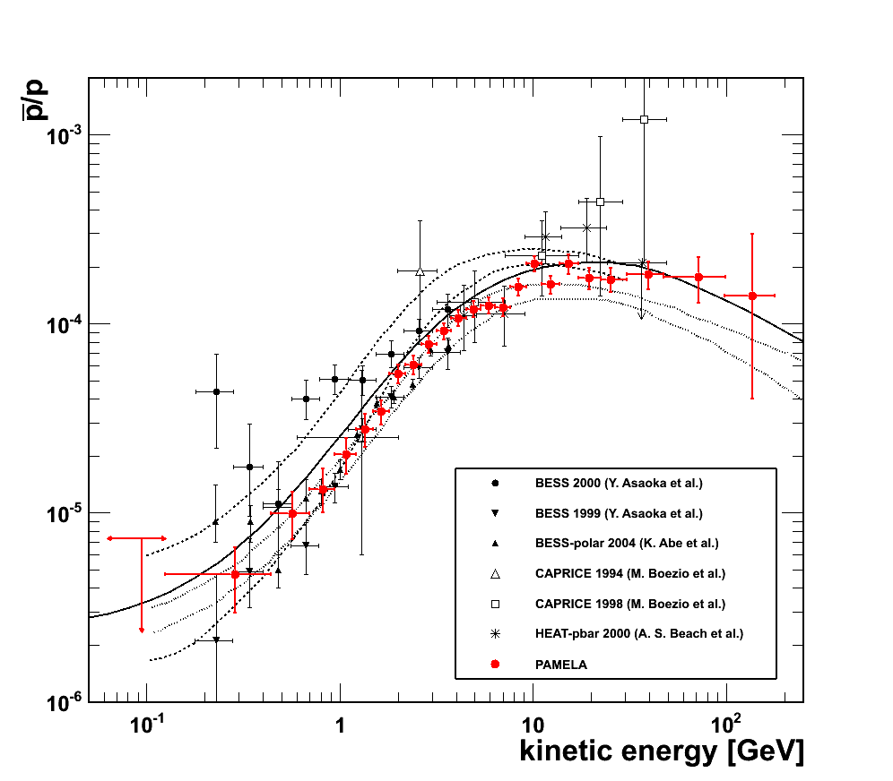
Antiproton to proton ratio
Simon et al. (ApJ 499 (1998) 250)
Ptuskin et al. (ApJ 642 (2006) 902)
Donato et al. (PRL 102 (2009) 071301)
PRL 102, 051101 (2009) and PRL 105, 121101 (2010)

Slide 51
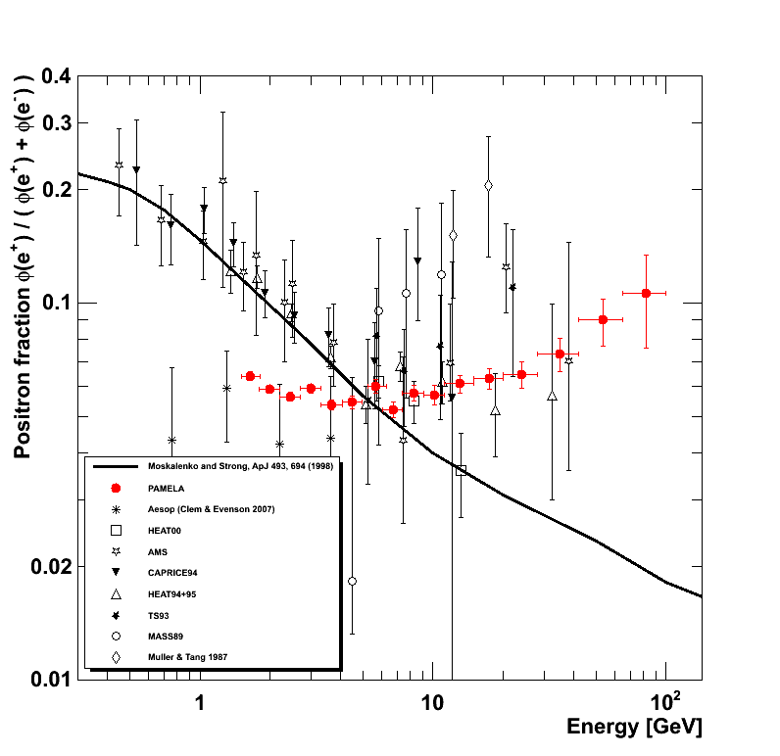
Positron to Electron Ratio
Secondary production Moskalenko & Strong 98

Slide 52
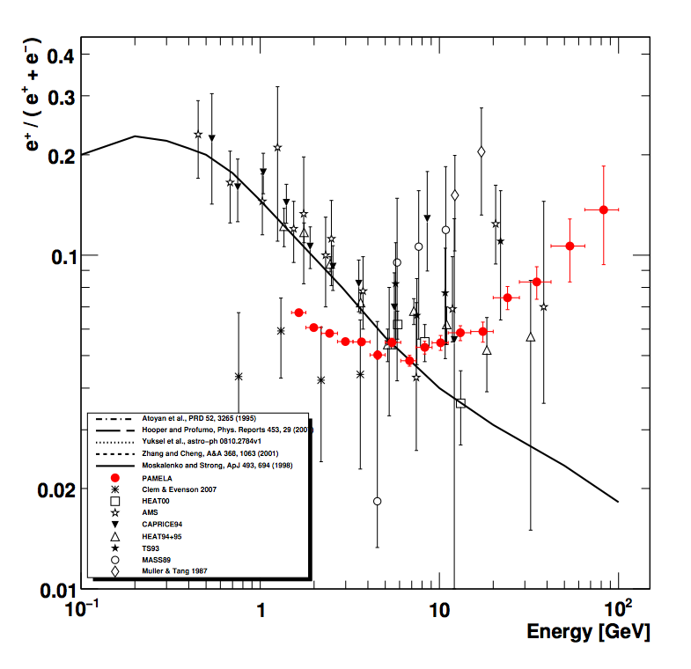
A Challenging Puzzle for Dark Matter Interpretation

Slide 54
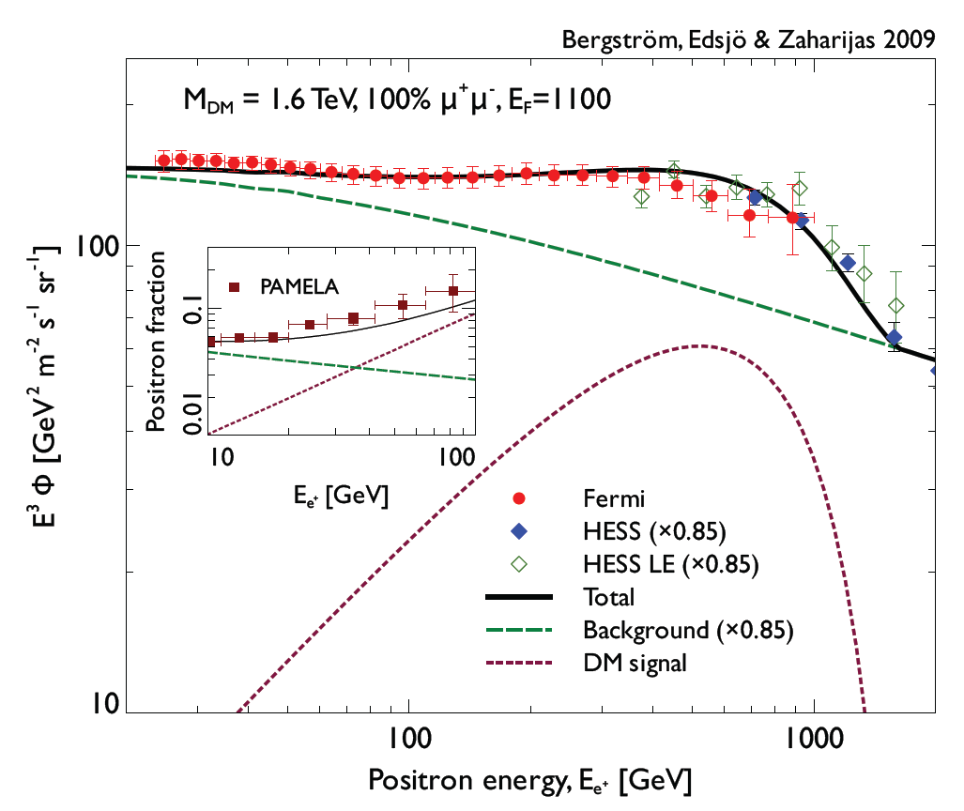
Fermi (e⁺+ e⁻) and PAMELA ratio
Bergstrom et al. astro-ph 0905.0333v1

Slide 55
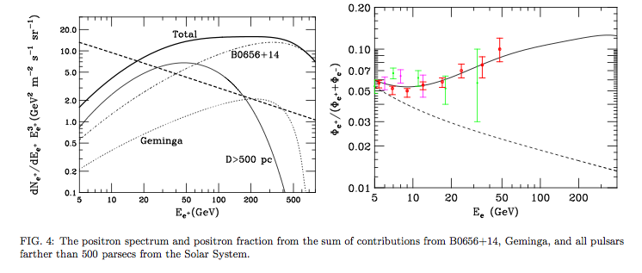
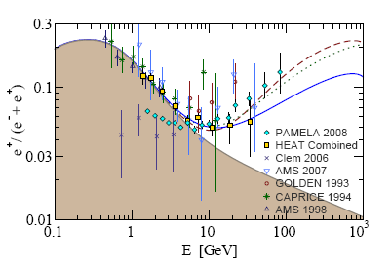
Example: pulsars
H. Yüksak et al., arXiv:0810.2784v2
Contributions of e- & e+ from Geminga assuming different distance, age and energetic of the pulsar
diffuse mature &nearby young pulsars
Hooper, Blasi, and Serpico
arXiv:0810.1527

Slide 56


Solar Modulation of galactic cosmic rays
Study of charge sign dependent effects
Asaoka Y. et al. 2002, Phys. Rev. Lett. 88, 051101),
Bieber, J.W., et al. Physi-cal Review Letters, 84, 674, 1999.
J. Clem et al. 30th ICRC 2007
U.W. Langner, M.S. Potgieter, Advances in Space Research 34 (2004)
Pamela
AMS-01
Caprice / Mass /TS93
BESS

Slide 57

Time Dependence of PAMELA Proton Flux
Decreasing
solar activity
Increasing
GCR flux

Slide 58

Time Dependence of PAMELA Proton Flux
Preliminary

Slide 59

Helium solar modulation

Slide 60

Time Dependence of PAMELA Electron (e⁻) Flux
Preliminary

Slide 61

Time Dependence of PAMELA Electron (e⁻) Flux
Preliminary

Slide 62




Charge dependent solar modulation
¯
+
¯
Pamela
+
A > 0
Positive particles
A < 0

Slide 63







December 2006 Solar particle events
Dec 13th largest CME since 2003, anomalous at sol min

Slide 64








December 13th 2006 event
Preliminary!

Slide 65

December 13th 2006 He differential spectrum
Preliminary!

Slide 66




December 14th 2006 event
X-ray
X-ray
P,e-
P,e-
Low energy tail of Dec 13th event
Arrival of event of Dec 14th
Magnetic Field
Magnetic Field
Neutron Monitor
Neutron Monitor
Solar Quiet spectrum
Below galactic spectrum:
Start of Forbush decrease
End of event of Dec 14th
Decrease of primary spectrum
Arrival of magnetic cloud from CME of Dec 13th
Shock 1774km/s (gopalswamy, 2007)
Decrease of Neutron Monitor Flux
Preliminary!

Slide 67
Thanks!

