Slide 1
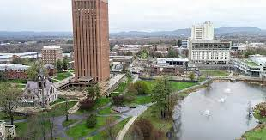

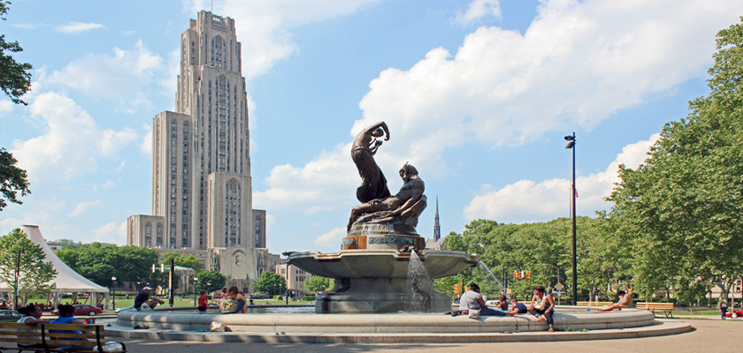

“Who Ordered That?”
The Dance of the Muon
Tao Han
Pitt PACC
University of Pittsburgh
June 6, 2024
University of Bologna
Founded 1787
Founded 1088

Slide 2
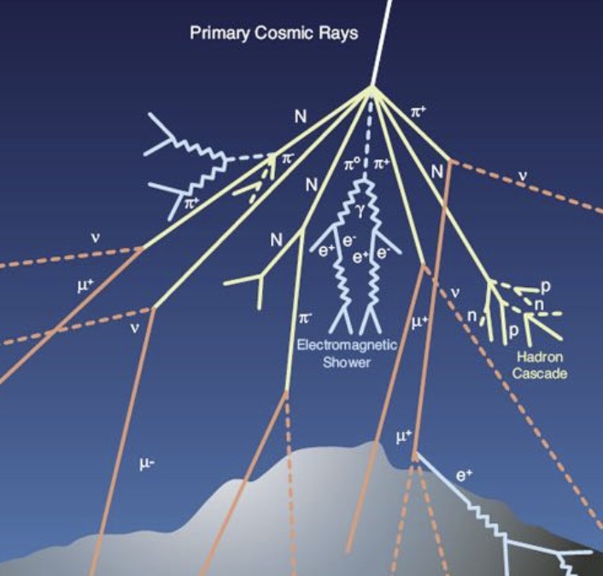
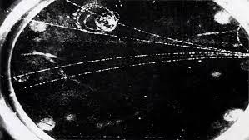
Who Ordered That?!
A surprising discovery
In 1936, Anderson & Neddermeyer used a cloud chamber and found a (±) charged particle in the cosmic ray: m_{e-} < M < m_{p+}
Pair production from 𝛄*
Highly ionizing: a slow-motion M ~ 200 m_{e-}
Decaying to electron with a lifetime
𝞽 ~ 2 x 10⁻⁶ s
Highly penetrating: no strong interactions,
thus NOT Yukawa’s “meson” to mediate
p⁺, n strong nuclear force.
“Who ordered THAT ?!”
-- I. I. Rabi (1944 Nobel Laureate)

Slide 3
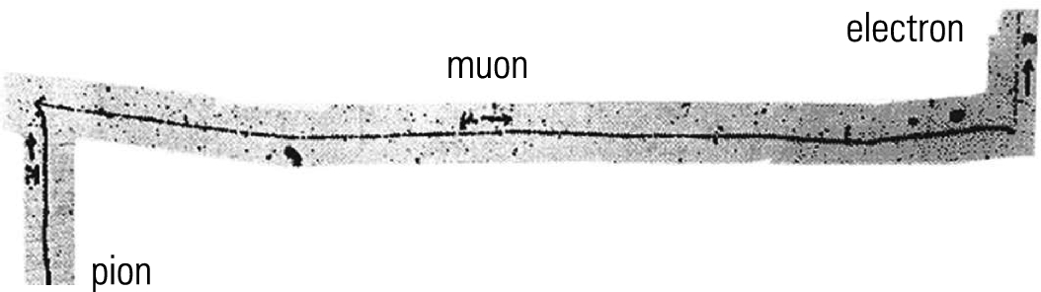
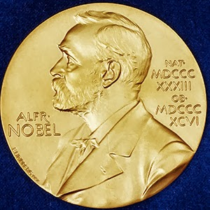
The “usher” for particle physics:
-- there are two “mesons”!
In 1948, Lattes et al. used a photographic emulsion detector, observing two charged particles: 𝝿± → 𝝻± → e±
The discovery of 𝝻± led to another discovery of 𝝿±!
-- both particles named by Lattes.
The 𝝿^{±,0} are the Yukawa mesons
mediating the strong force!
(Yukawa, 1949)
(Powell, 1950)

Slide 4

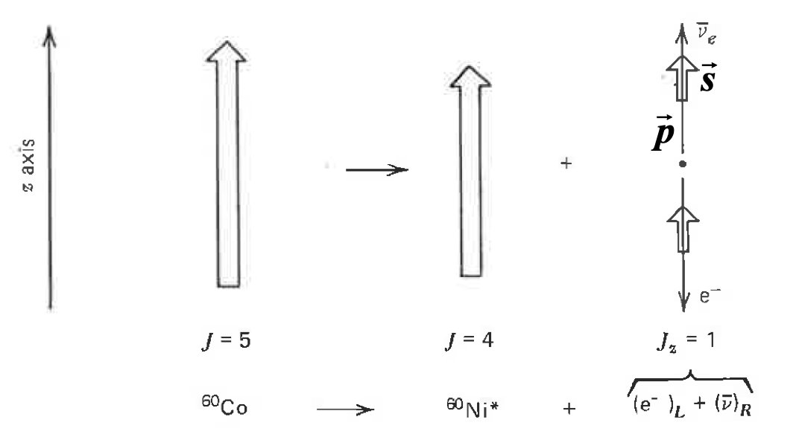
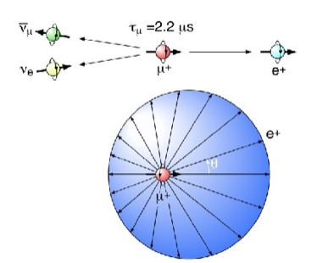
Parity violation in muon decay
Following Prof. C.S.Wu’s experiment in 𝝱-decay:
(Lee & Yang
1957)
Phys. Rev. 105, 1413 (1957)
Neutrons and 𝛍± decays involve the weak nuclear force:
Lederman et al. & Friedman et al.
made it with polarized muons:
Phys. Rev. 105, 1415 (1957);
Phys. Rev. 106, 1290 (1957)

Slide 5
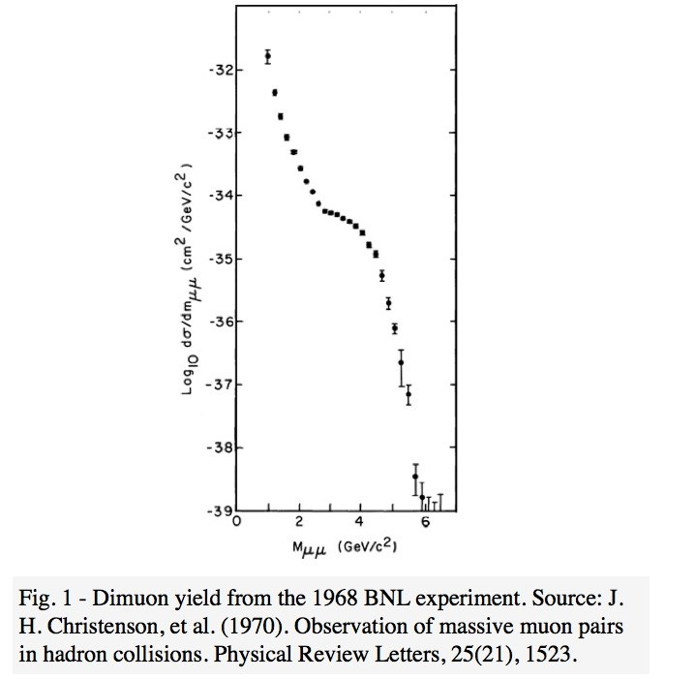
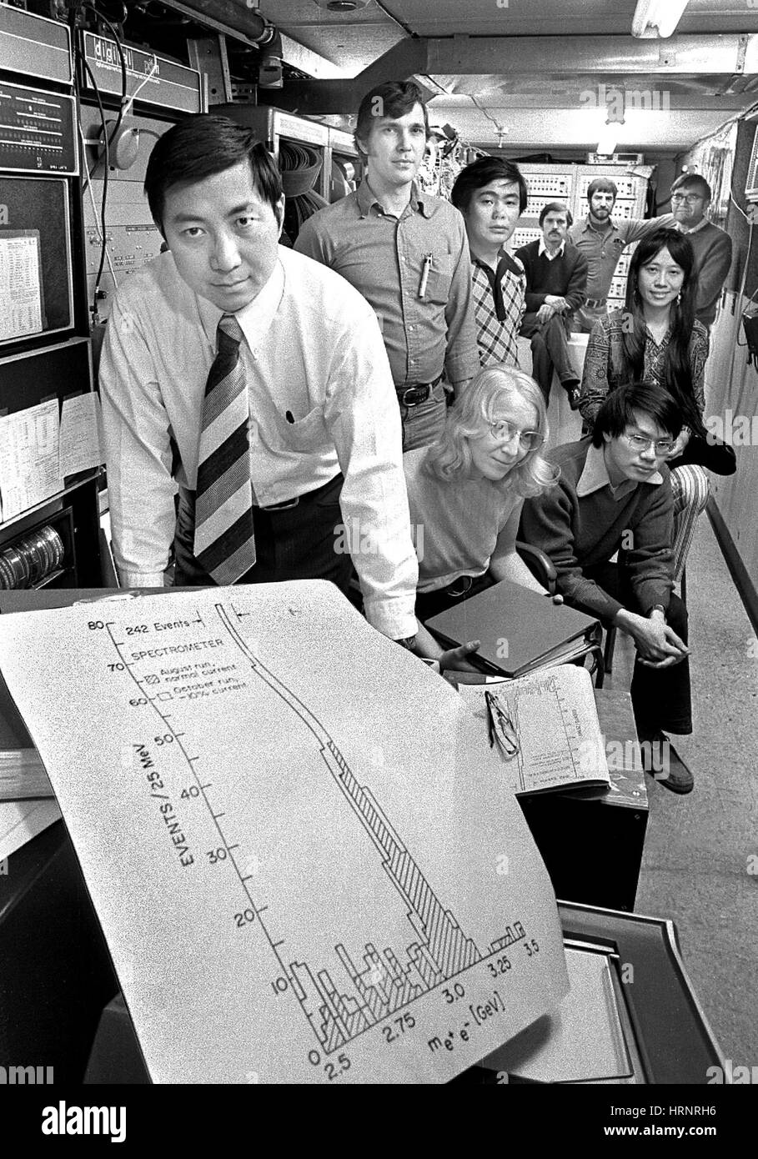
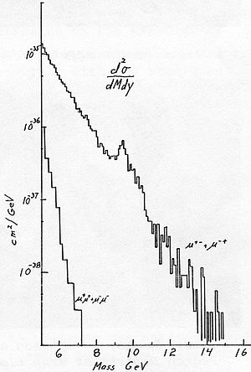
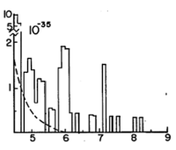

Heavy Quark Onia:
“Lederman’s shoulder”:
1968-1969@BNL di-muon expt:
“Oops-leon”
(Leon Lederman, 1976)
-
-
the 𝚼(bb)→𝛍⁺ 𝛍⁻ Discovery
ushered the J/𝜓(cc) Discovery
(1976)

Slide 6
Two flavors of neutrinos:
Lederman-Schwartz-Steinberger made the 𝜈_{𝜇} beam!
And there “𝜈” is NOT 𝜈_{e}!
(1988)
Phys. Rev. Lett. 9, 36 (1962)
(1). Muon flavor identified → flavor physics, before Cabibbo !
--- Two-neutrino mixing by S. Sakata: Prog. Theor. Phys. 28 (1962) 870.
(2). Neutrino beam and scattering opens a new avenue
Neutrino Deeply Inelastic Scattering
In addition to
Discovery of “weak neutral current”
(DIS, 1990)
Precisions:

Slide 7
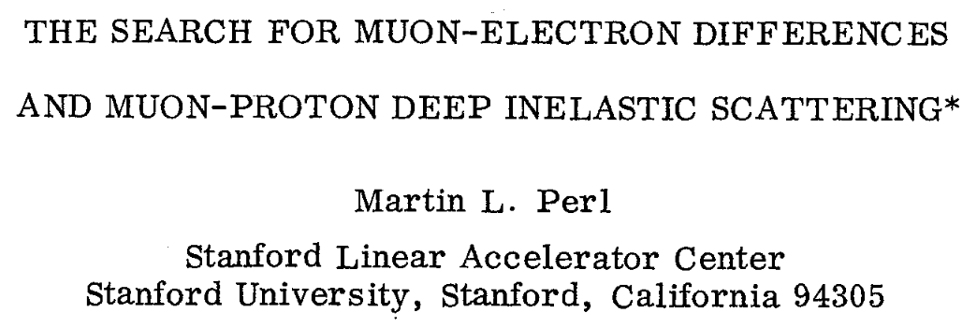
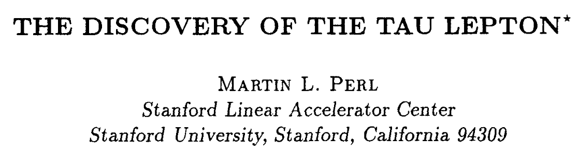

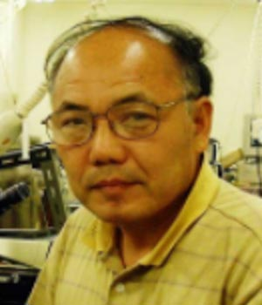

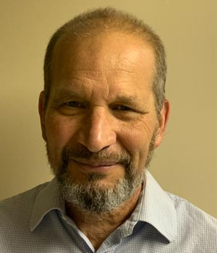
Who ordered That? A Tri-peat
(1995)
(1975)
Consequently, that led to yet another discovery:
DONuT experiment @ FNAL (2000) detected the 𝜈_{𝜏}
three generations of leptons completed!
2022 Panofsky Prize!
Byron Lundberg
Kimio Niwa
Regina Rameika
Vittorio Paolone

Slide 8
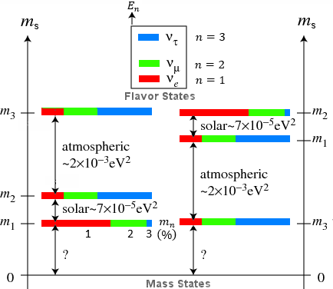
Muons as sources of atmospheric 𝜈_{𝜇,e}
The Super-K / SNO experiments provided
very precise measurements of neutrino oscillations
among 3-flavors & 2 mass differences
(2015:
McDonald &
Kajita)

Slide 9
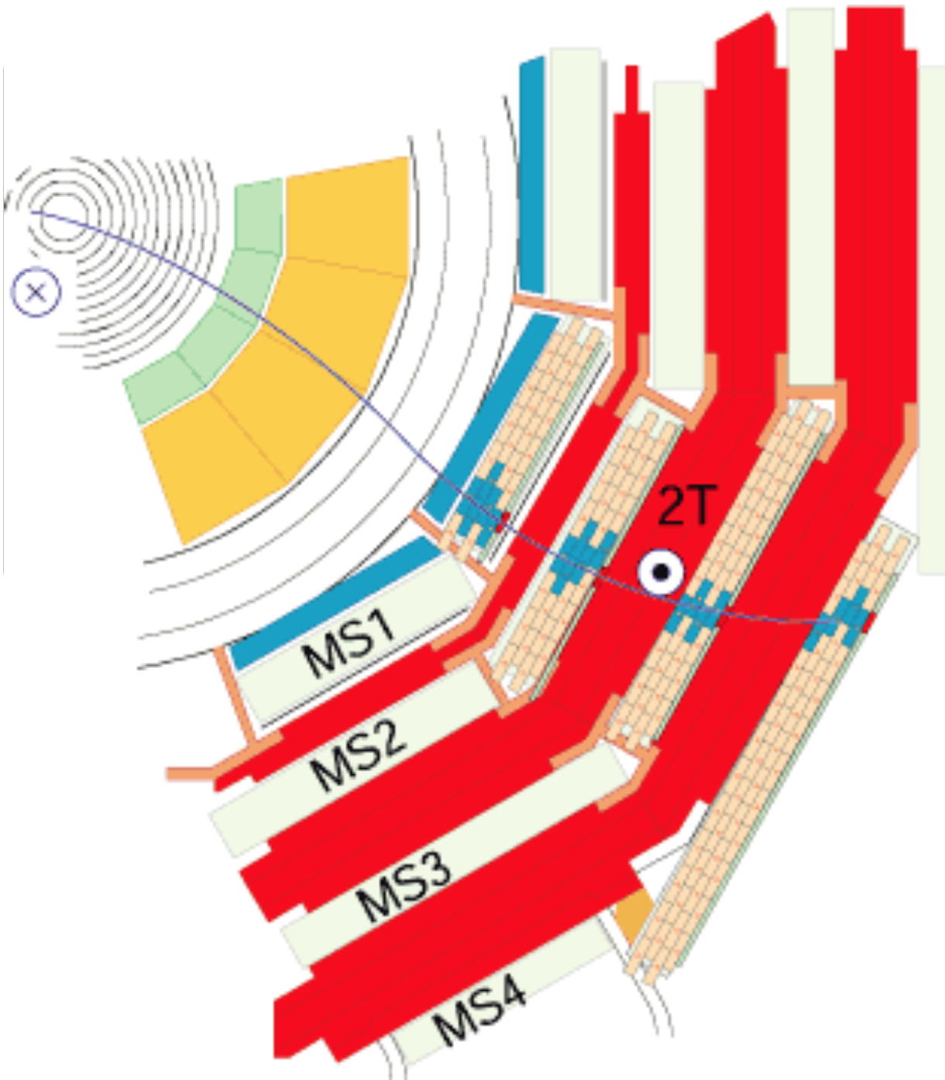
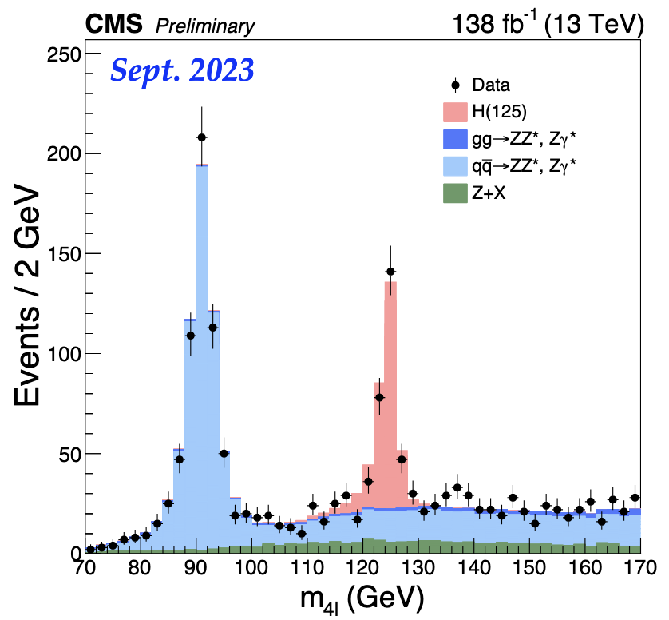

Muons for discovery @ Colliders
Muons are the most penetrating particle, thus most “visible”
at the LHC: W± , Z, top …
CMS: “Compact Muon Solenoid”
(2013)
The Higgs boson discovery:

Slide 10
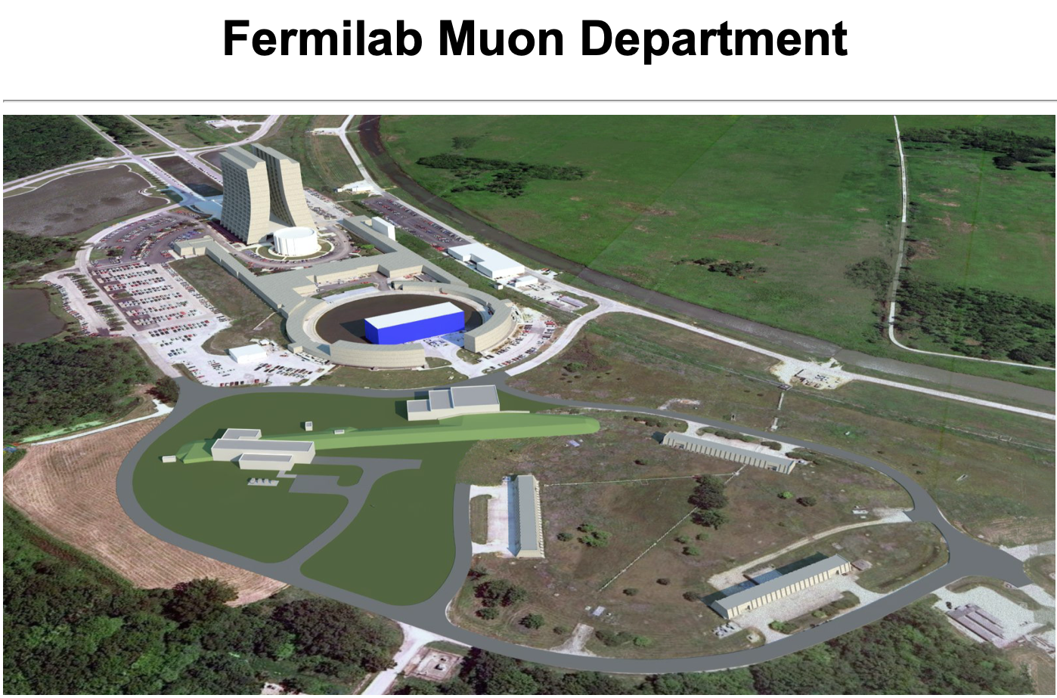

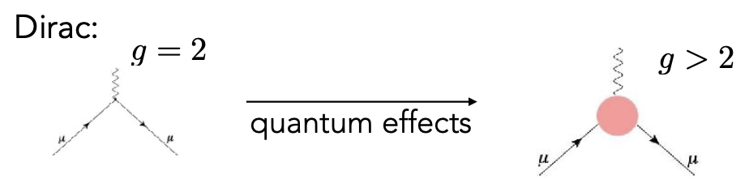
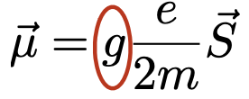
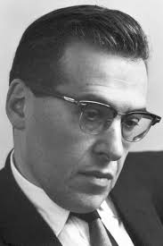
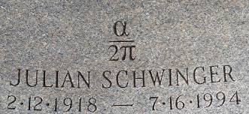
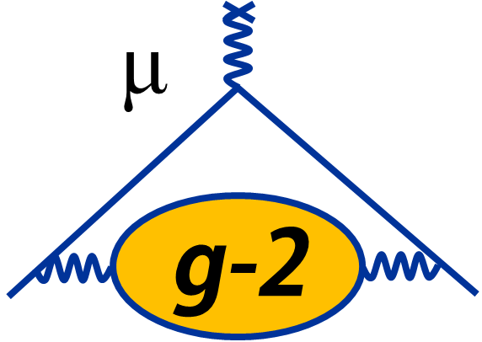
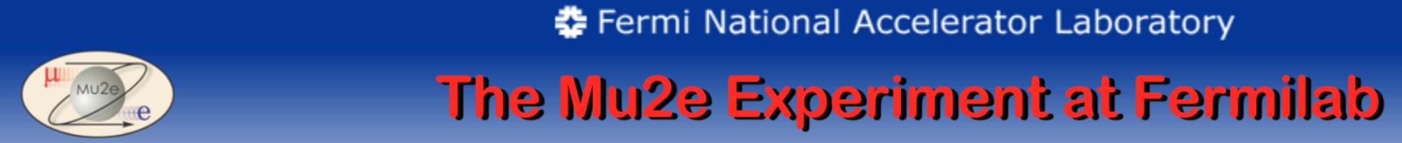
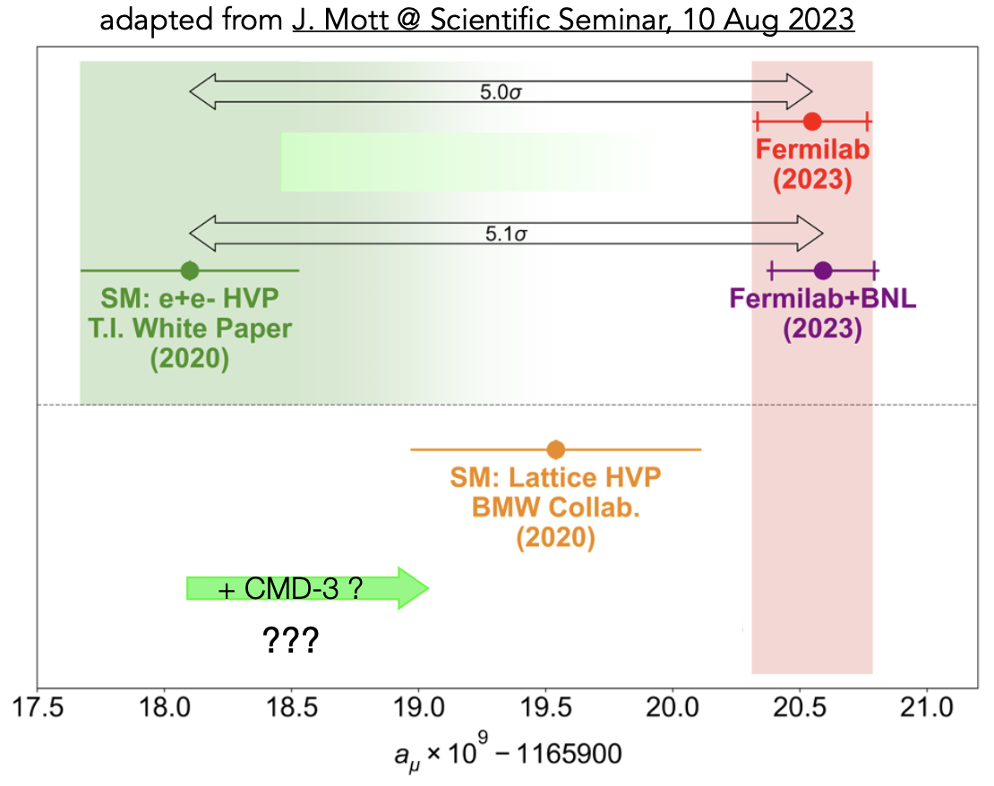
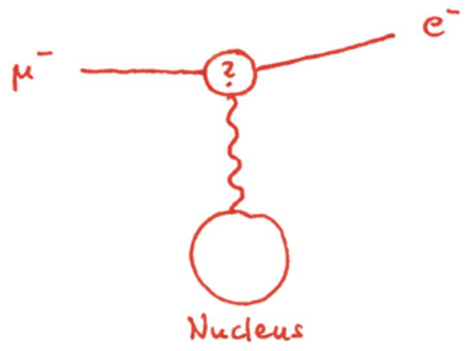
Continuing Explorations
FNAL: “the muon campus”
The muon anomalous magnetic moment
sensitive to new physics:
(m_{𝜇}/m_{e})²~42,000
Current bound:
B(𝛍→e𝛄)< 4x10⁻¹³
~ (m_{N}/M_{W})⁴
10¹⁷ 𝛍’s data sample to come!
Also: COMET @ J-PARC;
AICap @ PSI

Slide 11
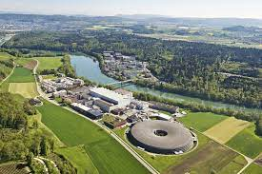
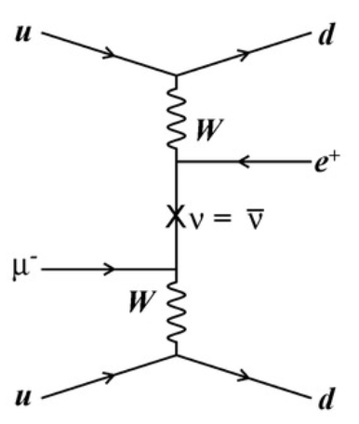

Paul Sherrer Institute (PSI),
Laboratory for Particle Physics
AICap: 𝛍-e conversion
FAST: muon lifetime
Lambshift in muonic hydrogen
MEG: 𝛍 → e𝛄 @ 10⁻¹⁴ level
𝛍3e: flavor violating decay
𝛍-Mass: muonium transition
MUSE: 𝛍-proton scattering
PIONEER: pion decays
muon physics leader
in Switzerland
Of particular interest, 𝜟L=2 transition:
test neutrino Majorana nature

Slide 12

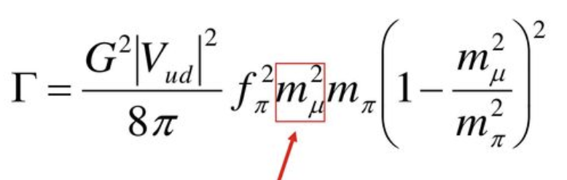
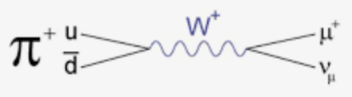
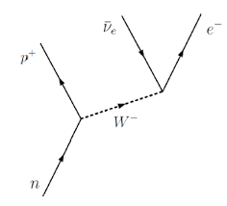
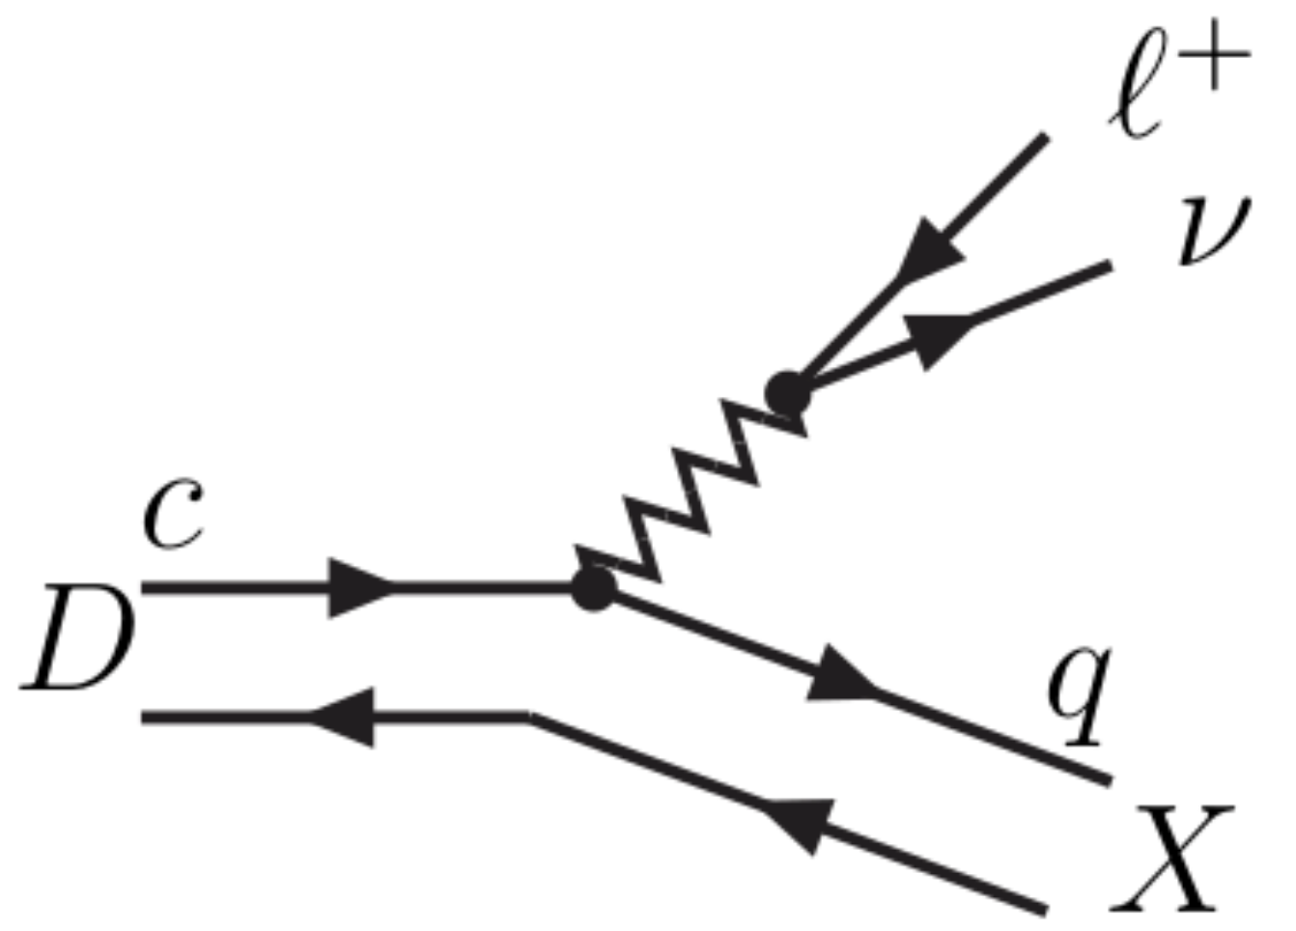
Lepton Flavor non-universality
Meson’s 2-body decays scale with m_{l}²
Meson’s 3-body decays, like the 𝛃–decay,
are flavor-universal in the SM:
→ Universality in K,D,B meson decays has been a sensitive test to the SM, and possible new physics BSM.
For reference on flavor anomalies, e.g., e-Print: 1704.05435

Slide 13
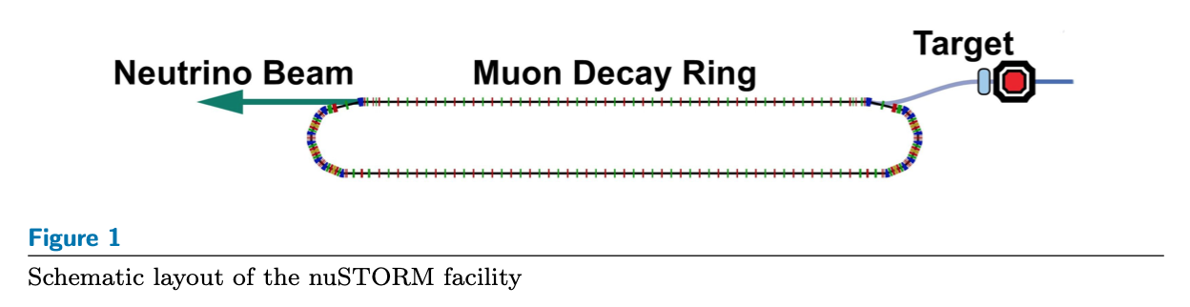
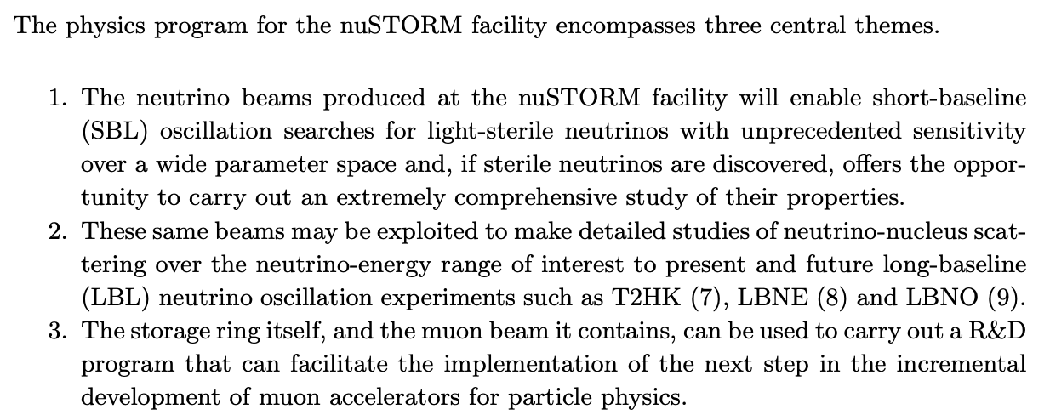
Nu-Storm @ FNAL / PIP-II

Slide 14
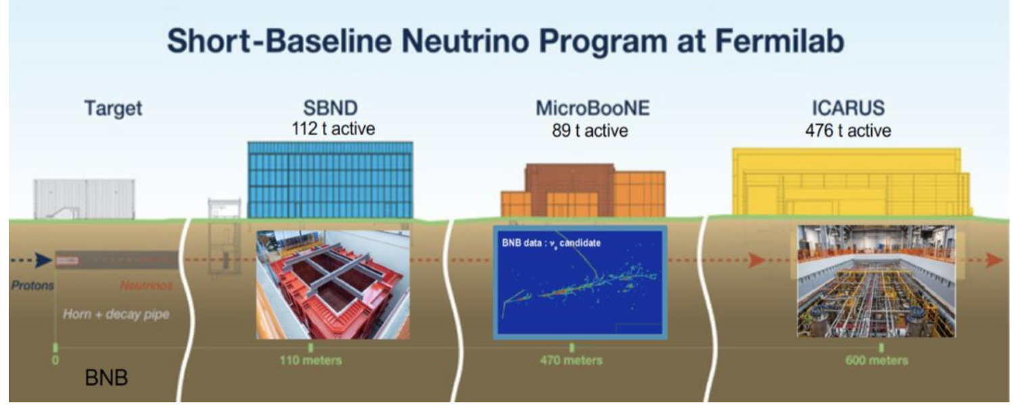
SBNE: Short-Baseline Neutrino Experiments
Pioneer the Liquid Argon TPC technology
Resolve LSND / MiniBooNE anomalies
Search for (light) new physics

Slide 15
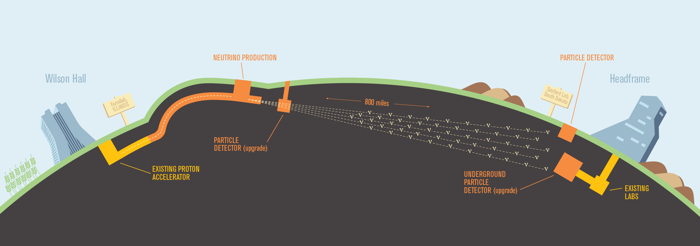
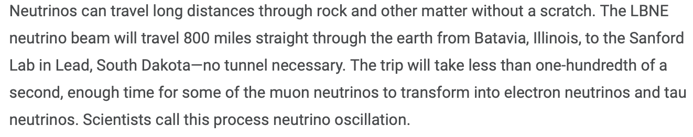
LBNE: Long-Baseline Neutrino Experiments
DUNE: Deep Underground Neutrino Experiment,
the “ultimate” neutrino experiment
DUNE will pursue major science goals:
Leptonic CP violation, precision measurements of 𝜃₁₃, 𝜟m²₁₃
Dark matter searches
Proton decay
Supernova, formation of neutron star/black holes

Slide 16
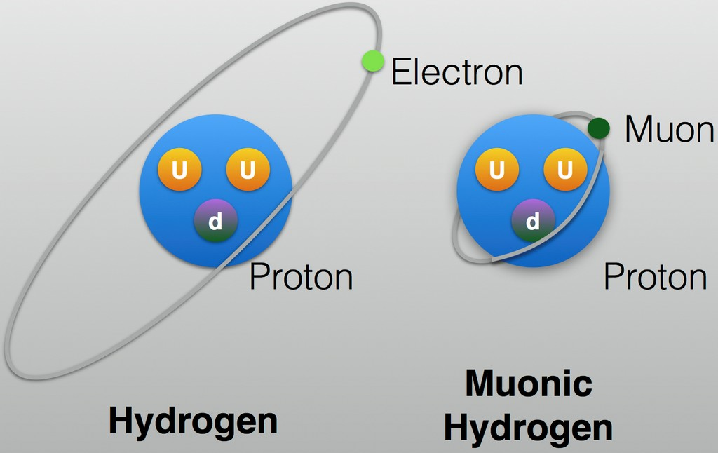
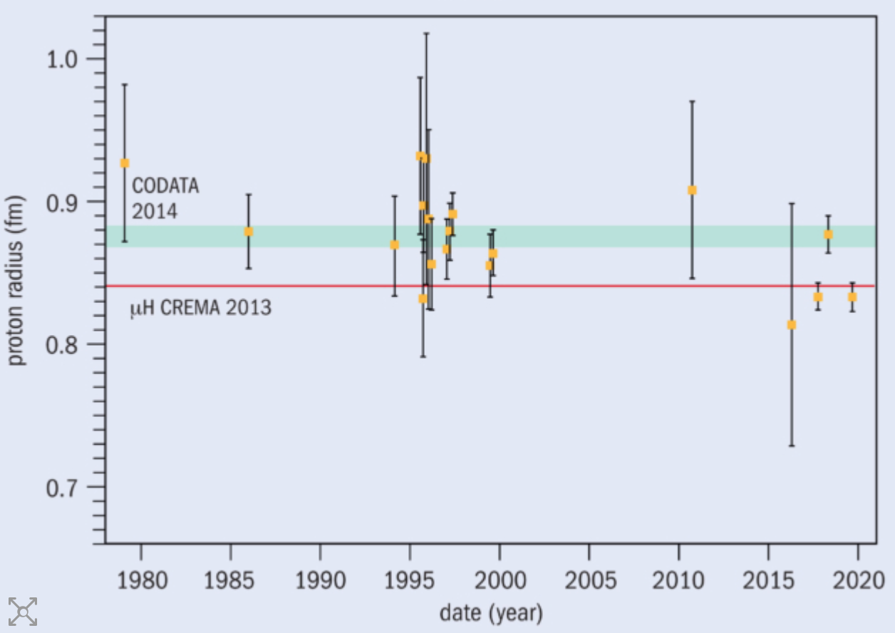
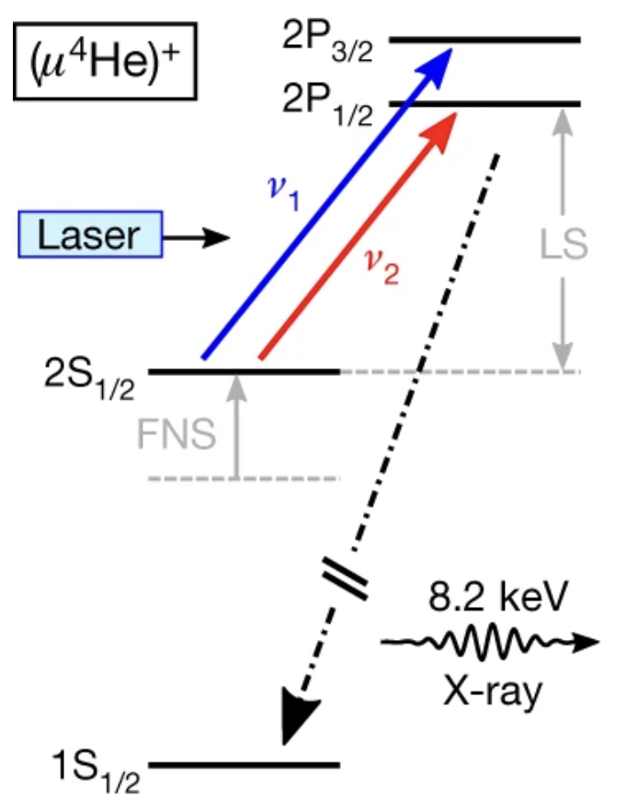

MUONS BEYOND HEP
Muonic atom for precision physics
Nature 09250: July 8, 2010
r_{B} = (𝛼 m)⁻¹: r_{B}(𝛍⁻)=r_{B}(e⁻)/207=2.2x10⁻⁵ nm
Wavefunction overlap: (m_{𝛍}/m_{e})³~10⁷ stronger
Lamb shift: 10⁵ larger
Very sensitive to probe
the proton size/properties: PSI, CREMA
Best precision for the helium nucleus size:
PSI: Nature 589, 527(2012)

Slide 17
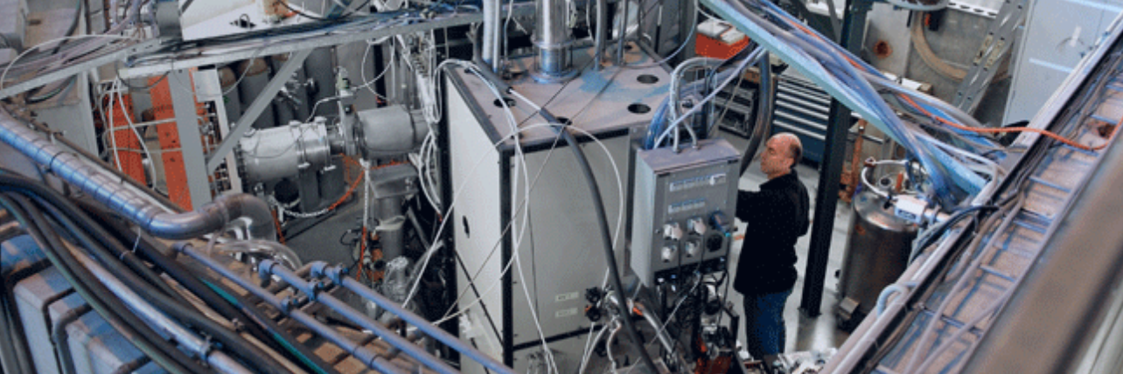
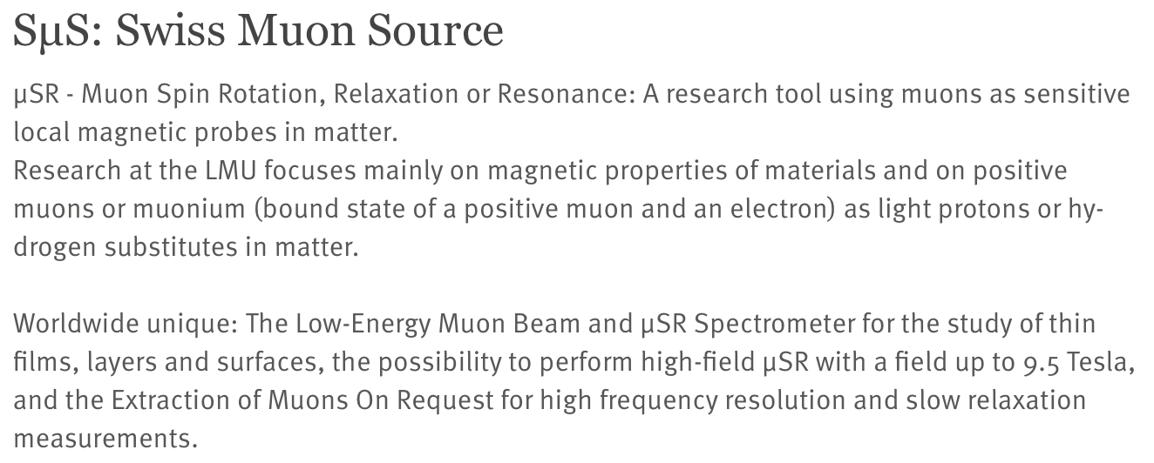
Muons for material science: PSI

Slide 18

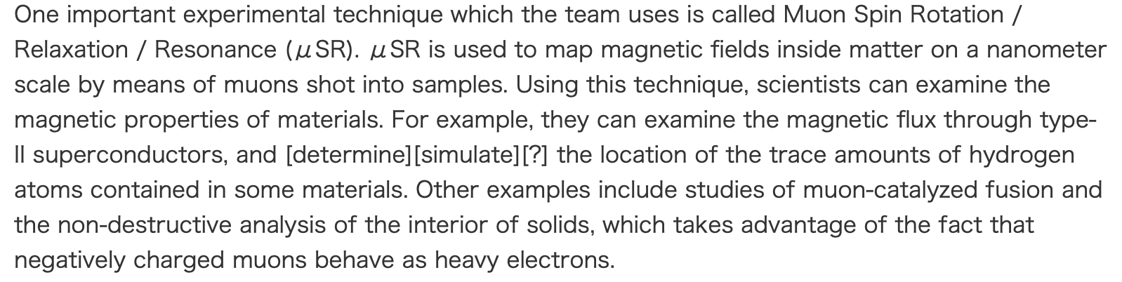
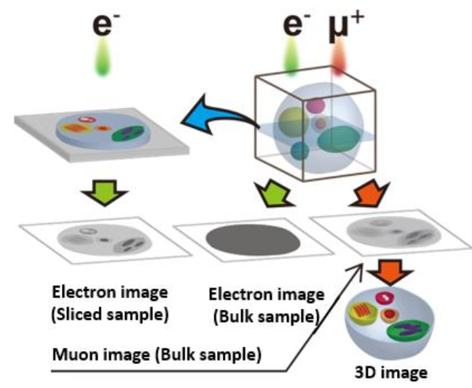
Muons for material science: KEK
KEK, Japan:
Transmission Muon Microscope
TMM @ KEK
Advantages of TMM
versus an electron microscope

Slide 19

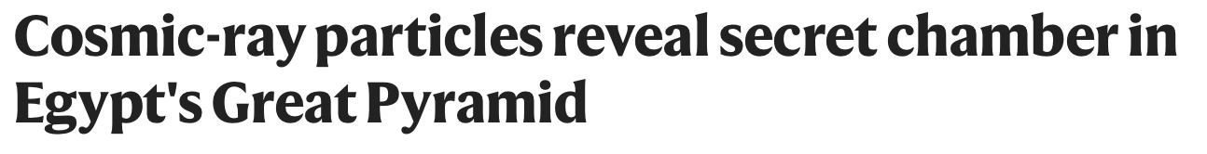
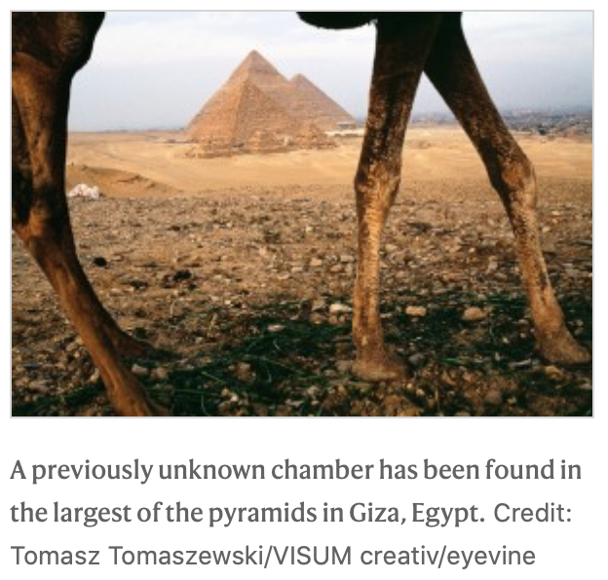
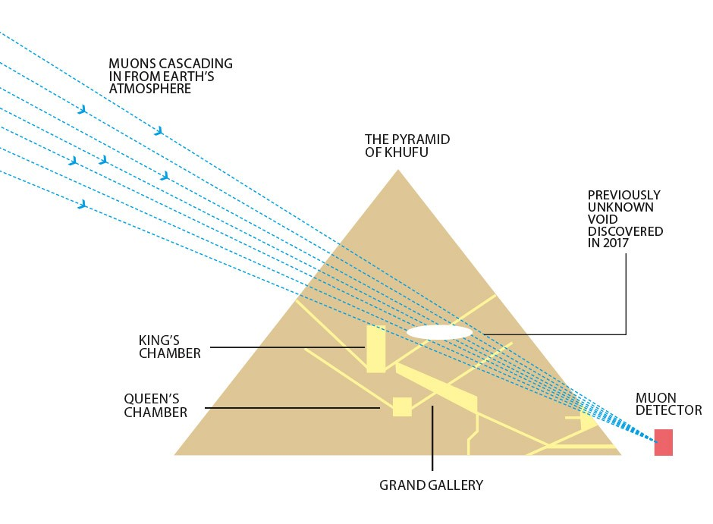
Muon Tomography: Cosmic muons
Atmospheric muon flux ~ 200/m²/s
Muons are penetrating!
(November 2, 2017, and update Jan. 2023)

Slide 20
A Muon Collider
Who Ordered That Collider?

Slide 21

Advantages of a muon collider
Much less synchrotron radiation energy loss than e’s:
which would allow a smaller and a circular machine:
Unlike the proton as a composite particle,
E_{CM} efficient in 𝛍⁺𝛍⁻ annihilation
Much smaller beam-energy spread:
𝚫E/E ~ 0.01% - 0.001%

Slide 22
Disadvantages of a muon collider
Production: Protons on target → pions → muons:
Require sophisticated scheme for 𝛍 capture & transport
“Never play with an unstable thing!”
Very short lifetime: in micro-second,
Muons cooling in (x,p) 6-dimensions
→ Difficult to make quality beams and a high luminosity
[Note: E_{𝛍} ~ 1 TeV → 𝛾 ~ 10⁴ → 𝛾𝜏 = 0.02 s → d=6,000 km]
Beam Induced Backgrounds (BIB)
from the decays in the ring at the interacting point,
[Note: 𝛔_{pp}(total)~100 mb; 𝛔_{𝛍 𝛍} (total)~100 nb]
Neutrino beam dump (environmental hazard)
𝛔_{𝛎} ~ G_{F}² E² → Shielding?

Slide 23
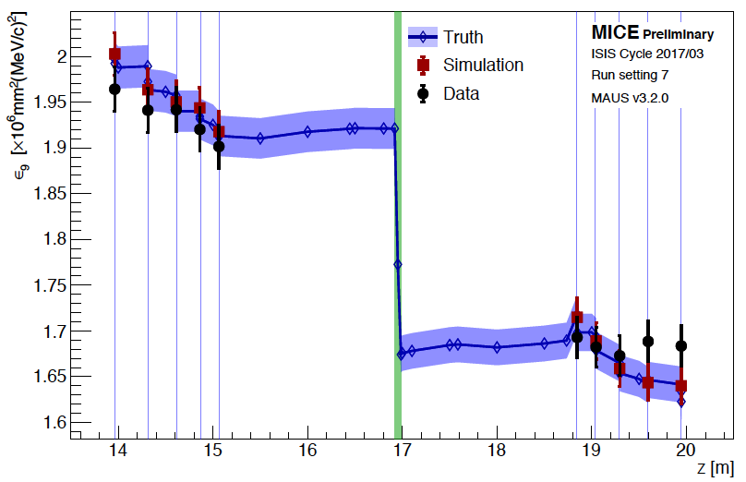





The recent excitement: the “Muon Shot”
Muon Accelerator Project (MAP)
https://arxiv.org/abs/1907.08562, J.P. Delahauge et al., arXiv:1901.06150/
U.S. P5 (Particle Physics Project Prioritization Panel)
The path to 10 TeV pCM (partonic c.m. energy):

Slide 24
Collider benchmark points:
The Higgs factory:
E_{cm} =m_{H}
L ~ 1 fb⁻¹/yr
𝜟E_{cm} ~ 5 MeV
Multi-TeV colliders:
Lumi-scaling scheme: 𝛔 L ~ const.
1 ab⁻¹ /yr
The conceivable choices:
Ecm = 3 TeV - 14 TeV
European Strategy, arXiv:1910.11775; arXiv:1901.06150; arXiv:2007.15684.

Slide 25


Ideal, conceivable case:
(Δ = 5 MeV, Γ_{h} ≈ 4.2 MeV)
An optimal fitting would reveal Γ_{h} → O(3.5% )

Slide 26
A Multi-TeV Muon Collider
Exciting energy-frontier!
Photon-induced QED cross sections
large rates
m_{jj}
Quarks/gluons come into the picture via SM DGLAP:
: the valance.
: LO sea.
Quarks: NLO; gluons: NNLO.
TH, Yang Ma, Keping Xie,
arXiv:2007.14300

Slide 27
“Semi-inclusive” processes
Just like in hadronic collisions:
𝞵⁺𝞵⁻ → exclusive particles + remnants
VBF
𝞵⁺𝞵⁻
annihilations
Costantini, F. Maltoni, et al., arXiv:2005.10289; Y. Ma et al., arXiv:2007.14300

Slide 28
Underlying sub-processes:
VBF
𝞵⁺𝞵⁻anni
𝞵⁺𝞵⁻anni
Partonic contributions
𝞵⁺𝞵⁻ Collider --
“Buy one, get one free”:
Annihilation +VBF
VBF

Slide 29

Precision Higgs physics
10M H, 500K HH @ 10 TeV
Muon Collider Forum Report: https://arxiv.org/abs/2209.01318
≈ sub % → M > 2 TeV

Slide 30

Higgs pair production & triple coupling:
dictate EW phase transition & impact
on early universe cosmology!
D. Buttazzo, D. Redogolo, F. Sala, arXiv:1807.04743;
TH, D. Liu, I. Low, X. Wang, arXiv:2008.12204

Slide 31




Pushing the “Naturalness” limit
The searches for top quark partners
(most wanted in “naturalness”);
& gluinos, gauginos …
E=30
14
10 TeV
gauginos
→ Higgs mass fine-tune: δm_{H}/m_{H} ~ 1% (1 TeV/Λ)²
Thus, m_{stop} > 8 TeV → 10⁻⁴ fine-tune!

Slide 32
WIMP Dark Matter
(a conservative SUSY scenario)
Consider the “minimal EW dark matter”: an EW multi-plet
The lightest neutral component as DM
Interactions well defined → pure gauge
Mass upper limit predicted → thermal relic abundance
Cirelli, Fornengo and Strumia:
hep-ph/0512090, 0903.3381;
TH, Z. Liu, L.T. Wang, X. Wang:
arXiv:2009.11287

Slide 33



WIMP Dark Matter
Covering the thermal target
TH, Z. Liu, L.T. Wang, X. Wang: arXiv:2009.11287; arXiv:2203.07351

Slide 34





Summary: “Who ordered That?”
The muon is such a pleasant surprise Nature offers us!
Leads to many discoveries
Provides deeper understanding of Nature
Continues to play a key role in going forward
Far reaching scope:
all involves with
muon physics →
, Higgs factory
, Muon collider
Muon physics has taken many spot-lights
in contemporary HEP!
Look forward to more surprises with muons!

