Slide 1
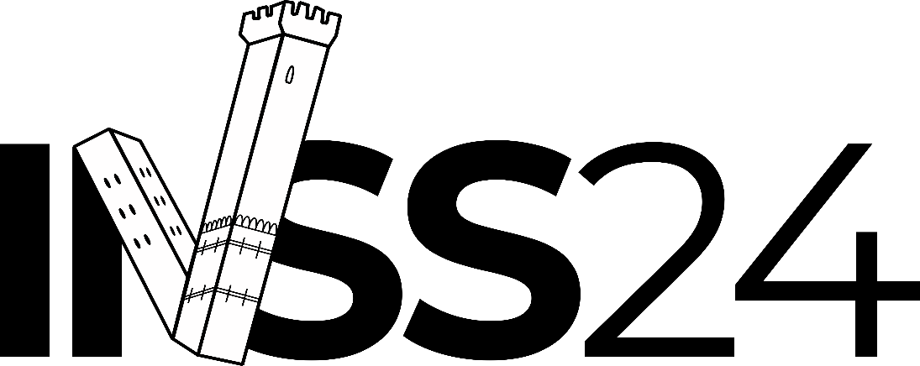
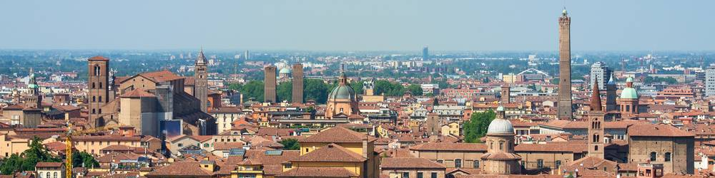


Neutrinos in multimessanger astronomy solution for exercises
15th International Neutrino Summer School 2024
Maurizio Spurio, maurizio.spurio@unibo.it
Università di Bologna and INFN

Slide 2
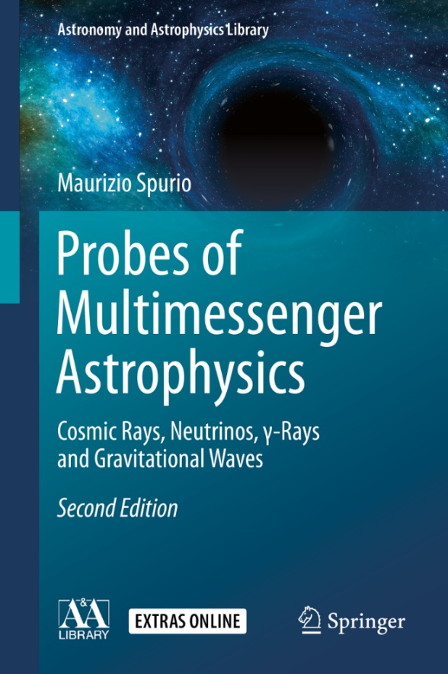
Didactic material
Index of contents
An Overview of Multimessenger Astrophysics
Charged Cosmic Rays in Our Galaxy
Direct Cosmic Ray Detection
Indirect Cosmic Ray Detection
Diffusion of Cosmic Rays in the Galaxy
Galactic Accelerators and Acceleration Mechanisms
The Extragalactic Sources and UHECRs
The Sky Seen in γ-rays
The TeV Sky and Multiwavelength Astrophysics
High-Energy Neutrino Astrophysics
Atmospheric Muons and Neutrinos
Low-Energy Neutrino Physics and Astrophysics
Basics on the Observations of Gravitational Waves
Microcosm and Macrocosm
https://www.dropbox.com/s/31mhpdxrgc2qse0/astroparticle-IIedc.pdf?dl=0 (my preprint version)

Slide 3
Answers to exercises and discussion arguments

Slide 4
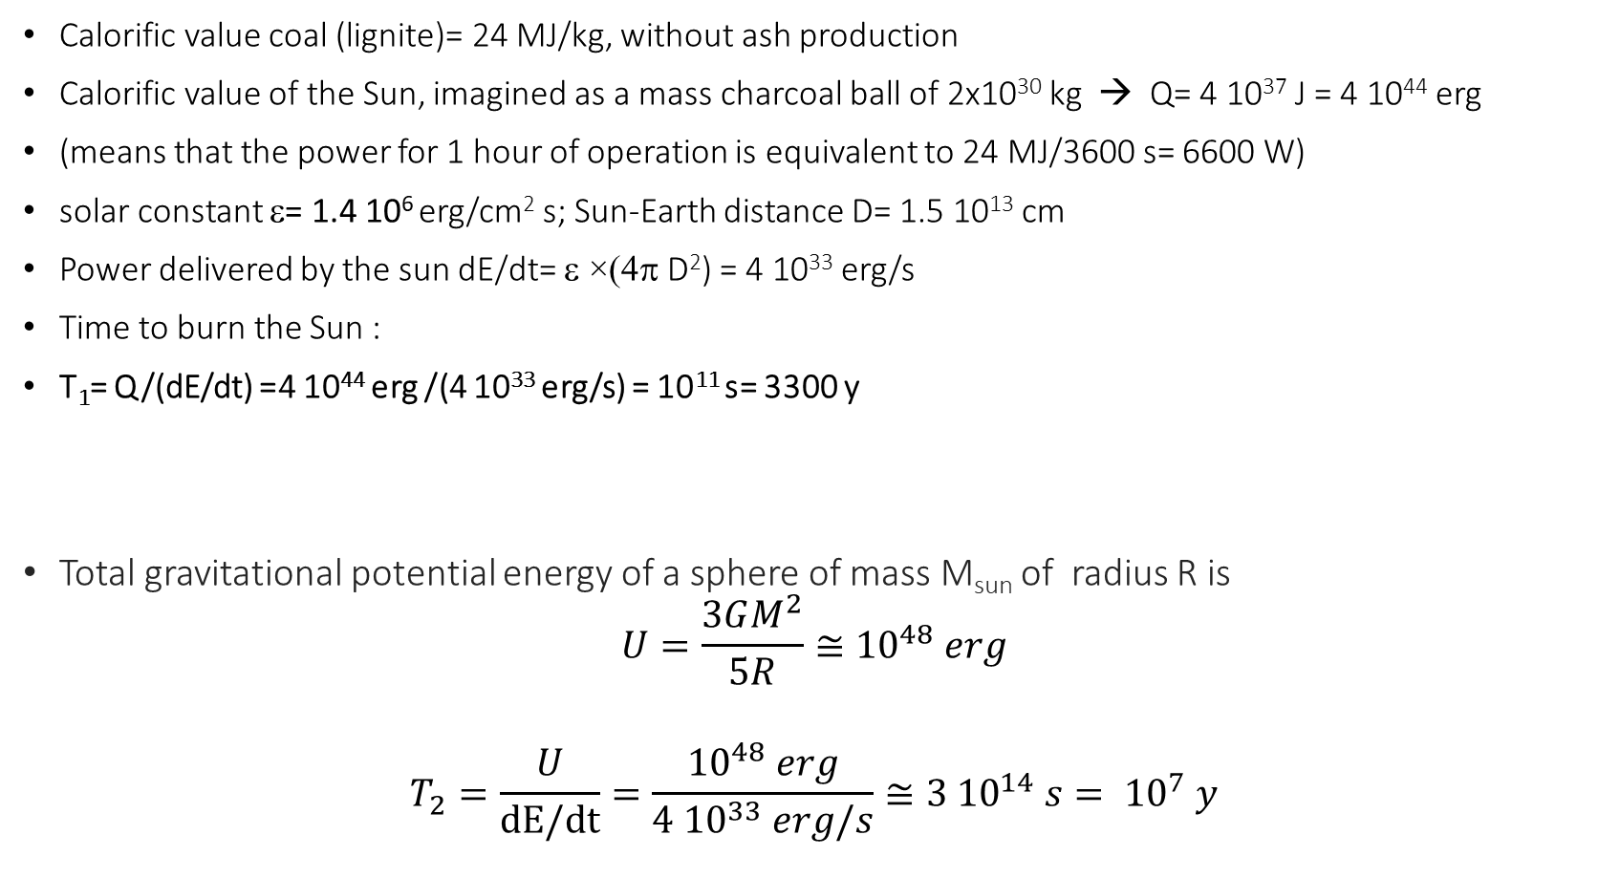
Ex 1: The Sun age in EM burning
Calorific value coal (lignite)= 24 MJ/kg, without ash production
Calorific value of the Sun, imagined as a mass charcoal ball of 2x10³⁰ kg → Q= 4 10³⁷ J = 4 10⁴⁴ erg
(means that the power for 1 hour of operation is equivalent to 24 MJ/3600 s= 6600 W)
solar constant ε= 1.4 10⁶ erg/cm² s; Sun-Earth distance D= 1.5 10¹³ cm
Power delivered by the sun dE/dt= ε ×(4π D²) = 4 10³³ erg/s
Time to burn the Sun :
T₁= Q/(dE/dt) =4 10⁴⁴ erg /(4 10³³ erg/s) = 10¹¹ s= 3300 y
Total gravitational potential energy of a sphere of mass M_{sun} of radius R is
$$U=\frac{3GM^{2}}{5R}≅{10}^{48} erg$$
$$T_{2}=\frac{U}{\text{dE}\text{/}\text{dt}}=\frac{{10}^{48} erg}{{4 10}^{33} erg/s}≅{3 10}^{14} s= {10}^{7} y$$
Ex 2: The Lord Kelvin Sun age extimation

Slide 5
Ex 3: The Sun age in nuclear fusion
Nuclear size is 10⁻⁶ the dimension of atoms
Colombian repulsion energy between protons must be 10⁶ higher than atomic binding energy
Nuclear binding energy 10⁶ higher than atomic binding energy
The Sun age must be 10⁶ higher than foreseen in exercise 1, i.e. order of few 10⁹ y

Slide 6
Exercize 4: The SN1987A: how many events?
1- Energy released 2.5 10⁵³ erg
2- Average ‾ν_{e} energy ≈ 16 MeV = 2.5 10⁻⁵ erg
3- N_{source}= (1/6) × 2.5 10⁵³/ (2.5 10⁻⁵)= 1.7 10⁵⁷ ‾ν_{e}
4- LMC Distance : D=52 kpc = 1.6 10²³ cm
5- Fluency at Earth: F = N_{Source}/4pD² = 0.5 10¹⁰ cm⁻²
6- Targets in 1 Kt water: N_{t} = 0.7 10³² protons
7- cross section: σ(‾ν_{e}+p) ~ 2x10⁻⁴¹ cm²
8- Ne+ = F (cm⁻²)× σ (cm²)× N_{t} (kt⁻¹)= 0.5 10¹⁰ × 2x10⁻⁴¹× 0.7 10³²
= 7 positrons/kt
9 – M(Kam II) = 2.1 kt, efficiency ε~ 80%
10 – Events in Kam II = 7 x 2.1 x e ~ 12 events
For a SN @ Galactic Center (8.5 kpc) :
N _{events}= 7x(52/8.5)² = 260 e⁺/kt
Exercize 5:
IMB had smaller PMTs that Kamiokende, less covered area, thus an higher energy threshold (20 MeV) and a much smaller detection efficiency

Slide 7
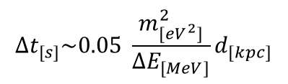
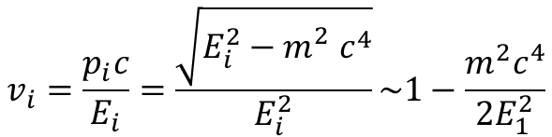

Ex 6: Neutrino mass limit from SN
The observation of SN ν’s brings a better understanding of the core collapse mechanism from the feature of the time and energy spectra;
Moreover, an estimation of the neutrino masses could be done in the following manner. The velocity of a particle of energy E and mass m, with E >> m, is given by (with c = 1):
$$v_{i}=\frac{p_{i}c}{E_{i}}=\frac{\sqrt{E_{i}^{2}−m_{}^{2}c^{4}}}{E_{i}^{2}}\sim 1−\frac{m^{2}c^{4}}{2E_{1}^{2}}$$
Thus, for a SN at distance d, the delay of a ν from the highest/lowest energy neutrino, ΔE, due to its mass is (in proper units)
$$∆t_{[s]}\sim 0.05 \frac{m_{[{eV}^{2}]}^{2}}{∆E_{[MeV]}}d_{[kpc]}$$
Therefore, neutrinos of different energies released at the same instant should show a spread in their arrival time. For SN1987A, assuming Kam data and Δt=13 s, ΔE=30 MeV and d=50 kpc, we get:
$$mc^{2}<12 eV$$

Slide 8
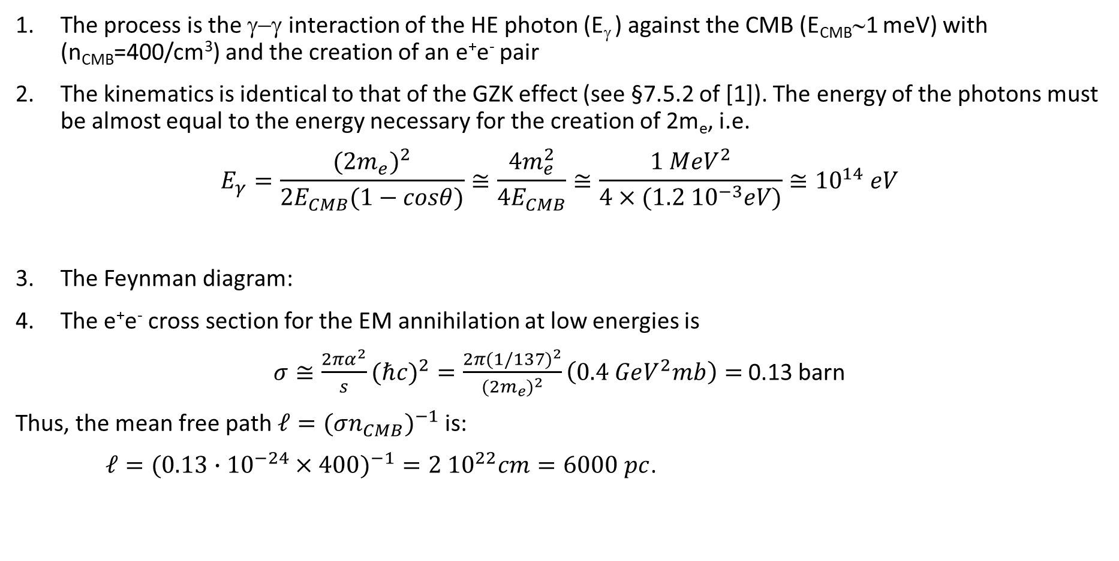
EX 8: Attenuation of 100 TeV gamma-rays
The process is the γ−γ interaction of the HE photon (E_{γ} ) against the CMB (E_{CMB}∼1 meV) with (n_{CMB}=400/cm³) and the creation of an e⁺e⁻ pair
The kinematics is identical to that of the GZK effect (see §7.5.2 of [1]). The energy of the photons must be almost equal to the energy necessary for the creation of 2m_{e}, i.e.
$$E_{γ}=\frac{(2m_{e})^{2}}{2E_{CMB}(1−cosθ)}≅\frac{{4m}_{e}^{2}}{{4E}_{CMB}}≅\frac{1 {MeV}^{2}}{{4×(1.2 10}^{−3}eV)}≅{10}^{14} eV$$
The Feynman diagram:
The e⁺e⁻ cross section for the EM annihilation at low energies is
$σ≅\frac{2πα^{2}}{s}(ℏc)^{2}=\frac{2π(1/137)^{2}}{(2m_{e})^{2}}\left(0.4 GeV^{2}mb\right)=$ 0.13 barn
Thus, the mean free path $ℓ=(σn_{CMB})^{−1}$is:
$ℓ=(0.13∙{10}^{−24}×400)^{−1}=2 {10}^{22}cm=6000 pc$.

Slide 9

Ex 9: Neutron decay
The Lorentz factor is $γ=\frac{E}{m}=\frac{{10}^{9}}{1}$ thus
$L=γcτ={10}^{9}×3 {10}^{10}×1000=3 {10}^{22}$cm
1 pc = 3 x 10¹⁸ cm, thus $L={10}^{4} pc$
O(10 kpc) is the typical radius of a spiral Galaxy

Slide 10
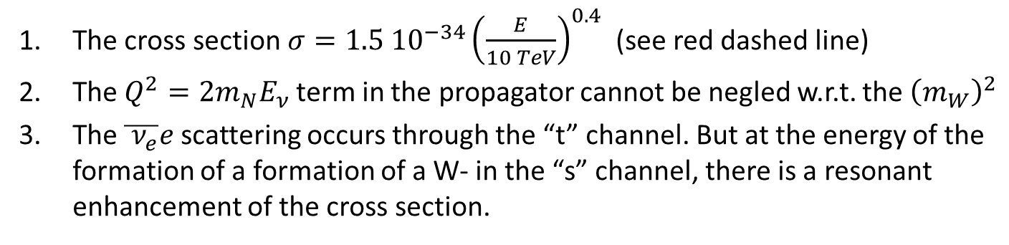
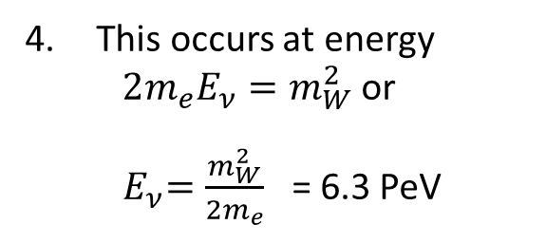
Ex 10: Neutrino cross section
The cross section $σ=1.5 {10}^{−34}{\left(\frac{E}{10 TeV}\right)}^{0.4}$ (see red dashed line)
The $Q^{2}=2m_{N}E_{ν}$ term in the propagator cannot be negled w.r.t. the ${\left(m_{W}\right)}^{2}$
The $\overline{{ ν}_{e}}e$ scattering occurs through the “t” channel. But at the energy of the formation of a formation of a W- in the “s” channel, there is a resonant enhancement of the cross section.
This occurs at energy $2m_{e}E_{ν}=m_{W}^{2}$ or
${ E}_{ν}={\frac{m_{W}^{2}}{2m_{e}}}_{}^{}$= 6.3 PeV

Slide 11
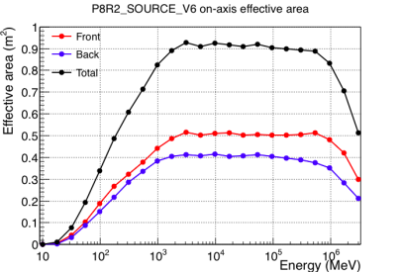
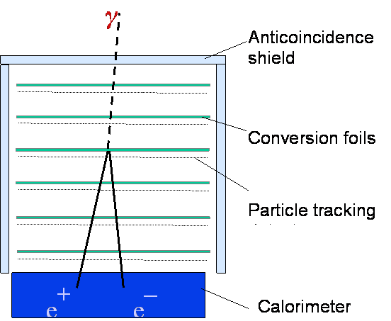
Comparision with LAT effective area
Fermi-LAT effective area vs. E for normal γ-ray incidence
Fermi-LAT = pair-conversion telescope
The A^{eff} is a fundamental quantity: The number of observed events is the integral over energy of the neutrino flux [cm² s GeV]⁻¹ with A^{eff} [cm²]
LAT: Almost 90% of incoming γ-rays are detected (=converted into observable particles), if the g-ray is within the correct energy range. Below, the tracks are too short to be observed; at higher energies, the containment of the calorimeter is insufficient.

Slide 12
Ex 12: How many sensors in a 1km³ NT
1) In the ANTARES/IC OMs
N_{γ}= L_{μ} ×300 Čγ/cm= 3x10⁷ Čγ
N_{pe}= (OMs× V_{OM} × N_{γ} × ε_{QE} )/1 km³
=100
10” PMT =0.05 m²
OMs=5000
This is the order of OMs buried in IceCube. ANTARES has 900 OMs
For KM3NeT the area of 31 PMTs of 3’’ is equivalent to that of 3PMTs of 10’’. Thus, 1/3 of OMs are needed
L_{ass}~60 m
V_{OM}= 3 m³

