Slide 1
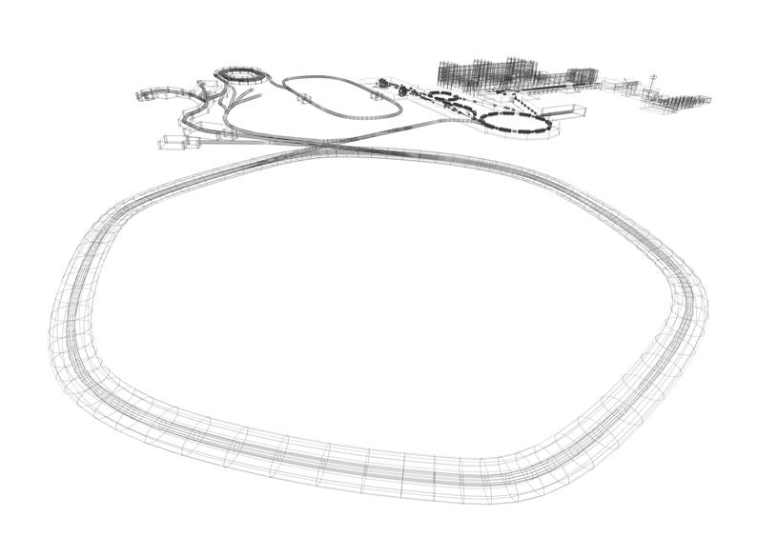
30.01.2024
GSI & FAIR
Marco Durante

Slide 2
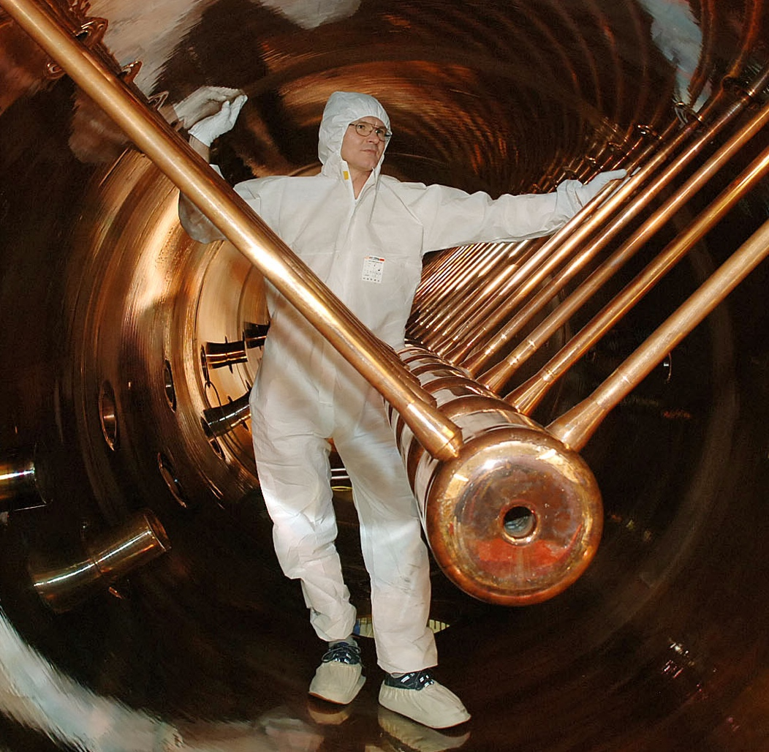
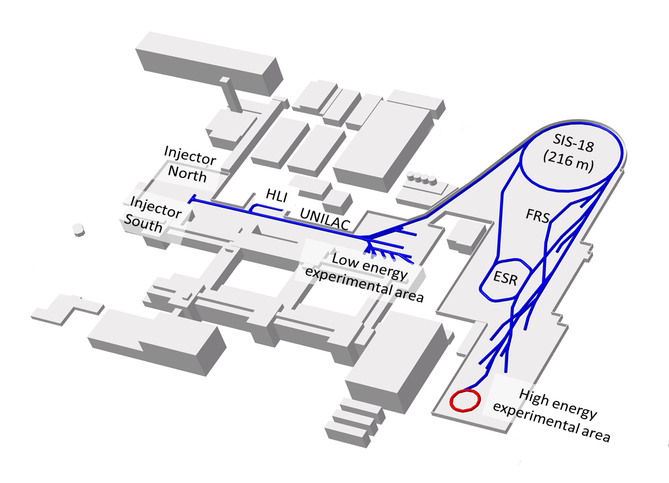
GSI Darmstadt – over 50 Years of Scientific and Technical Competence
Phelix
Laser
CRYRING
All ions from H to U including exotic beams
Energy up to 1 GeV/n for heavy ions (4.5 GeV protons)
Notes:
Beschriftung/Beschneiden des Beschleunirgebildes

Slide 3
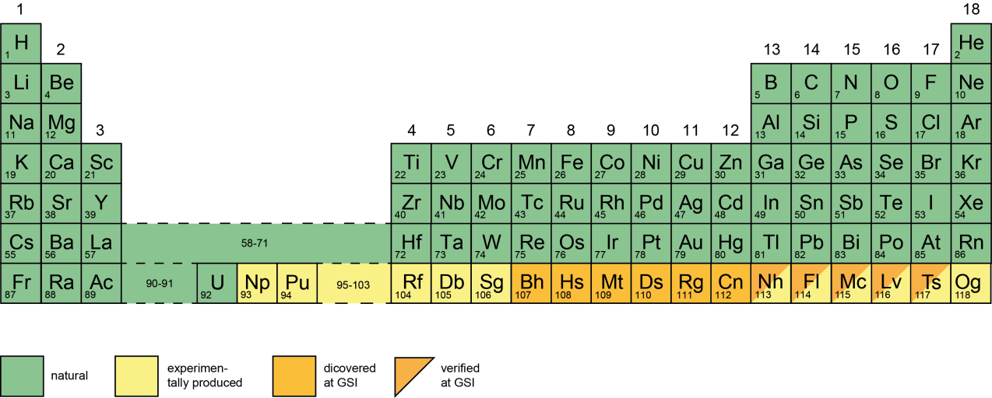
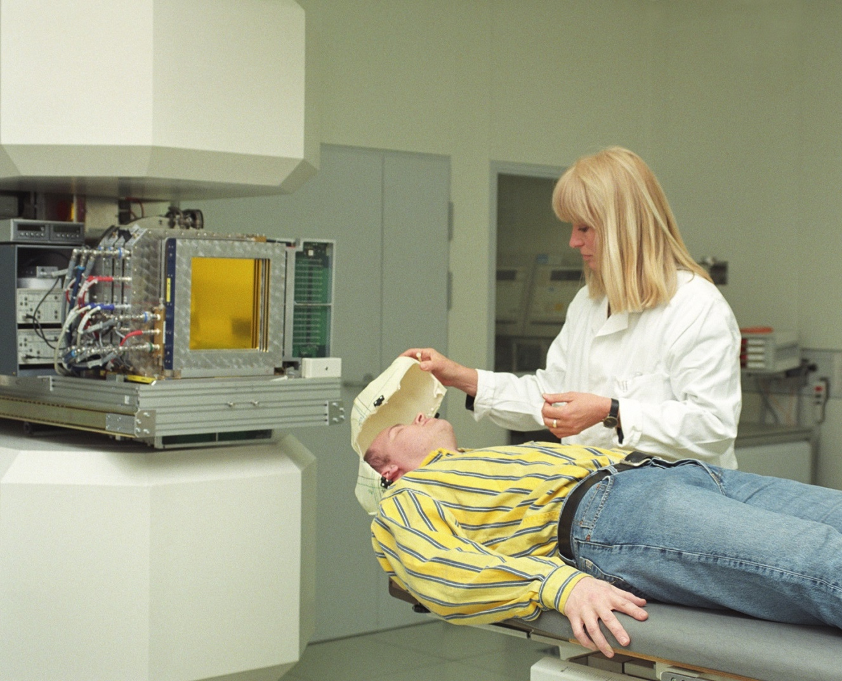
GSI Discoveries
New chemical elements
Hundreds of new isotopes
New decay modes
First center in Europe to treat cancer
patients (440) with C-ions (1997-2007)

Slide 4
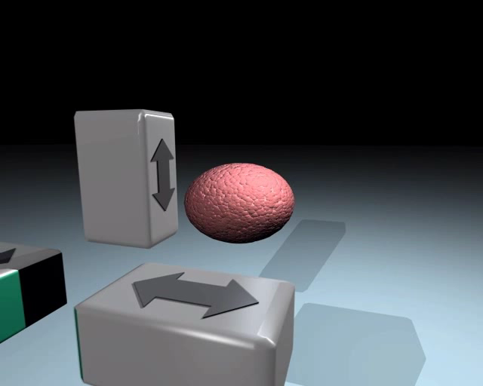

Slide 5
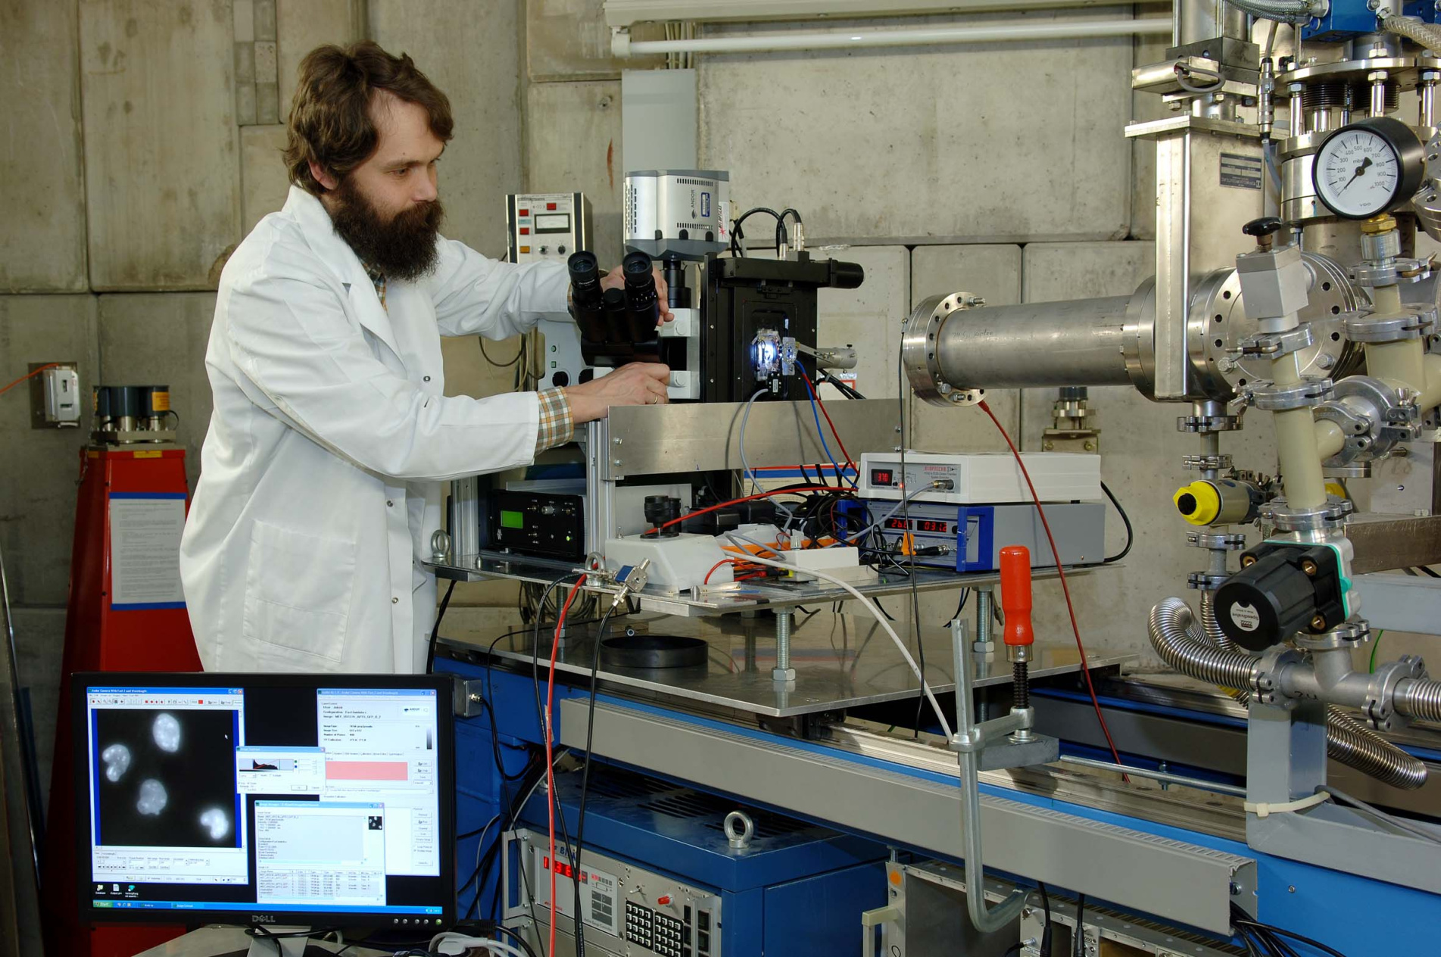
Beamline live microscopy @GSI

Slide 6
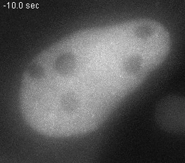
Jakob et al., Proc. Natl. Acad. Sci. USA 2009
Cosmic rays in a human cells
© GSI
Notes:
Animated gif

Slide 7
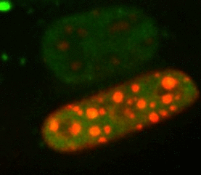
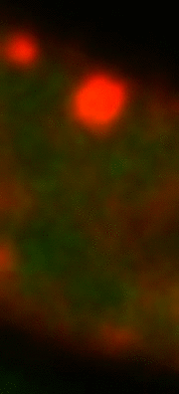
Jakob et al., Nucl. Acids Res. 2011

Slide 8
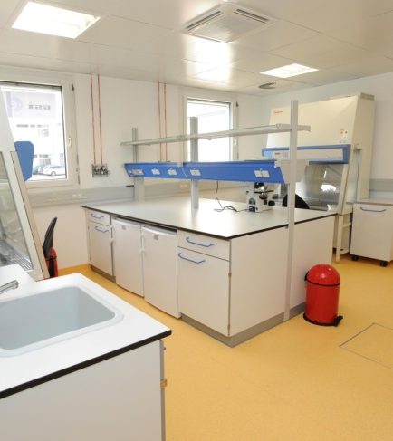
Infrastructures
Tissue culture laboratory
Animal facility (mice and rats)
Microscopy laboratory (confocal, digital holographic,…)
Complete dosimetry for ion beams
X-Strahl SARRP
μCT

Slide 9
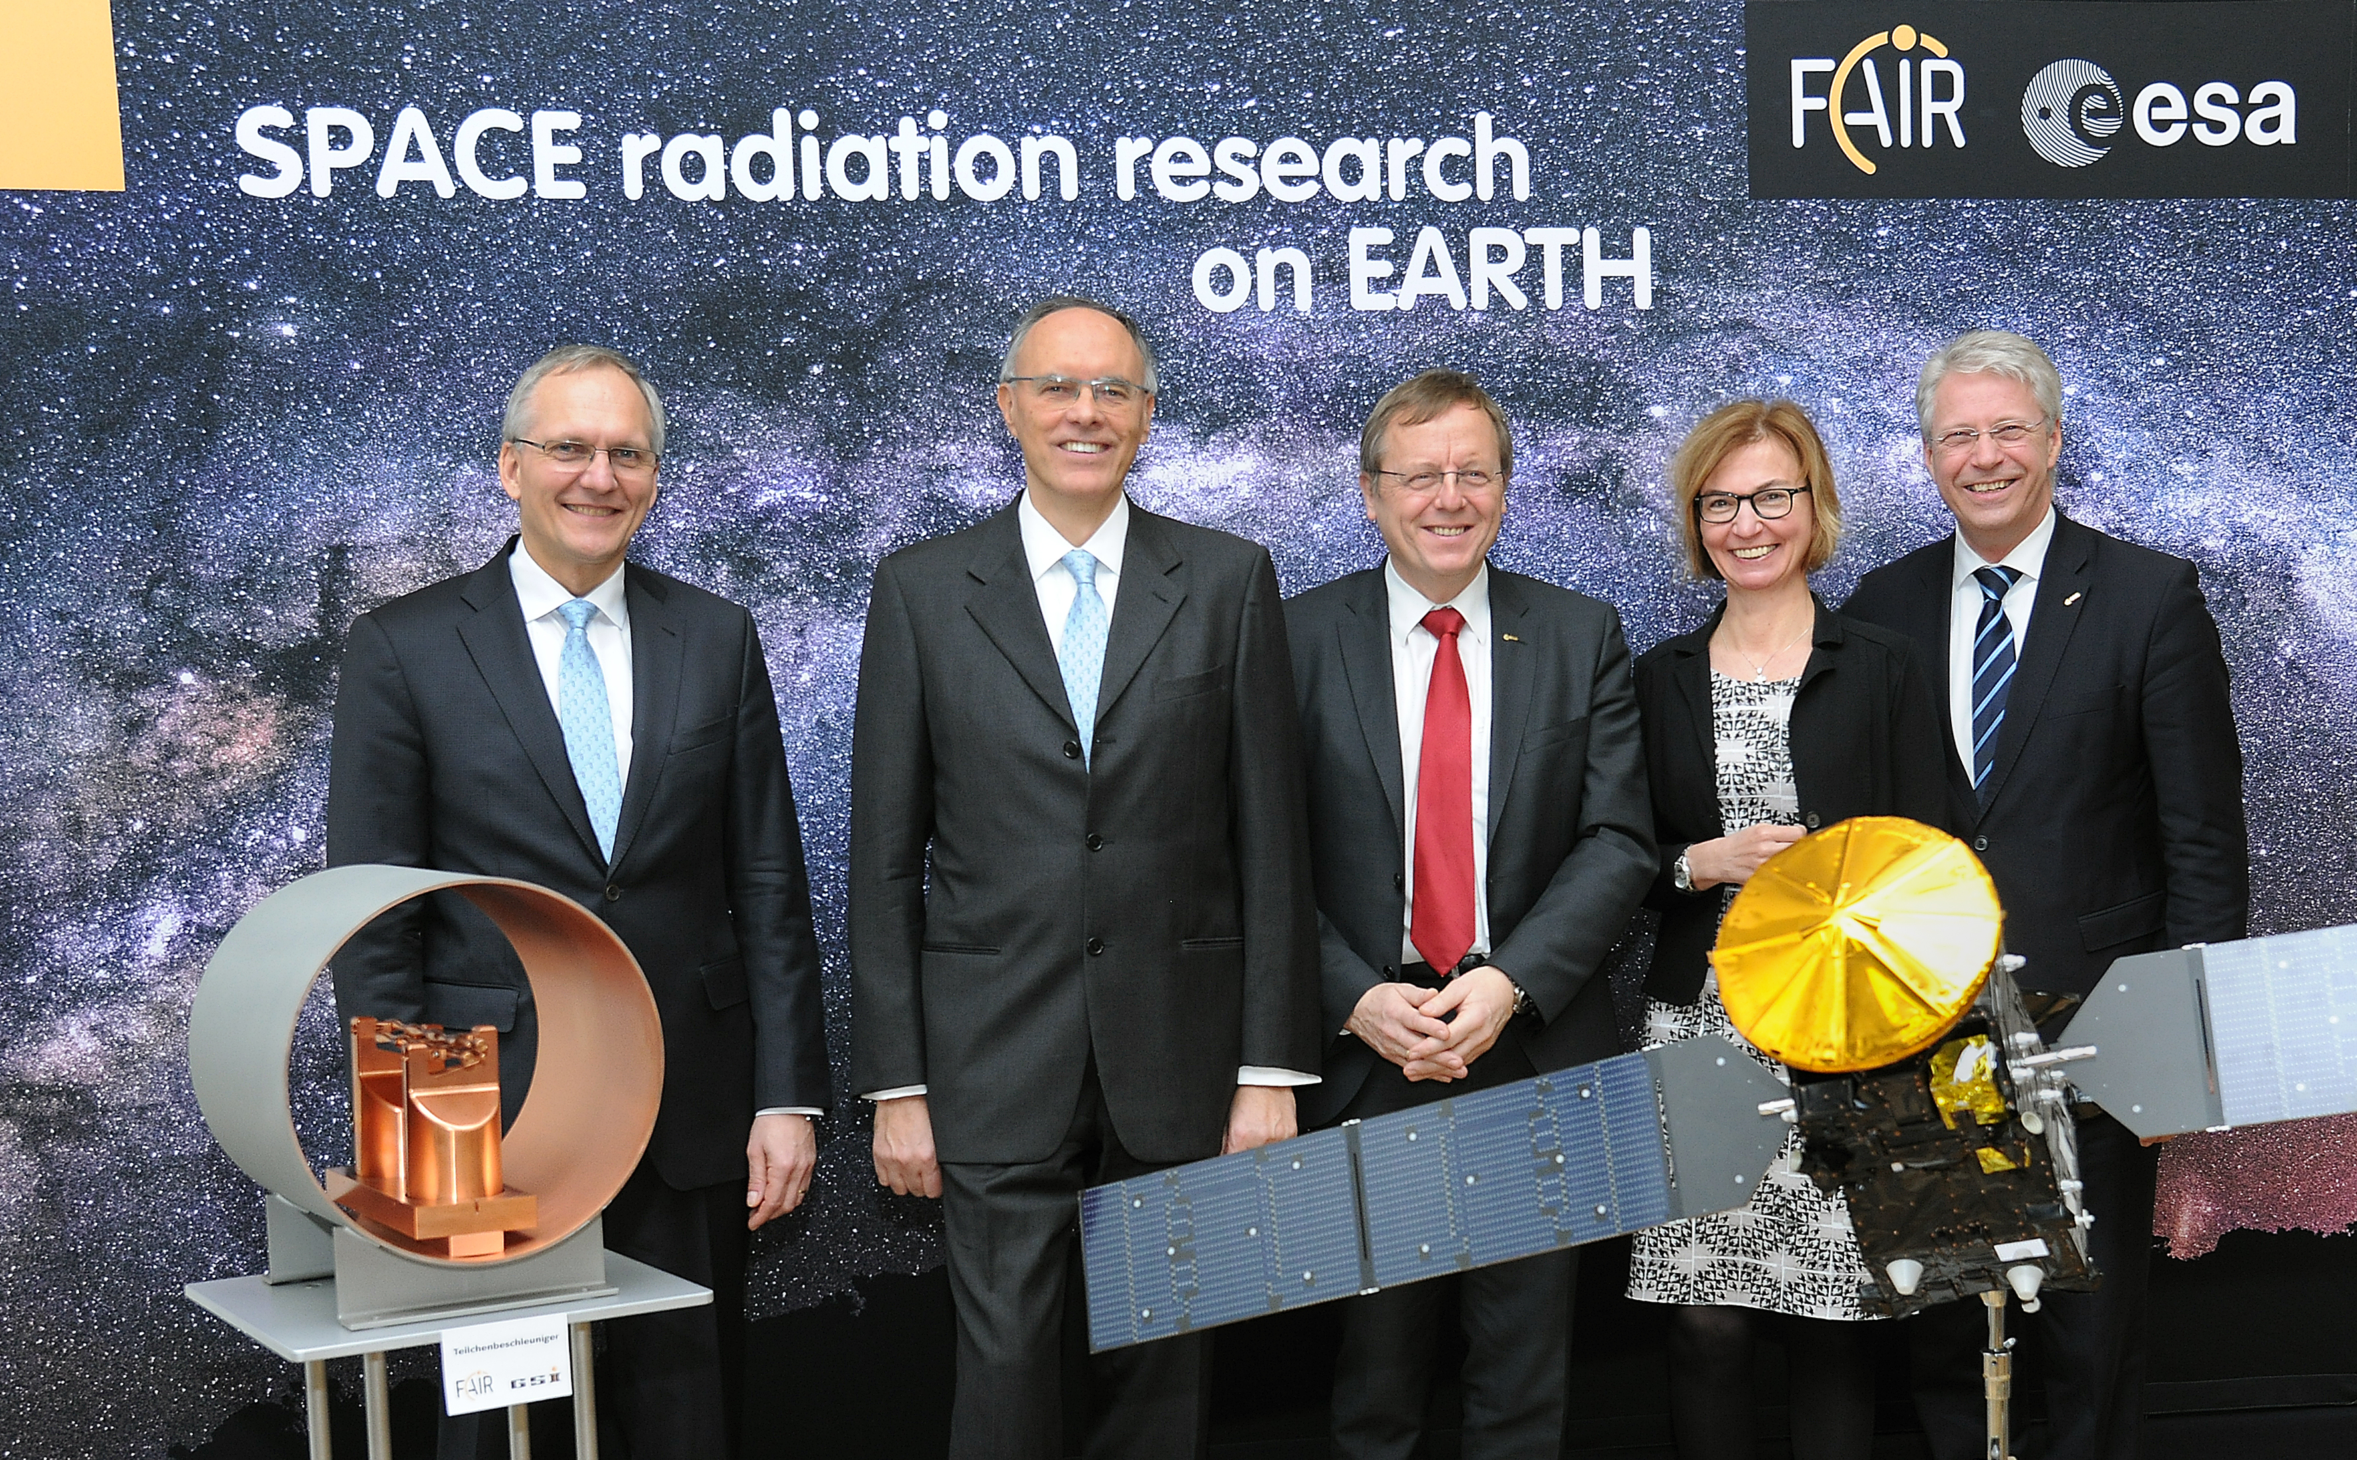

Simulation of cosmic radiation
Cooperation with European Space Agency ESA
For Mars missions:
  Protection of astronauts
  Development of components suited for space travel

Slide 10
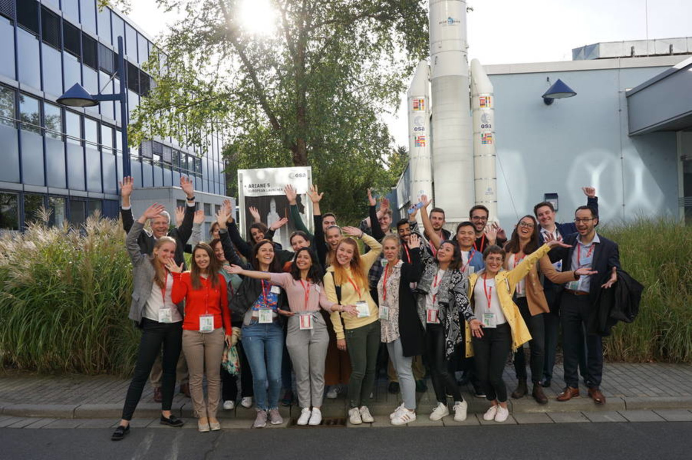
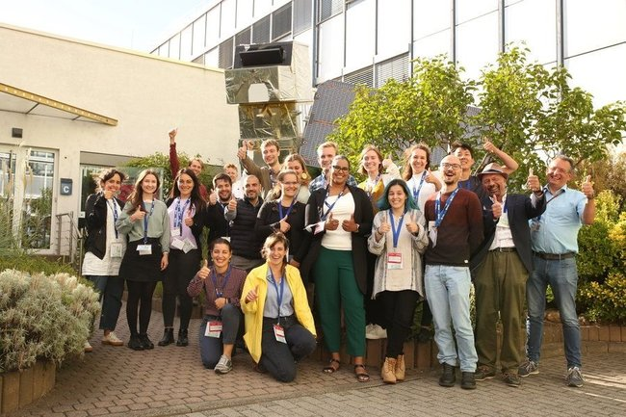
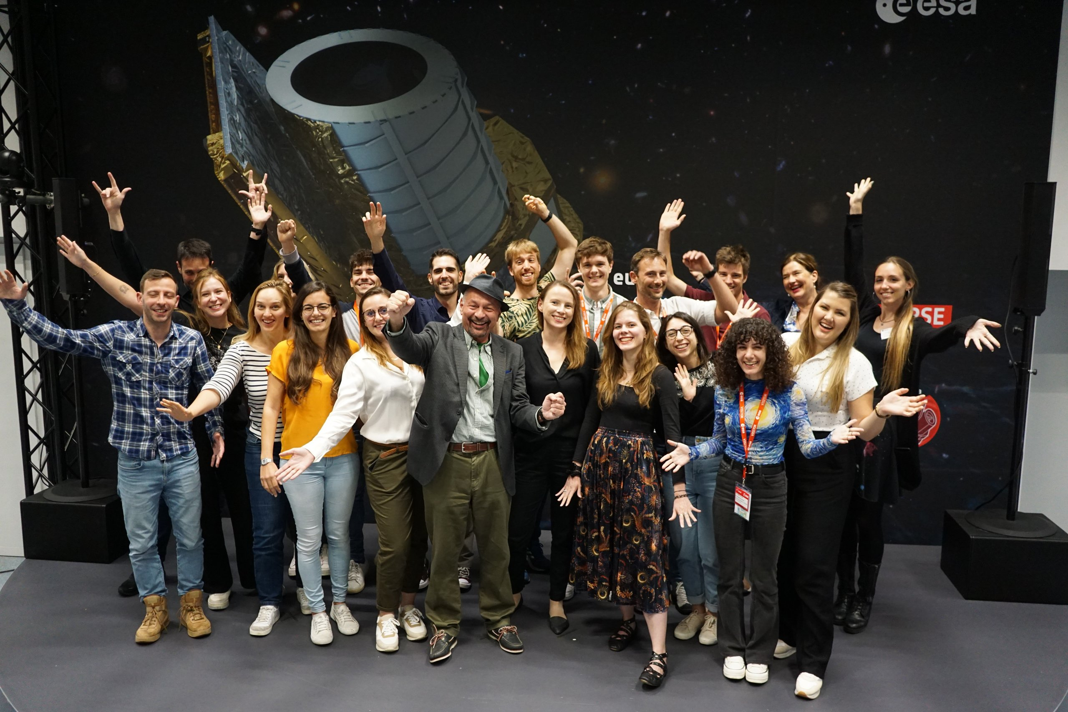
ESA-FAIR Summer School
2022
2019
2023
www.gsi.de/esa-fair-summer-school.htm
NEXT SCHOOL: August 25-September 10, 2024

Slide 11
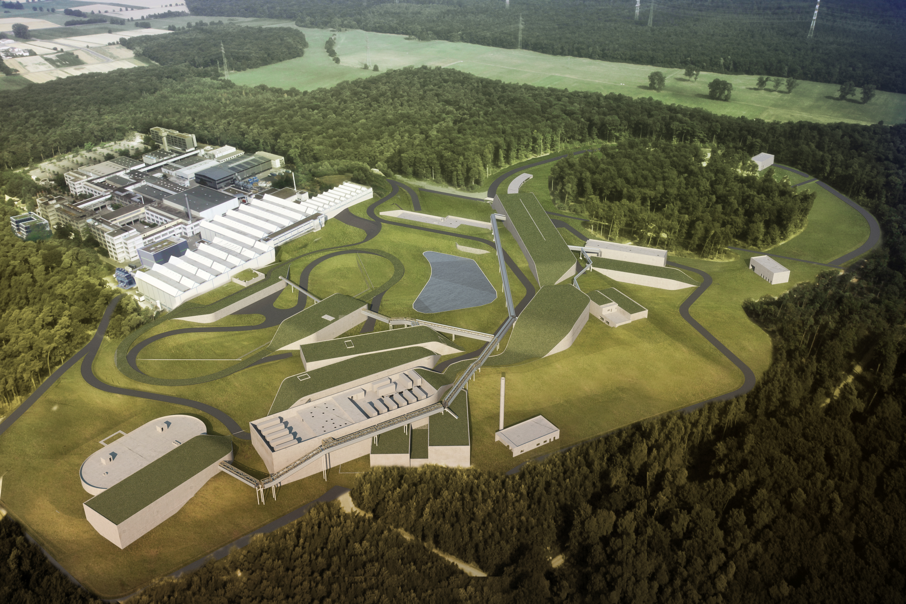
FAIR Darmstadt
20 accelerator and experimental structures,
labs and other operation
and supply structures
Underground accelerator ring
with a circumference
of approx. 1,100 m
Around 150,000 m² of total area
Around 3 G€ price tag

Slide 12
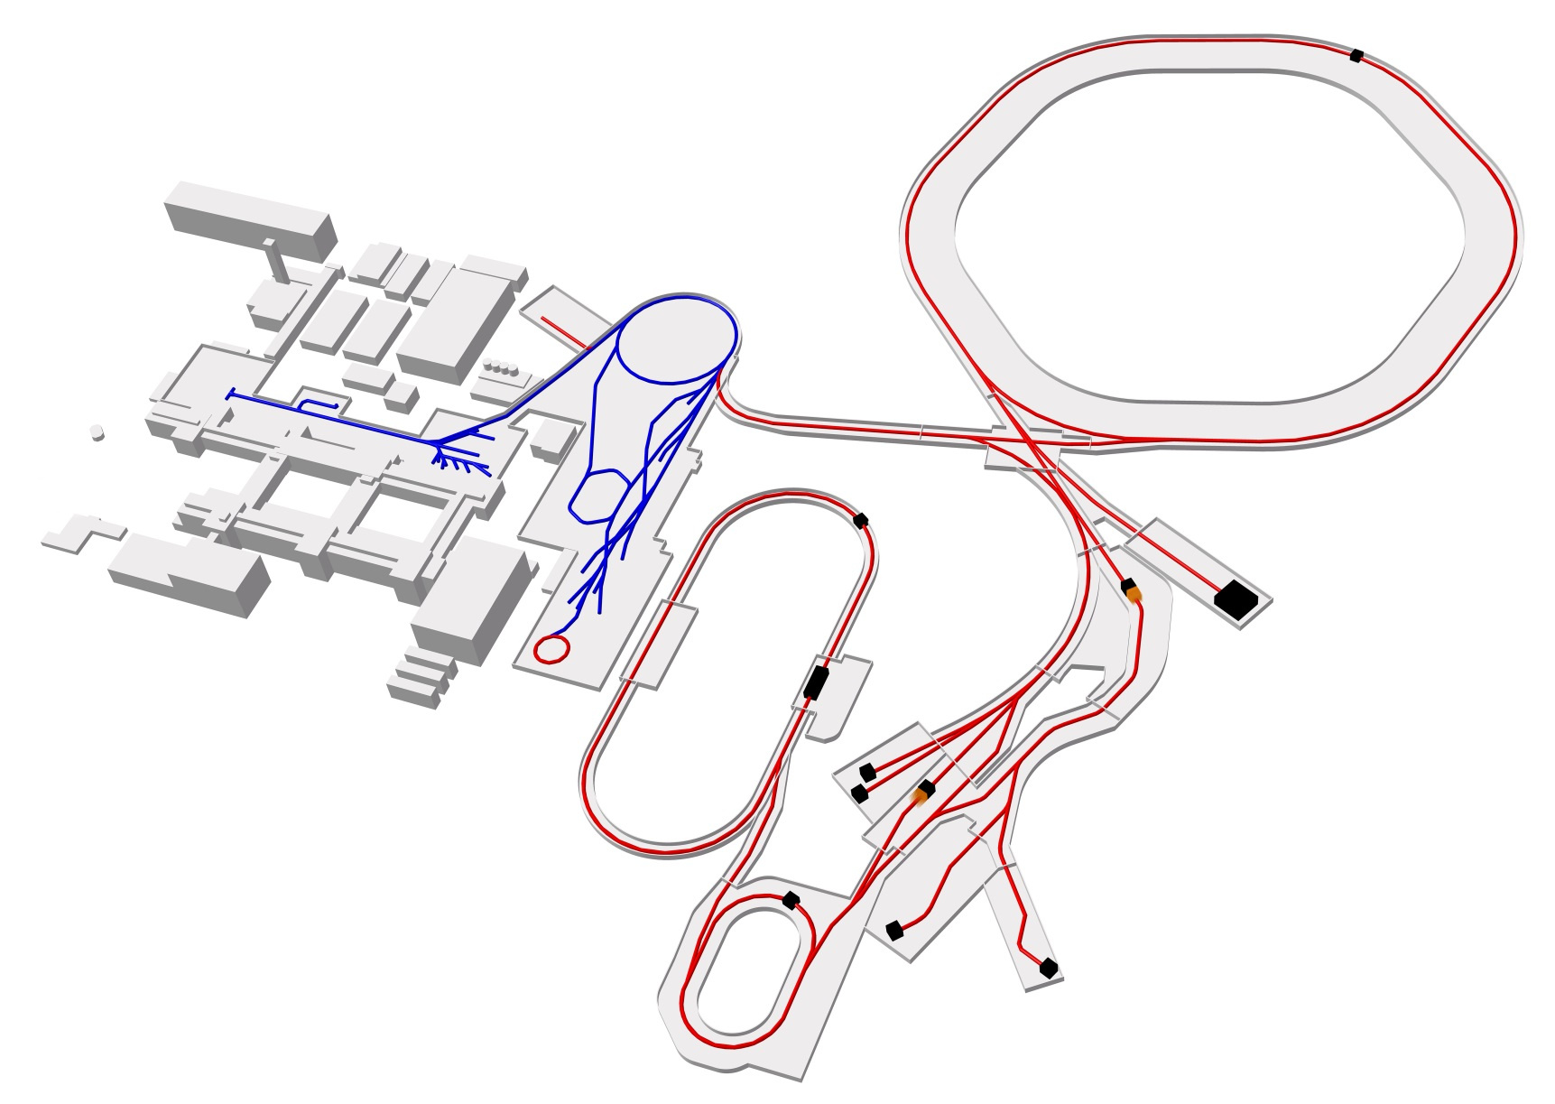
FAIR – The facility
Intensity
Precision
Storage rings
Linear accelerator
Ring accelerator
Ring accelerator
SIS100
Intensity: up to 100x the current GSI/SIS18 intensity
Energy: up to 10 GeV/n
Production
of new nuclei
100 meters
Antiproton ring
Production
of antiprotons
Existing facility
Experimental and storage ring
Planned facility
Collector
ring CR
Experiments

Slide 13

FAIr construction site timelaps 2028-2023

Slide 14

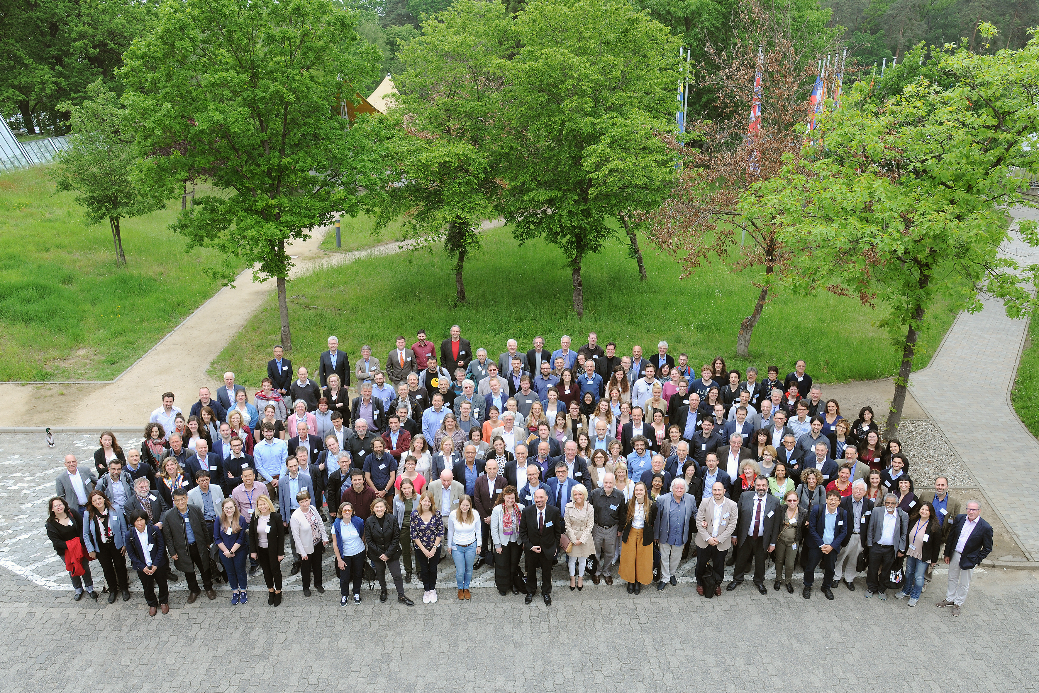

International Biophysics Collaboration Meeting
Darmstadt, May 20-22, 2019
www.gsi.de/bio-coll
250 participants from 27 countries in 5 continents

Slide 15


Added science with additional facilities - FAIR
Patera et al., Front. Phys. 2020

Slide 16
User access
Bio-PAC (basic radiobiology, medical physics, particle therapy) – approx. 25 shifts/2 years
ESA-PAC (space radiation protection) – approx. 20 shifts/2 years
Additional beamtime is granted for GSI Biophysics Department projects with extra-mural funds (currently 1 ERC AdG, 1 ERC CoG, 3 Horizon Europe, 1 NIH)
User support
Provided by the Biophysics Department
Liaison scientist
Animal experiments need an ethical permission in Germany language – will be written at GSI in consultation with external groups

Slide 17
Critical aspects
Beamtime will be very limited until FAIR starts normal operations (>2028)
We need to improve user supports especially in terms of manpower
We need a greater involvement of the low-dose research community with interest in energetic charged particles (basic radiobiology studies, animal research,….)

Slide 18
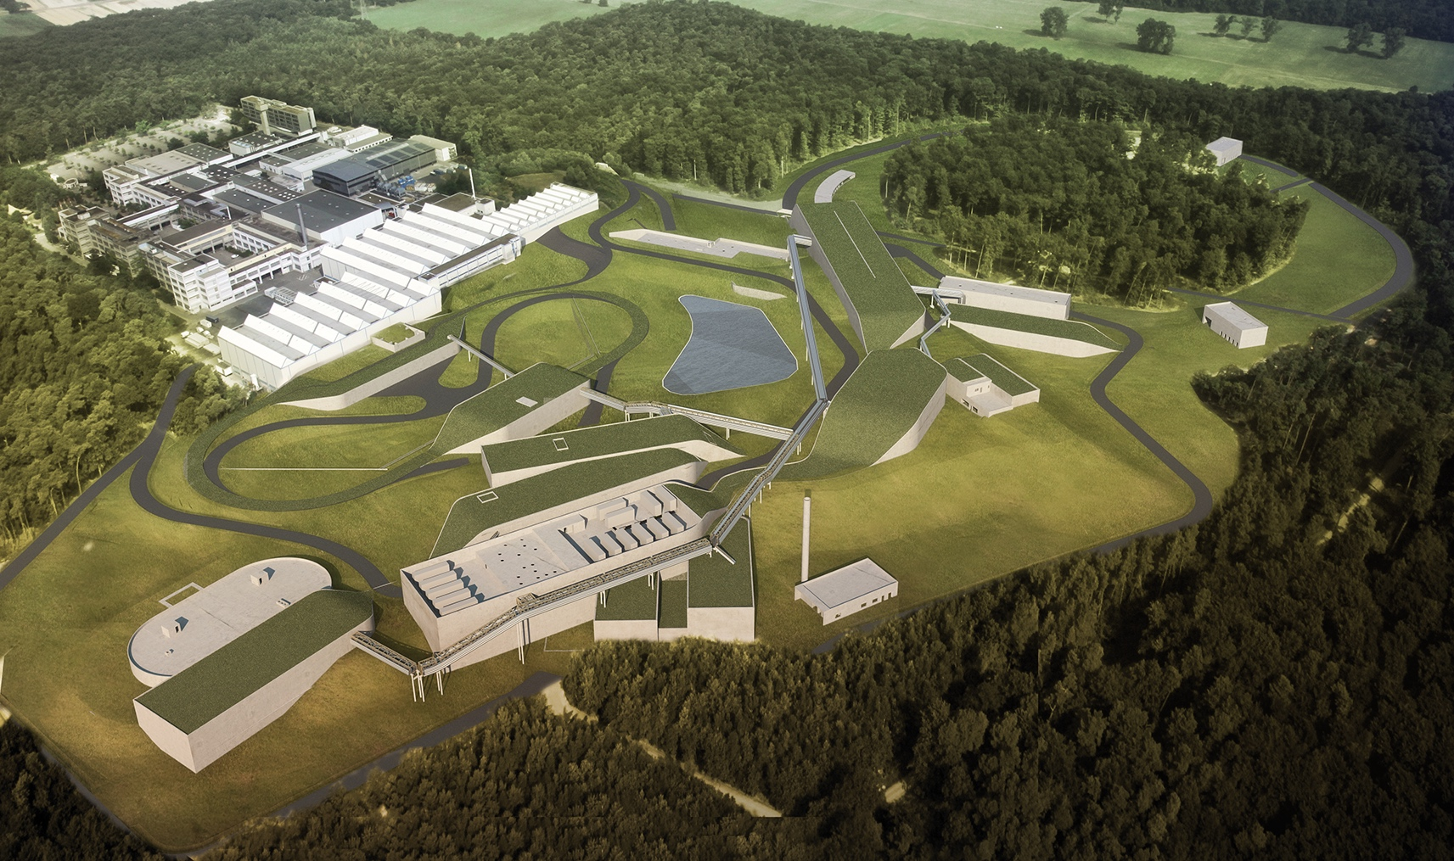
FAIR 2025
Unique Opportunities
. . . & Challenges
Thank You!

