Slide 1

Irradiation facilities @ INFN
G. Cuttone
INFN-LNS
PIANOFORTE WP5 Infrastructures Workshop
Catania 29-30 Jan. 2024

Slide 2
Irradiation facilities @ LNL

Slide 3
INFN-LNL facilities for radiobiological studies:
Light ion broad beam irradiation facility at the 7MV Van de Graaff CN
electrostatic accelerator
(protons, deuterons, helium-3 and helium-4 ions; E: 0.8-12 MeV)
Light ion microbeam facility at the 7MV Van de Graaff CN
electrostatic accelerator for “single-ion single-cell” irradiation
(protons, deuterons, helium-3 and helium-4 ions; E: 0.8-12 MeV)
Heavy ion broad beam facility at the Tandem-ALPI accelerator complex (A>4; E: 5-26 MeV/amu)
Gamma beam Co-60
SPES Facility

Slide 4
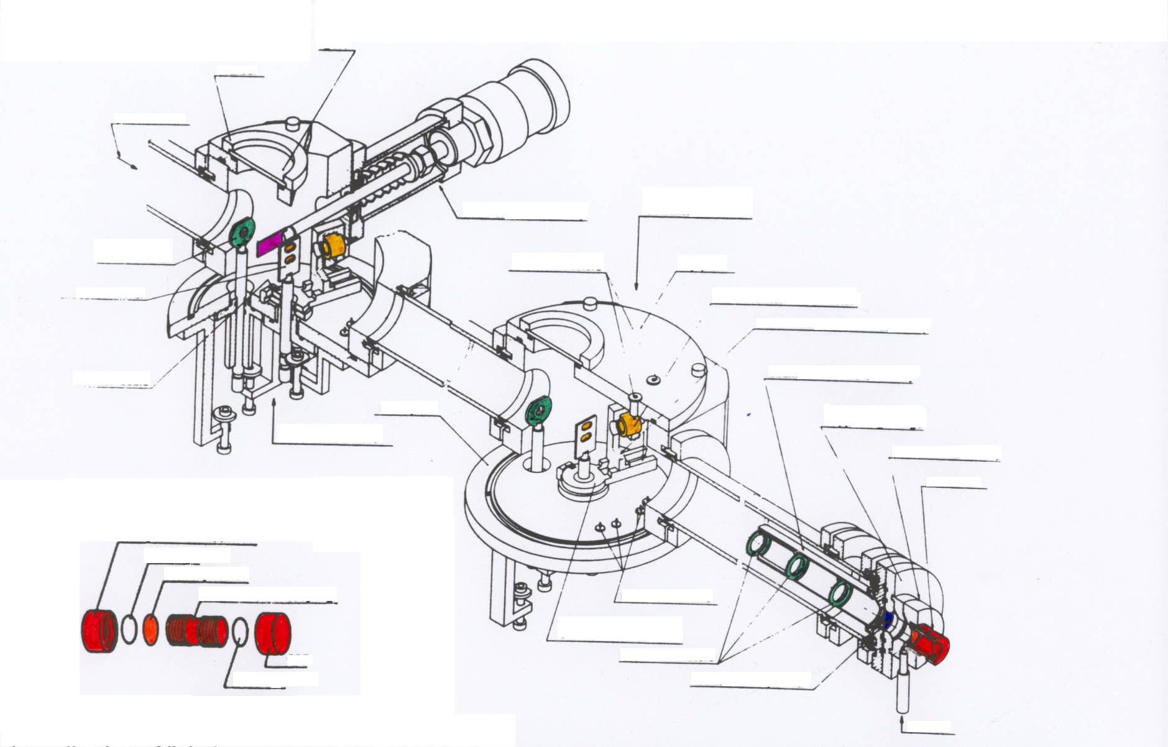
Equipment installed on the beamlines
roundel
glass
Ion Beam
beam stopper
CHAMBER #2
beam collimator
lemo connectors
top plate
gold scatterer
on-line beam monitor
beam monitor assembly
vernier scale
beam collimator assembly
base plate
thin window supporting flange
CHAMBER #1
Petridish holder
especially designed
Petridish
Flanged tube support
Teflon gasket
Thin mylar foil
Stainless steel coupling
lemo connectors
beam
cap
turning beam
monitor table
beam
collimators
Teflon gasket
aluminized mylar foil
PETRIDISH
air inlet
Ref: Belli, Cherubini et al., NIM A256(1987)576-580
INFN-LNL Broad-Beam Irradiation facility for Radiobiology Studies
Set up at the 7MV CN Van de Graff accelerator and at the Tandem-ALPI accelerator complex

Slide 5
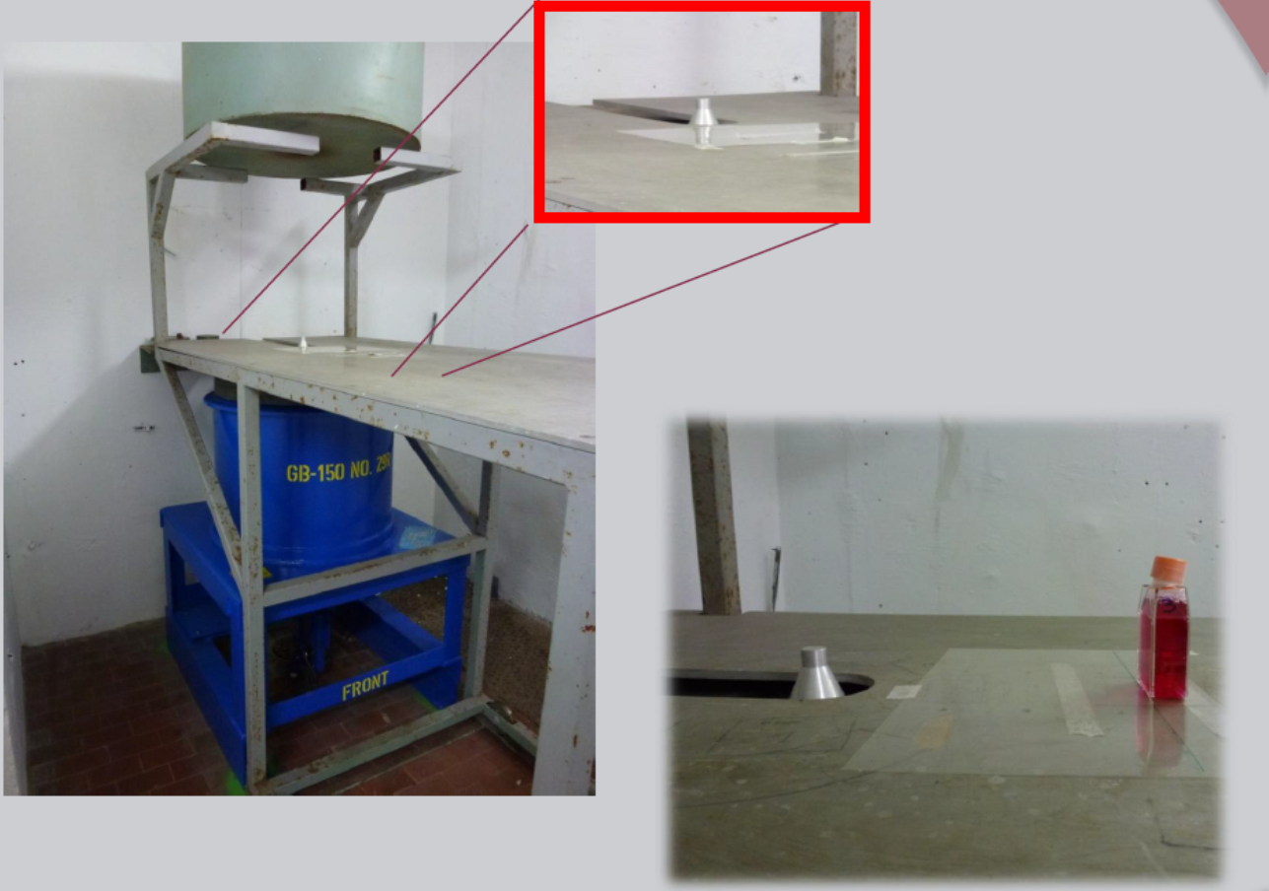
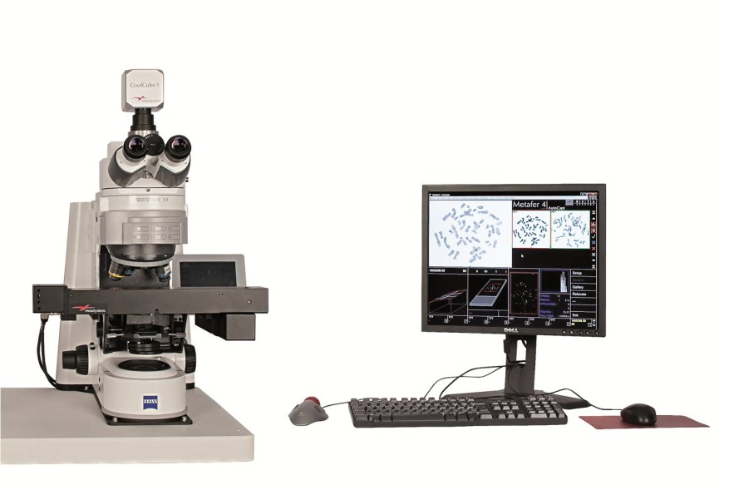
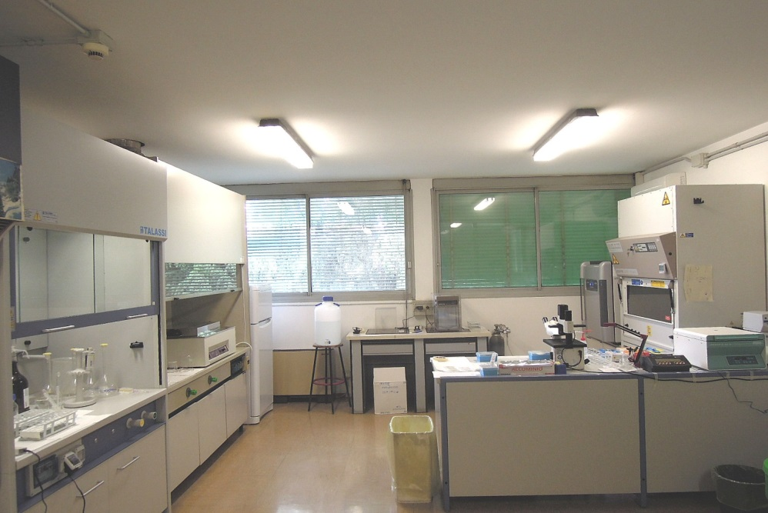
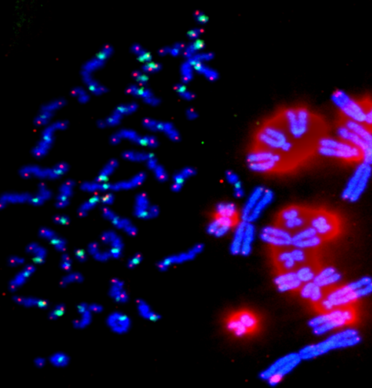
Gamma Beam ⁶⁰Co for irradiation with photons
Biological Dosimetry @LNL
Dose rate 165 mGy/min @ 30 cm
Notes:
Gamma Beam Co60 used for studies of biological dosimetry

Slide 6
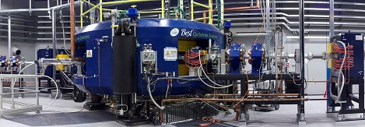
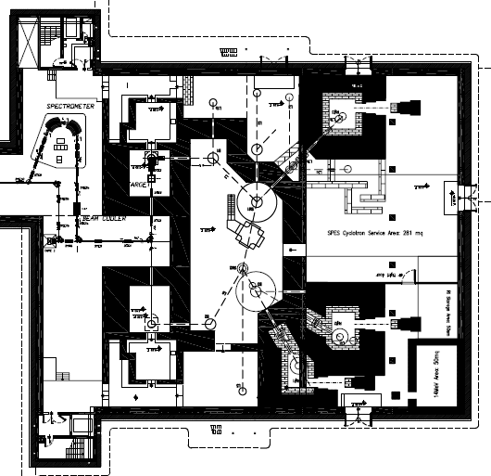
Under commissioning
Dedicated bunker for nuclear cross section measurements (ca 100 nA)
The SPES Project Cyclotron delivering a 40-70 MeV proton beam, up to 750 μA of current
Possibility of having a future beam-line at SPES

Slide 7

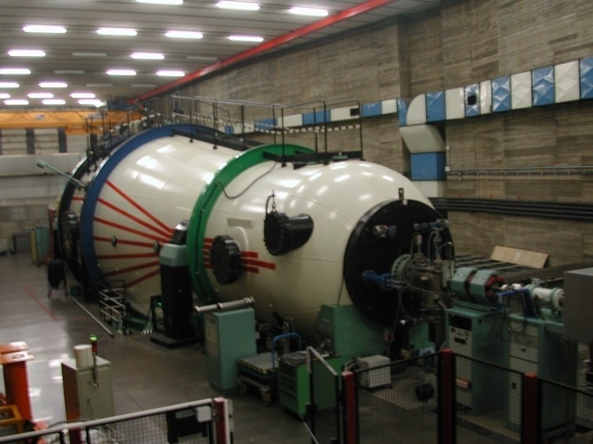
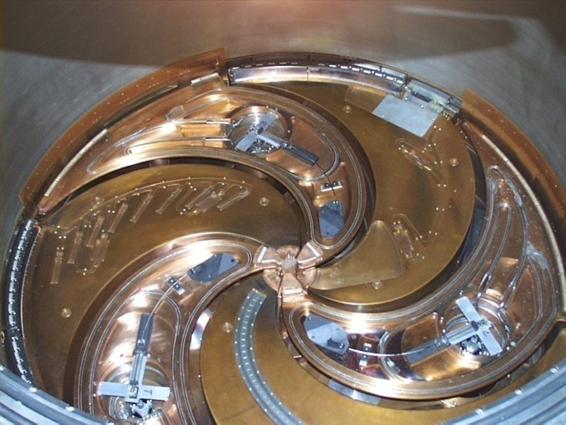
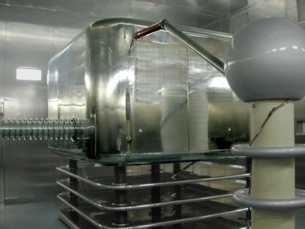
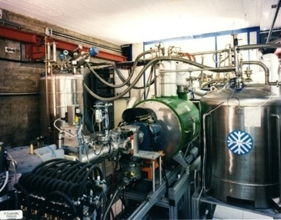
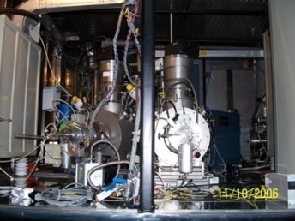
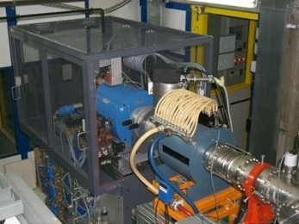
Accelerators at Laboratori Nazionali del Sud
Istituto Nazionale di Fisica Nucleare
LABORATORI NAZIONALI DEL SUD
LNS is recognized as ESA/ASi Irradiation Facility having:
- designed and implemented a system able to host the samples in front of the beam, by assuring both a very accurate positioning in front of the thinny beam and a very good beam diagnostic and particles counting;
- implemented a very rigorous QA/QC system, in order to guarantee an extremely high reproducibility of the testing parameters and reporting to the users.
Sputtering Sources
ECR Source Normal conducting CAESAR
Platform at 450 KV
Superconducting ECR Source SERSE

Slide 8

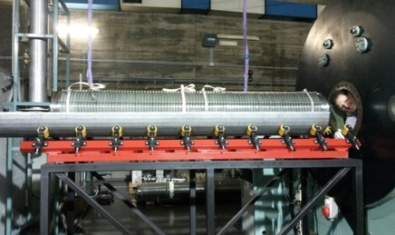
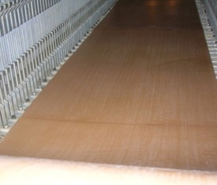
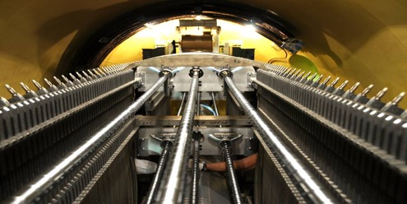
Tandem
Istituto Nazionale di Fisica Nucleare
LABORATORI NAZIONALI DEL SUD
HVEC MP 15 MV Tandem in operation since 1984
In 2014-2015 a big upgrade done due to:
- infiltration of SF6 in tube 1
- obsoloscence of charging system (belt not available from HVEC)
¹H, ²H
⁶Li, ⁷Li
⁹Be, ¹⁰Be
¹⁰B, ¹¹B
¹²C, ¹³C
¹⁴N
¹⁶O, ¹⁷O, ¹⁸O
¹⁹F
²³Na
²⁴Mg, ²⁵Mg
²⁷Al
²⁸Si, ²⁹Si
³²S, ³⁴S
³⁵Cl, ³⁷Cl
⁴⁰Ca
⁵⁸Ni, ⁶⁰Ni
⁶³Cu, ⁶⁵Cu
⁷⁰Ge
⁷⁹Br
⁹³Nb
¹¹⁶Sn, ¹²⁰Sn
¹²⁷I
¹⁹⁷Au
Substitution of tube 1 with a new one by Vivirad (France)
Belt replaced by Pelletron

Slide 9
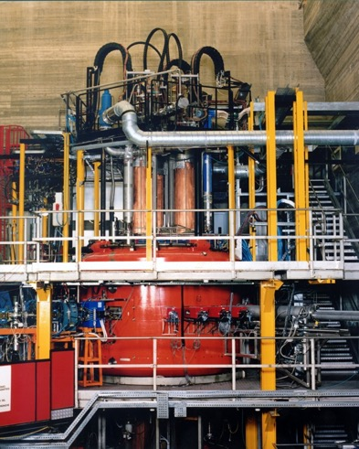
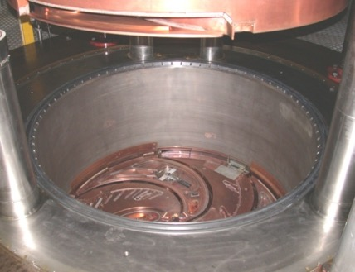

Superconducting Cyclotron
Istituto Nazionale di Fisica Nucleare
LABORATORI NAZIONALI DEL SUD
In operation from 1994 to 2020
^{A}X E (AMeV)
H₂⁺ 62,80
H₃⁺ 30,35,45
²D⁺ 35,62,80
⁴He 25,62,80
He-H 10, 21
⁹Be 45
¹¹B 55
¹²C 23,62,80
¹³C 45,55
¹⁴N 62,80
¹⁶O 21,25,55,62,80
¹⁸O 15,55
¹⁹F 35,40,50
²⁰Ne 20,40,45,62
²⁴Mg 50
²⁷Al 40
³⁶Ar 16,38
⁴⁰Ar 15,20,40
⁴⁰Ca 10,25,40,45
^{42,48}Ca 10,45
⁵⁸Ni 16,23,25,30,35,40,45
^{62,64}Ni 25,35
^{68,70}Zn 40
⁷⁴Ge 40
^{78,86}Kr 10
⁸⁴Kr 10,15,20,25
⁹³Nb 15,17,23,30,38
¹⁰⁷Ag 40
¹¹²Sn 15.5,35,43.5
¹¹⁶Sn 23,30,38
¹²⁴Sn 15,25,30,35
¹²⁹Xe 20,21,23,35
¹⁹⁷Au 10,15,20,21,23
²⁰⁸Pb 10
(T/A)_{max} = K_{bending} (Q/A)² 25 AMeV Au36+
(T/A)_{max} = K_{focusing} (Q/A) 100 AMeV fully stripped
Bending limit K=800
Focusing limit Kfoc=200
Pole radius 90 cm
Yoke outer radius 190.3 cm
Yoke full height 286 cm
Min-Max field 2.2-4.8 T
Sectors 3
RF range 15-48 MHz

Slide 10
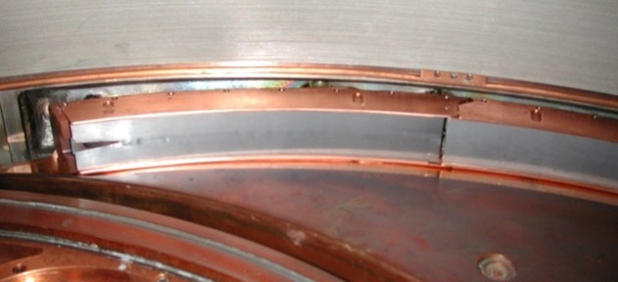
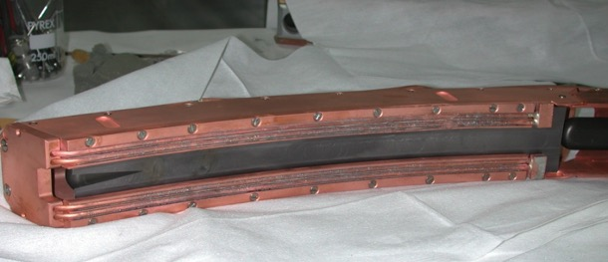
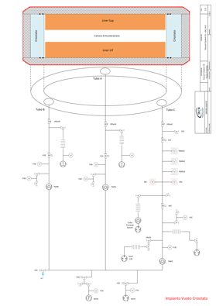
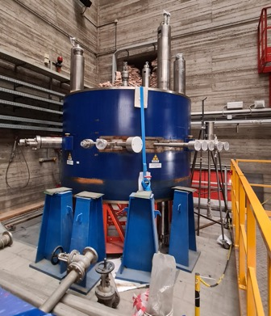
Motivation for upgrade: Beam intensity limitation and cryostat reliability
Istituto Nazionale di Fisica Nucleare
LABORATORI NAZIONALI DEL SUD
Setto: raffreddato direttamente
Nuovo materiale del setto: W vs. Ta
Spessore maggiore: 0.3 vs. 0.15 mm
Efficienza di estrazione 63% vs. 50%
Electrostatic Deflextor
¹³C⁴⁺ @ 45 AMeV Pextr = 150 watt
I=1020 enA= 1.5x10¹² pps
Cryostat
Perdite schermo azoto
Scarsa tenuta tra camera di accelerazione e camera criostato per probabile fessurazione criostato in una delle n saldature

Slide 11
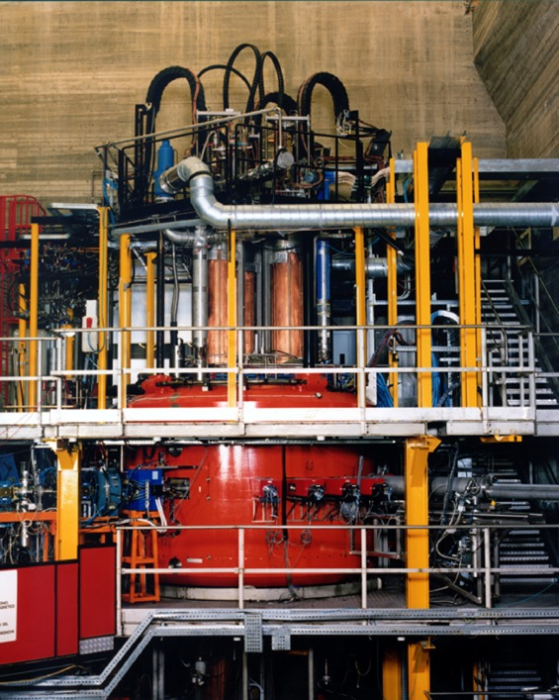
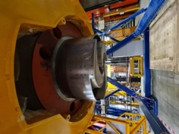
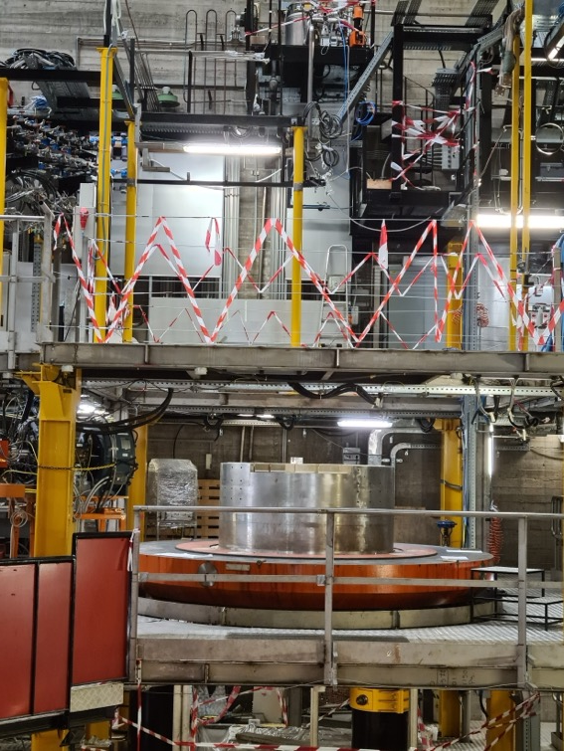
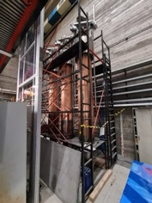
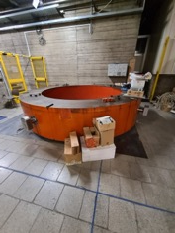
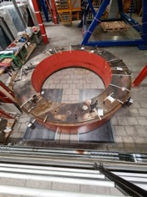
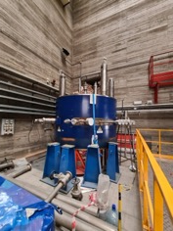
Ciclotrone Superconduttore
2020
2023

Slide 12
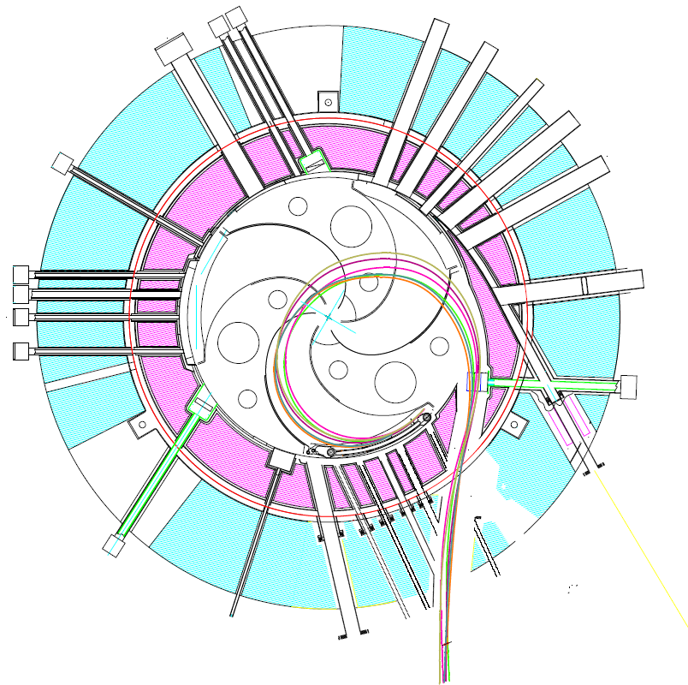
Upgraded Superconducting Cyclotron
Extraction by stripping: High efficency-> intensity gain of 100
Extraction by stripping is based on the instantaneous change of the magnetic rigidity of the accelerated ion, when its charge state increases after crossing a thin stripper foil
For ions with A<40, and energies higher than 15 MeV/u, the abundance of q=Z exceeds 99%
Ions Extracted by Stripping
Ions Extracted by Deflection

Slide 13
Conditions for Tandem restart
- Completion on maintenance
- ordine NEC (may-june ‘24)
- air flow system summer ‘24
- smoke detector idem
- test w/o beam fall’24
- test with beam first semester ‘25
- Fire Safety system march’24-june’25
Beam to users september’25

Slide 14
Conditions for Ciclotron restart
- completamento manutenzioni @LNS
-magnet&cryostat delivery december’24
- full set of magnetic measurements
- cyclotron fully assembled fall’25
- test w/o beam first quarter ‘26
- test with beam summer ‘26
- Fire safety system july’24-december’25
Beam to users last quarter ‘26

Slide 15
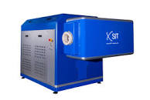


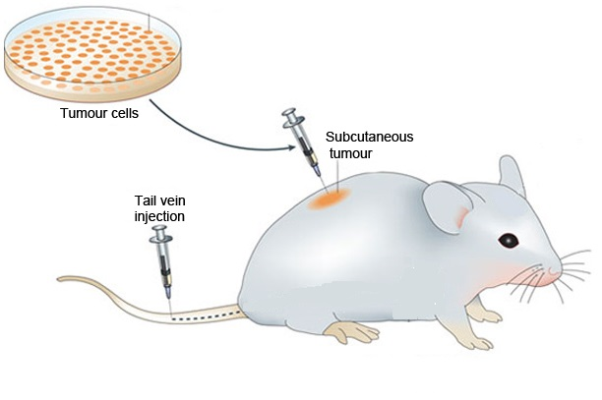
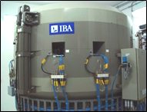



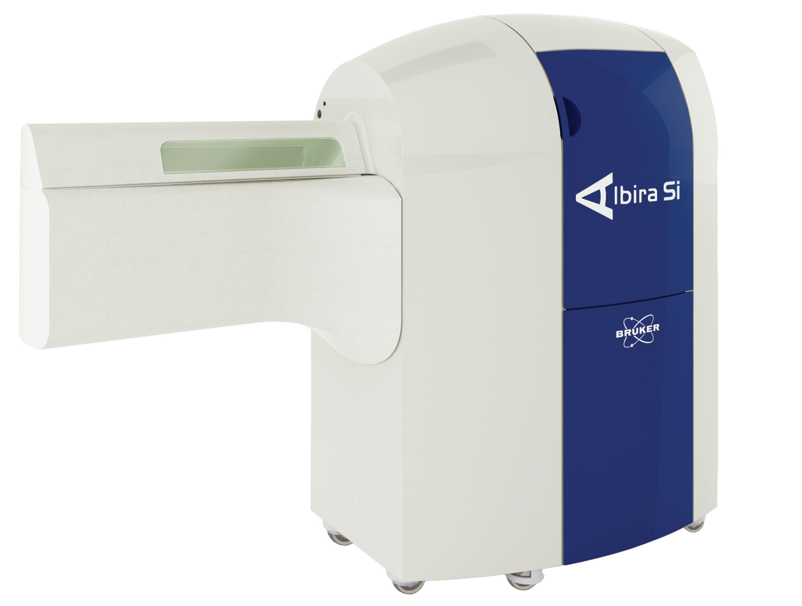
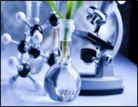
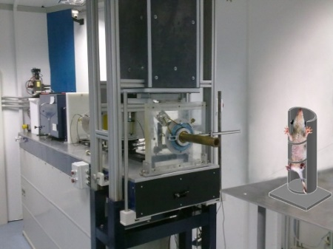
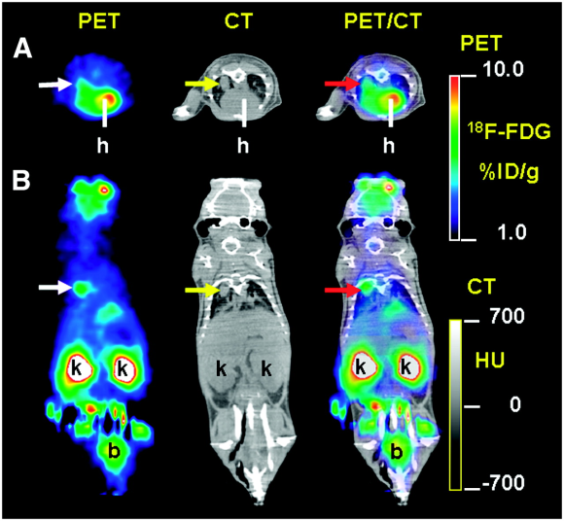


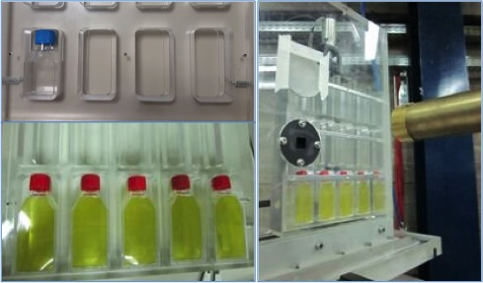
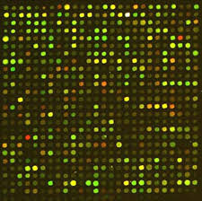


THE UNIQUE NATIONAL NETWORK PROVIDING RESEARCH AND SERVICE ACTIVITY IN THE PRECLINICAL IMAGING, HADRONTHERAPY, FLASH AND ULTRA-FLASH THERAPY
Preclinical
Cyclotron
RadioBiology Lab
CATANA

Slide 16


HUB Leader Mi-Bicocca
Spoke 4 (Leader UniCT)
Innovative radiotherapy techniques and imaging
(Flash therapy & BNCT)
INFN Units: CT, LNL, LNS, NA, PV, TO
Pilot 4.4: Preclinical Studies of Flash and Ultra-flash therapy at Catania.
INFN: LNS, Catania & Pavia
Flash Therapy Study based on SIT Linac at Unict-Capir and Ultra Flash Therapy based on laser Plasma Acceleration at INFN-LNS

Slide 17

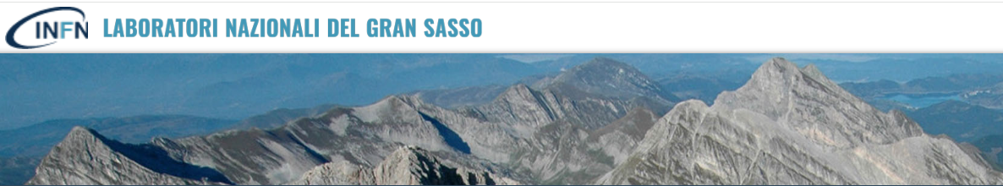
P. Morciano-Cosmic Silence Collaboration
Underground radiobiology
at LNGS laboratory

Slide 18
LNGS represents a unique opportunity for investigating the response of biological systems to below natural radiation background
(extremely low radiation dose/dose rate)
All living organisms have to deal with the natural level of radioactivity on the Earth as well as with cosmic rays. Which is the role of natural variations of background radiation during the Life evolution? How does it contribute to the development of cellular defense mechanisms?
Relevant scenario for both basic and applied science
Study of fundamental mechanism(s) of action of low natural background radiation on living organisms and improvement of knowledge on adaptation and evolution
Opportunity to test the linear no-threshold (LNT) model currently used in radiation protection, for which stochastic risk is directly proportional to dose and no detriment is expected below the average natural environmental background
Opportunity for space research to untangle the contribution of the two stressors, microgravity and radiation.
Notes:
Cosa rappresentano i LNGS in quanto laboratori sotterranei nella ricerca biologica

Slide 19
Deep Underground Laboratories (DULs) allow to carry out studies at dose rates significantly lower than on the Earth’s surface
Compared to that at the Earth’s surface, inside DULs, the dose/dose rate contribution due to photons and directly ionizing low-LET (mostly muons) cosmic rays can be considered negligible, being reduced by a factor between 10⁴ and 10⁷ depending upon shielding (muon rate ~ 1/m²h at LNGS).
Radiation exposure due to neutrons is also extremely low, being reduced by a factor between 10² and 10⁴ (10³ at LNGS)
One further contribution to the overall dose/dose rate can come from radon decay products, but it depends upon the radon concentration, which can be kept at the same levels of the reference radiation environment by a suitable ventilation system or it can be strongly reduced by radon abatement systems (Radon concentration is comparable between external and underground environment at LNGS).
Terrestrial gamma rays represent the major contribution to the dose/dose rate inside the DULs and can be further reduced by shielding.
Notes:
Quali sono le carattericìstiche salienti di un DULs con specifici riferimenti ai LNGS

Slide 20
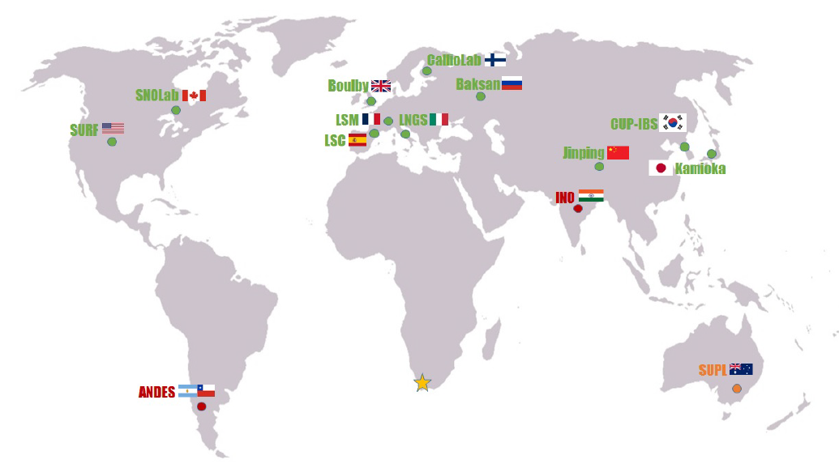
Map of the existing or planned worldwide DULs
green dots: the operating facilities
INFN-Laboratorio Nazionale del Gran Sasso (LNGS) is one of the largest in terms of size and infrastructure.
CJML
1400 m (3800 m.w.e. vertical depth)
Muon rate ~ 1/(m2 h)
Surface: 17800 m2
Volume: 180000 m3
Ventilation: 1vol/3hours
Three large experimental halls (~100x20x18 m3)
22 experiments currently running
Easy accessible via highway tunnel (no difference in atmospheric pressure with repect to the above ground facility)che
WIPP
Paarl
Modified from Adam et al. Paarl Africa Underground Laboratory_arXiv:2306.12083v1 [hep-ex] 21 Jun 2023
Notes:
Una ventina di DULs nel mondo. LNGS è considerato uno dei più importanti in termini di complessità e dimensioni

Slide 21
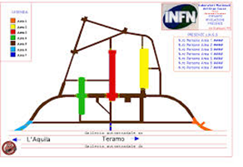
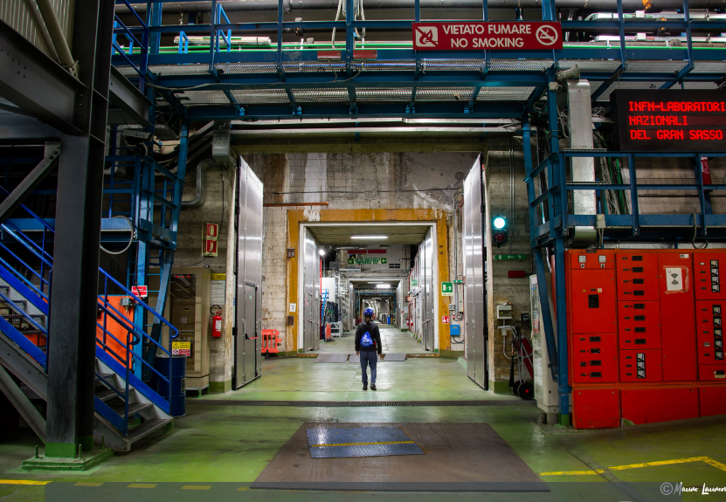
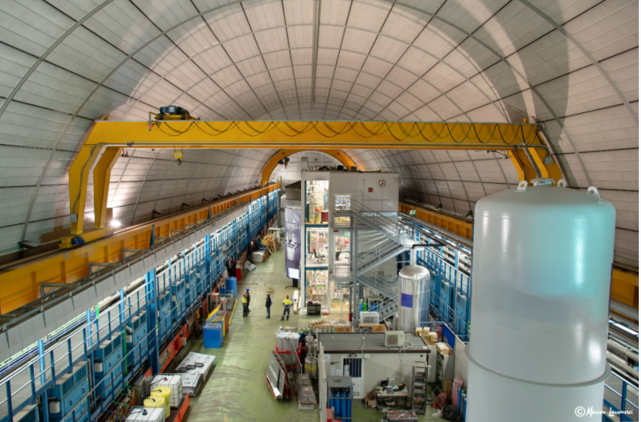
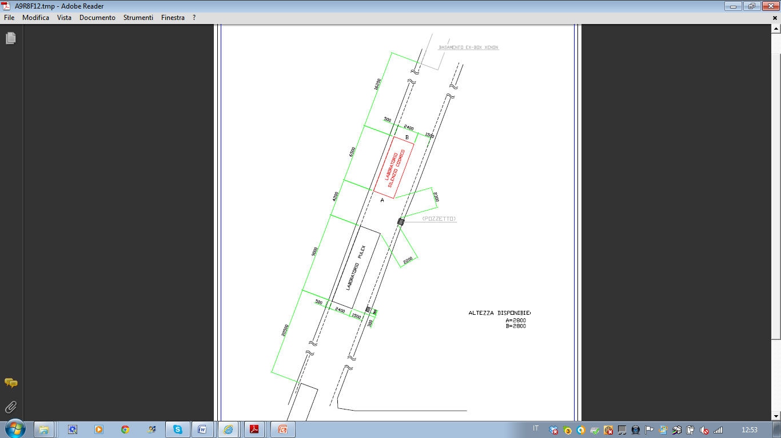
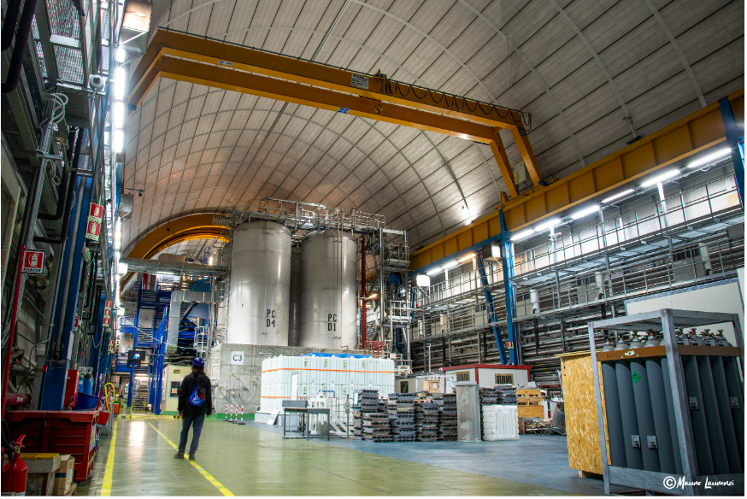
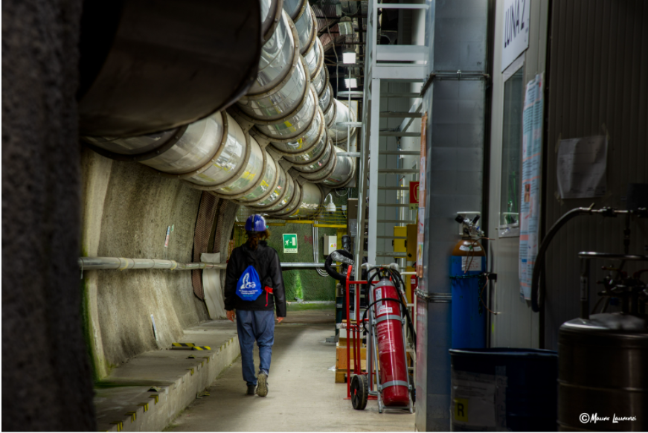
The LNGS Underground Laboratory and Biology Labs
Biology Labs
P. Morciano-Cosmic Silence Collaboration
Notes:
Qualche immagine dei LNGS sotterranei e dove sono dislocati i lab di biologia

Slide 22
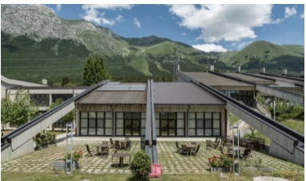
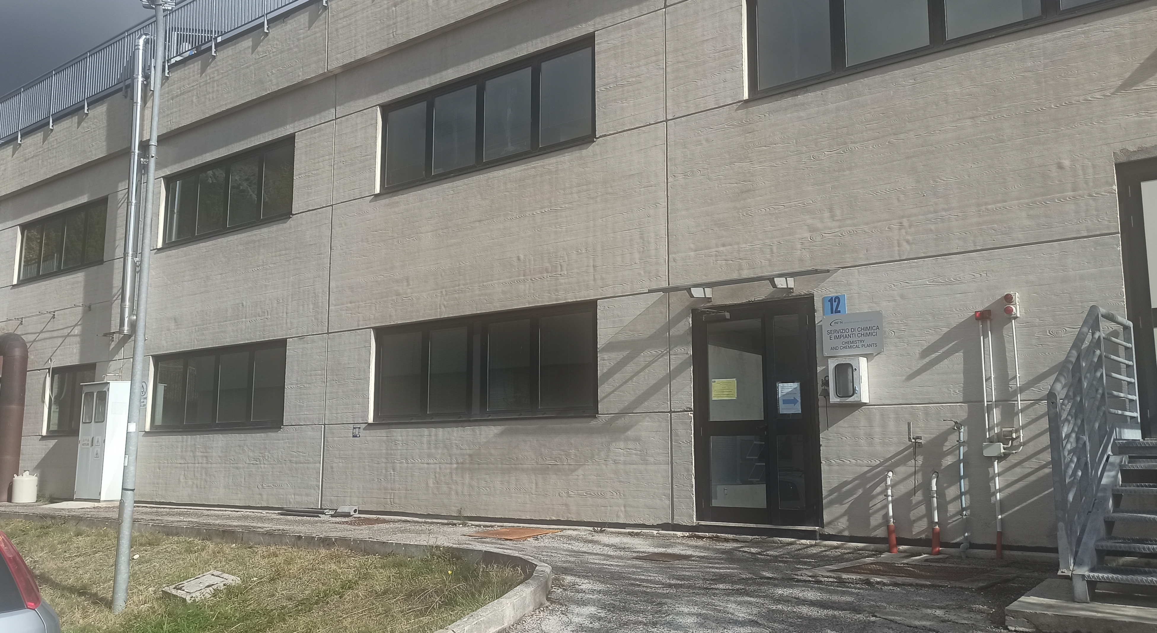
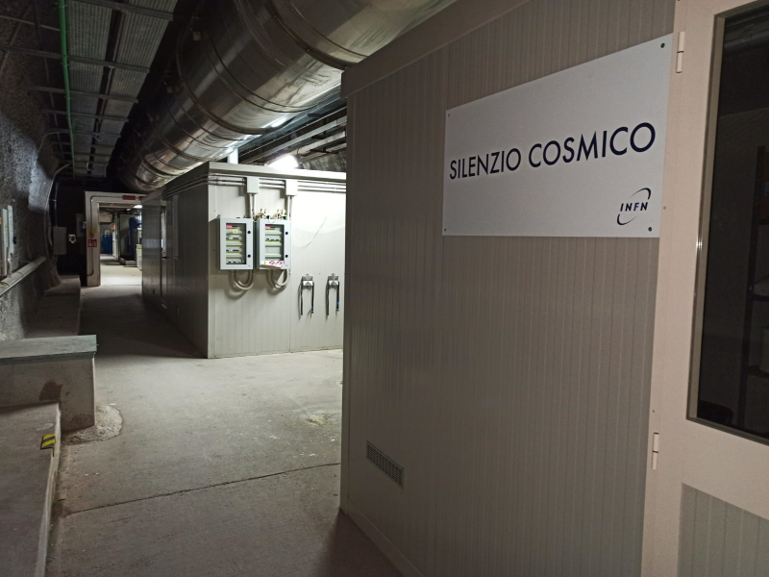

Experimental approach: comparison between above ground and underground environments
LNGS BIOLOGY FACILITIES
Above ground
Underground
Reference Radiation Environment, RRE
Low Radiation Environment, LRE
SMALL ANIMALS
CELL CULTURE
Cosmic Silence
Pulex
Chemistry and Chemical Plant Service
SMALL ANIMALS
CELL CULTURE
Notes:
Una slide per spiegare che ai LNGS ci sono tre lab di biologia. Uno all’esterno per esperimenti sia su cellule che su piccoli animali e due sotterranei (uno Pulex, dedicato agli esperimenti su cells e l’altro Cosmic Silence dedicato agli studi in vivo (piccoli animali)

Slide 23
At doses comparable to the environmental background, there is little effect which can be masked by other health effects
The design of an experiment is a delicate and challenging work
All parameters (biological and physical) that can influence the response of a biological system must be taken into account and possible differences must be minimized in an attempt to make the radiation level the “only” difference between RRE and LRE
Among the most important ones:
Temperature and light (use of incubators or temperature/light control systems)
Pressure (monitoring)
Air quality (use of filters)
Radon (ventilation systems and monitoring)
Cell culture medium and reagents/food for organisms (purchase and use of the same products for the entire dutation of the experiment)
As for environmental radiation, dosimetric measurements of components of the radiation spectrum during the experiments are mandatory

Slide 24










THE LNGS UNDERGROUND AND ABOVE GROUND
BIOLOGY LABORATORIES’ EQUIPMENT
SMALL ANIMAL (Drosophila) LAB:
2 identical refrigerated incubators
CO2 system to manipulate Drosophila
2 Stereo microscopes (one with camera)
Mice rack at LRE(not yet in use)
mice rack
CELL COLTURE LAB:
3 identical CO2 incubators
Biological hoods
2 Inverted microscopes
Optic microscope
Thermostatic water baths
Refrigerated incubator
Ancient iron shielding
OTHER GENERAL EQUIPMENTS AND INSTRUMENTS
Refrigerator (4-6°C and -20°C)
Cryogenic storage dewars
Systems for gamma ray modulation: a 10 cm thick lead shield, an ancient iron shielding, Marinelli beakers filled with tuff, a natural gamma emitter
AlphaGUARD device measuring T°, relative humidity and radon concentration (for constant ambient monitoring)
Biological hood
CO2 incubator
Gamma rays modulation systems
Support from LNGS Services: Chemistry & Chemical Plants, Special Techniques for detection of rare events, Computing and Network, Electronics, Accellerators, Mechanics, Industrial Design……
Notes:
L’equipaggiamento e gli strumenti dei lab di biologia

Slide 25
Dosimetric characterization of
above ground (RRE) and underground (LRE) environments
 | LNGS External (RRE) |  | LNGS Underground (LRE)
Photons and directly ionizing cosmic rays (low LET, mostly muons) (nSv/h) | 47ª |  | negligible
Neutrons (high LET) (nSv/h) | 21^{b} |  | negligible
Total γ-rays (terrestrial, low LET) (nSv/h) | 31ª |  | 27ª
Total low LET dose (nSv/h) | 78 |  | 27
Radon concentration kept at same level in the two environments (about 15-20 Bq/m³) thanks to an efficient air ventilation system in underground.
Reduction of total low LET dose of about 4 times in underground LRE with respect to the above ground RRE environment (that can be modified using shielding or exposure to natural emitting materials)
Radiation quality different in underground where cosmic ray and neutron contribution is almost negligible
(ª) measures with Reuter Stokes, Automess and TLD and evaluation, at the LNGS altitude, based on UNSCEAR 2008 (Vol I. Sources and Effects of Ionizing Radiation; (^{b}) literature data
For further information see: Ampollini M et al. Front. Phys. 2023. doi: 10.3389/fphy.2023.1274110
Notes:
Caratterizzazione ambientale con i contributi dei singoli componenti dello spettro di radiazione ambientale nei due ambienti esterno ed underground. Riferimento al lavoro che la descrive in dettaglio

Slide 26
Saccharomyces cerevisiae cultured for 1 week (~120 generations) at LRE and RRE (University of Rome) | Mutation induction (hprt locus) | Satta et al., Mutat Res 1995
Long term experiments (months)
Chinese hamster V79 cells cultured for up to 9-10 months (>120 generations) at LRE and RRE (RRE: Istituto Superiore di Sanità, Rome; external LNGS laboratory) | Cell growth Antioxidant enzymes activity Apoptosis Mutation induction (hprt locus) | Satta et al., Radiat Environ Biophys 2002 Fratini et al., Radiat Environ Biophys 2015
TK6 human lymphoblasts cultured for up to 6 months at LRE and RRE (Istituto Superiore di Sanità Rome) | Cell growth Micronuclei induction Antioxidant enzymes activity | Carbone et al. Radiat Environ Biophys 2009
Short term experiments (weeks) | Long term experiments
A11 mouse hybridoma cells (short term experiments, few weeks) RRE (Istituto Superiore di Sanità Rome) | Cell proliferation caspase-3 activation PARP1 cleavage | Fischietti et al., Front Public Health 2021
Drosophila melanogaster (RRE: L’Aquila University) | Life span Ferility DNA repair (mutants) | Morciano et al., J. Cell Physiol. 2018 Morciano et al., Radiat. Res. 2018 Esposito et al., Front Public Health 2020
Drosophila melanogaster (RRE: external LNGS laboratory) | Chromosome breaks DNA repair (mutants) | Porrazzo et al., Int. J. Mol. Sci. 2022 Morciano et al., Frontiers in Physics 2023 Ampollini M. et al Frontiers in Physics 2023
Summary of in vitro and in vivo experiments at LNGS
LRE: Low Radiation Environment
RRE: Reference Radiation Environment
Yeast
Cultured mammalian cells
Fly
Notes:
Una slide che mostra tutte le pubblicazione dell’attività di radiobiologia dal 1995 ad oggi

Slide 27







The DISCOVER22 experiment
“DNA Damage and Immune System COoperation in
VEry low Radiation environment”
INFN-CSN5 funded experiment (2023-2025)
Interdisciplinary experiment divided in three work packages (WP)
WP1: Radioimmunobiology: in vitro studies (cells)
Task 1.1 - Immune system pathway activation
Task 1.2 - Modulation of immune system’s differentiation
WP2: Radioimmunobiology: in vivo studies
Task 2.1 – Analysis of the immune system genes in fruit fly, D. melanogaster
WP3: Physic studies
Task 3.1 - Microdosimetry
Task 3.2 - Biophysical modelling
For further information see: Morciano P, et al. Front. Phys 2023. doi: 10.3389/fphy.2023.1263338
Notes:
L’attuale esperimento interdisciplinare di Commissione 5 in corso e le istituzioni coinvolte (Pubblicazione di riferimento)

