Slide 1
Enhancing spatial resolution in MÖNCH detectors for electron microscopy via deep learning
Xiangyu Xie :: Postdoc :: Paul Scherrer Institute
TREDI 2024, Turino, Feb 20-22, 2024

Slide 2
Direct Electron Detector for Electron Microscope, the “resolution revolution”
Sensor
Electronics
Sensor
Electronics
Monolithic Active Pixel Senor (MAPS)
Widely applied for (cryo-)imaging and diffraction measurements
K2, Falcon…
Good spatial resolution
Pixel size usually $<15 μm$
Limited frame rate
Poor radiation hardness
Hybrid Pixel Detector (HPD)
Getting popular for diffraction measurements
Jungfrau, Medipix…
High dynamic range and frame rate
Good radiation hardness
Poor resolution
Large pixel size usually $≥55 μm$
Electron multiple scattering
MAPS
HPD
Resolution
Data availability
Radiation hardness
Dynamic range
Frame rate

Slide 3
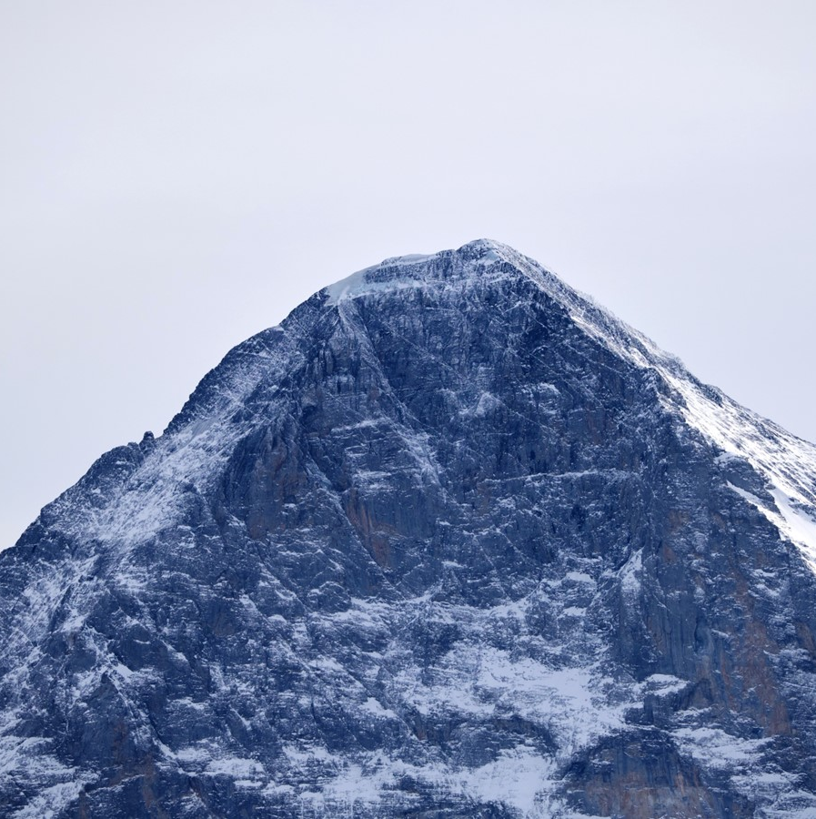
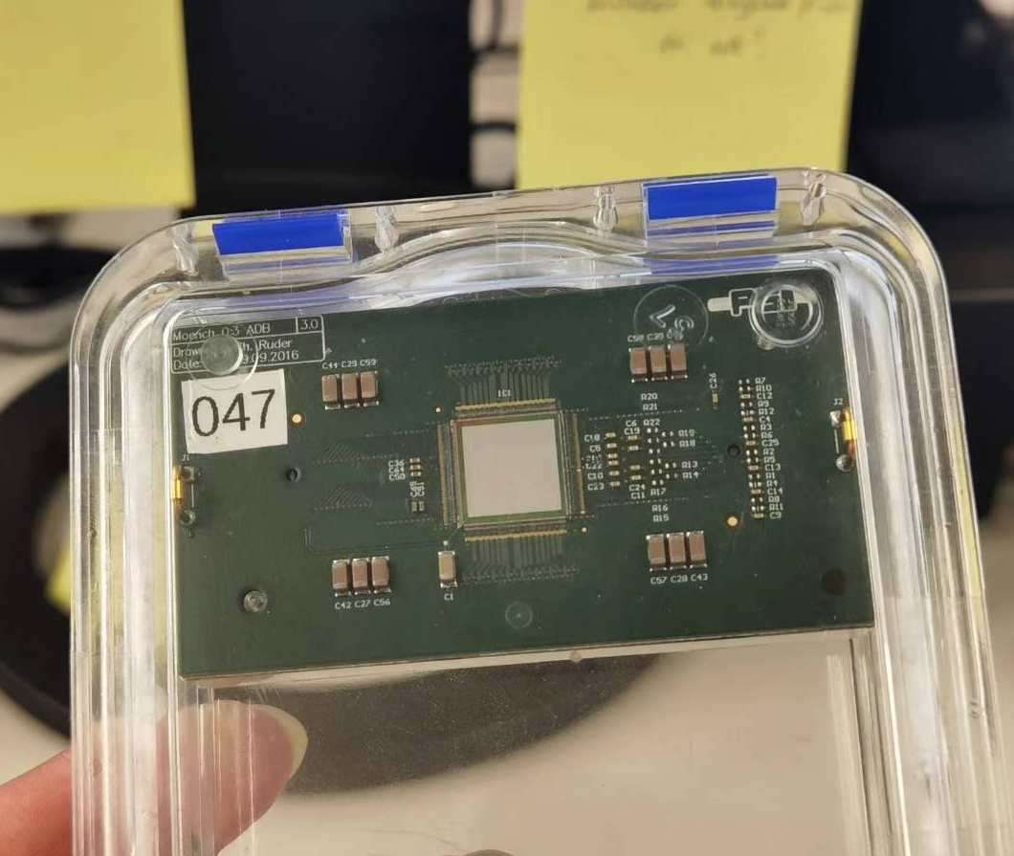
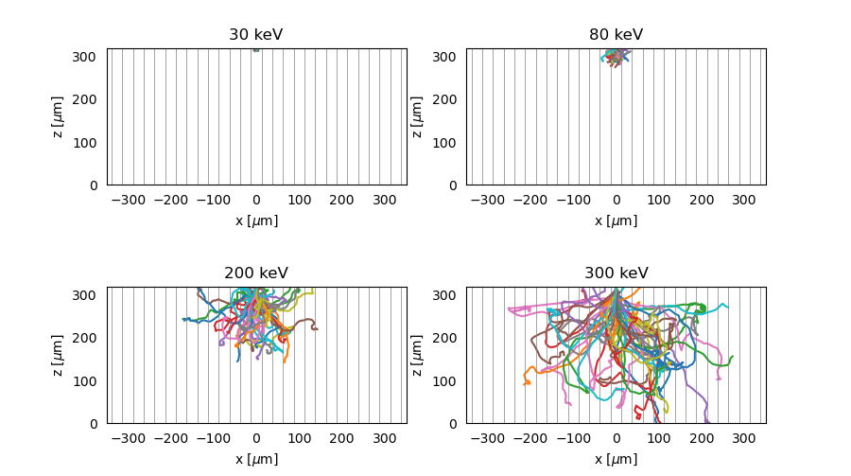
MÖNCH, towards a universal detector for diffraction and imaging
MÖNCH, a HPD with much smaller pixel
$25 μm$ pitch, $400×400$ pixels per tile
Charge integration mode, up to $6 kHz$
While for multiple scattering
Poor resolution for $e^{−}$ with $E>80keV$
Deep learning to reconstruct position
From the complex pattern to learn
Nature of energy deposition
Charge diffusion
Lead an equivalent smaller pixel size
MAPS
HPD
Resolution
Deep learning?
Data availability
Radiation hardness
Dynamic range
Frame rate

Slide 4
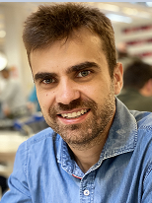
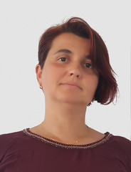
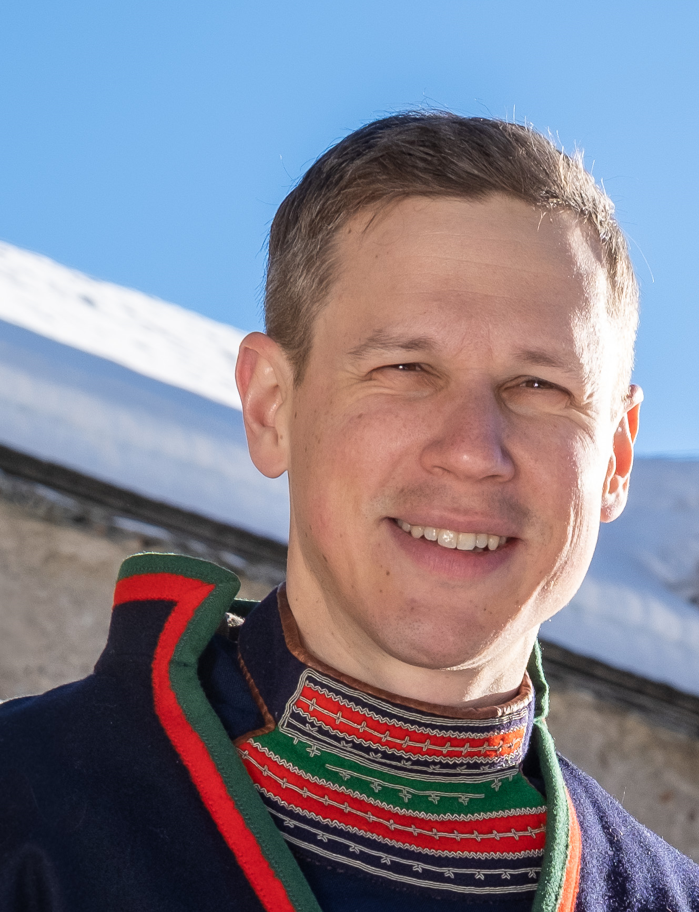
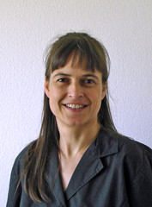
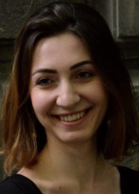
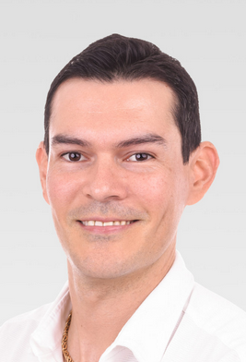
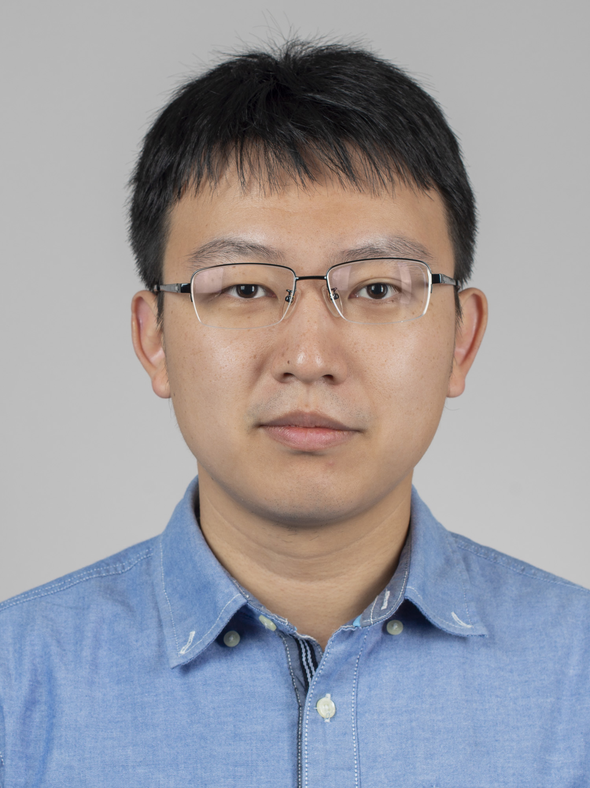
Project members
Funded as a Swiss Data Science Center(SDSC) project (link)
Swiss Data Science Center (SDSC) and
SDSC hub @ PSI
PSI
Electron Microscope Facility group
PSI
Photon Science Division Detector group
Dr. Carl Remlinger

Slide 5
Project overview
Deep learning development
Neural network candidate models
A baseline model (results discussed in this report)
Auto-encoder
…
Samples preparation
Simulation and measurement
Key: the ground truth impact point
Characterization
Spatial resolution
Detective quantum efficiency
Standard sample imaging
Deployment & dissemination
Data processing pipeline

Slide 6
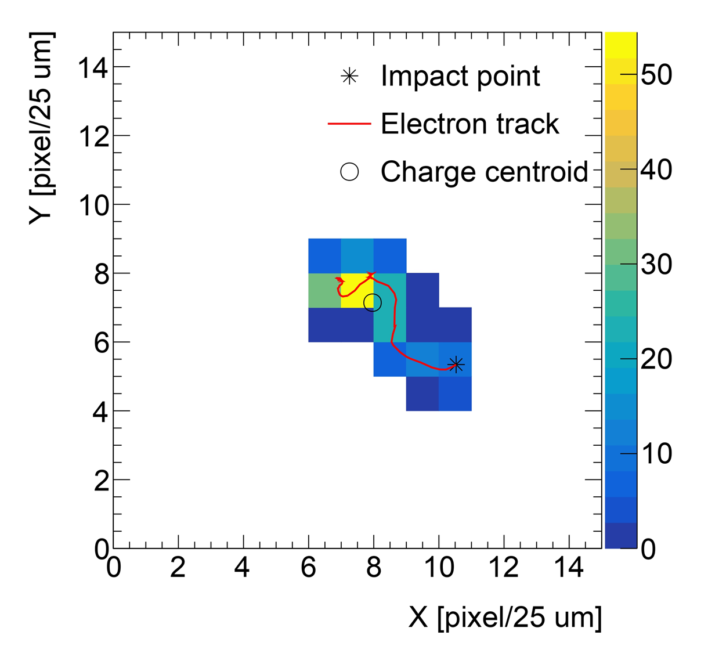
Baseline neural network model
Readout pattern
Features
Input: readout pattern and features
Backbone model for readout patterns
7 Convolutional Neural Network(CNN)
Kernel size 3; 64 output channels
One Fully Connected(FC) layer
Feature model for manually extracted features
One FC layer
7 features: cluster size, nominal energy …
Model size:$\sim 600k$ parameters
Training takes a few hours on a RTX4090 GPU
Optimizer: Stochastic Gradient Descent implemented in PyTorch
Loss function: Squared Error Loss
CNN
Feature model
CNN
Backbone model
…
FC
CNN
CNN
FC
Simulation for a $200 keV$electron
FC
Impact
point

Slide 7
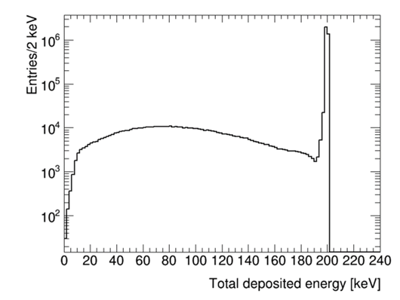
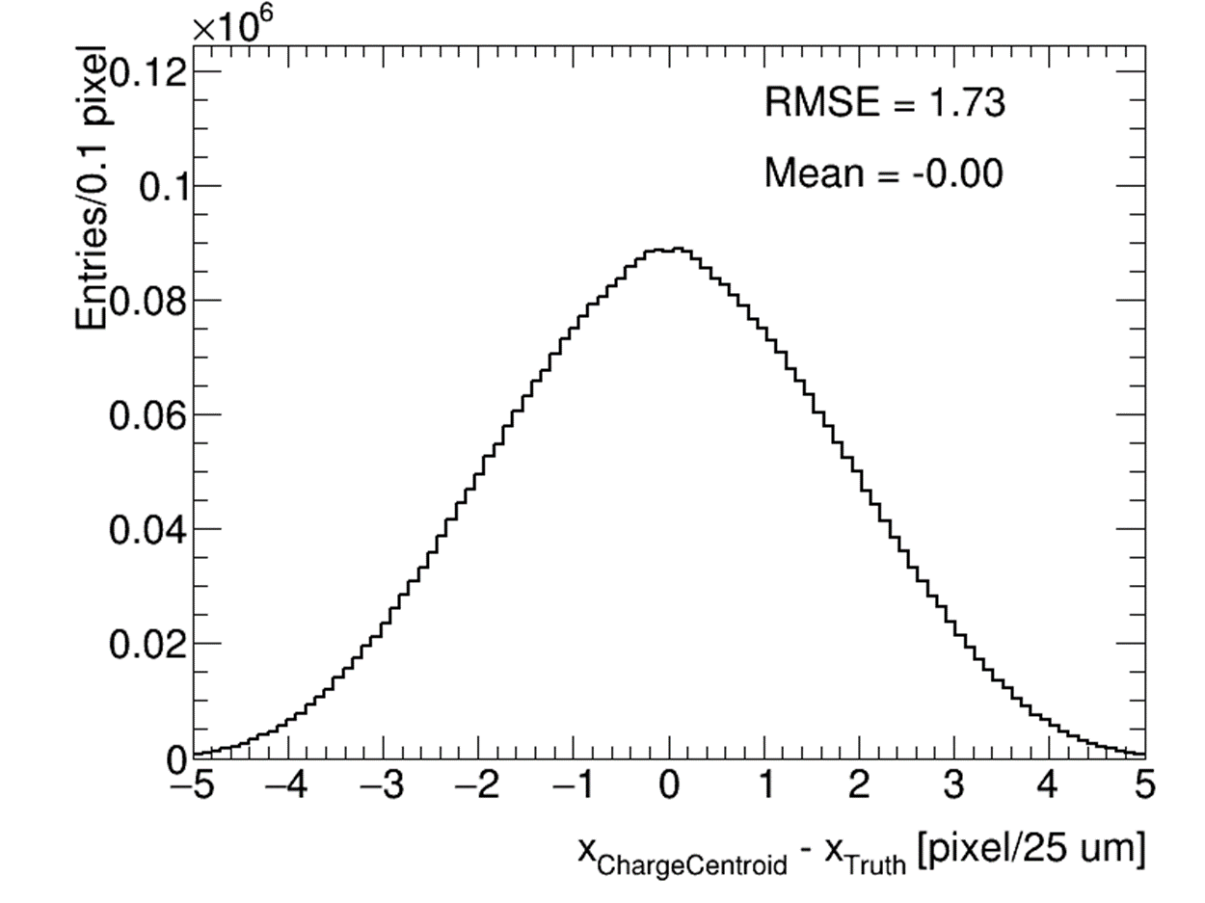
Simulation-based: samples analysis
Simulation setup
Geant4 + charge diffusion model [link]
$320 μm$silicon sensor
$V_{bias}=90 V$
Start with $200 keV$ electrons
Total samples: $4M$
$70\%/30\%$ for training/testing
Simulation analysis
$\sim 15\%$ backscattered electrons
Charge centroid gives $σ_{x}=1.73 pixel$
Backscattered electrons
Charge centroid method

Slide 8
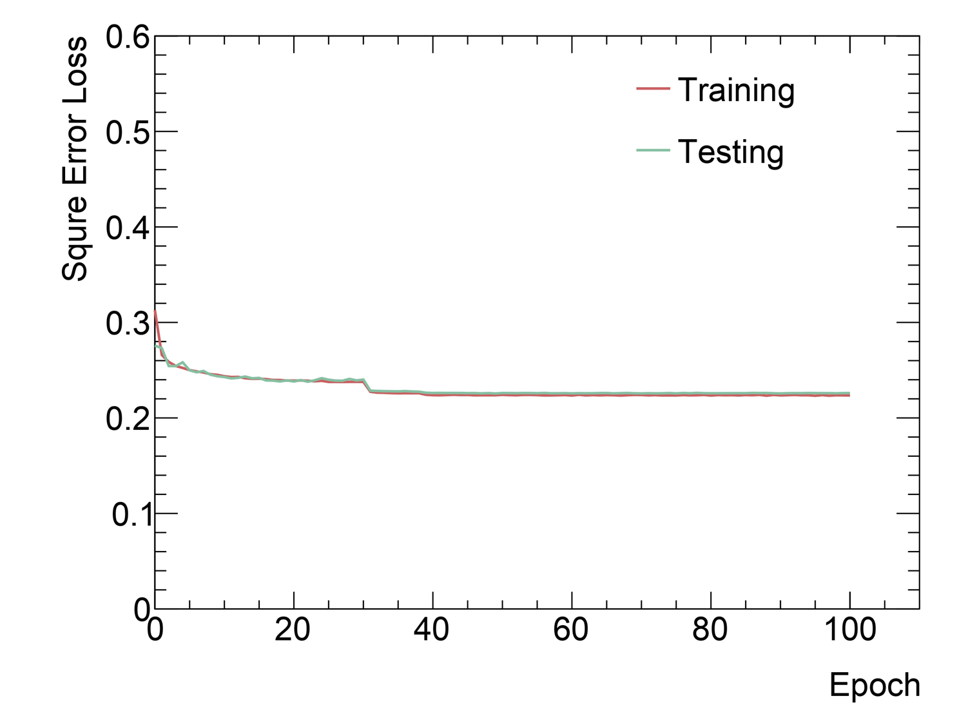
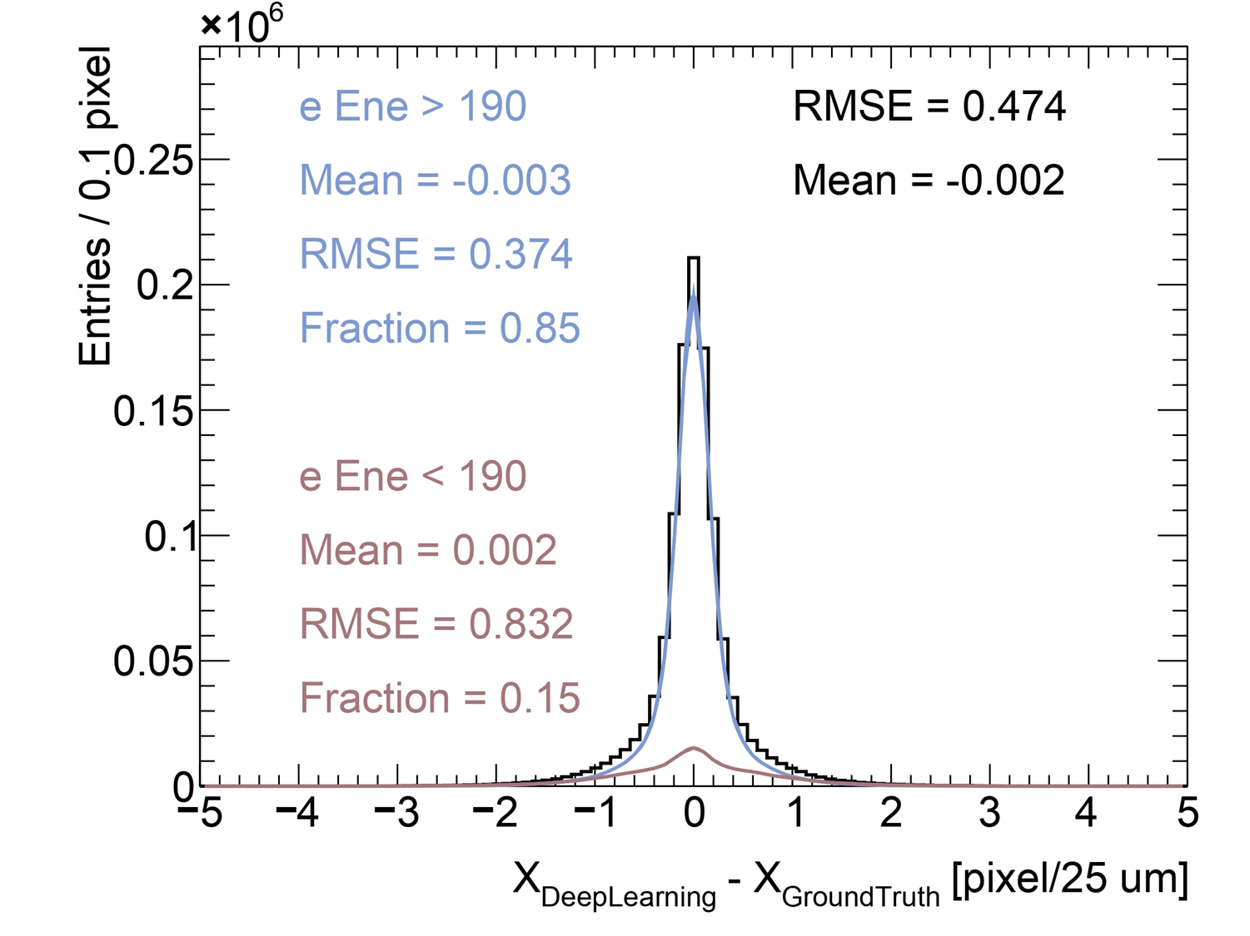
Simulation-based: training and results
Training setup
$100$ epochs/iterations
Data augmentation
Sample rotation and flipping
Training label smoothing
Synthetic noise ($σ=0.18 keV$)
Simulation-based results
Deep learning gives $σ_{x}=0.47$ pixel
Fully deposited $e^{−}$: $σ_{x}=0.37$
Backscattered $e^{−}:σ_{x}=0.83$
Knife-edge measurements
Data processed by the trained model
Super resolution ($0.5×$ physical pitch)
$σ_{x}=0.66$ pixel
Square Error Loss
Testing dataset

Slide 9
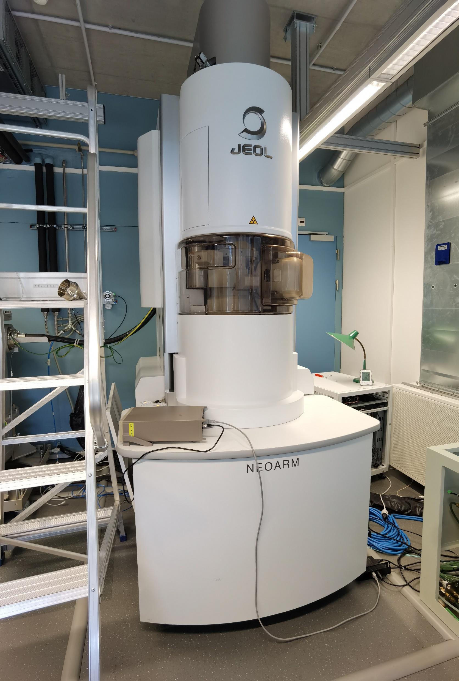
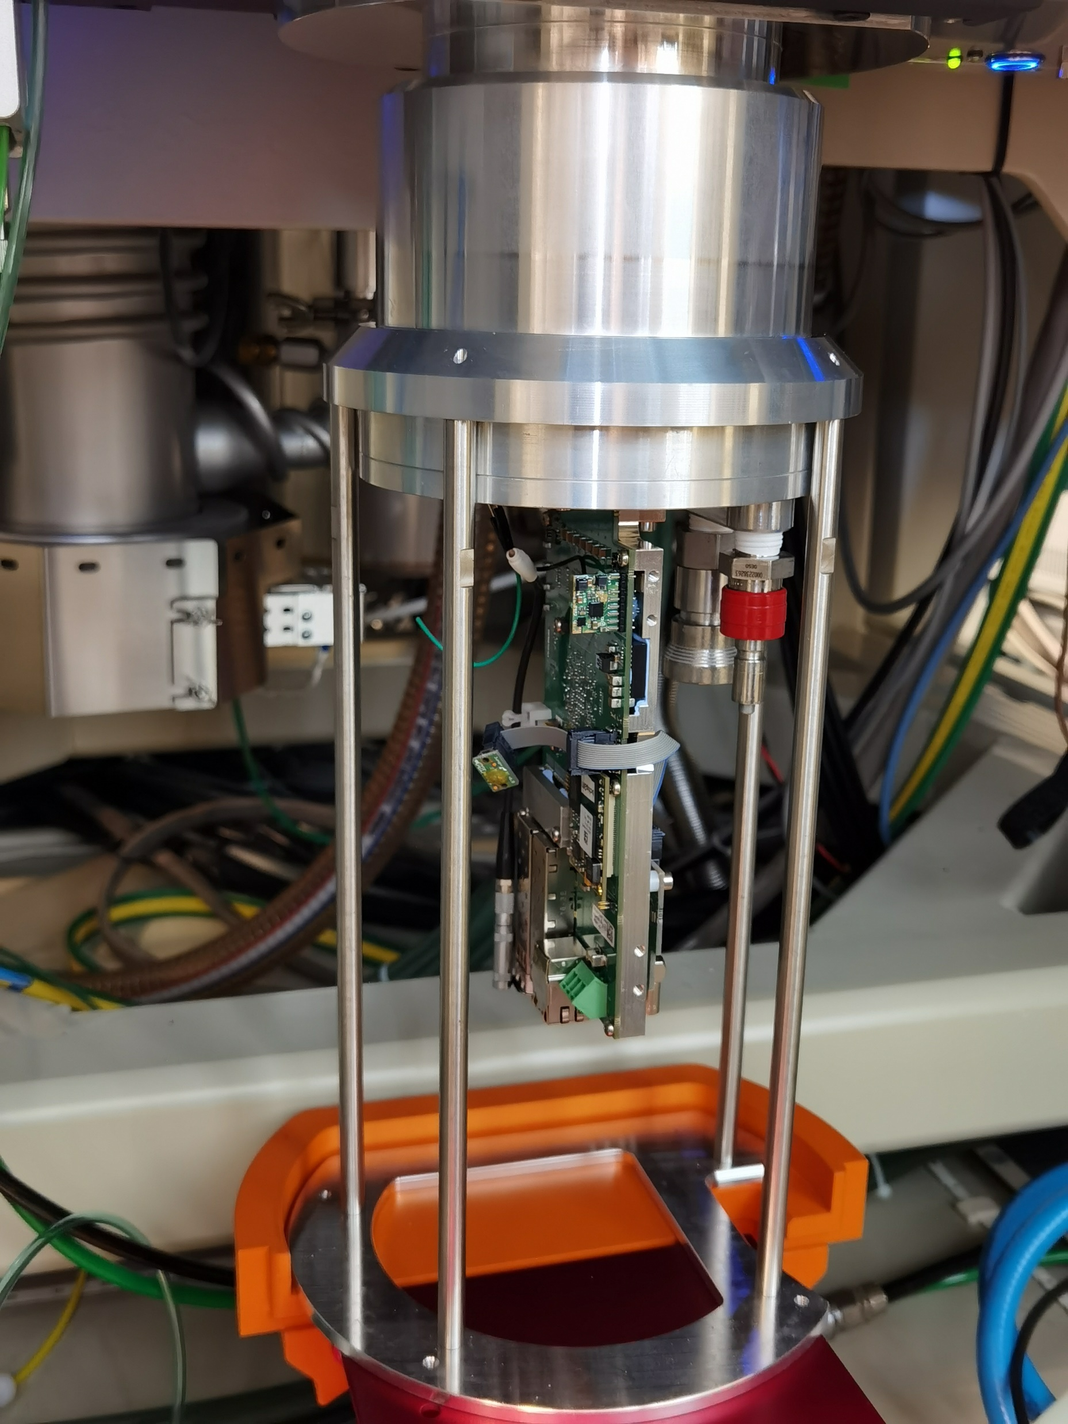
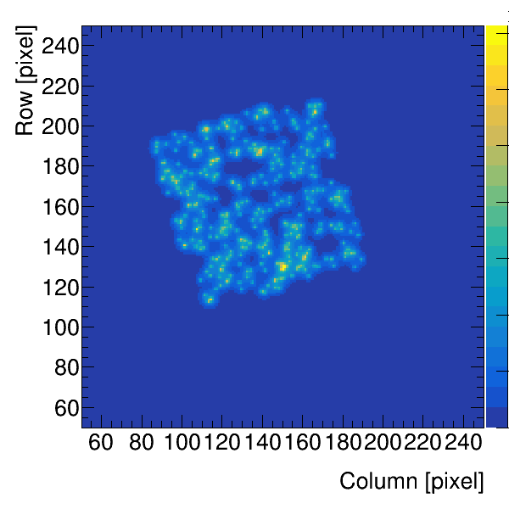
Measurement-based: data taking setup
EM: Jeol JEM ARM200F
$200 keV$ beam
Customized alignments
Perpendicular narrow beam ($\sim μm$)
Detector: MÖNCH v0.3
One tile; $400×400$ pixels
$V_{bias}=90 V$
Ground truth impact points obtaining
EM randomly scans with longer dwell time ($\sim s$)
$430$ scan points $×10,000$ frames
Unbiased ground truth position: $\overline{x}, \overline{y}$
With negligible uncertainty
Overlay of the scanning

Slide 10
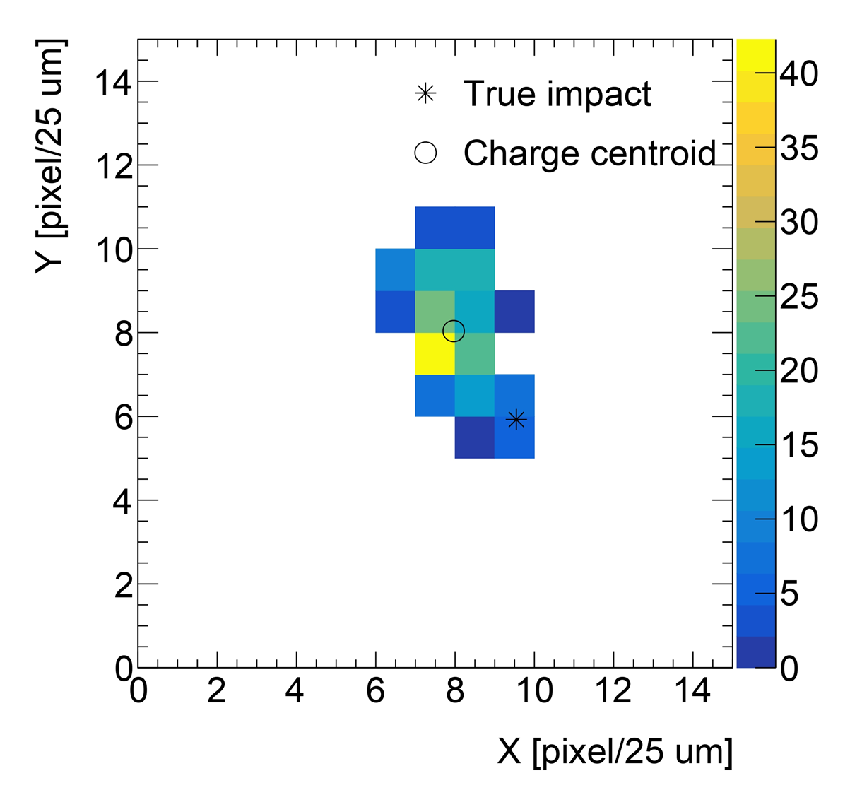
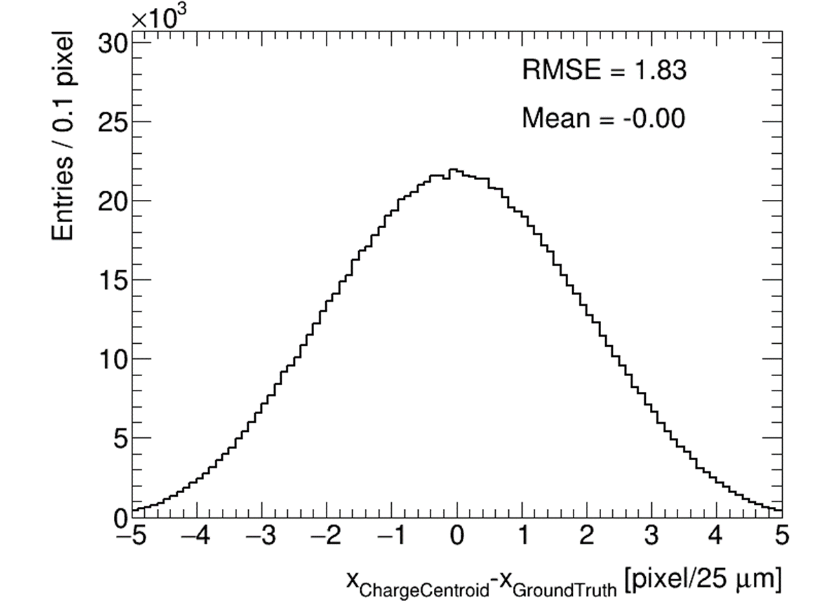
Experiment-based: sample analysis
Frame level
Mask malfunction region
Pedestal subtraction
Energy conversion
Cluster finding and selection
Adjacent pixels over a threshold of $5×Noise≈0.9 keV$
$20 keV<E_{cluster}<220 keV$
Outlier filtered
Total samples: $\sim 1M$
Charge centroid gives $σ_{x}=1.83 pixel$
Charge centroid method

Slide 11
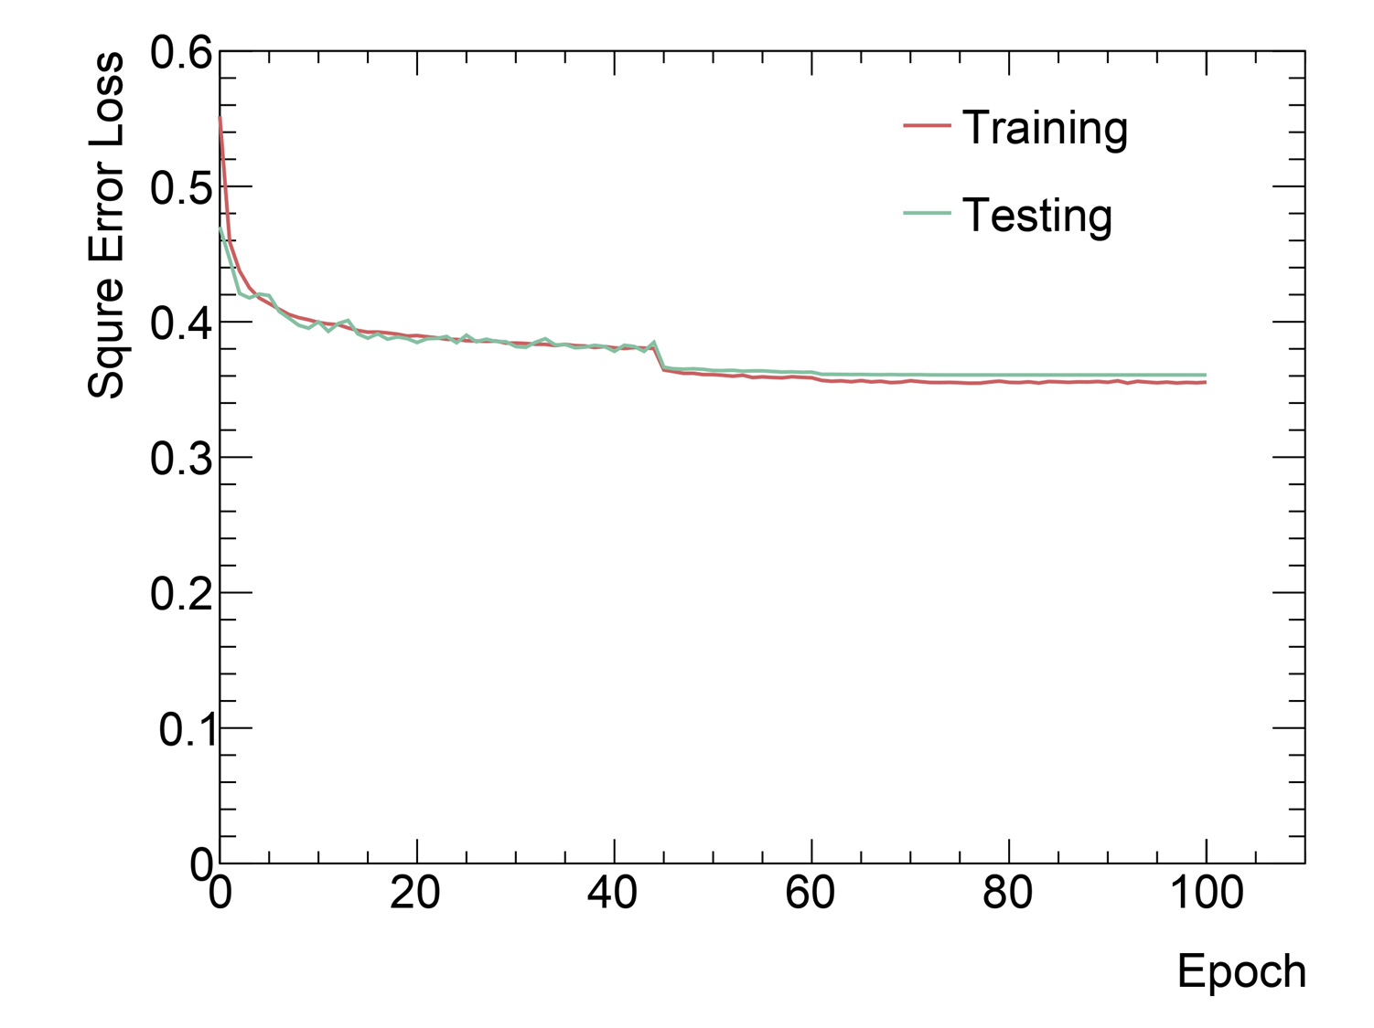
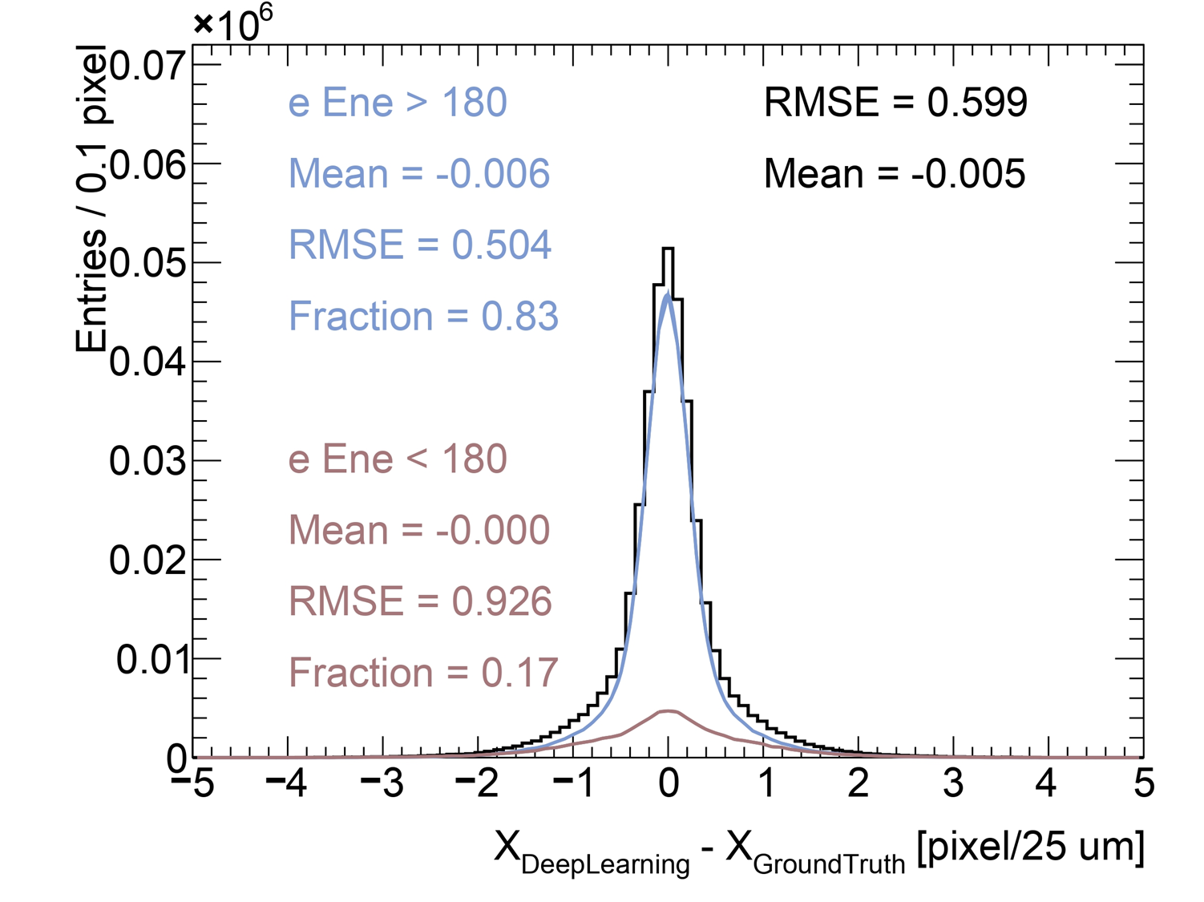
Experiment-based: deep learning results
Training setup
$100$ epochs
Data augmentation
Sample rotation and flipping
Training label smoothing
Experiment-based results
Deep learning give $σ_{x}=0.60 pixel$
Fully deposited $e^{−}$: $σ_{x}=0.50$
Backscattered $e^{−}:σ_{x}=0.93$
Knife-edge measurements
Data processed by the trained model
Super resolution ($0.5×$ physical pitch)
$σ_{x}=0.60 pixel$
Square Error Loss
Testing dataset

Slide 12
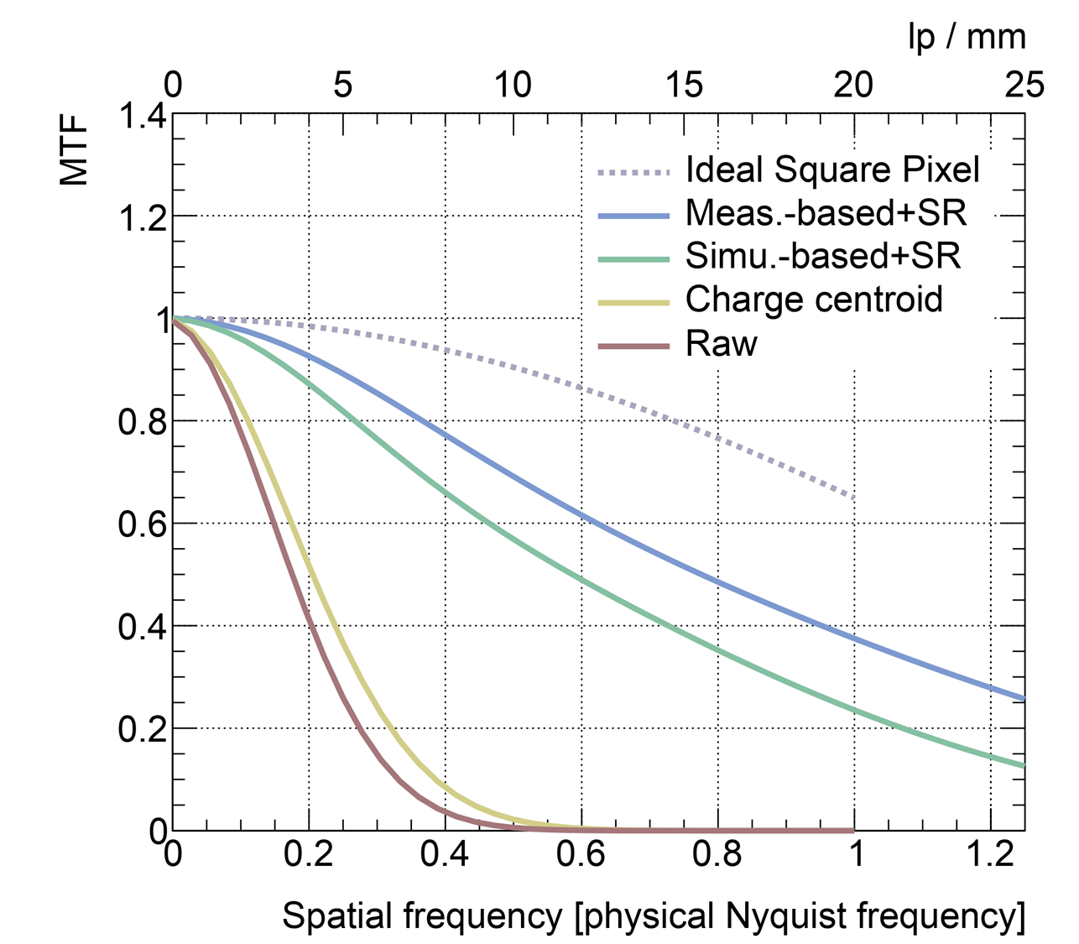
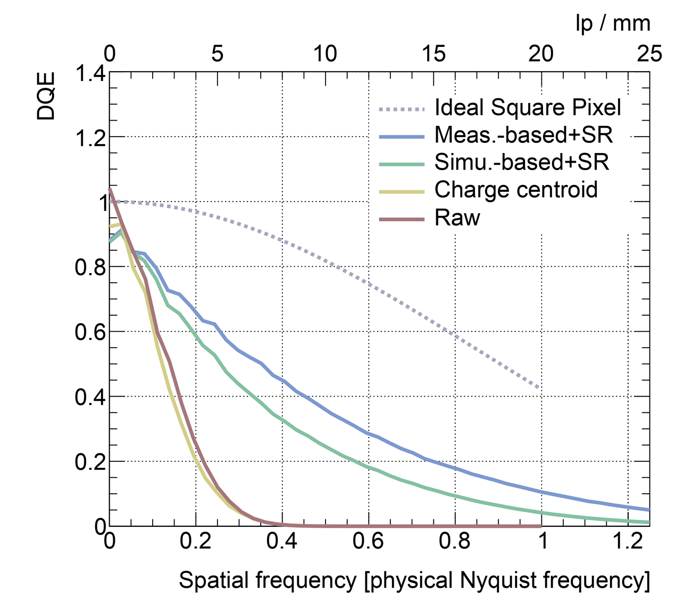
Preliminary MTF and DQE results ($200 keV$)
$$DQE\left(ω\right)={MTF}^{2}\left(ω\right)\frac{d_{n}^{2}}{nNPS(ω)}$$
$$MTF\left(ω\right)=ℱ\left[PSF\left(x\right)\right]$$
Electron flux $≈18 e^{−}/s/pixel$

Slide 13
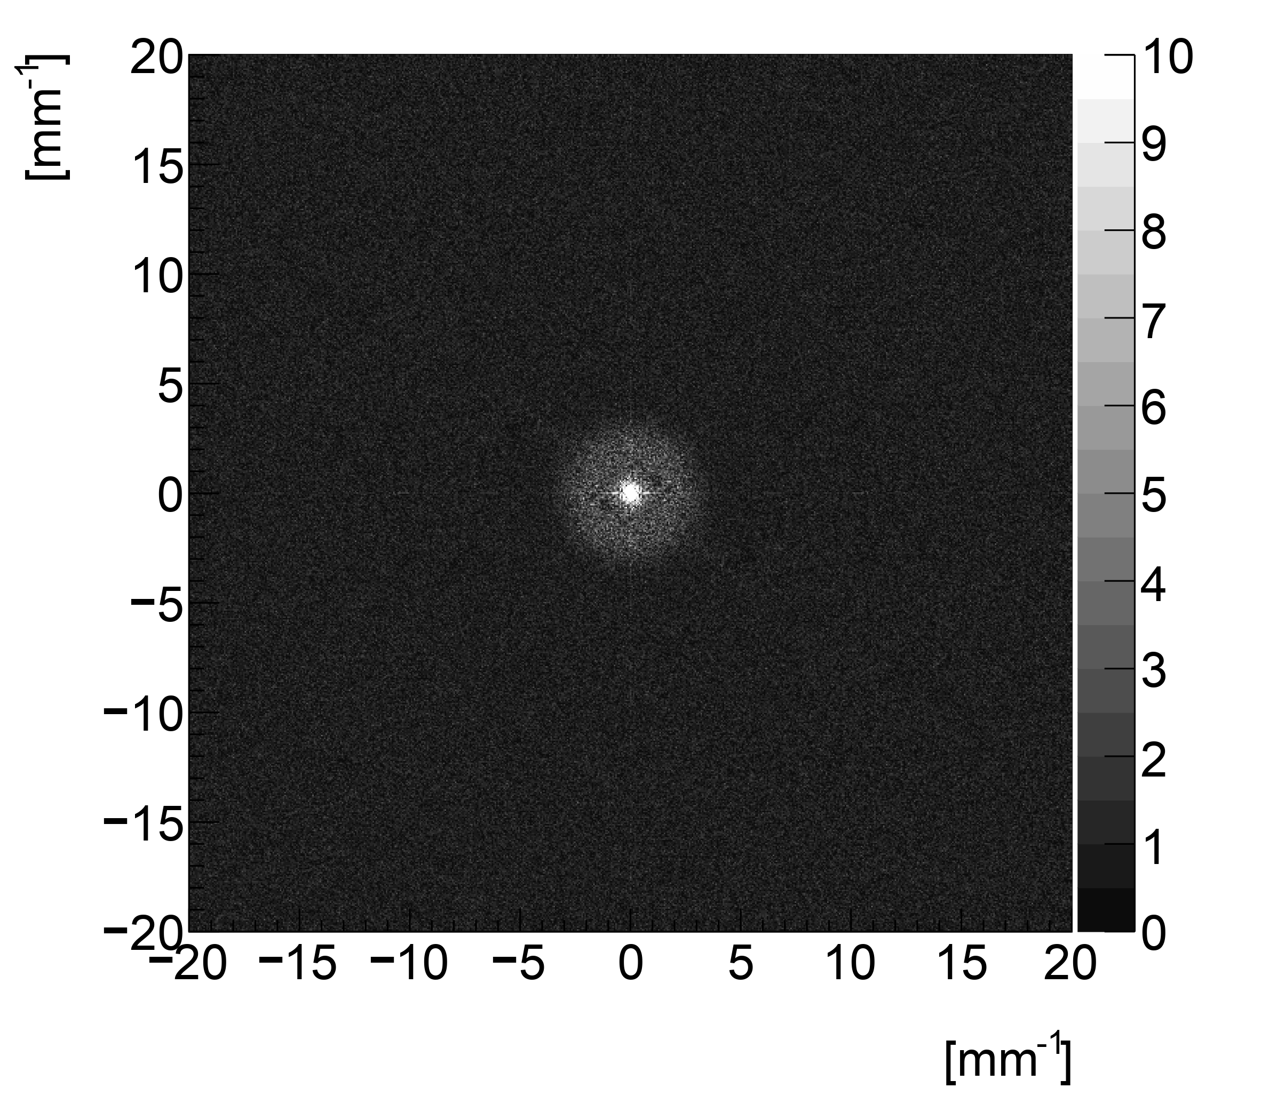
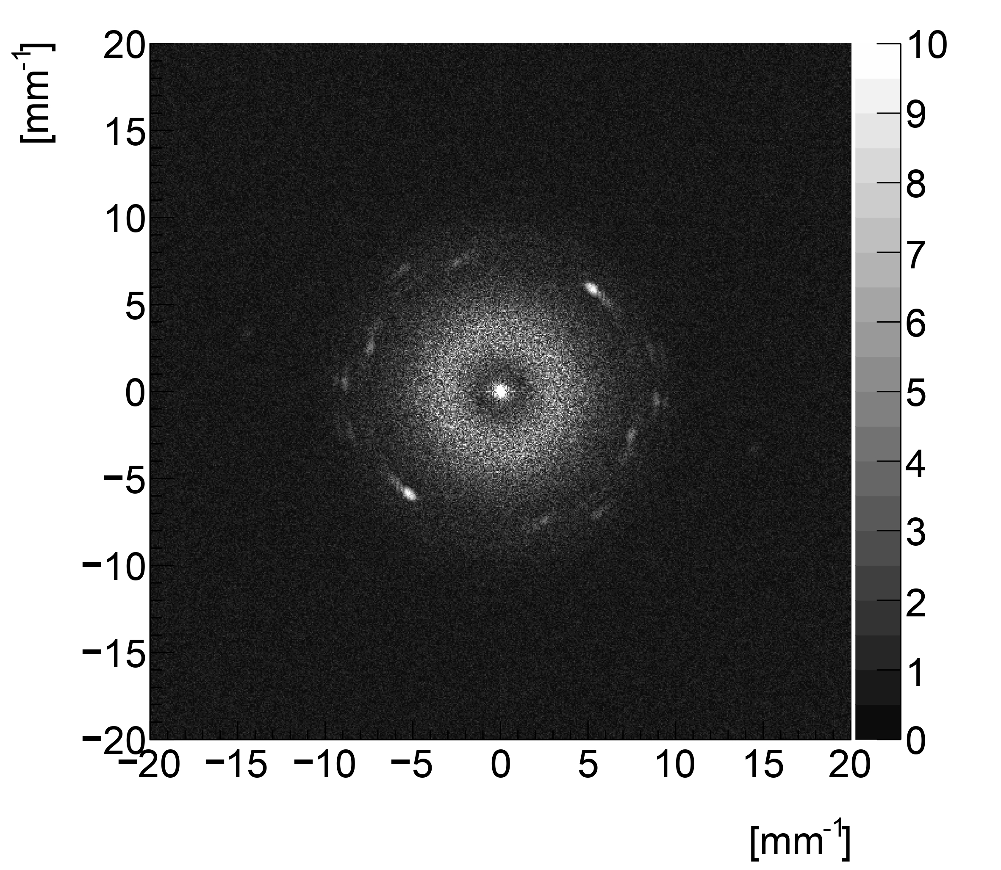
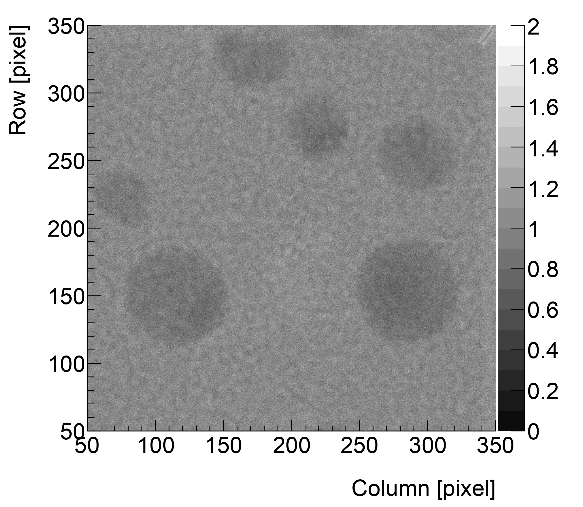
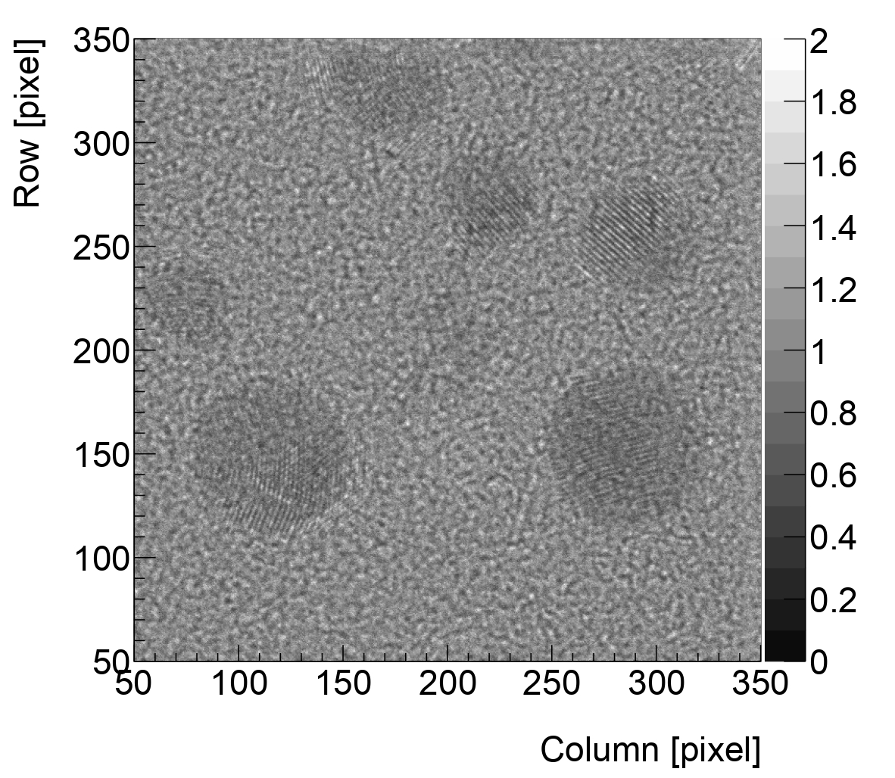
Results from the measurement data
TEM sample with continuous carbon and gold nanoparticles
Charge centroid
Deep learning
With deep learning, we can see the ring corresponding to $2.35 Å$ atom arrangements

Slide 14
Summary and outlook
DOI 10.1088/1748-0221/19/01/C01020
Significant improvements in spatial resolution on MÖNCH, via deep learning
Promising performance for energies lower than $200 keV$
Outlook
Further detector calibration
Further simulation development
Data processing pipeline
MÖNCH spatial resolution | Charge centroid | Deep learning + super resolution
 |  | Simulation based model | Measurement based model
$σ_{x}$ [$25 μm$ pixel] | 1.83 | 0.66 | 0.60
Notes:
E.g., pixel-wise gain and pedestal

Slide 15
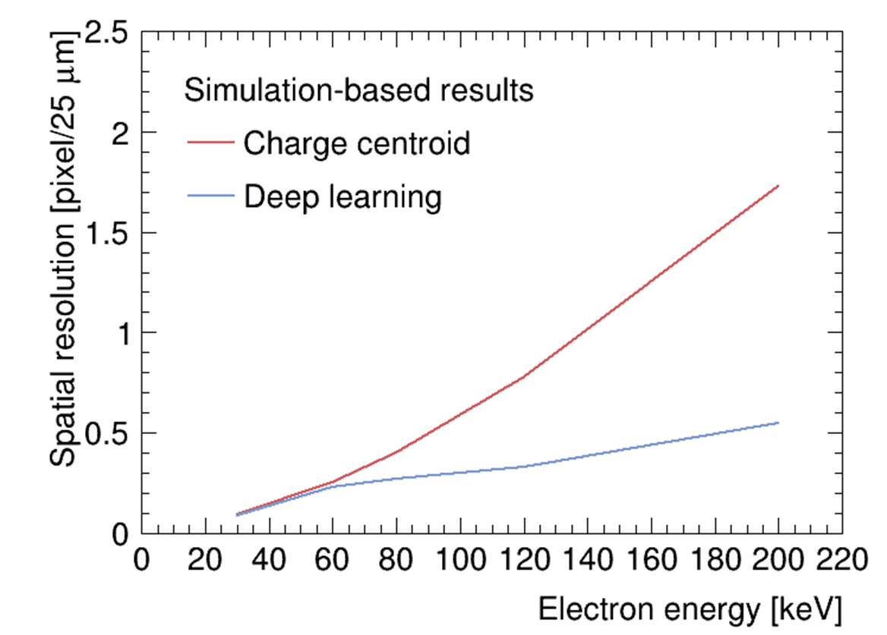
Backup: early-stage simulation-based results

Slide 16
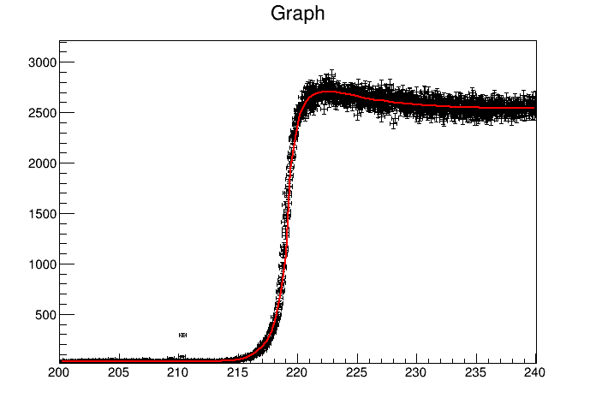
Backup: Fitting function for ESF
$$p_{0}+A_{1}\left(1+Erf\left(\frac{x−μ}{\sqrt{2}σ_{1}}\right)\right)+A_{2}\left(1+Erf\left(\frac{x−μ}{\sqrt{2}σ_{2}}\right)\right)+H\left(x\right)A_{3}Exp(\frac{x−μ}{τ})$$
$Chi2/NDF<2$
Double-Erf term
Corresponding to different behaviors of the backscattered electrons and fully-deposited electrons
Exponential term
To model the bump around the edge due to single-electron-cluster selection

Slide 17
Backup: Deep learning workflow
Testing samples
Model structure designed in prior;
Parameters get updated during training
Training samples
Neural network model
Loss calculation & backward propagation
Training samples
Neural network model
Loss calculation & backward propagation
Samples consist of readout pattern and truth impact position
Loss: distance between predictions and labels;
Loss updates model parameters via gradient descent
Results compared with label

