Slide 1
Hybrid detectors for soft X-ray photon science using iLGAD sensors
Viktoria Hinger :: Postdoc :: PSI Center for Photon Science :: Detectors Group
19th TREDI Workshop on Advanced Silicon Radiation Detectors :: 21 February 2024

Slide 2
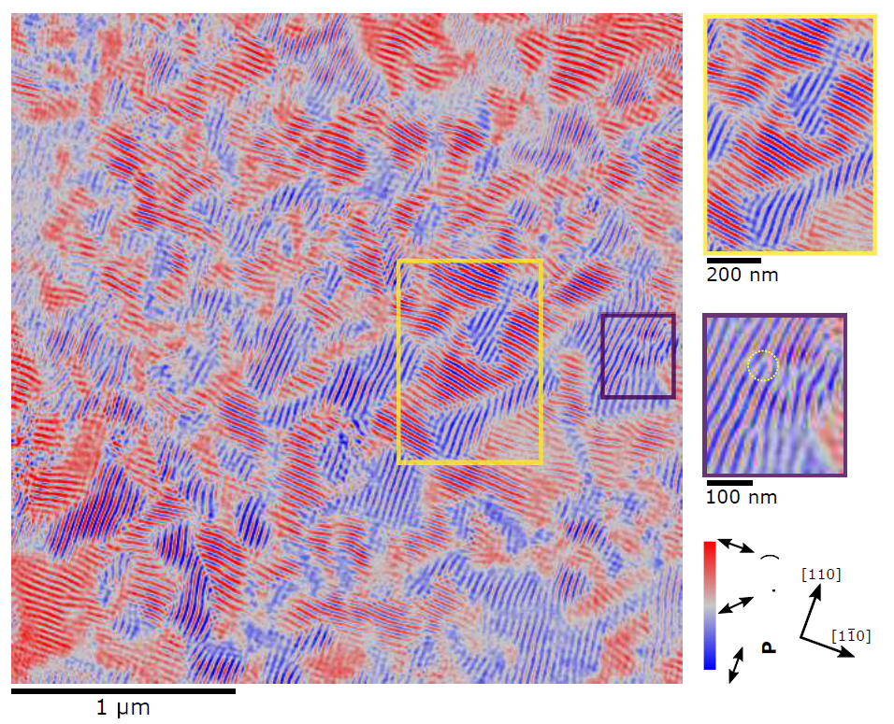
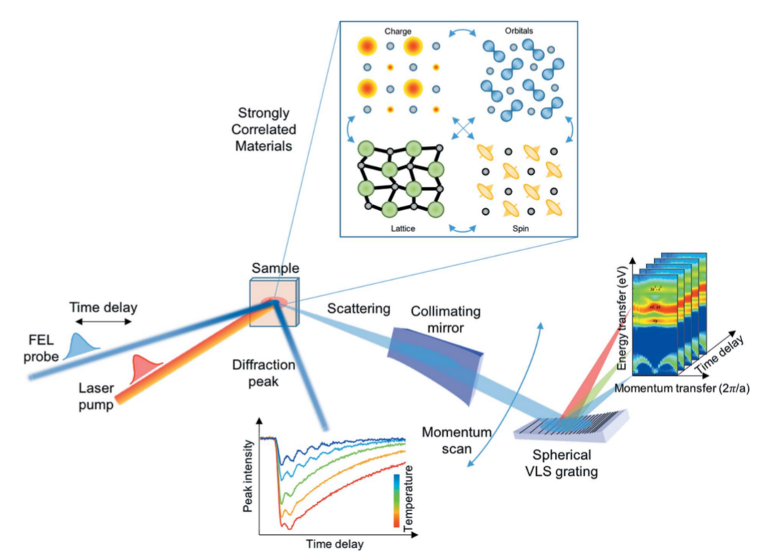
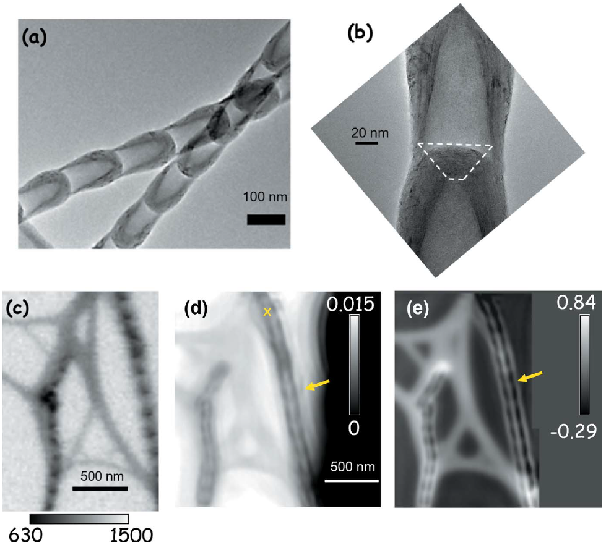
Soft X-ray applications at synchrotrons and FELs
L-edges of 3d transition metals
Fe, Cu, Zn, …
Batteries
Quantum materials
Superconductors …
“Water window” and light elements
C and O K-edges (282 – 543 eV), B, F, Mg, …
Biological samples
Catalysis
Photosynthetic water splitting …
TEM
STXM
Amplitude
Phase
Magnetic contrast ptychography of BiFeO₃
T. A. Butcher et al 2023 arXiv:2308.13465
Time resolved resonant inelastic X-ray scattering (RIXS)
R. Abela et al 2019 J. Synchrotron Rad. 26, 1073-1084
BN nanobamboo STXM & ptychography imaging, 192 eV
J. Vijayakumar et al 2023 J. Synchrotron Rad. 30, 746-757

Slide 3
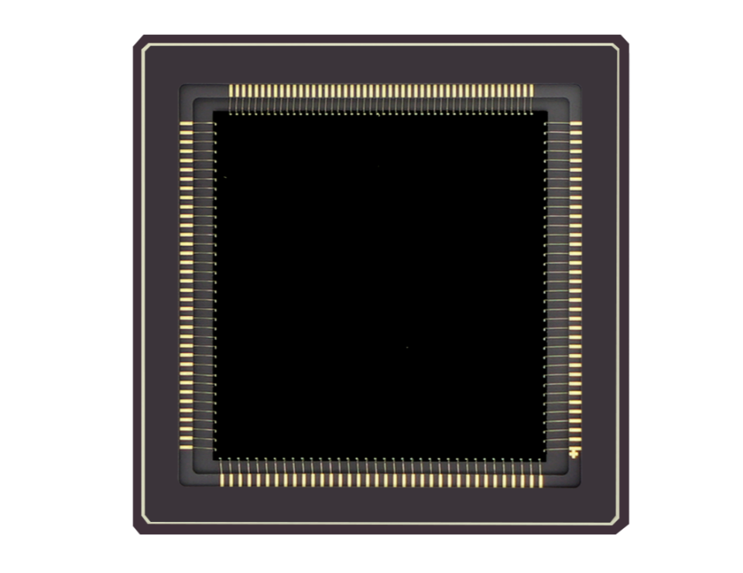
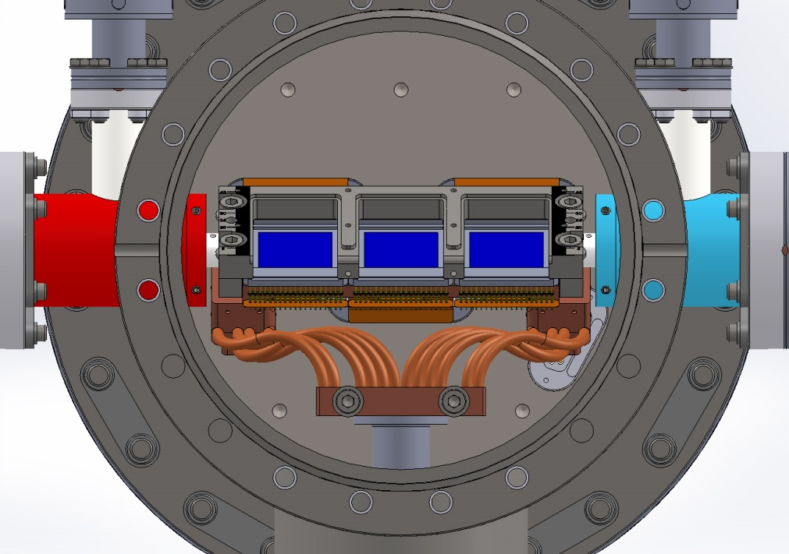
Limitations of current systems: frame rate and area
Charge coupled device (CCD)
Low noise ($\sim$ 1 e⁻)
High spatial resolution
Slow readout ($\sim$ 1 Hz )
Shutter required
Limited area ($\sim$ 2 × 2 cm²)
Scientific CMOS image sensor
Low noise (1-2 e⁻)
High spatial resolution
Moderate frame rates (≤ 70 Hz)
Limited dynamic range
Limited area ($\sim$ 2 × 2 cm²)
Electron multiplying CCDs at SLS SAXES
(RIXSCam, https://www.xcam.co.uk), courtesy of T. Schmitt
GSENSE400BSI (https://gpixel.com)
K. Desjardins et al 2020 J. Synchrotron Rad. 27, 1577-1589
pnCCD: $\sim$3e⁻, $\sim$ 150 Hz, 4 × 8 cm²
M. Kuster et al 2021 J. Synchrotron Rad. 28, 576-587.

Slide 4
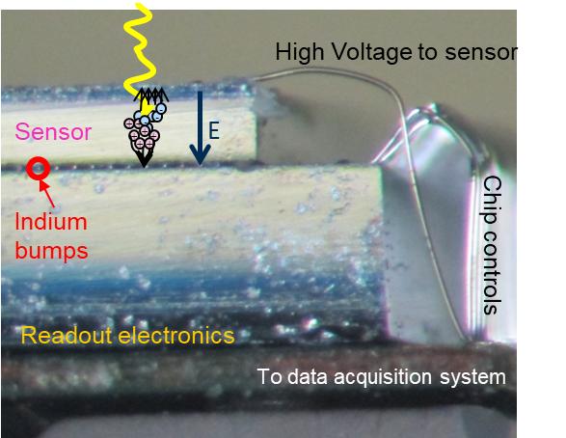
Hybrid detectors can tackle these challenges …
High frame rates (≥ kHz)
Large dynamic range ($\sim$ 10⁴-10⁵ photons charge integrating, “unlimited” for photon counters)
Customizable area (e.g., 4 × 8 cm² single module, tileable)
Notes:
Could put pictures

Slide 5
… if we resolve limitations in the soft X-ray range
Current limitations
Readout noise (≥ 20 e⁻)
Low quantum efficiency at soft X-ray energies
We can optimize sensor and chip separately!

Slide 6
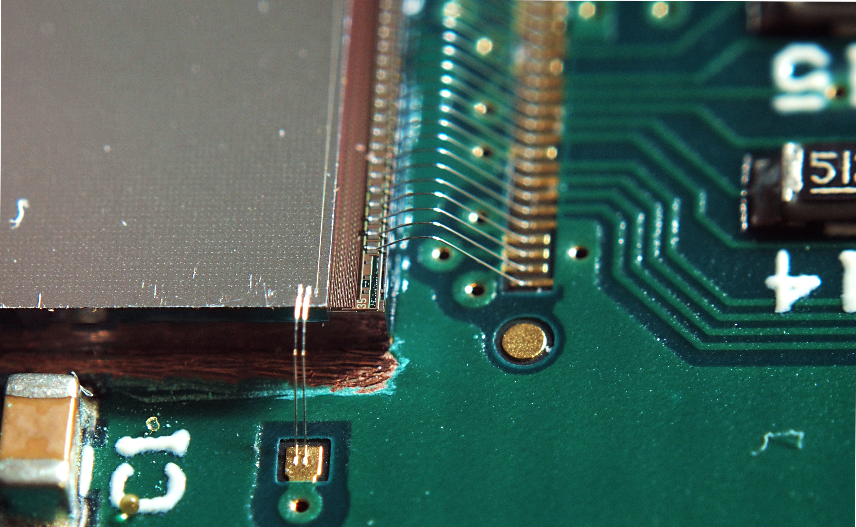
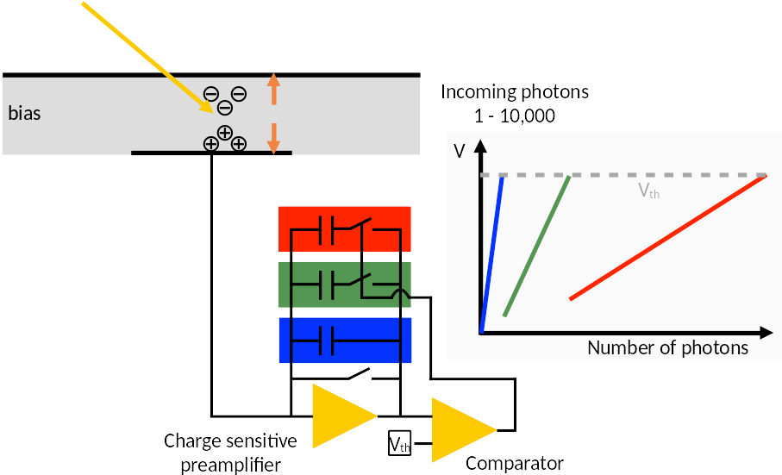
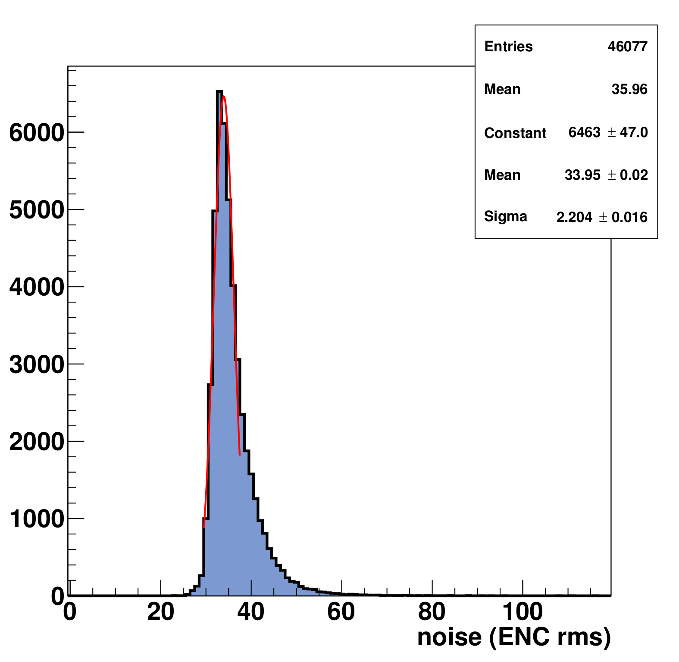
JUNGFRAU – low noise, high dynamic range
Charge integrating
75 x 75 µm² pixel
@ 12 keV
Jungfrau mountain
Wire bonded ASIC
Dynamic gain switching
G2
Noise below Poisson limit over the full dynamic range
Low-noise ASIC version JUNGFRAU 1.1
G1
G0
max. 2.2 kHz frame rate
for continuos readout
34 e⁻ r.m.s ENC (was 52 e⁻ in JF1.0)
SNR $\sim$ 10 @ 1.2 keV (detection limit for JUNGFRAU with standard sensors)
Courtesy of A. Mozzanica

Slide 7
Thin entrance window improves quantum efficiency
M. Carulla et al 2024 Sensors 24, 942
Thin passivation
Passivated interface
62% at 250 eV: comparable to standard CCD and CMOS image sensors
Al/Si interface
Std. sensor

Slide 8
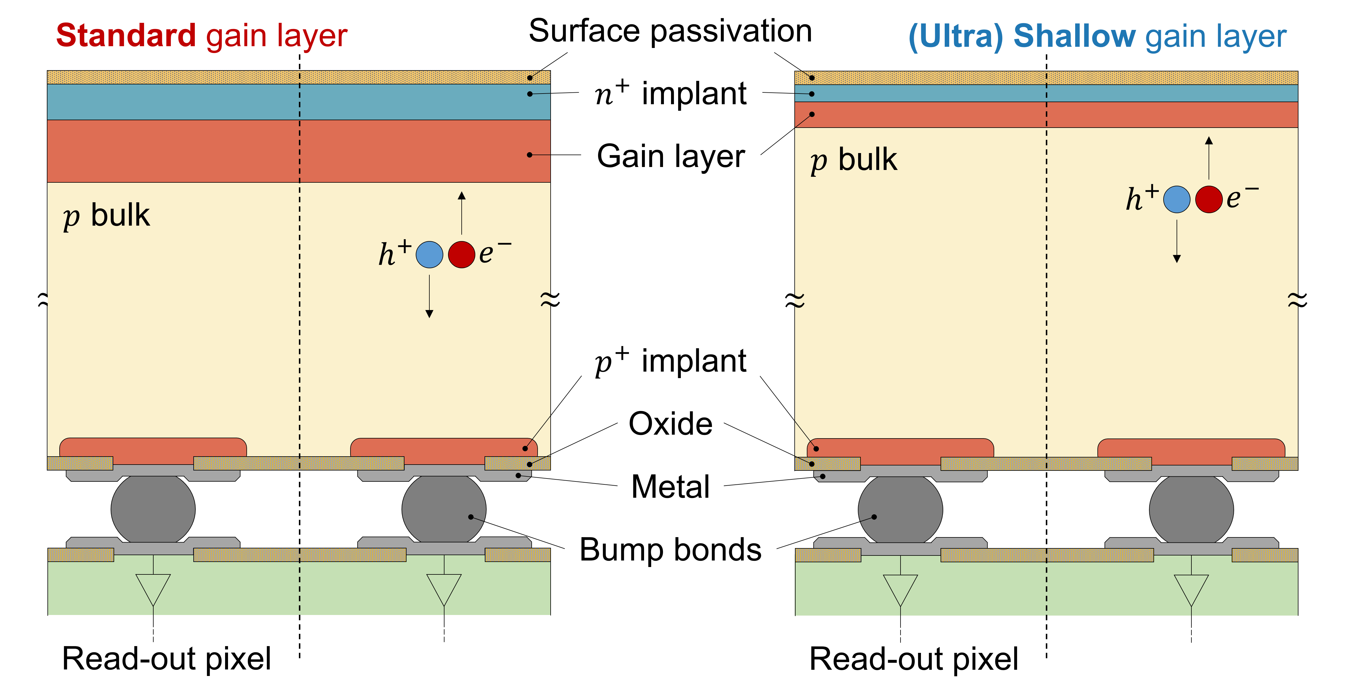
Inverse low gain avalanche diode (iLGAD) sensors for soft X-rays
Courtesy of F. Baruffaldi

Slide 9
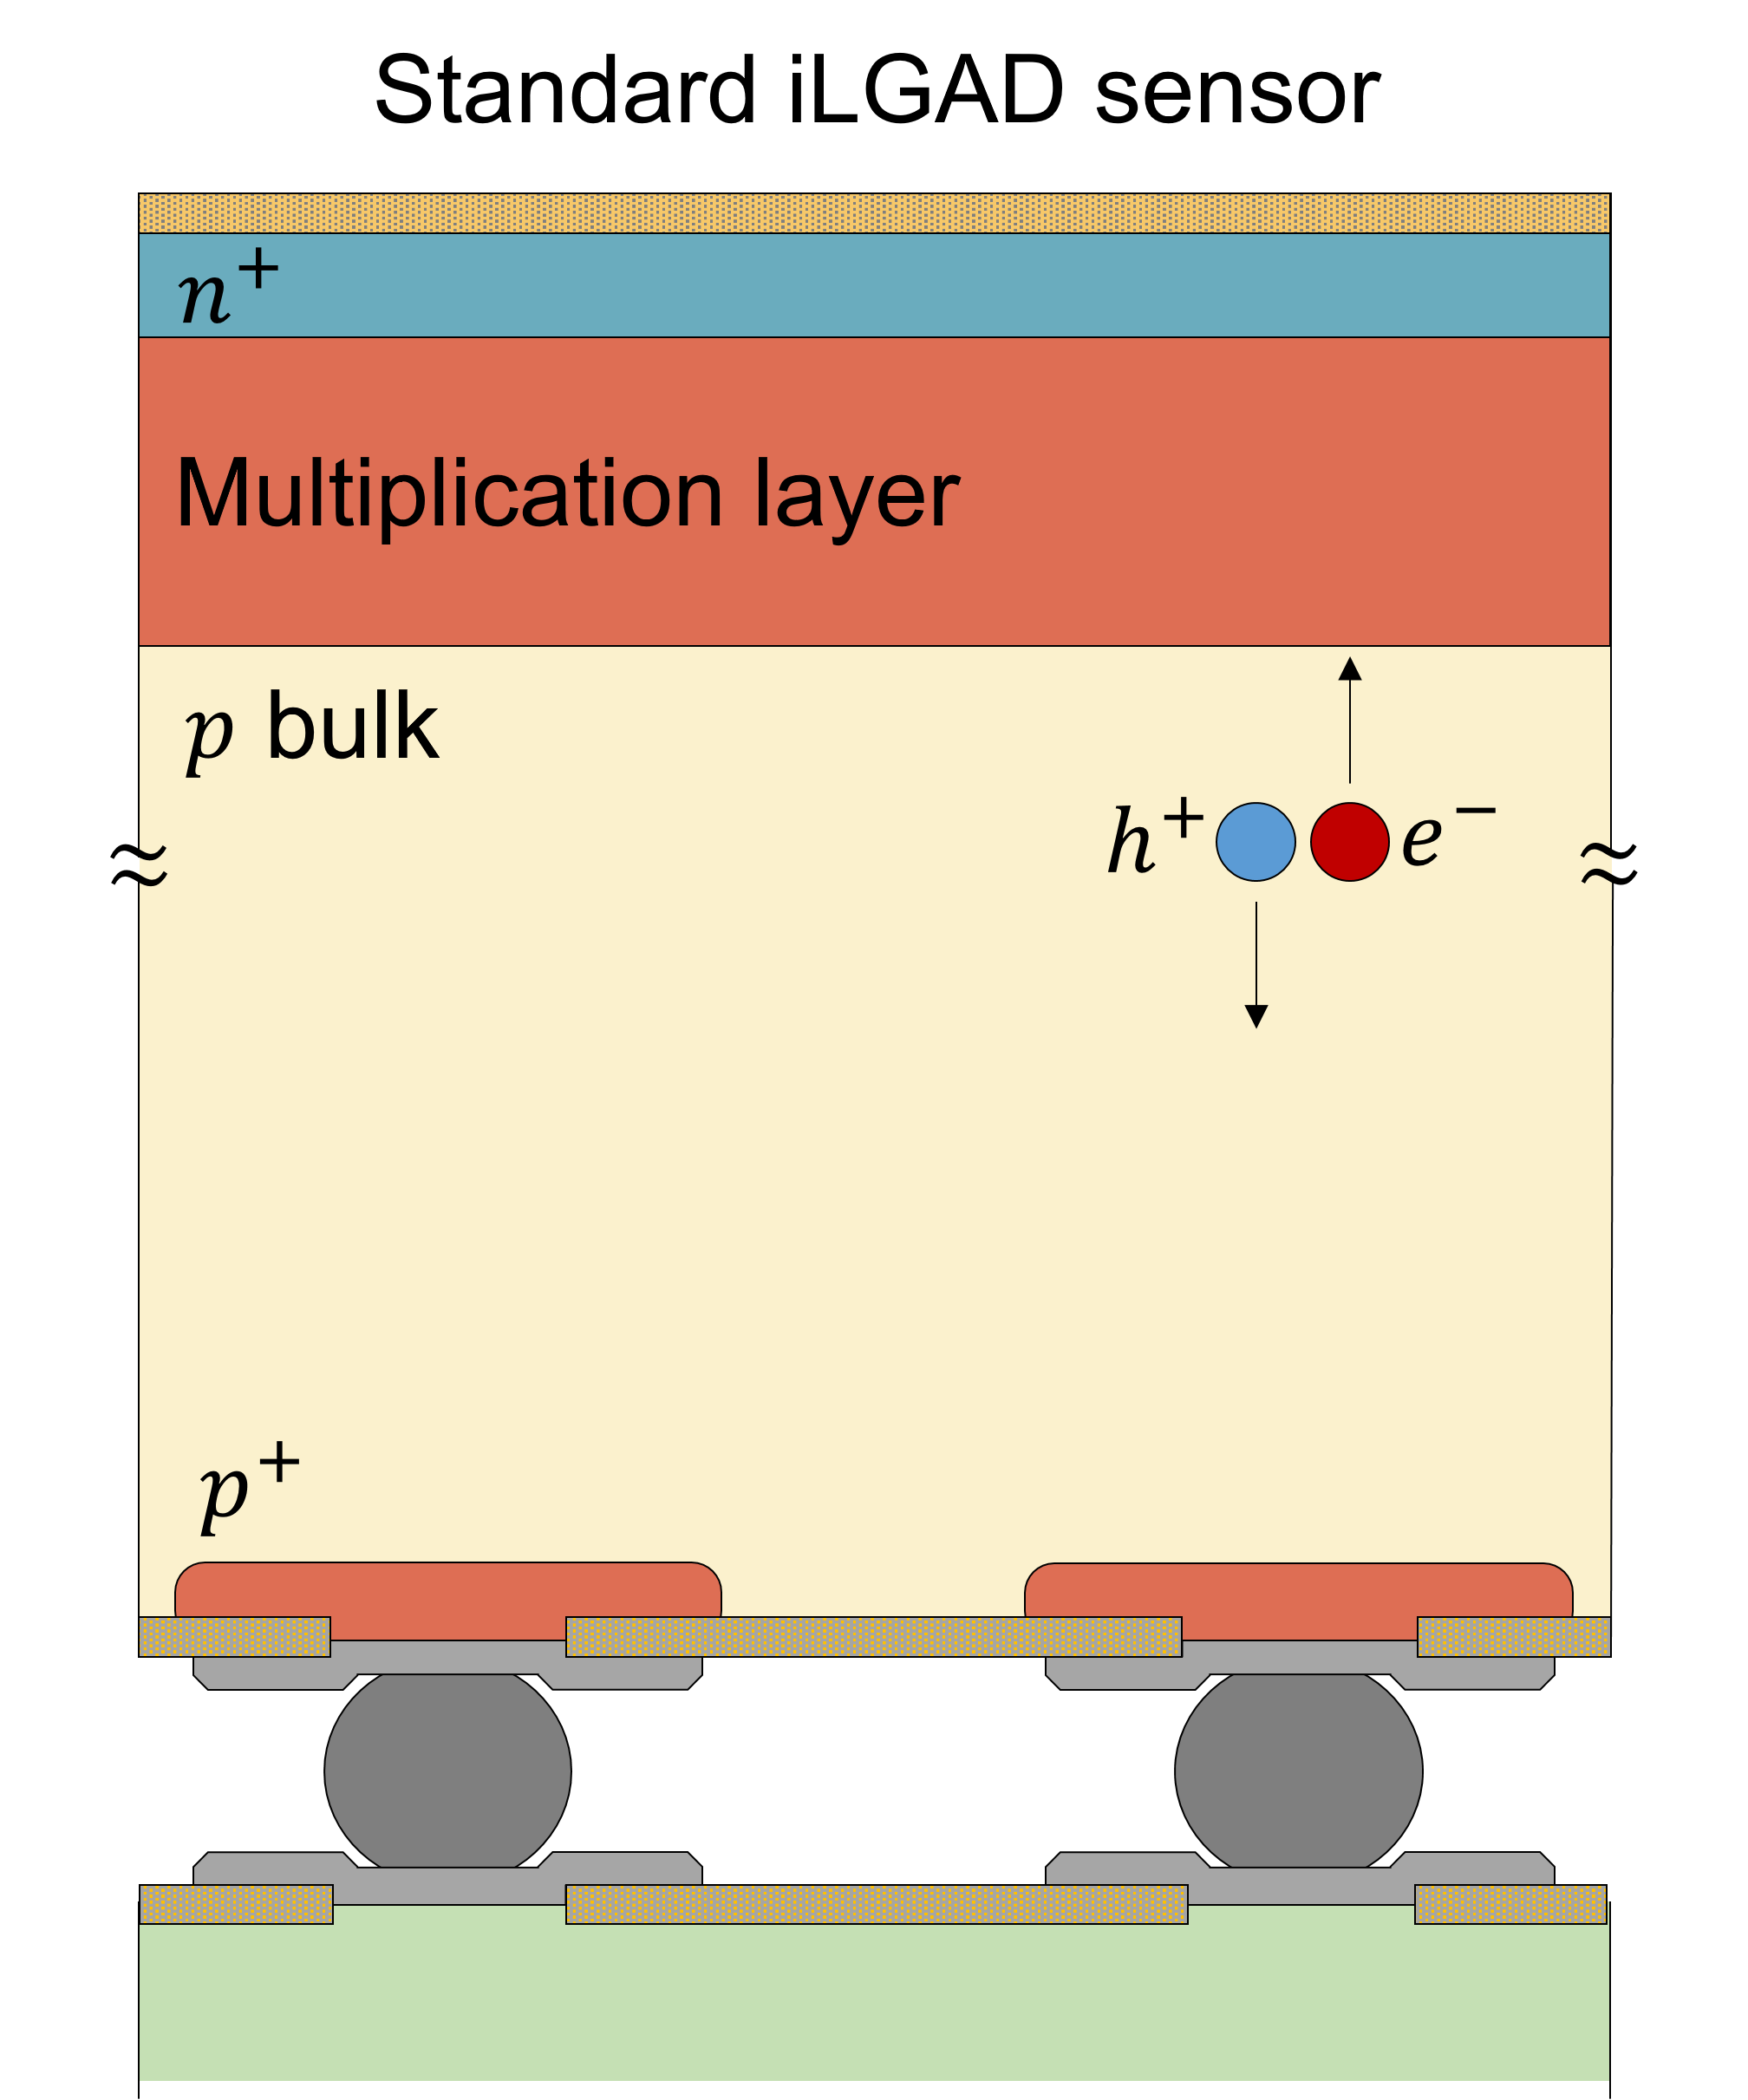
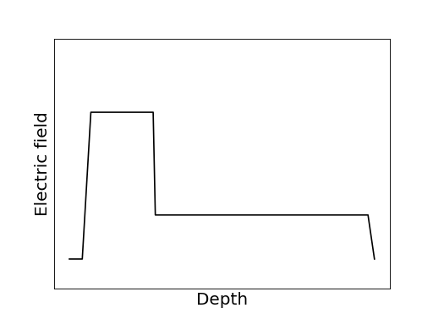
iLGAD depth-dependent multiplication factor
+
+
-
holes
-
+
-
-
+
-
+
+
-
-
+
-
-
+
-
electrons
Courtesy of M. Carulla

Slide 10
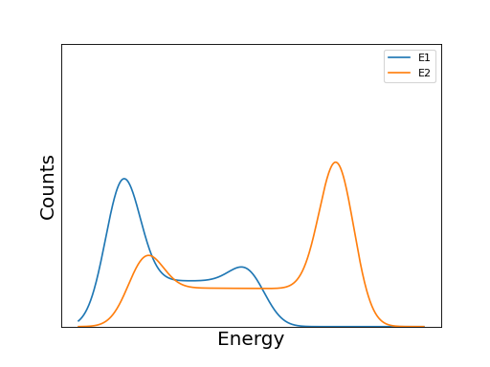
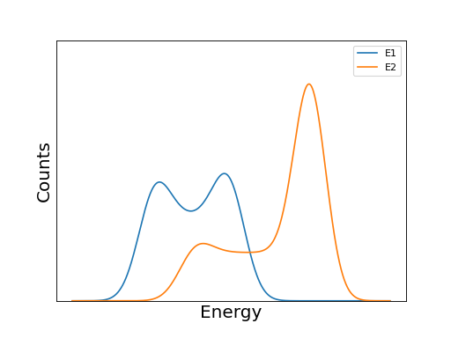
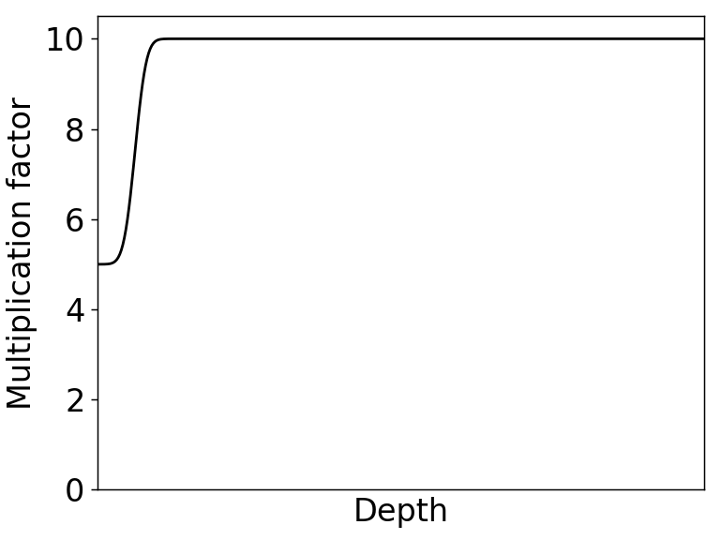
iLGAD depth-dependent multiplication factor
Standard gain layer
(Ultra) Shallow gain layer
M_{h}/M_{e} $\sim$ 0.25
E1 < E2
M_{h}/M_{e} $\sim$ 0.5
E1 < E2
n+
n+
M_{e}
gain layer
M_{e}
gain layer
M_{h}
M_{h}
A. Liguori et al 2023 JINST 18 P12006
Courtesy of M. Carulla

Slide 11
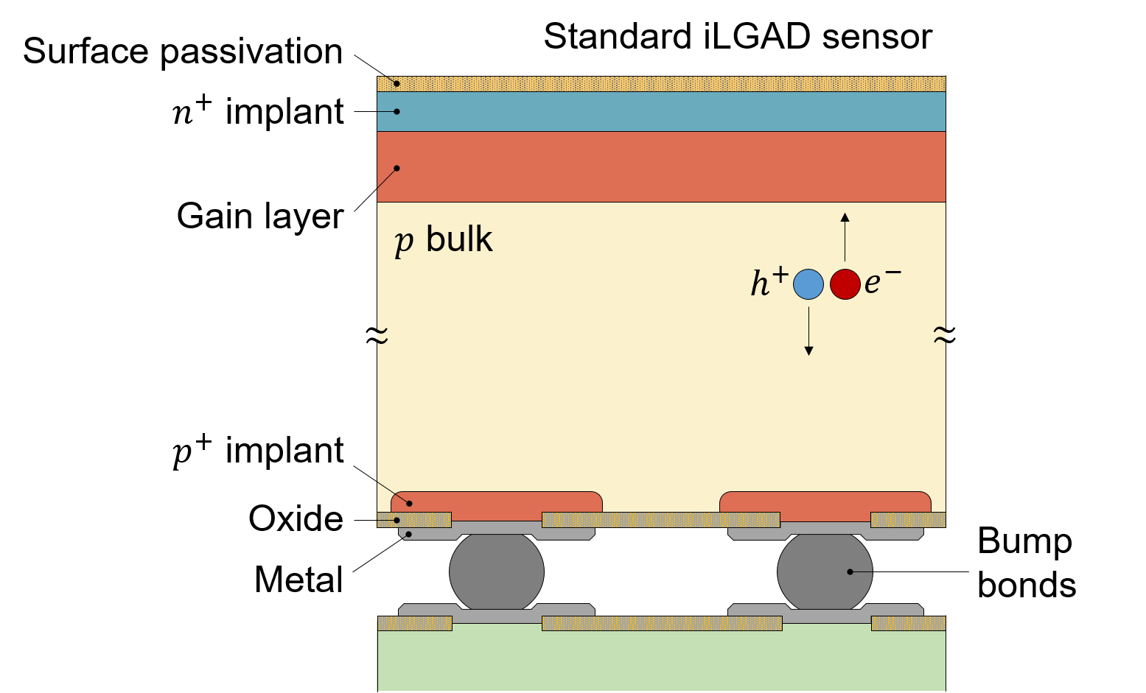
The first JUNGFRAU-iLGAD prototype
G2
G1
G0
JUNGFRAU 1.1
Standard gain layer

Slide 12
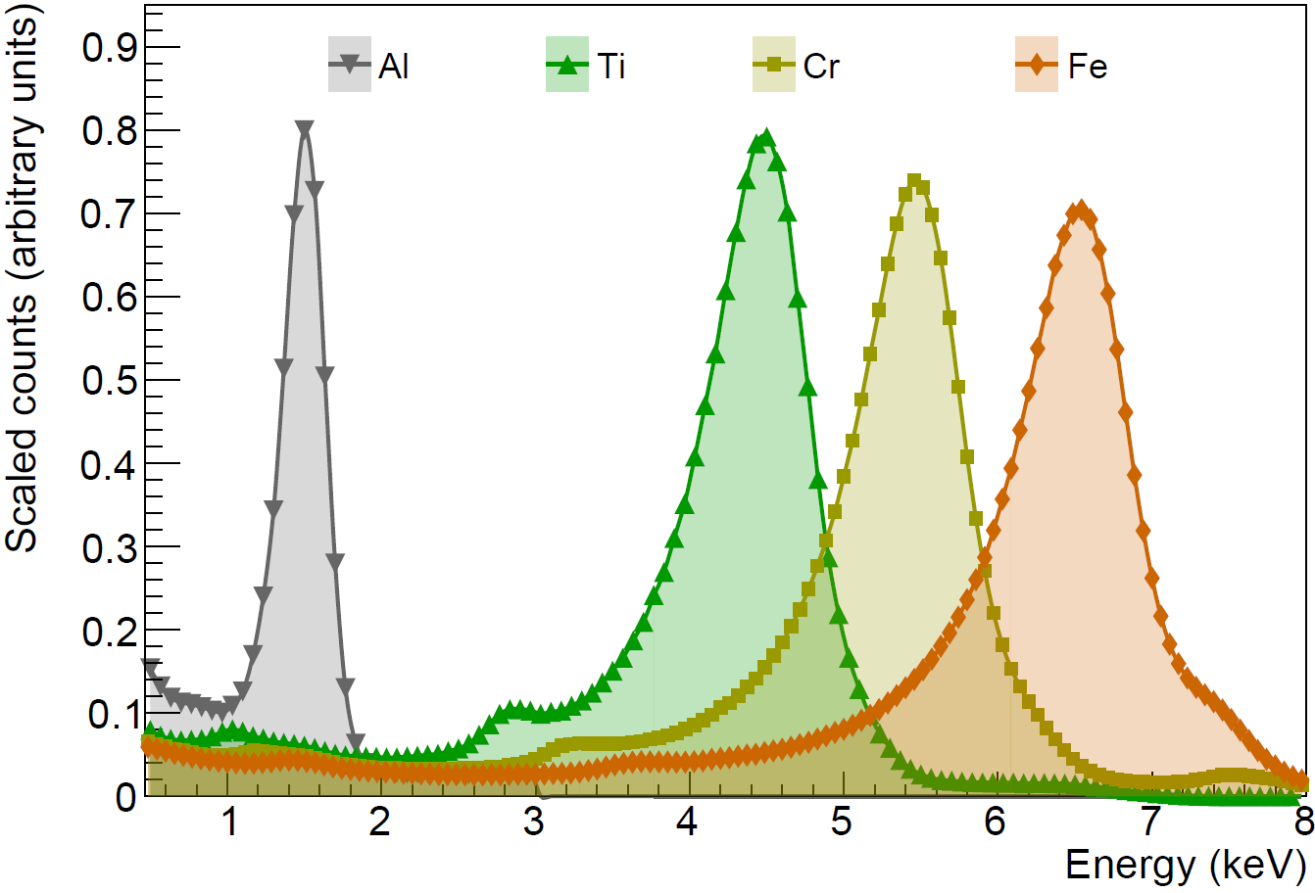
Characterization using X-ray fluorescence
10 µs, -22°C, 2 × 2 clusters, cumulative spectra across 80 × 50 pixels
200 V bias
Four metal targets
Al (K_{α}: 1.5 keV)
Ti (K_{α}: 4.5 keV)
Cr (K_{α}: 5.4 keV)
Fe (K_{α}: 6.4 keV)
-22°C to 15°C
5 µs to 100 µs integration time
V. Hinger et al 2024 Front. Phys. (forthcoming)

Slide 13
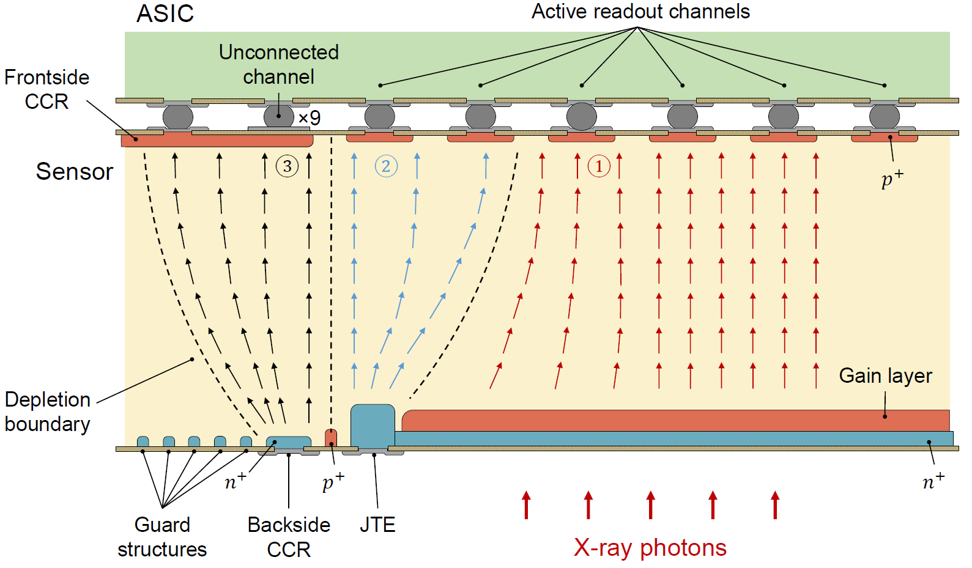
Border pixels measure non-amplified signal…

Slide 14
…allow extracting iLGAD multiplication factor M
Ti K_{α}-line (4.5 keV)
Multiplication

Slide 15
Two domains of iLGAD multiplication factor M
-22°C, 10 µs integration time
$\sim$ 10% variation
Notes:
3.5% pixel-by-pixel gain variations

Slide 16
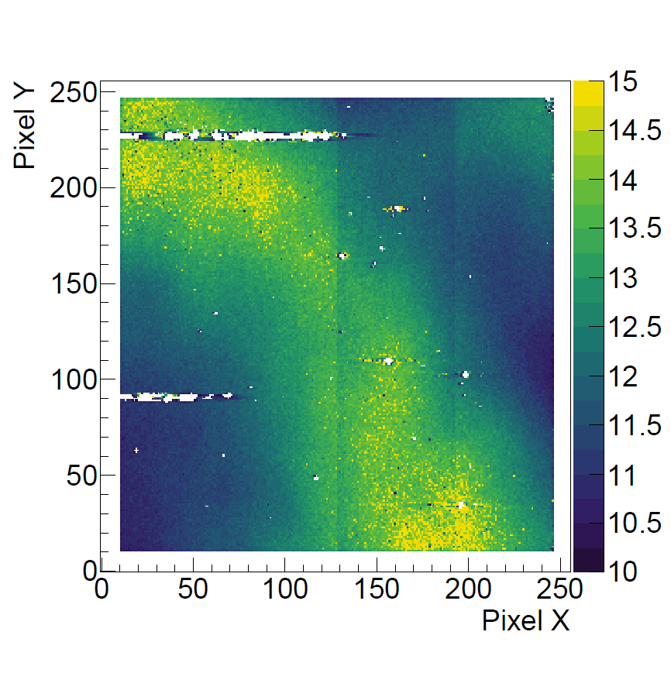
M is strongly influenced by the temperature
Customized simulation program (by J. Zhang):
Solving the 1D Poisson equation
Incorporating doping profiles and concentrations
Calculating electric field distribution
Impact ionization coefficients modelled with Okuto-Crowell and updated parameters by Currás Rivera and Moll (IEEE Trans. Electron Devices 2023 70 2919–2926)
Simulated difference: 1.25% integrated dose

Slide 17
Cooling is required to reduce leakage current
From the slope of the pedestal as a function of integration time:
$$I\left(A\right)=\frac{slope({ADU}/s)}{g_{JF}({ADU}/{keV})}×\frac{1000({eV}/{keV})}{3.6 eV}×q_{0}$$

Slide 18
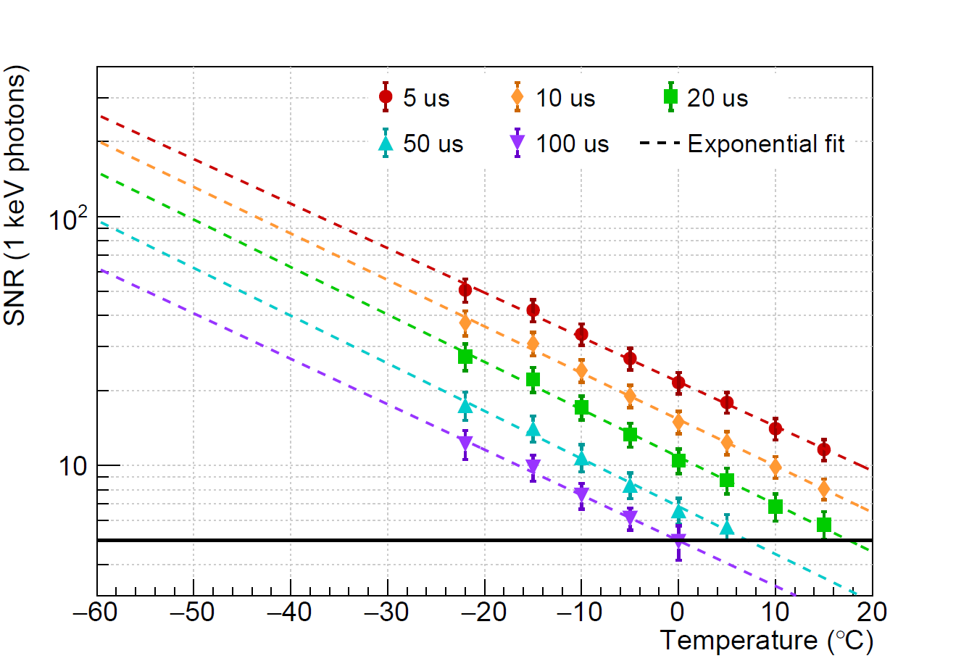
Effective detector noise profits from increasing gain
SNR = 51 (25 for 2 × 2 cluster)
Improvements are available!
Shallow gain layer (M_{h}/M_{e} $\sim$ 0.5)
Decrease of ASIC noise with decreasing temperature
5.5 e⁻ r.m.s.
200 eV: SNR > 5 (2 × 2 cluster)
For photon energies < 500 eV:
Hole multiplication (M_{h}/M_{e} $\sim$ 0.25) dominates
Gain increase, leakage current decrease
SNR = 5

Slide 19
Applications

Slide 20
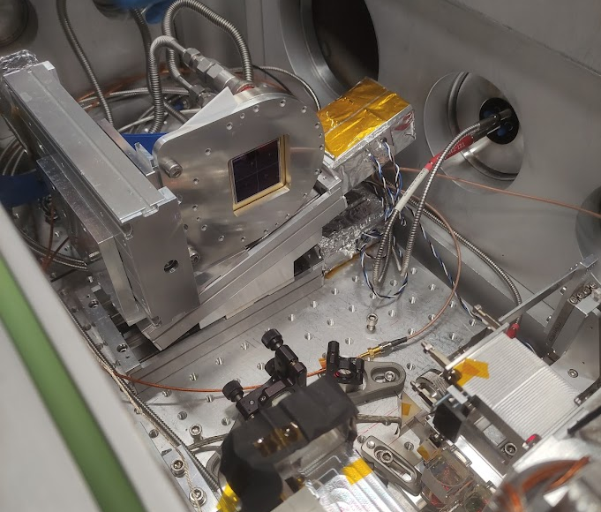
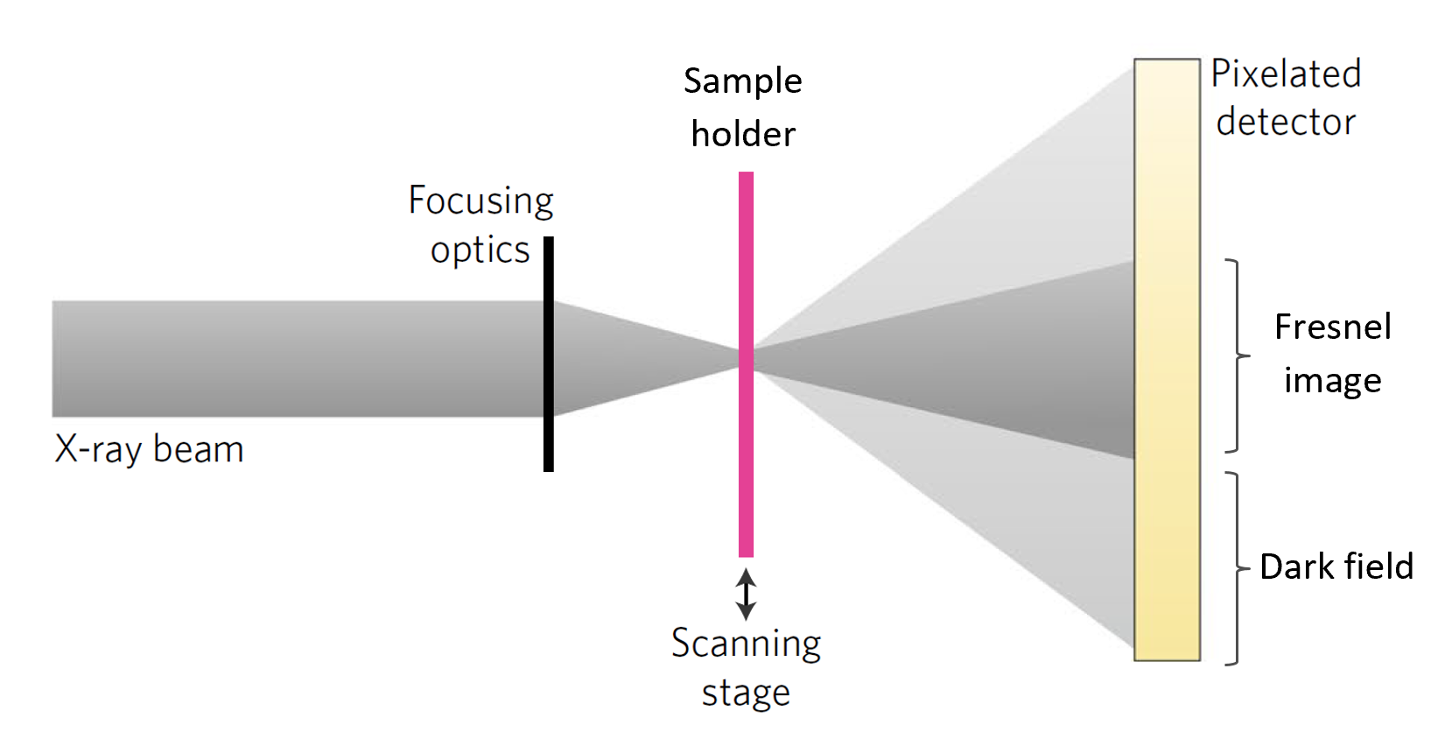
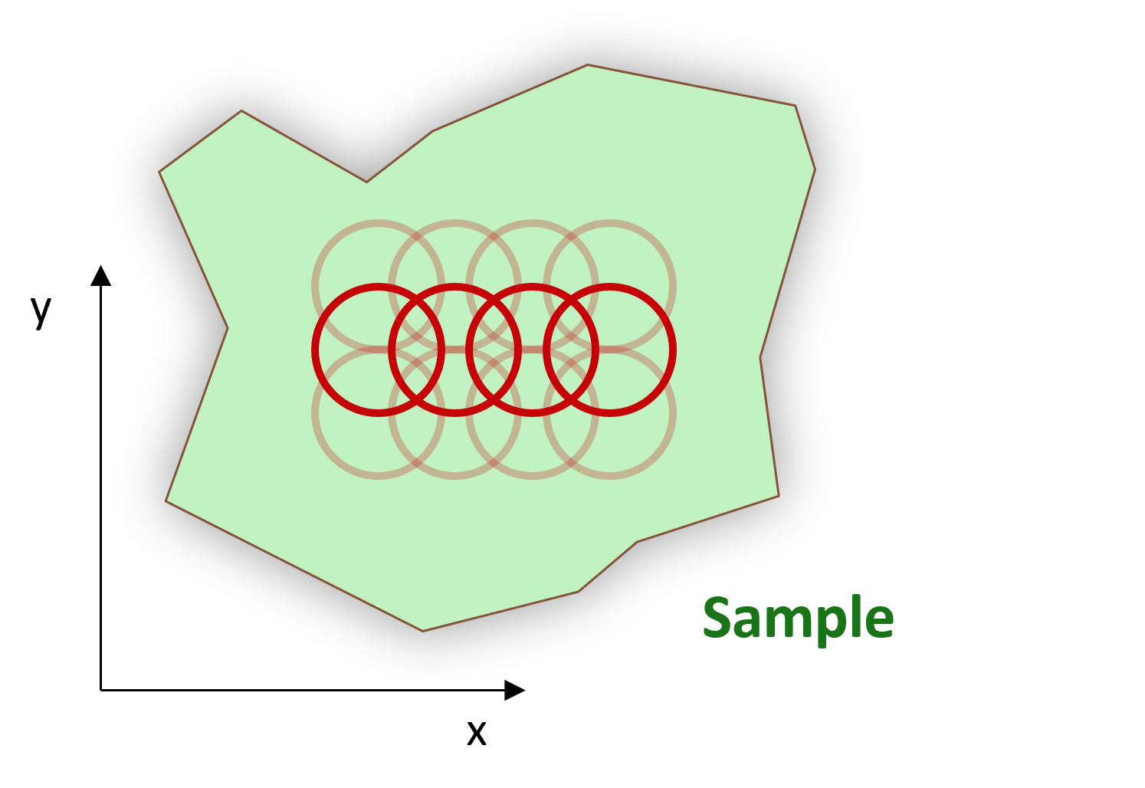
Soft X-ray ptychography
F. Baruffaldi et al 2023, in preparation
Single-photon-counting iLGAD-EIGER detector
at SLS SIM beamline
Scanning Transmission X-ray Microscopy (STXM)
+
Coherent Diffraction Imaging (CDI)
Wavelength limited resolution
Magnetic contrast ptychography of BiFeO₃
T. A. Butcher et al 2023 arXiv:2308.13465

Slide 21
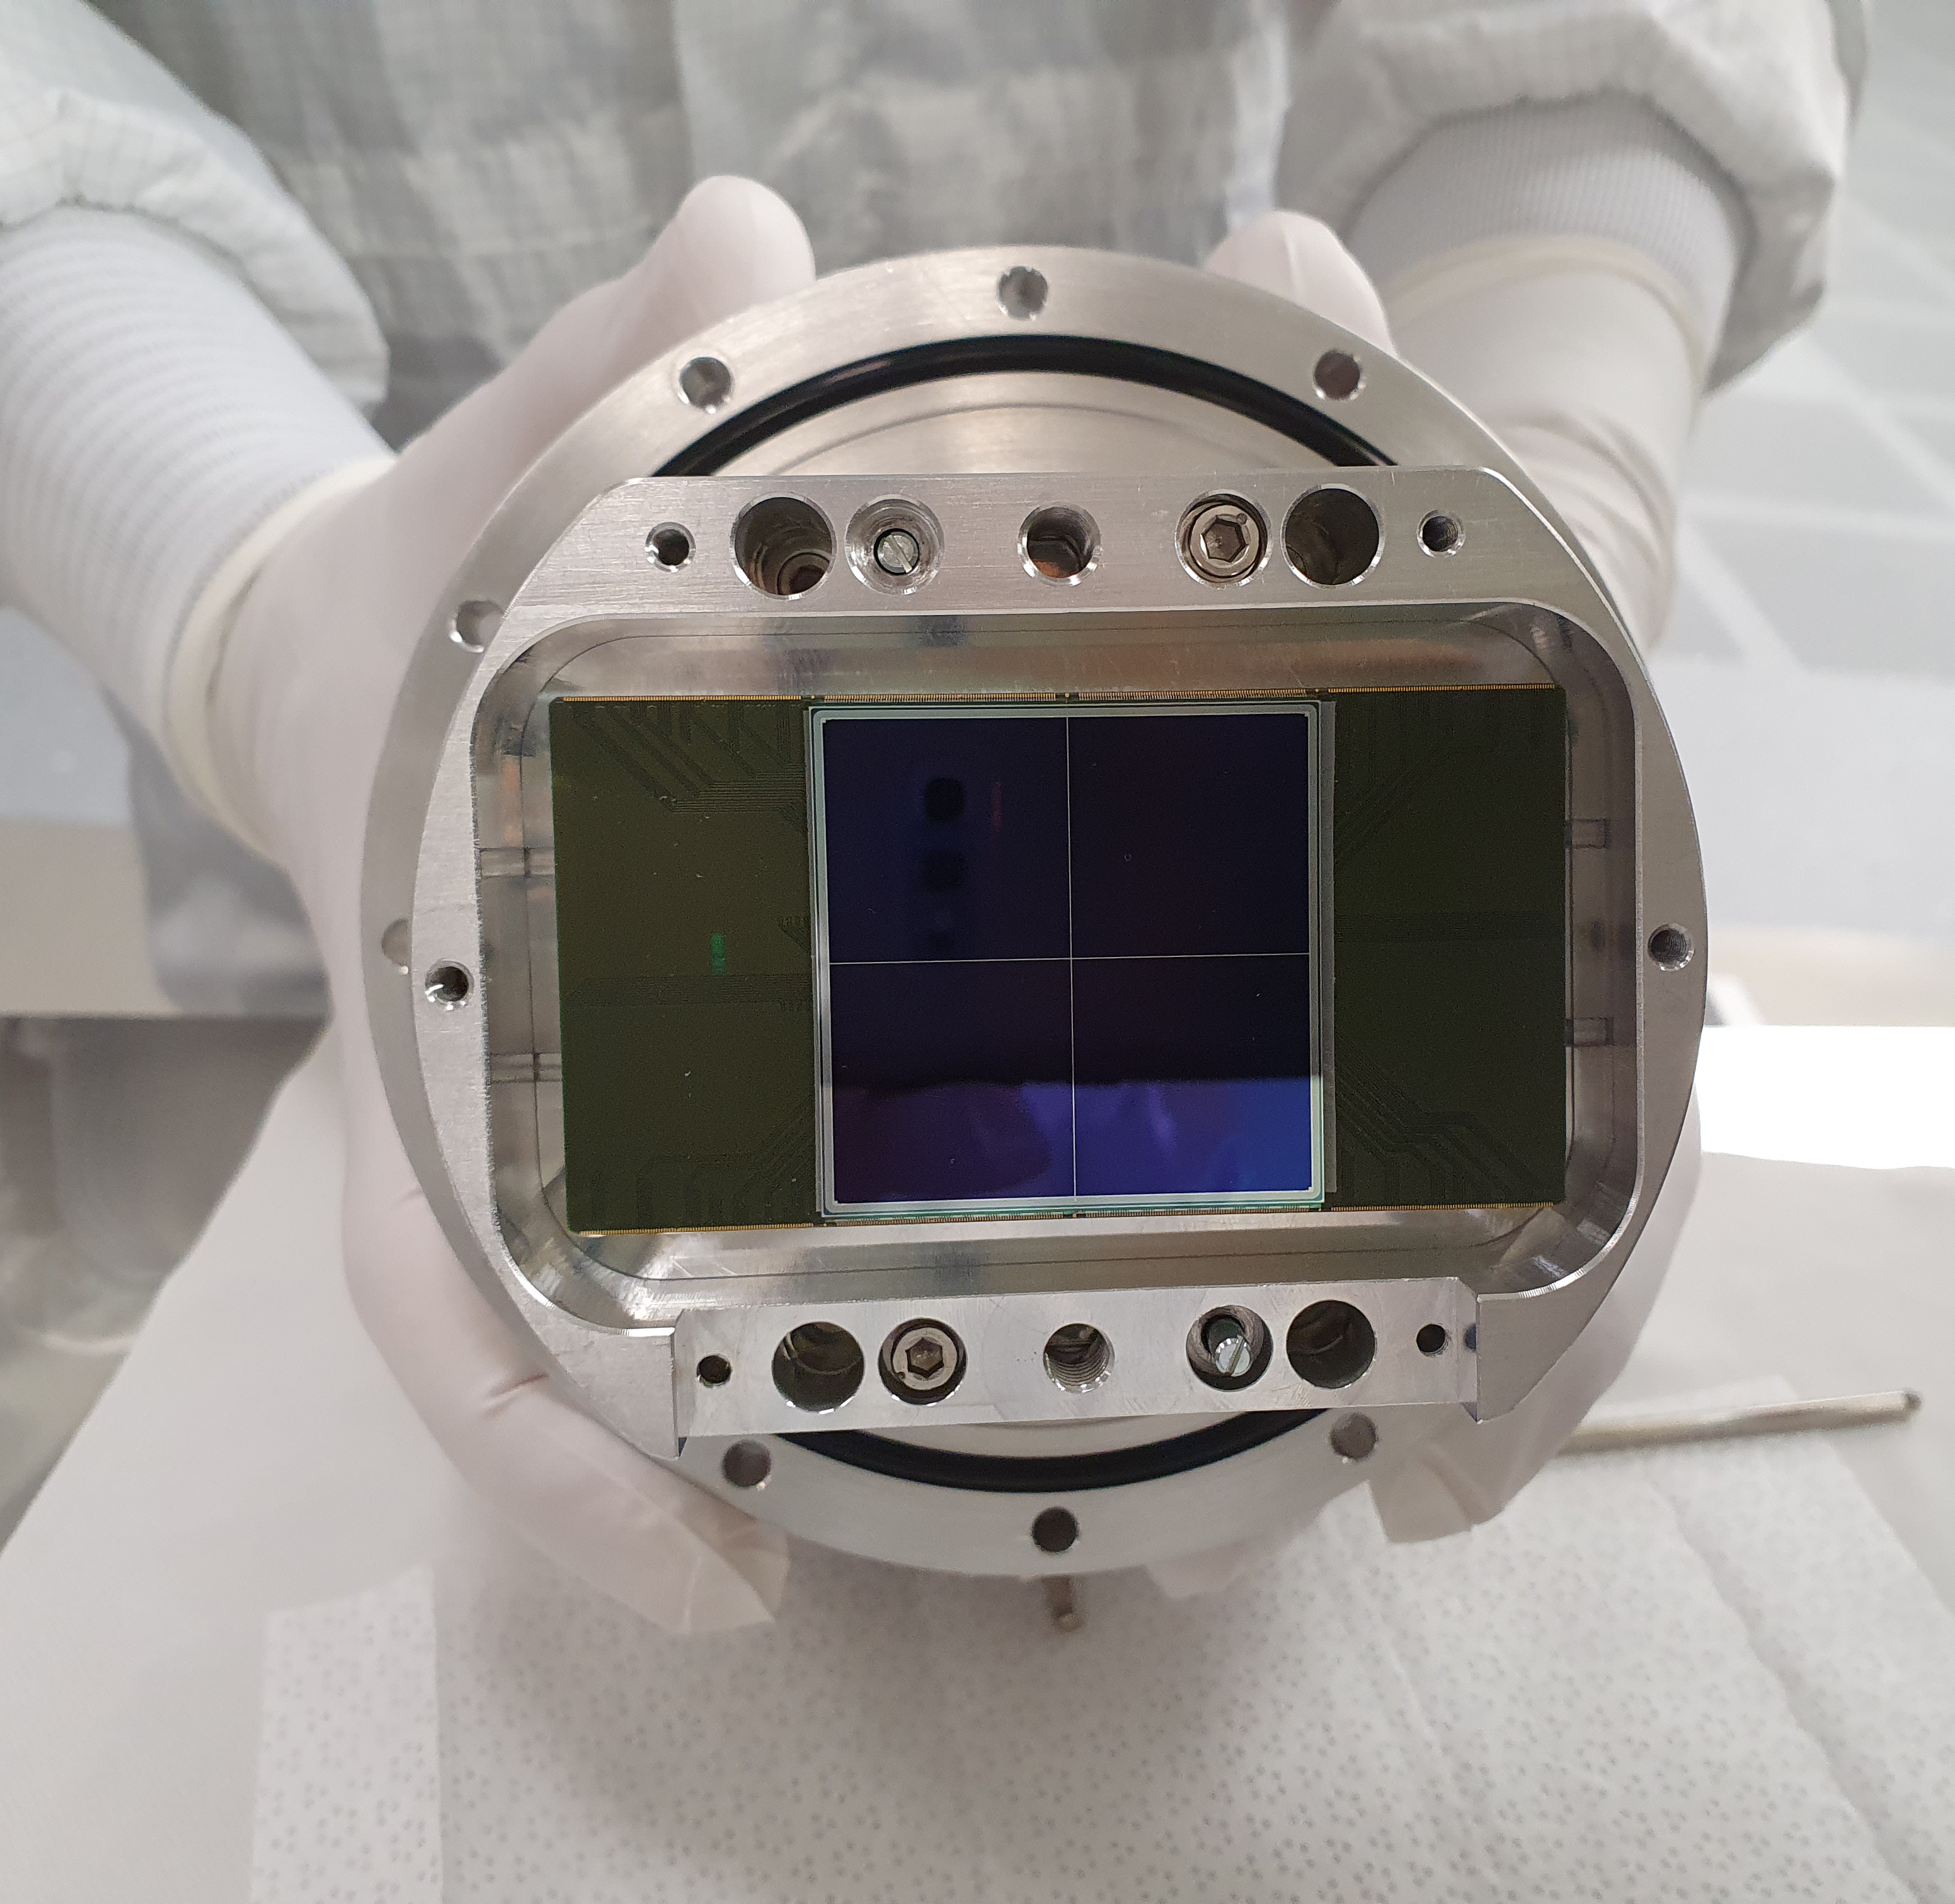
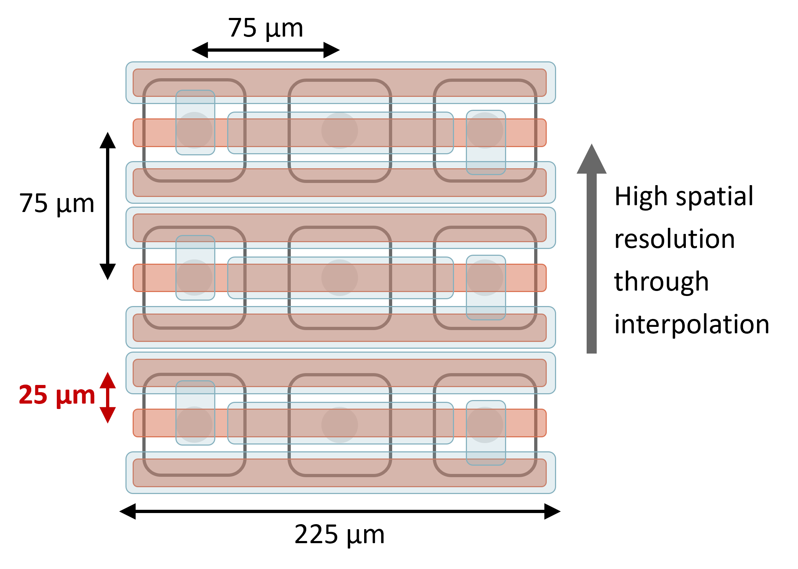
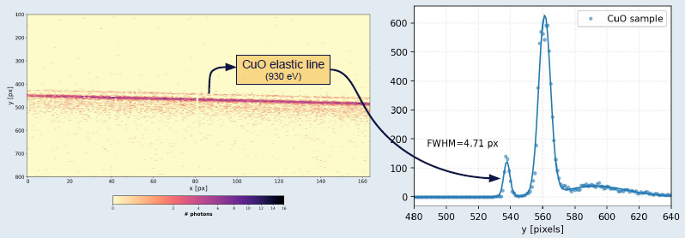
Resonant Inelastic X-ray Scattering (RIXS)
JUNGFRAU-iLGAD module
Rectangular pixels (“strixels”)
R. Abela et al 2019
J. Synchrotron Rad. 26,
1073-1084
Energy resolution
$$↕$$
Spatial resolution
hRIXS at EuXFEL SCS,
courtesy of N. Duarte

Slide 22
Takeaway messages

Slide 23
iLGADs with thin entrance window enable hybrid detectors to operate in the soft X-ray range
Improved quantum efficiency
Signal amplification

Slide 24
By cooling the detectors, we can resolve single photons down to $\sim$ 200 eV
1 keV: SNR = 200 → 200 eV: SNR > 5 (2 × 2 cluster)
SNR = 5
Multiplication factor depends strongly on temperature
SNR > 5 at 200 eV with T < -50°C, improvements are realistic

Slide 25
The technological advancements of X-ray light sources are driving the development of detectors
Magnetic contrast ptychography of BiFeO₃
T. A. Butcher et al 2023 arXiv:2308.13465
Time resolved resonant inelastic X-ray scattering (RIXS)
R. Abela et al 2019 J. Synchrotron Rad. 26, 1073-1084

Slide 26
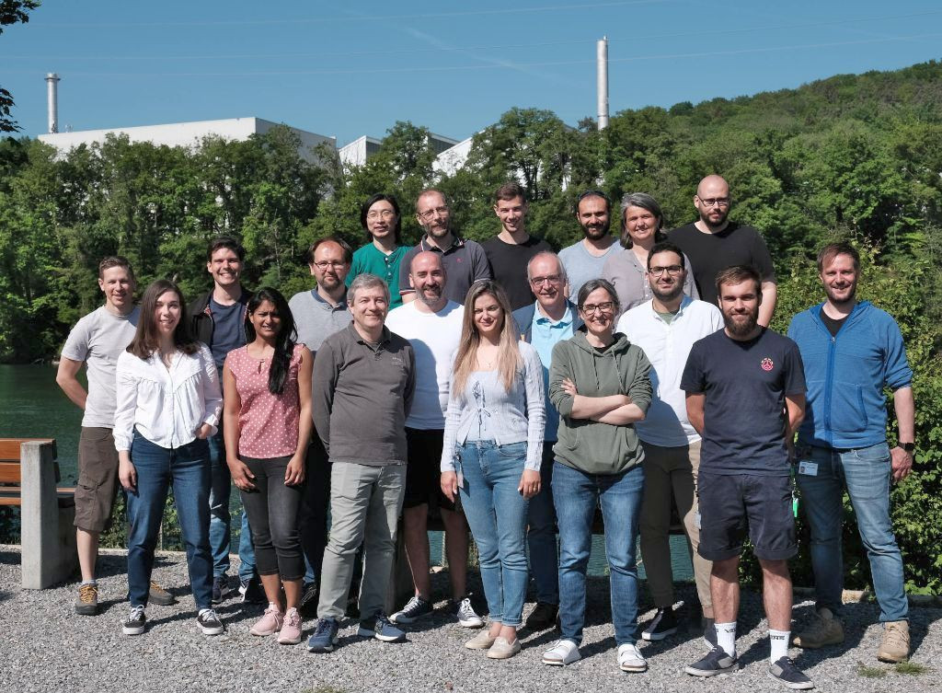
Acknowledgements
PSI Center for Photon Science Detectors Group
R. Barten, F. Baruffaldi, A. Bergamaschi, B. Braham, M. Brückner, M. Carulla, R. Dinapoli, S. Ebner, K. D. Ferjaoui, E. Fröjdh, D. Greiffenberg, S. Hasanaj, J. Heymes, V. Hinger, T. King, P. Kozłowski, C. Lopez Cuenca, D. Mezza, K. Moustakas, A. Mozzanica, C. Ruder, K. A. Paton, B. Schmitt, P. Sieberer, D. Thattil, X. Xie, J. Zhang
Fondazione Bruno Kessler
A. Bisht, G. Borghi, M. Boscardin, M. Centis Vignali, F. Ficorella, O. Hammad Ali, G. Paternoster, S. Ronchin

Slide 27
Backup

Slide 28
Sensors for soft X-rays: Thin entrance window
J. Zhang et al 2022 JINST 17 C11011
Al/Si interface

Slide 29
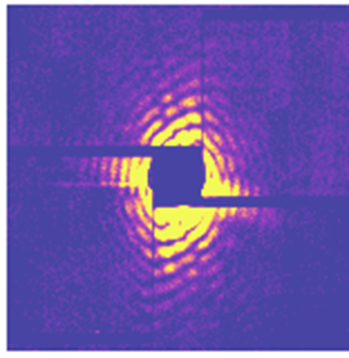
Sensors for soft X-rays: First application
Full-size 4M system at SwissFEL Maloja
Courtesy of A. Mozzanica
V. Hinger et al 2022 JINST 17 C09027
Single-particle diffraction on Xe clusters,
courtesy of K. A. Schnorr

Slide 30
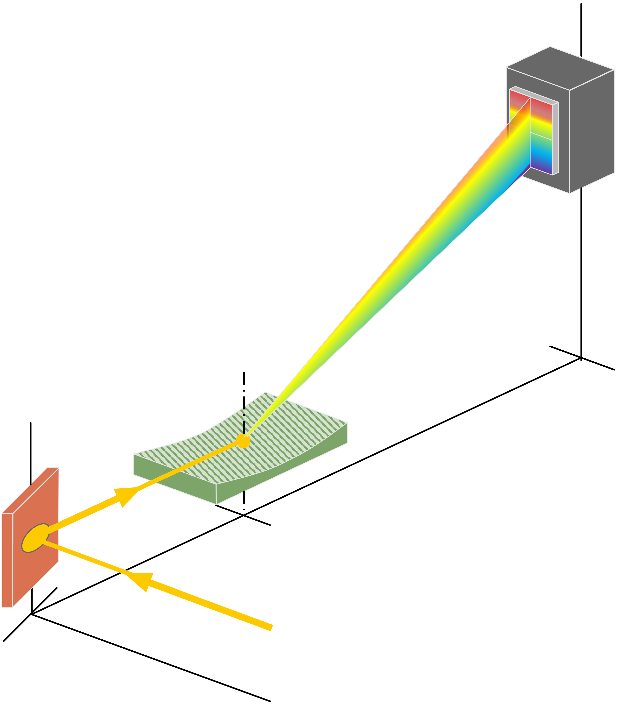
Application: Resonant Inelastic X-ray Scattering
Detector
Method
Scan incoming x-ray beam over electronic resonance
Measure transfered energy and momentum
Impact
Probe complex electronic-structural information
Element, chemical, and orbital site specific
Energy dispersion
Spherical grating
Sample
Energy resolution
$$↕$$
Spatial resolution

Slide 31
“Strixels”: High resolution in one dimension
75 µm
75 µm
High spatial resolution by interpolation
25 µm
225 µm

