Slide 1


Silicon in Space
Matteo Duranti
Istituto Nazionale Fisica Nucleare – Sez. di Perugia

Slide 2
Silicon in Space
PhysRevLett.124.211102

Slide 3
Silicon in Space
PhysRevLett.124.211102
Jokes apart:
- we use our detectors (mainly the Si trackers) to measure the Z of the CR particles
- input charge could be 6² or 8² (C and O), 14² (Si) or even 26² (Fe) or above, times a MIP…

Slide 4
Silicon (μstrip) in Space
State of the art and perspectives for Si microstrip tracking systems in space
Matteo Duranti
Istituto Nazionale Fisica Nucleare – Sez. di Perugia

Slide 5
Outline
Scientific case and state of the art
(far, intermediate and near) future
pros and cons of μstrips
LGADs?

Slide 6
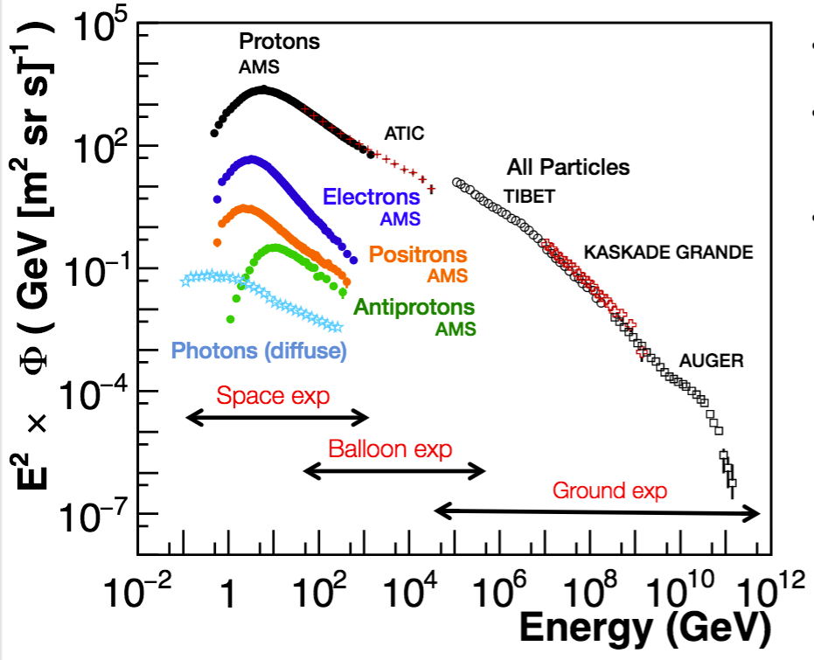
Cosmic Rays
Φ(E) ∝ E^{-γ}
(γ ~ 2.7-3.1)
measuring in Space (or balloon) allows single particle measurements
→ precise composition and spectra measurement
BUT
cosmic ray spectra are tipically power laws:
1 order of magnitude in energy → 2 orders of magnitude in flux (i.e. in statistics)

Slide 7
The experimental challenge
No atmosphere:
  Stratospheric ballon
  Satellite / Space station
Limits on size / weight / time / power consumption
Detector design focused on specific measurements
Antimatter / Isotopes Magnetic spectrometers
Nuclei / e⁺+e⁻ / Gammas Calorimeters

Slide 8
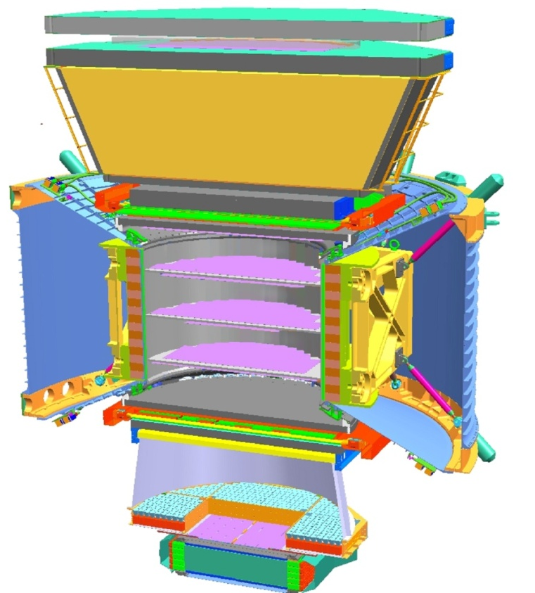
Astro-particle detectors – state of the art
AMS-02 (in orbit since 16/05/2011):
1
TRD
Time of Flight
2
3-4
5-6
Tracker
7-8
Time of Flight
RICH
9
ECAL
accurate spatial resolution (<10 μm) Si-μstrip for Rigidity measurement up to TVs;
charge measurement capability (0.1 c.u.) for at least a couple of detectors (Tracker, Time of Flight);
Electromagnetic CALorimeter (17 X₀) for e⁺, e⁻, γ Energy measurement;
Time of Flight (σ_{t} ~ 120 ps, σ_{β} ~ %) for trigger, arrival direction (upward/downward) and isotopic composition (up to few GeV, then Ring Imaging Cherenkov, σ_{β} ~ 0.1 %);
Transition Radiation Detector and ECAL to distinguish hadrons (90% of Cosmic Rays, CR, are protons, 10% He) from electromagnetic particles (e⁻ are 1% of CR, e⁺ 0.1%), e/p identification;
~ 2 kW

Slide 9
Astro-particle detectors – state of the art
AMS-02 (in orbit since 16/05/2011):
Fermi-LAT (in orbit since 11/06/2008):
1
TRD
Time of Flight
2
3-4
5-6
Tracker
7-8
Time of Flight
RICH
9
ECAL
moderate spatial resolution (~60 μm) Si-μstrip for pair-production measurement;
electromagnetic calorimeter (10 X₀) for e⁺, e⁻, γ Energy measurement;
plastic scintillator anticoincidence shield for charged CR veto;
electromagnetic calorimeter to perform e/p identification;
Tungsten plates in the tracker for photon conversion;
~ 1.5 kW

Slide 10
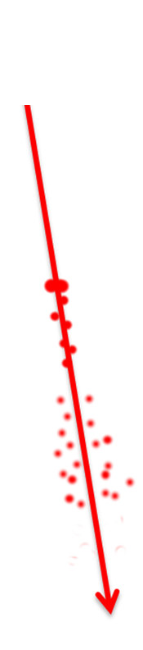
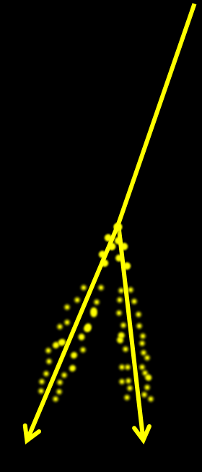
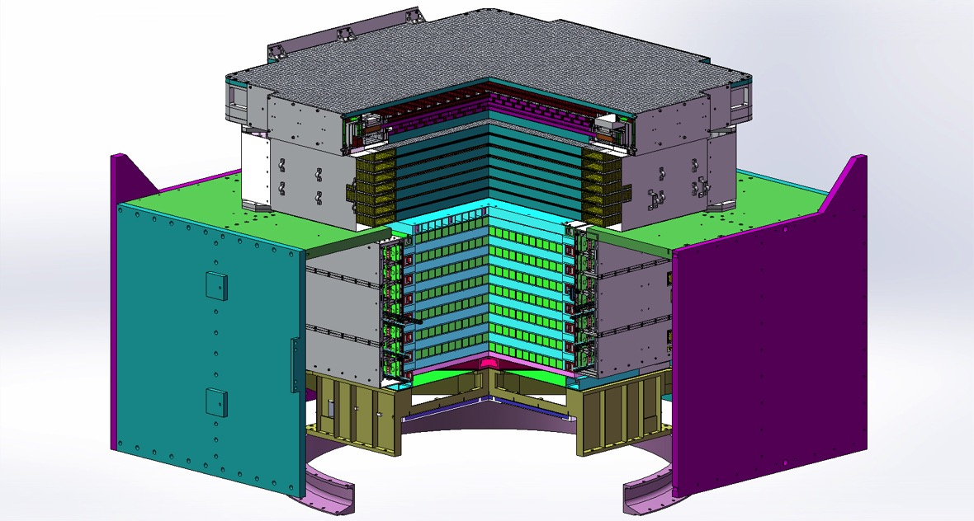
Astro-particle detectors – state of the art
AMS-02 (in orbit since 16/05/2011):
Fermi-LAT (in orbit since 11/06/2008):
DAMPE (in orbit since 17/12/2015):
CR
1
TRD
γ
Time of Flight
2
3-4
5-6
Tracker
7-8
Time of Flight
RICH
9
ECAL
moderate spatial resolution (~40 μm) Si-μstrip for pair-production measurement;
charge measurement capability (0.1 c.u.) for at least a couple of detectors (Tracker, Plastic Scintillator Detector);
electromagnetic calorimeter (31 X₀) for e⁺, e⁻, γ and hadron Energy measurement;
Plastic Scintillator Detector, PSD, for charged CR veto;
electromagnetic calorimeter to perform e/p identification;
Tungsten plates in the tracker for photon conversion;
~ 0.5 kW

Slide 11
Fight for your right (to have statistics)
flux
(given by Nature)
Exposure time
Energy bin
Acceptance
spectrometer
(BL²)
calorimeter (X₀)
surface AND solid angle

Slide 12
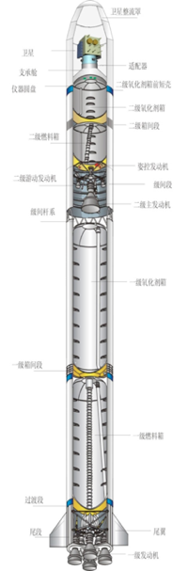
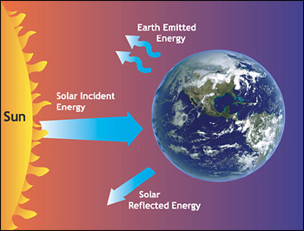
HEP detectors in Space
Mechanical stress at launch:
Static acceleration
Random vibration
Sinusoidal vibration
Pyroshock
Life in space:
Thermal stresses due to Sun-light (seasonal / day-night effects)
Vacuum
Radiation
Careful Design, Model validation and Qualification are needed to ensure highest possible reliability

Slide 13
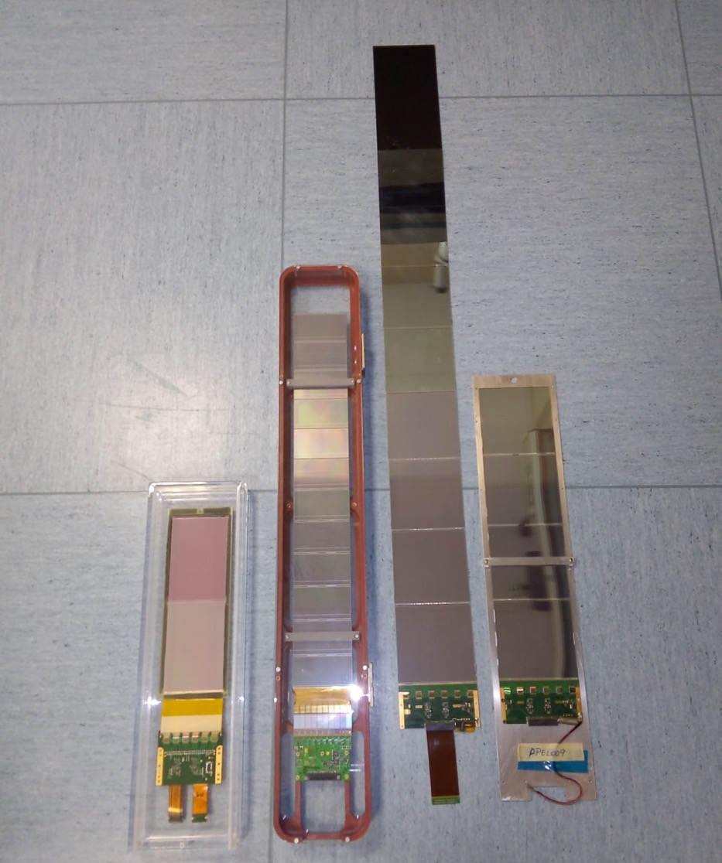
Perugia / μstrip in Space
State of the art
strongly biased from/towards activities conducted in Perugia
focused on μstrip sensors. Why μstrip? Example AMS-02 tracker:
  ~6 m²
  total of 200k channels for ~ 200 watt
  100 μm pitch → 10 μm (30 μm) spatial resolution in bending (non bending) plane
  Back of the Envelope:
  x-side =sqrt(6m²) ~ 2.5m²
  maximum length of ladders: l=0.5 m
  #ladders per y-side (or layers) = s/l
  pitch, p = 100 μm = 10⁻⁴ m
  #channels_{strip} = (s/l) * s/p = 120k
  → strip = 2*120k ~ 10⁵
  → pixel = 120k*120k ~ 10¹⁰
future experiments
DAMPE
AMS-02
LIMADOU

Slide 14
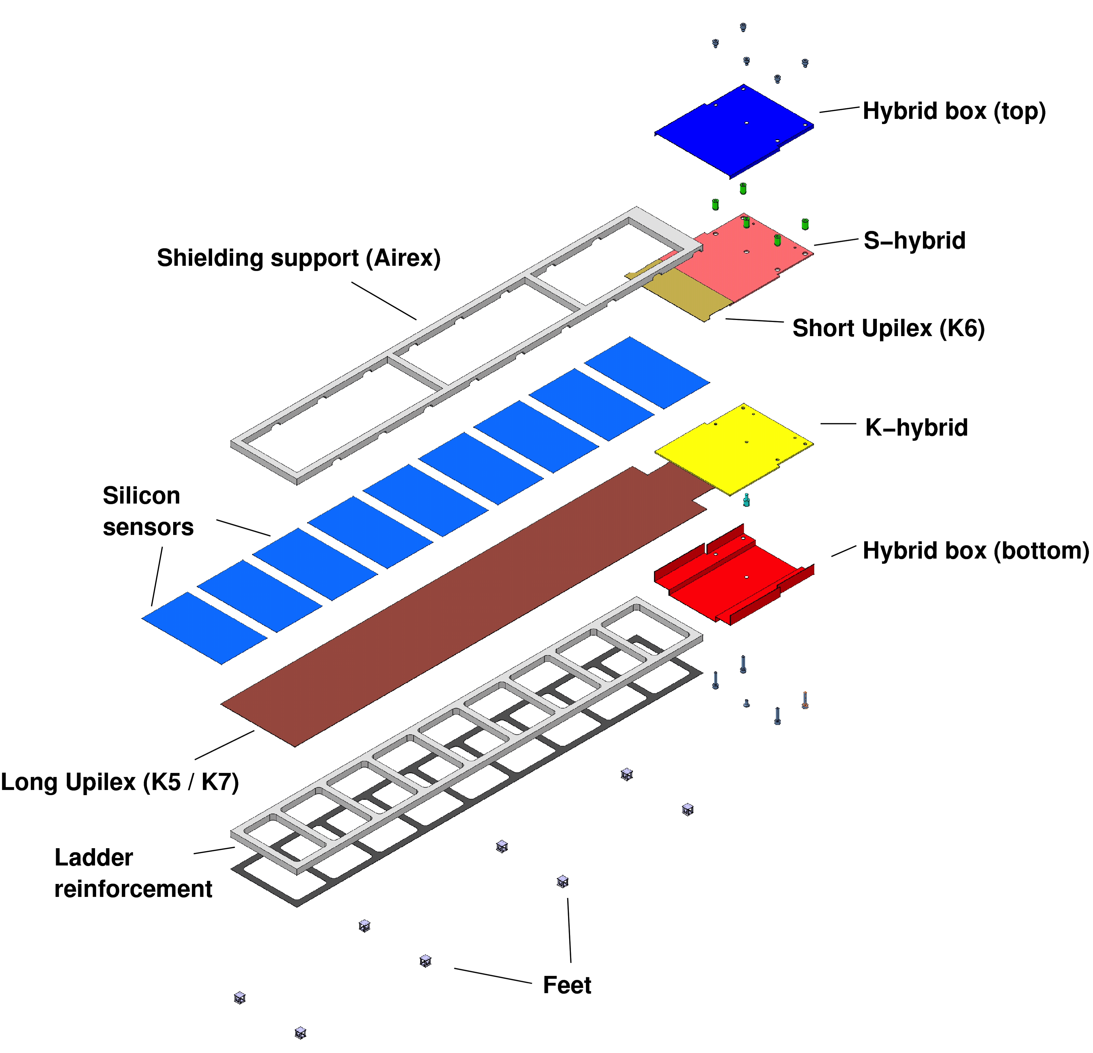
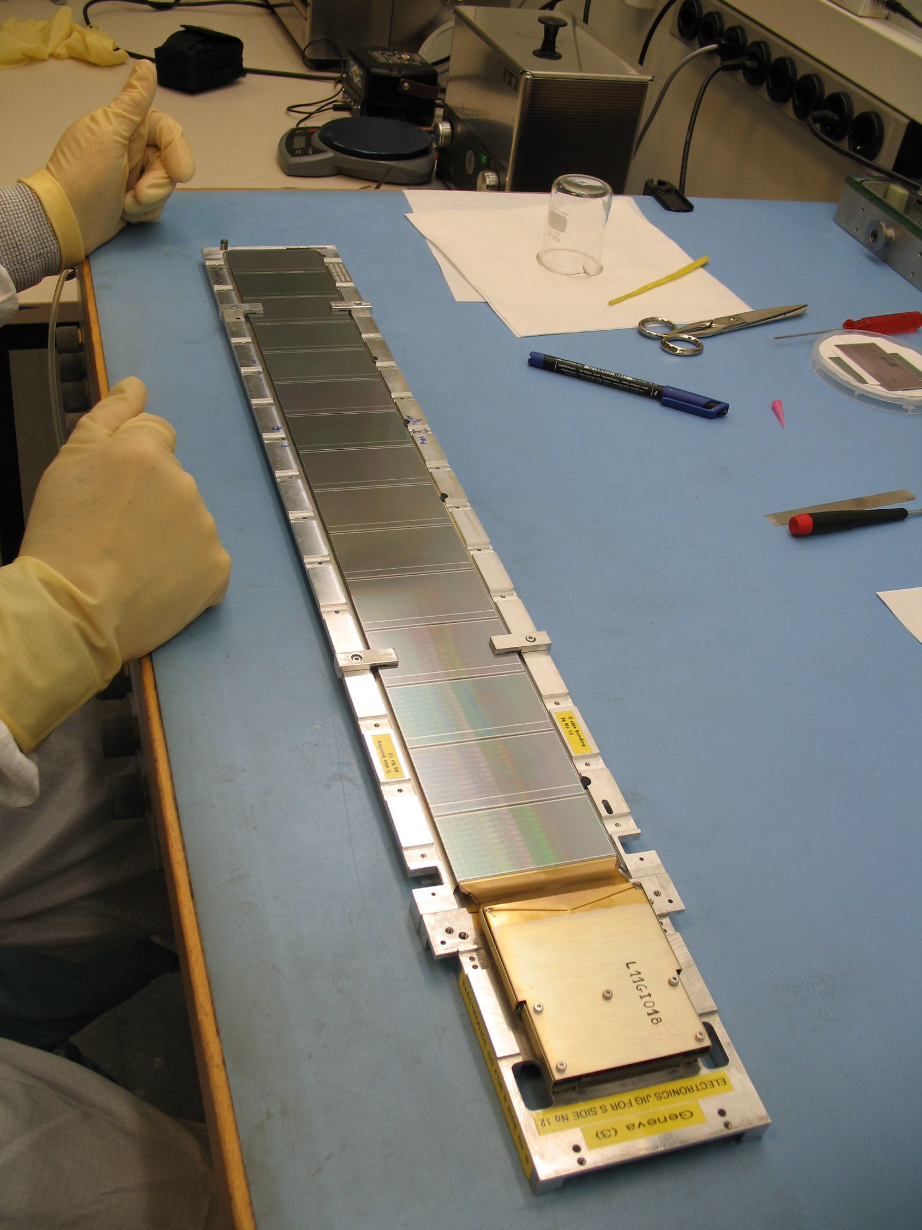
AMS-02: Silicon "ladder"
192 flight units
5 – 15 wafers (28 – 60 cm) each
→ daisy chain (parallel!) of many
wafers
→ impedance of the sensor of
the order of 50-100 pF
1024 high dynamic range,
AC coupled readout channels:
  640 on junction (S) side
  384 on ohmic (K) side
Implant/readout pitch (floating strips!):
  27.5/110 μm ("S"/junction/p-side/bending side)
  104/208 μm ("K"/ohmic/n-side/non-bending side)

Slide 15
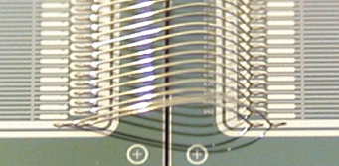
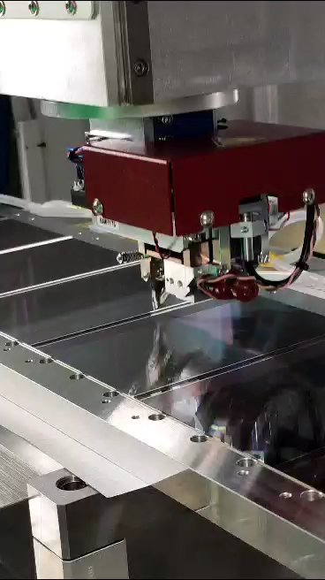
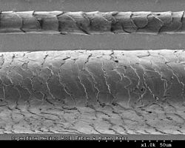
Wire bonding
Merino wool
bonding wire: 25 μm
Merino wool: 20 μm
Human hair: 200 μm
Human hair

Slide 16
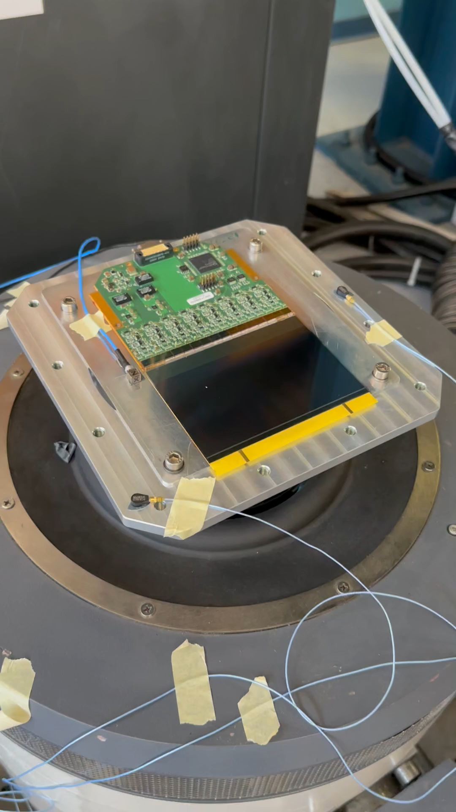
wire bonds vibration test

Slide 17
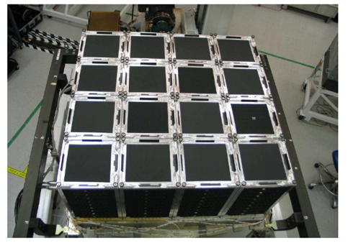
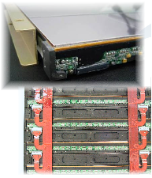
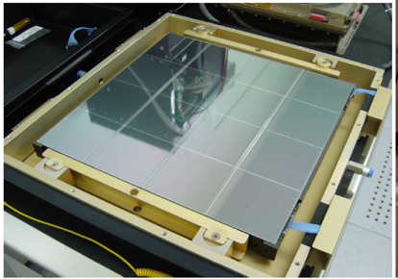
Fermi-LAT (2008)
strip pitch 230 μm
readout pitch 230 μm
73 m² surface
9216 sensors
2304 ladders
k channels

Slide 18
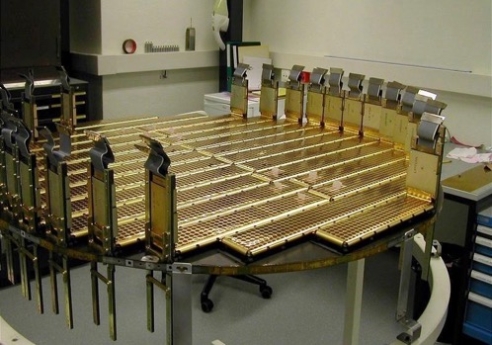
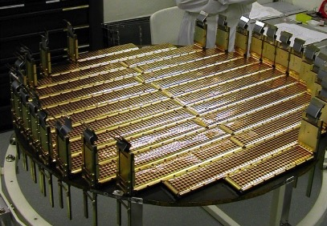
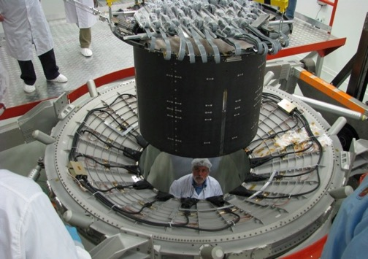
AMS-02 Silicon Tracker (2011)
6.3 m² surface
2264 sensors
192 ladders
197k channels
190 W
strip pitch 27.5 μm
readout pitch 110 μm

Slide 19
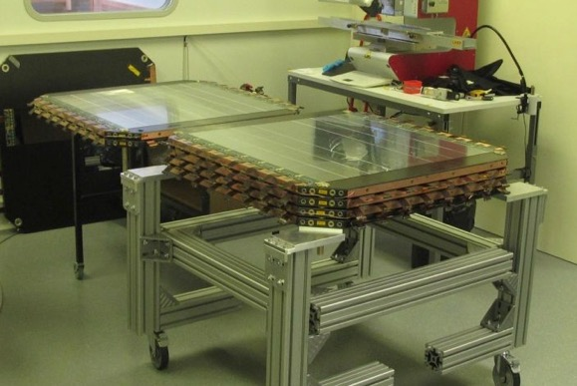
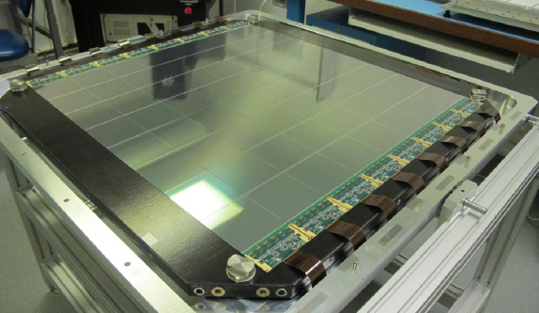
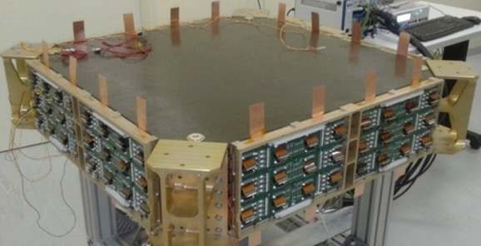
The DAMPE Silicon TracKer (2015)
76 cm
strip pitch 120 μm
readout pitch 240 μm
6.9 m² surface
768 sensors
192 ladders
74k channels
23 W

Slide 20
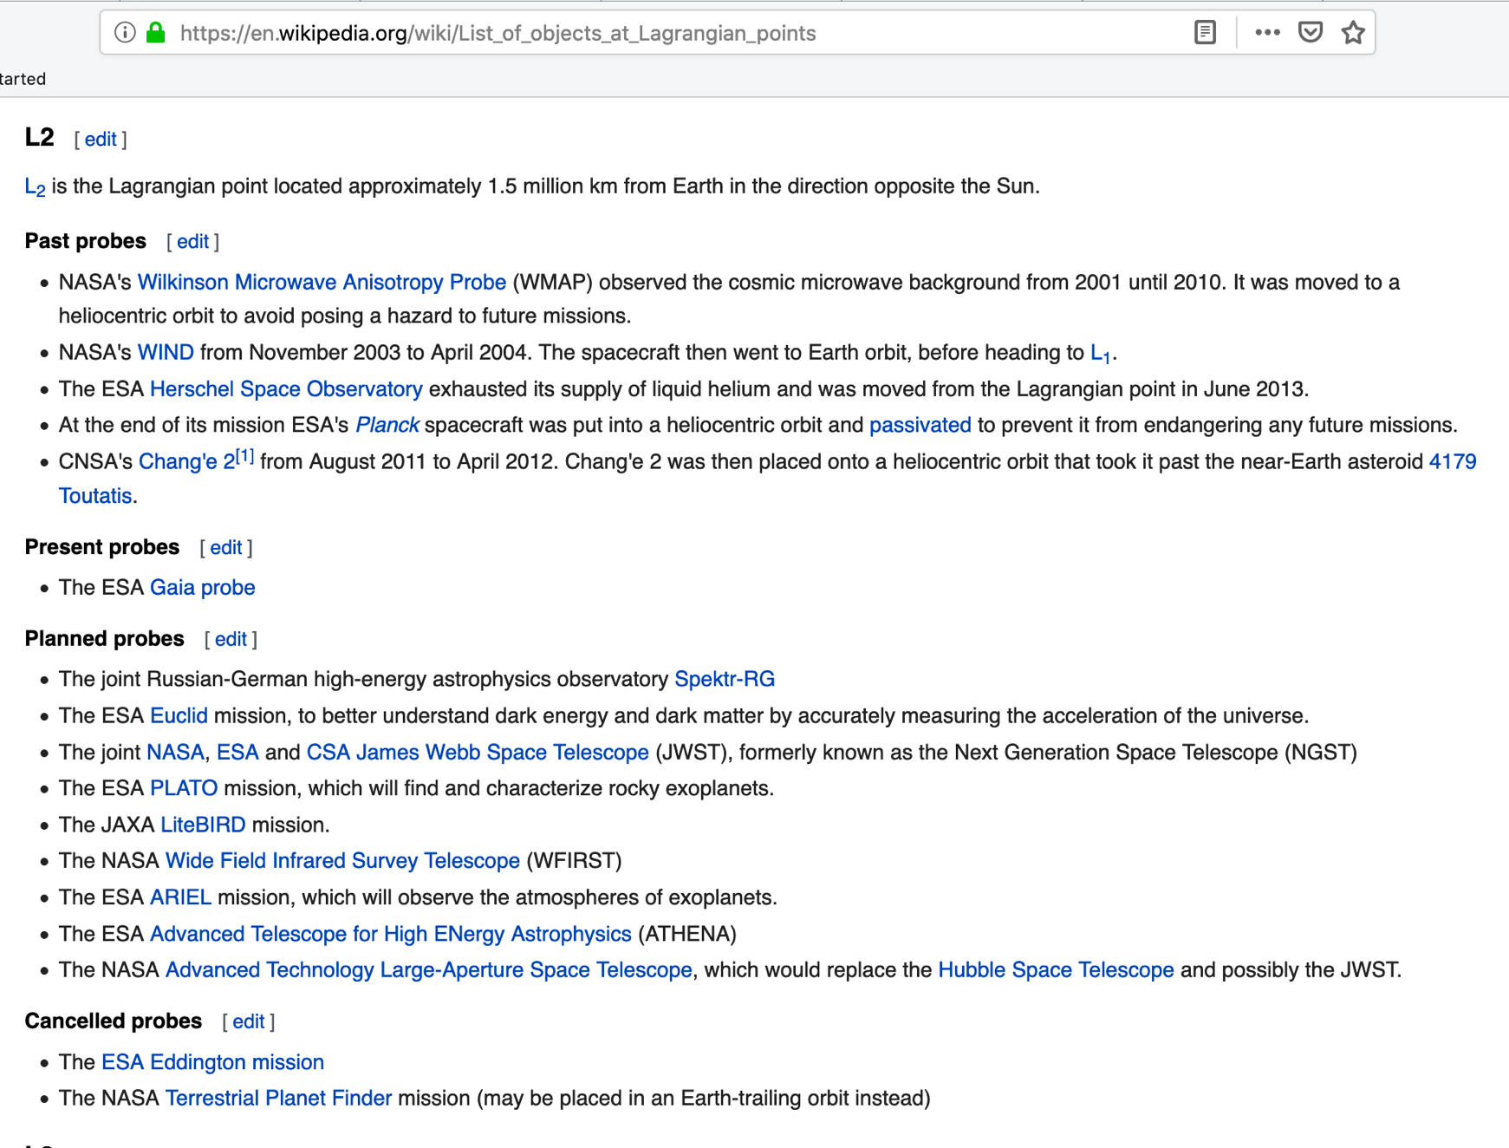
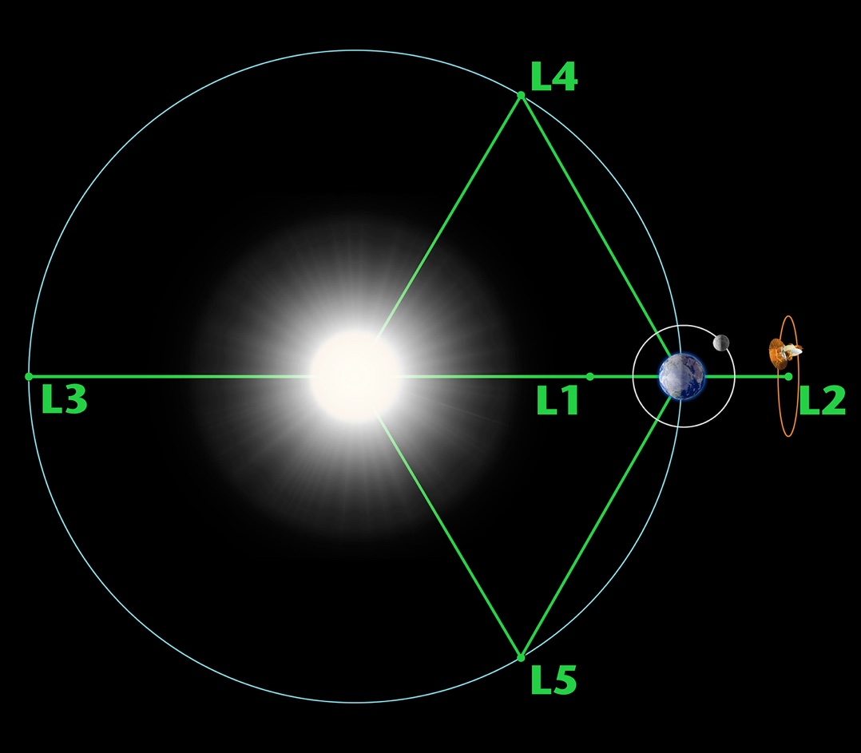
the (far) future is in L2, a nice place in space

Slide 21

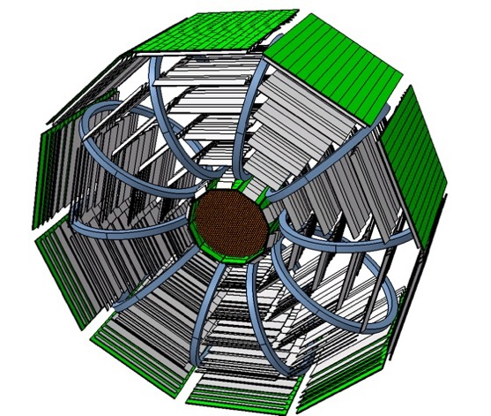
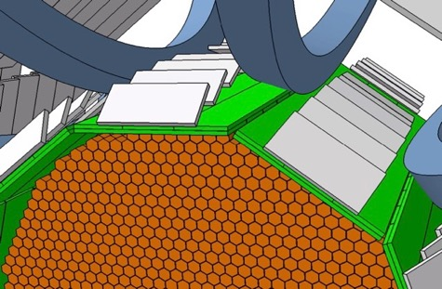
ALADInO - Antimatter Large Acceptance Detector In Orbit
supercoducting coils: magnet
scintillators: ToF
Silicon ladders: tracking
Diameter: 4.4 m
Length: 2.2 m
Acceptance: 3 m²sr
MDR > 20 TV
CaloCube: energy
(INFN CSNV)
~100 m² surface
O(5 μm) spatial resolution
2M channels
1 kW

Slide 22
AMS-100
~200 m² surface
O(5 μm) spatial resolution
10M channels
5 kW

Slide 23
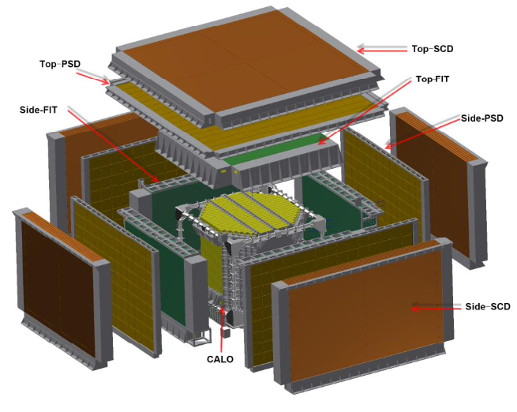
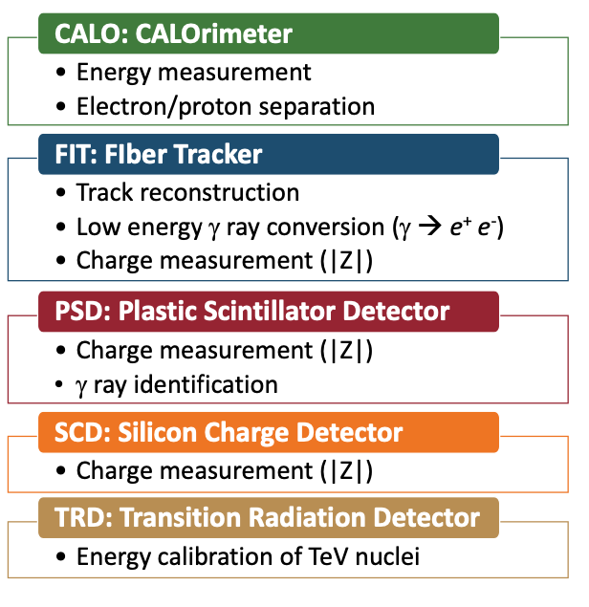
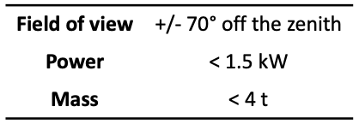
intermediate future: HERD
to be installed on board the Chinese Space Station (2027)

Slide 24
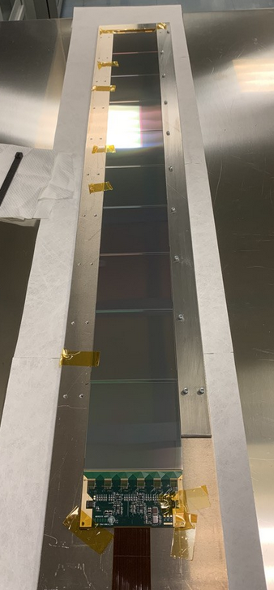
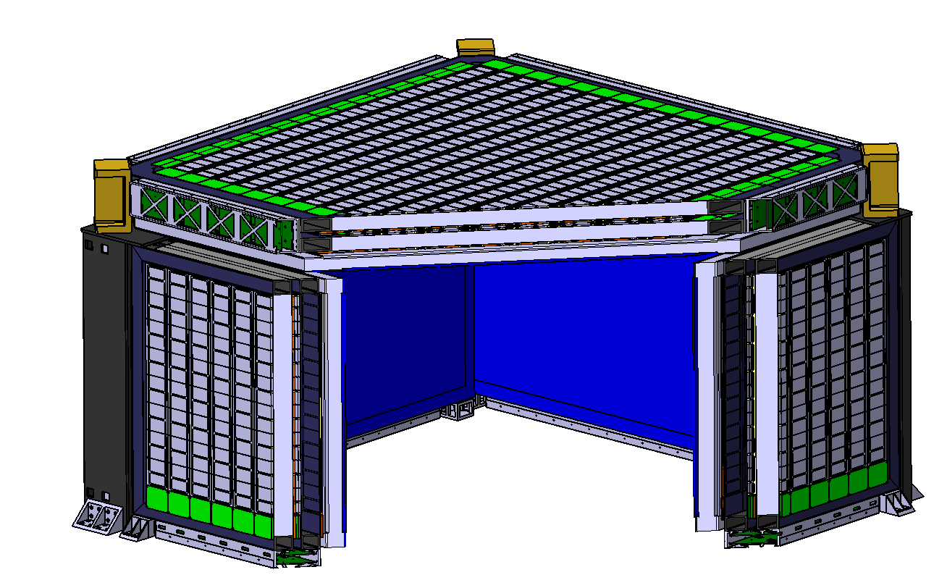
HERD Silicon Charge Detector
80-100 cm long ladders
2 m
2 m
1.2 m
~60 m² surface, 8 layers
6144 SSD
768 ladders

Slide 25
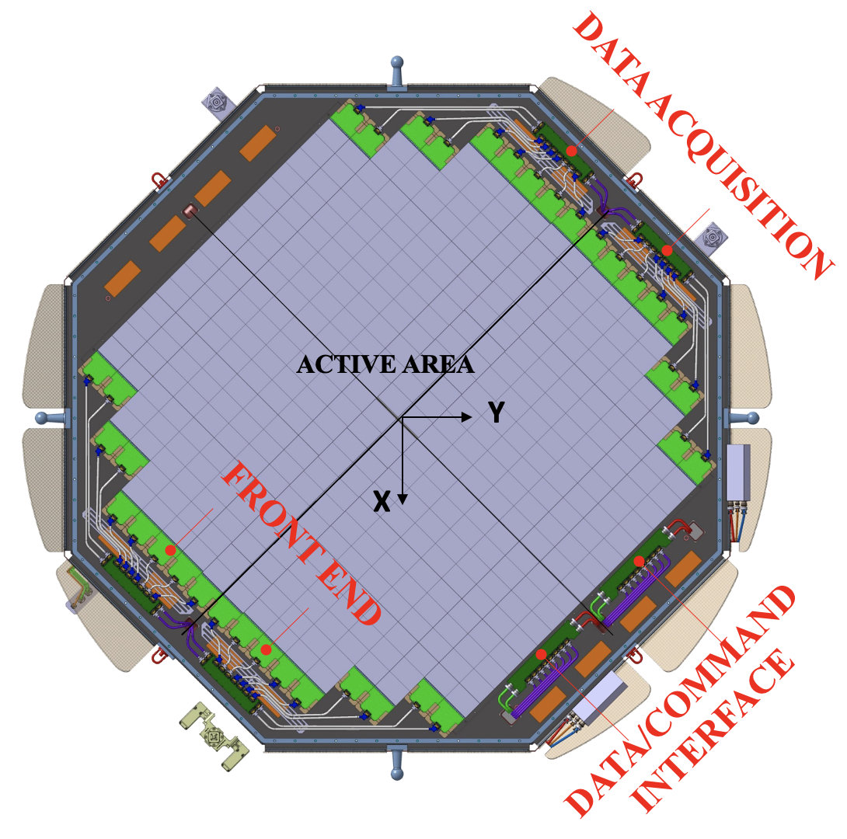
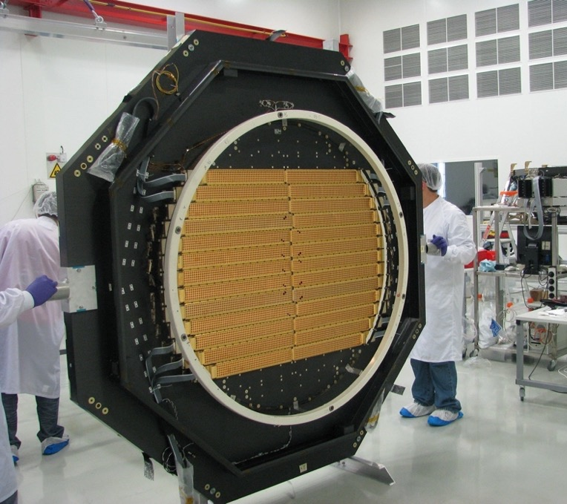
The near future: AMS-02 L0 upgrade
~ 8 m² surface, 2 layers (45° stereo)
768 sensors
72 ladders
72k channels
~ 120 W
AMS-02 Layer1
to be ready by early 2025

Slide 26
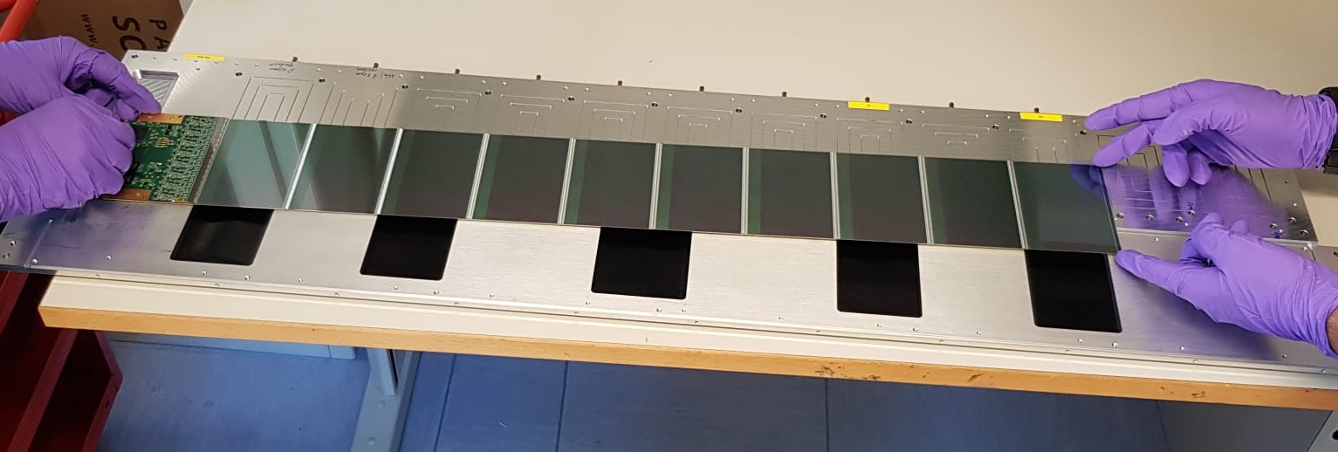
The near future: AMS-02 L0 upgrade
the basic element of the detector
charge measurement:
high dynamic range FE
spatial resolution:
110 µm readout pitch
the detecting part: 8, 10 and 12 sensors
the readout
electronics
64-96 cm long ladders

Slide 27
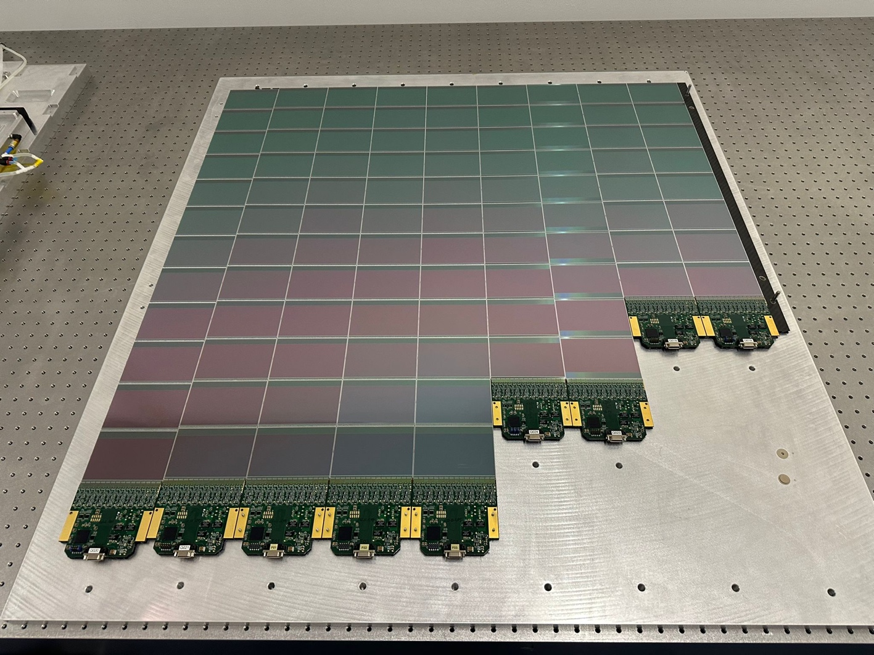
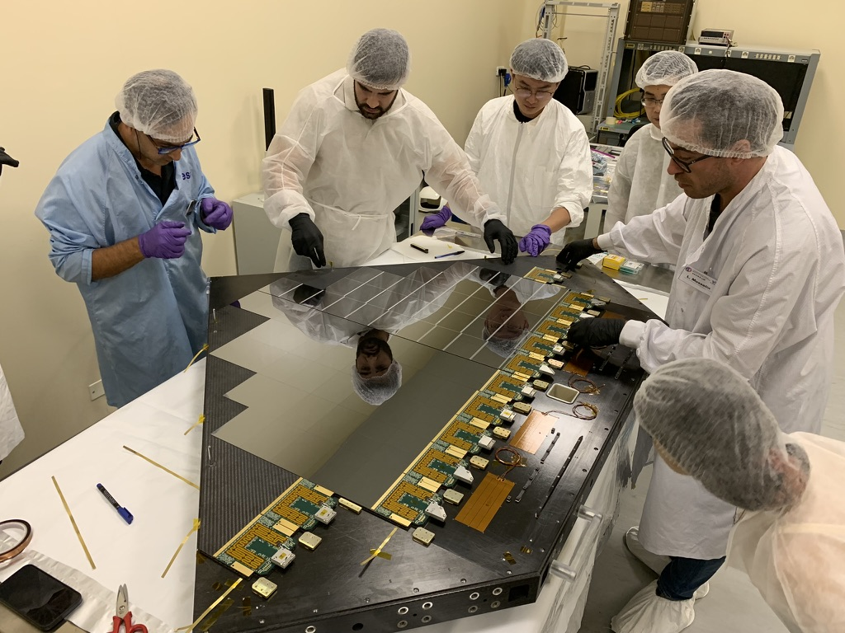
AMS-02 L0 upgrade
101 cm
96 cm
data/cmd
5 V

Slide 28
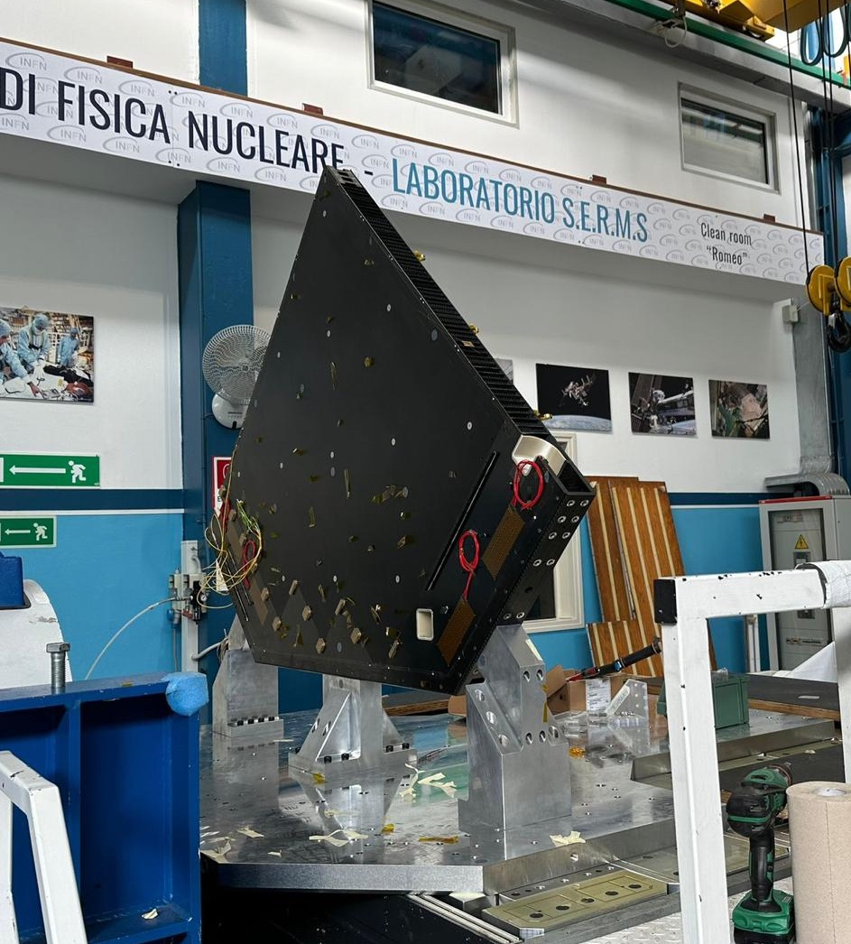
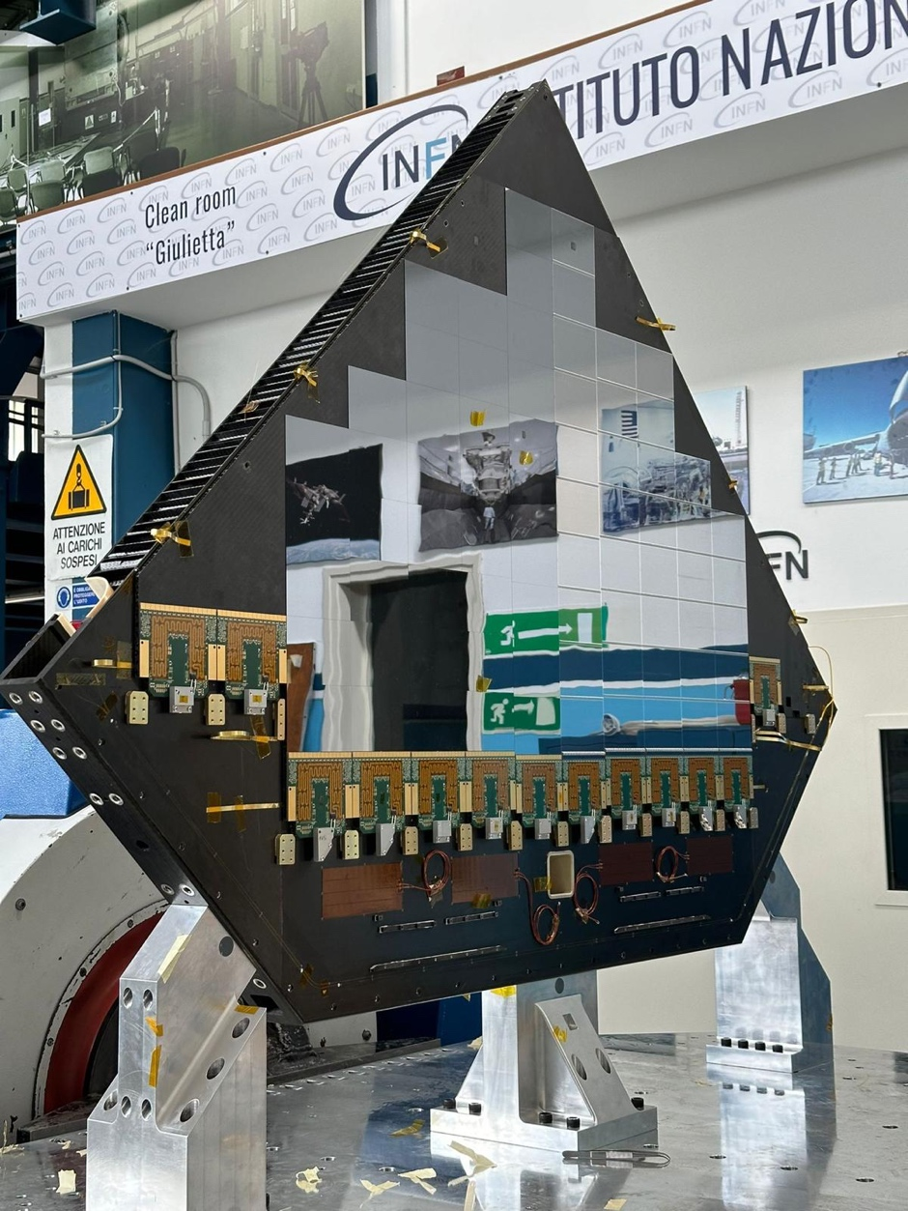
Vibration test of a silicon detector

Slide 29
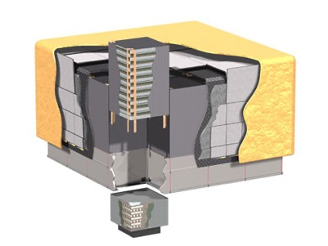
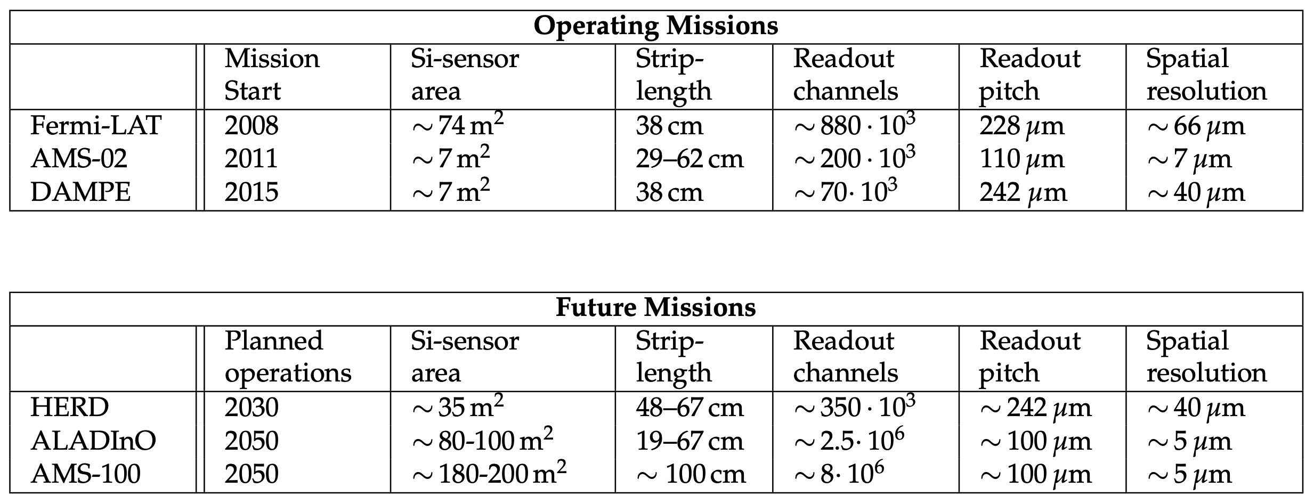
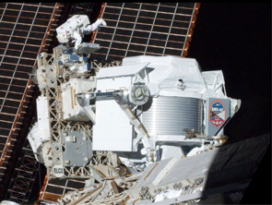
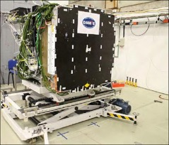
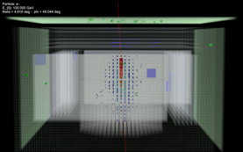
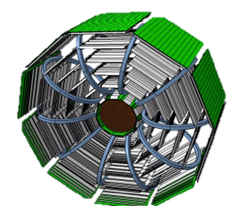
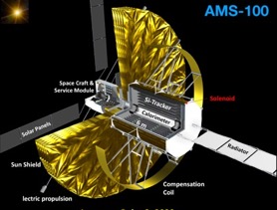
Silicon Microstrip detectors in space
Most of space detectors for charged cosmic ray and γ-ray measurements require solid state tracking systems based on Si-μstrip sensors.
Si-μstrip detectors are the only solution to instrument large area detectors with larger number of electronics channels coping with the limitations on power consumption in space
[1] HERD Collaboration. HERD Proposal, 2018 https://indico.ihep.ac.cn/event/8164/material/1/0.pdf
[2] Battiston, R.; Bertucci, B.; et al. High precision particle astrophysics as a new window on the universe with an Antimatter Large Acceptance Detector In Orbit (ALADInO). Experimental Astronomy 2021. https://doi.org/10.1007/s10686-021-09708-w
[3] Schael, S.; et al. AMS-100: The next generation magnetic spectrometer in space – An international science platform for physics and astrophysics at Lagrange point 2. NIM-A 2019, 944, 162561. https://doi.org/10.1016/j.nima.2019.162561
(see M. Duranti, V. Vagelli et al., Advantages and requirements in time resolving tracking for Astroparticle experiments in space, Instruments 2021, 5(2), 20; https://doi.org/10.3390/instruments5020020)

Slide 30
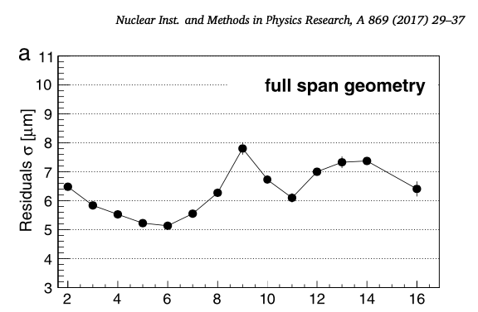
AMS-02 (junction, "S", "p-side", "bending")
27.5 μm
27.5 μm
27.5 μm
27.5 μm
110 μm
14 μm
p-type
p-type
300 μm
n-type
spatial resolution:
- 10 μm @ Z=1
- 5-6 μm @ Z>1
to be compared with
27.5 μm /sqrt(12) ~ 8 μm
NOT
110 μm /sqrt(12) ~ 32 μm
read-out strip
floating strip

Slide 31
AMS-02 (junction, "S", "p-side", "bending")
27.5 μm
27.5 μm
27.5 μm
27.5 μm
110 μm
25%
75%
300 μm
n-type
Ramo's theorem: only the closest strip (i.e. “digital")
→ capacitive coupling permits to know the fired strip
→ 27.5 μm /sqrt(12) ~ 8 μm
Thanks to charge sharing we can do even better than "digital"

Slide 32
Sensor's scheme (junction)
decoupling
capacitance
C_{g}
C_{d}
C_{i}
interstrip
capacitance
C_{ii}
p = pitch
l = strip lenght
d = thickness
first-to-third strip
capacitance
C_{b}
backplane
capacitance
C_{i} = interstrip capacitance ~ 1 pF/cm * l = 10 – 100 pF
C_{d} = decoupling capacitance ~ 1000 pF (DC sensors) or 120 pF/mm² (AC sensors) > C_{i} C_{b} C_{g} C_{ii}
C_{b} = backplane capacitance ~ 1 pF/cm * l * p/d = 0.5 – 2 * 10 – 100 pF
C_{g} = guardring capacitance << C_{i}
C_{ii} = first-to-third strip capacitance << C_{i}

Slide 33
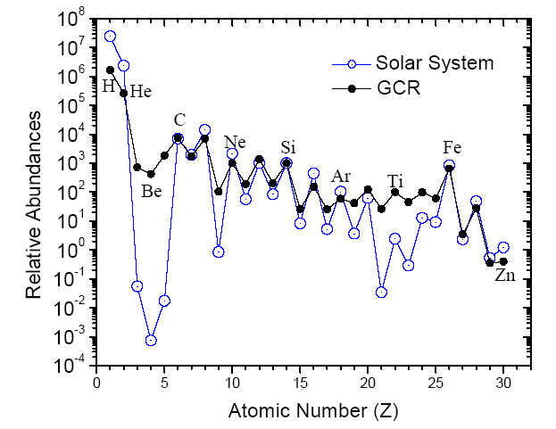
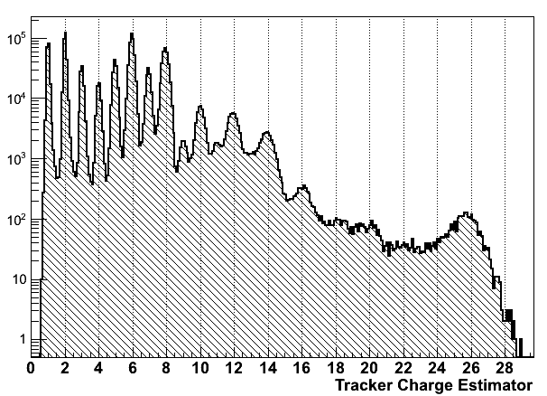
AMS-02: Charge collection (few months of data)
Abundances not corrected for detector efficiencies
H and He prescaled
C
O
Entries
Si
Fe
After few months of data on space the galactic cosmic rays (GCR) nuclear abundances are easily observed with an unprecedented statistics

Slide 34
AMS-02 (junction, "S", "p-side", "bending")
25% x C_{i}/C_{d}
25%
75%
300 μm
when the main two strips are saturated (at Front End level), the "overflow", towards other readout strips, allows to "recover" both the charge and the position

Slide 35
Sensor's scheme (junction)
decoupling
capacitance
C_{g}
C_{d}
C_{i}
interstrip
capacitance
C_{ii}
p = pitch
l = strip lenght
d = thickness
first-to-third strip
capacitance
C_{b}
backplane
capacitance
C_{i} = interstrip capacitance ~ 1 pF/cm * l = 10 – 100 pF
C_{d} = decoupling capacitance ~ 1000 pF (DC sensors) or 120 pF/mm² (AC sensors) > C_{i} C_{b} C_{g} C_{ii}
C_{b} = backplane capacitance ~ 1 pF/cm * l * p/d = 0.5 – 2 * 10 – 100 pF
C_{g} = guardring capacitance << C_{i}
C_{ii} = first-to-third strip capacitance << C_{i}
What if we want a thin LGAD with a strip geometry?
Capacitance (C_{b}) become a big problem…

Slide 36
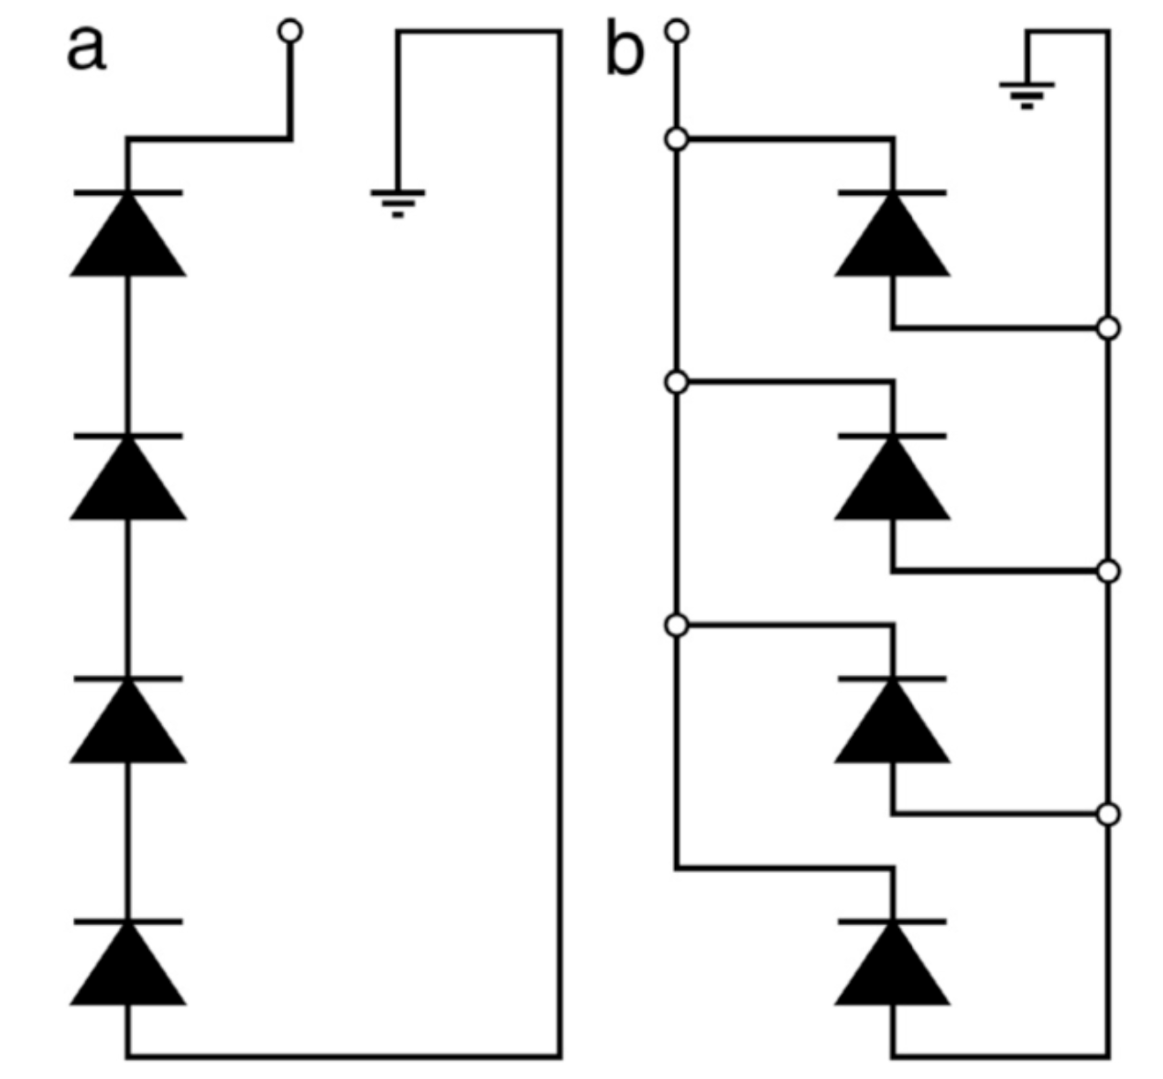

Serial vs parallel
multi-SiPM readout:
b) typical "parallel" readout
✔︎ bias voltage independent of number of SiPMs
✘ total capacitance seen by readout FEE scales with the number of SiPMs
a) "serial" readout
✘ ︎ bias voltage scales with of number of SiPMs
✔ total capacitance seen by readout FEE scales down (!) with the number of SiPMs

Slide 37

PRIN2022 - PTSD
INFN (PI M. Duranti)
+ ASI (Co-PI V. Vagelli)
~ 200 k€ received funds

Slide 38

Ideas behind the project
combine a standard μstrip sensor (2D + Z) with an LGAD (2D + timing)
serial readout of the "stack" to reduce LGAD capacitance
use standard μtrip as "structural" material for a very thin LGAD layer

Slide 39
Ideas behind the project
combine a standard μstrip sensor (2D + Z) with an LGAD (2D + timing)
serial readout of the "stack" to reduce LGAD capacitance
use standard μtrip as "structural" material for a very thin LGAD layer

Slide 40

Ideas behind the project
combine a standard μstrip sensor (2D + Z) with an LGAD (2D + timing)
serial readout of the "stack" to reduce LGAD capacitance
use standard μtrip as "structural" material for a very thin LGAD layer
Is possible to "daisy chain" the sensors (LGAD but also standard μstrip) connecting them in series and not in parallel?
→ capacitance would decrease as the length of the sensors increases!

Slide 41


Si sensors

Slide 42
Backup

Slide 43

Preliminary work
Sensor (LGAD, standard)
bias resistor
decoupling C
backplane C
(50 pF LGAD,
10 pF standard)
leakage
diode

Slide 44

Preliminary work
Sensor (LGAD, standard)
bias resistor
decoupling C
backplane C
(50 pF LGAD,
10 pF standard)
leakage
diode
CSA (values
almost random…)

Slide 45

Preliminary work
Signal in sensor
Sensor (LGAD, standard)
bias resistor
decoupling C
backplane C
(50 pF LGAD,
10 pF standard)
Signal in sensor
leakage
diode
Simple serial conf, compared with other (reference) ones
CSA (values
almost random…)

Slide 46

Preliminary work
1 LGAD + 5 standard
1 LGAD + 1 standard
only LGAD
only (5) standard
only (1) standard

Slide 47

Preliminary work
✔︎ the LGAD signal is passing trough the standard sensor: seems working!
✔︎ the CSA should see only the standard sensor capacitance, being the lower
✘ the LGAD sees, as effective "decoupling capacitance", the standard sensor capacitance: the collected signal is depressed by the ratio of standard/LGAD capacitance (see violet and blue curves vs red one, and blue curve vs violet one)
✔︎ the standard sensor sees its whole decoupling capacitance, but also a "complex" (a network, including the LGAD) backplane capacitance: the signal is not severely but still depressed (blue curve vs green or orange). To be understood completely…
signal in LGAD signal in standard

Slide 48
Cosmic Rays
if:
what we get is something like:
and this is what we use for the flux measurement
cosmic ray spectra are tipically power laws:
1 order of magnitude in energy → 2 orders of magnitude in flux (i.e. in statistics)

Slide 49


Spectrometer power consumption mitigation (AMS)
Placing the magnetic field in smart configurations (e.g. the Halbach array configuration in AMS) allows to have:
- bending direction
- non-bending (*) direction
This allow to push the spatial resolution (and so the power consumption) only in one direction.
For example in AMS, for He nuclei:
- bending direction, ~ 7μm;
- non-bending, , ~ 30μm;
* actually the particle is bent also in this direction. It's only true that its momentum in this direction is not modified…

Slide 50


Astro-particle detectors – planned and dreamed
- exploit the CR "isotropy" to maximize the effective geometrical factor, by using all the surface of the detector (aiming to reach Ω = 4π)
- the calorimeter should be highly isotropic and homogeneous:
  the needed depth of the calorimeter must be guaranteed for all the sides (i.e. cube, sphere, …)
  the segmentation of the calorimeter
  should be isotropic
→ this is in general doable just with an homogeneous calorimeter
→ CaloCube
CR
CR
CR
CR
HERD on the CSS (2027):
ALADInO @L2 (2050?):
AMS-100 (2050?):
ToF
TRK
CALO

Slide 51

AMS-02: Silicon Tracker
9 layers of double sided silicon detectors arranged in 192 ladders
~6 m²
total of 200k channels for ~ 200 watt
10 μm (30 μm) spatial resolution in bending (non bending) plane
momentum resolution ~10% @10 GeV
high dynamic range front end for charge measurement
wide temperature range
(-20/+40 survival, -10/+30 oper.)
6 honeycomb carbon fiber plane
detector material ~ 0.04 X₀

Slide 52


AMS-02: Cooling with 2-phases CO₂ pumped loop
Tracker Thermal Cooling System (TTCS)

Slide 53
AMS-02: Silicon "ladder"
192 flight units
7 – 15 wafers (28 – 60 cm) each
C_{b} = 7pF
C_{strip} = 1.2pF/cm
→ C_{b} + C_{strip} ~ C_{strip}
C_{coupling} = 700pF
→ 1/C_{strip} + 1/C_{coupling} ~ 1/C_{strip}

Slide 54
AMS-02: Silicon "ladder"
Y
X
Y
"multiplicity" (or "ambiguity"): the 1500-3000 K-side channels needed for each ladder are "merged" into 384.

Slide 55


AMS-02 upgrade "L0"
New Silicon Tracker Plane
L0-Y
bending direction
7 micron
L0-U
rotated 45º
10 micron bending
10 micron non-bending
Existing Tracker L1
New Silicon Tracker Layer: one plane, two layers, each ~ 4m²
ladders of
12 sensors
ladders of
10 sensors
ladders of
8 sensors
Si sensors
z
x
y
Front-end electronics
Acceptance increased to 300% (10 years data becomes 30 years data)
Notes:
Acceptance increased by a factor 2.5-3, depending on the analysis and selections.

Slide 56
MC simulation
MC Simulation:
based on Geant4 (via Generic Geant Simulation, GGS,
Mori, N Nuc. Instr. Meth. Section A, Volume 1002, 21 Jun 2021)
simple geometry "a la DAMPE": only tracker + calorimeter
Informations saved:
energy lost and deposited
spatial coordinates
timing
…

Slide 57
Back-scattering
1 TeV protons
Hits in the tracker (E_{dep} >10 keV vs Δt between the i^{th} hit and the 1st hit (i.e. the CR passing in the first layer of the tracker)
Δt=5*65ps=5*c*2cm
measurements
assuming 100 ps resolution
particles produced from the interaction of the CR with the silicon detectors
Δt=O(100ps)
Δt=O(10ns)
Δt=O(10μs)
back-scattering
Hits from back-scattering
tracker layers
O(100ps) timing resolution enables to separate back-scattering from primary hits in the tracker → improved efficiency in track reconstruction

Slide 58
Back-scattering
Δt=65ps=c*2.2cm
A simple cut (e.g. 550 ps from the first), removes:
~ 40% of the hits
~ 90% of the back-scattering hits
Simulating a timing resolution (gaussian with σ=100 ps)

Slide 59
e/p identification
the electromagnetic shower is composed only by "ultra-relativistic" particles
→ the time arrival in the tracker is (at most):
~ 2d / c
d
the hadronic shower could be composed by "slow" particles
→ the time arrival in the tracker could be delayed

Slide 60


e/p identification
all hits in tracker
5M primaries generated:
- 700 GeV electrons
- 1 TeV protons (depositing ~ 700 GeV in the ECAL)
looking at all the hits in tracker offers an "high statistic" tool to, for example, train a Multi-Variate algorithm
only latest hit in tracker
even the naive idea to look only at the "slower" hit in tracker shows two populations crearly distinct
the two populations (electrons and protons) are clearly distinct –> the e/p identification capability seems confirmed and seems also improving with energy

Slide 61
Ideas behind the project
from: https://indico.cern.ch/event/1044975/contributions/4663642/attachments/2394145/4094091/VCI-AMS-100-TKirn.pdf

Slide 62
Front-End with timing
LGAD-SiMS
ΔV = O(100V)
Front-End with CSA
SiMS
ΔV = O(100V)

Slide 63
Front-End with timing
LGAD-SiMS
ΔV = O(200V)
LGAD-SiMS

