Slide 1


Silicon sensors in Medical Physics
Simona Giordanengo
INFN Torino

Slide 2
Outline
Radiation detectors in medical physics:
  where and why?
Silicon sensors for:
  beam monitoring in particle therapy,
  timing applications,
  Flash radiotherapy (FLASH RT),
  proton/ion imaging.
Silicon sensors in Medical Physics - S. Giordanengo, INFN Torino – TREDI Torino - 22/02/2024
Notes:
In my talk I’ll start with a short review of radiation detectors applications in medical imaging and therapy, then the focus of the talk will be on new beam monitors for PT and FLASH RT followed by an overview of silicon sensors development for dosimetry, micro-dosimetry and radiobiology

Slide 3

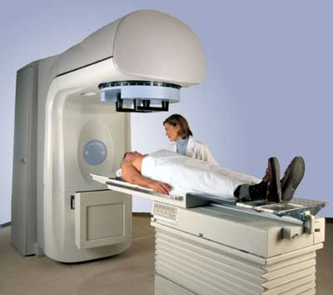
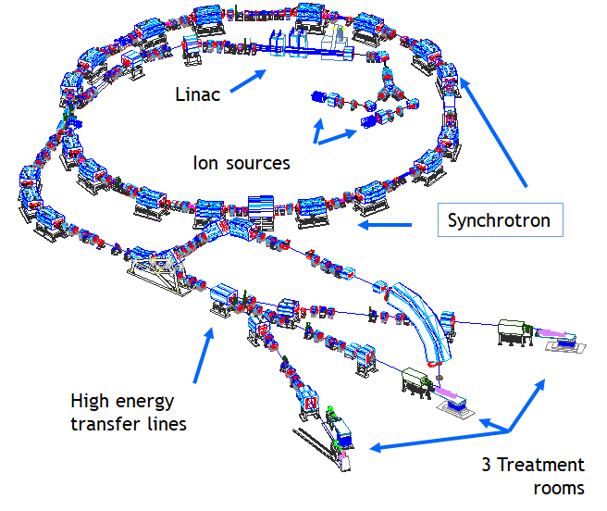
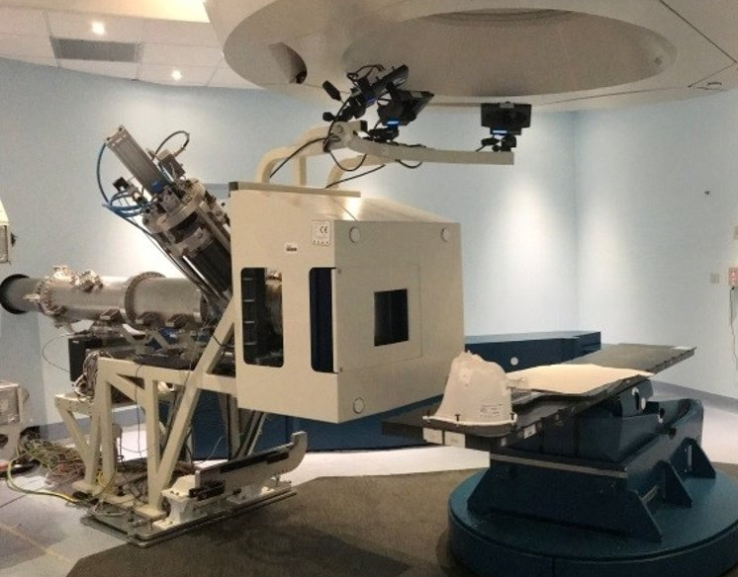
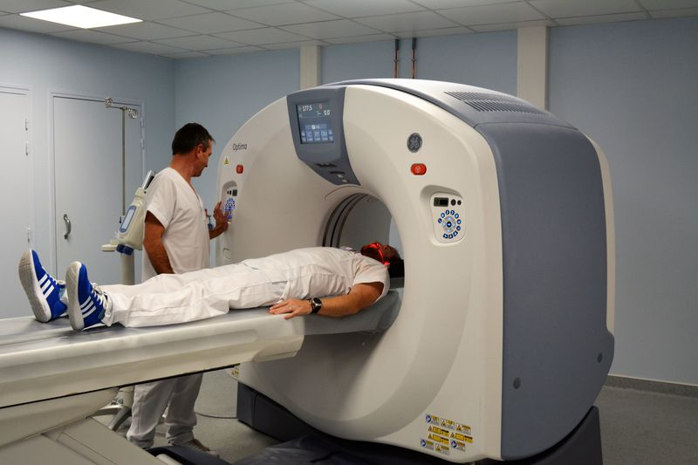
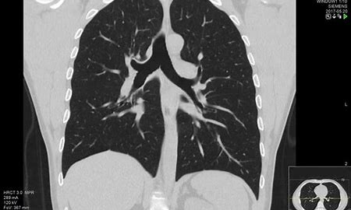
Introduction
Radiation detectors in medical physics: where and why?
Medical Imaging techniques
X-ray Imaging
Computed Tomography (CT)
Positron Emission Tomography (PET)
Single Photon Emission Computed Tomography (SPECT)
Image fusion PET-CT
Radiotherapy with external beams
Cyclotron for protons and Synchrotron for protons&light ions
LINAC for radiotherapy
Benefits from new technologies
→ improve image resolution and sensitivity
Photons (6 - 18 MV)
Electrons (6 - 18 MeV)
Protons (60-250 MeV/u)
Carbon ions (115-400 MeV/u)
Silicon sensors in Medical Physics - S. Giordanengo, INFN Torino – TREDI Torino - 22/02/2024
Notes:
This slice is trivial but essential to highlight the crucial role that detet

Slide 4
Radiation detectors for radiotherapy
Beam commissioning
  - Before facility startup
Beam monitoring
  - Online to guide and control the beam delivery
Quality Assurance
- daily/weekly/monthly
Dosimetry
- daily
Microdosimetry
Radiobiology
Radiotherapy with external beams
Cyclotron for protons and Synchrotron for protons&light ions
LINAC for radiotherapy
Photons (6 - 18 MV)
Electrons (6 - 18 MeV)
Protons (60-250 MeV/u)
Carbon ions (115-400 MeV/u)
Silicon sensors in Medical Physics - S. Giordanengo, INFN Torino – TREDI Torino - 22/02/2024

Slide 5
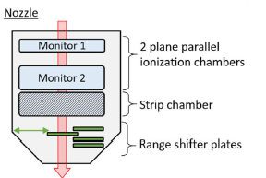
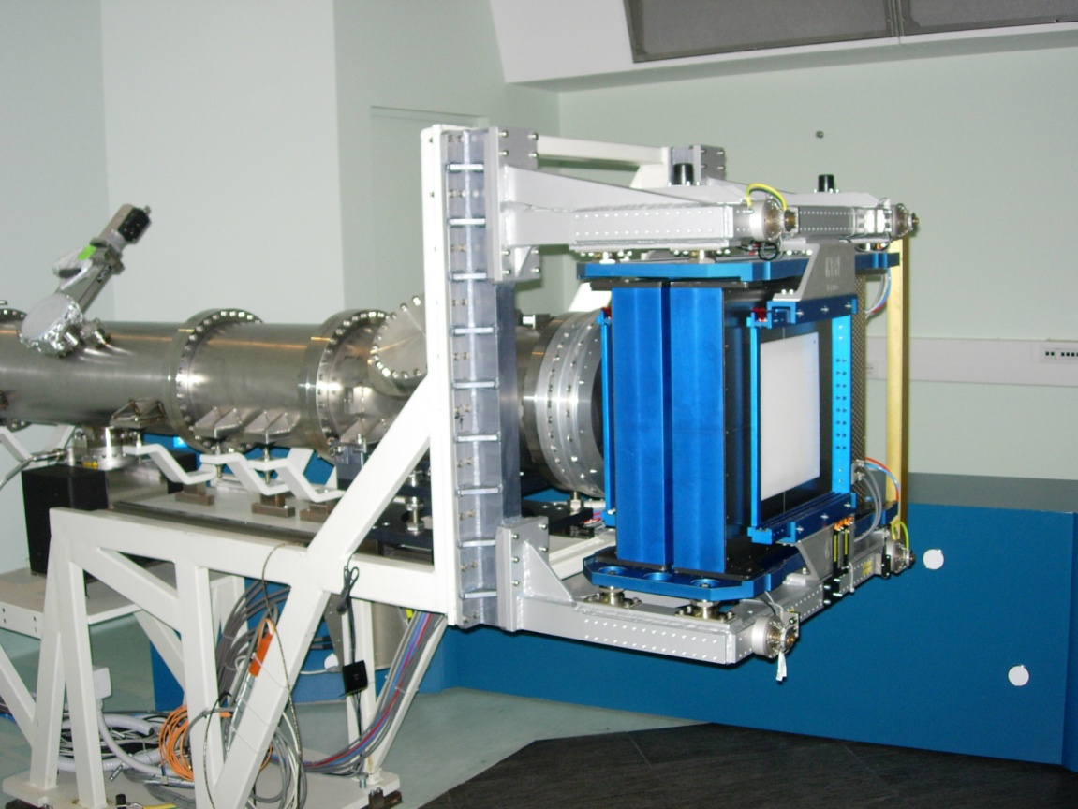
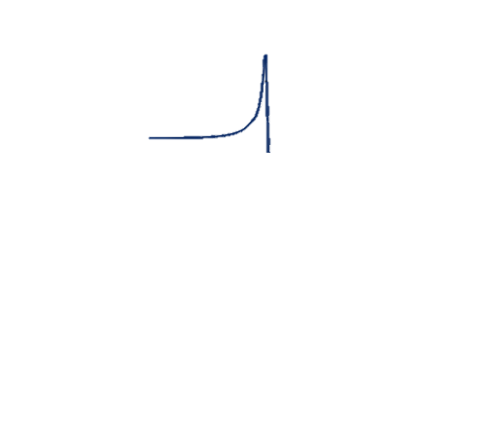
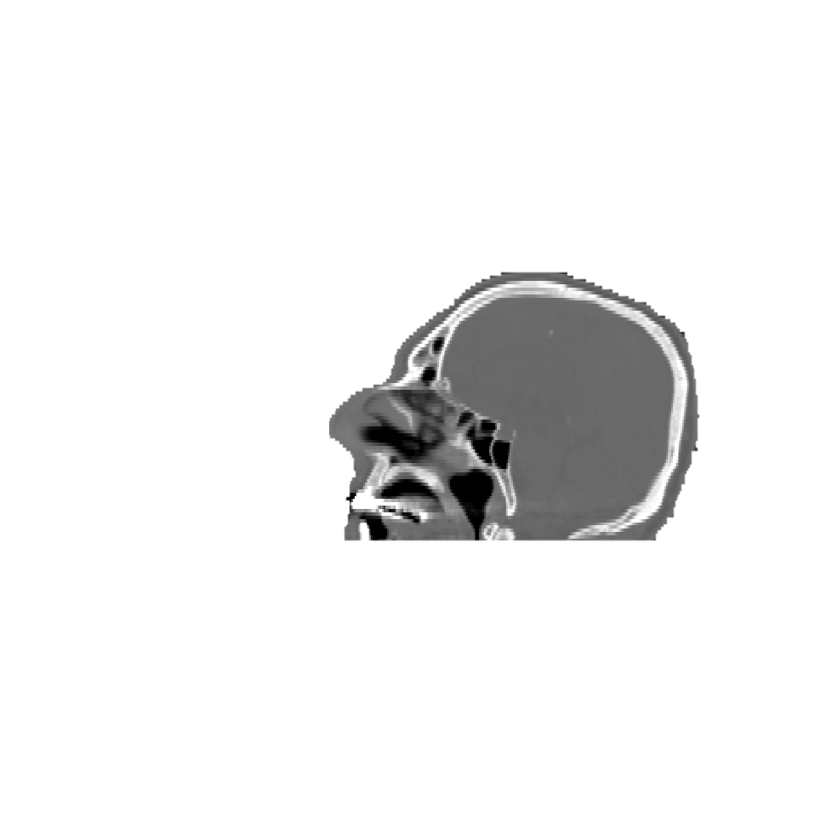
The role of beam monitors in the nozzle
Nozzle equipped with particle detectors integrated with the accelerator control system to guide and control the beam in real time.
PSI – Gantry 1
CNAO horizontal beam line
𝛄 511 keV
Charged particles
beam
𝛄 prompt
𝛄 511 keV
neutrons
Phys. Med. Biol. 68 (2023) 105013
Nucl. Instr. Met. A 698 (2013) 202
Silicon sensors in Medical Physics - S. Giordanengo, INFN Torino – TREDI Torino - 22/02/2024
Notes:
Well, you all know that to guide and control the beam delivery, every nozzle is equipped with beam monitors integrated with the accelerator control system.
which measure in real time the beam fluence and position, mandatory and if needed.
One easy question: are they, or the most advanced beam monitors able to control the beam energy online?
No
Why?
First because the beam energy is guaranteed by the accelerators, but the crucial reason is that it’s not trivial the energy measurement in the limited space and time constrained by clinical requirements. We will see this topic later
detectors

Slide 6
Beam characteristics for particle therapy
Target dimension: 1 ÷ 40 cm
Tumor
Pencil Beam
Not to scale
Beam range in water for protons&ions → | 3÷30 cm
Beam energy range (protons) [MeV, β, MIP] Beam energy range (C ions) | 60÷250 MeV, β 0.34-0.59 , 5-2 MIP 120÷400 MeV/u (β 0.46-0.71)
Beam intensity (particles/s) | 10⁸÷10¹⁰ p/s 4×10⁷÷4×10⁸ Cions/s
Spot size (FWHM in air at the isocenter) | FWHM 7÷20 protons /4÷8 mm Cions (highest÷lowest) Energy
Field size at the isocenter | 20x20/40×40 cm² (min-max)
Silicon sensors in Medical Physics - S. Giordanengo, INFN Torino – TREDI Torino - 22/02/2024

Slide 7
Beam parameters measured in the nozzle
To be measured during treatment, along the beam line just before the patient …
Not to scale
Tumor
Exit window
Pencil Beam
FWHM → 3 ÷ 10 mm
FWHM_{y}
Beam flux and fluence (beam Intensity – dose rate)
Accepted uncertainty 1-2 %
Transversal Beam positions
Accepted uncertainty ±0.5 mm
Transversal Beam shape (FWHMs)
Accepted uncertainty ±1 mm
FWHM_{x}
Beam range or energy
→ Accepted uncertainty 1 mm (0.5 – 1 MeV)
Currently not online!!
Silicon sensors in Medical Physics - S. Giordanengo, INFN Torino – TREDI Torino - 22/02/2024

Slide 8
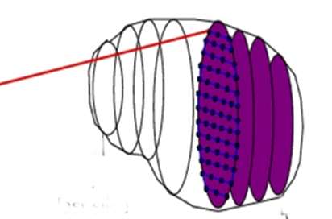
Pencil beams are driven by beam monitors
Sinergy with scanning system
Monitor 1
Monitor 2
Treated spots
y
y
Scanned Field
Scanned Field
ionization chambers
z
z
x
E_{n}
x
First slice
(min energy)
Isocenter
Isocenter
Scanning magnets
2 : Integral chambers
2 : Strip chambers
Last slice
(max energy)
Monitor on-line the beam fluence and position (mandatory), FWHM (optional)
Set the beam position spot by spot through the scanning magnets power supplies
Correct on-line the beam position (feed-back operations)
Stop the beam when something is wrong (beam parameters out of range)
Silicon sensors in Medical Physics - S. Giordanengo, INFN Torino – TREDI Torino - 22/02/2024
Notes:
,

Slide 9
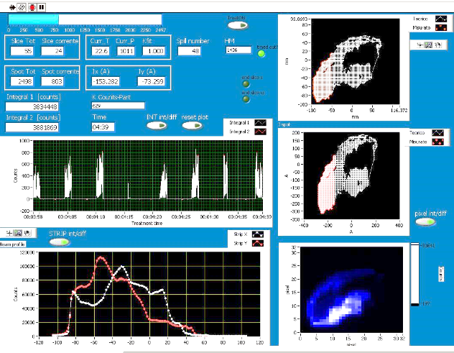
Online beam delivery progress
Dose Delivery System GUI in the CNAO Local Control Room
First slice
(min energy)
Last slice
(max energy)
Silicon sensors in Medical Physics - S. Giordanengo, INFN Torino – TREDI Torino - 22/02/2024

Slide 10
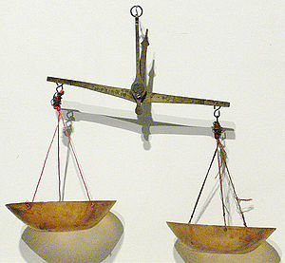
Robustness vs Performances in medical applications
Performances
and accuracy
Robustness
Silicon sensors in Medical Physics - S. Giordanengo, INFN Torino – TREDI Torino - 22/02/2024

Slide 11
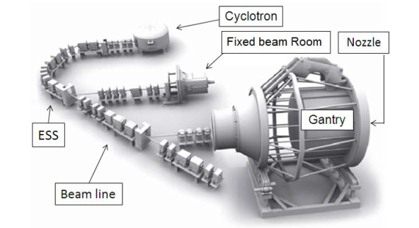

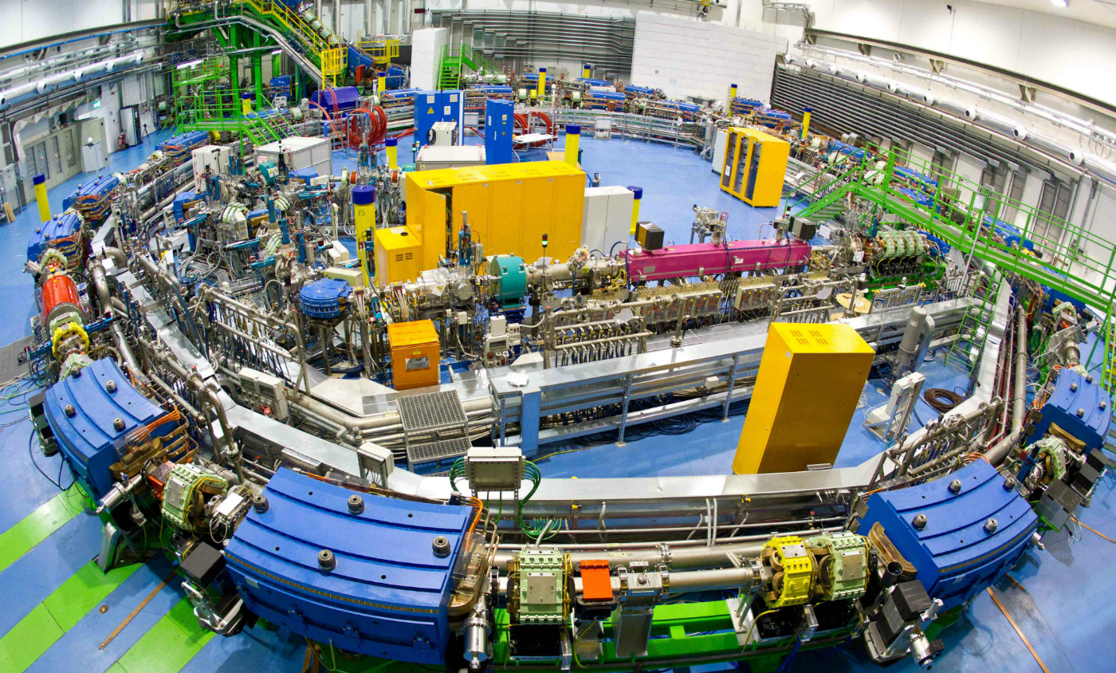
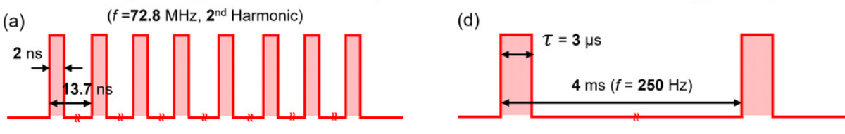
Beam monitor must deal with different beam temporal structures
Cyclotron
Synchrotron
The cyclotron provides proton therapy reliably and at low cost (main vendors on the market: IBA, Varian, Mevion, Hitachi).
Energy modulation with degraders.
Multi-ion accelerator (more flexible than cyclotrons).
Beam delivered in spills
1 s
Beam monitor
integrated charge
3-5 s
11
Silicon sensors in Medical Physics - S. Giordanengo, INFN Torino – TREDI Torino - 22/02/2024

Slide 12
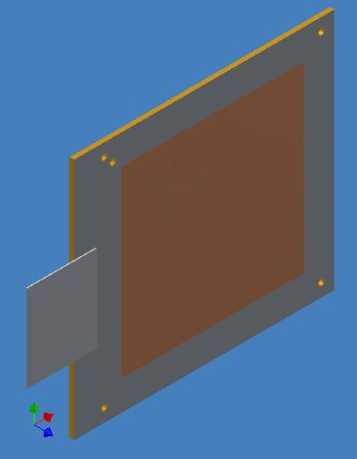
State-of-the-art
→ large area gas ionization chambers
ADVANTAGES
Sequence of Parallel Plate ICs:
→ single large electrode for FLUENCE
→ electrodes segmented in strips for BEAM POSITION and SHAPE
Reliability & long term (years) stability
Large (up to 40x40 cm²) sensitive area
Simple to use
Deeply studied manufacture
A few mm water equivalent thickness
Radiation resistant
Gas used:
Air
N_{2,}
Ar-CO₂
Roadmap: proton therapy physics and biology
Paganetti et al. Phys. Med. Biol. 66 (2021) 05RM01
“Currently ionization chambers(IC) are predominately used (in fact they are legally required in most countries). “
E = 1 kV/cm
Thickness ~ 1 mm of water
12
Silicon sensors in Medical Physics - S. Giordanengo, INFN Torino – TREDI Torino - 22/02/2024

Slide 13
State-of-the-art
→ large area gas ionization chambers
LIMITATIONS
Sequence of Parallel Plate ICs:
→ single large electrode for FLUENCE
→ electrodes segmented in strips for BEAM POSITION and SHAPE
Long collection times ~ 100 µs
Low Sensitivity ~ 10⁴ protons
Poor time resolution ~ no/poor
Deviation from linearity @ high dose rates
Gas used:
Air
N_{2,}
Ar-CO₂
Not suitable for
fast scanning modalities
timing applications
high dose rates (FLASH)
E = 1 kV/cm
Thickness ~ 1 mm of water
13
Silicon sensors in Medical Physics - S. Giordanengo, INFN Torino – TREDI Torino - 22/02/2024

Slide 14
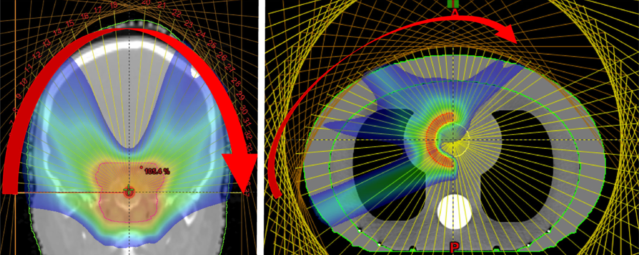
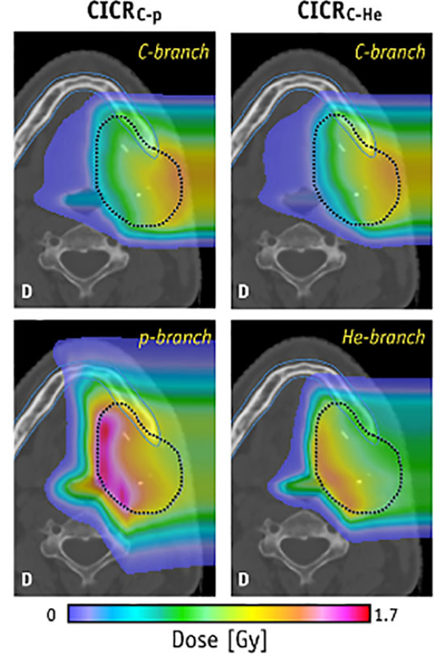
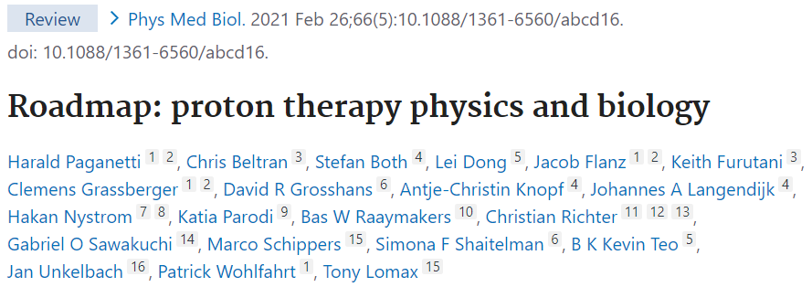
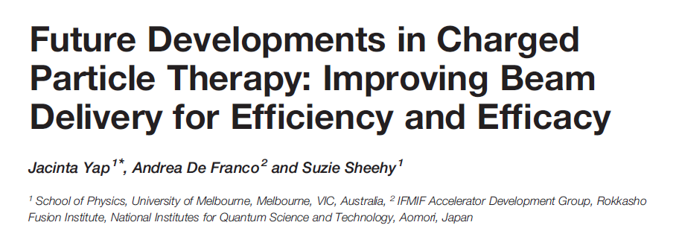
New challenges for beam monitoring
New accelerators (different timing structures and treatment procedures)
Advanced treatment modalities (multiple rescanning, online image-guided, …)
Hipofractionation up to FLASH
Fast pencil beam scanning
Proton Computed Tomography
14
Silicon sensors in Medical Physics - S. Giordanengo, INFN Torino – TREDI Torino - 22/02/2024

Slide 15
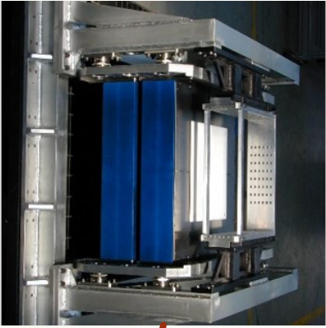
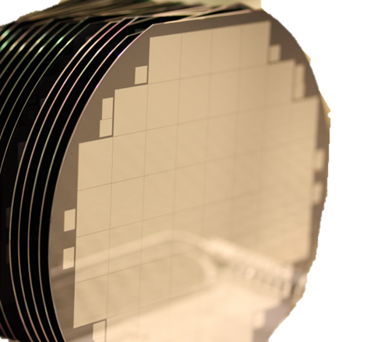
INFN MoveIT project (2017-2021)
Solid state detectors for p-beam monitoring
IONIZATION CHAMBERS
SOLID STATE SENSORS: LGAD 45-60 µm thickness
int. gain ~ 10
Main issues at φ = 10¹⁰ p/cm²s
Signal pile-up
→ fast sensors & readout
→ segmentation
Radiation tolerance
→ manufacturing strategies
→ damage compensation
Large sensitive area
→ technological challenge
Increased complexity
Collection times ~ 100 µs
Sensitivity ~ 10⁴ protons
Time resolution ~ no/poor
~ ns
single protons
<< 100 ps
Not suitable for
fast scanning modalities
timing applications
direct counting # protons
timing applications
Silicon sensors in Medical Physics - S. Giordanengo, INFN Torino – TREDI Torino - 22/02/2024
15

Slide 16
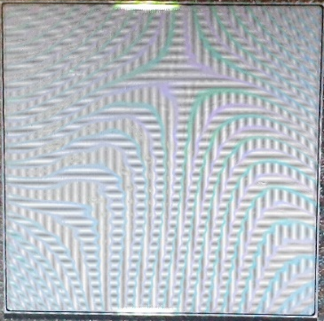
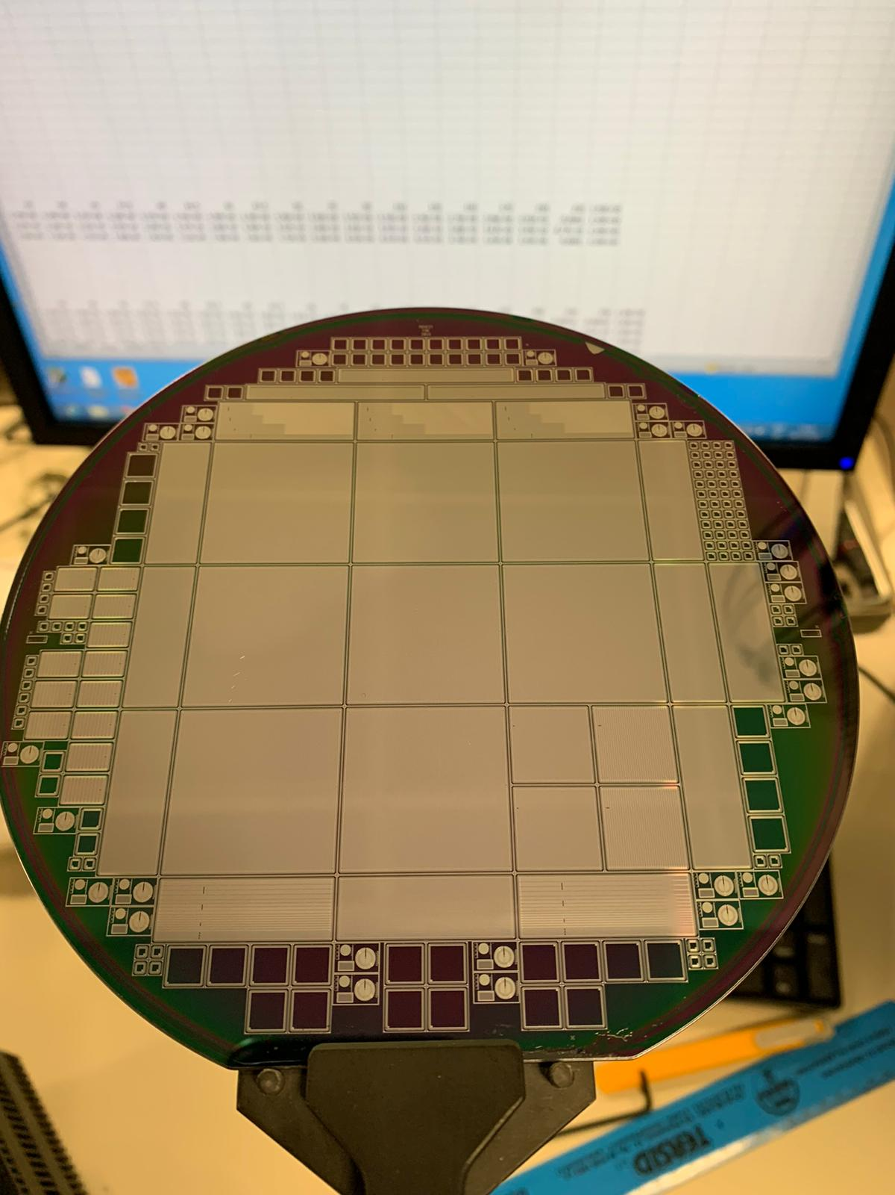

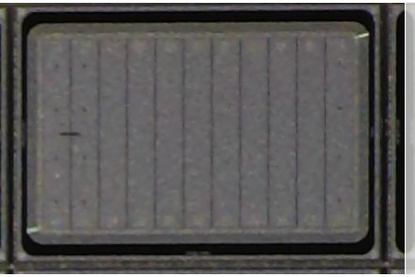
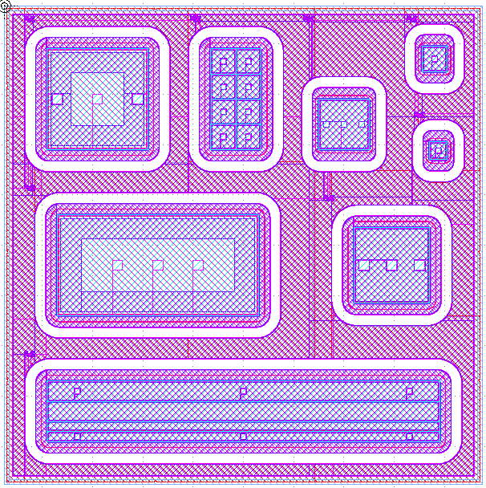

Thin Low Gain Avalanche Detectors
+
thickness of sensitive volume < 50 µm
internal charge multiplication ~ 10
Enhanced signal of very small duration
Time resolution of tens of ps
Strip detectors (strip area ~ 3 mm², active thickness 45µm)
Internal gain
yes | no
✓ | ✓
✓ | ✓
✗ | ✓
Detectors for particle counting
Large area (2.7×2,7 cm²)
144 strips
Detectors for timing applications
Smaller size, 11 strips
Strip area 2.2${mm}^{2},$active thickness
45 $μm,$total thickness 615 $μm$)
Si- substrate removed to reduce total thickness to 70 µm
Beam spot
1 cm FWHM
Pads for large ionization rate studies
4 active thicknesses (15/20/30/45 µm)
5 pad sizes (0,125/0,25/0,56/1/2 mm²)
Use:
Protons
Use:
C-ions
FLASH
Silicon sensors in Medical Physics - S. Giordanengo, INFN Torino – TREDI Torino - 22/02/2024
16

Slide 17

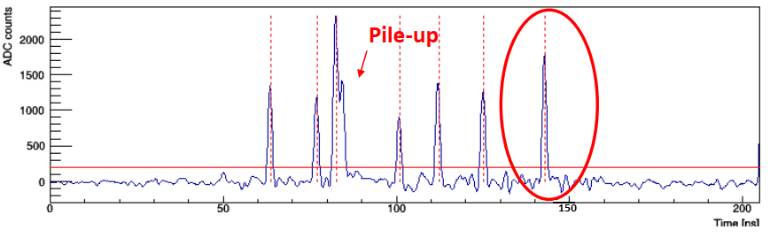
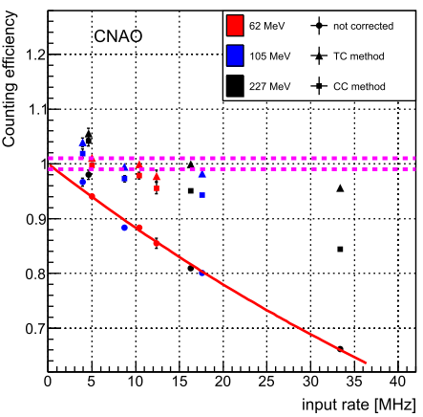
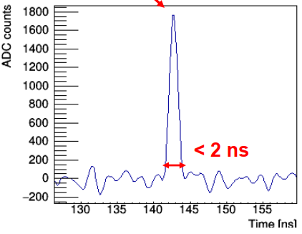
Proton counting
Data collected with strip sensors + digitizer
Pile-up correction studies
117 MeV protons
Strip area 2mm²
threshold
Short peak duration
Large Landau fluctuations
Single particle discrimination
Signal pile-up
CNAO beam flux
5 x 10⁸ p/cm²s
Mohammadian-Behbahani M, et. al., NIM A 1040 (2022) 167195
Monaco V, et. al., Phys. Med. Biol. 68 (2023) 235009
Silicon sensors in Medical Physics - S. Giordanengo, INFN Torino – TREDI Torino - 22/02/2024

Slide 18
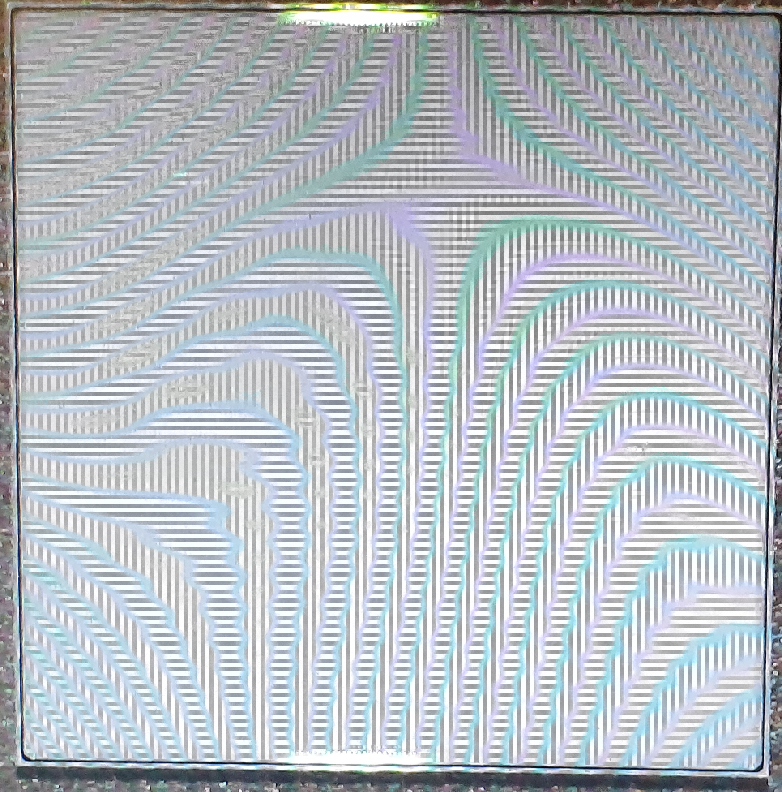
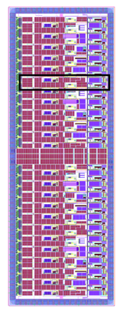
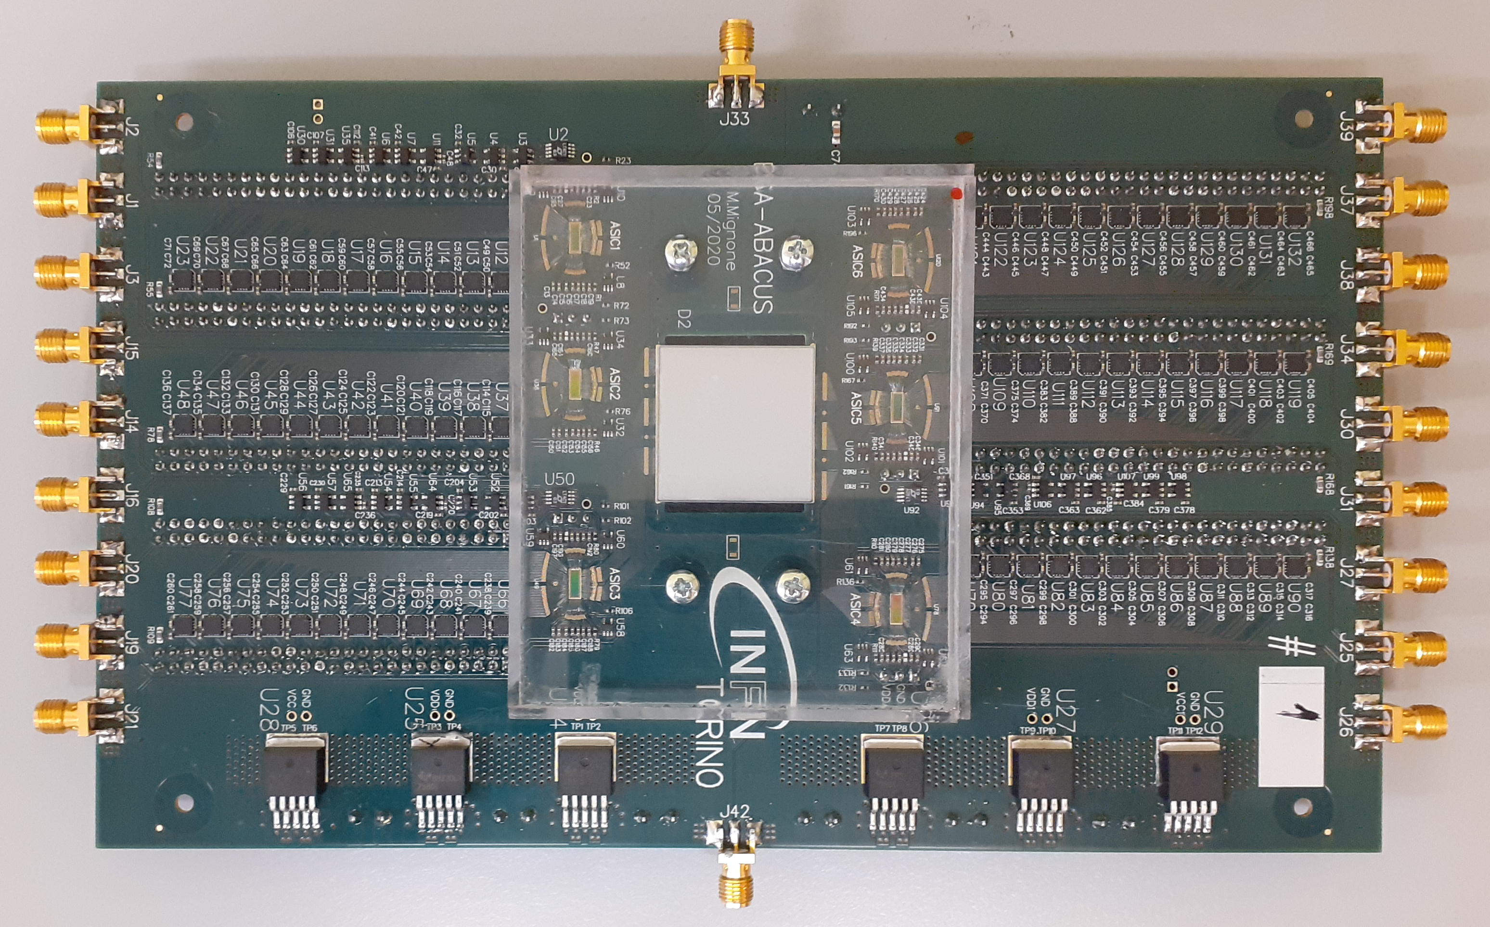
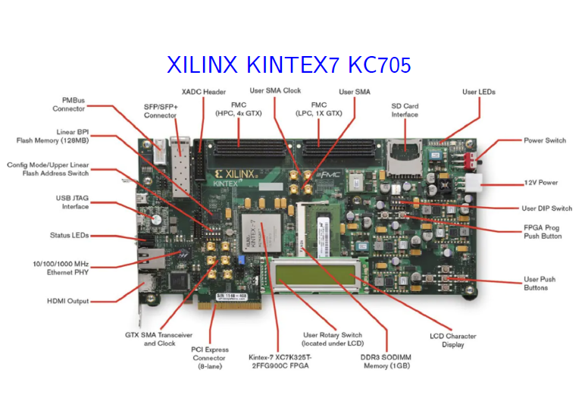
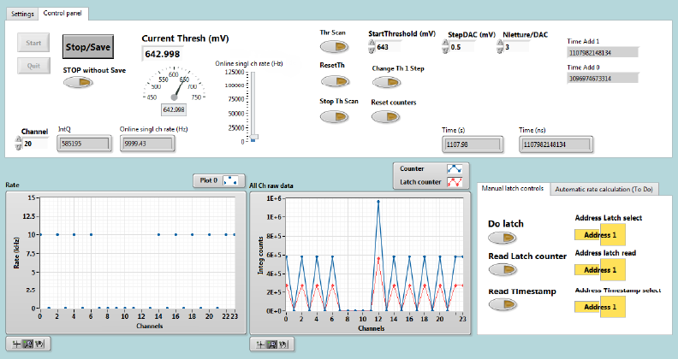
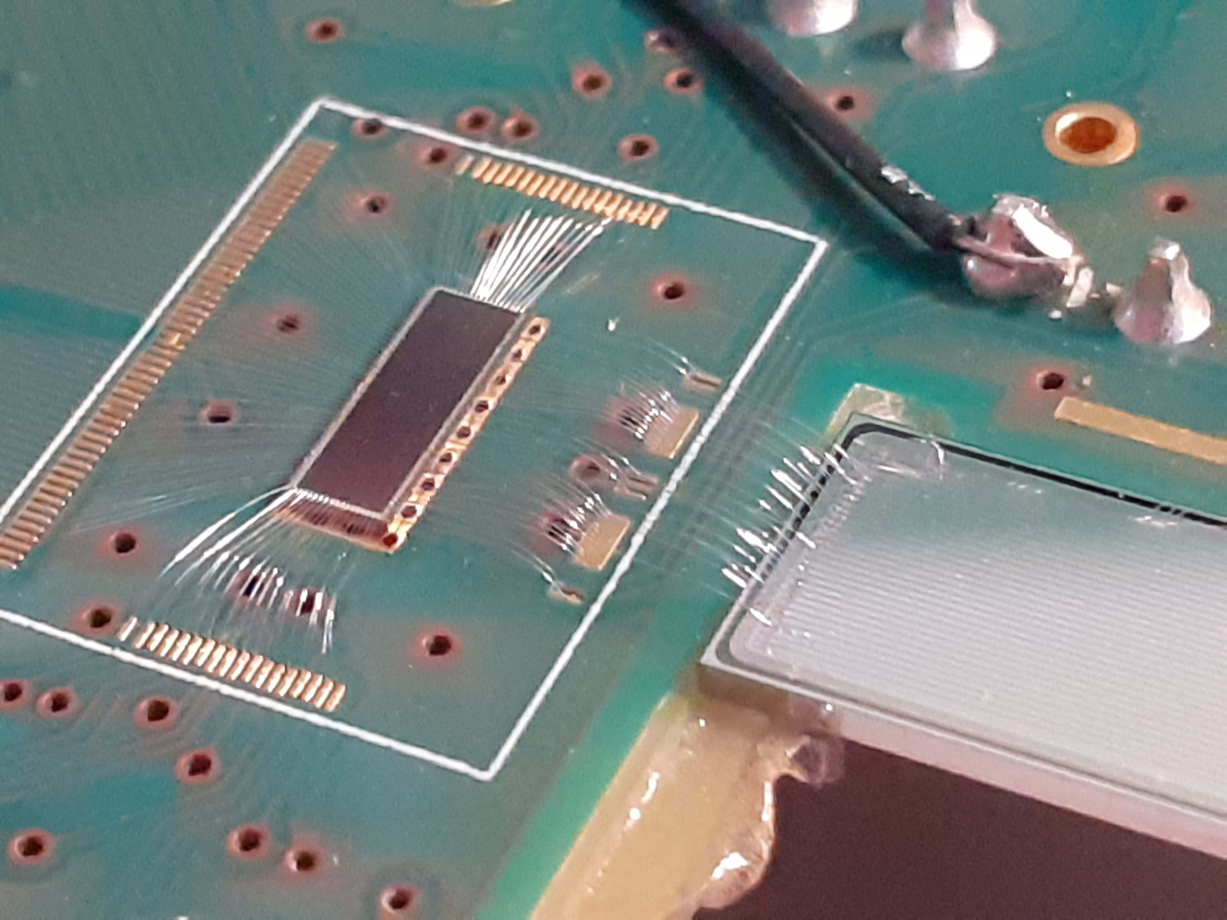
Technologies for multi-channels silicon detectors
Custom ASIC
Custom Frontend board
Proton pencil
beam
LGAD strips
ABACUS
ESA-ABACUS
3 FPGA
LabVIEW interface
Kintex-7
Gbit ethernet interface
1 cm FWHM
10⁸ p/s*cm²
146 strips
6 ABACUS
24x6 channels
Silicon sensors in Medical Physics - S. Giordanengo, INFN Torino – TREDI Torino - 22/02/2024
Notes:
Slide per sottolineare la complessità di un rivelatore e le tecnologie necessarie

Slide 19
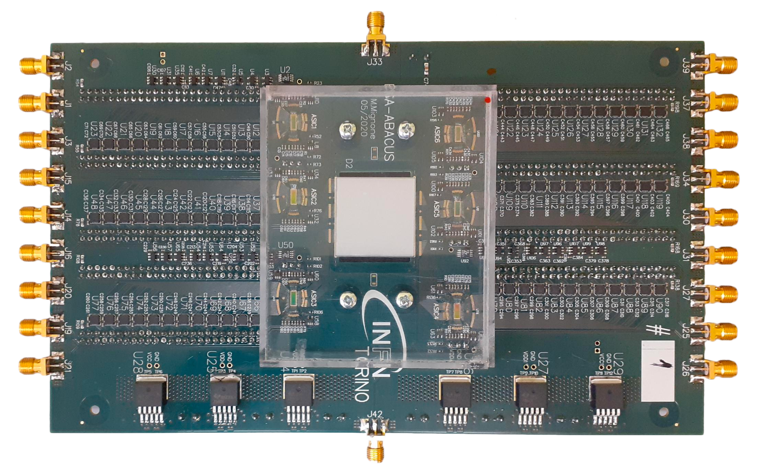
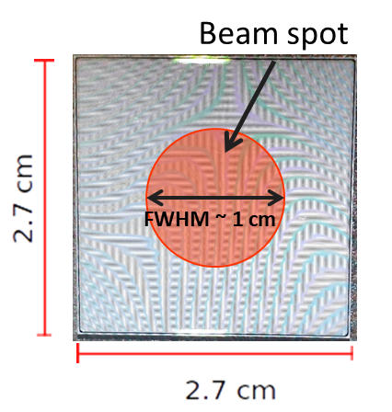
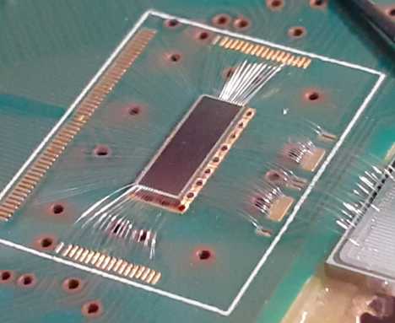
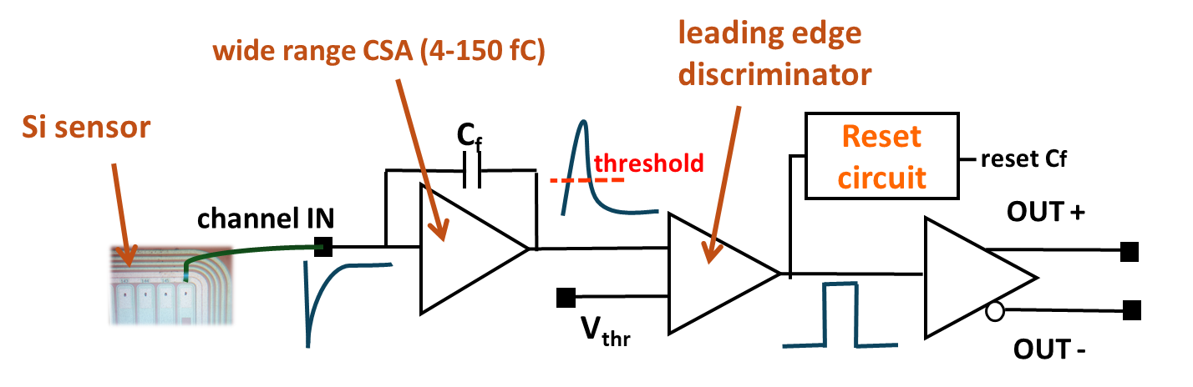
2.7×2.7 cm² particle counter (ESA ABACUS)
Silicon strip sensor
Strips width: 114 μm
Pitch: 180 μm
Active thickness: ~50 μm
Capacitance: ~7 pF
The ABACUS chip (x6)
110 nm CMOS technology, chip area = 2 × 5 mm², 24 channels, 144 in total. CSA dynamic range: 4 fC – 150 fC. Dead time : < 10 ns.
LVDS
Silicon sensors in Medical Physics - S. Giordanengo, INFN Torino – TREDI Torino - 22/02/2024

Slide 20
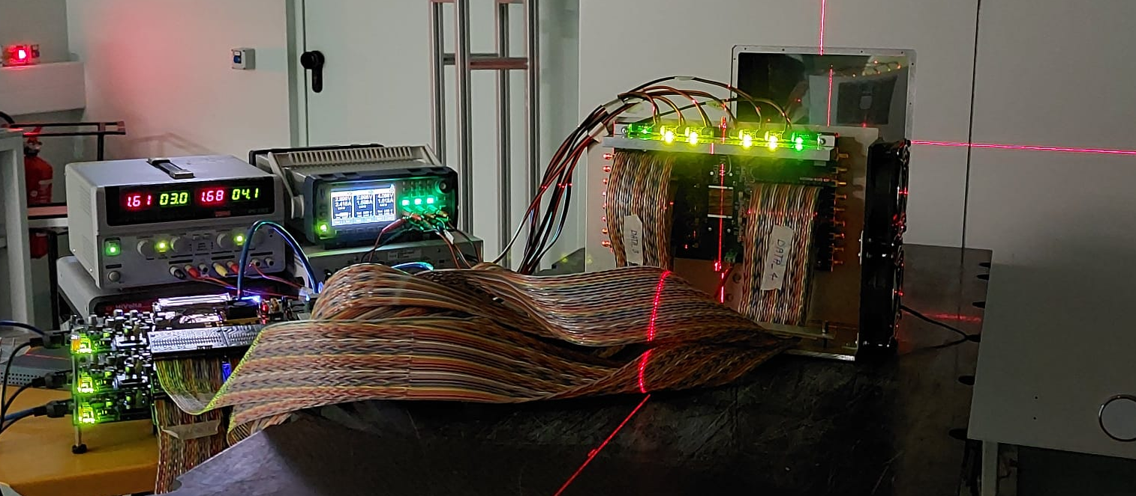
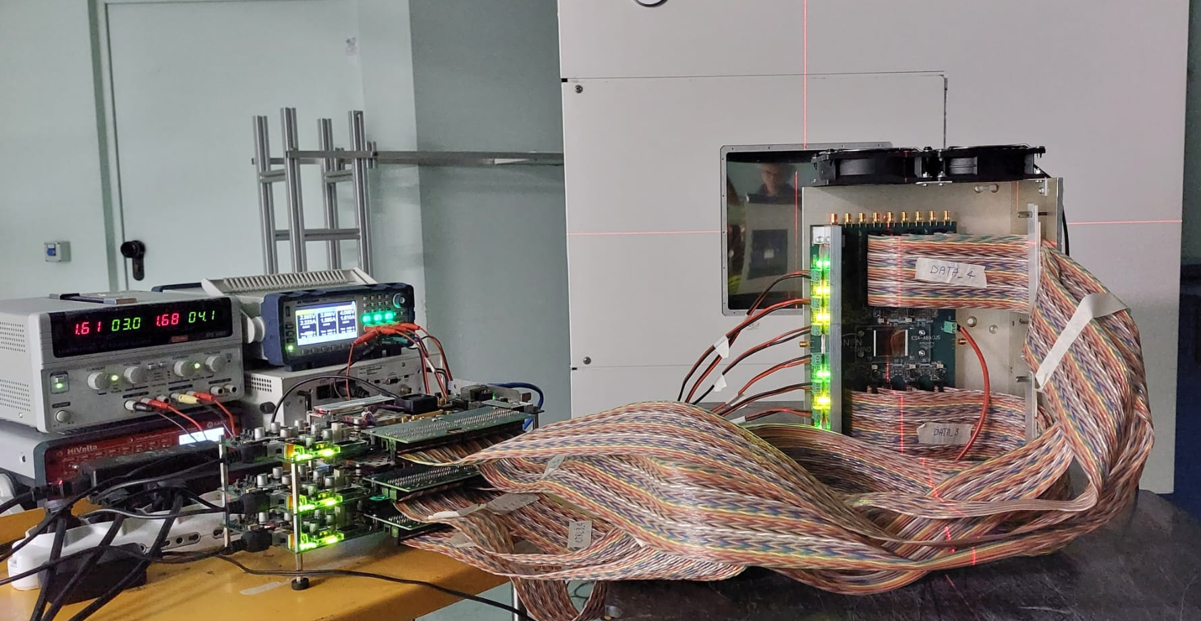
Particle counter test at CNAO to study the counting efficiency with protons and carbon ions
y
x
Z
beam direction
Runs with different energies in the clinical energy range
  60 - 230 MeV (protons)
  115 - 400 MeV/u (carbon ions)
Different beam fluence rate:
  20, 50, 100 % of maximum fluence rate

Slide 21
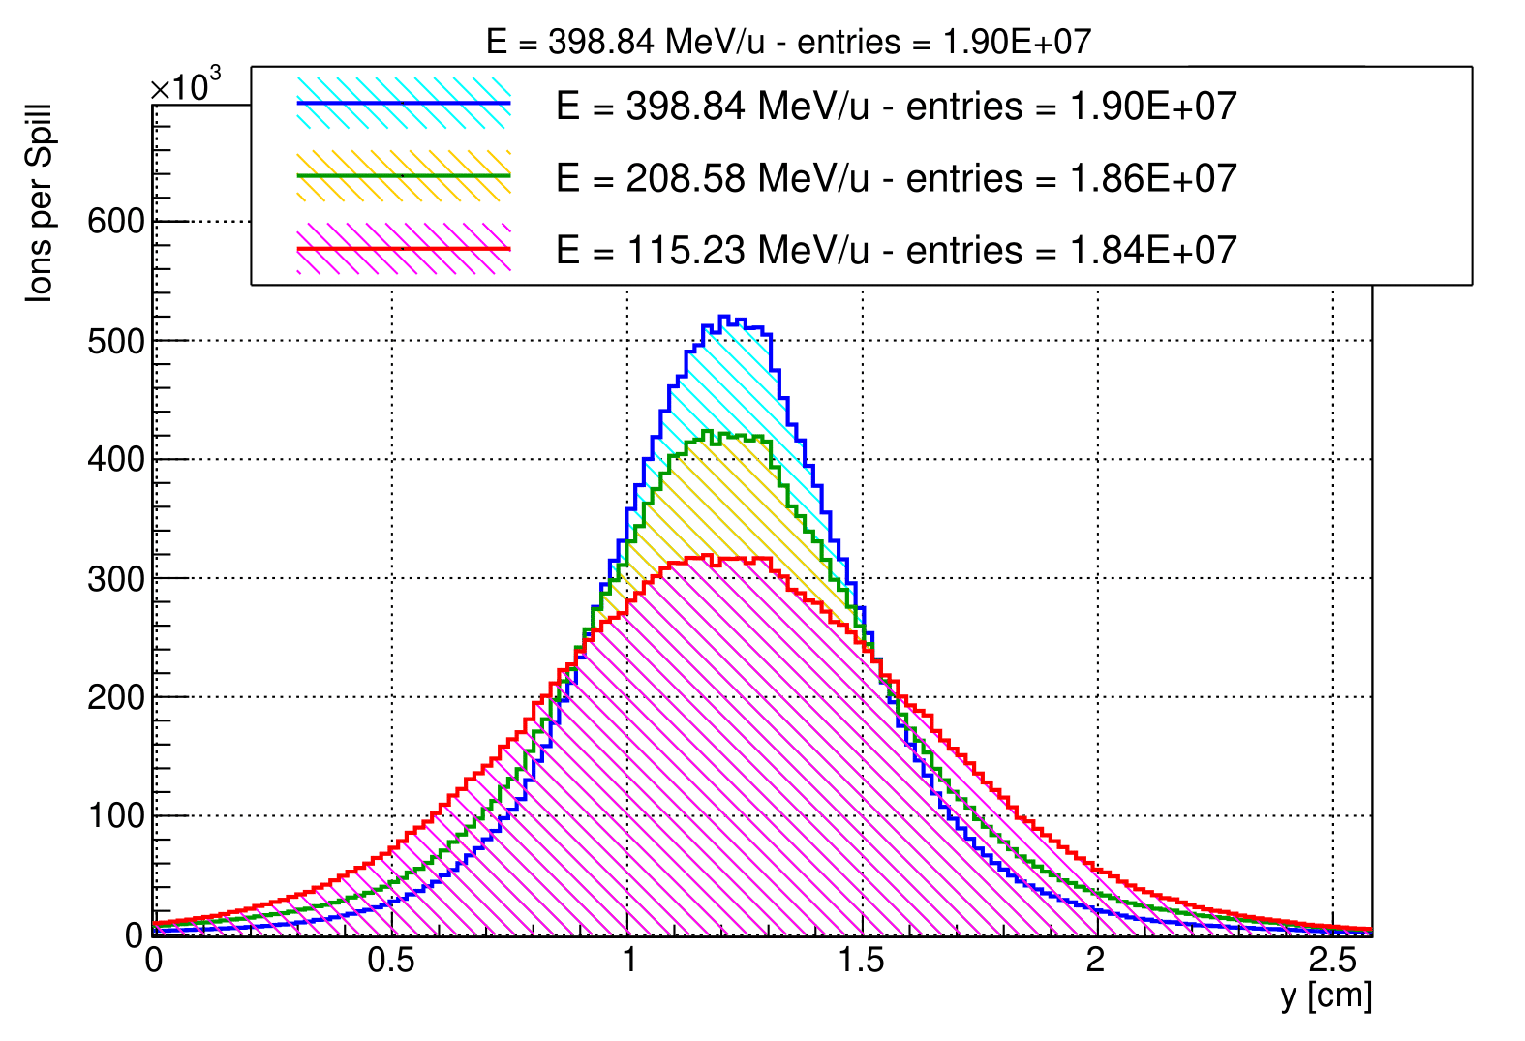
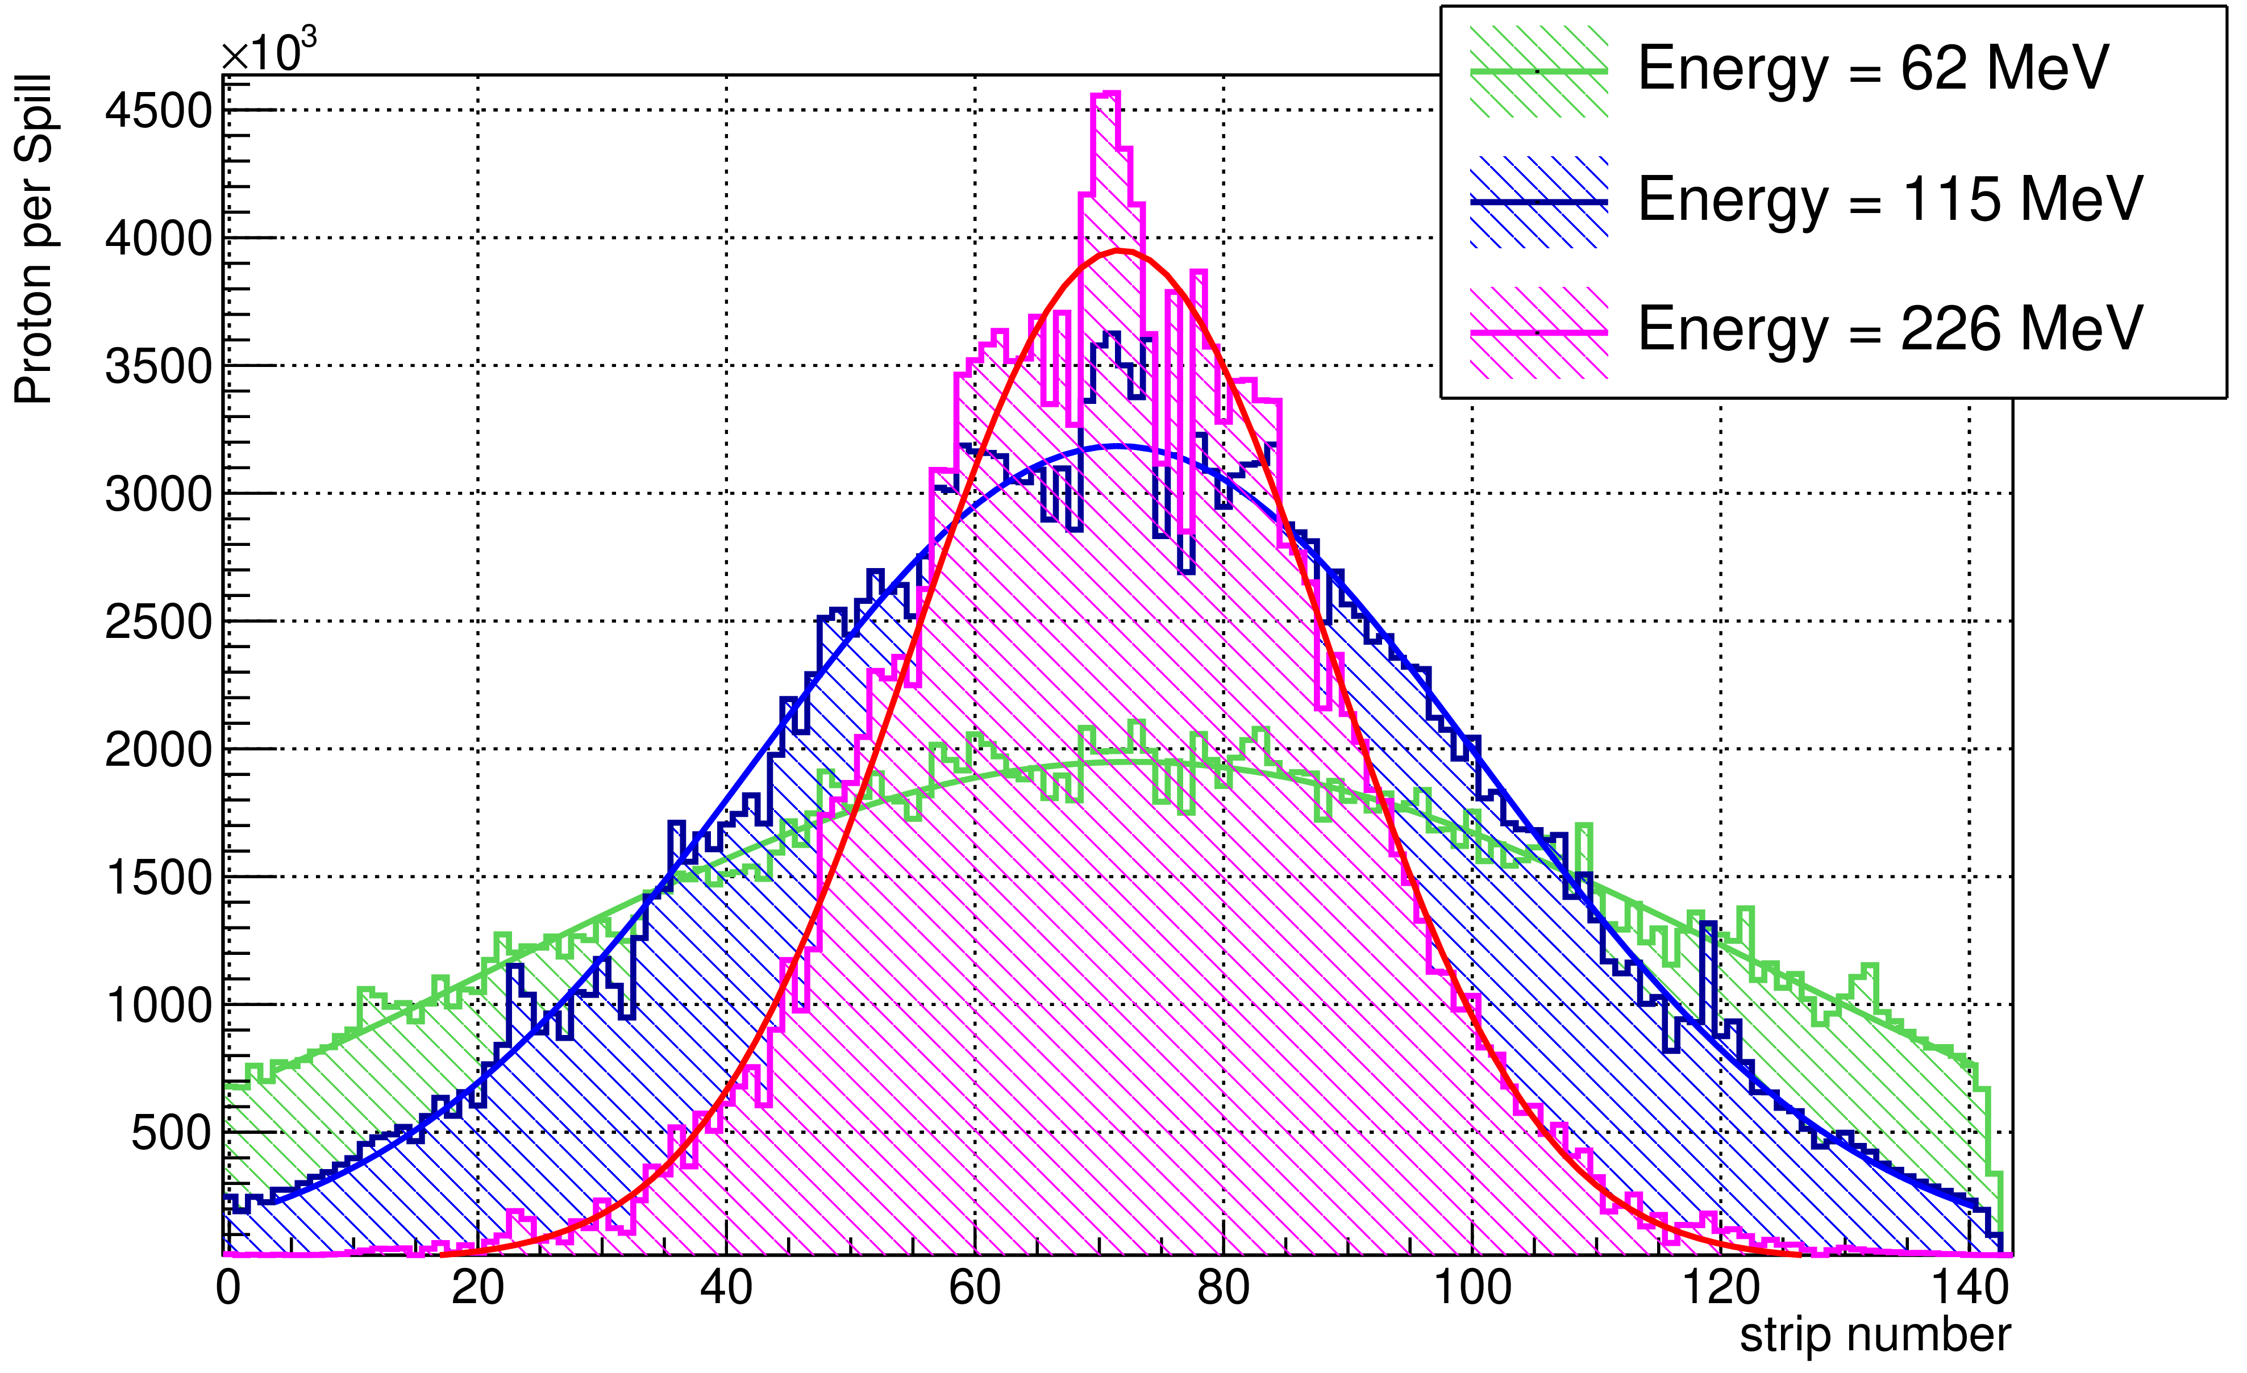
Measured beam profiles and fluence at CNAO
Protons per spill
Protons
Carbon Ions
  Three different energies, 60 - 230 MeV (protons), 115 - 400 MeV/u (carbon ions)
  Three different beam fluence: 20, 50, 100 % of the maximum fluence rate.
  Counting efficiency: 50% protons, > 90 % Carbon ions
Silicon sensors in Medical Physics - S. Giordanengo, INFN Torino – TREDI Torino - 22/02/2024

Slide 22
Perspectives about online beam fluence and position control
Technology ready for fix pencil beam characterization.
Improved front-end readout will overcome noise issues encountered with protons.
Current LGAD radiation tolerance will guarantee 1 year of safe operation
The challenge
Increase the sensitive area (> 24x24 cm²)
  Pixel segmentation needed
22
Silicon sensors in Medical Physics - S. Giordanengo, INFN Torino – TREDI Torino - 22/02/2024

Slide 23
Exploiting timing performances of fast silicon detectors
23
Silicon sensors in Medical Physics - S. Giordanengo, INFN Torino – TREDI Torino - 22/02/2024

Slide 24

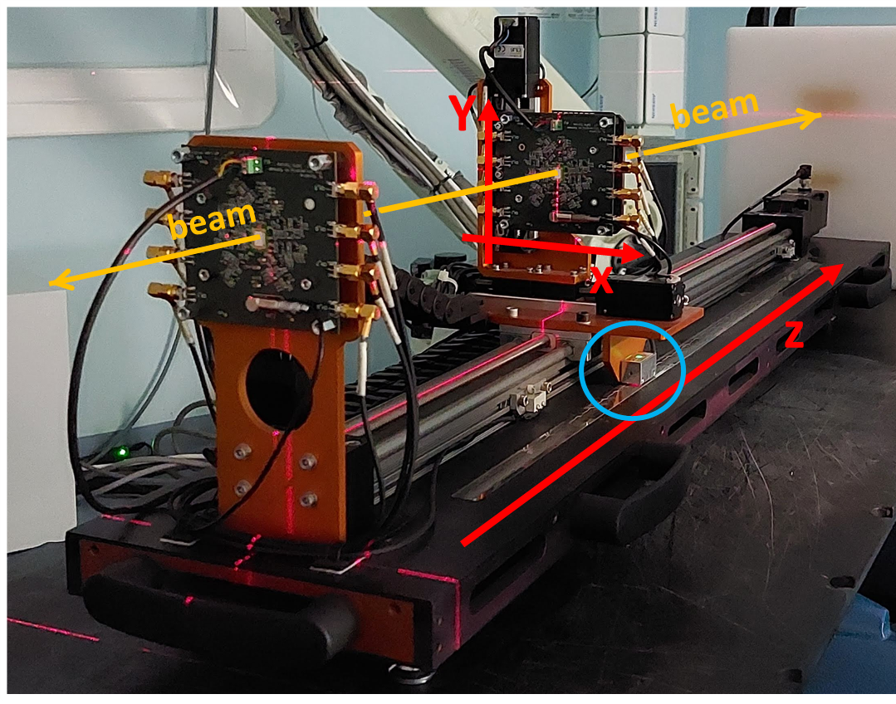
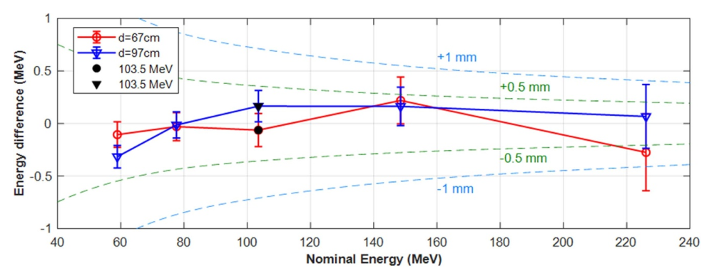
Timing application (i): beam energy detector
Beam energy/range from time-of-flight
Beam telescope
LGAD sensors
beam
L
range can be measured with ±1 mm uncertainty;
need few ms of active acquisition time;
requires precise calibration of the system.
A. Vignati, et. al., Phys. Med. Biol. 65 (2020) 215030
A. Vignati, et. al., Med. Phys. 50 (2023) 5817-5827
24
Silicon sensors in Medical Physics - S. Giordanengo, INFN Torino – TREDI Torino - 22/02/2024

Slide 25
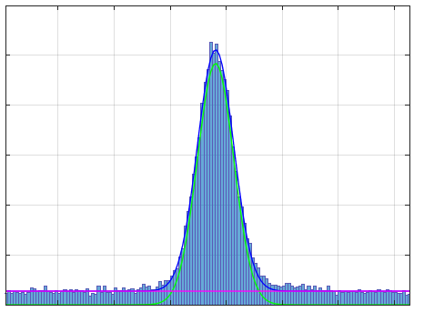
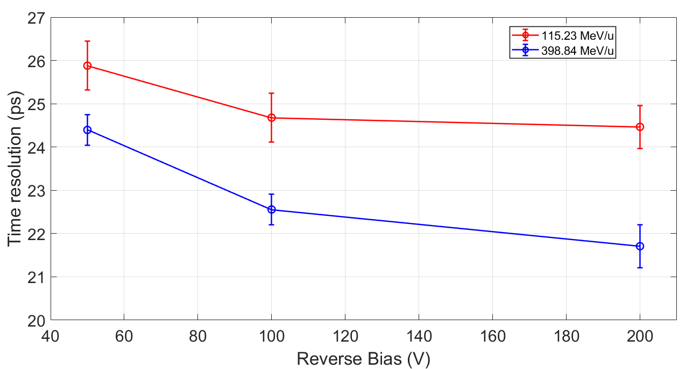


Time resolution for ion crossing with thin silicon sensor
Two Si sensors with the same characteristics placed in a telescope configuration 30 cm apart.
Beam energies (MeV/u): 115.2 and 398.8.
Bias voltage: 50V, 100V, and 200 V.
Coincidences
σ_{t} (ps) = σ($∆t$) / $\sqrt{2}$
Time difference $(∆t)$
115 MeV/u
Time resolution values for single ion crossing were less than 26 ps
(relative error < 2%)
400 MeV/u
CARBON IONS

Slide 26
Perspectives about online beam energy control
Today
Current treatments do not need online beam energy control
→ the beam energy is guaranteed by the accelerators control system
Future
→ Clinical treatments with LINAC accelerator will provide fast energy modulation with online beam energy control.
The challenge
→ Energy measurement in the limited space and time constrained by clinical requirements.
26
Silicon sensors in Medical Physics - S. Giordanengo, INFN Torino – TREDI Torino - 22/02/2024

Slide 27
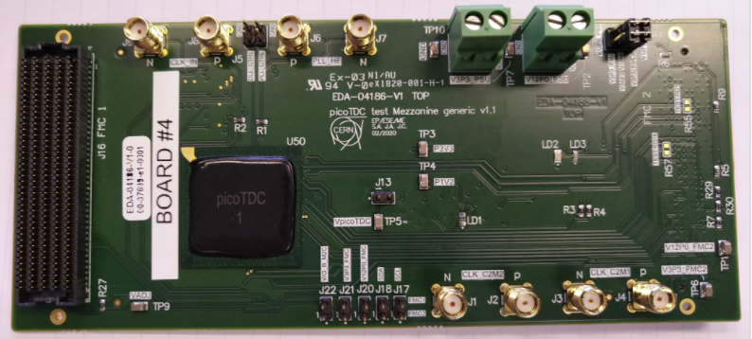
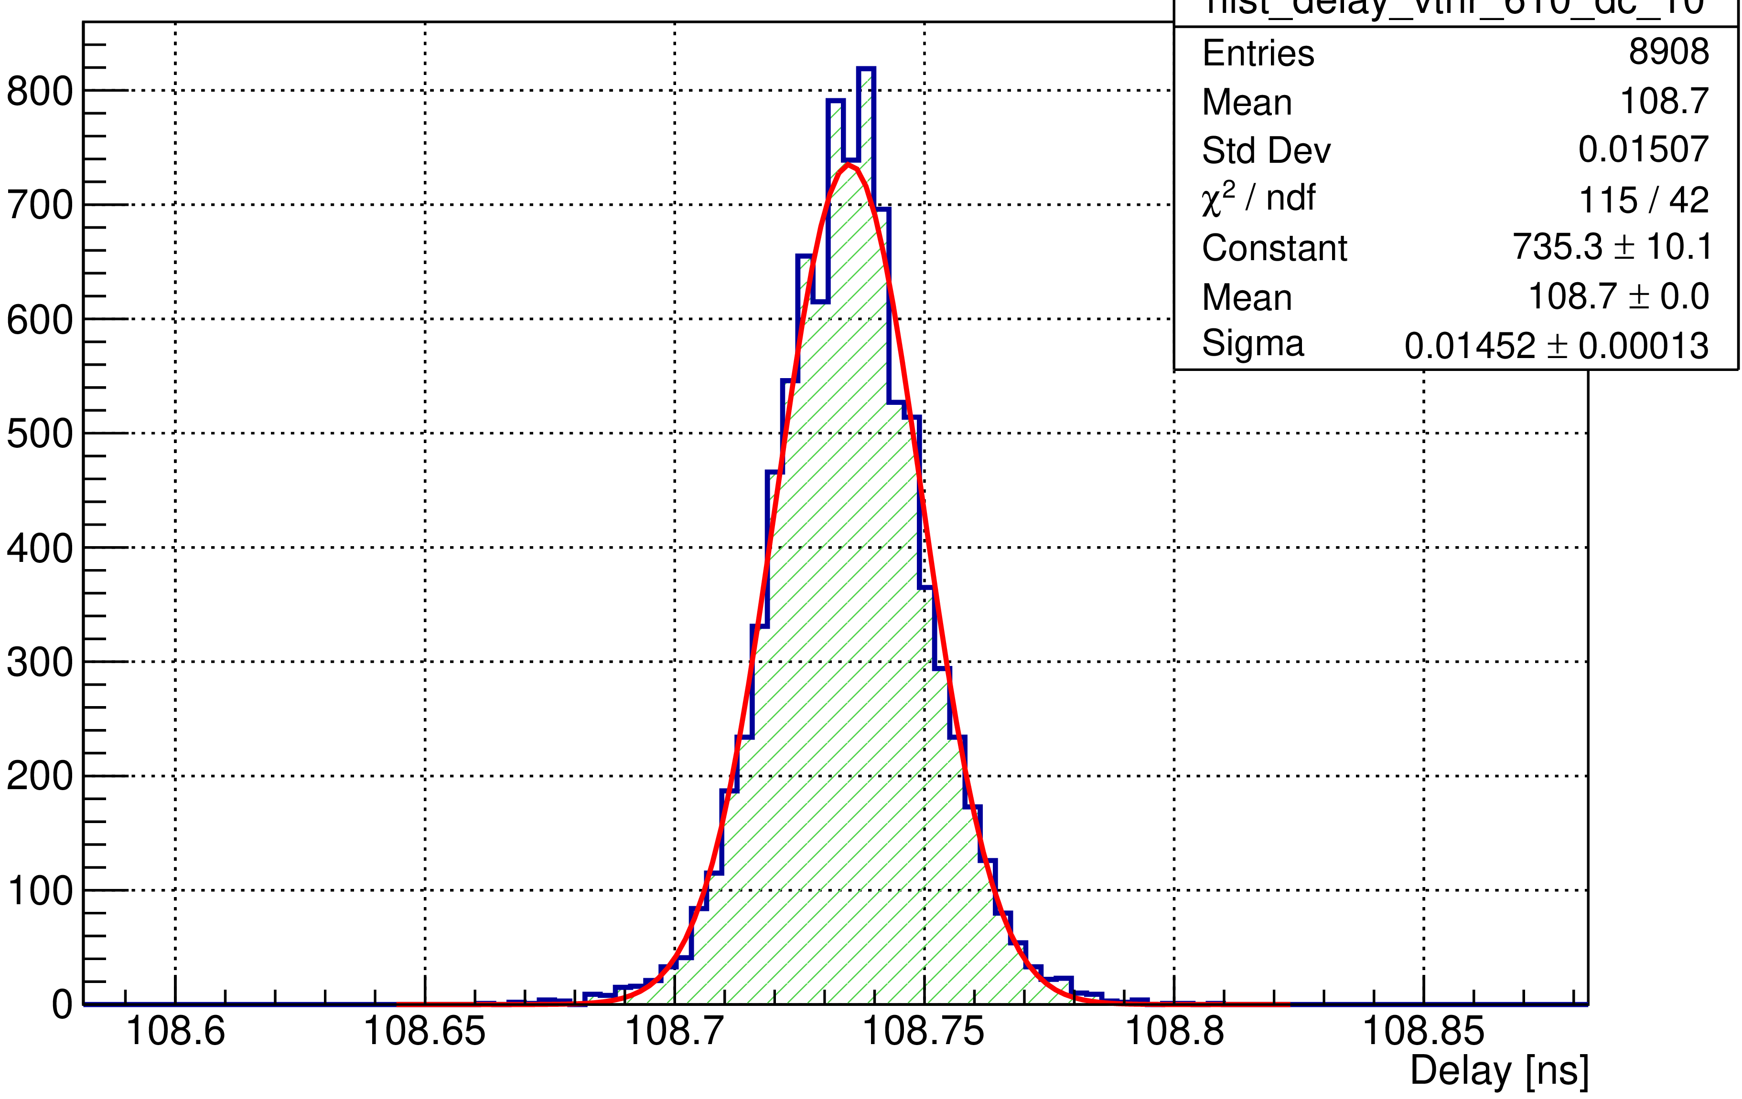
Particle crossing time measurements
CERN picoTDC evaluation board (64 input channels)
Successfully integrated with 8 channels of ESA-ABACUS
Conversion efficiency 100%
Tested up to 150 MHz freq.
3ps or 12ps binning
very low jitter (<1ps)
High rate capability
Readout through FPGA
1 channel
Q_{in} = 48 fC
f = 1 MHz
15 ps time resolution
27
Silicon sensors in Medical Physics - S. Giordanengo, INFN Torino – TREDI Torino - 22/02/2024

Slide 28





CERN PicoTDC
Kintex 7 FPGA
Acquisition PC
picoTDC integration
ABACUS digital outputs
Digital control signals
ASIC 1
F. Pennazio
ASIC 2
CTRL 1-2
ASIC 3
ASIC 4
CTRL 3-4
ASIC 5
ASIC 6
CTRL 5-6
Kintex 7 KC705 FPGA

Slide 29


Timing application (ii): beam time microstructure with picoTDC
Time difference between 2 c-ions
3 ps bin size
20 µs time window
The bunch structure and the accelerator radiofrequency were observed for all the energies.
Carbon ion energy = 398 MeV/u
Carbon ion energy = 115 MeV/u
Preliminary results
Preliminary results
362 ns
29
Silicon sensors in Medical Physics - S. Giordanengo, INFN Torino – TREDI Torino - 22/02/2024

Slide 30
Timing application (iii): Start time for Prompt Gamma Timing
PET-PGT detector
(γ position and time)
START for
Prompt Gamma Timing
F. Pennazio’s talk
patient
LGAD detector
IC chambers
PET-PGT detector
(γ position and time)
30
Silicon sensors in Medical Physics - S. Giordanengo, INFN Torino – TREDI Torino - 22/02/2024
Notes:
The focus is on beam monitors, followed by the PET-PGT system and charge particles detectors, all these instrumentation operate online, in the treatment room during the delivery.
Accurate and safe treatment need several detectors
[23] Muraro S et al. Front Oncol6:177, 2016
[24] Mattei I et al. Nucl Instrum Methods Phys Res A 954:161229, 2020
[25] Félix-Bautista R et al. Phys Med Biol 64:175019, 2019
[26] Henriquet P et al. Phys Med Biol 57:4655, 2012
[27] Fischetti M et al. Sci Rep 10:20735, 2020
Scintillating crystals coupled to Silicon PhotoMultiplier (SiPM) measure the secondary particles produced by the interaction between the primary beam and human tissues to provide in-vivo treatment delivered verification.
Both annihilation photons (for PET modality) and nuclear de-excitation photons (multi-detector PGT modality) are collected within the same detector (PET-PGT detector).
SiPMs readout signals are integrated with the information of the primary particle transit time, measured by new beam monitors based on thin, segmented and fast planar silicon detectors readout through high-performance DAQ system, based on fast TDC and FPGAs.
Secondary charged particles [23] are detected with very high efficiency as a nearly background free signal. Their production positions, through the Interaction Vertex Imaging (IVI) technique, can be used to spot
inter-fractional morphological changes and beam range variations with respect to the planning [24] or to check the beam position in the transverse plane inside the patient [25]. Silicon pixel detectors [26] and scintillating
fibres devices have been proposed and, recently, the latter have been tested on patients treated with carbon ions within the INSIDE project [27]. However, to fully exploit IVI capabilities, the detected tracks of secondary
charged particles have to be maximised by reducing the detector dead time and enlarging the active area, getting as close as possible to the patient.

Slide 31
Exploiting thin silicon sensors for FLASH RT
31
Silicon sensors in Medical Physics - S. Giordanengo, INFN Torino – TREDI Torino - 22/02/2024

Slide 32


FLASH radiotherapy
FLASH RT delivers radiation (electrons, photons, particles) at ultra-high dose rate (UHDR, average dose rate > 40 Gy/s) in < 200 ms.
FLASH EFFECT:
Does not induce classical radiation induced toxicity in normal tissues.
Retains antitumor efficacy compared to standard RT
32
Silicon sensors in Medical Physics - S. Giordanengo, INFN Torino – TREDI Torino - 22/02/2024

Slide 33

FLASH radiotherapy
A crucial role: dose delivery time structure (parameters need to be kept under control )
The most of the pre-clinical studies using electron beams (by LINACs with E<20 MeV)
33
Silicon sensors in Medical Physics - S. Giordanengo, INFN Torino – TREDI Torino - 22/02/2024

Slide 34
New field for BM: FLASH RT
Interrupting a FLASH treatment quickly enough to avoid a misadministration is clearly a non-trivial task and no publicly available testing data exist showing a commercial system is able to stop delivery of a FLASH dose quickly enough to address this need. [Taylor et al. Med Phys. 2022]
Main Challenges
Ultra High Dose Rate and high dose deliveries --> Reproducibility and interlock activation
Only the dependence on the average dose rate and on the duration of the entire irradiation has been clearly observed so far, but the roles of…
Dose per pulse
Instantaneous dose per pulse
Pulse duration and frequency
.. still remain to be understood.
[Di Martino 2020 frontiers]
Main Requirements
Linearity and no saturation
Radiation hardness
Introduction of correction factors
Optimization of the existing technologies
Investigation of novel detection methods
Possible solutions
34
Silicon sensors in Medical Physics - S. Giordanengo, INFN Torino – TREDI Torino - 22/02/2024

Slide 35



Solid State Devices for Beam Monitoring
Ultra-thin ~10$μm$, segmented, high polarized
High sensitivity, spatial res, developed technology
Unkown factors: linearity with dose-rate, recombination effect, radiation resistance
Radiation hardness, high resistivity, large saturated carrier velocity
Challenging issues: dose-rate linearity, possibility of straddle areas several cm²
High electrical stiffness, speed of charges, melting T, thermal diffusivity, industrual maturity
Preliminary sim: dose-rate linearity up to 10¹¹ Gy/s on X-ray beams for SiC membrames (2 $μm$ thick)
35
Silicon sensors in Medical Physics - S. Giordanengo, INFN Torino – TREDI Torino - 22/02/2024

Slide 36


Silicon sensors for FLASH RT beam monitoring
Conventional IC used in LINACs
Ultra-thin ~10$μm$, segmented, high polarized
High sensitivity, spatial res, developed technology
Unkown factors: linearity with dose-rate, recombination effect, radiation resistance
Ionization chambers
Main issues
High dose rates (FLASH)
→ 10³ × dose rates
→ plasma effects in silicon
Radiation tolerance
→ manufacturing strategies
→ damage compensation
Deviation from linearity @ high dose rates | Less recombination @ high dose rates 10² × E field 10² × charge mobility 10⁻¹ × thickness
Not suitable for high dose rates (FLASH) | New applications Monitoring high intensity and pulsed beams (high dose rates needed for FLASH RT)
36
Silicon sensors in Medical Physics - S. Giordanengo, INFN Torino – TREDI Torino - 22/02/2024

Slide 37





Monitoring of FLASH UHDR electron beams
INFN-FRIDA project
2021-2024
ElectronFlash accelerator (CFR - Pisa)
9 MeV electrons pulsed beam
Beam current: 1-100 mA
Pulse duration: 4 𝜇s
Pulse frequency: 5 Hz
Uniform fields using 3 cm PMMA plastic applicator
Sensors tested
45/ 30𝜇m thickness
2/1/0.25 mm² area
Bias voltage: 10V ÷ 200V
Dose/Pulse 0 ÷ 10Gy
f
Flash diamond and silicon sensor in same conditions
13mm solid water slab
Silicon sensors in Medical Physics - S. Giordanengo, INFN Torino – TREDI Torino - 22/02/2024
37

Slide 38


Monitoring of FLASH UHDR electron beams
4 𝜇s pulse duration
4 𝜇s pulse duration
FLASH regime
FLASH regime
Charge collected (nC/pulse)
Measured dose (Gy/pulse)
Measured dose (Gy/pulse)
Collected charge/pulse scales with pad area and sensor thickness
Ratios between different area/thickness independent from dose/pulse
38
Silicon sensors in Medical Physics - S. Giordanengo, INFN Torino – TREDI Torino - 22/02/2024

Slide 39


4D-tracking with LGADs for proton Radiography&CT
Measurement of residual proton energy from ToF in pCT applications
Calorimeter/
Range monitor
patient
Residual proton energy
proton
Tracking
detectors
Tracking
detectors
ToF
Schematic of a TOF calorimeter based on LGAD detectors.
The TOF is measured between two timing stations (T1/T2 and
T3/T4), each consisting of two generic LGAD planes
Phys. Med. Biol. 67 (2022) 095005
39
Silicon sensors in Medical Physics - S. Giordanengo, INFN Torino – TREDI Torino - 22/02/2024

Slide 40

Summary and Conclusions
Specific optimization of
sensors,
frontend readout,
high performance DAQ,
tailored on specific applications
(counting, timing, imaging, dosimetry, radiobiology, …)
> 24x24 cm² Si-based beam monitor in clinical nozzle
40
Silicon sensors in Medical Physics - S. Giordanengo, INFN Torino – TREDI Torino - 22/02/2024

Slide 41
Conclusions
Silicon detectors offer interesting features for new developments in radiation therapy
For beam monitoring in PT: integrating counting and timing in the same device seem possible with state-of-the-art TDCs
Good linearity with dose per pulse was demonstrated in FLASH e⁻ beams
Silicon sensors in Medical Physics - S. Giordanengo, INFN Torino – TREDI Torino - 22/02/2024

Slide 42

Thank you for your attention!

Slide 43
Spare slide

Slide 44



New detector requirements
HIGH SENSITIVITY
  → GOOD SIGNAL TO NOISE RATIO
  → FAST SIGNAL CREATION
FINE GRANULARITY
TRANSPARENT TO THE BEAM
RESISTANT TO RADIATION
LARGE AREA ( > 20x20 cm²)
DEAD TIME FREE
Increase the charge generated for each proton
$Q=\frac{S∙d∙e}{W}$
W small
Hgher density
→ S larger
Short collection time
$t≈\frac{d}{μ∙E}$
Reduced thickness
High Electric field E
$W=3,6 eV e S(120 MeV)=1,2\frac{MeV}{mm}$ ,
10⁵ e⁻ /h in 300 μm → Q=16 fC
For Silicon ….

Slide 45


Hybrid microdosimeter exploits silicon sensors tracking capability
A Novel Hybrid Microdosimeter for Radiation Field Characterization Based on the Tissue Equivalent Proportional Counter Detector and Low Gain Avalanche Detectors Tracker: A Feasibility Study
https://doi.org/10.3389/fphy.2020.578444
Notes:
In the proposed
setup, the TEPC will provide the energy deposition ϵ directly in a tissue-equivalent medium while the LGADs will offer information about particle spatial distribution with a precision of about 200 or 300 μm, depending on the chosen configuration. Together with the TEPC that provides energy depositions, LGADs constitute the tracker stage of HDM.
to reconstruct the particle path inside the TEPC, from which we could estimate the real track length.
Distribuzione di energia divisa per la lunghezza media, con il tracciamento misuri dove è passata la particelle e dividi per una lunghezza vera e non media (rivelatori devono essere molto precisi per energie basse dei secondari che devono attraversare tutti I layer del rivelatore. Trasparenti.
Per fare tracking ti aiuta a misurare in modo più preciso la

Slide 46
Imaging with protons and ions → proton/ion radiography proton/ion Computed Tomography
→ needed to reduce uncertainty in the water equivalent path, density
→ measure the residual proton energy
→ measure directly the Stopping Power 3D distribution will take advantage from 4D particle tracking through silicon sensors

Slide 47






Imaging with X-rays : state-of-the-art
TOMOGRAFIA COMPUTERIZZAZA
MAMMOGRAFIA
ANGIOGRAFIA
Film-based Detectors
Scintillation Detectors
Solid-state Detectors → amorphous silicon (a-Si) or cadmium telluride (CdTe) coupled with thin-film transistor (TFT) arrays.
Advantages: high spatial resolution, fast readout times, and low noise levels.
Used in Direct digital radiography (DR) systems.
Charge-Coupled Devices (CCDs) and CMOS detectors → not commonly used in medical X-ray imaging
Amorphous Silicon Flat-Panel Detectors (FPDs) → amorphous silicon layer coupled with an array of thin-film transistors (TFTs).
FPDs offer high spatial resolution, fast readout speeds, and low radiation dose requirements.
Notes:
Film-based Detectors: Traditional X-ray imaging initially used photographic films as detectors. X-ray photons expose the film, causing a chemical change that creates a latent image. The film is then developed to produce a visible image. While still used in some applications, film-based detectors are increasingly being replaced by digital detectors due to their lower sensitivity and longer processing times.
Scintillation Detectors: Scintillation detectors use materials called scintillators that emit light when exposed to X-rays. Common scintillator materials include cesium iodide (CsI), gadolinium oxysulfide (GOS), and amorphous selenium (a-Se). Photodetectors, such as photomultiplier tubes (PMTs) or photodiodes, then convert the emitted light into an electrical signal. Scintillation detectors are used in both indirect and direct digital X-ray imaging systems.
Solid-state Detectors: Solid-state detectors directly convert X-ray photons into electrical signals without the need for a scintillator. These detectors typically consist of materials like amorphous silicon (a-Si) or cadmium telluride (CdTe) coupled with thin-film transistor (TFT) arrays. Solid-state detectors offer advantages such as high spatial resolution, fast readout times, and low noise levels. They are commonly used in direct digital radiography (DR) systems.
Charge-Coupled Devices (CCDs) and Complementary Metal-Oxide-Semiconductor (CMOS) Detectors: CCDs and CMOS detectors, which are commonly used in digital cameras and consumer electronics, can also be adapted for X-ray imaging. These detectors capture the light emitted by scintillators or directly detect X-rays and convert it into electrical signals. While not as commonly used in medical X-ray imaging, they find applications in research, industrial, and astronomy X-ray imaging systems.
Amorphous Silicon Flat-Panel Detectors (FPDs): FPDs are a type of solid-state detector commonly used in modern digital X-ray systems. They consist of an amorphous silicon layer coupled with an array of thin-film transistors (TFTs). X-ray photons interact directly with the silicon, generating electron-hole pairs that produce an electrical signal. FPDs offer high spatial resolution, fast readout speeds, and low radiation dose requirements.
If interpreted as waves, X-rays-just like visible light-experience a phase shift in matter, and this-if exploited correctly-can produce a new class of X-ray images, which then depict the wave interactions of X-rays with matter, rather than only the attenuating properties, as done until now.

Slide 48




Imaging with e+
Arrays of photon detectors around the patient to detect the 2 γ opposite directions
Therapeutic hadron beams produce β⁺ emitters in the body
Offline and in-beam PET provide the range of particles and the dose distribution
For diagnostic purpose
PET-PGT detector
(γ position and time)
PET-PGT detector
(γ position and time)
Notes:
Positron Emission Tomography (PET) uses detectors specifically designed to capture the emitted positrons from radiopharmaceuticals administered to the patient. These detectors are crucial components of PET scanners, enabling the reconstruction of images showing the distribution of the radiotracer within the body. Here are the main types of detectors used in PET:
Scintillation Crystals: These crystals are often made of materials like lutetium oxyorthosilicate (LSO), lutetium-yttrium oxyorthosilicate (LYSO), or gadolinium orthosilicate (GSO). When a positron annihilates with an electron, it produces two gamma photons moving in opposite directions. These photons interact with the scintillation crystals, producing flashes of light (scintillations) that are detected by photodetectors.
Photodetectors: Photomultiplier tubes (PMTs) or avalanche photodiodes (APDs) are commonly used as photodetectors in PET scanners. They convert the scintillation light emitted by the scintillation crystals into electrical signals that can be processed by the PET system.
Coincidence Detection Circuitry: PET detectors are arranged in pairs or arrays around the patient. When two detectors detect simultaneous gamma photons (resulting from positron annihilation events occurring near-simultaneously), it is termed a coincidence event. Coincidence detection circuitry is used to identify and record these events, which are then used to reconstruct the PET image.
Time-of-Flight (TOF) Detectors: Some modern PET scanners incorporate TOF detectors, which measure the time difference between the detection of two coincident gamma photons. This information can improve image quality and reconstruction by providing more accurate localization of the radiotracer uptake within the body.
Detector Arrays: PET scanners consist of arrays of detectors positioned around the patient. These arrays can have different configurations, such as rings or panels, depending on the scanner design. The detectors in these arrays work together to capture gamma photons emitted from the patient and produce data for image reconstruction.
These detector components work in concert to detect the gamma photons emitted during positron annihilation events, allowing PET scanners to create detailed images of biochemical processes in living tissues. Advances in detector technology continue to improve the sensitivity, resolution, and overall performance of PET imaging systems.

Slide 49
Advanced Imaging with Phase-Contrast X-ray imaging for medical imaging
If interpreted as waves, X-rays-just like visible light-experience a phase shift in matter, and this-if exploited correctly-can produce a new class of X-ray images, which then depict the wave interactions of X-rays with matter, rather than only the attenuating properties, as done until now.
Grating Interferometry
can be performed both at Synchrotron Radiation (SR) facilities and using laboratory X-ray sources. Until now, GI has been applied in a laboratory setting
mostly with low-brilliance X-ray tubes, by using either long or compact interferometer
arrangements [1,3,4]. Liquid-metal-jet sources, combined with a phase and an analyzer grating,
improve the resolution and sensitivity of PCI, thanks to a higher photon flux [5]. GI systems at
25 keV [6] and 9.25 keV [7] yield reduced scan times or an improved signal to noise ratio;
The use of a high granularity detector pushes the resolution down to the micron scale.
X-ray sCMOS camera
Notes:
Film-based Detectors: Traditional X-ray imaging initially used photographic films as detectors. X-ray photons expose the film, causing a chemical change that creates a latent image. The film is then developed to produce a visible image. While still used in some applications, film-based detectors are increasingly being replaced by digital detectors due to their lower sensitivity and longer processing times.
Scintillation Detectors: Scintillation detectors use materials called scintillators that emit light when exposed to X-rays. Common scintillator materials include cesium iodide (CsI), gadolinium oxysulfide (GOS), and amorphous selenium (a-Se). Photodetectors, such as photomultiplier tubes (PMTs) or photodiodes, then convert the emitted light into an electrical signal. Scintillation detectors are used in both indirect and direct digital X-ray imaging systems.
Solid-state Detectors: Solid-state detectors directly convert X-ray photons into electrical signals without the need for a scintillator. These detectors typically consist of materials like amorphous silicon (a-Si) or cadmium telluride (CdTe) coupled with thin-film transistor (TFT) arrays. Solid-state detectors offer advantages such as high spatial resolution, fast readout times, and low noise levels. They are commonly used in direct digital radiography (DR) systems.
Charge-Coupled Devices (CCDs) and Complementary Metal-Oxide-Semiconductor (CMOS) Detectors: CCDs and CMOS detectors, which are commonly used in digital cameras and consumer electronics, can also be adapted for X-ray imaging. These detectors capture the light emitted by scintillators or directly detect X-rays and convert it into electrical signals. While not as commonly used in medical X-ray imaging, they find applications in research, industrial, and astronomy X-ray imaging systems.
Amorphous Silicon Flat-Panel Detectors (FPDs): FPDs are a type of solid-state detector commonly used in modern digital X-ray systems. They consist of an amorphous silicon layer coupled with an array of thin-film transistors (TFTs). X-ray photons interact directly with the silicon, generating electron-hole pairs that produce an electrical signal. FPDs offer high spatial resolution, fast readout speeds, and low radiation dose requirements.
If interpreted as waves, X-rays-just like visible light-experience a phase shift in matter, and this-if exploited correctly-can produce a new class of X-ray images, which then depict the wave interactions of X-rays with matter, rather than only the attenuating properties, as done until now.

Slide 50

Beam delivery techniques
Phys. Med. Biol. 63 (2018) 145006
Scan paths for: spot scanning, raster scanning and line scanning
Iso-energy slice (E = 151 MeV)
Beam weights were optimized for a total field dose of 0.606 Gy
REVIEW
Frontiers - 2021
doi: 10.3389/fonc.2021.780025
«The possibility of volumetric rescanning and other advanced techniques require the BDS to be able to deliver efficiently with fast energy modulation.»
Notes:
Different scanning patterns are available. For spot scanning, the beam is turned off between movement to the next spot but remains on for the whole delivery in raster scanning. The control is on MU and the beam is Spot scanning and raster scanning are driven by the dose, it means that the beam is delivered in each spot without moving position and the main difference is
Spot, raster and continuous line scanning patterns for PBS delivery. Spots and solid lines indicate beam-on irradiation and dashed lines indicate
movement with beam-off. For
continuous line scanning, the dose is delivered across a linear path (rather than as spots) and may be turned off between movement to subsequent lines.
For spot and raster scanning techniques the delivery is done in dose-driven mode: the beam stays on until a certain preset dose amount of charge has been collected in a beam monitor.

Slide 51

Protons - beam projection on y axis
FWHM [cm]
Protons per spill
We are loosing the
tails of the beam for
62 MeV
Strip number
0 cm
2.7 cm
Energy [MeV]
The lower the energy and the wider the beam because of multiple scattering of protons with air
Curves → Gaussian fit
$$FWHM = 2 \sqrt{2 ln(2)} σGuaussian fit ∙p$$
Strip pitch = 180 µm
Expected FWHM at isocenter from Mirandola et Al 10.1118/1.4928397

Slide 52





C-ions counter
Comparison of beam FWHM with GAFCHROMIC films
3% difference between low-high energy
$$\frac{\text{\# }\text{measured} \text{ions} }{\text{\# }\text{ions} \text{from} \text{CNAO} \text{monitors} }$$
Tails of beam profile
Beam Intensitiy 20%
50%
3%
1% difference between low-high intensity
1%
100%
0 cm
2.7 cm
Pile-up inefficiency reduced to 0.5% after corrections
Spots of 5*10⁷ C ions

Slide 53


Beam monitor systems
Continuous check of beam parameters
IC CONV: Gas-filled IC → IC UHDR :
high rate of recombination, too slow
Need of new beam monitoring device to stop delivery of a FLASH dose quickly enough
Conventional IC used in LINACs
Existing technologies
    High temporal resolution
    High spatial resolution
    Beam transparency
    Large response dynamic range
    Large sensitive area
    Radiation hardness
DOSIMETERS
BEAM MONITOR
Ultra-Thin Ionization
chamber (UTIC)
PTW 60019 microDiamond
Beam Current
Transformers (BCT)

Slide 54



Experimental setup
TERA08 measurements
45 𝜇m thickness, 2mm² area
RC circuit to extend signal duration and not exceed 256𝜇A for 64 chns
RC connected to TERA08 and NI module
Bias voltage 200 V
Increasing dose-per-pulse (DPP) from 0 to ~10Gy/pulse
Oscilloscope measurements
45𝜇m / 30𝜇m thickness, 2mm², 1mm² ,0.25 mm² area
3 pads connect to 3 oscilloscope channels
Bias voltage: 10V, 50V, 100V, 150V, 200V
Increasing DPP (from 0 to ~10Gy/pulse)
Compare different areas/thickness charge generation
RC
TERA08
f
National Instruments PXIe-1071 PXI Chassis
Keysight infiniuum S-series DSOS254A
45𝜇m
30/45𝜇m

Slide 55




Readout system: TERA08
Readout with TERA08 (64 equal CHNs)
In each CHN current-to-frequency converter (each digital pulse = fixed input charge quantum)
Converter based on recycling integrator architecture
Chip structure
DAQ Period ($μs$) | $Q_{c}$(fC) | Max conversion freq per chn | Max conversion (total) | Max current (for 64 CHNs)
1e4 (0.01 s) | 200 fC | 20 MHz | 1280 MHz | ± 256 𝜇A

Slide 56


TERA08 and oscilloscope comparison
45 𝜇m thickness, 2mm² area
200V bias voltage
Good linearity (R² > 99%) up to dose-rates >10Gy/pulse (1Gy/pulse is already FLASH regime)
Good correlation of charge measured with TERA08 and oscilloscope
UNPUBLISHED RESULTS!
FLASH regime

Slide 57


Electric Field distortion
At bias < 150 V (where the sensor is completely depleted) a shortening of the signal was observed: electric field distortion at high dose rates?
TCAD Sentaurus simulations ongoing
200 V
UNPUBLISHED RESULTS!

Slide 58



Next steps: TERA09
WORK IN
PROGRESS!
Frontend chip based on 64 charge recycling CHNs
Extended current range with respect to TERA08 (preliminary design and test phase): 12 µA / chn with 200 fC.
Larger sensor (Area 2.7⨉2.7 cm² and 146 strips) to cover all beam spot area (~ cm²)
Strip based / pad based system: Online control of beam shape and dose after one single shot
Large sensor
Detector board
TERA09
Current range | 100 pA-100 μA
Max conv freq | 62.5 MHz
[ Designed to cover proton beam spot ]

Slide 59

Electric Field distortion
At bias < 150 V (where the sensor is completely depleted) a shortening of the signal was observed: electric field distortion at high dose rates?
TCAD Sentaurus simulations ongoing
50 V
UNPUBLISHED RESULTS!

