Slide 1


Glass-free SiPMs with Through Silicon Vias for VUV/NUV light detection
J. Dalmasson, L. Parellada-Monreal, F. Acerbi, A. Ficorella, A. Gola, S. Merzi, M. Ruzzarin, N. Zorzi and G. Paternoster
Fondazione Bruno Kessler
Feb 21st 2024
jdalmasson@fbk.eu
www.fbk.eu

Slide 2
Outline
Vacuum Ultra-Violet (VUV)
SiPM Technology
Bulk TSV
First Run of Glassless VUV-sensitive SiPM at FBK
Electrical Characterization
Conclusion

Slide 3
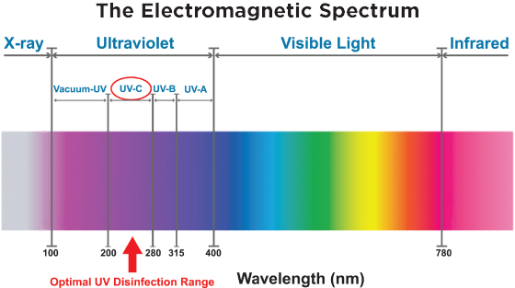
Vacuum Ultra-Violet (VUV)
Why Vacuum?
This part of the spectrum is strongly absorbed by most gases present in atmosphere λ_{abs}~0.1-10mm
It propagates only in vacuum (or noble gasses)

Slide 4
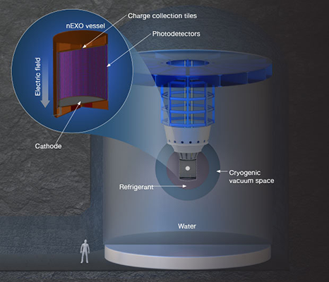

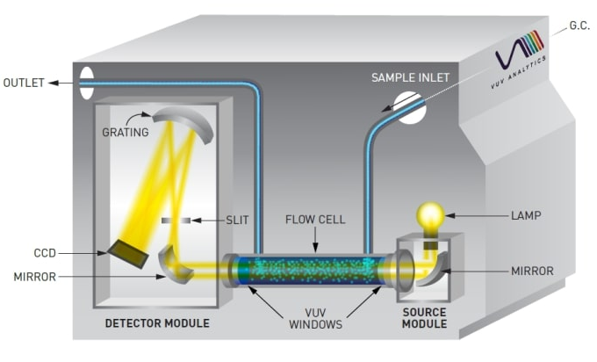
Why is VUV Detection Interesting?
Industrial Gas Analysis
Isomer identification
Interaction with wide variety of gases
Rare Events Physics
Liquid Xenon (LXe) based experiments:
Good Absorber
Chemically Inert
High Yield Scintillator (178nm)
Self-Transparent

Slide 5
Why is VUV Detection Interesting?
Industrial Gas Analysis
Isomer identification
Interaction with wide variety of gases
Rare Events Physics
Liquid Xenon (LXe) based experiments:
Good Absorber
Chemically Inert
High Yield Scintillator (178nm)
Self-Transparent
Exotic Application for Quantum Technologies

Slide 6
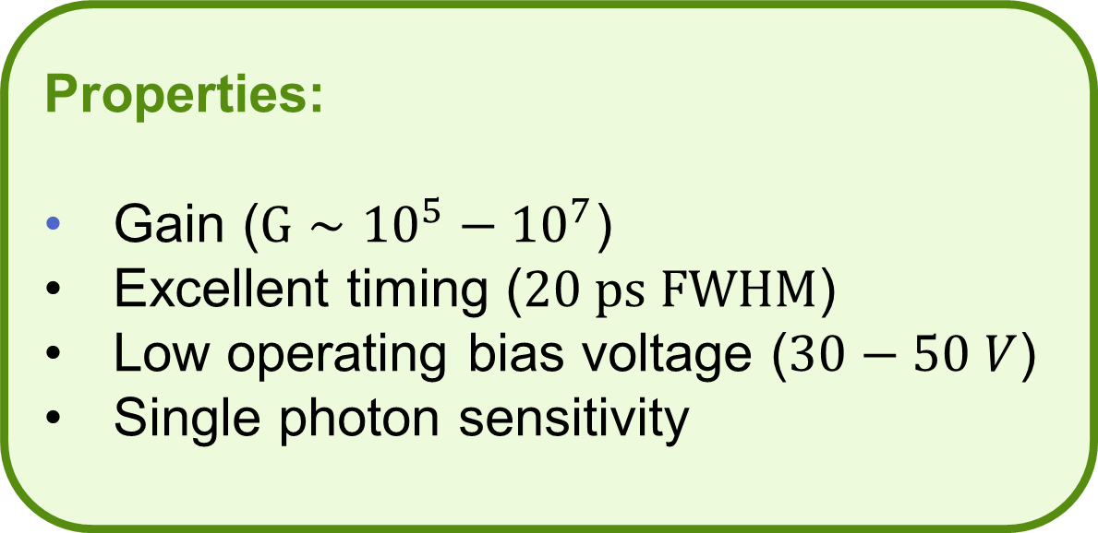
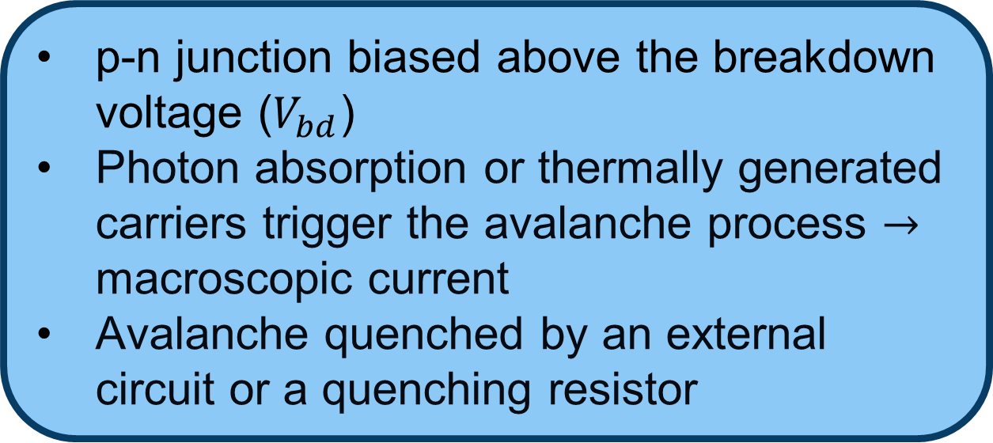
Single Photon Avalanche Diode (SPAD)
p-n junction biased above the breakdown voltage ($V_{bd}$)
Photon absorption or thermally generated carriers trigger the avalanche process $→$ macroscopic current
Avalanche quenched by an external circuit or a quenching resistor
Metal contact
Quenching resistor
High Field Region
Depletion region
epi
Properties:
Gain ($G∼{10}^{5}−{10}^{7}$)
Excellent timing ($20 ps FWHM$)
Low operating bias voltage ($30−50 V$)
Single photon sensitivity
Deep
Trench
Isolation
=
=
Bulk

Slide 7
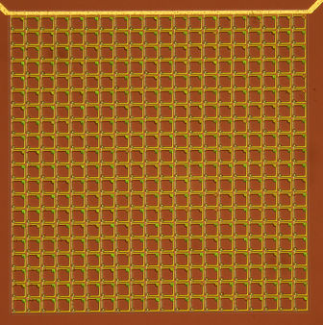
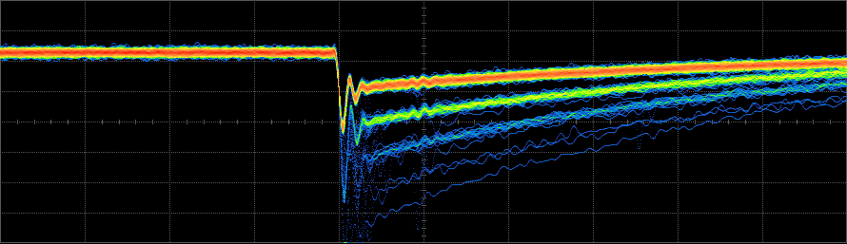

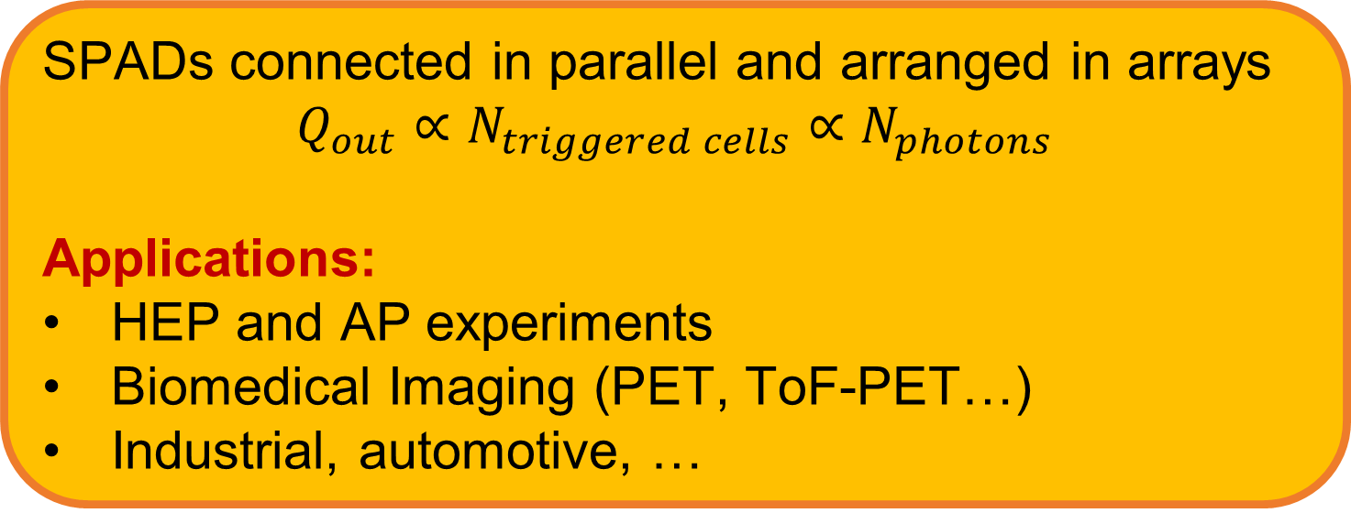

Silicon PhotoMultiplier (SiPM)
SPADs connected in parallel and arranged in arrays
$$Q_{out}∝N_{triggered cells}∝N_{photons}$$
Applications:
HEP and AP experiments
Biomedical Imaging (PET, ToF-PET…)
Industrial, automotive, …
$$∼10 μm −100 μm$$
$$∼1 mm −10 mm$$

Slide 8
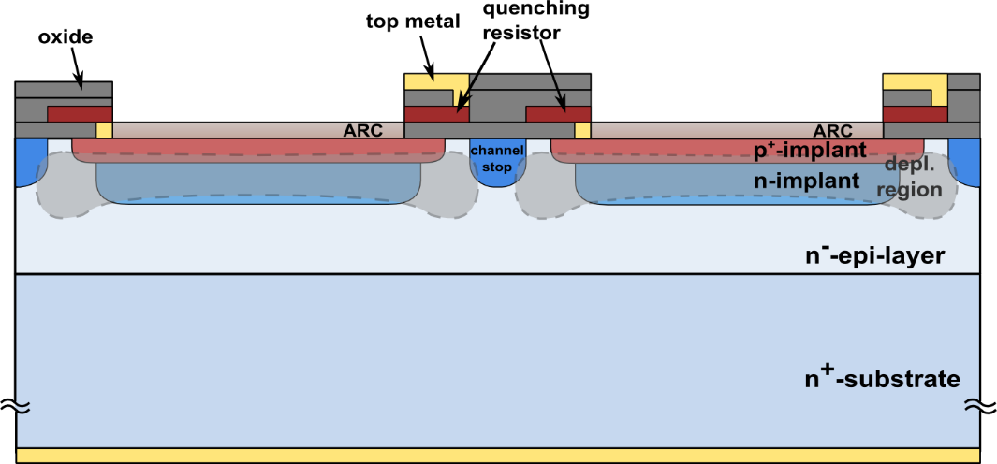
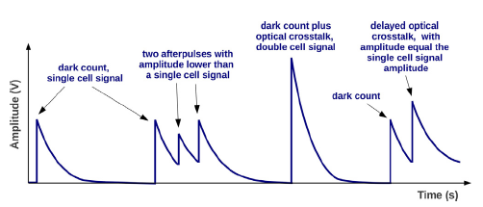
Noise in SiPM
Primary Dark Count Rate
  Thermally generated carriers or tunneling
Primary DCR
Acerbi F., Gundacker S, “Understanding and simulating SiPMs”, Nuclear Instruments and Methods in Physics Research Section A, 926, 2019,16-35,, https://doi.org/10.1016/j.nima.2018.11.118.

Slide 9
Noise in SiPM
Primary Dark Count Rate
  Thermally generated carriers or tunneling
After Pulse
  Trapping and release of carriers in the same cell
After Pulse
Primary DCR
https://doi.org/10.1016/j.nima.2018.11.118

Slide 10
Noise in SiPM
Primary Dark Count Rate
  Thermally generated carriers or tunneling
After Pulse
  Trapping and release of carriers in the same cell
Direct Cross Talk
  Secondary photons produced in the avalanche are absorbed in the neighboring cells
Delayed Crosstalk
  Secondary photons produced in the avalanche are absorbed in the neutral region, then the photo-generated carriers diffuse towards the active region and trigger the avalanche in the neighboring cells
After Pulse
Primary DCR
DiCT
DeCT
https://doi.org/10.1016/j.nima.2018.11.118

Slide 11
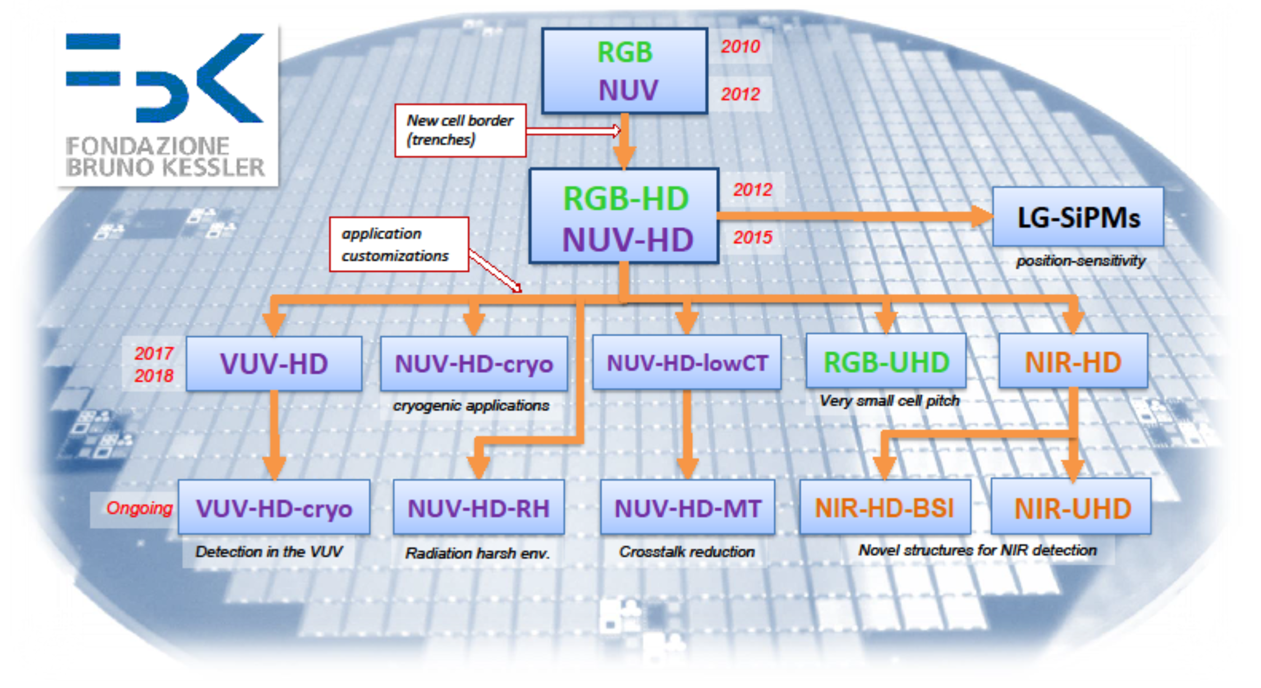
Wide SiPM R&D Program at FBK

Slide 12
Wide SiPM R&D Program at FBK

Slide 13
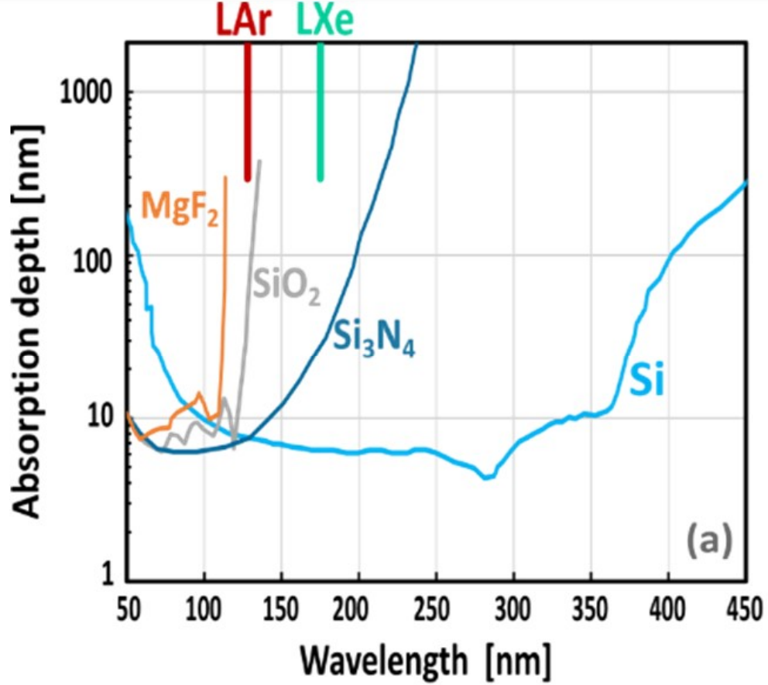
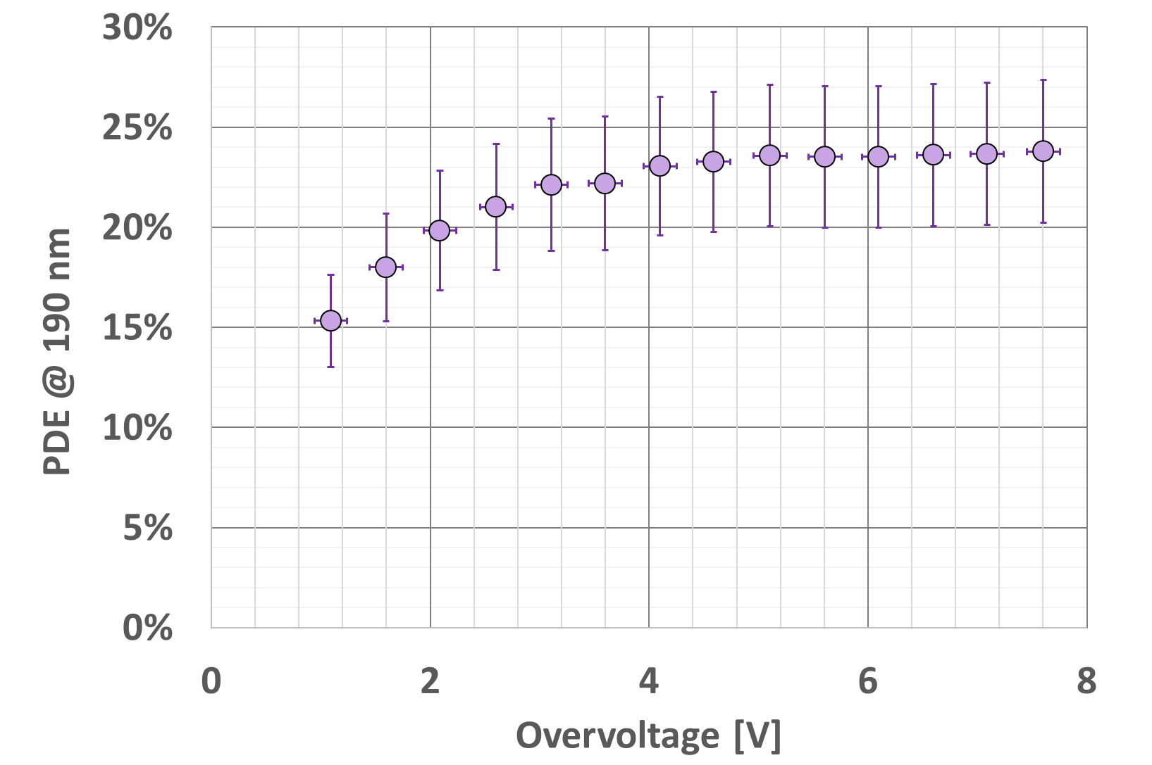
VUV-HD Technology
In a nutshell:
  Optimization of the charge collection close to the surface
  Minimization of reflection and absorption in the ARC
  Removal of the Si₃N₄ layer (strongly absorbs VUV)
p⁺-on-n junction
35x35μm² cell size
10x10mm² SiPM
T=165K
https://doi.org/10.1109/TED.2019.2935690

Slide 14
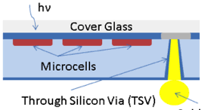
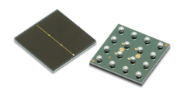
Towards High Integration: TSV
TSV advantages for a SiPM
High density array assembly with reduced non-active area
Wire-bond not required in application where it is potentially critical
Silicon Photo-Multiplier (SiPM)
Single photon sensitive silicon detector
Compact and modular device
High integration capability with Through Silicon Vias (TSV)
What is a TSV?
Vertical electrical connection that passes completely through a silicon wafer, bringing the signal from the top (normally photosensitive side) to the bottom side of the device tier (interface with the front-end electronics)
TSV drawbacks for a SiPM
Device attached to a glass support wafer
Presence of a permanent bonding adhesive
Source: onsemi.com
Example of SiPM with TSV from Broadcom

Slide 15
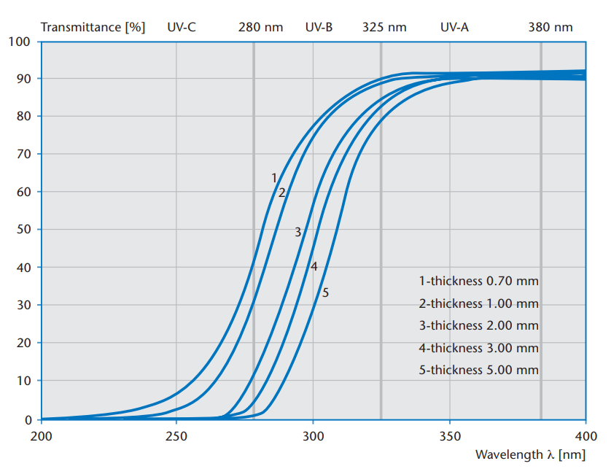
VUV Related Challenges
Glass used for support wafer
100
Borosilicate Glass
SCHOTT
80
Glass can only be present as support structure during manufacturing and removed afterwards
60
Transmission [%]
1- 0.70 mm
2- 1.00 mm
3- 2.00 mm
4- 3.00 mm
5- 5.00 mm
40
20
Borosilicate Glass
SCHOTT
VUV
0
200
250
300
350
400
Wavelength (nm)

Slide 16
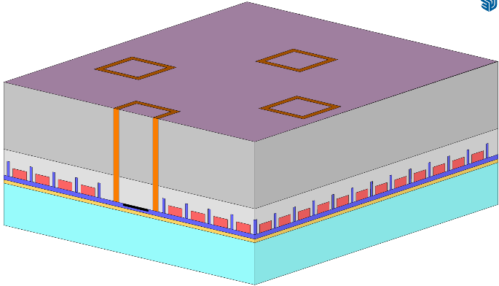
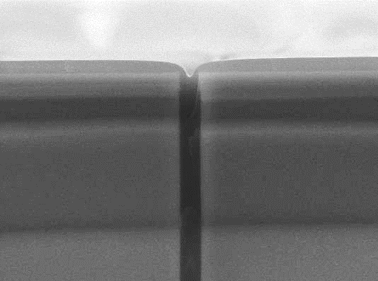
Solution proposed: Bulk-TSV
Support Glass
(only for processing)
SPADs
Bulk-TSV concept
It exploits the low resistivity substrate of SiPM to create TSV without any metallization.
Silicon TSV (no metal filling), delimited by pass-through trenches.
TSV density in the range 1-100 vias/mm²
Low resistivity (estimated ~10 Ohms) per via
TSV width in the range 10 µm – 100 µm. It depends on the Final Silicon Thickness.
For the glass-free version Si thickness ~150 µm. Via diameter = 100 µm
High resistivity epi-layer
(few µm)
Low resistivity substrate
(> 100 µm)
Trench isolation
TSV
Back contacts
SiPM trench
Bulk- TSV

Slide 17
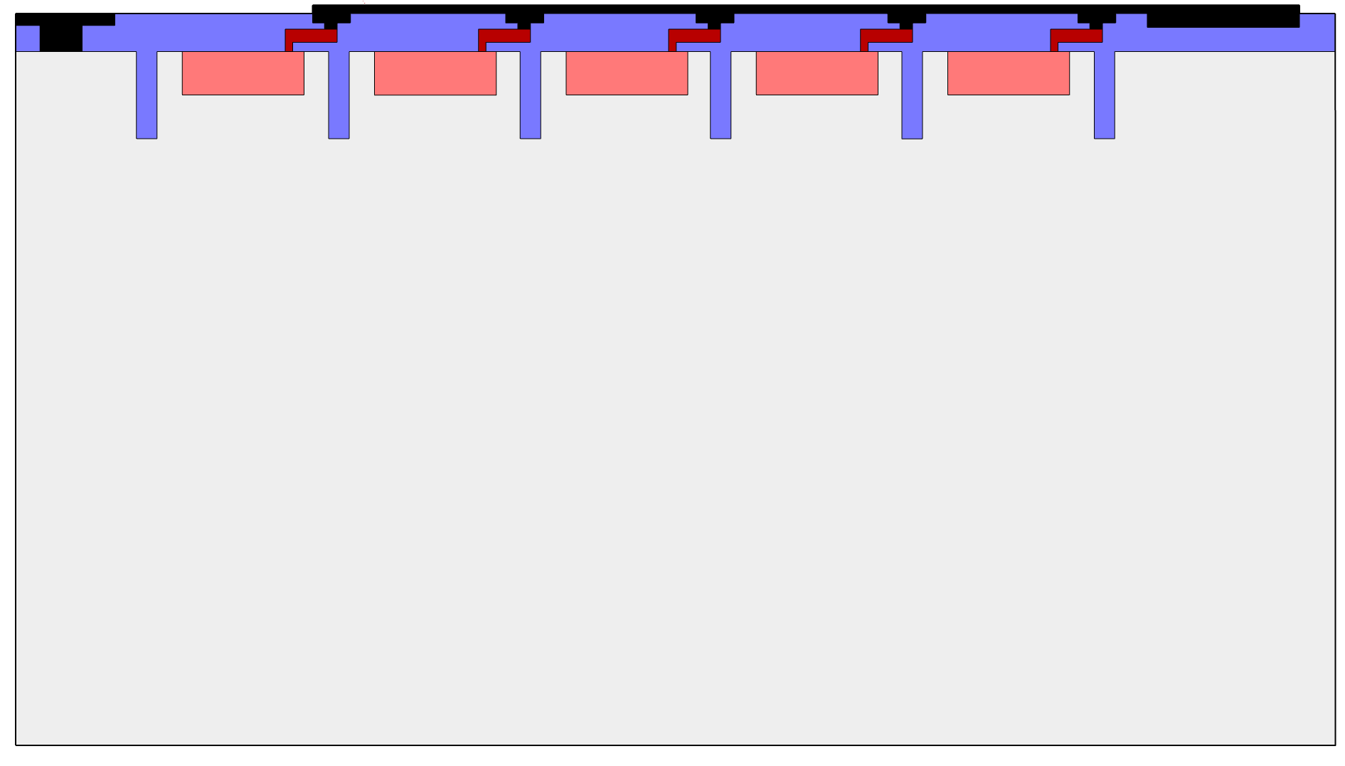
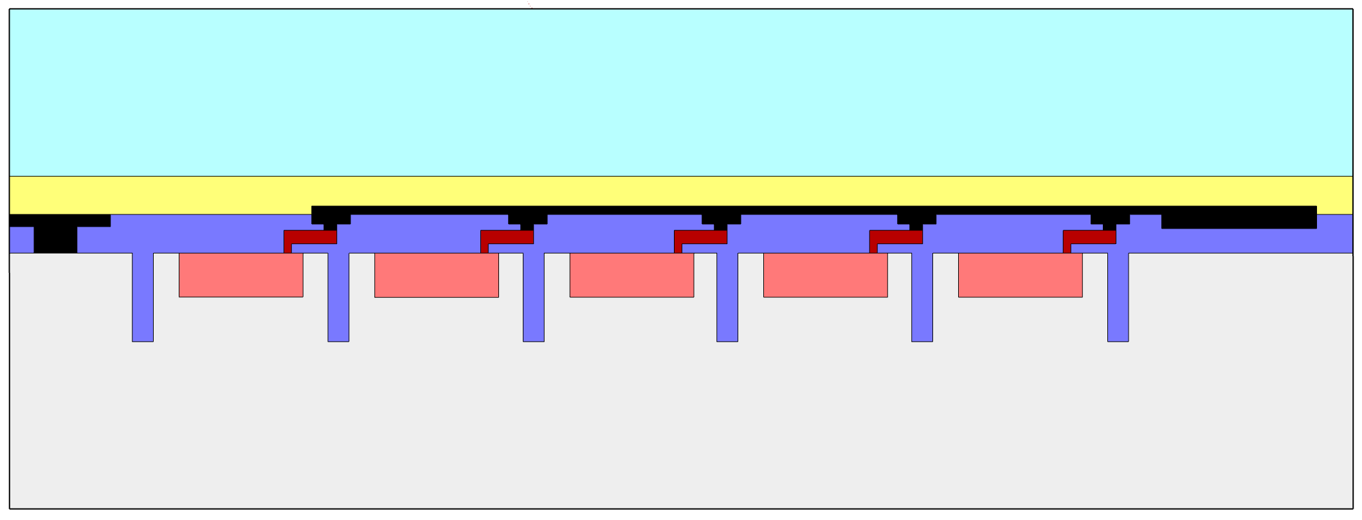

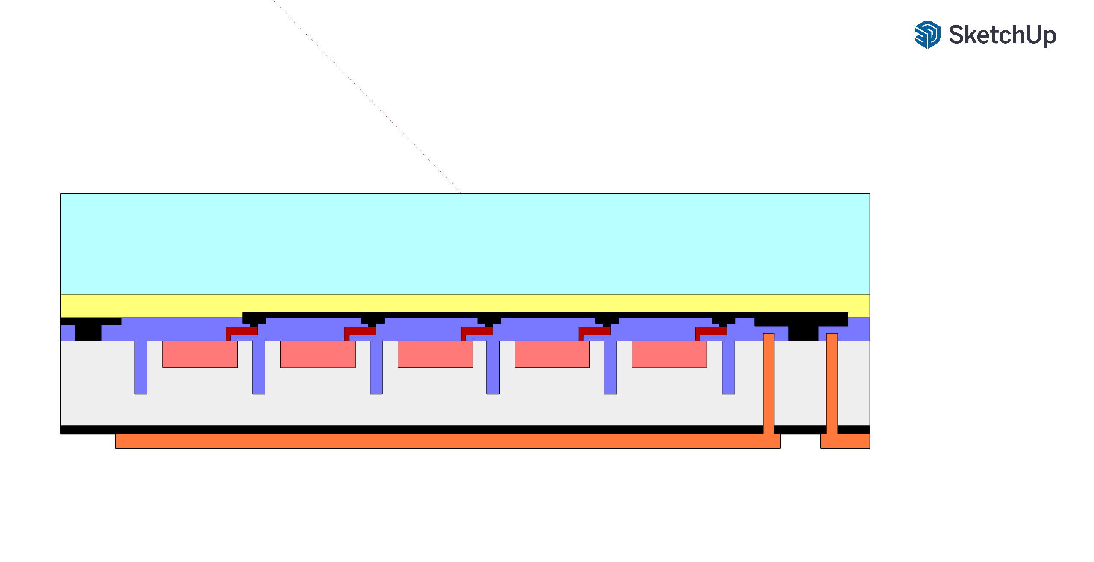
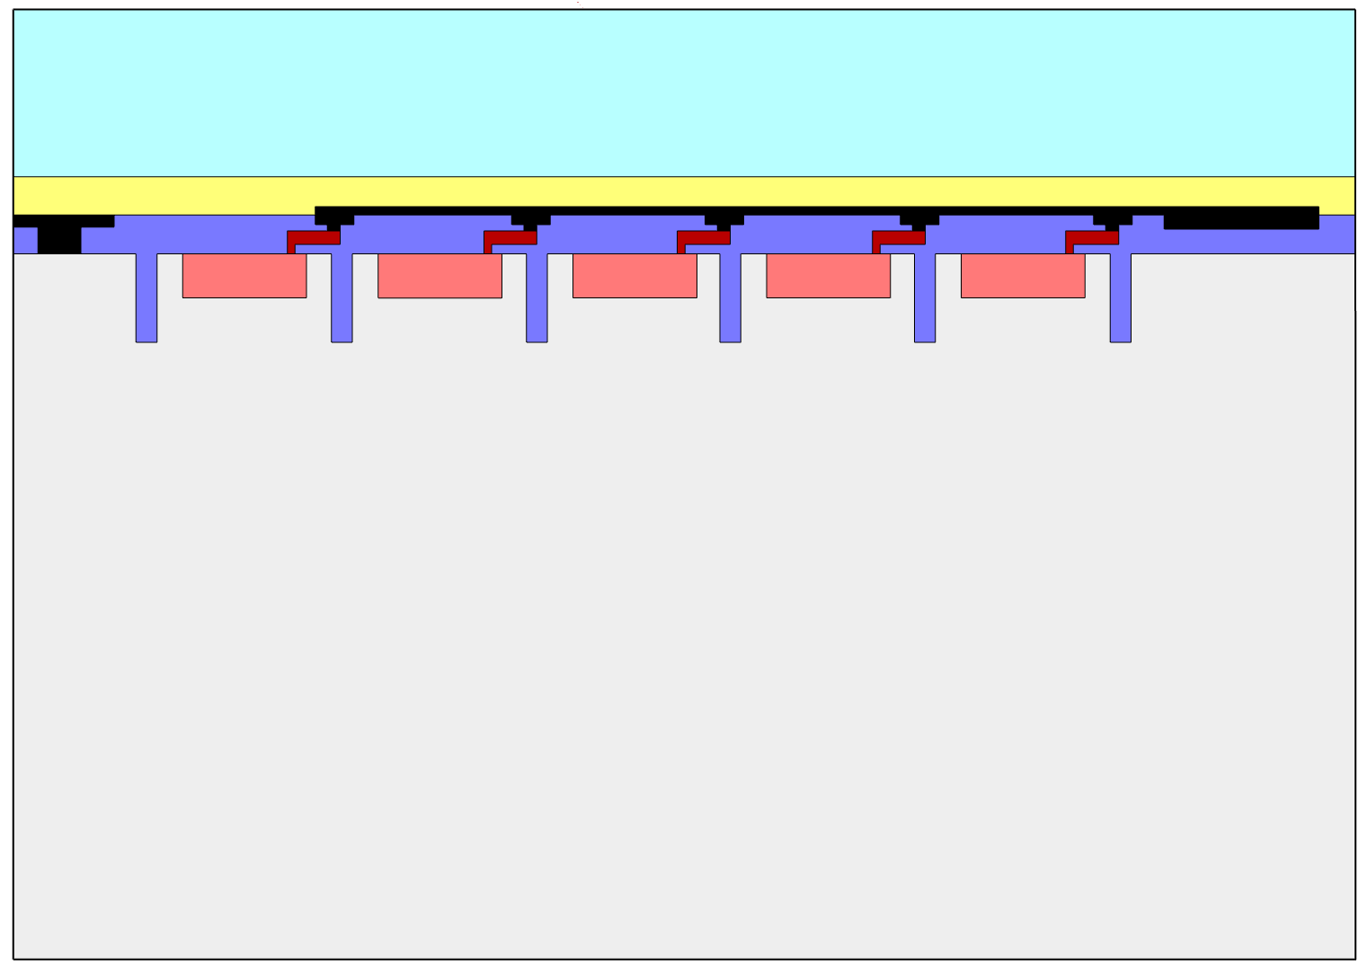
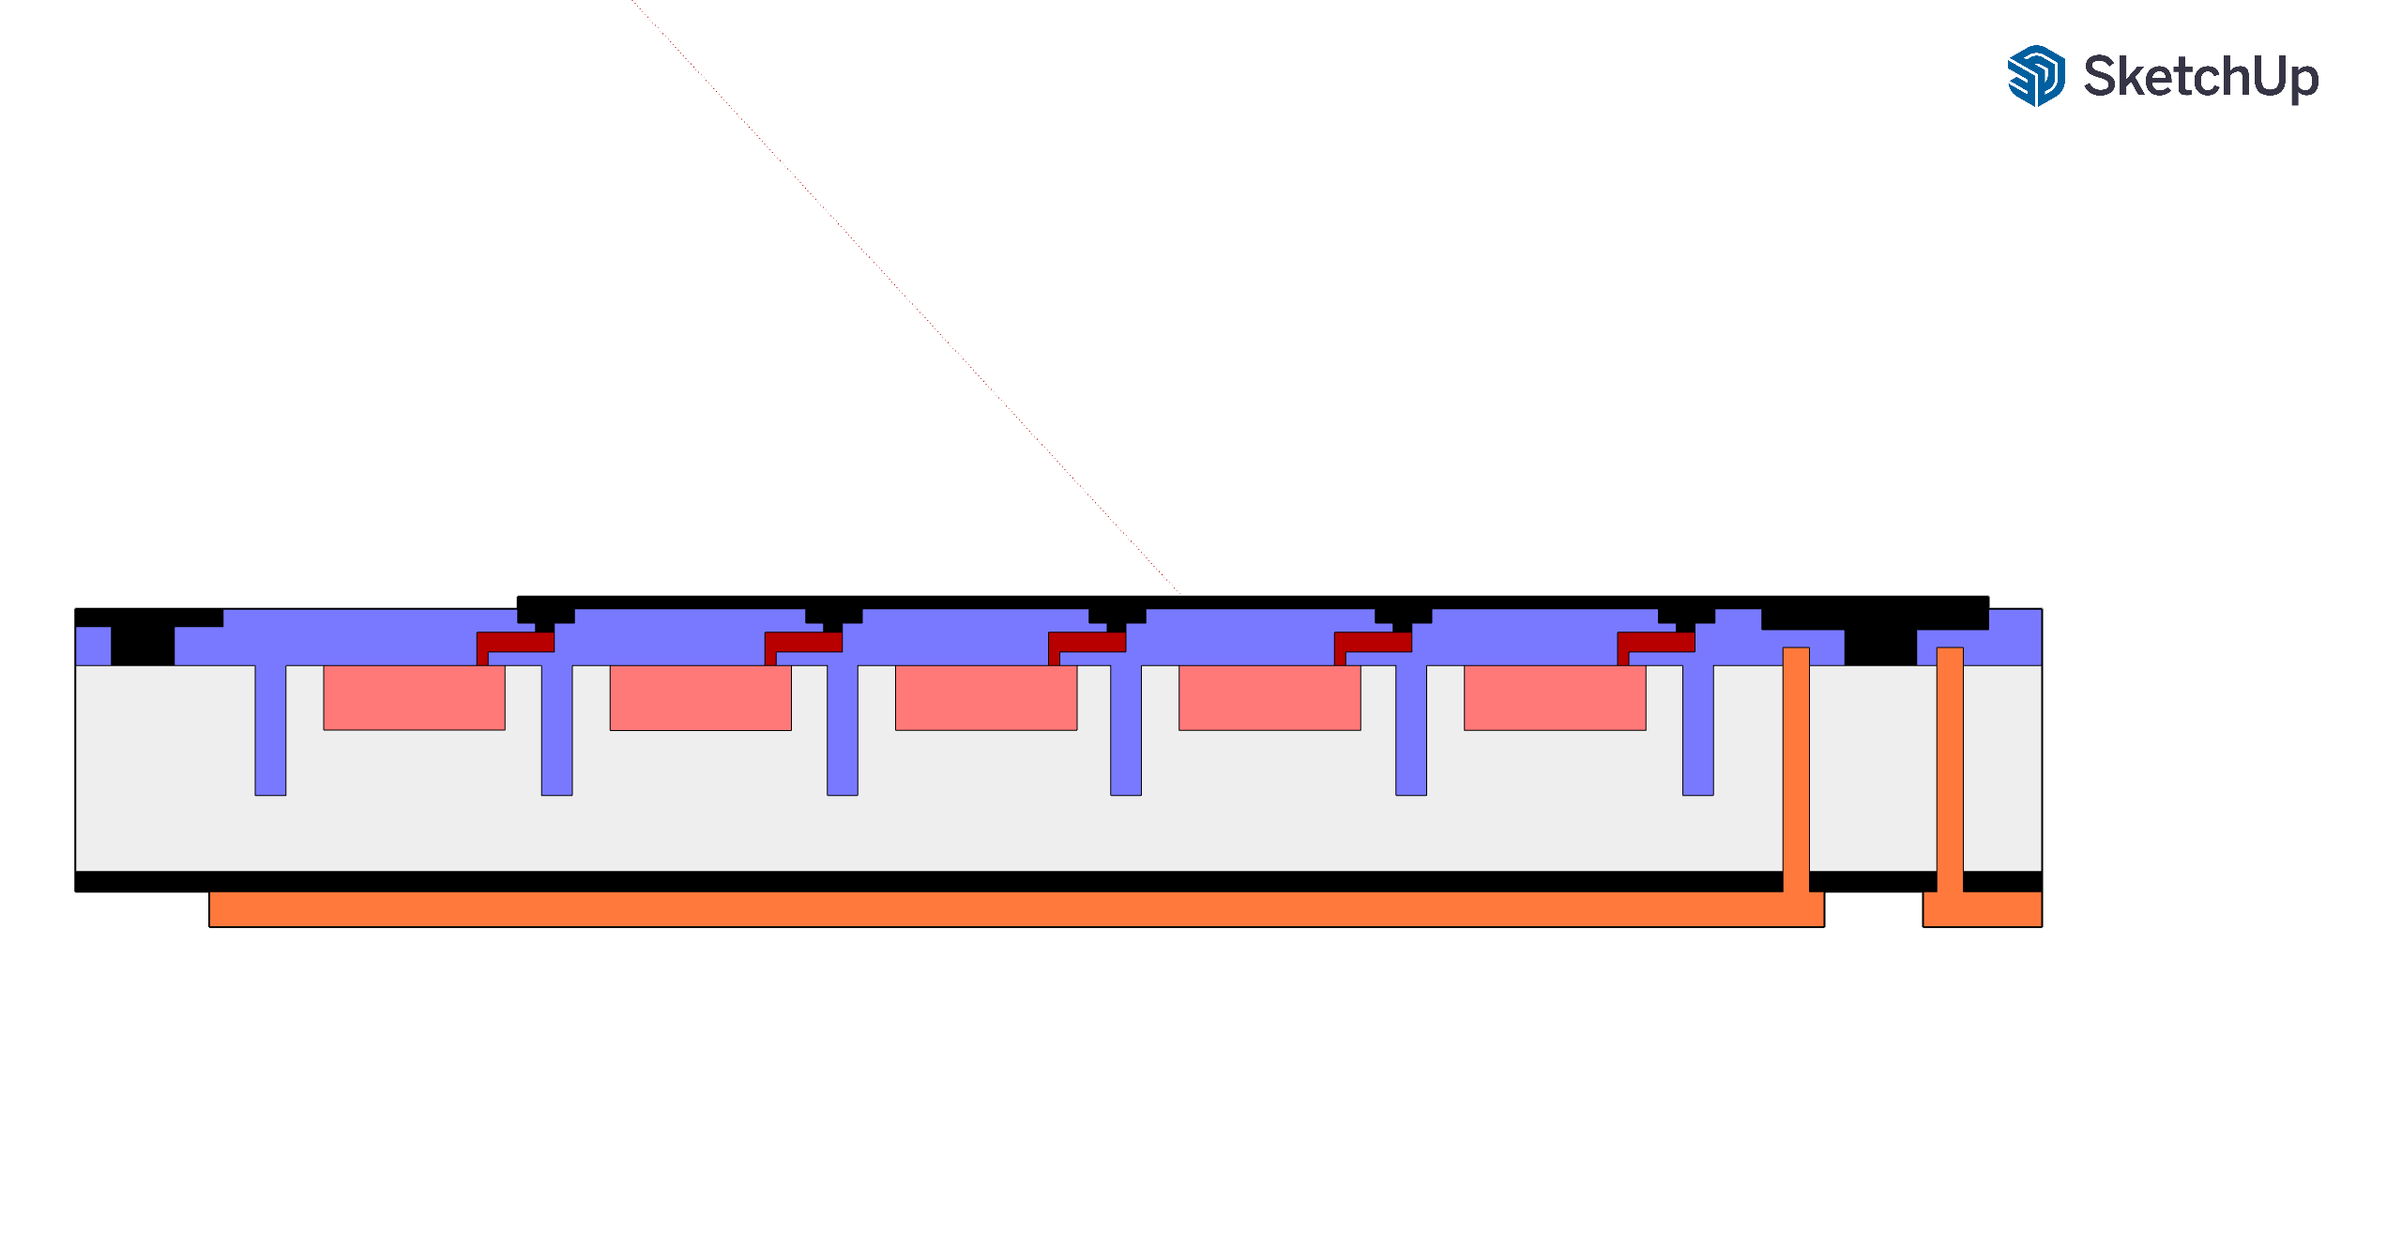
Fabrication process flow - TSV Via Last (not to scale)
1- SiPM fabrication
3- Grinding down to about 150 µm
Metal
Silicon
N-P junction
Oxide
Adhesive
Organic polymer
Glass
Quenching resistor
4- TSV formation + contacts formation
Front end of line is unchanged
2- Temporary Glass Bonding
5- Debonding
Thickness at least 150 µm

Slide 18
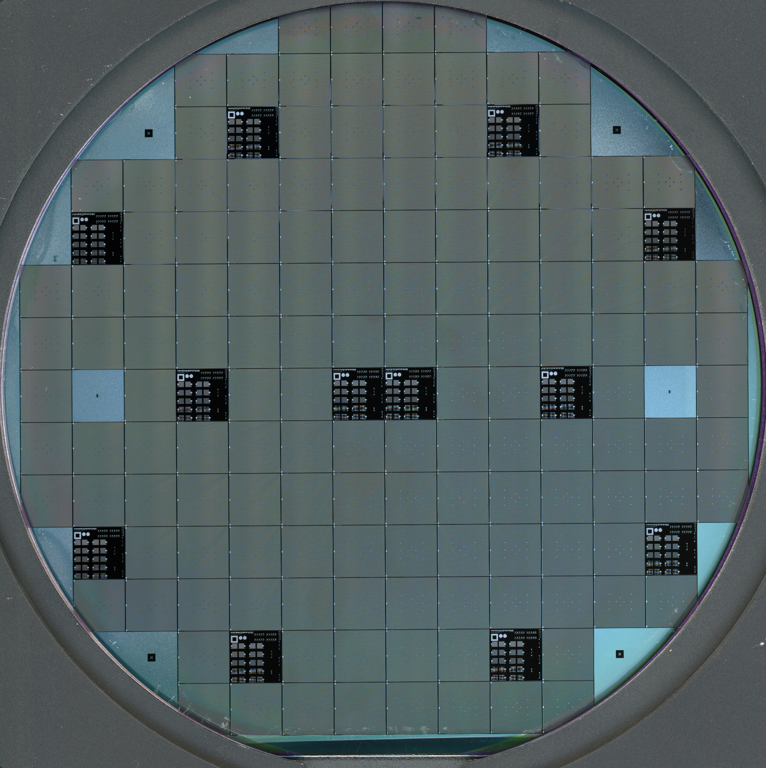
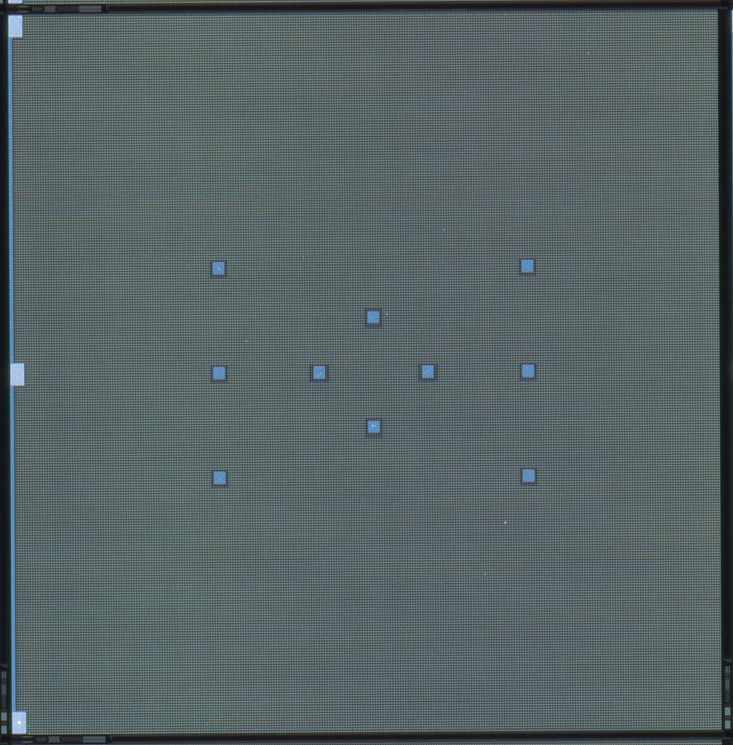
SiPM with Via-Last TSV: Device layout
10 mm x 10 mm SiPM
10 TSV in parallel per SiPM
Vias diameter: 100 µm
First produced wafer with TSV at FBK
TSV
The fill factor is reduced by less than 1% compared with non-TSV SiPM
150 µm Silicon thickness wafer

Slide 19
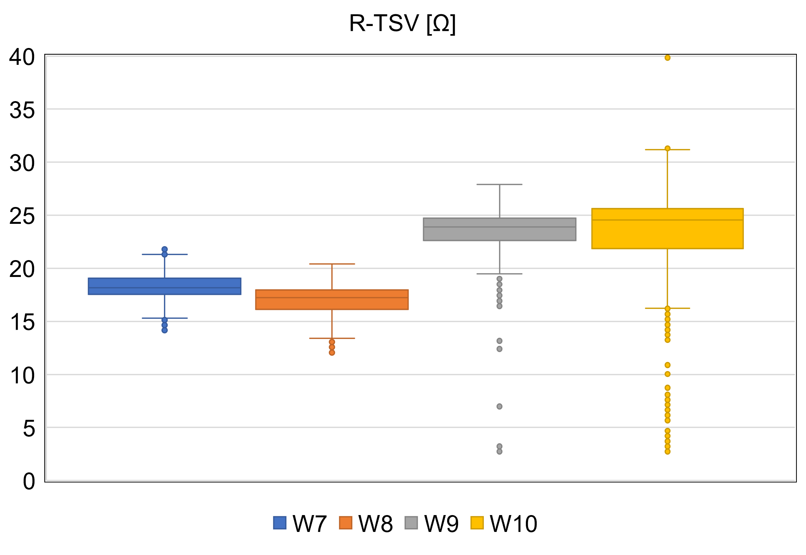
Electrical characterization: SiPM with TSV
Series Resistance of 2 TSV
Single TSV Rs ~ 6-15 Ohm
(dominated by the resistance of the epitaxial layer)
(2-wires measurements. Parasitic resistances are included)
Ongoing approaches to further reduce the TSV resistance:
Removing the epitaxial layer
Doping the epitaxial layer
Increasing the number of TSV
10 TSV in parallel per SiPM
Total TSV resistance/SiPM ≤ 1.5 Ohm/SiPM

Slide 20
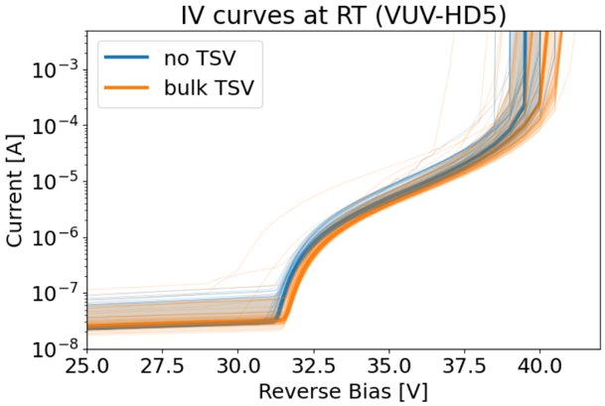
Electrical characterization: SiPM with TSV at RT
2nd divergence
Pre-breakdown current
Breakdown voltage
I-V curves of SiPM with and without TSV are comparable at RT

Slide 21
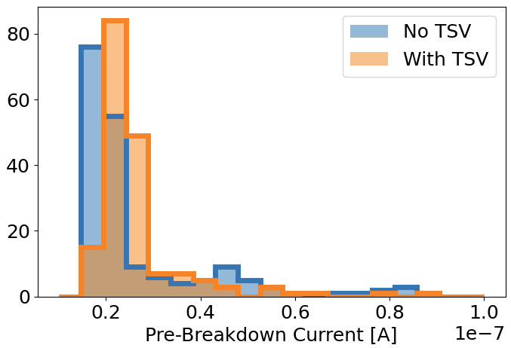
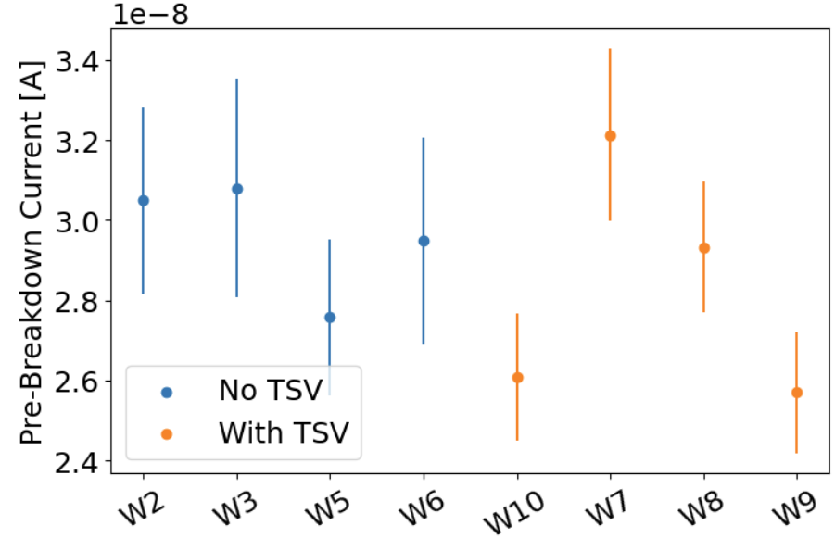
Electrical characterization: SiPM with TSV at RT
Pre-Breakdown current
I-V curves of SiPM with and without TSV are comparable at RT

Slide 22
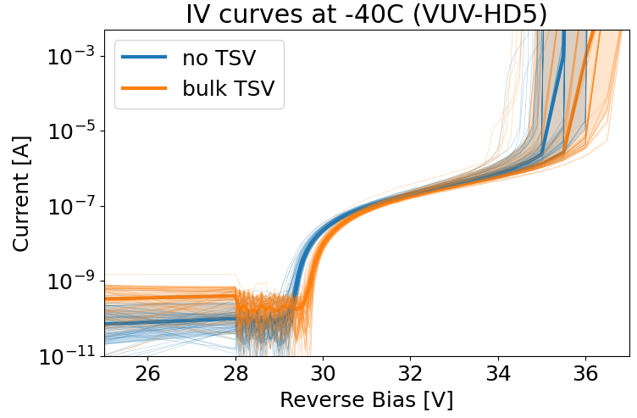
Electrical characterization: SiPM with TSV vs Temp.
I-V curves of SiPM with and without TSV are also comparable at -40C

Slide 23
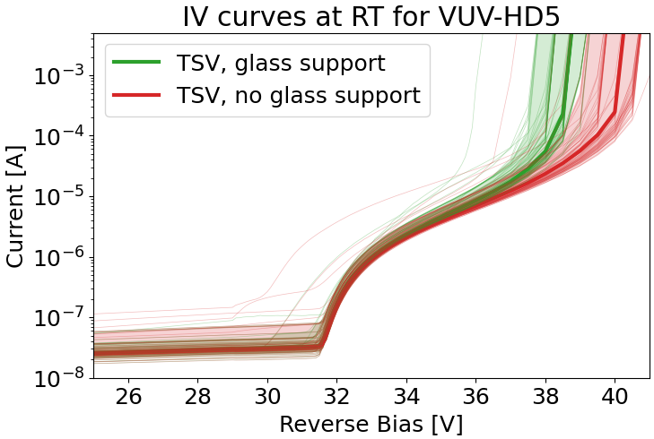
Electrical characterization: SiPM with TSV at RT
Effect of the glass wafer
Delayed 2nd divergence: most probably due to a reduction of external optical crosstalk probability due to the absence of the glass carrier
2nd divergence related to the correlated noise

Slide 24
Electrical characterization: SiPM with TSV at RT
Effect of the glass wafer
Delayed 2nd divergence: most probably due to a reduction of external optical crosstalk probability due to the absence of the glass carrier
External crosstalk is generated by secondary photons emitted during an avalanche that escape from the silicon device, are reflected on the different optical interfaces above the SiPM, and return to the device generating a new avalanche in a different cell.
Increase of the correlated noise
↓
Anticipated 2nd divergence
↓
Limited maximum excess bias
↓
Limited PDE
Light emitted during avalanche
Gola, Alberto, et al. "SiPM optical crosstalk amplification due to scintillator crystal: effects on timing performance." Physics in Medicine & Biology 59.13 (2014): 3615.

Slide 25
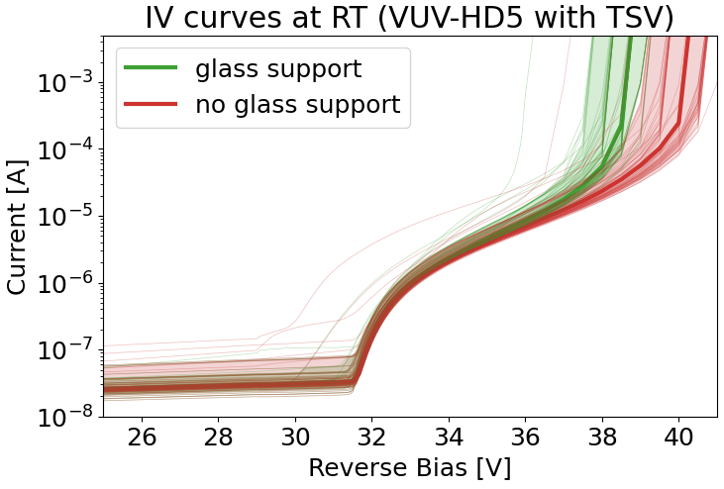
Electrical characterization: SiPM with TSV at RT
Effect of the glass wafer
Delayed 2nd divergence: most probably due to a reduction of external optical crosstalk probability due to the absence of the glass carrier
Light emitted during avalanche
2nd divergence related to the correlated noise

Slide 26
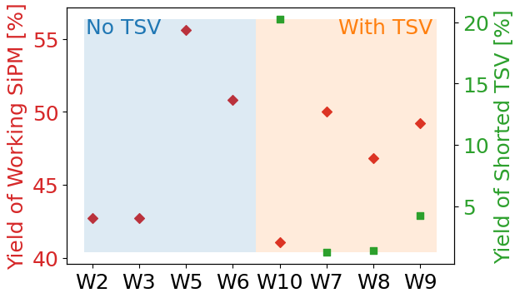
Electrical characterization: SiPM with TSV at RT
Yields
Fraction of OPEN TSV
top metal is not in contact with the back metal
Fraction of SHORT TSV
the bulk is contacted with the TSV
NO OPEN TSV
OBSERVED

Slide 27
Electrical characterization: SiPM with TSV at RT
Yields
Fraction of OPEN TSV
top metal is not in contact with the back metal
Fraction of SHORT TSV
the bulk is contacted with the TSV
NO OPEN TSV
OBSERVED
Fraction of Shorted TSV [%]

Slide 28
Conclusions
FBK has successfully fabricated Glass-less SiPM with Through Silicon Vias for VUV light detection preserving the main parameters of the device such as:
                - Pre-breakdown current
      - Breakdown voltage
      - Wafer yield for 10x10mm² SiPM
Bulk-TSV technology using silicon as a conductive material has been presented
TSV resistance achieved is in the range of 10 Ohm/TSV. Process-related approaches to further reduce it are ongoing
      Debonding the glass carrier wafer has shown a shift on the 2nd divergence most probably due to a reduction of the external optical cross-talk probability
at RT and at -40C
Bulk-TSV technology can be easily applied to different applications apart from physics experiments such us for TOF-PET applications

Slide 29

Thank you
lparelladamonreal@fbk.eu
www.fbk.eu
9th November 2023

Slide 30

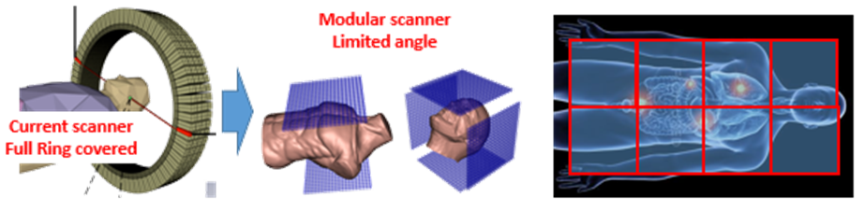
Future and ongoing work with Bulk-TSV technology
Record of Timing
SiPM trench
Very fine TSV pitch ➔ “miniSiPM”
~ 20 µm
Bulk- TSV
~ 50 µm
JS-03-02 Digilog: A digital-analog SiPM towards 10 ps prompt-photon tagging in TOF-PET
S. Gundacker et al.
Petvision project
M-03-043 Next generation PET imager
R. Pestotnik et al.

Slide 31
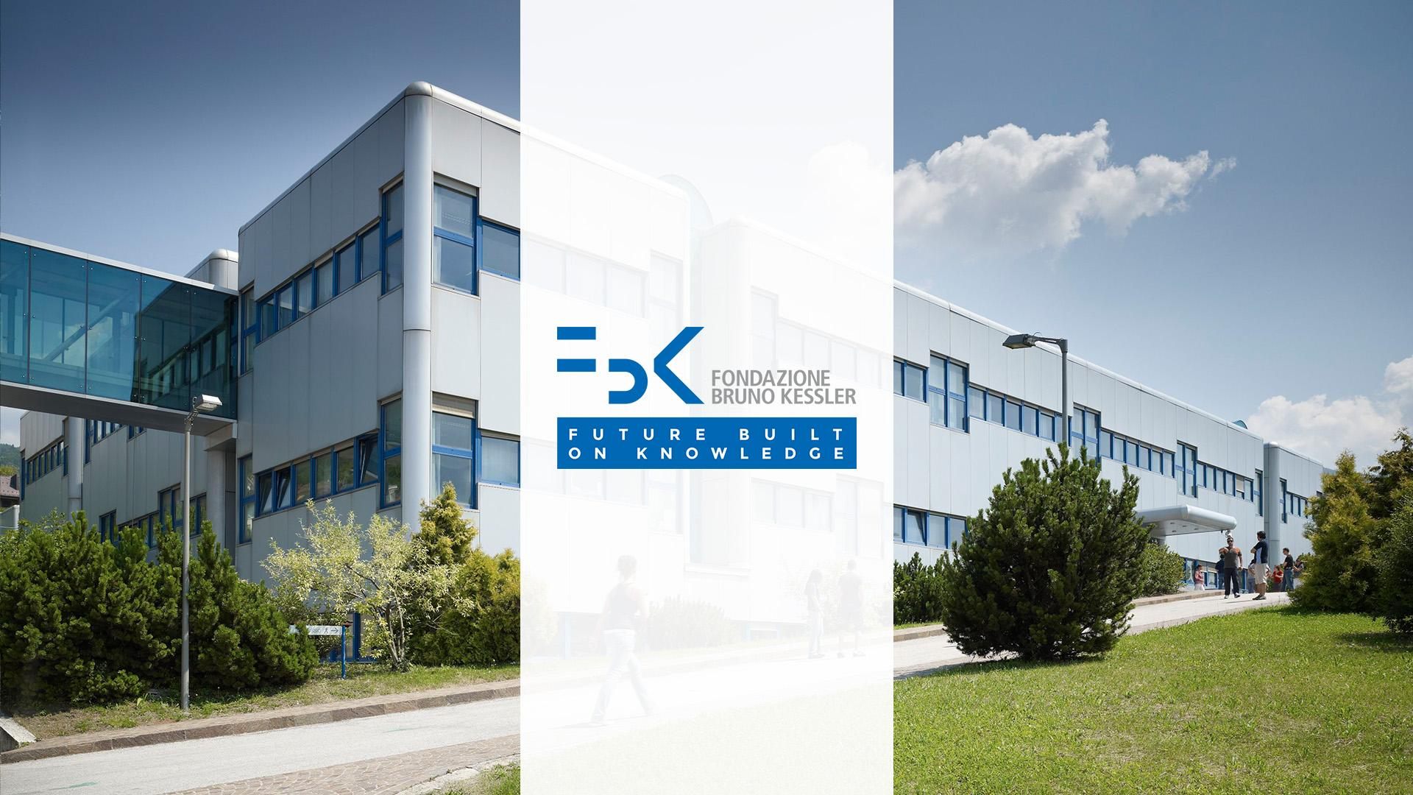

Slide 33
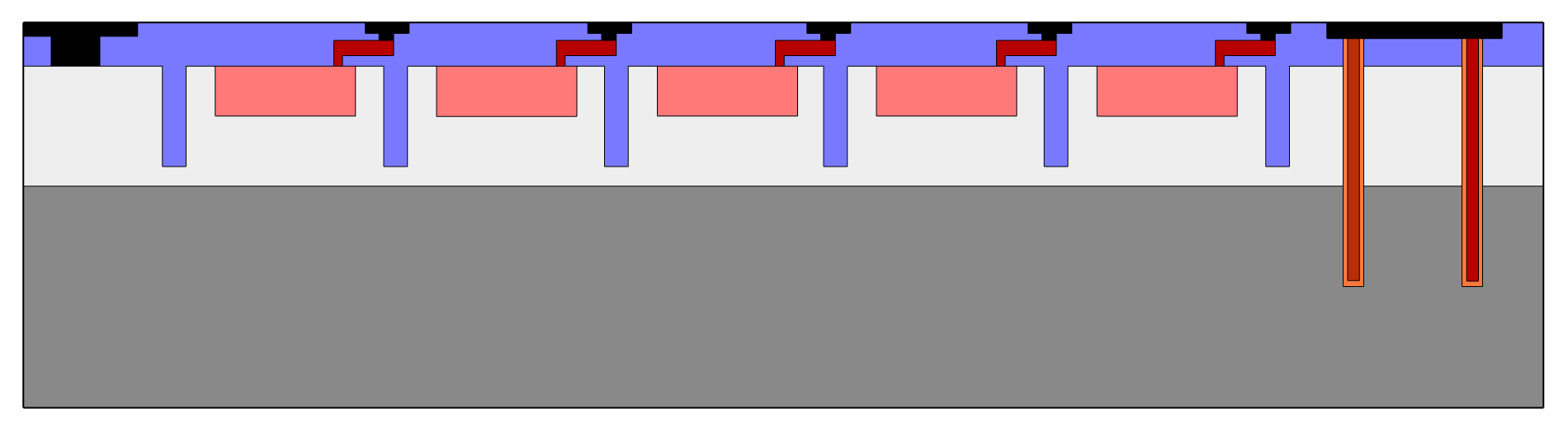
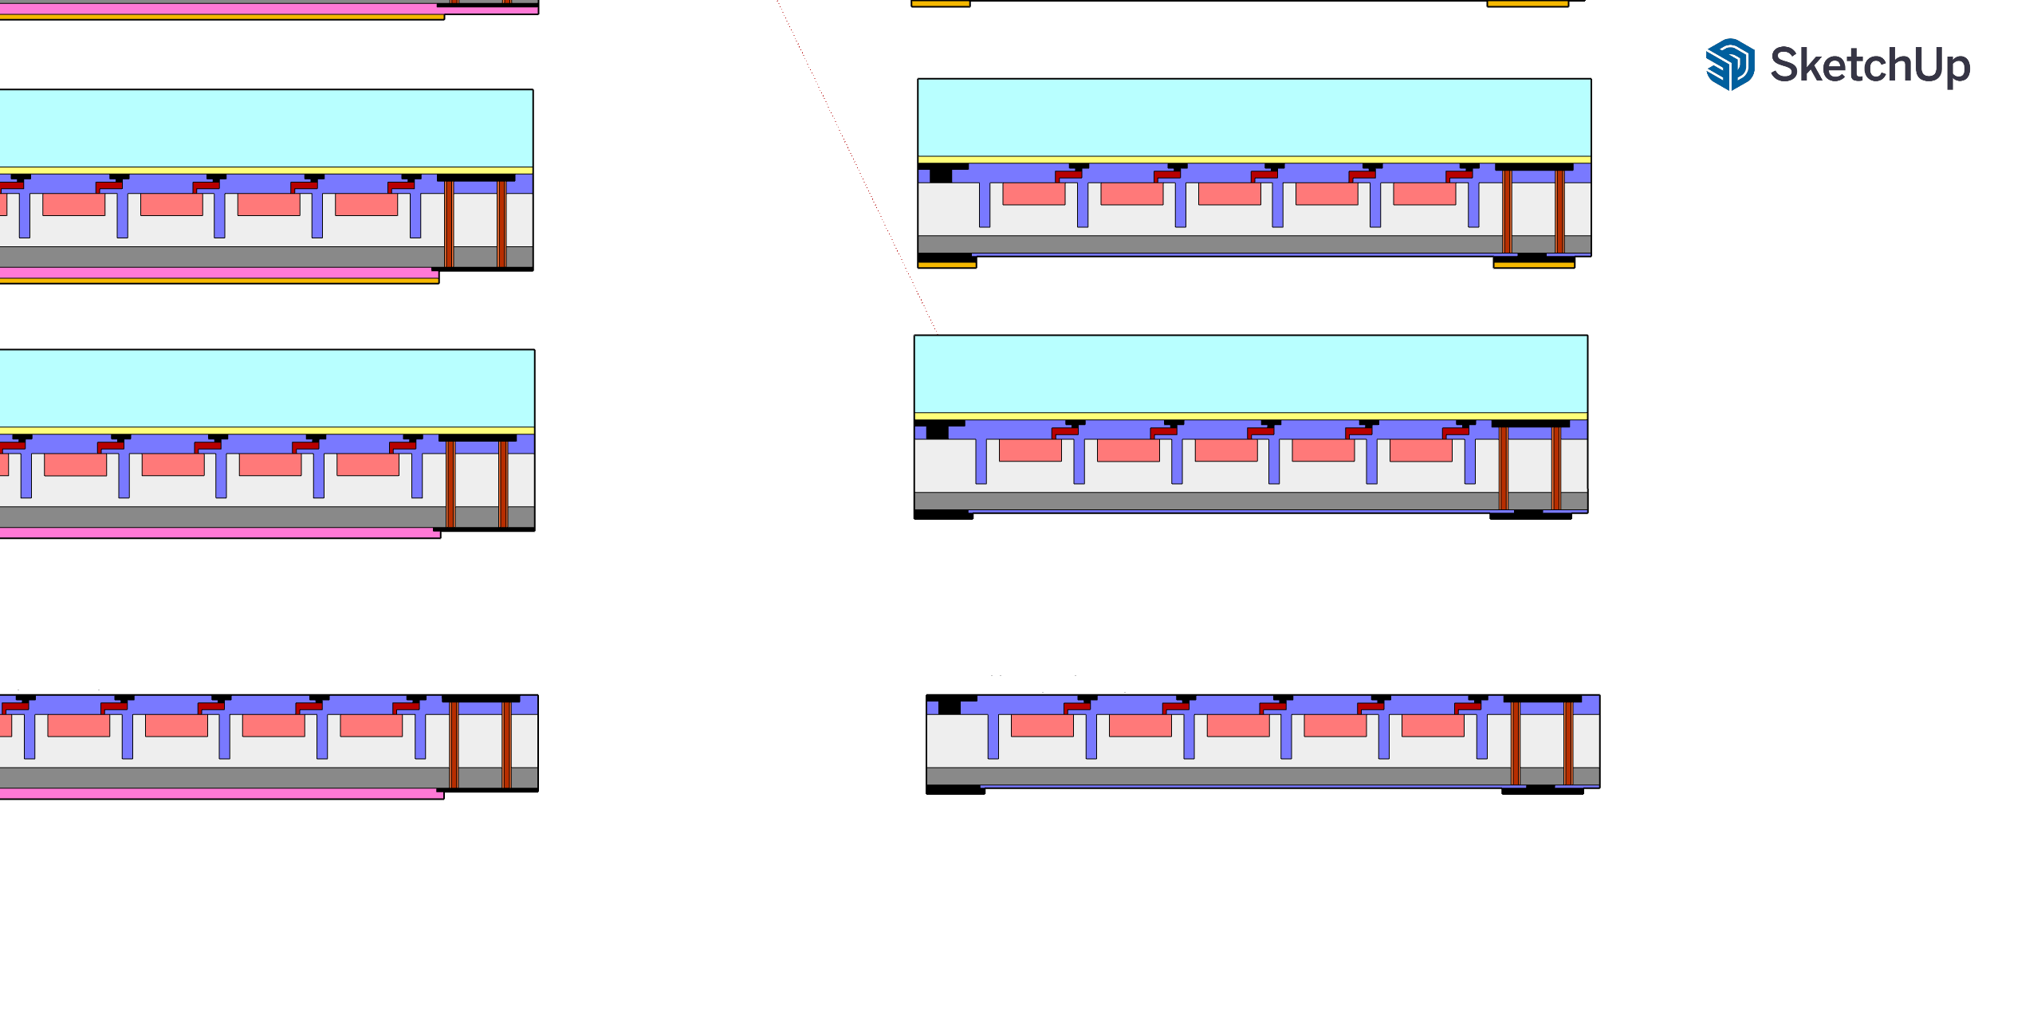

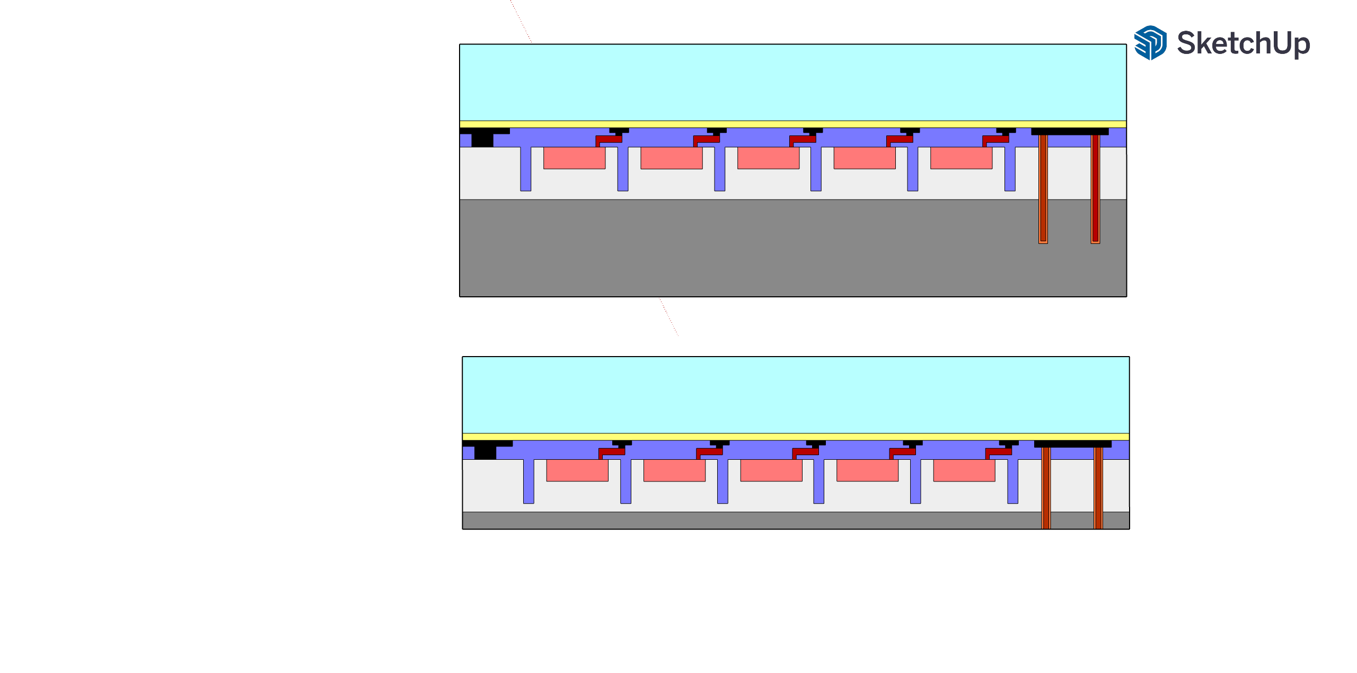
Other TSV approach: Via Mid
Via Mid
SiPM fabrication + TSV formation
Contacts formation
High thermal budget allowed (high quality and conformal material deposition)
Necessity to adapt the device process flow ➔ Critical lithography needs to be carried out after the TSV fabrication
Edge Trimming + BONDING
DEBONDING
NO-DEBONDING
THINNING
Thickness at least 150 um
Thickness 10-50 um

Slide 34
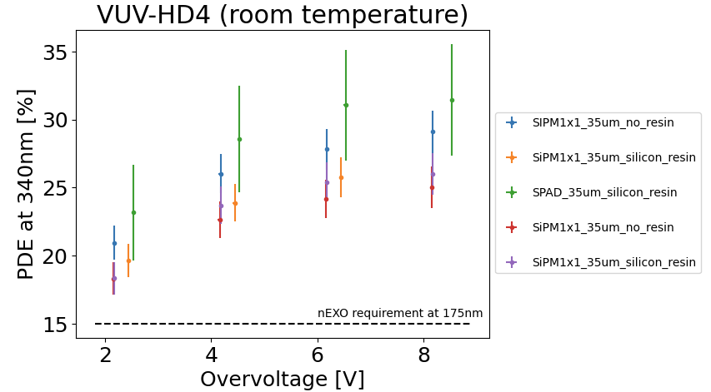
PDE VUVHD4 at 340 nm
VUV-HD4, HD5 and HD6 have the same technology so similar PDE performances are expected among the three runs

Slide 35
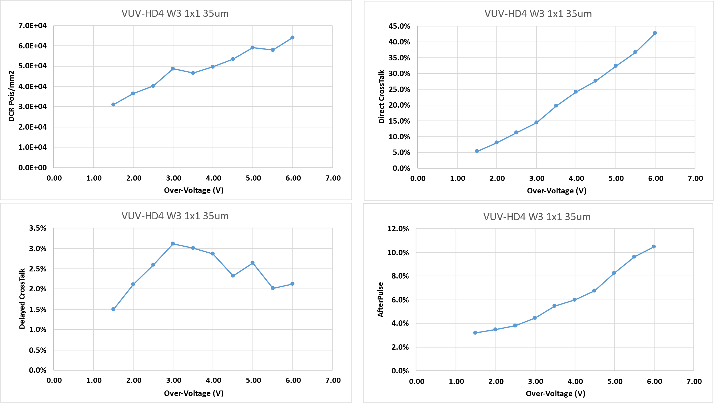
VUVHD4

Slide 36
Cyclotene transmittance
Few um of BCB are used as the adhesive for permanent bonding

Slide 37
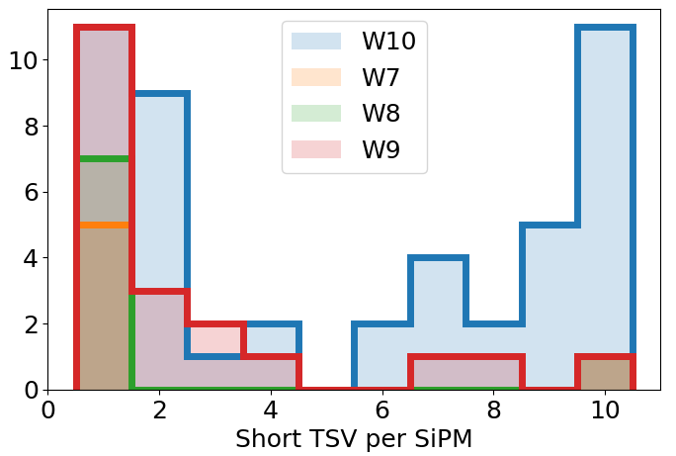
# of Short TSV/ SiPM
# SiPM per wafer

Slide 38
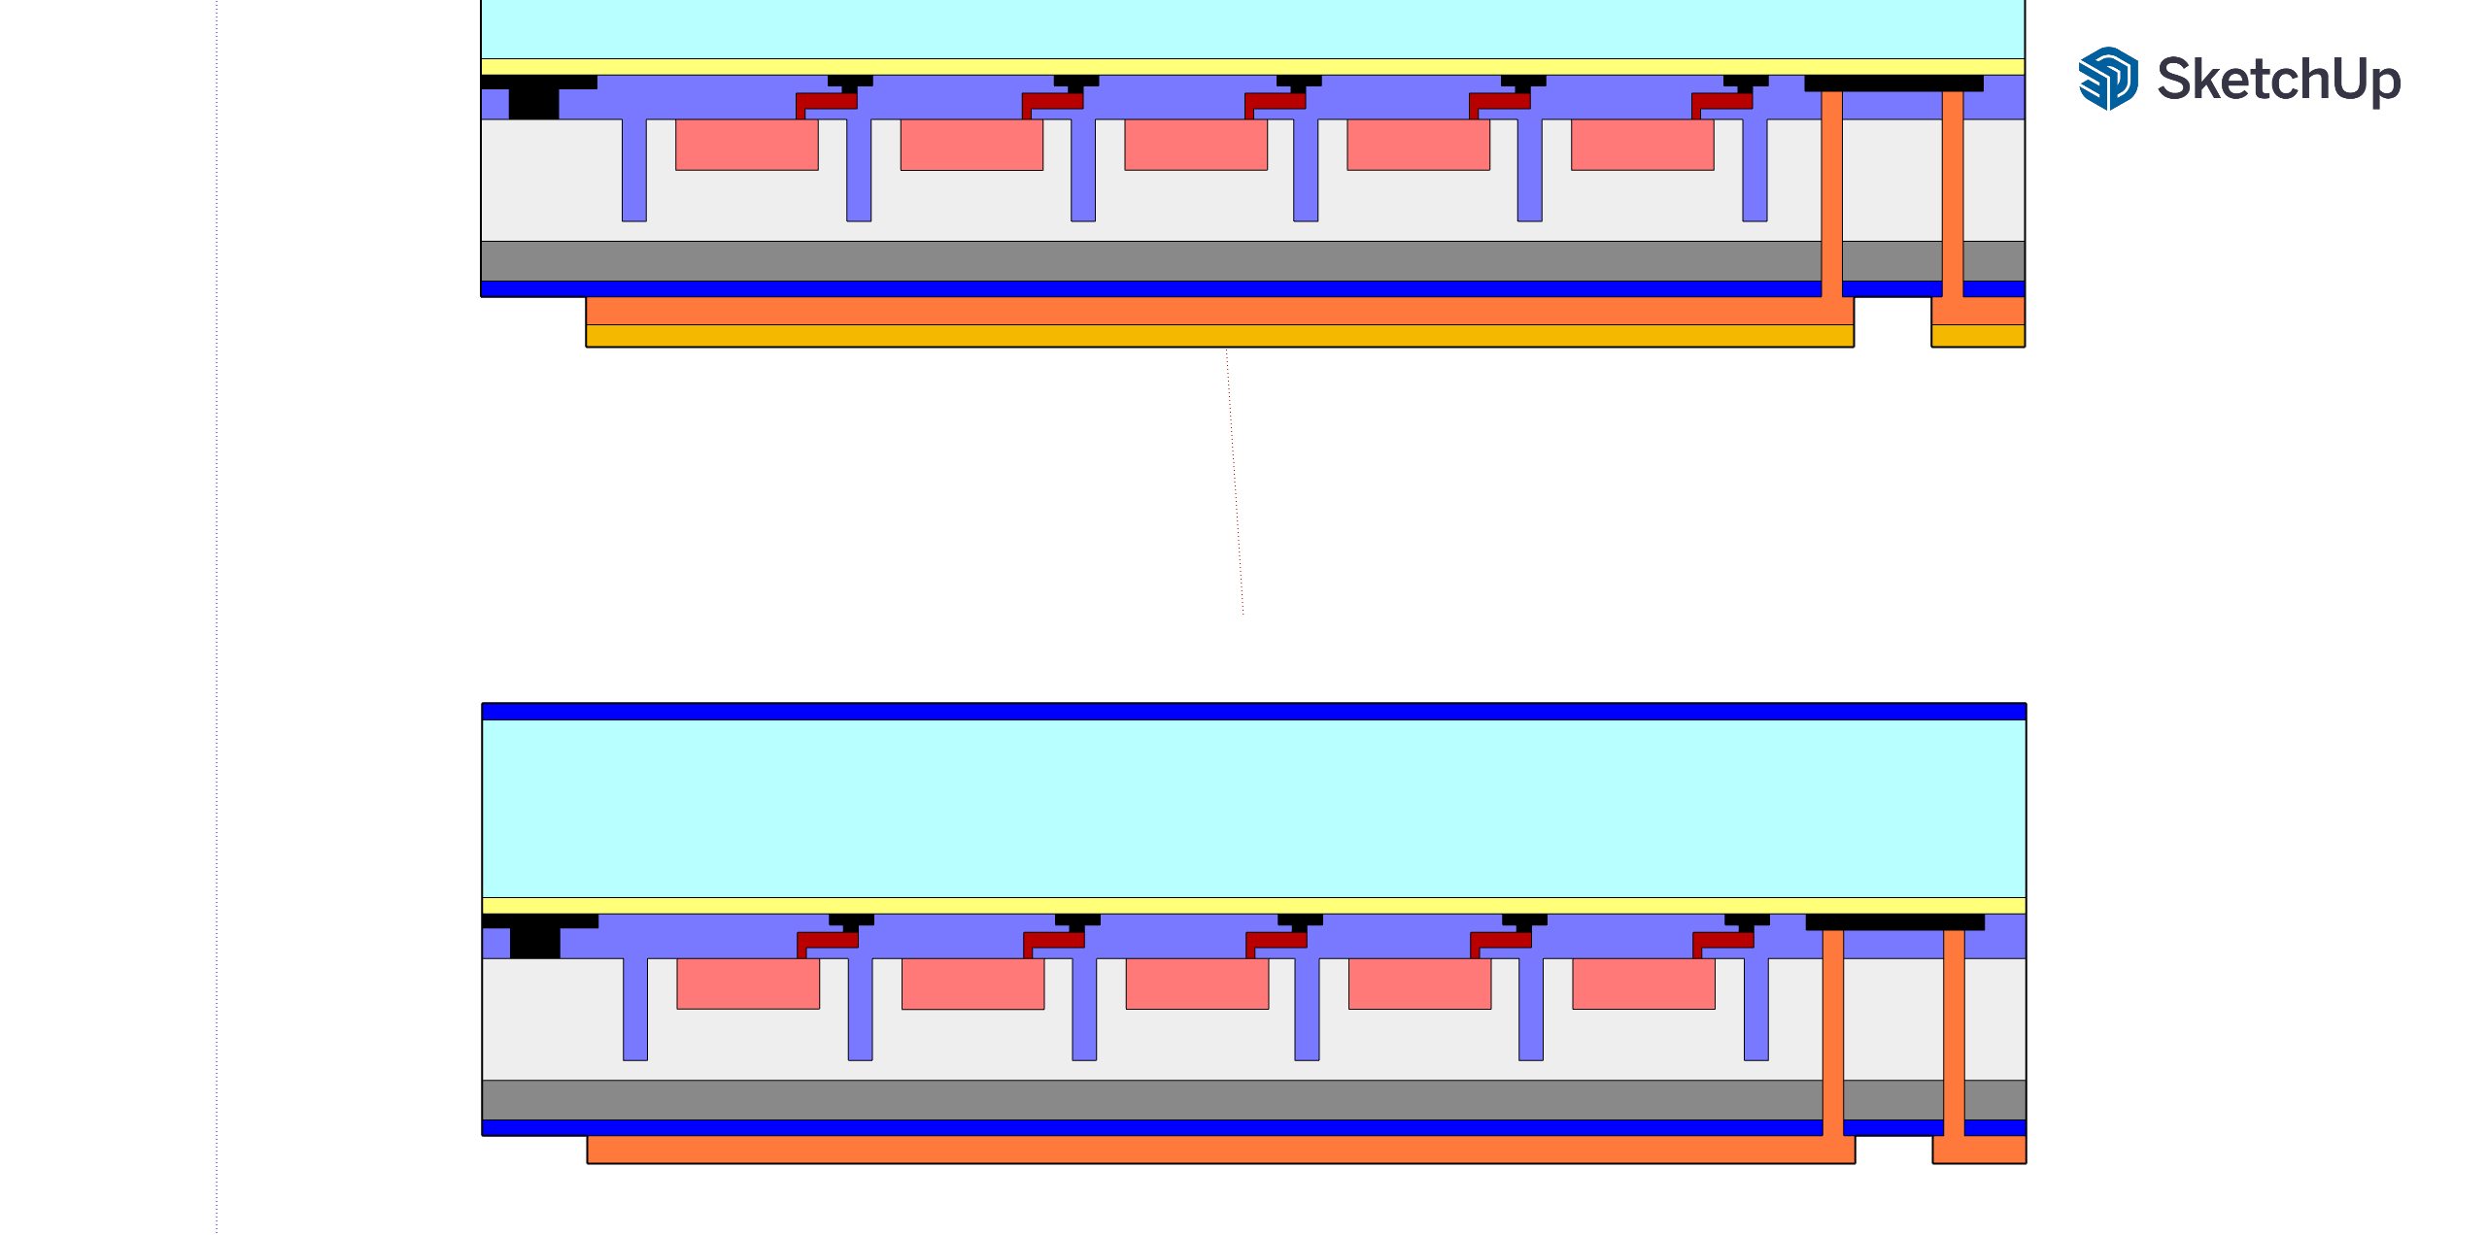
3. SiPM with Via-Last TSV:
IV curves
Organic polymer
BACK
150um
100um
Front
Forward
Reverse
few um width
W7
R ~ 16.8Ω
Marked as good SiPM
Good TSV
Example of a “good” device
Same I-V curves, regardless of the used TSV channel

Slide 39
3. SiPM with Via-Last TSV:
IV curves – Failure analysis
Organic polymer
BACK
150um
100um
Front
Forward
Reverse
few um width
W7
R ~ 4Ω
Marked as 1 bad TSV
R ~ 13Ω

Slide 40
3. SiPM with Via-Last TSV:
IV curves – Failure analysis
Organic polymer
BACK
150um
100um
Front
Forward
Reverse
few um width
W7
Marked as good TSV
Bad SiPM
R ~ 16.5Ω
Example of a defective SiPM with good TSVs
Same I-V curves, regardless of the used TSV channel

Slide 41
Forward I-V
Forward
SiPM without TSV
R ~ 11.3 Ω
I (A)
SiPM with TSV
R ~ 16.8 Ω
V (V)

