Slide 1
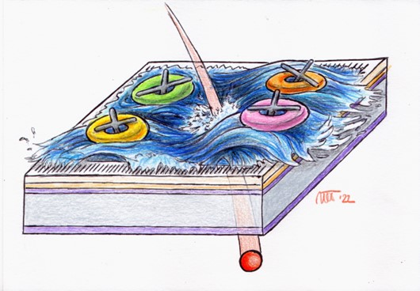
RSD2 performance in the AIDAINNOVA SPS test beam
Luca Menzio (INFN Torino)
on behalf of the AIDAINNOVA testbeam team

Slide 2
Contents
Introduction
Resistive read-out in silicon detectors
Experimental Set-up
AIDA test beam setup @ SPS
Chubut2 acquisition board
Analysis and Results
Analysis flow
1.3 mm-pitch sensor results
450 µm-pitch sensor characterization
Conclusions

Slide 3
Contents
Introduction
Resistive read-out in silicon detectors
Experimental Set-up
AIDA test beam setup @ SPS
Chubut2 acquisition board
Analysis and Results
Analysis flow
1.3 mm-pitch sensor results
450 µm-pitch sensor characterization
Conclusions

Slide 4
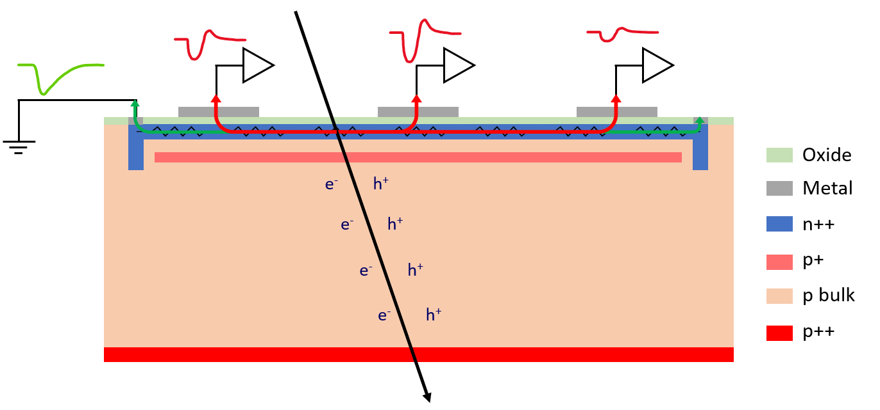
Resistive Read-out
e-h pairs are produced by the impinging particle in the sensor volume
AC-coupled signals
Electrons are multiplied (LGAD)
Charge is induced in the n+ layer (resistive layer)
Nearby electrodes see a fast signal
Charges in the n+ flow to ground
AC-coupled electrodes
50 μm
Signal sharing
Luca Menzio – INFN Toino
In normal pixel detectors ${\text{σ}}_{x}=k\frac{ pitch}{\sqrt{12}}$ with $k\sim 0.5−1$
Resistive read-out sensors have
${\text{σ}}_{x}≪pitch$
Time resolution typical of thin LGADs

Slide 5
Resistive Read-out
Charge sharing over silicon surface
Excellent position resolution with large pads
Internal gain (LGAD)
Excellent Timing
Luca Menzio – INFN Toino
Pros
Low channel density
Thin sensors
Low power consumption
Low material budget
+ 100 % intrinsic fill factor!
Promising candidate for 4D tracking

Slide 6
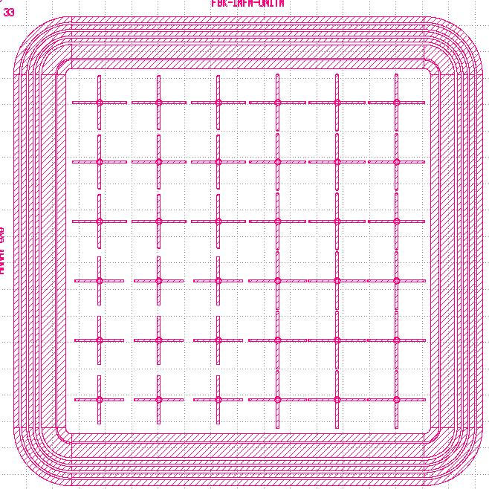
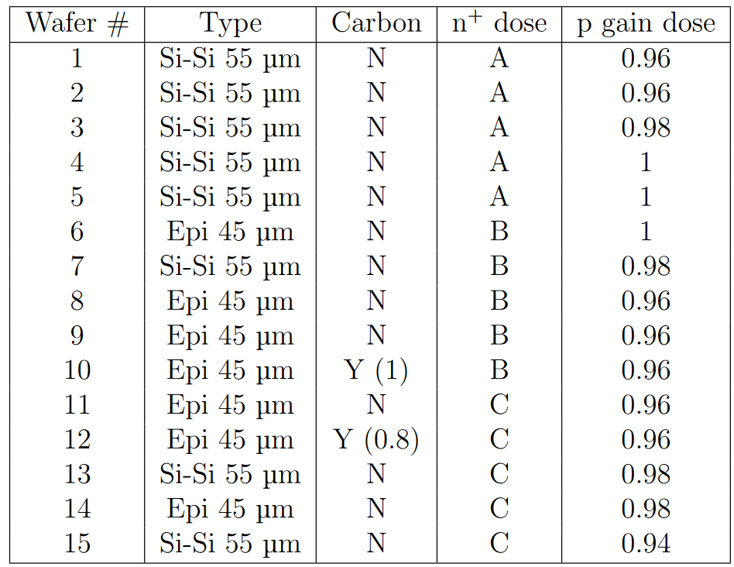
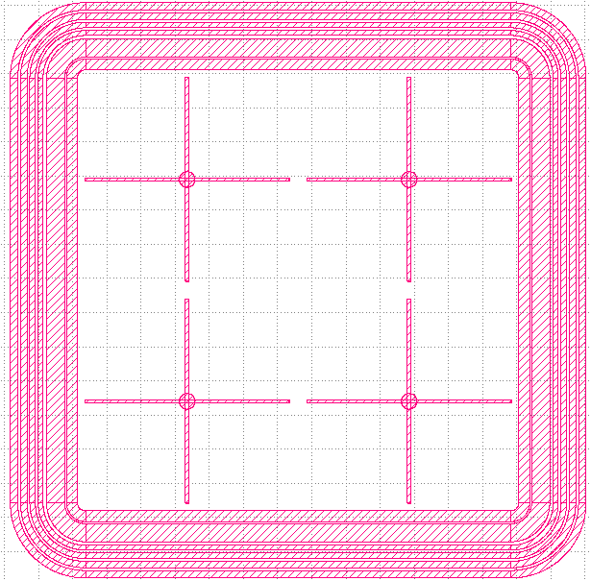
DUTs – RSD devices
The DUTs come from the second production by FBK of Resistive Silicon Detectors (RSD2)
Two devices tested:
450x450 µm² from W7
1.3x1.3 µm² from W13
Same AC-electrodes layout – crosses to help the signal containment
Different n+ layer resistivity
450 x 450 µm²
Luca Menzio – INFN Toino
1.3 x 1.3 mm²

Slide 7
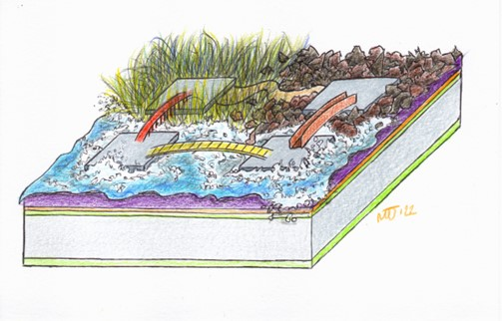
Contents
Introduction
Resistive read-out in silicon detectors
Experimental Set-up
AIDA test beam setup @ SPS
Chubut2 acquisition board
Analysis and Results
Analysis flow
1.3 mm-pitch sensor results
450 µm-pitch sensor characterization
Conclusions

Slide 8
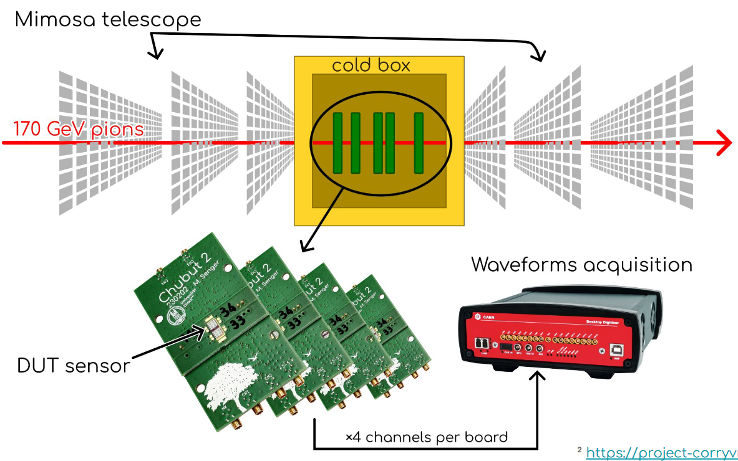
AIDA Test Beam
The test beam was performed in the CERN H6 beamline (120 GeV pions/protons)
MIMOSA telescope
CAEN DT5742 digitizer, 16 channels @ 5GS/s
Trigger is a 3x3 mm² UFSD1 LGAD
DUTs on the Chubut2 read-out board
RSD runs:
2 DUTs, 1.3 mm and 450 μm pitch biased at 240 V and 200 V, respectively
No time reference

Slide 9
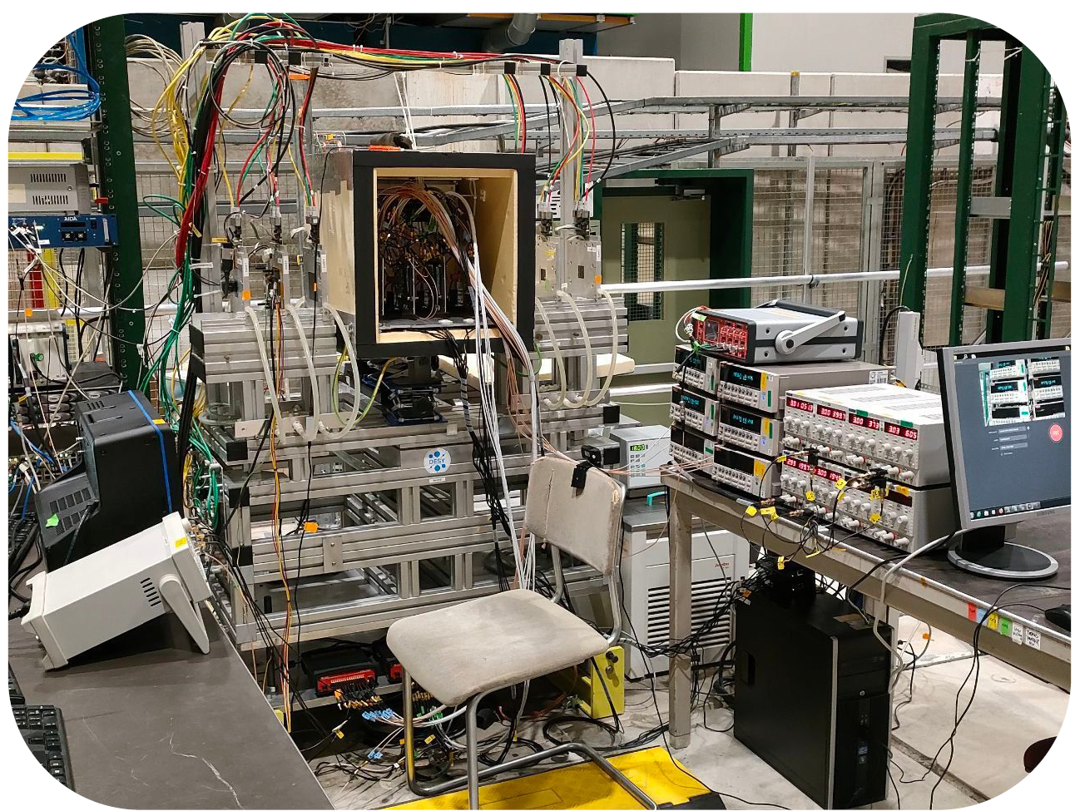
AIDA Test Beam

Slide 10
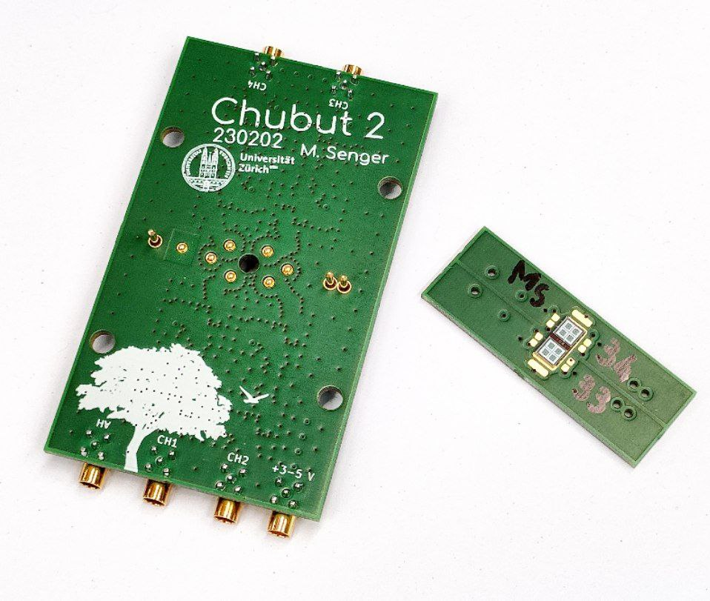
Chubut2 Acquisition Board
The Chubut2 is a low-noise discrete readout board specifically developed for LGAD testing
It features a
Carrier boards that hosts the DUT
Main board with amplification and power delivery circuitry
The design employed for this test beam has 4 identical channels, each with about 3540 Ω transimpedance on 50 Ω input and output
Good S/N with a budget friendly way of switching between sensors (one main board, multiple carrier boards)
Open source project¹
Luca Menzio – INFN Toino
¹https://github.com/SengerM/Chubut_2?tab=readme-ov-file

Slide 11
Contents
Introduction
Resistive read-out in silicon detectors
Experimental Set-up
AIDA test beam setup @ SPS
Chubut2 acquisition board
Analysis and Results
Analysis flow
1.3 mm-pitch sensor results
450 µm-pitch sensor characterization
Conclusions

Slide 12
Waveforms and Tracks Analysis
EUDAQ2 rawfile
Waveforms
Tracks
Luca Menzio – INFN Toino
Employing the Beta-analysis script
Reconstructed with corryvreckan
SPS RSD Analysis script

Slide 13
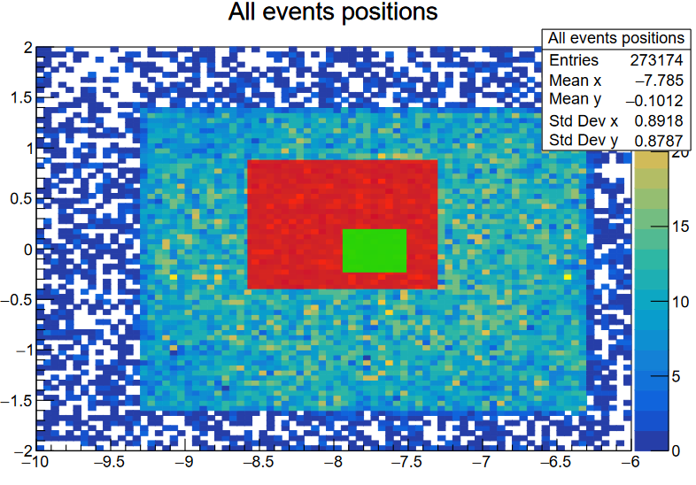
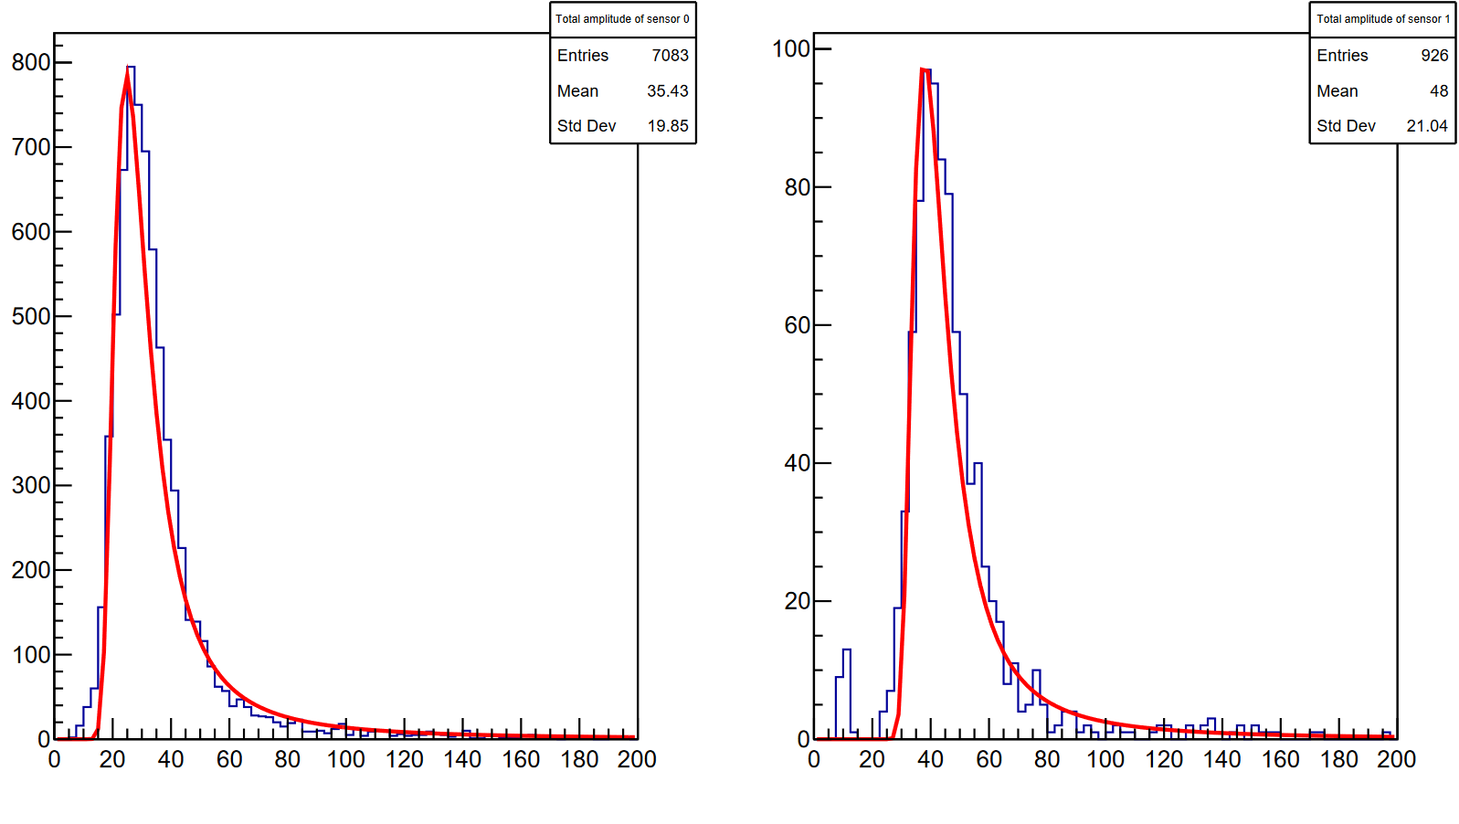
Having a look at the sensors
The sensors overlap in space and have good signals
Trigger
1.3 x 1.3 mm²
450 x 450 µm²
# Entries
# Entries
~25 mV MPV
~38 mV MPV
Luca Menzio – INFN Toino
Sum of the 4 electrodes amplitudes (mV)
Sum of the 4 electrodes amplitudes (mV)
1.3 mm sensor
450 µm sensor

Slide 14
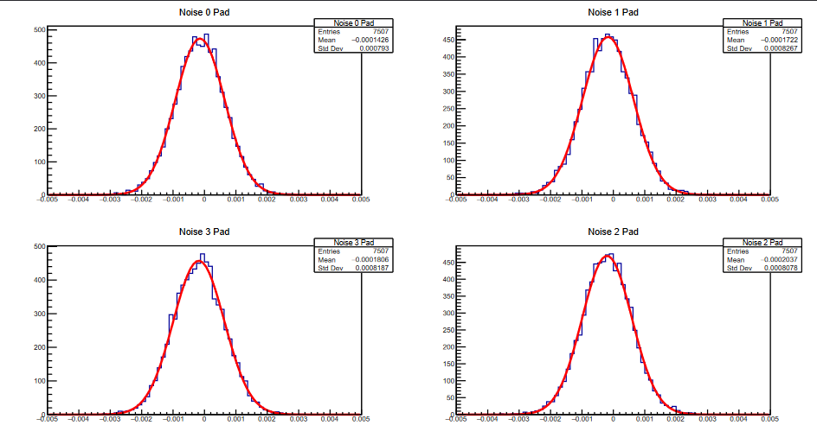
Having a look at the sensors
The sensors overlap in space and have good signals
1.3 x 1.3 mm²
450 x 450 µm²
# Entries
# Entries
~25 mV MPV
~38 mV MPV
Luca Menzio – INFN Toino
All channels of both sensors have low noise ~0.8 mV
Sum of the 4 electrodes amplitudes (mV)
Sum of the 4 electrodes amplitudes (mV)

Slide 15
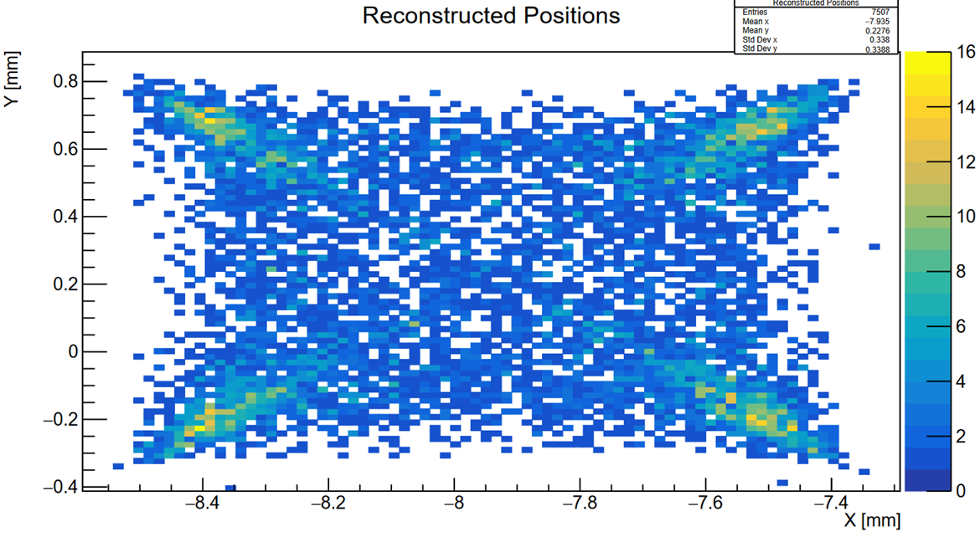
W13 1.3 mm – Position Reconstruction
Firstly, the position was reconstructed with the analytical formula based on the charge (amplitude) imbalance
The distortion of the reconstructed positions map is typical of this reconstruction method
Luca Menzio – INFN Toino

Slide 16
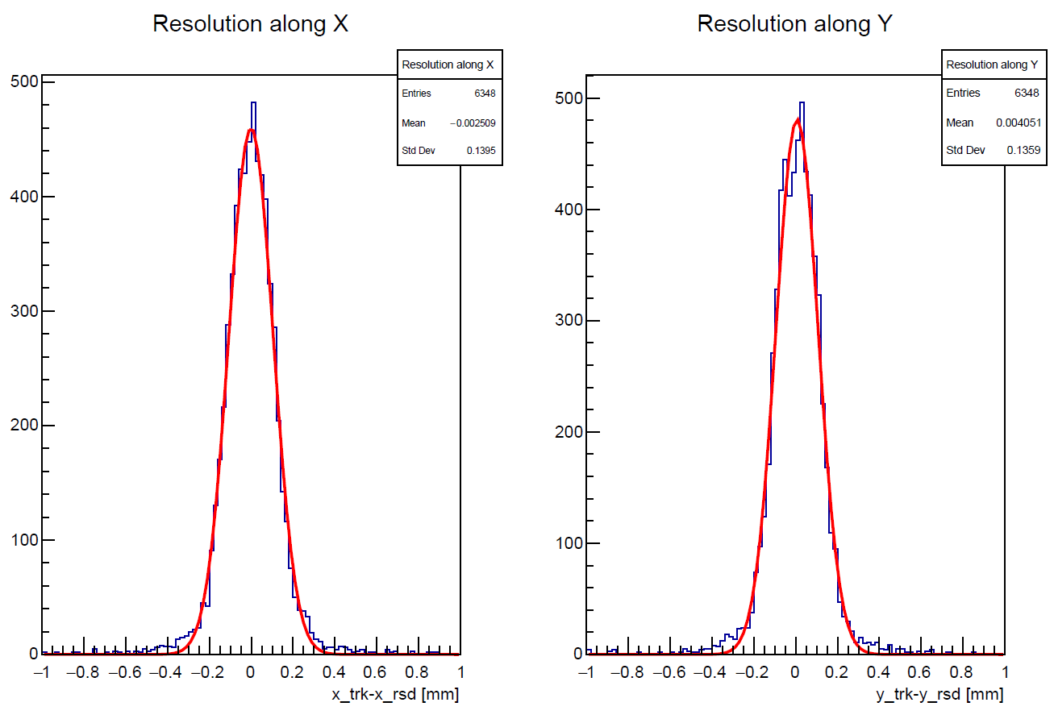
W13 1.3 mm – Position Resolution
About 95 µm on each axis – 13 % of the pitch. Better than standard binary pixels (29 %)
As already studied and demonstrated using the data collected with the TCT setup,
the resolution can be improved applying a correction (distortion mostly due to the reconstruction method):
- use of a “migration matrix”
- use of a template to assign the hit position
- use of machine-learning technique
# Entries
# Entries
Luca Menzio – INFN Toino

Slide 17
W13 1.3 mm – Machine Learning studies
82.9 µm
79.6 µm
We tried to implement a Deep Neural Network (presented in the last TREDI)
Although the statistics is very poor for Machine Learning, the results are very promising and present a 15% improvement compared to the non-corrected results
Luca Menzio – INFN Toino

Slide 18
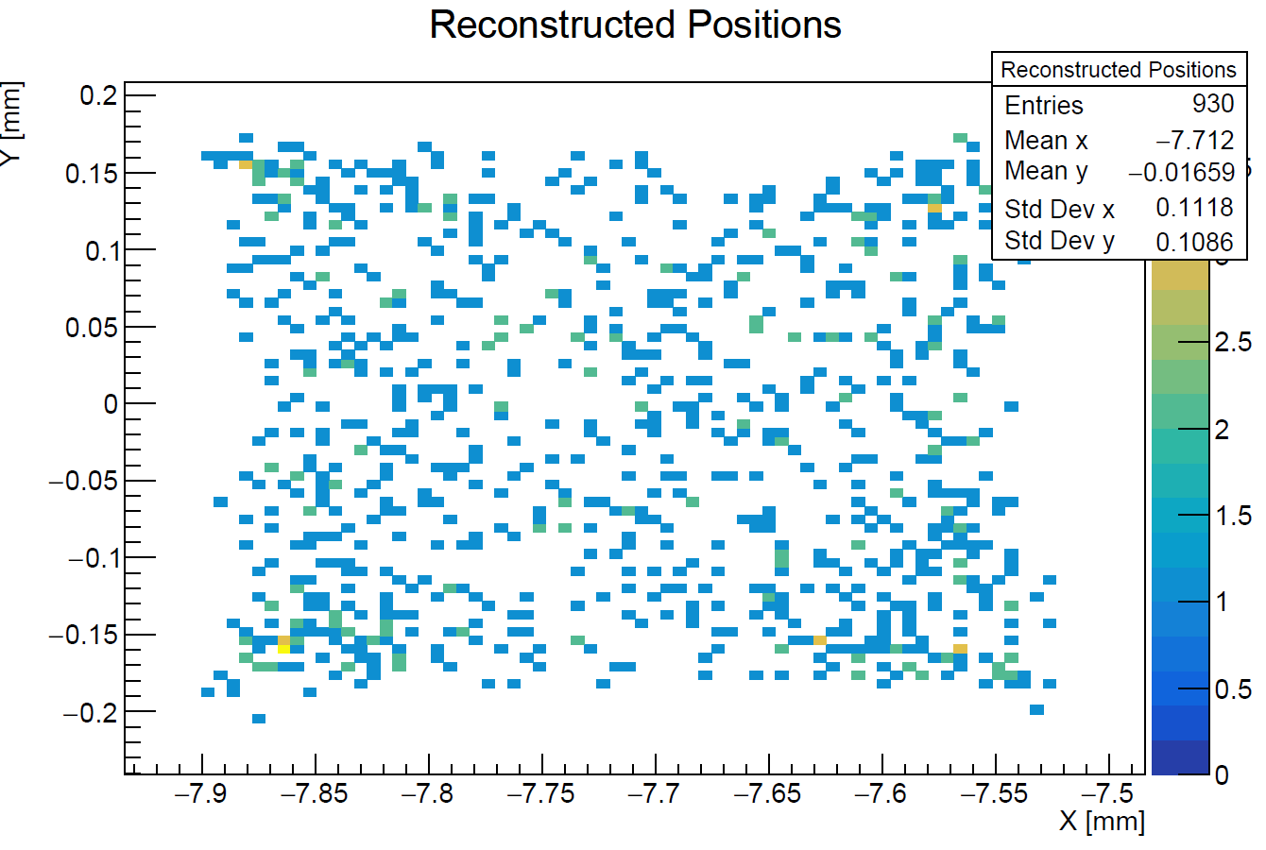
W7 450 μm – Analytical Method
The results of the 450 μm-pitch sensor benefit from the better signal-to-noise ratio
Luca Menzio – INFN Toino

Slide 19
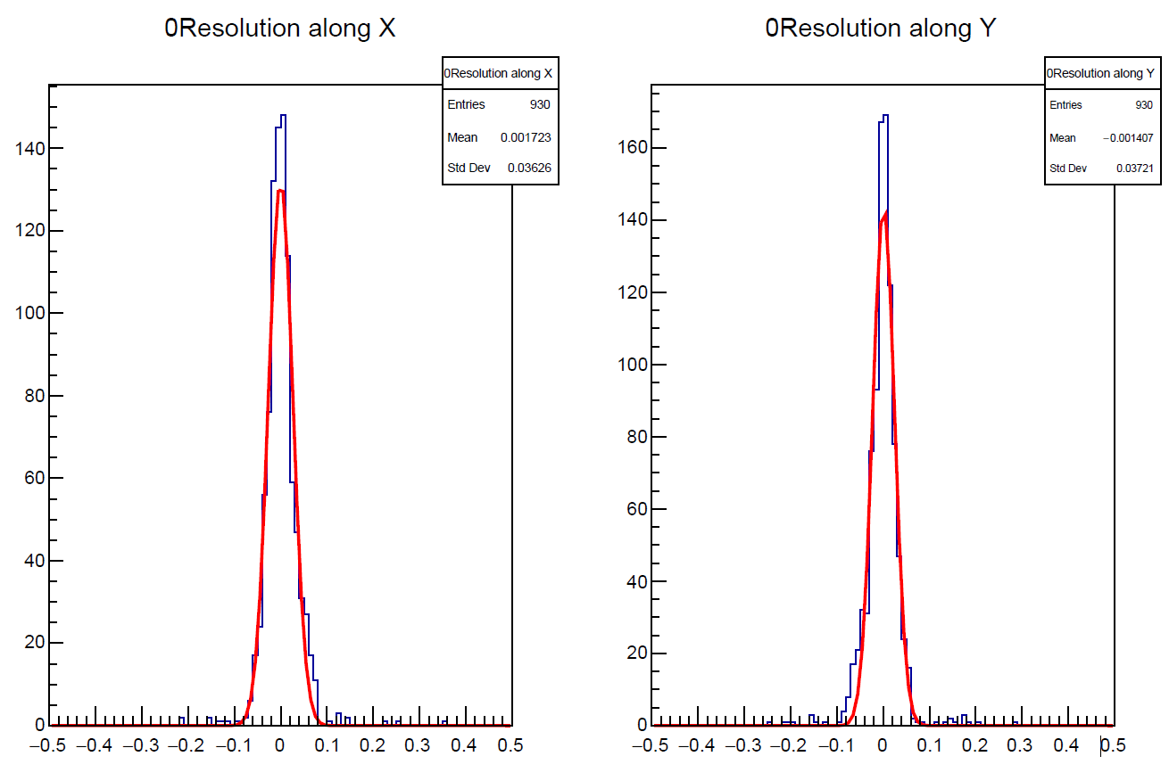
W7 450 μm – Analytical Method
The results of the 450 μm-pitch sensor benefit from the better signal-to-noise ratio
Reconstruction with the charge imbalance formula leads to a resolution of about 25 µm on each axis
→ 5% of the pitch
# Entries
# Entries
Luca Menzio – INFN Toino
x_trk – x_rsd [mm]
y_trk – y_rsd [mm]

Slide 20
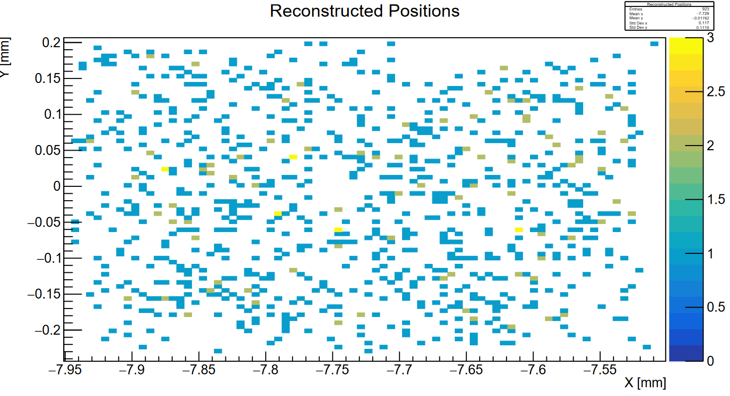
W7 450 um – Template Method
Positions were also reconstructed using the “template method”.
The hit position is extracted starting from the amplitudes read out by the four electrodes, using the template computed with the test beam data @DESY (see Nicolò’s talk)
The template was computed using the same sensor type, but different sensor die, n+ resistivity, and electronics
The template works well!
No position distortion pattern is visible
Luca Menzio – INFN Toino

Slide 21
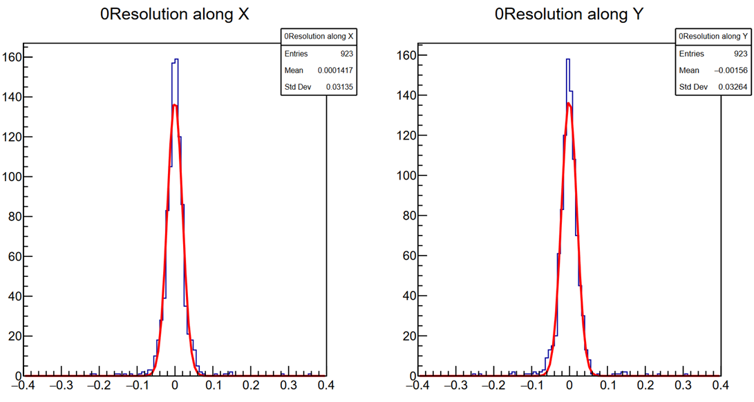
W7 450 um – Template Method
Secondly, positions were reconstructed thanks to a template method.
About 20 µm on each axis with the template reconstruction (19.5 µm) – 4% of the pitch
The reconstruction with the template computed in a different experimental setup is viable
# Entries
# Entries
Luca Menzio – INFN Toino
x_trk – x_rsd [mm]
y_trk – y_rsd [mm]

Slide 22
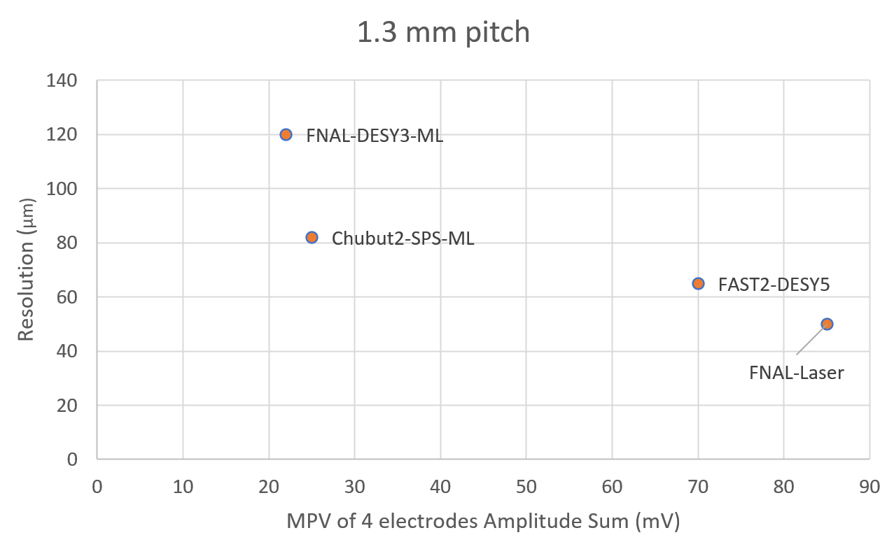
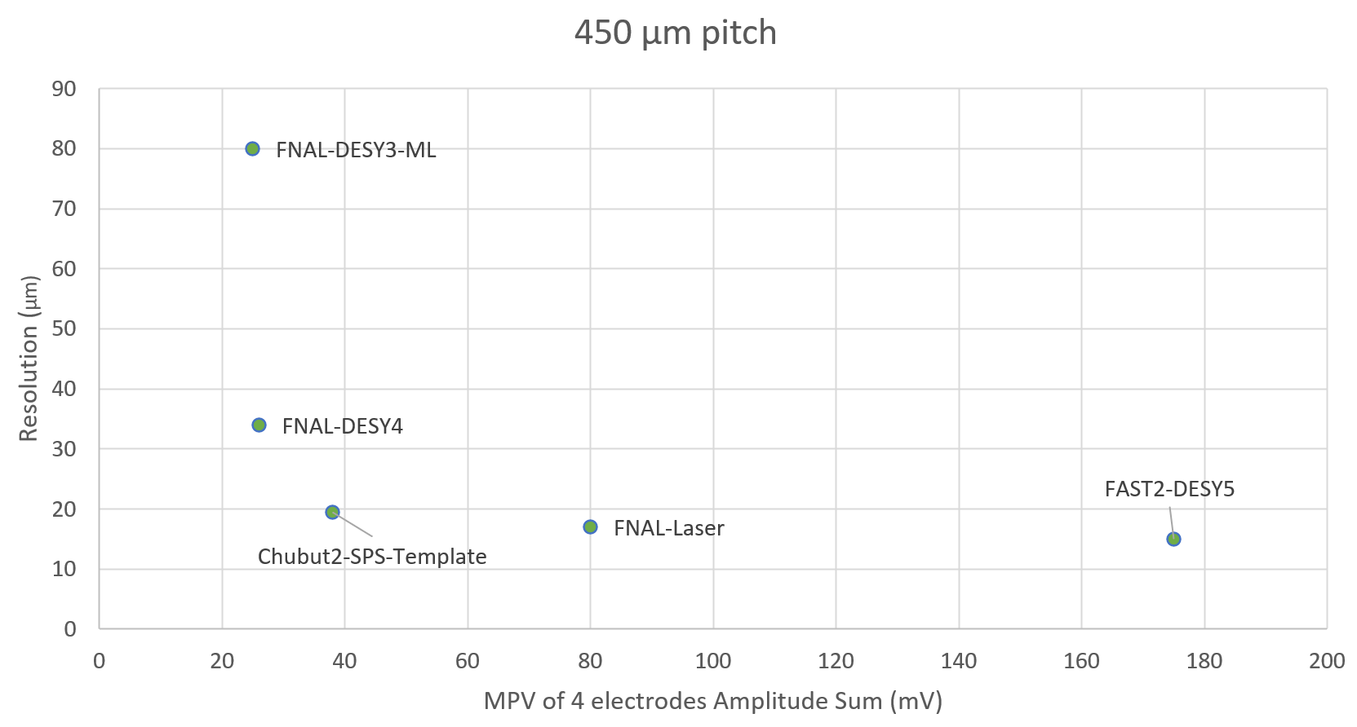
Comparison with other test beams
Comparing with the best results achieved in other test beams
Luca Menzio – INFN Toino
Suffering from low signals and low statistics.
It would benefit from a dedicated template/Machine Learning training dataset
Performance is very good thanks to the template model created on another test beam facility and on another electronics!
Good results with low signals
Very good results with low signals

Slide 23
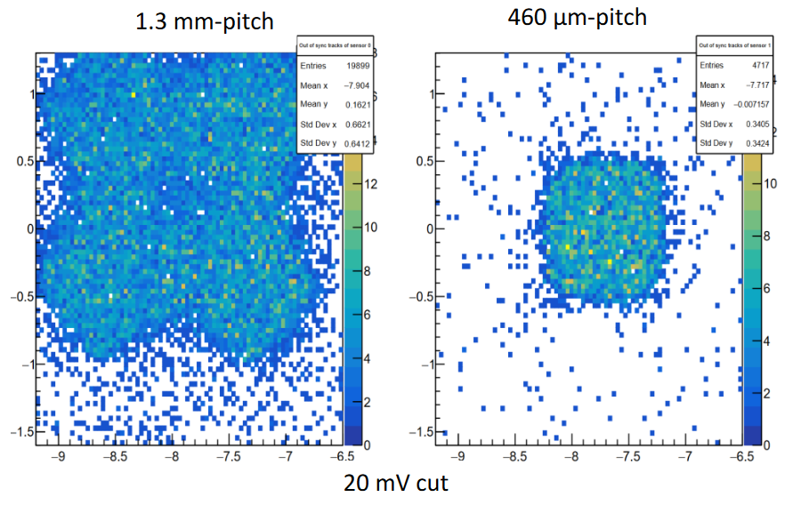
Efficiency
We defined a hit on a sensor as the combination of three conditions
time: the RSD hit timestamp must be compatible with the tracks in the tracker
amplitude: sum of the four signals amplitudes must be above a certain threshold (~3x sigma noise)
track: there is a reconstructed track pointing inside the sensor area
But some tracks are reconstructed in the wrong positions!
1.3 x 1.3 mm²
450 x 450 µm²
Luca Menzio – INFN Toino
The silicon physically ends here

Slide 24
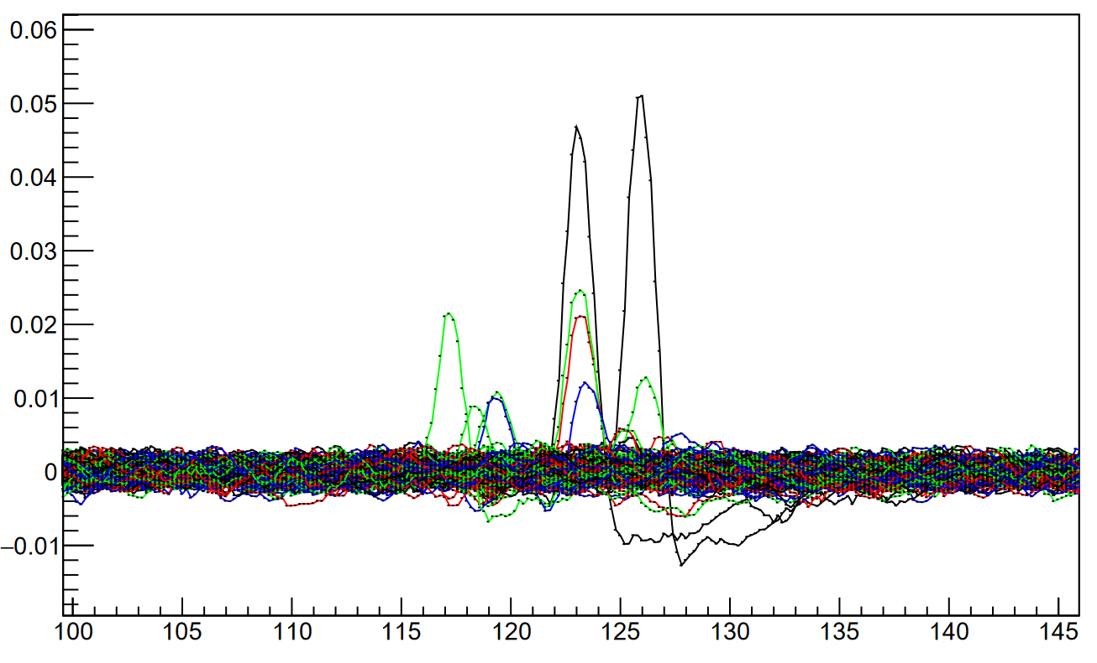
Efficiency
1.3 x 1.3 mm²
450 x 450 µm²
Luca Menzio – INFN Toino

Slide 25
Efficiency
Because of the tracks small mis-reconstruction, one has to use the signals on one of the two sensors to infer the efficiency of the other
→ only the efficiency of the smaller sensor can be computed
$${Eff}_{450μm}=\frac{\#tracks(hit_{450μm}∧ hit_{1.3mm})}{\#tracks\left(track_{450μm} ∧ hit_{1.3mm}\right)}$$
Luca Menzio – INFN Toino

Slide 26
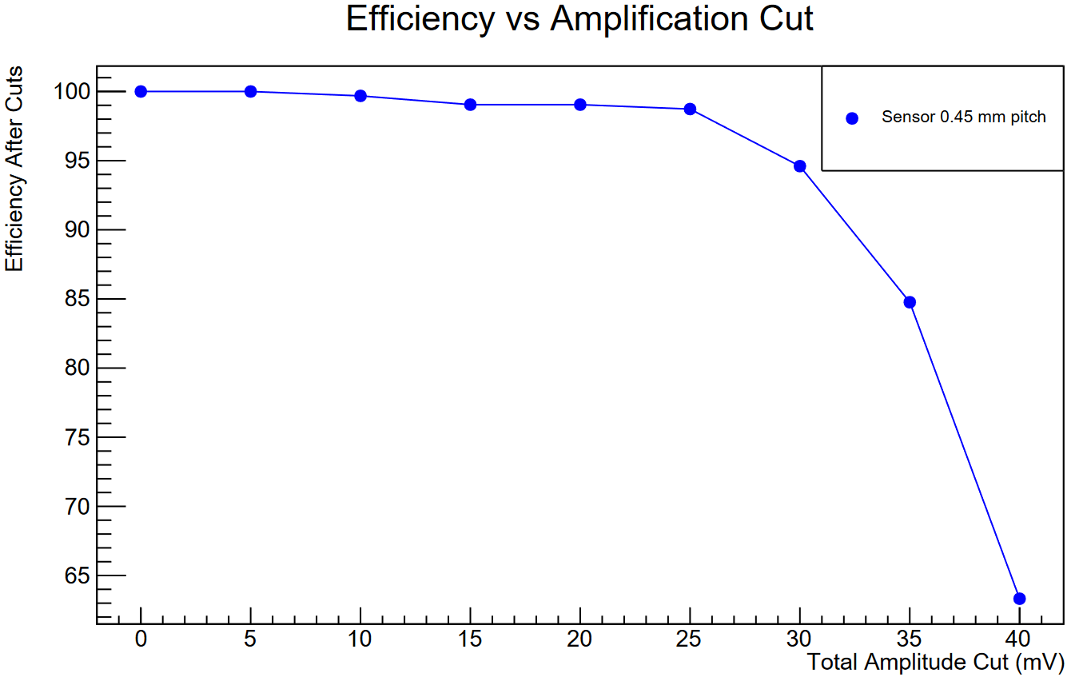
Efficiency
Because of the tracks small mis-reconstruction, one has to use the signals on one of the two sensors to infer the efficiency of the other
→ only the efficiency of the smaller sensor can be computed (completely inside the bigger one)
$${Eff}_{450μm}=\frac{\#tracks(hit_{450μm}∧ hit_{1.3mm})}{\#tracks\left(track_{450μm} ∧ hit_{1.3mm}\right)}$$
Luca Menzio – INFN Toino
Values of efficiency typical of silicon are maintained, > 99%
Threshold employed in this work

Slide 27
Conclusions
The performance of two RSD2 sensors, 1.3mm pitch and 450 μm pitch, were measured during the second AIDAinnova 2023 test beam at SPS.
The devices were bonded to a novel low-noise and open-source electronics: the Chubut2 board
The best spatial resolutions achieved are:
$σ_{1.3 mm}\sim$ 81 $μ$m employing a Machine Learning approach (6% of the pitch)
$σ_{450 μm}\sim$19.5 $μ$m with the template method (4.3% of the pitch)
Both designs achieve significantly better results than those of standard pixel detectors (15-30%) with a low number of channels.
The detection efficiency of a 450 μm pitch RSD2 was evaluated to be >99%
Luca Menzio – INFN Toino

Slide 28
AIDAinnova WP6 Test Beam group
CNM-Barcelona (AIDAinnova): Oscar David Ferrer Naval
IFCA (AIDAinnova + ETL): Ivan Vila Alvarez, Andres Molina
Ribagorda, Jordi Duarte Campderros, Efren Navarrete Ramos,
Marcos Fernandez Garcia, Ruben Lopez Ruiz
IJS (AIDAinnova): Gregor Kramberger, Jernej Debevc
The UFSD group (University of Torino / INFN): Roberta Arcidiacono, Nicolò Cartiglia, Marco Ferrero, Leonardo Lanteri, Luca Menzio, Roberto Mulargia, Federico Siviero, Valentina Sola
INFN Genova: Claudia Gemme
UZH (AIDAinnova): Anna Macchiolo, Matias Senger
Korea: D. Lee, W. Jun, T. Kim
CERN: A. Rummler, V. Gkougkousis
Luca Menzio – INFN Toino

Slide 29
Acknoledgements
We kindly acknowledge the following funding agencies and collaborations
This project has received funding from the European Union’s Horizon 2020 Research and Innovation programme under Grant Agreement No 101004761
INFN - Gruppo V, UFSD and RSD projects
INFN – FBK agreement on sensor production (convenzione INFN-FBK)
Horizon 2020, grant UFSD66952
Dipartimenti di Eccellenza, Univ. of Torino (ex L. 232/2016, art. 1, cc. 314, 337)
Ministero della Ricerca, Italia , PRIN 2017, progetto 2017L2XKTJ – 4DinSiDe
Ministero della Ricerca, Italia, FARE, R165xr8frt_fare
Luca Menzio – INFN Toino

Slide 30
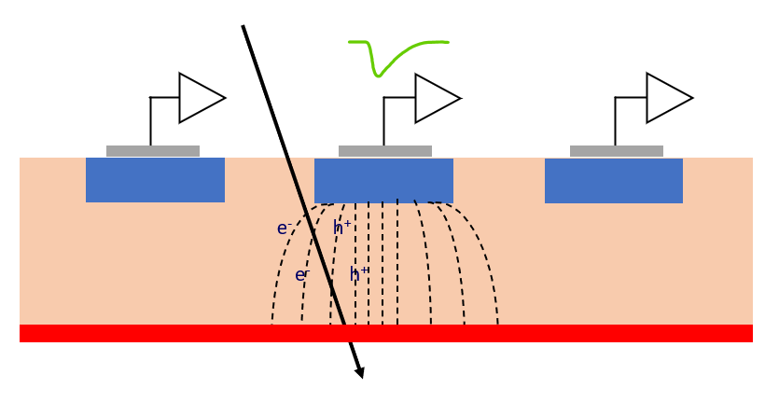
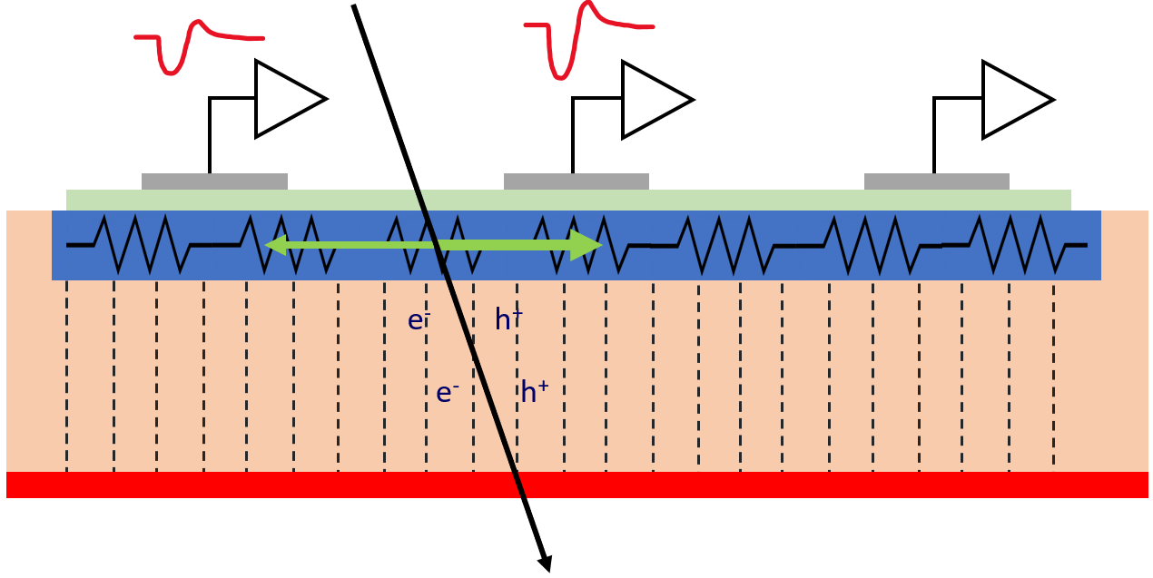
Resistive Read-out
Luca Menzio – INFN Toino
In resistive read-out, instead of many p-n diodes, there is a single diode.
The n-doped implant is resistive and acts as a signal divider
Very uniform electric and weighing fields, perfect geometry for timing
21st February 2024
TREDI 2024

Slide 31
Runs
Two test beam performed: June and August
Practically, only August has good runs (Mimosa problems, not much time for RSDs runs)
4 sensors:
- W13 1.3 mm-pitch
- 2x W7 450 um-pitch
- W3 450 um (low bias due to high current)
2-3 bias points per sensor
Given the nature of the readout board, 4 electrodes were read.
The analysis is restricted to one pixel of the matrix
41 | Data run, EVERYTHING LOOKS GOOD 🎉 🍻 🥳 | 87470
42 | Data run, EVERYTHING LOOKS GOOD 🎉 🍻 🥳 | 273174
43 | Data run, EVERYTHING LOOKS GOOD 🎉 🍻 🥳 | 27989
44 | Data run, EVERYTHING LOOKS GOOD 🎉 🍻 🥳 CAENGECO2020.log | 127551
50 | Data run, EVERYTHING LOOKS GOOD 🎉 🍻 🥳
51 | 🎉 🍻 🥳 | 409414
52 | 🎉 🍻 🥳 | 39820
With trigger signals
But corrupted 6th mimosa plane

Slide 32
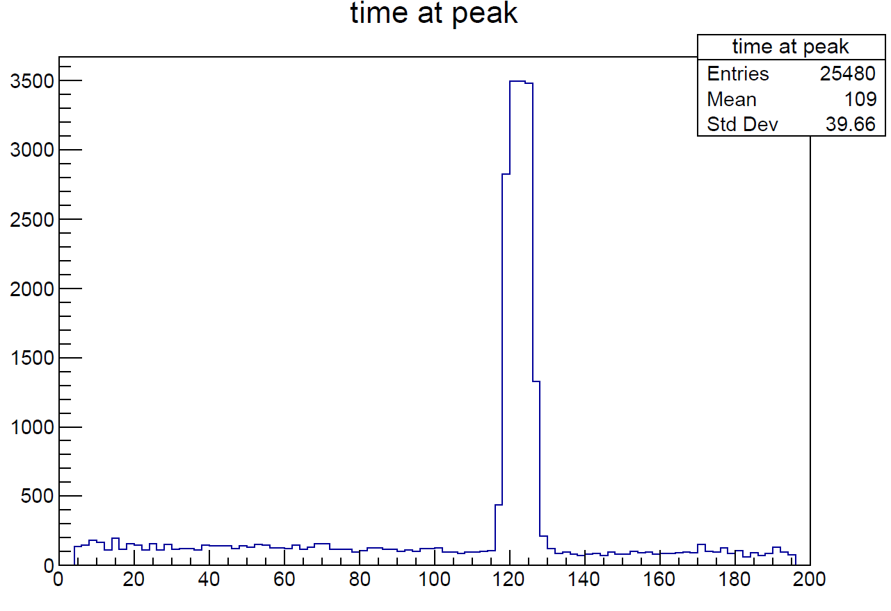
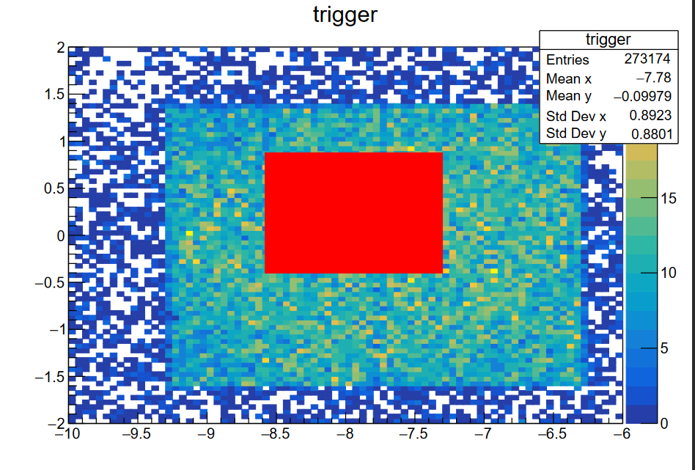
Cuts
1) Tracks within time window
2) Tracks inside the pixel

Slide 33
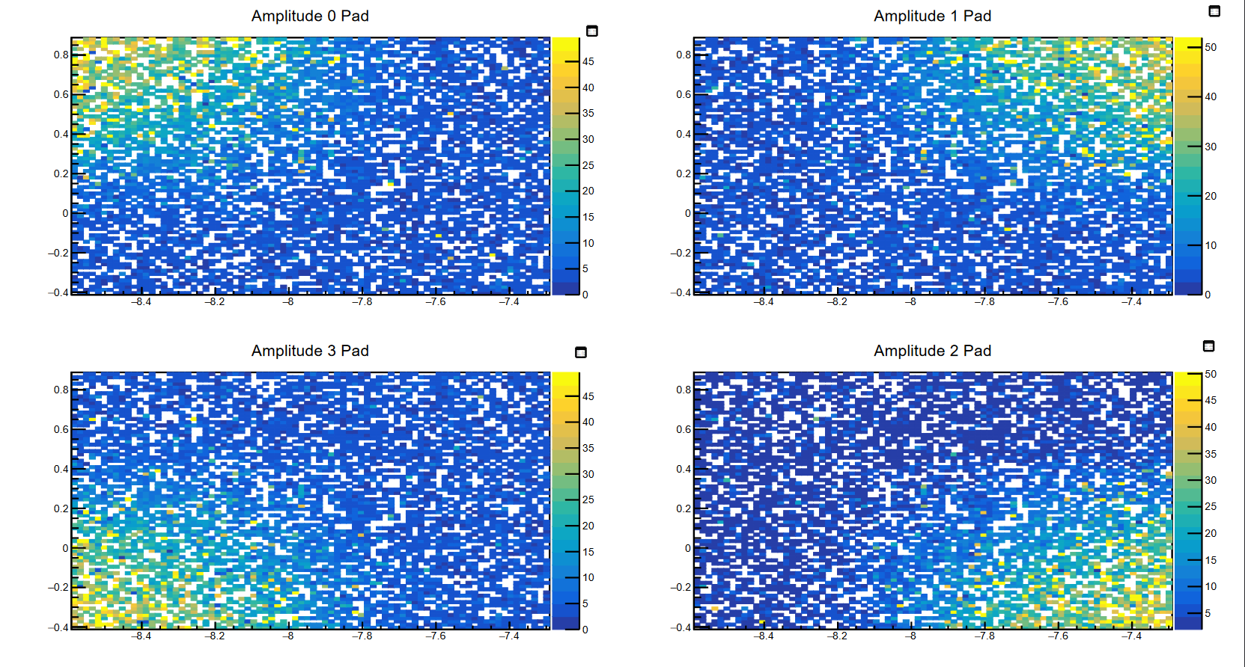
First sensor - W13 1.3mm
Quite small MPV for the amplitude (as expected) 30 mV
Very low noise <1 mV
S/N for the single pad is good

Slide 34
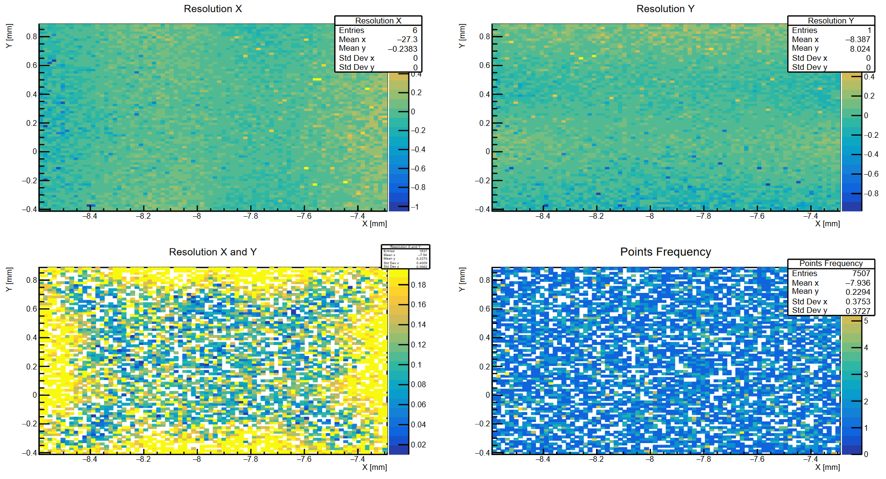
W13 1.3mm
Not very uniform, would benefit from some sort of correction (migration matrix/template/ML)

Slide 35
Taking a look at the data
W13 1.3 mm has smaller signals
Although not ideal, it can be used for the reconstruction (rotated by 2.5 degrees)
The data from the first 450 um W7 is good (rotated by 1.7 degrees)
High-enough signals and
Another data acquisition was performed in DESY with a similar sensor
The second 450 um W7 has really small signals, even if the bias is almost the same as the first sensor
The fourth sensor (450 um W3) had issues and its signals are very low cannot be used for reconstruction
Taken into consideration in this work
Luca Menzio – INFN Toino

Slide 36
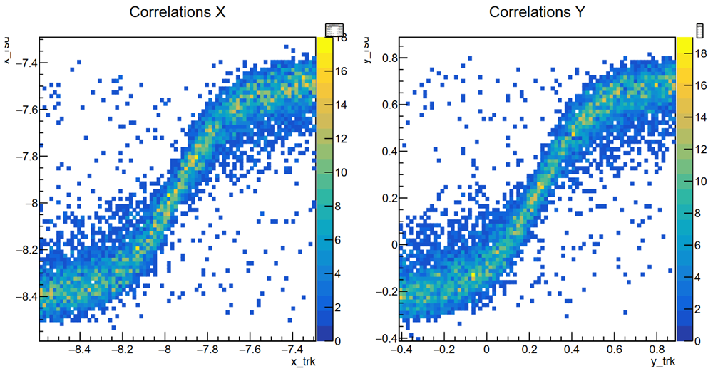
W13 1.3 mm – Position Reconstruction
Reconstruction with charge imbalance

Slide 37
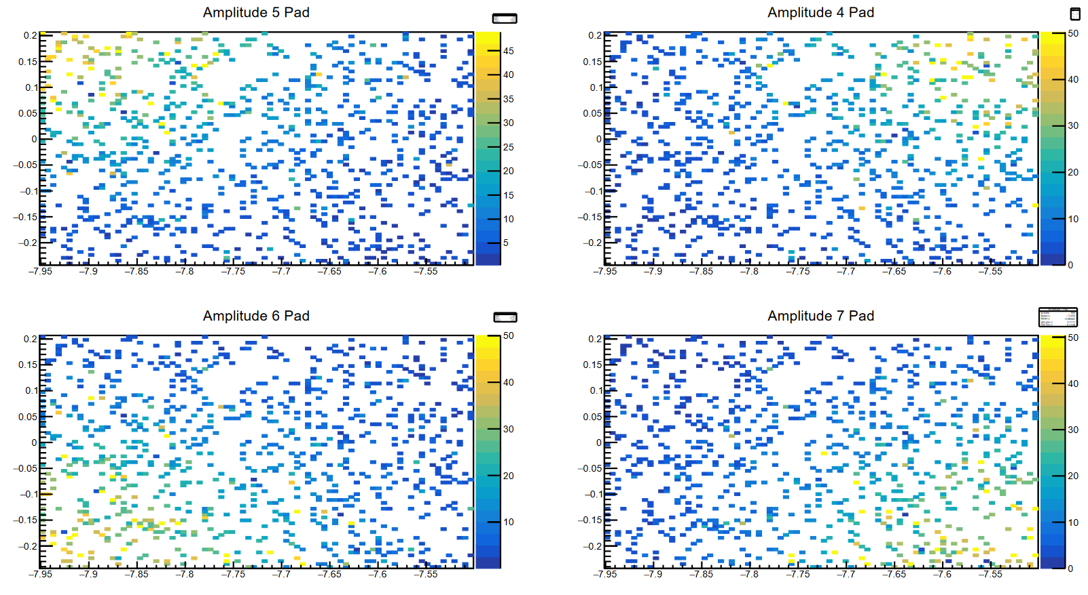
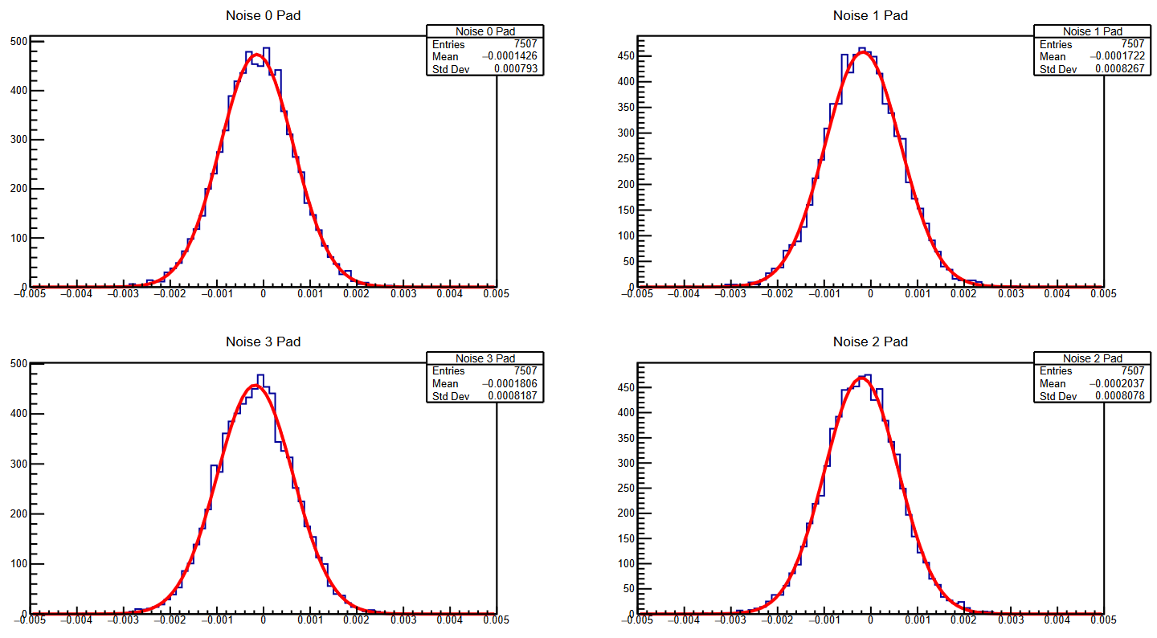
W7 450 um
Same as before, slightly better S/N

Slide 38
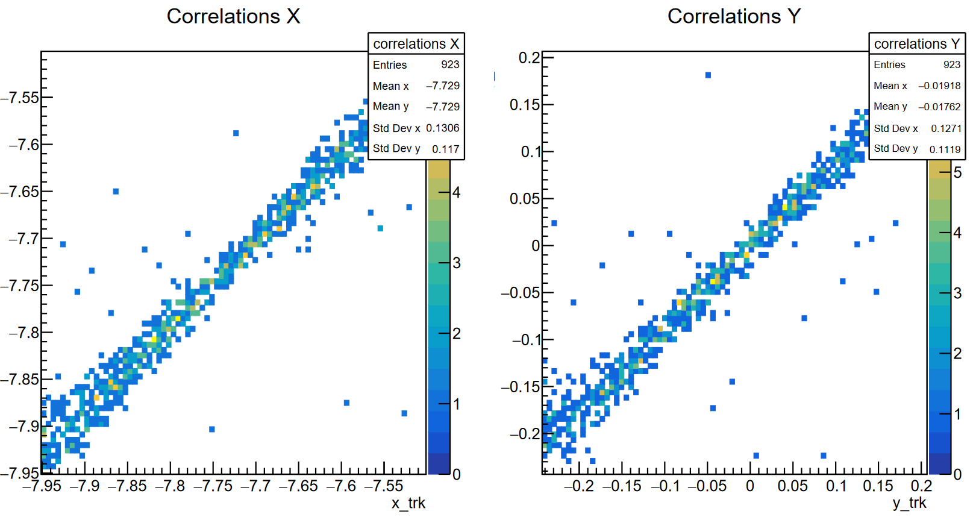
W7 450 um
Secondly, positions were reconstructed thanks to the information gathered at another test beam in DESY with a similar sensor. SPS positions are extracted by comparing the pads amplitudes with the ones registered in the DESY data (template)

Slide 39
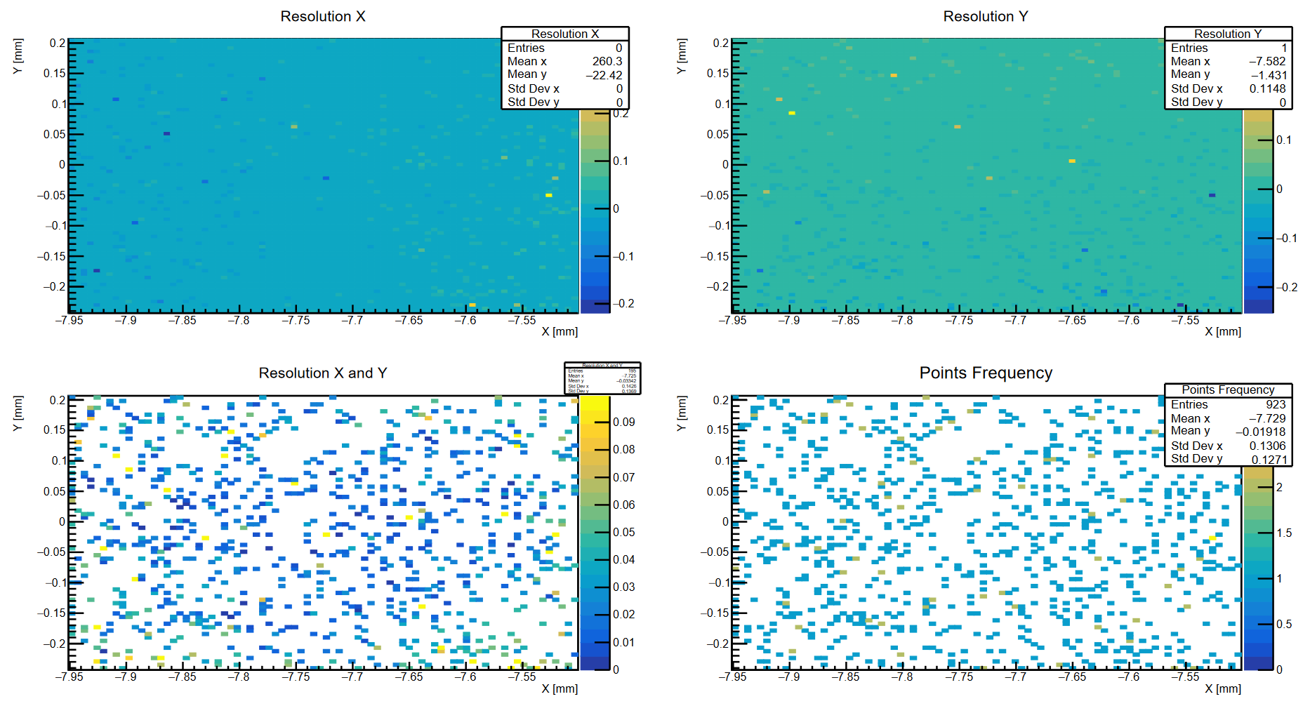
W7 450 um – first plane
Resolution is uniform over the whole pixel

Slide 40
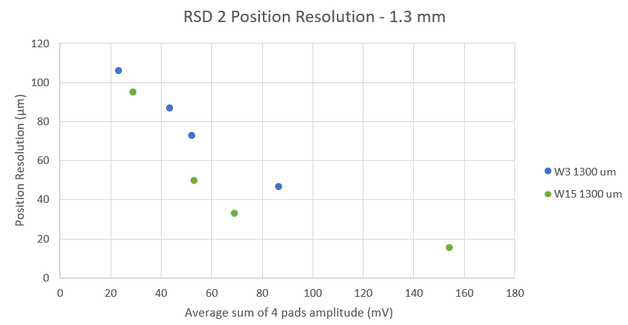
Comparison with TCT – 1.3 mm
TCT data was corrected, but the results are still comparable
For sake of completeness, the S/N ratio is different and this point should be further on the right. A correction is needed
This analysis

Slide 41
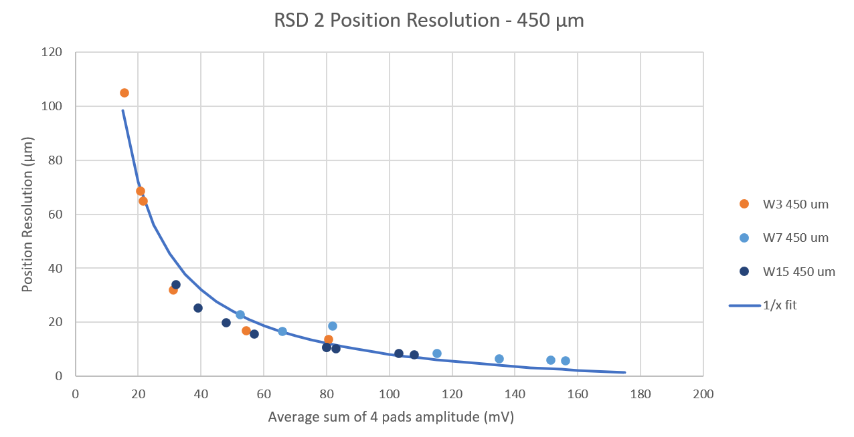
Comparison with TCT – 450 um
TCT data was corrected, but the results are still comparable
The difference is more visible in this plot
This analysis

Slide 42
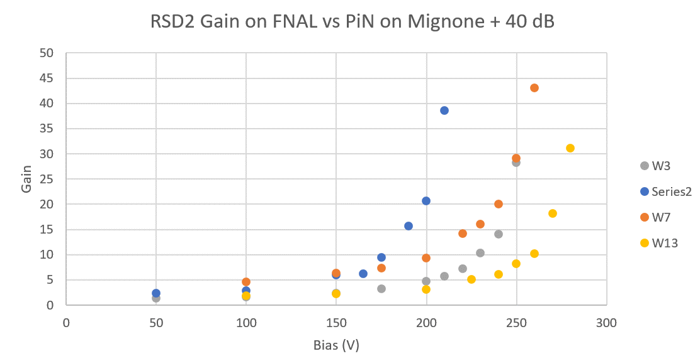
RSD2 Gain
UFSD4

