Slide 1


Mu2e News
Stefano Miscetti
LNF INFN, Italy
18 Dec 2023
Mu2e Italy Meeting

Slide 2
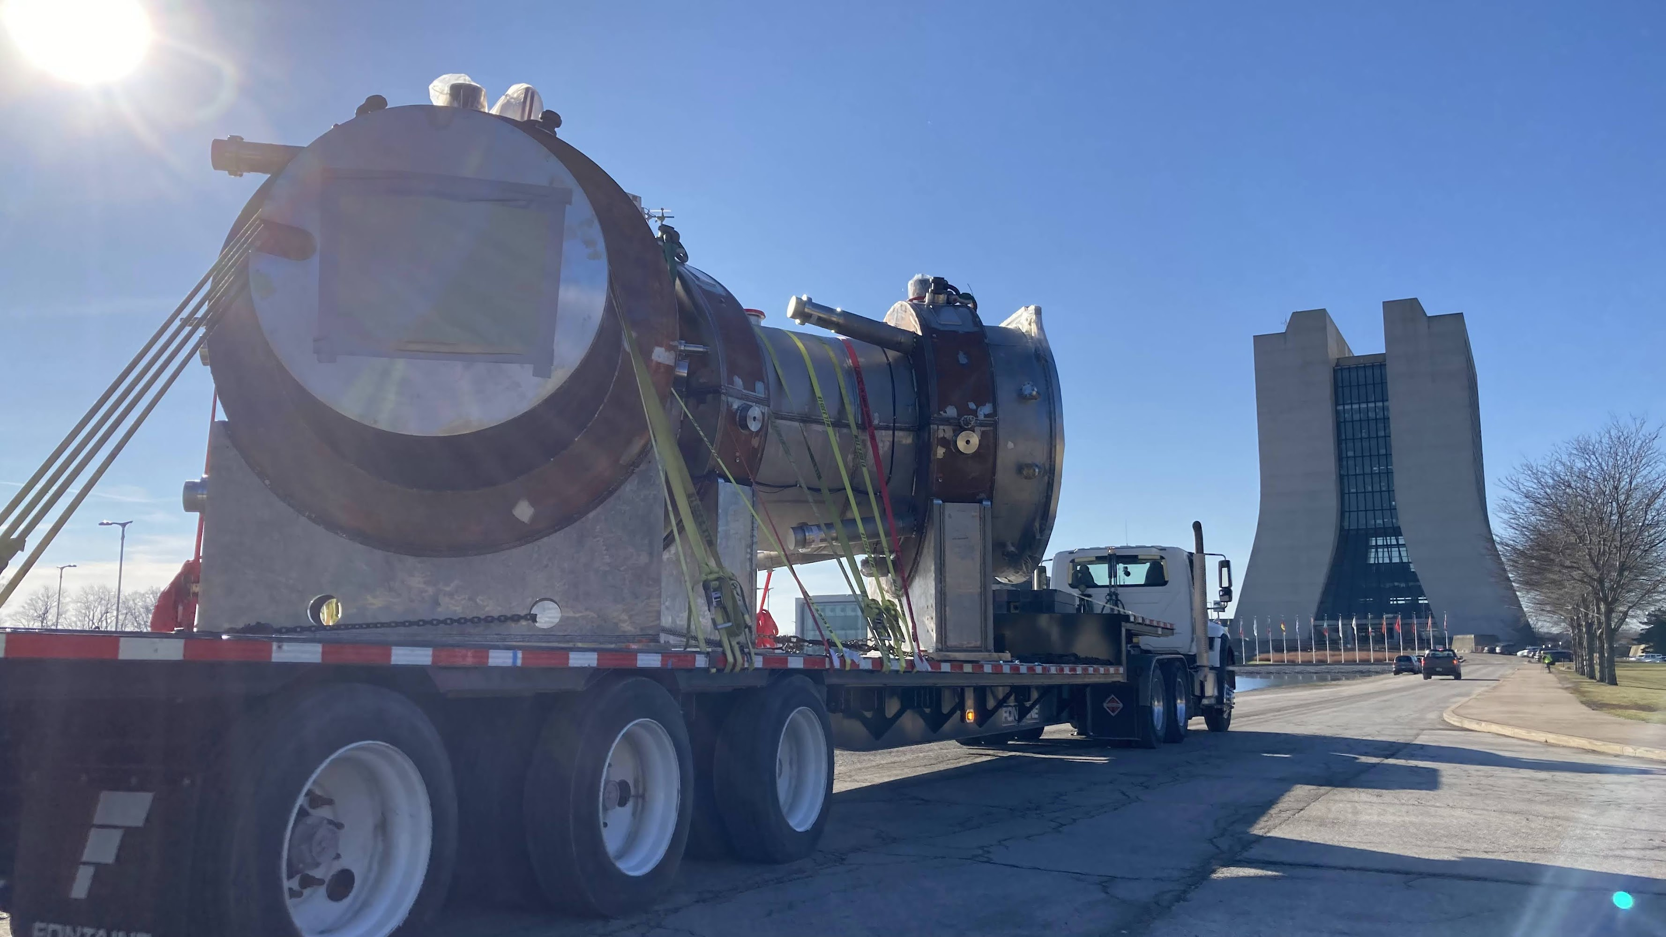
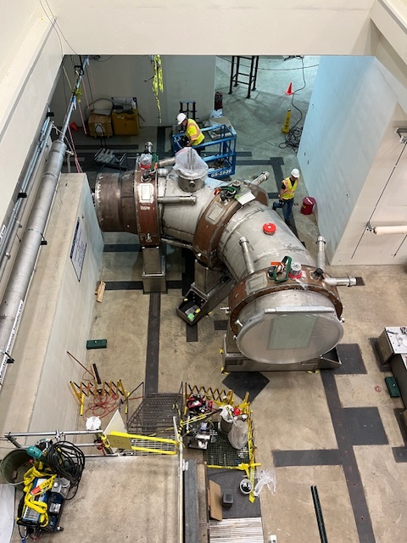
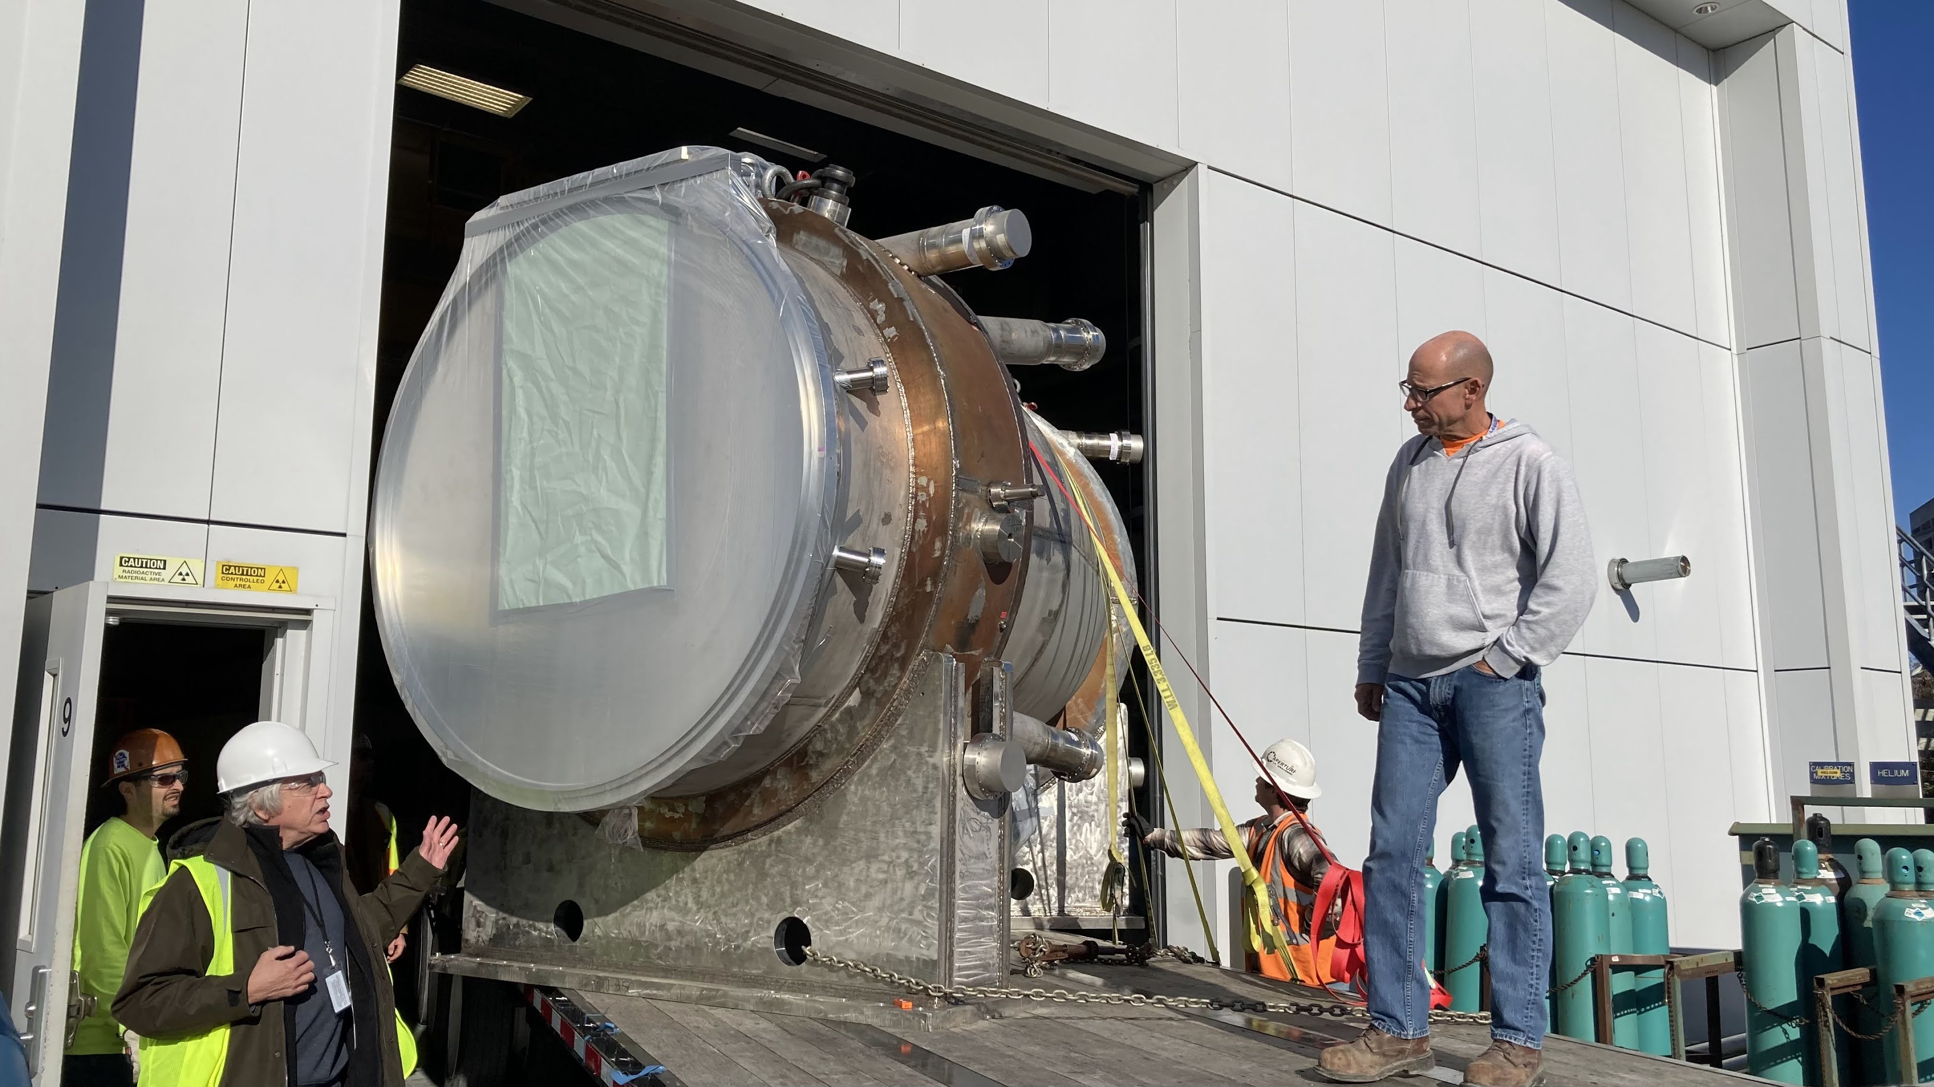
TS Move: TSU in the PIT – TSD in January
the project for solenoids is becoming reality: TSU Dec-7 2023

Slide 3
PS and DS
TSD expected to move in January. Again preparation of movement, wait for
best weather conditions. Preparation of pit adjustments. In the meanwhile
connection of criogenics for TSU. Here it is a A+.
→ Discussion about powering and cooling in advance of schedule is being
considered but not yet planned due to opportunities considerations
PS almost completed. Final touch in progress. Transportation under planning.
Big deal here is the installation in the pit. Plan is “entering from the PS hatch”.
Preparation of external crane in progress → It is a B
SPRING 2024.
DS coils have been completed. So no problems for the Superconducting cable.
→ Schedule here is a problem.
→ GA schedule still aggressive but Solenoid team does not believe it.
Project Schedule being corrected assuming a delay of O(1 Q)
This looks like a D-F score
→ See effect on next page

Slide 4
New schedule for PAC – Jan 8-12
Beginning of January, two presentations at PAC
→ Program Coordination – B.Casey: Mu2e status
→ Co-Spokes - B. Bernstein – impact of beam delivery on Mu2e
- We overlap now with Long Shutdown
- Also PIP-2 looks to be on the same path
- The directorate will discuss this with us and all experiments

Slide 5
P5 is on our side
- Lab Schedule does not take into account six month loss from Accident
at PIP-2 construction site
- We expect schedule will change→ pressing for 10% data in Run-1
- Best argument is success: Spring 2025 CR run in the pit
This is going to be the Collaboration Effort for 2024-2025

Slide 6
ORG-chart news
- Weekly meeting of EEC started
- Working now on organizing and populating lower side of the ORG-chart

Slide 7
Starting from Operation …
We expect Detector Ops Managers to cover 3 primary aspects:
  Online software
    This topic effectively includes run control, DCS, DQM, performance metrics, …
    We may end up organizing specific groups across subsystems to address these
  Hardware
    This is presently handled within Project, but in the next ~year will transition to Ops
    So probably Ops Managers should be 100% at Fermilab by this time
  Planning / reviews
    This is the essential function that the Ops Planning Team has been doing
    This makes it so the person responsible to deliver the work has made the plan
We want to have an Ops Manager for each subsystem
  Detectors seem clear-cut (DAQ, Trk, Calo, CRV, STM, Extinction Monitor)
  Solenoids, Accelerator, Data Processing & Computing might be a little different
If you are interested to be Subsystem Ops Manager, please discuss with your subsystem Project L2

Slide 8
OPS coordination focus: Spring 2024
Mu2e Ops Coordination focus in 2024 is on data collection
  Outfit test stand in Edwards Center (IERC)
  Organize a series of “Global Runs”
    Global run = run with more than one subsystem
    Local run = run with a single subsystem (VST is simplest version of local run)
Proposed schedule for Global Runs
  We would think each of the following would last ~one ~week (T-Th?)
  Mar 2024 : Global Run #1
  Jun 2024 : Global Run #2
  Sep 2024 : Global Run #3
  Dec 2024 : Global Run #4
  Mar 2025 : Project KPP Global Run
  After the Project KPP, Global runs will continue in some form or other leading up to beam
  Note: as far as this program is concerned, Project KPP is a by-product
Personal note: for Calorimeter and tracker expect also a so coldo
“Multi-Run” → Multiple boards (1 station or ½ disk) Apr-Jun 2024

