Slide 1
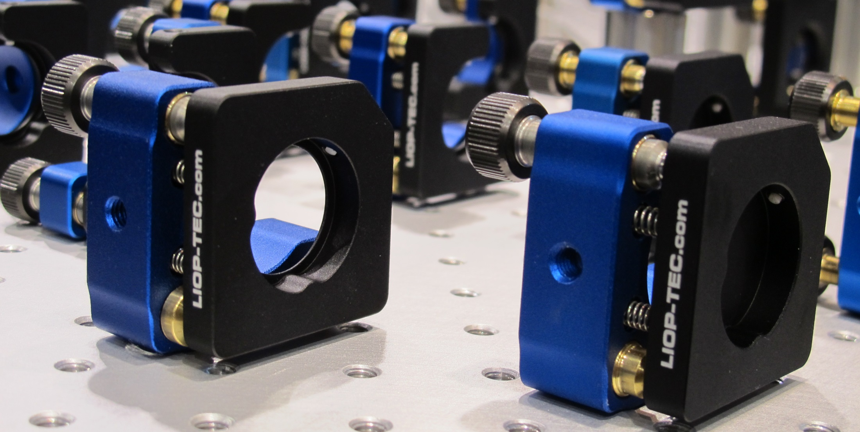

Slide 2
Dittá tedesca, sede a Radevormwald, vicino Colonia
Laser a dye ns
Passo delle viti 0,15mm (170 TPI)
mounts standard da ½“, 1“, 1.5“, 2“…etc
Custom made portaspecchi (piccoli e grandi)
grandi vuol dire 1m x 0,8m

Slide 3
0,15mm (170 TPI) standard pitch
Standard mounts
Custom made
Vacuum compatible
Ultra high vacuum
Custom made fine thread screws
Colour concept

Slide 4
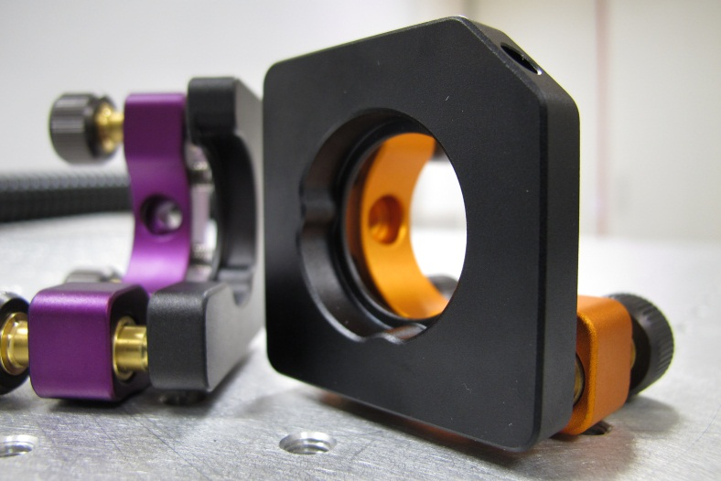
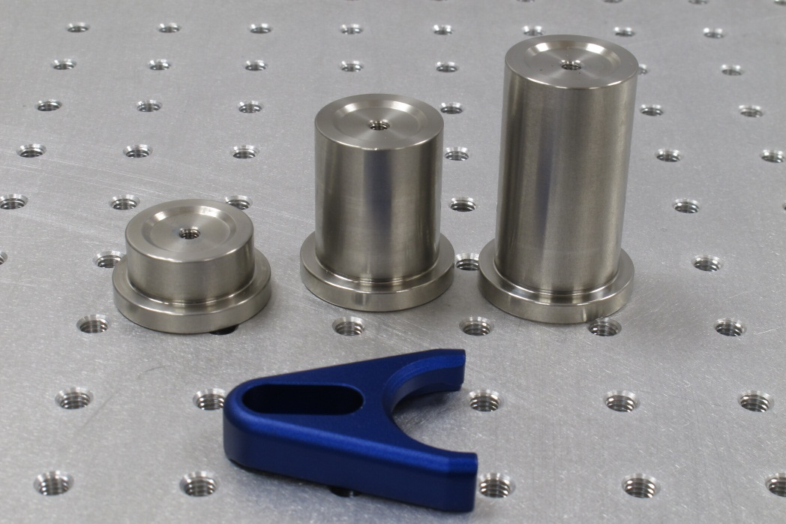
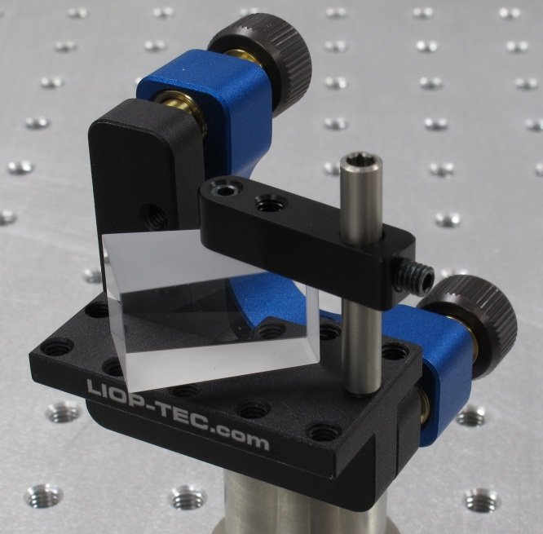
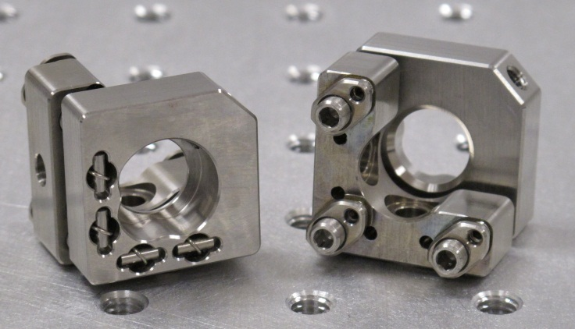
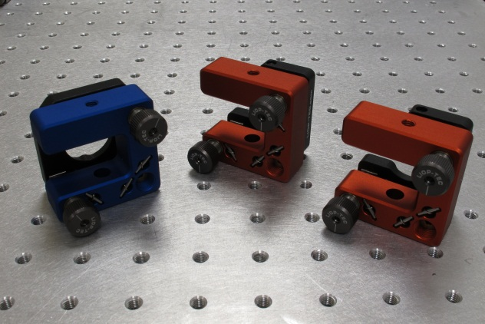

Slide 5
Pulsed ns dye lasers

Slide 6
