Slide 1
ATLAS Phase 2 RPC BI Gas distribution System

Slide 2
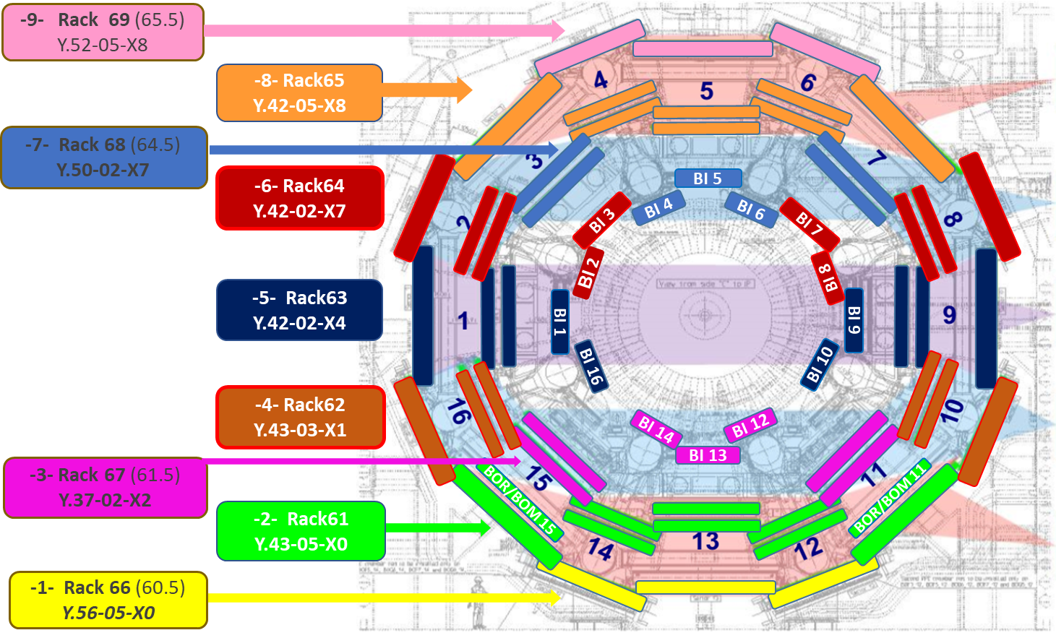
Present Gas System and its extension
In the present system 9 independent distribution level are served by 9 Racks. All the Rack are connected to the same closed-loop recirculation system flushing the same gas mixture. For the legacy system 128 Input + 128 Output stainless steel manifolds are installed in the barrel and connected to the Racks through copper pipes
For the future BI chambers 5 Racks already used for the legacy system flushed with the same gas mixture are already equipped with the extra- channels needed. The manifolds inside the barrel and the copper pipes through the Racks are yet to be installed

Slide 3
BI RPC Gas system distribution
1 Input + 1 Output stainless steel manifolds per 3 chamber layers per Sector per Side → 2 Input manifolds+ 2 Output manifolds → 32 Input Manifolds+32 Output Manifolds →Total 32 + 4* Gas channels of 1 Input + 1 Output each
1 Flow sensors + 1 Output Check valve per chamber
1 Input impedance per gas volume → 3 per chamber
1 Pressure Sensor per manifold → Total 72 (36 Input + 36 Out)
Z=0
Distr. box
Distr. box
Distr. box
Distr. box
Distr. box
Distr. box
Check Valve
Flow Sensor
F
F
F
F
F
F
F
F
F
F
F
F
side C
Side A
Gas Input Impedances
Distr. box
Distr. box
Distr. box
Distr. box
Distr. box
Distr. box
Z=0
* Additional 4 channels needed for BOR/BOM in sector 11 and 15

Slide 4
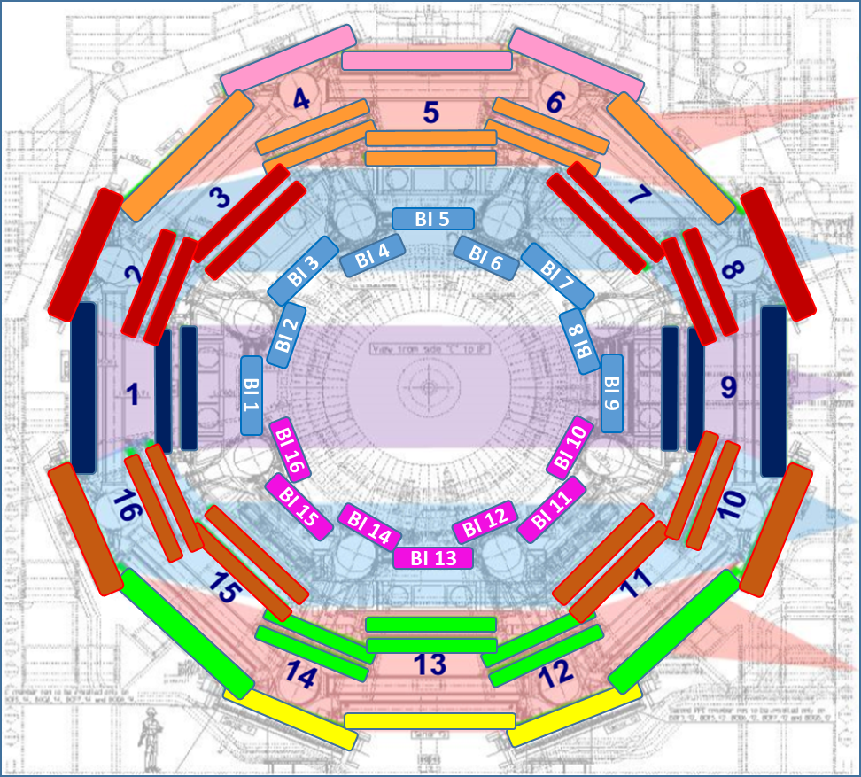
Rack Connections
Same gas mixture
Two different gas mixture
As feasibility study only:
Not before the END of the LS3
New BI gas recirculation system
Present closed loop gas system
Legacy closed loop gas system
-7- Rack 68 (64.5)
Y.50-02-X7
6 channels BI sect 4,5,6
-7- Rack 68 (64.5)
Y.50-02-X7
18 channels BI sector 1,2,3,4,5,6,7,8,9
8 Channels BML 3,7 removed
-6- Rack64
Y.42-02-X7
8 channels BI sect 2,3,7,8
-6- Rack64
Y.42-02-X7
8 channels BML 3,7
-5- Rack63
Y.42-02-X4
8 channels BI sect 1,9,10,16
-5- Rack63
Y.42-02-X4
untouched
-2- Rack61
Y.43-05-X0
8 channels BI sect 11,15
-4- Rack62
Y.43-03-X1
8 channels BML 11,15
-3- Rack 67 (61.5)
Y.37-02-X2
6 channels BI sect 12,13,14
-3- Rack 67 (61.5)
Y.37-02-X2
14 channels BI sect 10,11,12,13,14,15,16
8 Channels BML 11,15 removed

Slide 5
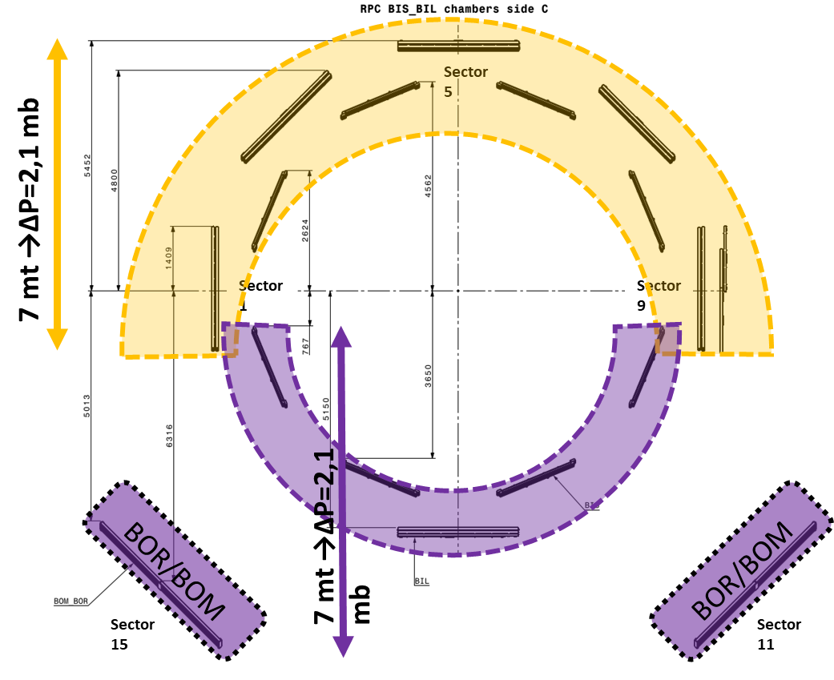
BI RPCs chambers pressure
Gas mixture hydrostatic Column ~ 0,3mbar/m
Max vertical distance from IP to top of RPC chambers
( Taking into account inclination of beam line by 0.708 degree)
Height from the cavern floor to the IP point is 11370 mm
courtesy of Tatiana Klioutchnikova
Estimated maximum chamber pressure=2.1mb¹+0.3mb²+0.3mb³+0.1mb⁴+0.3mb⁵=3,1mb
¹ hydrostatic pressure; ² manifolds ∆P; ³ flow sensor ∆P; ⁴ plastic pipe connection ∆P; ⁵ Offset

Slide 6
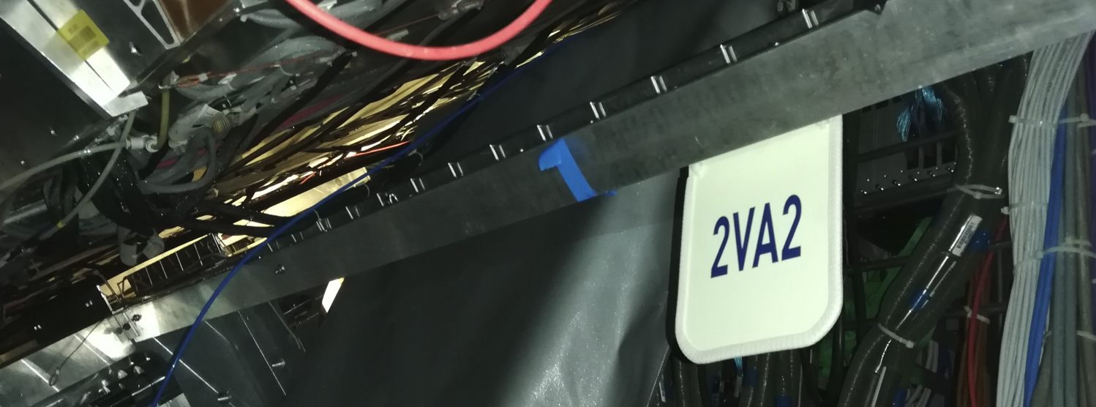
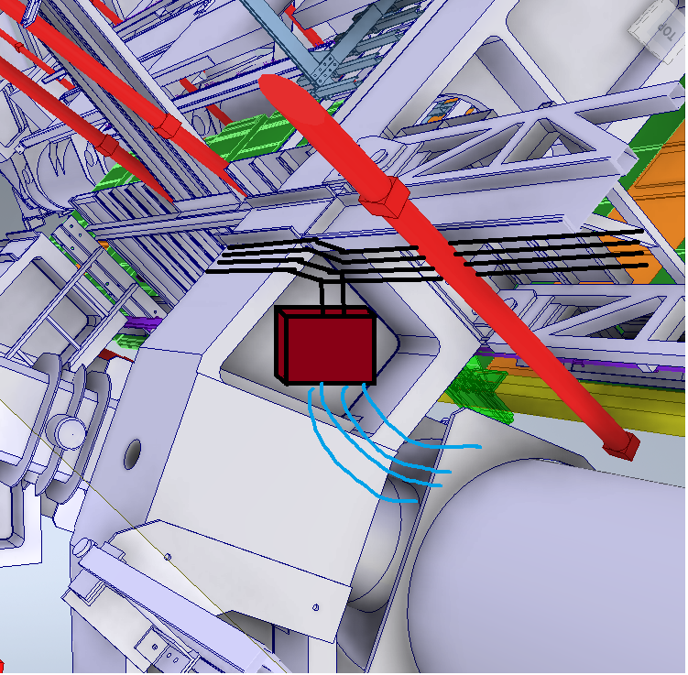
Gas Manifolds study for Sector 3 side A
4 manifolds
Z0
4 manifolds
distribution
Sector 3 – manifolds on side of existing cable tray
the safer routing path from the manifolds towards the chambers is along the Voussoir (vertical yellow pipe)
in each side of the Voussoir will be installed a distribution point “BOX” that will serve 2 to 4 chamber.
for the connections from manifolds to BOXES plastic pipe it will be allowed (easy to bent) but the connections must be guaranteed absolutely leak-proof. Possible solution: Tygon 3606 plus metal spiral protection
courtesy of Tatiana Klioutchnikova and Aydin Ozbey

Slide 7
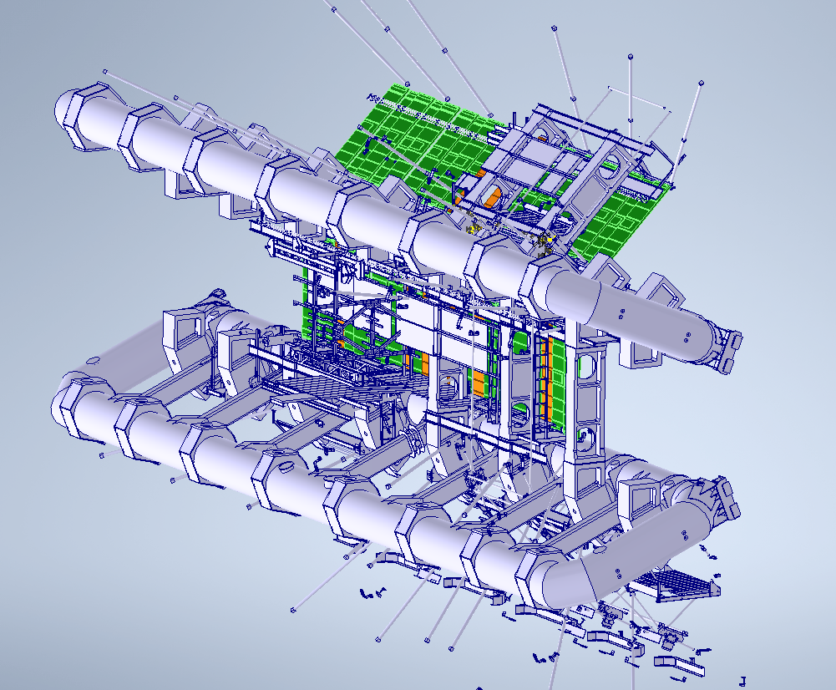
Sector 2 (Side A) has been chosen for the pilot application
Application point

Slide 8
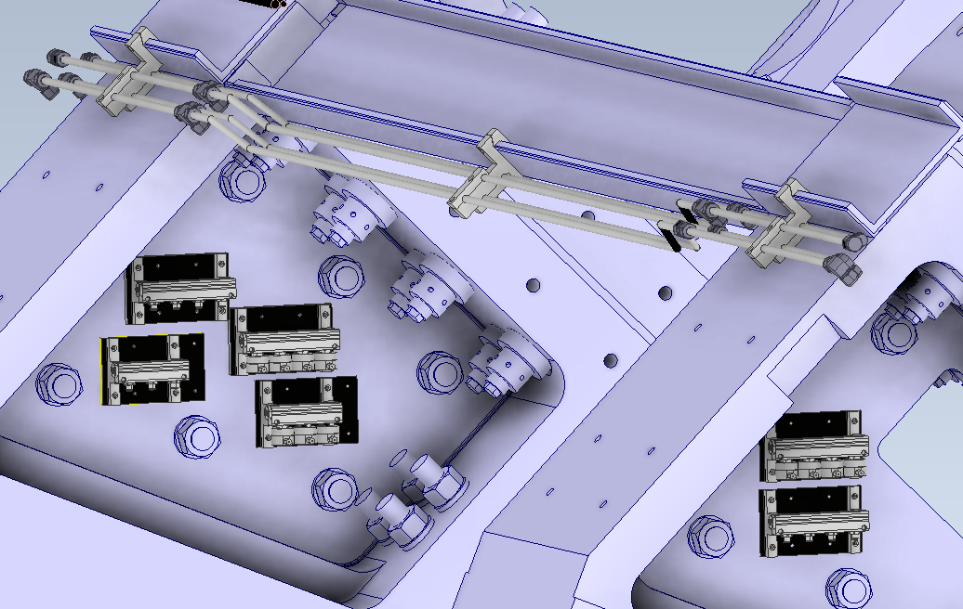
To Z0
First Voussoir (Outer Side)
1: BIS 1-4 Sector 2 (4 Ports Gas Input)
2: BIS 1-4 Sector 2 (4 Ports Gas Return)
3: BIL 4-6 Sector 3 (3 Ports Gas Input)
4: BIL 4-6 Sector 1 (3 Ports Gas Return)
Second Voussoir (Outer Side)
5: BIL 7-10 Sector 1 (4 Ports Gas Return)
6: BIL 7-10 Sector 3 (4 Ports Gas Input)
1
2
5
3
4
6

Slide 9
To Z0
First Voussoir (Outer Side)
1: BIS 1-4 Sector 2 (4 Ports Gas Input)
2: BIS 1-4 Sector 2 (4 Ports Gas Return)
3: BIL 4-6 Sector 3 (3 Ports Gas Input)
4: BIL 4-6 Sector 1 (3 Ports Gas Return)
Second Voussoir (Outer Side)
5: BIL 7-10 Sector 1 (4 Ports Gas Return)
6: BIL 7-10 Sector 3 (4 Ports Gas Input)
1
2
5
3
4
6

Slide 10
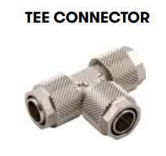
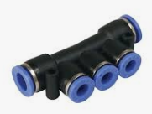
3
Chamber
Input
8
BIL Distribution Input Box
2
1
5
8
6
BIL Distribution Output Box
BIS Distribution
Box
BIL3 sect 3
a
c
1
2
3
1
2
3
d
5
Chamber
Output
b
Multiple Tee
Quick Connector
5
7
b
a
The parts in the dashed areas are in between the Chamber and Box, in a reachable location
Chamber
Output
8
7
Ly0 = Black
Ly1 = Green
Ly2 = Blue
a
8
BIS3 sect 2
Box→ Chamber: PUN-H
Out OD 6mm Natural, In OD 4 mm Silver
Chamber’s Input: PUN-H
OD 4mm Black=Ly0, Green=Ly1, Blue=Ly2
Chamber’s Output: PUN-H
OD 6mm Black=Ly0, Green=Ly1, Blue=Ly2
Chamber’s Inlets: PUN-H
OD 4mm Black=Ly0, Green=Ly1, Blue=Ly2
5
Tee fitting* 4mm
Multiple Tee 6 mm
Multiple Tee 4 mm
Impedances**: PUN-H OD 4mm length=100 mm
*Those Tee could be placed indifferently inside the chamber’s frame or not, not yet decided
** a needle is mounted inside the pipe to set the proper flow
6
a
a
b
7
c
BIL3 sect 1
d
8
d
8
Chamber
Input
6
c
8
Multiple Tee
Quick Connector
a

Slide 11
ATLAS Phase 2 RPC BI LV and HV distribution

Slide 12
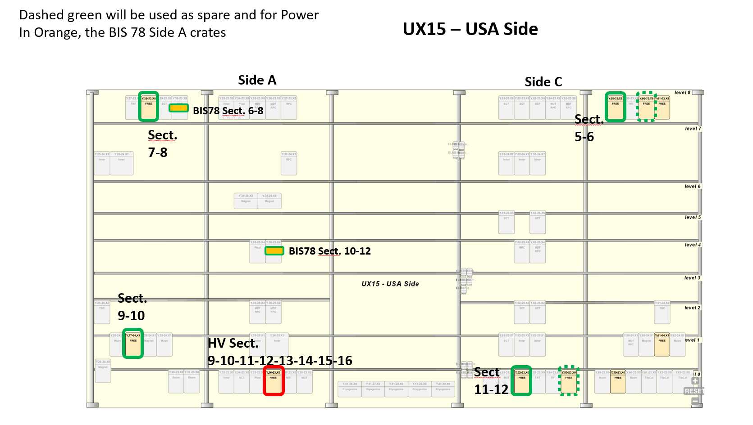
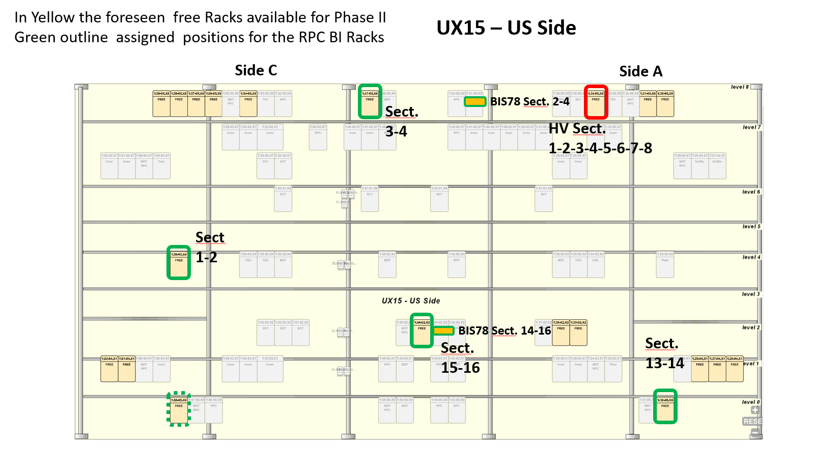

Slide 14
On Chamber Low Voltage cabling and connection
3 pairs VTH +1 pair Vanalog → Cat 5 Ethernet cable
1 pairs per Panel → 6 wires
Cable branch 1
Rack Y.aa-bb.Xc
Power Supply:
LV Power → 1 Ch Vdigital + sense
LV Control → 1 Ch Vth per RO panel + 2 Ch Vanalog (Tot 6 Ch/Chamber)
Chamber
LV connector on each side:
6 poles → 3 pairs LV power (1 per panel)
8 poles → 1 pair LV analog +3 pairs Vth → RJ45
2 conductors 2.5 mm^2 + 2 sense
→ LV power 1Ch V Digital
Flexi Connection
4m max
35 m maximum
Cable branch 2
1 pairs per Panel → 6 wires
3 pairs VTH +1 pair Vanalog → Cat 5 Ethernet cable
Flexi Connection: is an Y splitter to be installed in a reachable point in the chamber’s closest Cable Tray. It has two branches and chamber connectors preinstalled.
The Low Voltage in the Flexi is kept controlled by the power supply senses.
The branches must be designed to keep the voltage drop as low as the FRTE requirements.
In the Flexi connection will be placed Test points and Jumper Switches to be able to disconnect a single panel
The connector will be as simple as possible since the Rack cables could be routed without connectors

Slide 15
BIL+BIS RPC chambers LV connections
Sensors 1 cable 2 pair T, RH, 1 pair Power, 1 pair spare
CAT 5 Ethernet Ø5.5mm
Igap RO Cable 3 pairs + 1 pair spare CAT 5 Ethernet
3x HV CABLES Ø5.2mm
Ly0
Ly1
Ly2
LVDig Cable
Side HV
LVDig Cable
Gas In
(6 wire 1mm^2)
(6 wire 1mm^2)
Vth 3 pairs + Van 1 pair CAT 5 Ethernet Ø5.5mm
Vth 3 pairs + Van 1 pair CAT 5 Ethernet
Ly0
Ly1
Ly2
Ly0 = Black
Ly1 = Green
Ly2 = Blue
Gas Outputs
Gas Inputs

Slide 17
BIL side A
1 Rack for a double sector BI+BIS
quite crowded even for standard sectors
BIS side A
BIL side C
BIS side C

Slide 18
Studio sistemi ricircolo PP1

Slide 19
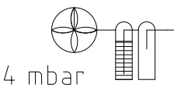
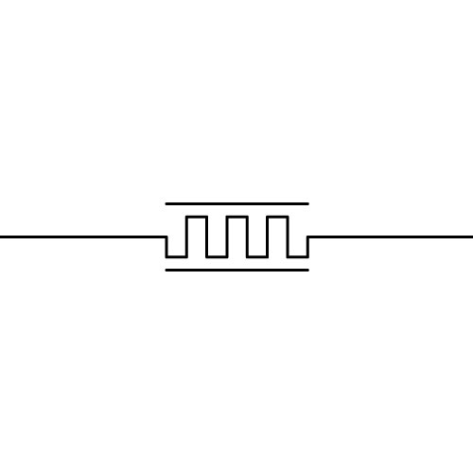
Test system
Low pressure
Valve
PT
Flow Meter
Pump
Humidity sensor
High pressure
Dehumidifier
Vent
OUT
RH
Safety Bubbler
Oxygen Sensor
Needle valve
PT
Peltier
A
Chamber
OUT
IN
Flow
IN
Fresh Input
Purifier Vessel

Slide 20
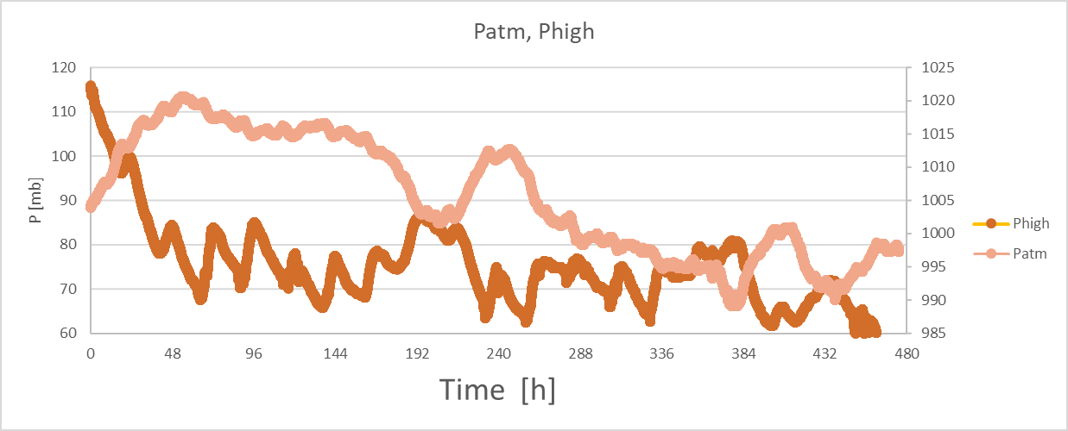
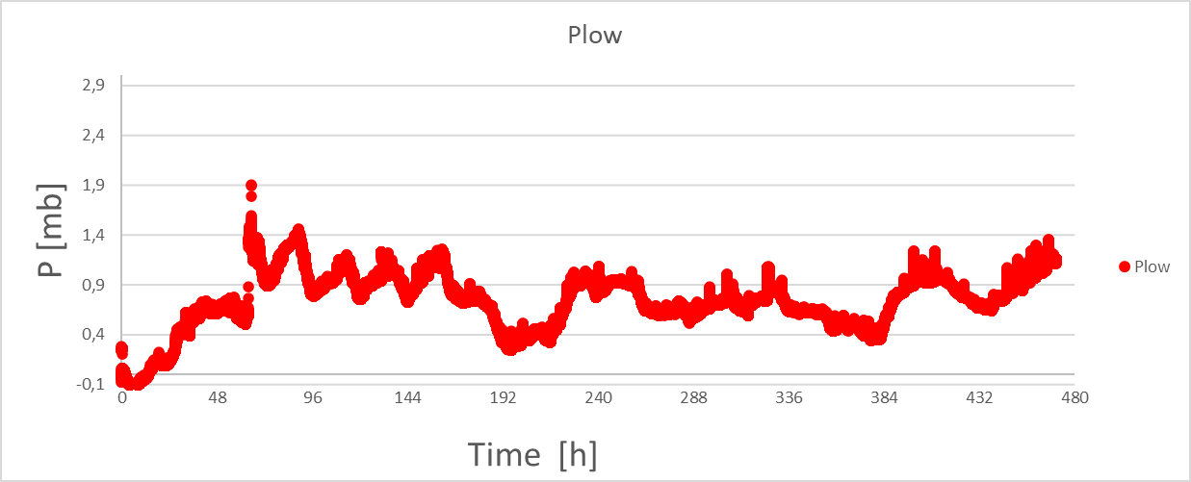
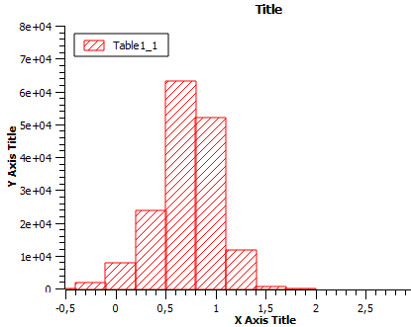
Pchamber
Pchamber

Slide 21
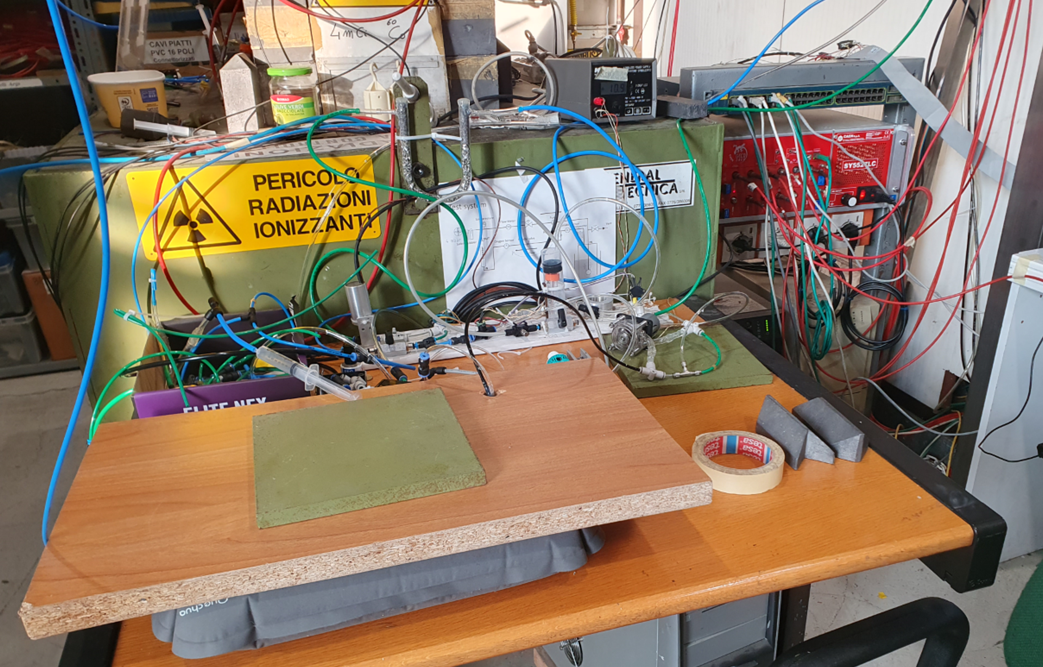
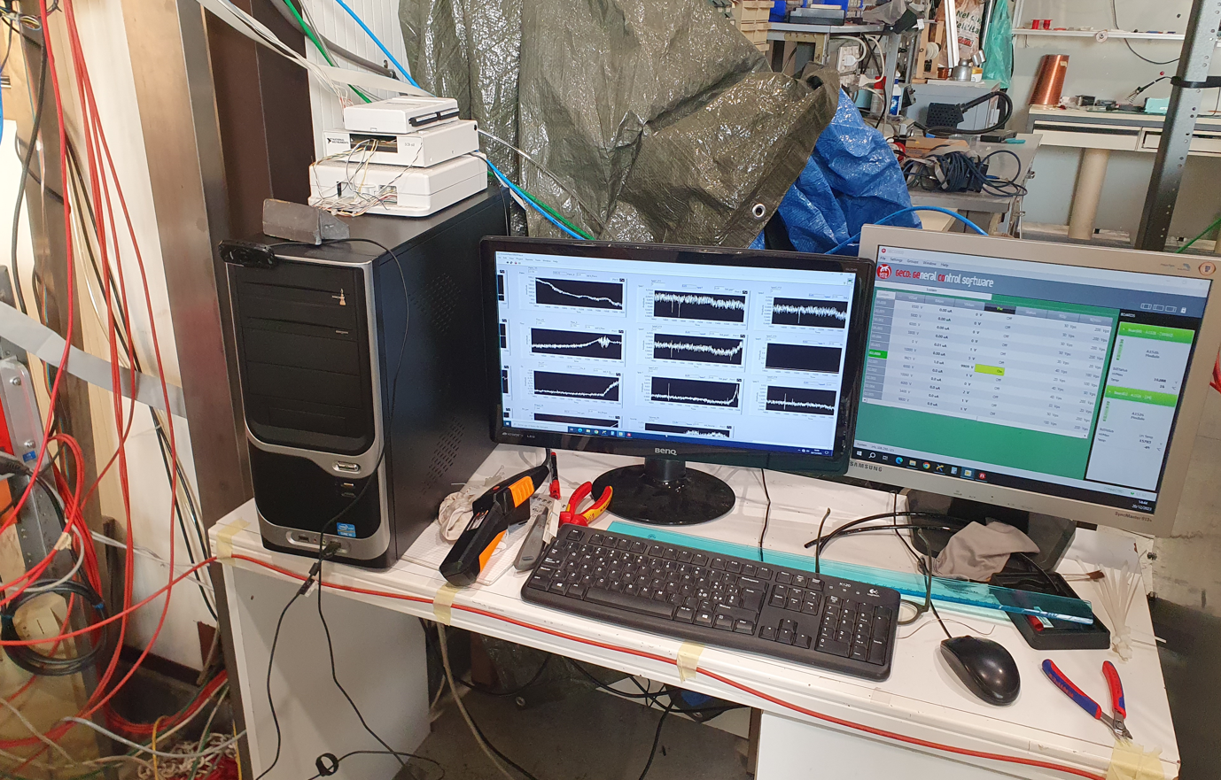

Slide 22
Last but not least:
Corso Nazionale INFN Gas per i rivelatori di particelle

