Slide 1
Quantum Architectures for Analogues and Theory Applications

Slide 2
Outline
Digital Simulations
Spin Systems (PRL 112, 200501 (2014), Phys Rev X 5 021027 (2015))
Fermionic Systems (10.1038/ncomms8654)
QG (PRL 119, 040501 (2017), Nature volume 612, pages 51–55 (2022))
Analog Simulations
GAAH Model (arXiv:2206.13107)
Hawking Radiation (Nature Communications | ( 2023) 14:3263)
Dirac Equation (New Journal of Physics 15 (2013) 055008)
Digital Analog Simulations
Fermion Fermion scattering (PRL 114, 070502 (2015))
Optimal Control (PHYSICAL REVIEW A 101, 062307 (2020))
Analog Circuits (REVIEWS OF MODERN PHYSICS 84 2012, EPL 128, 24002 (2020)
Digital-Analog Quantum Simulations with Superconducting Circuits arxiv:1711.09810

Slide 3
Digital Simulations

Slide 4
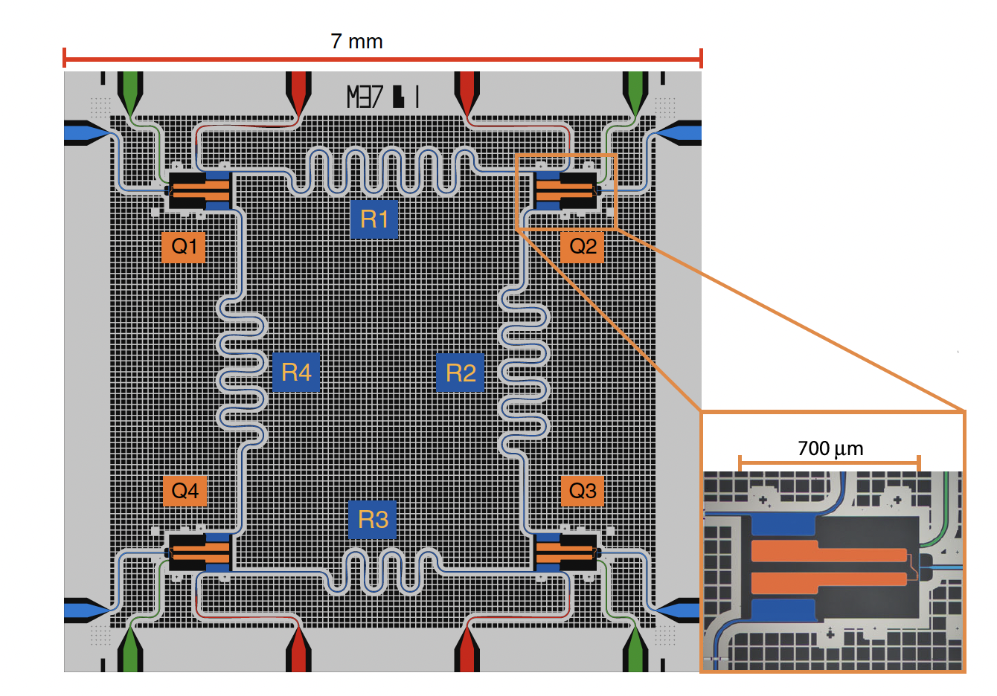
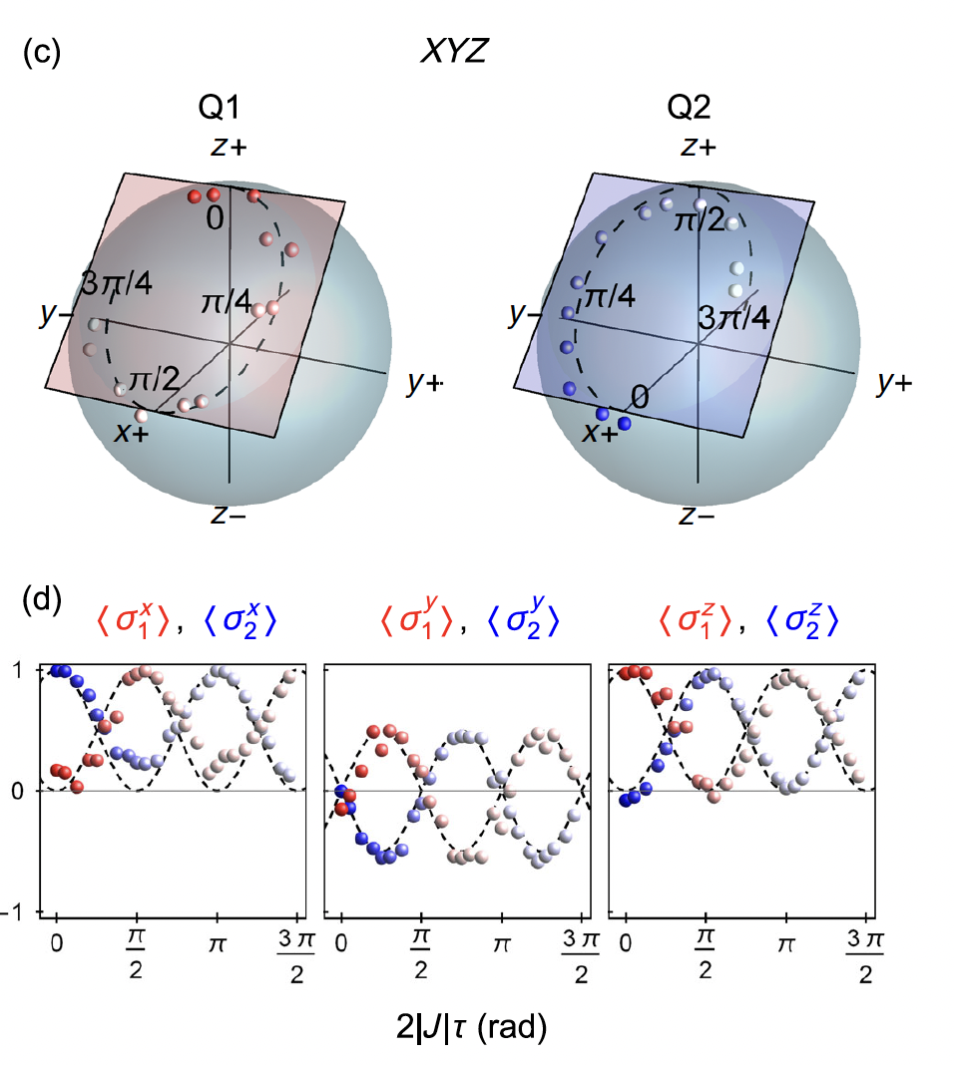
Spin Systems
Heisenberg Model
Suzuki-Lie-Trotter expansion
Phys Rev X 5 021027 (2015)

Slide 5
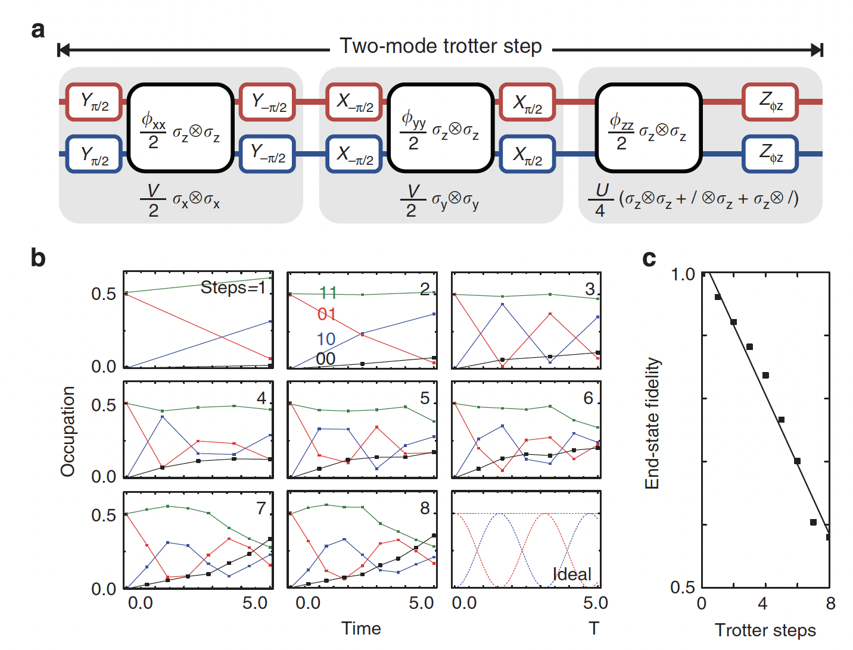
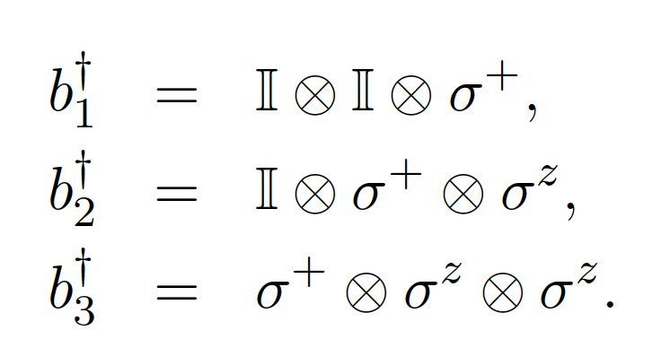
Fermionic Systems
Fermi-Hubbard model
Jordan-Wigner mapping
DOI: 10.1038/ncomms8654

Slide 6
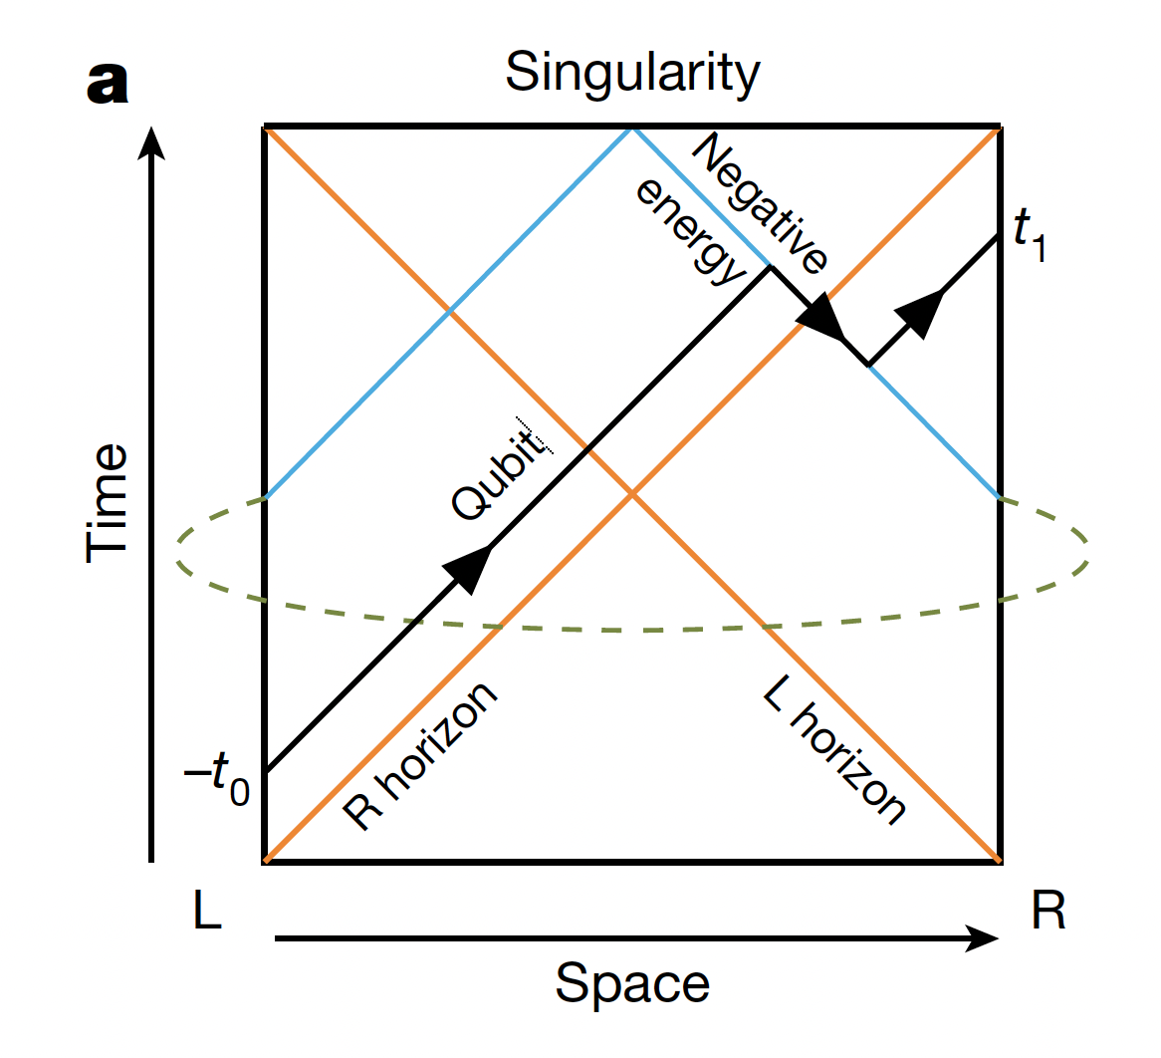
Quantum Gravity
Sachdev-Ye-Kitaev (SYK) model
Simulation on the Google Sycamore superconducting qubit array with a nine-qubit circuit of 164 controlled-Z gates and 295 single-qubit gates
PRL 119, 040501 (2017), Nature volume 612, pages 51–55 (2022)

Slide 7
Analog Simulations

Slide 8
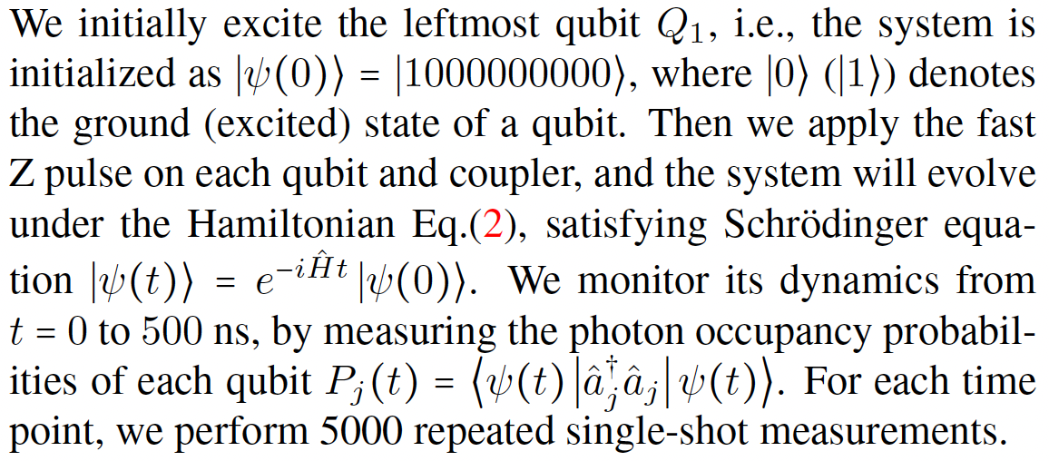
GAAH model
Generalized Aubry André Harper model
10 qubits with tunable couplers
arXiv:2206.13107

Slide 9
Hawking Radiation
(1+1) Dira field on curved space
Nature Communications | ( 2023) 14:3263

Slide 10
Dirac Equation
m=0
m=p
m>>p
By using three classical microwave drives, superconducting qubit strongly coupled to a resonator field mode can be used to simulate the dynamics of the 1+1 Dirac equation:
Wigner function W(x, p) of the field mode state inside the resonator
mass
kinetic
potential
New Journal of Physics 15 (2013) 055008

Slide 11
Digital-Analog Simulations

Slide 12
Fermion Fermion Scattering
Analog-digital quantum simulation of fermion-fermion scattering mediated by a continuum of bosonic modes. Qubits simulate fermionic modes via
digital techniques, while the continuum of an open transmission line simulates bosonic modes in quantum field theory.
PRL 114, 070502 (2015)

Slide 13
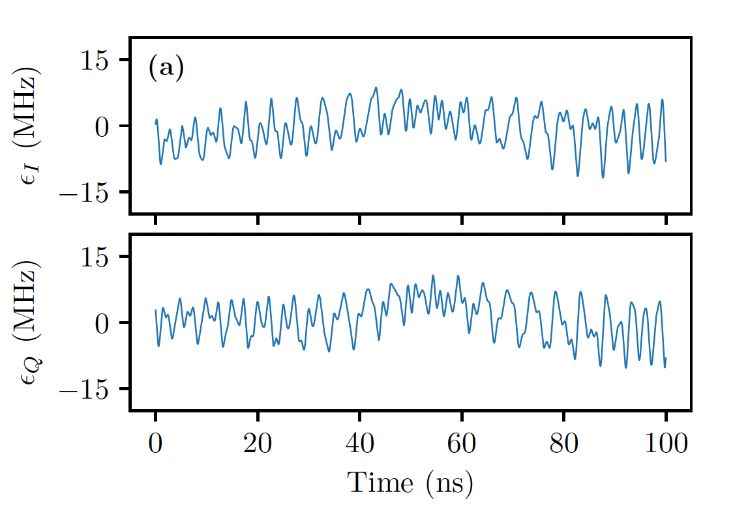
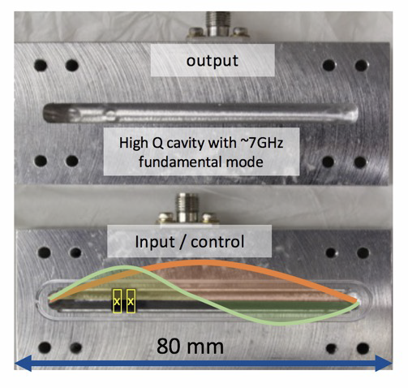
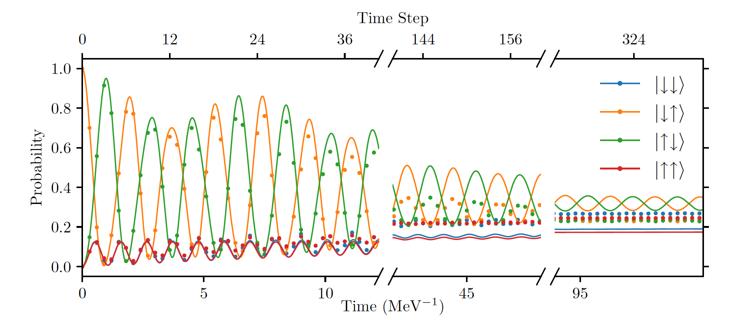
Optimal Control on a qudit
Pederiva et al. PHYSICAL REVIEW A 101, 062307 (2020)

Slide 14
Analog Circuits
REVIEWS OF MODERN PHYSICS, VOLUME 84, JANUARY–MARCH 2012

Slide 15
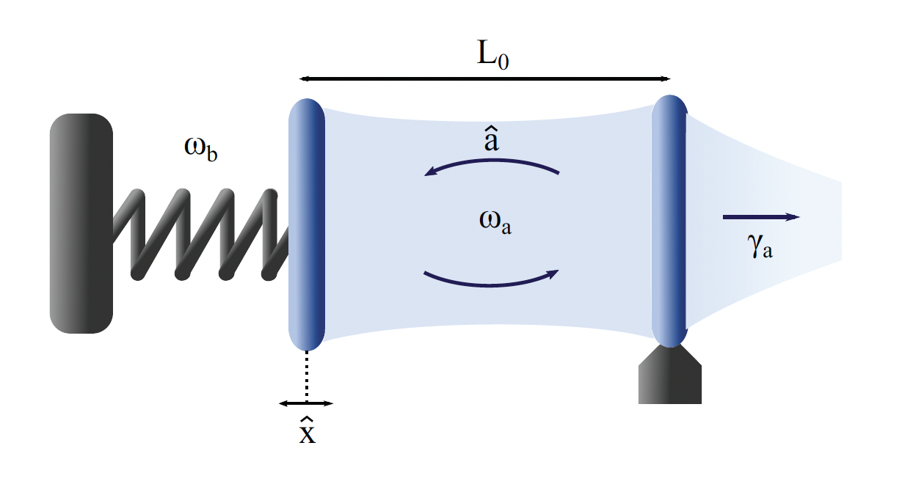
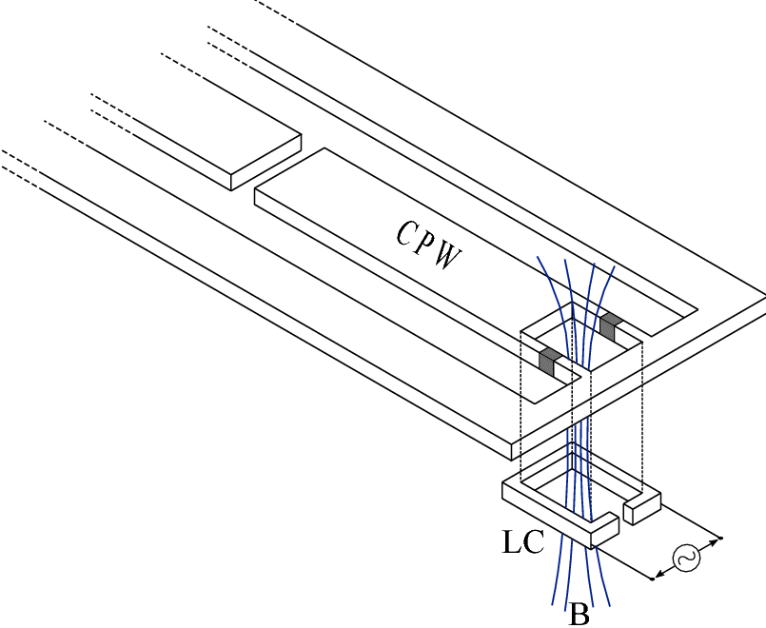
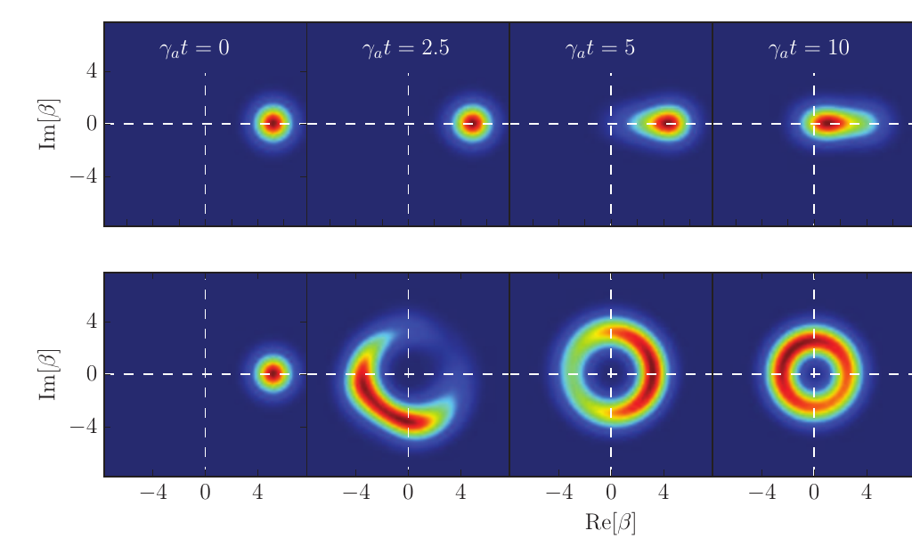
Possibility of transforming the virtual photons corresponding
to the zero-point fluctuations into an observable quantum
vacuum radiation when the background on which the
quantum field lives is modulated in either space or time
Baby toy model: friction force on dynamical Casimir emission
S. G. Butera & IC, Quantum fluctuations of the friction force induced by the dynamical Casimir emission, EPL 128, 24002 (2020).

Slide 16
Superconducting Devices at INFN

Slide 17
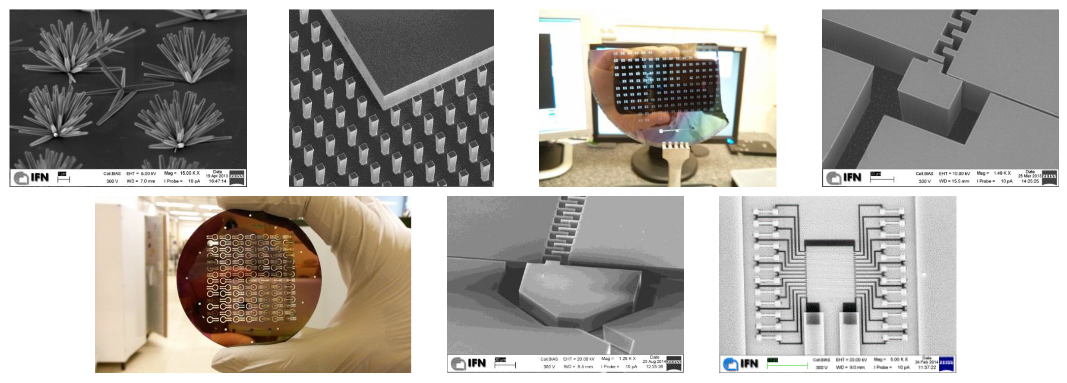
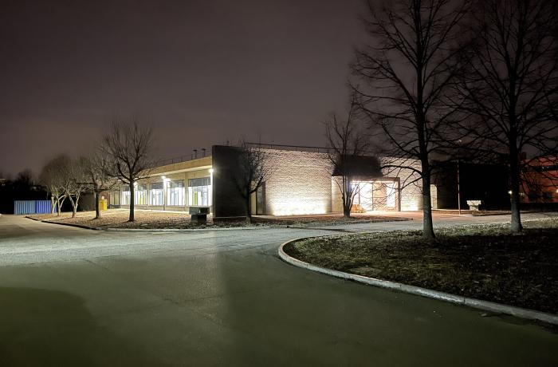
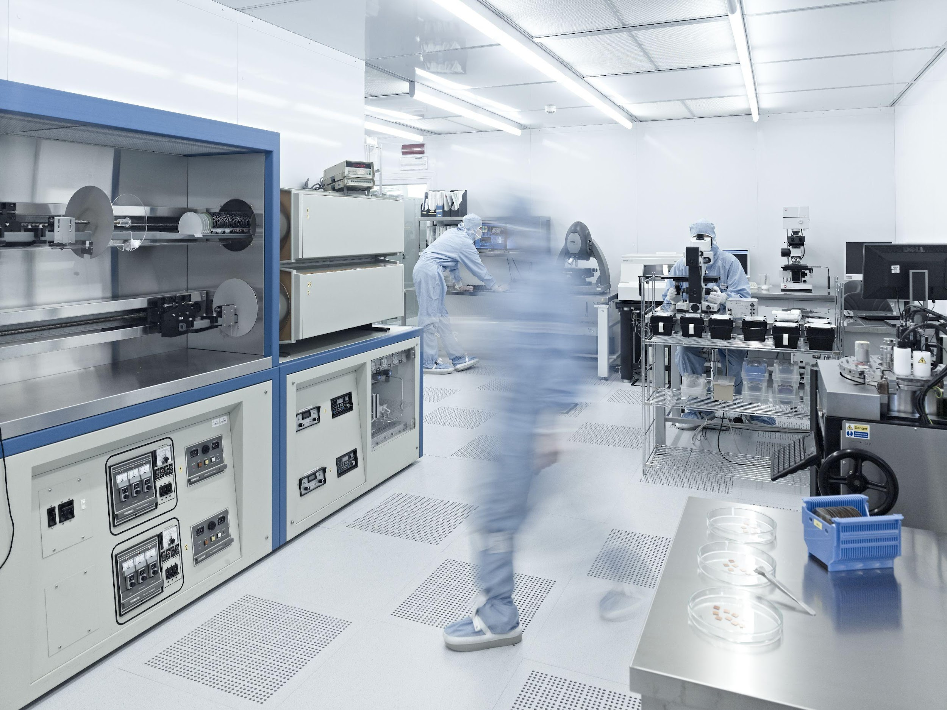
CNR, National Research Council
INRiM, Italian Metrology Institute
FBK, Fondazione Bruno Kessler

Slide 18
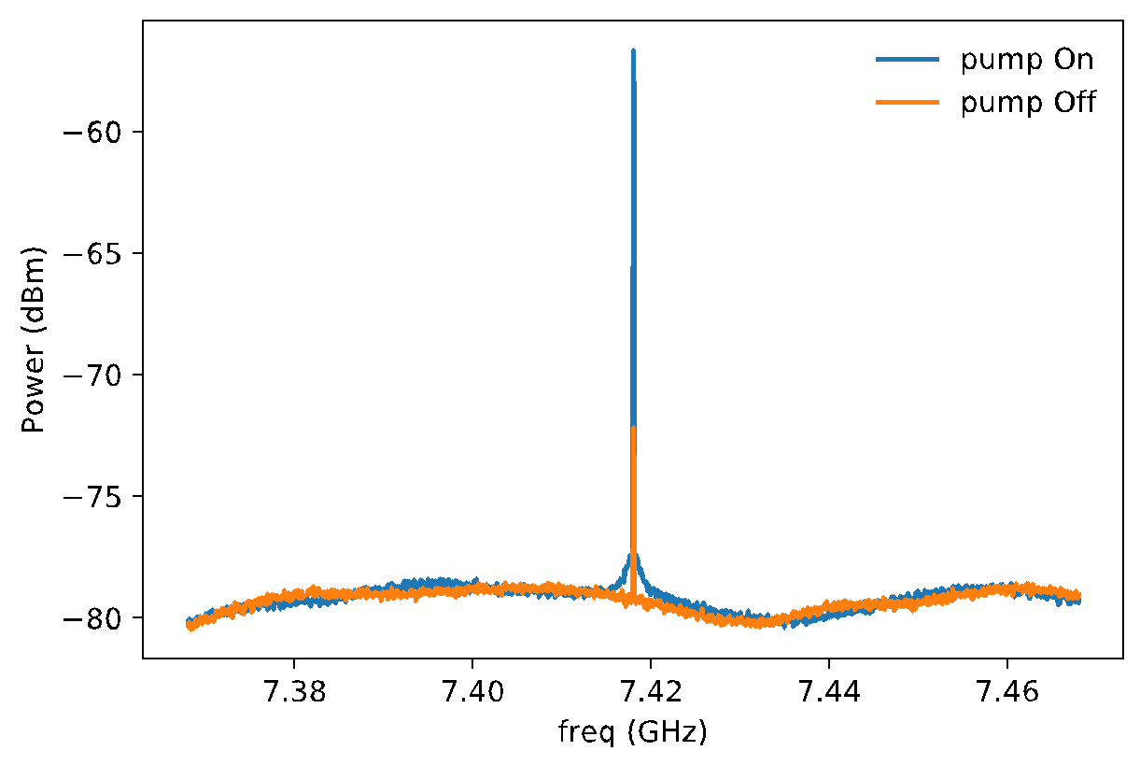
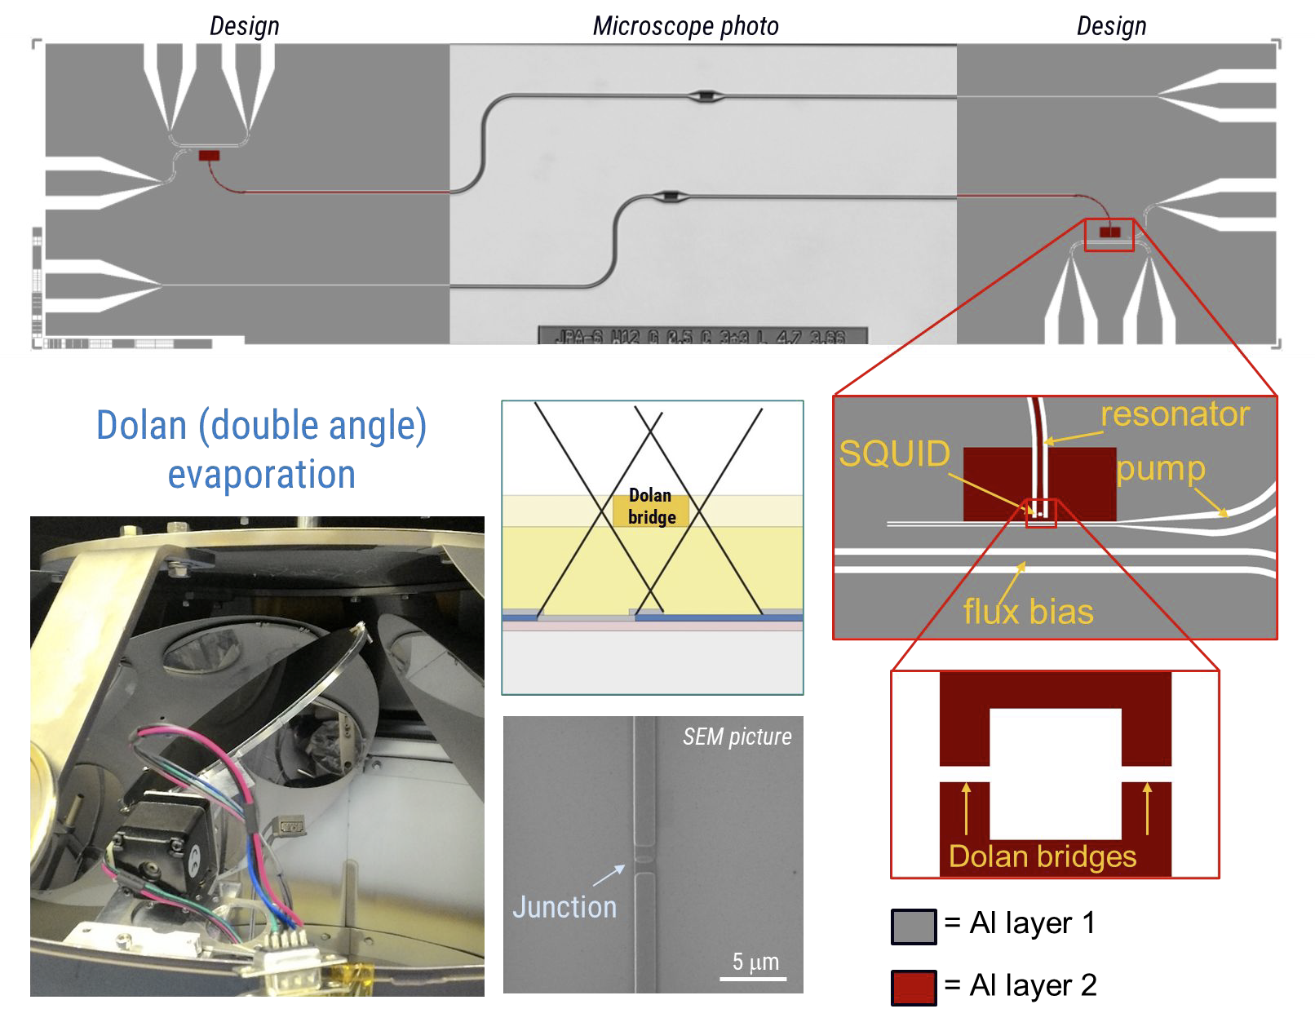
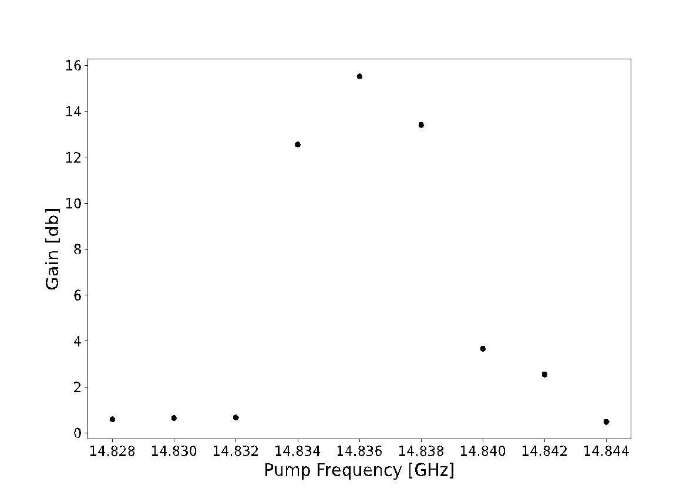
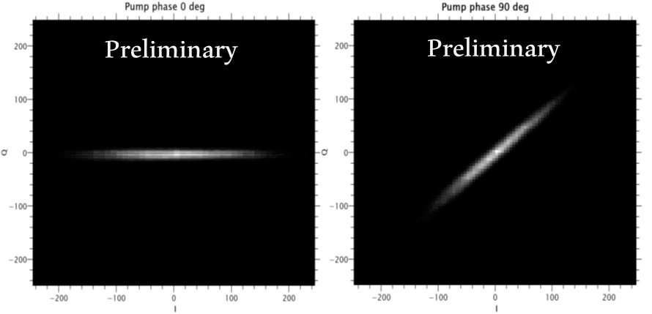
Realization of a Flux JPA
2×5MHz

Slide 20
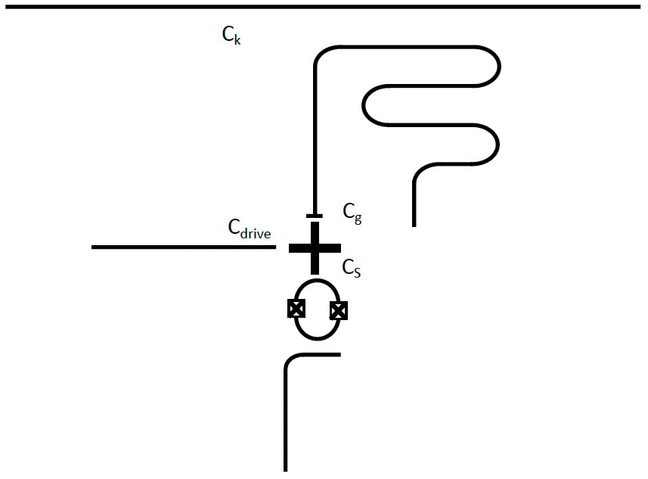
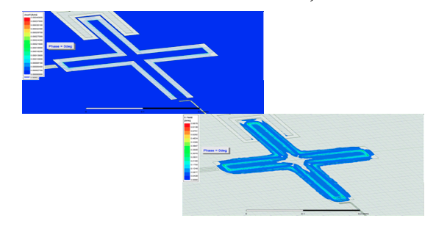
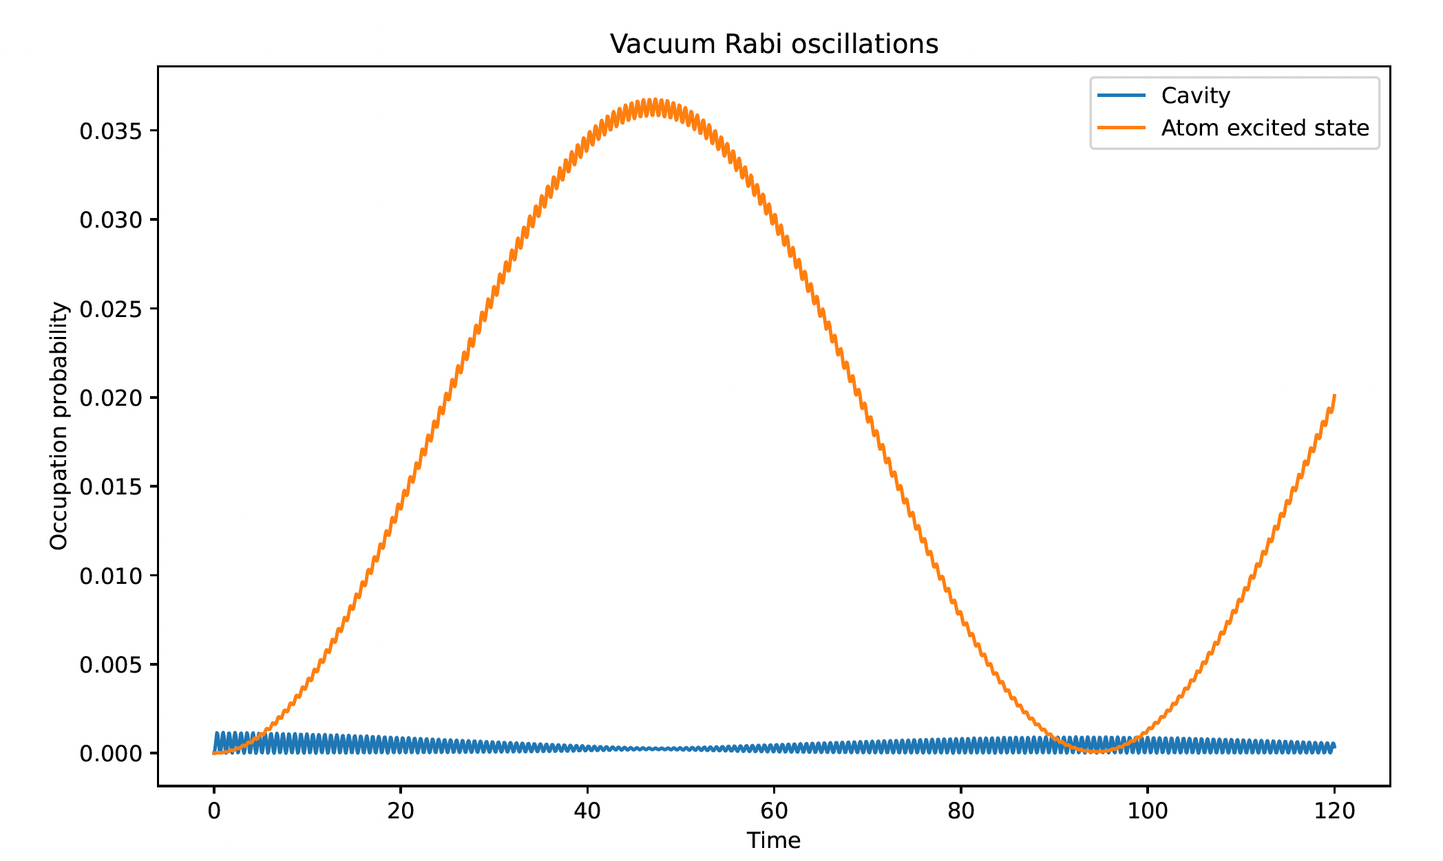
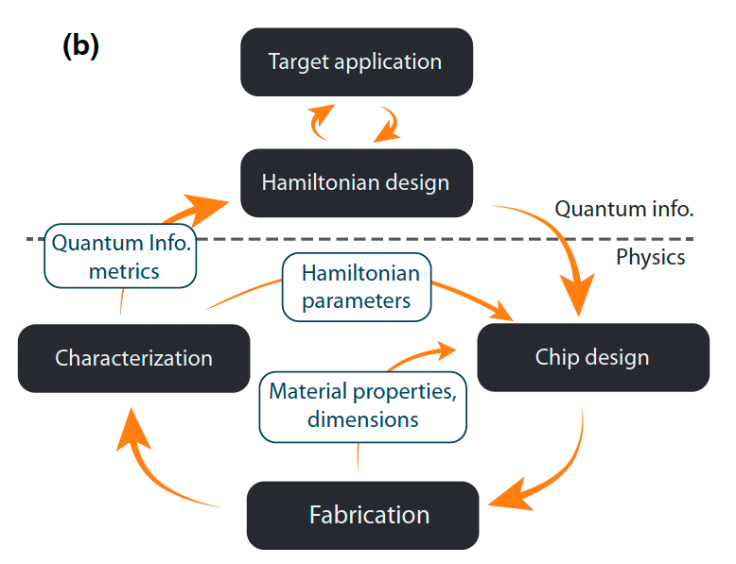
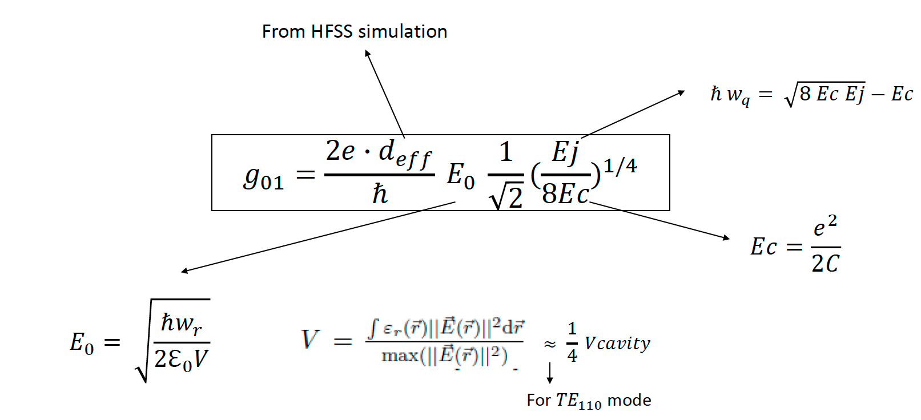
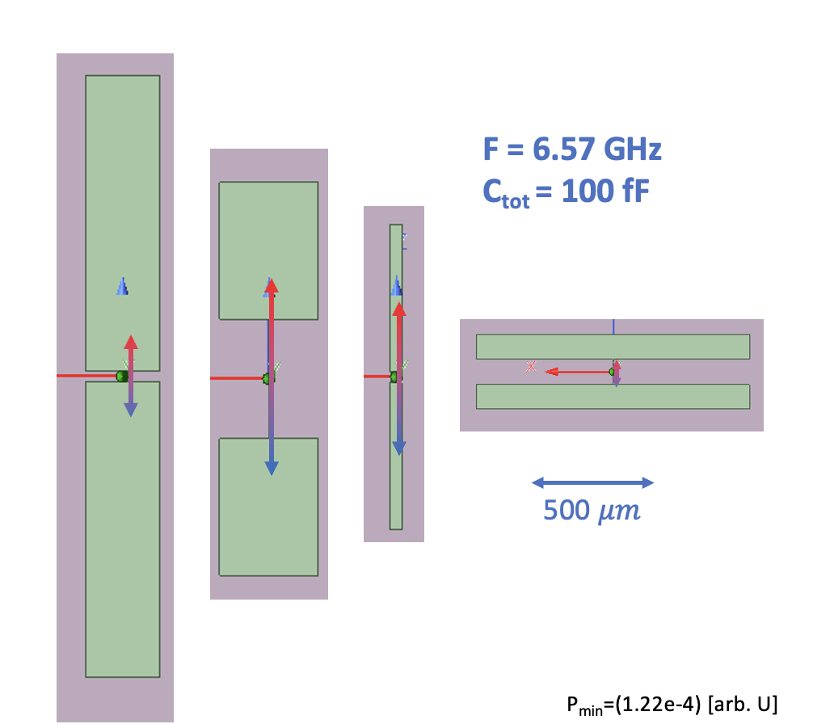
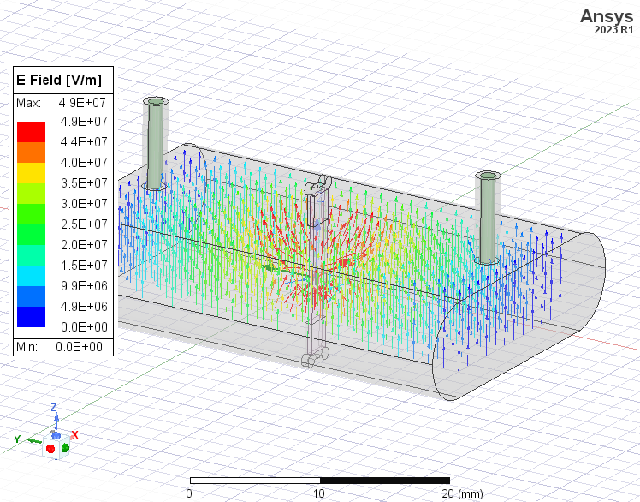
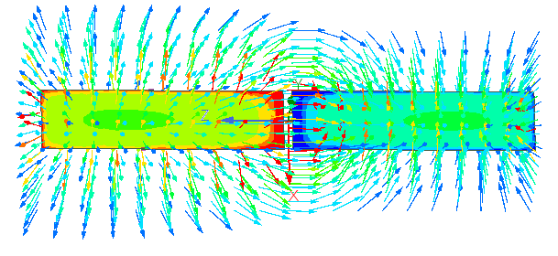
Design of 2D and 3D Superconducting Qubits
2D Qubits
Circuit Modeling
Circuit Design
Electromagnetic Simulations
Quantum Simulation
1) Connect physical elements (C, L, Ic, Z0) to quantum-circuit properties (lifetime, frequency, couplings)
2) Design of circuit with first estimate of circuit element values
3) Layout realization, E.M. simulation and design optimization.
4) Evolution of quantum Hamiltonian based on circuit parameters
3D Qubits
Y. Gao, PRX QUANTUM 2, 040202 (2021)

Slide 21
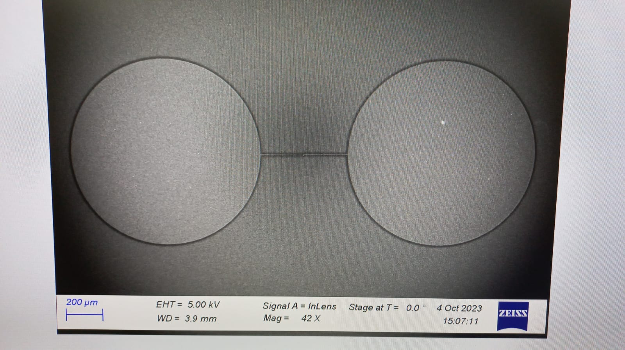
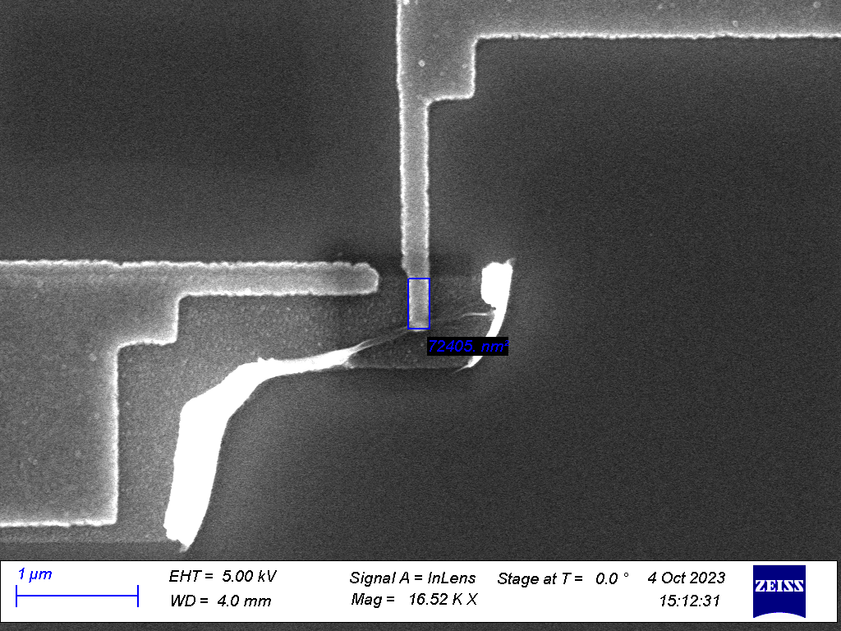
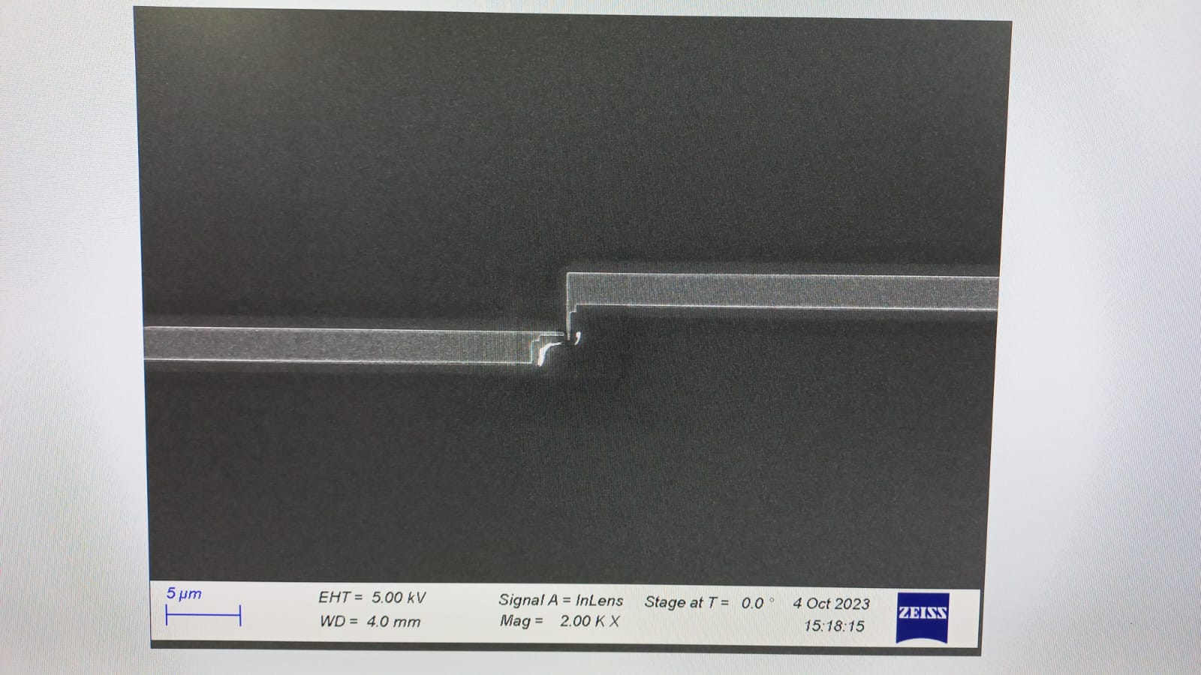
Manufactoring of 3D qubits with circular pads at CNR
r₀
d₁
Aluminum JJ with area approx. 200 x 350 nm

Slide 22
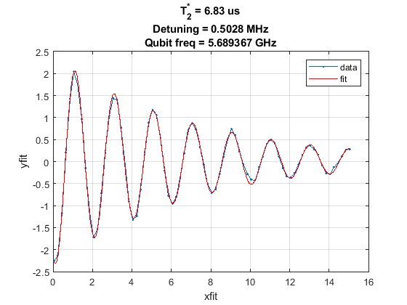
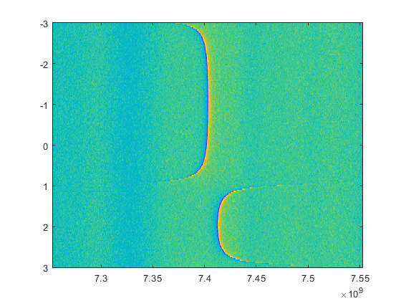
2d qubits
Ramsey
First version fabricated @ NIST
Second Fab @ NIST currently under characterization
Next fab @ FBK
Qubit spectroscopy
Avoided crossing
Power [dBm]
Bias [V]
Frequency [Hz]
Frequency [Hz]

Slide 23
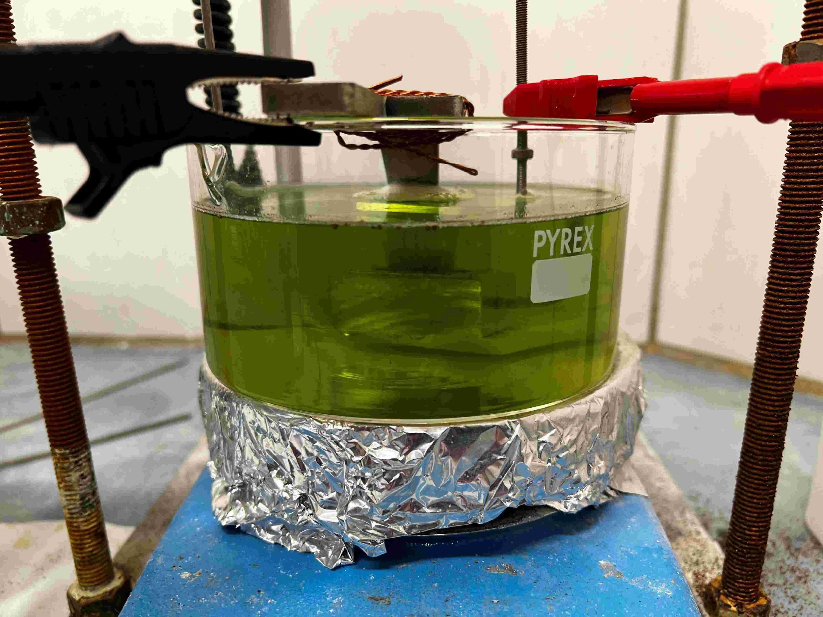
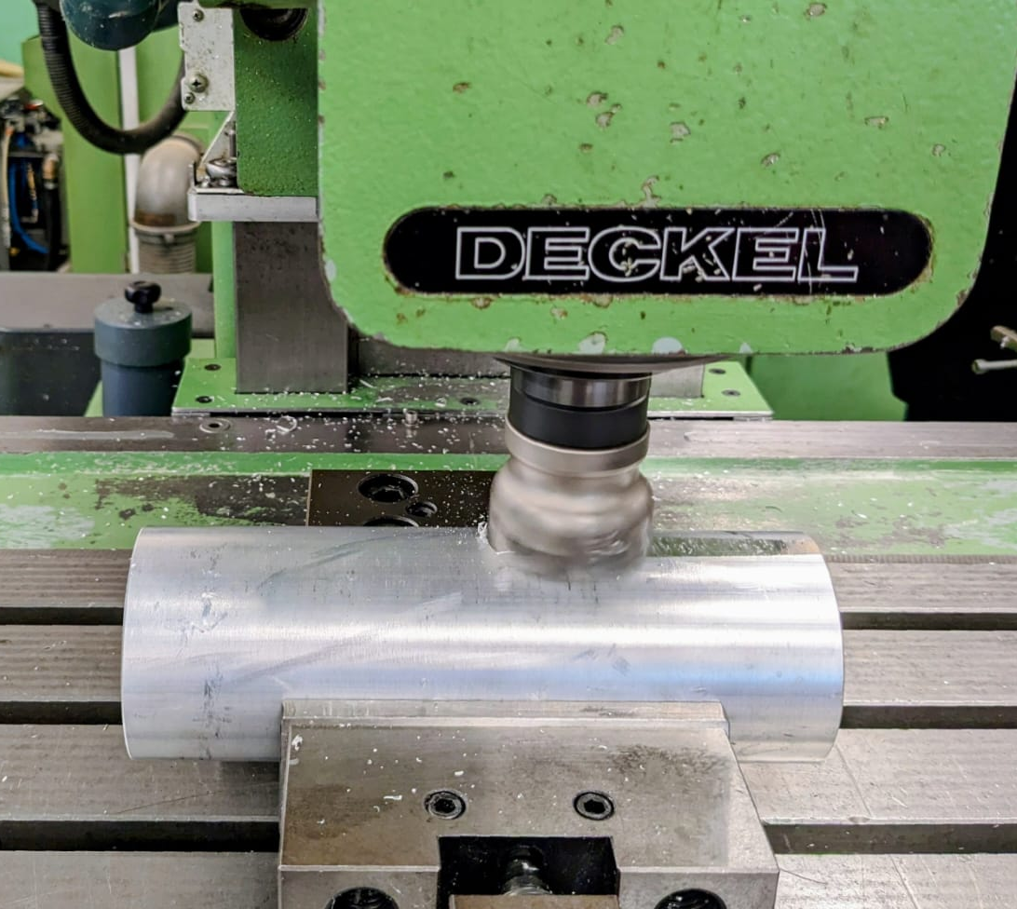
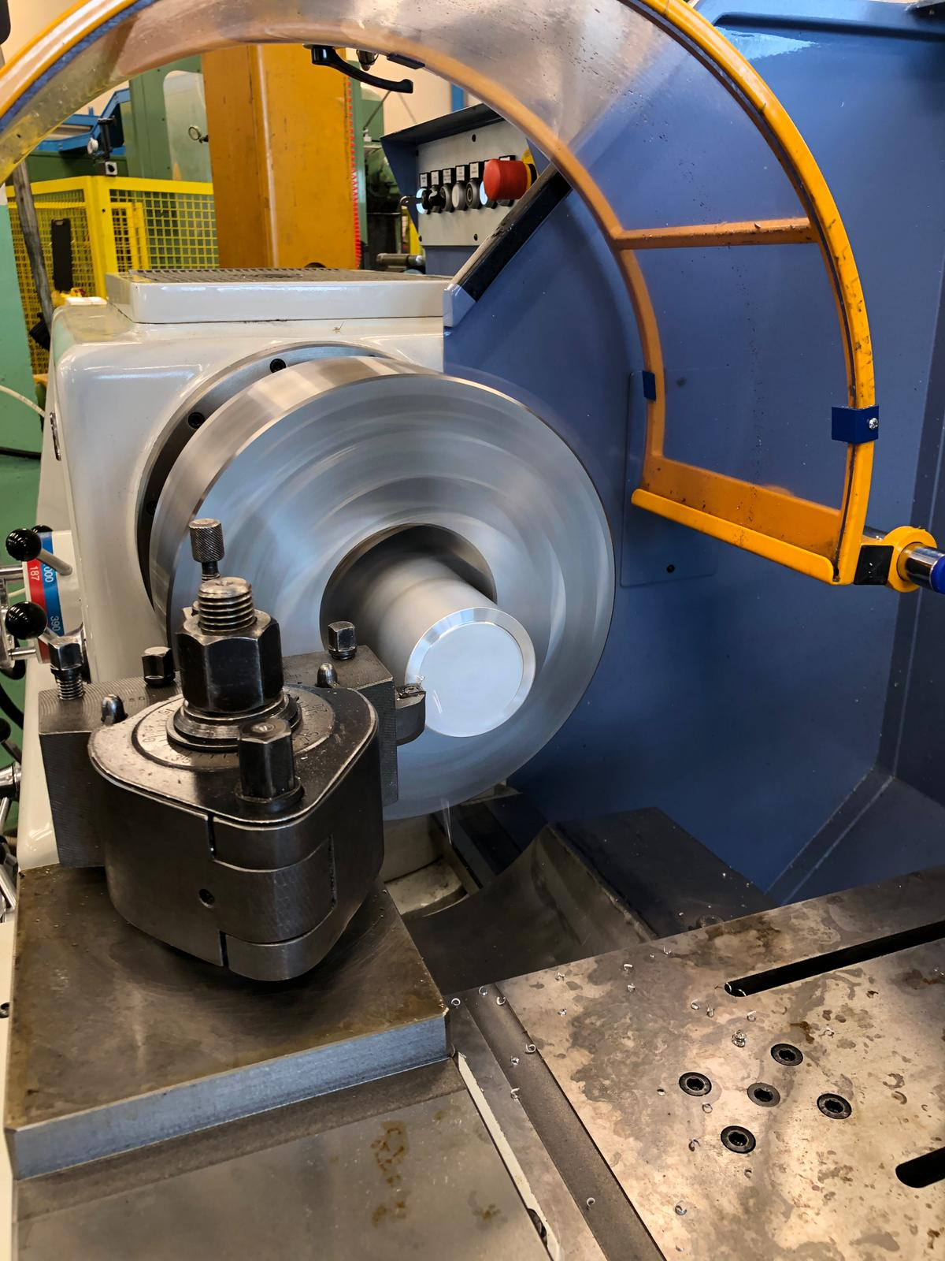
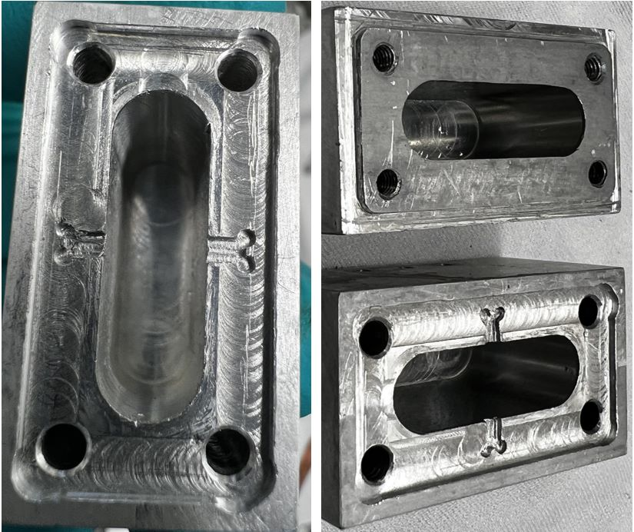
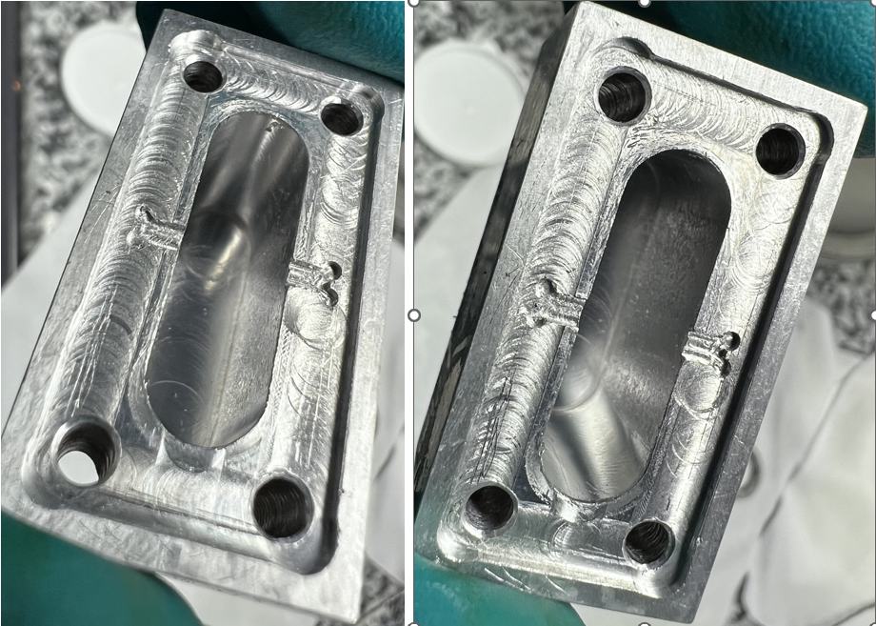
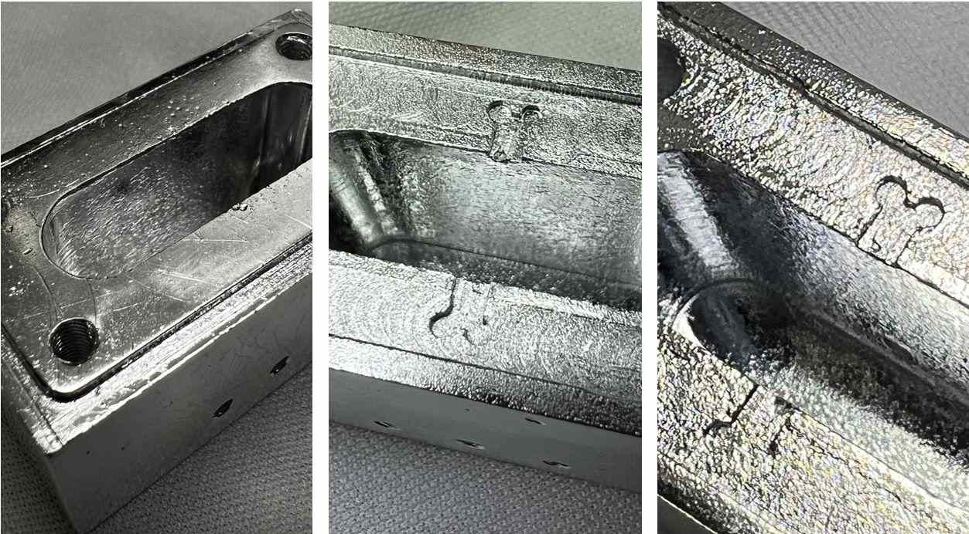
3D Cavity Fabrication
Mechanical machining
Vibro-tumbling
Electropolishing

Slide 24
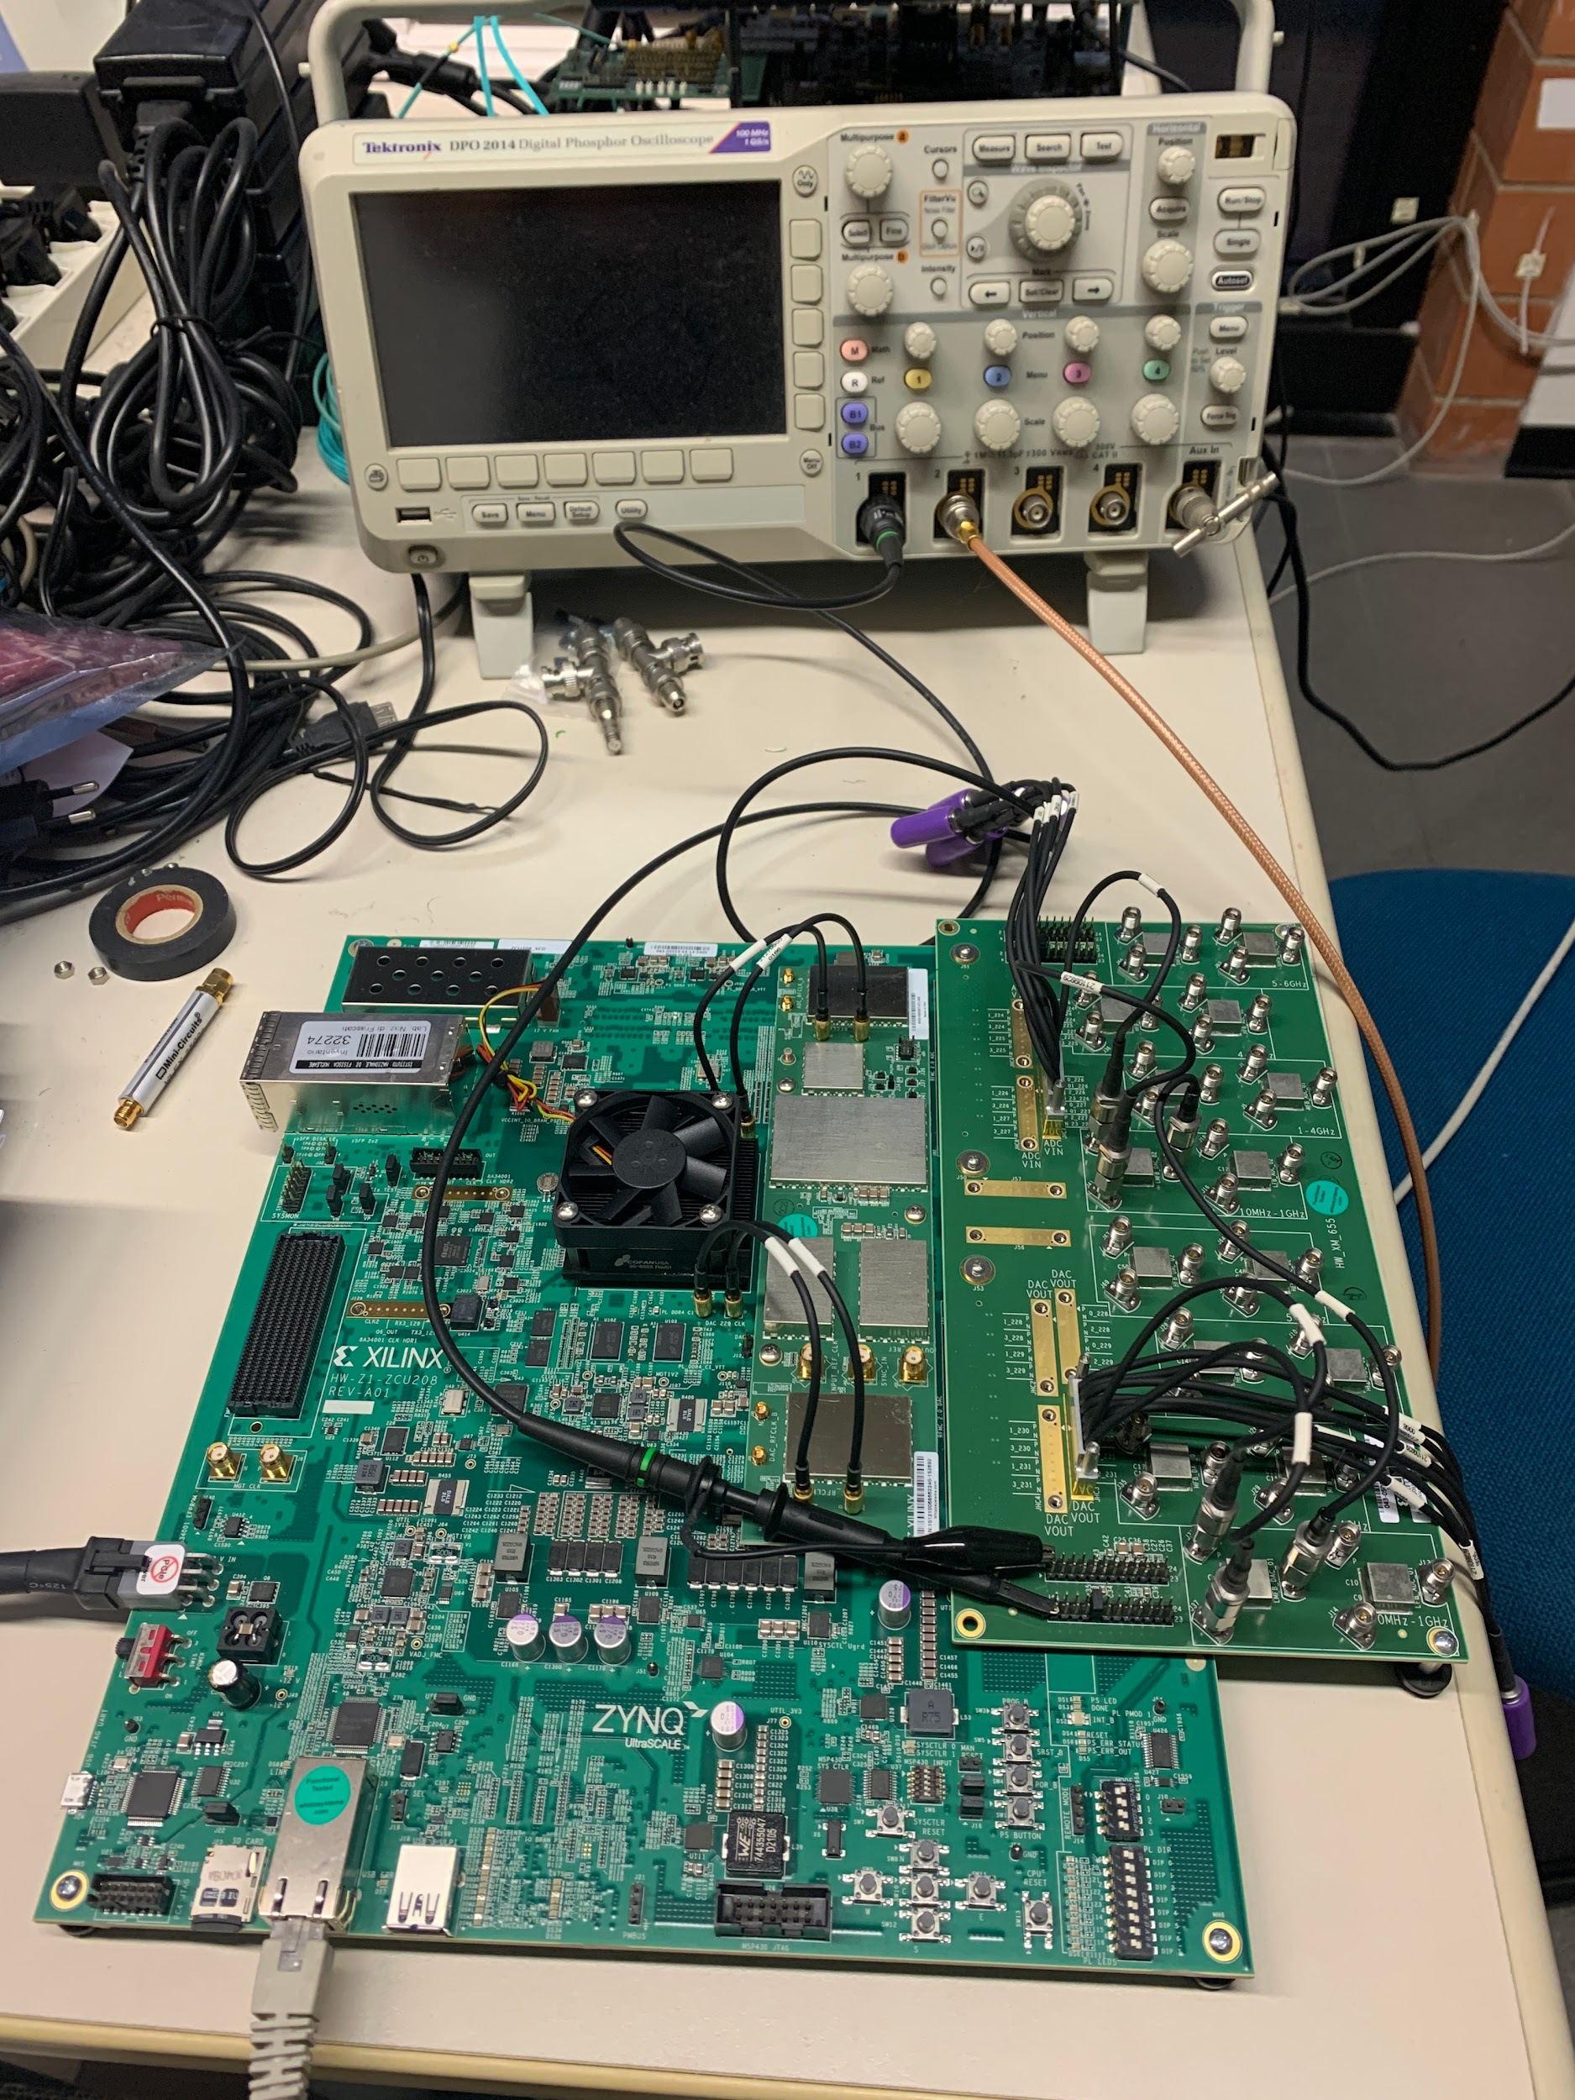
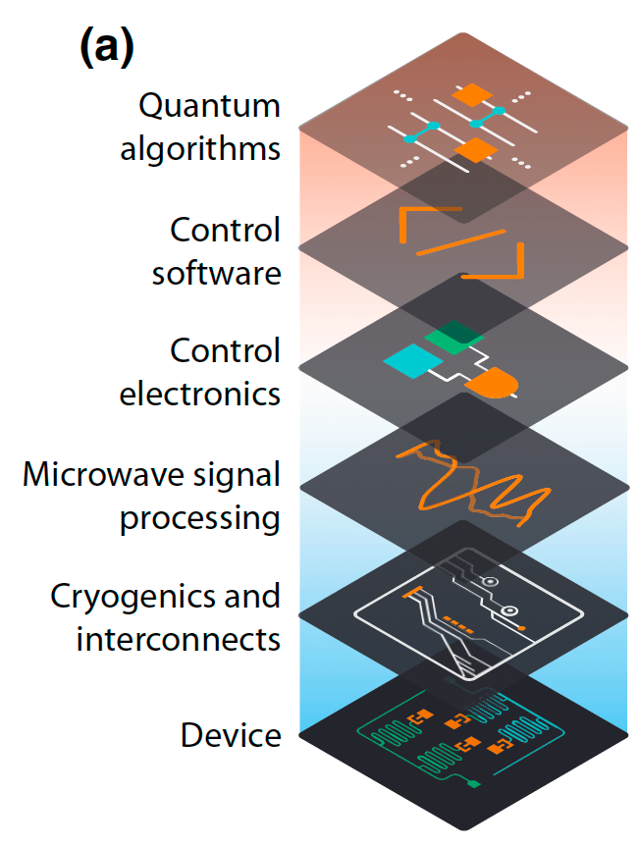
Qubit control with RFSoC hardware
QICK is a kit of firmware and software done to use the Xilinx RFSoC to control quantum systems.
Firmware exists for the ZCU111, ZCU216, and RFSoC4x2 evaluation boards.
Extending use of QICK also to the ZCU208 board.

Slide 25
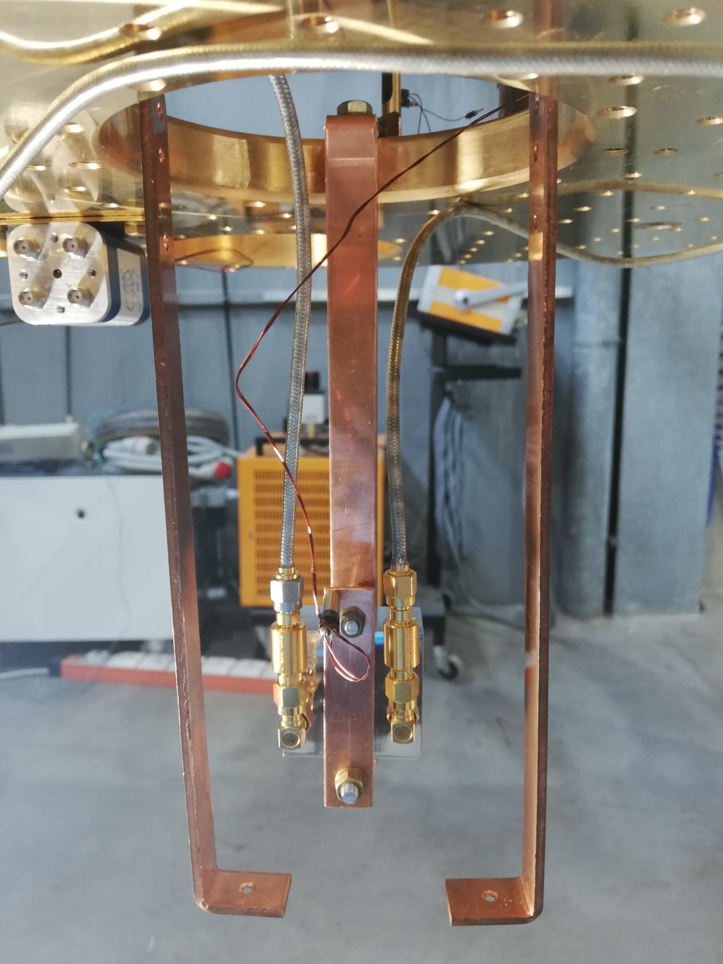
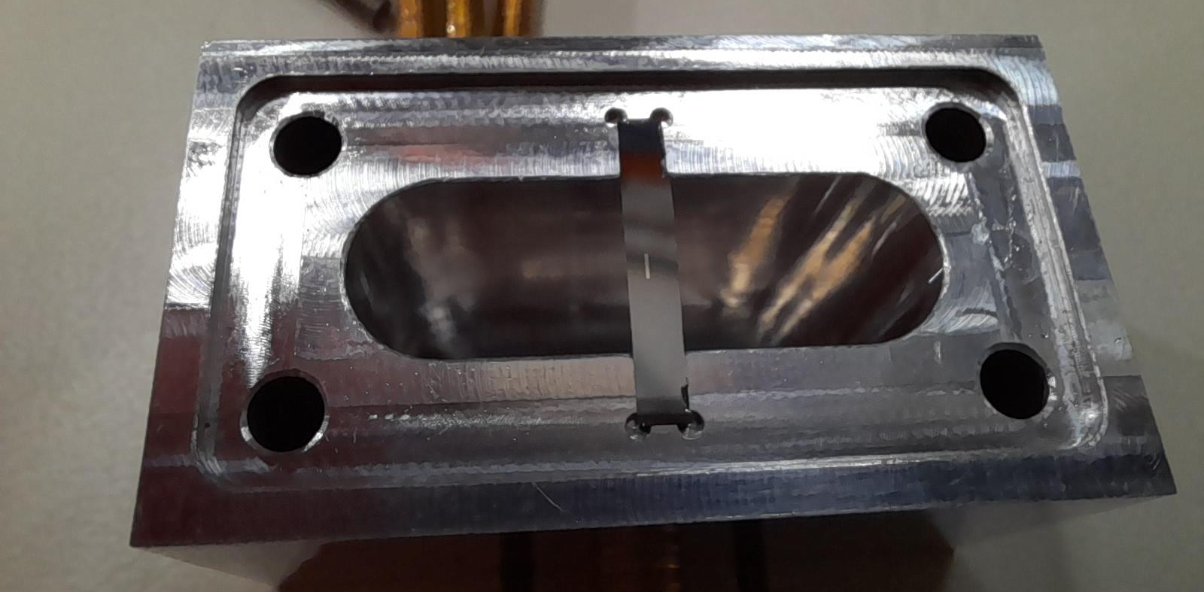
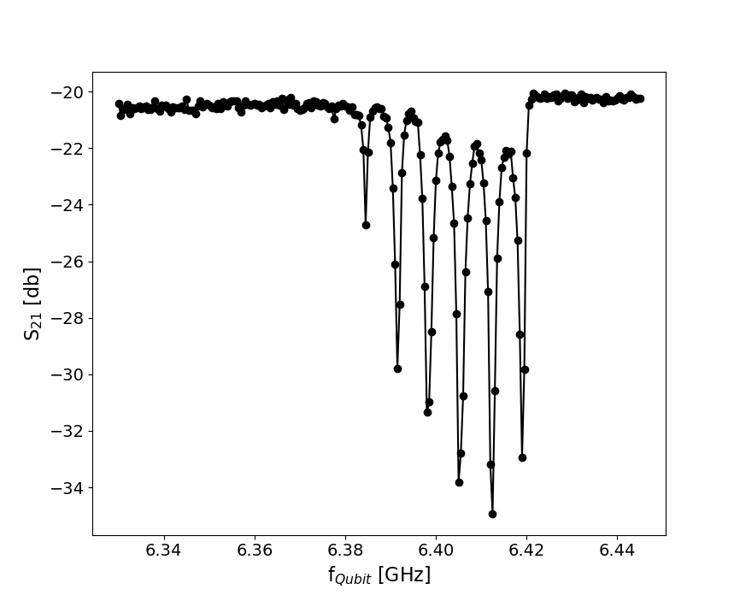
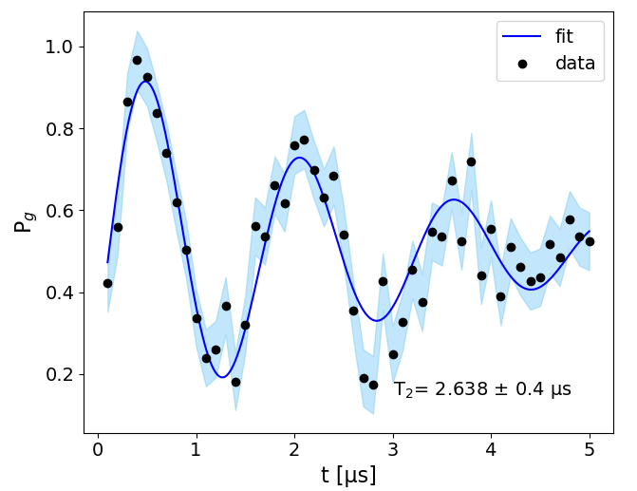
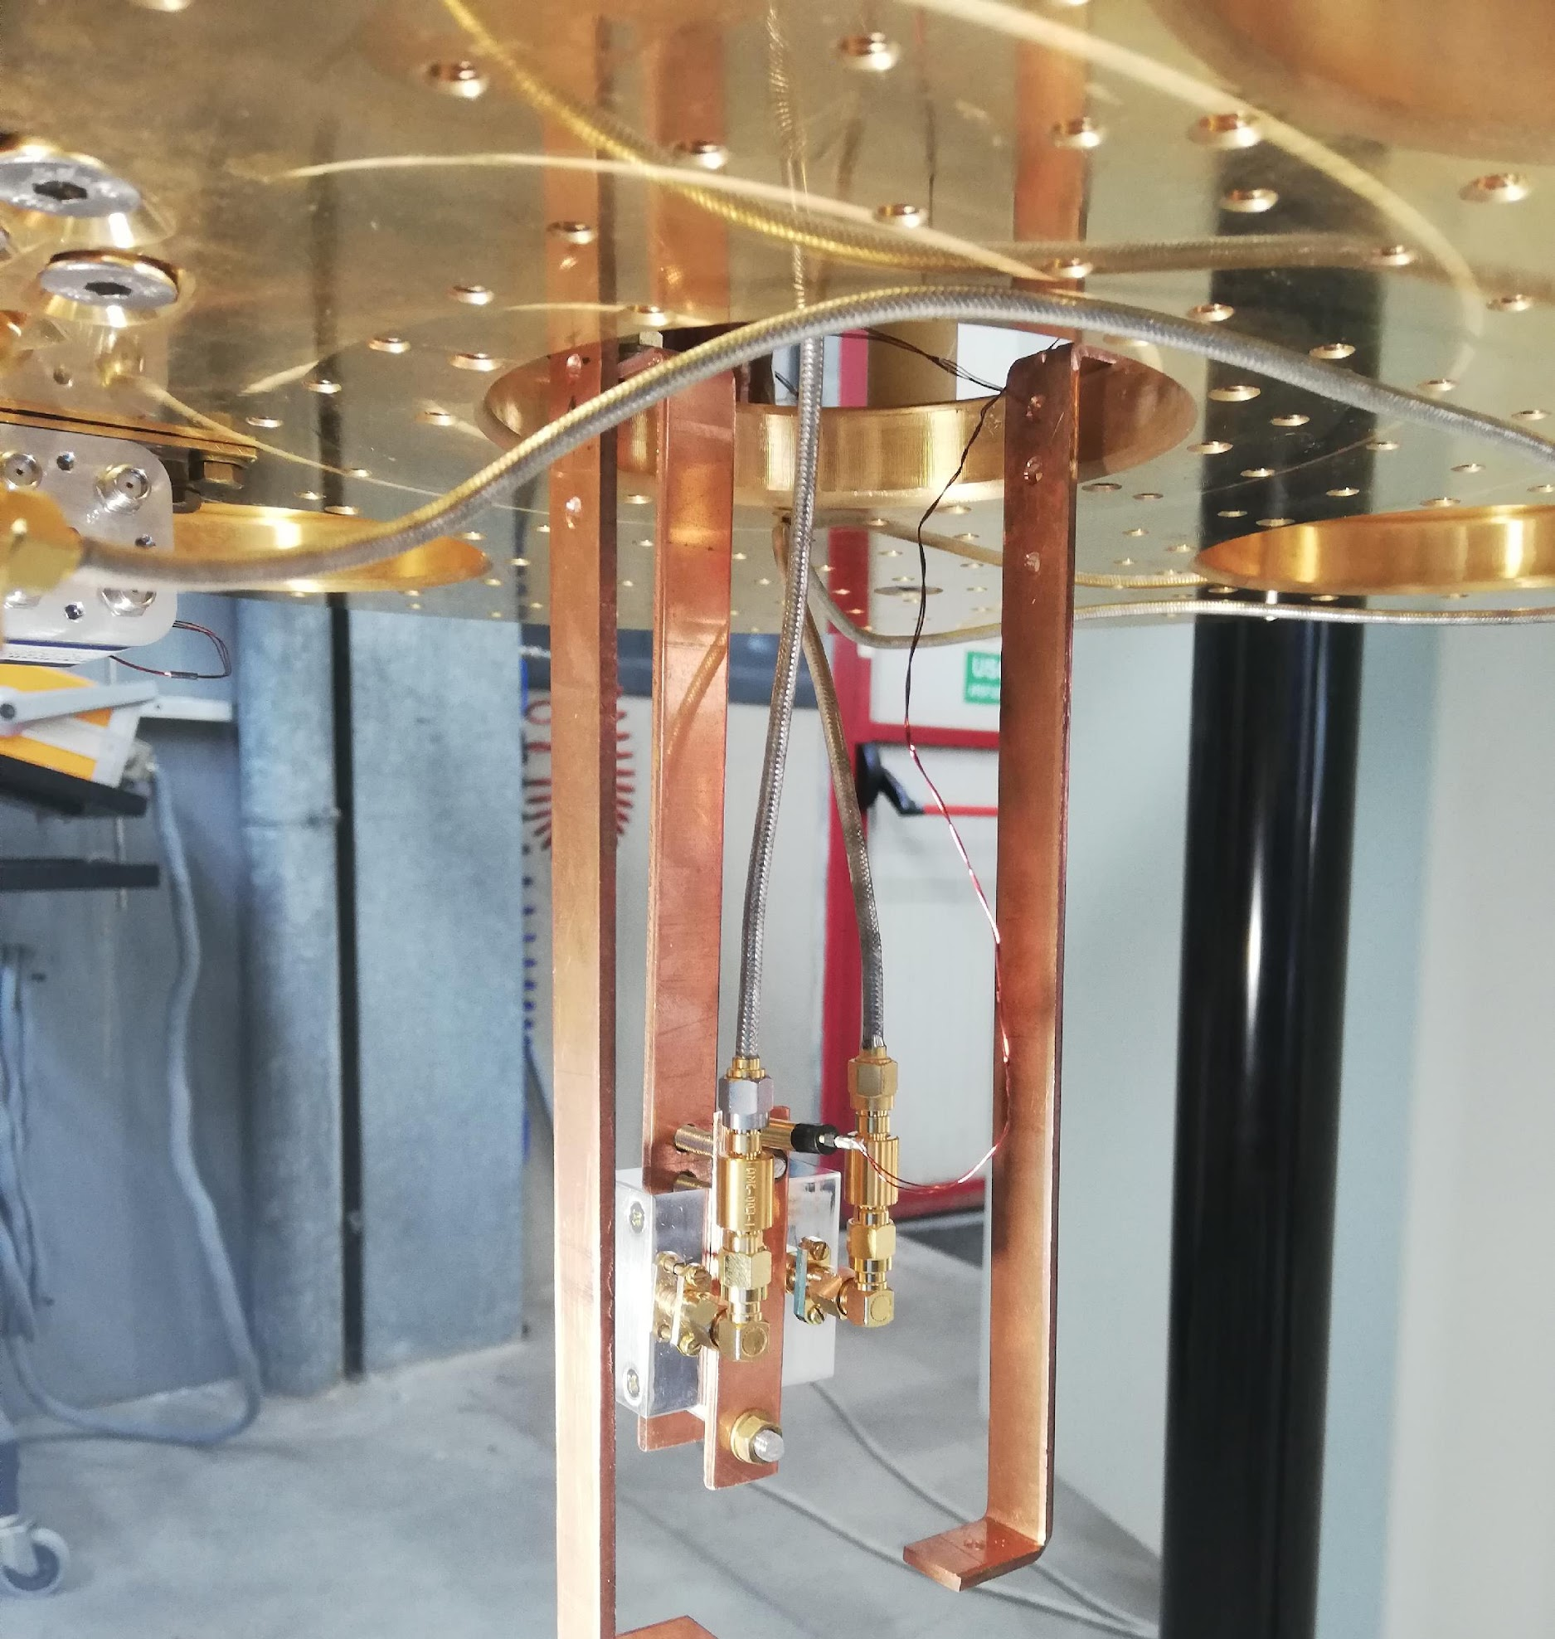
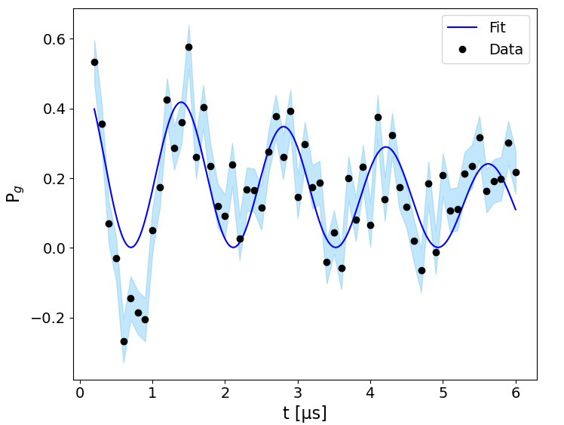
3D Resonator Coupled to a Superconducting Qubit
Photon Counting
Ramsey Spectroscopy
Rabi Oscillations
Number of photons in cavity
4 3 2 1 0
3D qubit manufactured at the Technology Innovation Institute of Abu Dhabi

