Slide 1
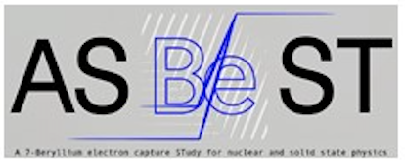
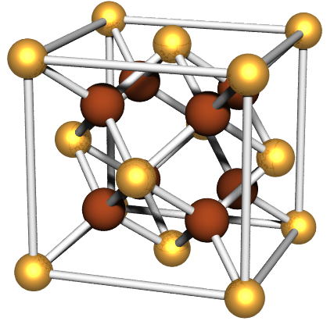
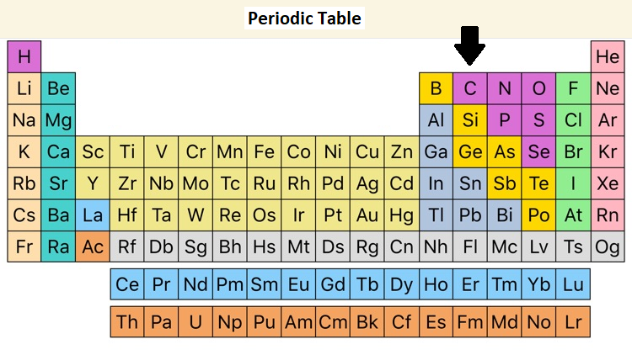
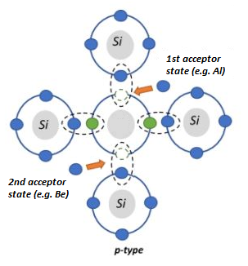
Substitutional Impurities in Solids
Marco Pieruccini CNR-IMM
Why substitution with impurities ?
Doping of semiconductors; e.g. Al borrows one electron to build up four sp3 bonds: $\sim 1 eV$ energy cost. Lattice regularity needed for appropriate level formation
Other issues… e.g. anchoring ${}_{ }^{7}{Be}$ ions in well defined conditions (again lattice regularity). In this case two electrons are needed to build the four bonds, with a cost of $\sim 2 eV$.
Si,
SiC,
…
Tetrahedral
Coord.
Conduction Band
Localized acceptor states
$$E_{g}$$
Valence Band
Note the unbalance of electric charge around the impurity

Slide 2
Ion Implantation in solids
Marco Pieruccini CNR-IMM
Main Features
Controlling: Profile Localization Dose
Implantation produces a metastable locally disordered material: an extremely viscous liquid which would tend to approach the thermodynamically more stable crystalline state
Lattice damage
Beneficial: enhances the probability of substitution (e.g. dangling bonds)
Drawback: need to recover crystal regularity (possible with low damage);
this can be done through
Control of implantation conditions
Post-implantation annealing
Implanted Si on Si
$$\sim 1.5 μm$$
Si

Slide 3
Thermodynamics of a Viscous Liquid
Marco Pieruccini CNR-IMM
Heat Bath
A system in contact with a Heat Bath consists of two interpenetrating subsystems: one made of FAST d.o.f. (short wavelengths) and the other consisting of the SLOW diffusive d.o.f. (long characteristic lengths).
The subsystems are not physically distinct in the sense that in a given set of units whatsoever the d.o.f. are partitioned between the fast and slow classes.
SLOW diffusive d.o.f.
FAST
deg. of freedom
WORK
Ideal equilibrium is described by the red $S(E)$ line. Viscosity onset is accompanied by a reduction of the mean configurational entropy ${Ns}_{c}$.
This regime is parametrized by the mean fluctuation $∆μ_{fast}$:
$$∆μ_{fast}≅Ts_{c}$$
equilibrium
liquid
$$−{Ns}_{c}$$
Entropy
Quenching of SLOW modes: viscosity
WORK = $N∆μ_{fast}$
Total Energy

Slide 4
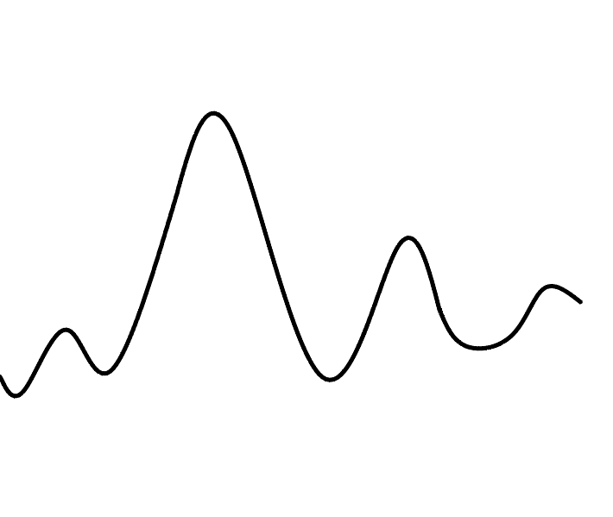
The mean-field specific pseudo-Potential for a Viscous Liquid (from a general minimization of the overall free energy)
Marco Pieruccini CNR-IMM
$${\left\langle E\right\rangle }_{ζ}$$
Without a sufficient energy gain the variety of metastable states cannot be explored
Random probing metastable states
$$S_{b}=−k_{B}\sum_{ζ}{p_{ζ}\ln{p_{ζ}}}$$
Energy
$$ζ$$
$$\left\langle ζ\right\rangle$$
$$F_{c}= \overline{{\left\langle E\right\rangle }_{ζ}W_{ζ}} + λ\overline{{∆μ}_{ζ}} − TS_{b}$$
$$\overline{{\left\langle E\right\rangle }_{ζ}W_{ζ}}$$
$$λ\overline{{∆μ}_{ζ}}$$
Configurations ( time arrow $→$)
Cooling towards $T_{g}$ one has ${\left\langle E\right\rangle }_{ζ}W_{ζ}→0$, that is
$λ≈\frac{\left\langle ζ\right\rangle }{Ts_{c}}$
If a unit succeeds crossing a barrier $\left\langle ζ\right\rangle$ to rearrange, then this energy redistributes among $λ$ other units in the form of configurational entropy.
$$−{ Ns}_{c}$$
Entropy
$$N∆μ_{fast}$$
Energy

Slide 5
Escape from Metastable States in implanted solids…
Marco Pieruccini CNR-IMM
A defect made of $m$ atoms in a semiconductor just implanted is in a metastable state and in regime of strong confinement:
$$m≪\frac{E}{Ts_{c}}≈λ$$
$E$ can’t be reached and the disordered spot keeps frozen.
Need of high-$T$ post-implantation annealing to reduce the theoretical threshold $λ$ …
… or wait for an energy supply (fluctuation)
$$∆E=m(E−mTs_{c})$$
… and Recover Crystal Regularity
Faster process
Lattice disorder is related to configurational entropy. Evolution towards thermodynamic stability (regular crystal lattice) implies a decrease of $s_{c}$ in time (relaxation time approximation + cooperativity):
$$s_{c}$$
$$\frac{ds_{c}}{dt}=−ν_{0}\left({ j}_{ion}\right) e^{− \frac{mE}{k_{B}T}} e^{\frac{{m^{2} s}_{c}}{k_{B}}} \left[s_{c}−s_{cr.}\right]+{\dot{s}}_{ion}$$
$$j_{ion}$$
time
Finite number of attempts $N_{t}$ for damage recovery/substitution

Slide 6
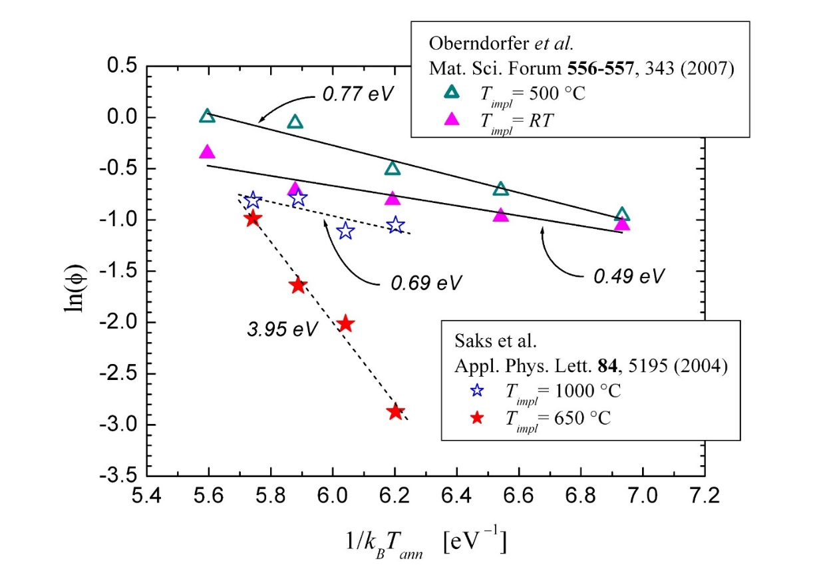
Substitutional fraction $φ$ vs. Implantation/post-impl.-Annealing
Marco Pieruccini CNR-IMM
1) All attempts for substitution ($N_{t}$) occurred during implantation or annealing: $φ=N_{t}p \sim e^{− ∆E /k_{B}T_{ann}}$
$\sim 1 eV$ for Al in 4H-SiC, consistent with the density saturation value, for which
$$F_{mix}=U\left(∆E\right)−TS=0$$
entropy recovery
2) Few attempts for substitution occurred during implantation or annealing: $φ \sim τ_{ann} e^{−\{∆E+{∆E}_{s}\}/k_{B}T_{ann}}$
${∆E}_{s} ≈3 eV$ suggests Al-substitutions in damaged sites (in regular ones it would be much higher)
High implantation damage $→ \left\{\begin{matrix}\text{high} \text{probability} \text{of} \text{substitution}\text{ (}\text{fast} \text{processes}\text{)} \\ \text{difficult} \text{lattice} \text{recovery} \text{on} \text{annealing} \\ \text{small} N_{t}\text{ (}\text{due} \text{fast} \text{kinetics}\text{)}\end{matrix}\right.$
Compromise is needed; relevance of implantation conditions
For ${}_{ }^{7}{Be}$ in 4H-SiC ($∆E≅2 eV$): need of high-$T$ implantation due to limits in $T_{ann}$
$$τ_{ann}=30 min$$
0.58 eV
$$τ_{ann}=5 min$$

Slide 7
END
Marco Pieruccini CNR-IMM

Slide 8
Fluctuations in the slow d.o.f. subsystem are correlated with fluctuations in the fast d.o.f.
Marco Pieruccini CNR-IMM
SLOW
FAST
$${Ts}_{c}≅∆μ_{fast}$$
$$Δμ_{fast}=−k_{B}T\ln\left\{ \frac{\sum_{E≥ζ}{E^{n}e^{−E/k_{B}T}}}{Z_{n,0}} \right\}$$
In an ensemble of $n$ independent oscillators, for which $Z_{n,0}=\sum_{E≥0}{E^{n}e^{−E/k_{B}T}}$, the fluctuations able to trigger a structural transition are those of sufficient energy $E≥ζ$. Alternative picture: cutoff of LONG-wavelength, LOW-energy modes.
$n$ increases on cooling… because this way the density of states increases as well, which enhances the probability that the physical group of units attracts energy from the heat bath.
When the amplitude of the oscillations grows enough, then a structural change takes place.

