Slide 1


INFN Accelerator School 2023 under push of Pierluigi Campana alias
IV course of the
INTERNATIONAL SCHOOL OF PARTICLE ACCELERATORS
«KJELL JOHNSEN, GUSTAV VOSS AND EDMUND WILSON» directed by Thomas Taylor (CERN)
Topic:
Novel acceleration schemes and enabling technologies:
Muon Collider, Plasma acceleration, ERL and dielectrics.

Slide 2
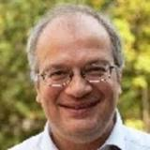
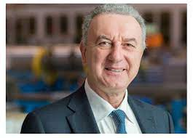
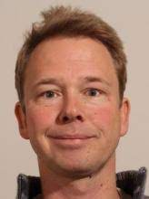
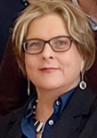
The directors of the 2023 Course
Dr Ralph Assmann
  Desy (previously at CERN till 2012)
  moving to GSI in September 1st, 2023 as Head of Acceleration Operation and Development (ACC) with professorship at Univ. of Frankfurt
  LHC collimation system, Euepan network for Plasma Accelerators, EuPraxia
Prof. Lucio Rossi
  1981 Univ of Milano and INFN-Mi, 2001-2020 CERN, 2020 Univ.of Milano & INFN-Mi
  Italian Sup Cyclotron, LHC SC Magnet System & Superconductor, founder and director (2011-2020) of HL-LHC, Project coordinator of PNRR-IRIS 2022-2025
Dr. Frank Tecker
  CERN
  PS, CLIC, CTF3
  Director of the CERN Accelerator School
Thanks to eng. Tiina Benson,
our tireless problem solver

Slide 3
2023: The beginning of the INFN Accelerator school
2020 INFN has started the initiative of INFN-Accelerators (https://acceleratori.infn.it/it/)
Among various initiatives, the start of the INFN Accelerator School in 2023, using infrastructure of Erice which is already supported by INFN.
2023 there were specialized courses on:
  CAS: on RF and on Magnets
  IAS: SC for accelerators
We have decided to have a general school
  No specific technology, No specific accelerator layout (FCC, or linear collider or orhter)
→ the conclusion was to offer an overview on
  Novel acceleration schemes and enabling technologies: Muon Collider, Plasma acceleration, ERL and dielectrics.
  However, with an introduction to basic and to the present limitations and future goals
  Covering the classical domain of accelerator for fundamental physics…

Slide 4
Professorship and attendance
Organisation started February 2023 : difficult to put together the professor team given the vacation period…
We succeed but relatively late (last confirmation end of April)
So, notice of the school rather late (started in April 2022 for July 2024!)
Competition with many other school this year → medium attendance
→ this made possible to live the school in an interactive methods
Attendance is quite variable, mostly beginners
anyway, difficult to find student (and even professors) expert on all these various field…
So the teaching team was asked to keep an adequate level of lecturing …

Slide 5
Agenda can be retrieved on Indico page accessible from INFN-A
https://agenda.infn.it/event/35286/timetable/#20230727
Beam dynamics basics
Limitations
Muon Collider
Plasma accele-ration
Dielectric accele-ration
ERL
Energy Recovery Linacs
SEMINAR
Intro
Student self–pres.
4 Q&A

Slide 9
INFN Accelerator School 2025
(school will be every two years)
Time slot and timeline
Themes
Decision on the slots:
  3 – 10 October 2025
  5 – 12 November 2025
  December possible, too…
  Max 50 students
Decision by INFN on directorship
  Rossi & Taylor School director
  Ferrario-Rossi-Zimmermann directors of the 2025 Course
→ Advisory Board (7-8 people)
July 2024: Decision on the topic of the 2025 INFN School
October 2024 : list of professors and talks
December 2024: advertising
Target 23 → 40 (50% non-IT)
  Proposal of grants (funding?)
NOW → June 2024
  Call for proposals
  Technology (one or more)
  Type of accelerator (ESPP update?)

