Slide 1
INFaN
Irradiation National Facility Network
Giada Petringa (Laboratori Nazionali del Sud)
Luca Foggetta (Laboratori Nazionali di Frascati)
Terza Giornata Acceleratori
4-5 Aprile 2024 – INFN Frascati National Laboratory

Slide 2
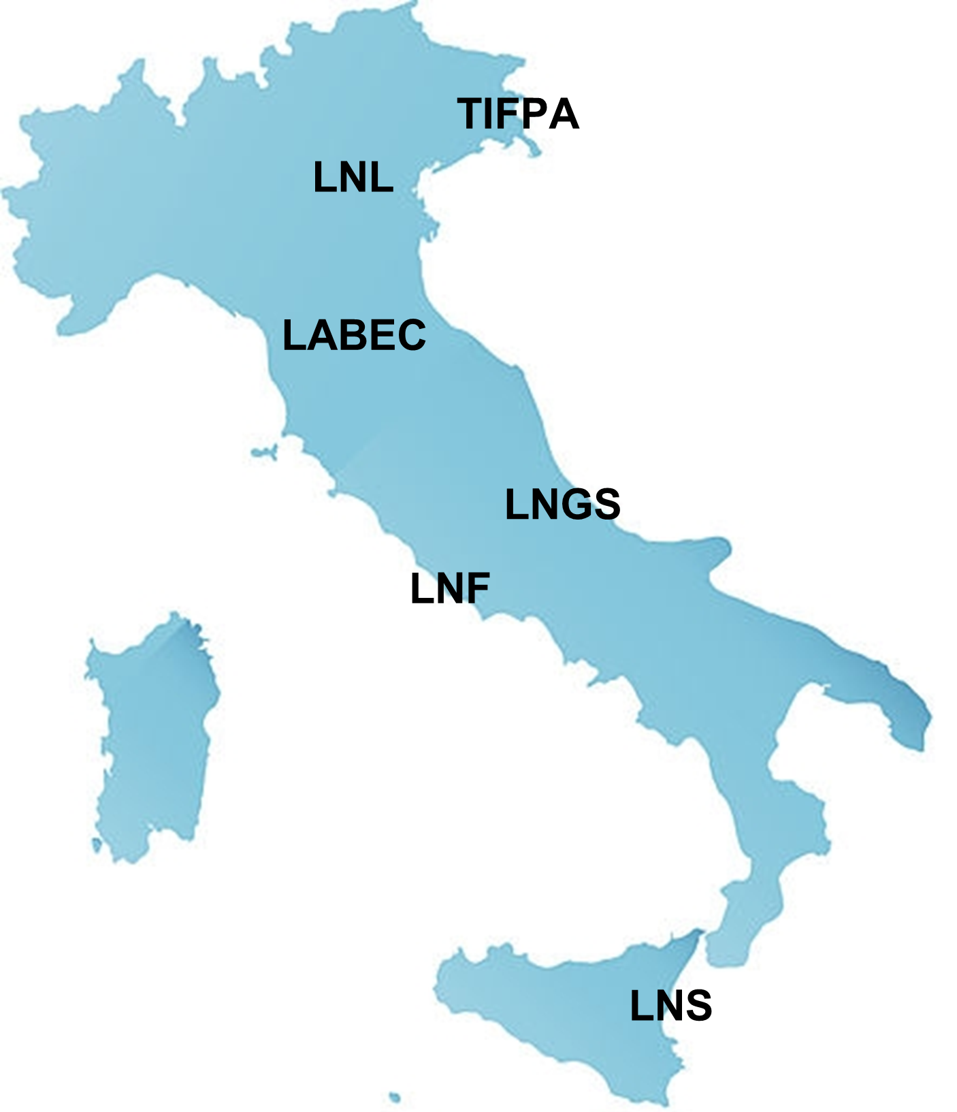
Irradiation National Facility Network: the main goal
2
The proposal is initiated in INFN-A environment to establish an internal INFN network connecting IRRADIATION facilities that are dedicated to external users.
This proposal is founded on a shared request for abstraction and synergy among the numerous scientific, technological, and technical management experiences of irradiation facilities across the national territory and under the management of INFN.
Single and independent way of working
Collaborative win-win approach
AIMS
INTERNAL NETWORK: Establish an internal network within INFN for scientific, technological, technical, and infrastructure exchange between irrad facilities for mutual operational benefit.
GENERALIZED INFRASTRUCTURE with NATIONAL SERVICEs: Utilize a generalized infrastructure based on national services that includes information, beam time calls, and access procedures to INFN irrad facilities for scientific and third-mission purposes, while respecting the usage norms and local customs of the facilities, which will integrate into an abstract IT infrastructure.
COMMON FUNDING: the collection of funds to implement innovative and experimental operational solutions (e.g., detectors, hardware and software infrastructure) of shared ownership and common use, as well as to support and implement the network itself.
Contacted facilities
(up to now only charged one)

Slide 3
INFaN - members
3
INFN Site | INFaN | Contact E-mail PAC (ask for beam) | Reference/Call Site
INFN-LNF | Luca Foggetta | luca.foggetta@lnf.infn.it btf_sciresp@lists.lnf.infn.it | https://booking.dsi.infn.it/ https://btf.lnf.infn.it
INFN-LNS | Giada Petringa | giada.petringa@lns.infn.it | https://www.lns.infn.it/it/user/come-chiedere-fascio.html
INFN-LNL | Luca Bellan | luca.bellan@lnl.infn.it PACbeams@lnl.infn.it | https://www.lnl.infn.it/ https://www.lnl.infn.it/en/call-for-pac-proposals/
INFN-LNGS | Matthias Junker | matthias.junker@lngs.infn.it Bellotti-IBF-PAC@lngs.infn.it | https://l.infn.it/bellotti
INFN-FI (LABEC) | Mirko Massi Massimo Chiari | massi@fi.infn.it chiari@fi.infn.it | https://web.infn.it/labec/en/elementor-111/
INFN-TIFPA | Francesco Tommasino Enrico Verroi | francesco.tommasino@tifpa.infn.it enrico.verroi@tifpa.infn.it | https://www.tifpa.infn.it/sc-init/med-tech/p-beam-research/
temporarily stopped due to the upgrade

Slide 4
Regular meetings involving the entire network and official talks to share the network activity
4
First INFaN meeting on 21/06/2023
Discussion on proposal and establishment of the network.
The proposal was highly valued (thanks to INFN-Acceleratori!)
Especially for the collaborative efforts: software development for applications, CSN-V call, ...
Certain facilities (recently opened or undergoing upgrades) demonstrate significant interest in national tools (data delivery/storage, e-ticketing, logging).
A common requirement was identified: the need for more dedicated personnel for project implementation (outsourcing is also possible).
Second INFaN meeting on 11/07/2023
Specifically for the demonstration of call management software.
Detailed presentation of the national services involved and onsite demonstration.
Strong interest from the participating facilities and subsequent follow-up.
Some have suggested their own IT staff to be engaged, already keen on establishing an Expanded IT Group for data/DB control and management systems.
Readiness to adopt the software by some, along with the requirement for additional IT manpower (2 FTEs relocated for two years + infrastructure maintenance)
Dedicated talk during the periodical CSNV meeting - 24/07/2023
Dedicated talk @Giornata monotematica SIRR - 30/11/2023

Slide 5
Generalized common infrastructure
National Level
Distributed IT facility for INFAN
Local Level (Customizable)
INFN main site
Facility web site
National service
fully mantained
more reliable
wiki.infn.it
@lists.*.it
GODIVA
AAII
Userportal
Booking
DB
Backup
Territorial access
Light web DB facility
Wiki.infn
Calls Newsletter (now performed by hand replies)
Mailing list
Local level object linking
Booking app
Guided path to best beam needed
Own call DB
Dissemination
Repository Software
BTF way of operation could explore a new paradigm of working for easy develop and integration from external project and internal collaboration
Data Logging

Slide 6
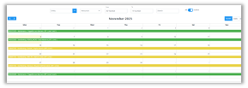
Booking DSI SW
Booking DSI: Facility beam time and users management software based on an automated approval workflow.
Call for users and calendar management. Users' territorial and lab access. Auth Process and ticketing traceability.
INFN LNF developing
Beam Test Facility(BTF)
More than one year of continuous operation​
Few bugs in the first two months (only losing some user shifts display on UI but the automation worked well) ​
Weekly, last-minute shift, renunciation or rebooking​
> 300 users in automated managed shift (weekly based) up to now
DAɸNE-L Facility
In final developing, test started
Many lines, authoritative beam line scientist and PAC approval
Daily opportunity fast entrance and scheduled shifts
INFN-LABEC developing
Released few month ago
Collaboration born on INFN-A
Similar aim (internal or users management)
Many lines: 5 for TANDEM facility
Typical developing time ~3 person-month
(full customization, design-devel-test-debug)​
Definitely simple to use, as reported by users​
IT infrastructure seems reliable
Tech note
https://www.openaccessrepository.it/record/143679
Developed by G. L. Napoleoni (LNF Computing Center, main dev.), R. Orrú, M. Tota. BTF group, LNF AD-Secretariats and Personnel-Secretariats

Slide 7
What is the next?
AIMS
INTERNAL NETWORK: Establish an internal network within INFN for scientific, technological, technical, and infrastructure exchange between irrad facilities for mutual operational benefit.
GENERALIZED INFRASTRUCTURE with NATIONAL SERVICEs: Utilize a generalized infrastructure based on national services that includes information, beam time calls, and access procedures to INFN irrad facilities for scientific and third-mission purposes, while respecting the usage norms and local customs of the facilities, which will integrate into an abstract IT infrastructure.
COMMON FUNDING: the collection of funds to implement innovative and experimental operational solutions (e.g., detectors, hardware and software infrastructure) of shared ownership and common use, as well as to support and implement the network itself.
partially on going
Next topic = Logging
we have to understand how to proceed

Slide 8
Thanks for your attention

Slide 9
Presentazione in CSNV – Luglio 2023
Possibile sigla sperimentale in CSNV
4
Sviluppo di rivelatori e diagnostiche innovative da installare nelle facility
Creazione di uno standard (hardware & software) comune tra le facility
Personale dedicato all’implementazione e al mantenimento della struttura generalizzata
Al momento sembra che la CSNV non possa accettare un progetto avente queste caratteristiche
Call CSNV
Nuova proposta
Esperimento CSNV

