Slide 1


Attività Sapienza su acceleratori e PNRR: stato e prospettive
L. Palumbo
D. Alesini, G. Bisogni, F. Bosco, F. Cardelli, M. Carillol, E. Chiadroni, G. Cuttone, D. De Arcangelis, A. Di Gregorio, R. Di Raddo, L. Faillace, L. Ficcadenti, G. Franciosini, G. Franzini, A. Gallo, L. Giuliano, V. Lollo, M. Magi, M. Migliorati, A. Mostacci, P. Cirrone, L. Palumbo, V. Patera, L. Piersanti, S. Pioli, R. Remetti, A. Sarti, B. Spataro, G.Torrisi, A. Vannozzi

Slide 2
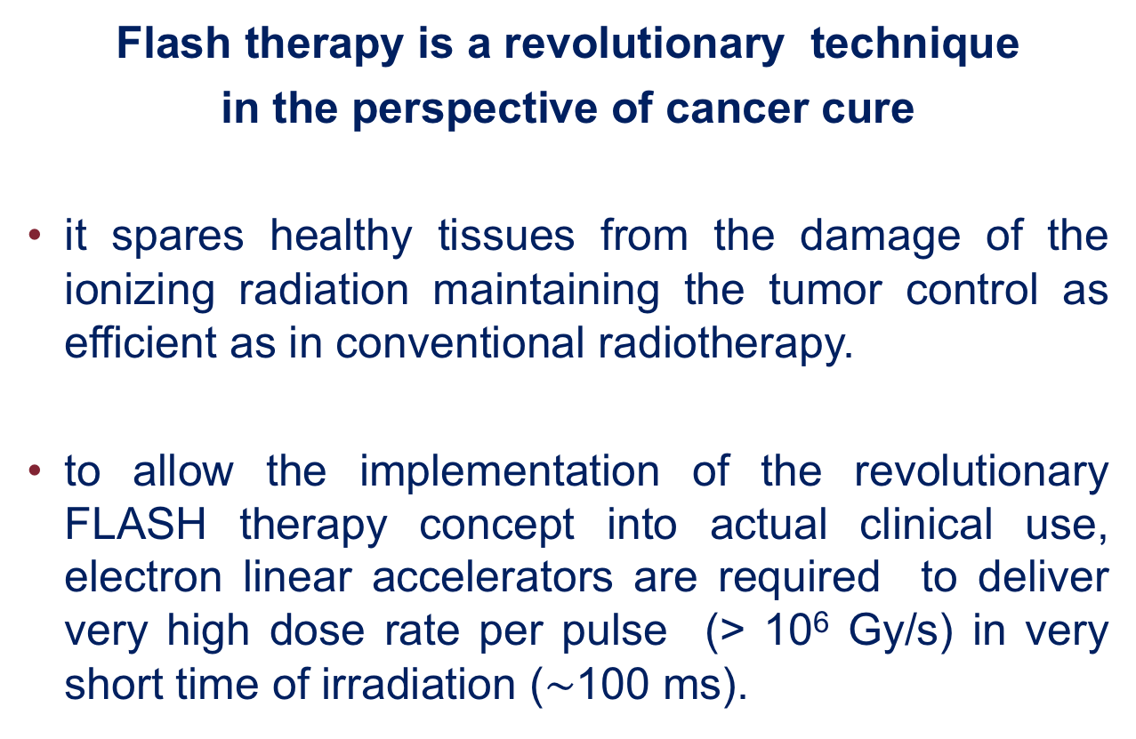
Flash therapy is a revolutionary technique
in the perspective of cancer cure
it spares healthy tissues from the damage of the ionizing radiation maintaining the tumor control as efficient as in conventional radiotherapy.
to allow the implementation of the revolutionary FLASH therapy concept into actual clinical use, electron linear accelerators are required to deliver very high dose rate per pulse (> 10⁶ Gy/s) in very short time of irradiation ($\sim$100 ms).
INFN Acceleratori - LNF, 4-5 aprile 2024

Slide 3
Is the evidence robust?
DOSE MODIFYING FACTOR
First evidence on animals….. Much less damage to standard tissue for same dose release
Mouse skin treated with electron beam
Conventional therapy
34 Gy 31 Gy 28 Gy
INFN Acceleratori - LNF, 4-5 aprile 2024

Slide 4
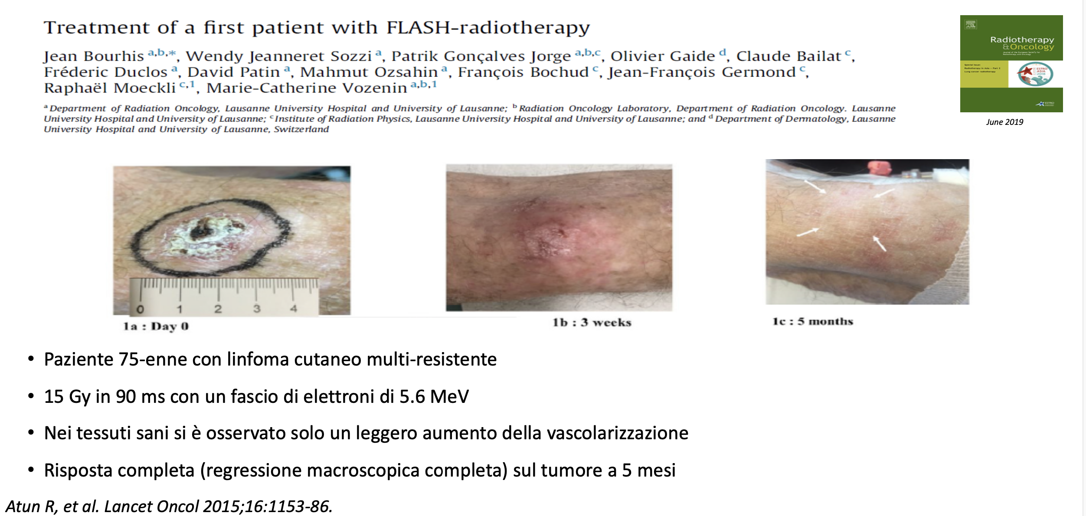
Is the evidence robust?
The evidence seems robust, even if the exact features are yet to be explored. The first patients has been already treated!!!
Electron Beam 5.6 MeV, 15 Gy in 90 ms
INFN Acceleratori - LNF, 4-5 aprile 2024

Slide 5
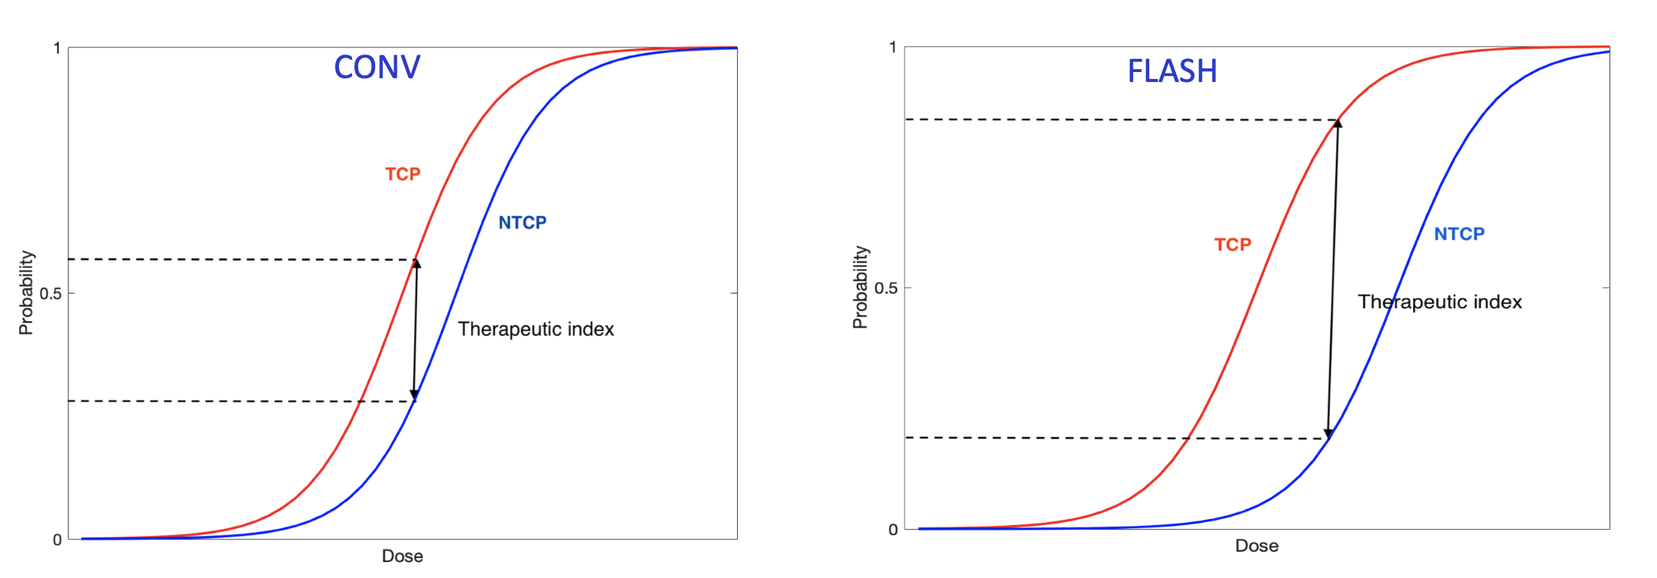
FLASH EFFECT
Probability
Probability
Dose
Dose
TCP = Tumor Control Probability
NTCP = Normal Tissue Complication Probability
INFN Acceleratori - LNF, 4-5 aprile 2024

Slide 6
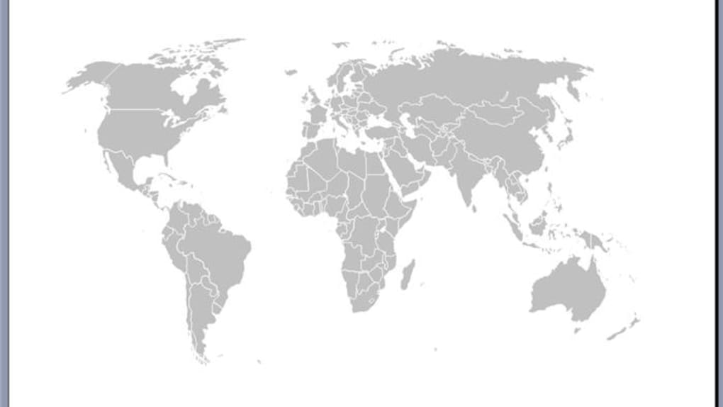
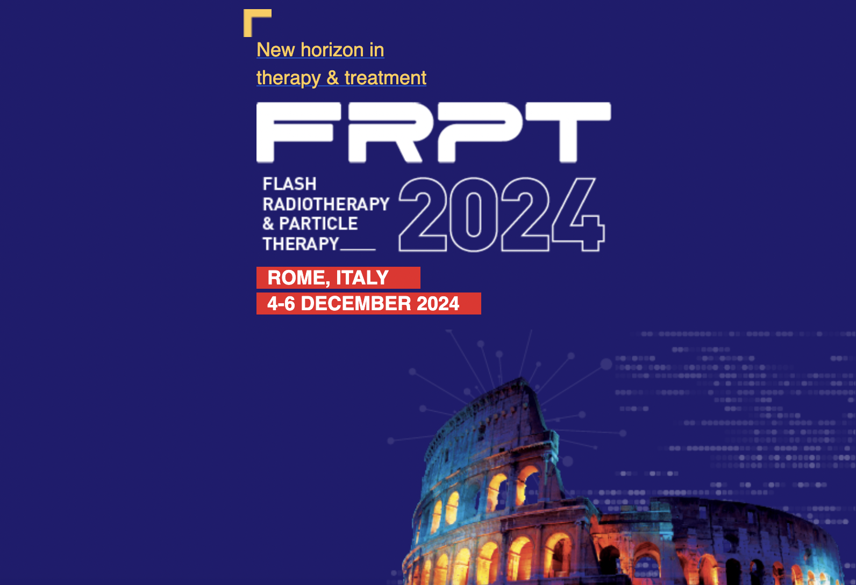
ELECTRON FLASH LINACS
Anversa EF
Lund
Elekta SL75
Oxford
Rossendorf
ELBE
Tsinghua CN
Curie
EF
CHUV
Oriatron e6
Stanford Varian clinac 21ex
PisaEF
Catania EF
Atlanta Univ. USA
CLEAR
CERN
Roma C-b
INFN Acceleratori - LNF, 4-5 aprile 2024

Slide 7
What does it mean in terms of dose delivery?
INFN Acceleratori - LNF, 4-5 aprile 2024

Slide 8
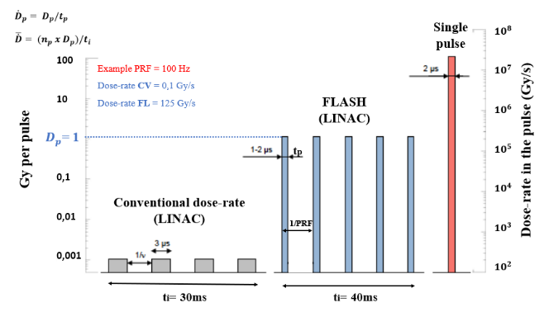
CONVENTIONAL VS FLASH
INFN Acceleratori - LNF, 4-5 aprile 2024

Slide 9
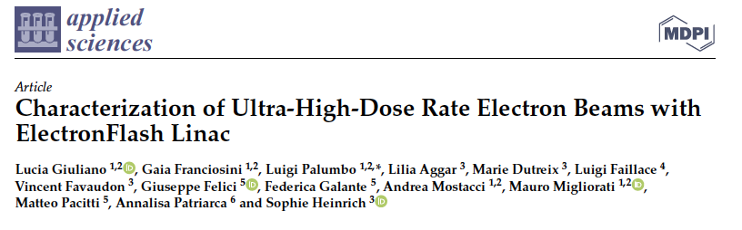
2020 Electron ELECTRON-FLASH 7 MeV – SIT Company
2023

Slide 10
TOWARD VHEE LINACS
FOR DEEP TUMORS
INFN Acceleratori - LNF, 4-5 aprile 2024

Slide 11
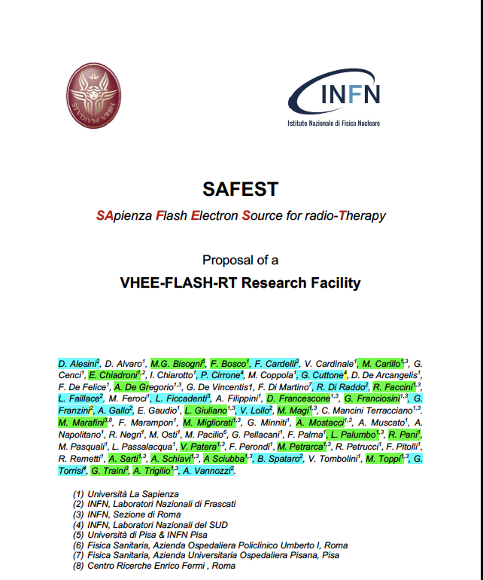
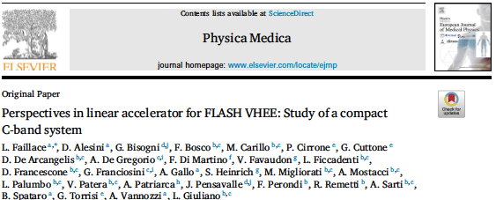
JOINT
STUDY GROUP
SAPIENZA – INFN
2021
2022
2022
INFN Acceleratori - LNF, 4-5 aprile 2024

Slide 12
What range of energy ?
INFN Acceleratori - LNF, 4-5 aprile 2024

Slide 13
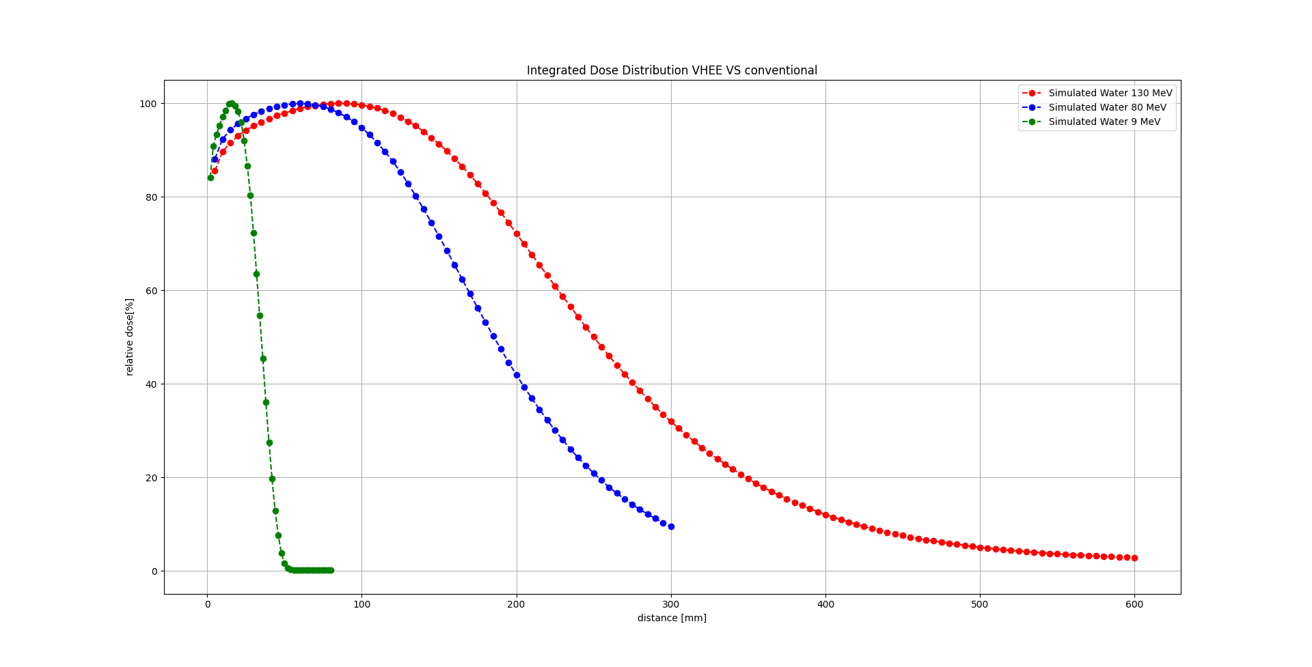
PDD Integrated Dose – 9 MeV, 80 MeV, 130 MeV
,
Percentage Depth Dose curve
100%
Beam spot 3 cm
Integrated Relative Dose
9 MeV
80 MeV
130 MeV
1
10
20
30
40
50
cm
1
10
Never introduced such VHEE in clinical RT till now!

Slide 14
1. VHEE BETTER THAT PHOTONS EVEN WITHOUT FLASH
SIMULATIONS WITH MONTECARLO CODE SHOW THAT
2. VHEE COMPARABLE WITH PROTONS IN CASE OF FLASH
(V. PATERA)
INFN Acceleratori - LNF, 4-5 aprile 2024

Slide 15
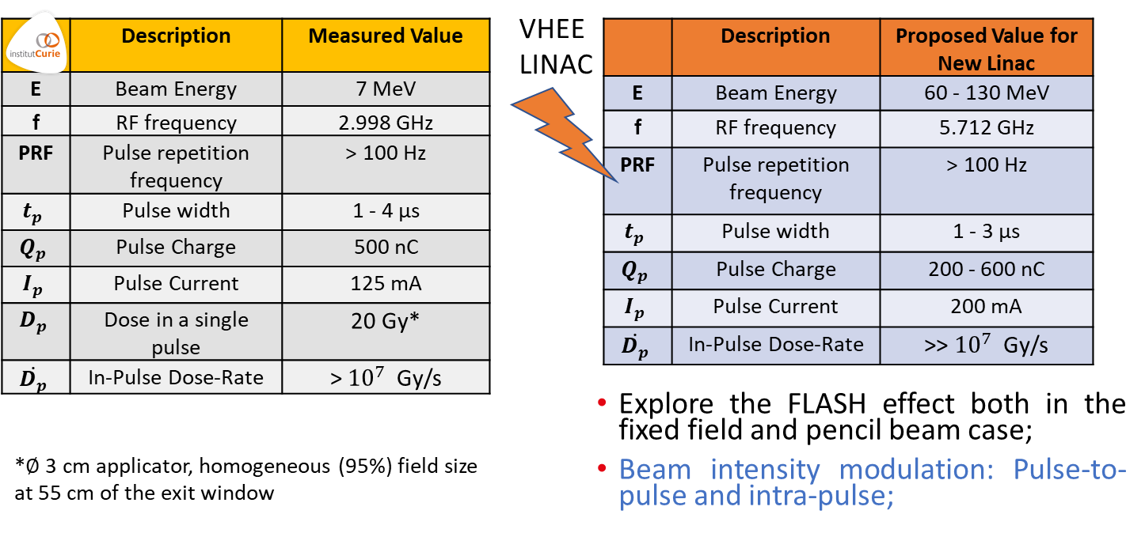
INFN Acceleratori - LNF, 4-5 aprile 2024

Slide 16

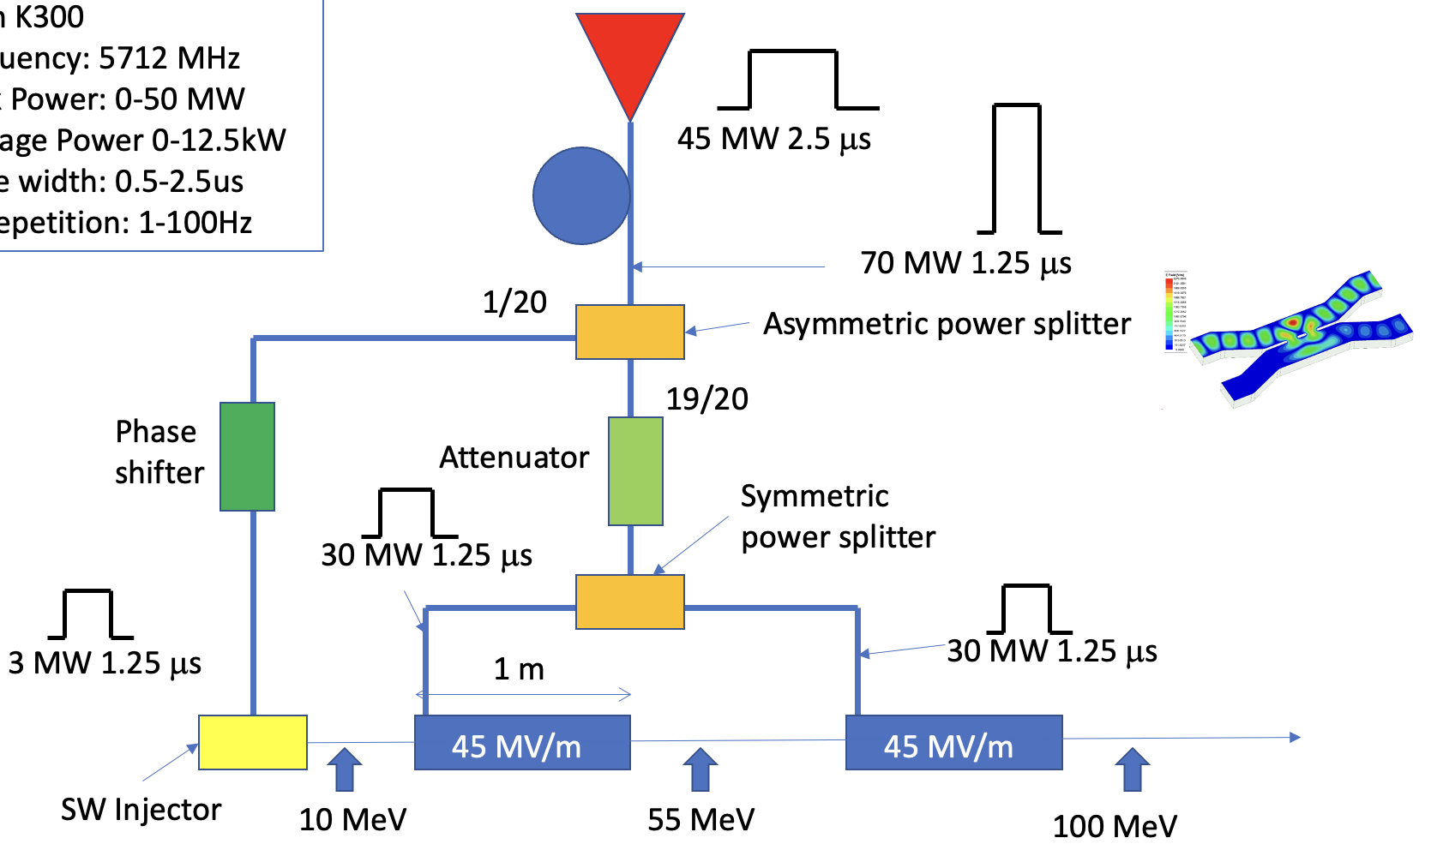
SCHEME FOR 100 MeV Linac
Frequency | 5.712 GHz
Beam Energy | 65 - 100 MeV
RF Repetition rate | 100 Hz
Current | 100 mA
C-band average accelerating gradient | 45 MV/m
RF pulse duration | 1.5 – 2.5 μs
In pulse dose rate | > 10^6 Gy/s
Average dose rate | > 100 Gy/s
Dose per pulse | >> 1 Gy
Standing wave Injector
Traveling wave

Slide 17

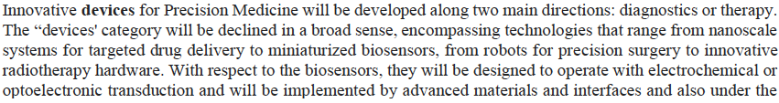

* Inizialmente insieme a INFN (G. Cuttone)

Slide 18

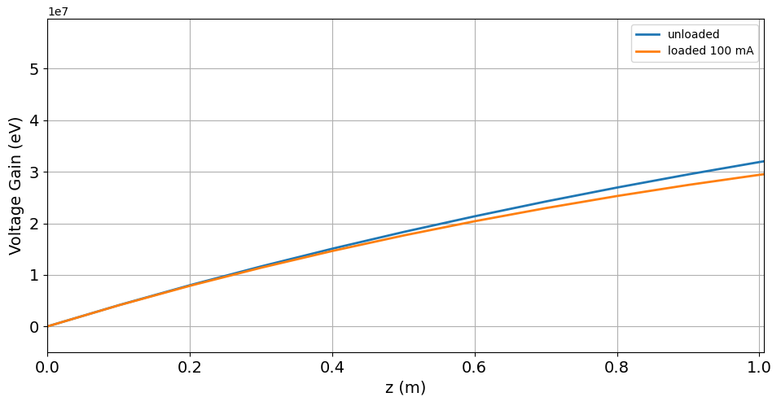

FLASH FUNDED WITH BUDGET 1.7 ME
5.5 MW
5 μs
Pulse compressor 17.5 MW, 1.6 μs
Asymmetric power splitter
Phase shifter
Attenuator
15 MW
SW Injector
TW Structure
OBIETTIVO INIZIALE
REALIZZATO PRESSO SIT, TRASFERITO ALLA SAPIENZA A FINE PROGRAMMA

Slide 19
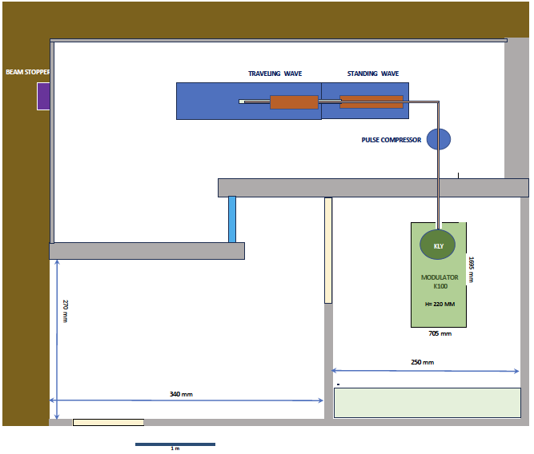
SIT ha ridotto la sua partecipazione
Budget Trasferito a Sapienza
Laboratorio FLASH presso SBAI
Lavori per adeguamento laboratorio da iniziare in autunno

Slide 20
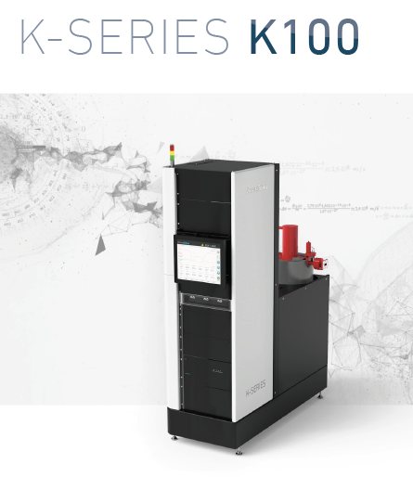
SCANDINOVA
5.5 MW
5 μs

Slide 21
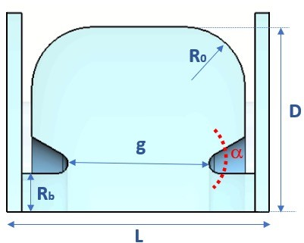
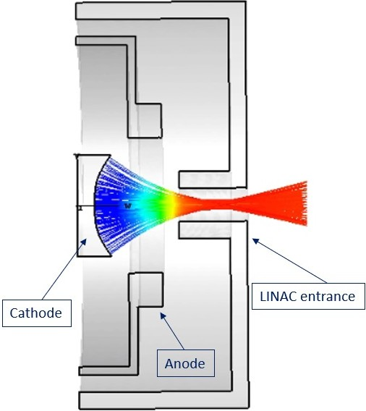
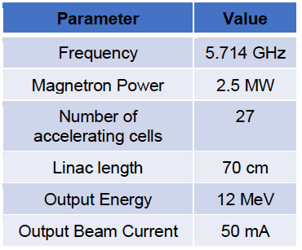
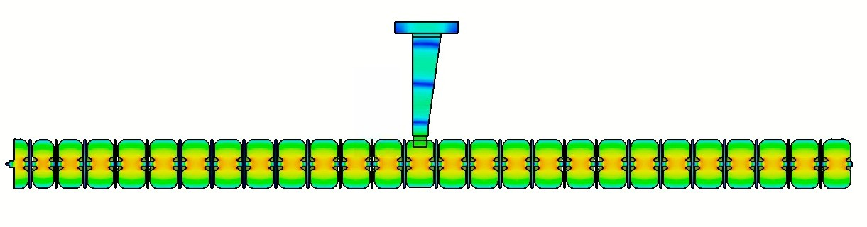
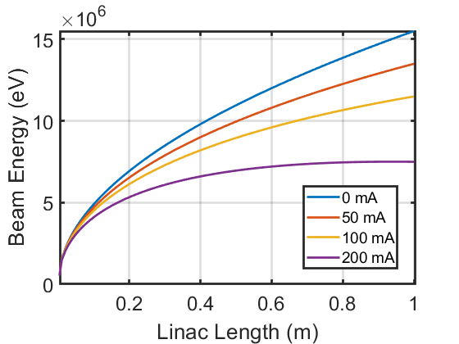
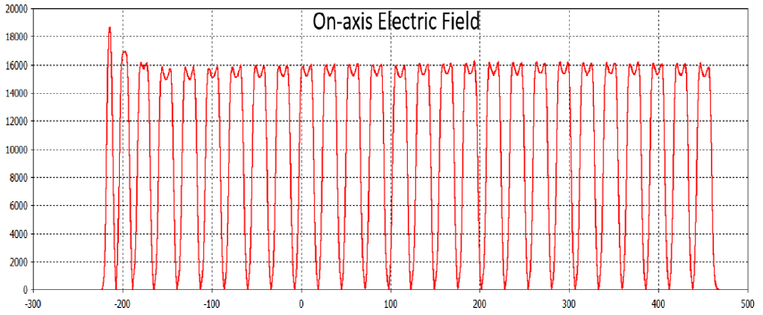
DESIGN AND PROTOTYPING OF SW injector
Electron source: DC thermionic gun at 15 kV.
Single cell parameters [mm]
D | g | L | Rb | Ro | α
38.25 | 15.6 | 24.4 | 3 | 6 | 30°
Cavity type: standing wave, bi-periodic, on-axis coupling cells
Electromagnetic field: π/2 accelerating mode
Nose - cone geometry: high electric field at the noses zone
Bunching section for low-energy beam capture (> 45%)
Beam energy up to ≈ 10 MeV and 100 mA beam peak current
Power in
Input
2023
DC gun
10 MeV
Bunching section
100 mA

Slide 22
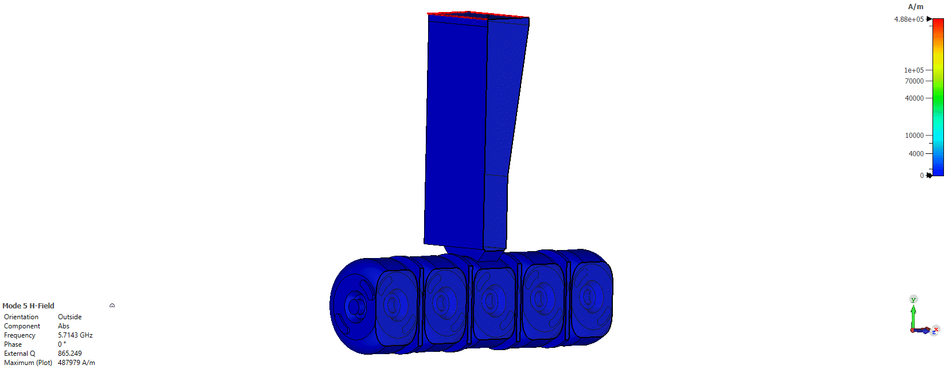
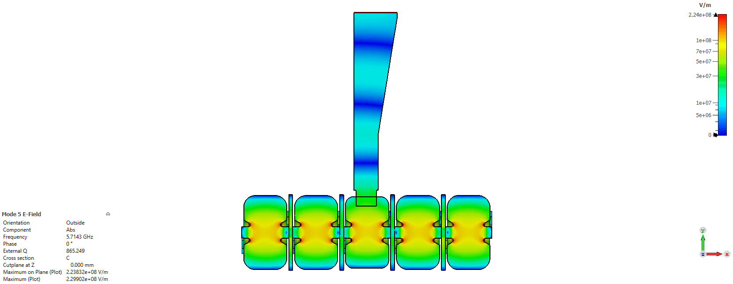
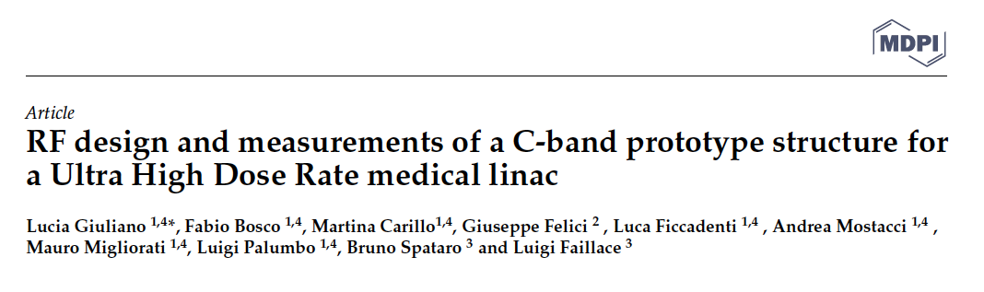
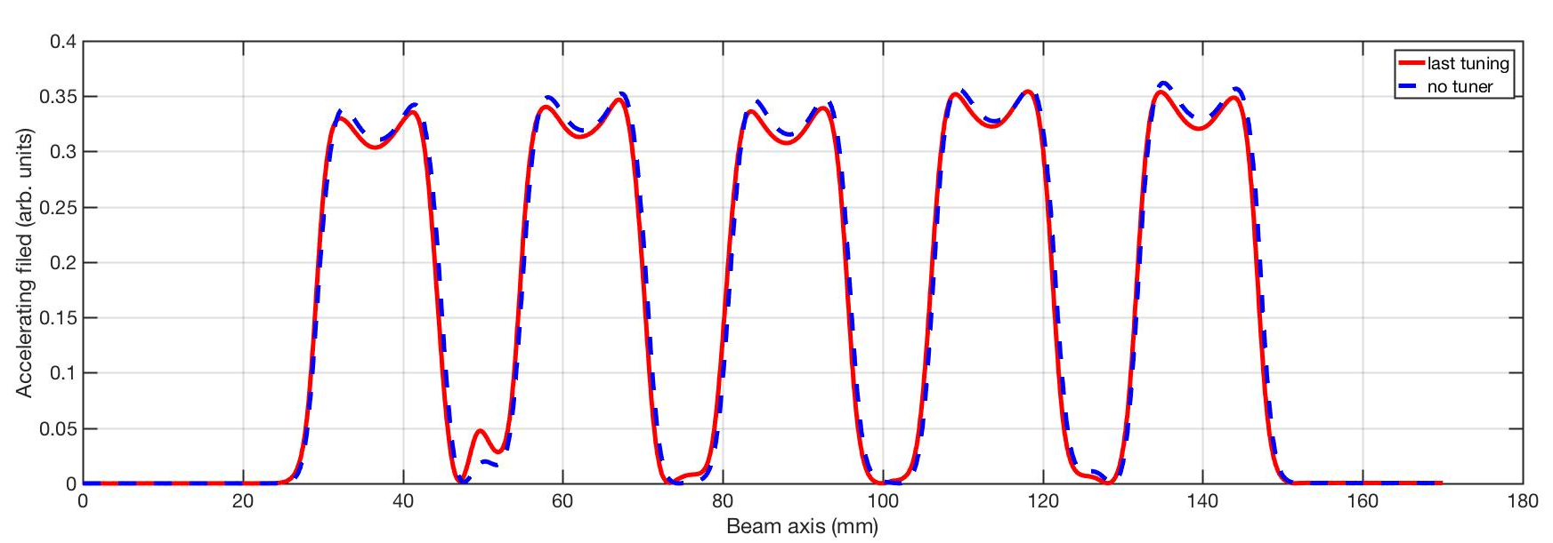
SW biperiodic 𝜋/2 structure prototype
Input power
H field
E field
Resulting profile of the on-axis accelerating electric field

Slide 23
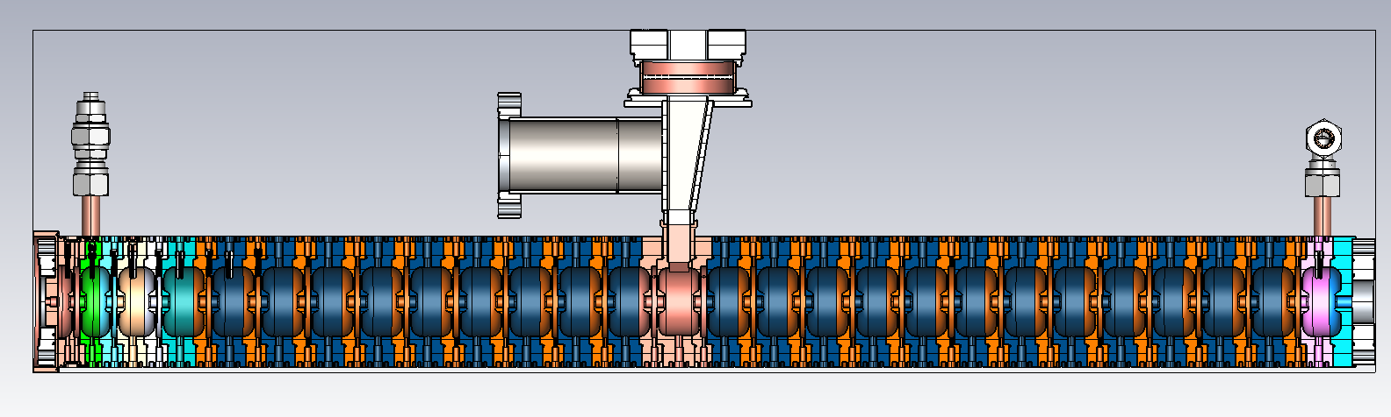
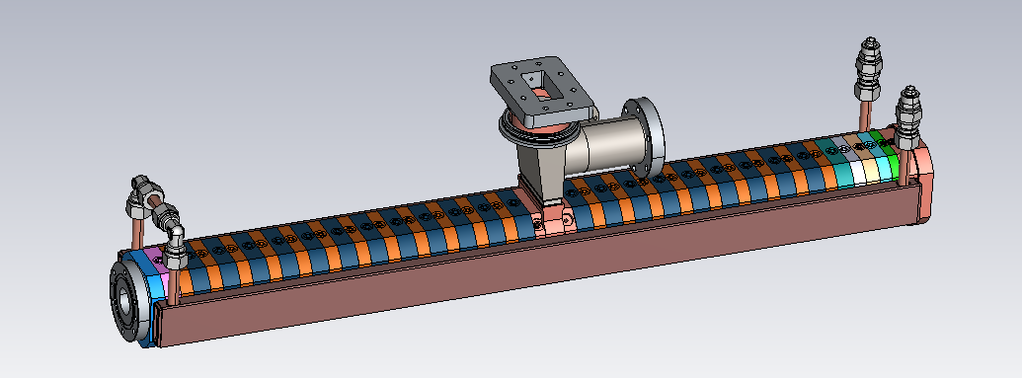
Mechanical drawing of the SW linac (SIT)
prototyping on going

Slide 24
5.5 MW
5 μs
Pulse compressor 17.5 MW, 1.6 μs
Asymmetric power splitter
Phase shifter
Attenuator
15 MW
SW Injector
TW Structure

Slide 25
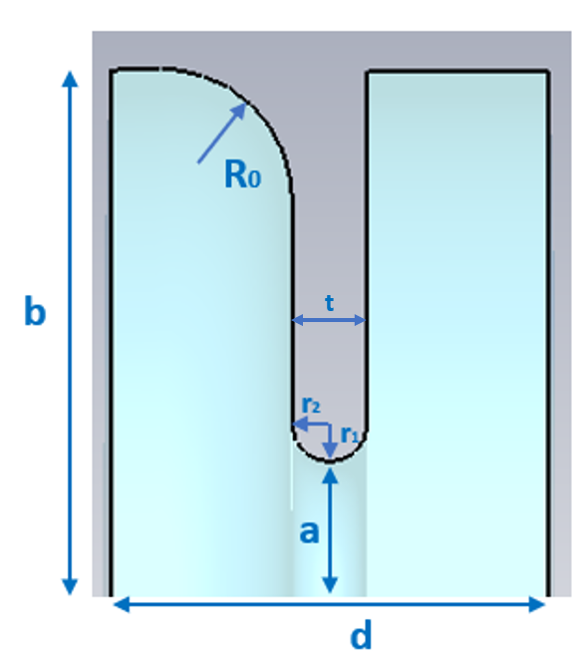
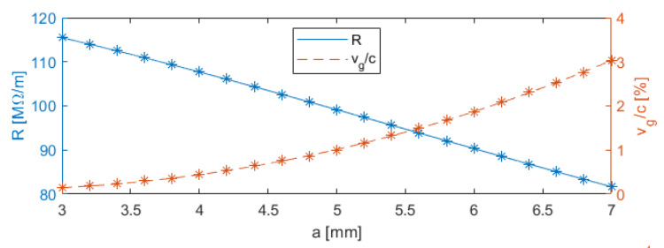
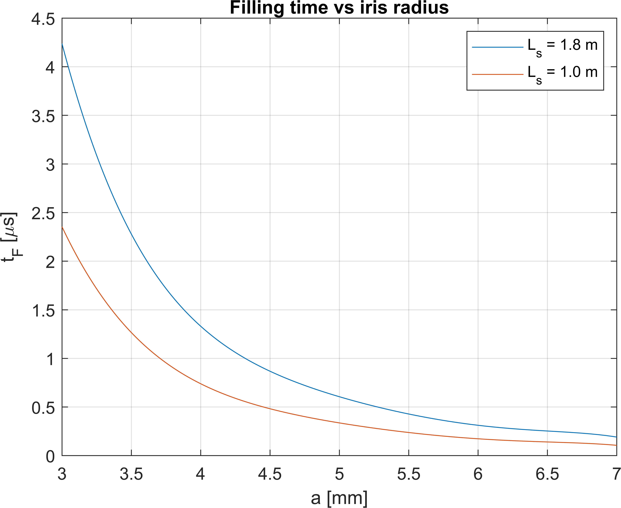
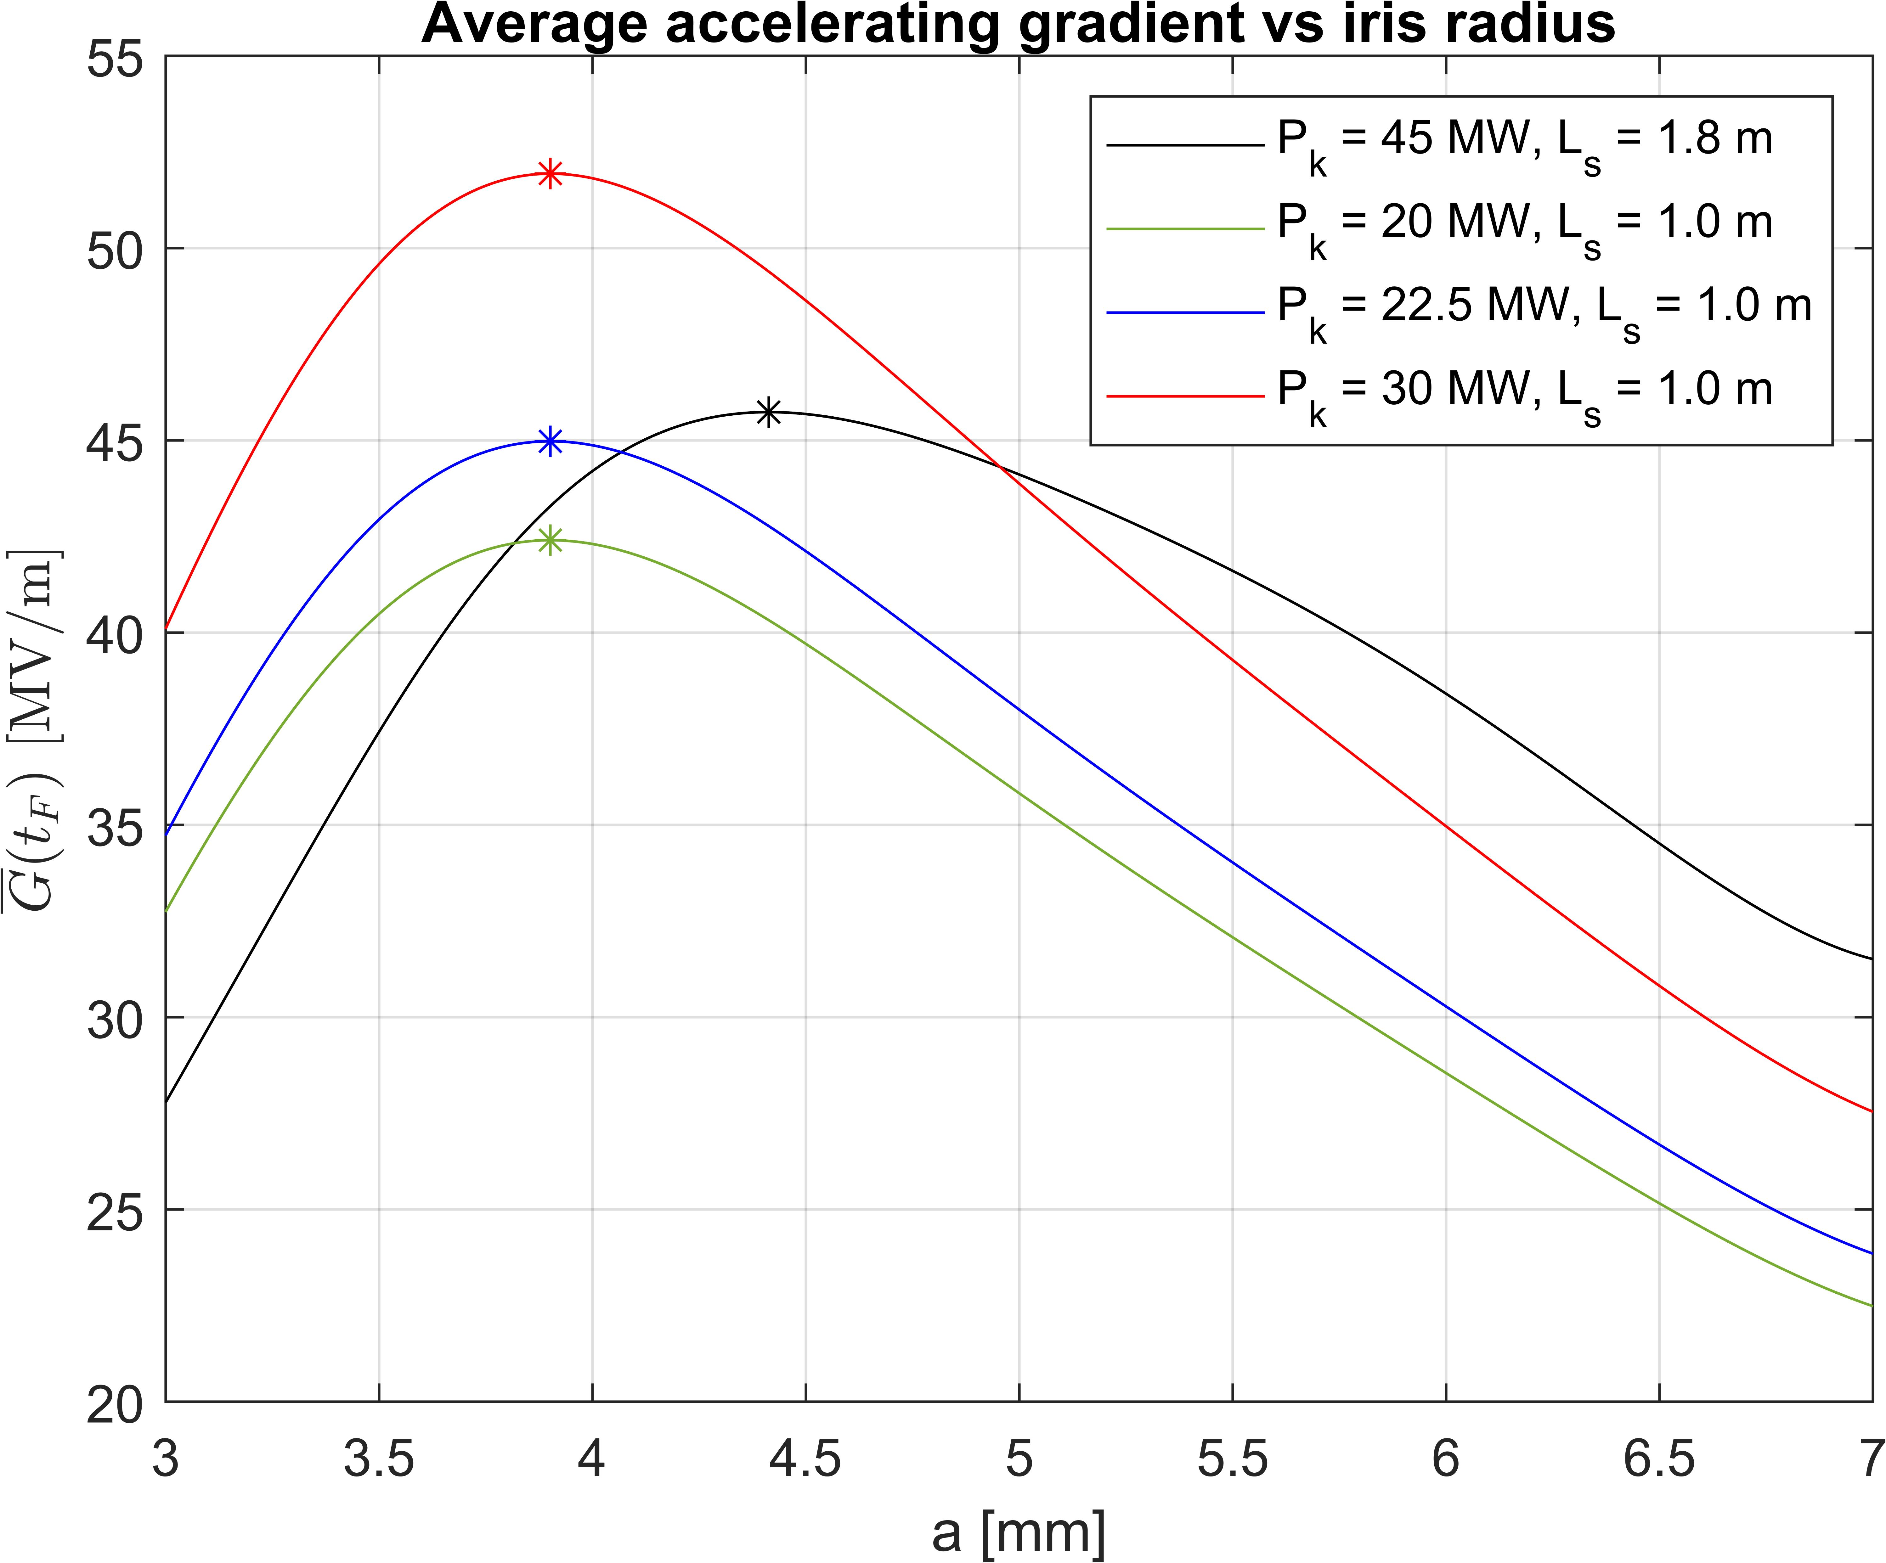
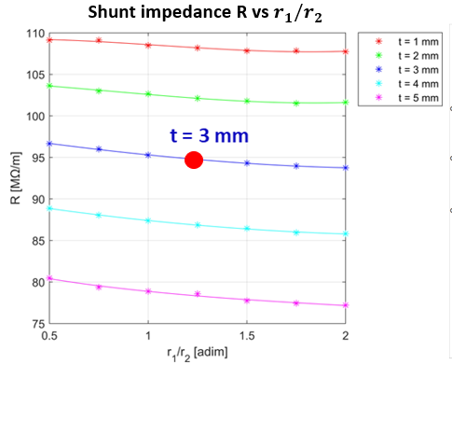
DESIGN AND PROTOTYPE TW HIGH GRADIENT (2/3)𝜋
Single Cell design
Single cell RF parameters in mm
a | b | d | R0 | t | r1/r₂
5 | 21.03 | 17.5 | 6 | 3 | 1.25
IRIS OPTIMIZATION
Shunt impedance R = 95 MΩ/m for r1/r2 = 1.25 and t=3

Slide 26
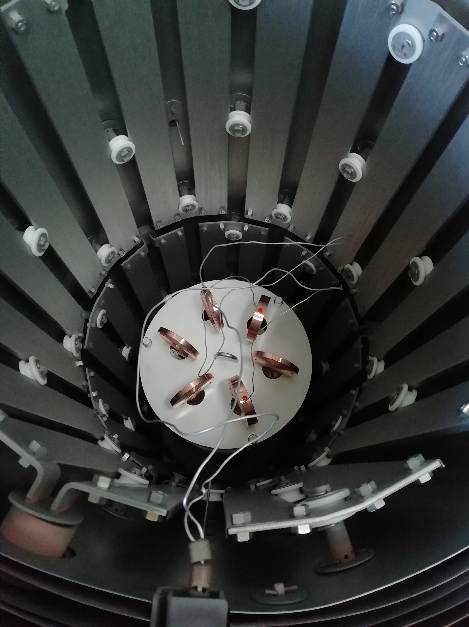
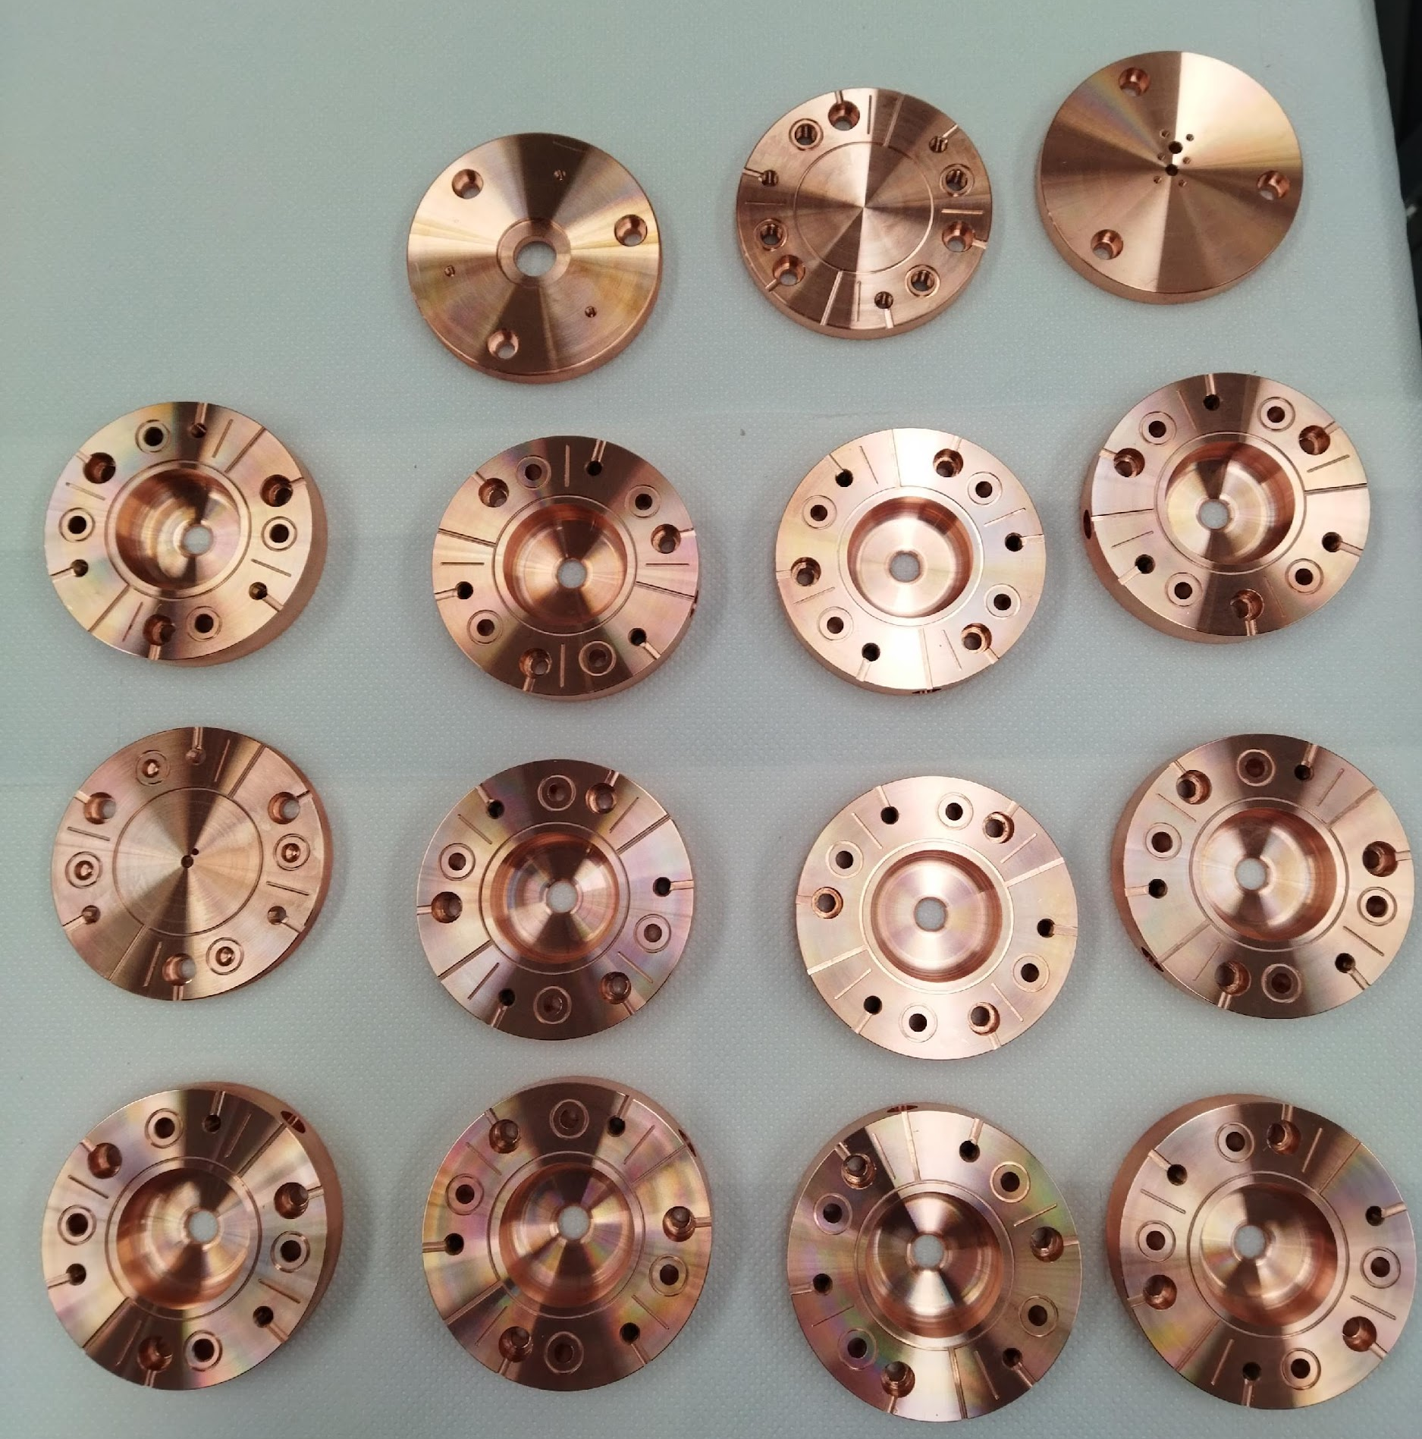
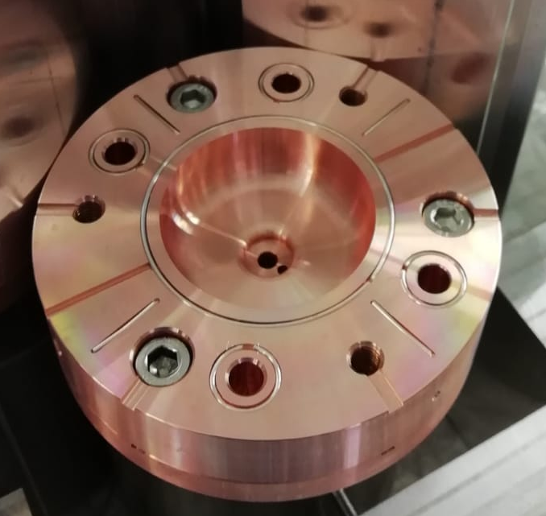
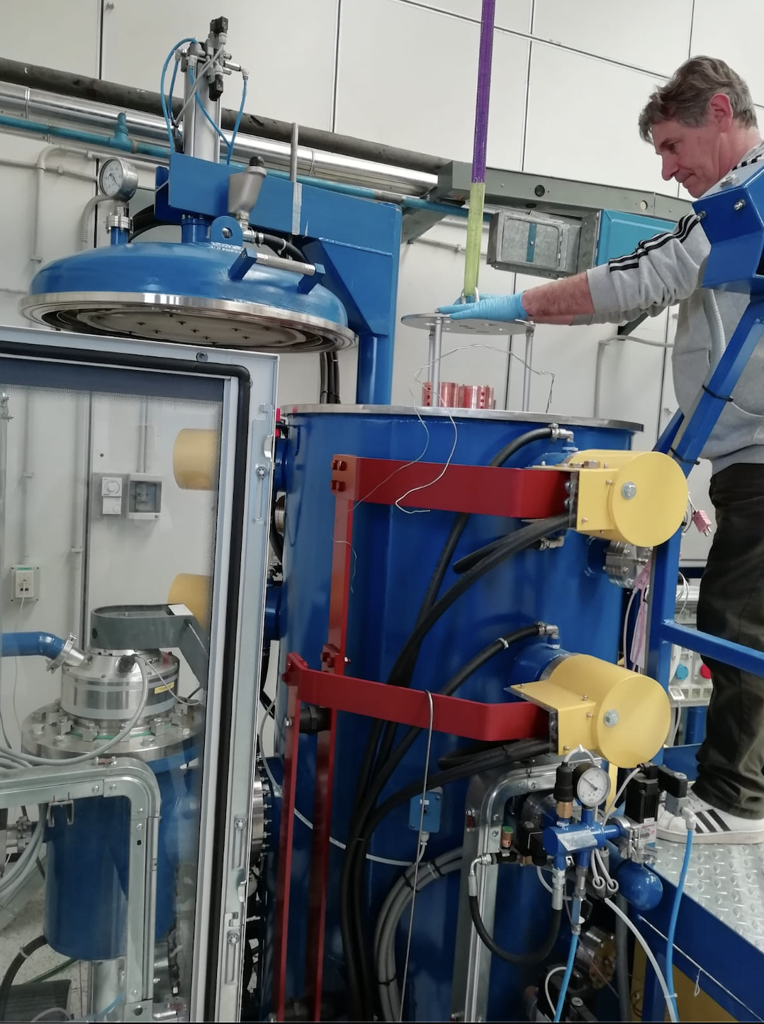
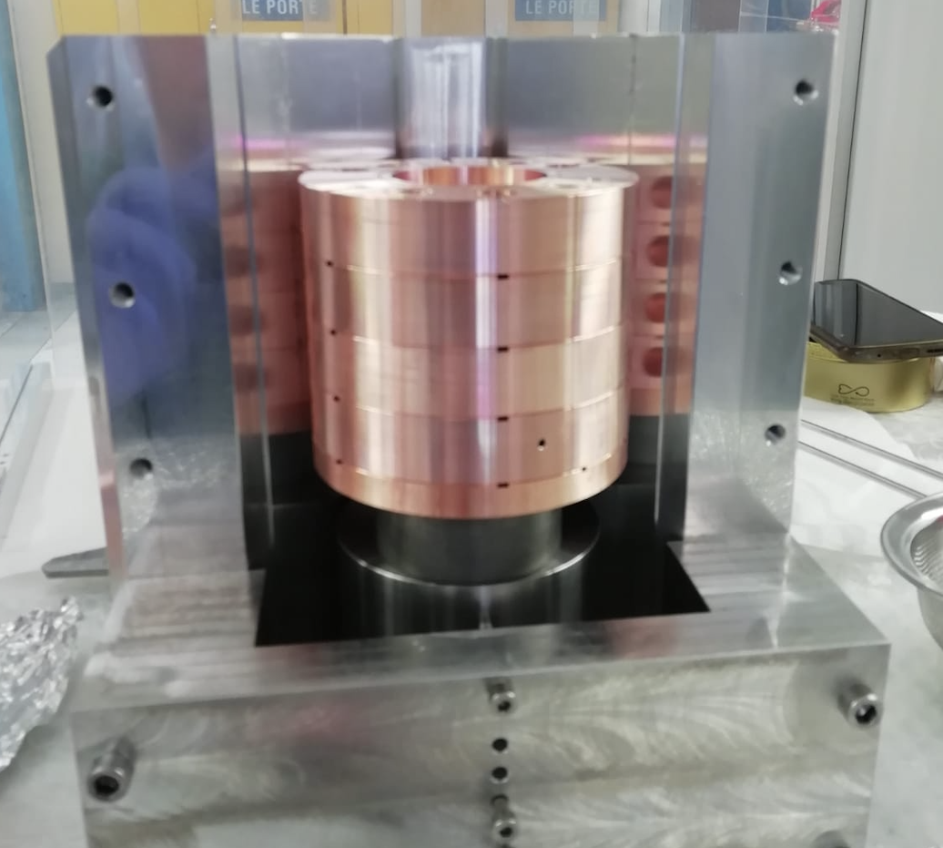
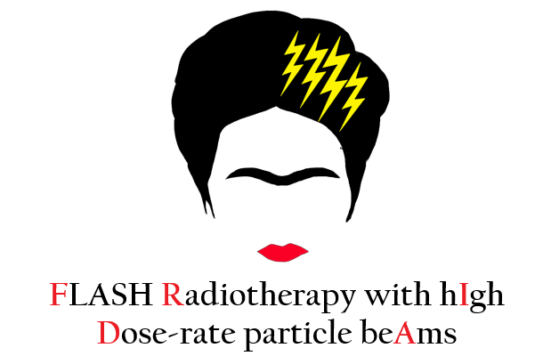
Prototyping phase 1
Two pre-prototypes on 5-cells without couplers to test the brazing procedure, vacuum sealing and the in-house mechanical design.
Brazing alloy
Water hole
Screws to join the cells
In house building of the accelerating cavities
Main contributors: D. Alesini, R. Di Raddo, L. Faillace, L. Giuliano, M. Magi, M. Migliorati
INFN Acceleratori - LNF, 4-5 aprile 2024

Slide 27
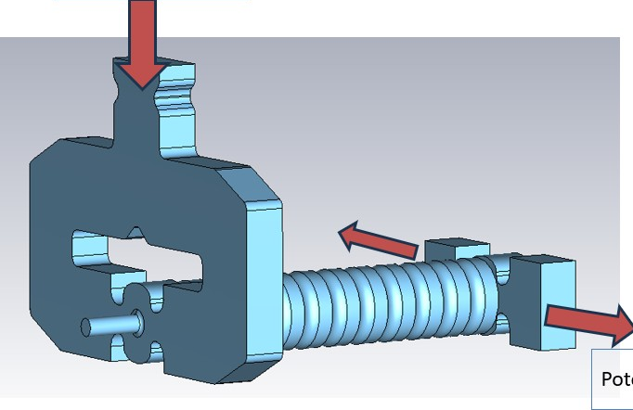
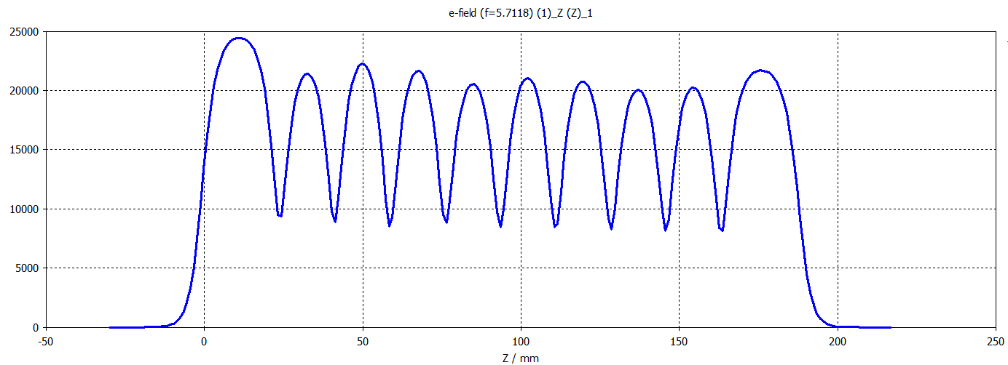
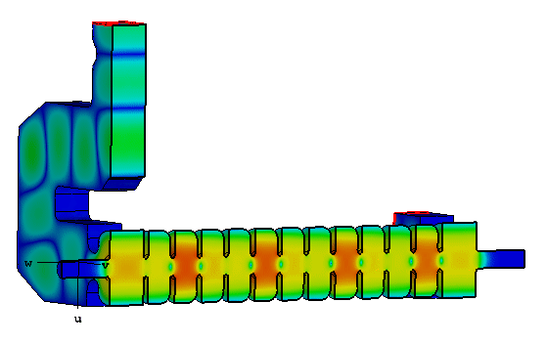
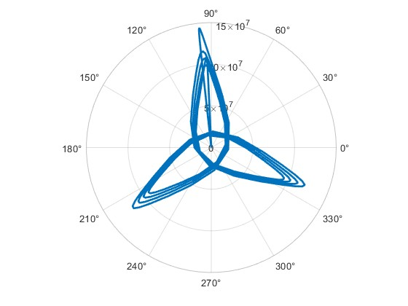
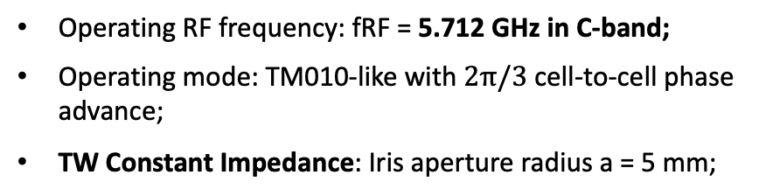




Prototyping phase 2
Single Cell design
Power in
Asymmetric cell to facilitate in-house mechanical processing.
Dual-feed different input and output RF power couplers
a | b | d | R0 | t | r1/r₂
5 | 21.03 | 17.5 | 6 | 3 | 1.25
Beam axis
Power out
3D Electric field on beam axis
INFN Acceleratori - LNF, 4-5 aprile 2024

Slide 28
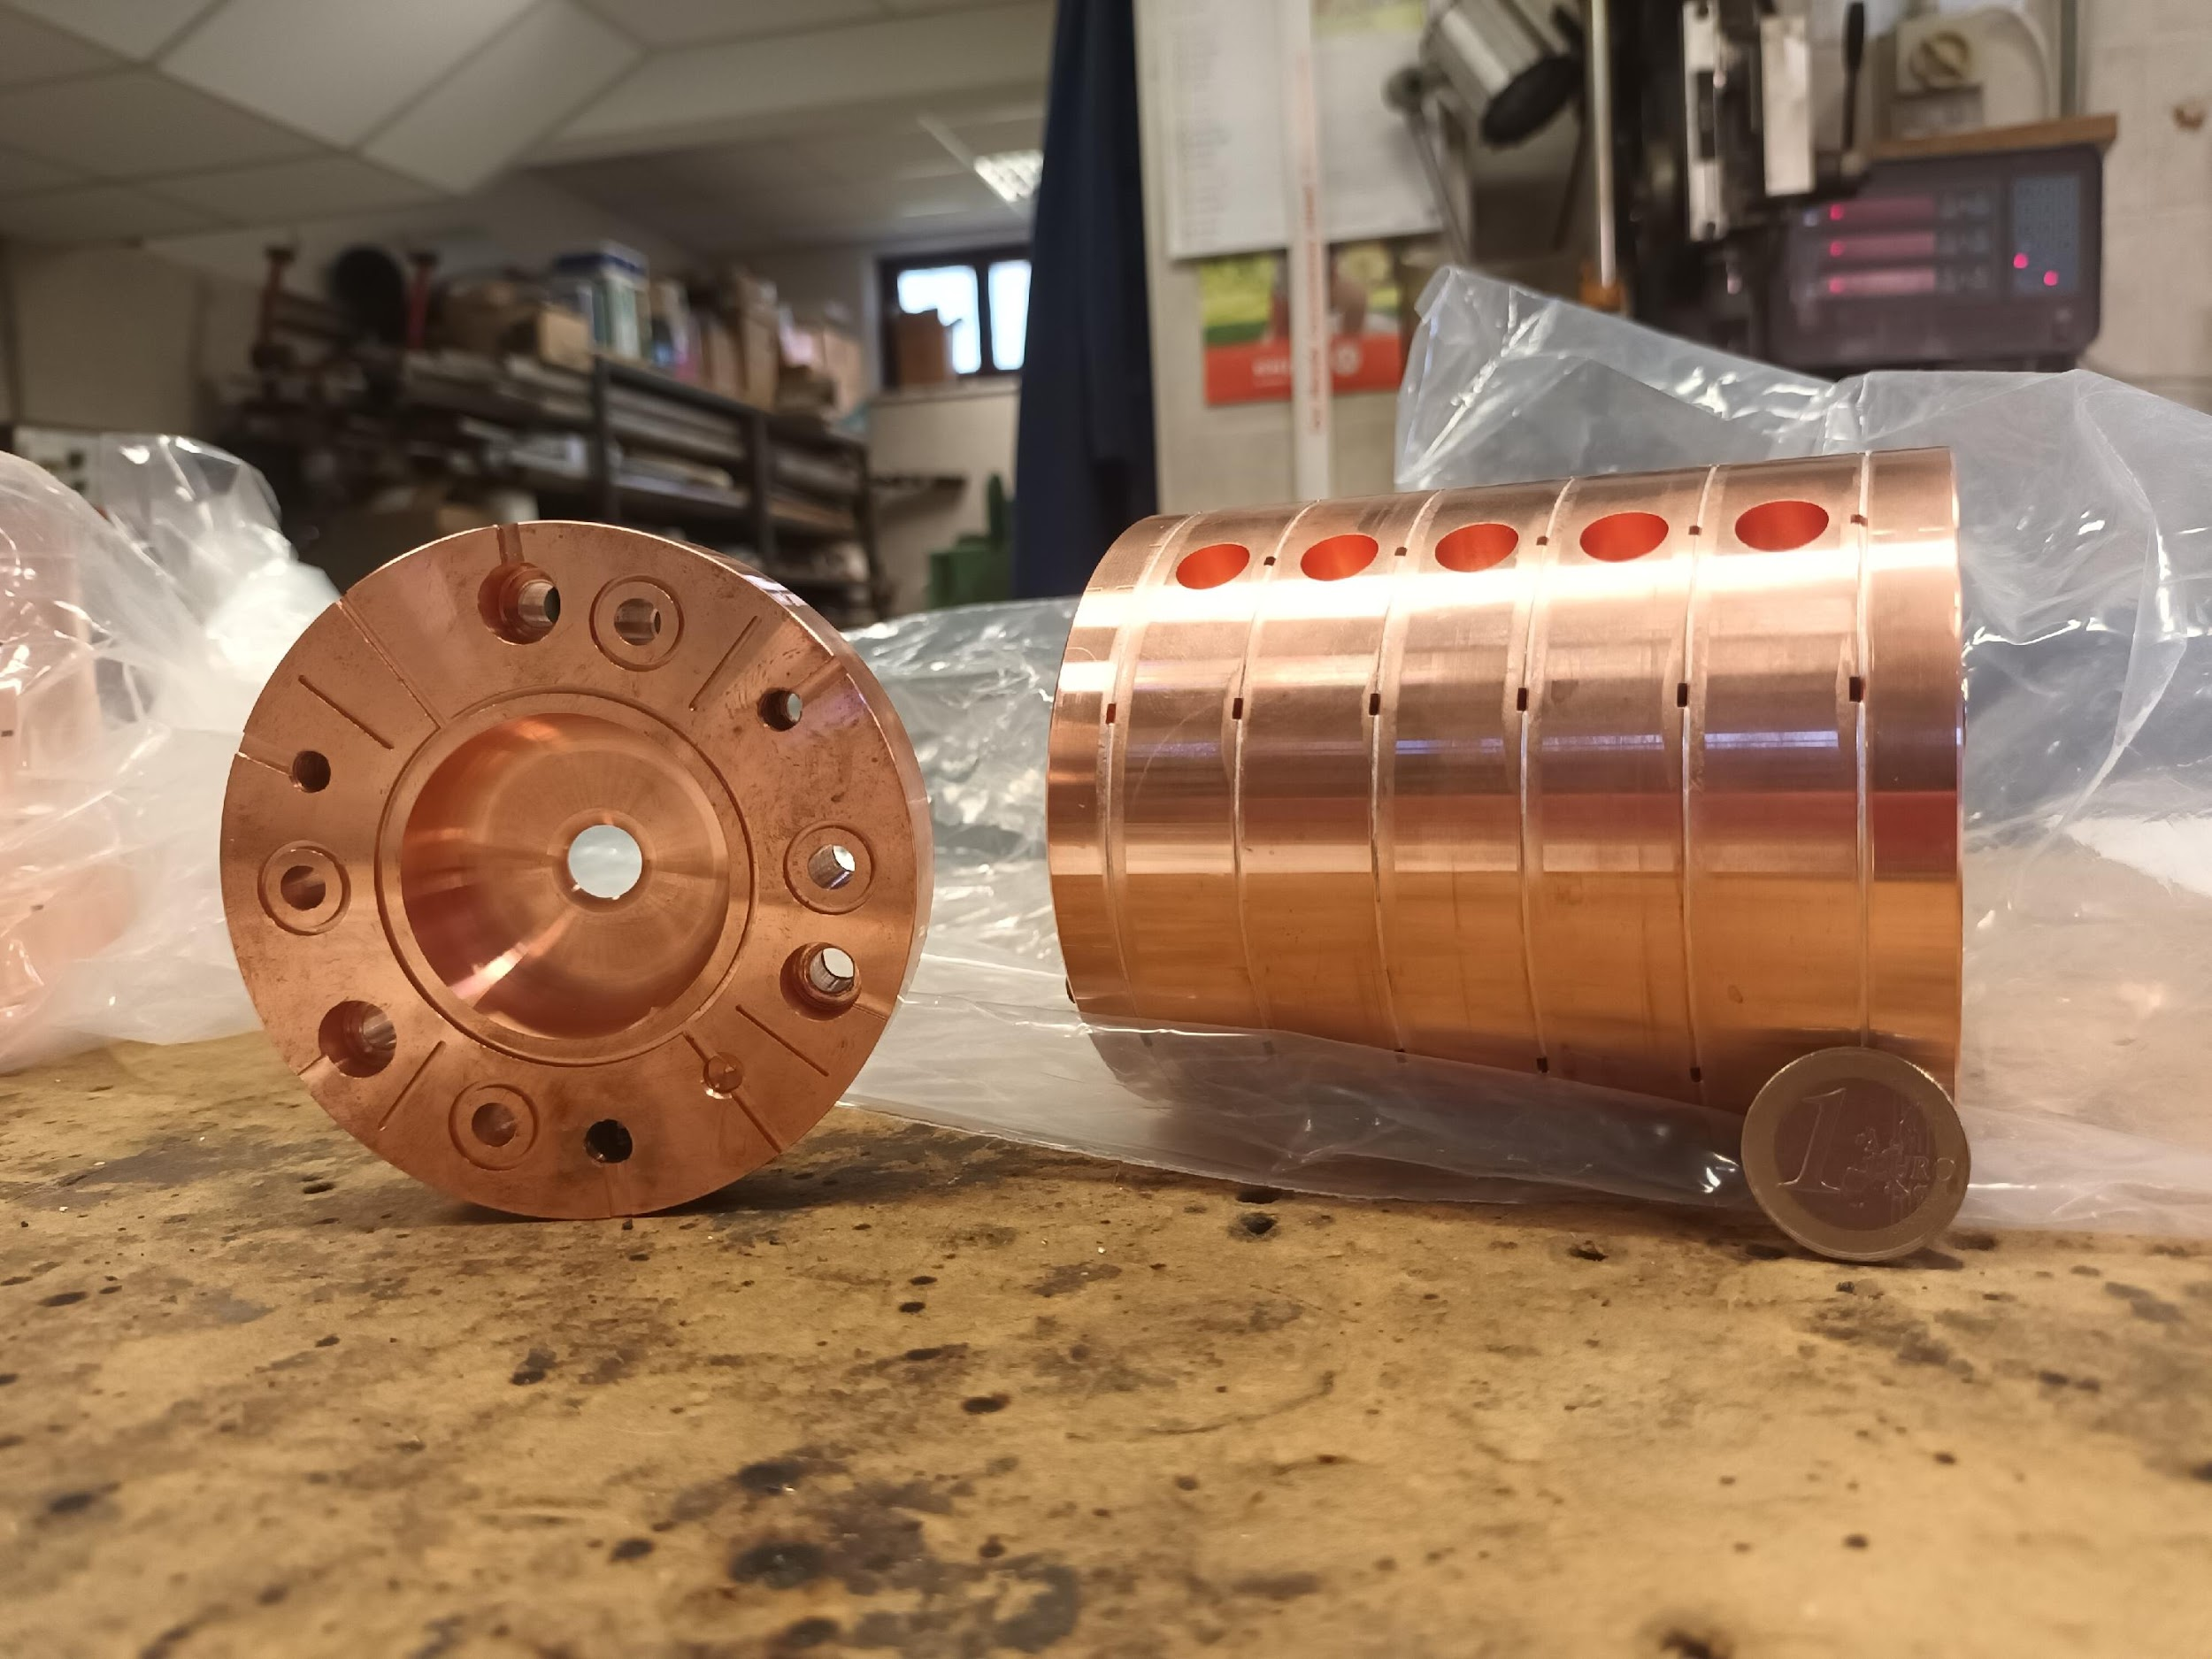
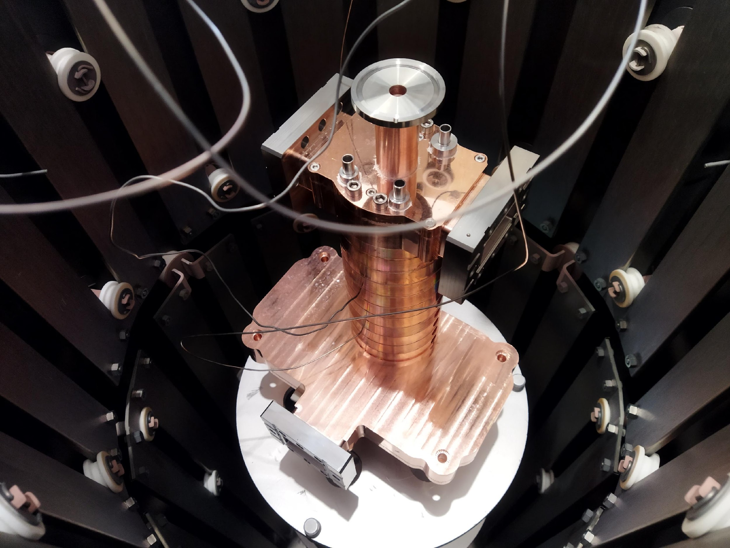
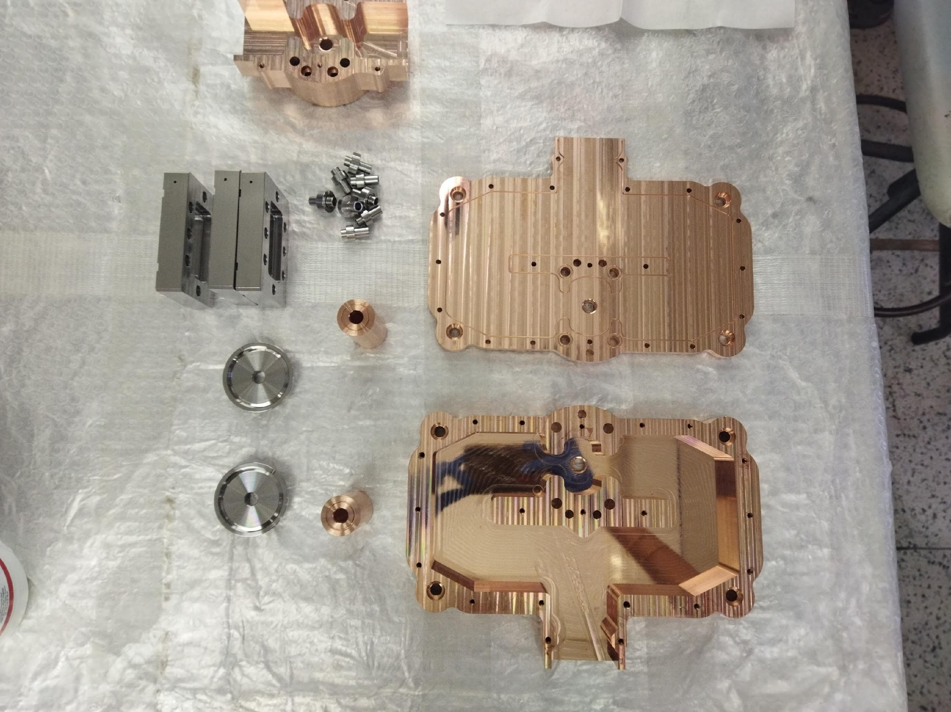
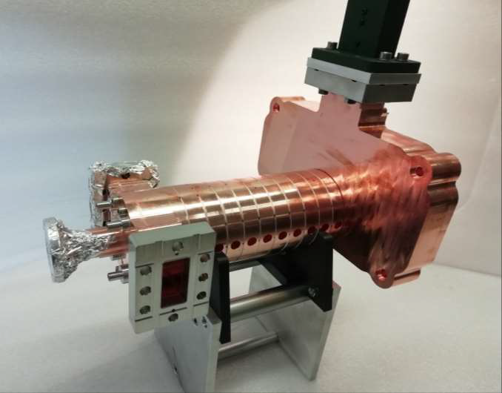

Prototyping phase 2
A prototype of 12 cells with couplers has been brazed @INFN LNF –FRASCATI oven to perform low-power RF tests.
Structure in the INFN LNF –FRASCATI oven ready to be brazed
In house building of the accelerating cavities
Main contributors: D. Alesini, R. Di Raddo, L. Faillace, L. Giuliano, M. Magi, M. Migliorati
INFN Acceleratori - LNF, 4-5 aprile 2024

Slide 29
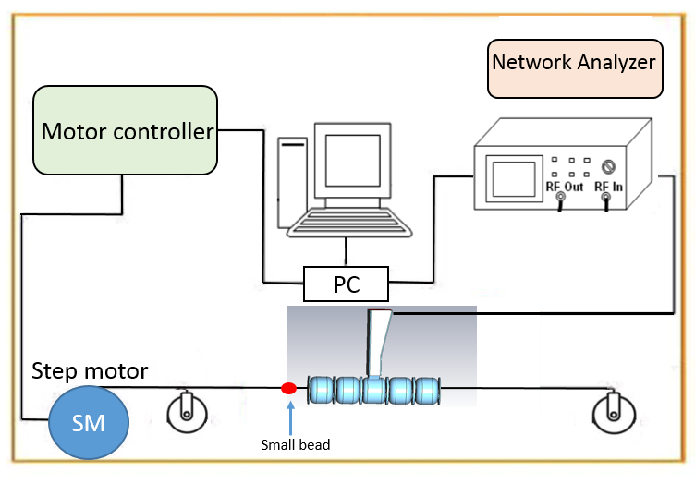
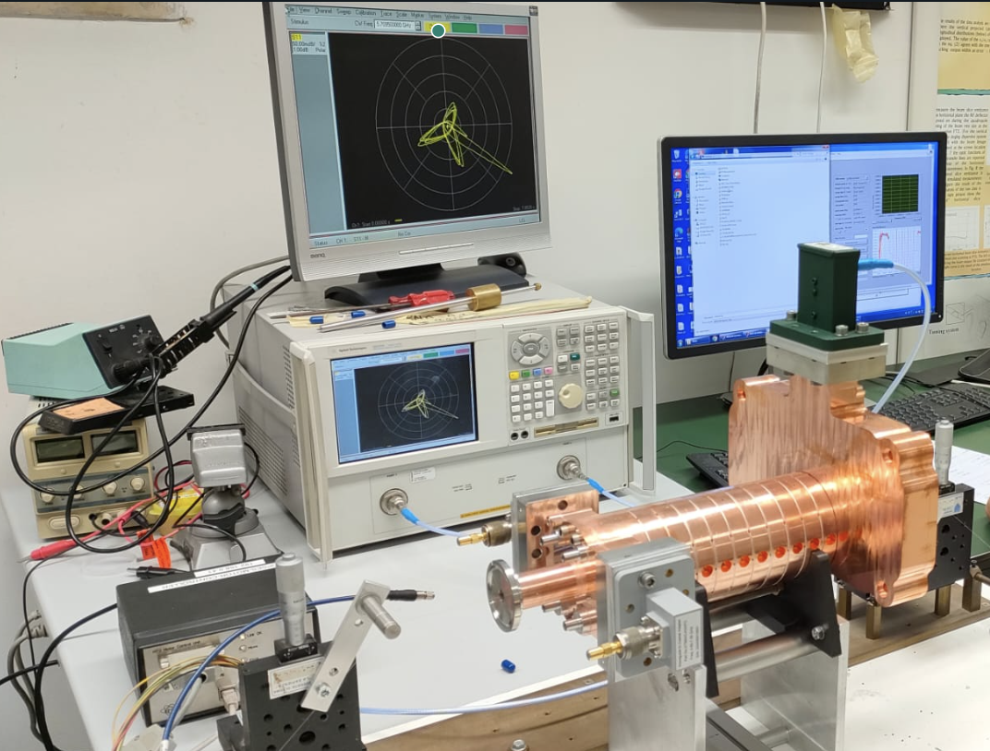

Measurement of electric field with “bead-pull”
A Radio Frequency (RF) signal is applied by the Network Analyzer (VNA)
A perturbing object (glue bead) is attached to a horizontal fish wire.
4
1
Pc
3
RF signal
2
3. Using a step-by-step motor, the wire goes through the structure and measures the electric field perturbations caused by the bead
4. All the data are stored in a PC
Network Analyzer
RF cavity under test
Step- motor
RF cavity under test

Slide 30





BeadPull measurements after tuning
After tuning the structure presents a average phase advance is 120,38° , the petals are superimposed in the RF phase diagram
The electric field presented still a stationary pattern: final coupler needed to be tuned
Input coupler
Output coupler
Tuning by deformation
tuners
Others contribution: F. Cardelli, D. Alesini,L.Faillace, L.Ficcadenti A. Mostacci

Slide 31



Prototyping phase 3
To be tested in power at LNF
INFN Acceleratori - LNF, 4-5 aprile 2024

Slide 32


PULSE COMPRESSOR (G. Torrisi LNS)

Slide 33
FUNDINGS & SCHEDULE

Slide 34


TOWARD VHEE LINACS
FOR DEEP TUMORS
INFN PROJECT 2021
FRIDA
PNRR NATIONAL PROJECT 2022
A compact C-band Linac for FLASH therapy: accelerator and dosimetry study (2020)
Commissione Scientifica Ateneo
Sapienza medie attrezzature
SBAI Contracts
260 kE
Basic VHEE Prototype
SAPIENZA 1.500 kE
SIT 230 KE
R&D RF Structure 120 kE
Pulse compressor 70 kE

Slide 35

PROJECT TIMELINE

Slide 36

COLLABORAZIONE SAPIENZA-INFN

Slide 37

ROMA1
LNF
LNS

Slide 38


Slide 39



Slide 40
PE6 : FLASH-LAB
Referente Sapienza PNRR
Vincenzo Patera
Project Coordinator
Luigi Palumbo
SIT
Treatment Plans VHEE
A. Sarti
LINAC VHEE-FLASH
M. Migliorati
Dose engine: G. Traini & G. Franciosini
Linac Parameters : M. Migliorati & L. Giuliano
RF Design : L. Giuliano
Optimization: A. Schiavi & A. Di Gregorio
RF prototype: A. Mostacci
Online Beam Monitor : M. Marafini
Diagnostics : A. Mostacci
Radioprotection: A. Di Gregorio & G. Franciosini, F. Perondi
Beam Dynamics : L. Giuliano
Beam measur. : E. Chiadroni
Beam Delivery : A. Vannozzi (INFN) & A. Trigilio
Linac Controls : A. Mostacci
e-beam/dose character L. Giuliano
Magnets: A. Vannozzi (INFN)
WEB, Repository & Network M. Coppola
Mech. machining: M. Magi

Slide 41
LNS Collaboration
LNF Collaboration
G. Cuttone
RF Design : L Faillace, Alesini
G. Torrisi (Pulse compresor)
RF prototype: Faillace, Alesini
P. Cirrone
Diagnostics : G. Franzini
Beam Dynamics : L. Faillace
Roma1 Collaboration
RF Linac Controls : S. Gallo
Magnets: A. Vannozzi
Beam delivery : A. Vannozzi
L. Ficcadenti
C power test: Cardelli/Pioli
Facilities (off. Meccanica)
Controls: Piersanti
……….
Brasatura: Lollo, Di Raddo

