Slide 1
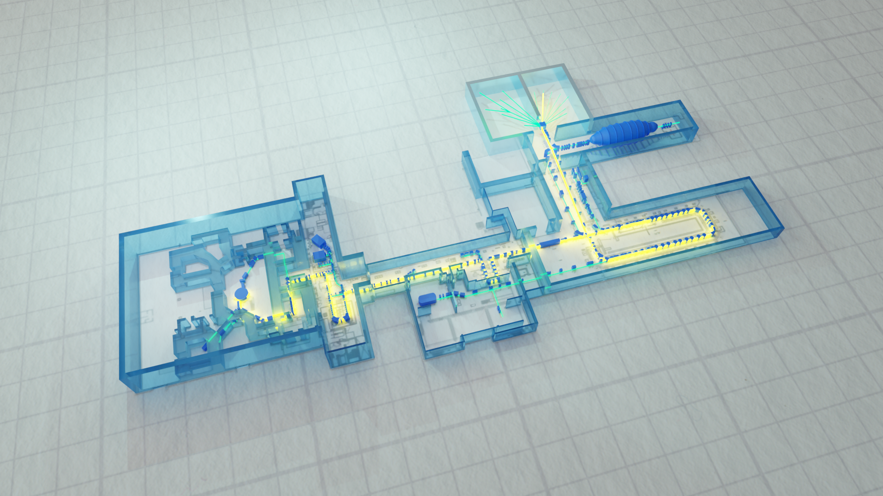

Attività LNL su acceleratori: stato e prospettive
Enrico Fagotti

Slide 2
Outline
SPES general status
PTA upgrade status
Next months plan

Slide 3
Outline
SPES general status
PTA upgrade status
Next months plan

Slide 4
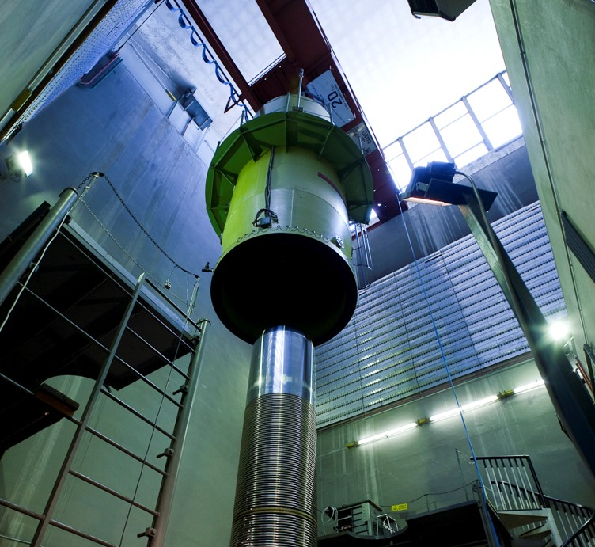
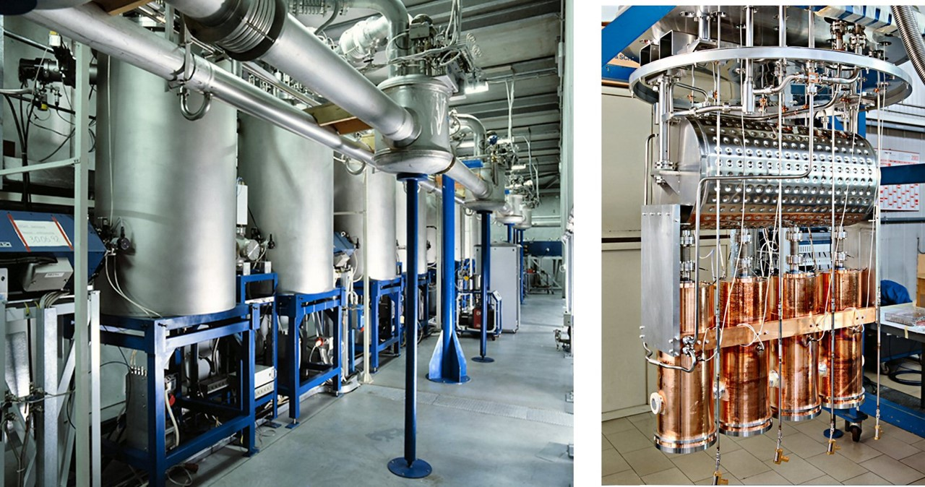
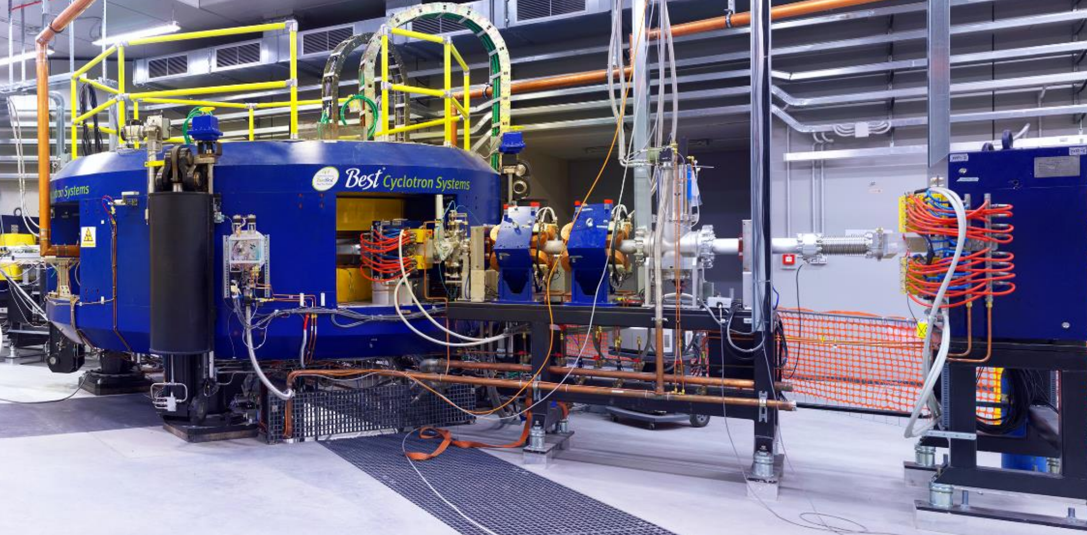
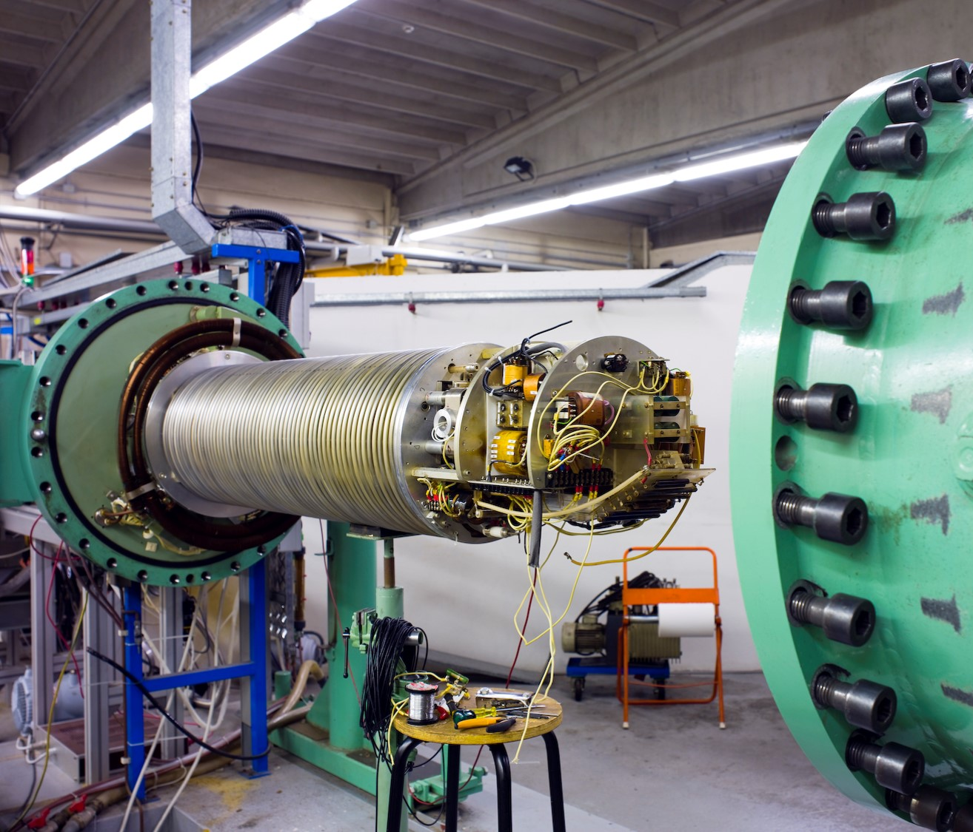
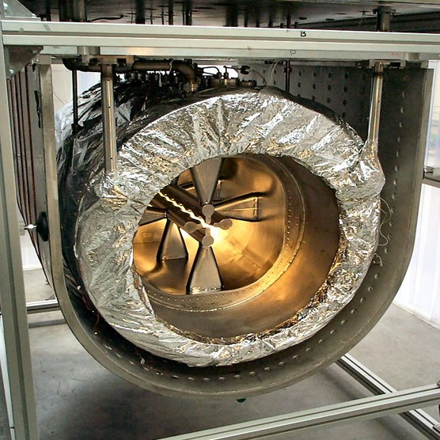
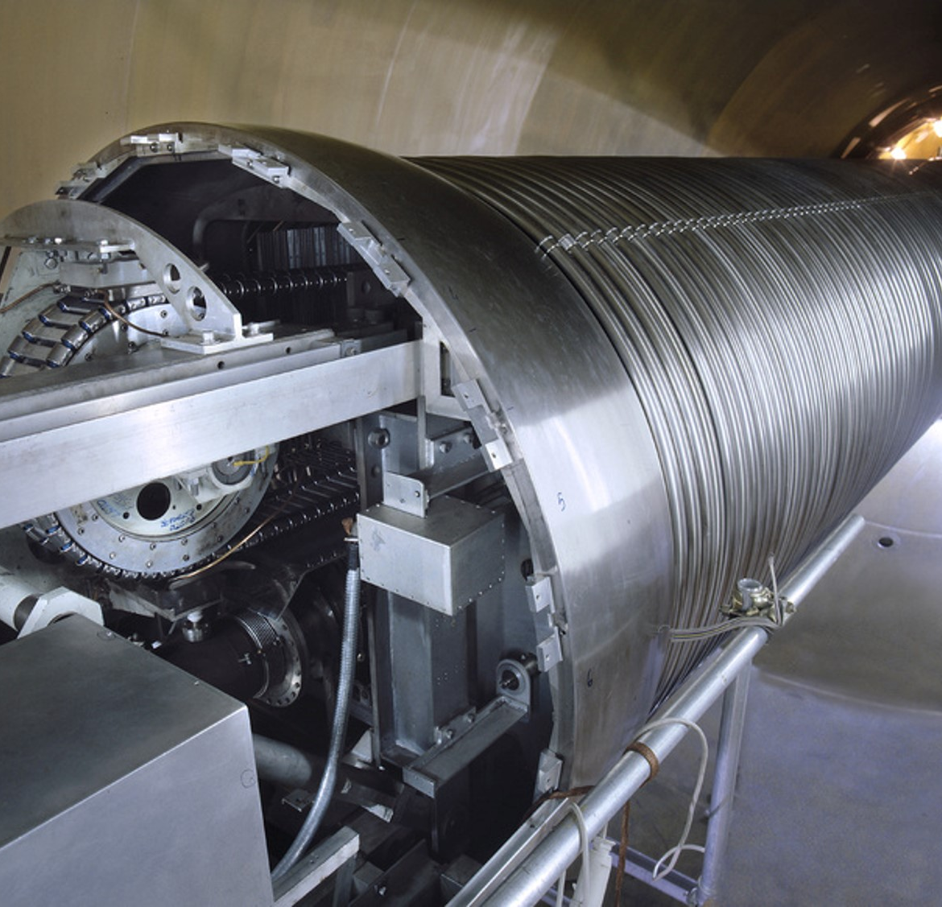
LNL Accelerators in the last 63 years
1961
1992
2015
1971
2003
1982

Slide 5
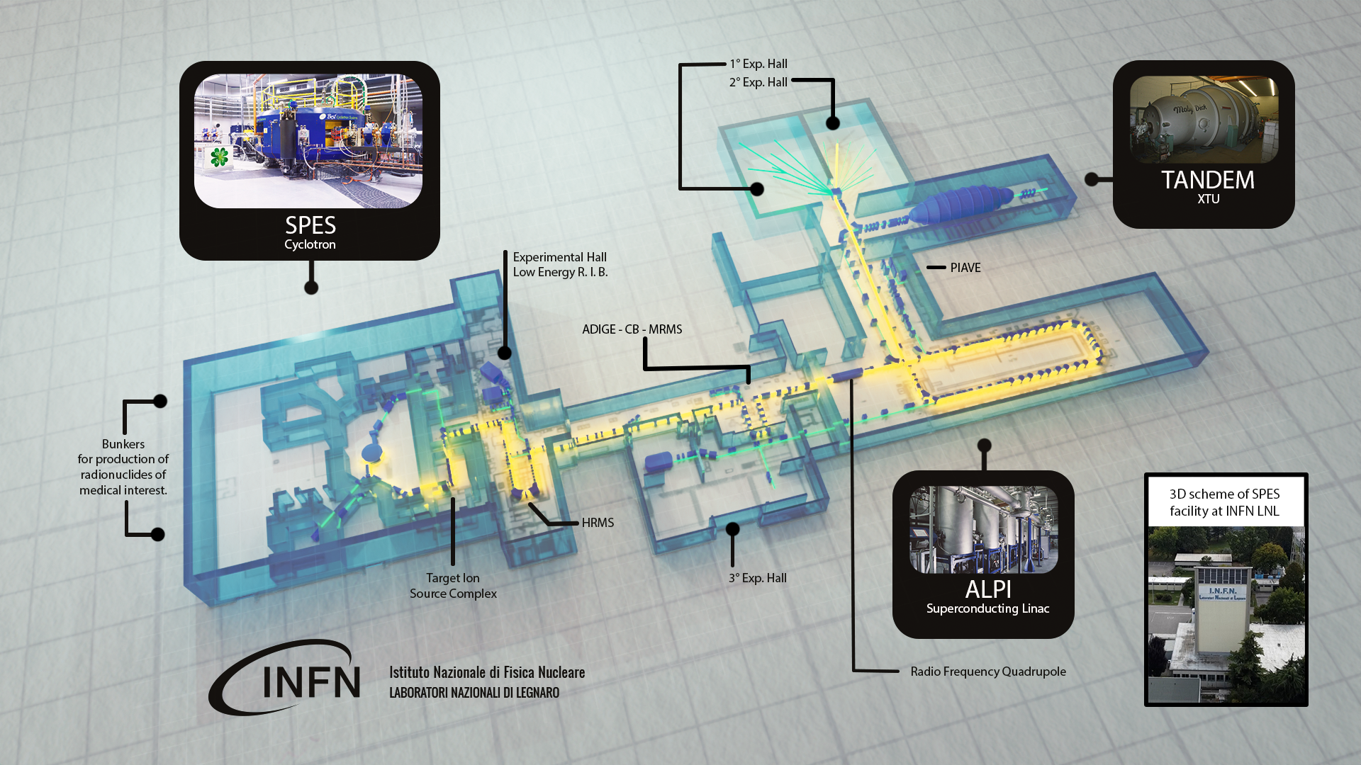
LNL Accelerators in the next years

Slide 6
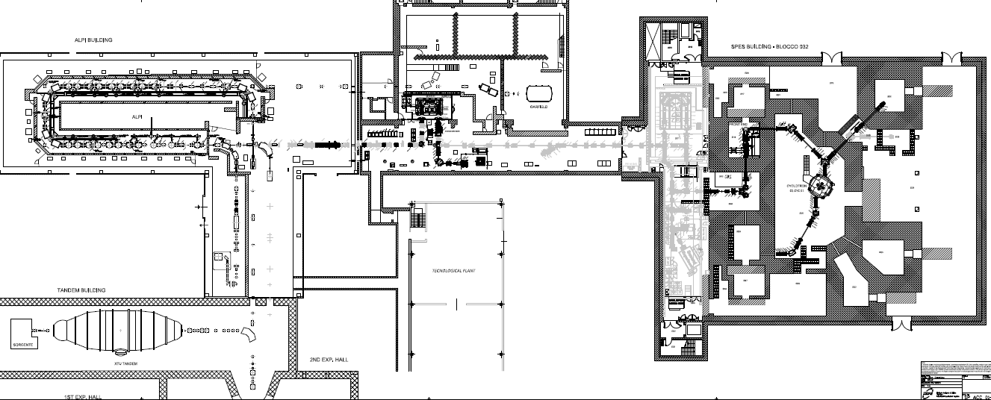
SPES phases
Phase 4
SPES RadioIsotope production
Phase3
SPES
injector (ADIGE)
Phase2
SPES
LERIB
Phase1
SPES
cyclotron
Phase5
SPES
RIB selection

Slide 7
SPES phases: phase 1 and phase 2
Phase 1 (2024)
Phase 2 (2025)
SPES-driver
Phase 2
TIS
40 keV exp hall
Phase 1
SPES
ISOL2:
LARAMED
TEMPORARY

Slide 8
SPES phases: phase 3
Phase 3 (2024-2025)
Phase 3
C.B. + MRMS
RFQ

Slide 9
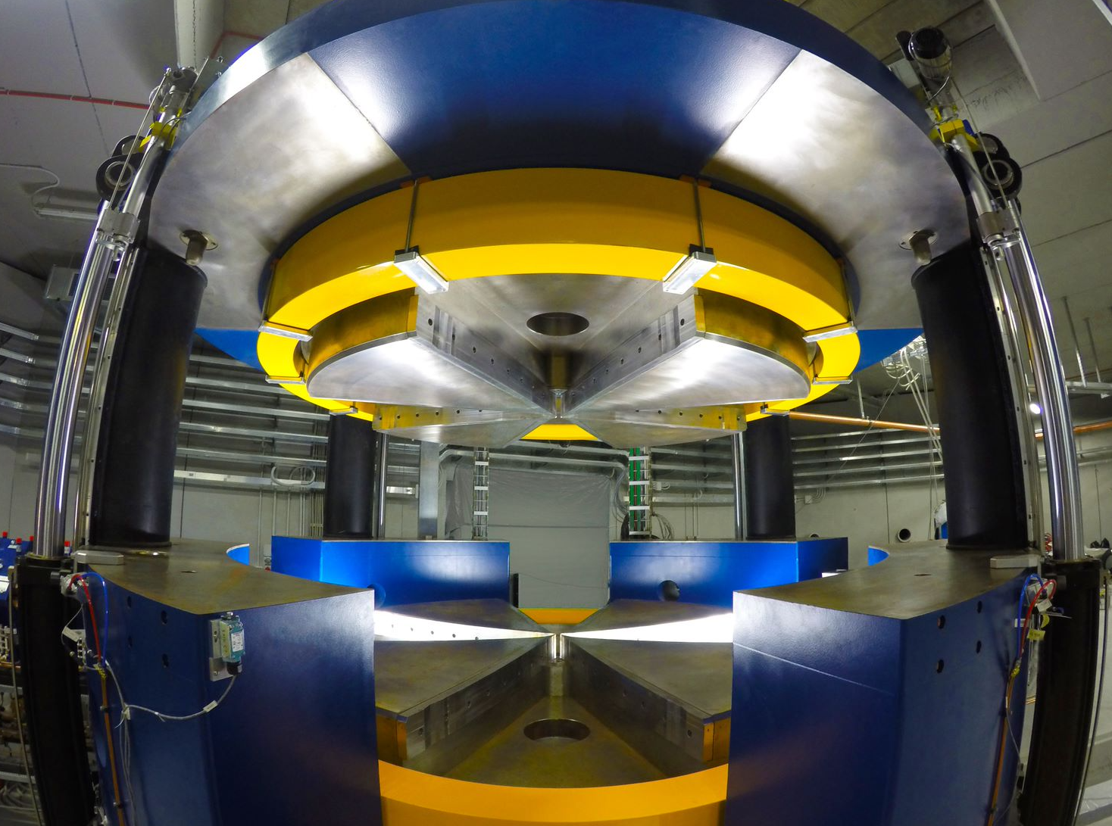
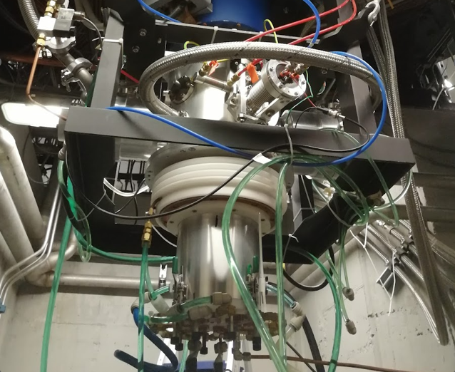
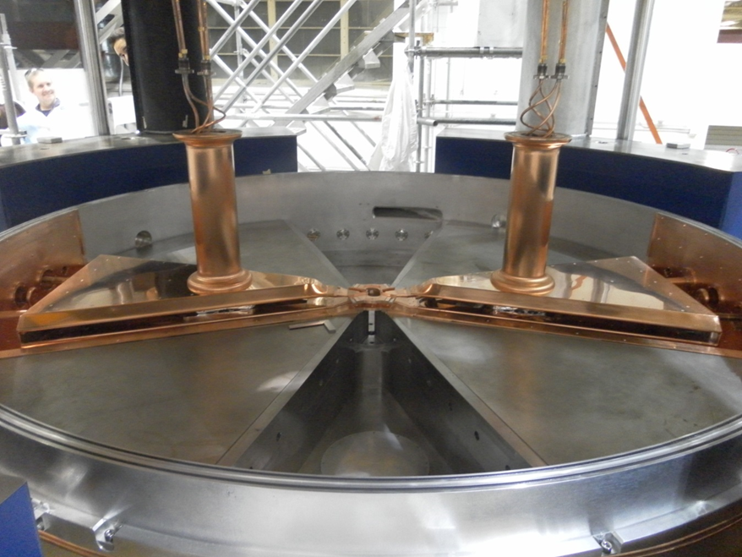
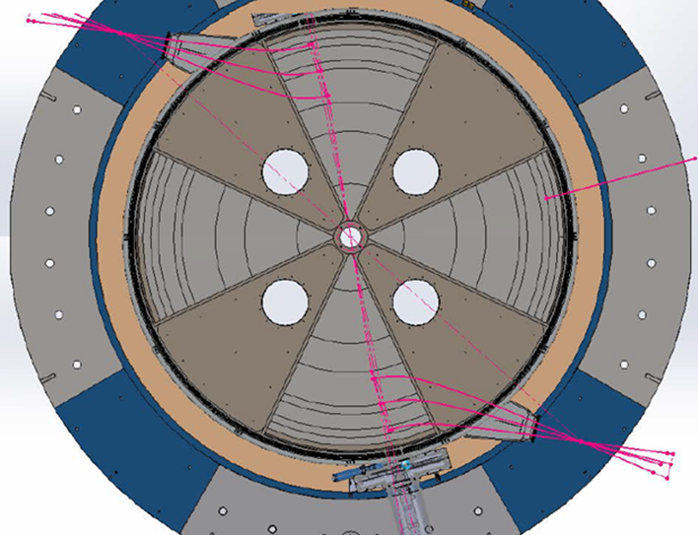
SPES ph. 1: cyclotron ready for ISOL2 irradiation test
Main Parameters
Accelerator Type | Cyclotron AVF 4 sectors
Particle | Protons (H⁻ accelerated)
Energy | Variable within 35-70 MeV
Max Current Accelerated | 750 µA (52 kW max beam power)
Available Beams | 2 at the same energy
Max Magnetic Field | 1.6 Tesla, resistive magnet, 25kW DC power supply
RF frequency | 2 cavities, 2 RF ampl. ,f_{RF}= 56 MHz, 4th harmonic mode, 55 kW power each
Vacuum | 4 cryo-pumps → P=2x10⁻⁸ Torr
Ion Source | External Multicusp H⁻ I=8 mA, Axial Injection
Dimensions | Ф=4.5 m, h=2 m
Weight | 150 tons

Slide 10
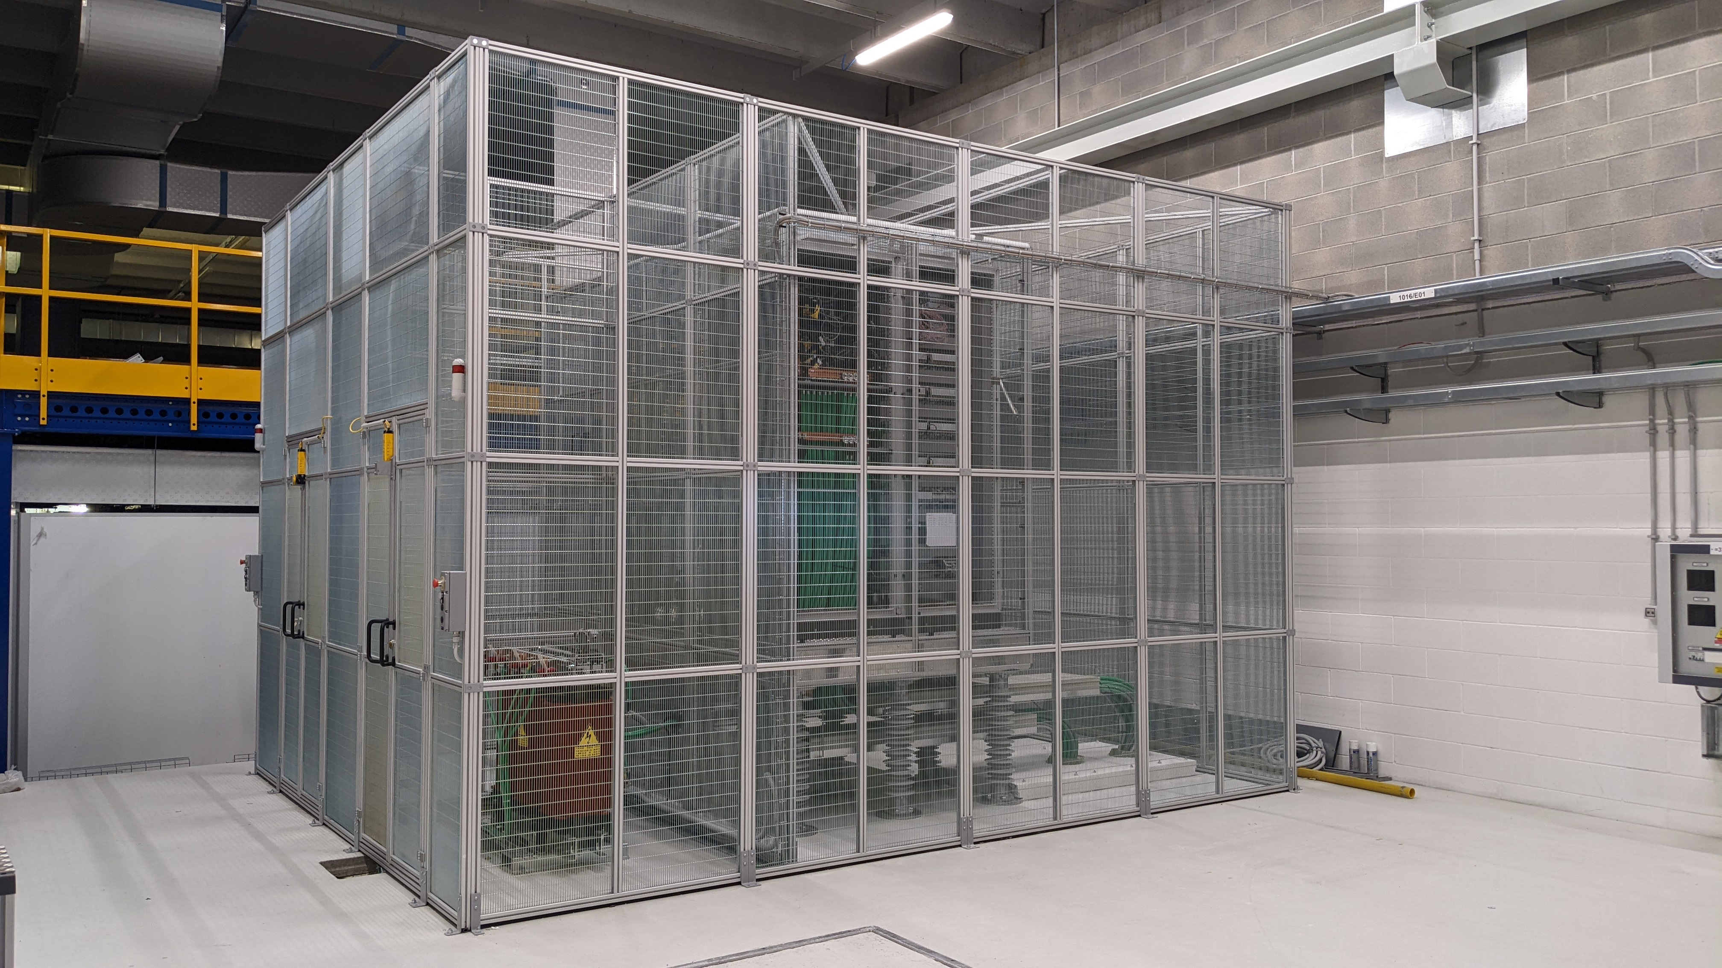
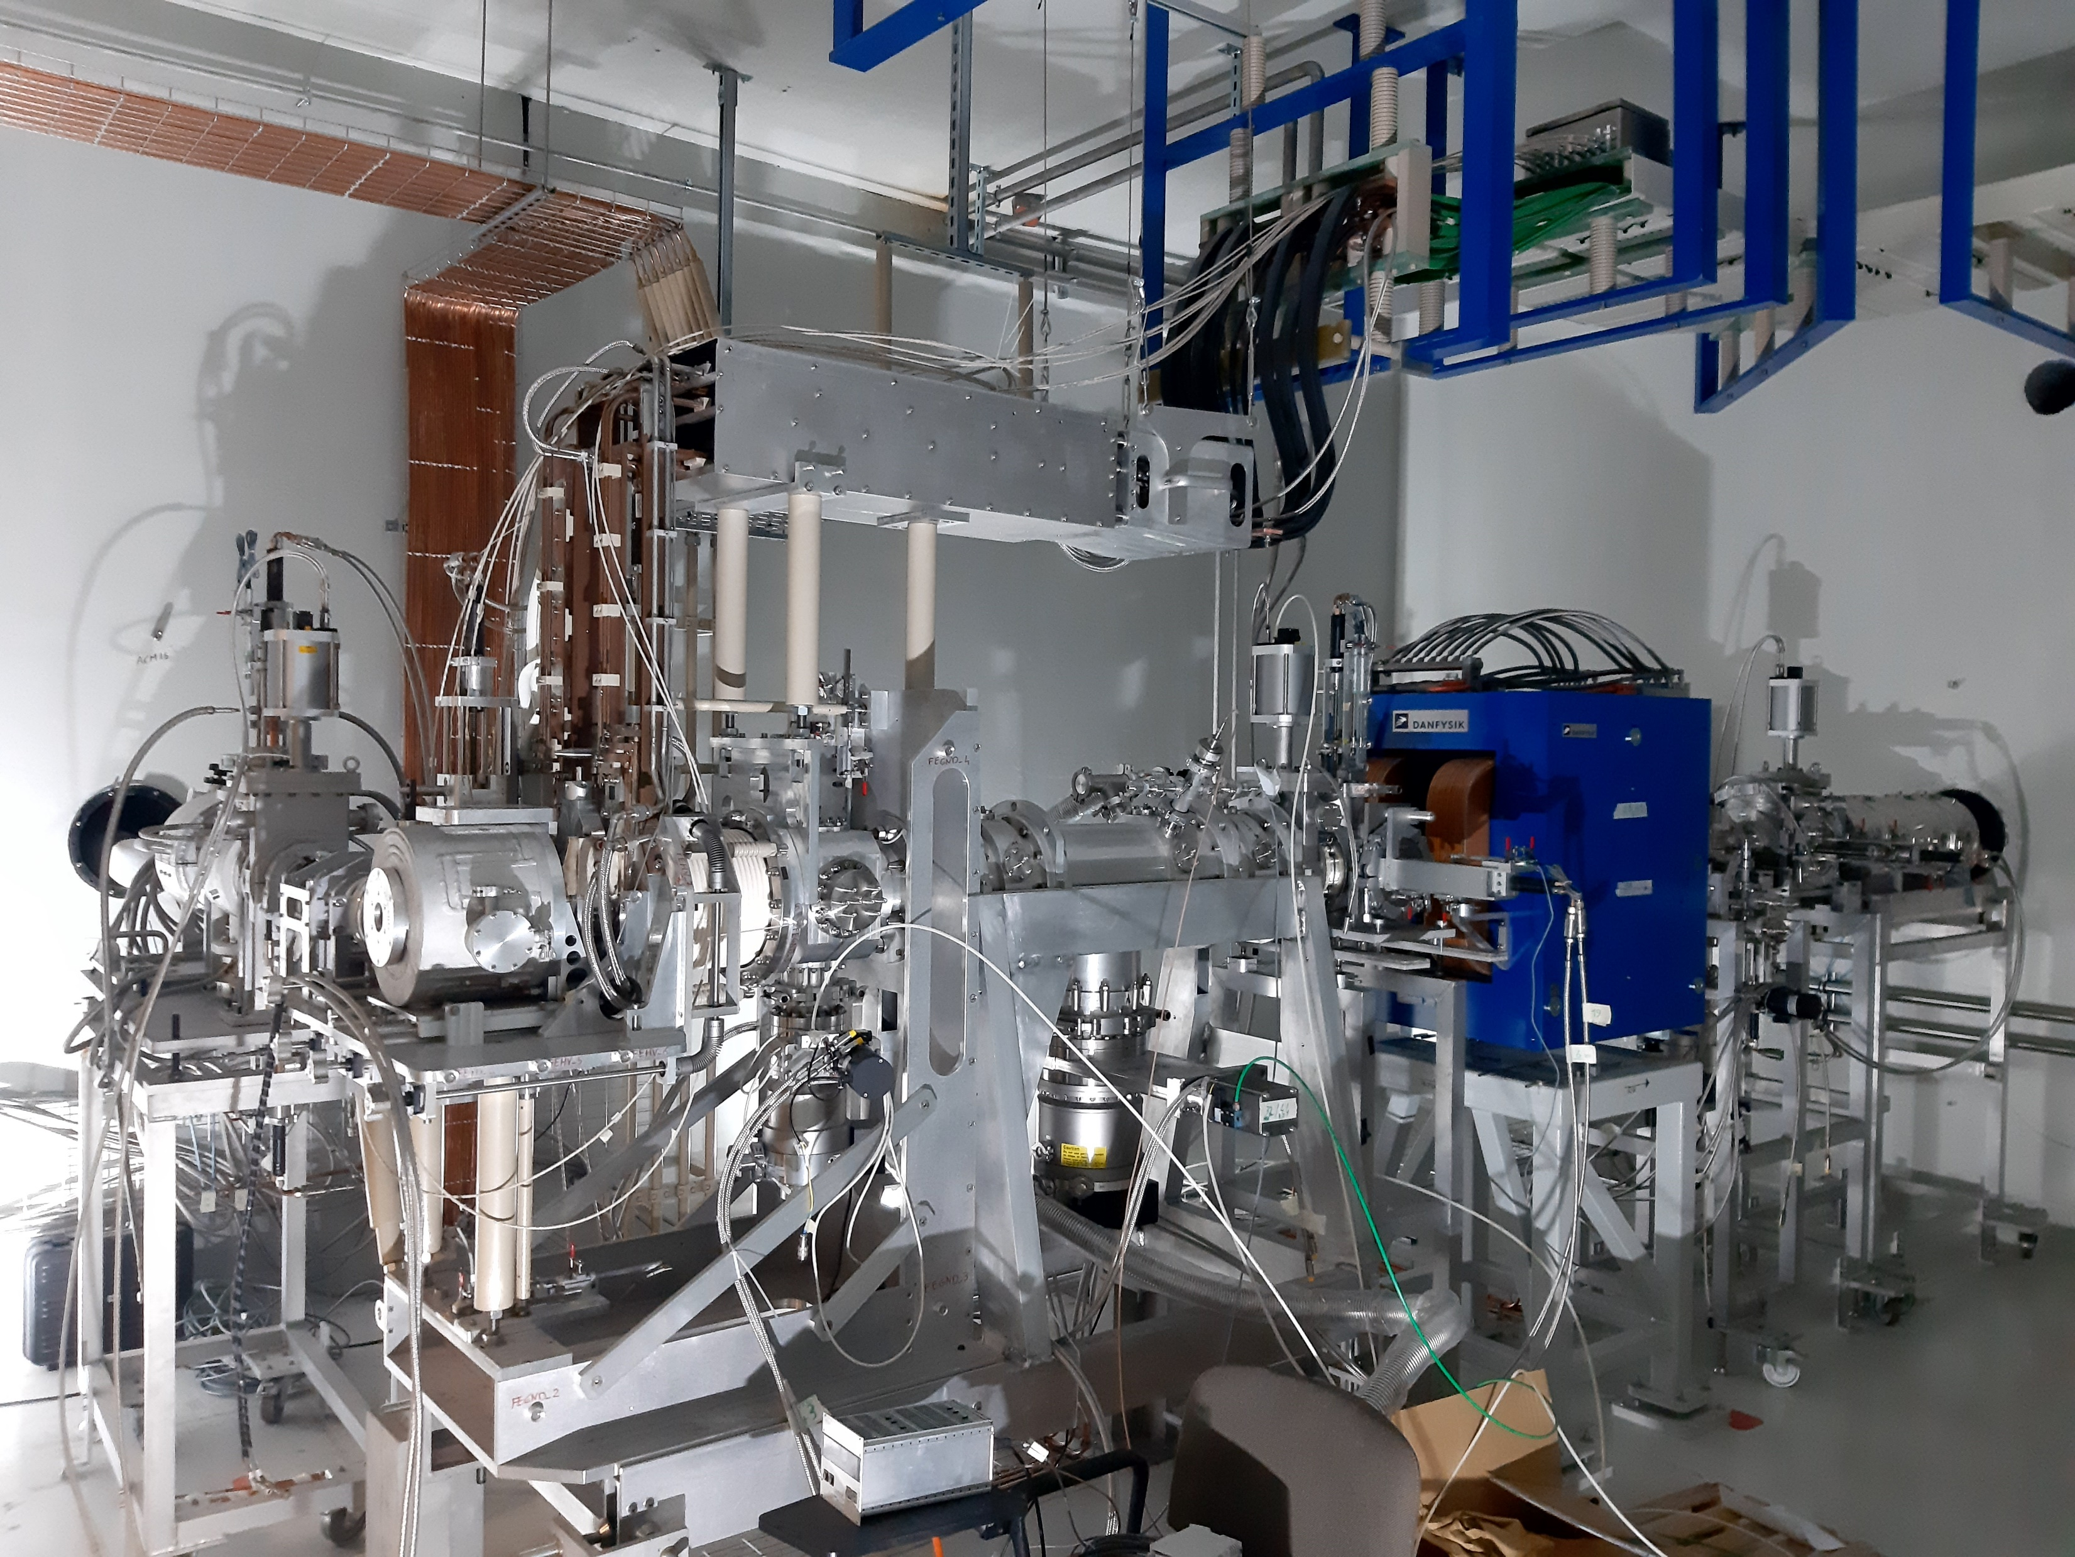
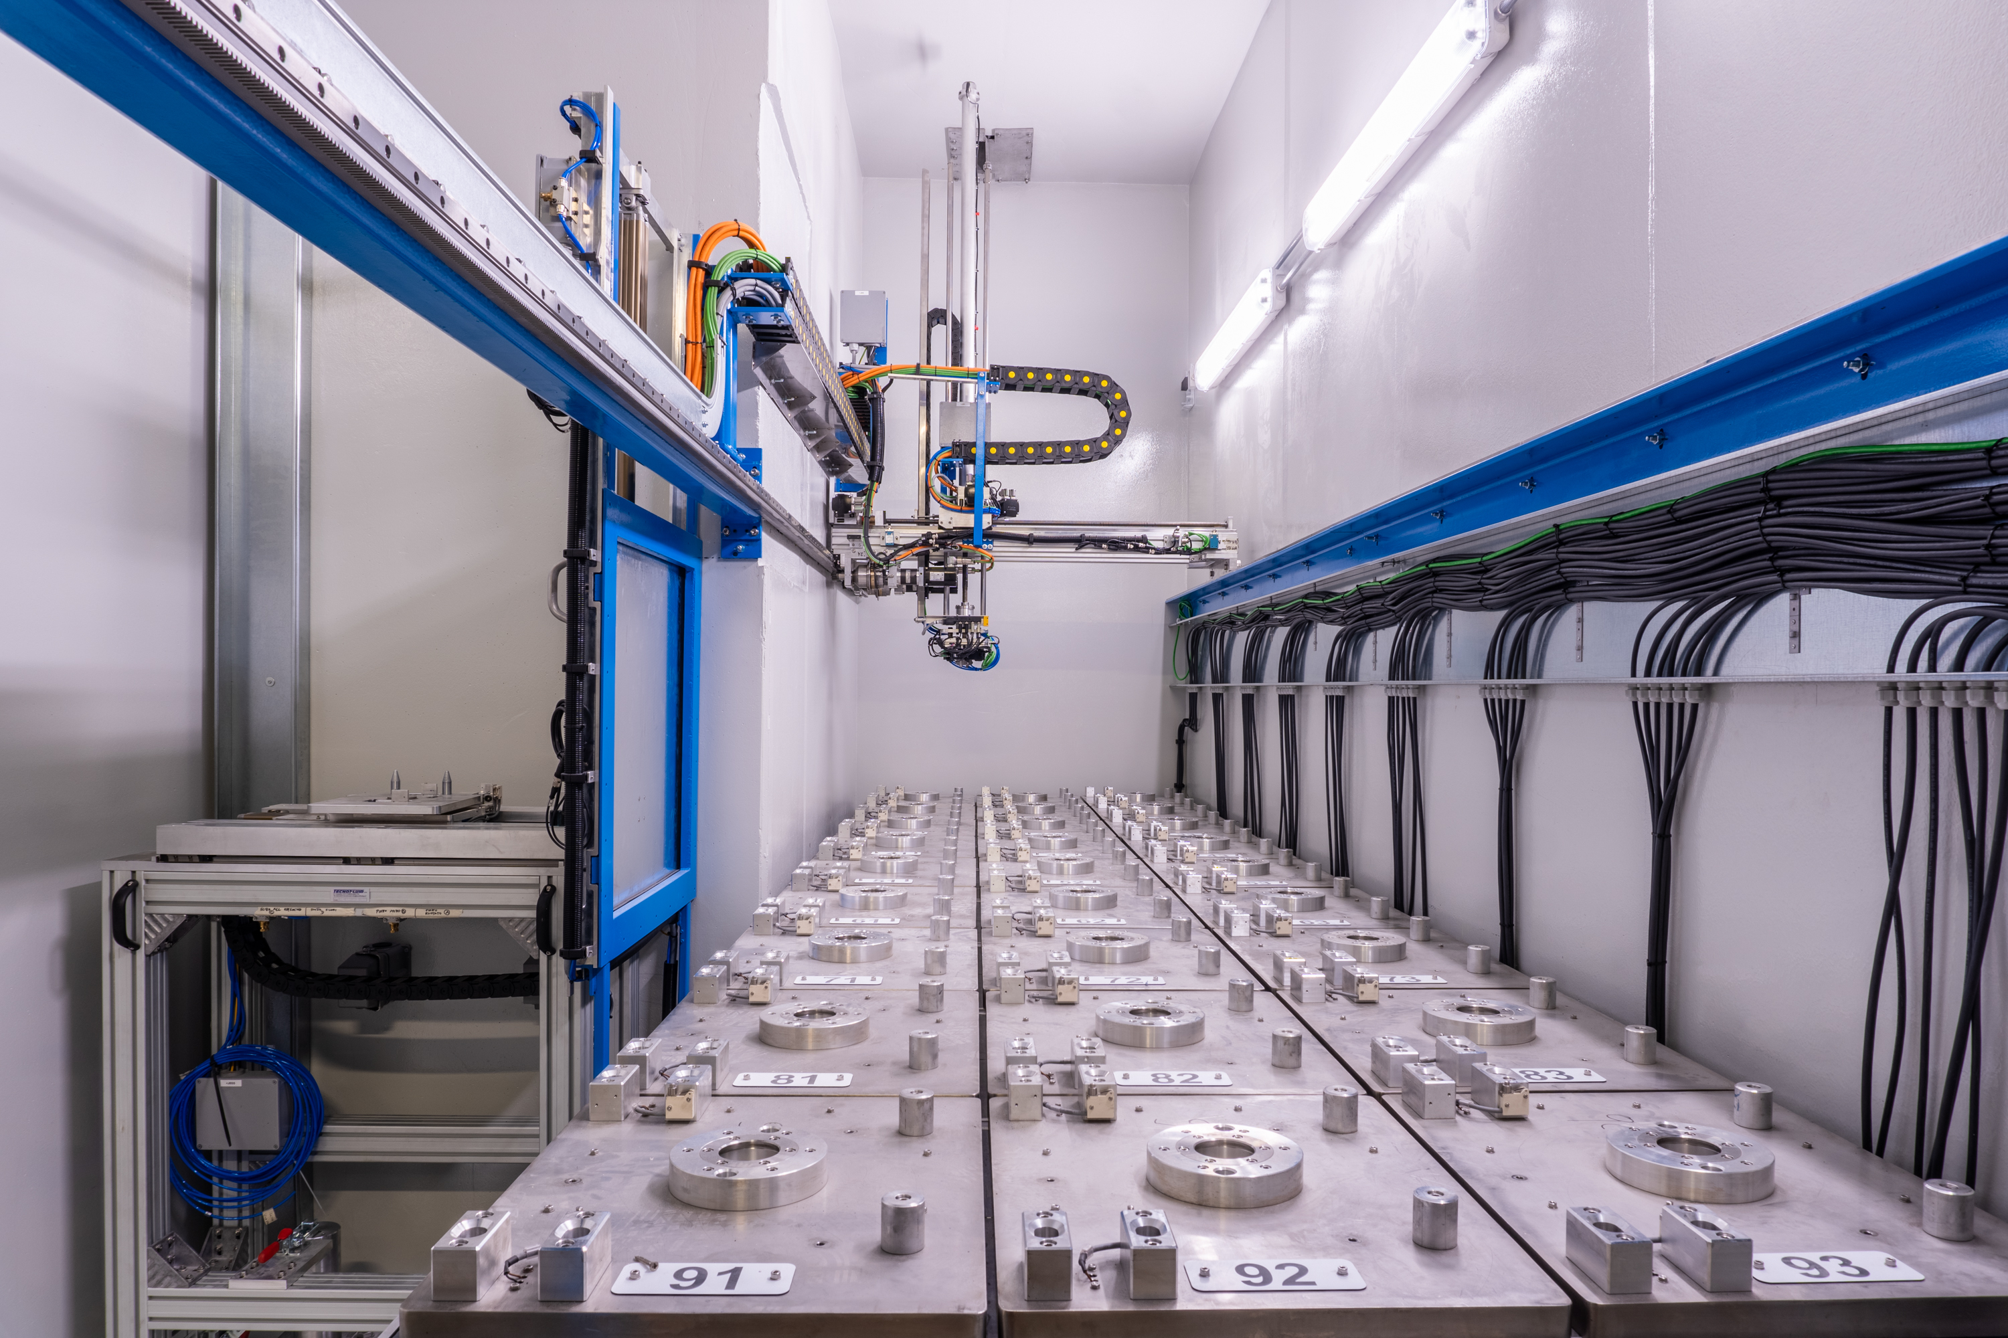
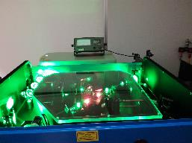
SPES ph. 2: cyclotron → ISOL1 → low E experiments
Aux plants:
-HV plants
-Ground plants
-TSS machine

Slide 11
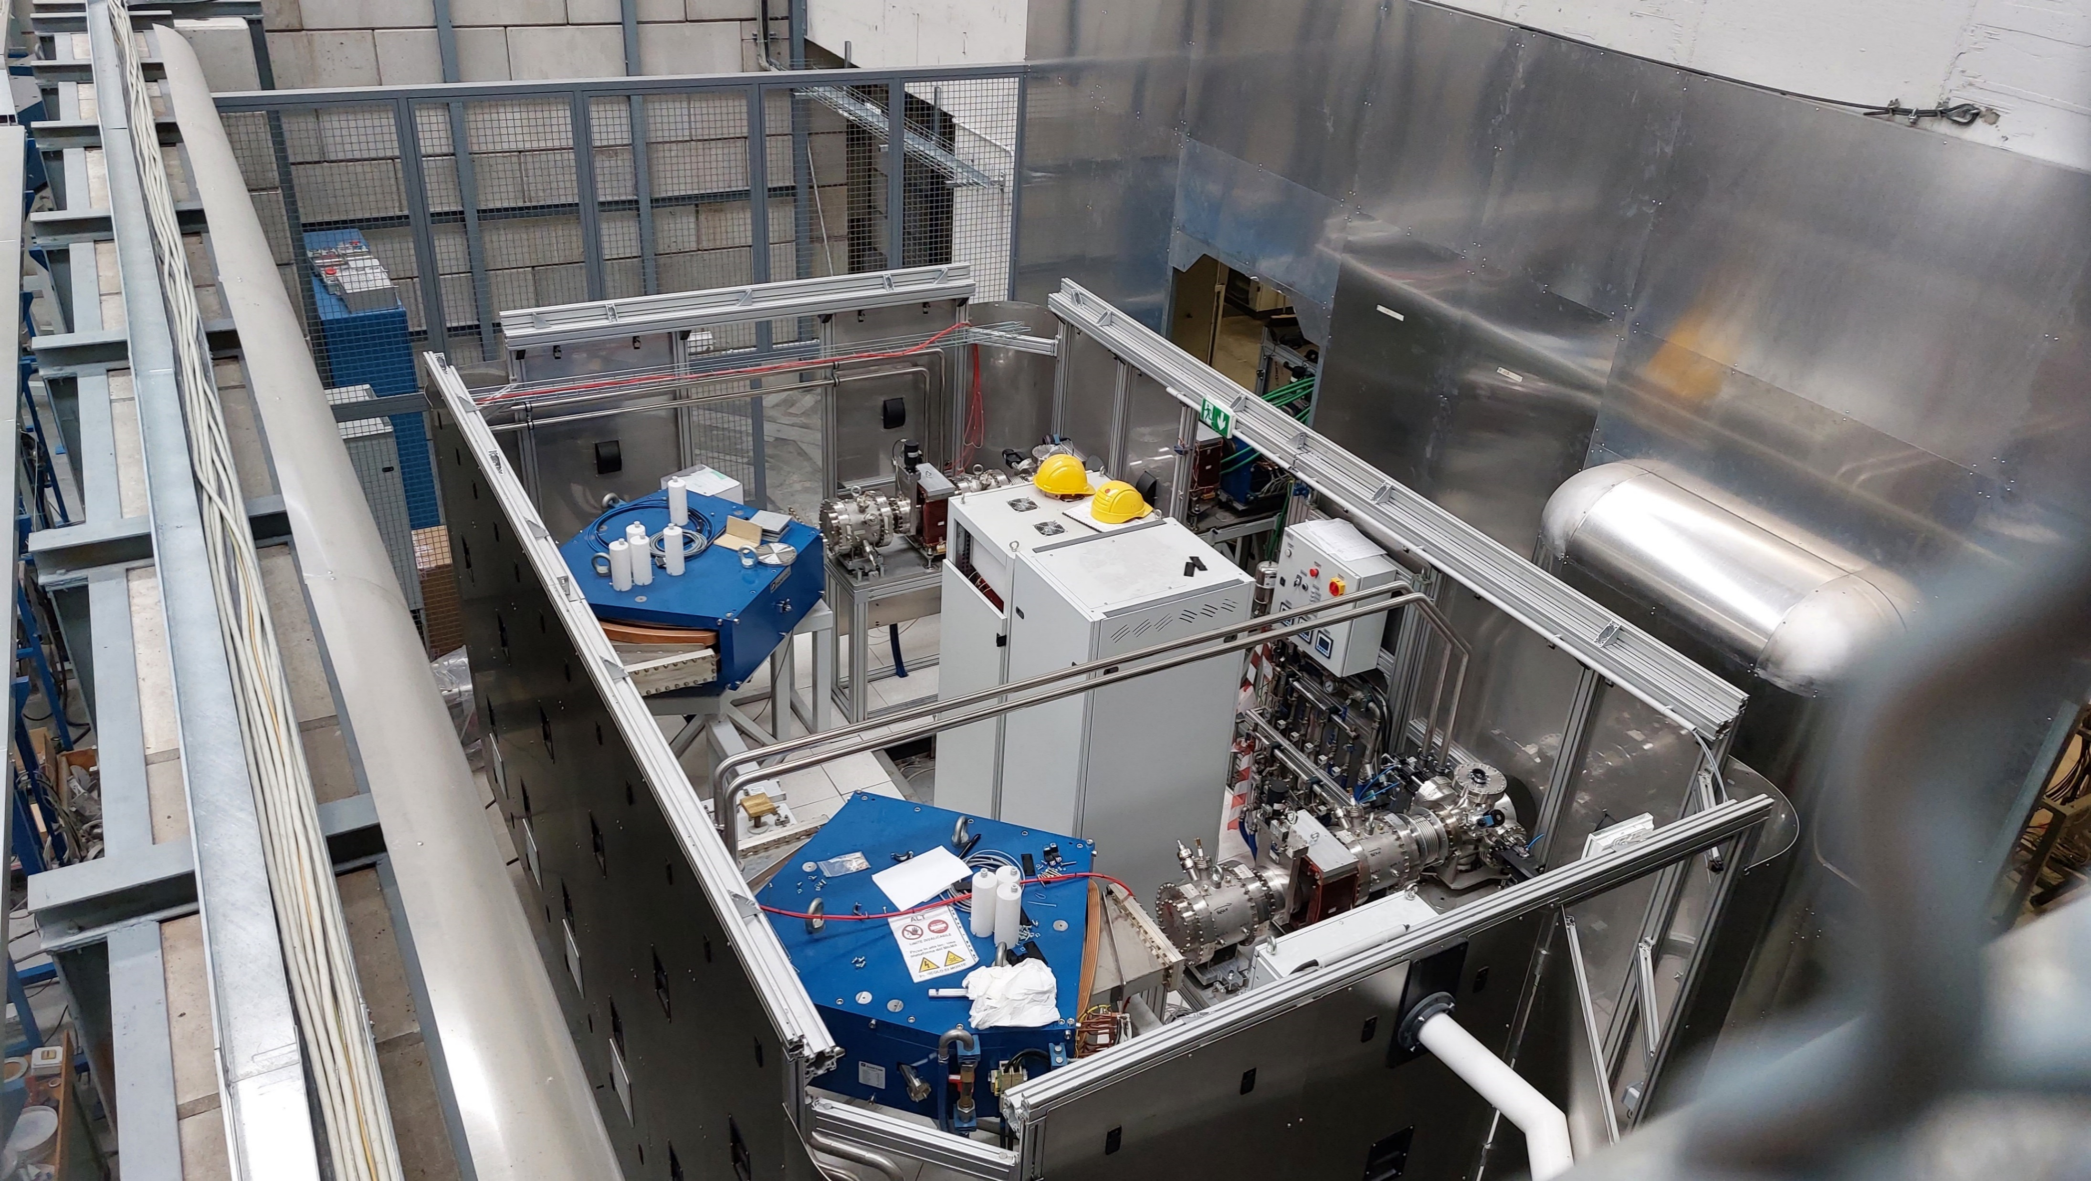
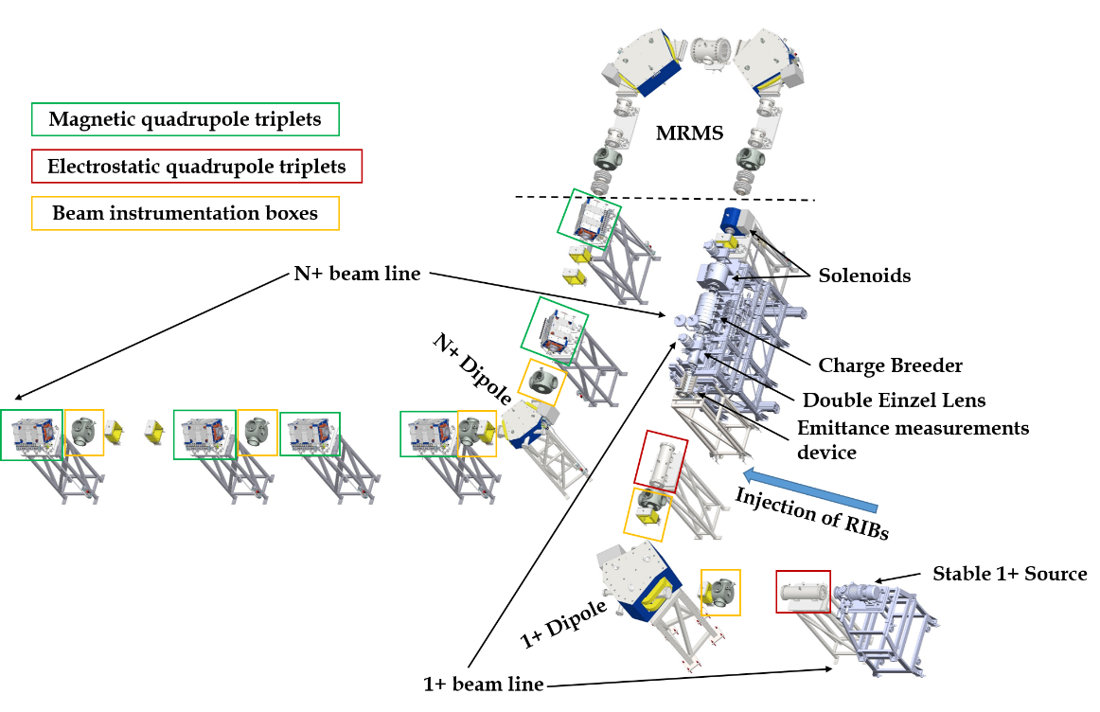
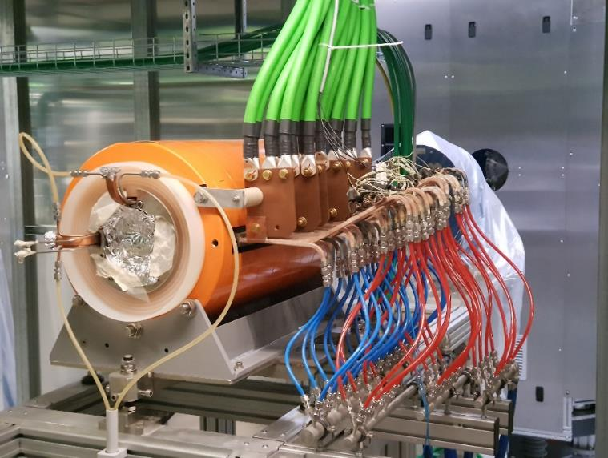
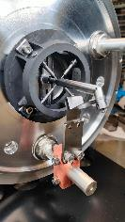
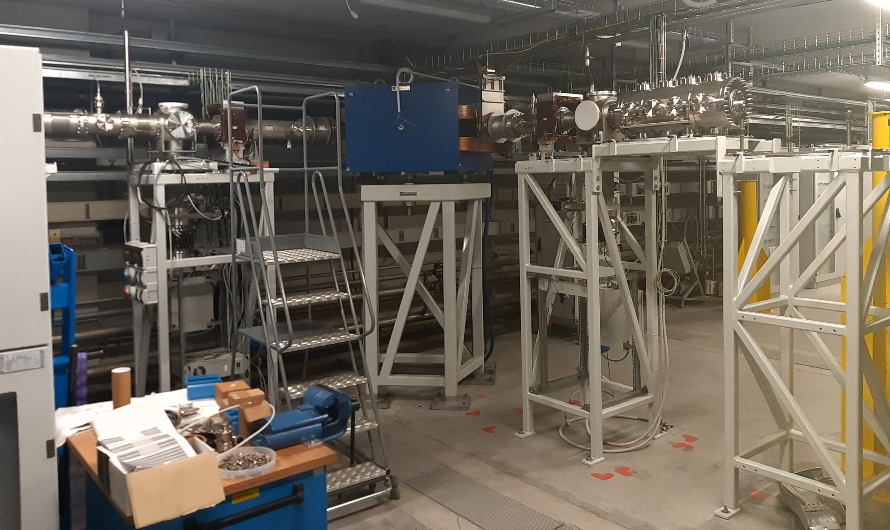
SPES ph. 3: ADIGE

Slide 12
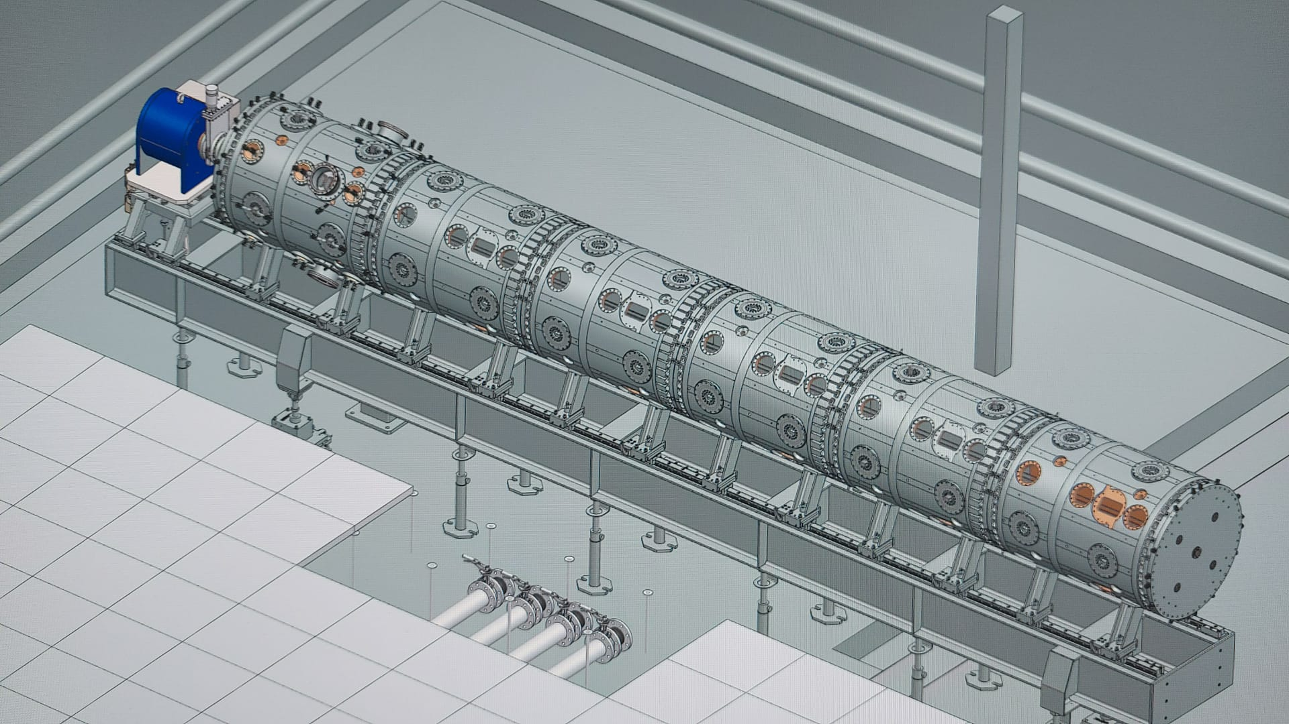
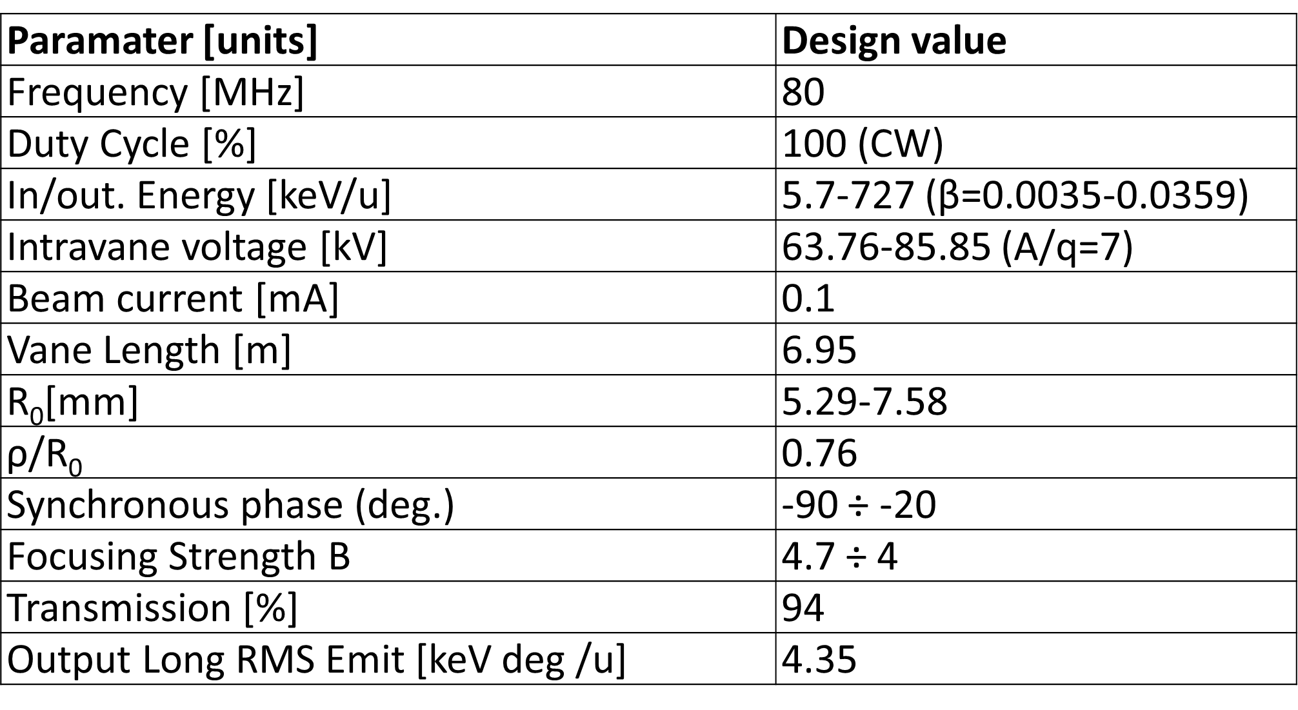
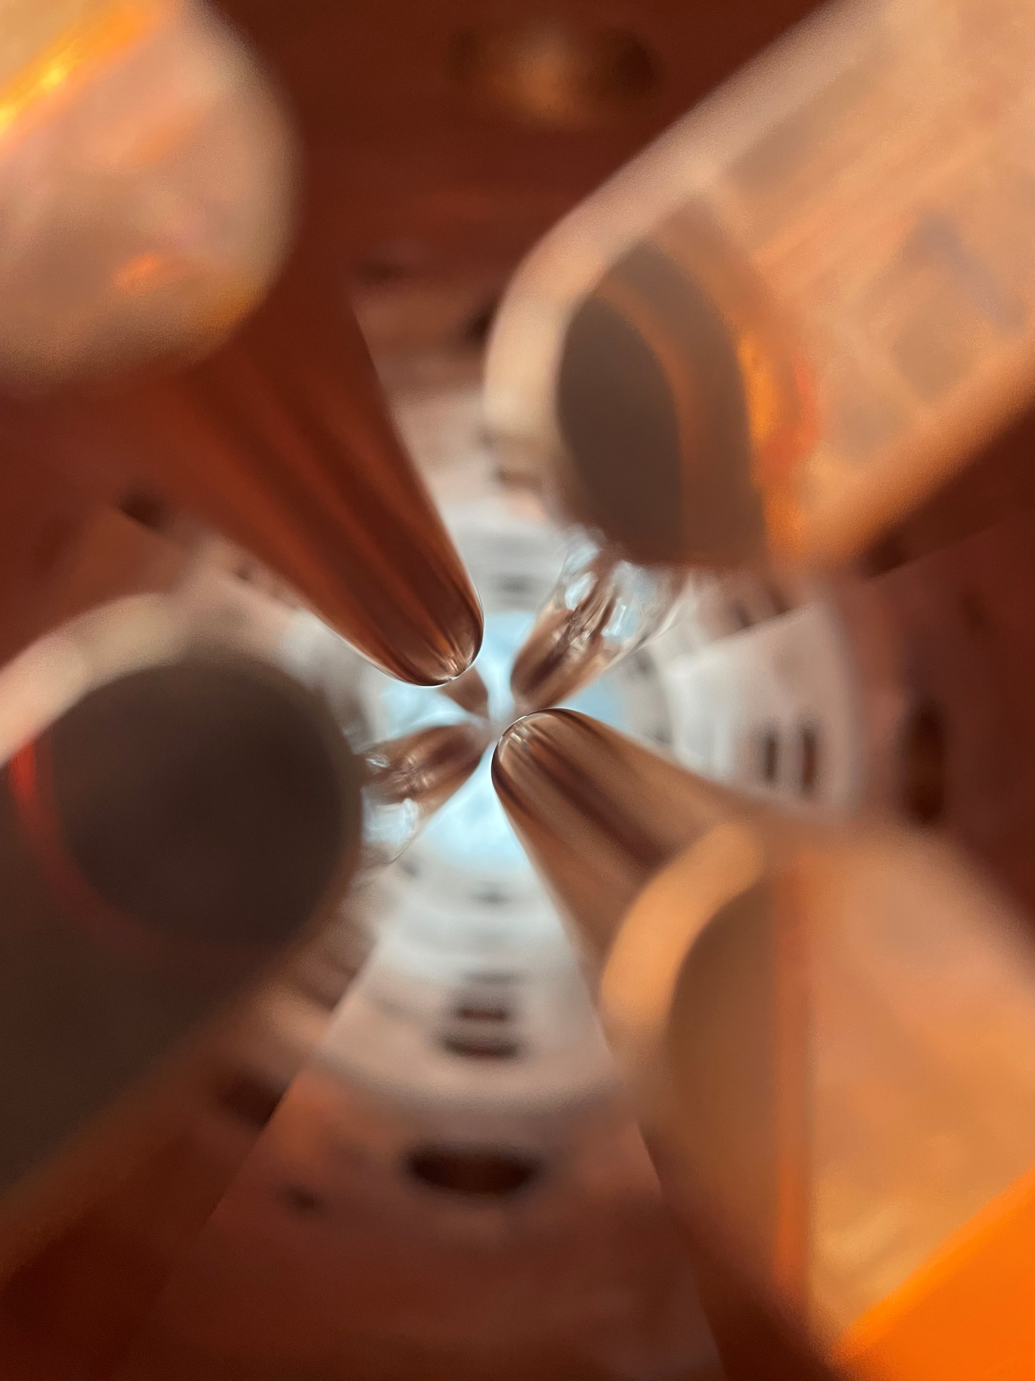
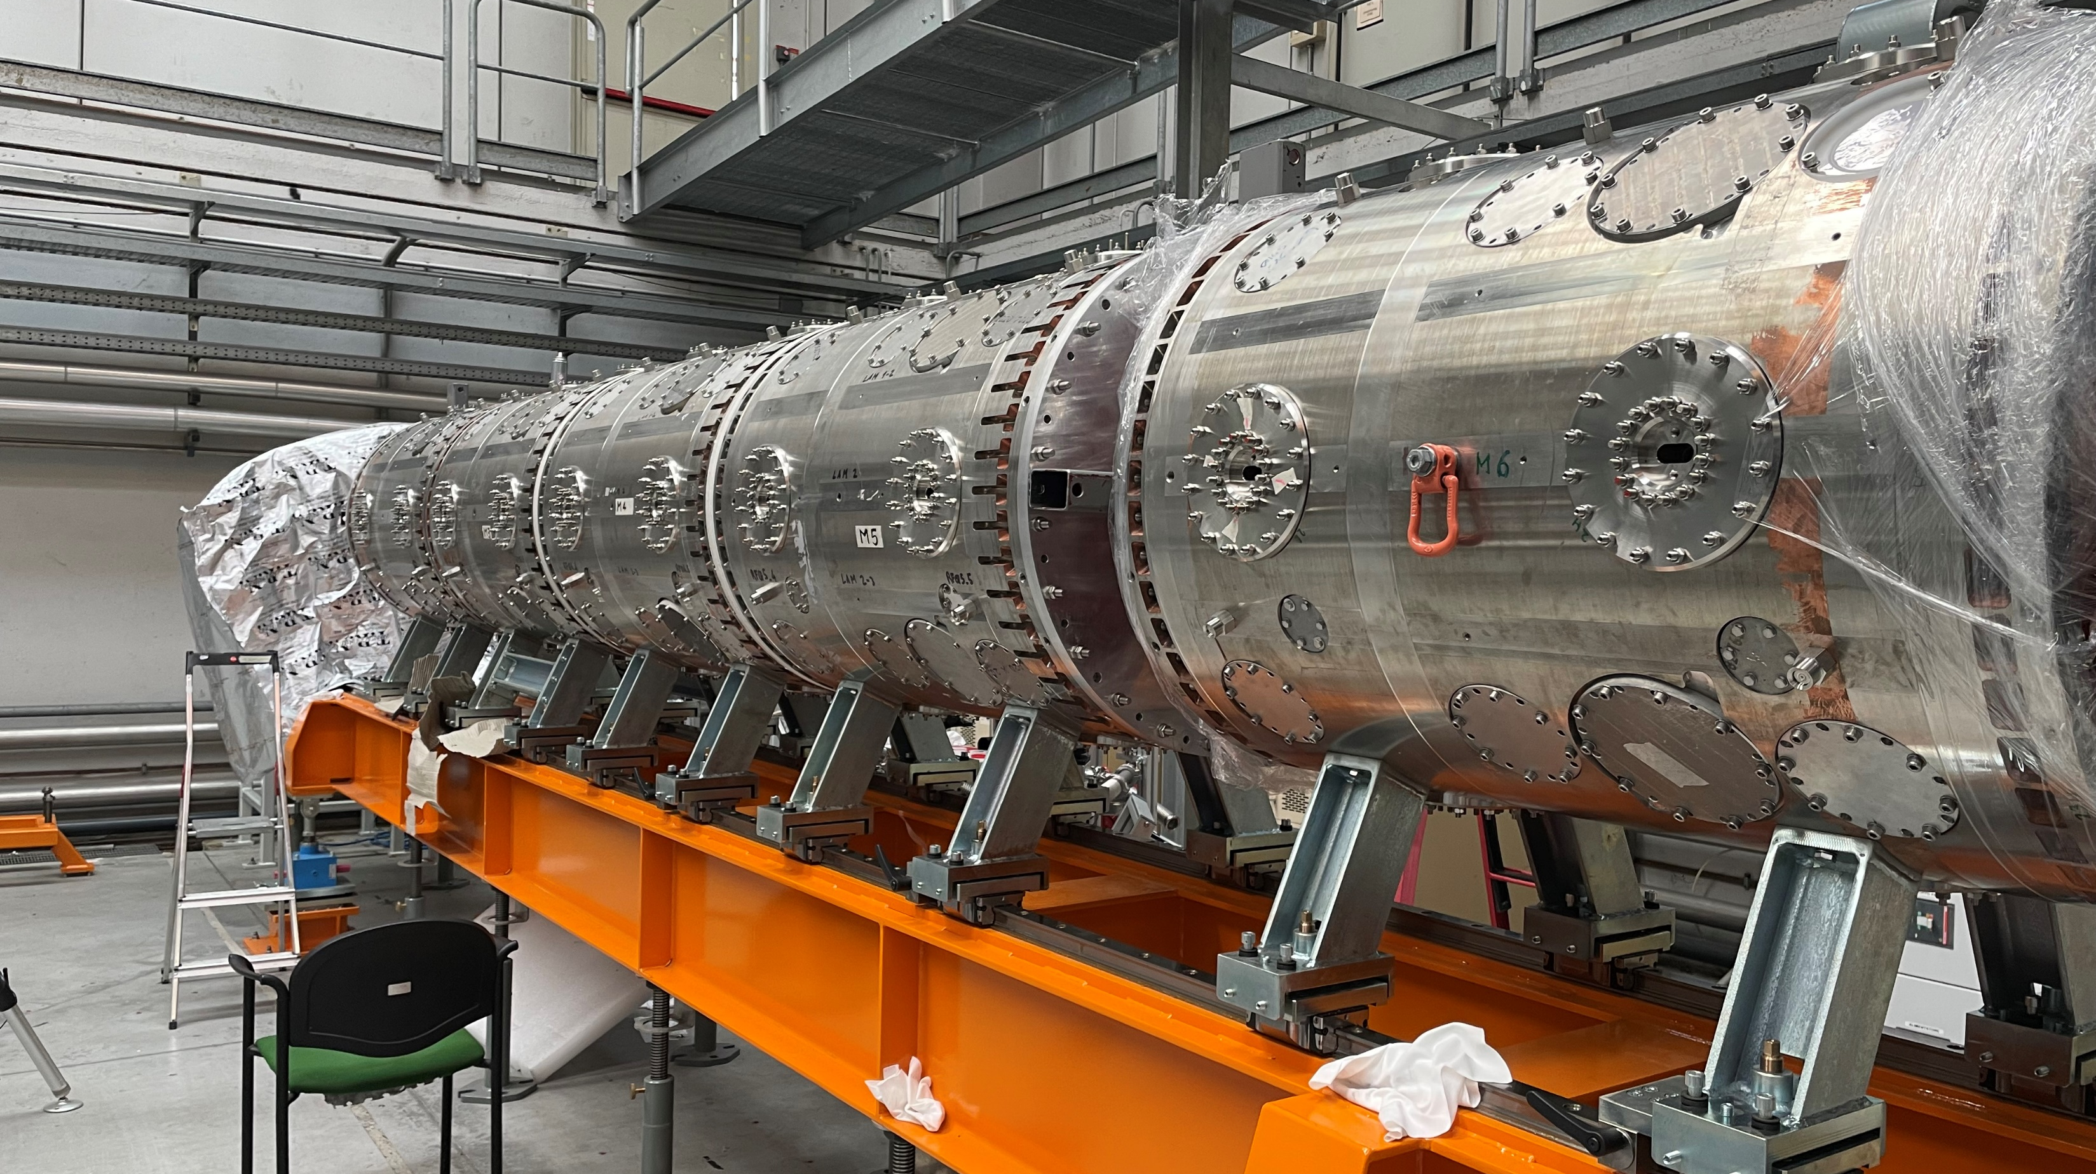
SPES ph. 3: RFQ

Slide 13
Outline
SPES general status
PTA upgrade status
Next months plan

Slide 14
Accelerator complex (2010 - 2023)

Slide 15
PTA elettrostatics vs RF (2013 - 2023)
TANDEM Domain
TANDEM Issues
Paradigm shift

Slide 16
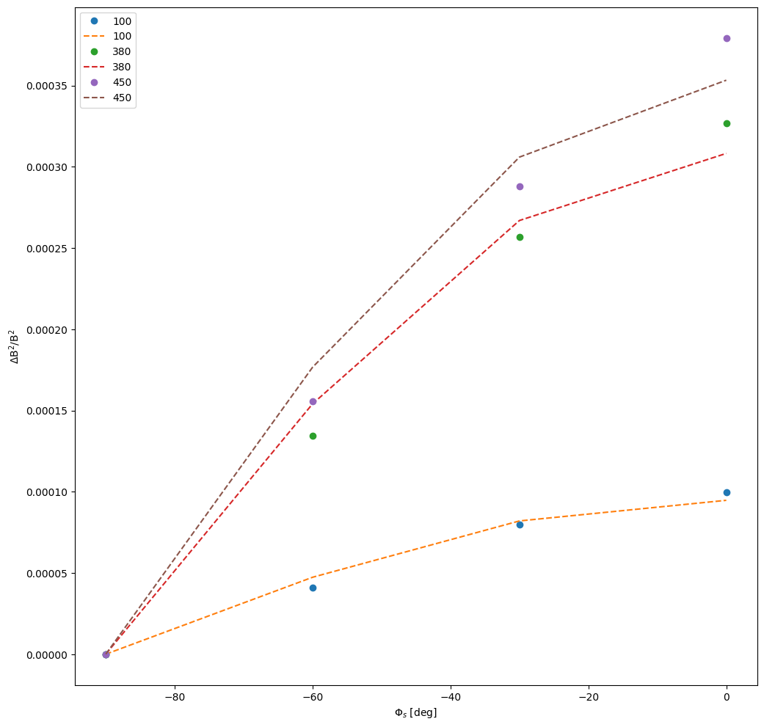
ALPI improvements
MEBT bunchers and SRFQs field calibrations.
Better ramp for the first cryostat cavities.
More realistic input conditions: increased emittances for simulations.
Buncher | Value w.r. sim.
HEB0 | -7%
HEB1 | -27%
HEB2 | -10%
SRFQ | Value w.r. sim.
1 | -7%
2 | -7%
MEBT Bunchers calibration
Max ALPI Transmission with heavy ions (best of past years)
with the essential contributions of alignments, RF systems, optimization methods and diagnostics
Max ALPI Transmission with heavy ions
50%-55%
35%
Much control of longitudinal dynamics
Notes:
Nell’insieme di una campagna di misure e re-commissioning di ALPI, dal punto di vista della dinamica del fascio ci si è incentrati nella migliore caratterizzazione della linea di iniezione di ALPI, in particolare dei buncher della MEBT e degli SRFQs. In particolare è stata trovata una errata calibrazione sul buncher HEB1.
Queste nuove calibrazioni, insieme ad un’altra serie di interventi (miglioramento rampe criostati 12,miglioramento simulazioni, allineamento SRFQs e criostati, miglioramenti nei sistemi RF e phasing, algoritmi di ottimizzazione ed un miglioramento delle diagnostiche hanno portato ad un record di trasmissione in ALPI, rispetto agli anni passati.

Slide 17
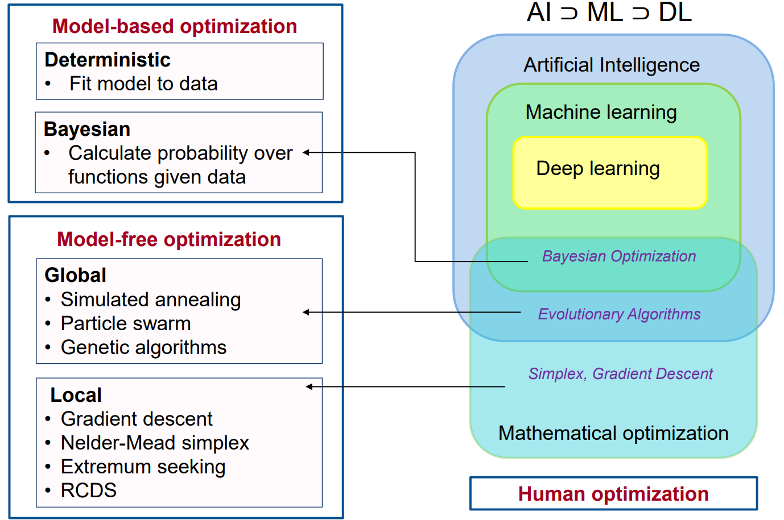
AI and ML areas of interests @ LNL linacs
Areas of Interest and study at LNL
Deep Learning (simulations)
Reinforced Learning (anomaly detection)
PSO - Particle Swarm Optimization
Real machine
Bayesian Optimization
ALPI provides the most extreme conditions for an algorithm to operate in:
Overstretched lattice beam dynamics
Mostly not known function
Instabilities due to some old equipment (e.g. timing systems, RF controllers, cryostat engineering…)
Massive number of cases: two (+1) different injectors and virtually all stable isotopes with A/q from 2.5 up to 8.5
Courtesy of Adi Hanuka - USPAS Course “Optimization and machine learning”
Notes:
Per quanto riguarda gli algoritmi di ottimizzazione, i linac di LNL sono l’ideale framework di studio (difficoltà di impostazione, casistica enorme, instabilità di vario genere etc..) per l’applicazione di tecniche innovative basate su AI e ML per l’impostazione dei LINAC.
In particolare, se consideriamo la classificazione utilizzata nel corso «Optimization and machine Learning» alla USPAS, a Legnaro si studiano e applicano gli algoritmi di AI, Machine Learning e Deep Learning, con i primi due applicati con iniziale successo alla macchina reale, come andrò ad illustrare.

Slide 18
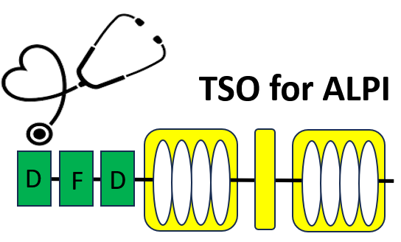
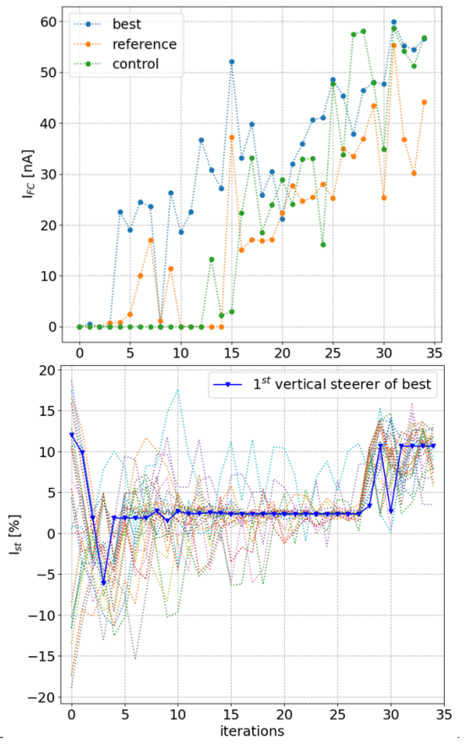
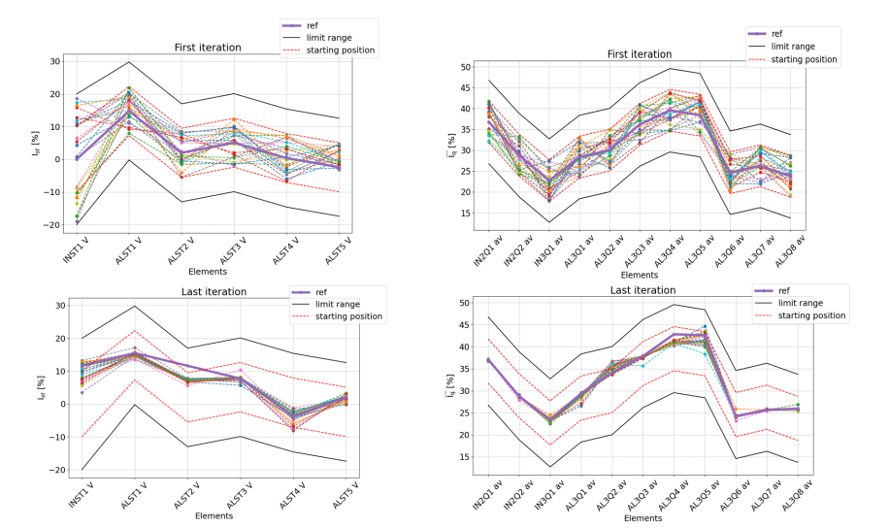
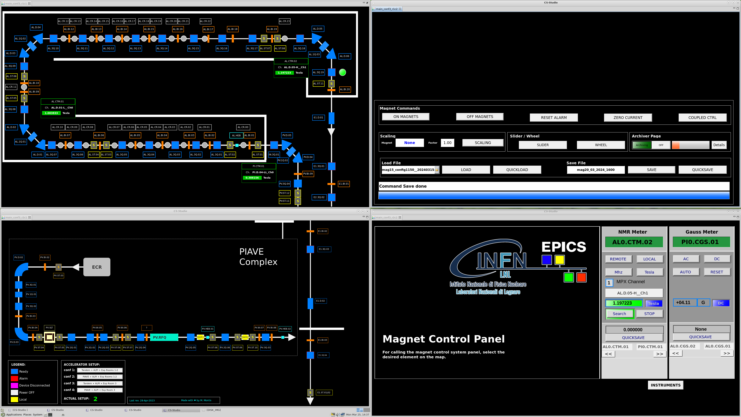
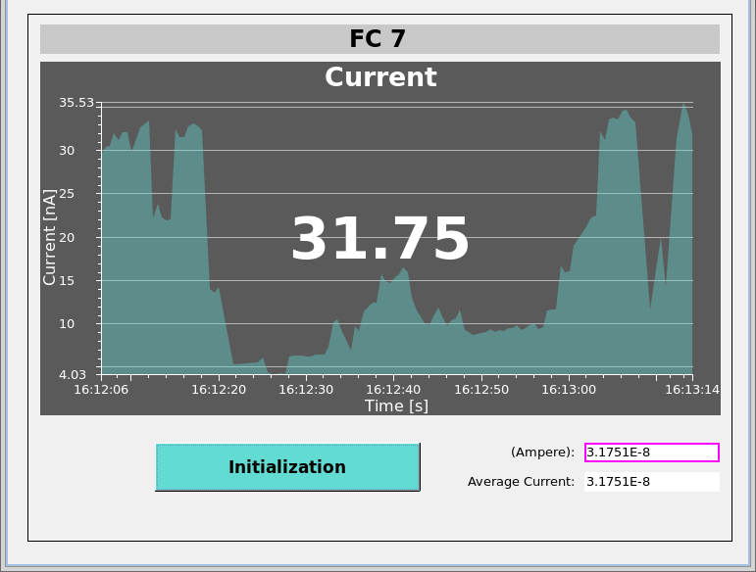

AI and ML optimization for LNL linacs - 1
Virtualization of FC 7: essential for speed up the conventional machine optimization and to built up the cost function at the end of the Linac
TSO Project: using the Particle Swarm Algorithm (PSO) tested the optimization of the transverse optics of the Linac. Tested up to 37 parameters
Line | No opt. | Manual | TSO
Transmission | 0% | 50% | 55%
Δt | - | 3 h | 1.5 h
Counteraction during the opt. of an instability on the vertical barycenter
${}_{ }^{32}{S^{9+}}$ @ 135 MeV
L. Bellan et al 2024 JINST 19 T03005
DOI 10.1088/1748-0221/19/03/T03005
Notes:
In ALPI, la funzione obbiettivo sia per l’ottimizzazione manuale che automatizzata è la FC prima dell’esperimento. A Marzo 2024 è stata virtualizzata per la prima volta dalla costruzione di ALPI, permettendo così sia una più agevole ottimizzazione che il suo utilizzo, tramite il framework EPICS, come funzione obbiettivo per gli algoritmi di AI e ML.
In particolare, dei primi test sono stati effettuati nella configurazione TANDEM-ALPI nel 2023, riguardanti l’impostazione automatizzata di tutti i quadrupoli, lenti e steerers, in contemporanea, osservando la corrente a metà linac.
Tramite l’algoritmo di intelligenza di sciame, si è riusciti ad ottimizzare in metà del tempo ottenendo più corrente rispetto all’impostazione manuale, con oscillazioni di corrente dell’ordine del 30%. Inoltre l’’algoritmo è riuscito a riconfigurare lo steering in maniera automatizzata rispetto ad un errore introdotto (a metà ottimizzazione) nei momenti primi nel fascio di input. Questo dimostra la capacità di tale algoritmo di agire in un sistema dinamico.

Slide 19
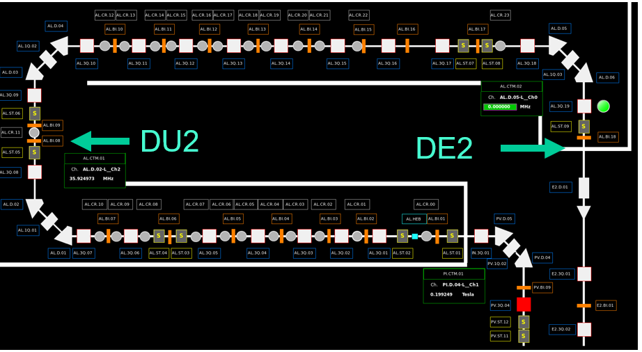
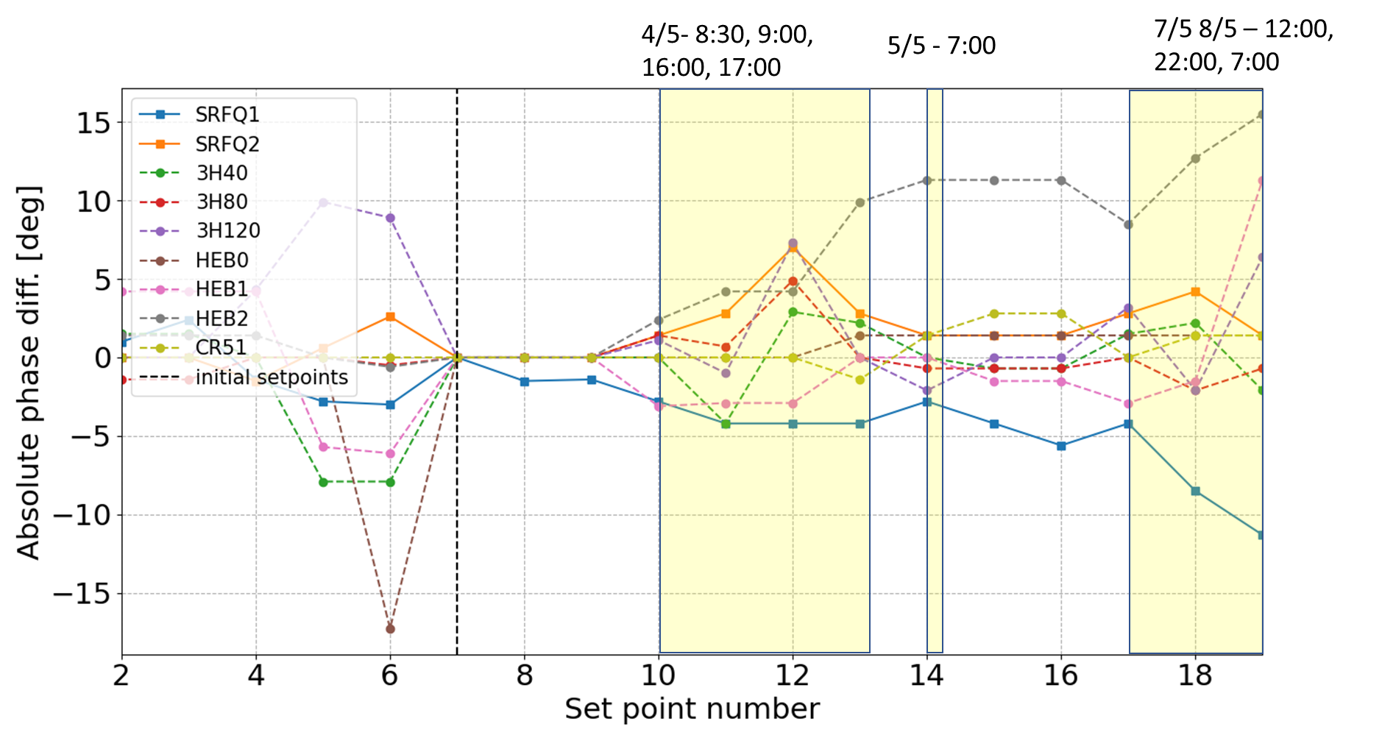




AI and ML optimization for LNL linacs - 2
Bayesian Optimization on the longitudinal phases up to the whole low energy branch and buncher fields.
40 parameters optimized in order of minutes!
Real-time optimization of longitudinal
acceptance on the machine - low energy branch
Input PIAVE phase drifts mitigation:
2023
Test Conditions:
$φ_{s}±4\deg{ }$
$$E_{0}±10\%$$
Step | Current value
Manual | 28 nA
BO | 42 nA
2024
Step | Current value
(at the end of phase drift) | 30 nA
BO | 70 nA
${}_{ }^{70}{Zn^{18+}}$ @ 500 MeV
${}_{ }^{208}{{Pb}^{31+}}$ @ 1270 MeV
Notes:
Un ulteriore algoritmo utilizzato nell’ottimizzazione longitudinale è un algoritmo Bayesiano. E’ stato utilizzato con successo nell’ottimizzare le fasi del ramo del basso beta, in contemporanea ai campi dei buncher della MEBT, osservando direttamente la corrente in FC7. L’ottimizzazione (durata qualche minuto) ha portato ad un aumento della trasmissione, implicando una aumento della scarsa accettanza longitudinale di ALPI. Risultato confermato da dei test implicanti la variazione di energia e fase di ALPI tramite l’ultimo buncher.
Questo algoritmo si è rivelato molto utile anche per mitigare gli ormai documentati drift in fase generati dal timing system /controller tra PIAVE ed ALPI, ri-ottimizzando la corrente in FC7: l’algoritmo ri-adatta al nuovo baricentro in energia e fase del fascio, spostato a causa delle instabilità. E’ importante sottolineare che questa non è una soluzione definitiva, ma una mitigazione del problema.

Slide 20

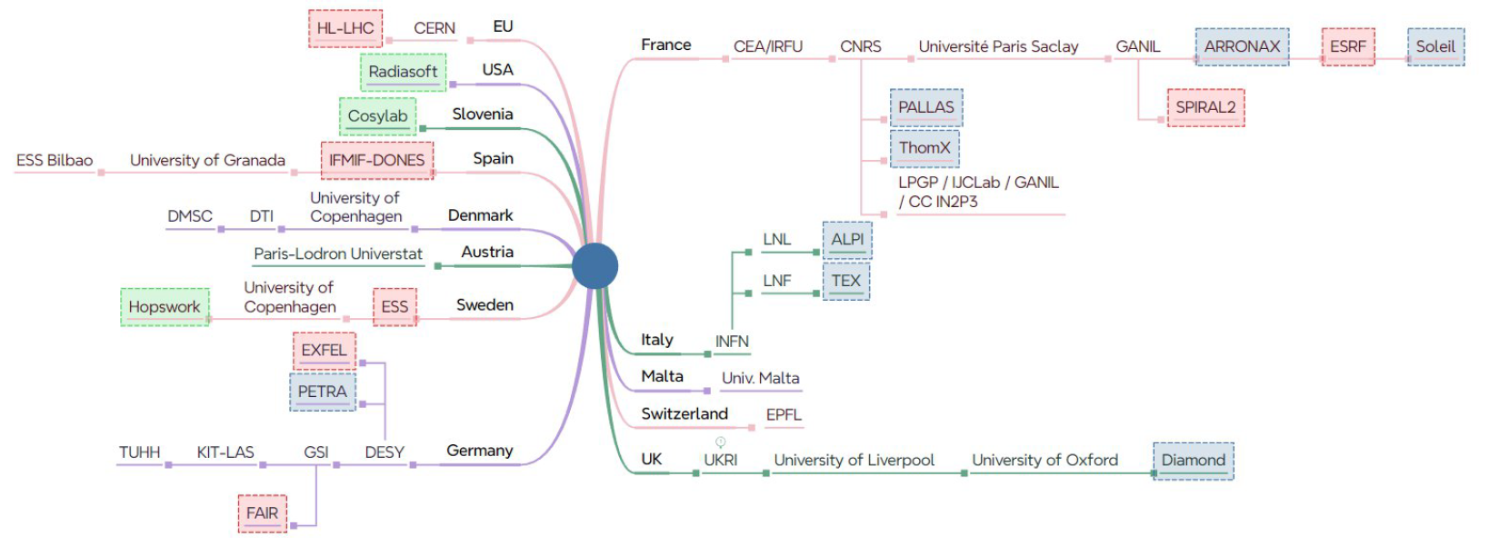
ARTIFACT Collaboration
A network of 30 institutes, spanning high-power superconducting linear accelerators, synchrotron light sources, and particle colliders
Scope: AI for accelerator research institutes and industry
Participation in HORIZON-INFRA-2024-TECH-01-01 call (4 March 2024)
LNL contribution: AI algorithms & Methods with particular emphasis on high intensity / heavy ions normal / superconductive Linacs.
Tasks:
Framework definition
Anomalies, failures and noise (deputy)
Optimization and control
LNL P.I. : Maurizio Montis
Notes:
L’implementazione di tecniche di AI negli acceleratori sono un settore di ricerca di punta. LNL, con ALPI, è contributor all’interno del network ARTIFACT, il quale unisce più di 30 istituti ed industrie a livello europeo ed internazionale che ha come obiettivo l’applicazione dell’AI negli acceleratori.
In particolare LNL partecipa nello studio delle metodologie AI nei linac ad alta intensità, per ioni pesanti e superconduttivi, con particolare enfasi all’ottimizzazione, all’anomalies detection e alla definizione del framework

Slide 21
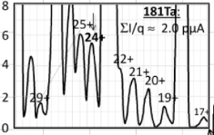
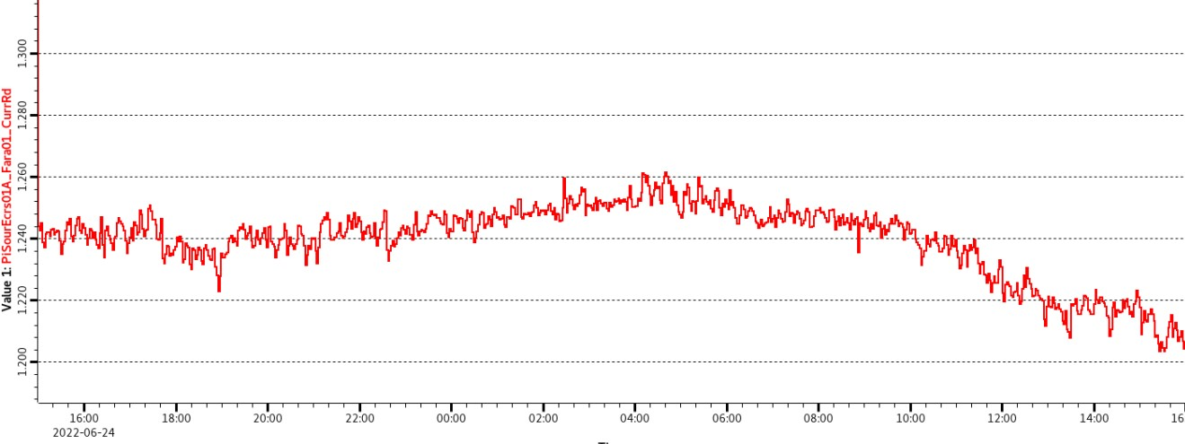
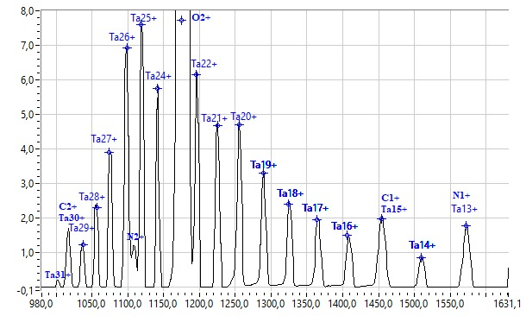
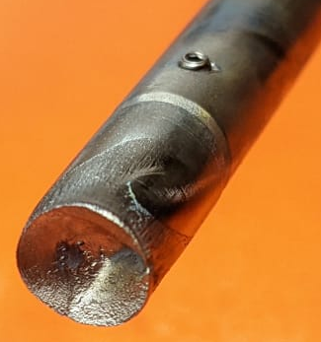

DEVELOPMENT OF U BEAMS
GOAL
    Production of 500 enA of ²³⁸U³²⁺ by sputtering
    This should translate in 0.5-1 pnA at the experiment
    Expected energy: ~7 MeV/A
EVALUATION OF THE FEASIBILITY
  U cannot be tested as a conventional beam
  LNL needs a specific authorization (request ongoing)
  Feasibility should be evaluated by a comparison with the production of another beam
U IS PRODUCED AT GANIL WITH THE SAME TECHNIQUE WE PLAN TO APPLY
PERFORMANCES ARE COMPARABLE TO WHAT WE WOULD GET
TO EVALUATE THE FEASIBILITY WE DECIDED TO COMPARE Ta PRODUCTION BETWEEN LNL AND GANIL
Ta²⁹⁺ 24 h stability
1,26 µA
Ta @ LNL
Ta @ GANIL
1,20 µA
U CAN BE CONSIDERED FEASIBLE
CONSUMPTION RATE: 65 mg/d.

Slide 22
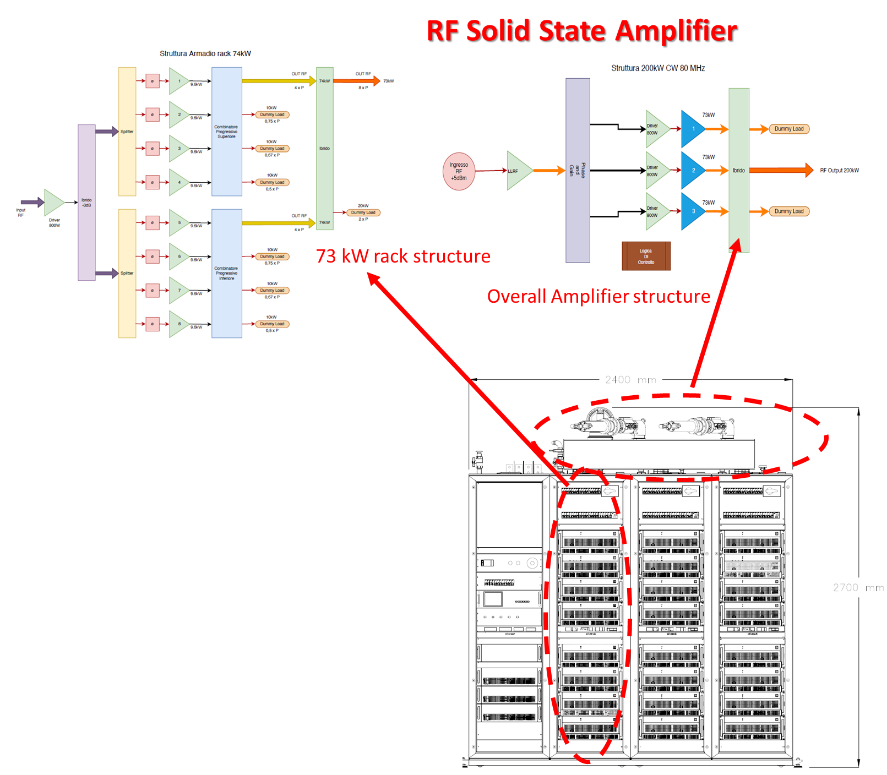
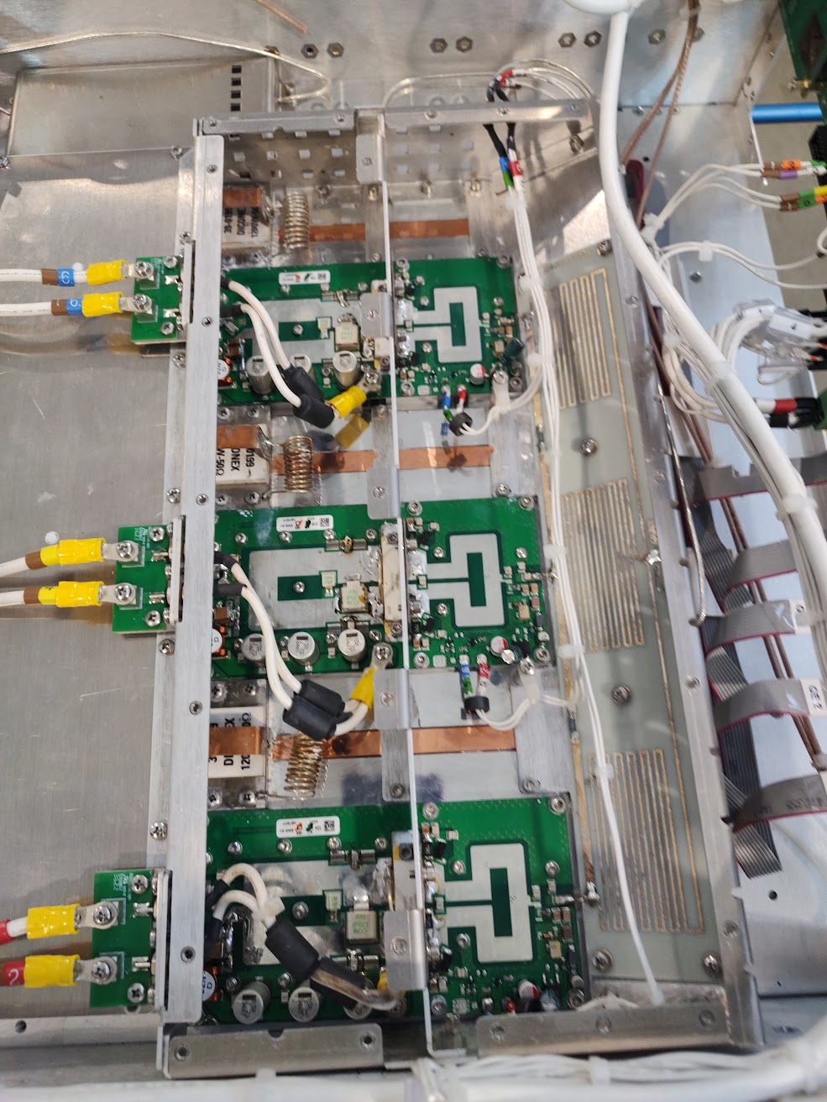
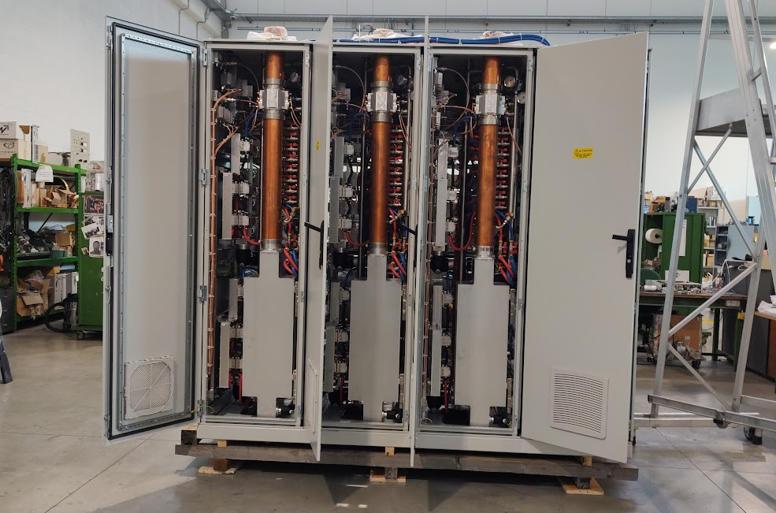
SPES RFQ: RF amplifier
Contract awarded to RTI (DB Elettronica, New Itelco and ELENOS)
The amplifier is able to withstand total reflection during the first 20 μs of the pulse and a maximum power value reflected in a continuous wave not less than 10% (20 kW) of the maximum output power of the amplifier
Amplifier Technology | Solid State
Output Power | 200 kW
Efficiency (RF Power/ Plug Power VA) | 60%
Linearity | ±1 dB in the range [20 kW, 180 kW]
Gain Stability | ≤ ±0.5 dB for temperature variation on the range [5°C 40°C]
Phase Stability | < ±1° (for power variation between 10% and 90%)
Detail of a 9 kW module
The Amplifier in phase of Assembly at the company premises

Slide 23
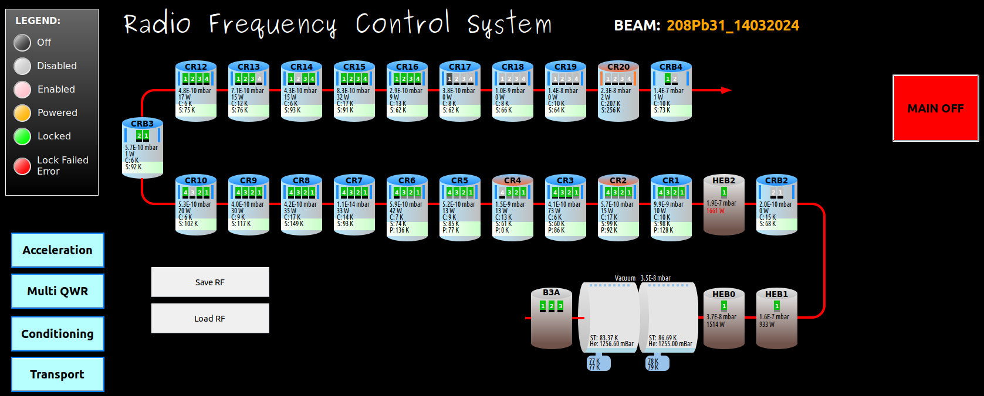
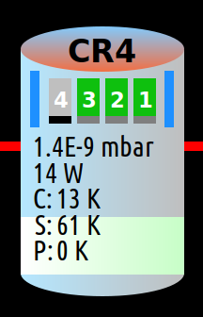
Updated LLRF CS & GUI
LLRF controllers are now controlled by EPICS and CSS
Replaced motion controllers (tuners&couplers) based on Beckhoff HW.
Cavity status
(see legend above)
Shield status
Vacum level
Total RF power
He tank level
Highest cavity temp.
Shileds temp.
Highest coupler temp.

Slide 24
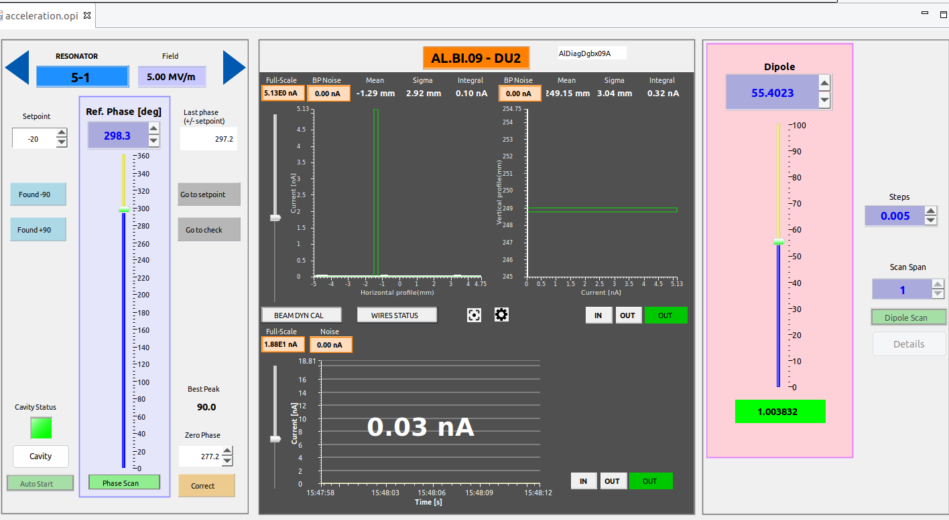
Improved LLRF Phasing
One dedicated interface to control the cavity phase/field set points, dipole field while monitoring the Beam Profile after a 90° bend.
Phase scanning and ±90 phase detecting can be manual or automatic.
Dipole field for the moment is manual (automatic procedure to be tested).
Cavity settings
Beam
Profiler & Faraday Cup
Dipole Settings

Slide 25
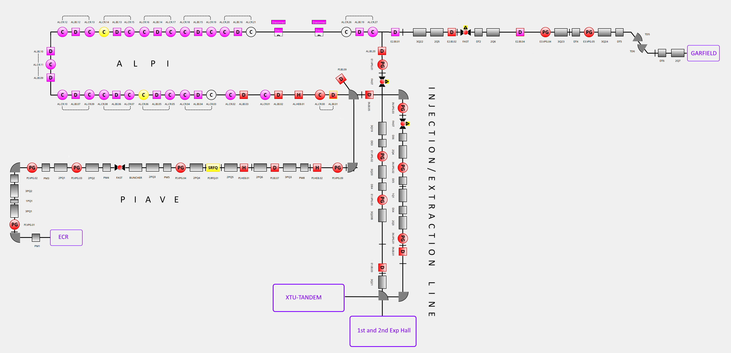
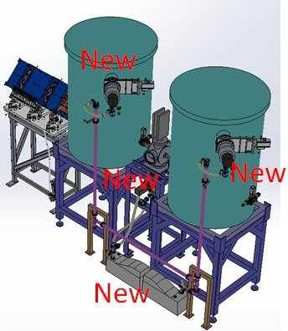
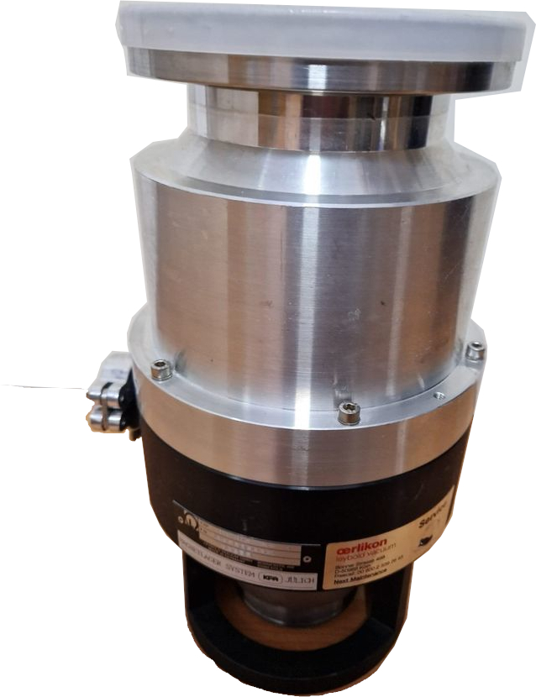
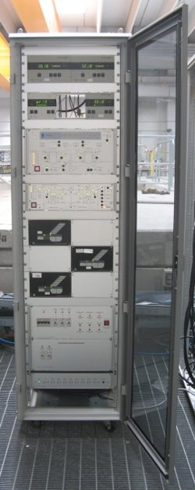


Vacuum control system: Status and Upgrade Plan
The vacuum system of ALPI
About 40 pumping groups
14 control Racks, provided by an external contractor
installed in the ‘90s
2022
2023
2025
2024
2027
2026
Vacuum:
Model out of the market
Lack of spares
Upgrade Plane:
2013 - 2021: Develop of new controls Racks
2021-2022
  NEW High level control system EPICS Based
  First batch of HW procurements
2022 – 2024 Progressive replacement of Vacuum and Controls
2024 – 202x Progressive replacement of Vacuum and Controls (time schedule related to available funds)
Y
Controls:
Out of the market
Lack of spares
No support from manufacturer
X
X
X
X
X
Notes:
Both Vacuum and controls are Obsolete and unmantainable
The Upgrade of Vacuum system Hardware require to upgrade also the control part
At the end of 2021 – first part of 2022, the vacuum supervision system done by TELEMA have been substituted by the new high leve control system in EPICS
In the summer 2022 have been substituted the first 2 racks of the old vacuum control system with the new racks with SIEMENS PLC --> 2 racks = 4 cryostat upgraded
Now the system automation and relative know how is internal, but the industrial automation and EPICS framework ensure the possibility of external contribution.

Slide 26
Outline
SPES general status
PTA upgrade status
Next months plan

Slide 27

SPES-CB MODIFICATION
TO PRODUCE STABLE BEAMS FOR THE COMMISSIONING OF THE ADIGE INJECTOR THE SPES-CB MUST BE TURNED INTO A CONVENTINAL ECR SOURCE
PRESENT LAYOUT
MODIFICATION OF THE INJECTION SIDE
microwaves
FURTHER MODIFICATION TO ALLOW METALLIC BEAMS PRODUCTION (under study)
MAXIMUM MAGNETIC FIELD UP TO 1.6 T
HIGHER CURRENT FOR HIGH CHARGE STATES OF HEAVY IONS
ONLY GASEOUS BEAMS COULD BE PRODUCED
THE PICTURE ABOVE SHOWS A PARTICLE CURRENT SPECTRUM (to be multiplied by q to get the conventional one)
oven
MAXIMUM MAGNETIC FIELD HIGHER THAN 2 T

Slide 28

ADIGE INJECTOR: COMMISSIONING
COMPLETE CHARACTERIZATION OF THE SPES-CB AND MRMS BY OPERATING THE N+ BEAM LINE UP TO POINT 3
2
1
PLASMA | BEAM | WHAT TO DO | CONDITIONS
He | He+ | First experience of tuning the CB; Check spectrum acquisition; Check transmission from CB to platform (point 1); Check transmission through the MRMS (point2); preliminary check of contamination | Platform off
He | He+ | First experience of tuning the CB; Check spectrum acquisition; Check transmission from CB to platform (point 1); Check transmission through the MRMS (point2); preliminary check of contamination; emittance measurement (point 3) | Platform on
O | O4+,O5+ | Check transport up to point 1 and 2 (A/q≤4) | Platform on/off
O | O6+ | Maximization of O6+; Check of the total extracted current; check transmission up to point 1 and 2 | Platform off
O | O6+ | Maximization of O6+; Check of the total extracted current; check transmission up to point 1 and 2 | Platform on
O | N2+ | Check transport up to point 1 and 2 for A/q=7 | Platform off
O | N2+ | Check transport up to point 1 and 2 for A/q=7 | Platform on
O | N2+ | Multipole setting thorough emittance measurement for A/q=7 | Platform on
O | All | Check transport with different CB potential up to point 1 and 2 | Platform on/off
O+Xe | All | Tuning the CB with heavy ions; check total extracted current; check transport for different CB potentials up to point 3; emittance measurement on Xe high charge state; resolution; contaminants | Platform on/off
3
EMITTANCE MEASURE

Slide 29

Application on ADIGE and further developments
Within the “conventional” commissioning operations plan (starting in 2025), we have a section dedicated to the optimization:
AI algorithms
Multipole
Optimization of the CB parameters (TBC)
First order moment setting through the MRMS
Second-order settings (beam envelopes)
RFQ transmission and optimization
ADIGE beam line
Reinforced Learning algorithms
Multipole tuning, Reinforced Learning
Perspectives:
Further improvement in the ALPI dynamics (ramp of the first cryostats)
Study of the algorithms on both the transverse optics of the whole linac (already started)
Individuation of the best algorithms for longitudinal and transverse optics
Development:
  Combination
  Coupling with Deep Learning
Heavy automatization of the accelerator setting (already started in ALPI)
Expansion of the applications to the LNL and collaboration accelerators
Notes:
Lo studio in ALPI sarà applicato direttamente nel collaudo dell’iniettore ADIGE, il quale prevede delle specifiche problematiche di matching. In particolare, verrà applicato al setting del multipolo degli algoritmi di reinforced learning che sono attualmente in fase di studio e preparazione. Il matching dell’RFQ e dell’ottica in generale sarà gestito dall’algoritmo che risulterà più efficace negli attuali studi di ALPI.
La road map prevede infatti la conclusione degli studi esplorativi sugli algoritmi di AI sul linac superconduttivo, lo sviluppo di un algoritmo ad hoc che permetta di sfruttare le potenzialità di ciascuno sia in ambito trasverso e longitudinale ed infine l’espansione dell’applicazione della tecnica risultante agli altri acceleratori LNL e coinvolti nelle collaborazioni internazionali.

Slide 30



SPES RFQ: tuning and conditioning
Tuning
RFQ is initially equipped with 72 dummy tuners and end plates
Bead pulling measurements to determine end plate thickness
End plate machining and copper plating
Dummy tuner heights determination according to the tuning algorithm
Final end plates installation
Final copper tuners installation in batches, in order to allow further adjustments
48 field pickups calibration
Final RFQ leak test
Target ±3% voltage perturbation
Conditioning
Installation of the Cooling System
Installation of the RF lines
RF coupler engineering and production launch
LLRF: integrated in the overall Linac
LCS: racks equipped and ready by December 2025

Slide 31



SPES RFQ: new LLRF
New LLRF digital board.
Direct RF sampling for 4 Pickups (one per vane digitally averaged) and 2 forward and 2 reflected powers.
48 pickups channels acquired through log amplifiers and commercial DAQe-2204 64 channel ADC board.
Software control system based on EPICS and Ipbus (https://ipbus.web.cern.ch/).
8 channel LLRF board

Slide 32
Updated LLRF CS & GUI
CSS will be upgraded to Phoebus
LLRF HW to be upgraded
SRFQ LLRF SW & HW to be upgraded

Slide 33



SPES/PTA vacuum systems
NEW Vacuum Systems for SPES
The total amount of installed vacuum HW will DUPLICATE
About 50 racks in Total (25 for SPES Beam lines),
4 Main Configurations (up to 21 cases), moltitude of HW combinations
System types significantly increase in COMPLEXITY
System | TMPs | PPs | EPs | TPGs | PEs | PIs | Racks
SPES Building | 26 | 12 | 10 | 29 | 31 | 88 | 16
SPES ADIGE | 25 | 10 | 10 | 24 | 23 | 65 | 9
Total | 51 | 22 | 20 | 53 | 54 | 274 | 25
Notes:
Picture of the Vacuum Control Systems over the LNL Accelerator Layout
Number of vacuum systems will became about the double, While System complexity will grow significantly
Several brand and model
Vacuum exaust recovery
Interface with different systems
Really tight space for installation and maintenance

Slide 34
Conclusions
Accelerator division (and lab) priorities change:
  Cyclotron restart and first beam in ISOL2
  First RIB from ISOL1 to low energy experiments
  ADIGE+RFQ completion and beam commissioning
Priority order becomes a real constraint in case of lack of human resources
PTA accelerator complex is facing important upgrades without sacrifyicing beam for users (currently!)
Next year first Uranium beam will be extracted from PIAVE injector and accelerated and transported to experimental hall for user experiments.

Slide 35
Accelerator division people
L.Antoniazzi
P.Antonini
A.Baldo
C.Baltador
A.Battistella
L.Bellan
A.Beltramin
G.Bisoffi
D.Bortolato
L.Boscagli
P. Bottin
S.Canella
O.Carletto
D.Carlucci
M.Cavenago
M.Comunian
A.Conte
M.Contran
S.Contran
D.Crivellaro
A.D’Este
R.A.Donolato
A.Fasolato
A.Ferrara
L.Ferrari
P.Francescon
A.Galatà
C.S.Gallo
F.Gelain
M.Giacchini
E.Giolo
F.Grespan
L.La Torre
M.Maggiore
D.Martini
D.Miazzi
M.F.Moisio
M.Montis
E.Munaron
F.Nerva
M.Pacchiega
A.Palmieri
R.Panizzolo
L.Pantano
A.Pisent
R.Ponchia
L.Pranovi
A.I.Rakotobe
C.Roncolato

Slide 36
Backup slides

Slide 37





ECR SOURCE @ LNL
LEGIS (LEGnaro ecrIS)
  PRODUCTION TECHNIQUES
  GASEOUS BEAMS
    CONDENSABLE
      OVEN (elements whose vapour pressure is 10⁻² mbar for T ≤1200 °C)
        More efficent
        Long start up
        Delicate parts
      SPUTTERING (others)
        Less efficient
        Easier to use
ION | CURRENT [µA]
 | PK | LNL
Xe²⁷⁺ | 1 | 3.5
Xe²⁸⁺ | - | 1
Ta²⁵⁺ | 3.5 | 7
Ta²⁷⁺ | 2.5 | Almost 4
Ta²⁹⁺ | - | >1
Pb²⁷⁺ | 1 | 7
Pb³²⁺ | - | >1
MUCH HIGHER PERFORMANCE THAN THOSE GUARANTEED BY THE COMPANY

Slide 38

Current and future beam availability
AVAILABLE
TO BE TESTED AGAIN
UNDER DEVELOPMENT
FEASIBLE
AVAILABLE WITH MIVOC
(others could be developed within ERIBS)

Slide 39

Improved LLRF Phasing 2/2
During the full angle scanning the FC current and Beam Profile centroid position are recorded and then correlated with an expected model and weighted by the total FC current. The figure-of-merit function is then to detect the cleanest non-accelerating phase (+90 or -90).
Taget phase for the cavity can than be calculated and checked (and than coerrected if necessary).
ADVANTAGES:
Shorter setup time: a full cryostat can be phased ~ 10 minutes.
The procedure is less prone to human errors.
The automatic scan can successfully deal with very faint o spreaded signals.
It provides the essential building blocks for a full automatic procedure.
+90 phase
FC
currents
Merit
function
Centroid
Position
-90 phase
Results

Slide 40




Impact of SPES vacuum systems
Challenges:
  Manage purchase and stocks according to the installations program
  Installation and commissioning (requires many peoples with different competencies)
  Manage many different types of new devices
  Manage the large amount of working HW (spares, maintenances, activation issues...)
  Controls development and versioning management
Where we are
A detailed PBS of all the vacuum infrastructure is completed
Most of the design needed for the installation phase is done
Installations are growing slowly
Instrument for asset management, intervention procedures and work organization needs to be improved.
Configurations of control system racks
have been mapped for all the LNL facitlity.
SW development are ongoing.
Target Ion Source
High Activity Gas recovery system
Notes:
New Challenges related to
Number and different types of new devices
Big effort for Installation and commissioning
Operation and maintence of all the systems
Controls development an versioning management
Up to now
Design, Purchases and installation procedures are well defined
Installation procede slowly mainly due to technical issue or man power availlability
Controls are ongoing
Many thinghs have to be improved for the operartion phase

Slide 41



SPES phase 4
The SPES facility for medical radionuclides production @LNL
A unique facility for research and production using P70 beams
RILAB
DIRECT method
LAboratory of Radionuclides for MEDicine
Standard production method
Closer to stability, higher intensity
E.g.: ⁴⁷Sc, ^{99m}Tc, ⁵¹Mn/⁵²Mn
ISOL method
RIFAC
Far from stability, high purity
E.g., UC_{x} target: ¹¹¹Ag, ¹³¹I, ⁹⁰Y, ⁸⁹Sr
The specificity of the SPES P70 proton driver is the energy domain: 35-70 MeV.
allows to develop a great research program on new production methods.
can be used for production in specific cases.

