Slide 1
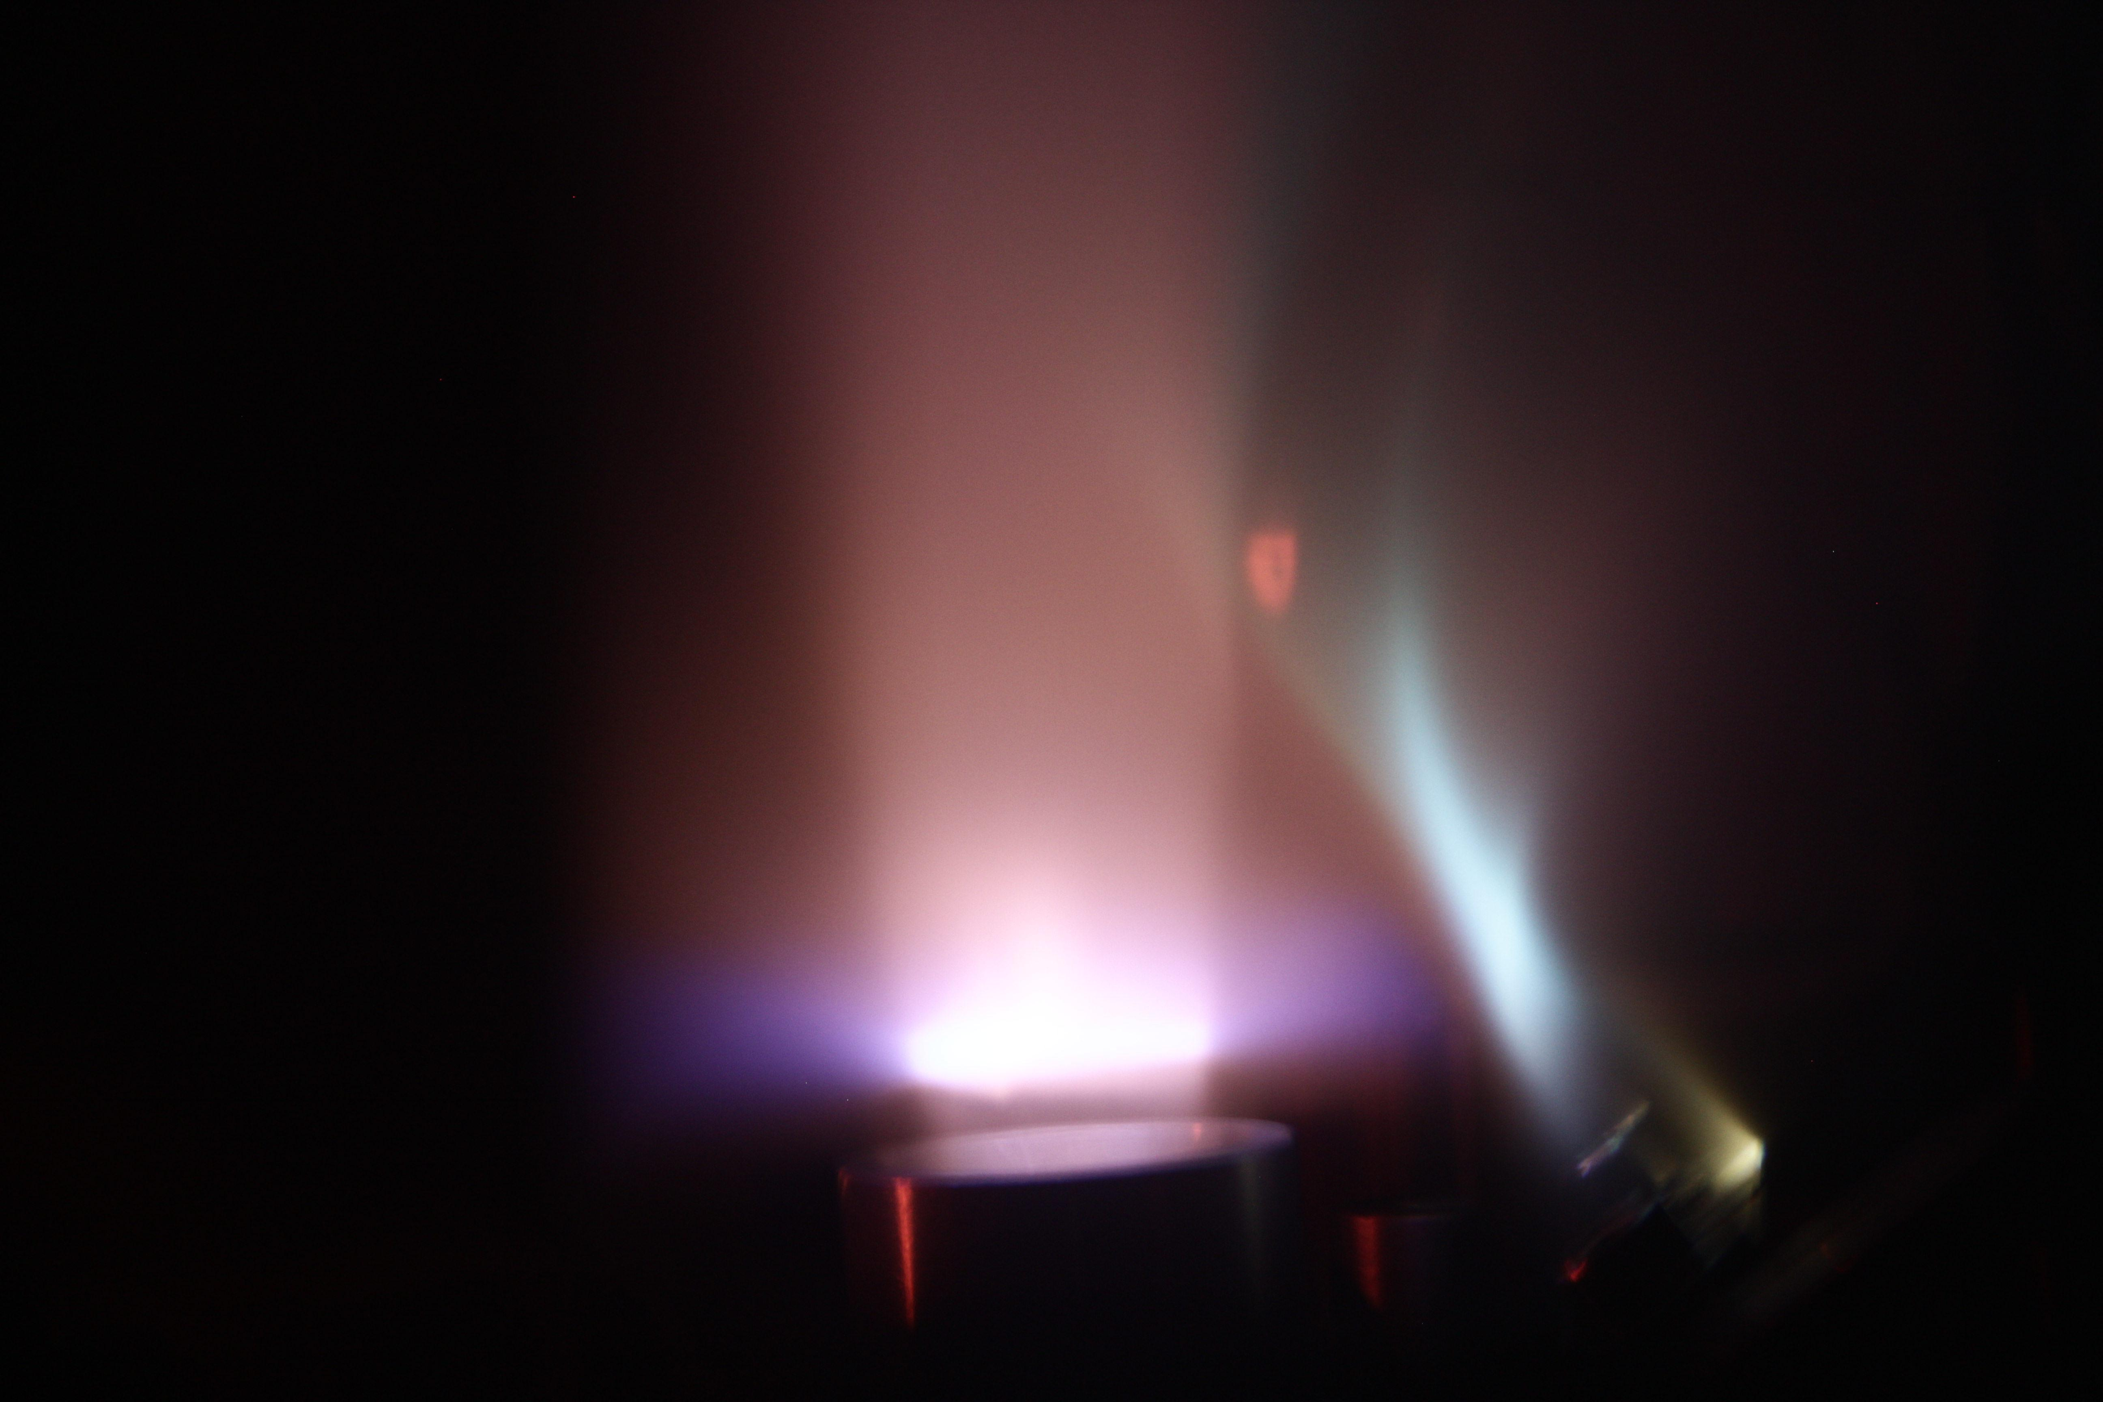
Introduction to Plasma Diagnostics
especially for diagnosing Plasma Accelerators!
Zulfikar Najmudin
EuPRAXIA-SS, Frascati, 24-04-2024

Slide 2
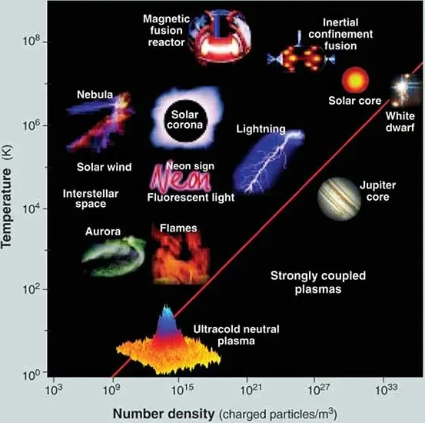
Plasma
Density / Temperature plot
Plasmas (most) generally characterised by their density and temperature
Range > 10⁷ in Te and 10³⁰(!) in ne
Two most important plasma parameters:
$$ω_{p}={\left(\frac{n_{e}e^{2}}{ε_{0}m_{e}}\right)}^{1/2}\text{(}\text{plasma} \text{frequency}\text{)}$$
$$λ_{D}={\left(\frac{ε_{0}k_{B}T_{e}}{n_{e}e^{2}}\right)}^{1/2}\text{Debye} \text{length}$$
ion source
wakefield
Image: The Contemporary Physics Education Project/www.CPEPphysics.org

Slide 3
Plasma Diagnostics
Density / Temperature plot
Some diagnostics that are not appropriate for plasma accelerators:
space craft
probes
coils
gravity waves
Ideally diagnostics are non-invasive, could be:
low intensity electromagnetic waves
low intensity particle probes
ion source
wakefield
Image: The Contemporary Physics Education Project/www.CPEPphysics.org

Slide 4
Density Diagnostics

Slide 5
Electromagnetic probes
The refractive index of a plasma

Slide 6
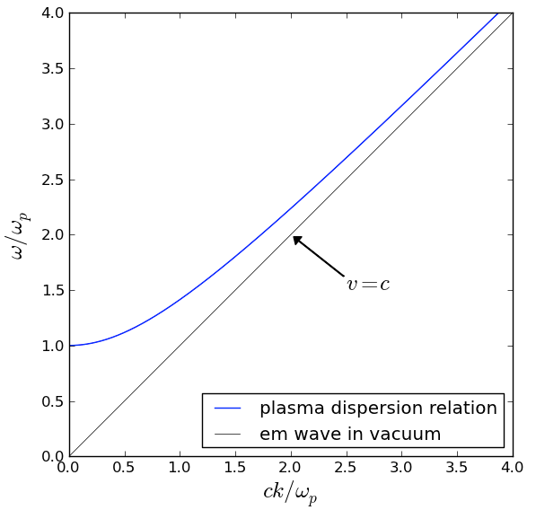
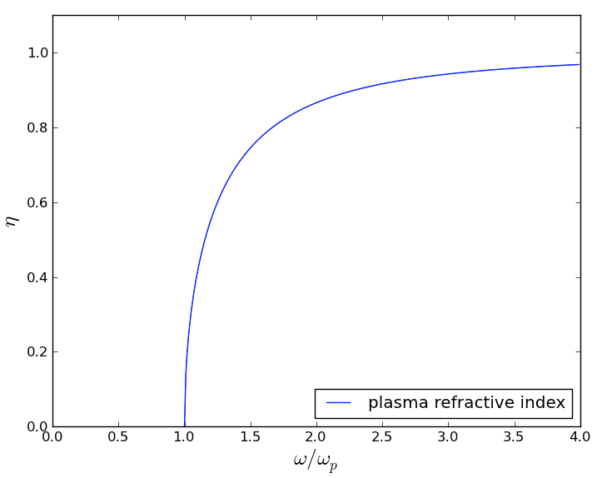
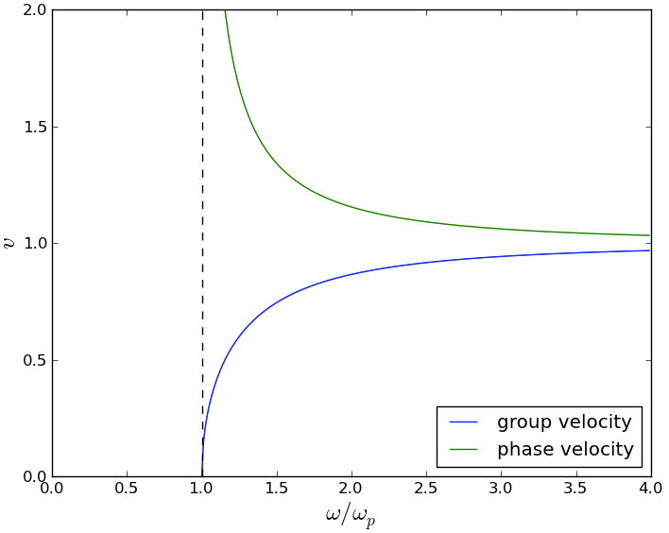
Electromagnetic probes
The refractive index of a plasma
$$v_{φ}=c/η=c(1−(ω_{p}/ω_{0})^{2})^{−1/2}$$
$$c^{2}k^{2}={ω_{0}}^{2}−{ω_{p}}^{2}$$
$$η=\sqrt{1−(ω_{p}/ω_{0})^{2}}$$
$$v_{g}=ηc=c(1−(ω_{p}/ω_{0})^{2})^{1/2}$$

Slide 7
Electromagnetic probes
Critical Density
Sweep microwave source until no transmission.
Density then at critical density where
$ω=ω_{p}$, ➜ $n_{cr}=\frac{ε_{0}m_{e}{ω_{0}}^{2}}{e^{2}}$

Slide 8
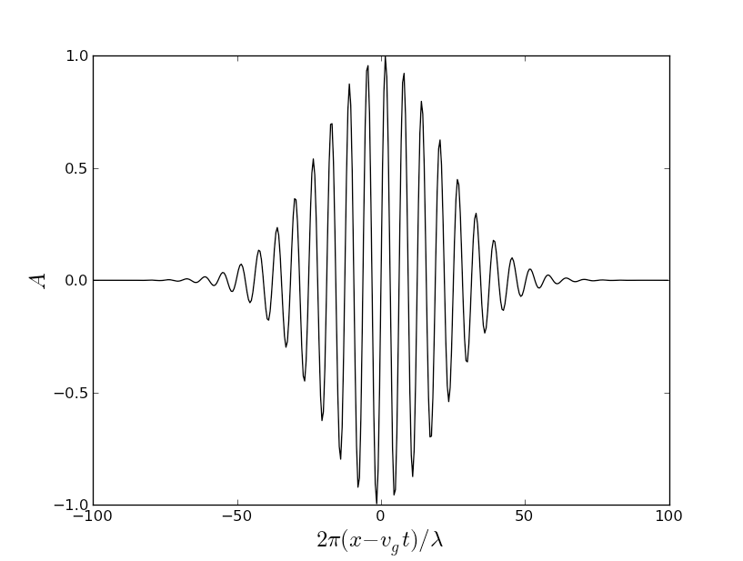
Electromagnetic probes
The refractive index of a plasma
Direction of motion

Slide 9
Electromagnetic probes
The refractive index of a plasma

Slide 10
Electromagnetic probes
The refractive index of a plasma

Slide 11
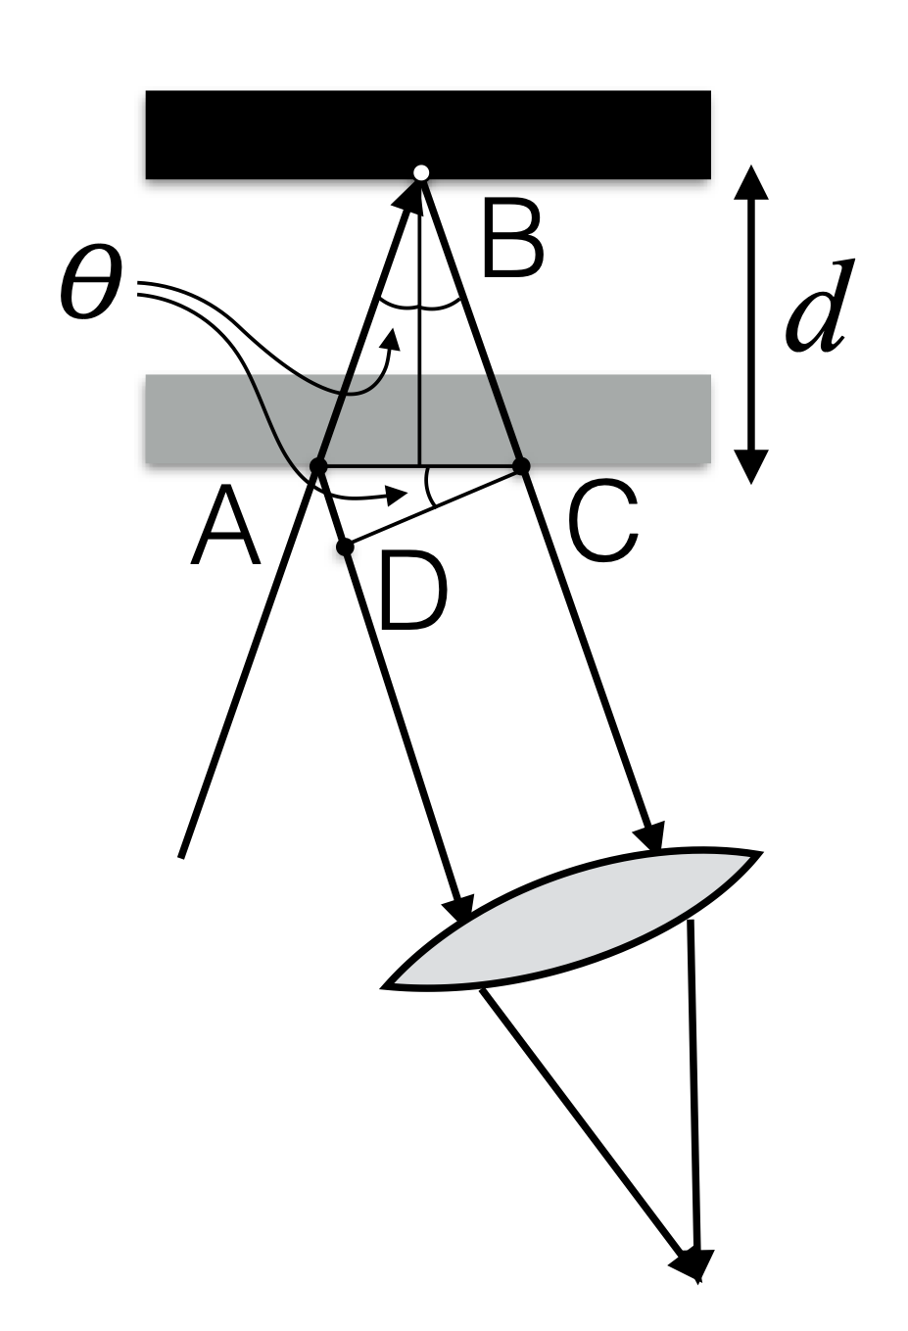
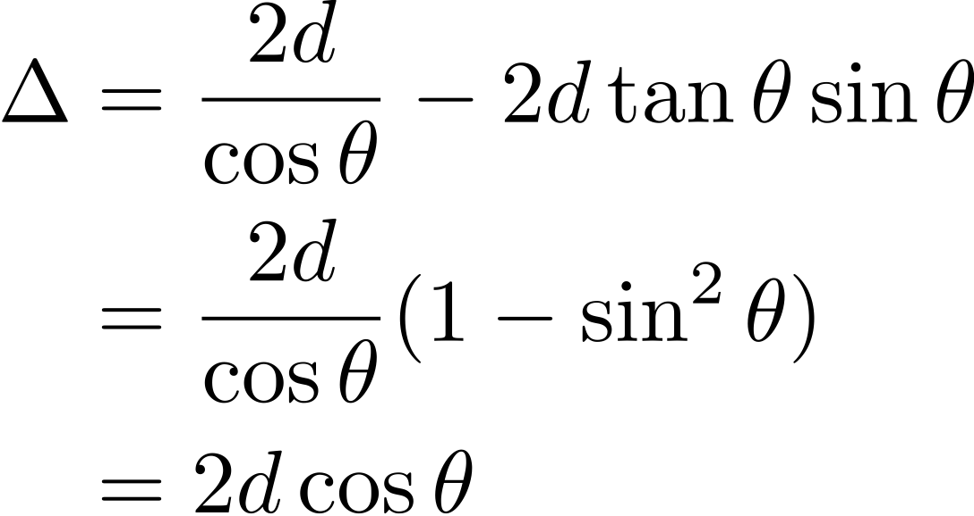
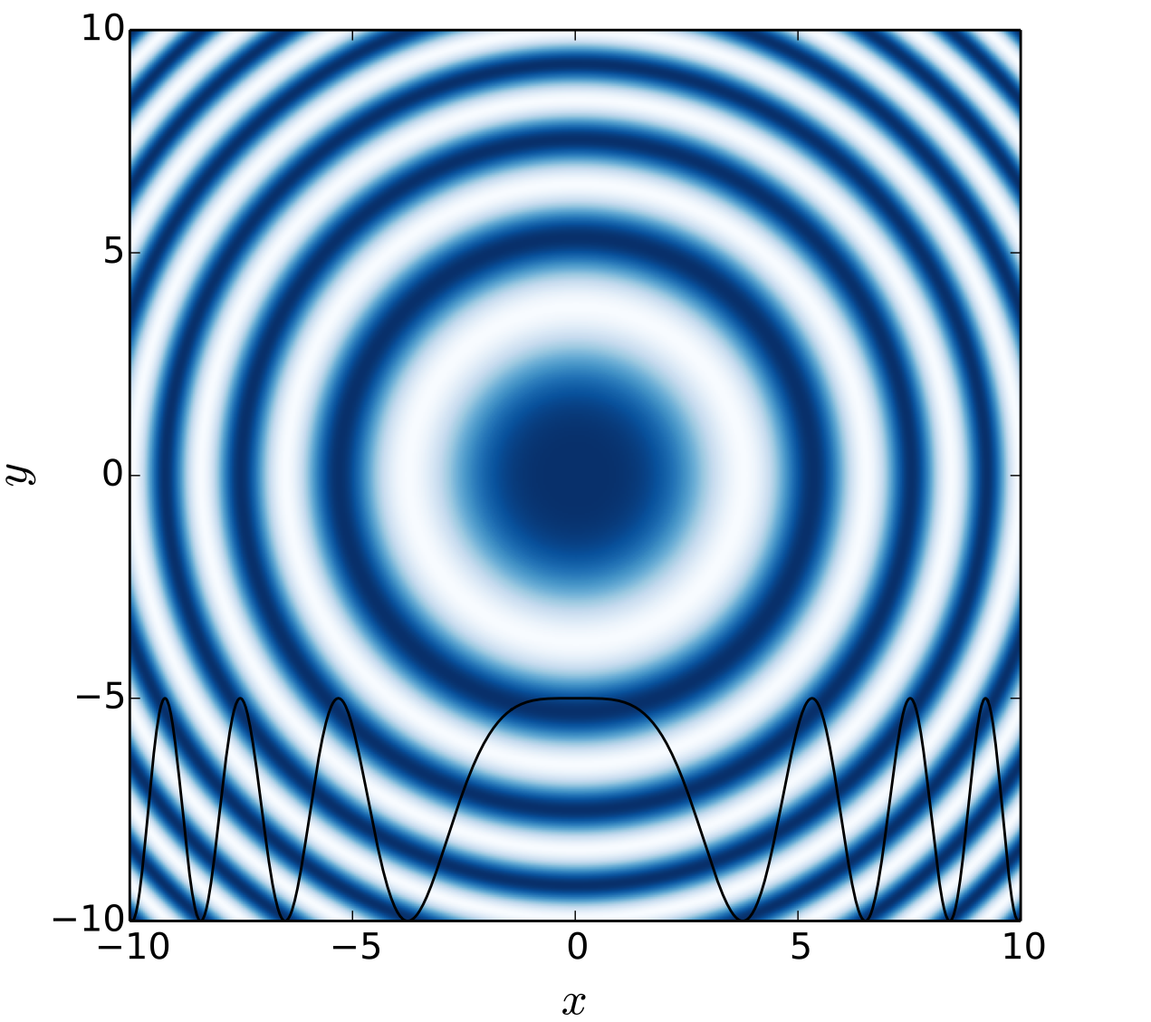
Electromagnetic probes
Interferometry basics
So constructive interference if
Note fringes are formed at infinity but can be ‘localised’ by using a lens

Slide 12
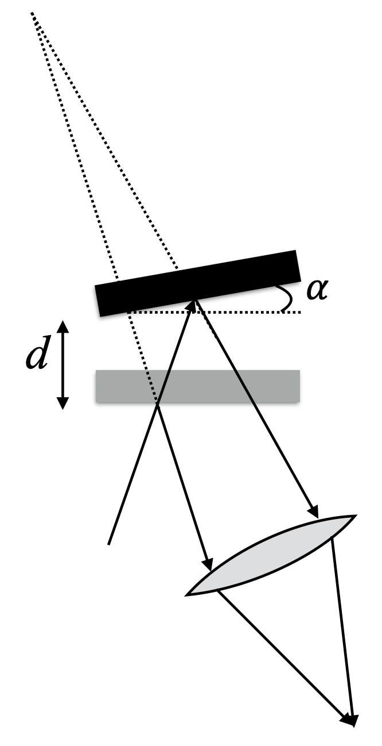
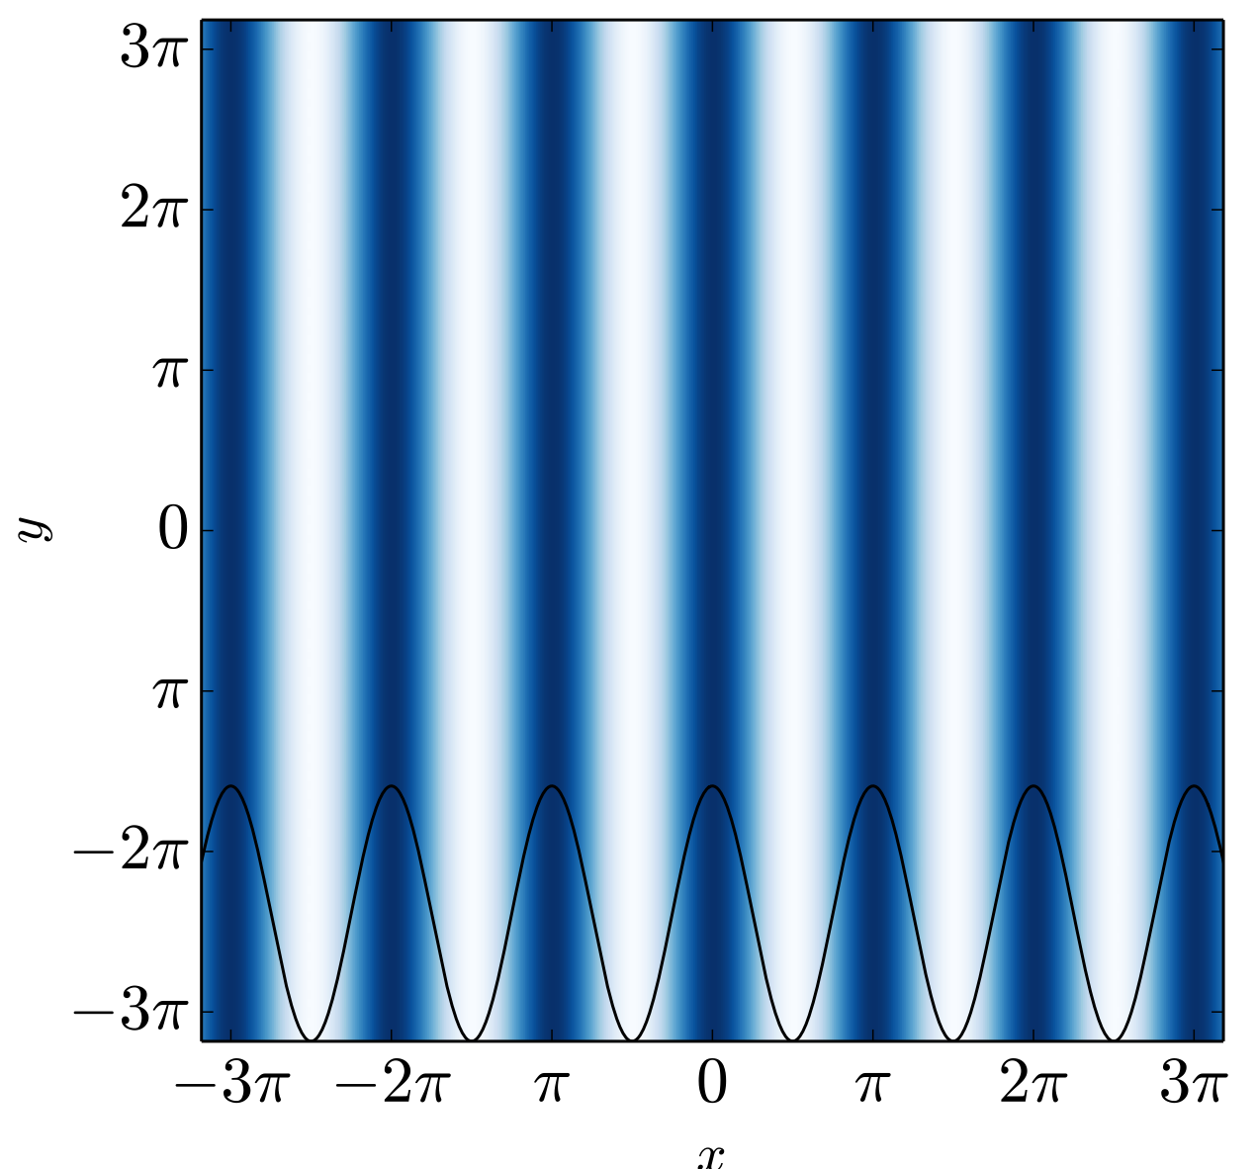
Electromagnetic probes
Interferometric imaging
For small angular tilt of mirror, moving x along the mirror gives extra delay (assuming $θ$ is small):
So neighbouring fringes at:
which gives a fringe spacing:
fringes already localised

Slide 13
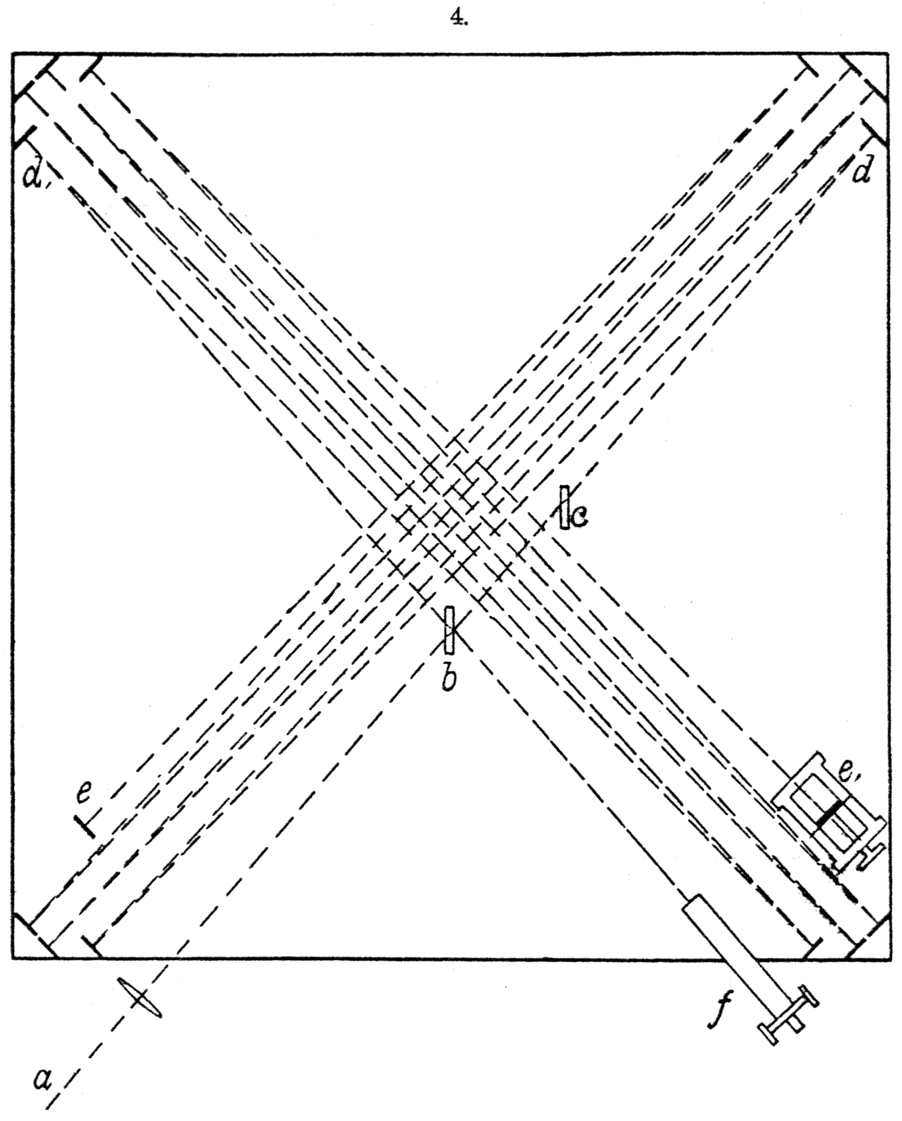
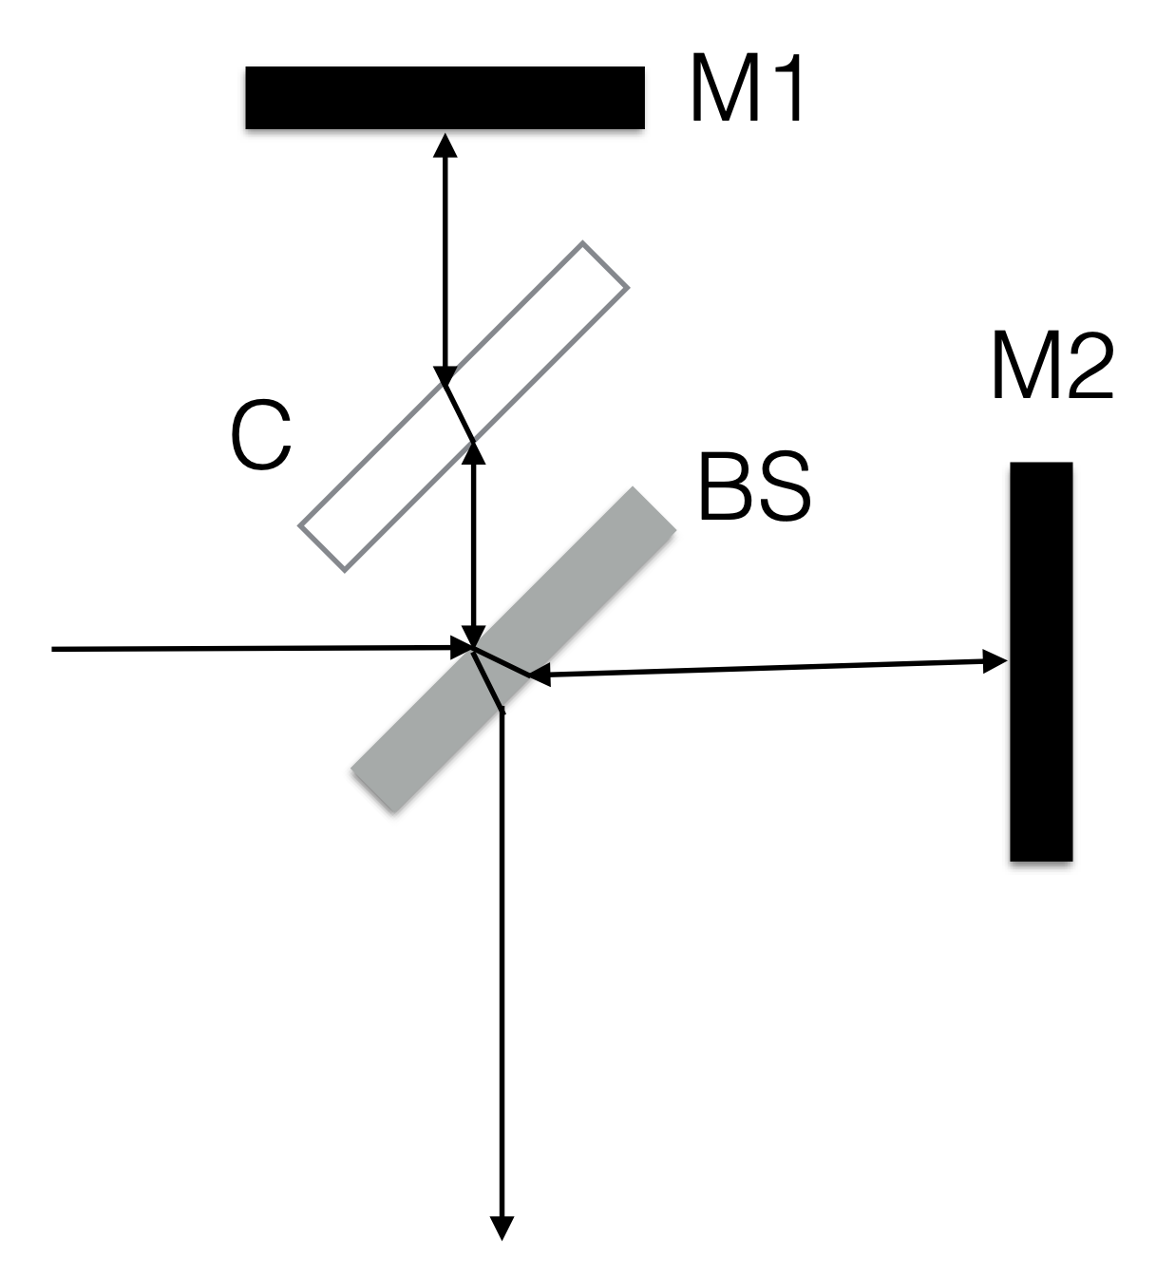
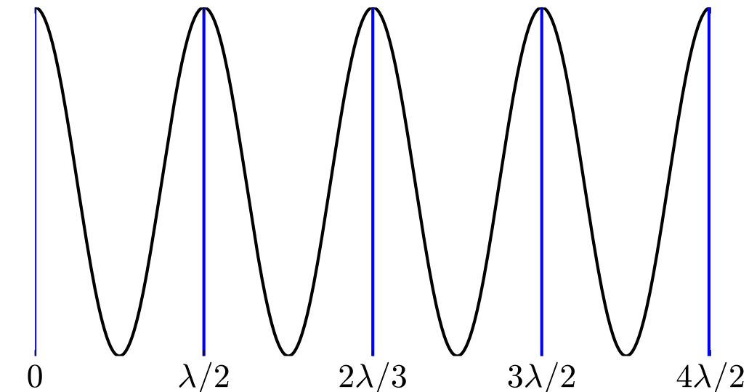
Electromagnetic probes
Types of interferometer: Michelson interferometer
By Albert Abraham Michelson (1852 – 1931) with Edward Morley (1838 - 1923) - aip.org, Public Domain, https://commons.wikimedia.org/w/index.php?curid=5807458
By Alain Le Rille - Own work, CC BY-SA 2.5, https://commons.wikimedia.org/w/index.php?curid=1577962

Slide 14
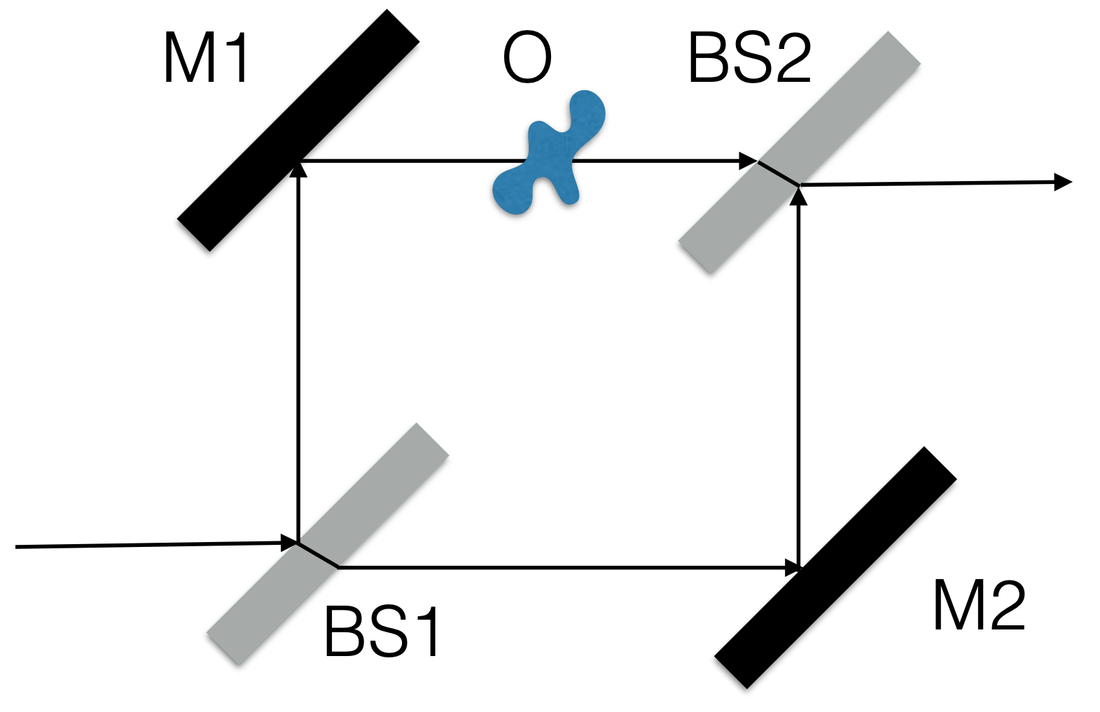
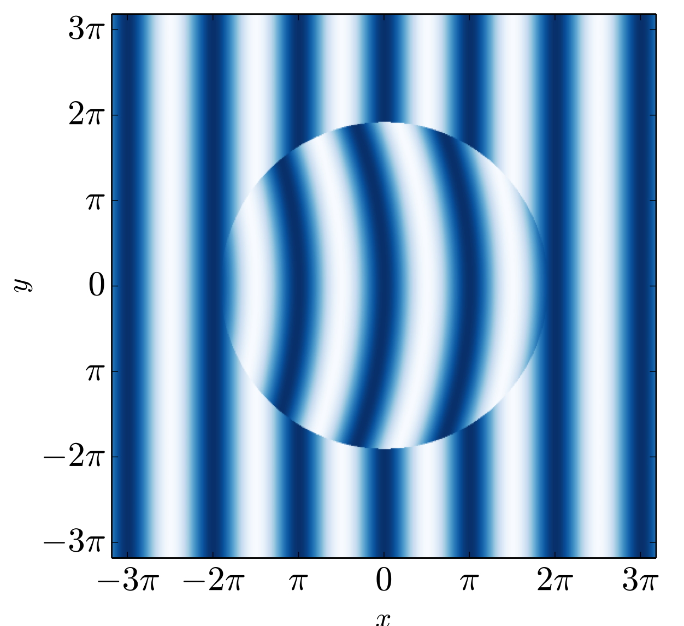
Electromagnetic probes
Types of interferometer: Mach-Zender interferometer

Slide 15
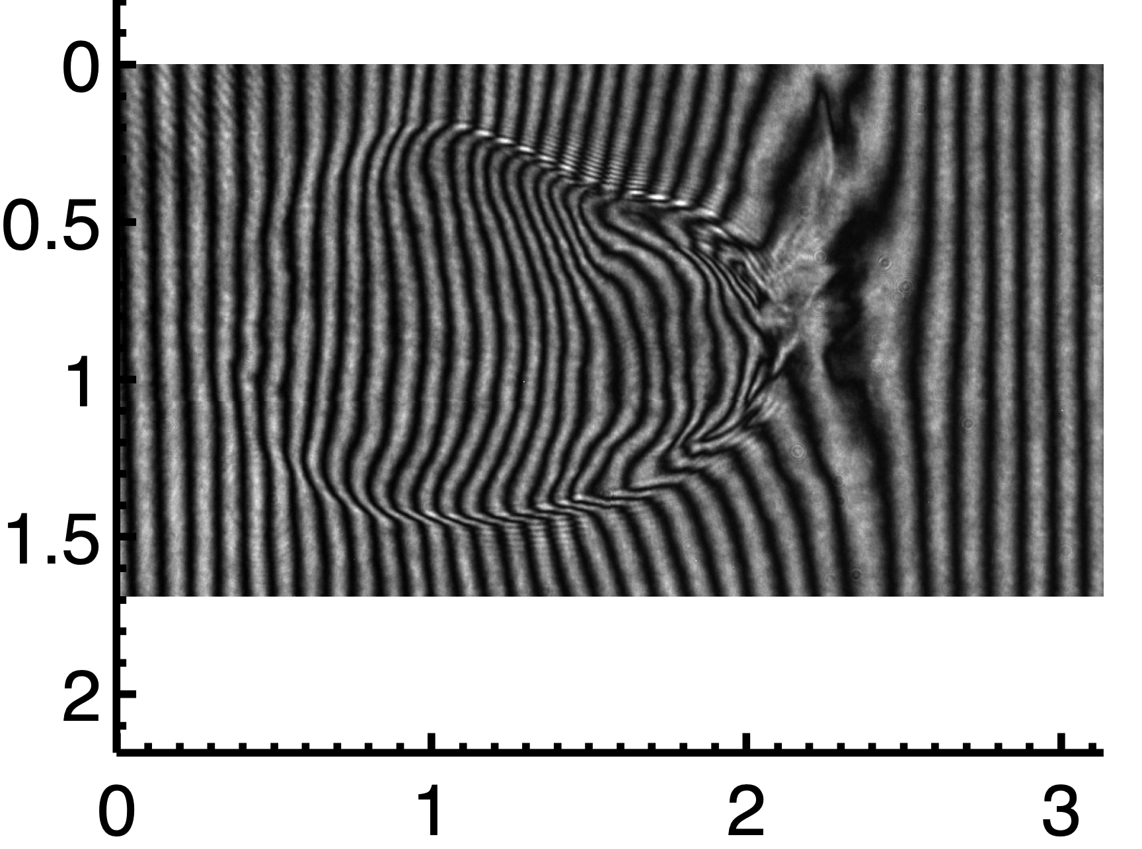
Electromagnetic probes
Types of interferometer: Mach-Zender interferometer

Slide 16
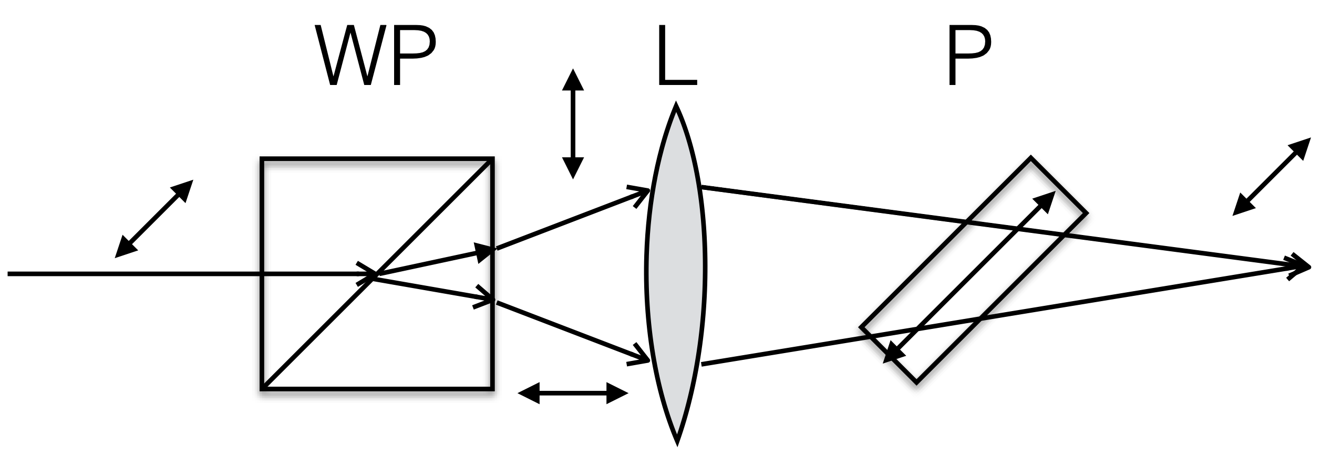
Electromagnetic probes
Types of interferometer: Nomarksi

Slide 17
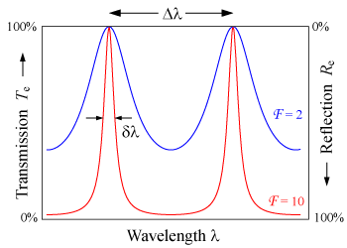
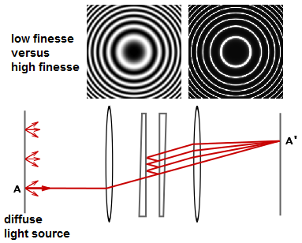
Electromagnetic probes
Types of interferometer: Farby-Perot Cavity
By User:Stigmatella aurantiaca, CC BY-SA 3.0, https://commons.wikimedia.org/w/index.php?curid=30144455
By ​English Wikipedia user DrBob, CC BY-SA 3.0, https://commons.wikimedia.org/w/index.php?curid=6409024

Slide 18
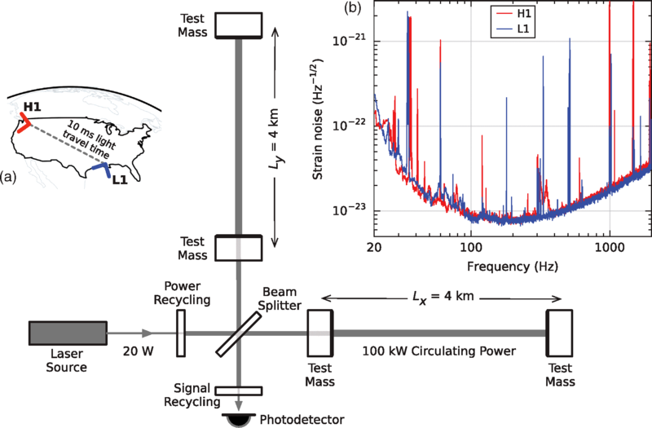
Electromagnetic probes
LIGO
LIGO Livingston, Louisiana,
By Abbott, B. P. et al. - Observation of Gravitational Waves from a Binary Black Hole MergerB. P. Abbott et al. (LIGO Scientific Collaboration and Virgo Collaboration)Phys. Rev. Lett. 116, 061102 doi:10.1103/PhysRevLett.116.061102, CC BY 3.0, https://commons.wikimedia.org/w/index.php?curid=46922746

Slide 19
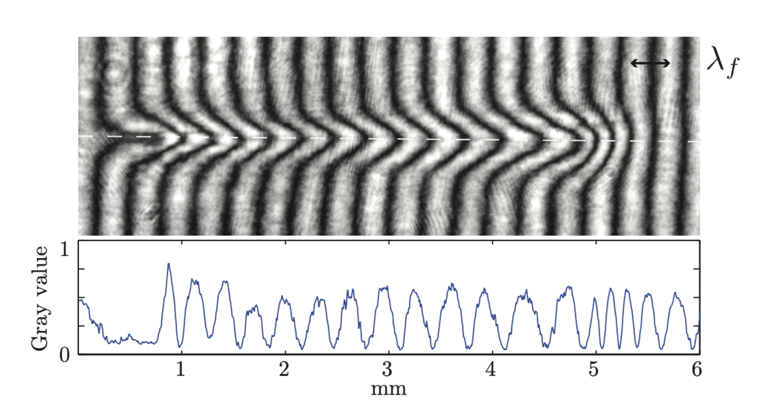
Electromagnetic probes
Analysing interferometers
To find density profile, three steps:
find phase delay
unwrap phase jumps
Abel inversion

Slide 20
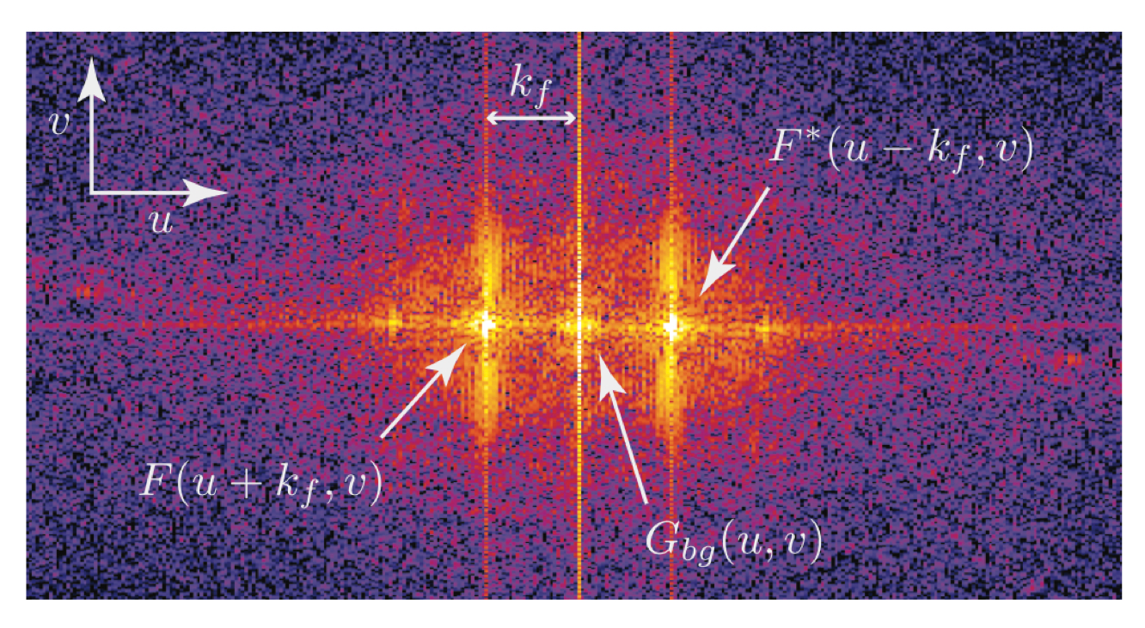
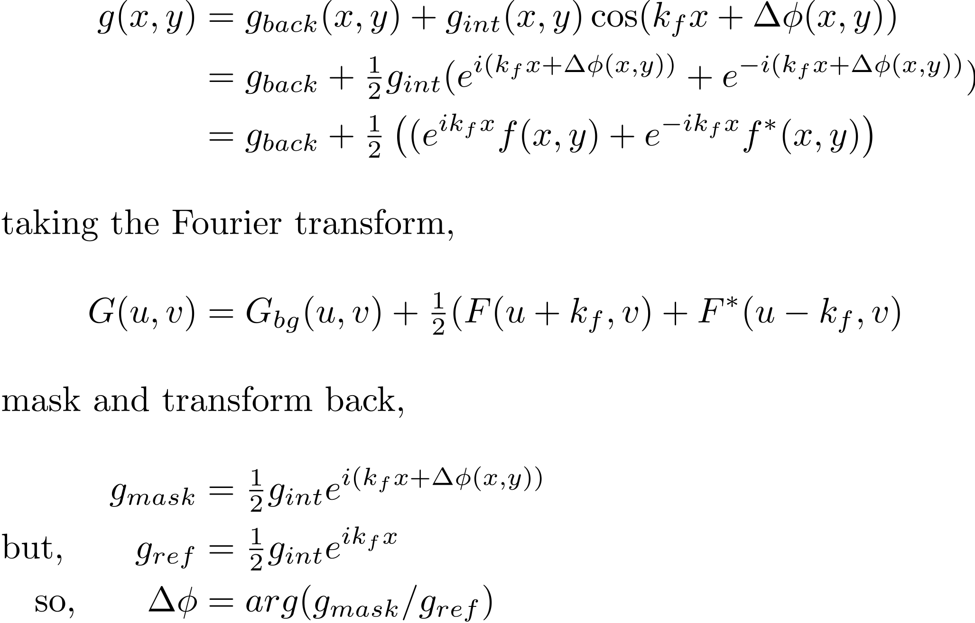
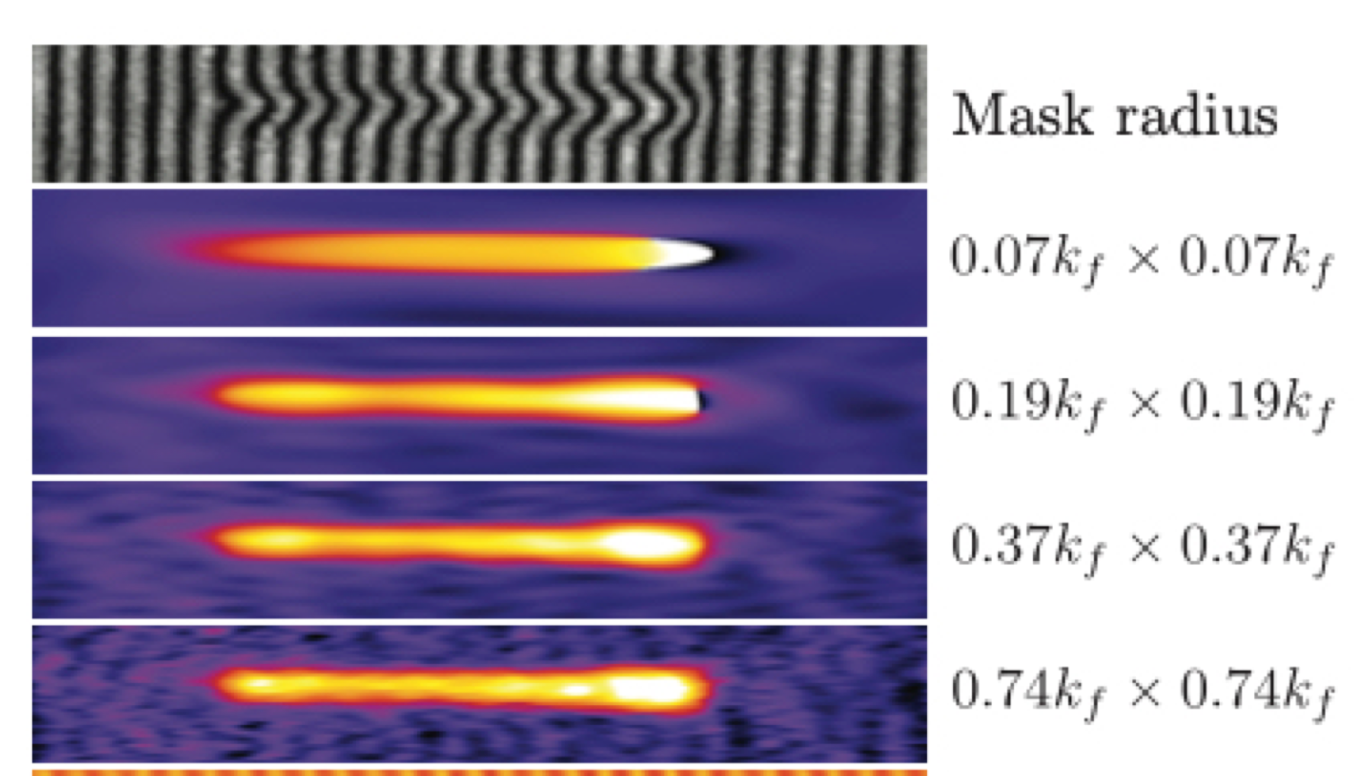
Electromagnetic probes
Analysing interferometers: phase retrieval
Mathematically interferogram is:
retrieved phase

Slide 21
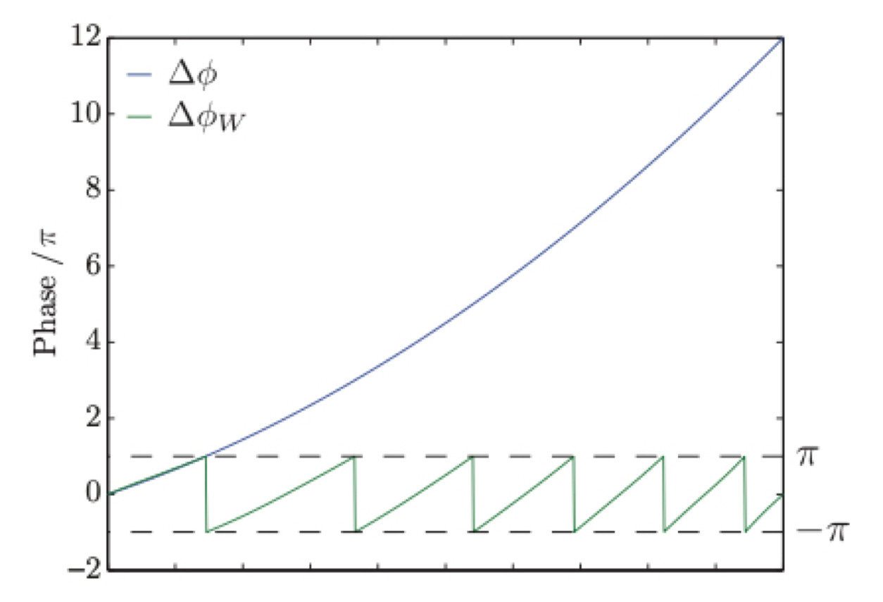
Electromagnetic probes
Analysing interferometers: phase unwrap
what to do if phase change exceeds 2π?
Volvo unwrap take gradient of $φ_{W}(x,y)=φ(x,y)−2πN(x,y)$

Slide 22
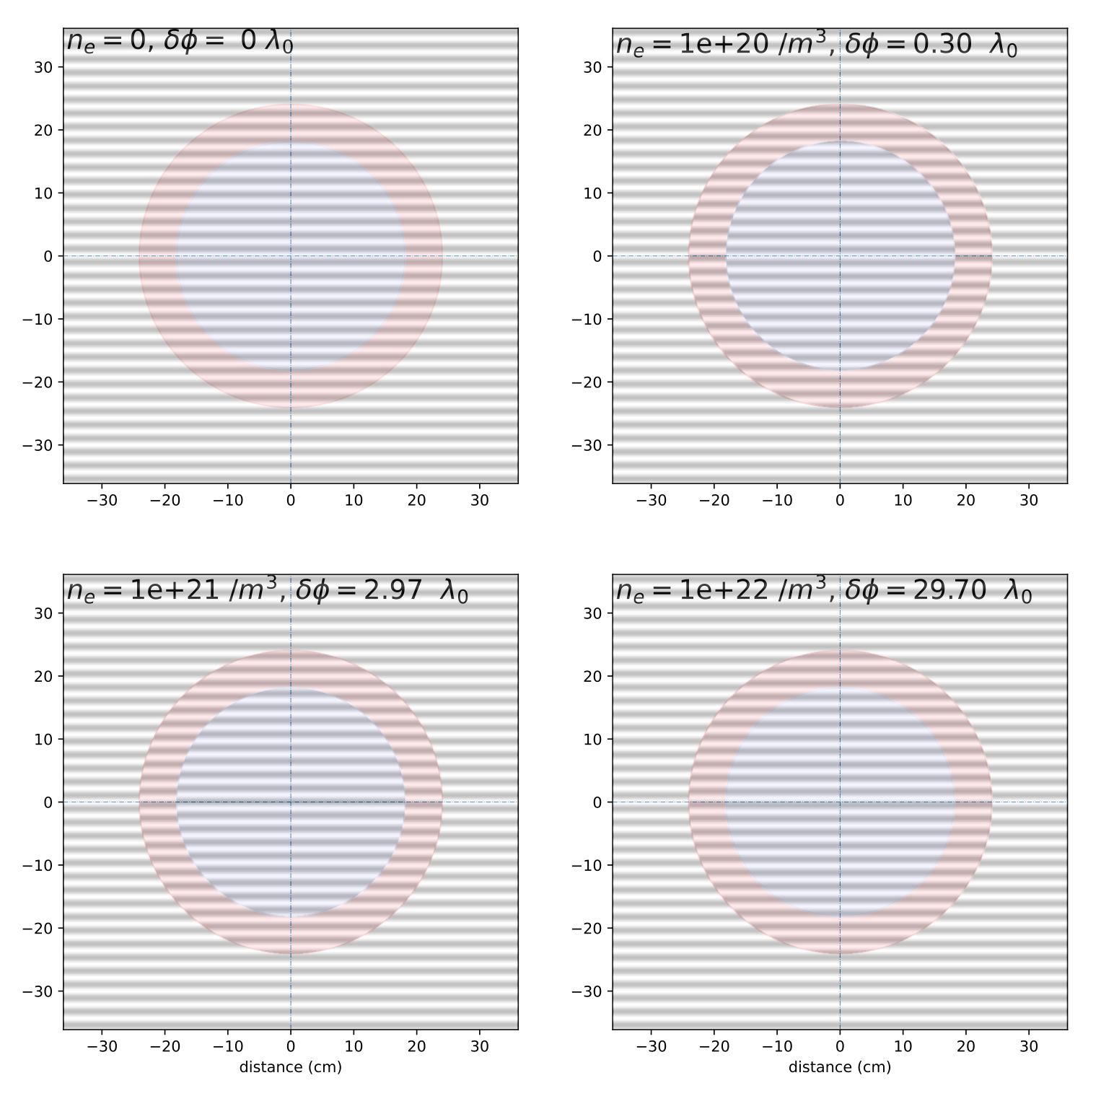
Electromagnetic probes
Analysing interferometers: Density determination
If density is uniform along plasma length then it is straightforward to find the density using:
$$Δφ=\frac{λ_{0}e^{2}}{4πm_{e}ε_{0}c^{2}}∫_{L}n_{e}(x,y)dz$$
$$→n_{e}(x,y)=\frac{4πm_{e}ε_{0}c^{2}Δφ}{λ_{0}e^{2}L}$$

Slide 23
Electromagnetic probes
Analysing interferometers: Density determination
If density is uniform along plasma length then it is straightforward to find the density using:
$$Δφ=\frac{λ_{0}e^{2}}{4πm_{e}ε_{0}c^{2}}∫_{L}n_{e}(x,y)dz$$
$$→n_{e}(x,y)=\frac{4πm_{e}ε_{0}c^{2}Δφ}{λ_{0}e^{2}L}$$

Slide 24
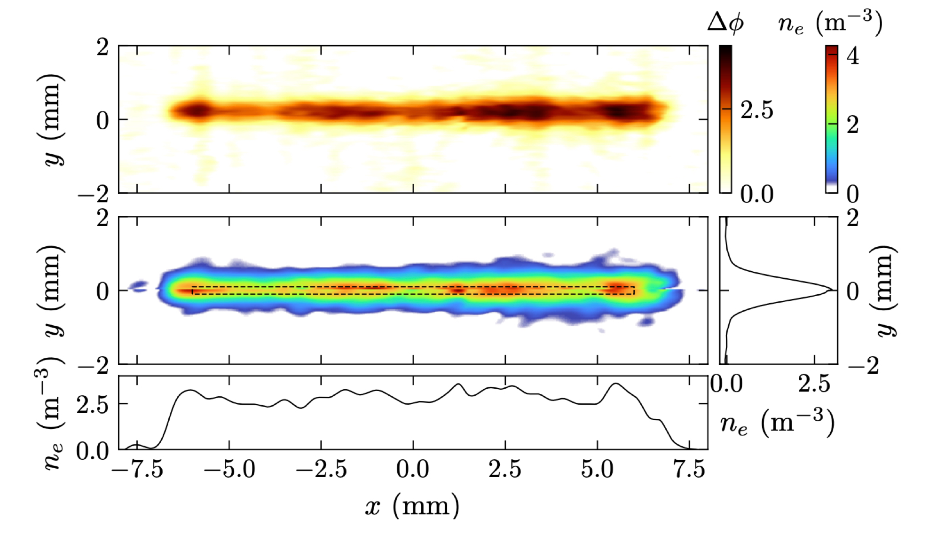
Electromagnetic probes
Analysing interferometers: Density determination
If cylindrical symmetry can be assumed, then can do a Abel inversion$n_{e}(x,r)=λ_{0}r_{e}∫_{r}^{∞}\frac{dΔφ(x,y)}{dy}\frac{1}{\sqrt{y^{2}−r^{2}}}dy$
Otherwise need multiple viewing angles (tomography)

Slide 25
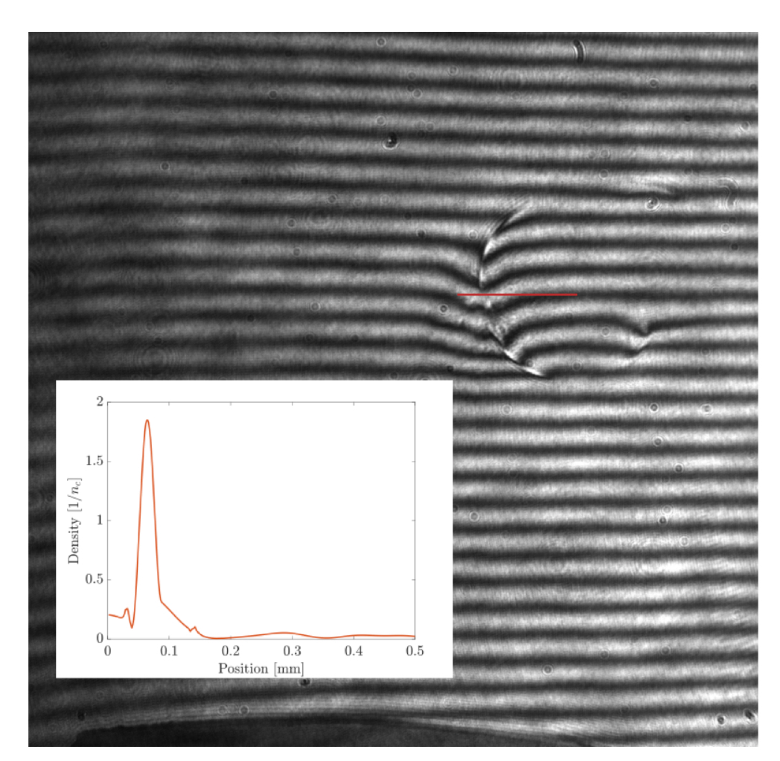
Electromagnetic probes
Analysing interferometers: Density determination
If cylindrical symmetry can be assumed, then can do a Abel inversion$n_{e}(x,r)=λ_{0}r_{e}∫_{r}^{∞}\frac{dΔφ(x,y)}{dy}\frac{1}{\sqrt{y^{2}−r^{2}}}dy$
Otherwise need multiple viewing angles (tomography)

Slide 26
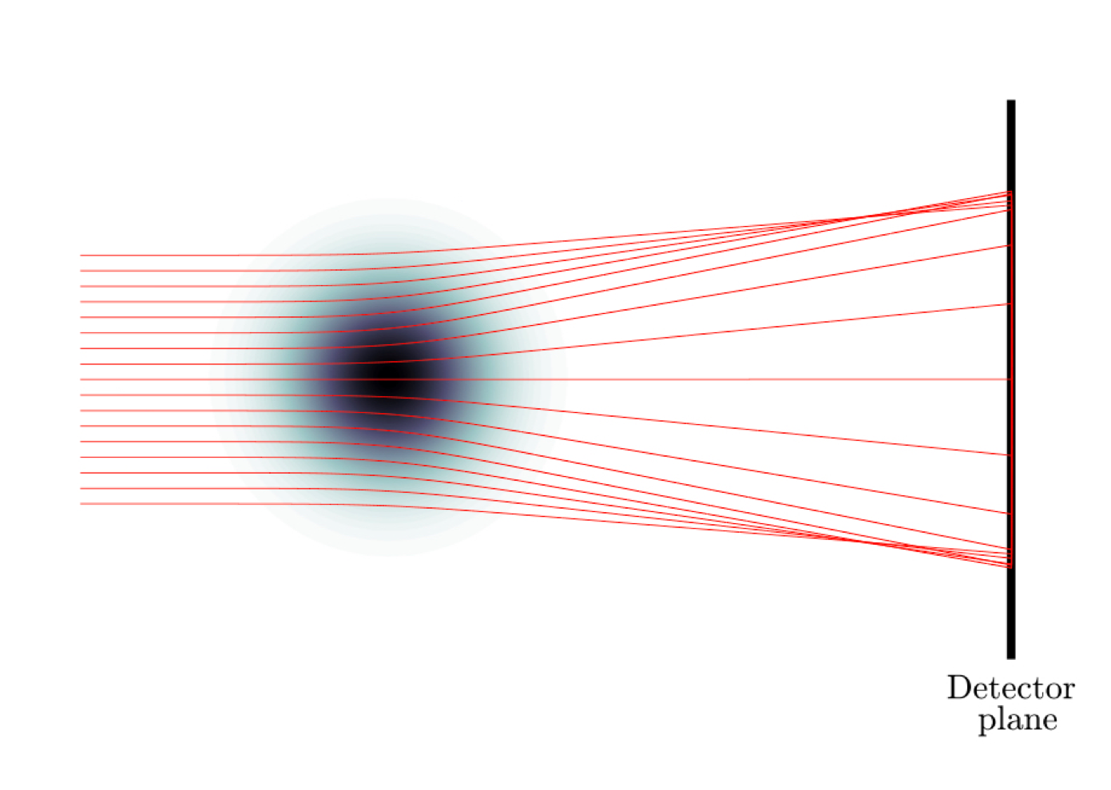
Electromagnetic probes
Shadowgraphy
Transverse gradients of refractive index can cause deflection of the beam
source of error for interferograms
can be used as a diagnostic

Slide 27
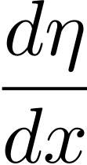
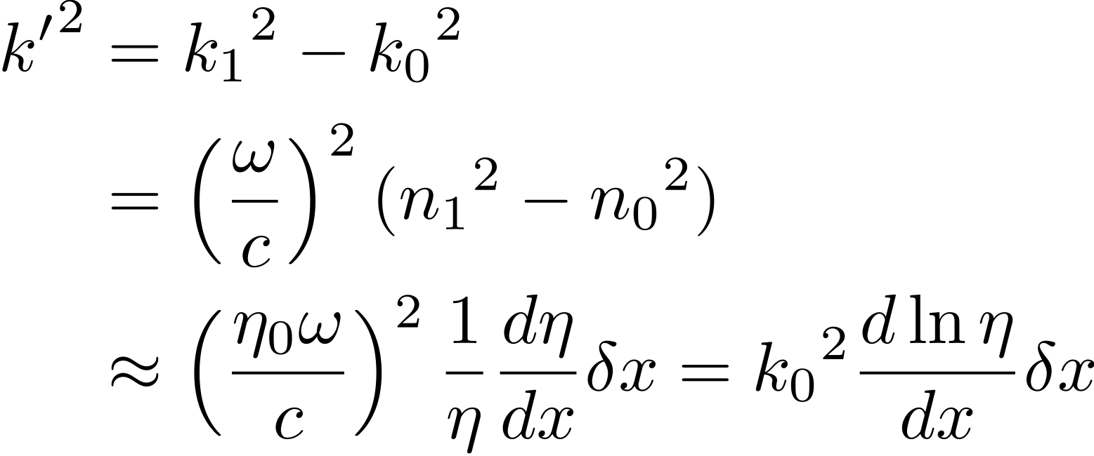
Electromagnetic probes
Shadowgraphy
We have,
$k_{0}=\frac{η_{0}ω}{c}$ and $k_{1}=\frac{η_{1}ω}{c}=\frac{ω}{c}(η_{0}+\frac{dη}{dx}δx)$
then,
k1
𝛅𝜽
k^{ʹ}
k0
but $δθ≈k^{′}/k_{0}\text{and}δθ≈δx/δz$, so $\frac{dθ}{dz}≈\frac{dlnη}{dx}$

Slide 28
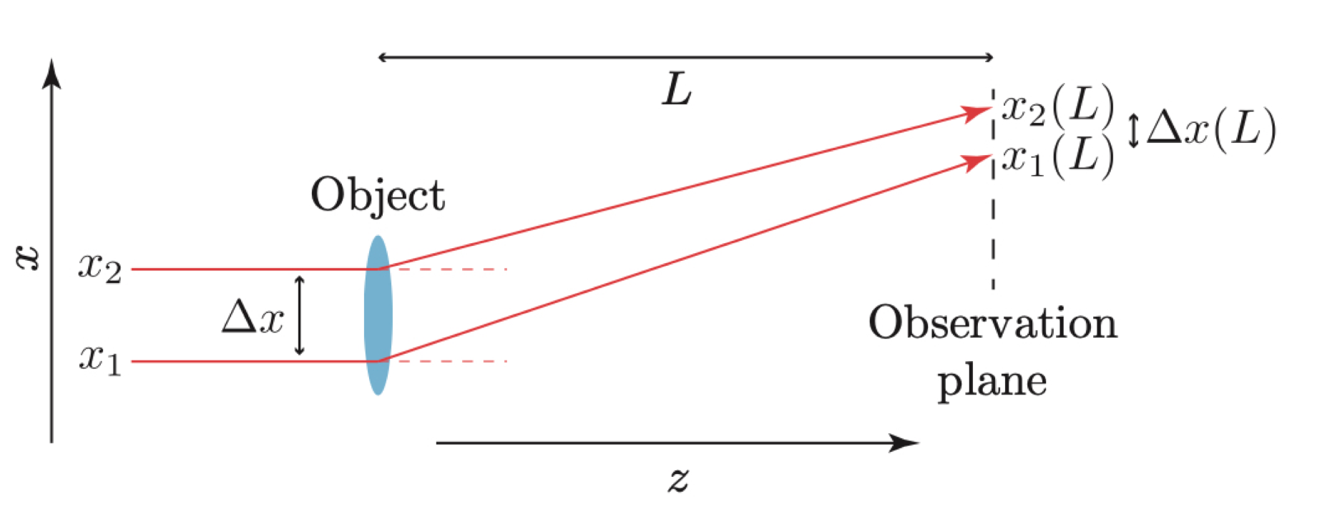
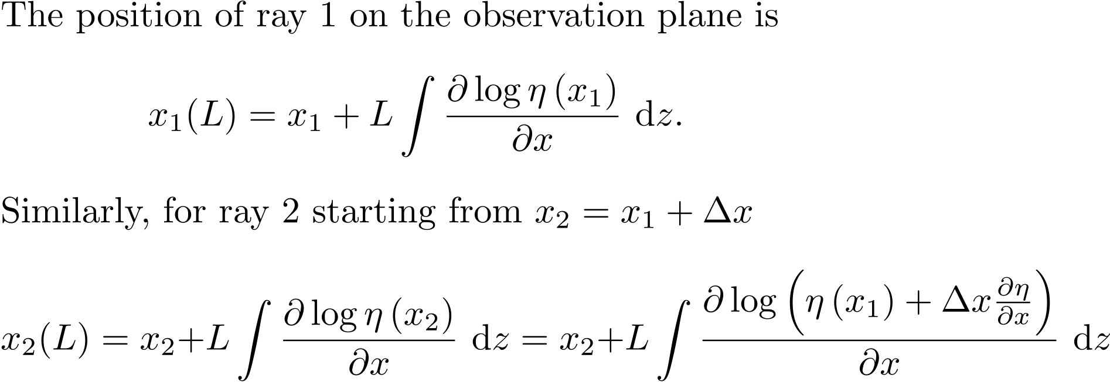
Electromagnetic probes
Shadowgraphy
Only if $\frac{dη}{dx}$ is changing is there a change in spacing of rays:
a change in $Δx$ causes intensity variation

Slide 29
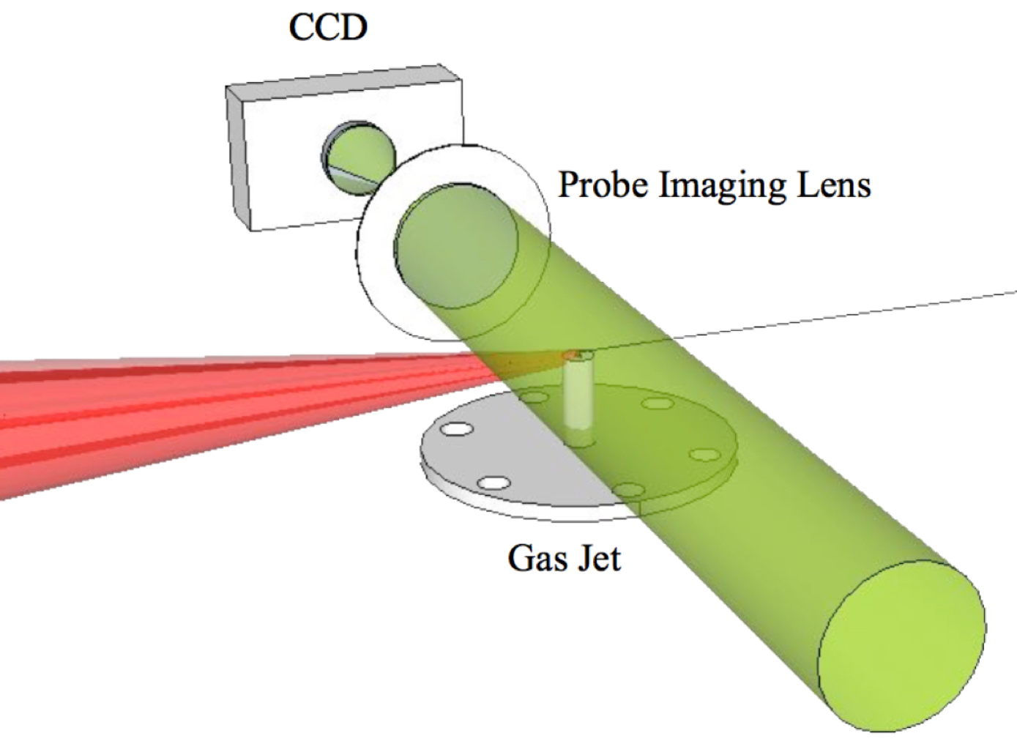
Electromagnetic probes
Shadowgraphy
CCD
microscope
drive laser,
1 J, 30fs
gas jet
ultrashort probe (< 10fs)
Sävert, A., et al. (2015). Direct Observation of the Injection Dynamics of a Laser Wakefield Accelerator Using Few-Femtosecond Shadowgraphy. Physical Review Letters, 115(5). https://doi.org/10.1103/PhysRevLett.115.055002

Slide 30
Temperature diagnostics

Slide 31
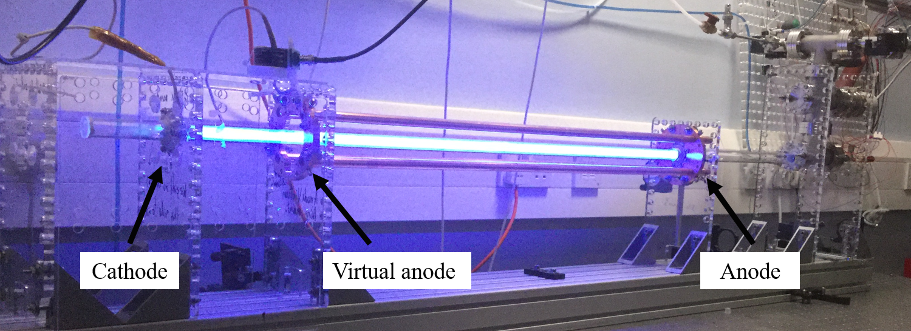
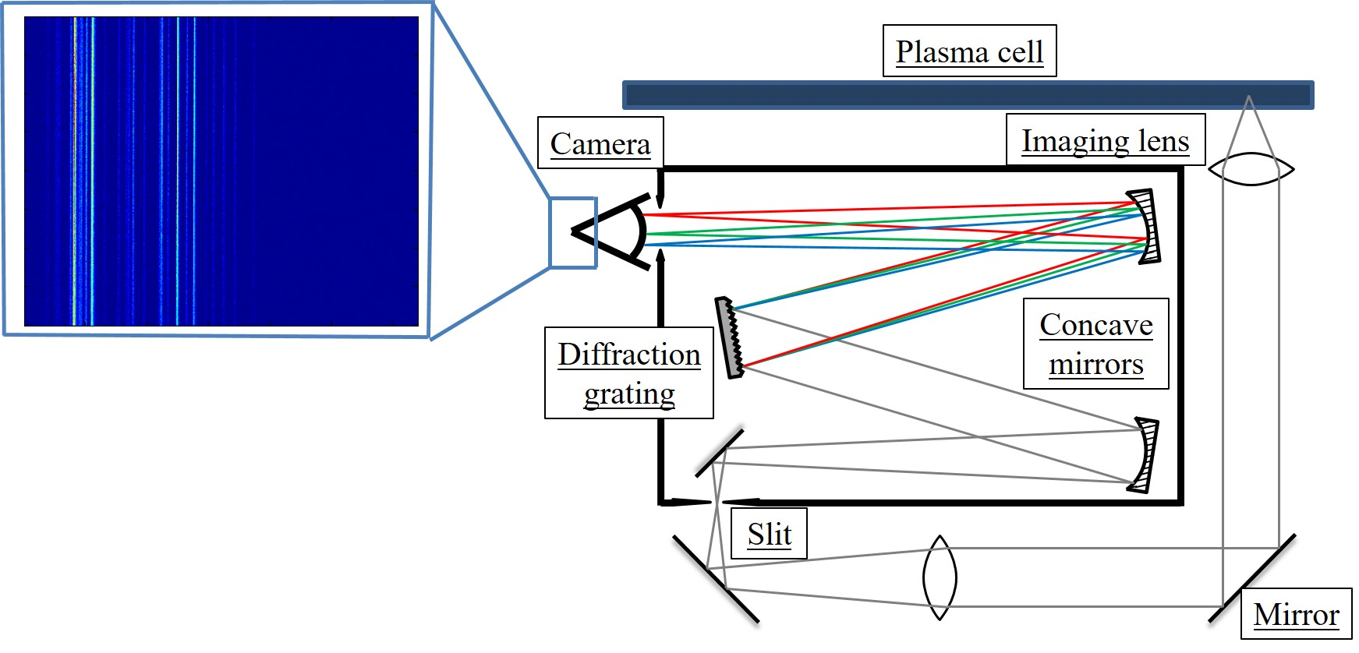
Temperature diagnostics
Spectroscopy
Plasma emit a combination of blackbody radiation and line emission.
Black body radiation from tenuous plasmas is usually weak
If sufficiently hot line emission will dominate blackbody radiation

Slide 32
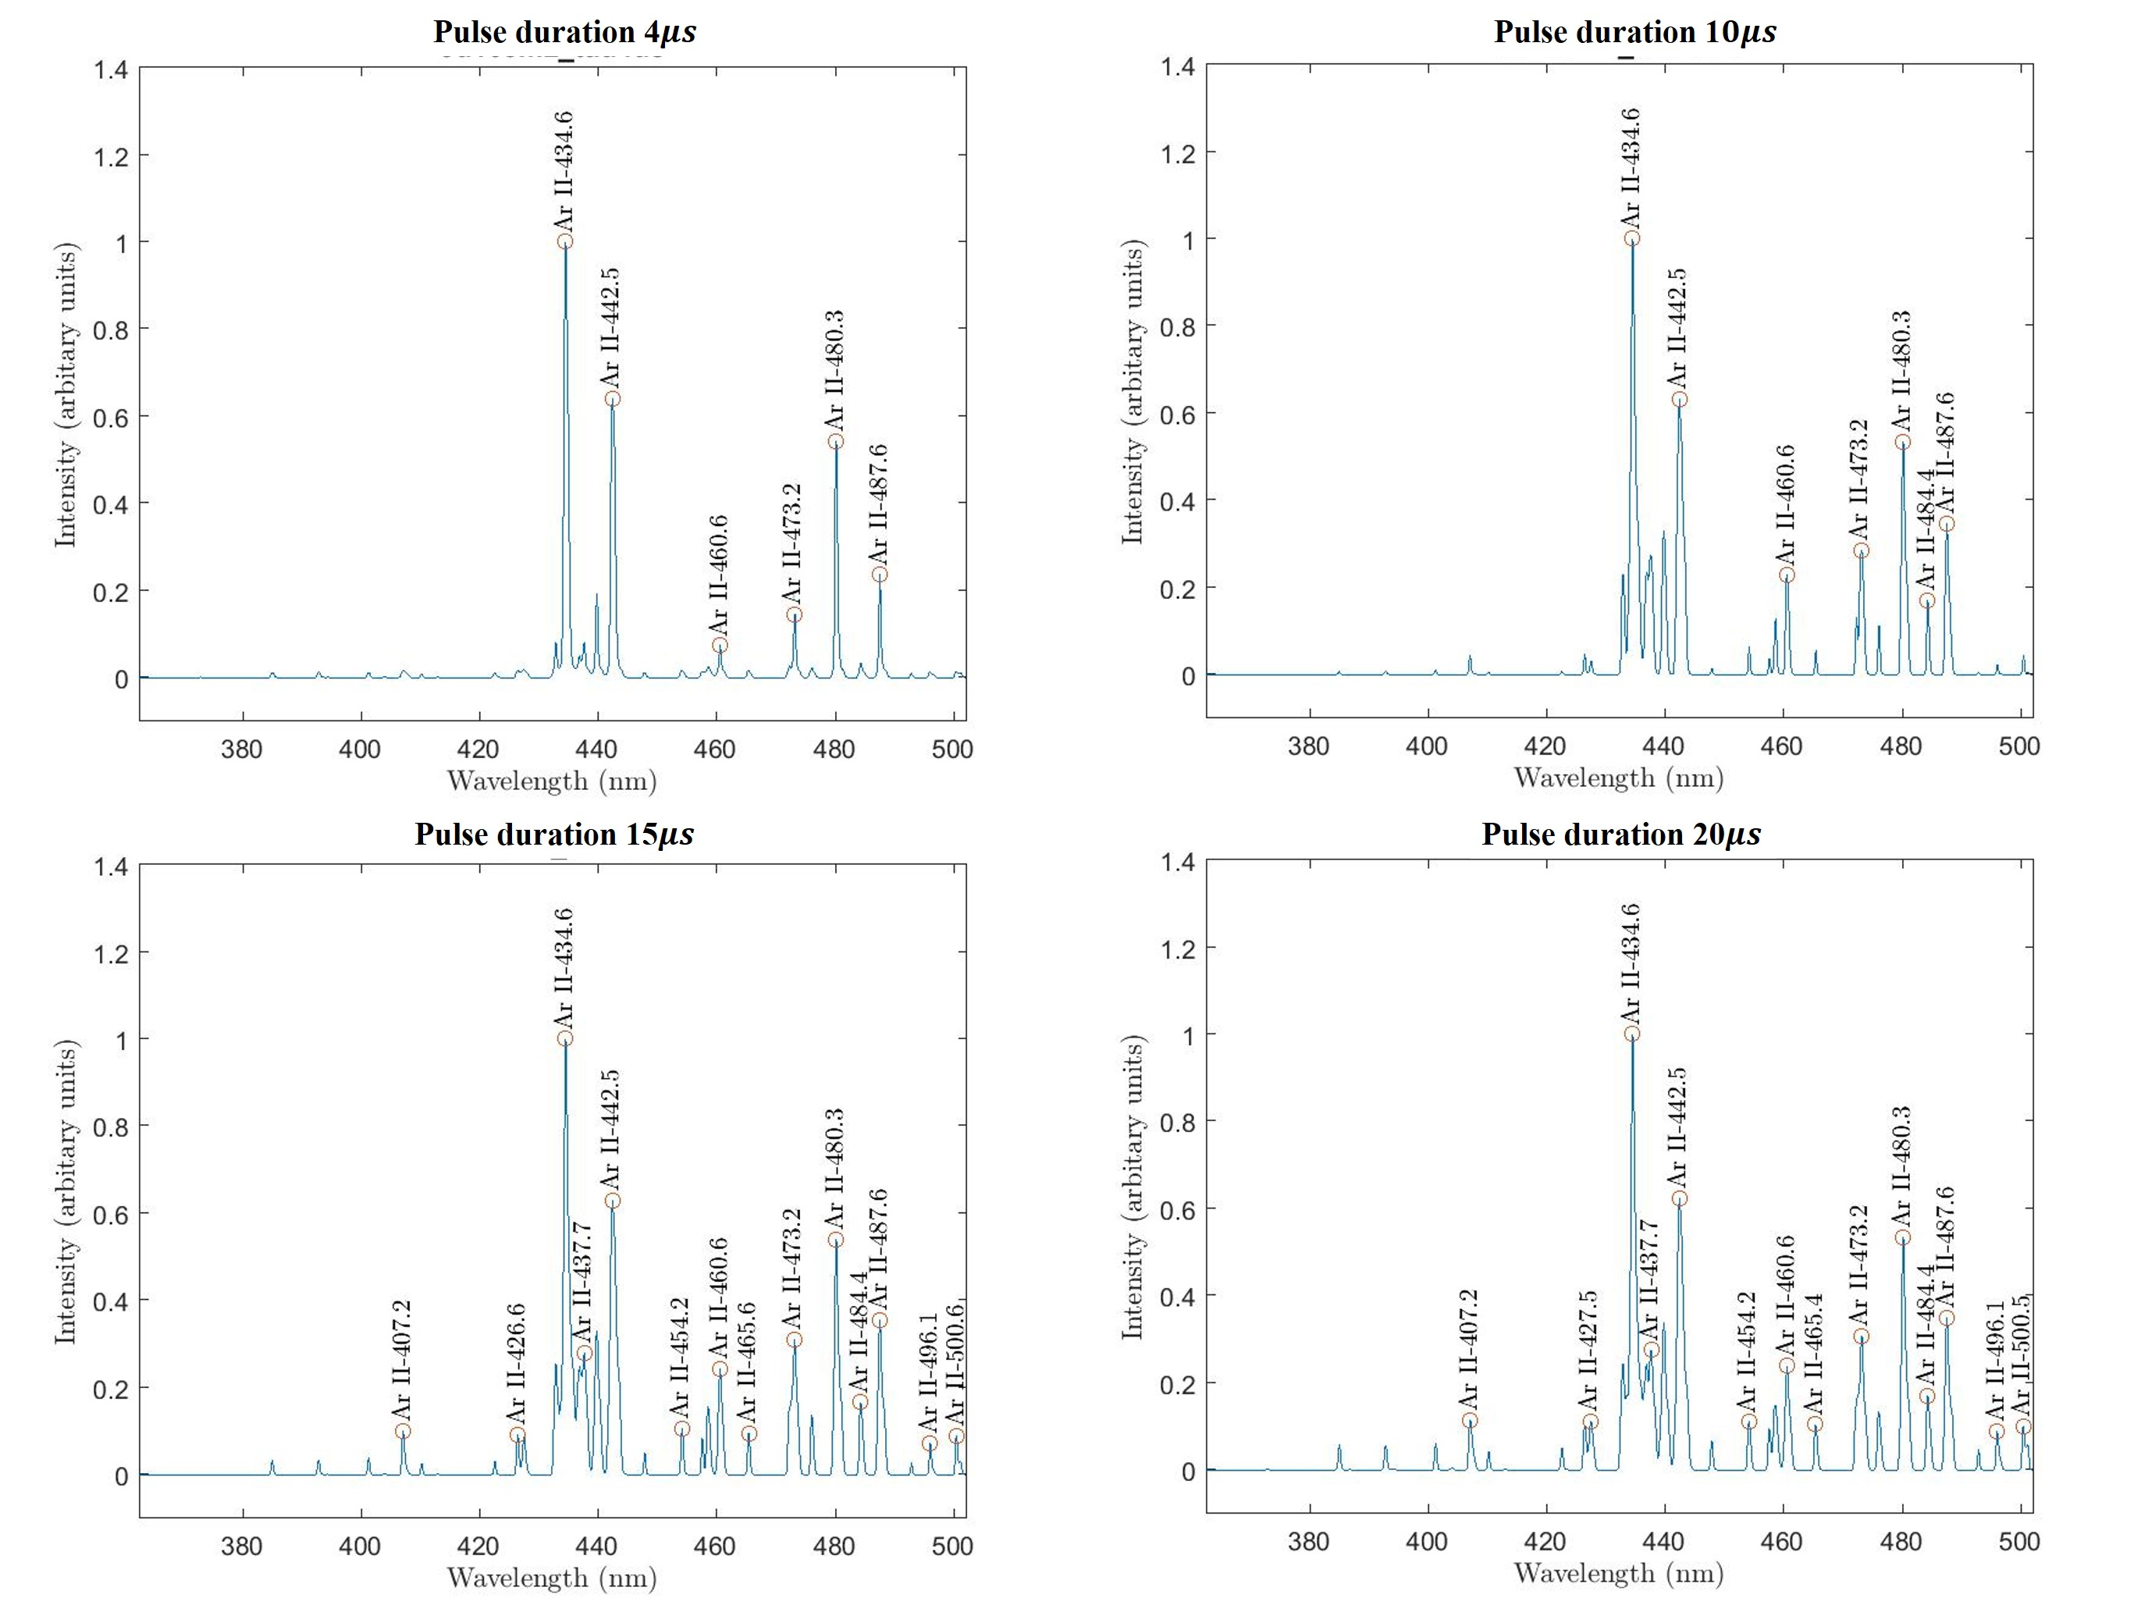
Temperature diagnostics
longer pulse
Spectroscopy - examples
$$2×{10}^{−2}mbar$$
$$5×{10}^{−2}mbar$$

Slide 33
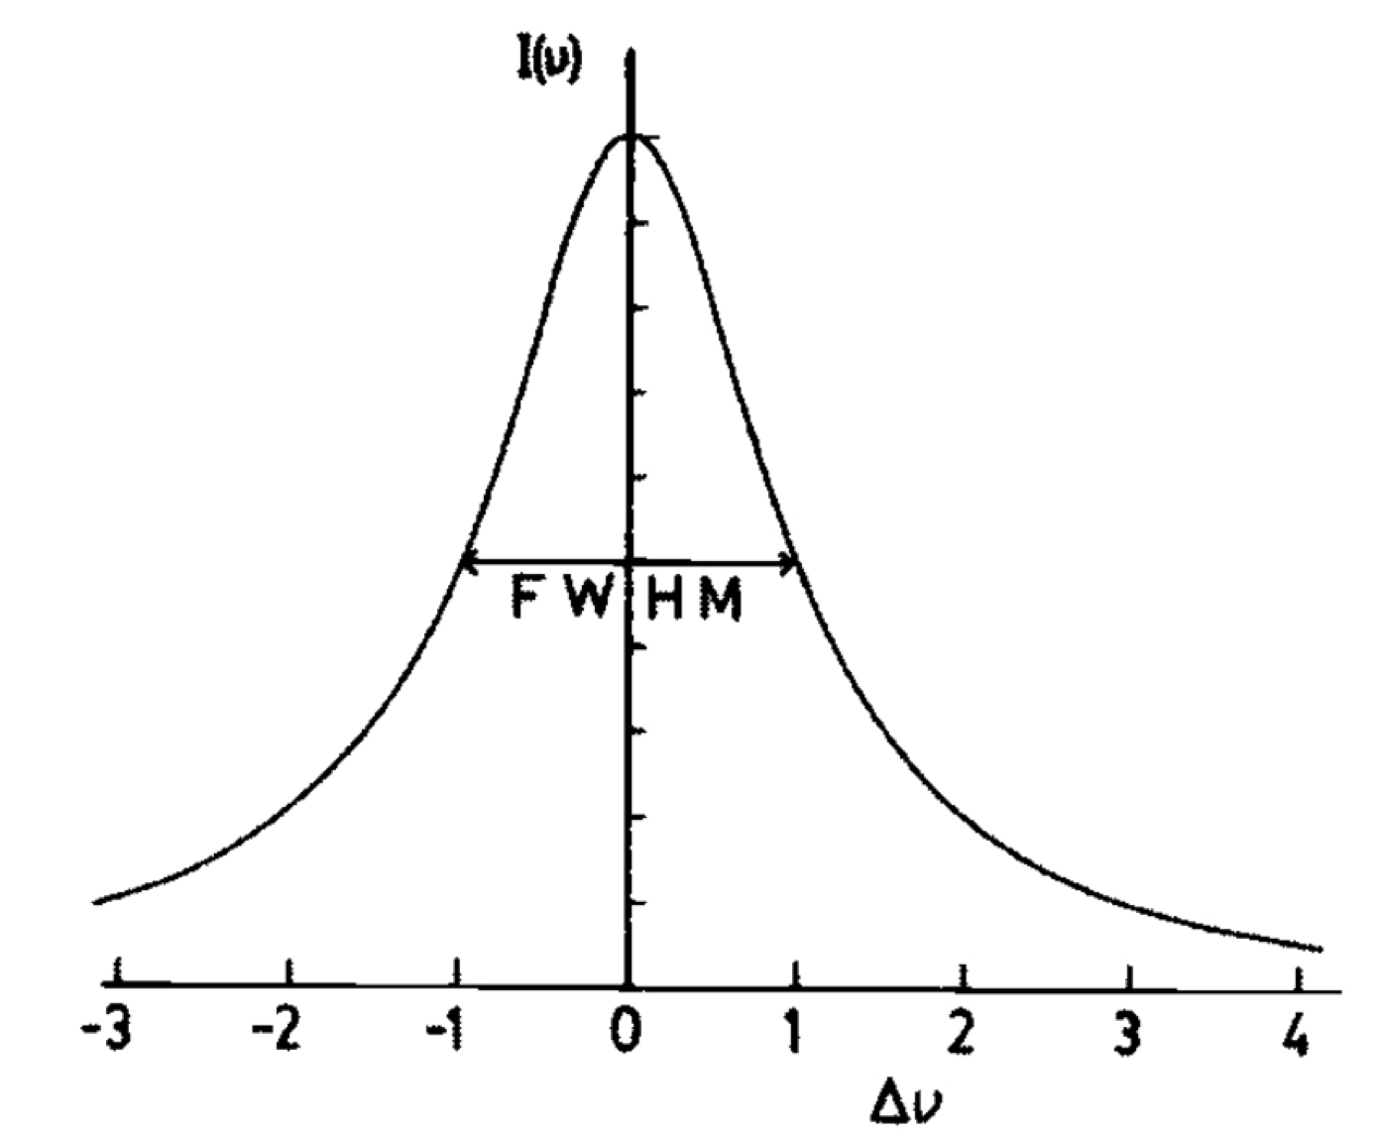
Temperature diagnostics
Spectroscopy - line broadening
Natural width of an atomic transition of energy
$$ΔE=\frac{h}{2πτ}$$
where $\frac{2}{τ}=Σ_{j}A_{ij}$ (sum of Einstein coefficients)
then line shape is Lorentzian:
$$I(ν)=I(v_{0})\frac{1}{1+[(ν−ν_{0})2πτ]^{2}}$$

Slide 34
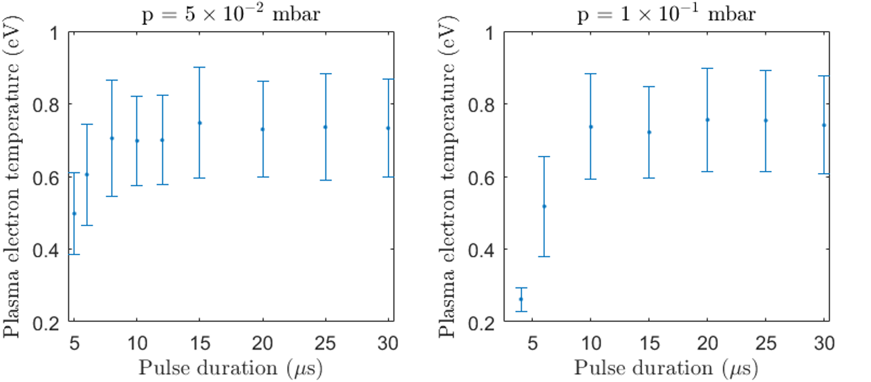
Temperature diagnostics
Spectroscopy - Doppler broadening
Doppler shift due to thermal motion:
$$Δν=ν−ν_{0}=(v/c)ν_{0}$$
which gives a (Gaussian) line shape:
$$I(ν)∝f([ν/ν_{0}−1]c)$$
$$I(ν)=I(v_{0})exp\left[\frac{−(ν−ν_{0})^{2}c^{2}}{2{c_{s}}^{2}{ν_{0}}^{2}}\right]$$
where ${c_{s}}^{2}=k_{B}T_{e}/m_{i}$ and $Δν_{1/2}=2(2ln2)^{1/2}ν_{0}(c_{s}/c)$

Slide 35
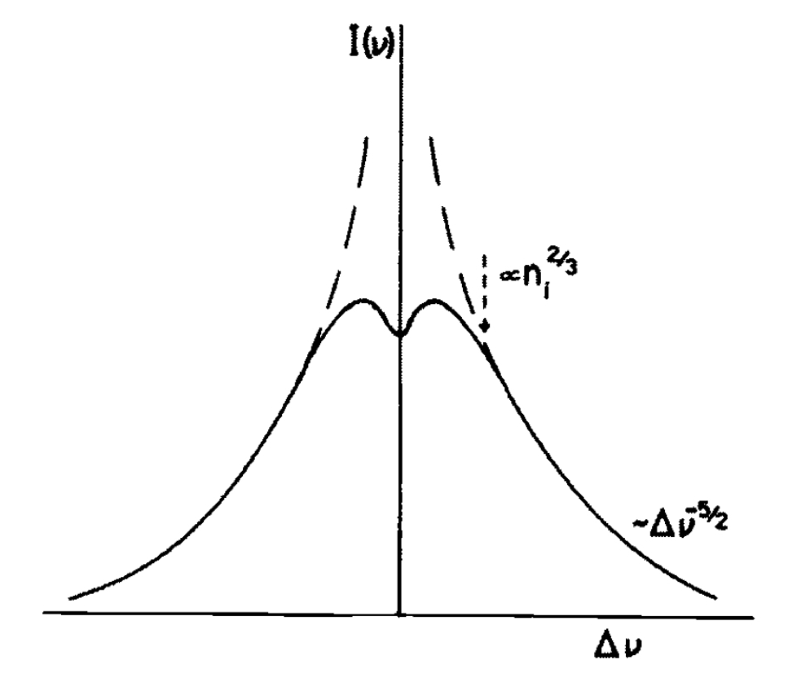
Temperature diagnostics
Spectroscopy
At high pressure, lines can also be broadened by ‘constant collision’ with fields of neighbouring ions (Stark effect). This also gives a Lorentian shape but is usually negligible in coronal plasma.
Convolution of Lorentzian and Gaussian profiles is called a Voigt profile. The two effects can be separated to give only the thermal spread.
Additionally further broadening of the Lorentzian (by Stark broadening) can also give density (though difficult).
Stark broadened line shape

Slide 36
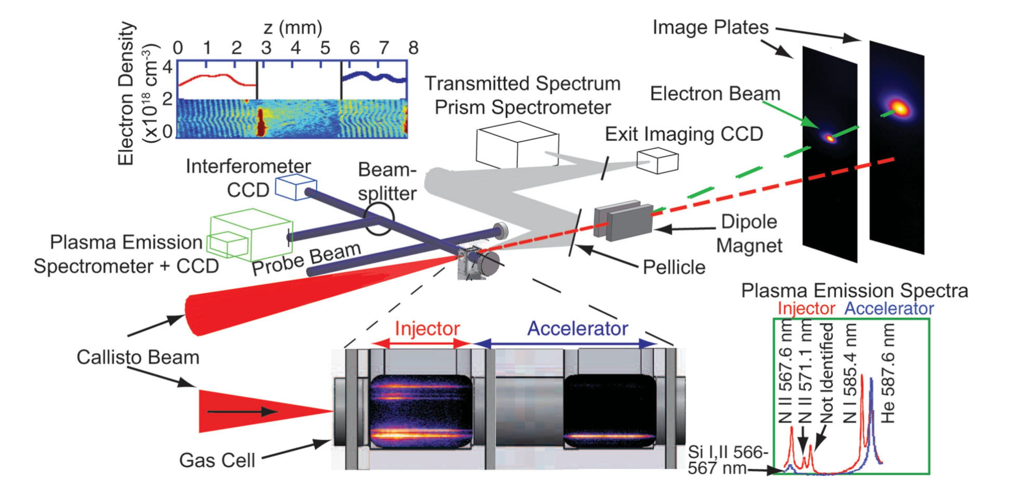
Temperature diagnostics
Spectroscopy
Spectroscopy can also be used to determine the presence of ‘impurity’ atoms
dopant added to one cell of gas cell to initiate ionisation injection
Pollock, B. B., et al (2011). Demonstration of a Narrow Energy Spread, similar to 0.5 GeV Electron Beam from a Two-Stage Laser Wakefield Accelerator. Physical Review Letters, 107(4).

Slide 37
Temperature diagnostics
Spectroscopy
Spectroscopy can also be used to determine the presence of ‘impurity’ atoms
colour changing due to H outgassing!
Spectroscopy not so useful for ultrafast measurements

Slide 38
Temperature diagnostics
Radiation
Oscillating electrons will generate radiation ≈ normal to their direction of motion

Slide 39
Temperature diagnostics
Radiation
Plasma emission typically on a long time scale (~ µsec in a tenuous plasma). However plasma electrons can be made to radiate instantaneously using a intense probe beam

Slide 40
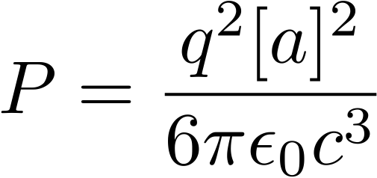
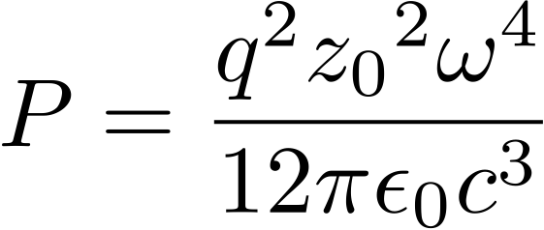
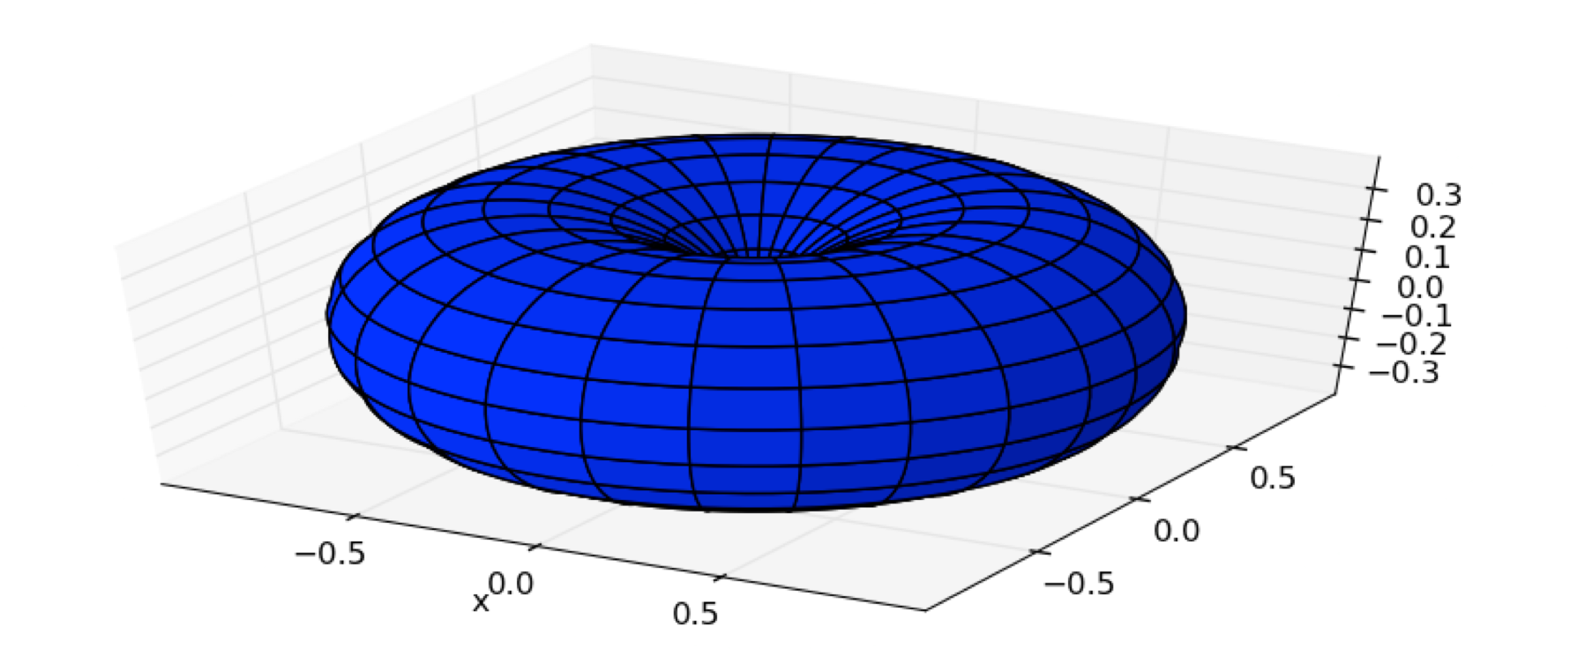
Temperature diagnostics
Thomson scattering - principles
The fields of an oscillating electron is give by:
And the total intensity scattered is given by:
which for a dipole of frequency $ω$ and amplitude $z_{0}$:

Slide 41
Temperature diagnostics
Scattering
But in a plasma the field due to different electrons can be correlated - need to add the contributions including full phase information.
The correlation term is given by the structure factor S(k, w):
For Maxwellian distributions, the structure factor can be written in terms of the parameter $α=1/kλ_{D}$.

Slide 42
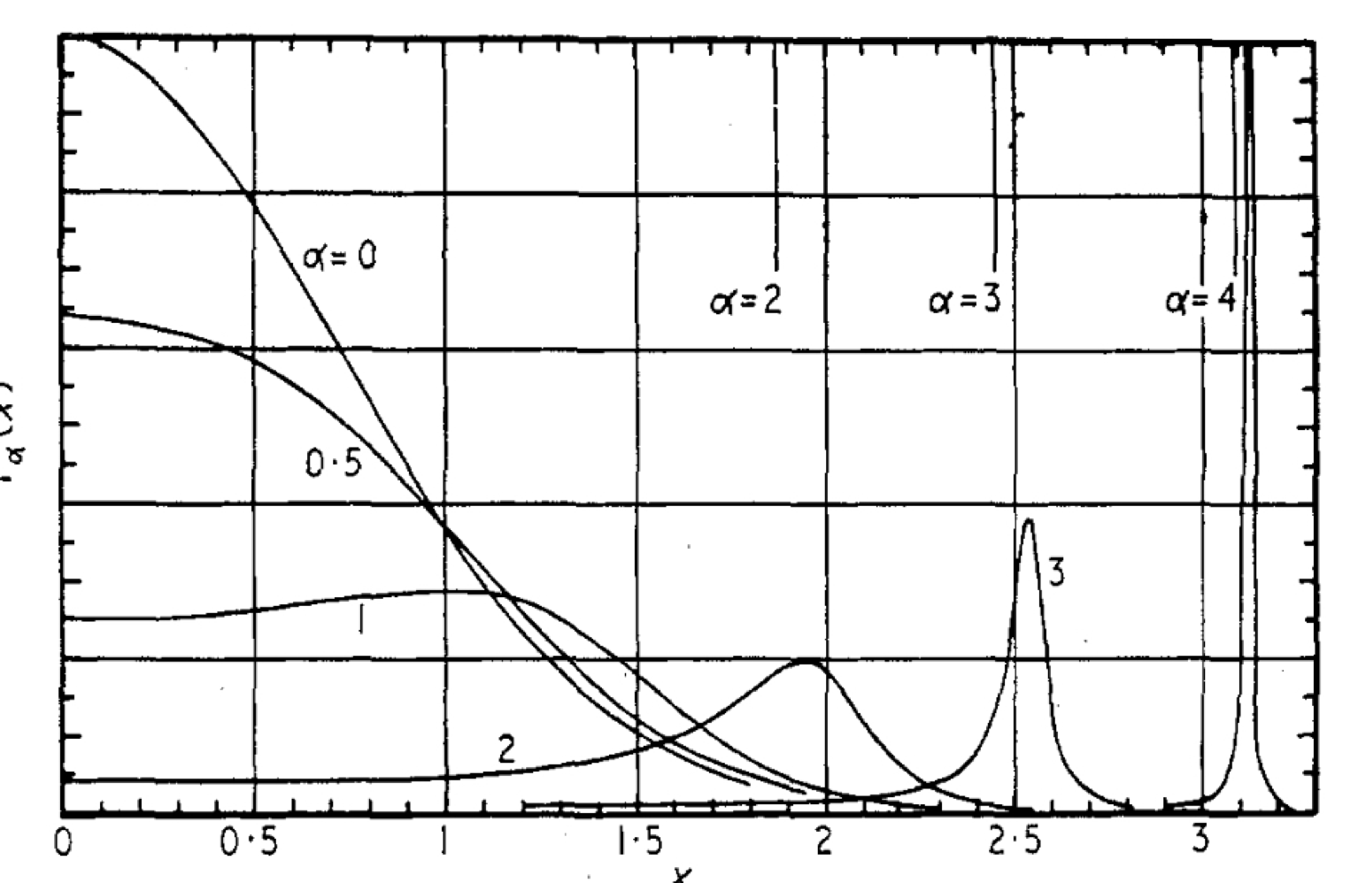
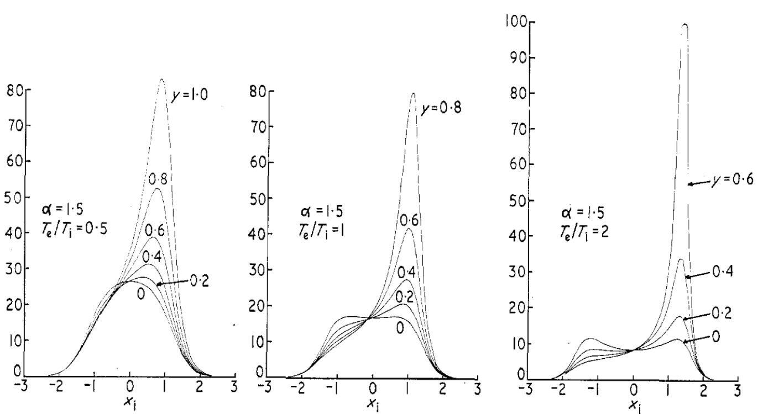
Temperature diagnostics
Scattering
For Maxwellian distributions, the structure factor can be written in terms of the parameter $α=1/kλ_{D}$.
Evans, D. E., & Katzenstein, J. (1969). Laser light scattering in laboratory plasmas. Reports on Progress in Physics, 32(1), 207

Slide 43
Temperature diagnostics
Thomson scattering
$k$ is given by the scattering geometry
ki
For $α≪1,\text{i}\text{.}\text{e}\text{.}(1/k)≪λ_{D}$, scattering ‘scale’ is much smaller than the Debye length. EM waves can probe the individual motions of the electrons.
For $α≫1,\text{i}\text{.}\text{e}\text{.}(1/k)≫λ_{D}$, individual motions are ‘averaged’ over, and waves can scatter over the correlated motions of the electrons.
NB correlation can be due to plasma electron oscillations (electron plasma waves), or off electrons whose motion is correlated to ion motion (ion acoustic waves).
k
large 𝛼
ks
k
ks
small 𝛼

Slide 44
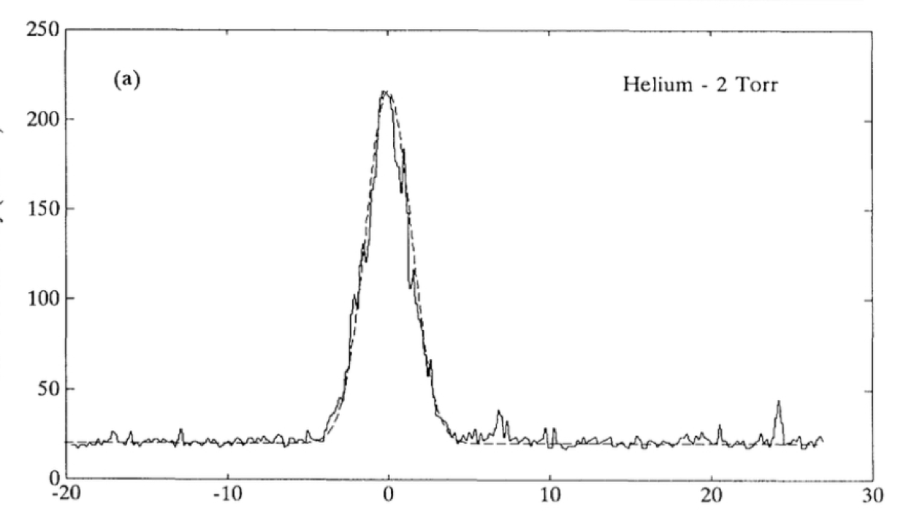
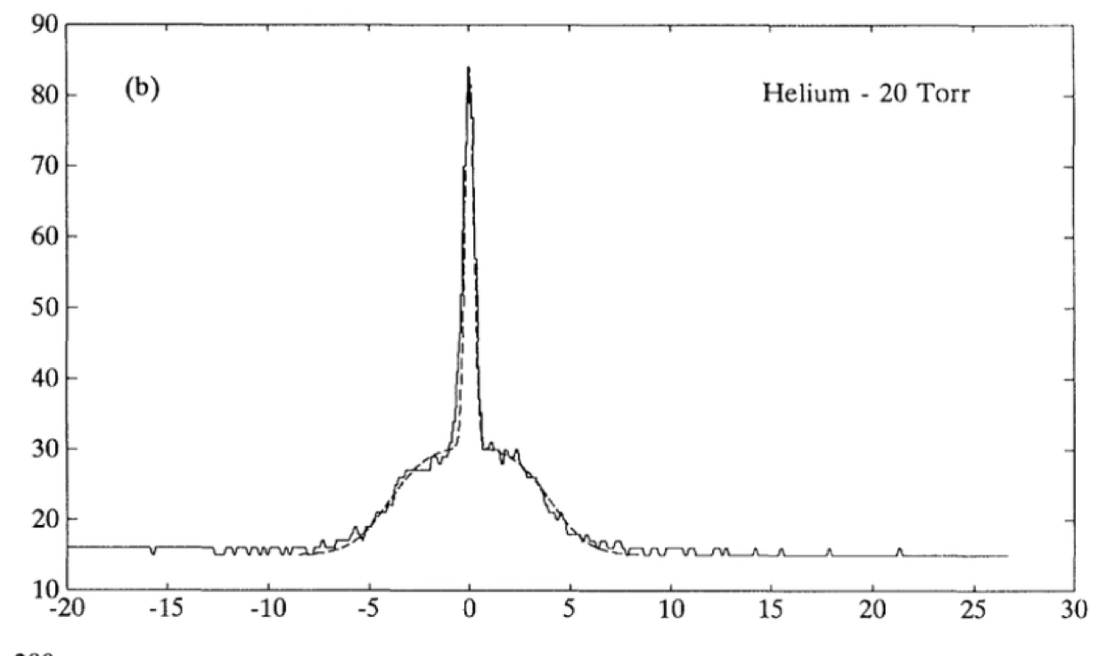
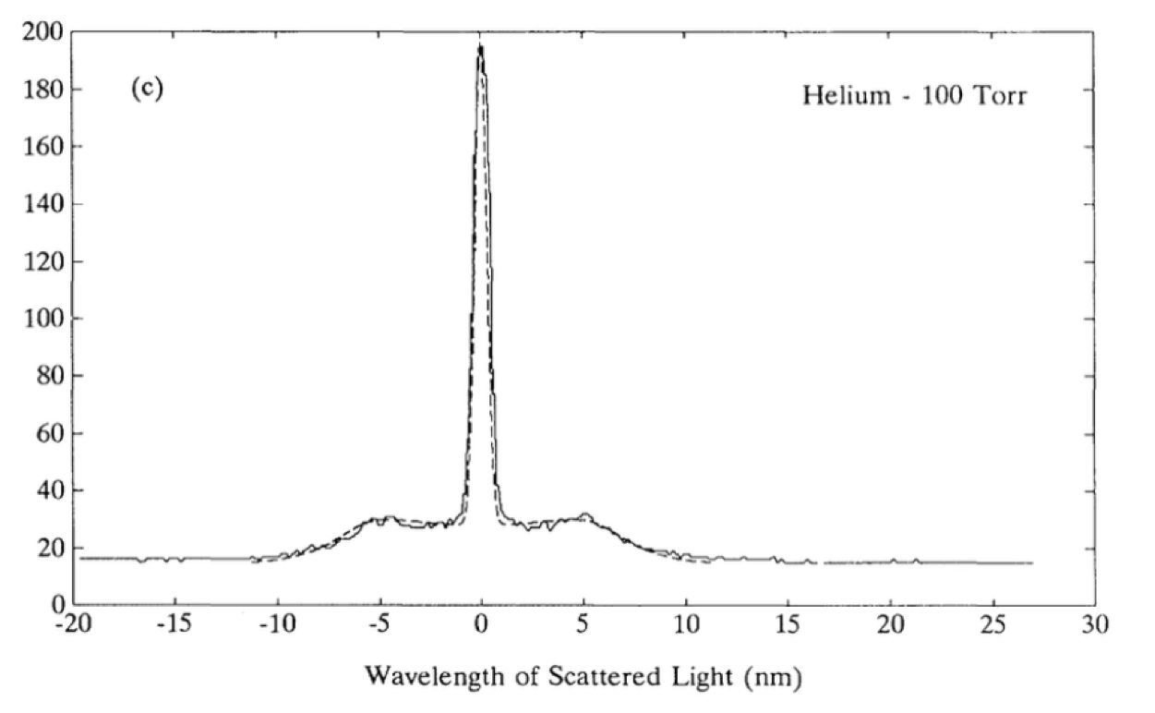
Temperature diagnostics
Examples of Thomson scattering
scattering of a 256 nm KrF laser from an optically self-generated plasma
increasing density decreases $λ_{D}(=ε_{0}k_{B}T_{e}/n_{e}e^{2})$, so increasing $α$
Offenberger, A. A., et al (1993). Electron temperature of optically ionized gases produced by high intensity 268 nm laser radiation. Physical Review Letters, 71(24), 3983–3986.

Slide 45
Temperature diagnostics
Thomson scattering from plasma waves
if suitably selected - can directly scatter from a high amplitude plasma wave
$$k_{p}=ω_{p}/c$$
self emission
$$k_{i}=\sqrt{{ω_{0}}^{2}−{ω_{p}}^{2}}$$
Thomson scattered sideband
$$k_{s}=\sqrt{(ω_{0}+ω_{p})^{2}−{ω_{p}}^{2}}$$
input wavelength
frequency separation of scattered sideband equals $ω_{p}$
Clayton, C. E., (1998). Plasma Wave Generation in a Self-Focused Channel of a Relativistically Intense Laser Pulse. Physical Review Letters, 81(1), 100–103.

Slide 46
Field diagnostics

Slide 47
Particle beam probing
Proton probing
Charged particle beams can also be used for probing
Protons from laser-solid interactions can have wide range of time-of-flight to target and fixed stopping range in detector stack
Can be used to detect both electric and magnetic fields
Willingale, L., et al (2011). Proton probe measurement of fast advection of magnetic fields by hot electrons. Plasma Physics and Controlled Fusion, 53(12), 124026.

Slide 48
Particle beam probing
Proton probing
Proton probing used to measure the dynamics of the space charge expansion that causes ion acceleration in laser-solid interaction
Romagnani, et al (2005). Dynamics of Electric Fields Driving the Laser Acceleration of Multi-MeV Protons. Physical Review Letters, 95(19), 195001.

Slide 49
Particle beam probing
Electron beam probing
LWFA generated electron beams can be femtosecond duration, and so short enough to freeze wakefield dynamics
Linear
Circular
Plasma Ramp
Wan, Y. et al (2023). Femtosecond electron microscopy of relativistic electron bunches. Light: Science and Applications, 12(1).

Slide 50
Other diagnostics

Slide 51
Other things you might be interested about
X-ray emission - particularly from betatron motion - gives information about electron beam size
Kneip, S., et al (2012). Characterization of transverse beam emittance of electrons from a laser-plasma wakefield accelerator in the bubble regime using betatron x-ray radiation. Physical Review Special Topics-Accelerators and Beams, 15(2), 021302.

Slide 52
Other things you might be interested about
Magnetic fields make plasmas optically active, and causes a Faraday rotation
Kaluza, M., Schlenvoigt, H.-P., Mangles, S., Thomas, A., Dangor, A., Schwoerer, H., Mori, W., Najmudin, Z., & Krushelnick, K. (2010). Measurement of Magnetic-Field Structures in a Laser-Wakefield Accelerator. Physical Review Letters, 105(11), 115002.

Slide 53
Other things you might be interested about
Sending a probe beam along with a plasma wave can give frequency shifts and so give information about moving refractive index changes
Dong, P. et al. (2010). Holographic visualization of laser wakefields. New Journal of Physics, 12. https://doi.org/10.1088/1367-2630/12/4/045016

Slide 54
Conclusions
Common density diagnostics:
interferometry
deflectometry
Common temperature diagnostics:
spectroscopy
Thomson Scattering
Common field diagnostics:
Proton probing
electron probing

