Slide 1
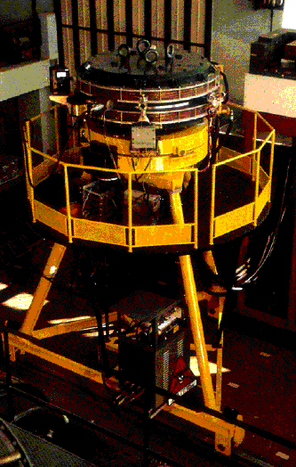
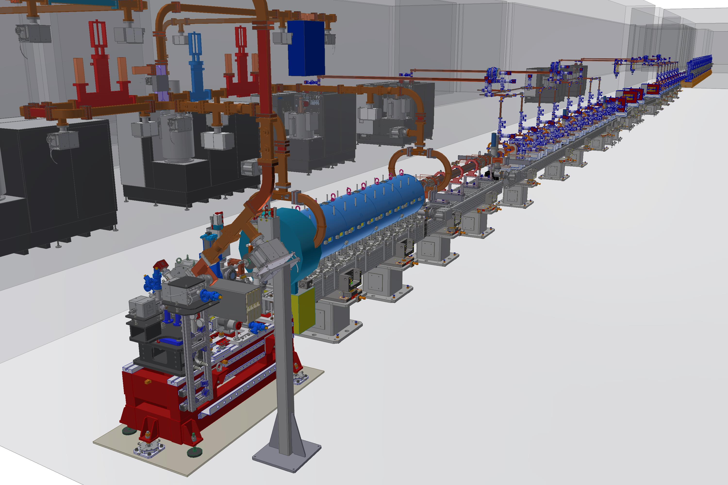

History of INFN
Andrea Ghigo
Istituto Nazionale di Fisica Nucleare
EuPRAXIA DN 2024 Andrea Ghigo Frascati 24 Apr 2024

Slide 2
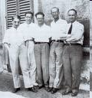
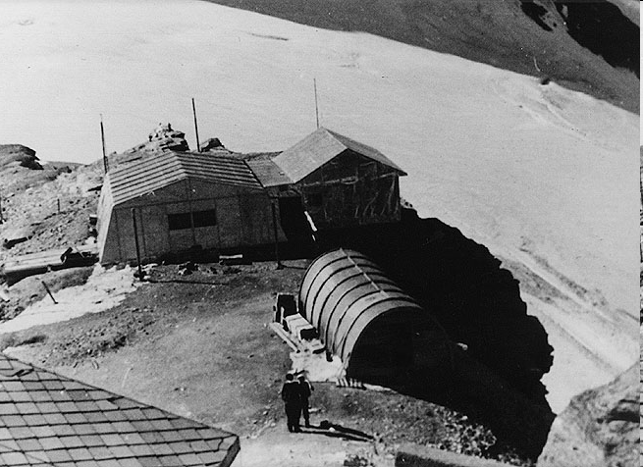
Background
The desire to continue the studies begun by Enrico Fermi and by the "boys of via Panisperna" was strong but after the war the difficulties of the reconstruction slowed down the project to build high-energy particle accelerators as happened in USA. But the excitement of that school, which enumerated among the best nuclear and particles physicists of the world was not arrestable.
In 1948 a laboratory was set up on the Cervino mountain for the observation of cosmic rays waiting for ’’the accelerators that produce them at home", as Gilberto Bernardini said, and at the Testa Grigia at 3500 m height, physicists from all universities worked together establishing strong personal and professional relationship that were fundamental to the growth of the INFN and CNEN

Slide 3
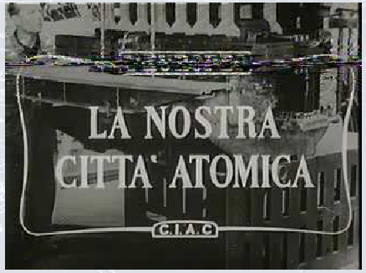
The Frascati National Laboratories
The history of the Frascati national laboratories started when Edoardo Amaldi and Gilberto Bernardini requested to the Italian Government building an accelerator to study the internal constituents of the atoms, as suggested by Enrico Fermi
Edoardo Amaldi and Gilberto Bernardini
Amaldi, Giordani and Campilli agreed to set up the National Committee for Nuclear Research, CNRN, financed by the Ministry of Industry. Minister Campilli, resident in Frascati, convinced his friend Senator Pietro Micara, mayor of Frascati, to give a plot of land with the curious name of ’’Macchia dello sterparo’’ (grove of brushwood…….)
It was decided to build a Synchrotron of energy up to 1000 MeV.

Slide 4
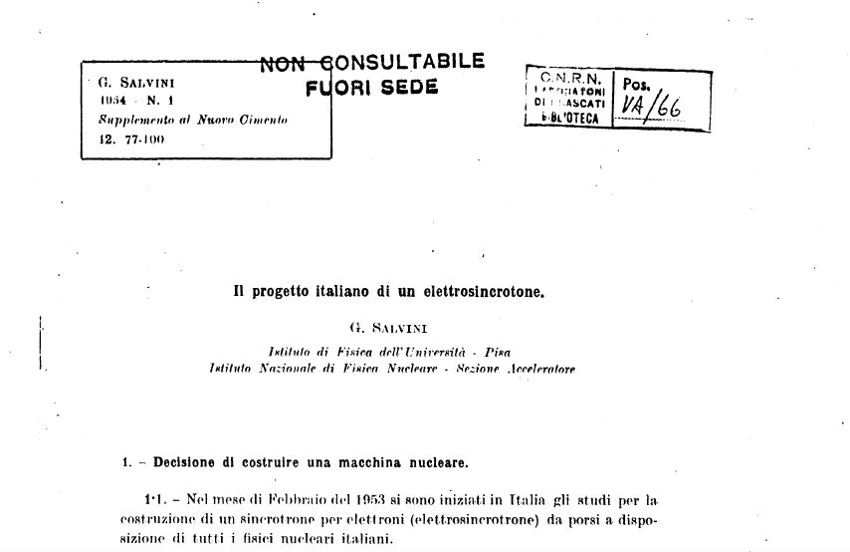
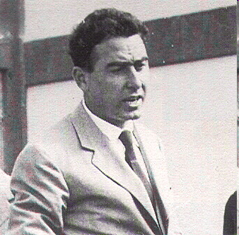
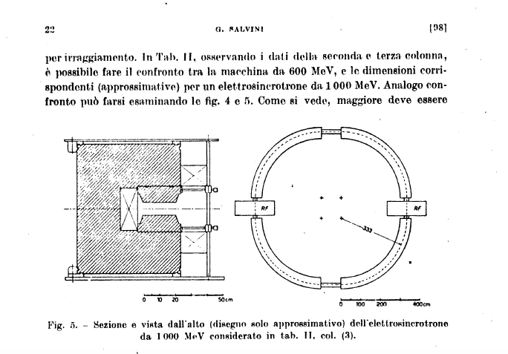
The Boss
The construction of the Synchrotron and the related research center
was entrusted to a 31-year-old physicist: Giorgio Salvini. He recruited a team of good and motivated physicists in the Italian universities
Giorgio Salvini
EuPRAXIA DN 2024 Andrea Ghigo Frascati 24 Apr 2024

Slide 5
Physics program
The Frascati Synchrotron aims to accelerate electron beam up to 1 GeV energy
The electron beam had been used to generate a γ beam, up to 1 GeV, by bremsstrahlung on target placed inside the machine.
The γ beam were had been used to study nuclear and electromagnetic forces between elementary particles.
Single and multiple photoproduction of charged and neutral pions.
Photoproduction of strange particle: heavy meson and hyperon
γ + p -> Λ⁰ + K⁺ (threshold 910 MeV)
γ + p -> Σ⁰ + K⁰ (threshold 1040 MeV)
Electron – photon experience to study nuclear form factors.
Photoproduction of particle pairs (μ+μ−, π+π−) with extracted beam on target
EuPRAXIA DN 2024 Andrea Ghigo Frascati 24 Apr 2024

Slide 6
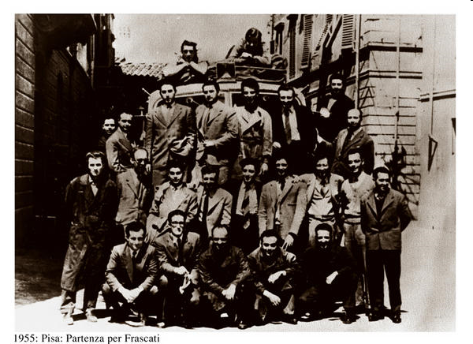
Pisa 1955: Researchers leaving for Rome.
In 1955 the accelerator section of the INFN in Pisa moved to Rome for the construction of the synchrotron. Following the decision to build the synchrotron in Frascati, this team will become the INFN-CNEN National Laboratories of Frascati.
EuPRAXIA DN 2024 Andrea Ghigo Frascati 24 Apr 2024

Slide 7
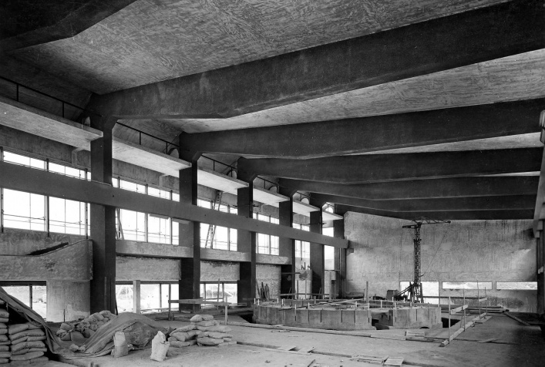
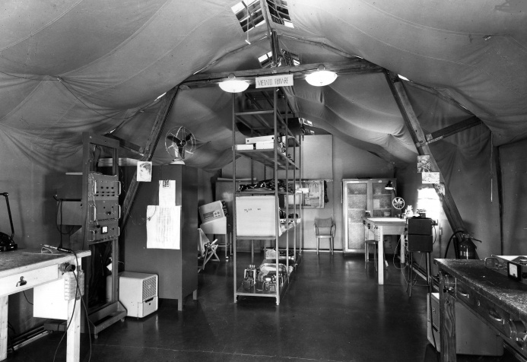
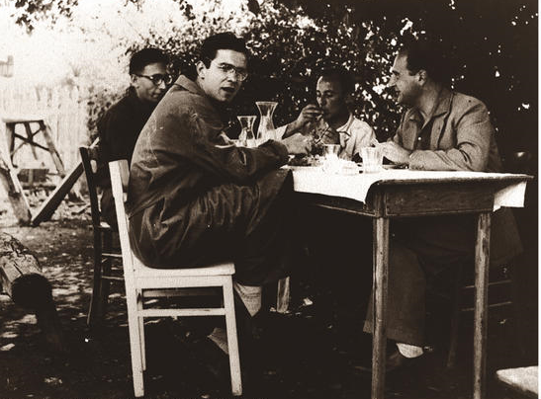
The Synchrotron building during costruction
The inner view of the building
with the large synchrotron
concrete basement
A temporary RF laboratory was set up in a tent waiting for the building
1956: The first canteen in Frascati. The photo is taken during the lunch break
EuPRAXIA DN 2024 Andrea Ghigo Frascati 24 Apr 2024

Slide 8
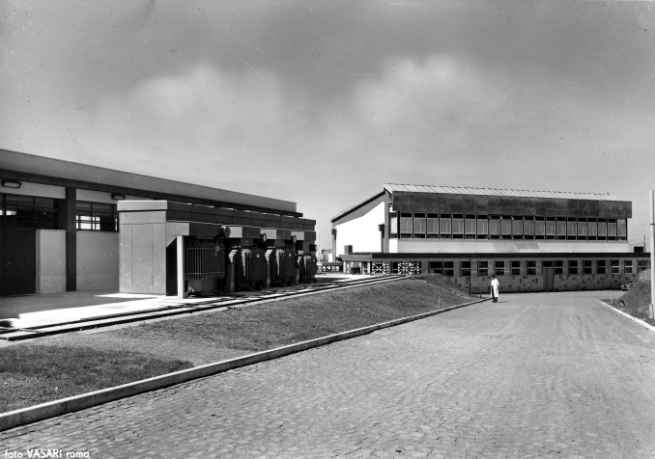
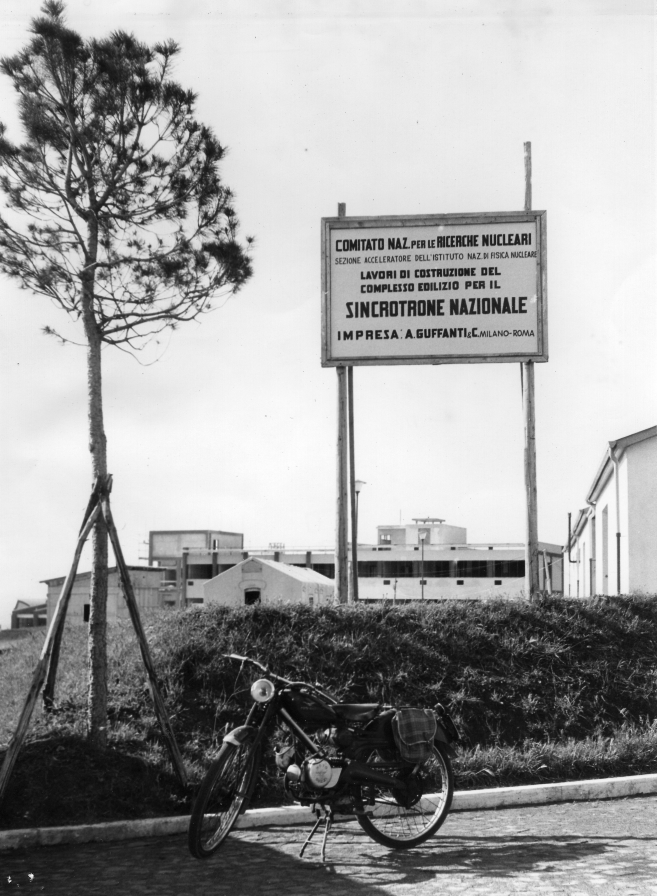
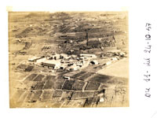
Building ready
The problem of lack of water was solved by digging a well
of 160 m "Absurdly deep almost to the antipodes" (Touschek)

Slide 9
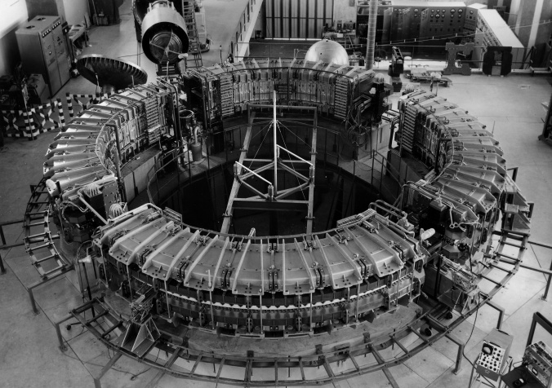
Synchrotron installation
EuPRAXIA DN 2024 Andrea Ghigo Frascati 24 Apr 2024

Slide 10
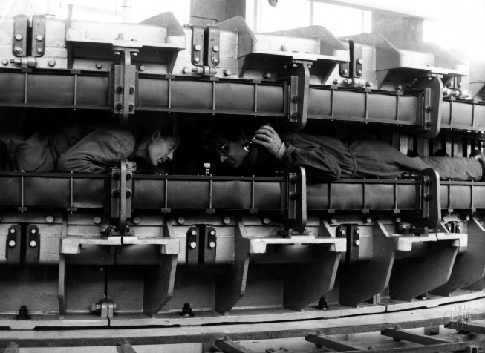
Final magnet inspection
EuPRAXIA DN 2024 Andrea Ghigo Frascati 24 Apr 2024

Slide 11
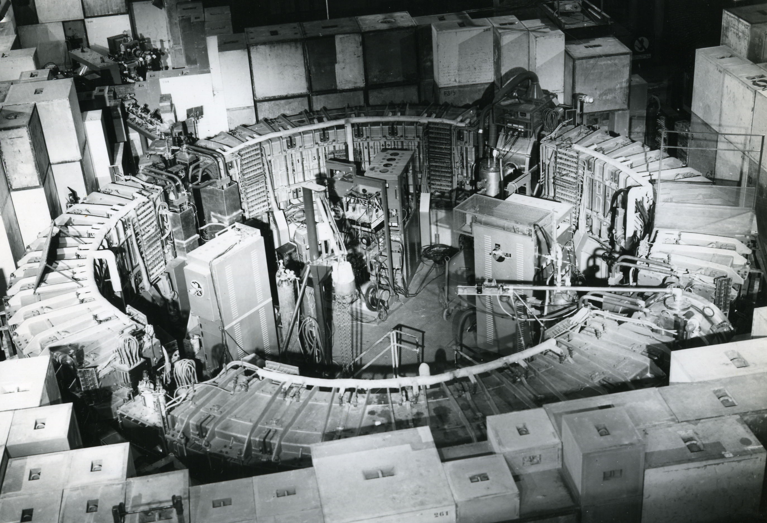
The Sinchrotron ready for the commissioning
The electro-synchrotron was the first high-energy accelerator built in Italy. It was approved in 1953 and construction began in 1957. After just two years, the accelerator was operational.
EuPRAXIA DN 2024 Andrea Ghigo Frascati 24 Apr 2024

Slide 12
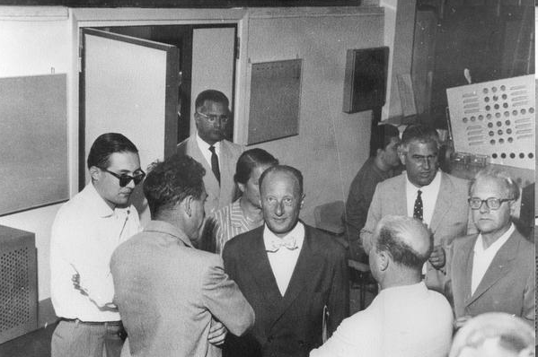
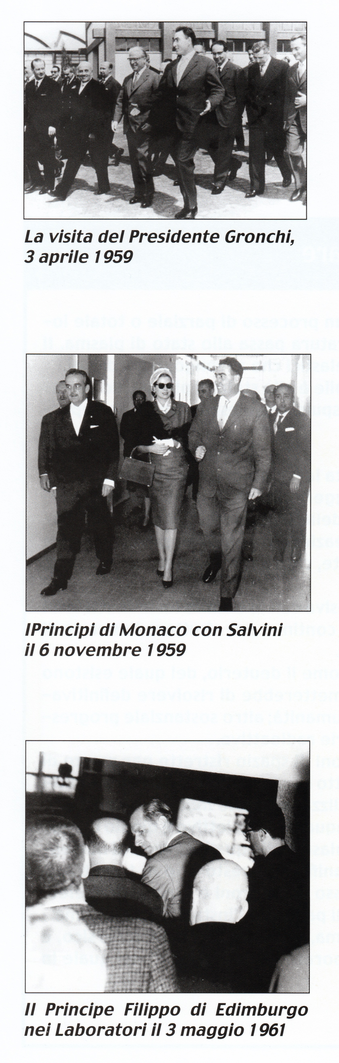
Notoriety: famous guests arrive
1959: President of EURATOM
Italian president: Gronchi
3 April 1959
Prince Philip of Edinburgh
3 May 1961
16/11/1959 The most famous visit:
Ranieri di Monaco and Grace Kelly

Slide 13
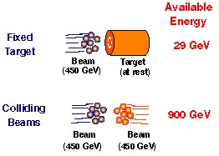
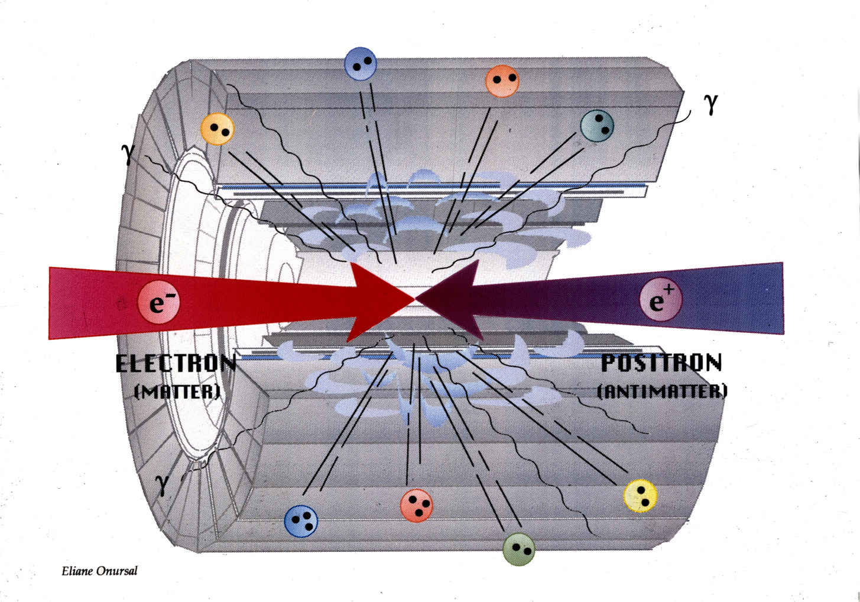
The brilliant idea of Bruno Touschek and the birth of particle colliders
Bruno Touschek's brilliant idea was to use "matter and antimatter" as colliding particles which, in their annihilation, would release all their energy to create new particles. Furthermore, the products of the collisions would have been relatively "simple" compared to those produced by the collision against a complex target.
Anello di Accumulazione
Rivelatore
EuPRAXIA DN 2024 Andrea Ghigo Frascati 24 Apr 2024

Slide 14
The AdA proposal
On February 17, 1960 Bruno Touschek proposed his idea of injecting and accumulating electrons and positrons in a ring and suggested to convert the synchrotron into the world's first matter and antimatter collider
Salvini was against the idea of using the synchrotron that had just gone into operation for user experiments. Giorgio Ghigo proposed to build a special prototype of this accelerator to test the principle. This accelerator was made up of a single suitably shaped magnet in which to inject and accumulate electrons and positrons
EuPRAXIA DN 2024 Andrea Ghigo Frascati 24 Apr 2024

Slide 15

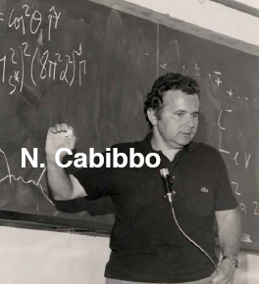
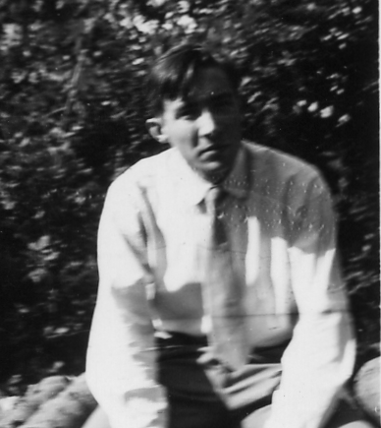
The first AdA followers
Theoretical physicists
Experimental physicists
Giorgio
Ghigo
Carlo Bernardini
Gianfranco Corazza
EuPRAXIA DN 2024 Andrea Ghigo Frascati 24 Apr 2024

Slide 16
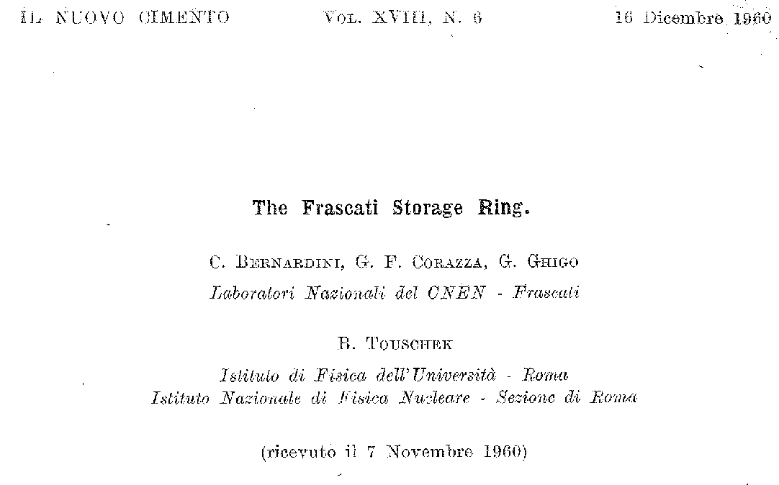
AdA (Anello di Accumulazione) 1960-1965
AdA was funded with a special contribution from the ministry and after less than a year it was ready to function!
AdA consists of a weakly focusing magnet storing counterpropagating e+/e- beams at 250 MeV energy (500 MeV c.m.)
Registration of the first electrons accumulated in AdA.
EuPRAXIA DN 2024 Andrea Ghigo Frascati 24 Apr 2024

Slide 17
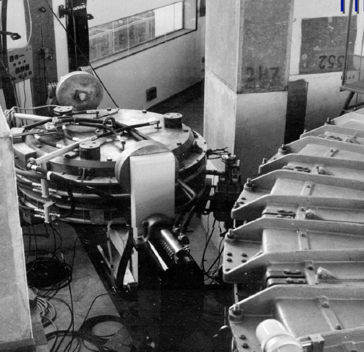
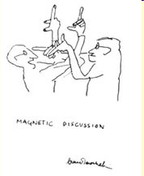
The beam extracted was also used to inject in the first electron-positron collider of the world, called ADA (Anello Di Accumulazione) invented by Bruno Touschek
To switch from electron to positron injection the magnet had been rotated around its axis: a technique called ‘’the rotisserie’’
Nobody could tell which were positrons and which electrons
Bruno Touschek
PHOTON 2019 Frascati 3 June 2019
But this is another story………..

Slide 18
ADONE
With the success of AdA, the construction of a high energy collider was immediately proposed and approved
In the year of its entry into operation, ADONE was the highest energy electron – positron collider in the world
100 m circumference– 3 GeV c.m. Energy
EuPRAXIA DN 2024 Andrea Ghigo Frascati 24 Apr 2024

Slide 19
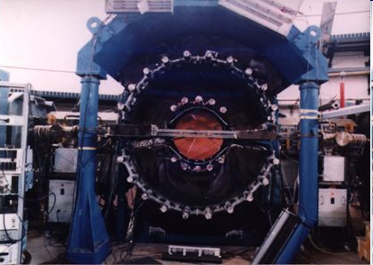
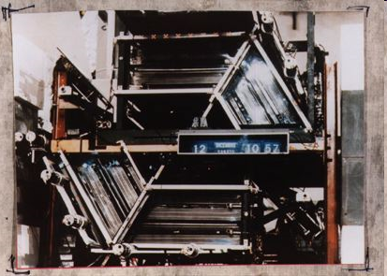
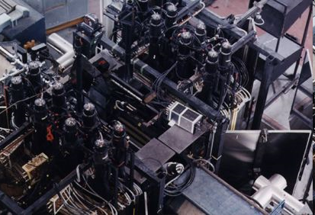
Main ADONE experiments
and results
Barione antibarione
Bosone
Measurements were made over the entire energy spectrum of the mesons
Multi hadronic production
Contributions to the discovery of tau the third lepton
Contributions to the discovery of the charm: the fourth quark
The most important results were the confirmation of the J / Ψ discovery.
The study of hadronic interactions
BCM
Gamma-Gamma

Slide 20
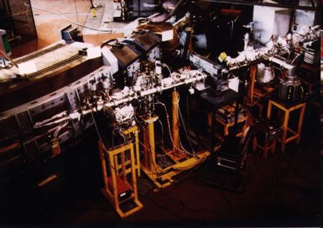
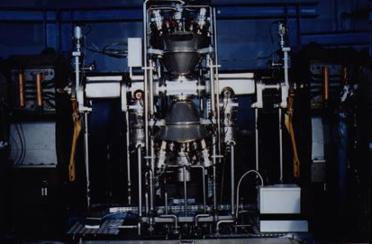
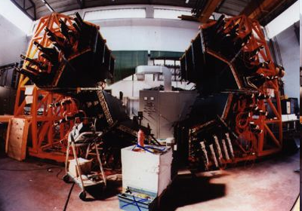
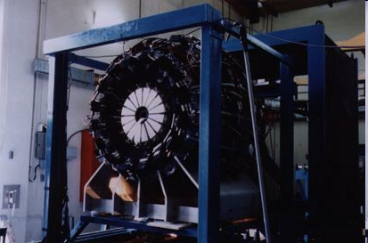
The ADONE second life
Synchrotron radiation
JET TARGET
ADONE was one of the first accelerators in which the synchrotron light was used continuously with lines dedicated to experiments
One of the first accumulation rings in which an undulator magnet is installed increasing the flux of outgoing radiation
One of the first in which the scattering of laser photons by the high energy electrons produced high energy photons (MeV) (LADON experiment)
Gamma rays were also produced by hitting electrons with a gas jet (Jet Target experiment)
FENICE: new hadron form factor
e+e- experiment
LADON
JET TARGET

Slide 21
LISA: LInear Superconducting Accelerator
LISA was born from Tazzari’s initiative based on the possibility of creating a high efficiency accelerator with superconducting technology
EuPRAXIA DN 2024 Andrea Ghigo Frascati 24 Apr 2024

Slide 22
DAΦNE: the Frascati Φ-Factory
In the early ’90 there was a big change in the collider development from the very high energy to very high luminosity to study the rare decay: particle “factory” were realized in Frascati, Stanford and Tsukuba
The first of these kind of machine was DAΦNE, “Double annular ring for Φ-factory nice experiments”
Cabibbo INFN President and Enzo Iarocci Director of the Laboratories gave the task of building the machine to Gaetano Vignola, who was joined by Mario Bassetti and his beam dynamics group and by Hank Hsieh who led the engineering group
EuPRAXIA DN 2024 Andrea Ghigo Frascati 24 Apr 2024

Slide 23
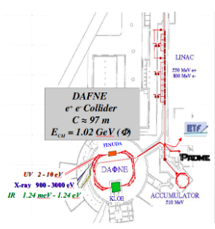
DAΦNE
The DAΦNE accelerator complex was installed in the refurbished ADONE buildings
The extreme high luminosity is achieved colliding very high currents of positrons and electrons stored in two separate rings
The two rings cross each other in two interaction points where the experimental apparata are installed
EuPRAXIA DN 2024 Andrea Ghigo Frascati 24 Apr 2024

Slide 24
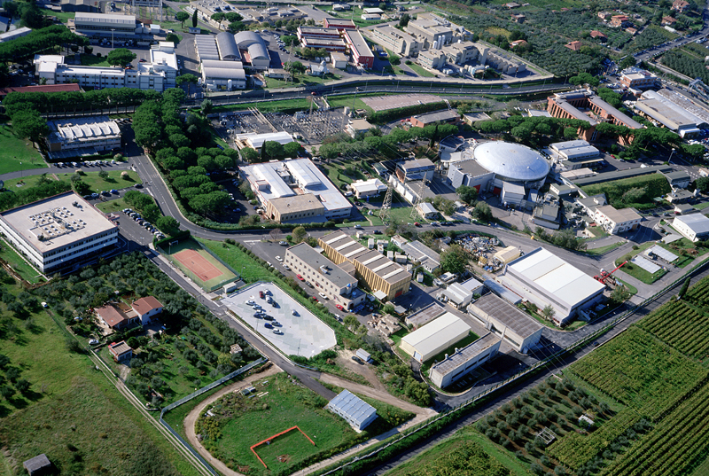
LNF
DAFNE-light
DAFNE
LINAC
BTF
The DAΦNE Φ-Factory complex
EuPRAXIA DN 2024 Andrea Ghigo Frascati 24 Apr 2024

Slide 25
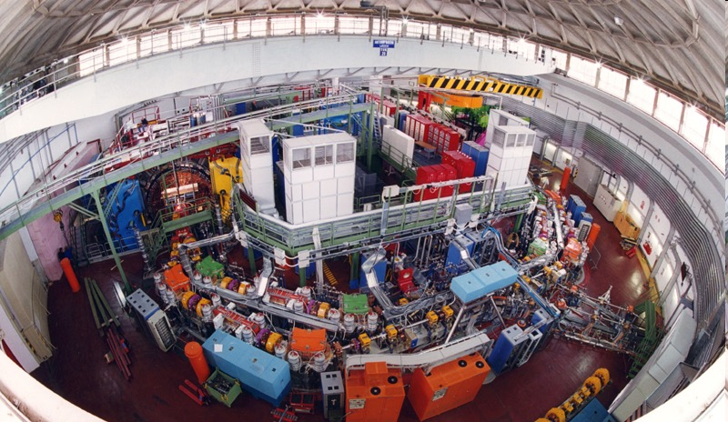
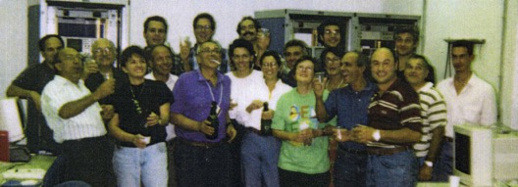
DAΦNE: the Frascati Φ-Factory
DAΦNE achieved the world records of luminosity at 1GeV energy and of positron current stored in a storage ring

Slide 26
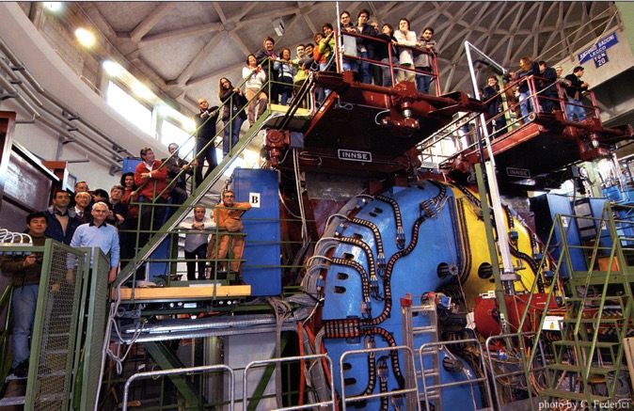
KLOE
Precision
measurements on:
Kaon physics
Flavour, Fundamental Symmetries
Hadron physics
Scalar mesons, Hadronic cross section
Gamma-Gamma physics

Slide 27
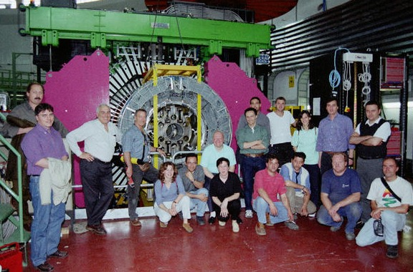
FINUDA
Production and study of hypernuclei
The FINUDA experiment studied the strong force through the insertion of kaons inside the nuclei
FINUDA was the first apparatus with many tags placed around the interaction point of a collider

Slide 28
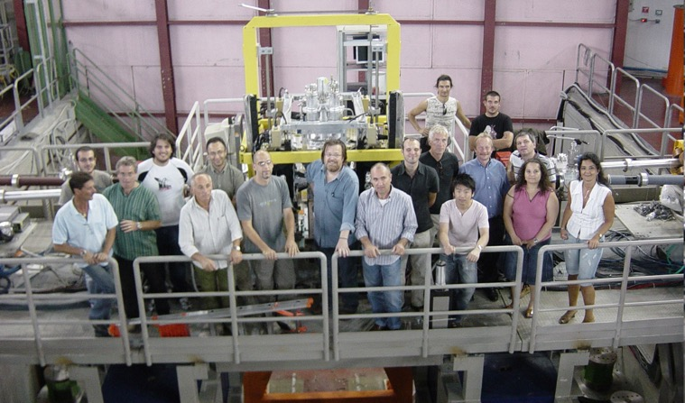
DEAR & SIDDHARTA
Measurements and study of kaonic atoms generated by the interaction of the kaons, produced at DAΦNE, with cryogenic target placed close to the interaction point
Measurement have been performed in kaonic hydrogen and kaonic deuterium
EuPRAXIA DN 2024 Andrea Ghigo Frascati 24 Apr 2024

Slide 29
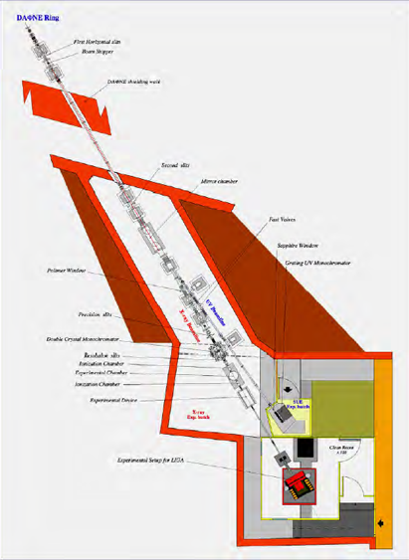
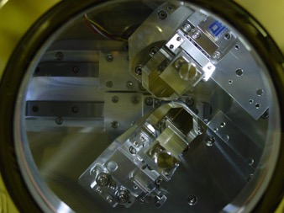
DAΦNE
Synchrotron radiation
- Wiggler soft x-ray beam line
- Critical energy E_{c} = 284 eV
-Working range 0.9 - 3.0 keV
- Soft X-ray absorption spectroscopy
High flux Synchrotron Radiation beam lines work parasitic mode
UV-VIS branch line
Double crystal monochromator
Wiggler UV branch line 650nm - 120nm
-Space applications
-Astrobiology and photo-biology
--Optical properties of materials
-UV aging of organic materials useful for space missions
Soft X-ray beamline
EuPRAXIA DN 2024 Andrea Ghigo Frascati 24 Apr 2024

Slide 30
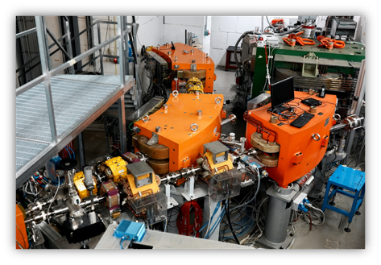
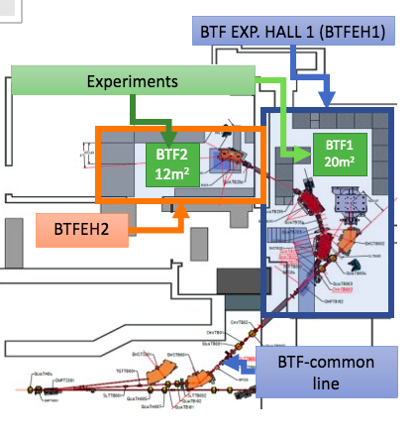
PADME @Beam Test Facility
The search for the “dark” photon by observing the production in the annihilation of electrons and the positrons in pairs of photons, to find events in which one of the two is of the dark type
Beam test facility uses the electron and positron beams of the DAΦNE linear accelerator
EuPRAXIA DN 2024 Andrea Ghigo Frascati 24 Apr 2024

Slide 31
LNF
The SPARC-LAB complex
FLAME
SPARC-LAB
EuPRAXIA DN 2024 Andrea Ghigo Frascati 24 Apr 2024

Slide 32
SPARC_LAB
Sources for Plasma Accelerators and Radiation Compton
with Lasers And Beams
SPARC is the first electron photo-injector using the working point now adopted by almost all the low emittance injectors
EuPRAXIA DN 2024 Andrea Ghigo Frascati 24 Apr 2024

Slide 33
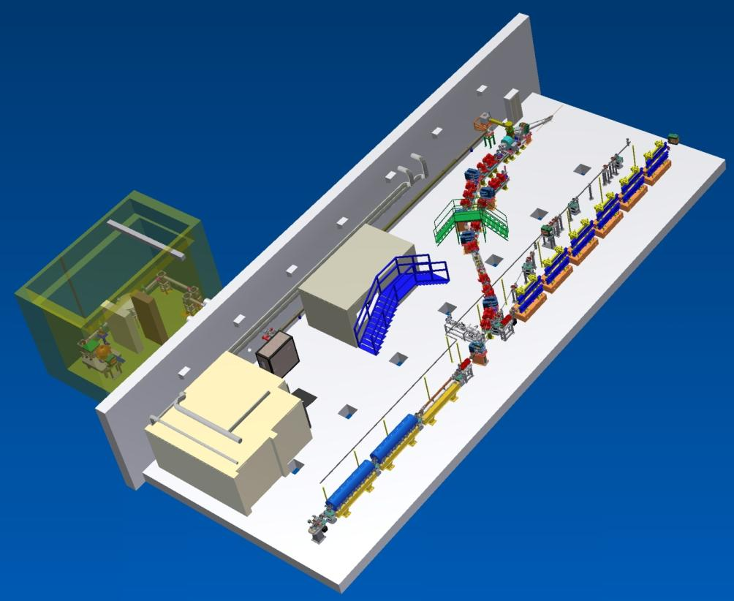
SPARC-LAB experiments
Thomson X-ray
EOS
FLAME
EXIN
FEL
(2colors)
COMB
THz Source
Free Electron Laser- FEL
Seeded FEL
FEL harmonics generation
Two colors FEL
First FEL driven by electron beam plasma accelerated
Particle driven plasma acceleration
Compton scattering
THz radiation generation
Betatron Radiation user facility

Slide 34
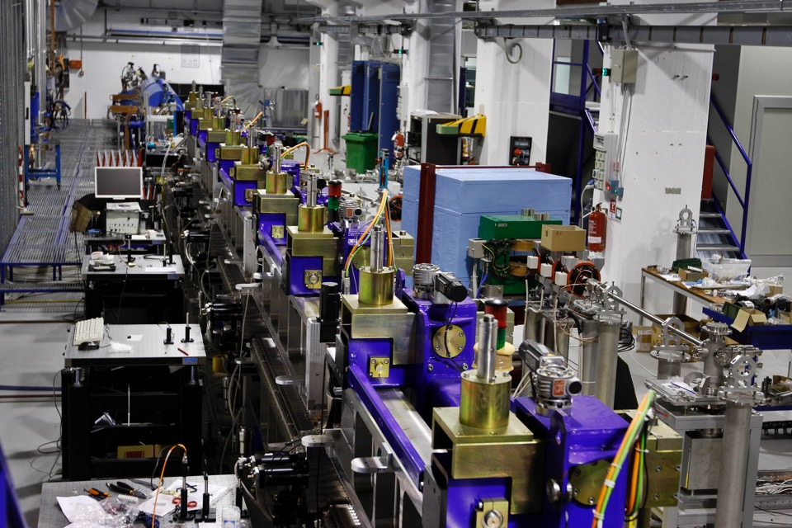
Free Electron Laser
The two color FEL, the FEL harmonics generation, the seeded FEL configurations, tested for the first time in SPARC, were then successfully replicated in other accelerators such as FERMI in TRIESTE, LCLS in Stanford
EuPRAXIA DN 2024 Andrea Ghigo Frascati 24 Apr 2024

Slide 35
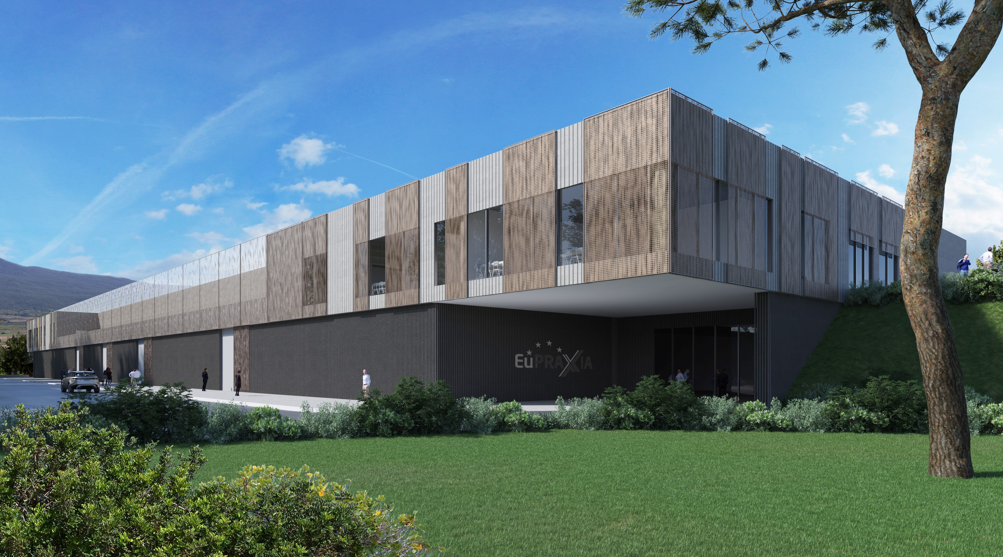
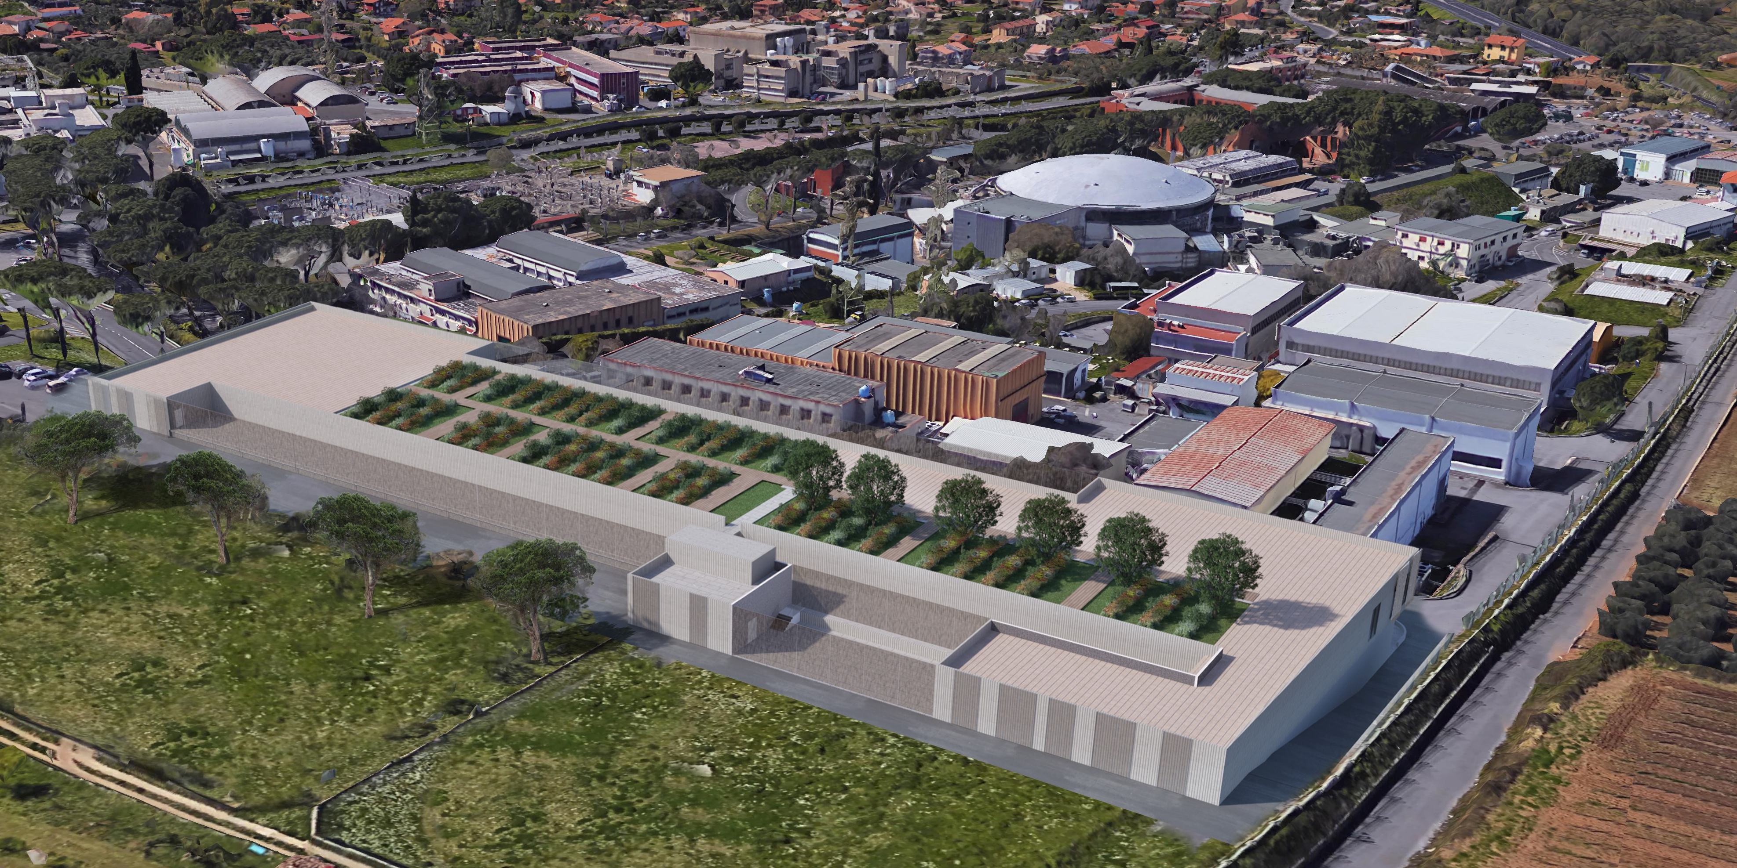
EUPRAXIA@SPARC-LAB
a new research infrastructure in costruction for Frascati laboratories to host a Free Electron Laser facility based on new concept accelerator
EuPRAXIA DN 2024 Andrea Ghigo Frascati 24 Apr 2024

Slide 36
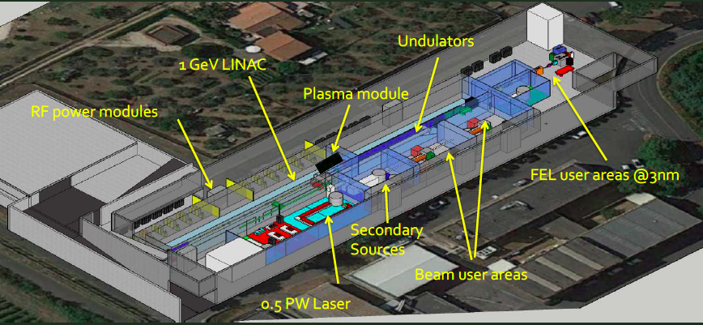
EUPRAXIA@SPARC-LAB
EuPRAXIA will be the first FEL facility that uses a newly developed accelerator based on RF technology in the X-band (12 GHz) and plasma acceleration stages
EuPRAXIA DN 2024 Andrea Ghigo Frascati 24 Apr 2024

Slide 37
Summary of the Frascati accelerators history
1958 -The Frascati Synchrotron was the first high energy accelerator in Italy
1961- AdA was the first matter antimatter collider in the world
1969 - ADONE was the highest energy e+e- collider
1982 - LISA was one of the first superconducting linac for FEL experiments with the recirculation concept
1998 - DAFNE was the first “Factory” in the world and the only one of its kind (Φ-Factory)
2007- SPARC is the first electron photo-injector using the working point now adopted by almost all the low emittance injector
Next - EuPRAXIA aim to be the first FEL facility that uses a newly developed accelerator that uses RF technology in the X-band (12 GHz) and plasma acceleration stages
EuPRAXIA DN 2024 Andrea Ghigo Frascati 24 Apr 2024

Slide 38

FLAME laser Filamentation in the Frascati sky
Thanks for attention
EuPRAXIA DN 2024 Andrea Ghigo Frascati 24 Apr 2024

