Slide 1
Free Electron Lasers
An Introduction
Enrica Chiadroni (Sapienza Rome University and INFN-LNF)

Slide 2
Outline
Motivation
FEL Physics
  Basic properties of the radiation from accelerated relativistic electron beams
  FEL collective instabilities and X-ray FELs
Properties of FEL Radiation
  SASE and Seeded schemes
High brightness beams for FELs

Slide 3
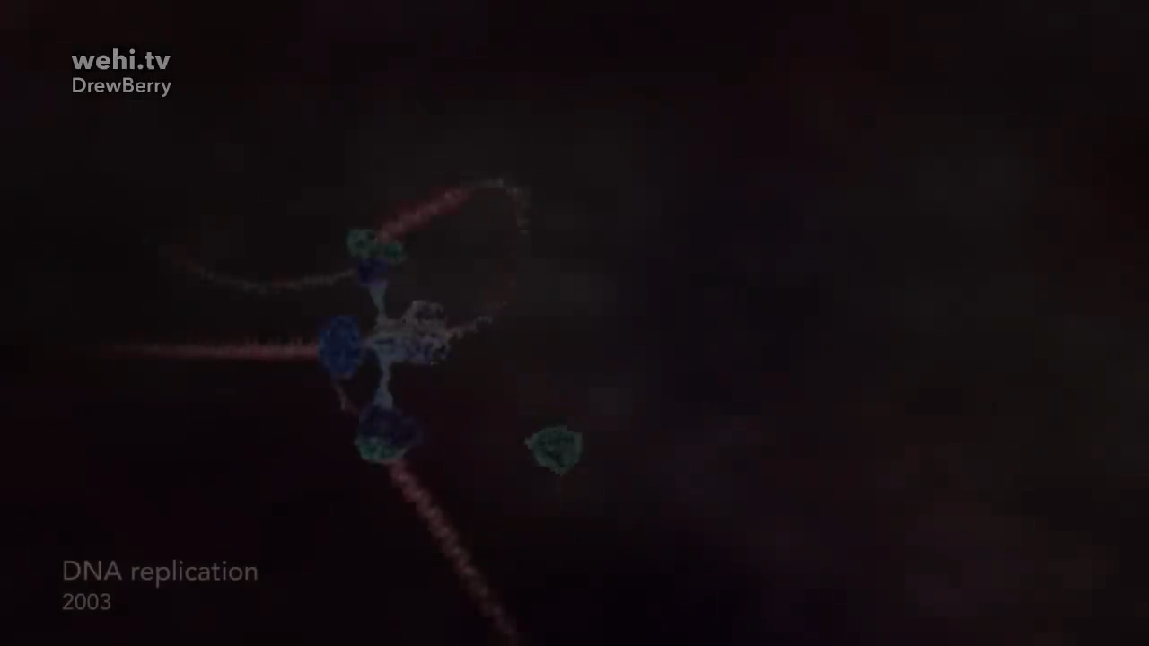
Static Properties of Matter

Slide 4
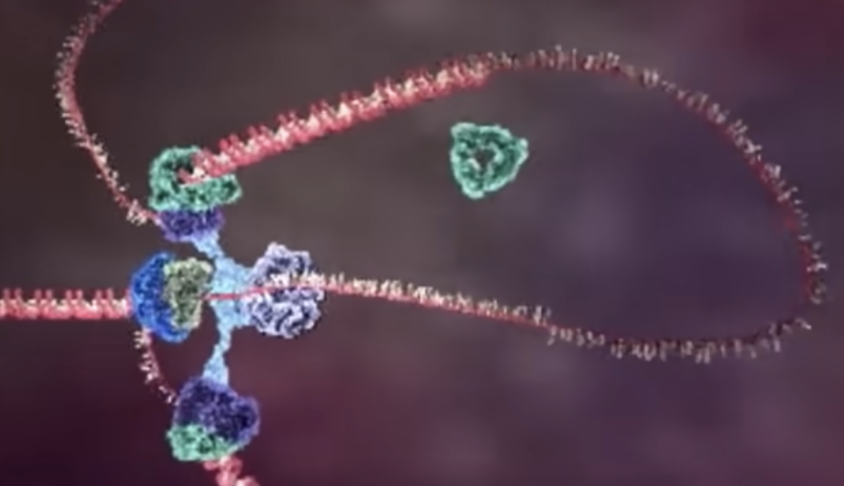
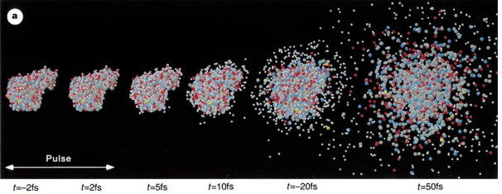
Static Properties of Matter
Static picture of a macro-molecule ➔ Need light
Required properties
Short wavelength (X-ray)
High energy per pulse
Ultra-short pulse (few femtoseconds)
Coherence

Slide 5

Dynamical Properties of Matter
https://www.youtube.com/watch?v=YTj4Hi1HdJQ

Slide 6
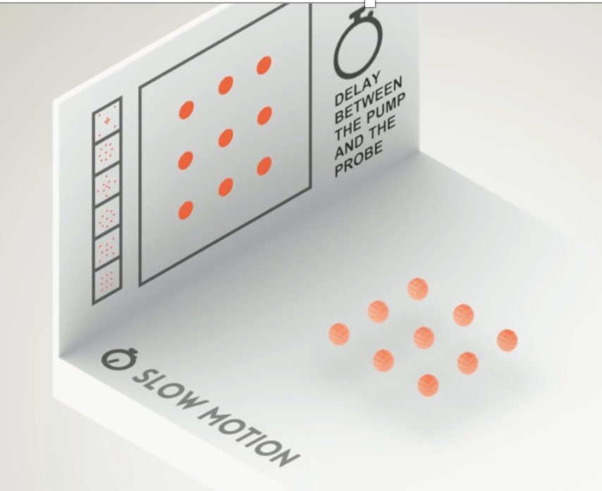



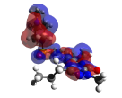
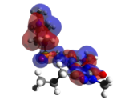
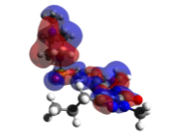
Dynamical Properties of Matter
Courtesy of C. Vozzi
Required properties
Ultra-short pulses (few femtoseconds)
Monochromaticity
Defined polarization
Stability and reproducibility
Dynamics of a molecular, atomic or electronic process

Slide 7
Requests for the Light Sources
Short-wavelength (X-rays)
High-energy
Ultra-short (few femtoseconds, or less)
Transverse and longitudinal coherence
Monochromaticity
Tunability in wavelength (10 to 0.1 nm)
Defined polarization
Stability and reproducibility

Slide 8
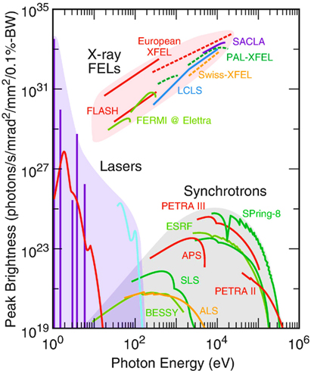
Available Sources
In the IR/UV spectral region, the large majority of previously mentioned properties can be obtained by means of conventional table-top lasers
However, in the VUV/X-ray spectral domain only light sources based on “free” accelerated electrons are able to meet all the requirements
  free-electron lasers having laser-like properties in the VUV/X-ray spectral domain can reach a peak brilliance up to 9 orders of magnitude larger than the latest SR sources
9 orders of magnitude
Credits by J. Ulrich et al.,
Ann. Rev. Phys. Chem. 63, 635 (2012)

Slide 9
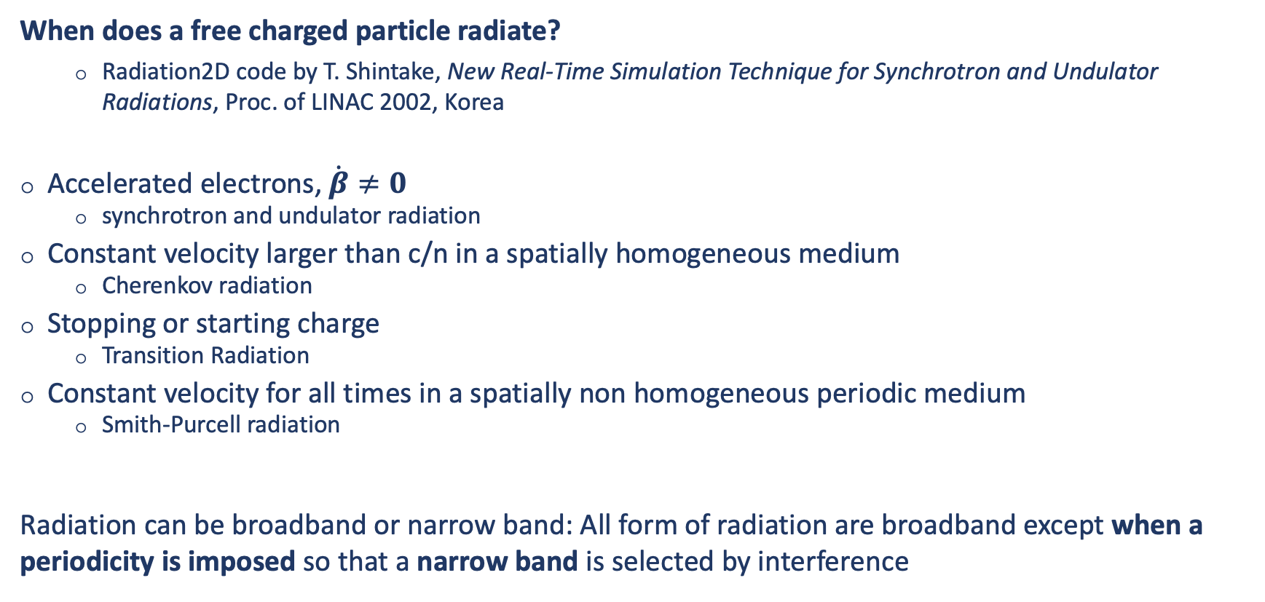
Radiation from Free Accelerated Electrons
When does a free charged particle radiate?
  Radiation2D code by T. Shintake, New Real-Time Simulation Technique for Synchrotron and Undulator Radiations, Proc. of LINAC 2002, Korea
Accelerated electrons, $\dot{β}≠0$
  synchrotron and undulator radiation
Constant velocity larger than c/n in a spatially homogeneous medium
  Cherenkov radiation
Stopping or starting charge
  Transition Radiation
Constant velocity for all times in a spatially non homogeneous periodic medium
  Smith-Purcell radiation
Radiation can be broadband or narrow band: All form of radiation are broadband except when a periodicity is imposed so that a narrow band is selected by interference

Slide 10
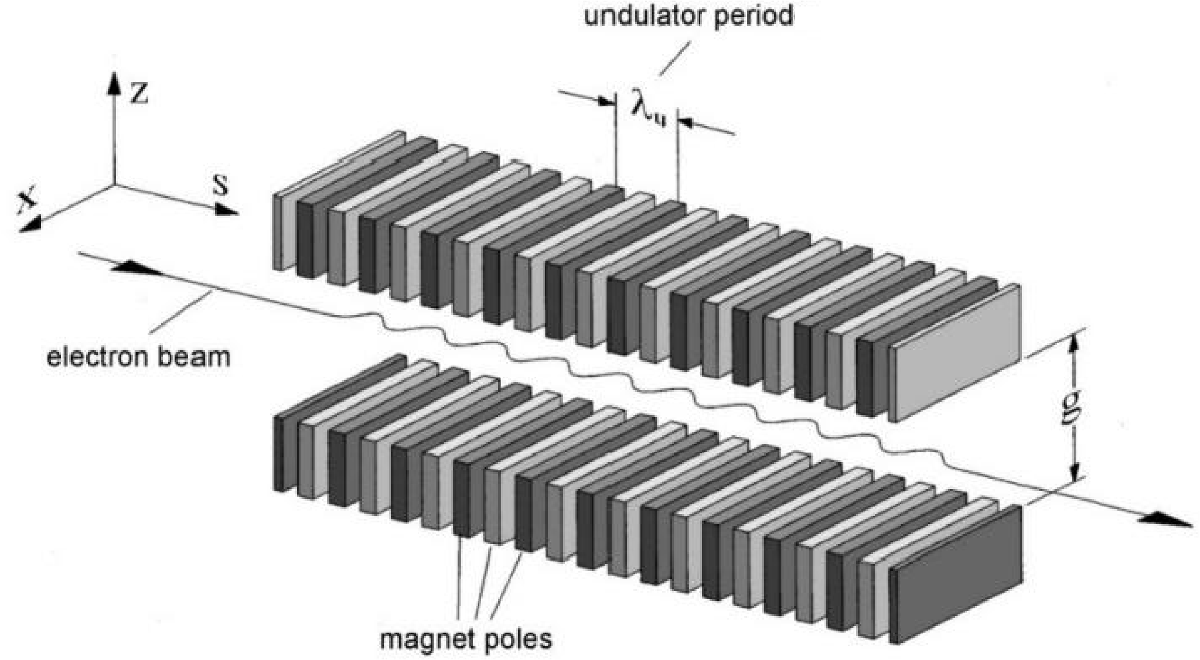
Undulator Magnet
1951: H. Motz proposed the use of a long array of alternating magnetic fields, an undulator magnet, to generate narrow band radiation and have an extended radiation source
J. Appl. Phys. 22, 527–535 (1951)

Slide 11
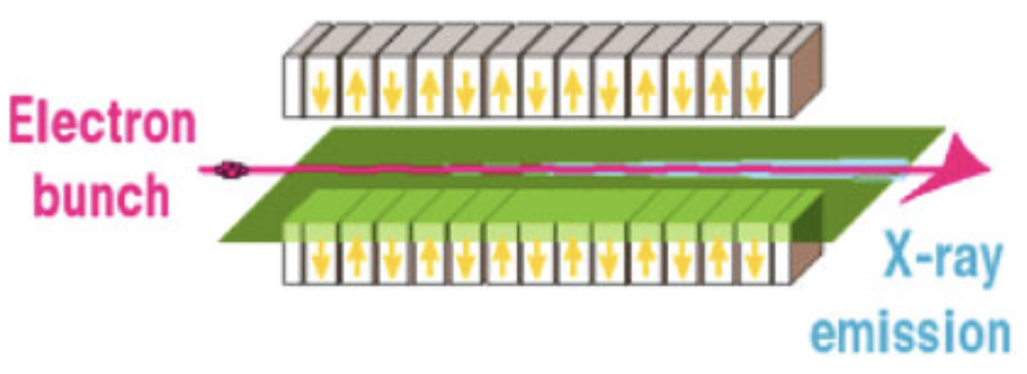
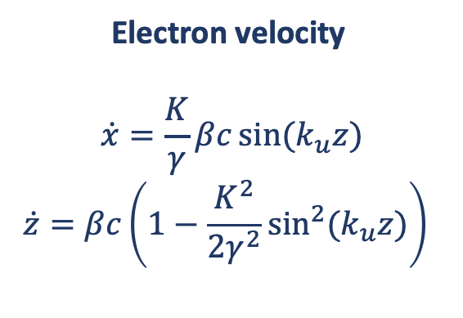
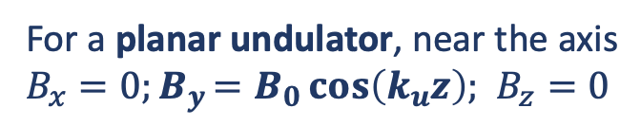
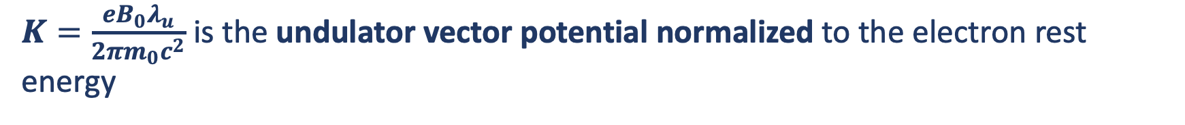
Undulator Radiation: Single Electron
λ_{u}
For a planar undulator, near the axis
$B_{x}=0{;B}_{y}=B_{0}\cos\left(k_{u}z\right);$ $B_{z}=0$
y
Electron velocity
$$\dot{x}=\frac{K}{γ}βc\sin{(k_{u}z)}$$
$$\dot{z}=βc\left(1−\frac{K^{2}}{2γ^{2}}\sin^{2}{(k_{u}z)}\right){ }$$
z
x
$K=\frac{eB_{0}λ_{u}}{2πm_{0}c^{2}}$ is the undulator vector potential normalized to the electron rest energy

Slide 12
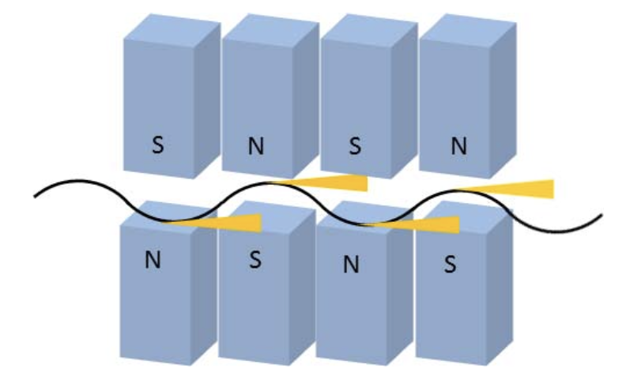

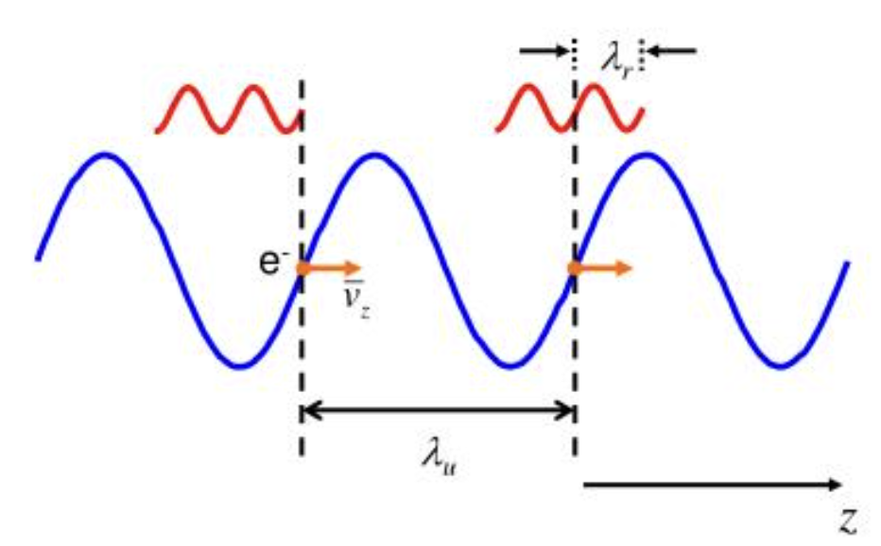
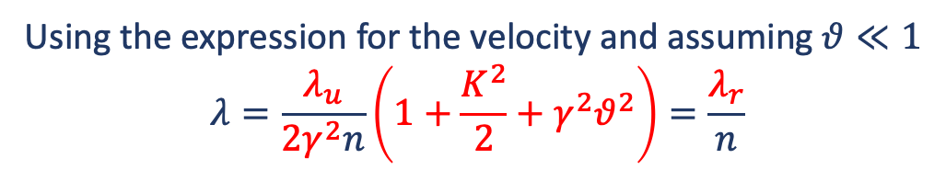
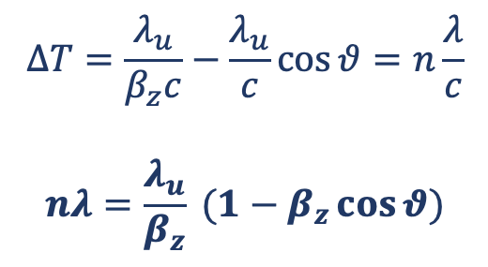
Undulator radiation: Resonance Condition
$$ΔT=\frac{λ_{u}}{β_{z}c}−\frac{λ_{u}}{c}\cos{θ}=n\frac{λ}{c}$$
$$nλ=\frac{λ_{u}}{β_{z}} (1−β_{z}\cos{θ})$$
Interference effect
Observer
Using the expression for the velocity and assuming $θ≪1$
$$λ=\frac{λ_{u}}{2γ^{2}n}\left(1+\frac{K^{2}}{2}+γ^{2}θ^{2}\right)=\frac{λ_{r}}{n}$$
Resonance condition
Radiation slips ahead by one wavelength per undulator period

Slide 13
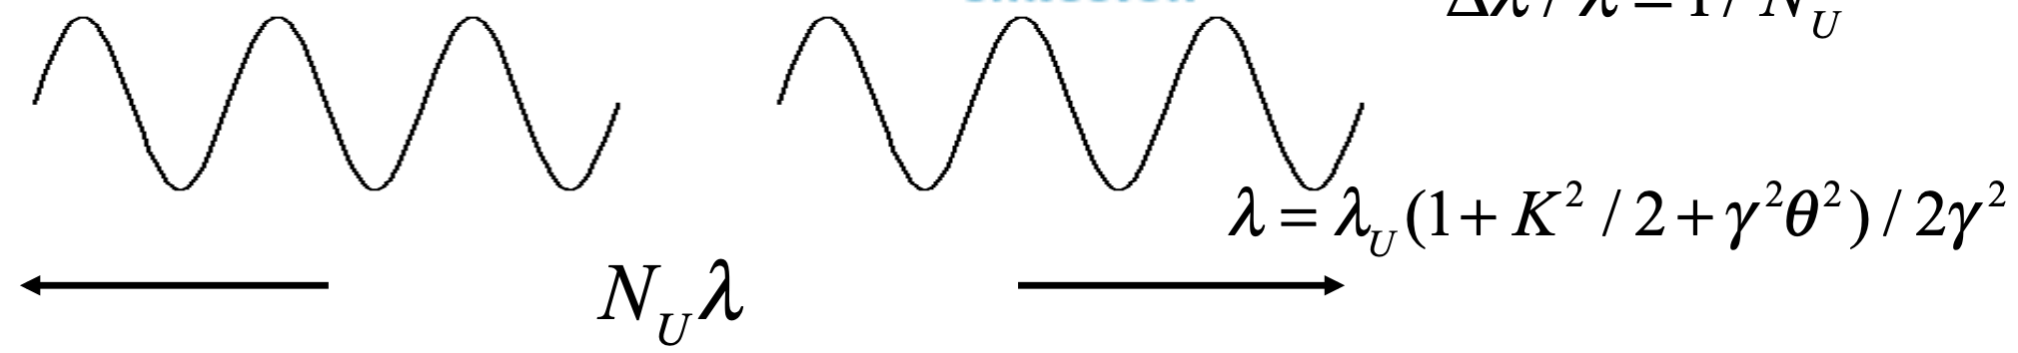
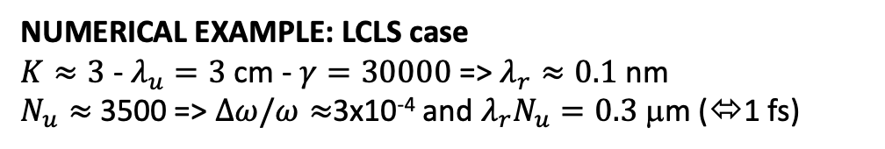


Undulator radiation: Bandwidth
Undulator with N_{u} periods
$$\frac{Δλ}{λ}≅\frac{1}{N_{u}}$$
$λ_{r}= λ_{u}\left(1+K^{2}/2+γ^{2}θ^{2}\right)$/ $2γ^{2}$
Each electron emits a wave train with N_{u} cycles
NUMERICAL EXAMPLE: LCLS case
$K≈3$ - $λ_{u}=3$ cm - $γ=30000$ => $λ_{r}≈0.1$ nm
$N_{u}≈$ 3500 => $Δω/ω≈$3x10⁻⁴ and $λ_{r}N_{u}=0.3$ μm (⬄1 fs)

Slide 14
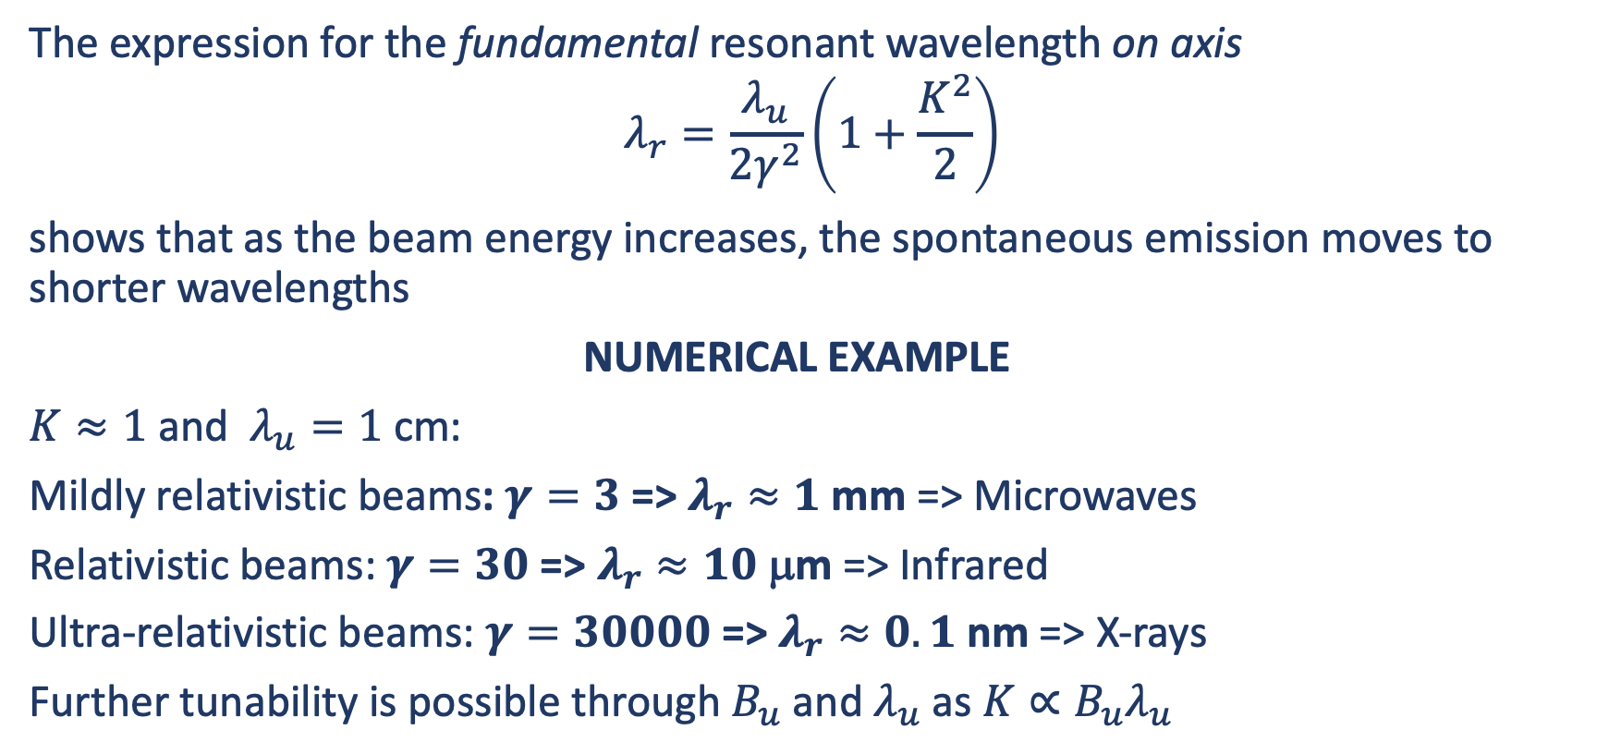
Origin of FEL Tunability
The expression for the fundamental resonant wavelength on axis
$$λ_{r}=\frac{λ_{u}}{2γ^{2}}\left(1+\frac{K^{2}}{2}\right)$$
shows that as the beam energy increases, the spontaneous emission moves to shorter wavelengths
NUMERICAL EXAMPLE
$K≈1$ and $λ_{u}=1$ cm:
Mildly relativistic beams: $γ=3$ => $λ_{r}≈1$ mm => Microwaves
Relativistic beams: $γ=30$ => $λ_{r}≈10$ μm => Infrared
Ultra-relativistic beams: $γ=30000$ => $λ_{r}≈0.1$ nm => X-rays
Further tunability is possible through $B_{u}$ and $λ_{u}$ as $K∝B_{u}λ_{u}$

Slide 15
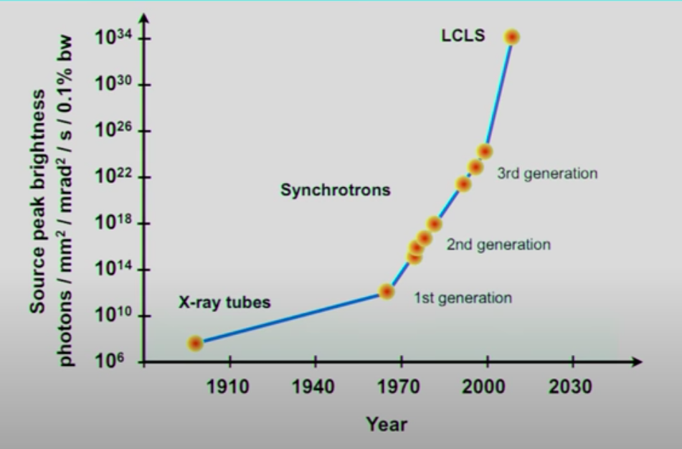
Synchrotron Radiation Sources
1st generation => Parasitic facilities: bending magnets radiation
  SPEAR at SLAC
2nd generation => Dedicated ring for SR generation
  SRS at Daresbury, Photon Factory at KEK, …
3rd generation => Optimized for SR generation with insertion devices (e.g. undulators and/or wigglers)
  ESRF, APS, Spring-8, …
Needed brightness
for imaging experiments

Slide 16
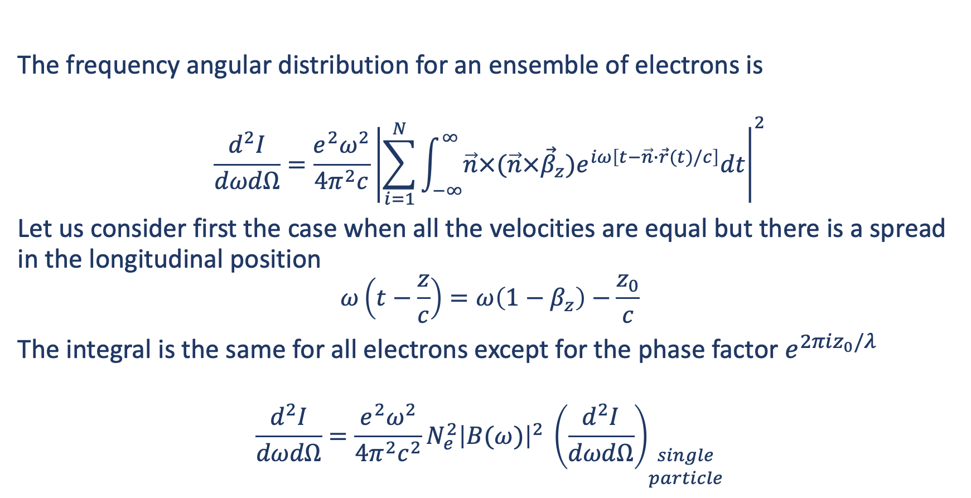
Ensemble of Particles
The frequency angular distribution for an ensemble of electrons is
$$\frac{d^{2}I}{dωdΩ}=\frac{e^{2}ω^{2}}{4π^{2}c}{\left|\sum_{i=1}^{N}{\int_{−∞}^{∞}{\vec{n}×(\vec{n}×{\vec{β}}_{z})e^{iω\left[t−\vec{n}∙\vec{r}(t)/c\right]}dt}}\right|}^{2}$$
Let us consider first the case when all the velocities are equal but there is a spread in the longitudinal position
$$ω\left(t−\frac{z}{c}\right)=ω\left(1−β_{z}\right)−\frac{z_{0}}{c}$$
The integral is the same for all electrons except for the phase factor $e^{2πiz_{0}/λ}$
$$\frac{d^{2}I}{dωdΩ}=\frac{e^{2}ω^{2}}{4π^{2}c^{2}}{N_{e}^{2}{\left|B(ω)\right|}^{2}}^{ }{\left(\frac{d^{2}I}{dωdΩ}\right)}_{\begin{aligned}single \\ particle\end{aligned}}$$

Slide 17
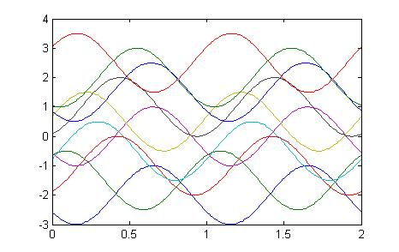
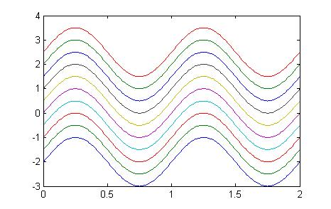


Emission from Many Particles
Incoherent emission
(Synchrotron radiation)
Coherent emission

Slide 18
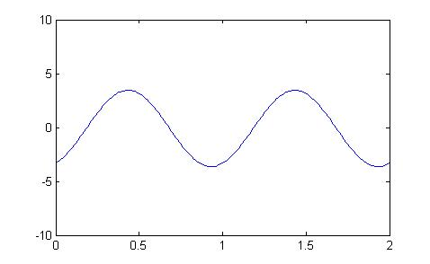
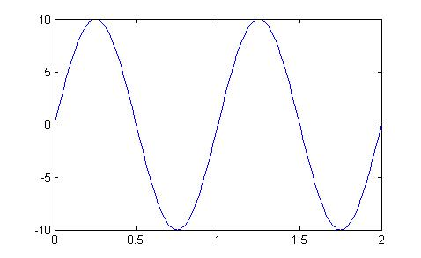
Emission from Many Particles
Incoherent emission
(Synchrotron radiation)
Coherent emission
Radiated power
linear with electron current
Radiated power
quadratic with electron current

Slide 19
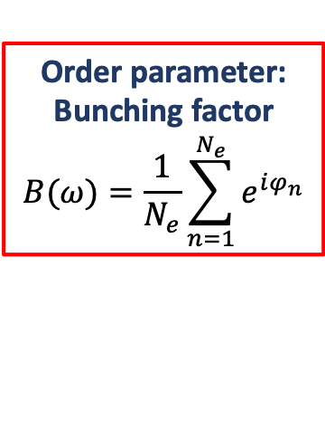
Emission from Many Particles
Incoherent emission
(Synchrotron radiation)
Coherent emission
(FEL)
Order parameter:
Bunching factor
$$B(ω)=\frac{1}{N_{e}}\sum_{n=1}^{N_{e}}{e^{iφ_{n}}}$$
Radiated power
linear with electron current
Radiated power
quadratic with electron current

Slide 20
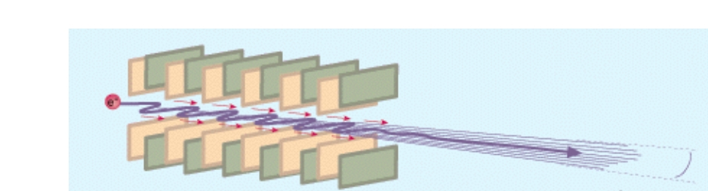
Stimulated Undulator Radiation
Relativistic electron beam
Undulator

Slide 21
Stimulated Undulator Radiation
Relativistic electron beam
Undulator
Electromagnetic field co-propagating with the electron beam and getting amplified
to the detriment of electrons’ kinetic energy

Slide 22
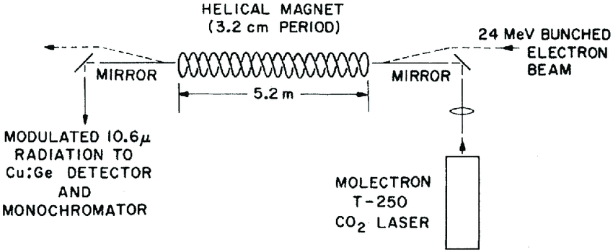
Stimulated Undulator Radiation
Relativistic electron beam
Undulator
Electromagnetic field co-propagating with the electron beam and getting amplified
to the detriment of electrons’ kinetic energy

Slide 23
Stimulated Undulator Radiation
Relativistic electron beam
Undulator
Electromagnetic field co-propagating with the electron beam and getting amplified
to the detriment of electrons’ kinetic energy
J. Madey, Stimulated emission of Bremsstrahlung in a periodic magnetic field, J. Appl. Phys. 42, p. 1906 (1971).
L. Elias, W. Fairbank, J. Madey, and T. Smith, Observation of stimulated emission of radiation by relativistic electrons in a spatially periodic transverse magnetic field, Phys. Rev. Lett. 36, no. 13, p. 717 (1976).

Slide 24
FEL Collective Instability
electrons
bunching ≈ 0
Initial condition:
weak electromagnetic field
electrons randomly distributed in phase
electromagnetic field
bunching > 0
Electrons start bunching on a λ scale
and the wave is amplified
λ
Resonant interaction ➔ Induced energy modulation ➔ Density modulation ➔ Coherent emission
R. Bonifacio, C. Pellegrini, L.M. Narducci Opt. Comm. 50-6, 373-378 (1984)

Slide 25
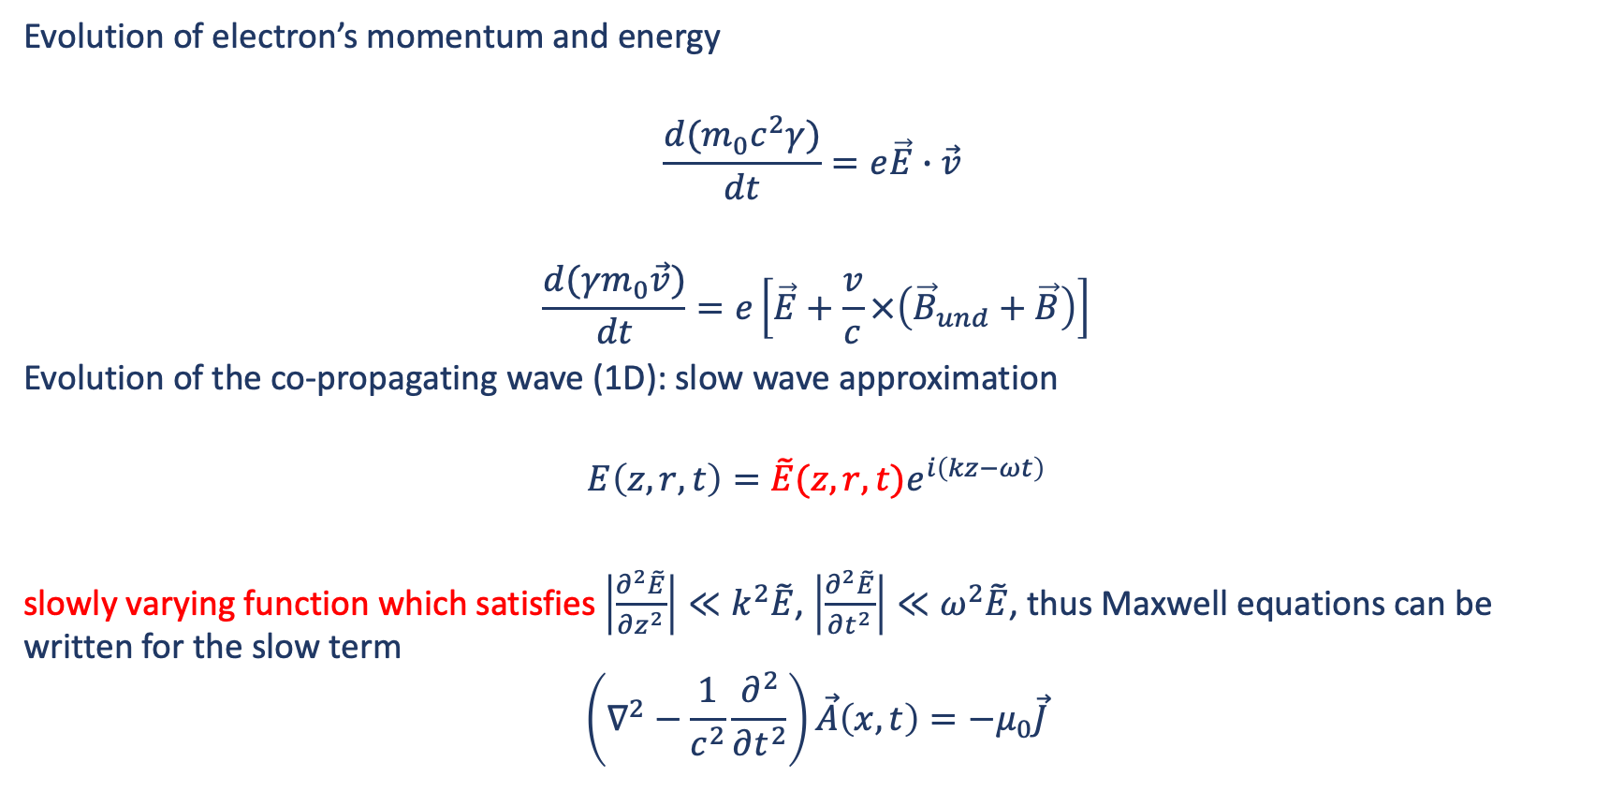
Self-Consistent FEL System
Evolution of electron’s momentum and energy
$$\frac{d(m_{0}c^{2}γ)}{dt}=e\vec{E}∙\vec{v}$$
$$\frac{d(γm_{0}\vec{v})}{dt}=e\left[\vec{E}+\frac{v}{c}×\left({\vec{B}}_{und}+\vec{B}\right)\right]$$
Evolution of the co-propagating wave (1D): slow wave approximation
$$E\left(z,r,t\right)=\tilde{E}(z,r,t)e^{i\left(kz−ωt\right)}$$
slowly varying function which satisfies $\left|\frac{∂^{2}\tilde{E}}{∂z^{2}}\right|≪k^{2}\tilde{E}$, $\left|\frac{∂^{2}\tilde{E}}{∂t^{2}}\right|≪ω^{2}\tilde{E}$, thus Maxwell equations can be written for the slow term
$$\left(∇^{2}−\frac{1}{c^{2}}\frac{∂^{2}}{∂t^{2}}\right)\vec{A}\left(x,t\right)=−μ_{0}\vec{J}$$
electric and magnetic fields
of the co-propagating wave
vector potential
electrons’ transverse current

Slide 26

FEL Equations: 1D Theory
Normalizing these equations
$$ψ_{j}=\left(k+k_{u}\right)z−ωt$$
$$η_{j}=\frac{γ_{j}−γ_{z}}{ργ_{z}}$$
the FEL dynamics can be described in a «universal form», where only a single parameter ρ plays a role
$$\frac{∂ψ_{j}}{∂z}=η_{j}$$
$$\frac{∂η_{j}}{∂z}=\left(Ae^{iψ_{j}}+c.c.\right)$$
$$\frac{∂A}{∂z}=−e^{−iψ_{j}}$$
ψ_{j} phase of the j-th electron in the
combined “ponderomotive”
(radiation + undulator) field
η_{j} energy deviation in units of the FEL parameter ρ
Phase
Energy
Field
R. Bonifacio et al. Phys. Rev. Lett. 73, 70 (1994)

Slide 27
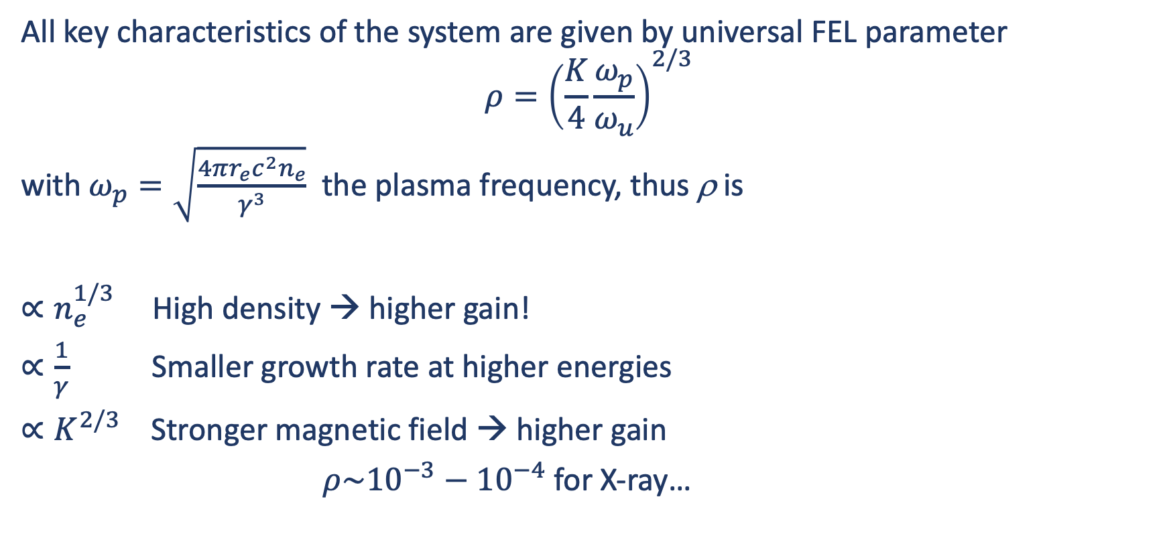
FEL ρ Parameter
All key characteristics of the system are given by universal FEL parameter
$$ρ={\left(\frac{K}{4}\frac{ω_{p}}{ω_{u}}\right)}^{2/3}$$
with $ω_{p}=\sqrt{\frac{4πr_{e}c^{2}n_{e}}{γ^{3}}}$ the plasma frequency, thus ρ is
$∝n_{e}^{1/3}$ High density → higher gain!
$∝\frac{1}{γ}$ Smaller growth rate at higher energies
$∝K^{2/3}$ Stronger magnetic field → higher gain
$ρ\sim {10}^{−3}−{10}^{−4}$ for X-ray…

Slide 28
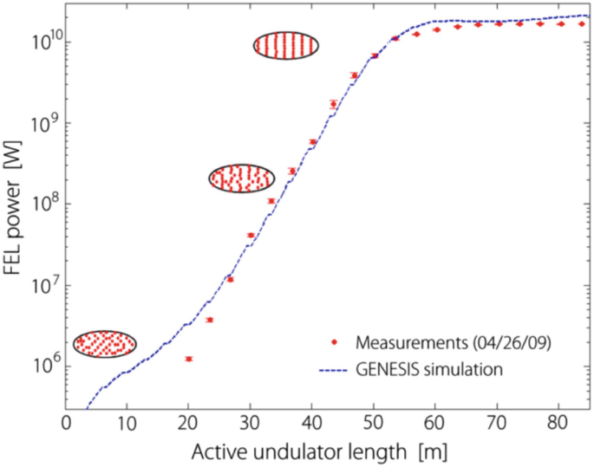
Self Amplified Spontaneous Emission (SASE)
Evolution of power and longitudinal beam density along the undulator from spontaneous radiation to FEL amplified radiation
Well bunched
Exponential gain
Random
P. Emma et al., “First lasing and operation of an ångström-wavelength free-electron laser,”
Nature Photon., vol. 4, pp. 641–647 (2010).

Slide 29
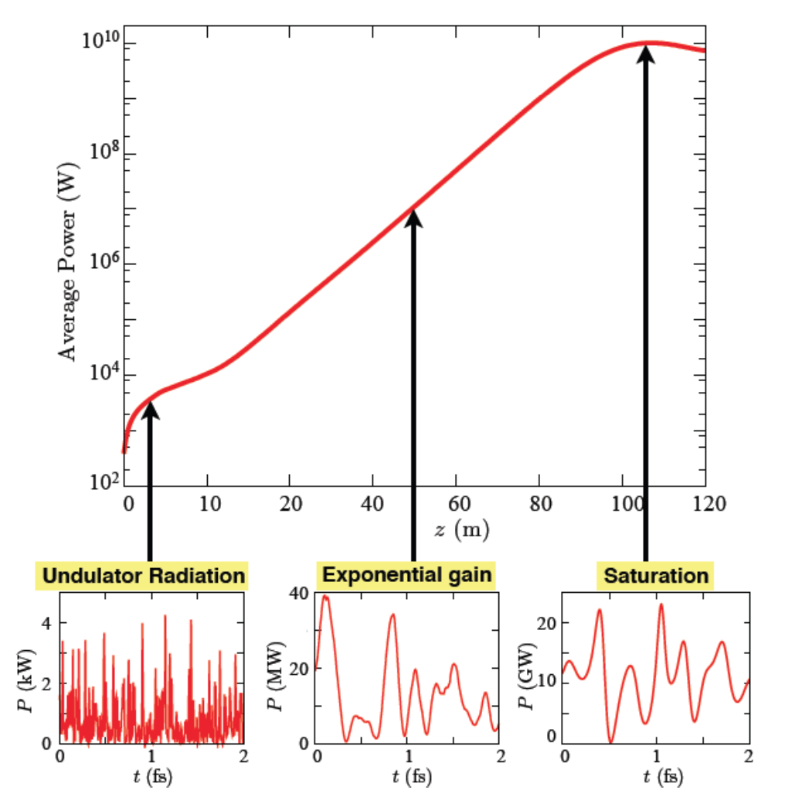
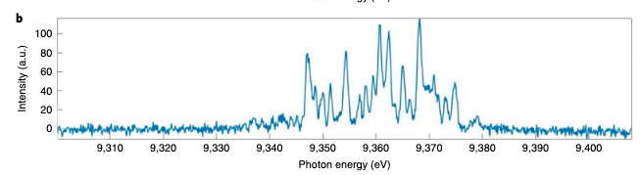
Self Amplified Spontaneous Emission (SASE)
Evolution of average power and spectrum along the undulator from spontaneous radiation to FEL amplified radiation
X-ray emission
Output power: several of GW
Pulse duration: tens of fs
Spectral bandwidth: 10⁻³
High degree of transverse coherence
Limited longitudinal coherence
Strong shot-to-shot fluctuations
XFEL,Hamburg (Germany)
W. Decking et al. Nat. Photon. (2020)

Slide 30
SASE Spectral and Temporal Performances
Temporal profile
Spectral profile
W. Ackermann et al., Nature, 2007

Slide 31
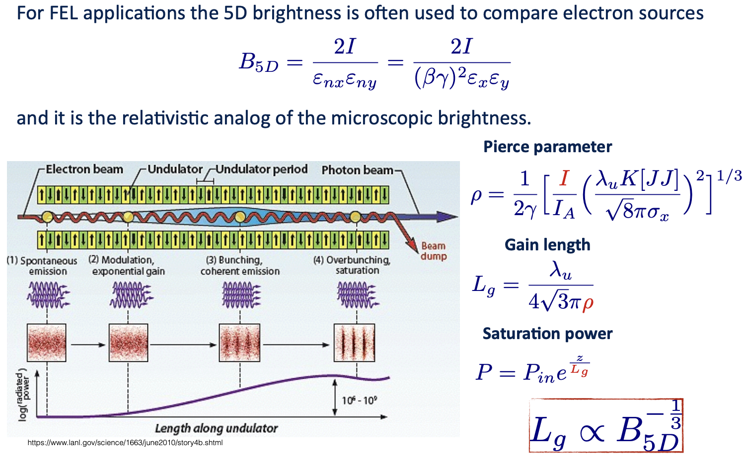
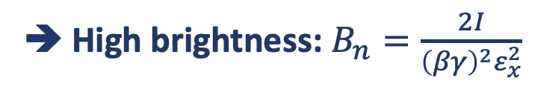
High Brightness Electron Beams
➔ High brightness: $B_{n}=\frac{2I}{{\left(βγ\right)}^{2}ε_{x}^{2}}$

Slide 32
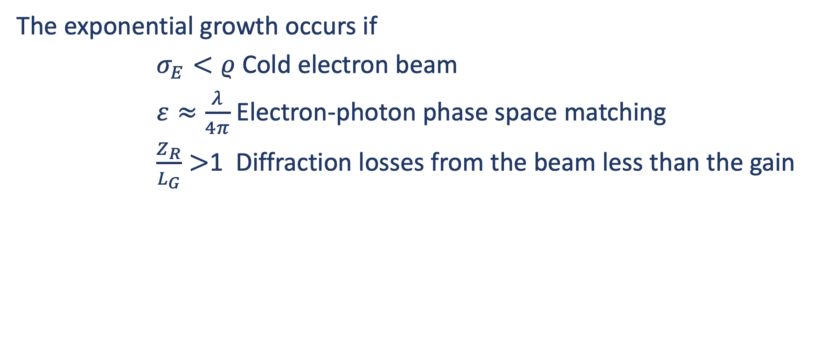
Electron Beam Quality Conditions
The exponential growth occurs if
$σ_{E}<ρ$ Cold electron beam
$ε≈\frac{λ}{4π}$ Electron-photon phase space matching
$\frac{Z_{R}}{L_{G}}>$1 Diffraction losses from the beam less than the gain

Slide 33
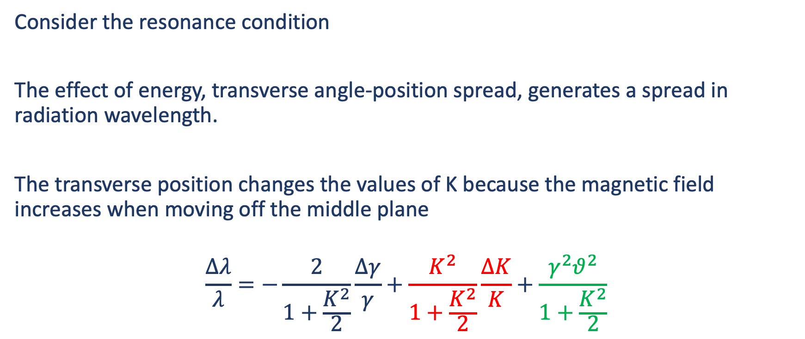
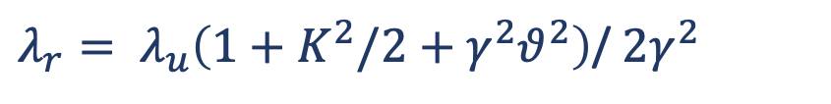
Effect of finite beam brightness on undulator radiation
$λ_{r}= λ_{u}\left(1+K^{2}/2+γ^{2}θ^{2}\right)$/ $2γ^{2}$
Consider the resonance condition
The effect of energy, transverse angle-position spread, generates a spread in radiation wavelength.
The transverse position changes the values of K because the magnetic field increases when moving off the middle plane
$$\frac{∆λ}{λ}=−\frac{2}{1+\frac{K^{2}}{2}}\frac{Δγ}{γ}+\frac{K^{2}}{1+\frac{K^{2}}{2}}\frac{ΔK}{K}+\frac{γ^{2}θ^{2}}{1+\frac{K^{2}}{2}}$$
Energy spread due to angle disribution
Energy spread due to transverse position

Slide 34
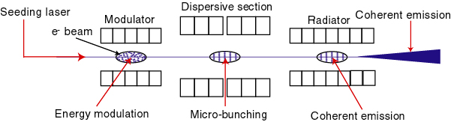
Overcome SASE Limits
Use an external coherent seeding signal, instead of spontaneous emission, to generate electron bunching
  ➔ Seeded harmonic generation scheme
λ_{s}
λ_{s}/n
e⁻ beam
Dispersive section
10⁹
Radiator
Power (W)
Distance along the undulator
Courtesy of L. Giannessi/G. De Ninno

Slide 35
Overcome SASE Limits
Use an external coherent seeding signal, instead of spontaneous emission, to generate electron bunching
  ➔ Seeded harmonic generation scheme
λ_{s}
λ_{s}/n
e⁻ beam
Radiator
Dispersive section
Temporal profile
Spectrum profile
σ _{t}~ 50 fs
Power (arb. units)
Pow. Spec. (arb. units)
Courtesy of L. Giannessi/G. De Ninno
z (μm)
Wavelength (nm)

Slide 36
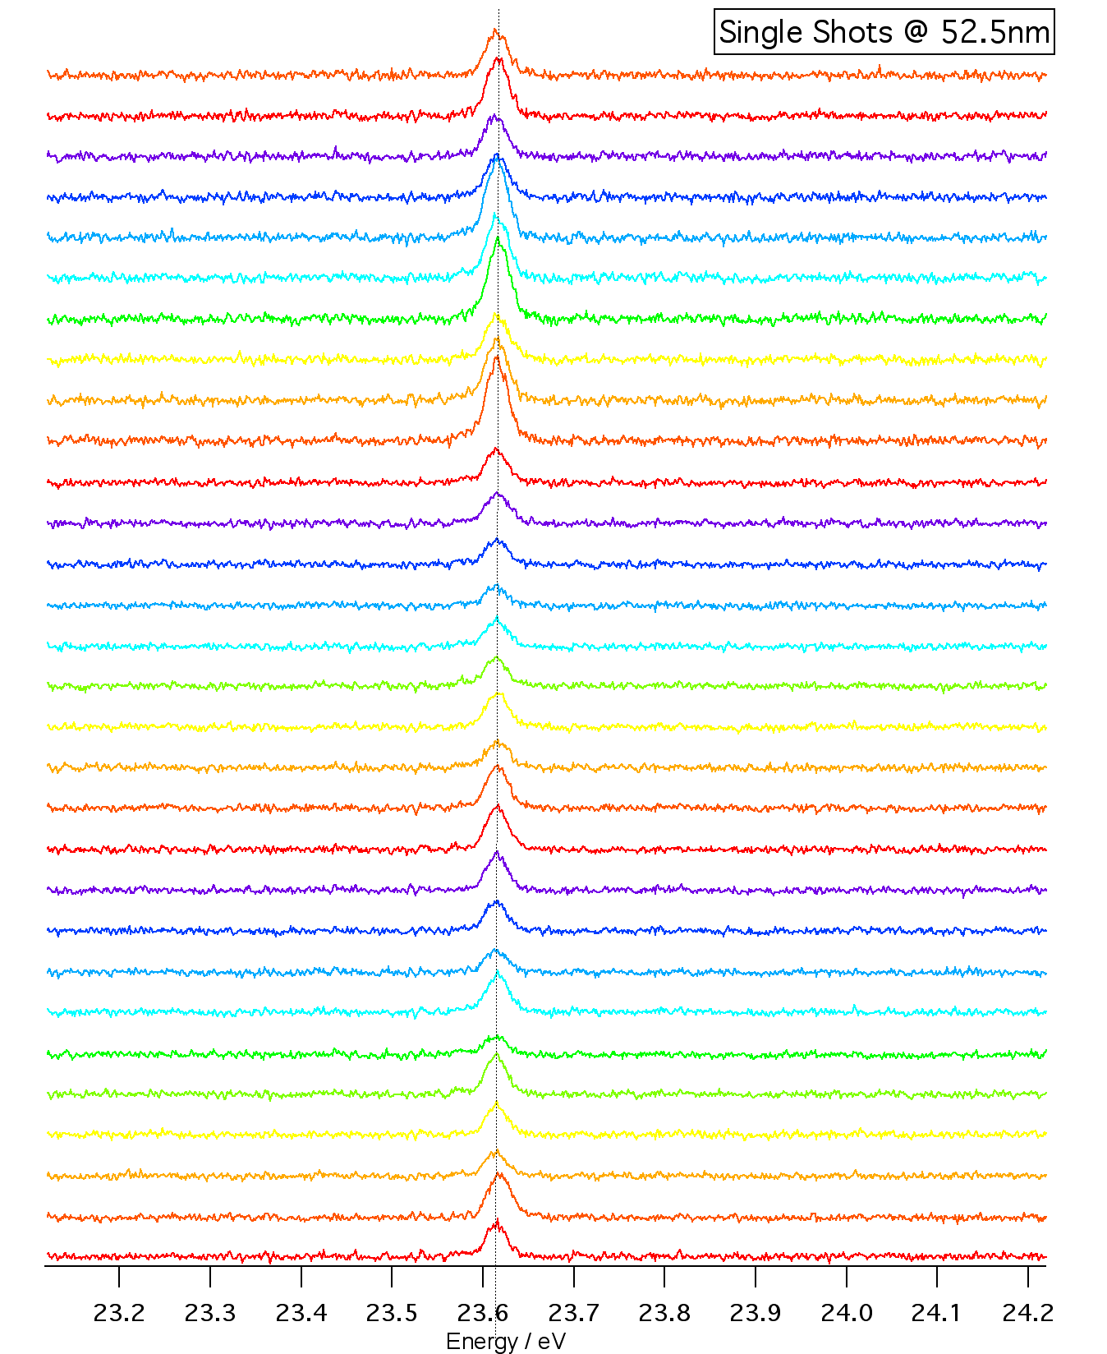
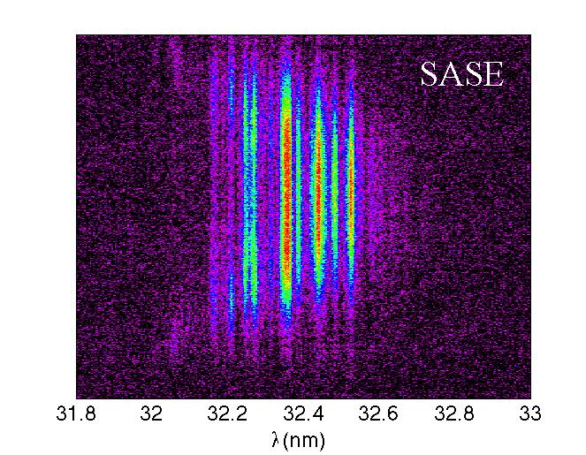
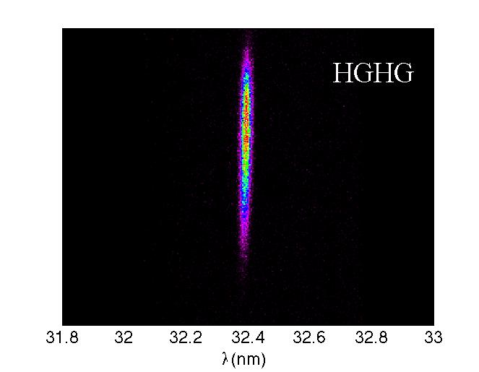
Spectral Bandwidth
32.4 nm
FERMI FEL operated in SASE and HGHG mode
32.4 nm
Spectral peak jitter: < 1 part in 10⁴
Spectral width: 0.1%
Courtesy of L. Giannessi/G. De Ninno

Slide 37
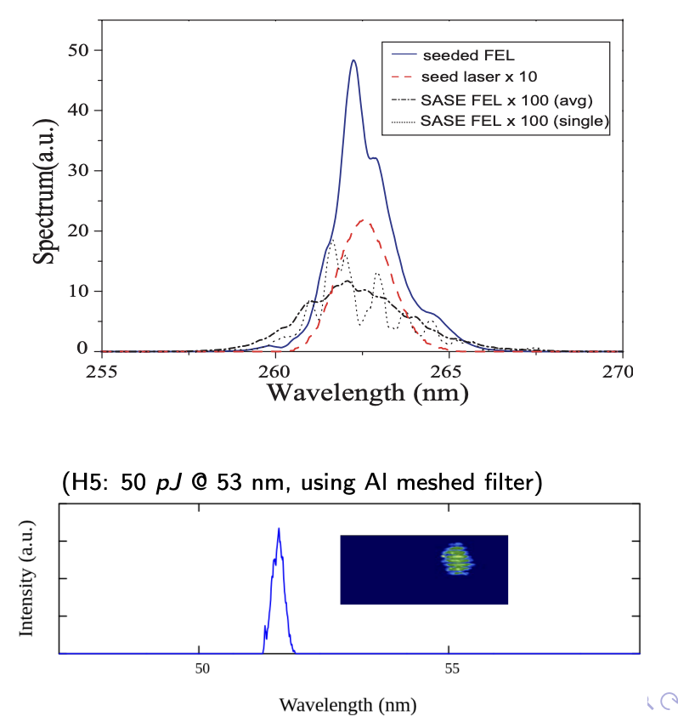
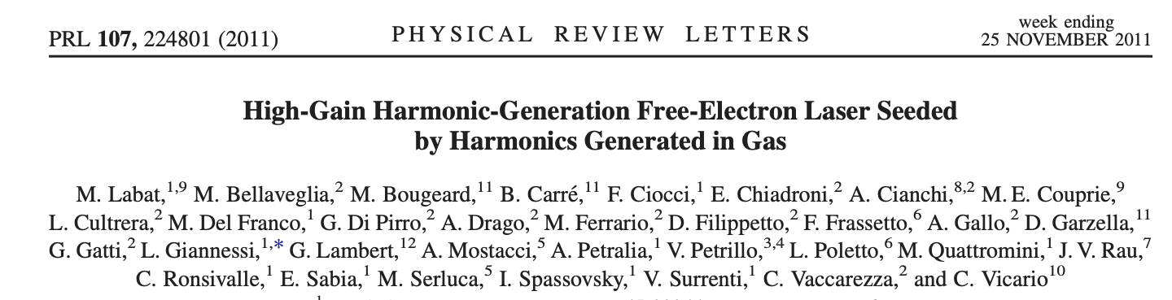
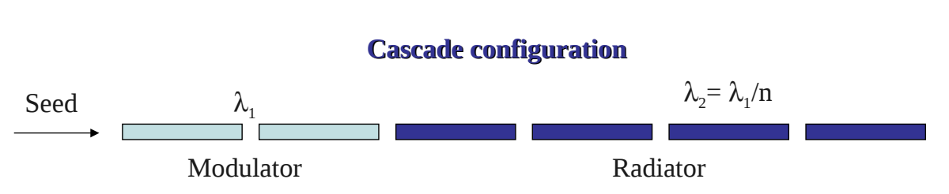
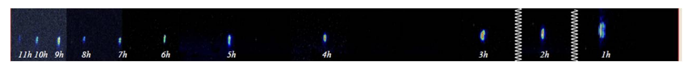
First demonstration at SPARC_LAB

Slide 38
Compact Short Wavelength FELs
5th generation light sources
Bridge gap between advanced accelerator concepts and FEL physics
  Plasma, Dielectric, IFEL, …
  High Brightness Beams required
  ➔ EuPRAXIA is a candidate!
4th generation → XFELs

Slide 39
Conclusions
High brightness electron sources have played an enabling role in the development of X-ray FELs
Electron source development remains one of the major challenges for future FEL-based light sources
XFEL radiation represents the most powerful and multi-disciplinary modern probes for the study of the structure of matter in fields as diverse as physics, chemistry, biology, material science, earth sciences, environmental sciences, and cultural artifact restoration
X-rays have the uniquely useful properties that they are partially transparent to solid objects allowing that inner architecture to be investigated, while their wavelengths are comparable to typical interatomic distances and can, moreover, be tuned to be resonant with electron binding energies in atoms
Advanced accelerator concepts can enable compact XFELs moving towards more compact and sustainable user facilities

Slide 40
References
G. De Ninno, Free-electron lasers: How do they work, Tutorial at IPAC2023
Z. Huang and K.J. Kim, USPAS course, FEL lecture notes, …
A. Marinelli and C. Pellegrini, Tutorial: Introduction to Free-Electron Laser Theory
G. Robb, Classical and Quantum Free Electron Laser, Talk
J. B. Murphy and C. Pellegrini, Introduction to the Physics of the Free Electron Laser, Laser Handbook, vol. 6 p. 9-69 (1990)

Slide 41
Thank You all for the attention!

Slide 43


