Slide 1
EuPRAXIA
Carsten P Welsch, INFN & Cockcroft Institute/U Liverpool
EuPRAXIA-DN School on Plasma Accelerators
Many slides courtesy R Assmann and M Ferrario

Slide 2
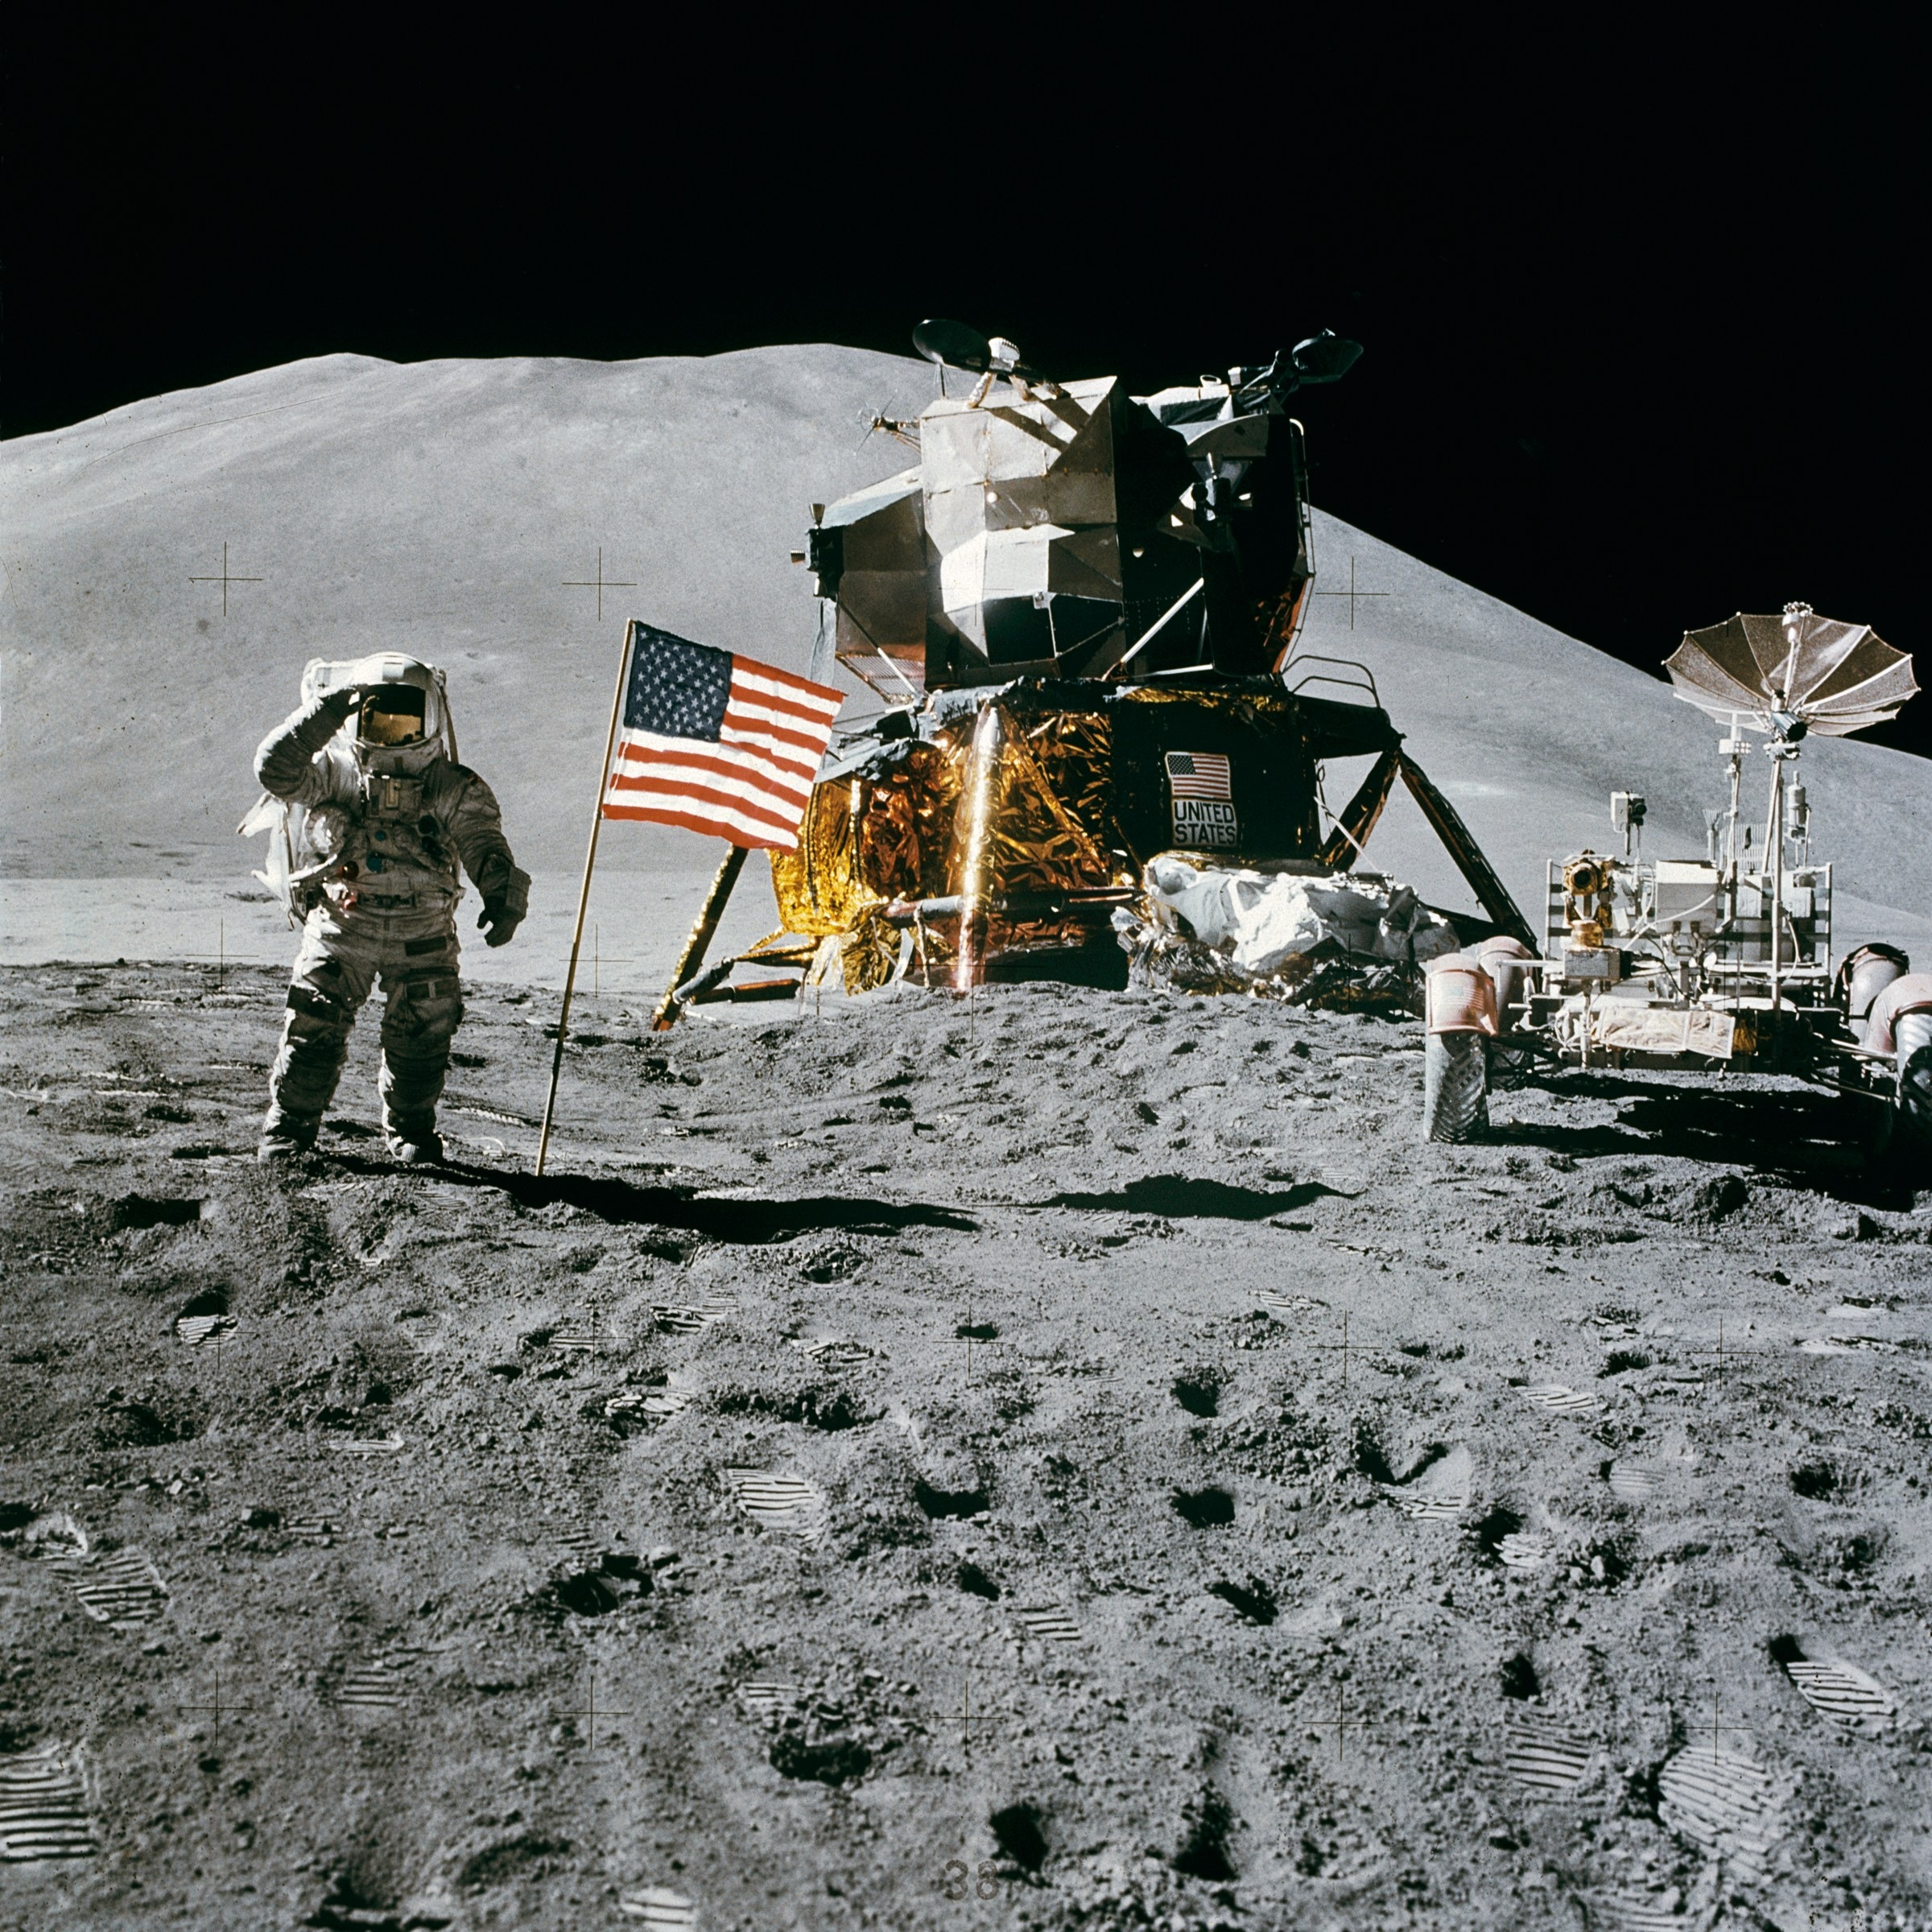
This nation should commit itself to achieve the goal, before this decade is out, of landing a man on the moon and returning him safely to earth.
J.F. Kennedy

Slide 3
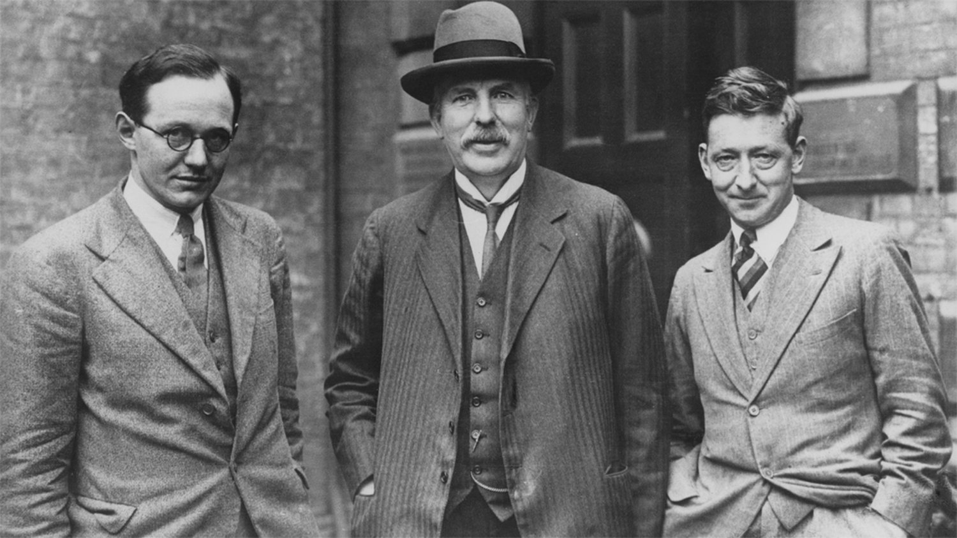
What we require is an apparatus to give us a potential of the order of 10 million volts which can be safely accommodated in a reasonably sized room and operated by a few kilowatts of power. We require too an exhausted tube capable of withstanding this voltage. (…) I see no reason why such a requirement cannot be made practical.
Long-term vision
World’s first accelerator for science

Slide 4

What we require is the design and construction of a laser capable of delivering pulses with a duration of 100 femtoseconds and an energy of 100 joules, at a repetition rate up to 100 Hertz and a user facility build around this technology in the next decade.
EuPRAXIA
Accelerating Innovation

Slide 5


Slide 6
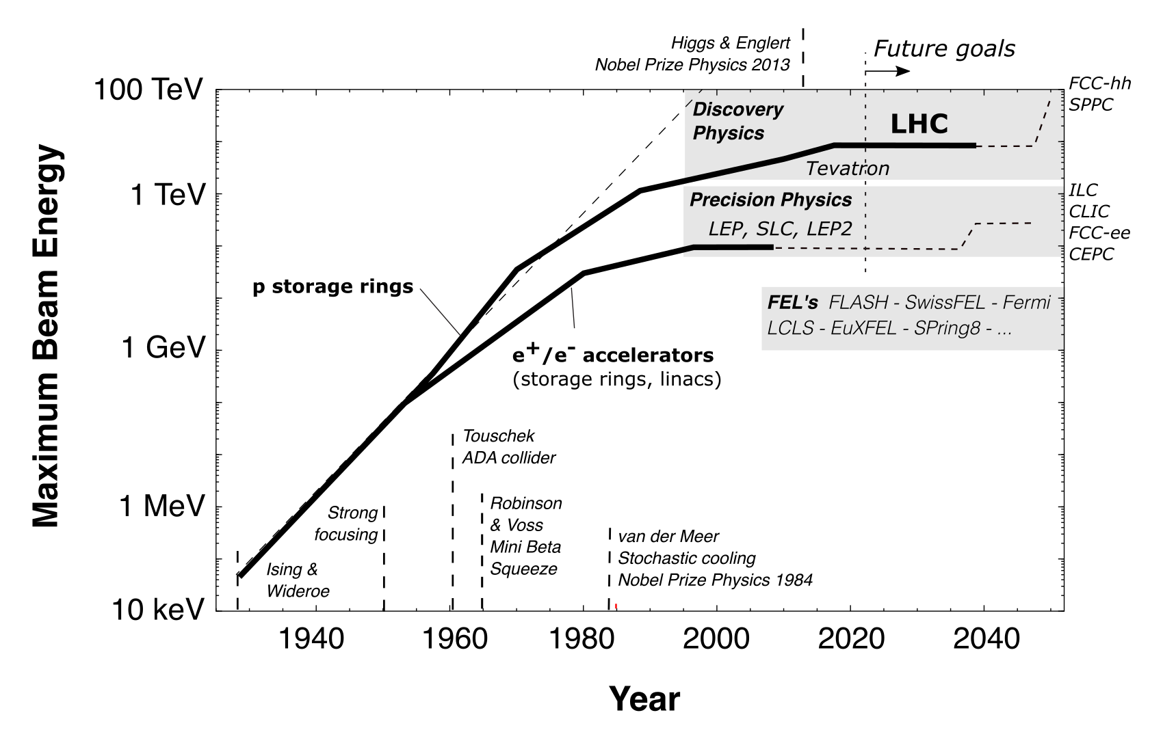
Progress in Particle Accelerators: Limits

Slide 7
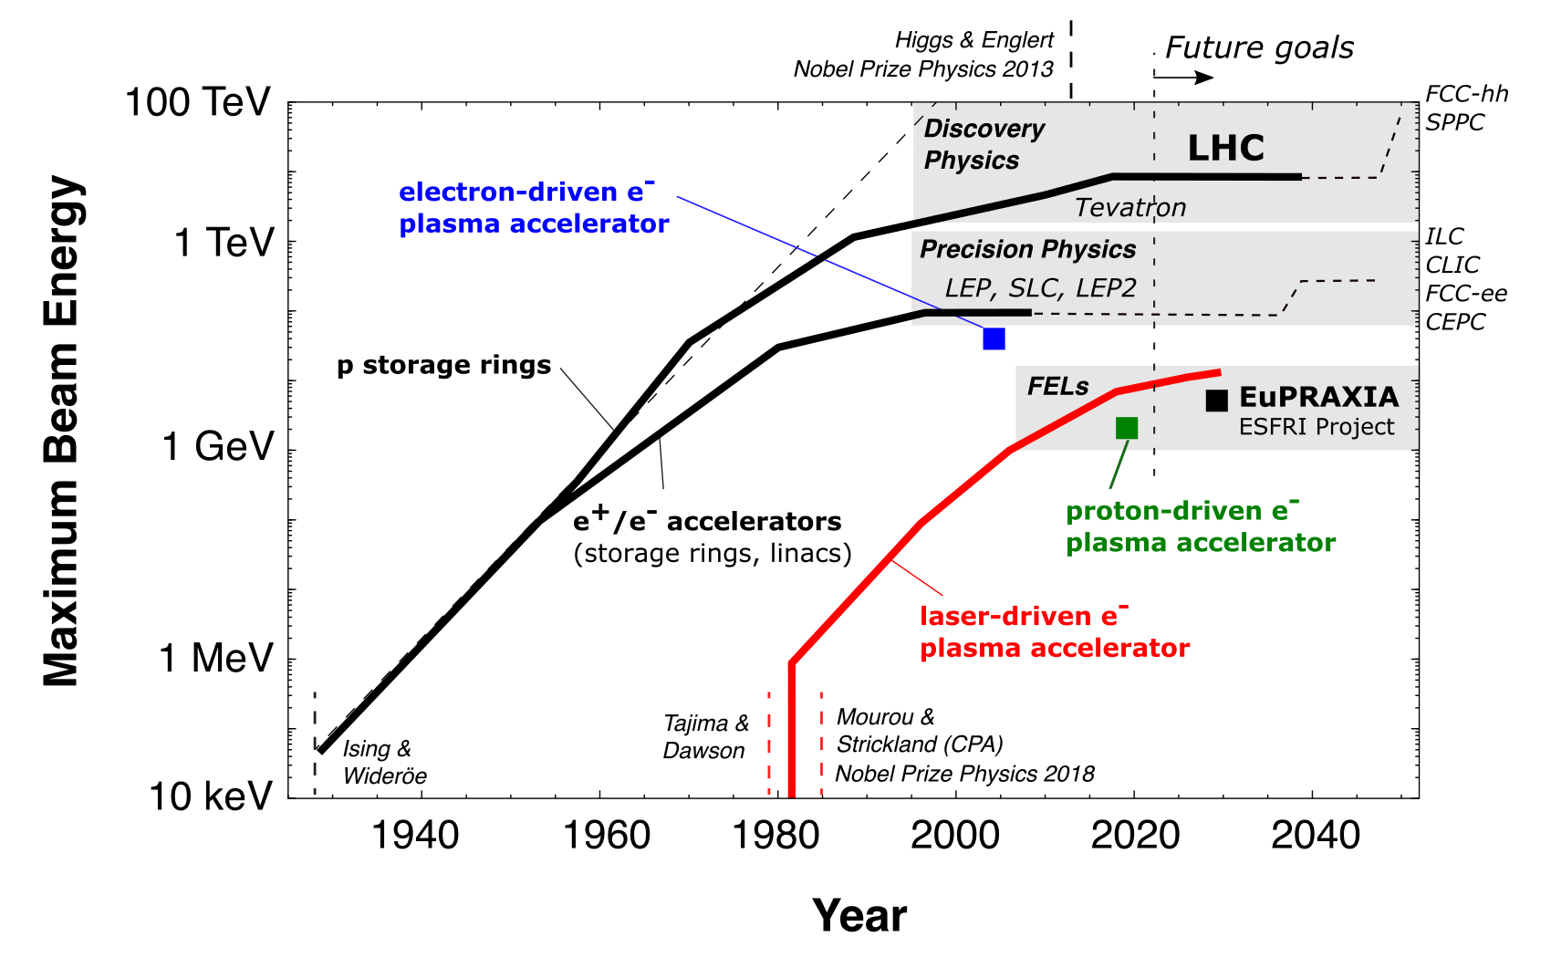
Progress in Particle Accelerators: Potential

Slide 8
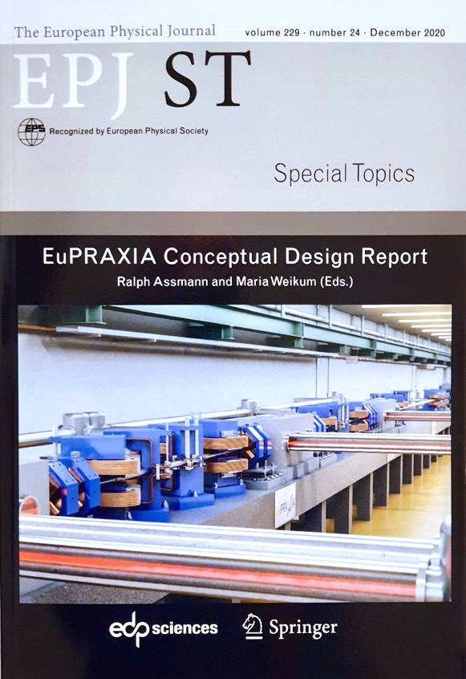
The EuPRAXIA Project
First ever design of a plasma accelerator facility.
Conceptual Design Report for a distributed research infrastructure funded by EU Horizon2020 program. Completed by 16+25 institutes.
Challenges addressed by EuPRAXIA since 2015:
  Can plasma accelerators produce usable electron beams?
  For what can we use those beams while we increase the beam energy towards HEP and collider usages?
Next phase consortium: > 50 institutes
Preparatory Phase project: 2022 – 2026 (approved)
Start of 1st operation: 2028
http://www.eupraxia-project.eu
600+ page CDR, 240 scientists contributed

Slide 9
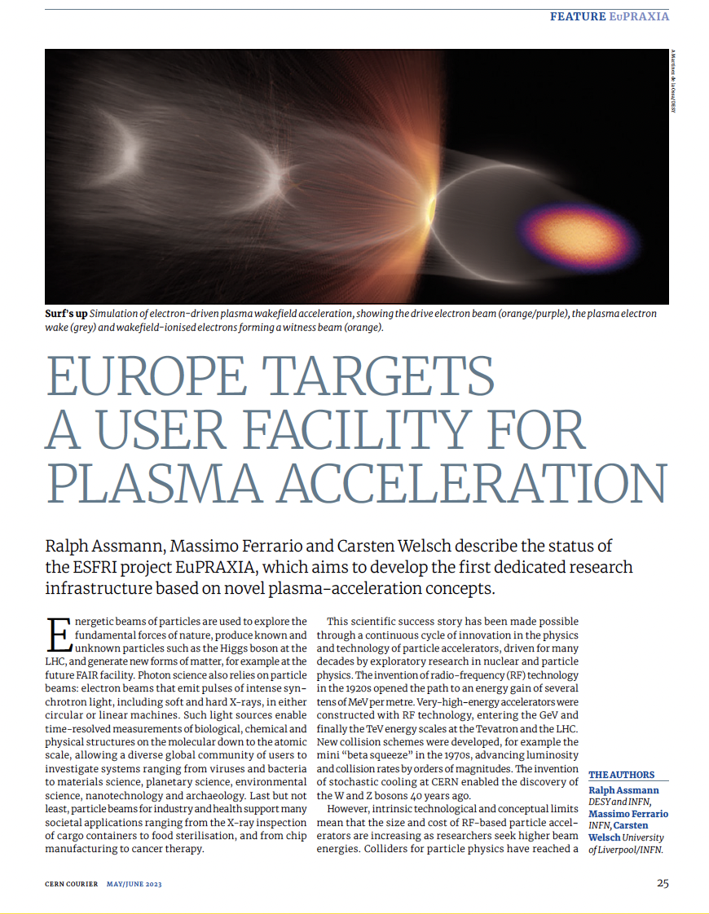
A New European High-Tech User Facility
Building a facility with very high field plasma accelerators, driven by lasers or beams
1 – 100 GV/m accelerating field
Shrink down the facility size
Improve Sustainability
1
Producing particles and photons to support several urgent and timely science cases
Drive short wavelength FEL
Pave the way for future Linear Colliders
2
https://www.eupraxia-facility.org

Slide 10
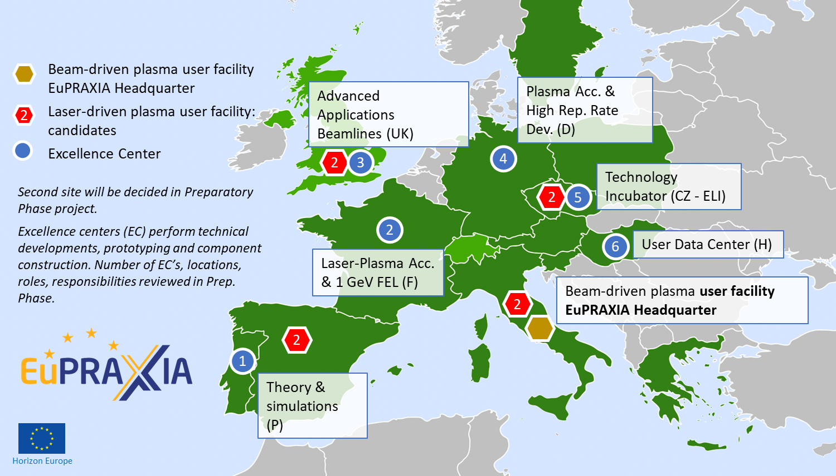
Distributed Research Infrastructure

Slide 11
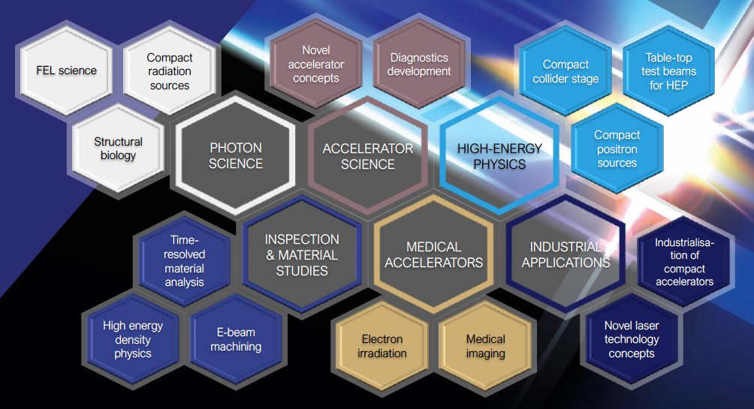
Intense R&D Program on critical components
Electrons
(0.1-5 GeV, 30 pC)
Positrons
(0.5-10 MeV, 10⁶)
Positrons (GeV source)
Lasers
(100 J, 50 fs, 10-100 Hz)
X-band RF Linac
(60 MV/m , up to 400 Hz)
Plasma Targets
Betatron X rays
(1-10 keV, 10¹⁰)
FEL light
(0.2-36 nm, 10⁹-10¹³)

Slide 12
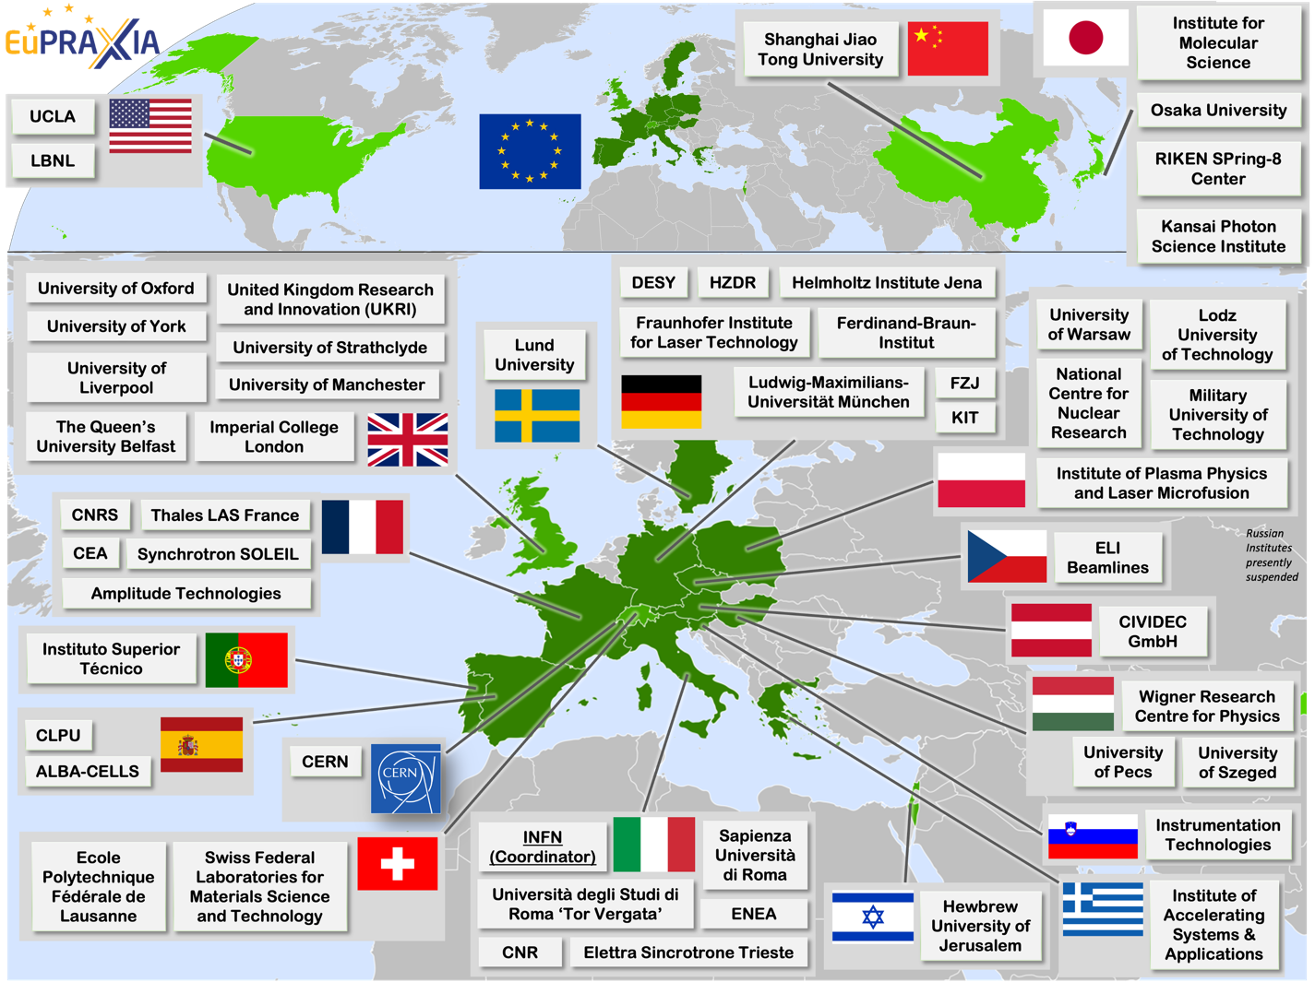
International Collaboration
The EuPRAXIA Consortium today: 54 institutes from 18 countries plus CERN
Included in the ESFRI Road Map
Very efficient in fund raising:
  Preparatory Phase consortium (funding EU, UK, Switzerland, in-kind)
  Doctoral Network (funding EU, UK, in-kind)
  EuPRAXIA@SPARC_LAB (Italy, in-kind)
  EuAPS Project (Next Generation EU)

Slide 13
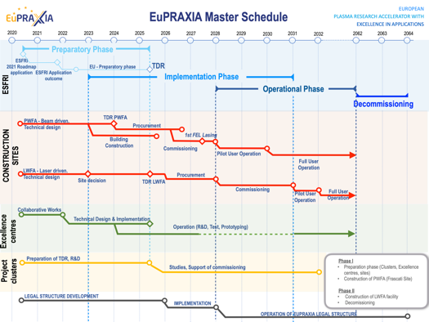
Preparatory Phase Main Goals
Managerial WP`s
  Outreach to public, users, EU decision makers and industry
  Define legal model (how is EuPRAXIA governed?), financial model, rules, user services and membership extension for full implementation
  Works with project bodies and funding agencies → Board of Financial Sponsors
Technical WP‘s (correspond to Project Clusters):
  Update of CDR concepts and parameters, towards technical design (full technical design requires more funding)
  Specify in detail Excellence Centers and their required funding: TDR related R&D, prototyping, contributions to construction
  Help in defining funding applications for various agencies
Clearly defined milestones & deliverables

Slide 14
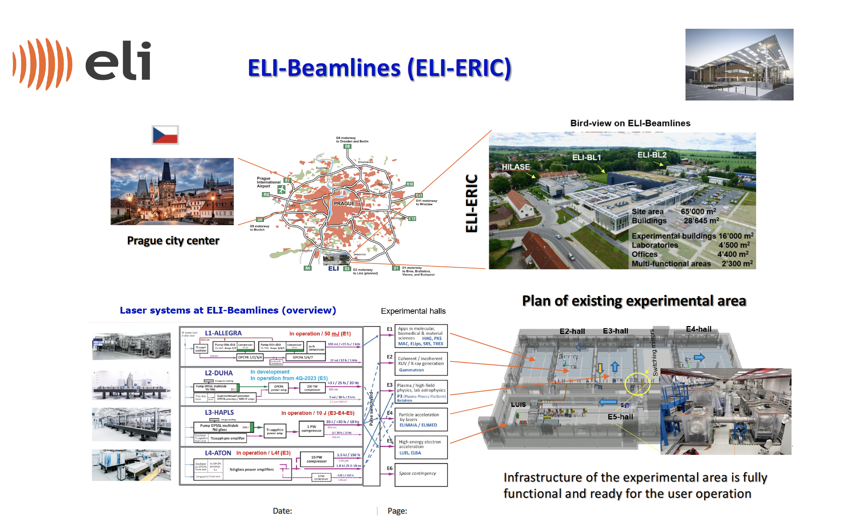
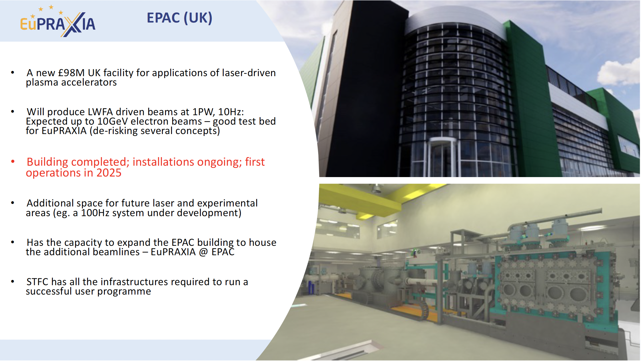
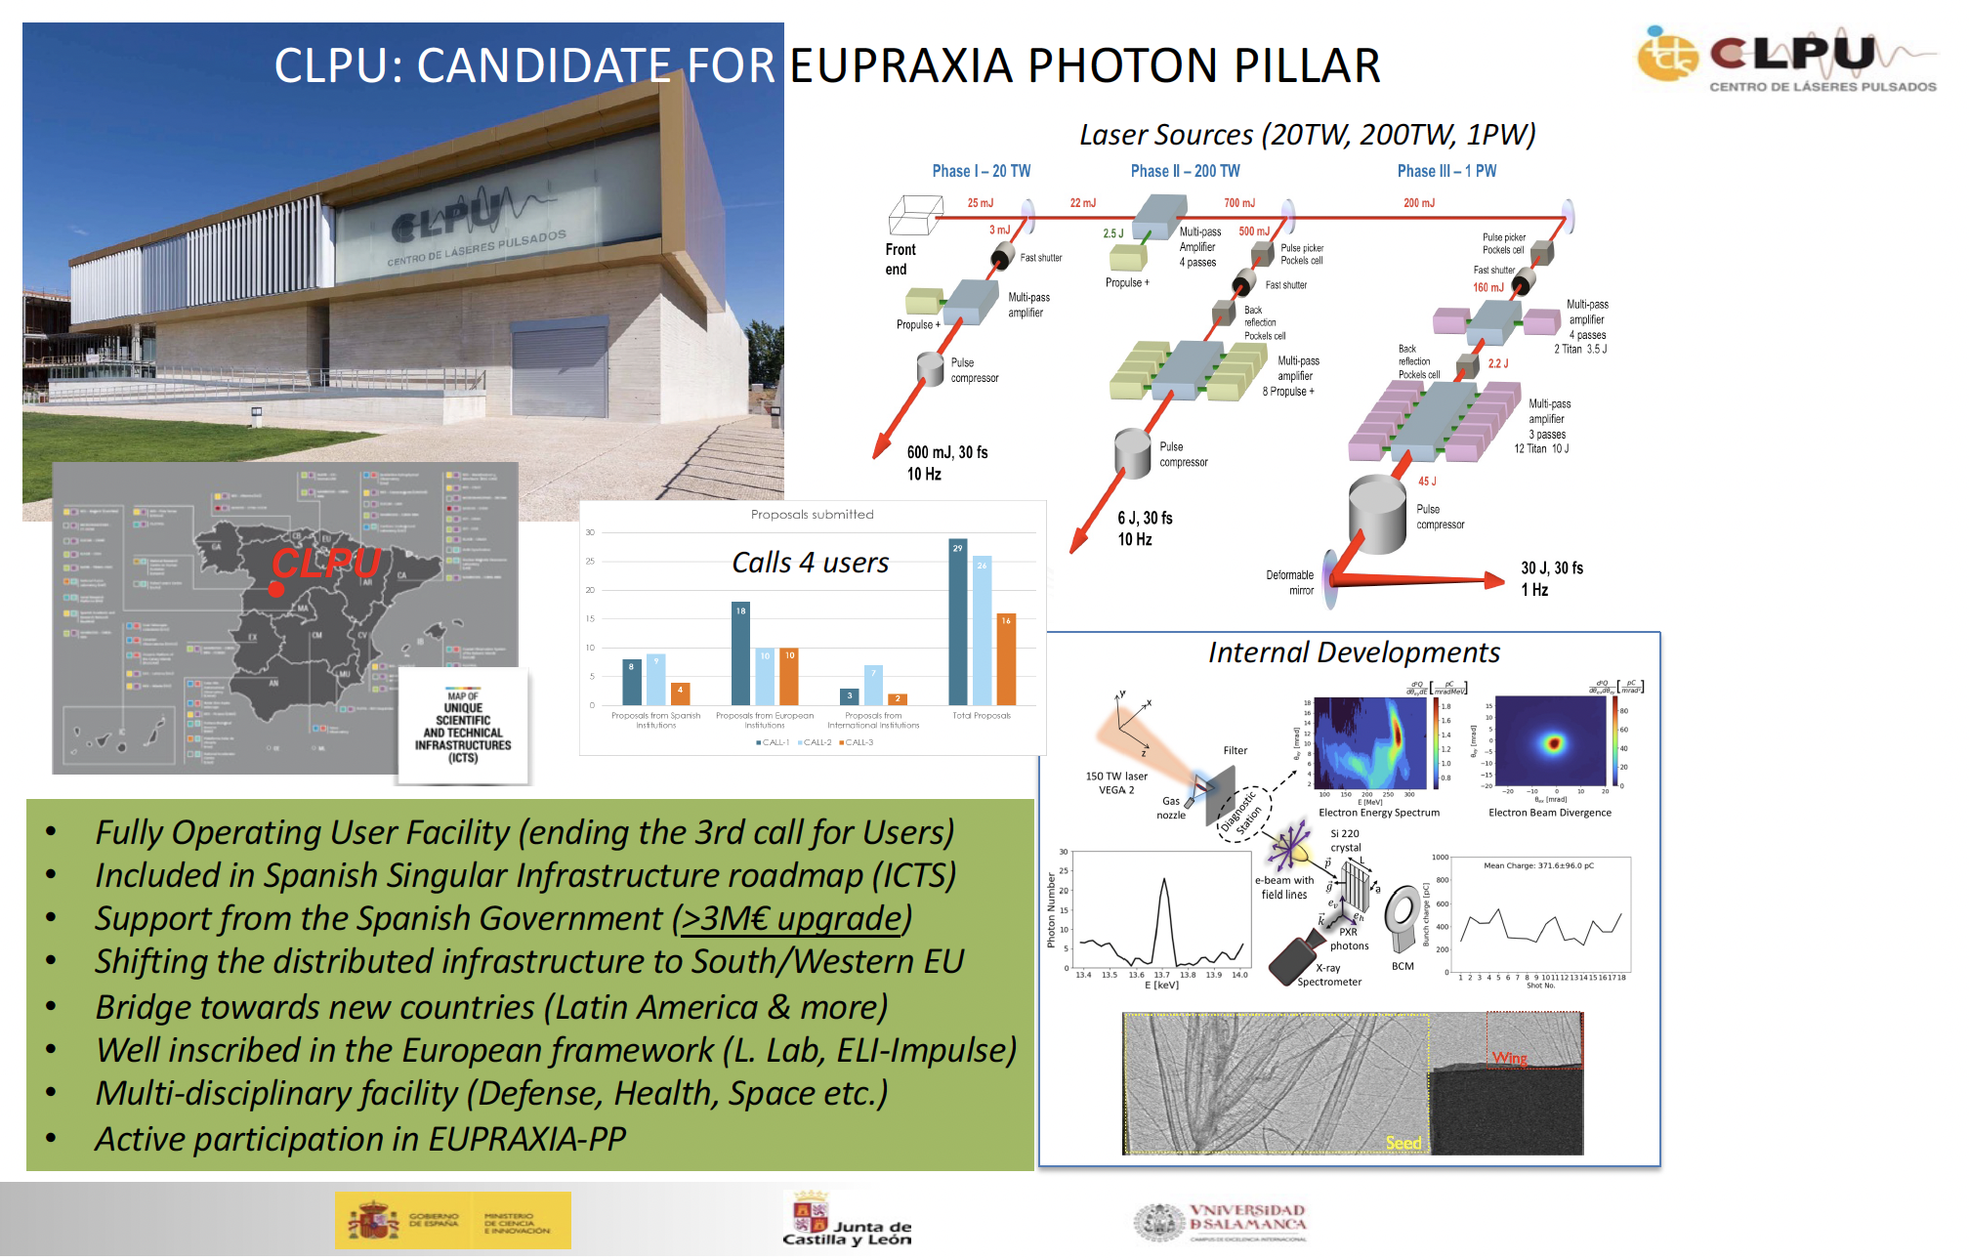
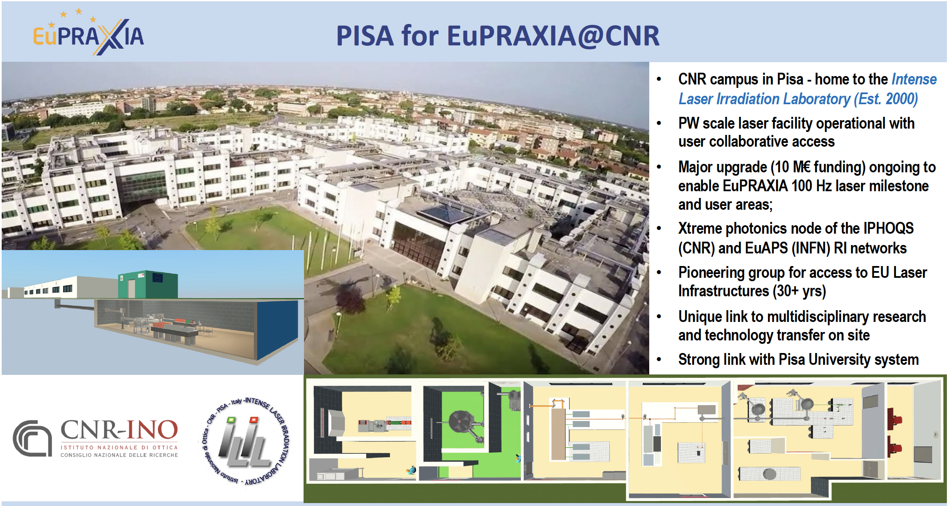
Candidates for EuPRAXIA Laser Site
Notes:
Maria

Slide 15
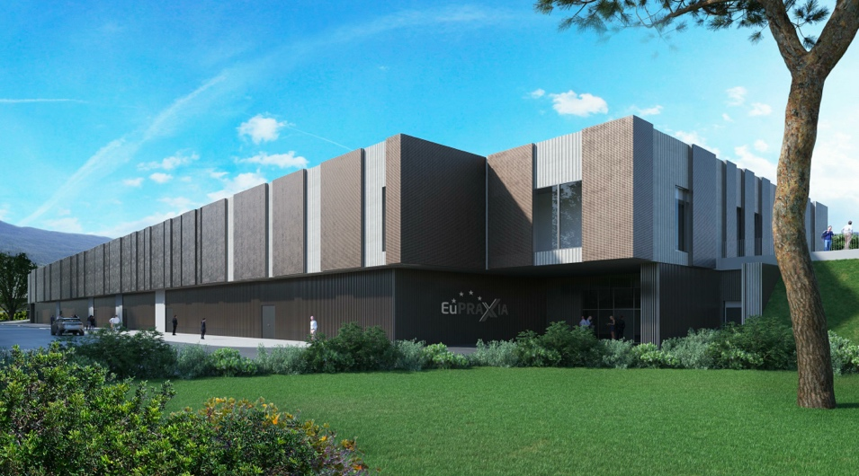
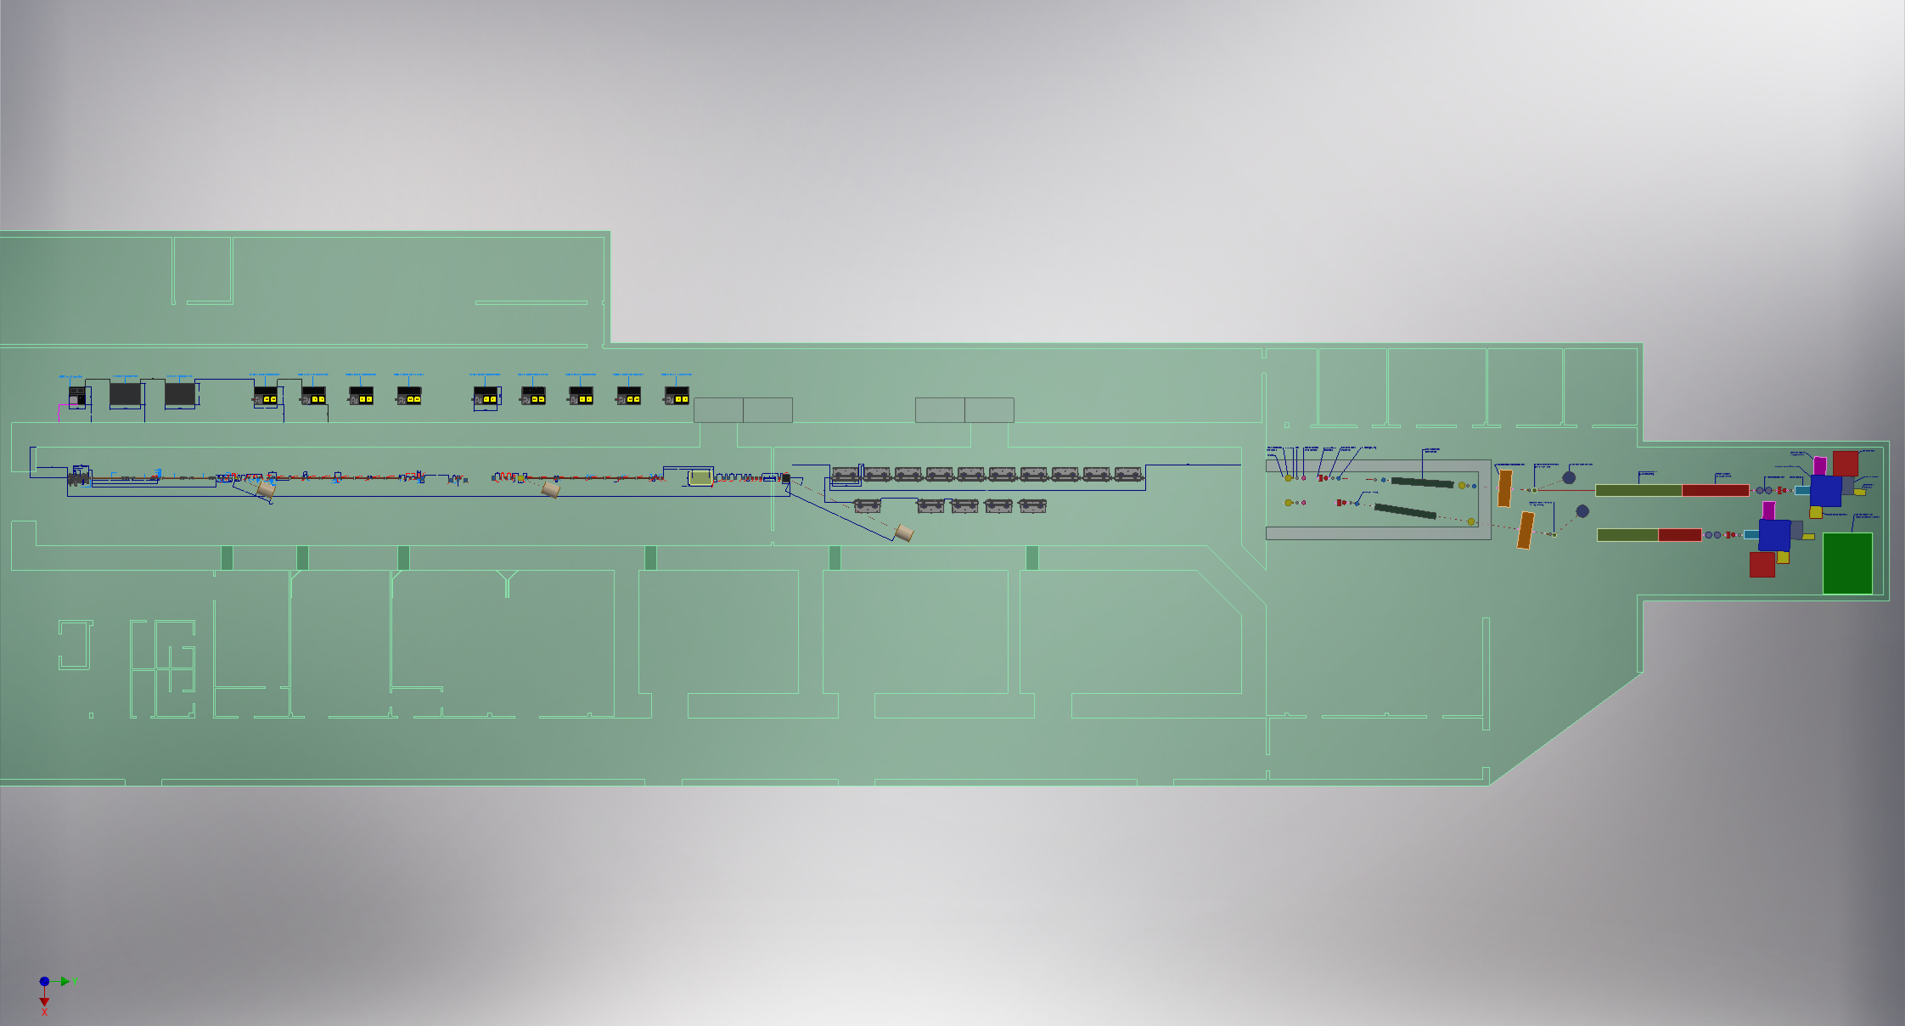
Headquarter and Site 1: EuPRAXIA@SPARC_LAB
Frascati`s future facility
> 130 M€ investment
Beam-driven plasma accelerator
Europe`s most compact and most southern FEL
The world`s most compact RF accelerator (X band with CERN)

Slide 16
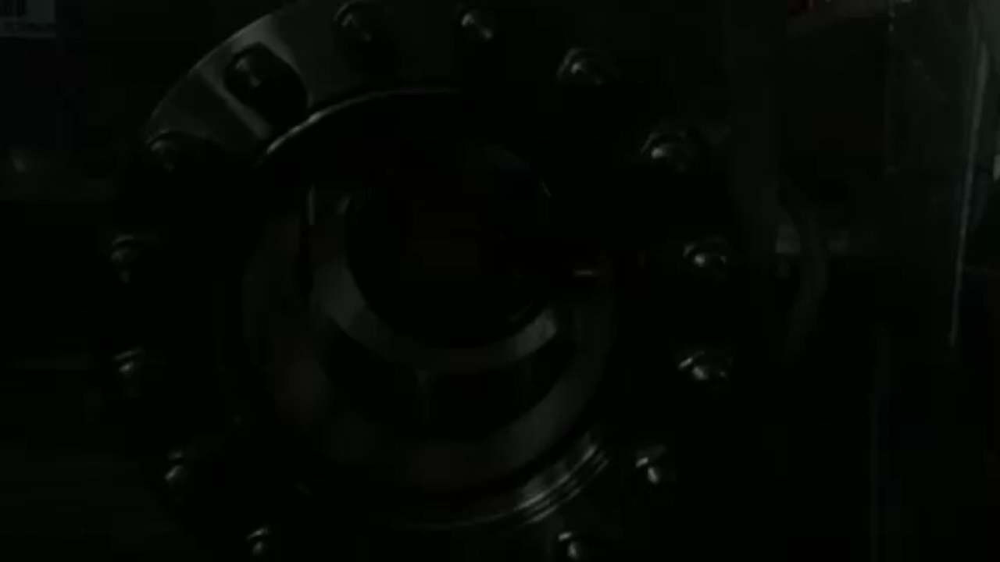
EuPRAXIA@SPARC_LAB
Undulators
1 GeV LINAC
Plasma module
RF power modules
FEL user area @4nm
Secondary
Sources
Beam user areas
0.5 PW Laser

Slide 17
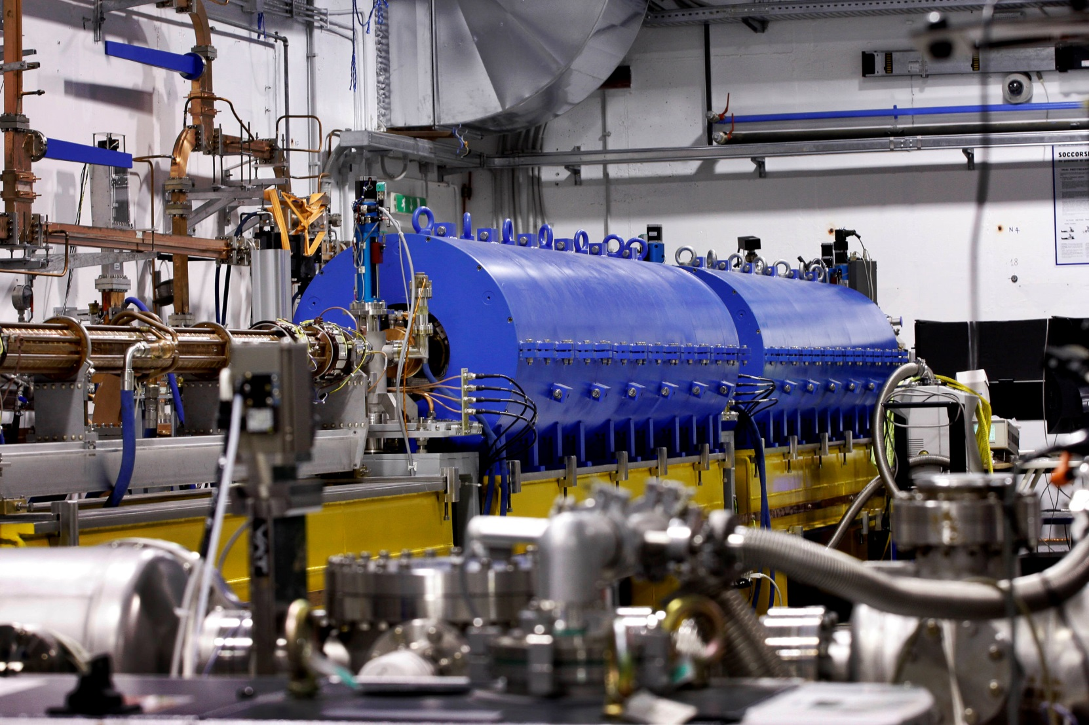
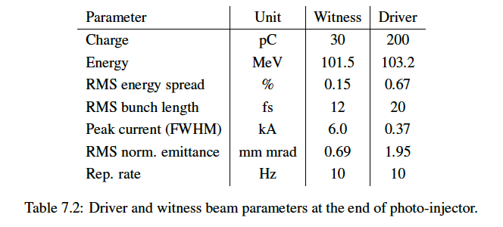
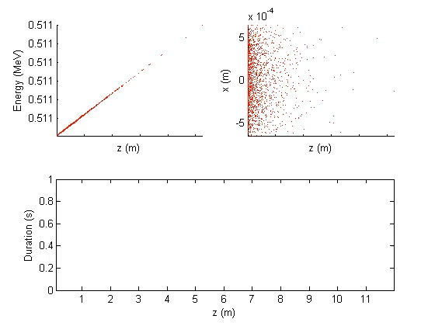
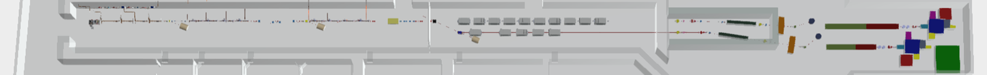
High Quality Electron Beams
10 m
Courtesy E. Chiadroni

Slide 18
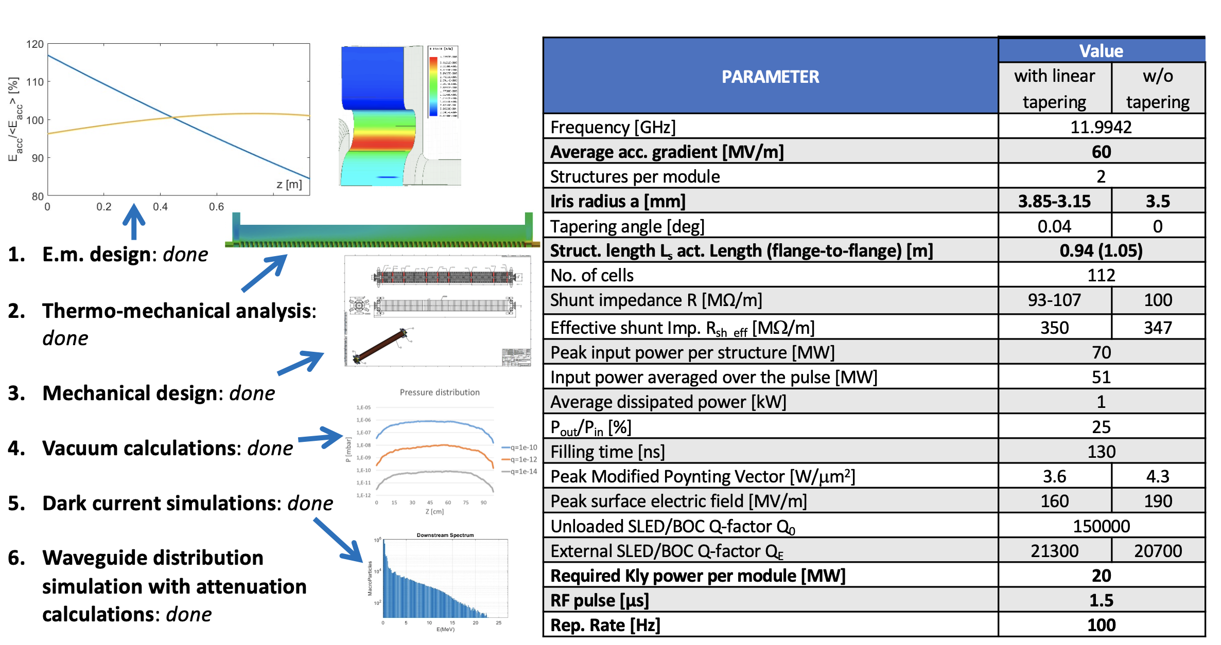
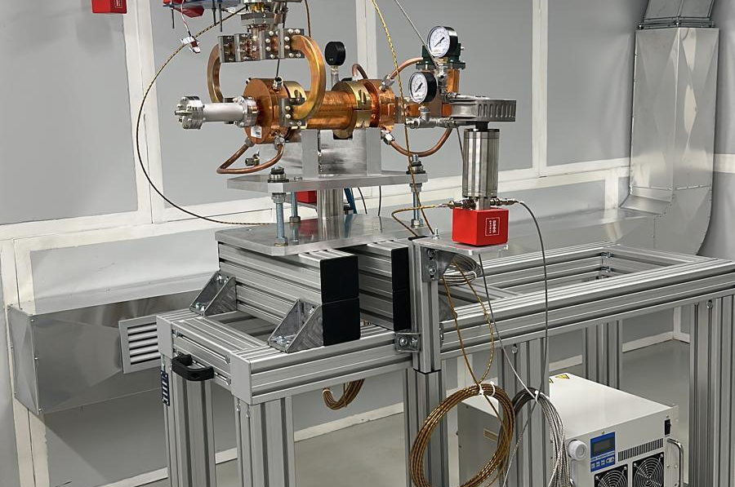
World`s Most Compact RF Linac: X Band
Courtesy D. Alesini
55 m

Slide 19
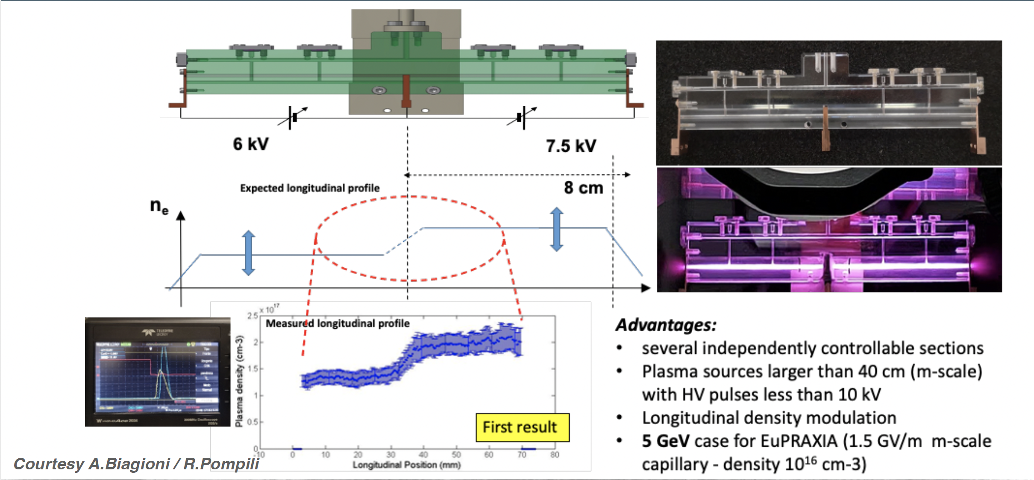
Plasma Module
3.5 m

Slide 20


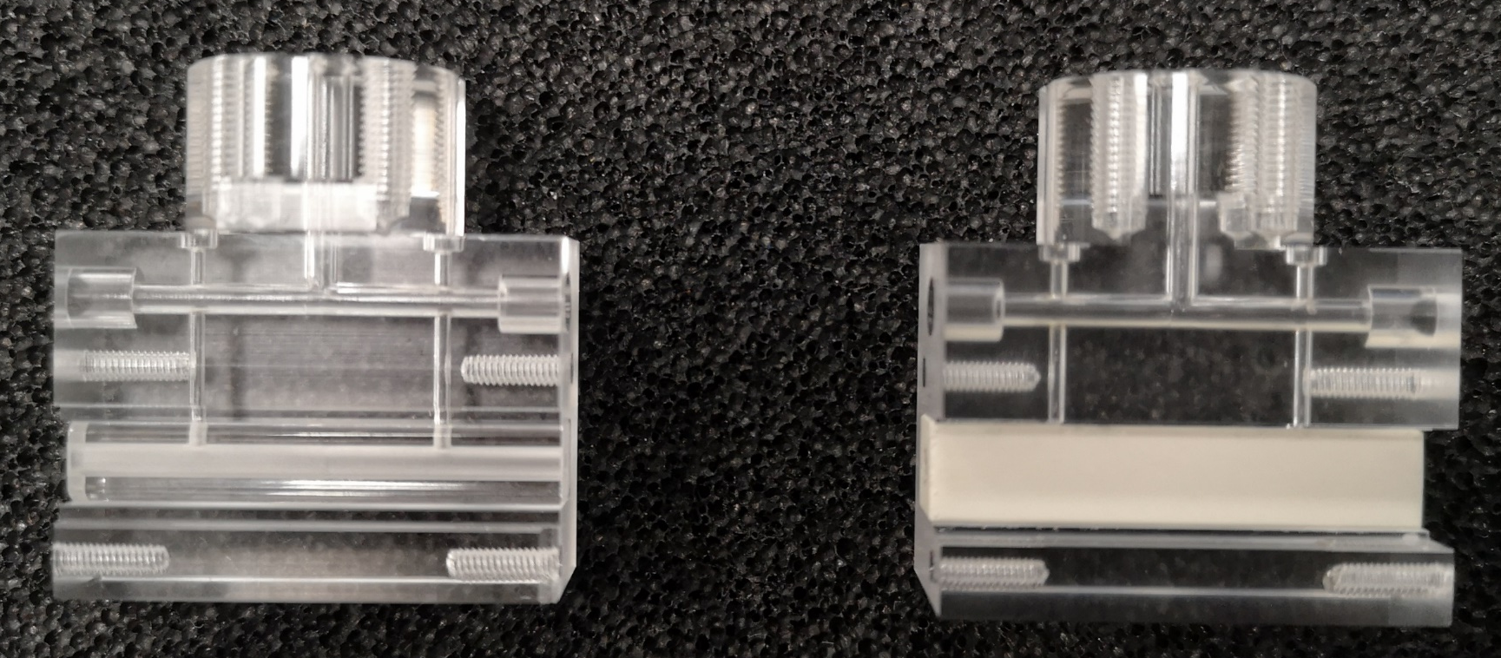
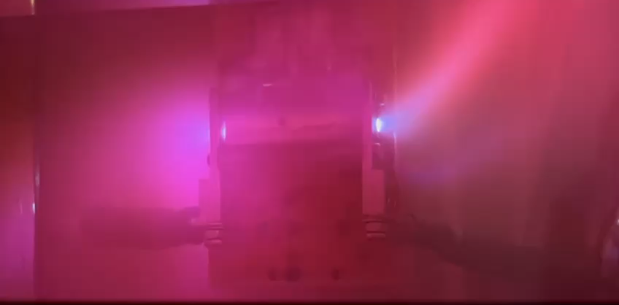
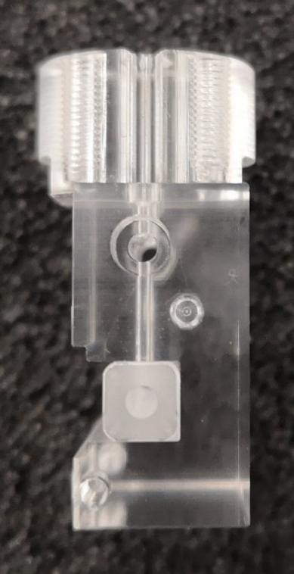
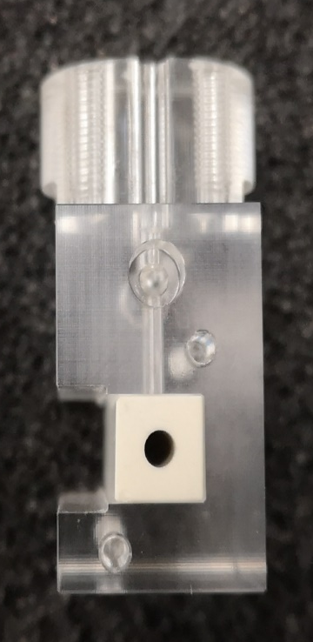
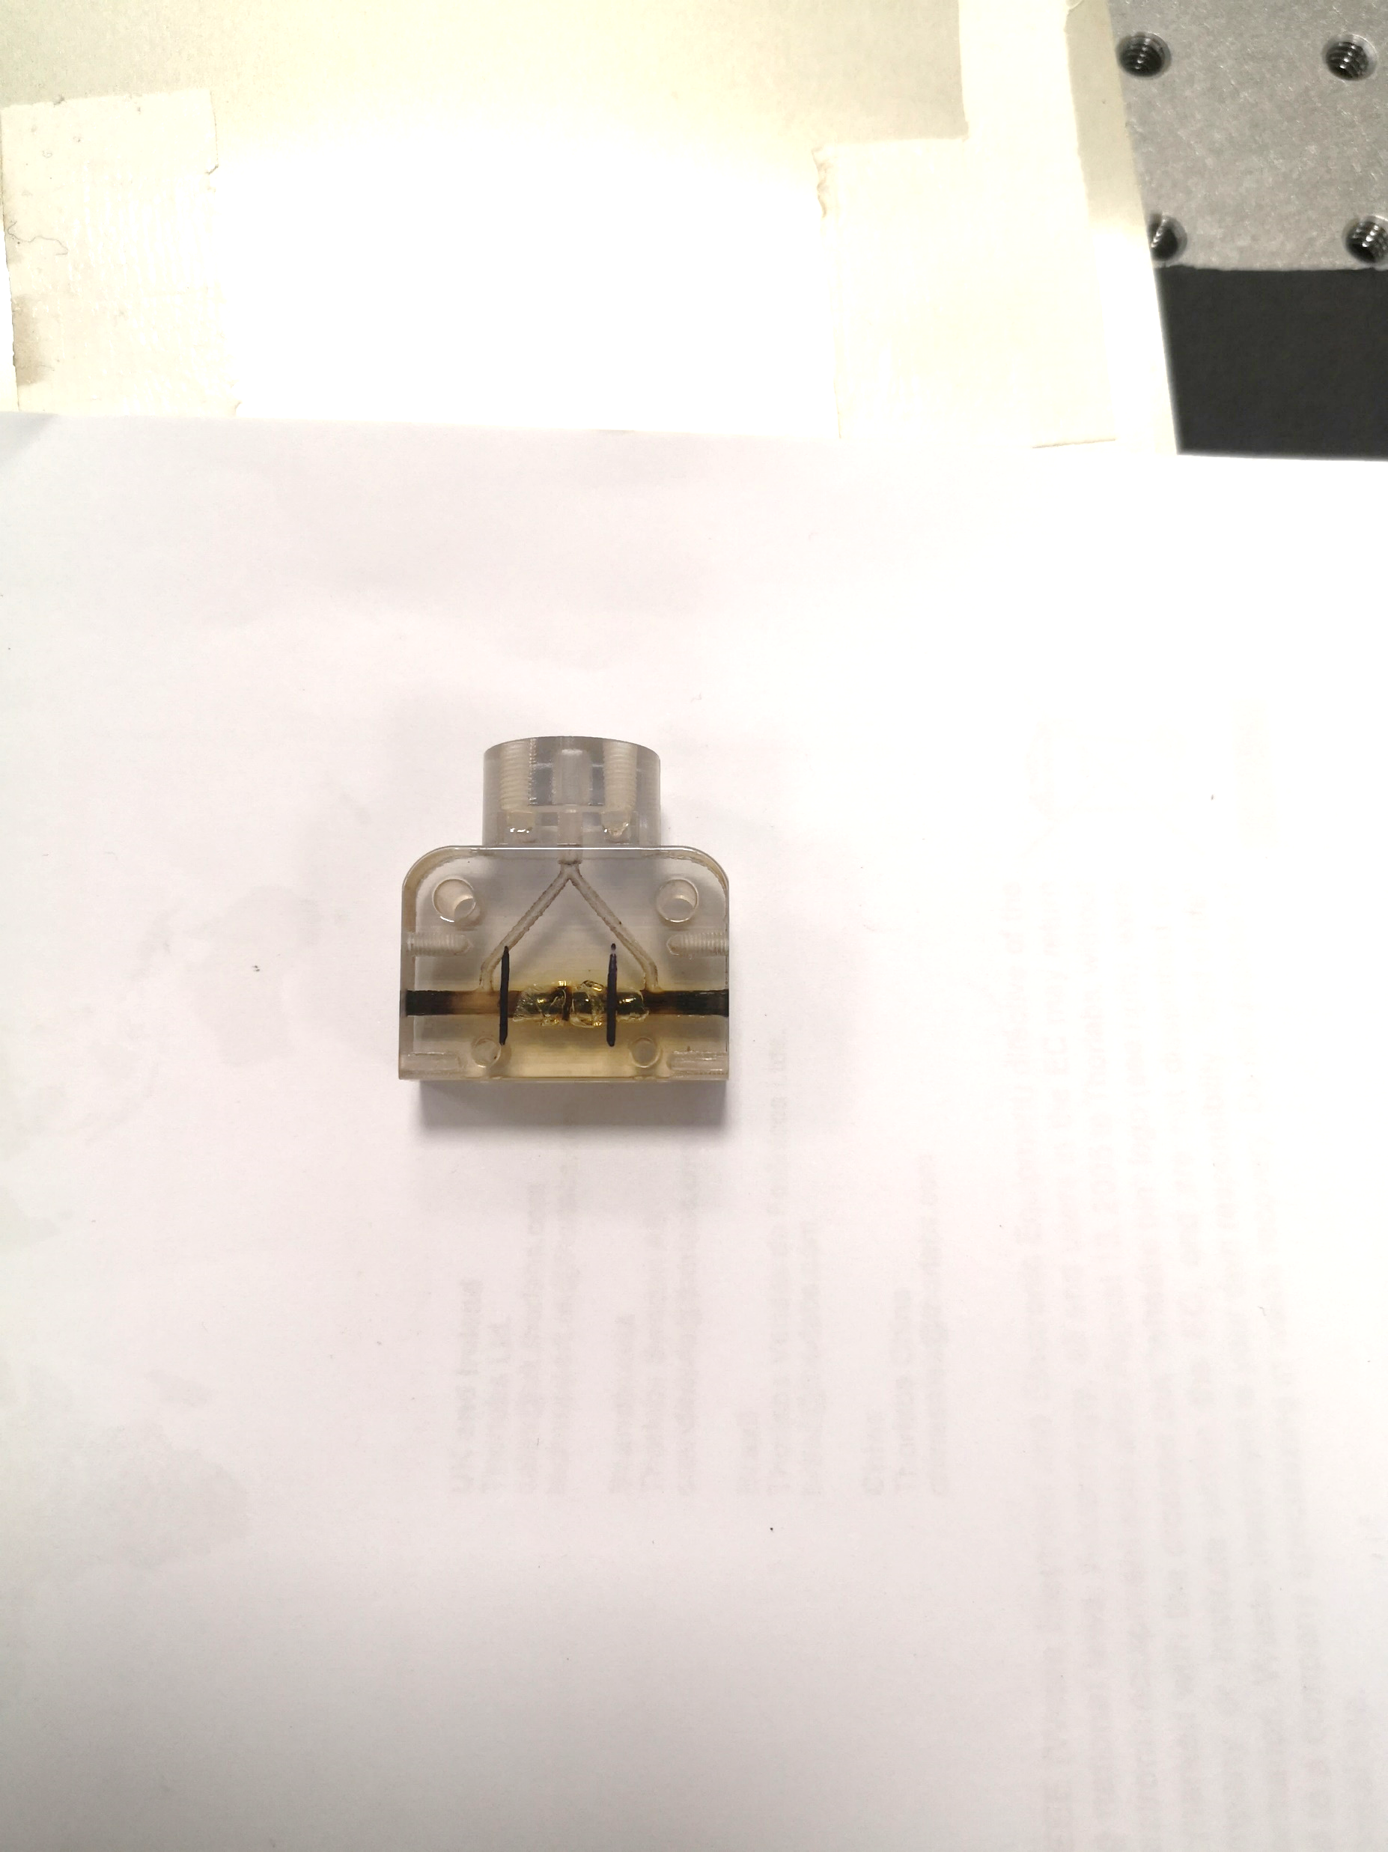
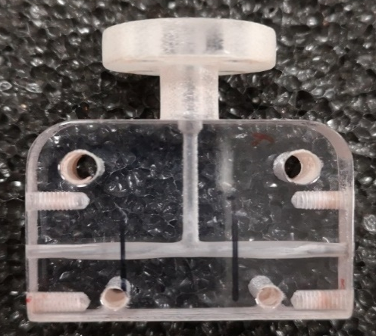
High repetition Rate capillary for EuPRAXIA
To operate at high repetition rate the key point is the thermal dissipation
  Solid-state high repetition-rate discharge system
  Strong materials capable of dissipating thermal energy
  Vacuum systems suitable for continuous flow gas injection (turbo and primary pumps cooling system)
Courtesy A. Biagioni, L. Crincoli
Test of strong materials (sapphire and ceramics)
High repRATE can cause a rapid degradation of unsuitable soft materials
50 Hz repetition rate discharges

Slide 21
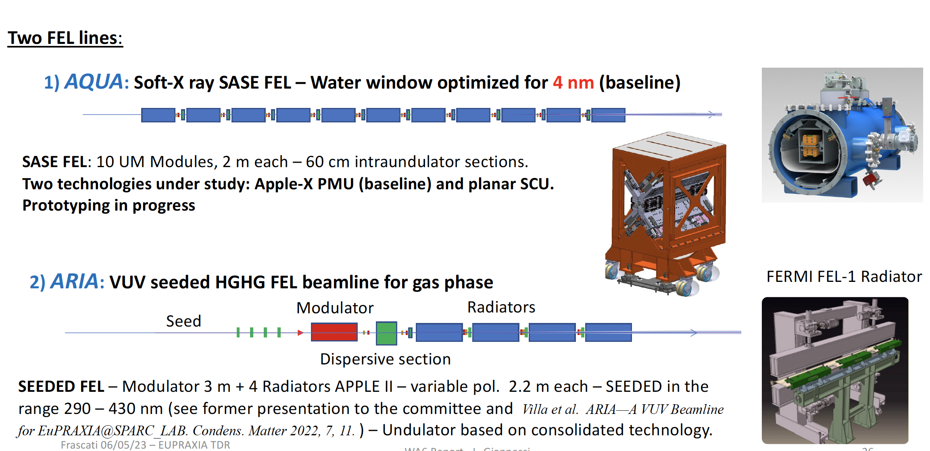
Radiation Generation: FEL
50-100
Courtesy L. Giannessi
40 m

Slide 22
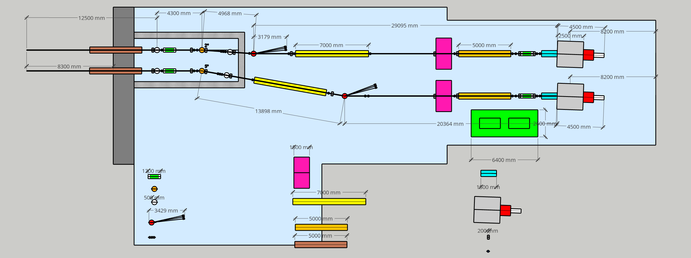
FEL Beamlines
AQUA beamline
ARIA beamline
Laser hutch
XGDM
Polarization/time measure
K-B mirrors
Mirror
BDA
Monochromator
Exp. Chamber
Spectrometer
Split & delay line
Solid attenuators
Gas absorber
Valves
BPM/screens
50 m

Slide 23
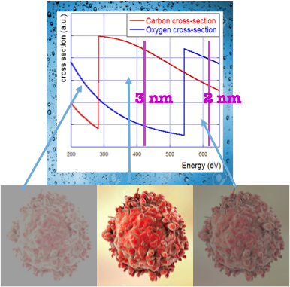
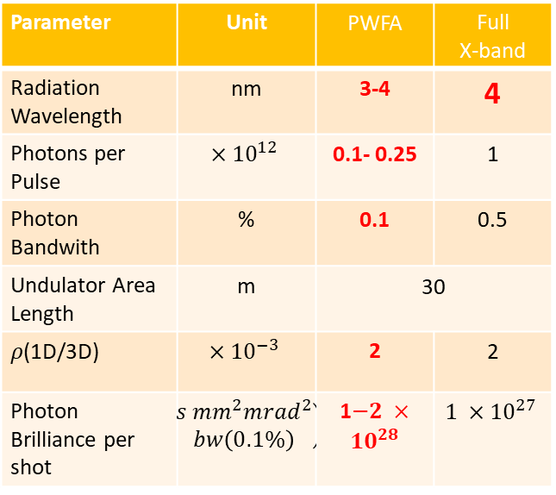
Expected SASE FEL performances
Parameter | Unit | PWFA | Full X-band
Electron Energy | GeV | 1-1.2 | 1
Bunch Charge | pC | 30-50 | 200-500
Peak Current | kA | 1-2 | 1-2
RMS Energy Spread | % | 0.1 | 0.1
RMS Bunch Length | 𝜇m | 6-3 | 24-20
RMS norm. Emittance | 𝜇m | 1 | 1
Slice Energy Spread | % | ≤0.05 | ≤0.05
Slice norm Emittance | mm-mrad | 0.5 | 0.5
In the Energy region between Oxygen and Carbon K-edge 2.34 nm – 4.4 nm (530 eV -280 eV) water is almost transparent to radiation while nitrogen and carbon are absorbing (and scattering)
Parameter | Unit | PWFA | Full X-band
Radiation Wavelength | nm | 3-4 | 4
Photons per Pulse | $$×{10}^{12}$$ | 0.1- 0.25 | 1
Photon Bandwith | % | 0.1 | 0.5
Undulator Area Length | m | 30 | 30
𝜌(1D/3D) | $$×{10}^{−3}$$ | 2 | 2
Photon Brilliance per shot | $$\left(\begin{aligned}s {mm}^{2}{mrad}^{2} \\ bw\left(0.1\%\right)\end{aligned}\right)$$ | 1$−2 ×{10}^{28}$ | $$1 ×{10}^{27}$$
Coherent Imaging of biological samples
protein clusters, VIRUSES and cells
living in their native state
Possibility to study dynamics
~10 ¹¹ photons/pulse needed
Courtesy C. Vaccarezza/L. Giannessi

Slide 24
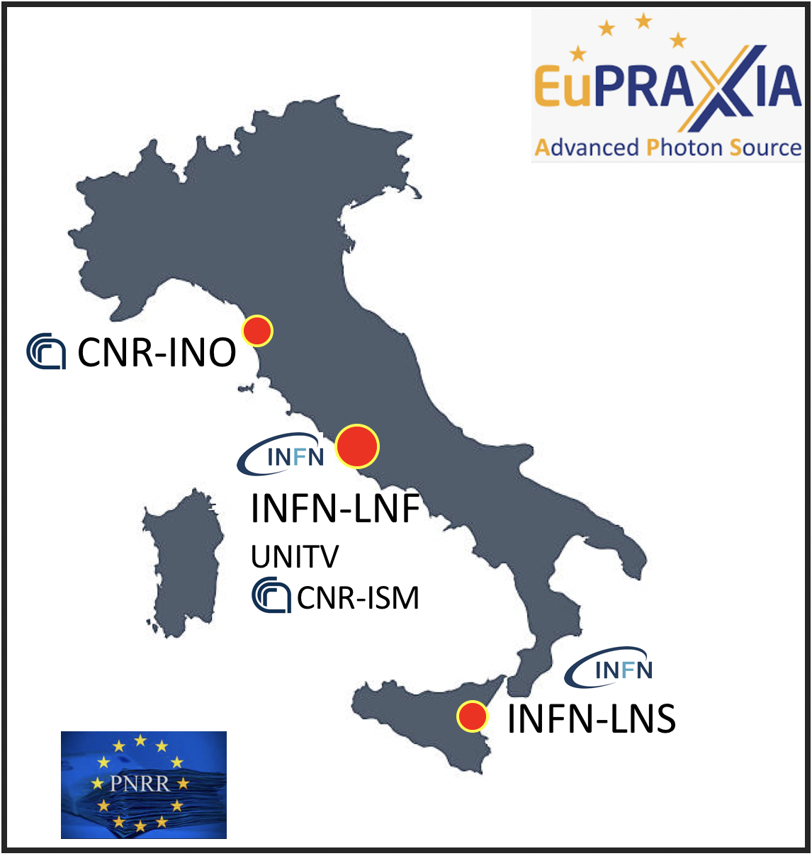
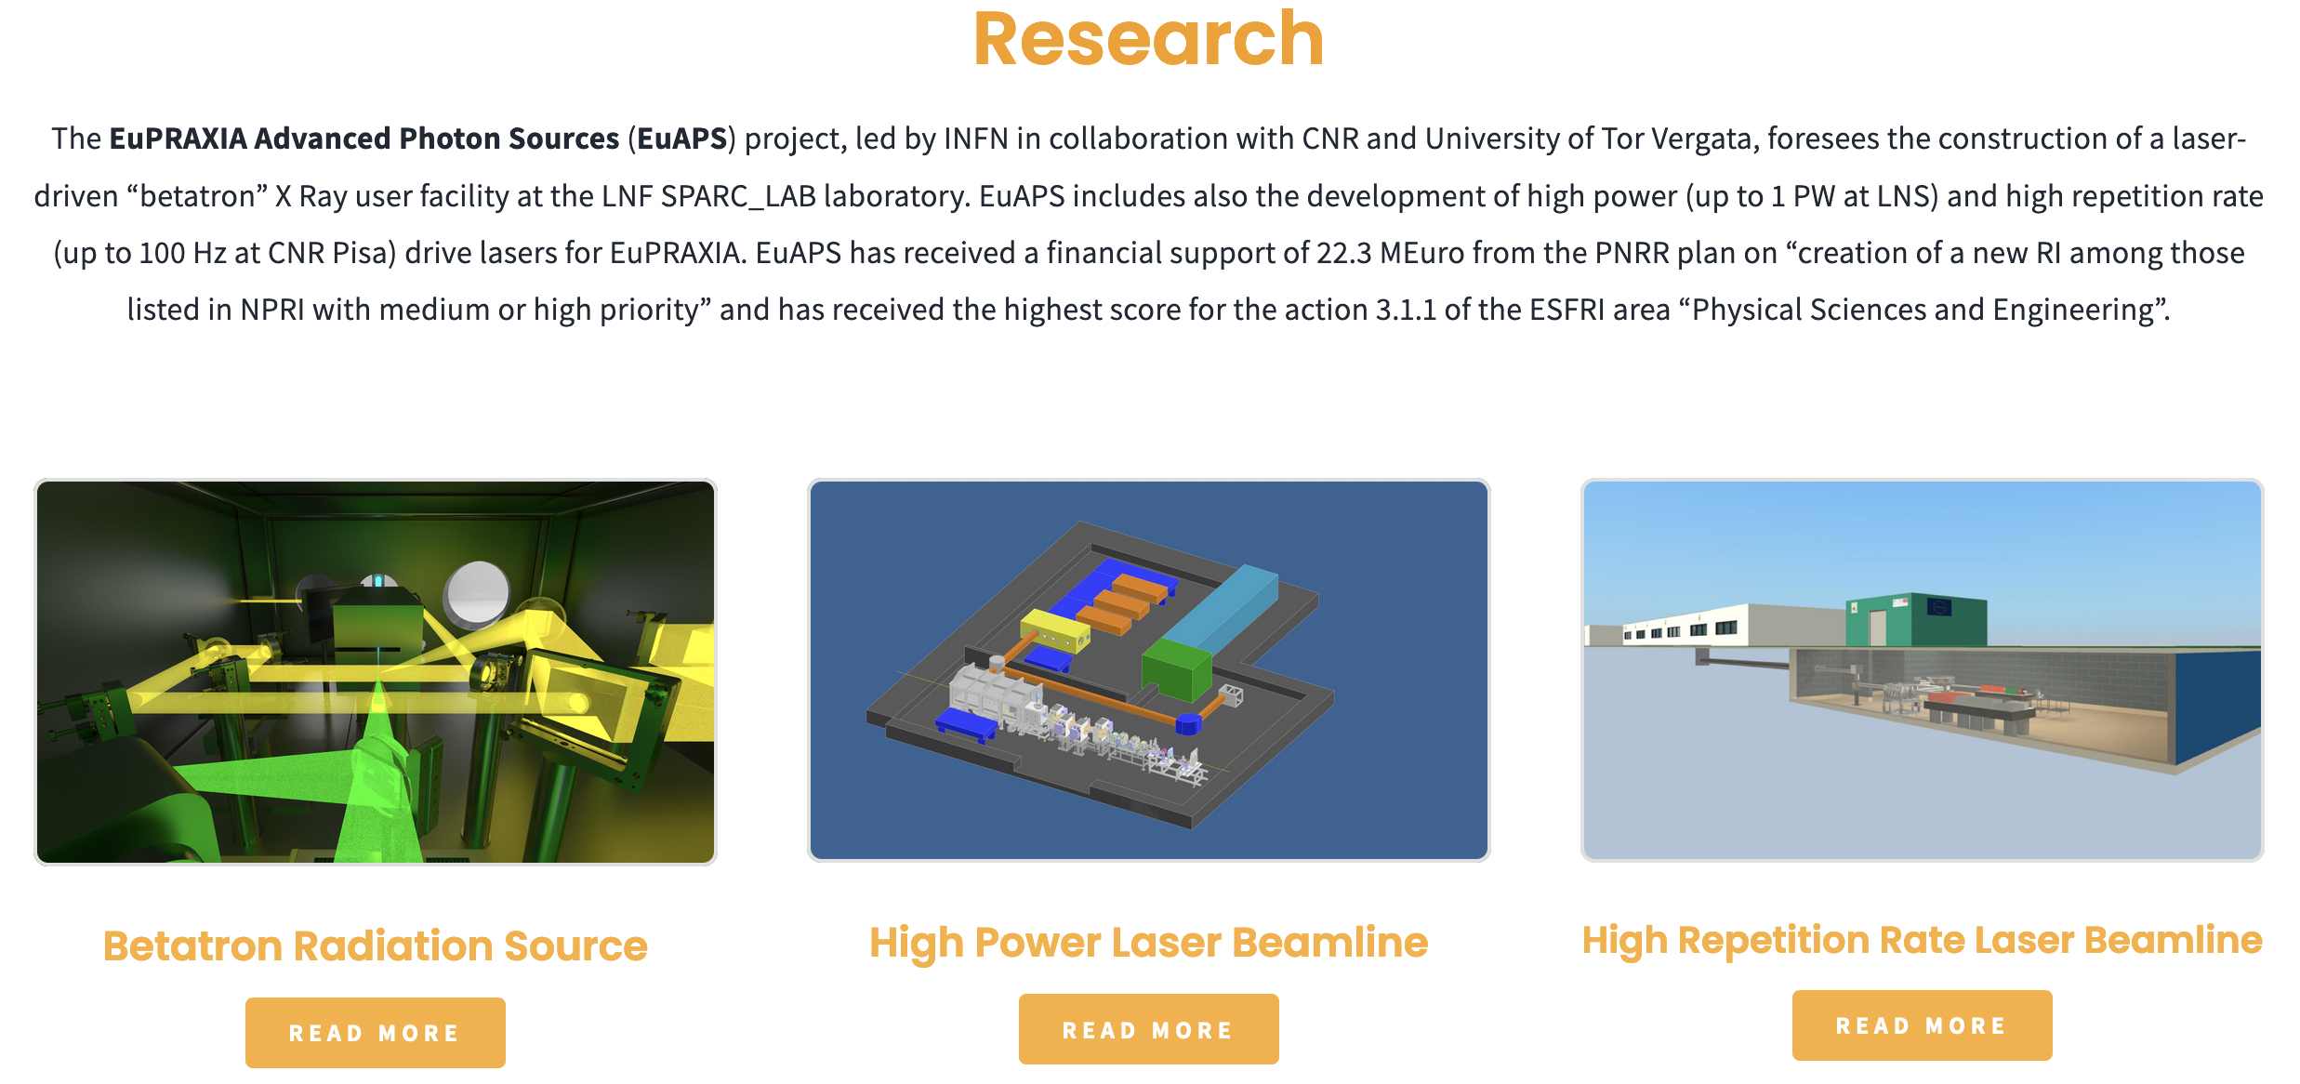
EuAPS: EuPRAXIA Advance Photon Sources
Principal Investigator: M. Ferrario
Infrastructure Manager: C. Bortolin
Management and Dissemination: A. Falone
Milano
A. Cianchi (Uni ToV)
P. Cirrone (INFN-LNS)
L. Labate (CNR-INO)
Potenza
M. Ferrario et al. INFN-23-12-LNF (2023)

Slide 25
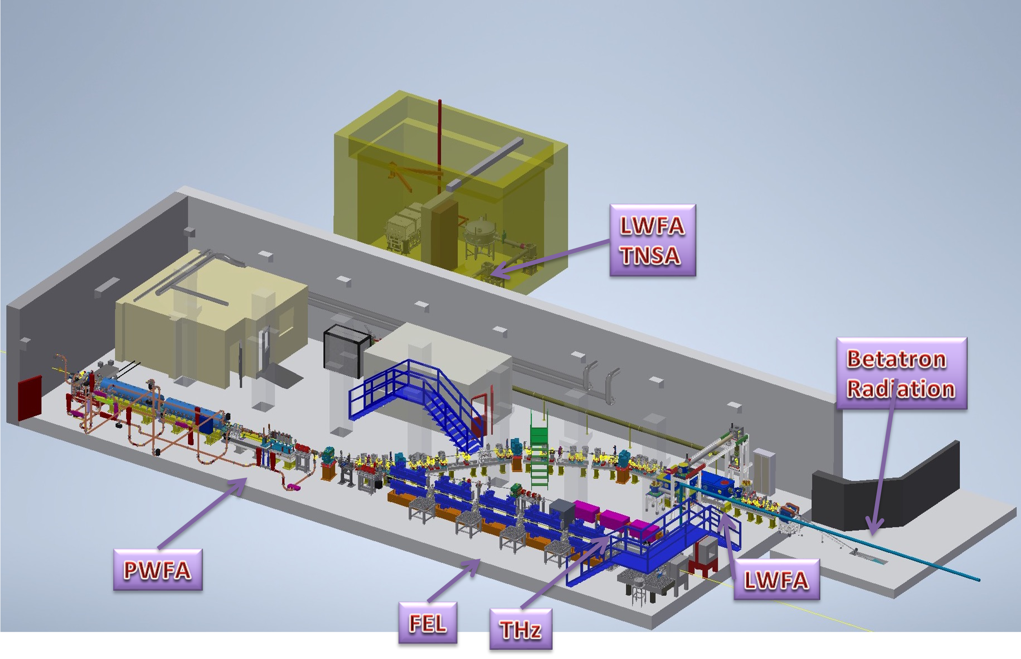
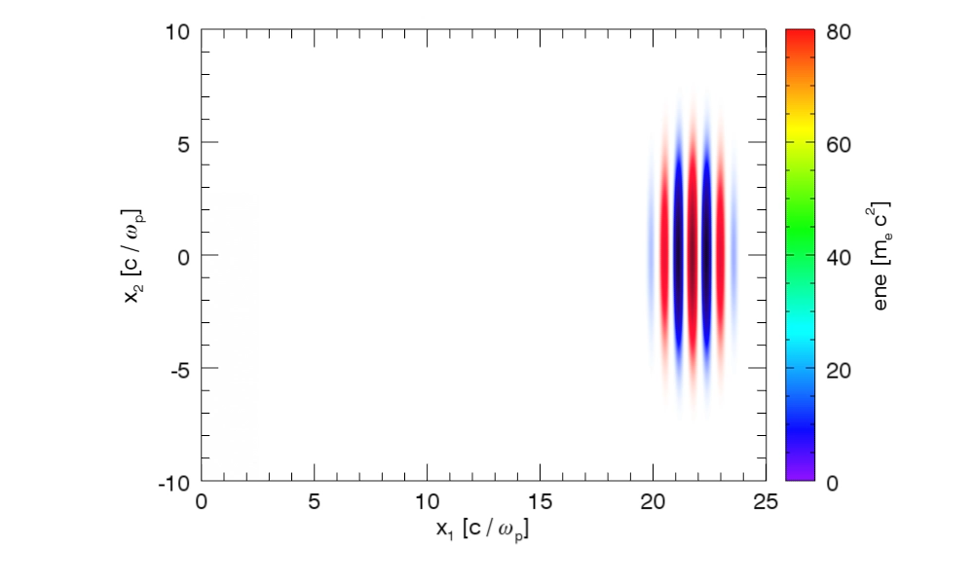
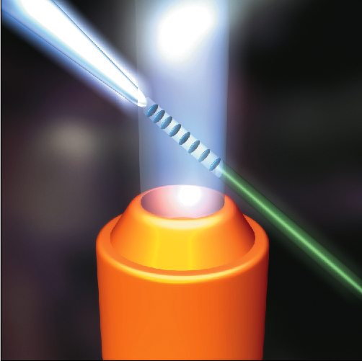
Betatron radiation source @SPARC_LAB
Electron beam Energy [MeV] | 50-800
Plasma Density [cm⁻³] | 10¹⁷ - 10¹⁹
Photon Critical Energy [keV] | 1 - 10
Nuber of Photons/pulse | 10⁶ – 10⁹
Courtesy J. Vieira, R. Fonseca/GoLP/IST Lisbon

Slide 26
Next step: PACRI?
HORIZON-INFRA-2024-TECH-01-01: R&D for the next generation of scientific instrumentation, tools, methods, solutions for RI upgrade
Submitted in March 2024
Budget ~10 M€
# | Partner | Acronym
1 | Elettra - Sincrotrone Trieste SCpA (Coordinator) | ST
2 | European Organization for Nuclear Research | CERN
3 | Istituto Nazionale Fisica Nucleare | INFN
4 | University of Liverpool | ULIV
5 | Thales-MIS | Th-MIS
6 | Scandinova Systems AB | SCND
7 | VDL ETG Technology & Development BV | VDL
8 | COMEB | COMEB
9 | United Kingdom Research and Innovation | UKRI
10 | Consiglio Nazionale delle Ricerche | CNR
11 | Extreme Light Infrastructure ERIC | ELI-ERIC
12 | Centre National de la Recherche Scientifique CNRS | CNRS
13 | Thales LAS France SAS | Th-LAS
14 | Amplitude | Amplitude
15 | Centro de LÁSERES Pulsados | CLPU
16 | Ferdinand-Braun-Institut gGmbH, Leibniz-Institut für Hoechstfrequenztechnik | FBH
17 | Associacao do instituto superior Tecnico para a Investigacao e Desenvolvimento | IST
18 | Università degli Studi di Roma La Sapienza | USAP
19 | Heinrich-Heine-Universitaet Duesseldorf | UDUS
20 | Deutsches Elektronen-Synchrotron DESY | DESY
21 | The Chancellor, Masters and Scholars of the Univ. of Oxford | UOX
22 | Ludwig-Maximilians-Universitaet Muenchen | LMU
23 | GSI Helmholtz Centre for Heavy Ion Research | GSI
24 | Università degli Studi di Roma Tor Vergata | UTOR
25 | SourceLAB | SourceLAB
26 | Paul Scherrer Institut (Associated partner) | PSI
WP No. | Work Package Title | Lead Partic. Short Name
1 | Coordination and project management | ELETTRA
2 | Scientific and industrial exploitation | ULIV
3 | Plasma accelerator theory and simulations | IST
4 | High repetition rate plasma structures | INFN
5 | Plasma acceleration diagnostics and instrumentation | CNRS
6 | High efficiency RF generator | Thales-MIS
7 | High repetition rate modulator | Scandinova
8 | X-band RF Pulse Compressor (BOC) | INFN
9 | RF tests and validation | CERN
10 | High repetition rate high power Ti:Sa amplifier module | UKRI
11 | Efficient kHz laser driver modules for plasma acceleration | CNR
12 | High-rep rate pump sources for laser drivers | ELI-ERIC
13 | Prototype of high average power optical compressor | Thales-LAS
14 | Laser Driver System Architecture,transport and engineering | CNRS
25 Members
+
1 Associated partner
19 Universities and Scientific Labs.
+
7 Industries

Slide 27
Plasma Accelerators for Compact Research Infrastructures (PACRI)
The objective of the PACRI project is to develop innovative breakthrough technologies, increasing their Technology Readiness Level (TRL) for electron accelerators while taking energy consumption, resource efficiency, costs, and environmental impact into due account.
This includes the following draft non-exclusive goals:
developing high rep-rate plasma modules, as required for the EuPRAXIA project, extending its scientific domain from high average brightness radiation sources up to high energy physics;
developing key laser components required to upscale high-power high repetition rate Laser technology as required by the EuPRAXIA and ELI Research Infrastructure.
improving the performance of normal conducting technology for X-band linac drivers, extending them to the kHz regime, with focus on efficiency and energy consumption;
supporting development towards compact linear colliders and nuclear physics facilities;
developing compact advanced undulator modules, in order to reduce the overall size of the future FEL facilities.
supporting the availability of compact X-ray facilities (FELs, ICSs, Betatron) to serve a larger number of users in many scientific fields, industry and society;

Slide 28
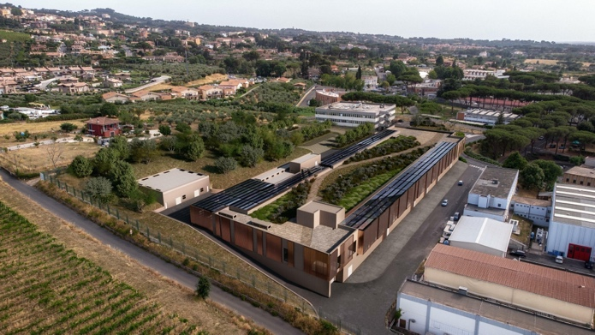
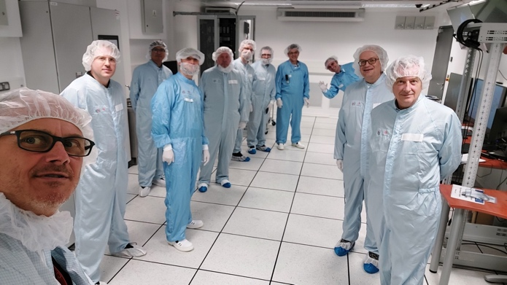
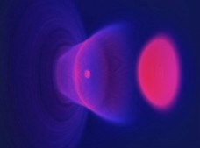
Conclusion
EuPRAXIA is the future of plasma accelerators and highly attractive for early-stage researchers: cutting-edge technologies for breakthrough science.
The doctoral network EuPRAXIA-DN is an important corner stone:
  addresses key R&D challenges in an interdisciplinary approach
  trains Fellows in crucial areas and brings the community together, supporting talent pipeline
Today is a unique opportunity to see future in the making.
It is a great pleasure to be here at LNF today and to share the exciting future of EuPRAXIA with you!

