Slide 1
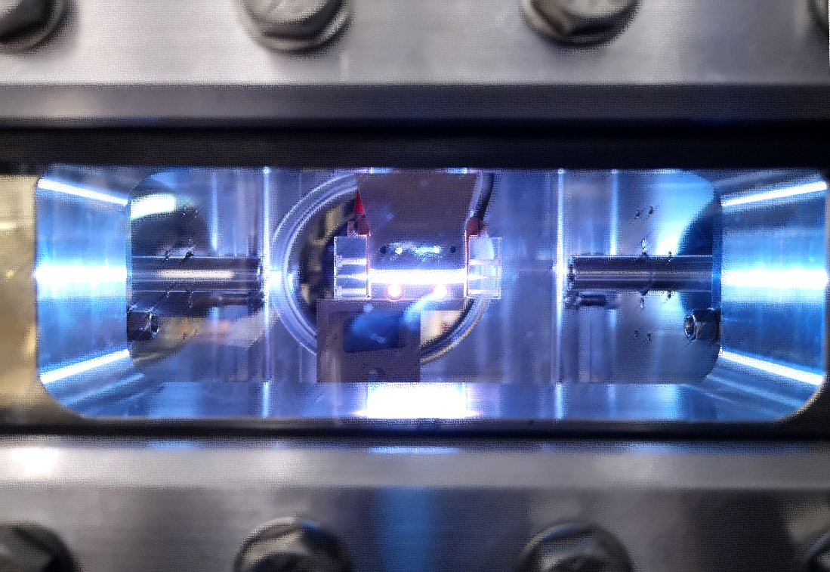



Technology of Plasma sources
Angelo Biagioni
EuPRAXIA_DN School on Plasma accelerators
Orto Botanico , Rome, Italiy | April 22 – 26, 2024
On behalf of the Sparc_lab collaboration
National Institute for Nuclear Physics, Italy

Slide 2
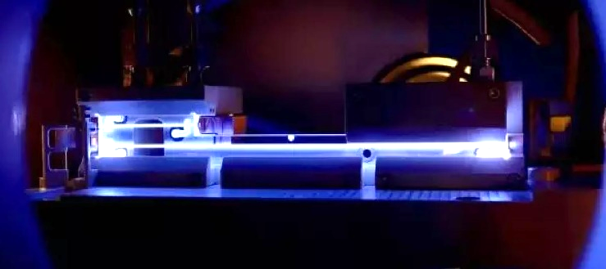

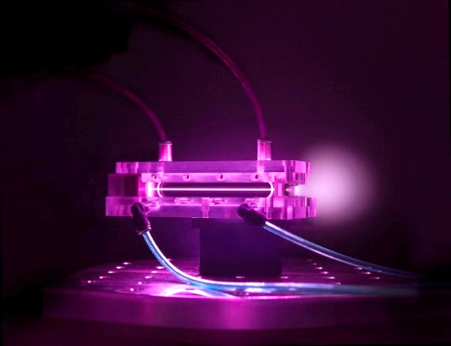

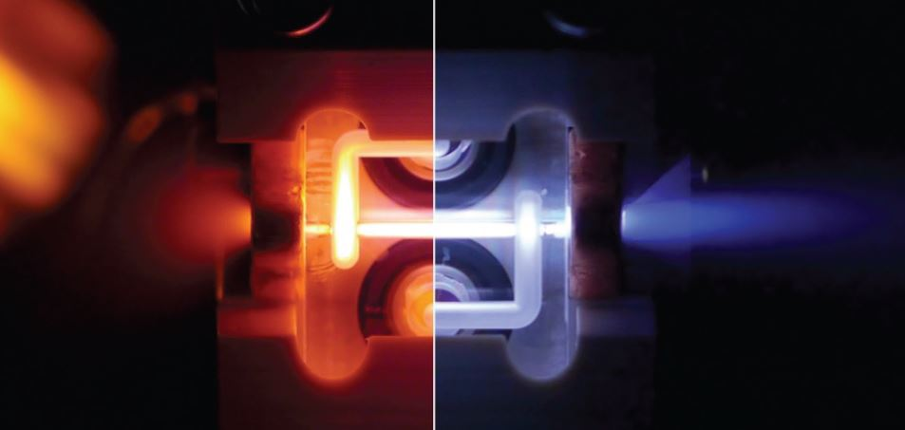
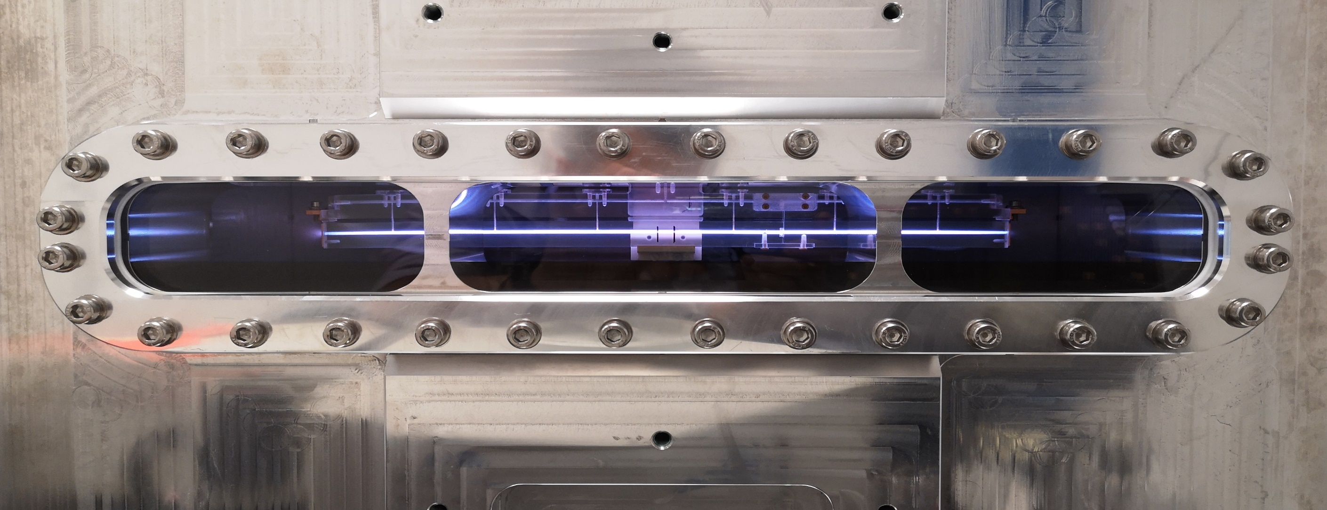


Plasma sources assume a large variety of shapes…
…Gas-filled capillary-discharge
Angelo.Biagioni@lnf.infn.it | EuPRAXIA_DN School on Plasma accelerators | Page 2/40

Slide 3
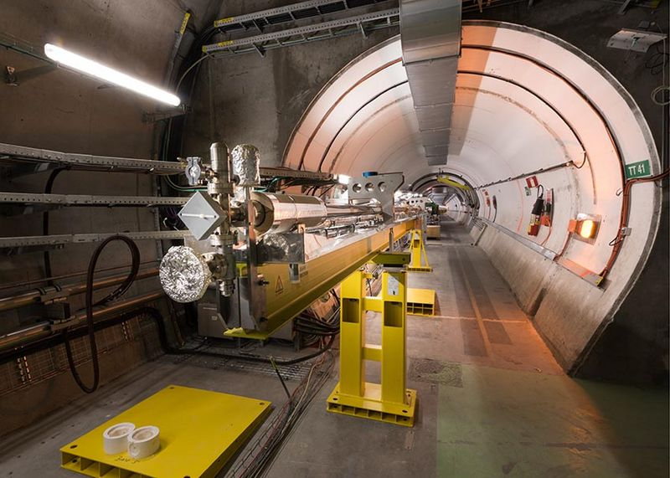



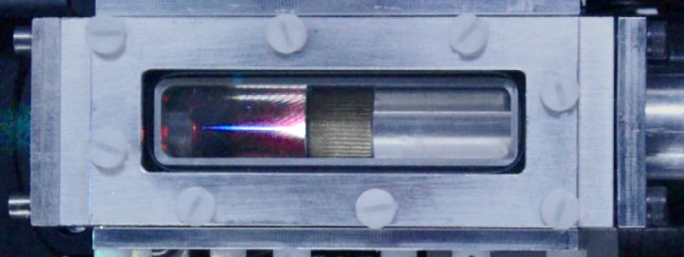
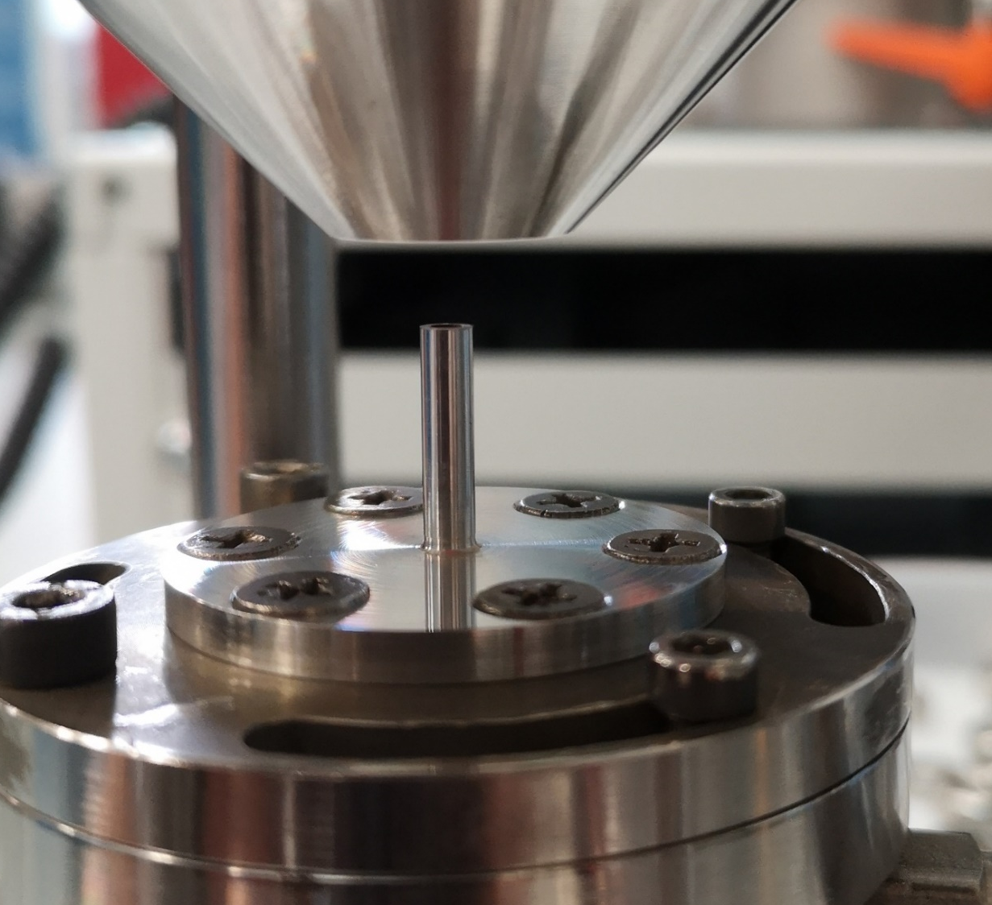


Plasma sources assume a large variety of shapes…
…Rubidium vapor oven
…Gas cell
…Gas jet
Angelo.Biagioni@lnf.infn.it | EuPRAXIA_DN School on Plasma accelerators | Page 3/40

Slide 4
Outline
Technology of plasma sources
  Introduction and motivations
  Basic concepts
  Plasma source properties and implementation
    Gas cell
    Heat-pipe ovens
    Gas jet
    Gas-filled capillary-discharge
  Plasma diagnostics
    Spectroscopic techniques
    Interferometric tecniques
    Plasma temperature
  High repetition rate plasma sources for EuPRAXIA project
Angelo.Biagioni@lnf.infn.it | EuPRAXIA_DN School on Plasma accelerators | Page 4/40

Slide 5
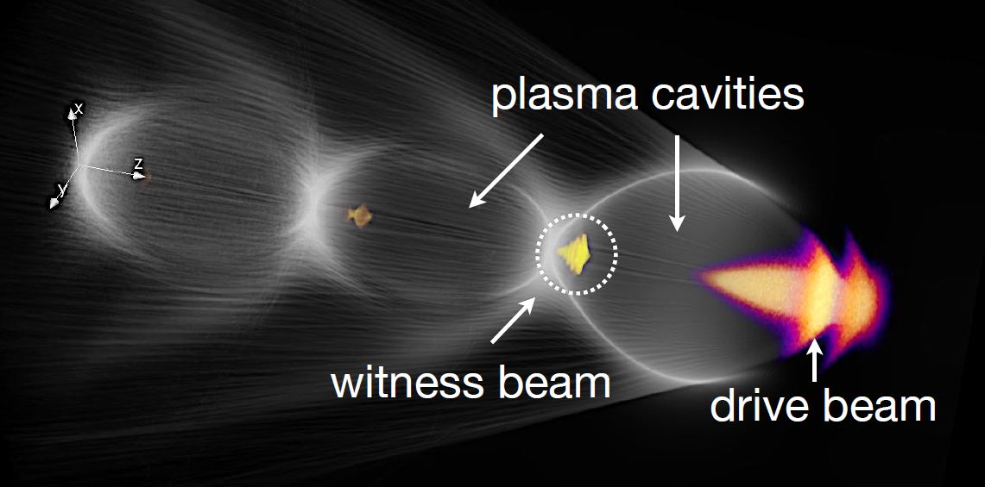
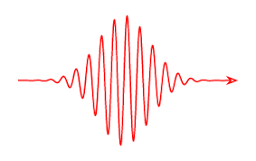
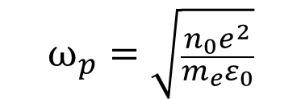
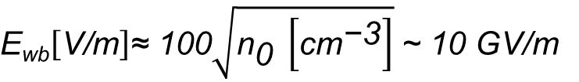
Motivations
Gas injection
LWFA Laser-driven wakefield acceleration
Drive beam is a laser pulse
PWFA Particle-driven wakefield acceleration
Drive beam is electron or proton beam
Plasma source
Plasma formation process
Wakefield
RF structures 20-100 MV/m
Plasma structures 1-100 GV/m
λ_{p}
$$ω_{p}=\sqrt{\frac{n_{0}e^{2}}{m_{e}ε_{0}}}$$
n₀ = 10¹⁶ cm⁻³ λ_{p} = 300 µm
Plasma source design for:
Plasma formation process
Density profiles – lifetime – size – ramps – stability - RepRate
Acceleration – Focusing – deflection
$\text{E}\text{wb}\left[\text{V}\text{/}\text{m}\right]\text{≈ 100}\sqrt{{\text{n}}_{\text{0}} \left[{\text{cm}}^{\text{−3}}\right]}$ ~ 10 GV/m
Wave-breaking field
Angelo.Biagioni@lnf.infn.it | EuPRAXIA_DN School on Plasma accelerators | Page 5/40

Slide 6
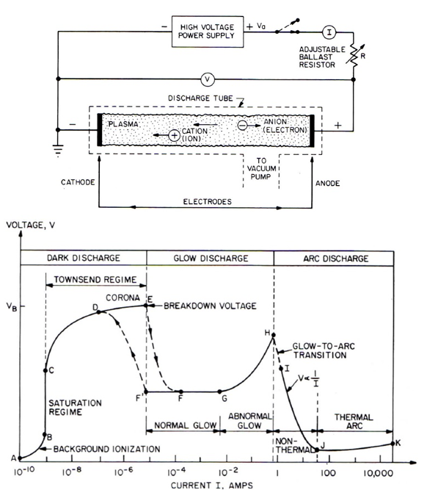
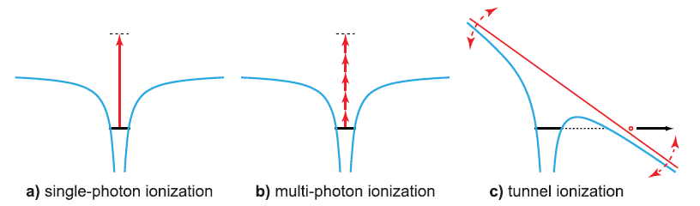
Basic concepts
Plasma generation mechanisms
Collisional ionization
  Electrical discharges
  Laser ionization
      Single-photon ionization
      Multi-photon ionization
      Tunneling ionization/field ionization (particle beams)
Electrical discharge
Plasma generation is fundamentally concerned with the ionization of a background medium, usually a gas, to produce electrons and ions in a controlled way
Laser beam
Laser beam
Particle beam
Angelo.Biagioni@lnf.infn.it | EuPRAXIA_DN School on Plasma accelerators | Page 6/40

Slide 7
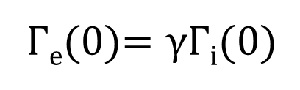
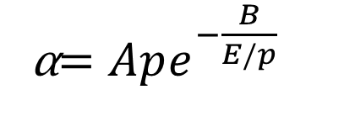
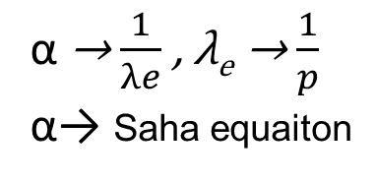

Basic concepts_ Electrical discharges
The most important collisional ionization mechanism is electron-impact ionization (Te/Tg)
  Dark discharge (Te>Tg)
    A-C region, background electrons (I ≈ 1 pA ÷ 1 nA)
    C-E region, the Townsend discharge (avalanche ionization)
  Glow discharge (Te>Tg)
    the current is still not dependent on the applied voltage
    It is determined by the secondary emission (γ) of electrons in the vicinity of the cathode (self-sustained discharge)
    the electron flux at the cathode is determined by the secondary emission, that is proportional to the ion flux present at the cathode
The first Townsend coefficient
$$I=I0e^{αd}$$
α → $\frac{1}{λe}$ , λ_{e} → $\frac{1}{p}$
α→ Saha equaiton
α$=Ape^{−\frac{B}{E/p}}$
p gas pressure
λe mean free path
E electric field
Γ_{e}(0)$=γ\text{Γ}\text{i}(0)$
The second Townsend coefficient
Xiao, Dengming, Gas Discharge and Gas Insulation (2016) Volume 6
Fundamental Theory of Townsend Discharge, pp. 47–88. doi:10.1007/978-3-662-48041-0_3
Angelo.Biagioni@lnf.infn.it | EuPRAXIA_DN School on Plasma accelerators | Page 7/40

Slide 8
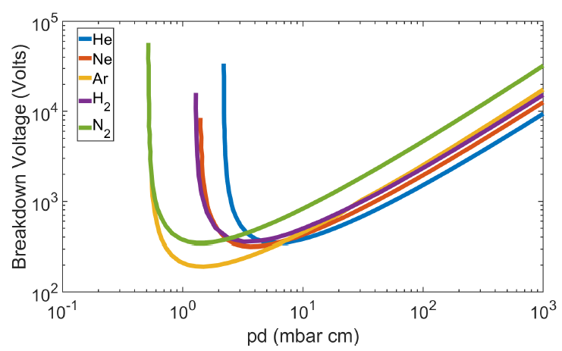
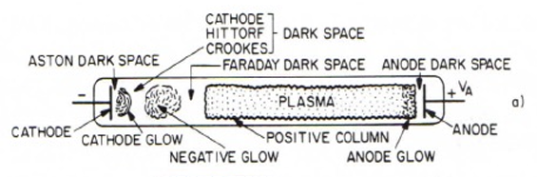
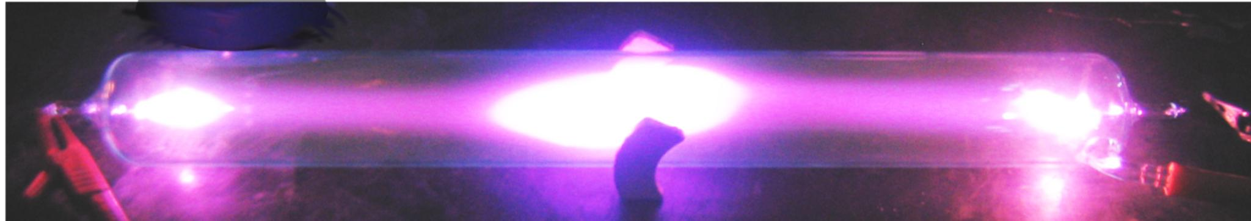

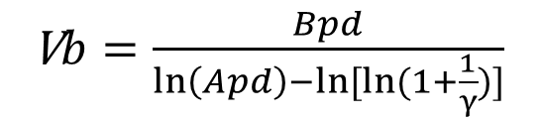
Basic concepts_ Electrical discharges
Paschen curve
p pressure
d gas length
During the dielectric breakdown, the electrons must be able to close the circuit Anode-Cathode, that is, they must reach the anode
Charge balance equation for both electrons and ions
There is still no a uniform plasma along the pipe
α$d=ln⁡(1+\frac{1}{γ})$
V$b=\frac{Bpd}{\ln\left(Apd\right)−ln⁡[ln⁡(1+\frac{1}{γ})]}$
Angelo.Biagioni@lnf.infn.it | EuPRAXIA_DN School on Plasma accelerators | Page 8/40

Slide 9
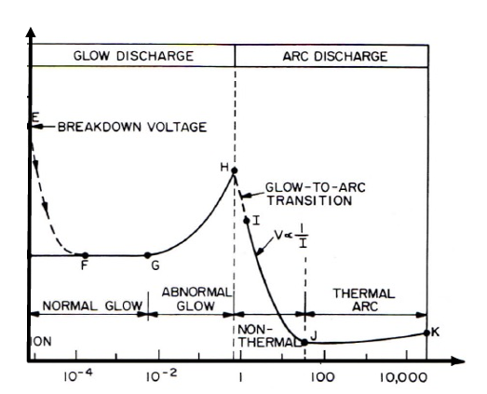
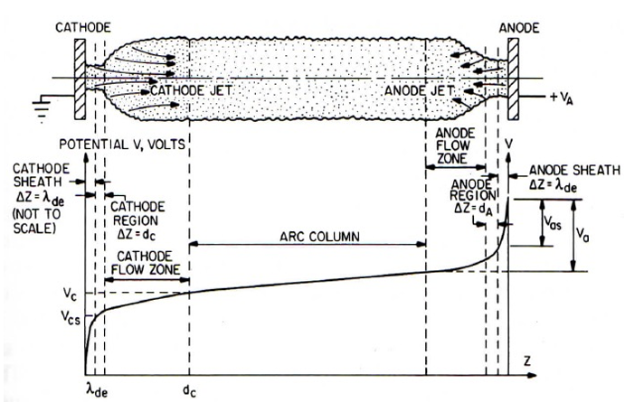
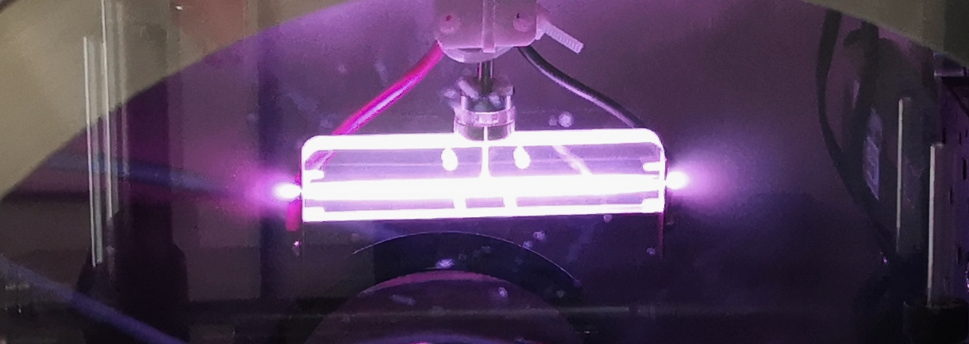
Basic concepts_Electrical discharges
  Arc discharge (Te>Tg – Te=Tg)
    triggered by the massive emission of electrons from the cathode due to intense heating of the cathode surface by the Joule effect obtained from the high current (thermoionic emission)
    H-J region, non-thermal regime Te>Tg, current 1-50 A
    J-K region, Te=Tg (LTE condition), currents can reach up to thousands Amps
Gas-filled discharge capillary
H2
10 cm/1 mm
V = 10 kV
I = 500 A
p = 50 mbar
Angelo.Biagioni@lnf.infn.it | EuPRAXIA_DN School on Plasma accelerators | Page 9/40

Slide 10
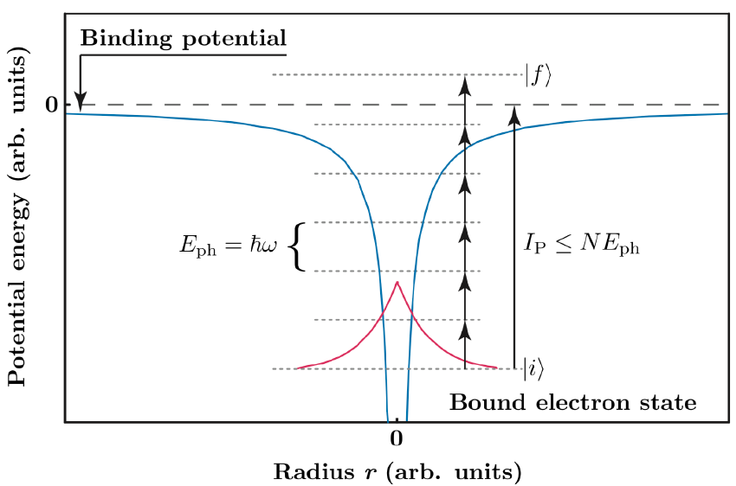
Basic concepts_Laser ionization
Single-photon ionization is possible when the photon energy is larger than the binding potential of the atom, hν > ε_{ion} (800nm photons have hν = 1.55 eV)
Li | 5.39 eV
H | 13.59 eV
N | 14.53 eV
He | 24.59 eV
Photons
Multi-photon ionization, when the laser intensity is high enough then there can be a large enough number of photons in the atomic volume to give a high probability of multiple (N) photons simultaneously ionizing the atom, Nhν > ε_{ion}
It is important to note that in multi-photon ionization, the energy of a single photon can amount to only a fraction of the minimum energy needed for removal of an electron
P. Gibbon et Al, Short Pulse Laser Interactions with Matter: An Introduction, Imperial College Press, 2005
Angelo.Biagioni@lnf.infn.it | EuPRAXIA_DN School on Plasma accelerators | Page 10/40

Slide 11
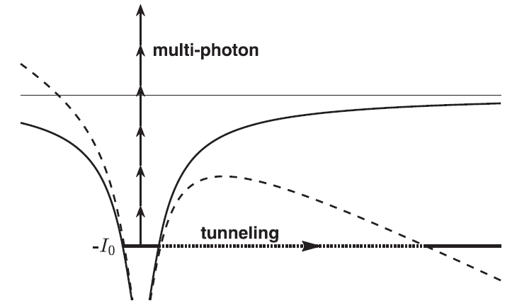
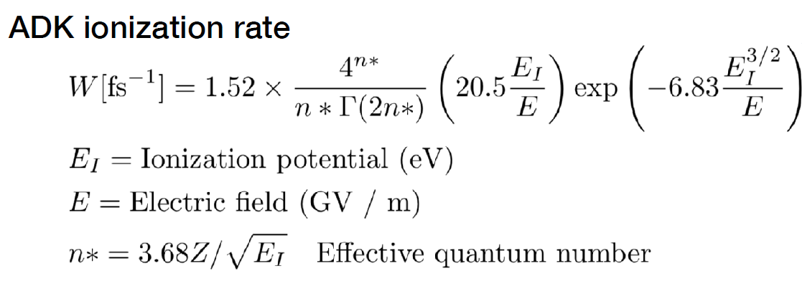
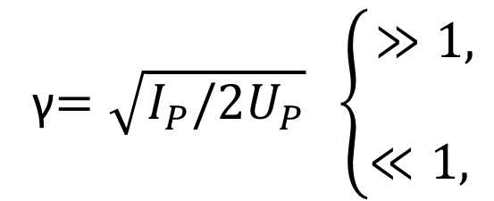
Basic concepts_Laser ionization
Tunnel ionization, If we consider the intense laser light an electromagnetic wave rather than a stream of photons, one sees that in the dipole approximation, the electric field in a strong laser beam can bend the Coulomb potential such that an electron can tunnel through the created barrier out into the vacuum
Electromagnetic wave
Keldish parameter
γ$=\sqrt{I_{P}/2U_{P}} \left\{\begin{aligned}≫1, \\ \\ ≪1, \end{aligned}\right.$
MPI
Columbian potential ~ 1/r
Potential energy
Field ionization
ADK (Ammosov, Delone and Krainov) ionization rate
I_{P}
Bound electron state
Radius
L. V. Keldysh, Ionization in the field of a strong electromagnetic wave, Sov. Phys. JETP 20, 1307–1314 (1965)
L. Gallmann et Al, Photoemission and photoionization time delays and rates, Structural Dynamics 4, 061502 (2017) https://doi.org/10.1063/1.4997175
Angelo.Biagioni@lnf.infn.it | EuPRAXIA_DN School on Plasma accelerators | Page 11/40

Slide 12
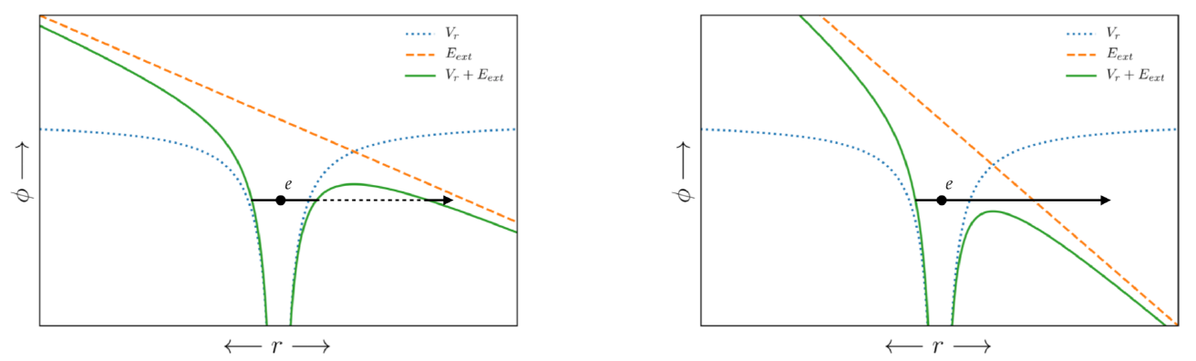

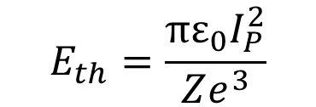

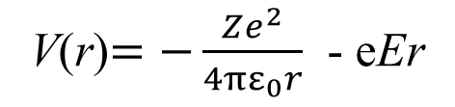
Basic concepts_Laser ionization
External potential –eEr
Columbian potential ~ 1/r
Tunneling ionization
Barrier suppression
ionization
V(r)$=−\frac{Ze^{2}}{4πε_{0}r}$ - eEr
$$\text{V}\text{(}\text{r}\text{=}r_{max}\text{)}=I_{P}$$
Atom | I_{p} (eV) | I_{th} (W/cm²)
H | 13.59 | 1.4x10¹⁴
He | 24.59 | 8.8x10¹⁵
$$E_{th}=\frac{πε_{0}I_{P}^{2}}{Ze^{3}}$$
Threshold electric field, above which barrier suppression ionization occurs
*
$I_{th}=4⨯{10}^{9}{\left(I_{P}\left[eV\right]\right)}^{4}\frac{1}{Z^{2}}\left[W/{{cm}^{2}}\right]$
Angelo.Biagioni@lnf.infn.it | EuPRAXIA_DN School on Plasma accelerators | Page 12/40

Slide 13
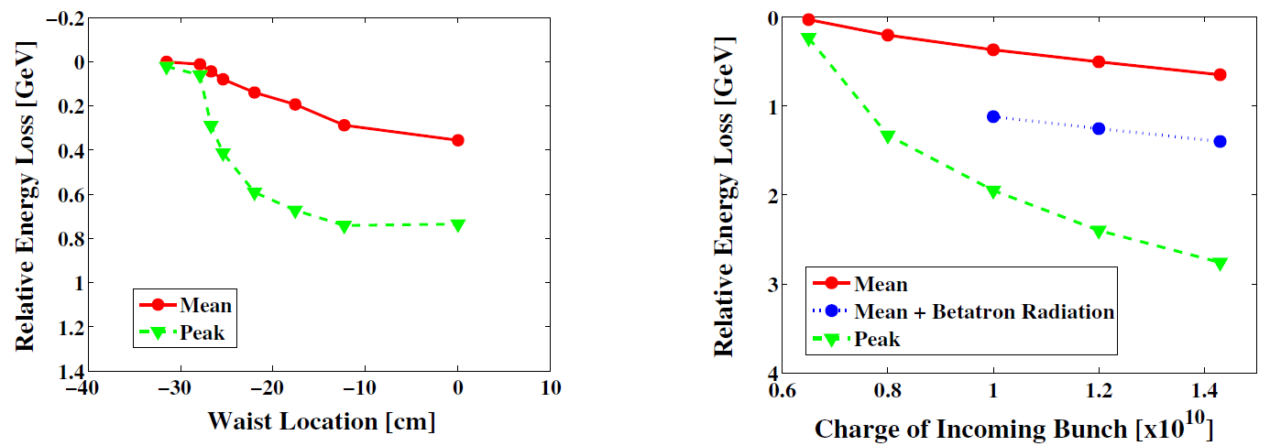
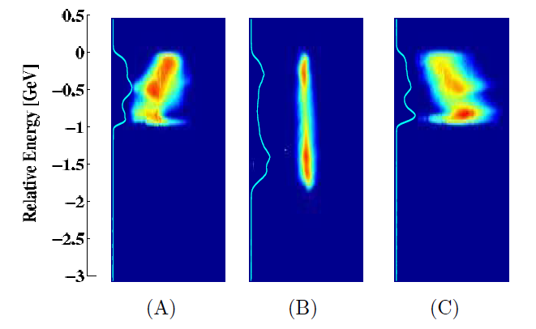
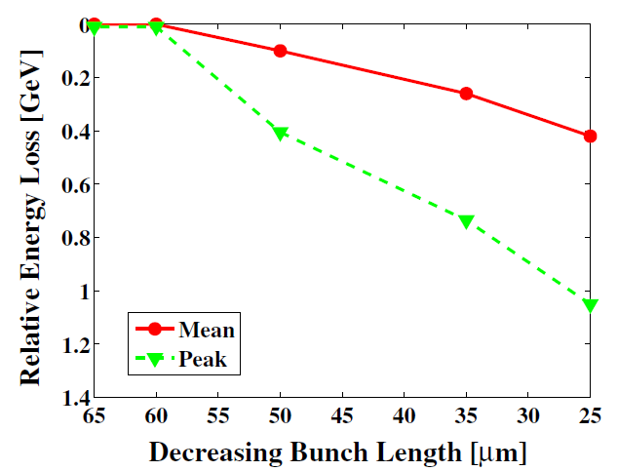
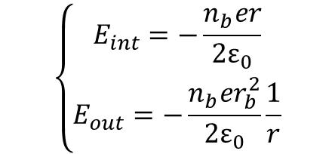
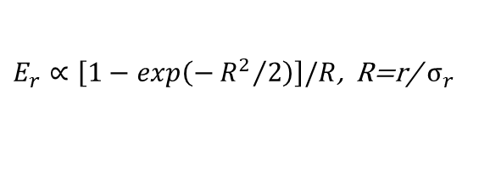
Basic concepts_Field ionization by particle beams
Plasma production via field ionization occurs when an incoming particle beam is sufficiently dense that the electric field associated with the beam ionizes a neutral vapor or gas
Electron beams Coulomb fields can exceed the threshold electric field for barrier suppression ionization from the previous Eq* (E_{Th}):
                Bunch length
                Charge
                Beam focusing (waist position )
$$\left\{\begin{aligned}E_{int}=−\frac{n_{b}er}{2ε_{0}} \\ E_{out}=−\frac{n_{b}er_{b}^{2}}{2ε_{0}}\frac{1}{r}\end{aligned}\right.$$
n_{b}
r_{b}
E_{th}(H2) = 35 GV/m
Emax = 45 GV/m
nb = 10¹⁸ cm⁻³
rb = 5 um
$E_{r}∝\left[1−exp\left(−{R^{2}}/2\right)\right]/R$, R=r/ $σ_{r}$
Before
After
n_{b}
M.V. Ammosov, N. B. Delone, and V. P. Krainov, Tunnel ionization of complex atoms and of atomic ions in an alternating electromagnetic field , Sov. Phys. JETP 64, 1191 (1986)
M. J. Hogan et Al, Multi-GeV Energy Gain in a Plasma-Wakefield Accelerator, (2005) PHYSICAL REVIEW LETTERS PRL 95, 054802DOI: 10.1103/PhysRevLett.95.054802
C. L. O’Connell et Al, Plasma production via field ionization, (2006) PHYSICAL REVIEW SPECIAL TOPICS - ACCELERATORS AND BEAMS 9, 101301 DOI: 10.1103/PhysRevSTAB.9.101301
r_{b}
Angelo.Biagioni@lnf.infn.it | EuPRAXIA_DN School on Plasma accelerators | Page 13/40

Slide 14
Plasma source properties and implementation
Gas jets
Heat-pipe ovens
Gas cells
Gas-filled discharge capillary
Angelo.Biagioni@lnf.infn.it | EuPRAXIA_DN School on Plasma accelerators | Page 14/40

Slide 15
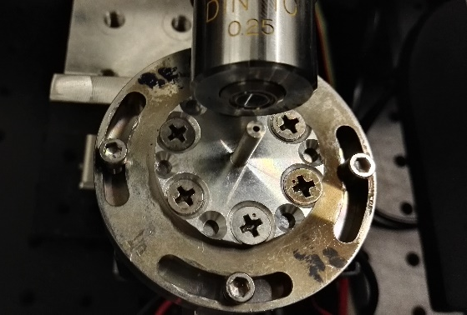
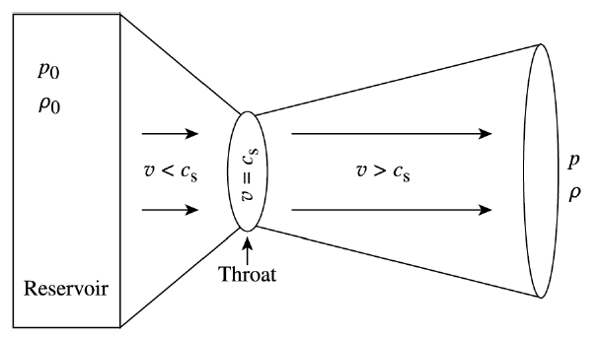
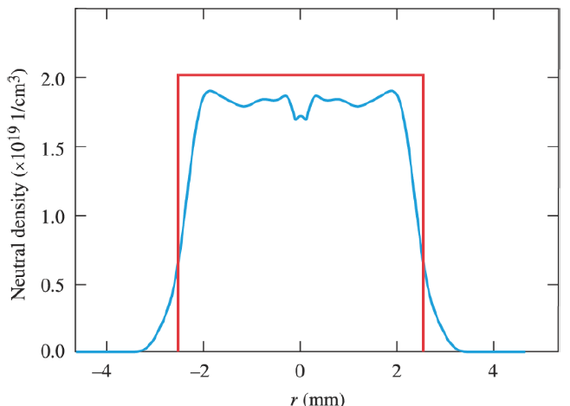
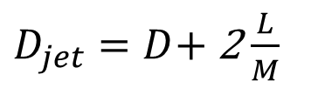


Plasma source properties and implementation_Gas jets
$$\frac{ρ}{ρ_{0}}={\left(1+\frac{γ−1}{2}M^{2}\right)}^{−\frac{1}{γ−1}}$$
$$\frac{A}{A^{∗}}=\frac{1}{M}{\left[\frac{2}{γ+1}\left(1+\frac{γ−1}{2}M^{2}\right)\right]}^{−\frac{γ+1}{2\left(γ−1\right)}}$$
The density ratio depends only on the Mach number and the adiabatic index of the target gas
At the nozzle exit, a lineout of the gas density will have a flattop profile with a diameter equal to the nozzle exit diameter and the peak density defined by first equation
Edges of the profile will gradually expand at an angle approximately equal to 1/M
M = v/c_{s}
$D_{jet}=D$+ 2 $\frac{L}{M}$
L
B. R. Lee et Al, Spatiotemporal characteristics of high-density gas jet and absolute determination of size and density of gas clusters. Sci Rep 10, 12973 (2020). https://doi.org/10.1038/s41598-020-69824-z
Ocean Zhou et Al, Effect of nozzle curvature on supersonic gas jets
used in laser–plasma acceleration, Phys. Plasmas 28, 093107 (2021); doi: 10.1063/5.0058963
Angelo.Biagioni@lnf.infn.it | EuPRAXIA_DN School on Plasma accelerators | Page 15/40

Slide 16
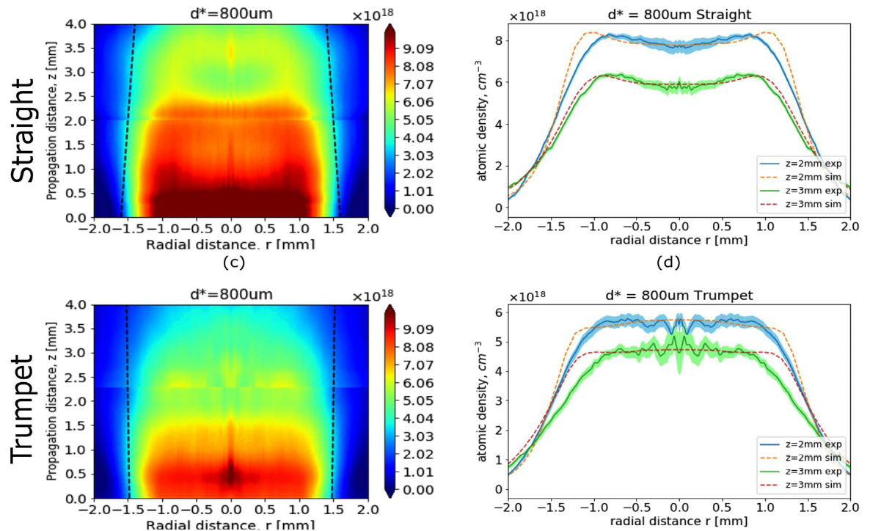
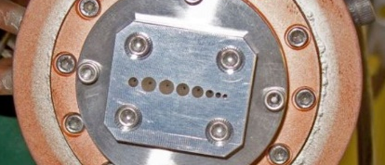
Plasma source properties and implementation_Gas jets
Nozzle geometry, Ar gas
Gas jets properties
Supersonic nozzles provide a near-flat-top density profile for laser wakefield acceleration experiments
Plasma density can be controlled by means of backing pressure P depending on the nozzle geometry and desired density
      P in the range 10 - 100 bar
      n_{e} typically in the range 10¹⁷ - 10²⁰ cm⁻³
Length typically a few mm (nozzle arrays, but higher gas flow rates)
Larger nozzle diameters give lower densities for same P
High gas flow rates, operation necessarily in pulsed mode
No plasma confinement components are required, so there is no wear and tear of source parts due to high plasma temperatures
Argon
80 bar
Valve opening 70 ms
Laser pulse
Laser pulse
M. Hansen et Al, Supersonic gas-jet characterization with interferometry and Thomson scattering on the OMEGA Laser Systema, Proceedings of the 22nd Topical Conference on High-Temperature Plasma Diagnostics (HTPD 2018) in San Diego, California, USA
B. R. Lee et Al, Spatiotemporal characteristics of high-density gas jet and absolute determination of size and density of gas clusters. Sci Rep 10, 12973 (2020). https://doi.org/10.1038/s41598-020-69824-z
Ocean Zhou et Al, Effect of nozzle curvature on supersonic gas jets
used in laser–plasma acceleration, Phys. Plasmas 28, 093107 (2021); doi: 10.1063/5.0058963
Angelo.Biagioni@lnf.infn.it | EuPRAXIA_DN School on Plasma accelerators | Page 16/40

Slide 17
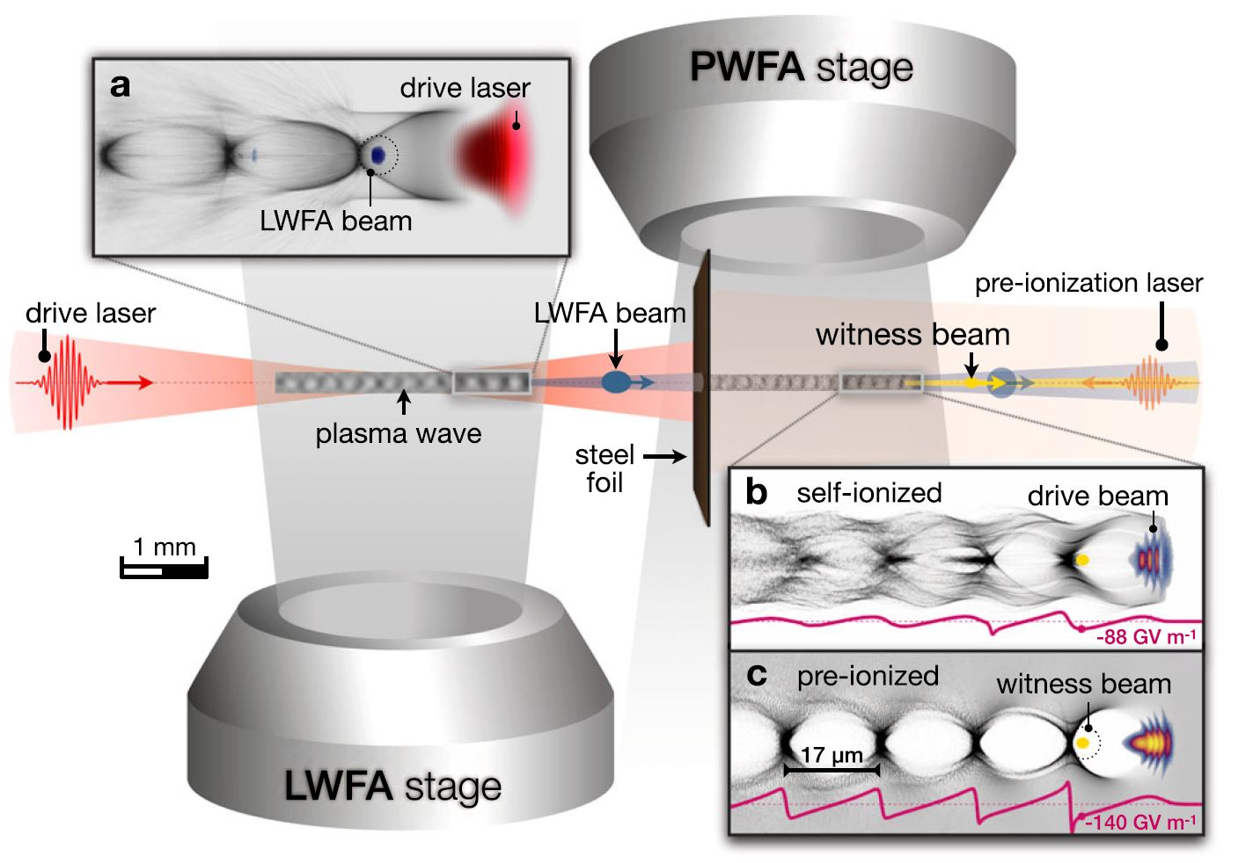

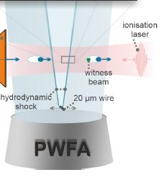
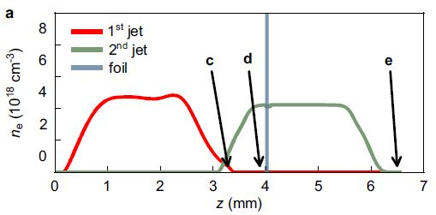
Plasma source properties and implementation_Gas jets
Staged LWFA-driven PWFA (LPWFA)
A high-intensity laser pulse drives an LWFA in the first stage, generating a high peak-current (>10 kA) electron beam which propagates into the second stage, acting as the PWFA driver.
In the PWFA stage, a witness beam (yellow) is accelerated. the witness beam is mostly composed of trailing background electrons that went through the foil and get trapped in the beam-driven plasma wake, where they experience peak accelerating fields surpassing 100 GV m−1
After expansion in the intermediate vacuum, the drive beam is effectively recaptured as it enters the PWFA stage.
A density downramp injection (DDI) scheme induced by a hydrodynamic shock-front in a PWFA improve properties of the plasma source:
  Second shock front is the source of witness injection
  we achieve energy tuning capability by adjusting the position of injection and thus changing the effective acceleration length of the injected witness.
Kurz, T. et al. Nat Commun 12, 2895 (2021).
Couperus Cabada, J.P. et al. Phys. Rev. Research 3 L042005 (2021)
Angelo.Biagioni@lnf.infn.it | EuPRAXIA_DN School on Plasma accelerators | Page 17/40

Slide 18
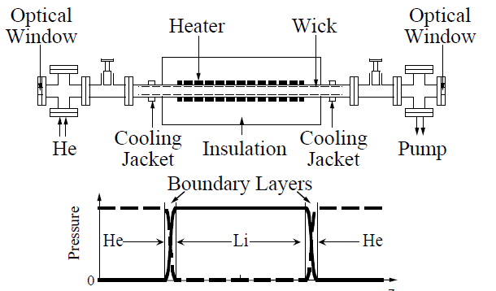
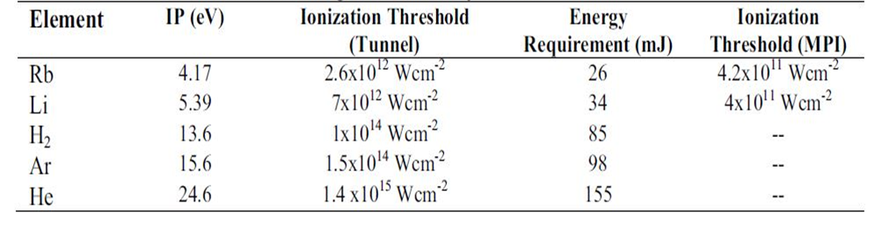
Plasma source properties and implementation_Heat-pipe ovens
Beam-driven plasma accelerators
Heat-pipe oven properties
Alkali metal (Li, Rb, Cs,…) heated to form vapor
The photo-ionized plasma is expected to have a very uniform transverse profile and a small longitudinal gradient (e.g. in AWAKE)
The maximum plasma density was 10¹⁴ - 10¹⁵ cm⁻³
Sharp boundaries and Plasma/Li density set by P_{He}
Li column length set by heating power (700-900°C) until the room temperature imposed by the jackets limits the length of this column
Long targets (m-scale)
Ionizable by drive beam or a laser pulse (low I_{P})
Muggli, P. et Al, Photo-Ionized Lithium Source for Plasma Accelerator Applications, IEEE Trans. Plasma Sci. 27 (1999).
Vafaei-Najafabadia, N. et Al, Meter Scale Plasma Source For Plasma Wakefield Experiments, AIP Conference Proceedings 1507, 650 (2012).
Angelo.Biagioni@lnf.infn.it | EuPRAXIA_DN School on Plasma accelerators | Page 18/40

Slide 19
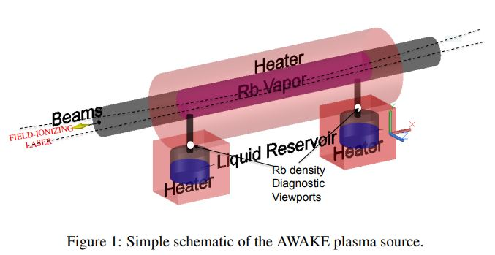
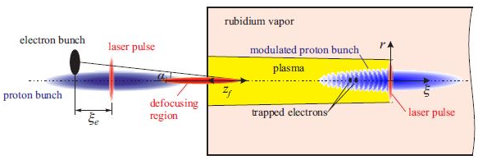
Plasma source properties and implementation_Heat-pipe ovens
10 m long, 40 mm diameter oil-heated pipe
Plasma is laser ionized (low I_{P} for Rb)
Alkali vapor expels buffer from heated region by collisions, steady-state when P_{alkali} = P_{buff}
Increasing heater power increases evaporation rate (but not T_{alkali}) and so the P_{alkali}
Pressure fixed by P_{buff}, hence length of alkali column L can be varied by changing the heating power delivered to the oven
The density uniformity is achieved by imposing a uniform temperature (200 °C) (within 0.2 %) along the source. The oil temperature stabilized to ±0.05 °C. Appropriate density gradients increase the energy gain
A threshold ionization process for the first Rb electrons is used to turn the uniform neutral density into a uniform plasma density.
to ensure an efficient electron trapping one needs short density ramps (< 10 cm): a continuous flow system through orifices has been chosen to shorten the ramps. The Rb sources placed as close as possible to the orifices to minimize the density ramps
Laser ionization:
  Long focal length lens or “axicon” and large spot size
  Tunneling/BSI as threshold process yields flat-top profile
  - SPI/MPI scales with power of n-photons required and varies with laser intensity profile
10 m
Long, thin proton bunches (400GeV) undergo a process called self-modulation, a particle-plasma interaction that splits the bunch longitudinally into a series of high-density micro-bunches, which then act resonantly to create large wakefields.
< 1pC
2 GeV
Density gradient 2%
650pC
20MeV
Adli, E. et Al, Acceleration of electrons in the plasma wakefield of a proton bunch, Nature 561, 363–367 (2018).
Gschwendtner, E. et Al, AWAKE, The Advanced Proton Driven Plasma Wakefield Acceleration Experiment at CERN. NIMA, 829 (2016).
Oz, E. et Al, AWAKE, An accurate Rb density measurement method for a plasma wakefield accelerator experiment using a novel Rb reservoir, arXiv:1511.08763 (2015).
Run2: 2021-2024 – two long plasma sections (electrical dscharge)
Angelo.Biagioni@lnf.infn.it | EuPRAXIA_DN School on Plasma accelerators | Page 19/40

Slide 20
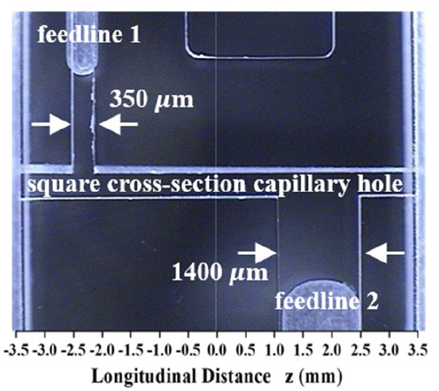




Plasma source properties and implementation_Gas cells
Gas injection
Very small dimenisons
Laser pulse
Gas cell pressure P
Plasma/Gas ramps
Gas cells properties
Region of uniform neutral gas contained by differential pumping at two input/output extremities
If flow resistance of outlets larger than inlets, uniform density distribution in central volume
Gas flow small enough to operate in steady state regime with continuous flow (typically <1 bar)
Variable length gas cell designs by using mechanically moving parts
Plume of gas from front and back of cell, plasma ramps to be controlled
Density easily adjusted by controlling gas flow or geometry in the range: 10¹⁶ - 10¹⁹ cm⁻³
Erosion of inlet/outlet due to the high-power laser pulses
Small dimensions, 100-300 μm in diameter and few mm in length
HOFI plasma channels
Very good behaviour to operate to high repetition rate (possible 1kHz)
Variable length gas cell
Angelo.Biagioni@lnf.infn.it | EuPRAXIA_DN School on Plasma accelerators | Page 20/40

Slide 21








Plasma source properties and implementation_Gas cells
Hydrodynamic optical-field-ionized plasma channels (HOFI)
Conditioned Hydrodynamic optical-field-ionized plasma channels (CHOFI)
The plasma channel is free-standing, no damages of the structure, so high repetition rate > 1kHz is possible
L_{att} ~ 1 m (axicon lenses)
since rapid collisional heating (depends on the gas density) requires high plasma densities, it has proved difficult to generate channels with low on-axis densities (ne > 10¹⁸ cm⁻³) and L > 1 cm
The development of methods for guiding intense laser pulses through plasma is crucial for LWFA (hollow transverse profiles)
A column of plasma is generated by optical field ionization; this expands hydrodynamically into the surrounding gas, driving a radial shockwave and forming a plasma channel along the axis of the plasma column.
Ar/N₂O
Shalloo, R.J. et Al, Phys. Rev. Accel. Beams 22 (2019).
Alejo, A. et Al, Phys. Rev. Accel. Beams 25 (2022)
C.G. Durfee & H.M. Milchberg, Phys. Rev. Lett. 71, 2409 (1993)
Depth of the channel increased by a factor of 10 to Δne = 1.3×10¹⁸ cm⁻³ (ne < 10¹⁷ cm⁻³) and Latt in the m-scale
Angelo.Biagioni@lnf.infn.it | EuPRAXIA_DN School on Plasma accelerators | Page 21/40

Slide 22




Plasma source properties and implementation_Gas-filled discharge capillaries
Discharge Plasma sources properties
Region of uniform neutral gas contained by differential pumping at two input/output extremities and realized by a thin capillary
Modulation of longitudinal gas distribution by special geometric shapes
Small gas flow to operate in steady state regime with continuous flow (P < 1 bar)
There is no movable parts
Small dimension of the HV source to produce plasma
Plume of gas from front and back of cell, plasma ramps to be controlled
Density easily adjusted by controlling gas flow, geometry or voltage in the range: 10¹⁵ - 10¹⁹ cm⁻³
Erosion of the plasma channel due to the electrical discharges to form plasma
Gas injection
Electrode
HV pulse
Gas inlets
Plasma channel
Plasma/Gas ramps
Electrodes
Plasma channel
HV
Time profile
x10¹⁷
Acceleration
Spatial profile
Density profile
Angelo.Biagioni@lnf.infn.it | EuPRAXIA_DN School on Plasma accelerators | Page 23/40

Slide 23




Plasma source properties and implementation_Gas-filled discharge capillaries
neutral gas distribution
0-5 ms
EuPRAXIA target
  40cm x 2mm
  10¹⁶ cm⁻³
  P = 20-30 mbar
  ~ 10 kV
2.5E17
0 – 5 ms
1 ms
Design of the gas-filled capillary-discharge
Geometry design
  Channel diameter to set plasma density
  Inlets for neutral gas distribution
  Materials (lifetime)
  HV-source design
    Voltage/current settings
    Gas injection
      Gas
      Continuous flow/pulsed flow system (Rep rate)
      Pressure
4.5 ms
6E16
2E16
Angelo.Biagioni@lnf.infn.it | EuPRAXIA_DN School on Plasma accelerators | Page 24/40

Slide 24




Plasma source properties and implementation_Gas-filled discharge capillaries
Active PlasmA alens (APL)
Time profile
Focusing
R capillary radius
I₀ peak current
J. van Tilborg et Al, Active Plasma Lensing for Relativistic Laser-Plasma-Accelerated Electron Beams, PRL 115, 184802 (2015)
Angelo.Biagioni@lnf.infn.it | EuPRAXIA_DN School on Plasma accelerators | Page 25/40

Slide 25






Plasma source properties and implementation_Gas-filled discharge capillaries
Integrated capillary
Studies on cross-talk effects:
Design of electrodes and HV-circuits to reduce the interaction among discharges through plsam ramps
Lens ON Acc ON Lens ON
Acc-200A
3 us
Lens-500A
Very long capillary
Design of m-scale capillaries for EuPRAXIA project by using segmented capillaries: design of HV-voltage circuits and discharge synchronization
Curved capillary for APD
Segmented capillary
Design of new geometries for curved channels: HV-circuits to allow high current pulses
Pompili, Riccardo, et Al, Guiding of charged particle beams in curved capillary-discharge waveguides, AIP Advances 8.1 (2018)
Angelo.Biagioni@lnf.infn.it | EuPRAXIA_DN School on Plasma accelerators | Page 26/40

Slide 26
Spectroscopic techniques
Plasma temperature
Interferometric tecniques
Plasma Diagnostics
Angelo.Biagioni@lnf.infn.it | EuPRAXIA_DN School on Plasma accelerators | Page 27/40

Slide 27




Plasma diagnostics_Spectroscopy
HOW IS THE CAPILLARY CHARACTERIZED?DENING TECHNIQUE
The Stark effect is the shifting and splitting of spectral lines of atoms and molecules due to the presence of an external electric field, it is responsible for the pressure broadening (Stark broadening) of spectral lines by charged particles in plasmas
Hydrogen-like and helium-like lines are the most sensitive to Stark broadening
Hb
Ha
wavelength
434nm
486nm
656nm
plasma light collection
Imaging of the plasma source
Stark broadening effect
Δλ
Δλ
Angelo.Biagioni@lnf.infn.it | EuPRAXIA_DN School on Plasma accelerators | Page 28/40

Slide 28





Plasma diagnostics_Spectroscopy
$$n_{eStark}=8.02×{10}^{12}{\left(\frac{∆λ}{α}\right)}^{3/2}{cm}^{−3}$$
Δ$λ_{Doppler}=\frac{2λ_{0}}{c}\sqrt{\frac{2kTln2}{M}}$
Lorentzian fit gives spectral line width Δλ (in Å in the formula)
  Doppler (Gaussian fit) → Temperature
  Pressure Broadening (Lorentzian fit) → Density
α value is a tabulated parameter
The spectrometer allows the balmer lines to be selected from the collected plasma light
Fast gate intensified CCD camera to acquire the plasma light
Lorentzian fit
$$∆λ$$
Mechanical
regulator
Electromechanical valve
Position (mm)
Capillary
H2 source
Δλ
Electrode
shadow
Vacuum
chamber
ICCD camera
Plasma
channel
Plasma light
Plasma plume
H_{β}
spectral line
Spectrometer
λ (nm)
Angelo.Biagioni@lnf.infn.it | EuPRAXIA_DN School on Plasma accelerators | Page 29/40

Slide 29

Plasma diagnostics_Spectroscopy
Position (mm)
λ (nm)
Plasma properties characterization as a function of time and spatial coordinate
shortest gating time of the ICCD camera over which S/N is sufficient (few ns)
CCD camera resolution (10 – 30 μm)
Time
Angelo.Biagioni@lnf.infn.it | EuPRAXIA_DN School on Plasma accelerators | Page 30/40

Slide 30





Plasma diagnostics_Temperature
H_{β} spectral line
I’
I
The parameters f (oscillator strength), g (statistical weights), λ (wavelenght), a₀ (Bohr radius), E (excitation energy of atom) E_{H} (ionization energy of the Hydrogen atom ), E∞, ΔE∞ (correction to the ionization energy E∞ of the lower ionization stage due to plasma interactions) are all tabulated on the NIST database
486nm
ICCD camera
Capillary
Plasma light
spectral lines
Spectrometer
S. S. Harilal, Electron density and temperature measurements in a laser produced
carbon plasma (1997), J. Appl. Phys. 82 (5)
Angelo.Biagioni@lnf.infn.it | EuPRAXIA_DN School on Plasma accelerators | Page 31/40

Slide 31




Plasma diagnostics_Laser interferometry
The integrated path length or phase of a laser pulse traversing a plasma depends on the index of refraction of the plasma
In the Mach-Zehnder interferometer one laser arm has traversed a plasma and one has not
The interference created by combining two different laser arms
Δφ observed is a line-of-sight integral and therefore the geometry of the target can affect the measure (for cylindrical symmetry Abel inversion)
ω0 needs to see significant phase shift, not too far away from critical density or long plasma (i.e., critical 10¹⁸ cm⁻³ in transverse measure with 1 um lasers)
Mach-Zehnder interferometer
ω0 Laser frequency
ωp Plasma frequency
nc critical density
L length of plasma traversed
Δφ total integrated phase shift
Milan Kalal and Keith Nugent, Abel inversion using fast fourier transforms, Applied optics,
27(10):1956–1959, 1988.
Angelo.Biagioni@lnf.infn.it | EuPRAXIA_DN School on Plasma accelerators | Page 32/40

Slide 32



Plasma diagnostics_Laser interferometry
Two-color interferometer
400 nm pulses are intrinsically coupled and locked in timing, phase, pointing, and stability, since they experience the same optical path.
Single laser pulse frequency doubled → two co-propagating harmonics at 800 and 400 nm (red and blue)
Δφ (Δt) due to different group and phase velocities in plasma
On exiting the plasma, remaining 800 nm pulse is also doubled (all blue)
Spectral interference pattern reveals information about temporal delay, phase shift, and the plasma density
J. Van Tilborg et al, Optics Letters 43, 12 (2018)
Angelo.Biagioni@lnf.infn.it | EuPRAXIA_DN School on Plasma accelerators | Page 33/40

Slide 33
High repetition rate plasma sources for EuPRAXIA project
Angelo.Biagioni@lnf.infn.it | EuPRAXIA_DN School on Plasma accelerators | Page 34/40

Slide 34
Spectroscopic measure of the plasma temperature
High repetition rate sources for EuPRAXIA project
EuPRAXIA accelerator will operate at 100 Hz in m-scale plasma sources
  Electrical discharge ionization process
    Solid-state high repetition-rate discharge system
    Strong materials capable of dissipating thermal energy
    Vacuum systems suitable for large quantity of gas in continuous flow regime (turbo and primary pumps cooling system)
    Electrical discharges in very log gas columns
      Laser ionization process
          High-power laser operating at high repetition rate (>100Hz)
          Vacuum systems suitable for large quantity of gas in continuous flow regime (turbo and primary pumps cooling systems)
          Laser guiding in long plasma sources
Gas injection
Plasma channel
Plumes
Electrodes
HV
Gas injection
Laser pulse
pressure P
Plumes
Angelo.Biagioni@lnf.infn.it | EuPRAXIA_DN School on Plasma accelerators | Page 35/40

Slide 35





High repetition rate sources for EuPRAXIA project
Mitigation of erosion of the capillary walls can be achieved by reducing the heat flux
PWFA (EuPRAXIA project)
5x10¹⁶cm⁻³ Pgas=20mbar
Ip=300A Rcap=2000um
Lcap=400mm Δt=600ns
Current pulse width and amplitude
Gas fill pressure
Capillary radius
the energy deposited into the capillary per shot:
E = Rp Ip² Δt = 100 mJ/shot
Rp = η Lcap/Scap
η
Plastic
400K
k=0.2
Glass
1700K
k=1-3
Crucial role of the thermal conductivity
Sapphire
2300K
k=40 [W/mK]
Conductive heat transfer law:
T2=300K
r2 =5mm
Discharge
Heating
300A, 400Hz
q
300A
100Hz
Diamond
3800K
k=1000
Cooling system
300K
T1,r1
Cylinder geometry
A. Gonsalves, et al, Demonstration of a high repetition rate capillary discharge waveguide, JAP, 119,10.1063/1.4940121
40W
P(W)
Angelo.Biagioni@lnf.infn.it | EuPRAXIA_DN School on Plasma accelerators | Page 36/40

Slide 36








High repetition rate sources for EuPRAXIA project
To operate at high repetition rate with gas-filled capillary-discharge the key point is the thermal dissipation
  Solid-state high repetition-rate discharge system
  Strong materials capable of dissipating thermal energy
  Vacuum systems suitable for continuous flow gas injection (turbo and primary pumps cooling system)
HV- generator
25 kV
20-200 mA
High voltage for plasma formation
High current output for high repRATE
Thermal dissipation of components is crucial
HV-switch
Test of strong materials (sapphire and ceramics)
2.2 kA
400 A
High repRATE can cause a rapid degradation of unsuitable soft materials
Current pulses from 100 to 2500 A at repetition rate from 1 to 400 Hz
Discharge capillary
Angelo.Biagioni@lnf.infn.it | EuPRAXIA_DN School on Plasma accelerators | Page 36/40

Slide 37








High repetition rate sources for EuPRAXIA project
Discharge capillary
0.5x10¹⁷ cm⁻³
Transverse profile after 10⁷ shots
1.5x10¹⁷ cm⁻³
Lifetime test of ceramic materials so far on 10⁷ shots at 30-50 Hz repetition rate (7 days, 8h per day), thermal conductivity higher than sapphire (70-90 with respect to 40 W/mK)
Working conditions 100Hz – 30 days -24 h per day
So far no degradtion, but anyway slight modifications may be compensated by changing pressure and tension applied
30 mm
HOFI plasma channels
Transverse profile 0 shots
a single
channel-forming
pulse (left)
(right) the second of a
pair of channel-forming
pulses separated by 1 ms (1kHz could be possible)
f=200 Hz
Pb=350 mbar
6.5 hours
1 mJ
40 fs
5 mm
A. Alejo,1, Demonstration of kilohertz operation of Hydrodynamic Optical-Field-Ionized Plasma Channels, Phys. Rev. Accel. Beams 25, 011301 (2022)
Angelo.Biagioni@lnf.infn.it | EuPRAXIA_DN School on Plasma accelerators | Page 37/40

Slide 38
References
Xiao, Dengming, Gas Discharge and Gas Insulation (2016) Volume 6
Fundamental Theory of Townsend Discharge, pp. 47–88. doi:10.1007/978-3-662-48041-0_3
P. Gibbon et Al, Short Pulse Laser Interactions with Matter: An Introduction, Imperial College Press, 2005
L. Gallmann et Al, Photoemission and photoionization time delays and rates, Structural Dynamics 4, 061502 (2017) https://doi.org/10.1063/1.4997175
L. V. Keldysh, Ionization in the field of a strong electromagnetic wave, Sov. Phys. JETP 20, 1307–1314 (1965)
M.V. Ammosov, N. B. Delone, and V. P. Krainov, Tunnel ionization of complex atoms and of atomic ions in an alternating electromagnetic field , Sov. Phys. JETP 64, 1191 (1986)
M. J. Hogan et Al, Multi-GeV Energy Gain in a Plasma-Wakefield Accelerator, (2005) PHYSICAL REVIEW LETTERS PRL 95, 054802DOI: 10.1103/PhysRevLett.95.054802
C. L. O’Connell et Al, Plasma production via field ionization, (2006) PHYSICAL REVIEW SPECIAL TOPICS - ACCELERATORS AND BEAMS 9, 101301 DOI: 10.1103/PhysRevSTAB.9.101301
M. Hansen et Al, Supersonic gas-jet characterization with interferometry and Thomson scattering on the OMEGA Laser Systema, Proceedings of the 22nd Topical Conference on High-Temperature Plasma Diagnostics (HTPD 2018) in San Diego, California, USA
B. R. Lee et Al, Spatiotemporal characteristics of high-density gas jet and absolute determination of size and density of gas clusters. Sci Rep 10, 12973 (2020). https://doi.org/10.1038/s41598-020-69824-z
Ocean Zhou et Al, Effect of nozzle curvature on supersonic gas jets
used in laser–plasma acceleration, Phys. Plasmas 28, 093107 (2021); doi: 10.1063/5.0058963
Kurz, T. et al. Nat Commun 12, 2895 (2021).
Angelo.Biagioni@lnf.infn.it | EuPRAXIA_DN School on Plasma accelerators | Page 38/40

Slide 39
References
Couperus Cabada, J.P. et al. Phys. Rev. Research 3 L042005 (2021)
Muggli, P. et Al, Photo-Ionized Lithium Source for Plasma Accelerator Applications, IEEE Trans. Plasma Sci. 27 (1999).
Vafaei-Najafabadia, N. et Al, Meter Scale Plasma Source For Plasma Wakefield Experiments, AIP Conference Proceedings 1507, 650 (2012)
Adli, E. et Al, Acceleration of electrons in the plasma wakefield of a proton bunch, Nature 561, 363–367 (2018).
Gschwendtner, E. et Al, AWAKE, The Advanced Proton Driven Plasma Wakefield Acceleration Experiment at CERN. NIMA, 829 (2016).
Oz, E. et Al, AWAKE, An accurate Rb density measurement method for a plasma wakefield accelerator experiment using a novel Rb reservoir, arXiv:1511.08763 (2015).
Shalloo, R.J. et Al, Phys. Rev. Accel. Beams 22 (2019).
Alejo, A. et Al, Phys. Rev. Accel. Beams 25 (2022)
C.G. Durfee & H.M. Milchberg, Phys. Rev. Lett. 71, 2409 (1993)
Pompili, Riccardo, et Al, Guiding of charged particle beams in curved capillary-discharge waveguides, AIP Advances 8.1 (2018)
J. van Tilborg et Al, Active Plasma Lensing for Relativistic Laser-Plasma-Accelerated Electron Beams, PRL 115, 184802 (2015)
S. S. Harilal, Electron density and temperature measurements in a laser produced
carbon plasma (1997), J. Appl. Phys. 82 (5)
Milan Kalal and Keith Nugent, Abel inversion using fast fourier transforms, Applied optics,
27(10):1956–1959, 1988.
J. Van Tilborg et al, Optics Letters 43, 12 (2018)
A. Gonsalves, et al, Demonstration of a high repetition rate capillary discharge waveguide, JAP, 119,10.1063/1.4940121
A. Alejo,1, Demonstration of kilohertz operation of Hydrodynamic Optical-Field-Ionized Plasma Channels, Phys. Rev. Accel. Beams 25, 011301 (2022)
Angelo.Biagioni@lnf.infn.it | EuPRAXIA_DN School on Plasma accelerators | Page 39/40

Slide 40

Thank you for your attention

