Slide 1
Beam Diagnostics for Plasma Accelerators
Dr Joseph Wolfenden
EuPRAXIA-DN School on Plasma Accelerators
Orto Botanico di Roma, 22-26 April 2024

Slide 2
Overview
What are we measuring and why?
Common diagnostic problems
Position
Transverse Emittance
Longitudinal Profile
Charge
Losses
Dr Joseph Wolfenden EuPRAXIA-DN School on Plasma Accelerators

Slide 3
What are we measuring and why?
Particle beam is a 6D phase space of N particles
Lots of complex/interesting projections and correlations
Dr Joseph Wolfenden EuPRAXIA-DN School on Plasma Accelerators

Slide 4
What are we measuring and why?
For a particular bunch we commonly want to know:
Transverse position - $\left\langle x\right\rangle$, $\left\langle y\right\rangle$
Propagation angle - $\left\langle x′\right\rangle$, $\left\langle y′\right\rangle$
Transverse size - $σ_{x}$, $σ_{y}$
Divergence - $σ_{x^{′}}$, $σ_{y^{′}}$
Transverse emittance - ${\text{ε}}_{x}$, ${\text{ε}}_{y}$
Energy - $E$
Energy spread - $ΔE$
Bunch Length - $σ_{t}$
Charge - $Nq$
Where is the beam? Where is it going?
What is the spatial beam size? What is the angular beam size?
Beam quality?
What is the bunch energy? How long is the beam? How is this changing?
How much beam is there/lost?
Dr Joseph Wolfenden EuPRAXIA-DN School on Plasma Accelerators

Slide 5
What are we measuring and why?
Measuring vs Monitoring
Measuring:
Very precise result
May take multiple data points to achieve
Invasiveness ok – the beam can be destroyed in the process
Monitoring:
Precision may not be as important
Often closer to single-shot
Non-invasive as a rule – the beam can be applied to something else
Dr Joseph Wolfenden EuPRAXIA-DN School on Plasma Accelerators

Slide 6
Transverse Emittance

Slide 7
Transverse emittance – current methods
Emittance measurements are reliant on profile measurements
Generally, beam is used to generate radiation
Radiation properties map to beam properties
Scintillation
Transition radiation
Synchrotron radiation
e⁻
e⁻
e⁻
Dr Joseph Wolfenden EuPRAXIA-DN School on Plasma Accelerators

Slide 8
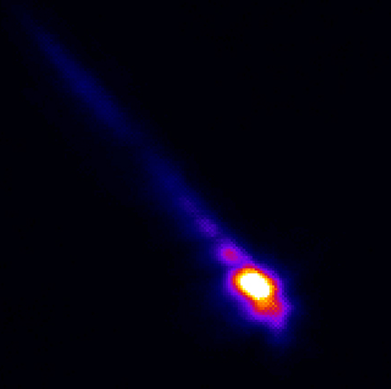
Transverse emittance – current methods
Emittance measurements are reliant on profile measurements
Generally, beam is used to generate radiation
Radiation properties map to beam properties
Scintillation
Transition radiation
Synchrotron radiation
σ_{x} = 90 um
CLARA (T. Pacey)
σ_{x} = 150 um
CLEAR (J. Wolfenden)
σ_{x} = 100 um (σ_{y} = 2 um)
Diamond (J. Wolfenden)
e⁻
e⁻
e⁻
700pC
>10nC
Dr Joseph Wolfenden EuPRAXIA-DN School on Plasma Accelerators

Slide 9
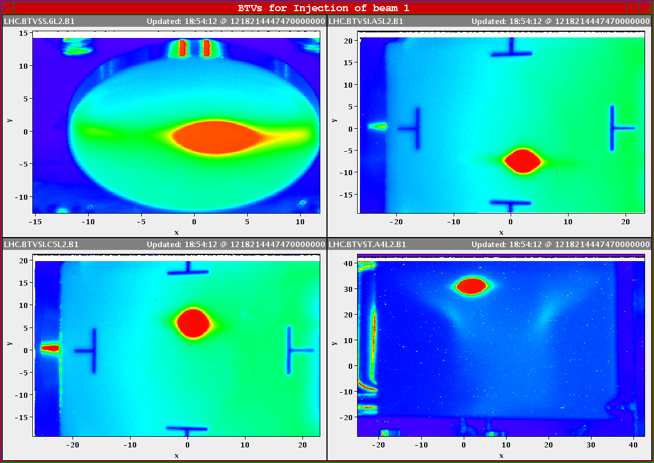
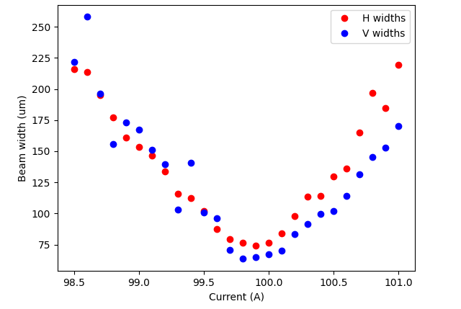
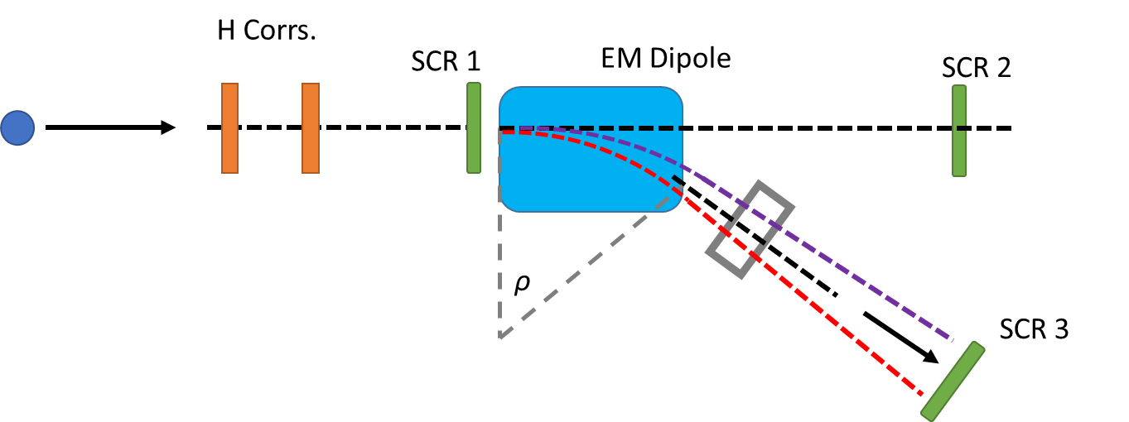
Transverse emittance – current methods
σ_{x} = 150 um
CLEAR (J. Wolfenden)
Many other methods
Used in many diagnostics
Positioning
Beam size
Emittance
Energy
…
700pC
First Beam in the LHC 8/8/2008
Image: T. Pacey
Dr Joseph Wolfenden EuPRAXIA-DN School on Plasma Accelerators

Slide 10
Transverse emittance – current methods
The most common method of calculating emittance is a quadrupole scan
This can be achieved in two ways:
Multi-screen
L₁
L₂
L₃
L_{n}
Beam Envelope
Screen
Quadrupole
Dr Joseph Wolfenden EuPRAXIA-DN School on Plasma Accelerators

Slide 11
Transverse emittance – current methods
The most common method of calculating emittance is a quadrupole scan
This can be achieved in two ways:
Multi-screen
L
Multi-current
Beam Envelope
K_{n}
Screen
Quadrupole
Dr Joseph Wolfenden EuPRAXIA-DN School on Plasma Accelerators

Slide 12
Transverse emittance – current methods
L
$$σ_{11}^{2}$$
K_{n}
Beam Envelope
Screen
K
Quadrupole
$$Σ_{f}=MΣ_{i}M^{T}$$
$$Σ= ε\left(\begin{matrix}β & −α \\ −α & γ\end{matrix}\right)=\left(\begin{matrix}\left\langle x^{2}\right\rangle & \left\langle xx′\right\rangle \\ \left\langle xx′\right\rangle & \left\langle {x′}^{2}\right\rangle \end{matrix}\right)=\left(\begin{matrix}σ_{11} & σ_{12} \\ σ_{12} & σ_{22}\end{matrix}\right)$$
$$M=M_{Drift}M_{Quad}=\left(\begin{matrix}1 & L \\ 0 & 1\end{matrix}\right)\left(\begin{matrix}1 & 0 \\ −K & 1\end{matrix}\right)$$
$$ε=det\left(Σ\right)=\sqrt{\left\langle x^{2}\right\rangle \left\langle {x′}^{2}\right\rangle −{\left\langle xx′\right\rangle }^{2}}$$
Dr Joseph Wolfenden EuPRAXIA-DN School on Plasma Accelerators

Slide 13
Transverse emittance – current methods
L
$$σ_{11}^{2}$$
K_{n}
Beam Envelope
Screen
K
Quadrupole
$$\left\langle x_{f}^{2}\right\rangle =\left[L^{2}\left\langle x_{i}^{2}\right\rangle \right]K^{2}−2L\left[\left\langle x_{i}^{2}\right\rangle +L\left\langle x_{i}{x^{′}}_{i}\right\rangle \right]K+\left[L^{2}\left\langle {x^{′}}_{i}^{2}\right\rangle +2L\left\langle x_{i}{x^{′}}_{i}\right\rangle +\left\langle x_{i}^{2}\right\rangle \right]$$
$=AK^{2}+BK+C$
$$\left\langle x_{i}^{2}\right\rangle =\frac{A}{L^{2}}$$
$$\left\langle x_{i}{x^{′}}_{i}\right\rangle =\frac{1}{L}\left(\frac{B}{−2L}−\left\langle x_{i}^{2}\right\rangle \right)$$
$$\left\langle {x^{′}}_{i}^{2}\right\rangle =\frac{C−2L\left\langle x_{i}{x^{′}}_{i}\right\rangle −\left\langle x_{i}^{2}\right\rangle }{L^{2}}$$
$$ε=\sqrt{\left\langle x^{2}\right\rangle \left\langle {x′}^{2}\right\rangle −{\left\langle xx′\right\rangle }^{2}}$$
[1]
Dr Joseph Wolfenden EuPRAXIA-DN School on Plasma Accelerators

Slide 14
Transverse emittance – current methods
Two main limiting factors:
Multiple measurements require a beam stability
Energy spread from a plasma accelerator is typically >1%
L
$$ε=\sqrt{ε_{0}^{2}+K^{2}σ_{x}^{4}σ_{γ}^{2}}$$
Beam Envelope
K_{n}
Screen
[2]
Quadrupole
Dr Joseph Wolfenden EuPRAXIA-DN School on Plasma Accelerators

Slide 15
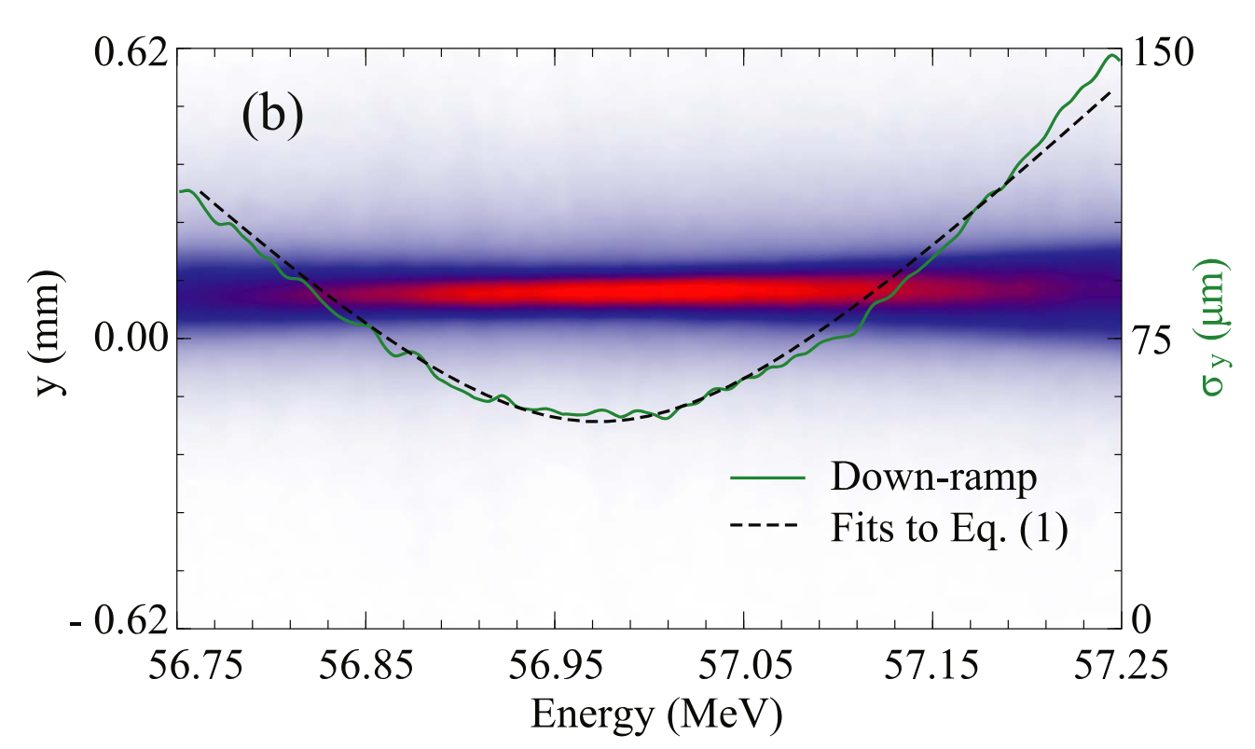
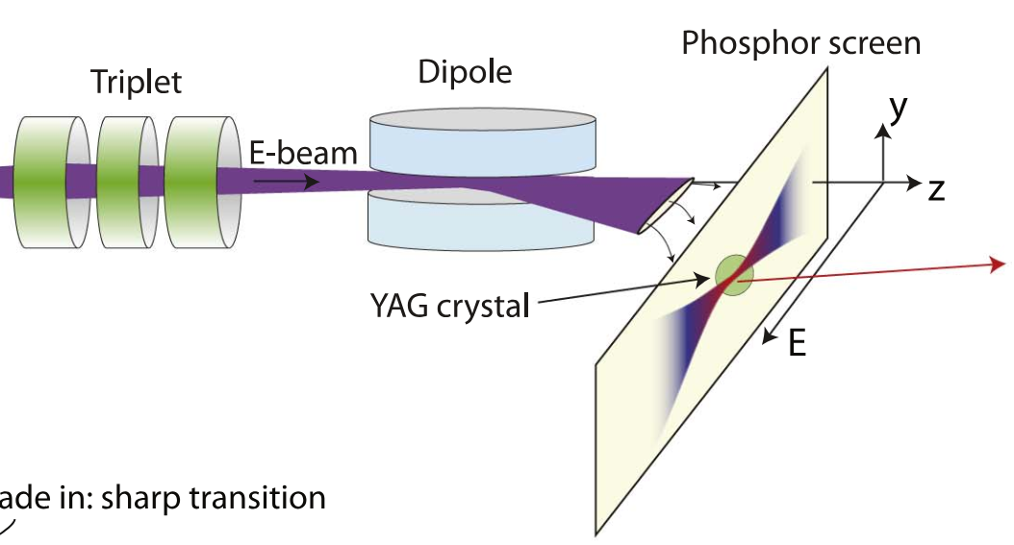
Transverse emittance - Butterfly
Use large energy spread to produce a single-shot quadrupole scan
$$σ_{y}\left(E\right)=\sqrt{{\left[R_{34}\left(E−∆E\right)\right]}^{2}{\left(ε_{y}/γσ_{y0}\right)}^{2}+{\left[R_{33}\left(E−∆E\right)\right]}^{2}{σ_{y0}}^{2}}$$
[3, 4]
Dr Joseph Wolfenden EuPRAXIA-DN School on Plasma Accelerators

Slide 16
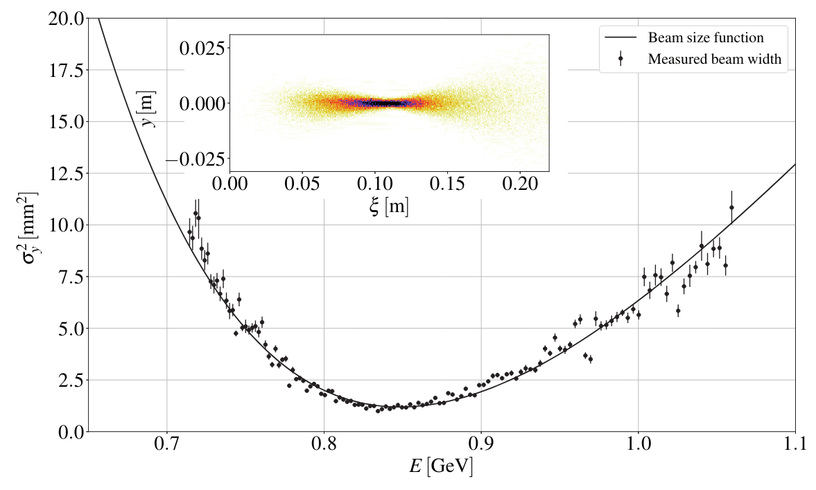
Transverse emittance - Butterfly
Known as a butterfly scan
[3, 4]
Dr Joseph Wolfenden EuPRAXIA-DN School on Plasma Accelerators

Slide 17
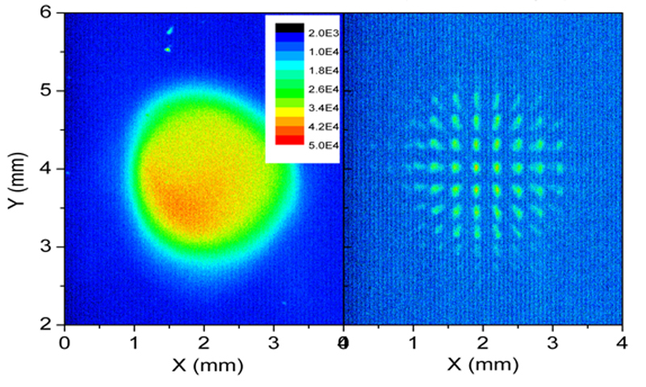
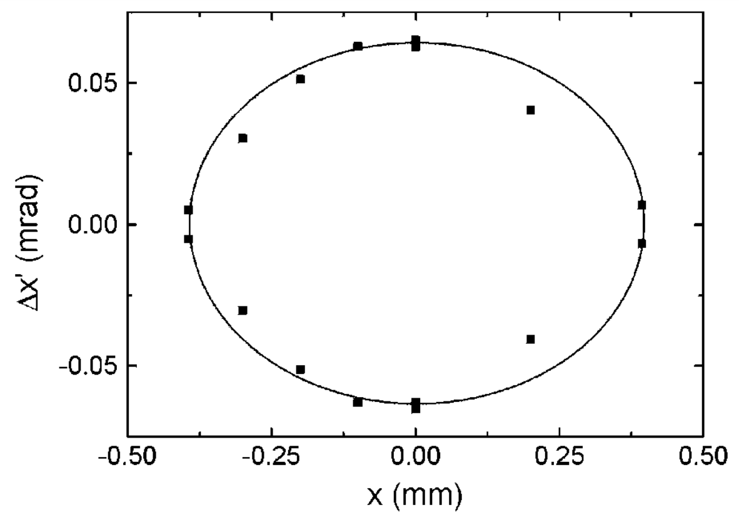
Transverse emittance – Pepper-pot
Single-shot alternative - pepper-pot
Possible to build a phase space map
Can also calculate emittance directly from image
Image: C. Welsch
Image: C. Welsch
$$ε^{2}=\frac{1}{N^{2}}\left[\sum_{j=1}^{p}{n_{j}{\left(x_{sj}−\overline{x}\right)}^{2}}\right]\left[\sum_{j=1}^{p}{\left[n_{j}σ_{{x′}_{j}}^{2}+n_{j}{\left({\overline{x′}}_{j}−\overline{x′}\right)}^{2}\right]}\right]$$
$$−\frac{1}{N^{2}}{\left[\sum_{j=1}^{p}{n_{j}x_{sj}{\overline{x′}}_{j}}−N\overline{x}\overline{x′}\right]}^{2}$$
[5,6]
Dr Joseph Wolfenden EuPRAXIA-DN School on Plasma Accelerators

Slide 18
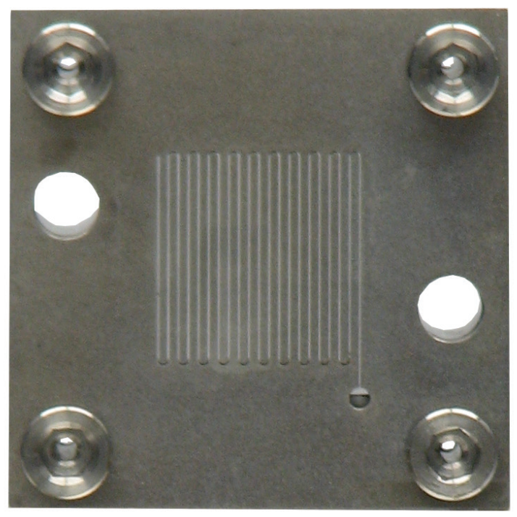
Transverse emittance – Pepper-pot
Applications can be complex due to specific beam requirements
Limited to ~1 mm mrad
Difficult to manufacture
Apertures
Thickness
Limited to low energy
Image: Radiabeam
[7,8]
Dr Joseph Wolfenden EuPRAXIA-DN School on Plasma Accelerators

Slide 19
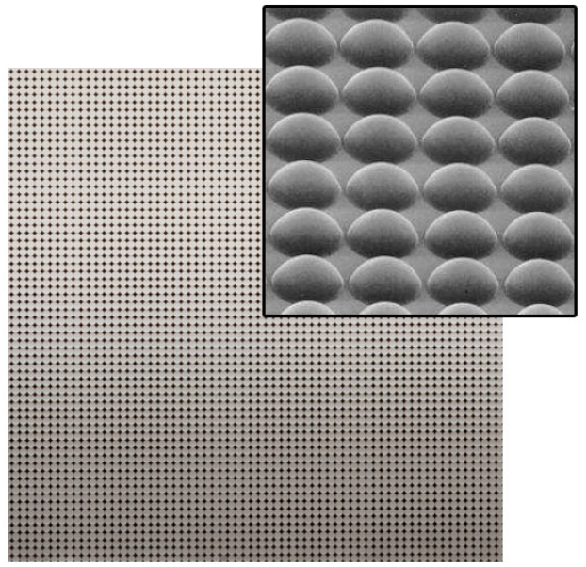
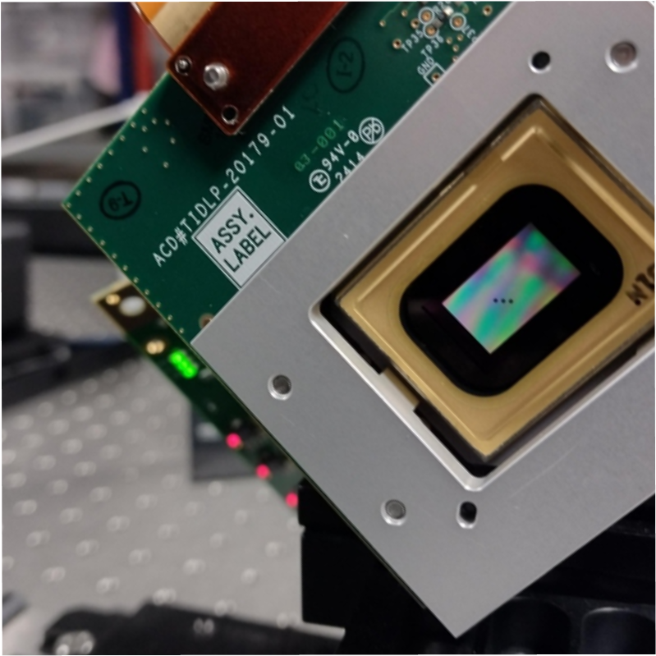
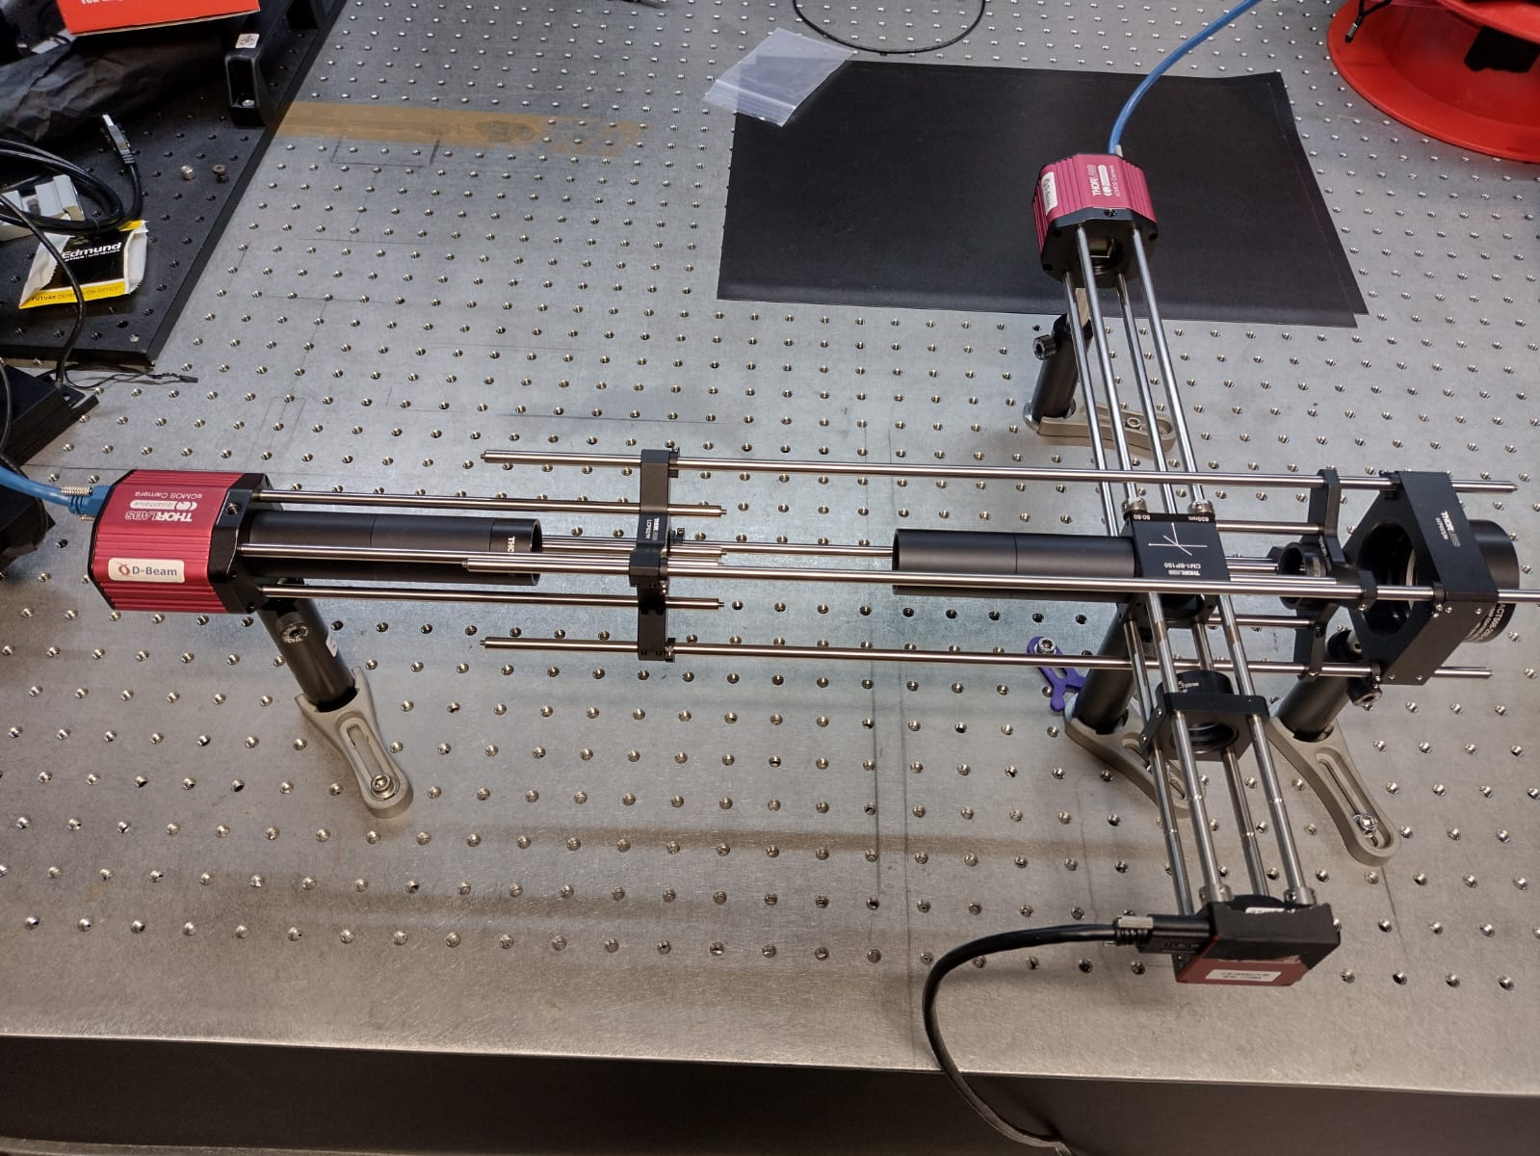
Transverse emittance – Optical mapping
Alternative is to map the optical phase space
Non/minimally invasive optical radiation sources can be used
Divergence resolution increase with energy
Micro-Lens Array
Pellicle Beamsplitter
[9,10]
Image: Thorlabs
Dr Joseph Wolfenden EuPRAXIA-DN School on Plasma Accelerators

Slide 20
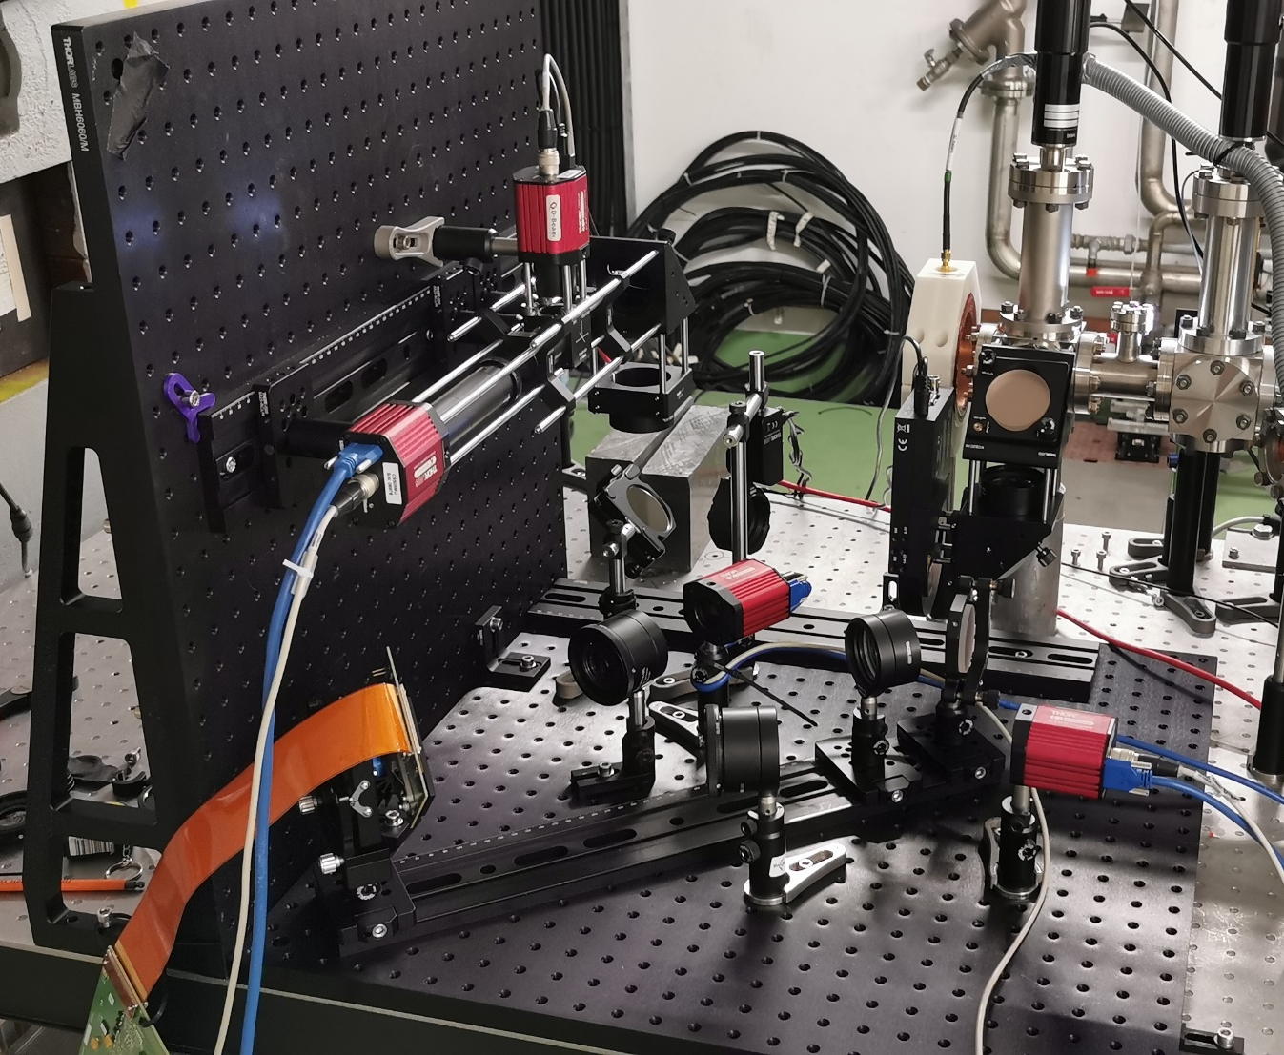
Transverse emittance – Optical mapping
Dr Joseph Wolfenden EuPRAXIA-DN School on Plasma Accelerators

Slide 21
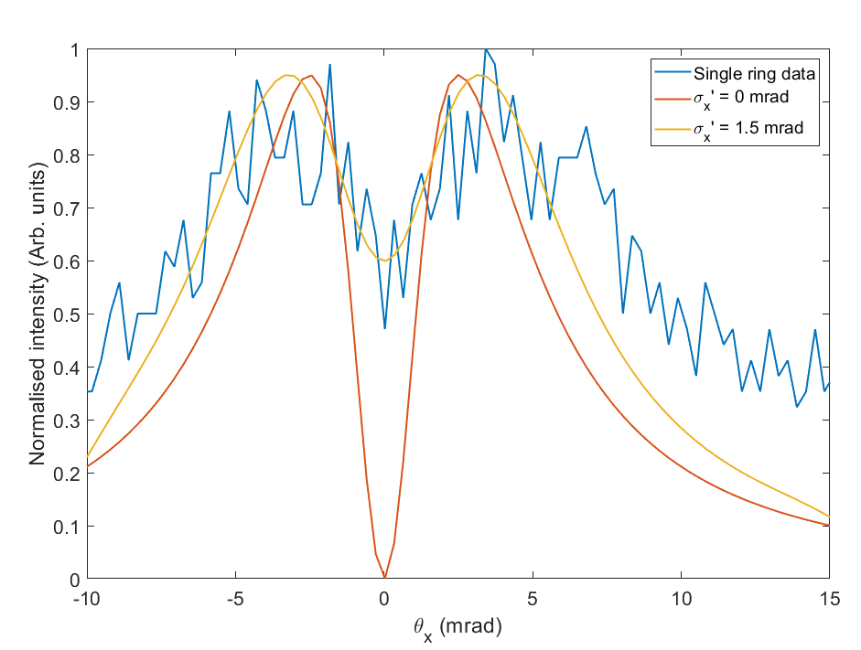
Transverse emittance – Optical mapping
Spatial
Angular
Dr Joseph Wolfenden EuPRAXIA-DN School on Plasma Accelerators

Slide 22
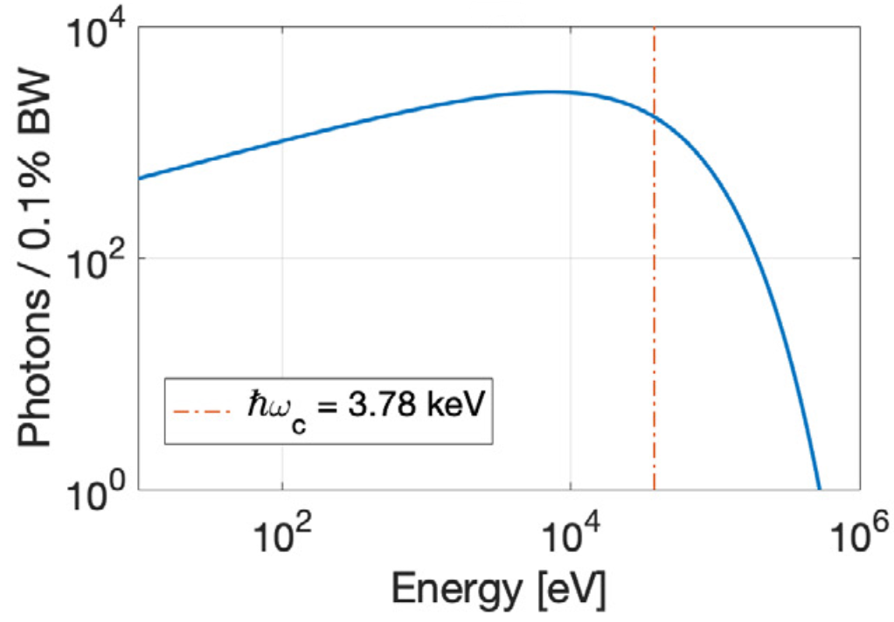
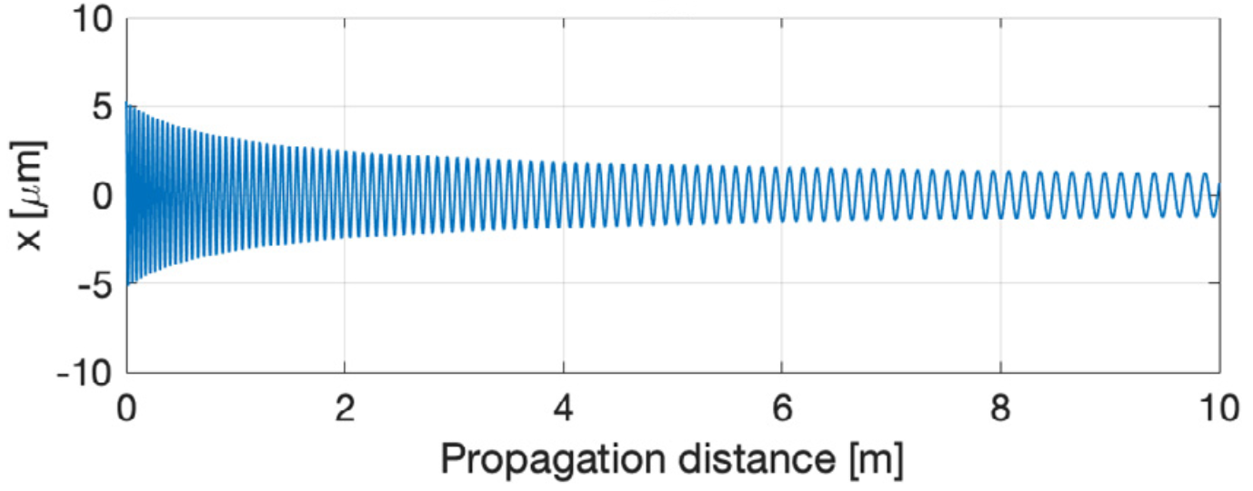
Transverse emittance - Betatron
Electrons travelling inside an ion channel can undergo Betatron oscillations, producing incoherent x-rays – Betatron radiation
The resulting spectrum is an incoherent sum over the spectra of the individual electrons
[11]
Dr Joseph Wolfenden EuPRAXIA-DN School on Plasma Accelerators

Slide 23
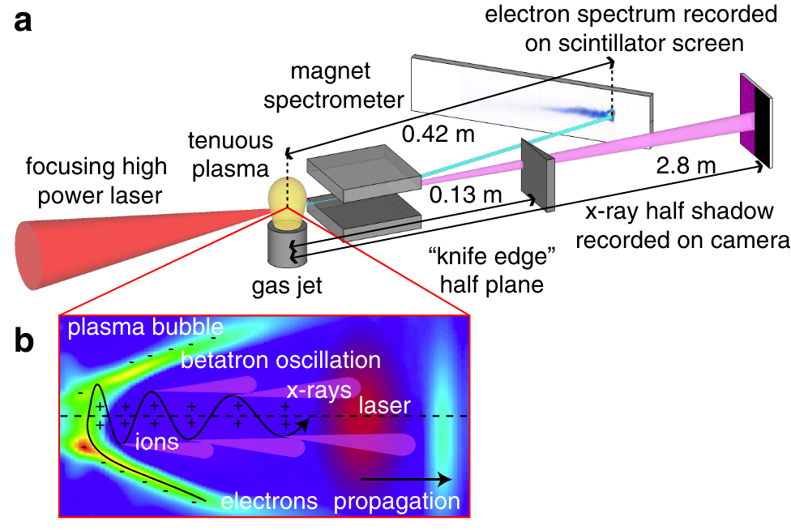
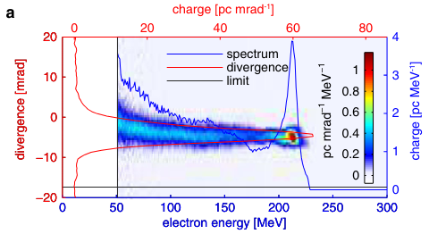
Transverse emittance - Betatron
Transverse beam size can be deduced from the critical frequency
Using independent measurements of divergence and energy, the normalised emittance can be inferred
[12]
Dr Joseph Wolfenden EuPRAXIA-DN School on Plasma Accelerators

Slide 24
Longitudinal Profile

Slide 25
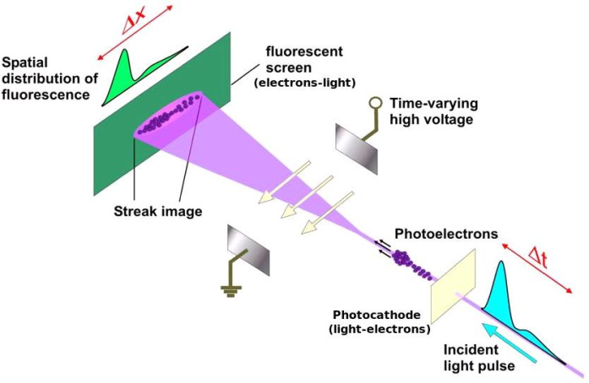
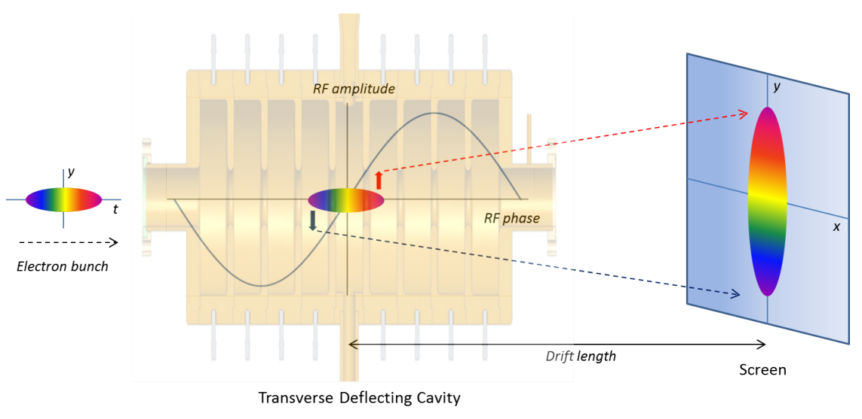
Longitudinal profile
Depends!
>1 ps (>0.3mm for $γ≫1$)
Streak camera
<1ps
Spectrometry
Interferometry
Transverse Deflecting cavity
Electro-optical
Dielectric structures
…
[13,14,15]
Dr Joseph Wolfenden EuPRAXIA-DN School on Plasma Accelerators

Slide 26
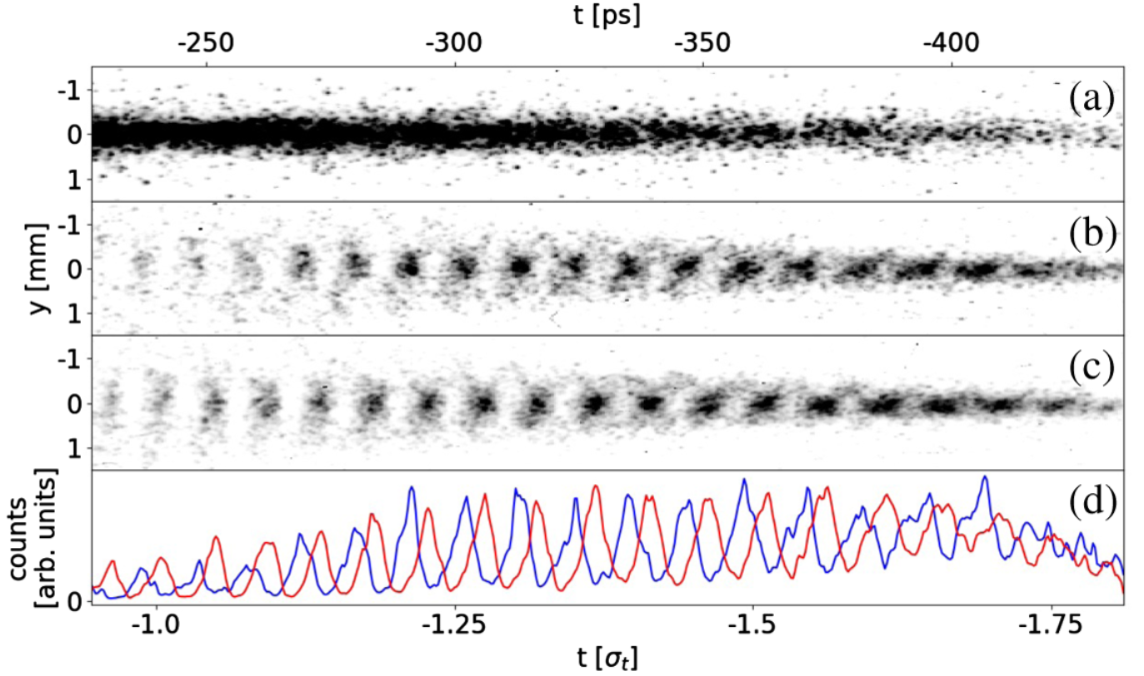
Longitudinal profile – Streak camera
Streak cameras are well developed standardised equipment
Highest resolution achievable ~200fs, but generally worse than this
Image: Hamamatsu
[16]
Dr Joseph Wolfenden EuPRAXIA-DN School on Plasma Accelerators

Slide 27
Longitudinal profile – Streak camera
Resolution is fundamentally limited, by:
Time dispersion of the photo-electrons
Space charge effects of the photo-electrons
Timing jitter when stacking multiple images
Image: Hamamatsu
[16]
Dr Joseph Wolfenden EuPRAXIA-DN School on Plasma Accelerators

Slide 28
Longitudinal profile – Deflecting cavity
Highly regarded and commonly used - resolution ~1fs
Type of RF cavity used to excite a transverse mode
Maps longitudinal profile into the transverse plane for imaging
[14,17]
Dr Joseph Wolfenden EuPRAXIA-DN School on Plasma Accelerators

Slide 29
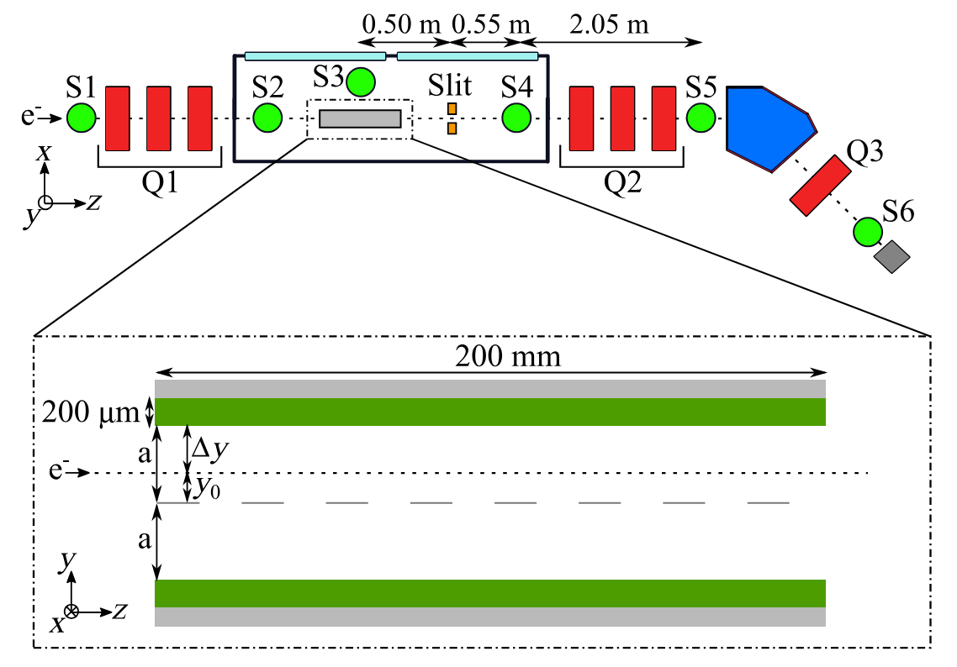
Longitudinal profile – Deflecting cavity
Expensive!
Destructive to the beam – no online monitoring
[14,17]
Dr Joseph Wolfenden EuPRAXIA-DN School on Plasma Accelerators

Slide 30
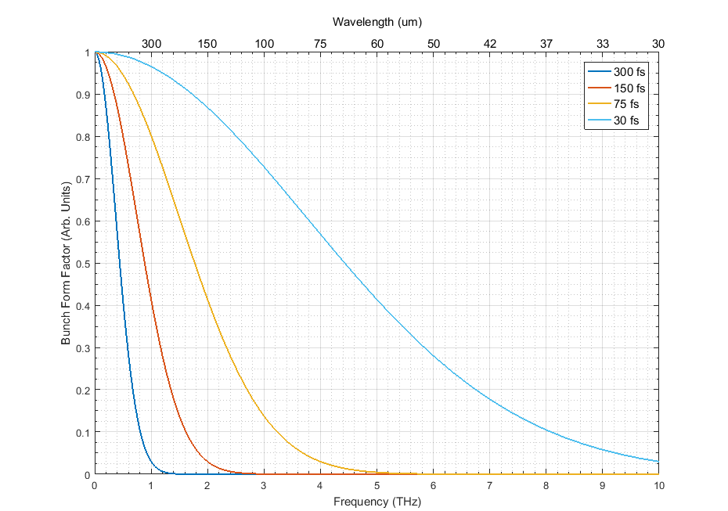
Longitudinal profile – Form factor
Spectroscopy and Interferometry aim to reconstruct the bunch form factor
Related to the longitudinal profile by a Fourier transform
A measure of the frequency content of the bunch
$$F={\left|\int{drf\left(r\right)e^{−ik_{x}x}e^{−ik_{y}y}e^{−ik_{z}z}}\right|}^{2}$$
Dr Joseph Wolfenden EuPRAXIA-DN School on Plasma Accelerators

Slide 31
Longitudinal profile – Form factor
Spectroscopy measures intensity as function of frequency directly
Interferometry measures correlation to infer form factor structure
$$F={\left|\int{drf\left(r\right)e^{−ik_{x}x}e^{−ik_{y}y}e^{−ik_{z}z}}\right|}^{2}$$
Dr Joseph Wolfenden EuPRAXIA-DN School on Plasma Accelerators

Slide 32
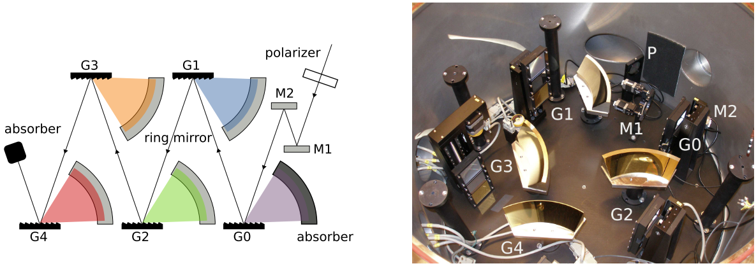
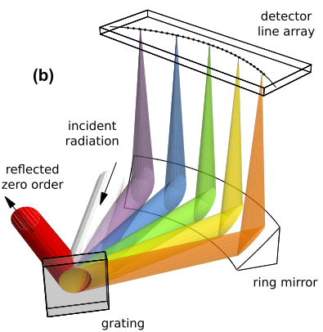
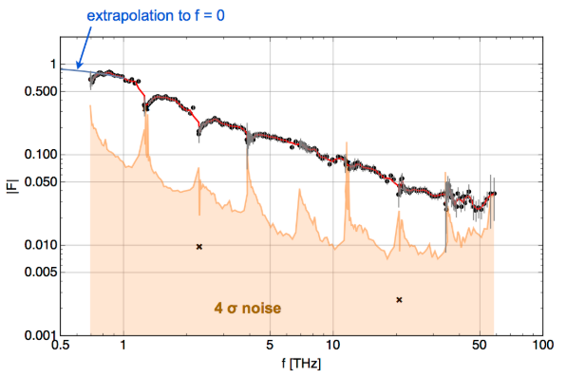
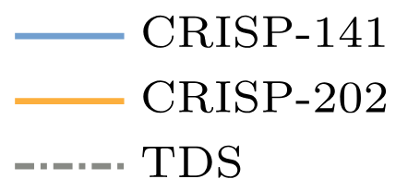
Longitudinal profile - Spectroscopy
[18]
Dr Joseph Wolfenden EuPRAXIA-DN School on Plasma Accelerators

Slide 33
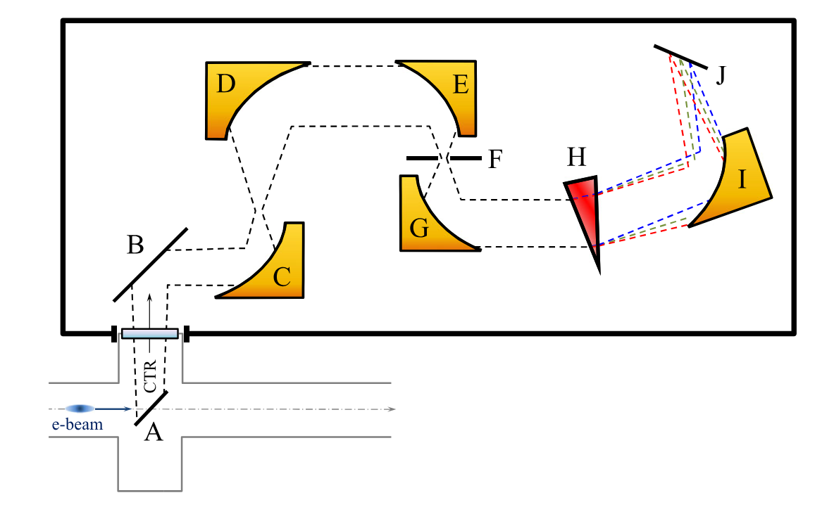
Longitudinal profile - Spectroscopy + VD
[19,20]
Dr Joseph Wolfenden EuPRAXIA-DN School on Plasma Accelerators

Slide 34
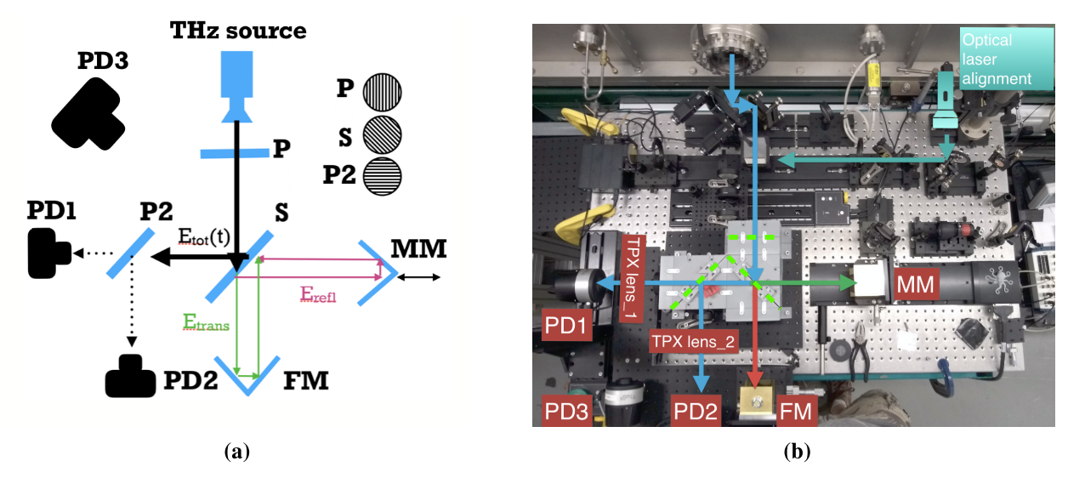
Longitudinal profile - Interferometry
[21]
Dr Joseph Wolfenden EuPRAXIA-DN School on Plasma Accelerators

Slide 35
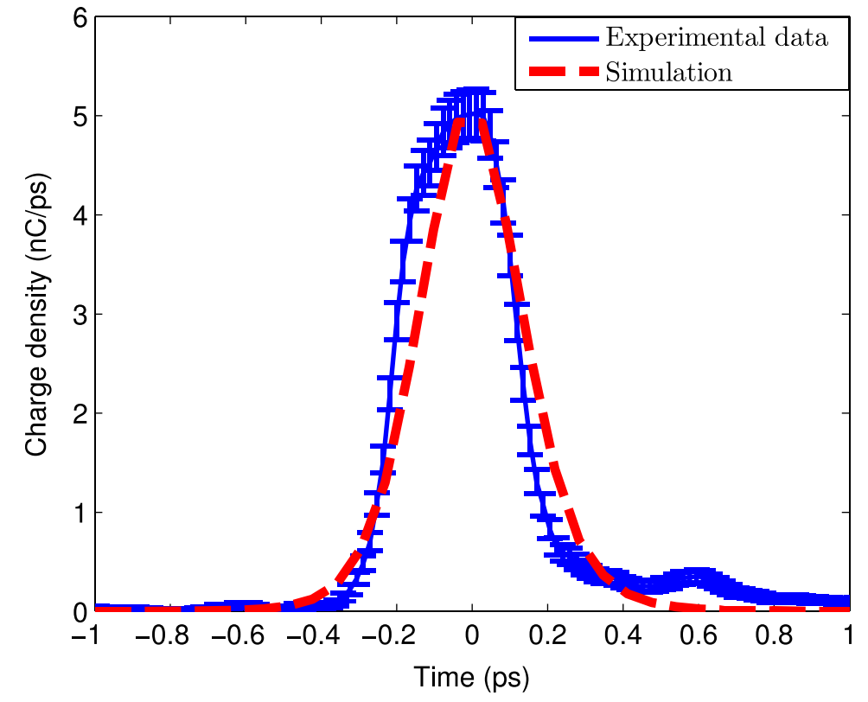
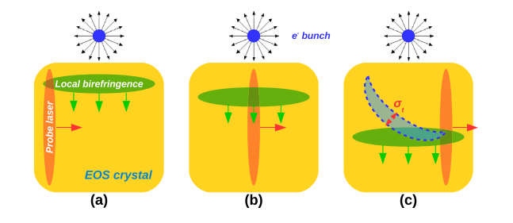
Longitudinal profile – EO sampling
Electro-Optical Sampling makes use of the Pockels effect
Fs-scale laser pulse is sent through an EO crystal
Bunch electric field changes refractive index of crystal
[9,22]
Dr Joseph Wolfenden EuPRAXIA-DN School on Plasma Accelerators

Slide 36
Longitudinal profile – EO sampling
Resolution is limited mainly by lattice resonances in the crystals
GaP is currently “best” at 54fs
[9,22]
Dr Joseph Wolfenden EuPRAXIA-DN School on Plasma Accelerators

Slide 37
Thank you for your attention! Open Questions?
Dr Joseph Wolfenden
EuPRAXIA-DN School on Plasma Accelerators
Orto Botanico di Roma, 22-26 April 2024

Slide 38
References
K. Floettmann, Phys. Rev. ST Accel. Beams 6, 034202 (2003), doi.org/10.1103/PhysRevSTAB.6.034202
A. Mostacci et al., Phys. Rev. ST Accel. Beams 15, 082802 (2012), http://dx.doi.org/10.1103/PhysRevSTAB.15.082802
S. K. Barber et al., Plasma Phys. Control. Fusion 60, 054015 (2018), https://doi.org/10.1088/1361-6587/aab6cd
J. Chappell et al., Proc. IPAC2019, Melbourne (2019), THPGW067, https://doi.org/10.18429/JACoW-IPAC2019-THPGW067
M. Zhang, Tech. Rep. FERMILAB-TM-1998, (1998), https://lss.fnal.gov/archive/test-tm/1000/fermilab-tm-1988.pdf
S. Fritzler et al., Phys. Rev. Lett. 92, 16 (2004), https://doi.org/10.1103/PhysRevLett.92.165006
A. Cianchi et al., Nucl. Instrum. Methods Phys. Res. A 720, 153-156 (2013), https://doi.org/10.1016/j.nima.2012.12.012
O. Apsimon et al., Nucl. Instrum. Methods Phys. Res. A 943, 162485 (2019), https://doi.org/10.1016/j.nima.2019.162485
F. Bisesto et al., Nucl. Instrum. Methods Phys. Res. A 909, 364 (2018), https://doi.org/10.1016/j.nima.2018.02.059
A. Cianchi et al., Nucl. Instrum. Methods Phys. Res. A 865, 63-66 (2017), http://dx.doi.org/10.1016/j.nima.2016.11.063
B. Williamson et al., Nucl. Instrum. Methods Phys. Res. A 971, 164076 (2020), https://doi.org/10.1016/j.nima.2020.164076
S. Kneip et al., Phys. Rev. ST Accel. Beams 15, 021302 (2012), http://dx.doi.org/10.1103/PhysRevSTAB.15.021302
Dr Joseph Wolfenden EuPRAXIA-DN School on Plasma Accelerators

Slide 39
References
M. Mahgoub et al., Proc. IPAC2012, New Orleans (2012). MOPPP032, https://accelconf.web.cern.ch/IPAC2012/papers/moppp032.pdf
J. Makenzie, Thesis (2018), https://livrepository.liverpool.ac.uk/3031981/1/200845969_Aug2018.pdf
B. Steffen et al., Proc. DIPAC09, Basel (2009), TUPB42, https://accelconf.web.cern.ch/d09/papers/tupb42.pdf
L. Verra et al., Phys. Rev. Lett. 129, 02480 (2022), https://doi.org/10.1103/PhysRevLett.129.024802
Y. Saveliev et al., Phys. Rev. Accel. Beam 25, 081302 (2022), https://doi.org/10.1103/PhysRevAccelBeams.25.081302
B. Schmidt et al., Phys. Rev. Accel. Beams 23, 062801 (2020), https://journals.aps.org/prab/pdf/10.1103/PhysRevAccelBeams.23.062801
A. Hanuka et al., Sci. Rep. 11, 2945 (2021), https://doi.org/10.1038/s41598-021-82473-0
T. Maxwell et al., Phys. Rev. Lett. 111, 184801 (2013), http://dx.doi.org/10.1103/PhysRevLett.111.184801
A. Curcio et al., Phys. Rev. Accel. Beams 23, 022802 (2020), https://doi.org/10.1103/PhysRevAccelBeams.23.022802
R. Pan et al., Nucl. Instrum. Methods Phys. Res. A 821, 8-12 (2016), https://doi.org/10.1016/j.nima.2016.03.043
Dr Joseph Wolfenden EuPRAXIA-DN School on Plasma Accelerators

