Slide 1

Beam Physics
of High Quality Beams
School on Plasma Accelerators
22–26 Apr 2024, Orto Botanico di Roma
Massimo Ferrario
INFN-LNF

Slide 2
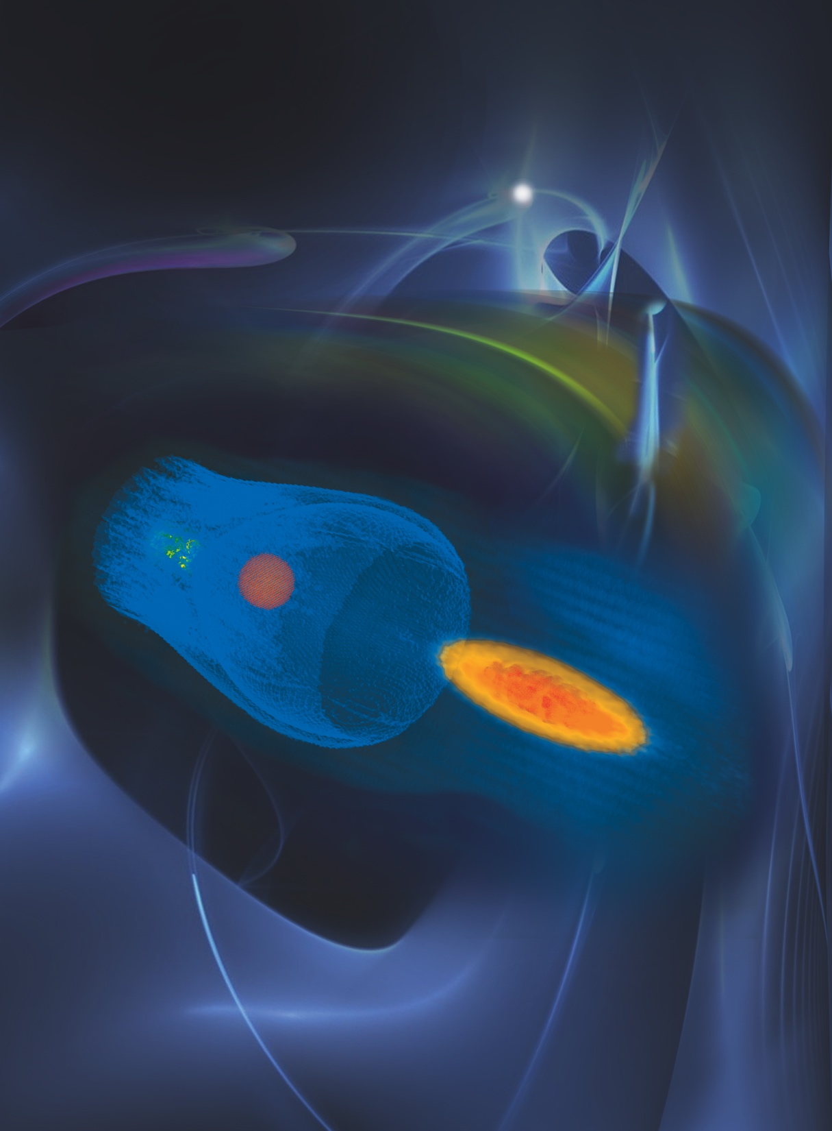
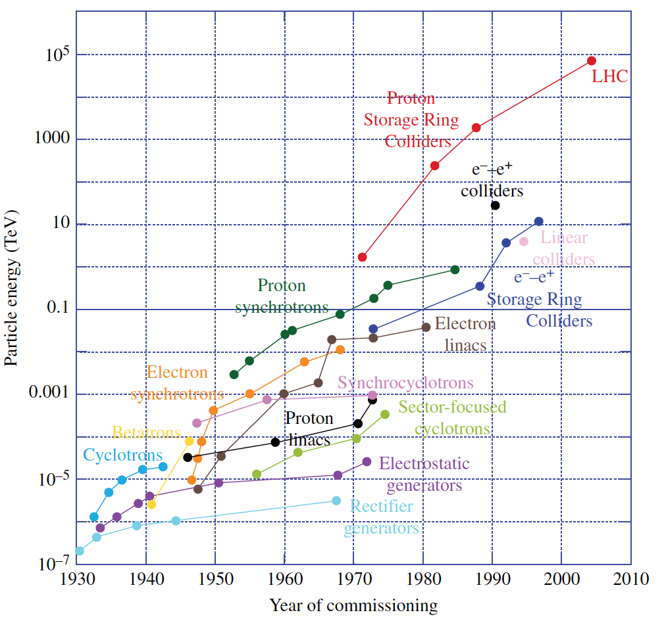
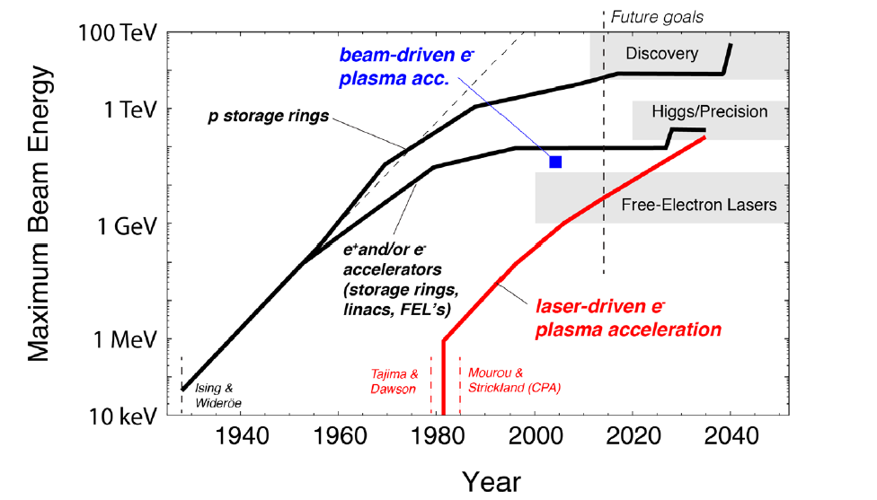
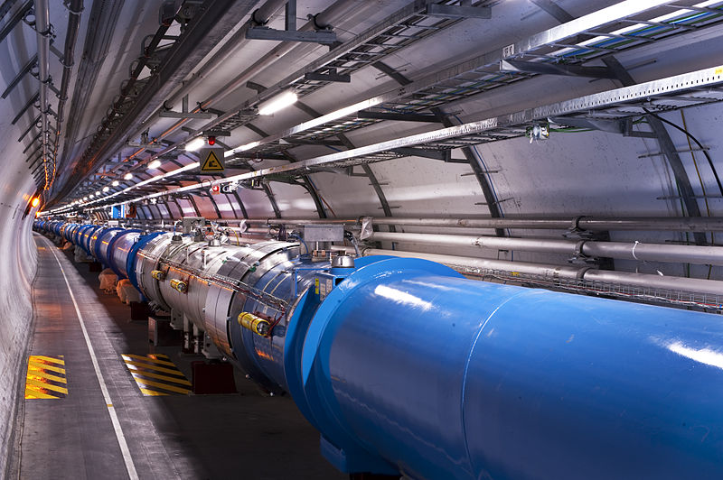
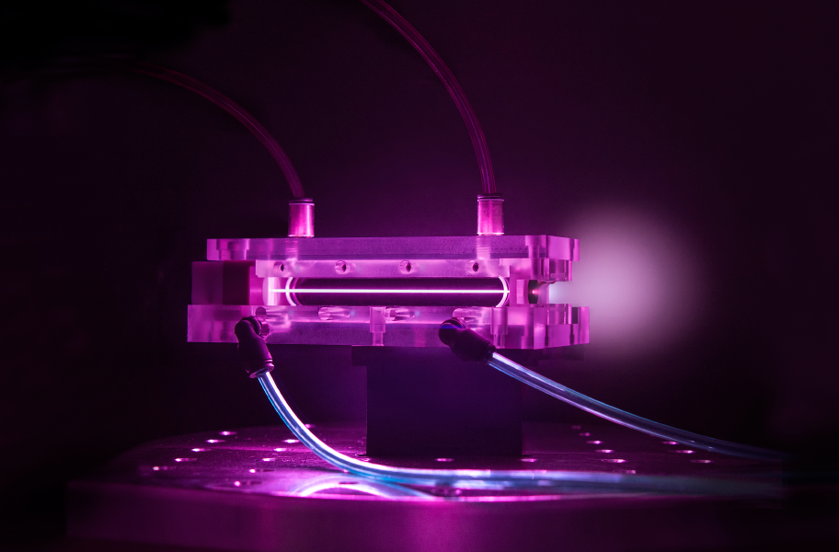
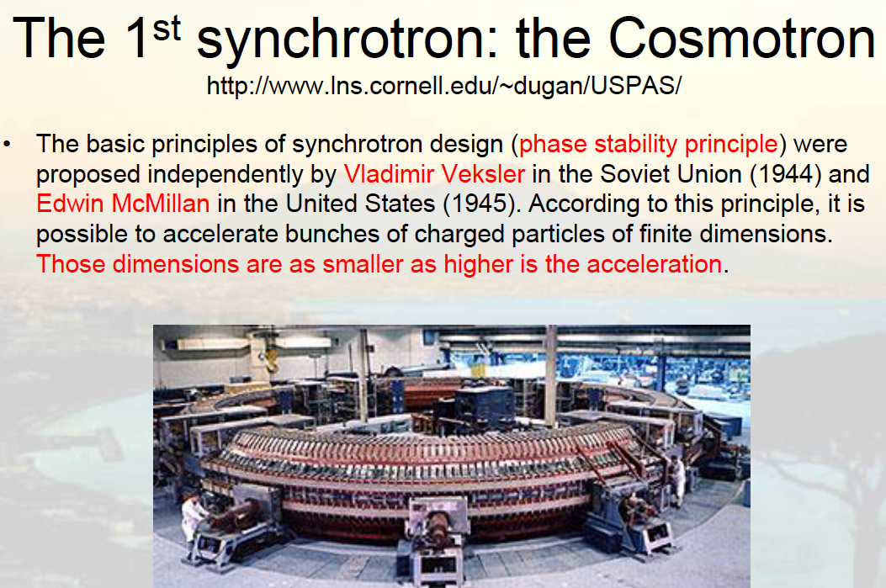
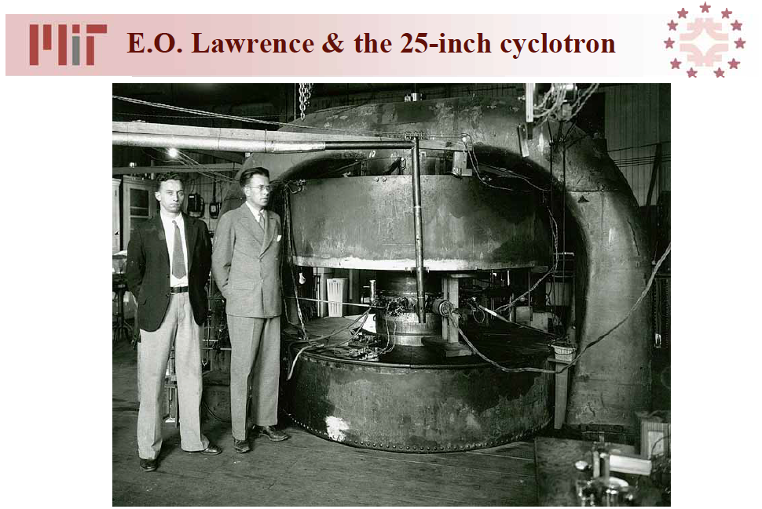
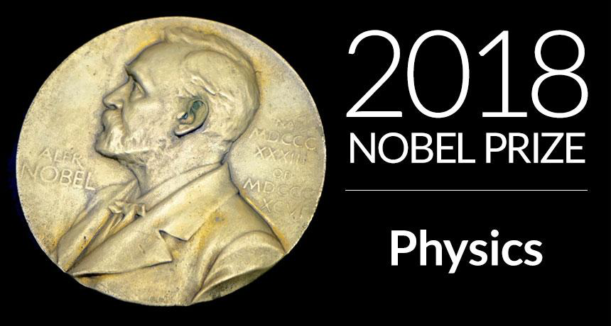
The Livingstone Diagram
Plasma Accelerator Achievements
Gradients up to 100 GV/m
Acceleration >10 GeV of electron beams
Basic beam quality for FEL demonstrated
(Energy of colliders is plotted in terms of the laboratory energy of particles colliding with a proton at rest to reach the same center of mass energy.)

Slide 3
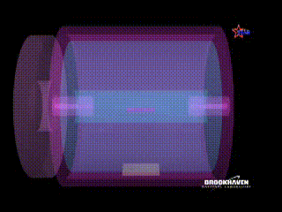
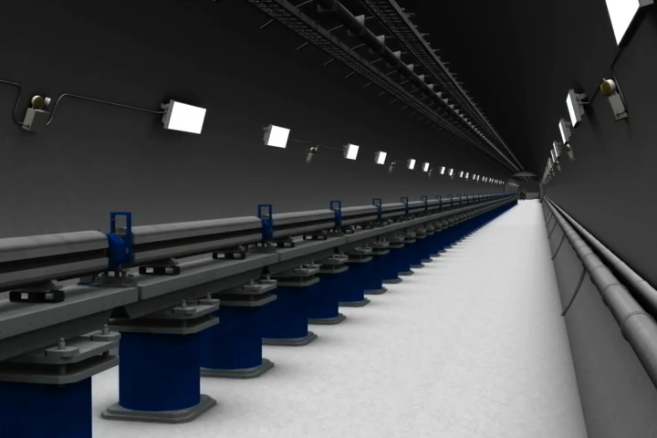
Advanced Applications require High Quality Beams
  Linear Colliders ==> High Luminosity
  N of particles per pulse => 10⁹
  High rep. rate f_{r}=> bunch trains
  Small spot size => low emittance
  Radiation Sources ==> High Brightness
  Short pulse (ps => fs)
  Little spread in transverse momentum and angle => low emittance

Slide 4
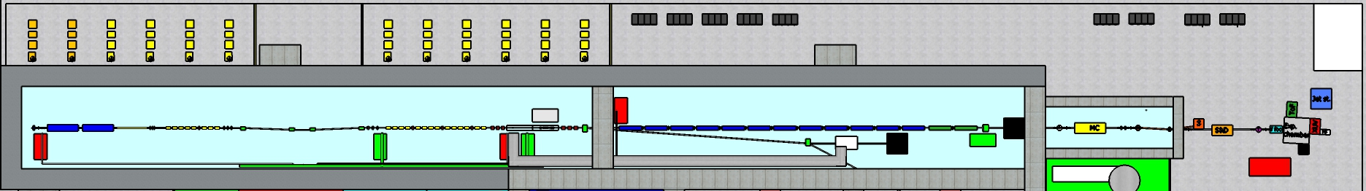
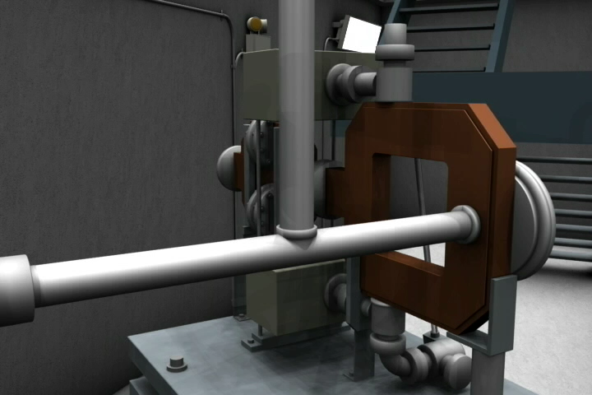
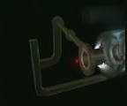
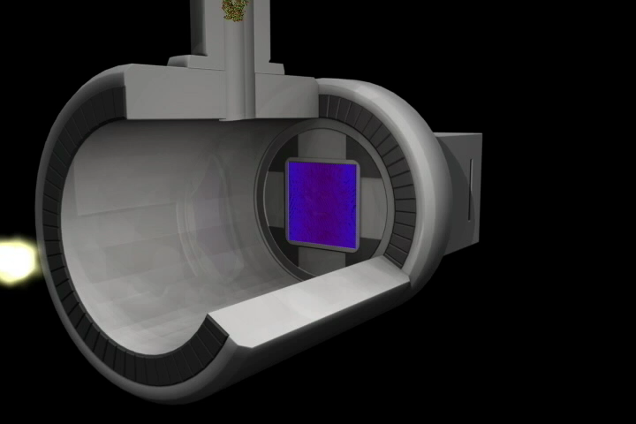
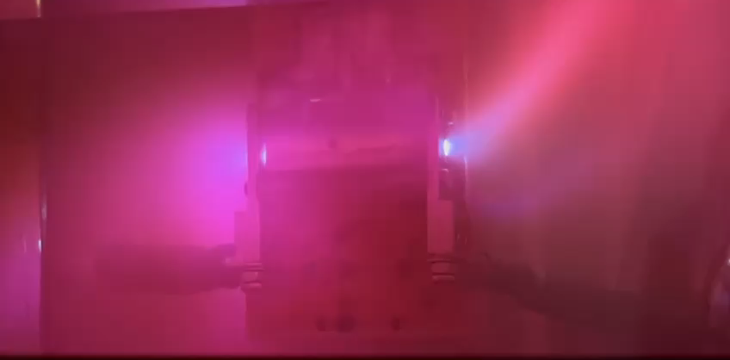
Different Regimes of Beam Propagation
55 m
40 m
Space charge dominated
Emittance dominated
(Wake Fields)
Plasma
dominated
Radiation dominated
Users dominated

Slide 5
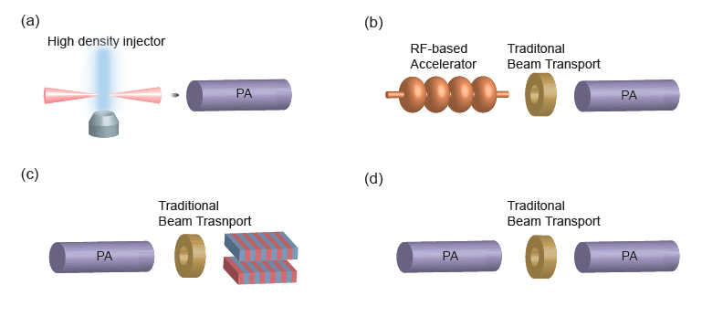
Matching Conditions are fundamental

Slide 6
  OUTLINE
    The rms emittance concept
    rms envelope equation
    Space charge forces
    Space charge induced emittance oscillations
    Matching conditions and emittance compensation

Slide 7
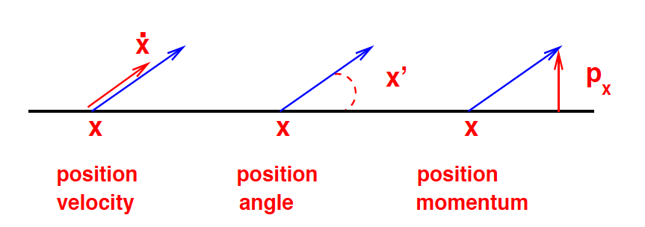
Typical coordinates to describe the particle motion
Configuration Space
Phase Space
Trace Space

Slide 8

Trace space of an ideal laminar beam
X’
X

Slide 9
Trace space of a laminar beam
X’
X

Slide 10
Trace space of a non laminar beam
X’
X

Slide 11
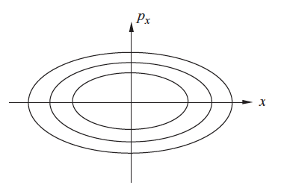
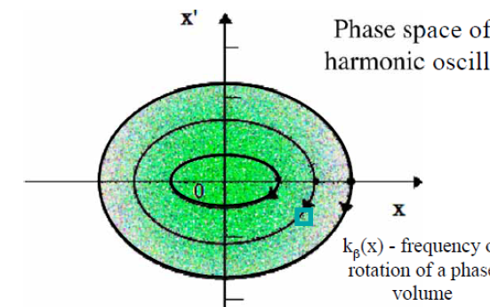
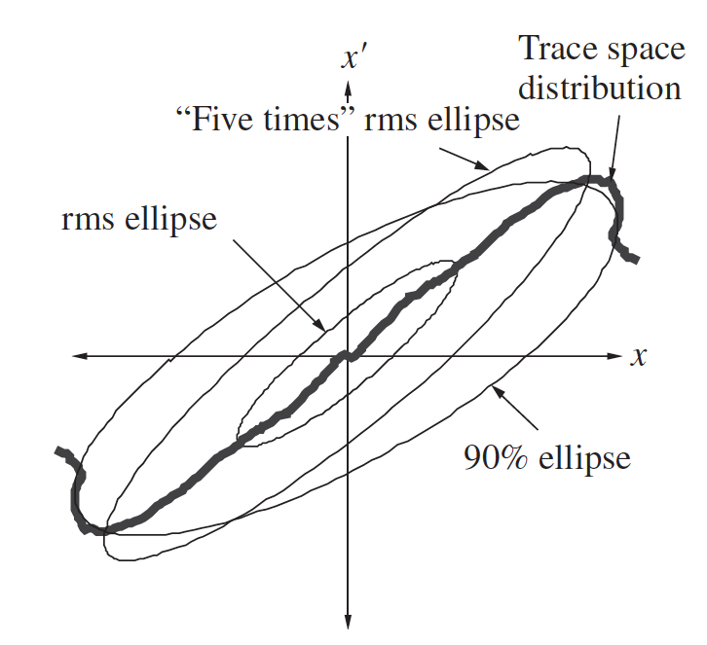


In a system where all the forces acting on the particles are linear (i.e., proportional to the particle’s displacement x from the beam axis), it is useful to assume an elliptical shape for the area occupied by the beam in x-x‘ trace space or x-p_{x} phase space.

Slide 12
Analytical Geometry: Ellipse
Canonical Ellipse equation
Rotated Ellipse
Emittance Ellipse

Slide 13
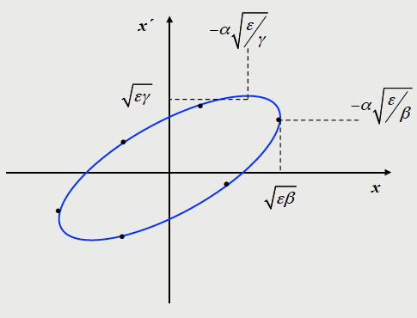
Ellipse equation:
Geometric emittance:
Twiss parameters:
Ellipse area:

Slide 14
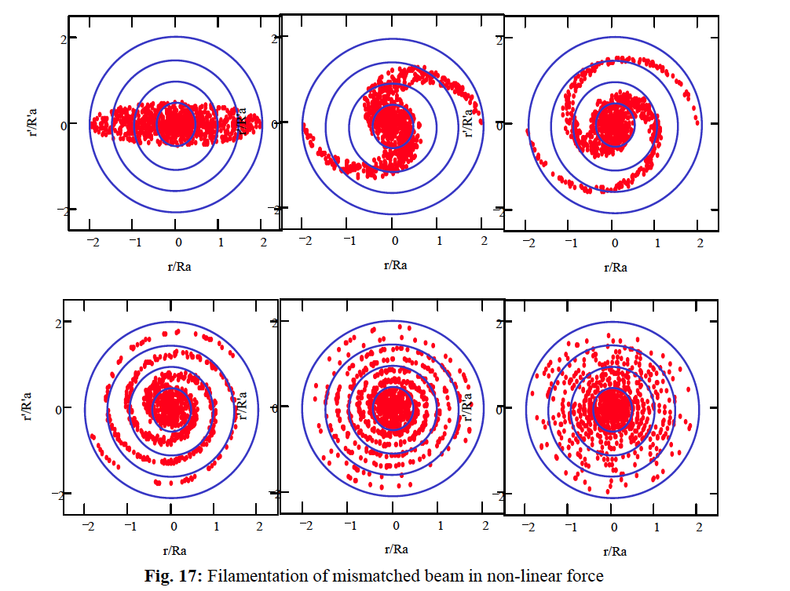

Slide 15
rms emittance
x’
rms beam envelope:
x
Define rms emittance:
such that:
Since:
it follows:

Slide 16
It holds also the relation:
Substituting we get
We end up with the definition of rms emittance in terms of the second moments of the distribution:

Slide 17
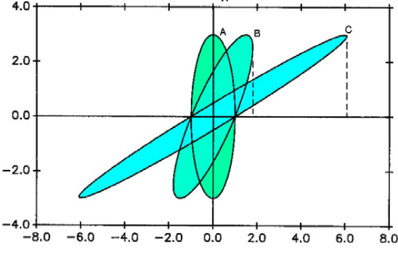
Which distribution has no correlations?
x’
x

Slide 18
What does rms emittance tell us about phase space distributions under linear or non-linear forces acting on the beam?
x’
x’
a’
a’
a
x
a
x
Assuming a generic correlation of the type:
When n = 1 ==> ε_{rms} = 0
When n = 1 ==> ε_{rms} = 0

Slide 19
Normalized rms emittance:
Canonical transverse momentum:
Liouville theorem: the density of particles n, or the volume V occupied by a given number of particles in the 6D phase space (x,p_{x},y,p_{y},z,p_{z}) remains invariant under conservative forces.
It hold also in the projected phase spaces (x,p_{x}),(y,p_{y})(,z,p_{z}) provided that there are no couplings.
Projected rms emittance instead is invariant only under linear forces => It is not a Liouvillian invariant

Slide 20
Normalized and un-normalized emittances
Assuming small energy spread within the beam, the normalized and un-normalized emittances can be related by the above approximated relation.
This approximation that is often used in conventional accelerators may be strongly misleading when adopted to describe beams with significant energy spread, as the one at present produced by plasma accelerators.

Slide 21
When the correlations between the energy and transverse positions are negligible (as in a drift without collective effects) we can write:
Considering now the definition of relative energy spread:
which can be inserted in the emittance definition to give:
Assuming relativistic electrons (β=1) we get:

Slide 22

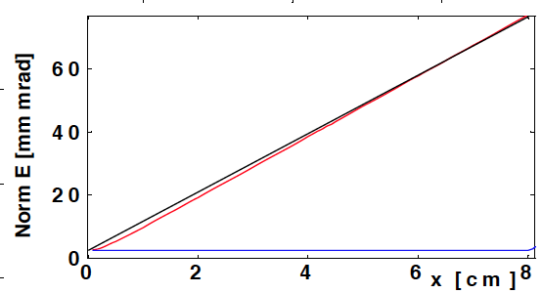
Geometric emittance
At the plasma-vacuum interface is of the same order of magnitude as for conventional accelerators at low energies; however, due to the rapid increase of the bunch size, it becomes predominant compared to the second term.
Simulation
Formula
Energy 350 MeV
Beam divergence 1 mrad
Energy spread 1%
Beam spot-size 1 µm
<γ>ε
Z
Migliorati et al., Phys. Rev. STAB 16, 011302 (2013)

Slide 23
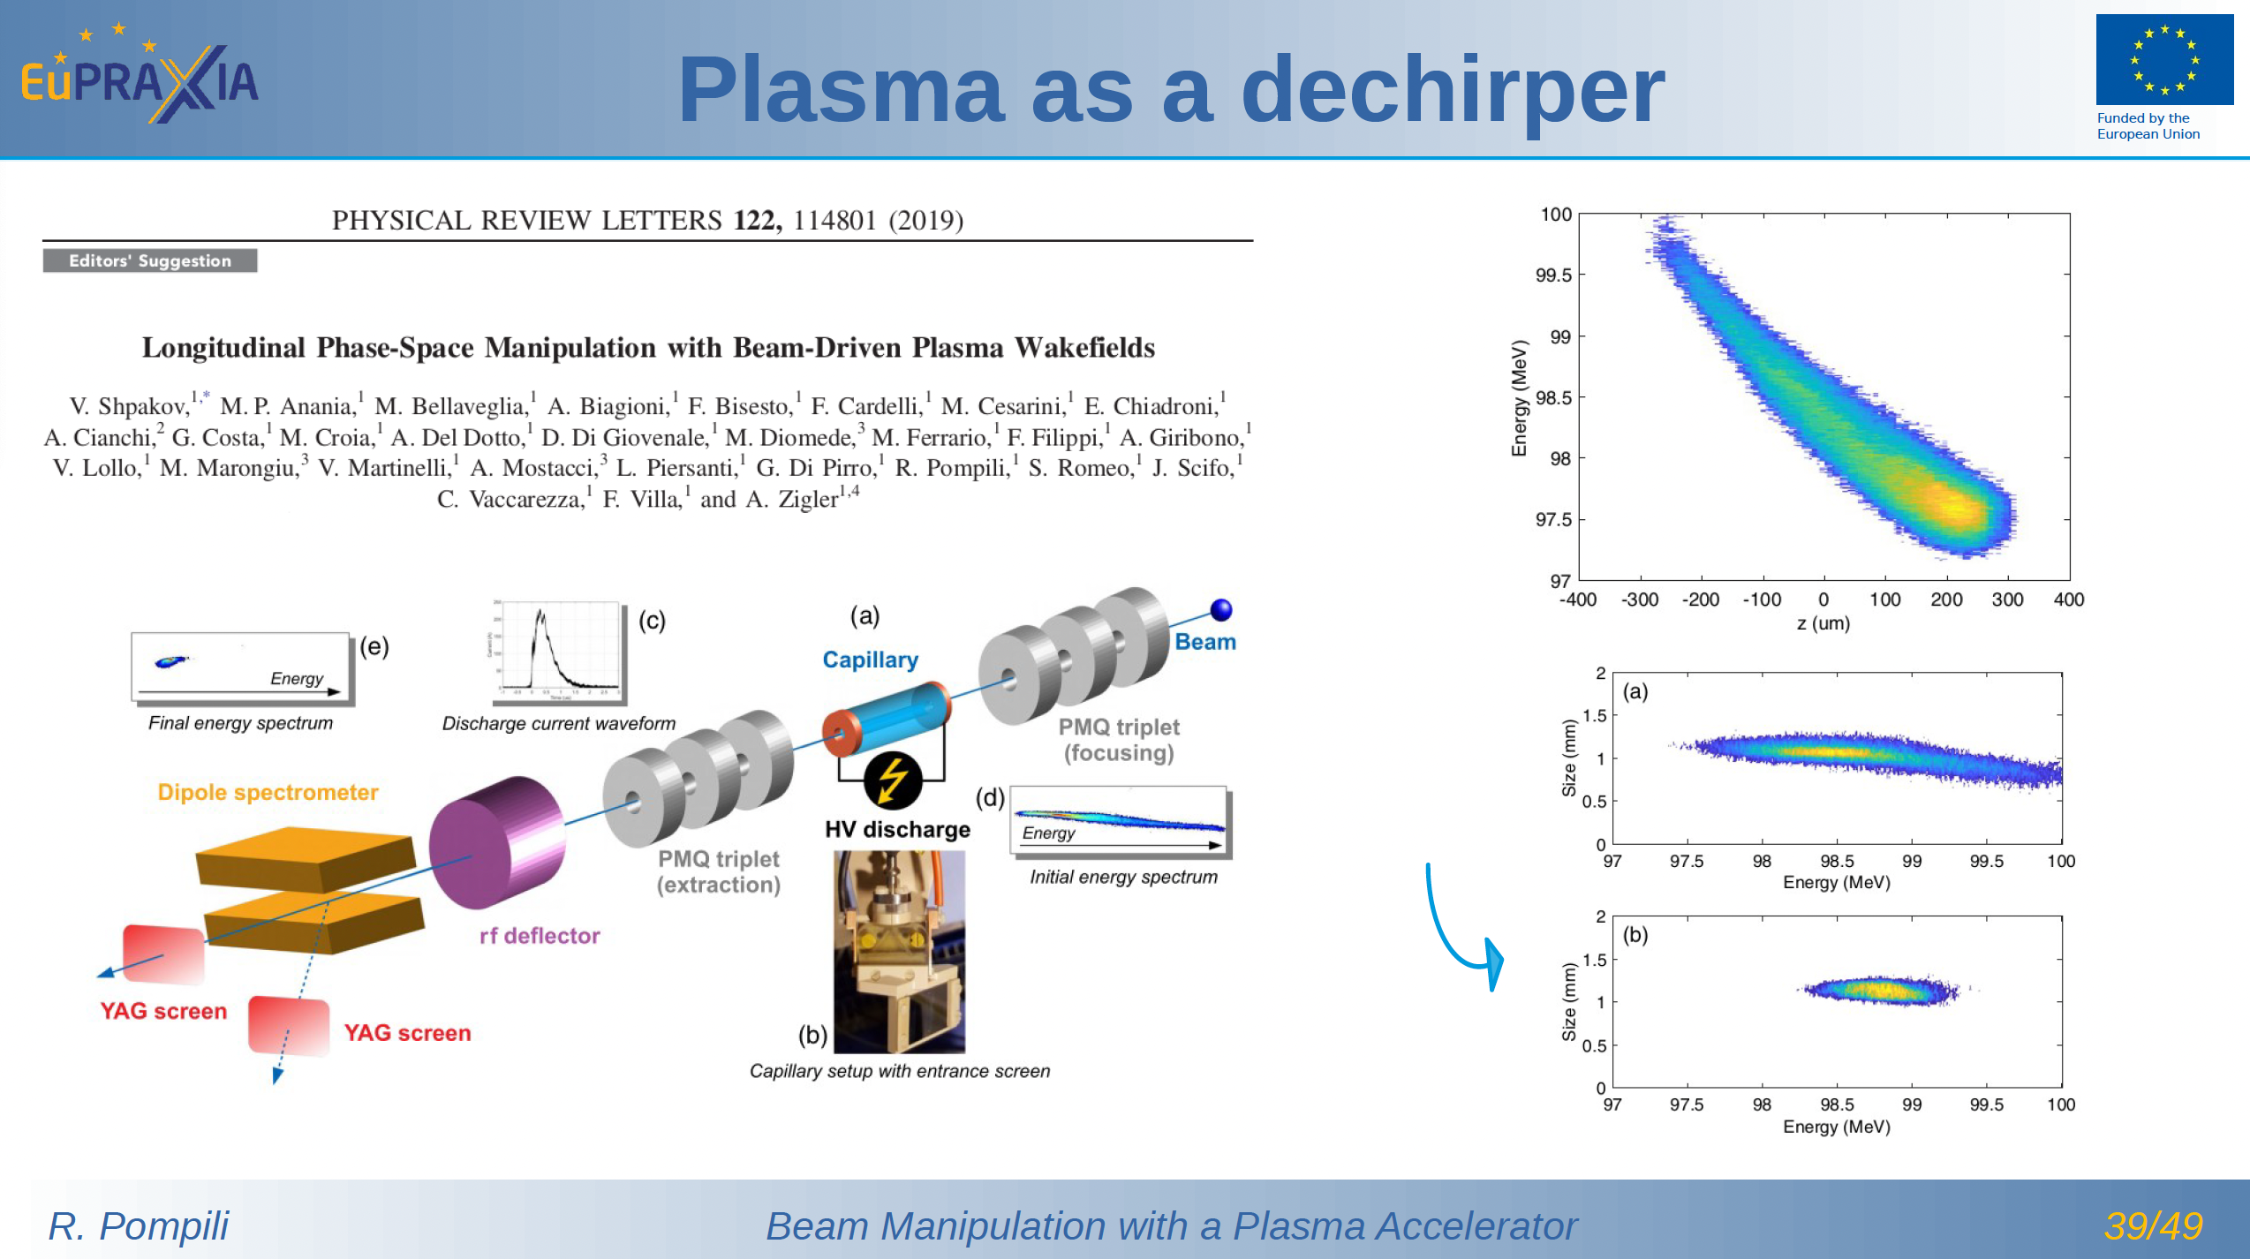
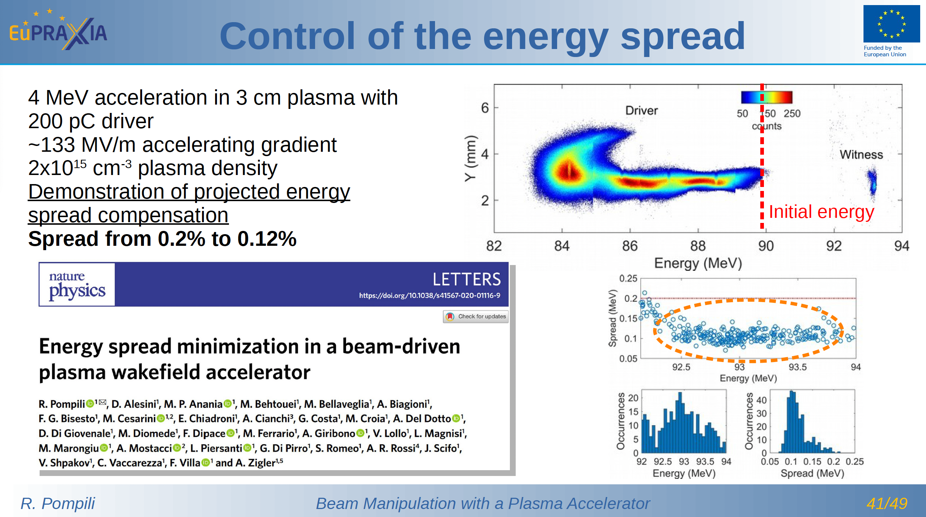

Slide 24
  OUTLINE
    The rms emittance concept
    rms envelope equation
    Space charge forces
    Space charge induced emittance oscillations
    Matching conditions and emittance compensation

Slide 25
Envelope Equation without Acceleration
Now take the derivatives:
And simplify:
We obtain the rms envelope equation in which the rms emittance enters as defocusing pressure like term.

Slide 26
Envelope Equation with Linear Focusing
Assuming that each particle is subject only to a linear focusing
force, without acceleration:
take the average over the entire particle ensemble
We obtain the rms envelope equation with a linear focusing force in which, unlike in the single particle equation of motion, the rms emittance enters as defocusing pressure like term.

Slide 27
  OUTLINE
    The rms emittance concept
    rms envelope equation
    Space charge forces
    Space charge induced emittance oscillations
    Matching conditions and emittance compensation

Slide 28
Continuous Uniform Cylindrical Beam Model
Gauss’s law
Ampere’s law

Slide 29
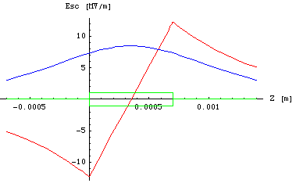
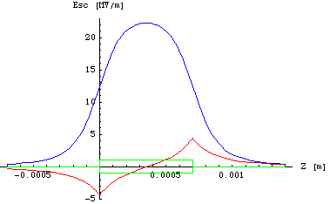
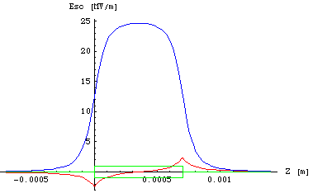
Bunched Uniform Cylindrical Beam Model
γ= 1
γ = 5
γ = 10
L(t)
R_{s}(t)
Δt

Slide 30
Lorentz Force
is a linear function of the transverse coordinate
The attractive magnetic force , which becomes significant at high velocities, tends to compensate for the repulsive electric force. Therefore space charge defocusing is primarily a non-relativistic effect. Using R=2σ_{x} for a uniform distribution:

Slide 31
Envelope Equation with Space Charge
Single particle transverse motion:

Slide 32
Now we can calculate the term that enters in the envelope equation
Including all the other terms the envelope equation reads:
Space Charge De-focusing Force
Emittance Pressure
External Focusing Forces
Laminarity Parameter:

Slide 33
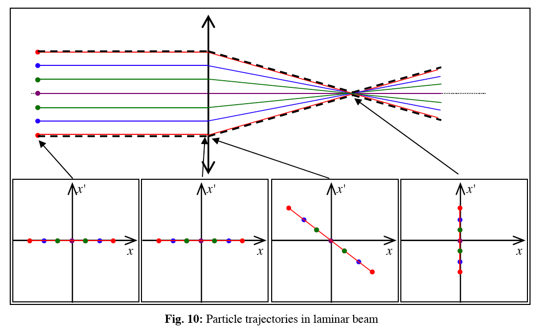
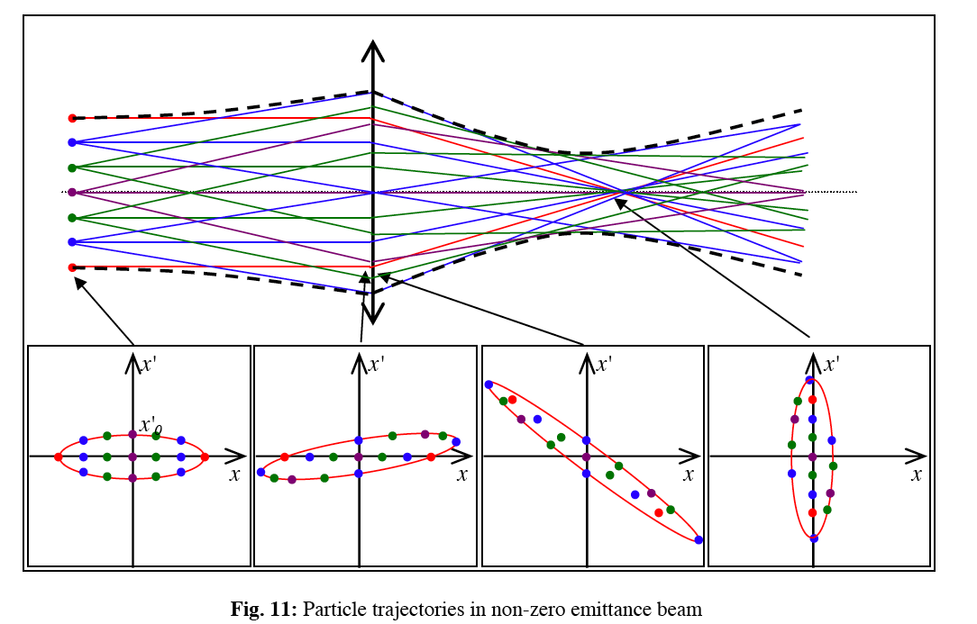
The beam undergoes two regimes along the accelerator
ρ>>1
Laminar Beam
ρ<<1
Thermal Beam

Slide 34
  OUTLINE
    The rms emittance concept
    rms envelope equation
    Space charge forces
    Space charge induced emittance oscillations
    Matching conditions and emittance compensation

Slide 35


Neutral Plasma
Single Component Cold Relativistic Plasma
Oscillations
Instabilities
EM Wave propagation
Magnetic focusing
Magnetic focusing

Slide 36





Surface charge density
Surface electric field
Restoring force
Plasma frequency
Plasma oscillations

Slide 37
Single Component Relativistic Plasma
Equilibrium solution:
Small perturbation:
Perturbed trajectories oscillate around the equilibrium with the same frequency but with different amplitudes:

Slide 38
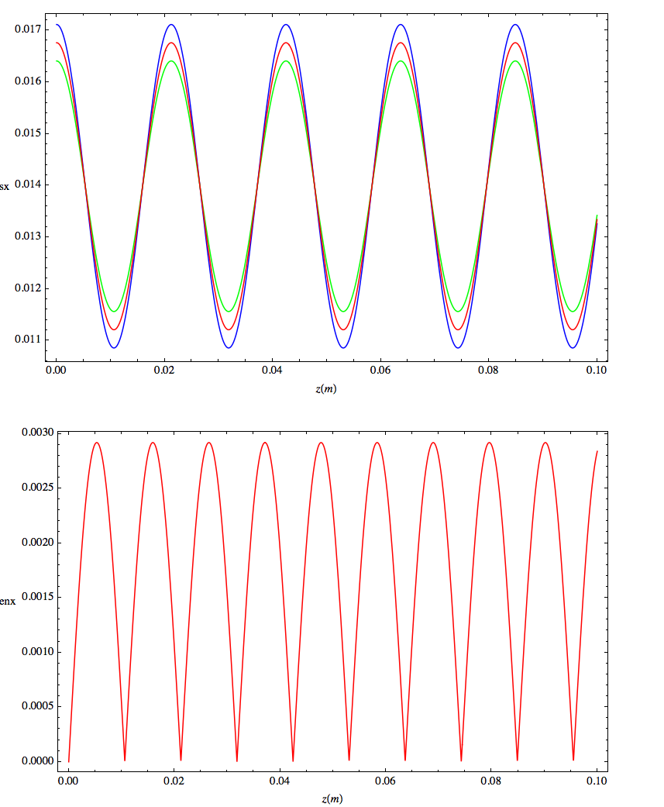
Envelope oscillations drive Emittance oscillations
σ(z)
ε(z)

Slide 39
Emittance Oscillations are driven by space charge differential defocusing in core and tails of the beam
p_{x}
Projected Phase Space
x
Slice Phase Spaces

Slide 40
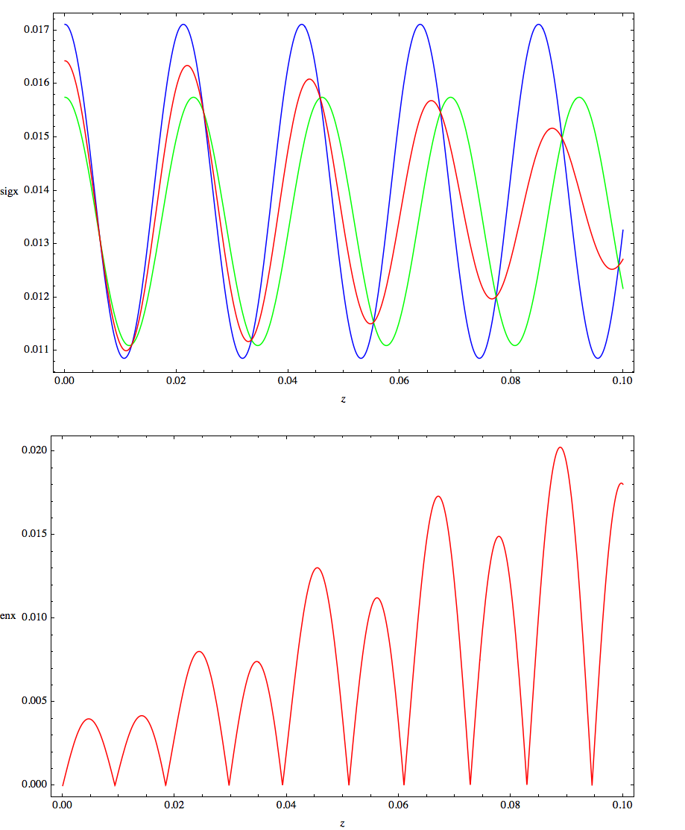
energy spread induces decoherence
σ(z)
ε(z)

Slide 41
  OUTLINE
    The rms emittance concept
    rms envelope equation
    Space charge forces
    Space charge induced emittance oscillations
    Matching conditions and emittance compensation

Slide 42
Envelope Equation with Acceleration
Space Charge De-focusing Force
Adiabatic Damping
Emittance Pressure
Other External Focusing Forces

Slide 43
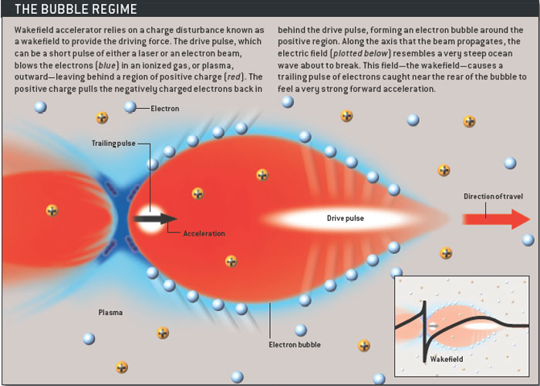
Matching Condition for a plasma accelerator
Courtesy Sci. Am
Courtesy of BELLA

Slide 44
Uniform Cylindrical Beam Model with ionized gas background
f_{e} : charge neutralisation factor
f_{m} : current neutralisation factor

Slide 45
Lorentz Force
Generalized Envelope Equation

Slide 46
Matching in a Plasma Accelerator with f_{e}=n_{p}/n_{e} and f_{m}=0
Let consider the charge screening effect of the plasma background with particle density n_{p ,} by defining f_{e}=n_{p}/n_{e}, where n_{e} is the bunch particle density and f_{m}=0. We also do not include any external focusing element so that k_{ext}=0. The envelope equation can be recast as:
or by recalling the definition of the Alfven current I_{A} and of the beam current I=ecn_{e}πσ² it can be written in a more familiar form as:

Slide 47
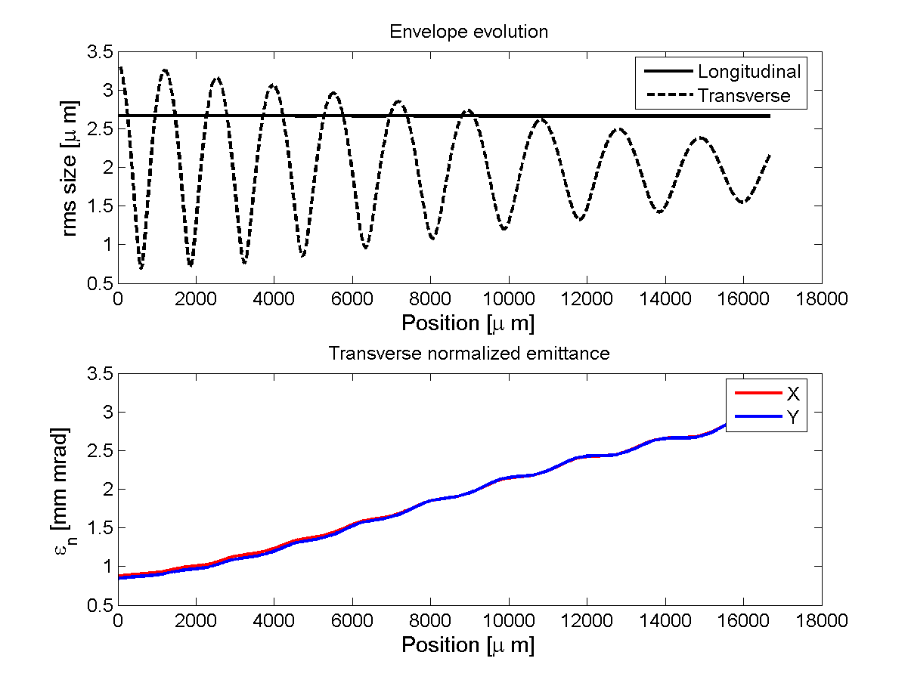
Transverse beam dynamics inside the plasma
Courtesy P. Tomassini

Slide 48
With the typical beam parameters in a plasma accelerator: 1 kA peak current, 1 μm normalized emittance, injection energy γ_{o}=300 and spot size about 5 μm, the laminarity parameter results to be ρ < 1, i.e. the beam is emittance dominated. We have also to neglect the adiabatic damping term, setting γ’=0 i.e. no acceleration. This approximation is quite strong but it will allow us to find at least a proper matching condition that holds at the entrance of the plasma column. It follows that the envelope equation can be approximated by the reduced expression:

Slide 49
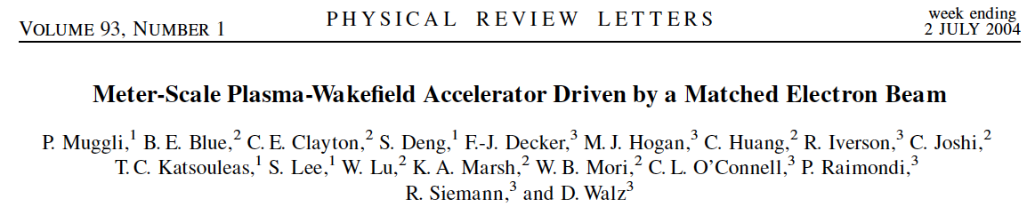
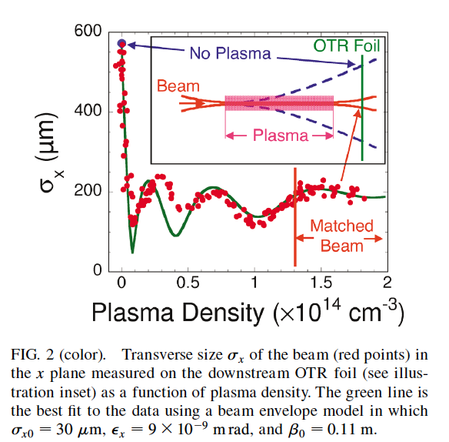

Slide 50
Adiabatic Plasma Lens

Slide 51
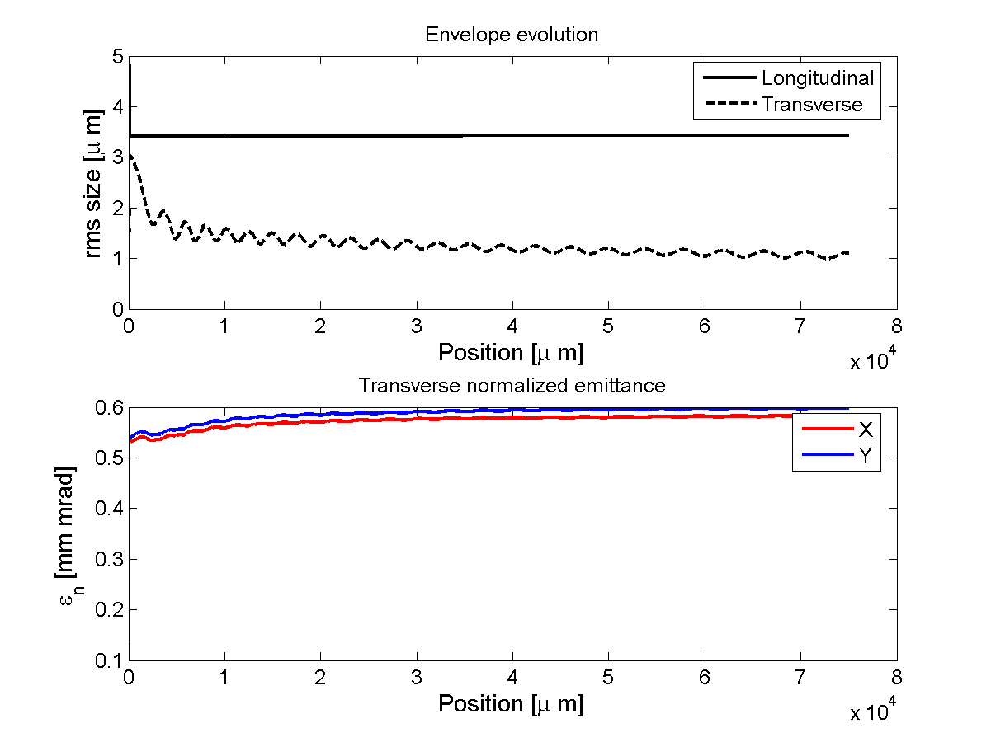

Slide 52
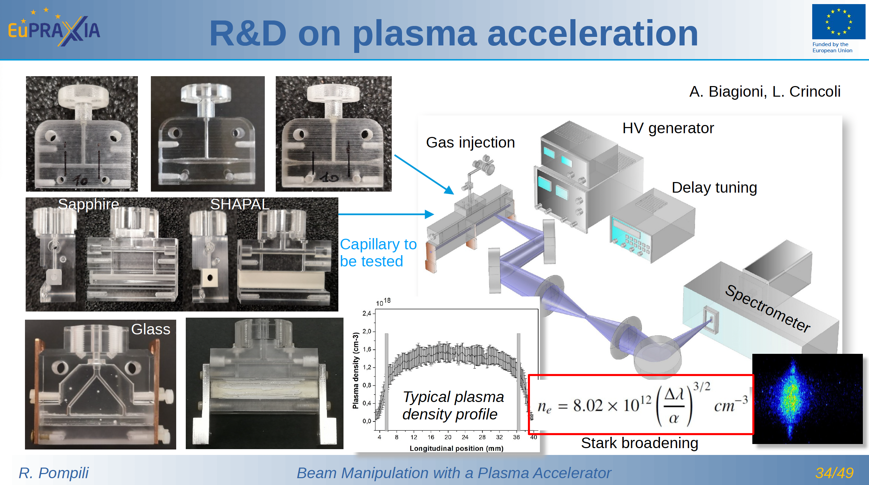

Slide 53
Thank for your attention
School on Plasma Accelerators
22–26 Apr 2024 Orto Botanico di Roma

Slide 54
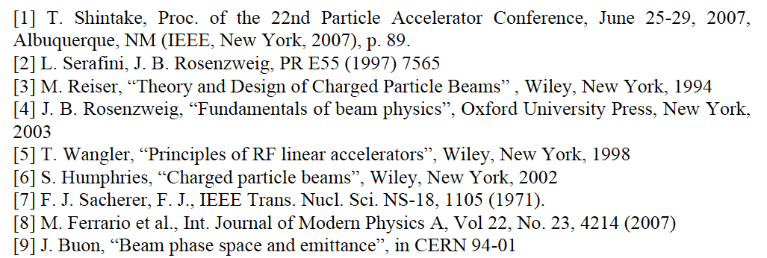
References:

Slide 55
Perturbation around the equilibrium solution:
σ = σ_{eq} + δσ
==>
2
2
2
2
2

Slide 56
2
2

Slide 57
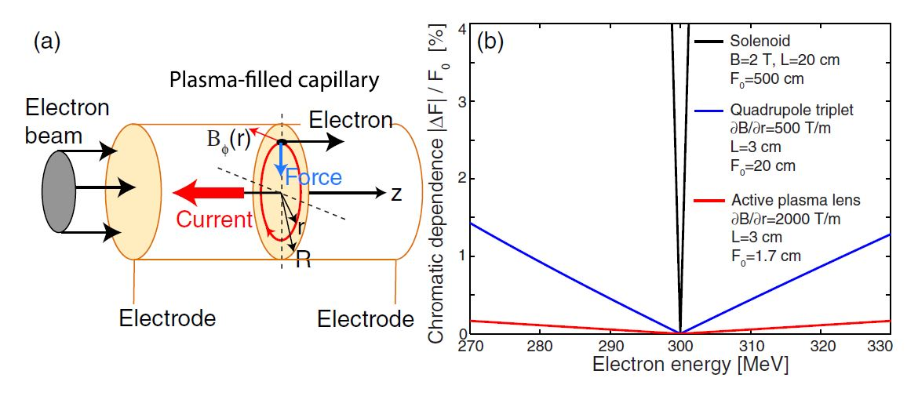

Active Capillary Lens
Focal Length

Slide 59
Adiabatic Plasma Lens

