Slide 1


School on Plasma Accelerators
April 22–26th, 2024
Orto Botanico di Roma
Introduction to linear accelerators (linacs)
Marco Bellaveglia
INFN-LNF, Frascati, Rome, Italy

Slide 2
Lecture outline
Part 1: Basic concepts
Part 2: From DC to RF accelerators
Part 3: Longitudinal dynamics
Part 4: Linac technology

Slide 3
Part 1
Basic concepts

Slide 4
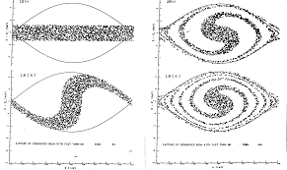
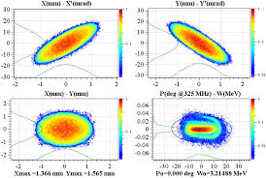
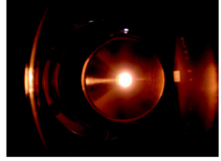
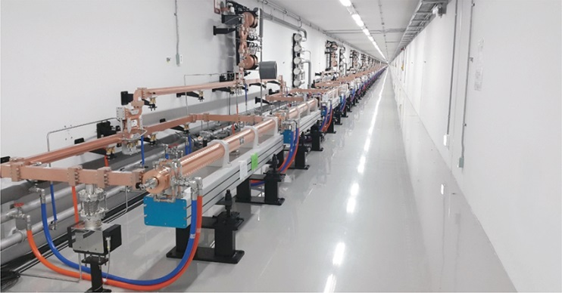
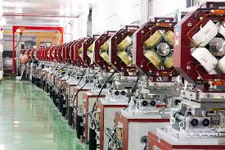
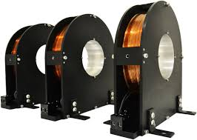
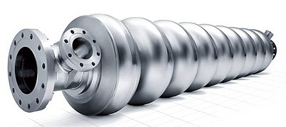
Linac main components and definitions
Thermionic effect
Photoelectric effect
Filed emission
Plasma sources
Radiation sources
Secondary emission
Transverse dynamics of accelerated particles
Longitudinal dynamics of accelerated particles
Accelerating and focusing fields
Particle source
Accelerated beam
Accelerating structures
Focusing elements

Slide 5
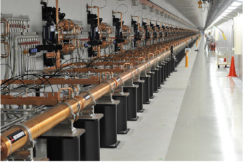
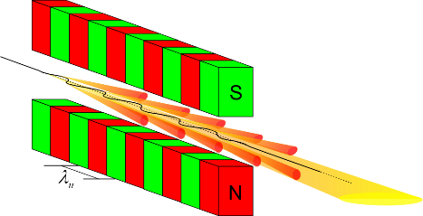
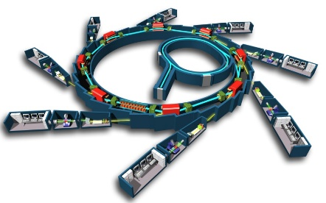
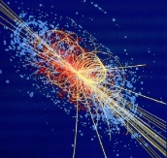
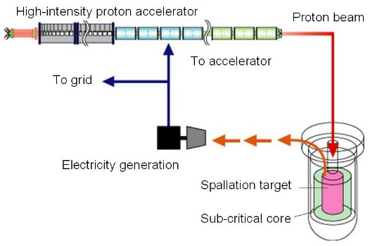
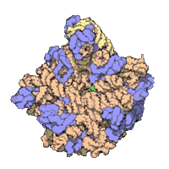
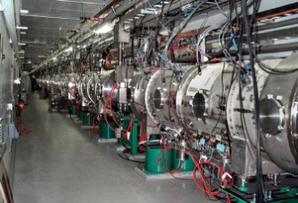
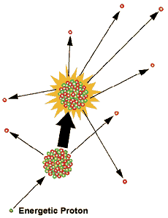
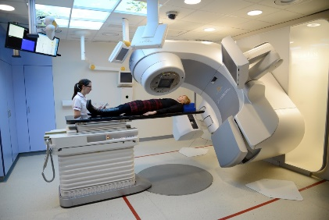

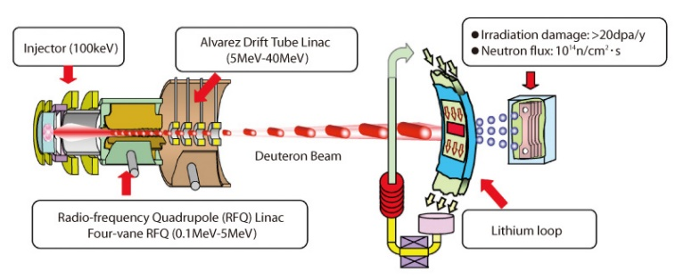
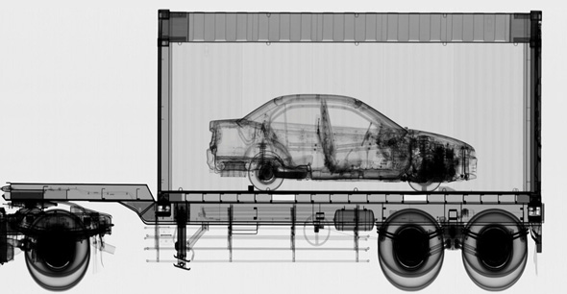
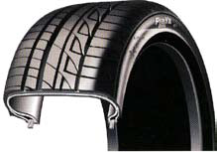

Linac applications
Nuclear waste treatment and controlled fission for energy production (ADS)
Free Electron Lasers
Injectors for synchrotrons
Spallation sources for neutron production
Medical applications: radiotherapy
∼10⁴ LINACs operating around the world
Industrial applications
Material/food sterilization
Material testing for fusion nuclear reactors
National security
Material treatment
Ion implantation

Slide 6
Particle sources notes
Electrons sources:
  Thermionic effect (high temperature filaments)
  Photo-electric effect (photo-cathodes and RF guns)
  Filed effect (quantum tunneling, FEM, nanotubes)
  Secondary sources (targets of emissive material)
Proton and ions sources
  Plasma sources (thermal, electrical or electromagnetic heating)
  Secondary sources (targets of emissive material)
Anti-matter and other sources
  Secondary sources (targets of emissive material)
  Radiation sources (radioactive elements, cosmic radiation)

Slide 7
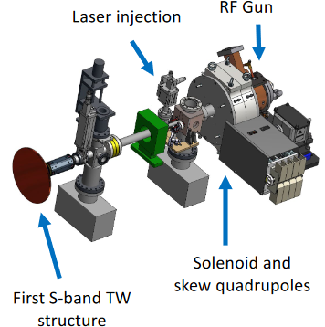
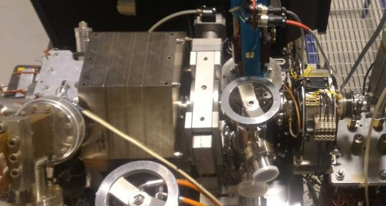
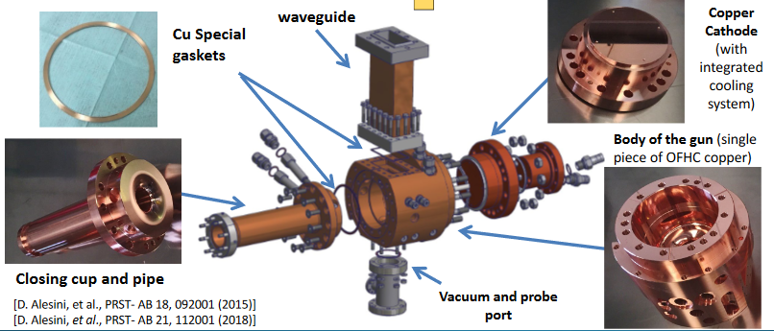
Example: The SPARC_LAB RF gun
Photocathode system parameters
Max peak field on
the cathode 120 MV/m
Repetition rate 10 Hz
Operating
vacuum 10⁻⁹ Torr
Quantum efficiency
max (typical) >5x10⁻⁶
Maximum gun
solenoid field 0.3 T
Laser central
wavelength 263 nm
RF frequency 2.856 GHz
RMS intrinsic
emittance 0.7 mm mrad/mm
Beam charge 10-1000 pC
Number of cells 1.6

Slide 8
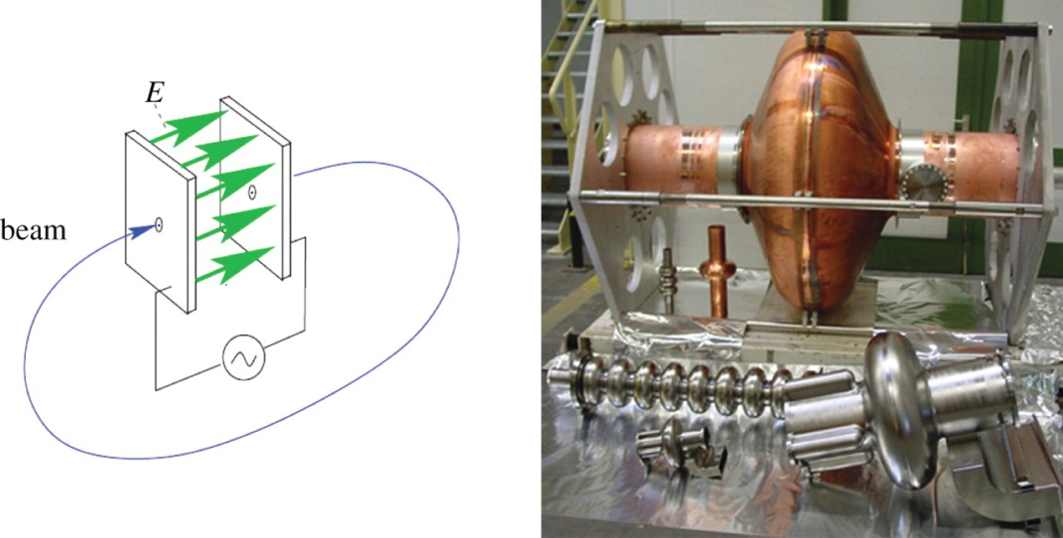
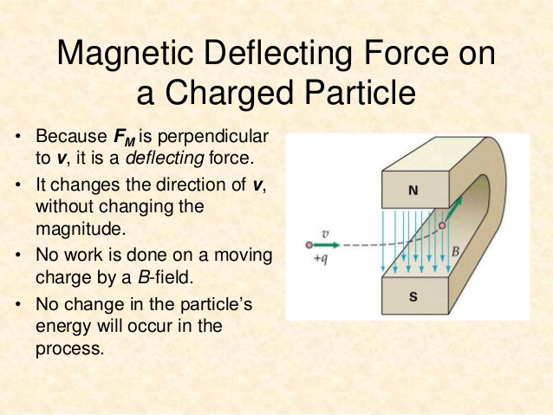
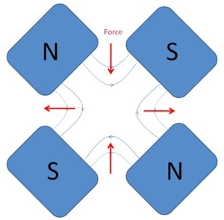
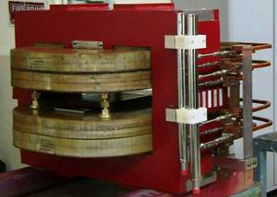
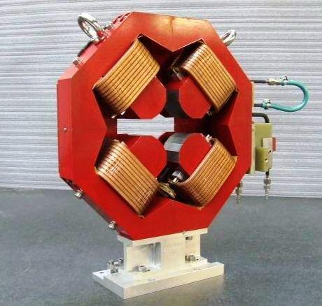
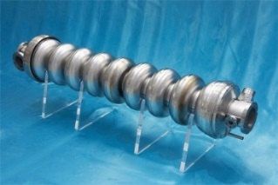
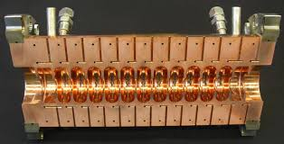
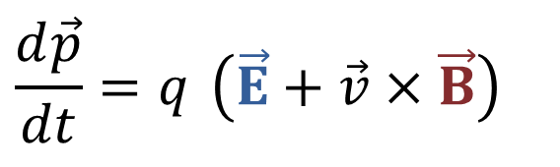
Lorentz force: acceleration and focusing
The basic equation that describes the acceleration/bending/focusing processes is the Lorentz Force.
Particles are accelerated through electric fields and are bended and focused through magnetic fields.
$$\frac{d\vec{p}}{dt}=q \left(\vec{E}+\vec{v}×\vec{B}\right)$$
ACCELERATION
BENDING AND FOCUSING
To accelerate, we need a force in the direction of motion
2nd term always perpendicular to motion => no energy gain

Slide 9
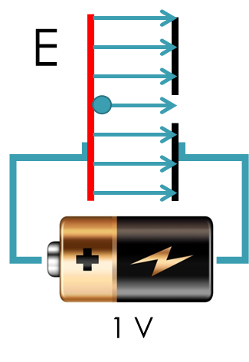
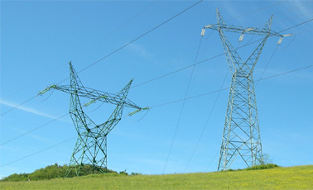
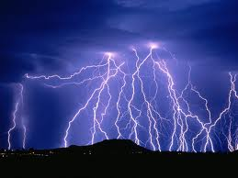
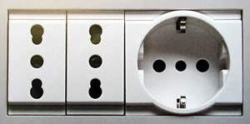
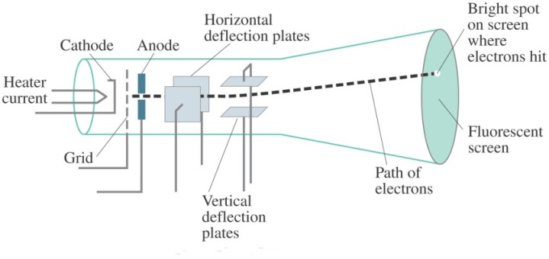
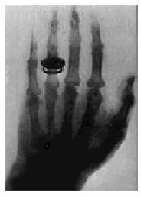
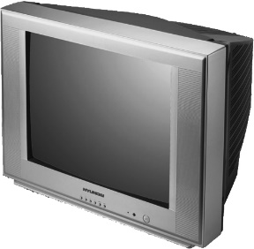



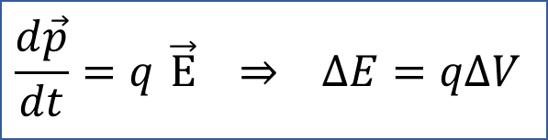
Acceleration basics
10⁵ V
$$\frac{d\vec{p}}{dt}=q \vec{E} ⇒ ΔE=qΔV$$
$$1eV=1.6×{10}^{−19}J$$
Particle energies are typically expressed in electron-volt [eV], equal to the energy gained by 1 electron accelerated through an electrostatic potential of 1 volt.
$$\vec{p}=momentum, q=charge$$
$$\vec{E}=electric field, ∆E=energy gain$$
10⁹-10¹⁰V
The energy gained by the electrons travelling from the cathode to the anode is equal to their charge multiplied the DC voltage between the two electrodes.
100-200 V
The first historical linear particle accelerator was built by the Nobel prize Wilhelm Conrad Röntgen (1900). Electrons emitted by the heated cathode were accelerated while flowing to another electrode connected to the positive generator pole (anode). Collisions between the electron beam (originally called cathode ray) and the anode produced X-rays.
+
-
Another accelerator application is the cathode-ray-tube television (CRT TV)
Electric field
Cathode
Anode
Voltage ΔV

Slide 10
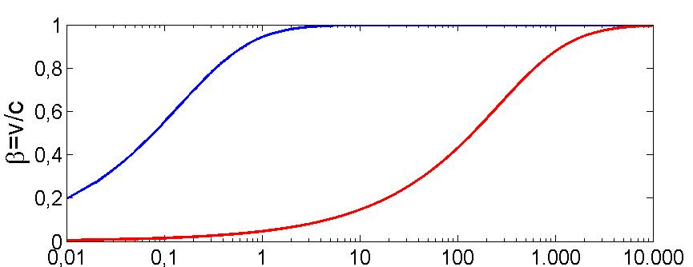
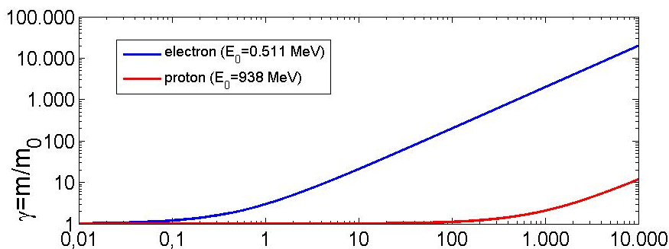
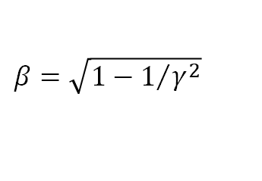

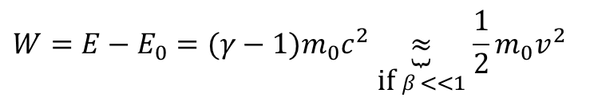
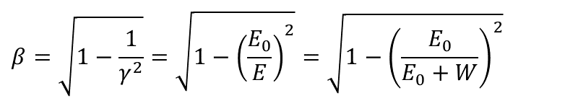

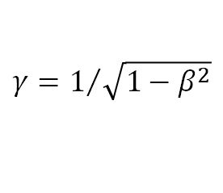
Single Particle Velocity VS Energy
$$β=\sqrt{1−1/{γ^{2}}}$$
$$γ=1/{\sqrt{1−β^{2}}}$$
rest mass m₀
rest energy E₀ (=m₀c²)
total energy E
relativistic mass m
velocity v
momentum p (=mv)
Kinetic energy W=E-E₀
Relativistic factor β=v/c (<1)
$$\left(m=γm_{0}\right)$$
$$W=E−E_{0}=(γ−1)m_{0}c^{2}\underset{\text{if} β<<1}{\underbrace{≈}}\frac{1}{2}m_{0}v^{2}$$
Relativistic factor γ=E/E₀ (≥1)
$$β=\sqrt{1−\frac{1}{γ^{2}}}=\sqrt{1−{\left(\frac{E_{0}}{E}\right)}^{2}}=\sqrt{1−{\left(\frac{E_{0}}{E_{0}+W}\right)}^{2}}$$
$$E^{2}=E_{0}^{2}+p^{2}c^{2}$$
Light particles (as electrons) are practically fully relativistic (β≅1, γ>>1) at relatively low energy and reach a constant velocity (∼c). The acceleration process occurs at constant particle velocity
Heavy particles (protons and ions) are typically weakly relativistic and reach a constant velocity only at very high energy. The velocity changes a lot during the acceleration process.
This implies important differences in the technical characteristics of the accelerating structures. In particular, for protons and ions we need different types of accelerating structures, optimized for different velocities and/or the accelerating structure must vary its geometry to take into account the velocity variation.
p⁺
Light particles
e⁻
Heavy particles
Kin. Energy [MeV]
e⁻
p⁺

Slide 11
Part 2
From DC to RF accelerators

Slide 12
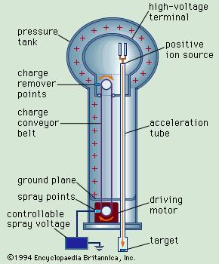
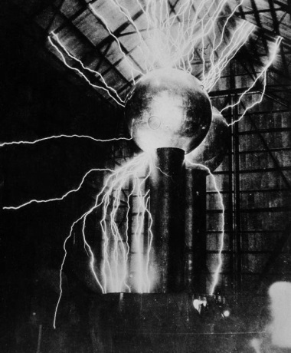
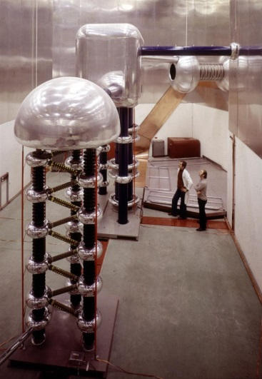
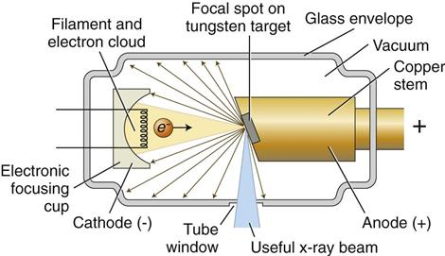
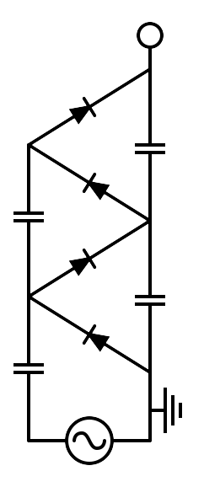
Electrostatic accelerators
To increase the achievable maximum energy, Van de Graaff invented an electrostatic generator based on a dielectric belt transporting positive charges to an isolated electrode hosting an ion source. The positive ions generated in a large positive potential were accelerated toward ground by the static electric field.
LIMITS OF ELECTROSTATIC ACCELERATORS
DC voltage as large as ∼10 MV can be obtained (E∼10 MeV). The main limit in the achievable voltage is the breakdown due to insulation problems.
APPLICATIONS OF DC ACCELERATORS
DC particle accelerators are in operation worldwide, typically at V<15MV (E_{max}=15 MeV), I<100mA.
They are used for:
material analysis
X-ray production
ion implantation for semiconductors
first stage of acceleration (particle sources)
750 kV Cockcroft-Walton
Linac2 injector at CERN from 1978 to 1992

Slide 13
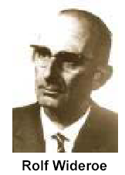



RF accelerators: Wideroe «Drift Tube Linac»
The particles are accelerated by the electric field in the gap between electrodes connected alternatively to the poles of an AC generator. This original idea of Ising (1924) was implemented by Wideroe (1927) who applied a sine-wave voltage to a sequence of drift tubes. The particles do not experience any force while travelling inside the tubes (equipotential regions) and are accelerated across the gaps. This kind of structure is called Drift Tube Linac (DTL).
If the length of the tubes (or, equivalently, the distances between the centers of the gaps) increases with the particle velocity during the acceleration such that the time of flight between gaps is kept constant and equal to half of the RF period, the particles are subject to a synchronous accelerating voltage and experience an energy gain of $∆E=q∆V$ passing through each gap.
In principle a single RF generator can be used to indefinitely accelerate a beam, avoiding the breakdown limitation affecting the electrostatic accelerators.
The Wideroe LINAC is the first RF LINAC
$$V\left(t\right)=V_{0}\sin{(ωt)}⁡$$
L₁
L_{n}

Slide 14



DC acceleration between two electrodes
+
Energy-momentum relation
$$E^{2}=E_{0}^{2}+p^{2}c^{2}$$
$$⇒2EdE=2pdpc^{2}$$
$$⇒dE=v\frac{mc^{2}}{E}dp$$
$$⇒dE=vdp$$
ΔV
-
E_{z}
source
z (direction of acceleration)
gap
ΔE
E_{z}
t
z
Lorentz force
$$\frac{dp}{dt}=q E_{z}\underset{z=vt}{\underbrace{⇒}}v\frac{dp}{dz}=q E_{z}⇒\frac{dE}{dz}=qE_{z}$$
$$\text{and}\text{,} \text{also}\text{,} \frac{dW}{dz}=qE_{z}, being W=E−E_{0}$$
rate of energy gain per unit length
$$ΔE=\int_{gap}{\frac{dE}{dz}dz}=\int_{gap}{qE_{z}dz}⇒ΔE=qΔV$$
energy gain per electrode pair

Slide 15





RF acceleration
Bunched beam
$$ΔV=V_{RF}\cos\left(ω_{RF}t\right)\text{,} ω_{RF}=2πf_{RF}=\frac{2π}{T_{RF}}$$
E_{z}
source
$$⇒ΔE=q{\hat{V}}_{acc}\cos\left(ω_{RF}t_{inj}\right)$$
z
$$E_{z}\left(z,t\right)=E_{RF}\left(z\right)\cos\left(ω_{RF}t\right)$$
gap
Particles accelerated
ΔE
$$V_{RF}=\int_{gap}{E_{RF}\left(z\right)dz}$$
z
Particles lost passing through the gap
t_{inj}
DC acceleration
RF acceleration
charge
charge
Bunched beam (in order to be synchronous with the external AC field, particles must be gathered in non-uniform temporal structure)
t
$$T_{RF}$$
t

Slide 16










RF acceleration
Transit time factor
$$ΔV=V_{RF}\cos\left(ω_{RF}t\right),$$
$${with ω}_{RF}=2πf_{RF}=\frac{2π}{T_{RF}}$$
gap
E_{z}
source
$$V_{RF}=\int_{gap}{E_{RF}\left(z\right)dz}$$
z
$$E_{z}\left(z,t\right)=E_{RF}\left(z\right)\cos\left(ω_{RF}t\right)$$
${\left.E_{z}\left(z,t\right)\right|}_{\begin{aligned}&seen \\ &by \\ &particle\end{aligned}}=E_{RF}\left(z\right)\cos\left[ω_{RF}\left(t+t_{inj}\right)\right]= {=E}_{RF}\left(z\right)\cos\left(ω_{RF}t+φ_{inj}\right)$, with $φ_{inj}=ω_{RF}t_{inj}$
$$E_{RF}\left(z\right)$$
-L/2
+L/2
z
t=z/v
$ΔE=q\int_{gap}{{\left.E_{z}\left(z,t\right)\right|}_{\begin{aligned}&seen \\ &by \\ &particle\end{aligned}}dz}=q\int_{{−L}/2}^{{+L}/2}{E_{RF}\left(z\right)\cos\left(ω_{RF}\frac{z}{v}+φ_{inj}\right)dz}$=
$$=q\int_{gap}{E_{RF}\left(z\right)dz}\frac{\int_{gap}{E_{RF}\left(z\right)\cos\left(ω_{RF}\frac{z}{v}\right)dz}}{\int_{gap}{E_{RF}\left(z\right)dz}}\cos\left(φ_{inj}\right)$$
$$ΔE=qV_{RF}T\cos\left(φ_{inj}\right)=q{\hat{V}}_{acc}\cos\left(φ_{inj}\right)$$
Hyp. of symmetric accelerating field
Average accelerating field in the gap
$${\hat{E}}_{acc}={{\hat{V}}_{acc}}/L$$
Average accelerating field seen by the particle
$$E_{acc}={V_{acc}}/L$$
T<1
Transit time factor
Injection phase
$$V_{RF}$$
Peak gap voltage

Slide 17

DTL synchronization
Low energy particles
If now we consider a DTL structure, we have that at each gap the maximum energy gain is $∆E=qV_{acc}$ and the particle increase its velocity accordingly to the relativistic formulae. It is convenient to refer to the center of each gap as follows:
+
-
+
-
v_{n}
Gap n+1
v_{n+1}
Gap n
E_{z}
E_{z}
L_{n}
L_{n+1}
L_{n+2}
L_{n}
L_{n+1}
L_{n+2}
z
z
E
In order to maintain the particle synchronous with the accelerating field at the center of each gap, the distance between the centers of the gaps (L_{n}) must increase as:
E_{n+1}
qV_{acc}
E_{n}
z
v
where${\bar{ v}}_{n}$is the average particle velocity between the gap n and n+1
v_{n+1}
The energy gain per unit length (i.e. the average accelerating gradient times q) is given by:
v_{n}
z
[eV/m]

Slide 18



Alvarez structures
Proton and ions acceleration
Alvarez's structure can be described as a special DTL in which the electrodes are part of a resonant macrostructure.
E_{z}
The DTL operates in 0 mode for protons and ions in the range β=0.05-0.5 (f_{RF}=50-400 MHz, λ_{RF}=6-0.7 m) 1-100 MeV;
In order to be synchronous with the accelerating field at each gap the length of the n-th drift tube L_{n} has to be:
$L_{n}={\bar{β}}_{n}λ_{RF}$
The beam is inside the “drift tubes” when the electric field is decelerating. The electric field is concentrated between gaps;
The drift tubes are suspended by stems;
Quadrupoles (for transverse focusing) can fit inside the drift tubes.
z

Slide 19





Alvarez structures
Examples
CERN Linac2 (1978 - 2018):
200 MHz, 7 m x 3 tanks, 1 m diameter, final energy 50 MeV
CERN Linac4 (since 2013), in 2020 became the source of proton beams for the (LHC):
352 MHz frequency, Tank diameter 520 mm, 3 resonators (tanks), Length ~13 m
Energy: 3 MeV to 40 MeV, β=0.08 to 0.283 → cell length from 68mm to 241mm.
Final energy is 160 MeV, using accelerating structures of different types (Cell-Coupled DTL and Side Coupled Linac)

Slide 20

High frequency accelerating fields
The condition L_{n}<<λ_{RF} (necessary to model the tube as an equipotential region) requires β<<1. Thus, the Wideröe technique can not be applied to relativistic particles.
$$\frac{ΔE}{ΔL}=\frac{qV_{acc}}{L_{n}}=qE_{acc}=\frac{2qV_{acc}}{λ_{RF}{\bar{β}}_{n}}$$
Moreover, when particles get high velocities the drift spaces get longer and one loses efficiency. To obtain a larger average accelerating gradient (E_{acc} [V/m]), smaller λ_{RF} (higher frequencies) must be considered.
The solution consists of enclosing the system in a cavity, whose resonant frequency matches the RF generator frequency.
Each cavity can be independently powered from the RF generator
High frequency and relative high-power sources became available after world war II pushed by military technology needs (such as radar). Moreover, the concept of equipotential DT can not be applied at small λ_{RF} and the power lost by radiation is proportional to the RF frequency.
Consequently, we must consider accelerating structures different from drift tubes.
waveguide
E_{z}
E_{z}

Slide 21







Accelerating structures: standing wave
High frequency RF accelerating fields are confined in cavities.
The cavities are metallic closed volumes were the e.m fields has a particular spatial configuration (resonant modes) whose components, including the accelerating field E_{z}, oscillate at some specific frequencies f_{RF} (resonant frequency) characteristic of the mode.
$$E_{z}\left(z,t\right)=E_{RF}\left(z\right)\cos\left(ω_{RF}t\right)$$
The modes are excited by RF generators that are coupled to the cavities through waveguides, coaxial cables, etc…
The resonant modes are called Standing Wave (SW) modes (spatial fixed configuration, oscillating in time).
The spatial and temporal field profiles in a cavity must be computed (analytically or numerically) by solving the Maxwell equations with the proper boundary conditions.
B
E

Slide 22








SW structures notes
  NC cavity Q∼10⁴
  SC cavity Q∼10¹⁰
Shunt Impedance
Quality Factor
R over Q
The shunt impedance is the parameter that qualifies the efficiency of an accelerating mode. The highest is its value, the larger is the obtainable accelerating voltage for a given power.
The quality factor Q is defined as the total energy stored in the cavity divided by the power dissipated on the walls
The R/Q is a pure geometric qualification factor. It does not depend on the walls conductivity. R/Q of a single cell is of the order of 100.
$$R=\frac{{\hat{V}}_{acc}^{2}}{P_{diss}} \left[Ω\right]$$
$$Q=ω_{RF}\frac{W}{P_{diss}}$$
$$\frac{R}{Q}=\frac{{\hat{V}}_{acc}^{2}}{ω_{RF}W}$$
Equivalent circuit
$$V_{acc}\left(t\right)={\hat{V}}_{acc}\left(1−e^{−\frac{t}{τ_{F}}}\right)$$
Example:
  Q∼10000
f_{RF}=1 GHz
τ_{F}=3.1 μs
The reachable $V_{acc}$ for a given power is proportional to $\sqrt{Q}$but, on the other hand, the filling time is $∝Q$
$${\left.τ_{F}\right|}_{NC}≈μs \\ {\left.τ_{F}\right|}_{SC}>100ms$$

Slide 23





Accelerating structures: travelling wave
$$P_{RF in}$$
$$P_{RF out}$$
To accelerate charged particles, the electromagnetic field must have an electric field along the direction of propagation of the particle.
The field has to be synchronous with the particle velocity.
In the standing wave (SW) structures in which the field has basically a given profile and oscillate in time (as example in DTL or resonant cavities): $E_{z}\left(z,t\right)=E_{RF}\left(z\right)\cos\left(ω_{RF}t\right)$
There is another possibility to accelerate particles: using a travelling wave (TW) structure in which the RF wave is co-propagating with the beam with a phase velocity equal to the beam velocity:
$$E_{acc}\left(z,t\right)=\underset{periodic with period D}{\underbrace{E_{P}\left(r,z\right)}}\cos\left(ω_{\text{RF}}t−k_{z}^{∗}z\right)e^{−αz}≈E_{IN}\cos\left(ω_{\text{RF}}t−k_{z}^{∗}z\right)e^{−αz}$$
These structures can be view as iris-loaded waveguides. Due to the presence of the irises the phase velocity of the propagating wave (that for an empty waveguide is always greater than c) is kept slightly below the speed of light, allowing the synchronism with the particles that pass through the structure and experience an accelerating phase.
Typically, these structures are used for electrons because in this case the phase velocity can be constant all over the structure and equal to c. In fact, it is difficult to modulate the phase velocity itself very quickly for a low β particle that changes its velocity during acceleration.
Power flow
D
E_{z}
z

Slide 24








TW structures notes
In a TW structure, the RF power enters into the cavity through an input coupler, flows (travels) through the cavity in the same direction as the beam and an output coupler at the end of the structure is connected to a matched power load.
If there is no beam, the input power, reduced by the cavity losses, goes to the power load where it is dissipated.
In the presence of a large beam current, however, a fraction of the TW power is transferred to the beam.
In a purely periodic structure, made by a sequence of identical cells (also called “constant impedance structure”), α does not depend on z and both the RF power flux and the intensity of the accelerating field decay exponentially along the structure:
$$E_{acc}\left(z,t\right)=\underset{\begin{aligned}\text{periodic} \text{function} \\ \text{with} \text{period} \text{D}\end{aligned}}{\underbrace{E_{P}\left(r,z\right)}}\cos\left(ω_{\text{RF}}t−k_{z}^{∗}z\right)e^{−αz}≈E_{IN}\cos\left(ω_{\text{RF}}t−k_{z}^{∗}z\right)e^{−αz}$$
$$E_{IN}=\sqrt{2αrP_{IN}}$$
$$V_{acc}=E_{IN}\frac{1−e^{−αL}}{α}$$
$$P_{F}\left(z\right)=P_{IN}e^{−2αz}$$
$$P_{OUT}=P_{IN}e^{−2αL}$$
The filling time is the time necessary to propagate the RF wave-front from the input to the end of the section of length L is:
$$τ_{F}=\frac{L}{v_{g}}$$
Differently from SW cavities after one filling time the cavity is completely full of energy
L

Slide 25
Part 3
Longitudinal Dynamics

Slide 26

Synchronous particle
Let us consider a SW linac structure made by accelerating gaps (like in DTL) or cavities.
In each gap we have an accelerating field oscillating in time and an integrated accelerating voltage (V_{acc}) still oscillating in time than can be expressed as:
$$V_{acc}={\hat{V}}_{acc}\cos\left(ω_{RF}t\right)$$
Let’s assume that the “perfect” synchronism condition is fulfilled for a phase φ_{s} (called synchronous phase). This means that a particle (called synchronous particle) entering in a gap with a phase φ_{s} (φ_{s}=ω_{RF}t_{s}) with respect to the RF voltage receive an energy gain (and a consequent change in velocity) that allow entering in the subsequent gap with the same phase φ_{s} and so on.
for this particle the energy gain in each gap is:
$$ΔE=q\underset{V_{acc_s}}{\underbrace{{\hat{V}}_{acc}\cos\left(φ_{s}\right)}}=qV_{acc_s}$$
both φ_{s} and φ_{s}* are synchronous phases
V_{acc}
V_{acc_s}
φ_{s}
φ_{s}*
t
T_{RF}

Slide 27


Phase Conventions
For circular accelerators, the origin of time is taken at the zero crossing of the RF voltage with positive slope
For linear accelerators, the origin of time is taken at the maximum of the positive crest of the RF voltage
circular accelerators
linear accelerators
$$V_{acc}={\hat{V}}_{acc}\sin\left(ω_{RF}t\right)$$
$$V_{acc}={\hat{V}}_{acc}\cos\left(ω_{RF}t\right)$$
φ_{s}
t
φ_{s}
t

Slide 28
Principle of phase stability
V_{acc}
Let us consider now the first synchronous phase φ_{s} (on the positive slope of the RF voltage). If we consider another particle “near” to the synchronous one that arrives later in the gap (t₁>t_{s}, φ₁>φ_{s}), it will see a higher voltage, it will gain a higher energy and a higher velocity with respect to the synchronous one. Therefore, its time of flight to next gap will be shorter, partially compensating its initial delay.
Similarly, if we consider another particle “near” to the synchronous one that arrives earlier in the gap (t₁<t_{s}, φ₁<φ_{s}), it will see a smaller voltage, it will gain a smaller energy and a smaller velocity with respect to the synchronous one. Consequently, its time of flight to next gap will be longer, compensating the initial advantage.
On the contrary, if we consider now the synchronous particle at phase φ_{s}* and another particle “near” to the synchronous one that arrives later or before in the gap, it will receive an energy gain that will increase further its distance from the synchronous one
φ₂
φ_{s}
φ₁
φ_{s}*
t
The choice of the synchronous phase in the positive slope of the RF voltage provides longitudinal focusing of the beam: phase stability principle.
The synchronous phase on the negative slope of the RF voltage is, on the contrary, unstable
Relying on particle velocity variations, longitudinal focusing does not work for fully relativistic beams (electrons). In this case acceleration “on crest” is more convenient.

Slide 29




Energy/phase equations (1/2)
In order to study the longitudinal dynamics in a LINAC, the following variables are used, which describe the generic particle phase (time of arrival) and energy with respect to the synchronous particle:
The energy gain per cell (one gap + tube in case of a DTL) of a synchronous and a generic particle are:
$\left\{\begin{aligned}&ΔE_{s}=q{\hat{V}}_{acc}\cos{φ_{s}} \\ &ΔE=q{\hat{V}}_{acc}\cos{φ}=q{\hat{V}}_{acc}\cos\left(φ_{s}+φ\right)\end{aligned}\right.$
Subtracting the two equations, we obtain:
$Δw=ΔE−ΔE_{s}=q{\hat{V}}_{acc}\left[\cos\left(φ_{s}+φ\right)−\cos{φ_{s}}\right]$
Dividing by the accelerating cell length ΔL and assuming $\frac{{\hat{V}}_{acc}}{ΔL}={\hat{E}}_{acc}$ (average accelerating field):
$\frac{Δw}{ΔL}=q{\hat{E}}_{acc}\left[\cos\left(φ_{s}+φ\right)−\cos{φ_{s}}\right]$
Using the approximation $\frac{Δw}{ΔL}≈\frac{dw}{dz}$:
$\frac{dw}{dz}=q{\hat{E}}_{acc}\left[\cos\left(φ_{s}+φ\right)−\cos{φ_{s}}\right]$
Arrival time (phase) of a generic particle at a certain gap (or cavity)
Arrival time (phase) of the synchronous particle at a certain gap (or cavity)
$$\left\{\begin{aligned}&φ=φ−φ_{s}=ω_{RF}\left(t−t_{s}\right) \\ &w=E−E_{s}\end{aligned}\right.$$
Energy of the synchronous particle at a certain position along the linac
Energy of a generic particle at a certain position along the linac
$$∆L$$
z
$$V_{acc}={\hat{V}}_{acc}\cos\left(ω_{RF}t\right)$$

Slide 30


Energy/phase equations (2/2)
On the other hand, we have that the phase variation per cell of a generic particle and of a synchronous particle are:
$\left\{\begin{aligned}&Δφ_{s}=ω_{RF}Δt_{s} \\ &Δφ=ω_{RF}Δt\end{aligned}\right.,$
where $∆t$ symbols represent the time of flight between two accelerating cells
Subtracting the two equations, we obtain:
$Δφ=ω_{RF}\left(Δt−Δt_{s}\right)$
Then dividing by the cell length $∆L$ and using the approximation $\frac{Δφ}{ΔL}≈\frac{dφ}{dz}$:
$\frac{dφ}{dz}=ω_{RF}\left(\frac{Δt}{ΔL}−\frac{Δt_{s}}{ΔL}\right)=ω_{RF}\left(\frac{1}{v}−\frac{1}{v_{s}}\right)⥂\underset{MAT}{\underbrace{≅}}−\frac{ω_{RF}}{cE_{0}β_{s}^{3}γ_{s}^{3}}w,$
where v, v_{s} are the average particles velocities.
$$\left\{\begin{aligned}\frac{dw}{dz}=q{\hat{E}}_{acc}\left[\cos\left(φ_{s}+φ\right)−\cos{φ_{s}}\right] \\ \frac{dφ}{dz}=−\frac{ω_{RF}}{cE_{0}β_{s}^{3}γ_{s}^{3}}w\end{aligned}\right.$$
Eventually, we derived this system of coupled (non linear) differential equations describe the motion of a non synchronous particles in the longitudinal plane with respect to the synchronous one.
MAT:
$$ω_{RF}\left(\frac{1}{v}−\frac{1}{v_{s}}\right)=ω_{RF}\left(\frac{v_{s}−v}{vv_{s}}\right)⥂\underset{\begin{aligned}&vv_{s}≅v_{s}^{2} \\ &v−v_{s}≅Δv\end{aligned}}{\underbrace{≅}}−\frac{ω_{RF}}{v_{s}^{2}}Δv=−\frac{ω_{RF}}{c}\frac{Δβ}{β_{s}^{2}} \text{remembering} \text{that} β=\sqrt{1−1/{γ^{2}}}⇒βdβ={dγ}/{γ^{3}}⇒−\frac{ω_{RF}}{c}\frac{Δβ}{β_{s}^{2}}≅−\frac{ω_{RF}}{c}\frac{Δγ}{β_{s}^{3}γ_{s}^{3}}=−\frac{ω_{RF}}{c}\frac{\overset{w}{\overbrace{ΔE}}}{E_{0}β_{s}^{3}γ_{s}^{3}}$$

Slide 31

Small amplitude energy-phase oscillations
Equation derivation
$$\left\{\begin{aligned}\frac{dw}{dz}=q{\hat{E}}_{acc}\left[\cos\left(φ_{s}+φ\right)−\cos{φ_{s}}\right] \\ \frac{dφ}{dz}=−\frac{ω_{RF}}{cE_{0}β_{s}^{3}γ_{s}^{3}}w→cE_{0}β_{s}^{3}γ_{s}^{3}\frac{dφ}{dz}=−ω_{RF}w\end{aligned}\right.$$
Deriving both terms of the second equation with respect to z:
$cE_{0}β_{s}^{3}γ_{s}^{3}\frac{d^{2}φ}{dz^{2}}+cE_{0}\frac{dβ_{s}^{3}γ_{s}^{3}}{dz}\frac{dφ}{dz}=−ω_{RF}\frac{dw}{dz}$
And, substituing $\frac{dw}{dz}$ defined in the first equation:
$cE_{0}β_{s}^{3}γ_{s}^{3}\frac{d^{2}φ}{dz^{2}}+cE_{0}\left(\frac{dβ_{s}^{3}γ_{s}^{3}}{dz}\right)\frac{dφ}{dz}=−ω_{RF}q{\hat{E}}_{acc}\left[\cos\left(φ_{s}+φ\right)−\cos{φ_{s}}\right]$
that is a general non linear differential equation that gives the phase evolution.
Assuming small oscillations around the synchronous particle $\cos\left(φ_{s}+φ\right)−\cos{φ_{s}}≅φ\sin{φ_{s}}$, deriving both terms with respect to z and assuming an adiabatic acceleration $\frac{dβ_{s}^{3}γ_{s}^{3}}{dz}$<<1:
$\frac{d^{2}φ}{dz^{2}}+\underset{Ω_{s}^{2}}{\underbrace{q\frac{ω_{RF}{\hat{E}}_{acc}\sin\left(−φ_{s}\right)}{cE_{0}β_{s}^{3}γ_{s}^{3}}}}φ=0$

Slide 32





Small amplitude energy-phase oscillations
Longitudinal phase space
More energy
$$V_{acc}$$
$$w$$
Arrive earlier
Arrive later
$$\frac{d^{2}φ}{dz^{2}}+\underset{Ω_{s}^{2}}{\underbrace{q\frac{ω_{RF}{\hat{E}}_{acc}\sin\left(−φ_{s}\right)}{cE_{0}β_{s}^{3}γ_{s}^{3}}}}φ=0$$
The condition to have stable longitudinal oscillations and acceleration at the same time is:
$\left.\begin{aligned}&Ω_{s}^{2}>0⇒\sin\left(−φ_{s}\right)>0 \\ &V_{acc}>0⇒\cos{φ_{s}}>0\end{aligned}\right\}⇒−\frac{π}{2}<φ_{s}<0$
If we accelerate on the rising part of the positive RF wave, we have a longitudinal force keeping the beam bunched around the synchronous phase
$\left\{\begin{aligned}&φ=\hat{φ}\cos\left(Ω_{s}z\right) \\ &w=\hat{w}\sin\left(Ω_{s}z\right)\end{aligned}\right.$
The trajectory of a generic particle in the longitudinal phase space is an ellipse and the angular frequency is simply $Ω_{T}=Ω_{S}β_{S}c$ that scale with $1/{γ^{3/2}}$, thus, for ultra relativistic particles, shrinks to 0 (the beam is frozen)
the bunch occupies an area in the longitudinal phase space called longitudinal emittance and the projections of the bunch in the energy and phase planes give the energy spread and the bunch length.
$${\hat{V}}_{acc}$$
$$V_{acc_s}$$
Less energy
φ_{s}
t
ϕ
Synchronous particle
w
w
Longitudinal emittance
is the phase space area including all the particles
0
ϕ
N. of particles
Energy
spread
N. of particles
Bunch length
ϕ
32

Slide 33

Real beam example
SPARC_LAB beam ready for a SASE experiment
Beam parameters
Beam energy | 150 MeV
Relative energy spread (rms) | 9 x 10⁻⁴
Slice energy spread (rms) | 2 x 10-4
Bunch length (rms) | 2.6 ps
Electron charge | 400 pC
Beam current | 53 A
Repetition rate | 10 Hz
Vertical emittance | 2.9 mm mrad
Horizontal emittance | 2.5 mm mrad
(a) Phase space of the e-beam measured with time/energy dispersion induced by rf-deflector (in time) and a spectrometer dipole (in energy), (b) beam slice energy spread (A) and energy (B) and (c) beam current as a function of time along the bunch.

Slide 34
Part 4
Linac technology

Slide 35

Typical linac layout
The overall LINAC has to be designed to obtain the desired beam parameters in term of:
-output energy/energy spread
-beam current (charge)
-long. and transverse beam dimensions/divergence (emittance)
Waveguide
network
Having, in general, constraints in term of:
-space
-cost
-power consumption
-available power sources
…

Slide 36



Linac example
SPARC_LAB photoinjector @LNF
In operation since 2006, originally as injector for FEL experient, it has undergone several upgrades
In its last configuration the photoinjector is made by:
  a 1.6 cell S- band RF gun used as 5.6 MeV electron source
  Two S-band TW structures at 2856 MHz used ass capturing section and booster
  C-band at 5712 MHz used as capturing section and energy booster
The R&D program has been carried out performing many experiments, such as: (i) conventional SASE and seeded FEL; (ii) Thomson back-scattering; (iii) THz generation; (iv) plasma beam focusing and acceleration (PWFA) with FEL generation; (v) laser interaction with matter.

Slide 37
Thank you for your attention

