Slide 1

Introduction to High Power Lasers
Leonida Antonio GIZZI, CNR-INO Pisa, Italy
also at INFN, Pisa, Italy
Intense Laser Irradiation Laboratory

Slide 2

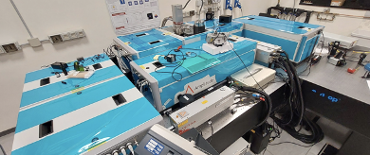
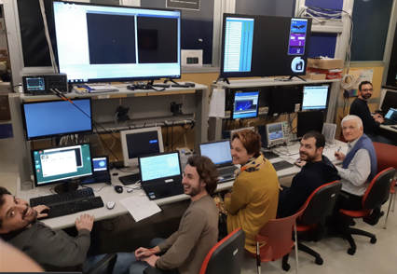
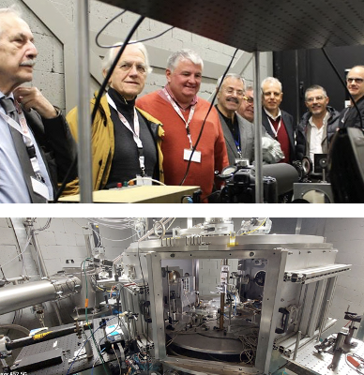
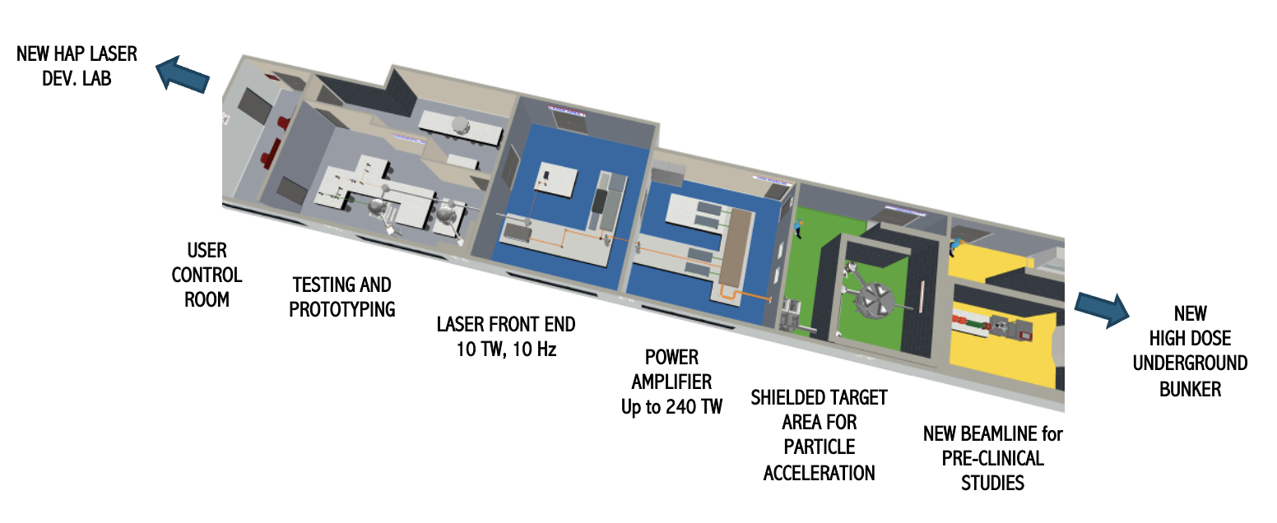
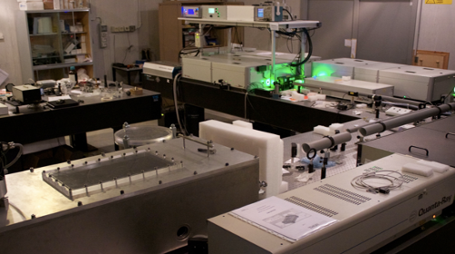
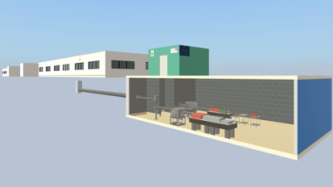
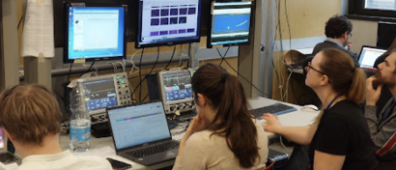







The Intense Laser Irradiation Laboratory (ILIL)
LASER CAPABILITIES:
240 TW, Ti:Sa, up to 5 Hz, 27 fs;
1kHz, >20 mJ, Ti:Sa + OPA
100 Hz, >1J, TiSA (procurement in progress)
2018

Slide 3

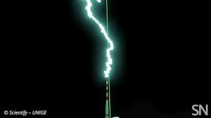
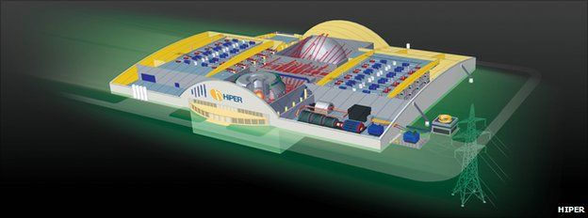
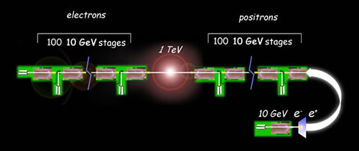
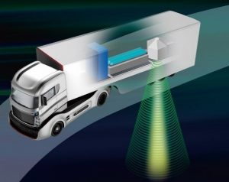
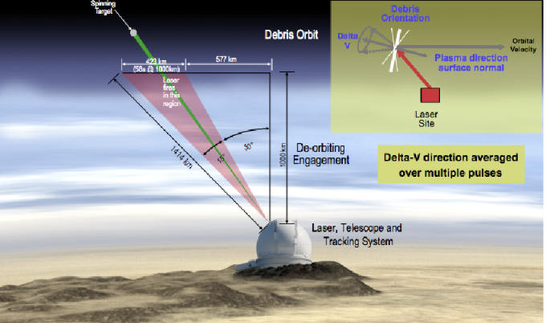
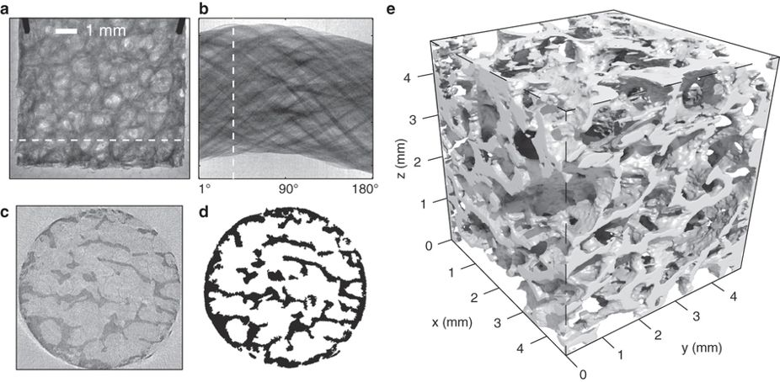
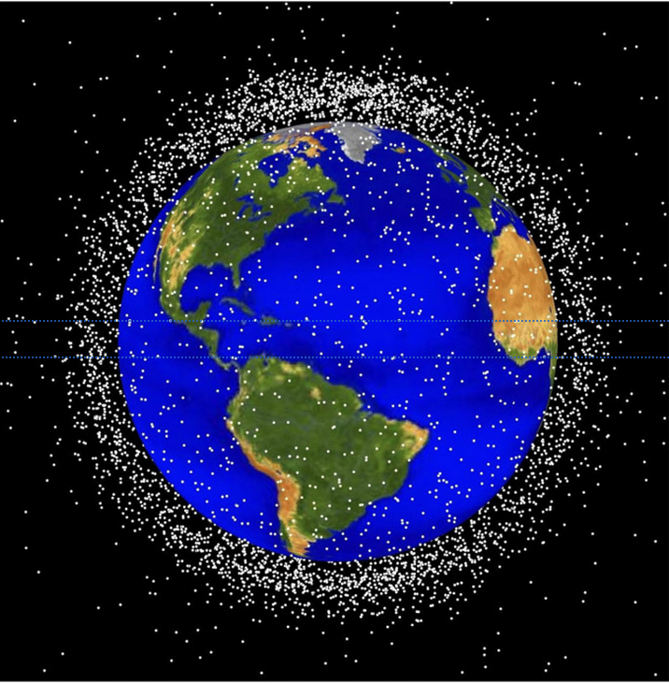
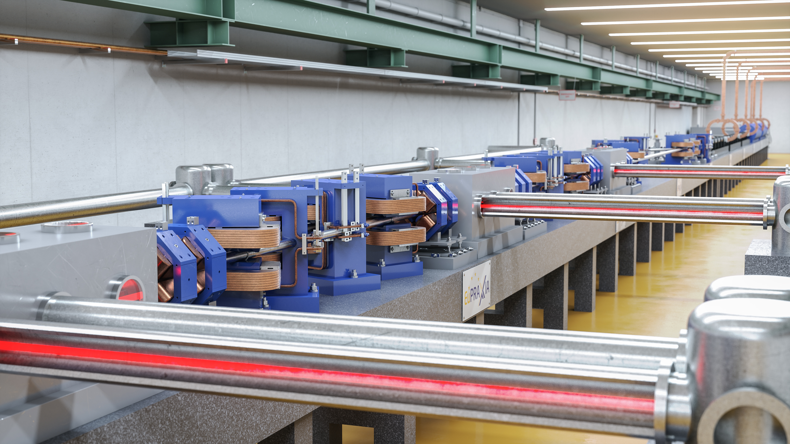

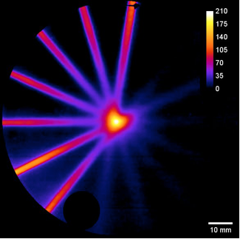
Grand challenges of laser-plasma science
ENERGY
Towards CDR
Needing high average power short pulses
Based on HP laser technology
FUNDAMENTAL SCIENCE
Towards CDR
INERTIAL FUSION ENERGY
S. D.Batani et al, HPLSE, 2023
SECURITY
Needing broadband for LPI mitigation
Proof of principle
LASER LIGHTENING ROD
HEP TeV COLLIDER
A. Houard. Nat. Photon. 17, 231–235 (2023).
C. Benedetti et al., https://doi.org/10.48550/arXiv.2203.08366
Betatron X-ray source
MULTI-DISCIPLINARY SCIENCE
LASER DRIVEN NEUTRON SOURCES
EuPRAXIA PP
Light sources
HEALTH
https://www.ile.osaka-u.ac.jp/eng/research/project/project-lans/index.html
VHEE FLASH Radiotherapy
SATELLITE DEBRIS REMOVAL
COMPACT PLASMA XRAY FEL
Needing compact and efficient high power USP laser technology
R. Assmann et al., https://doi.org/10.1140/epjst/e2020-000127-8
Based on Laser-Plasma Acceleration
C. Phipps , .Advances in Space Research. 49 (9): 1283–1300. (2011)
L.Labate et al. Sci Rep, 2020
Cost, durability, energy efficiency, mass production of underlying laser components key to enable these developments.

Slide 4
Contents
High power lasers
Short Pulse Ultraintense Lasers
Amplifying lasing media
Ultraintense Lasers: overview
From amplification to plasma
  Focal spot quality
  Temporal contrast
  Multipulse generation
Scaling laser drivers to large accelerator systems
  Potential and limits of existing Ti:Sa technology
  New schemes for high rep-rate and WPE
kHz laser driver for LPA
  A case study

Slide 5
High power lasers

Slide 6
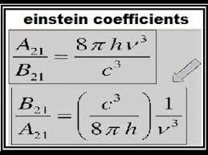
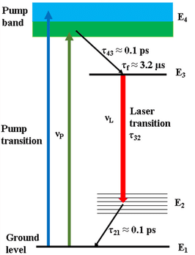
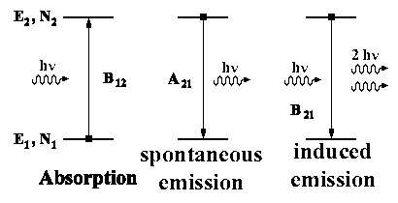
Main principles of a laser
Solid state laser for high power amplification
Excitation (pump radiation)
population inversion
spontaneous emission
stimulated emission
Cooling (loss)
Pump (Energy)
Gain medium
Cooling (loss)

Slide 7
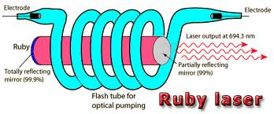
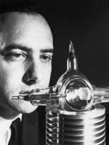
The origin of lasers in the lab
High power laser pulses
≈ nanosecond pulse duration Q-switch
Power: ≈ GW
Theodore Maiman, 1960
C.H. Townes, N.G.Basov and A.M.Prokhorov, Phisics Nobel rize, 1964
Orazio Svelto, La storia del Laser, in Il Laser, Cinquant’anni di idee luminose, CNR, ISBN 987-88-8080-120-7

Slide 8
MATERIAL DAMAGE LIMITS AMPLIFICATION
To avoid damage of optics and gain materials due to the growing electric field, laser intensity must be distributed over progressively larger diameters
2° Amplifier
3° Amplifier
Oscillator
1° Amplifier
Telescope
Telescope
Telescope
Consequence? “Gigantism” of high power, high energy lasers …

Slide 9

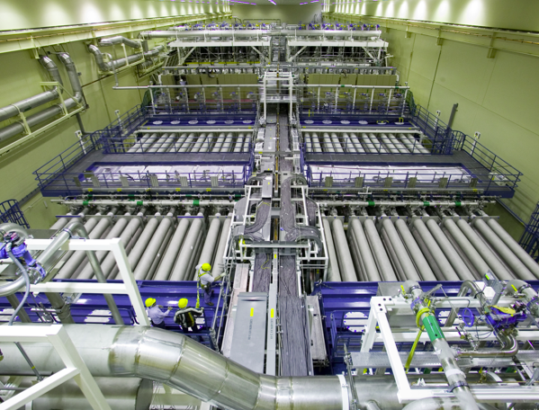

Conventional high power (high energy) lasers have huge size
Fusion ignition scale laser
Pulse energy:
2 MJ
Pulse duration:
4 ns
Peak power:
≈500 TW
Lawerence Livermore National Lab. California, USA
Ignition of inertial fusion achieved, Dec. 2022
Alternative approach to laser-matter interaction? High power at low energy per pulse and ultrashort pulse duration.

Slide 10
Short pulse, ultraintense lasers

Slide 11
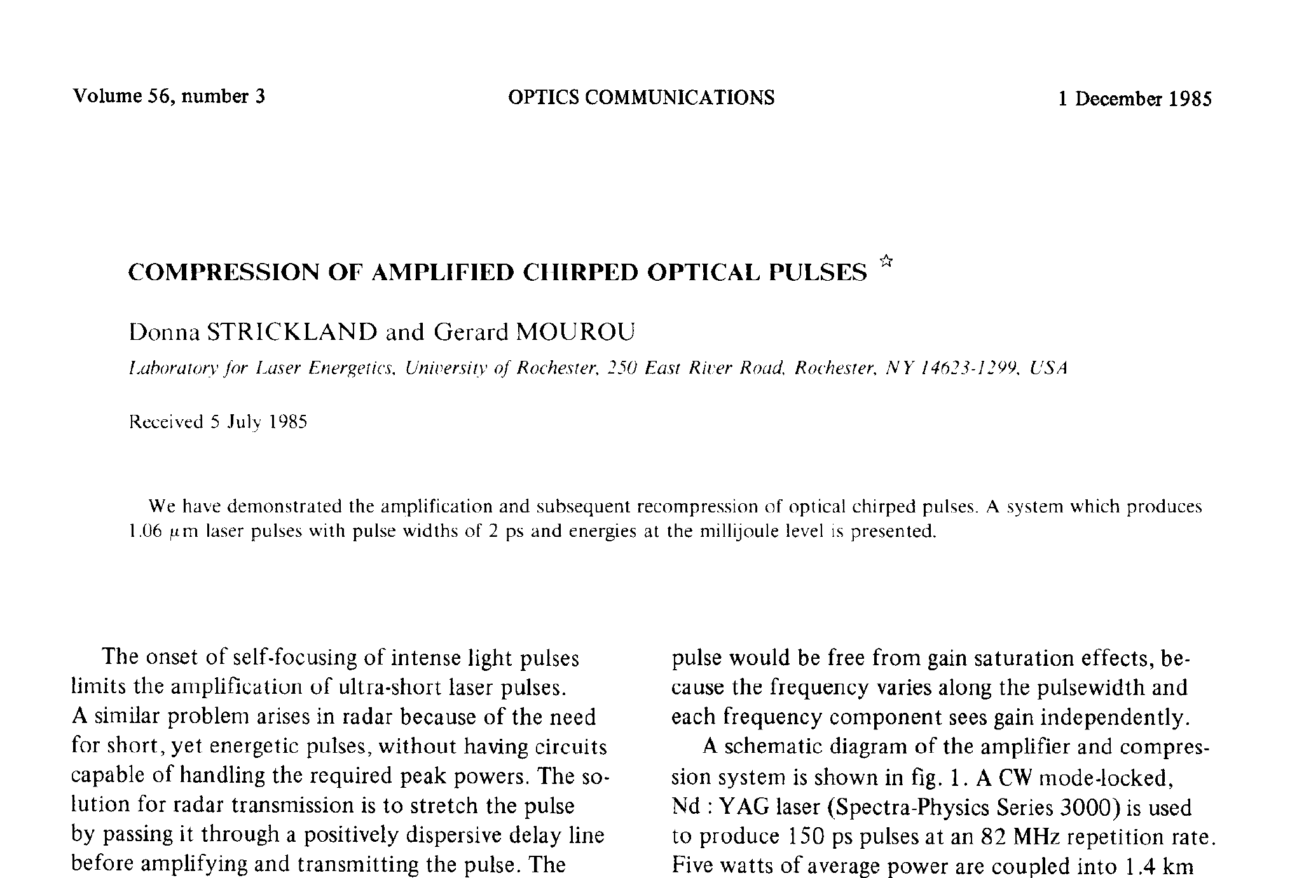
ORIGINAL PAPER
D. Strickland and G. Mourou, “Compression of amplified chirped optical pulses”, Opt. Commun. 56, 219 (1985)

Slide 12

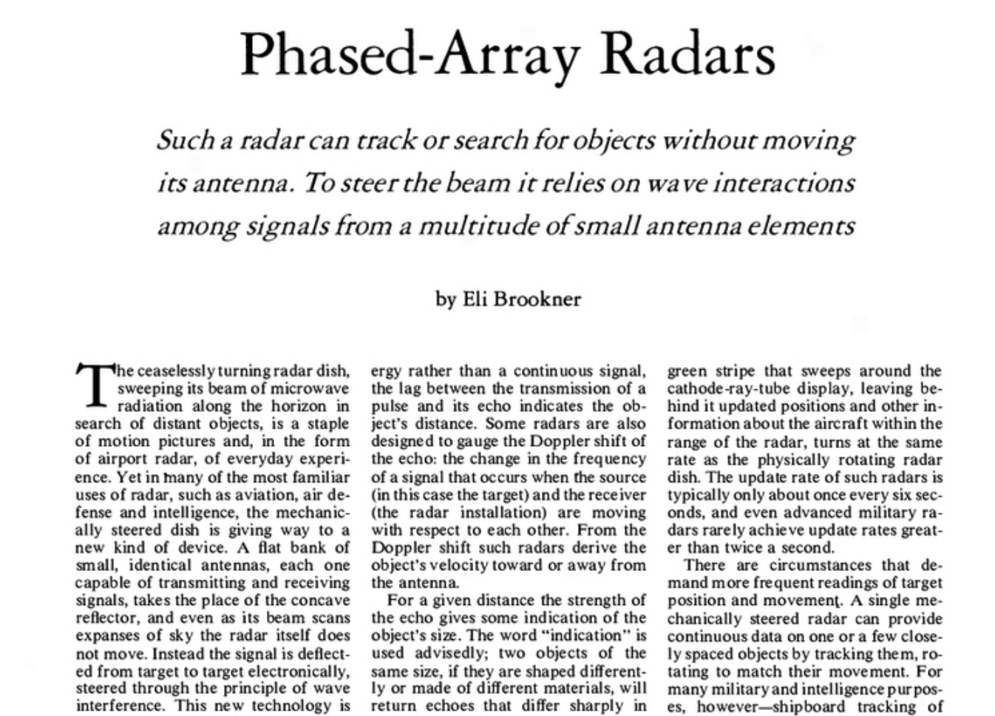
INSPIRATION from other field
Feb 1985

Slide 13

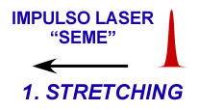
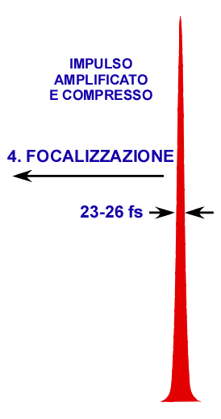
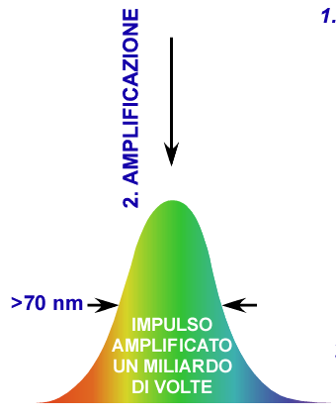




Chirped Pulse Amplification
A change of paradigm in high power lasers
Higher peak-power to date: 10 PW
Achievedn at the ELI-NP laser installation in Magurele (Romania)
C. Radier et al., HPLSE, 10, 21 (2022).
D. Strickland and G. Mourou, “Compression of amplified chirped optical pulses”, Opt. Commun. 56, 219 (1985)

Slide 14

Chirped Pulse Amplification ANIMATION

Slide 15
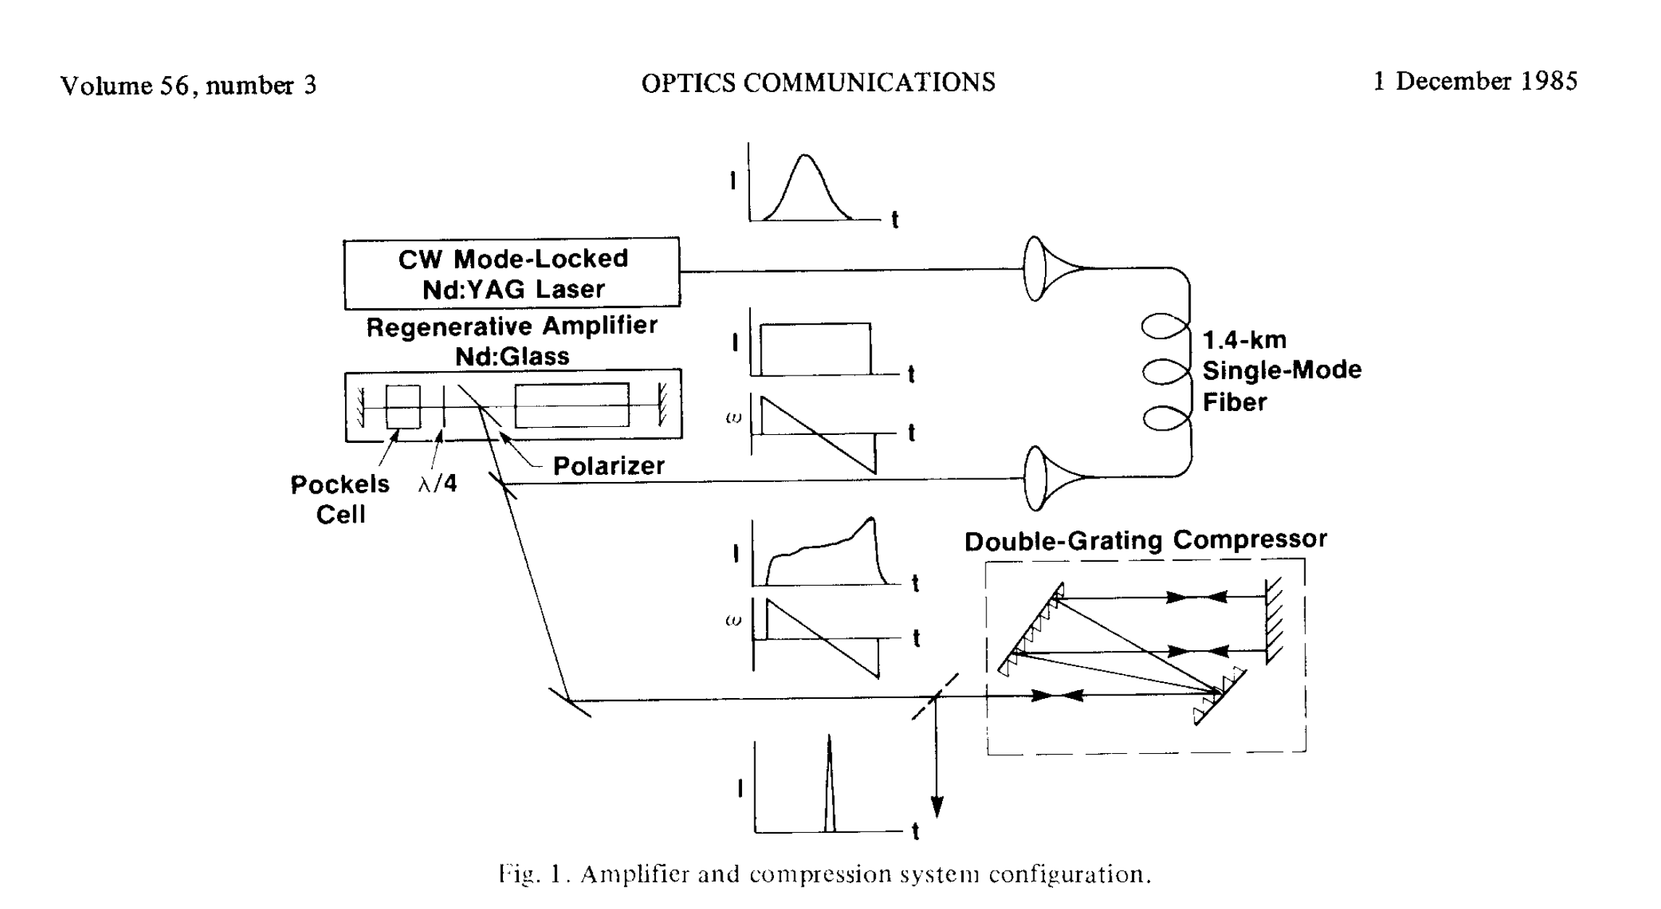
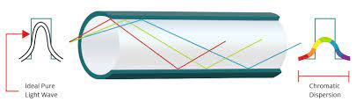
The original CPA EXPERIMENT
Dispersion in fibers

Slide 16
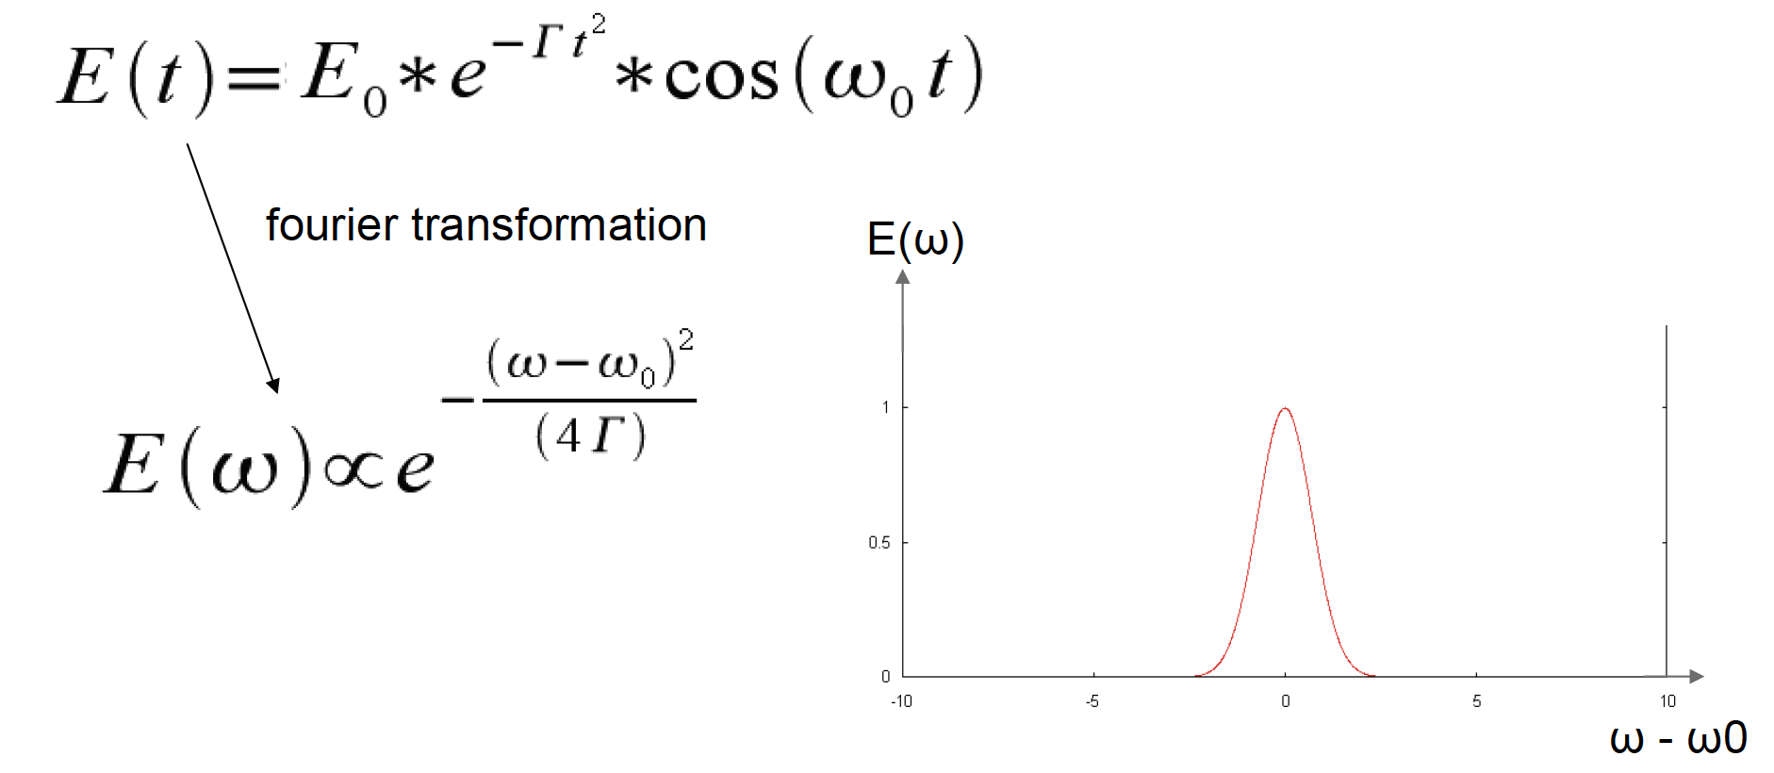
PULSE DURATION AND Bandwidth
We need a spectrum with a large bandwidth to achieve a short pulse

Slide 17
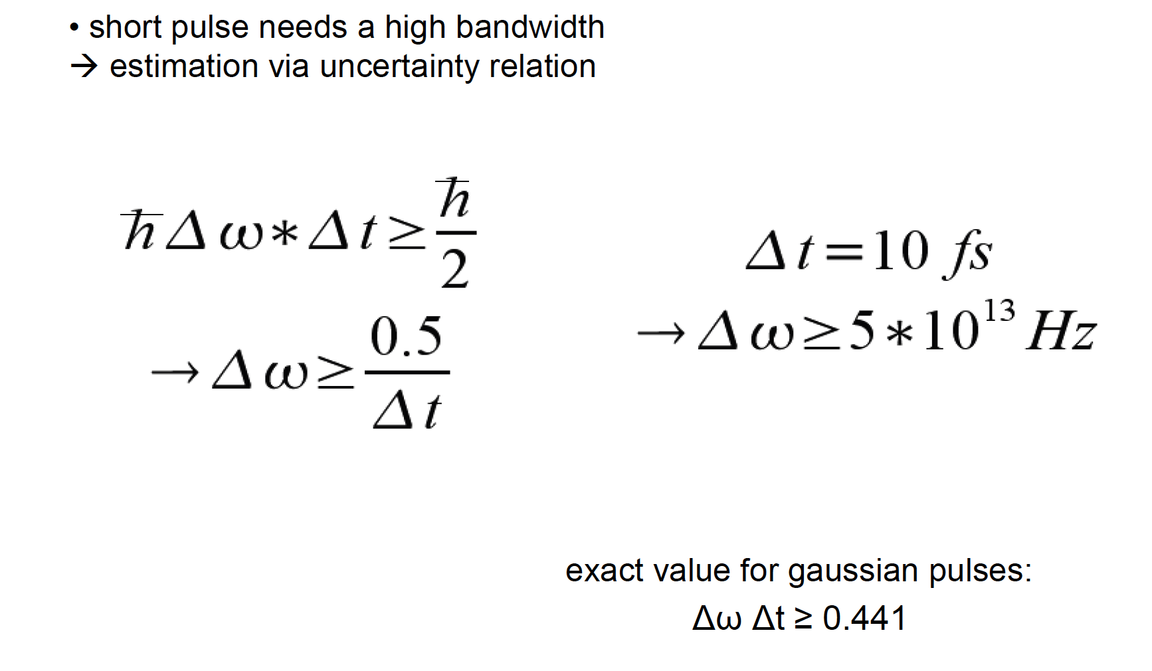
VIA UNCERTAINTY PRINCIPLE

Slide 18
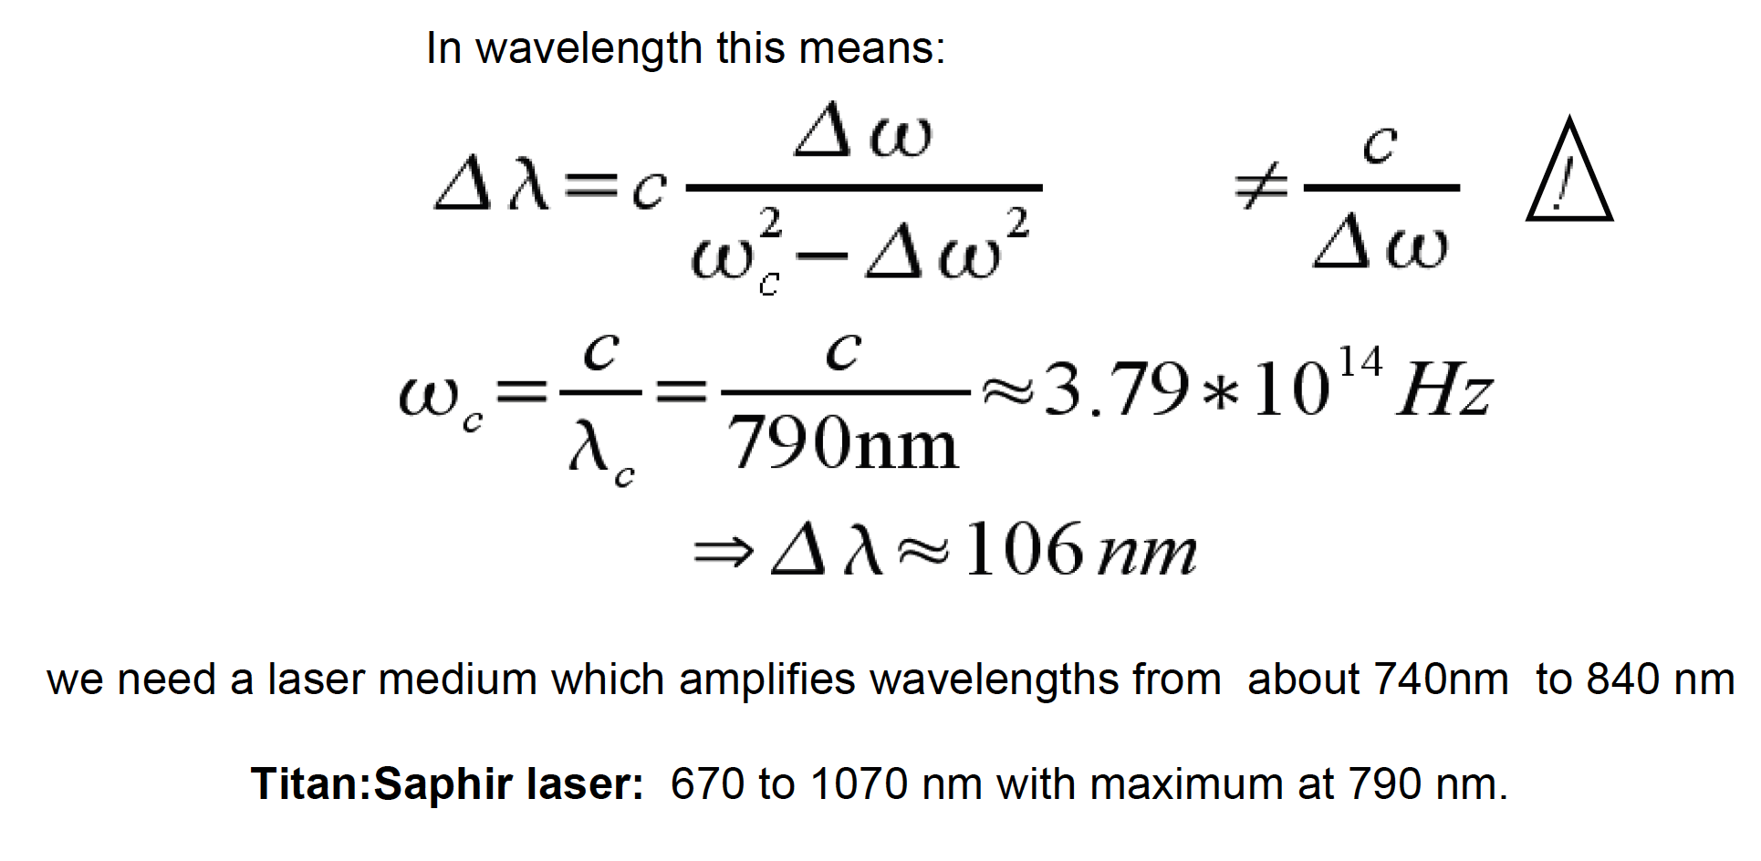
WAVELENGTH-WISE
We need a broadband seed pulse and a laser medium capable of amplifying wavelengths from 740 nm to 840 nm: very challenging

Slide 19
Amplifying lasing media

Slide 20
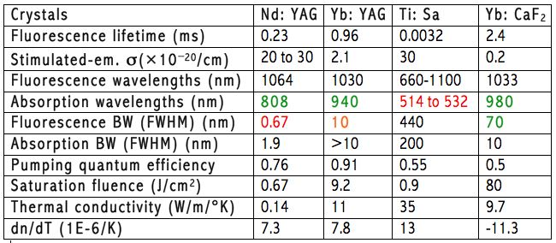
Key parameters of lasing media
Main parameters governing high power laser amplifiers:
  Spectral gain bandwidth: short pulse duration
  Thermal conductivity: limits repetition rate
  Abs. and emis. cross sections: gain, pump absorption and saturation
  Fluorescence lifetime: sets conditions on pumping
  dn/dT: limits beam quality

Slide 21
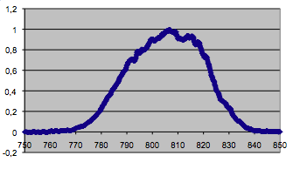
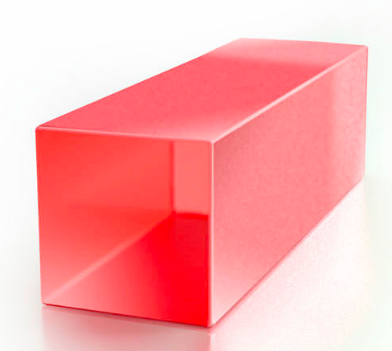
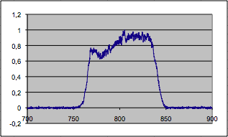
Key GAIN MATERIAL: Titanium doped Sapphire
Currently, most CPA lasers are based on Ti:Sapphire
Ti:Sa native spectrum
Ti:Al₂O₃
Ti:Sa with BW active control
Large gain bandwidth (680 nm – 1080 nm)
• High quantum efficiency
Thermal conductivity: 35 WK⁻¹m⁻¹
• Relatively long lifetime: 3 μs
• Typically pumped in the green with ns Q-switched pulses
Active bandwitdth control crucial to
overcome gain narrowing (non linear process) and enable sub-50 fs pulses

Slide 22
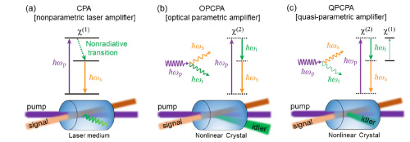
ALTERNATIVE APPROACH
Optical Parametric Chirped Pulse Amplification
Mainly for ultra-broad-band front-end preamplifiers
A. Dubietis et al. “Powerful femtosecond pulse generation by chirped and stretched pulse parametric amplification in BBO crystal,” Opt. Commun. 88, 437 (1992).
I.N. Ross et al. “The prospects for ultrashort pulse duration and ultrahigh intensity using optical parametric chirped pulse amplifiers,” Opt. Commun. 144, 125 (1997).

Slide 23
Ultraintense lasers: overview

Slide 24
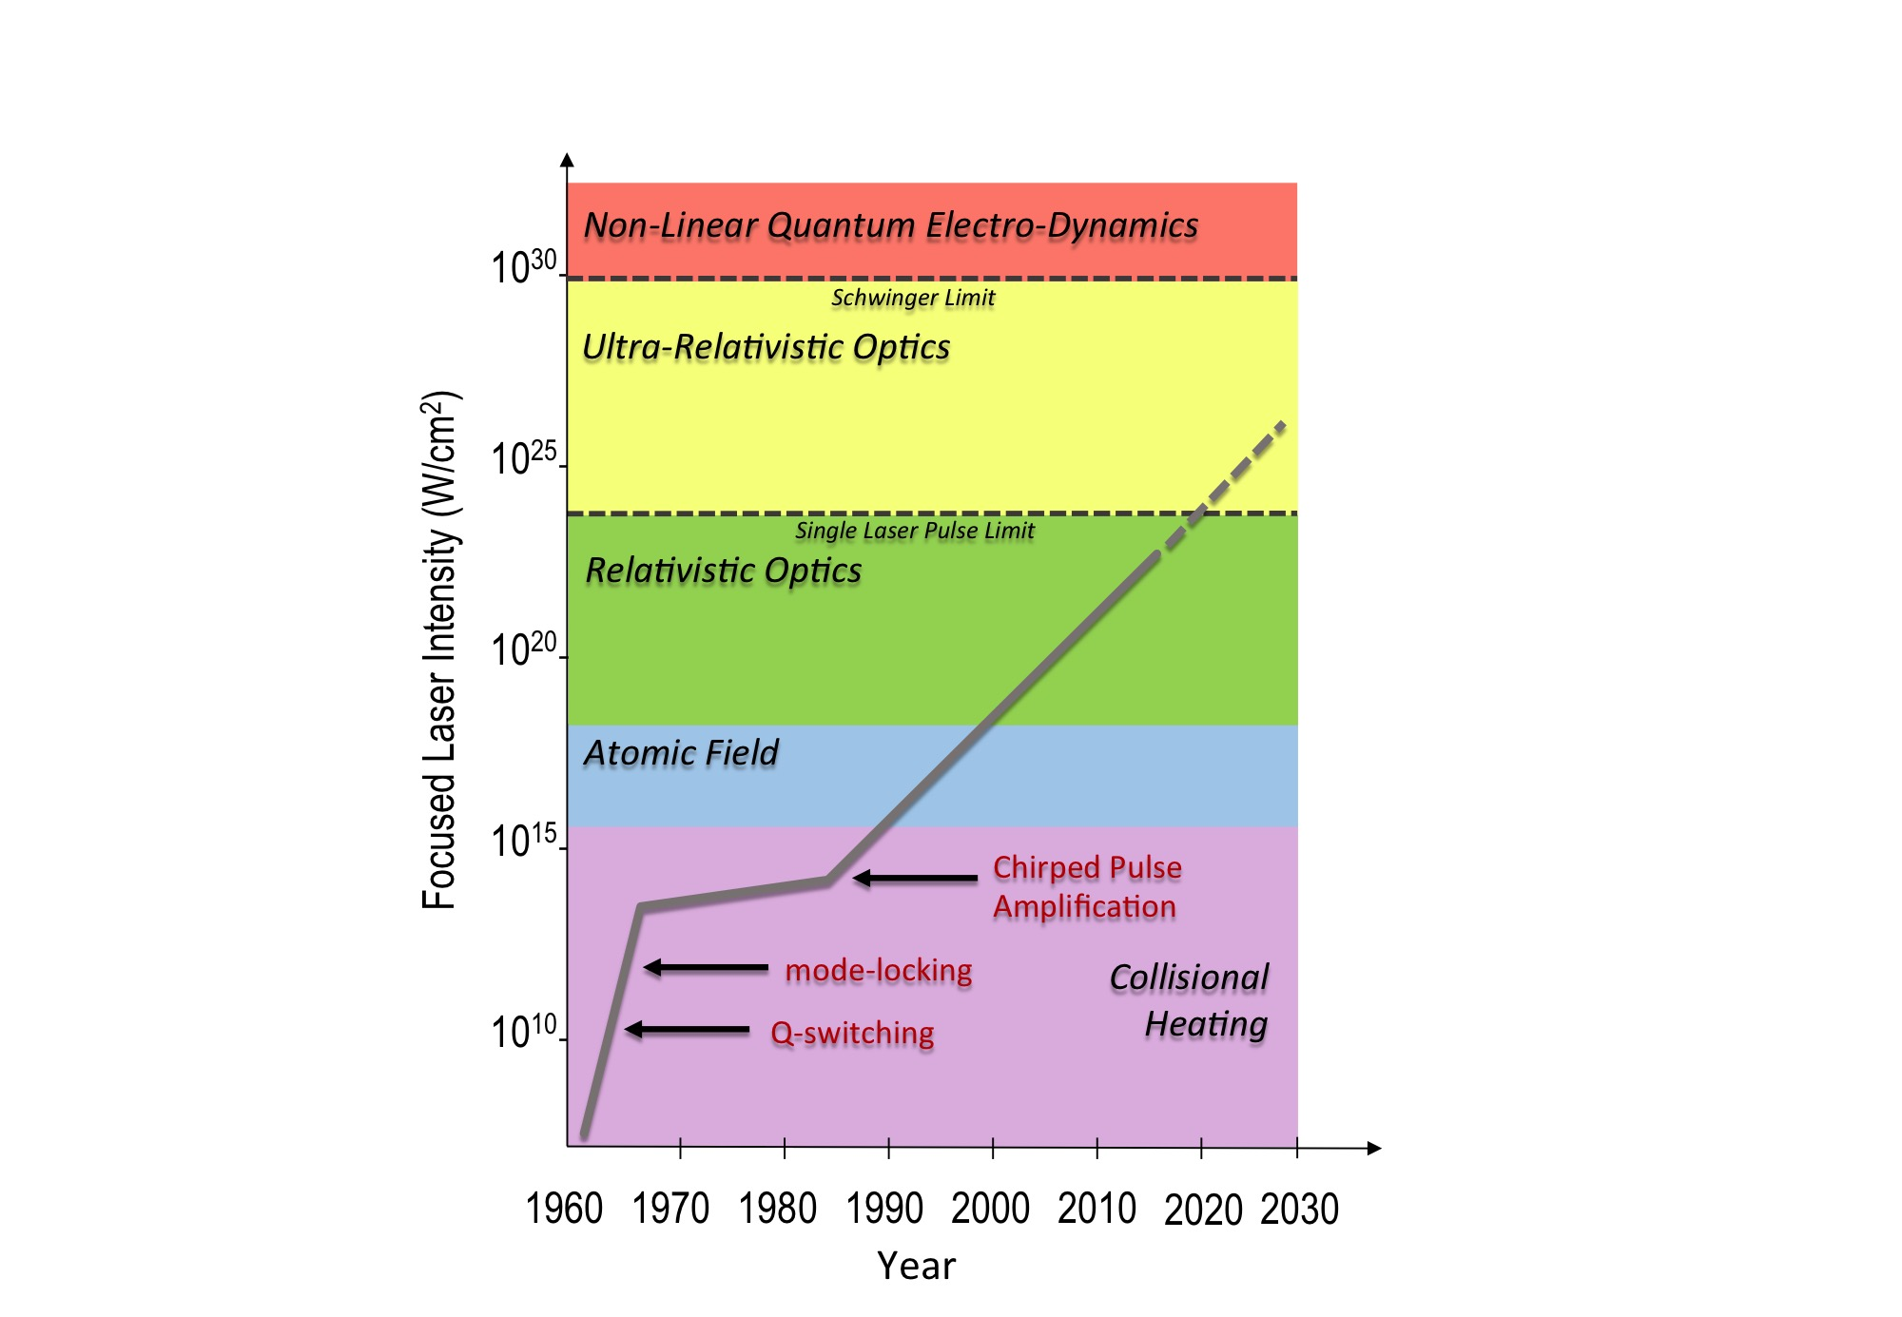

High intensity lasers: evolution
Major breakthrough following Chirped Pulse Amplification
Current laser technology developmentof CPA lasers [1] mainly driven by extreme intensity applications;
Laser-Plasma acceleration has developed along with progress in laser performance;
Recent LWFA-FEL demonstration [2] highlights the role of laser stability and control;
Need to focus on the technology required to achieve high-repetition rate at multi-joule (≈100 TW) scale [3], with high quality and enhanced control and stability;
Key role of industry to establish turn-key, high average/peak power ultrashort pulse technology;
1E23 W/cm2
Current highest intensity in the lab [4]
LASER-PLASMA ACCELERATORS
[1] D. Strickland and G. Mourou, "Compression of amplified chirped optical pulses." Optics communications 55, 447 (1985)
[2] W. Wang, K.Feng et al., Free-electron lasing at 27 nanometres based on a laser wakefield accelerator, Nature 595, 516–520 (2021)
[3] L.A. Gizzi et al., A viable laser driver for a user plasma accelerator, NIM A 909 , 58 (2018); https://doi.org/10.1063/1.4984906
[4] J. W. Yoon et al., “Realization of laser intensity over 1023 W/cm2,” Optica 8, 630-635 (2021), https://doi.org/10.1364/OPTICA.420520

Slide 25
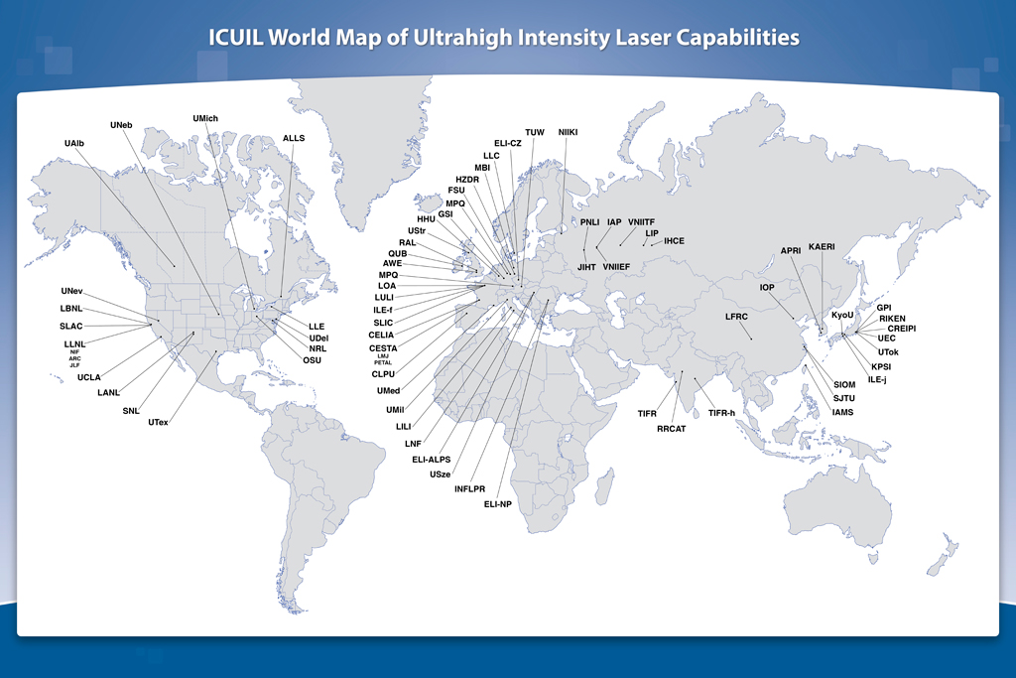
ULTRAINTENSE LASERS

Slide 26


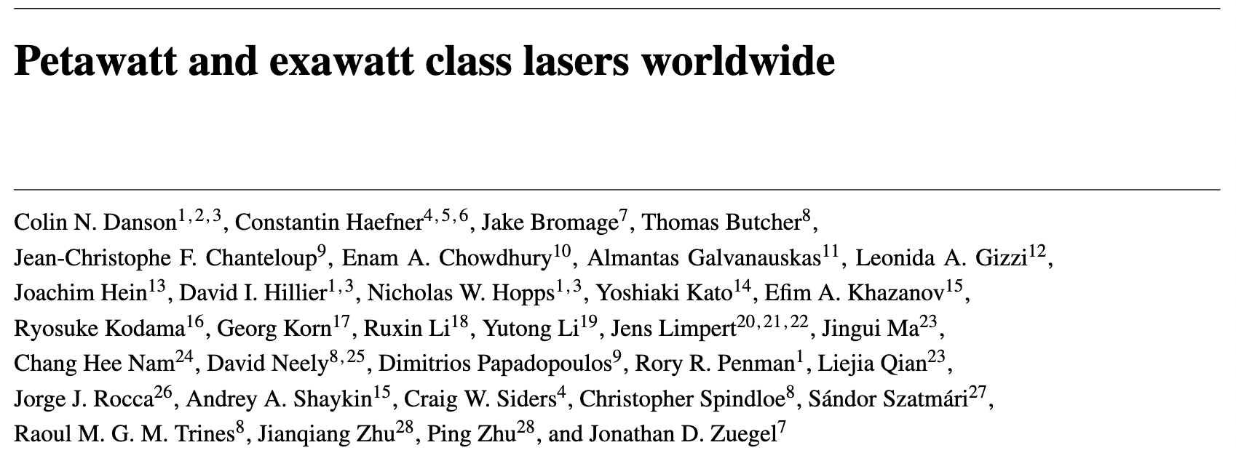

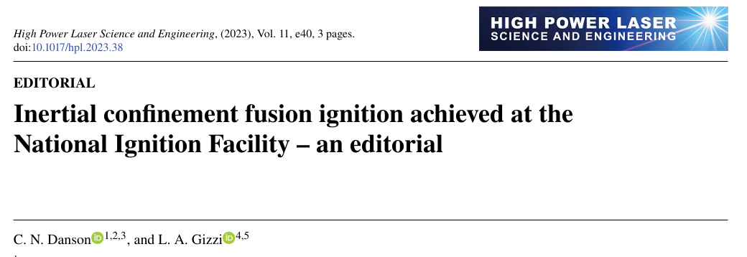

Review Article
High Power Laser Science and Engineering, (2019), Vol. 7, e54, 54 pages.
doi:10.1017/hpl.2019.36
Vol. 7, e54
2019
750 citations as 4/2024
Topic Editor
- Review article of high power lasers and facilities around the world
Vol. 11, Issue 3 03000e40 (2023)
Leonida Antonio Gizzi
CNR-INO, Italy
_{2022 Impact Factor}
4.8
- On behalf of all at High Power Laser Science and Engineering we would like to congratulate
the team at LLNL on demonstrating fusion ignition at the National Ignition Facility.
Notes:
The journal (high power laser science and engineering) focuses on the fields of high power lasers, high energy density physics, laser components, advanced laser technology and applications. Its latest JCR impact factor is 4.8. It ranks in JCR Quartile 1.
This journal is the home for facility-related papers. Welcome to submit your latest research to the journal.

Slide 27

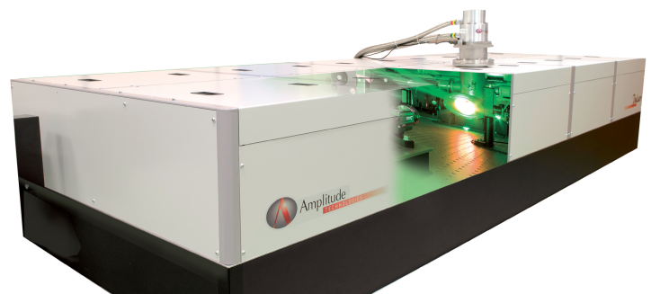
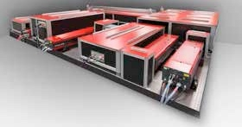
AVAILABLE INDUSTRIAL SYSTEMS
Current EU industrial systems offer robust solutions, incorporating ultrashort pulse capabilities at the PW level, in a compact footprint
Amplitude Technologies
PULSAR: 5 J, <25 fs, 5-10 Hz
Ti:Sapphire
Thales
ALPHA5/XS: 20 J, 25 fs, 5 Hz
Ti:Sapphire
Scientific lasers: still require expert users

Slide 28
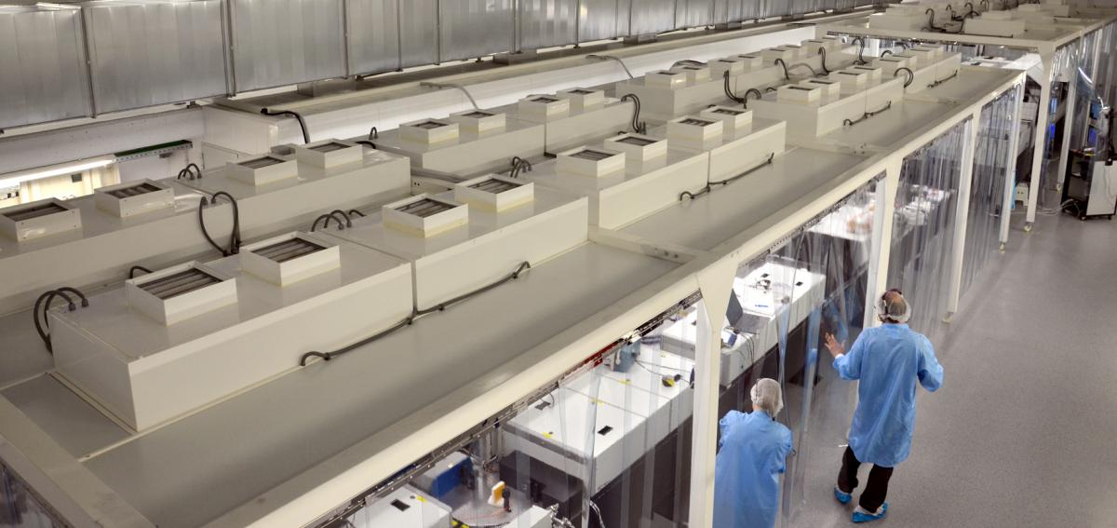
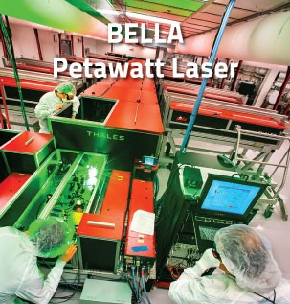
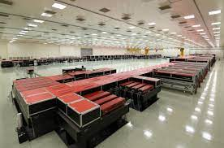
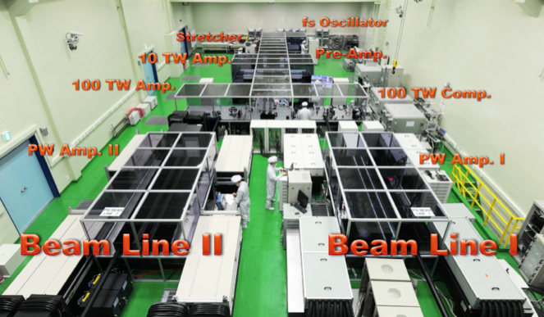
Many PW-CLASS lasers worldwide
VEGA Laser Facility
Salamanca, Spain
Almost unique systems built upon specifications of scientific cases
LBNL, Berkeley, USA
ELI-NP, Magurele, Romania
IBS, Center for Relativistic laser Science
Republic of Korea
And many more … ≈ 20

Slide 29


EXTREME LIGHT INFRASTRUCTURE(s)
A joint effort of the whole community
ELI-Beamlines facility, Prague, Czech Republic
ELI Attosecond Light Pulse Source (ELI-ALPS) in Szeged, Hungary
ELI Nuclear Physics (ELI-NP), Magurele, Romania
(Approx 1 Bln € investment)
Currently entering full operation phase

Slide 30
From laser pulse amplification and compression to interaction with plasma

Slide 31
Relevant blocks of a laser driver
Tackle power and coupling efficiencies and losses
Plasma
Cooling (loss)
Wall plug
Pump (Energy)
May be another DPSSL laser
Gain medium
Transport and focusing
Seed pulse
Optical Compressor
(vacuum)
Transport
Cooling (loss)
loss
All blocks from oscillator to focusing are key for stable electron acceleration

Slide 32
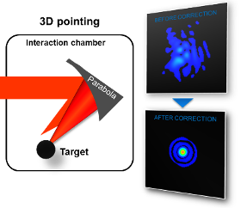
LWFA: laser power and quality control
Progress in laser specs is key to the development o Laser Wakefield Acceleration
LWFA: Theoretical model
T. Tajima, J. M. Dawson PRL 43, 267 (1979)
Beam Quality
(Energy in the focal spot)
Peak Power
CPA Laser invention,
D. Strickland and G. Mourou" Optics communications 55, 447 (1985)
1 TW
30%
1995: First electron beam
A. Modena et al., Nature 377 (606) 1995
2004: first monoenergetic electron beam 100 MeV
J. Faure et al., C.G.R. Gedders et al., S. Mangles et al., Nature 431 (2004)
10 TW
50%
2006: Energy gain: 1 GeV
W.P. Leemans et. al, Nature Physics 696 (2006)
2014: Energy gain: 4.3 GeV
W.P. Leemans et. al, PRL 113 (2014)
100 TW
70%
+ staging (proof of principle)
S. Steinke et al., Nature 530 (2016)
1 PW
Phase front correction with adaptive optics (from astronomy)
2019: Energy gain: 8 GeV
A. Gonsalves et. al, PRL 122(2019)
90%
10 PW
+ several additional quality parameters

Slide 33
From laser pulse amplification and compression to plasma irradiation
Focal spot quality

Slide 34
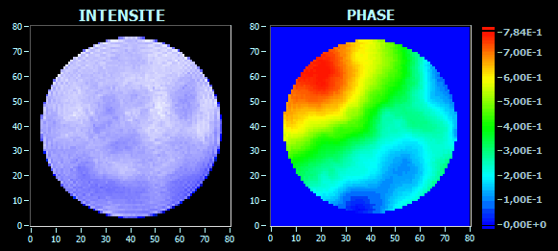
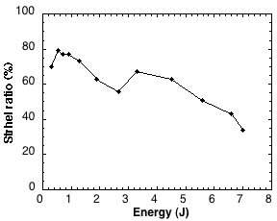






FOCAL SPOT BEAM QUALITY
As larger gain media and optics are used, optical aberrations become important and limit the focusability of laser pulses
Energy in the focal spot
Energy in the pulse
S_{r}=
STREHL RATIO
PHASE FRONT DISTORTIONS
Strehl ratio vs. energy
Amplification

Slide 35

Borrowing Astronomy Adaptive Technology
ESO’s Very Large Telescope (Paranal, Chile)

Slide 36




ADAPTIVE OPTICS for high power lasers
Active spatial phase control technique can be used to correct severe to moderate phase distortions;
Sensors are used to measure intensity and phase map of the beam;
Deformable mirrors are used to correct the measured wave front distortions in a closed loop;
S.-W. Bahk et al., Optics Letters 29, 2837 (2004)
A. PIROZHKOV et al., Optics Express 25, 17 (2017)
Key enabling component to reach high intensity

Slide 37
From laser pulse amplification and compression to plasma irradiation
Temporal contrast

Slide 38


Temporal features: contrast
Autocorrelator
Prepulse?
ASE
S. Luan et al., “High dynamic range third-order correlation measurement of picosecond laser pulse shapes”, Meas. Sci. Technol. 4, 1426 (1993)

Slide 39

Laser contrast: sub-ps time scale
Real
Ideal
Gizzi, L.A et al., Role of laser contrast and foil thickness in target normal sheath acceleration, Nuclear Instruments and Methods in Physics Research A829, 144–148 (2016)

Slide 40
TEMPORAL Contrast enhancement
High contrast is crucial to prevent plasma heating and expansion prior to the ultraintense interaction.
IMPORTANT for laser-plasma acceleration schemes based upon gas targets, but standard contrast (≈10⁷ or more) is normally sufficient;
CRITICAL for current schemes of ion acceleration based on laser solid interaction and in particular for nanostractured targets;
Solutions have been developed based on several principles:
Saturable absorber (SA) is the basic solution for a standard pulse cleaning;
Better control of ASE can be obtained using Optical Parametric Amplification (OPCPA);
Plasma mirror (PM) can provide excellent contrast down to the ps range;
  Limits the repetition rate of the laser;
Crossed polarized wave (XPW) generation is another solution¹ for suppression of prepulse and amplified spontaneous emission;
Non-linear (frequency doubling) conversion.
¹A. Jullien et al.,Opt. Lett., vol. 30, pp.920–922 (2005),
G. I. Petrov et al., Opt. Lett. 26, 355–357 (2001)

Slide 41


ACCESSIBLE Laser specs on plasma
Pulse duration as short as 15 fs at multi-PW power; band narrowing is managed by using OPCPA and/or bandwidth control/shaping capabilities;
Temporal contrast as high as 10¹²-10¹³, at ps timescale to prevent premature disruption of plasma conditions, using contrast enhancement;
Repetition rate ≈10 Hz at PW level;
Focusability close to diffraction limit, using wavefront correction;
Focused Intensity >10²² W/cm²;
Relativistic parameter
>>1
“A Superintense Laser-Plasma Interaction Theory Primer,” Andrea Macchi, Springer, 2013

Slide 42


Particle acceleration with lasers and plasmas
Acceleration of ions: interaction of tightly focused laser pulses at ultra-high (ultrarelativistic) intensities on high density (solid) targets;
Short focal length focusing optics
Small focal spot
Short Rayleigh length
Polarization distortions effects*
Acceleration of electrons: interaction of ultrashort laser pulses at (moderately) relativistic intensities with underdense (gas) targets;
Very long focal length optics
Larger focal spot diameter (30-50 µm)
Long Rayleigh length – channeling/guiding
* L. Labate, G. Vantaggiato, L.A. Gizzi, Intra-cycle depolarization of ultraintense laser pulses focused by off-axis parabolic mirrors, High Power Laser Science and Engineering, 6, 32 (2018).

Slide 43
OPEN ISSUES OF Laser Plasma Acceleration
Since 2004, systematic production of electron bunches with energy in the hundreds of MeV range to 10 GeV and moderate energy spread (5-10%)*
Exploration of applications ongoing worldwide – focusing on Xray FEL (EuPRAXIA)
OPEN ISSUES
QUALITY: energy spread, beam divergence, emittance, self-injection dynamics, plasma shaping
=>understanding of the physics of laser-plasma acceleration in real conditions
STABILITY: and control of bunch parameters, pointing
=>improve quality of lasers and laser-target coupling
SCALABILITY: staging (phase space matching) + higher energy, high repetition rate, high average power
=>develop new laser schemes for efficient high average power.

Slide 44
From laser pulse amplification and compression to plasma irradiation
Multipulse generation

Slide 45





The Resonant Multi-Pulse Ionization Injection
The Resonant Multi-Pulse Ionization injection is a new bunch injection scheme aiming at generating extremely low-emittance bunches [as low as 0.06 mm mrad]
ReMPI requires ONE short-pulse 100-TW class (e.g Ti:Sa) laser system. Since a unique very large-amplitude Ti:Sa pulse would fully ionize the atoms (N5+ or Ar8+ ), the pulse is shaped as a resonant sequence of sub-threshold amplitude pulses.
ReMPI
Ionization Threshold
A new scheme to generate the train of pulse in a stable, efficient and feasible way « Quasi Lossless Pulse Train generation by Early Amplitude division »
P. Tomassini et al., Phys. Plasmas 24 (2017)

Slide 46



MULTI-PULSE LASER GENERATION
Proof of principle validation using a two-pulse “train”, in progress
N-Michelson interferometers
Large beams: Delay mask
C. W. Siders et al., “Efficient high-energy pulse-train generation using a 2n-
pulse Michelson interferometer,” Applied Optics Vol. 37, Issue 22, 1998.
A. Marasciulli, PhD thesis, 2023
Proof of principle demonstration

Slide 47

NEXT STEP: STAGING OF ACCELERATING SECTIONS
Advanced staged acceleration with lasers
Multiple stages need multiple laser pulses: scaling of energy and repetition rate

Slide 48
Scaling lasers drivers to large accelerator systems

Slide 49

TOWARDS HIGH AVERAGE POWER
Future installations will require PW, fs pulses with kHz rep-rate (multi 10kW) lasers with high efficiency
Ti:Sa requires pumping with green laser light with high power and 10ns pulse duration - no existing diode lasers can fulfill these requirements
Choose different gain medium for future multi-kW laser systems
Aim at laser architectures that can directly exploit diode lasers.

Slide 50

Average power
Current reqirement for LPA driver: PW-class system, with high repetition rate (≈kHz) Demanding high average power (1-10 kW)
Machine drivers
Major effort required to fill the gap between existing and required laser technology

Slide 51
Relevant blocks of a laser driver
Tackle power and coupling efficiencies and losses
loss
Transmitted laser
Plasma
Cooling (loss)
Wall plug
Pump (Energy)
Use laser diodes
Gain medium
Transport and focusing
loss
Optical Compressor
(vacuum)
Transport
Cooling (loss)

Slide 52



CHANGE OF OPTICAL PUMPING TECHNOLOGY
Analysis of available technologies for PW-class, multi kW average power lasers;
Comparison with the requirements of user beamlines;
Current option: TiSa pumped with diode pumped solid state lasers (DPSSL) – robust;
In progress: Direct CPA for higher rep-rate, higher efficiency.
PUMP SOURCE: Flashlamp
PUMP SOURCE: Diode laser
Major developments in laser technology occurring now!

Slide 53


Roadmap on LPA Laser Driver technology
Laser-driven plasma acceleration needs ultrashort, high power lasers with high average power
Current industrial technology: ≈ Ti:Sa technology, pumped by flash-lamp pumped lasers
  Robust, reliable industrial technology
Mature technology: ≈ Ti:Sa technology, pumped by diode-pumped lasers
  Strong R&D effort in place (e.g HAPLS@ELI)
  ≈ 3-5 years to go to first industrial LWFA demonstrator (e.g. Eupraxia) [1]
Beyond TiSA: targeting higher wall-plug efficiency and rep. rate, kHz and beyond, stability, control (space, time, spectral);
  5-10 yrs for first efficient, multi-kW-scale demonstrator,
  A strategy is needed to steer effort in the LPA laser driver direction: LASPLA
The L3-HAPLS at ELI Beamlines Research Center in the Czech Republic. Credit: ELI Beamlines*
[1] R. Assmann et al., EuPRAXIA Conceptual Design Report, The European Physical Journal Special Topics 229, 3675–4284 (2020)
[2] C. Danson et al., Petawatt and exawatt class lasers worldwide High Power Laser Sci. and Eng. 7, e54 (2019)

Slide 54
Scaling lasers drivers to large accelerator systems
Scaling existing Ti:Sa technology

Slide 55

100 Hz, J-scale laser beamline
OPCPA
front-end
Laser driver stability
Control
(Eupraxia DN)
HRR Data collection
Front-end
High repetition rate target
Stretcher
High averge power
transport to target
At the limit of current industrial capability
Preamplifier
Ti:SA mutipass
DPSSL pump
High average power Compressor
Ti:Sa disk amplifiers
100 W
Joule scale / 100 Hz / > 100 W

Slide 56




HAPLS: Fully diode-pumped reprated PW system
Beamline (Prague)
Nd:YAG
10 Hz
300 W

Slide 57
EuPRAXIA LASER (Ti:Sa)
FRONTEND
MASTER Oscillator
FRONTEND
AMP1
37( 65) J, 0.5µm
FRONTEND
20(25)J, 0.5µm
AMP1
AMP1
9 (13) J, 0.8 µm
AMP2
PROPAGATION
AMP2
19 (37) J, 0.8 µm
Photocathode and diagnostics
AMP3
62 (126) J, 0.8 µm
105 J / 197 J, 0.5µm
PROPAGATION
COMPRESSION
PROPAGATION
COMPRESSION
COMPRESSION
5(7)J, 30(20)fs, 20(100)Hz
15(30)J, 30(20)fs, 20(100)Hz
50(100)J, 60(50)fs, 20(100)Hz
2-10 kW
TO FOCUSING
TO FOCUSING
TO FOCUSING
LASER1
150 MeV
LASER2
1 GeV
LASER3
5 GeV

Slide 58








EuPRAXIA Laser Driver: pump lasers
Developments based on diode pumping technology are in progress, progressively matching requirements
Schematic of DiPOLE 100Hz
Cryostat
Pump diodes
100Hz Front end
10J amplifier head
Amplitude P60
Flashlamp pumped Nd:YAG
Design: 60 J @ 10 Hz, 532 nm
VSF
Diode pump technology
  100J @ 10Hz
    Summer 2019 demonstrated 60J @ 10Hz, 515nm in LBO with 66% efficiency (91J @ 1030nm)
    Commissioning of DiPOLE100 @ XFEL commenced Q1 2020 – completion end 2021
    Energy scaling 145J @ 10Hz, 1030nm
    @ HiLASE in January 2021
  10J @ 100Hz
    Build @ CLF near completion –
    commissioning Q4 2021
Conversion to diode pumping fully designed - Premiumlight
Expected specs: 100 Hz – 10 kW (100 J/pulse @ 1µm)
Cost of diode still an issue
currently 5x compared to flash-lamps.
expected to decrease.
Maintenance free operation for 25-30 yrs.
Courtesy of P. Mason
Courtesy of F. Falcoz
More options available and further developing.

Slide 59
Thermal management
Transmission vs. “active mirror” configuration is currently being evaluated to account for thermal management
“Active mirror” geometry
Transmission geometry
Pro: Well established concept with no propagation through cooling fluid
Con: limited cooling (single face), to be modelled
Gain comparison (AMP3)
Pro: More efficient (double-side) cooling and reduced complexity;
Con: propagation through flowing cooling liquid
*) Water cooled Ti:Sa amplifier (“Active Mirror” configuration) under development at ELI-HU (After V. Cvhykov et al. , Opt. Lett, 41, 3017, 2016)
**) Fluid (D₂O ) cooled Nd:YAG laser, 20 kW CW pump power, D₂O (After X. Fu et al. , Opt. Express, 22, 18421 (2014)
***) Fluid (Siloxane ) cooled Nd:YLF laser, 5 kW CW pump power (After Z. Ye et al. , Opt. Express, 24, 1758 (2016)

Slide 60










Underpinning EuPRAXIA-like Laser driver
THERMAL
MANAGEMENT OF
POWER AMPLIFIERS
AMPLIFIER GEOMETRY
TRANSMISSION
VS. REFLECTION
DPSSL PUMP
SOURCES
TECHNOLOGY
DIODE LASERS EFFICIENCY,
BRIGHTNESS AND
LIFETIME
COMPRESSOR AND TRANSPORT: THERMAL AND MECHANICAL STABILITY
Multipass transmission
Gold -> MD, MLD, MMLD
reduction of the thermal load
cooling of residual heat
control of thermal effects
DiPOLE 100 (STCF)
WATER/GAS COOLING
Multipass reflection
P-60 technology (Amplitude)
Currently no solution for full system specs (P1): development
Main challenges: large optics, mechanical stability, beam quality control, pointing stability
Prototyping needed
Prototyping needed
Needs development

Slide 61
Scaling lasers drivers to large accelerator systems
New schemes for high repetition rate and high WPE

Slide 62




Efficiency path
TiSa technology is prompt and will demonstrate repetitive operation 24/7 and stability, but not scalable with poor efficiency (% level) due to the indirect pumping architecture:
Direct CPA is a solution for wall-plug (WP) efficiency and high rep-rate.
From flashlamp to indirect to direct diode pumping
Quantum defect
C. Siders et al., EAAC 2017
WP Efficiency > 20% possible:
We need a gain medium that can support amplification on a large bandwidth, has a low quantum defect and can be pumped directly with diode lasers: endless quest for the perfect laser medium!!

Slide 63
Roadmap on LPA Laser Driver technology
Laser-driven plasma acceleration needs ultrashort, high power lasers with high average power
Current technology: ≈ Ti:Sa technology, pumped by flash-lamp pumped lasers
  Robust, reliable industrial technology
Mature technology: ≈ Ti:Sa technology, pumped by diode-pumped lasers
  Strong R&D effort in place (e.g HAPLS@ELI)
  ≈ 3-5 years to go to first industrial LWFA demonstrator (e.g. Eupraxia) [1]
Beyond TiSA: targeting higher wall-plug efficiency and rep. rate, kHz and beyond, stability, control (space, time, spectral);
  5-10 yrs for first efficient, multi-kW-scale demonstrator,
  A strategy is needed to steer effort in the LPA laser driver direction: LASPLA
The L3-HAPLS at ELI Beamlines Research Center in the Czech Republic. Credit: ELI Beamlines*
[1] R. Assmann et al., EuPRAXIA Conceptual Design Report, The European Physical Journal Special Topics 229, 3675–4284 (2020)
[2] C. Danson et al., Petawatt and exawatt class lasers worldwide High Power Laser Sci. and Eng. 7, e54 (2019)

Slide 64
Several options under development
Fiber laser technology targeting the best WPE 30% in CW mode and coherent combination is being developed (FSU Jena-Fraunhofer IOF and Ecole Polytechnique-Thales in France).
  Suited for moderate energy per pulse/high rep-rate (10s of kHz);
  Now 96 fibers delivering 23 mJ and 674 W in a 235 fs pulse
Direct Chirped Pulse Amplification with lasing media pumped directly by diodes is ideal for higher efficiency and higher rep-rate;
  several materials under consideration, Yb:CaF2, Tm:YLF, Tm:Lu2O3 (with cross-relaxation and multi-pulse extraction) …
  PENELOPE (Jena) 150 J, 1 Hz, at 1030 nm
  Available ps kW thin disk lasers using plasma modulation (Oxford²)
OPCPA optical parametric amplification within large-aperture lithium triborate (LBO) crystals;
  ELI-Beamlines facility, L1 ALLEGRA (100 mJ at 1 kHz) and L2 AMOS (100 TW, 2 to 5 J between 10 and 50 Hz), and the Shenguang II Multi-PW beamline(SIOM, China) …
Thin Disk ps Lasers + spectral broadening + post compression³
  Industrial technology with demonstrated >kW operation ar ≈J per pulse energy.
L.A Gizzi, F. Mathieu, P. Mason, P P Rajeev, Laser drivers for Plasma Accelerators, in Félicie Albert et al, 2020 roadmap on plasma accelerators, 2021 New J. Phys. 23 031101, https://doi.org/10.1088/1367-2630/abcc62;
O. Jakobsson, S. M. Hooker and R. Walczak, PRL, (2021)
A.L. Viotti et al., Optica 9, 197-216 (2022).

Slide 65

Coherent Combination in Fibers
Diagram: E. Esarey, LBNL

Slide 66

Coherent Combination
Coherent combination has been proposed for Ti:Sa beamlets, in a similar approach as fiber combination, but with tiled-aperture.
Significant engineering issues to be overcome, but in line with current active control approach
Could relax constraints on heat load management of >kW beamline and need of large optics
Needs CDR
Z. Li, et al., Laser Photonics Rev.2023,17, 210070

Slide 67
kHz laser driver development for LPA
A case study: direct DPSSL CPA with Thulium

Slide 68


Thulium based laser gain materials
Currently under investigation(*): Tm:YLF
  Emission at 1,9 µm, eye safe;
  Ultrashort pulse (<100 fs);
  High peak power ≈ PW;
  High average power(scalable from kW to 300 kW);
  Direct pumping at 808 nm, using diodes operating in CW mode (available and scalable);
  Multi-pulse extraction at high repetition rate
  10 kHz; Ideal for accelerator technology;
  High efficiency;
  Mature material technology (crystal growth);
Ti:Sa
Tm:YLF
Tm: YLF Full specifications
Absorption peak wavelength 792 nm
Absorption cross-section at peak 0.55×10-20 cm2
Absorption bandwidth at peak wavelength 16 nm
Laser wavelength 1900 nm
Lifetime of 3F4 thulium energy level 16 ms
Emission cross-section @1900 nm 0.4×10-20 cm2
Refractive index @1064 nm no=1.448, ne=1.470
Crystal structure tetragonal
Density 3.95 g/cm3
Mohs’ hardness 5
Thermal conductivity 6 Wm-1K-1
dn/dT -4.6×10-6 (//c) K-1
Thermal expansion coefficient 10.1×10-6 (//c) K-1
Typical doping level 2-4 at.%
C. Haefner et al., EAAC 2017
High Efficiency enabled by multipulse extraction (energy storage)
Relatively new approach for short pulse operation: needs R&D, but promising

Slide 69



Recent advances with Tm:YLF
Energy density storage and extraction capabilities of Diode pumped Tm:YLF (narrowband)
Amplified pulse energy measurements up to 108.3 J for the 6-pass Tm:YLF power amplifier
Multi-pulse extraction demonstration resulting in 3.6 kW output power
“The multiple proof-of-principle demonstrations [..] reveal the potential for high efficiency, high energy density extraction using Tm:YLF for future high peak and average power laser systems.”
“Additional efforts are currently in progress to conduct chirped pulse amplification of ultrashort pulses using Tm:YLF at the joule-level for the first time.”
Issa Tamer, et al., "High energy operation of a diode-pumped Tm:YLF laser," Proc. SPIE 12401, High Power Lasers for Fusion Research VII, 1240109 (14 March 2023); doi:10.1117/12.2649103

Slide 70


Recent advances with Tm:YLF
Demonstration of a 1 TW peak power, joule-level ultrashort Tm:YLF laser*
E=1.59 J
Pulse duration=270 fs
P=1.7 TW
Pump: 35.3 kW p.p. 40 ms
* I. Tamer et al., Optics Letters 49, 1583 (2024)
**I. Tamer, et al., "High energy operation of a diode-pumped Tm:YLF laser," Proc. SPIE 12401, High Power Lasers for Fusion Research VII, 1240109 (14 March 2023); doi:10.1117/12.2649103

Slide 71



Laser grade ceramic option
Faster and cheaper vs. single crystal growth process – for cubic crystalline structure.
Large components, -shaping, -graded doping also optimized for thermal management – features not available for single crystals.
Several compositions (e.g. YAG, LuAG , Sc₂O₃, Lu₂O₃) and dopants (Nd, Yb, Er, Tm…) already available
Spectroscopic and thermomechanical properties similar to those of the corresponding single crystals
Better uniformity of dopant distribution on large gain elements
Industrial and R&D effort: (Japan); Research in China, Japan, Russia, USA, France and Italy (ISTEC-CNR) (ZENITH Smart Polycrystals)

Slide 72


Ceramic option: Tm in sesquioxide host
Sesquioxides doped with Tm3+, such as Tm:Lu2O3, Tm:Y2O3, and Tm:Sc2O3, are also emerging materials: their better thermo-optical properties make them promising for power scaling applications.
The growth of sesquioxide single crystals is very complicated, while it is possible to produce them in transparent ceramic form thanks to their cubic crystalline structure and optical isotropy.
Advantages of ceramic medium:
High thermal and mechanical features
Scalable size
Custom doping
Optimize energy efficiency
Tm:Lu₂O₃
Ceramic
Sample from Konoshima
C. Krankel, IEEE J. Sel. Topics Quantum Electro 21, Art. no. 1602013 (2015)

Slide 73



Ceramic option: Tm Lu₂O₃
Laser material: Tm:Lu₂O₃
  Emission at 2 µm;
  Large amplification bandwith
  Direct pumping at 800 nm, using diodes operating in CW mode (available and scalable);
  Cross relaxation partially compensates quantum defect – option of in-band pumping.
  Multi-pulse extraction at high repetition rate > 10 kHz; Ideal for accelerator technology;
  Mature material technology (large ceramic).
Tm:Lu₂O₃
Ceramic
Sample from Konoshima
s
[Antipov, 2011]
Commercial diode lasers
[Scholle et al., 2010]

Slide 74






Test platform
An oscillator cavity has been set up for Tm:Lu₂O₃ gain material characterization

Slide 75



Fundamentals for high efficiency?
Accurate characterizaton of absorbed pump energy to measure quantum efficiency
Measures for two different temperatures of 13 and 23°C
Quantum efficiency
Slope efficiency
Quantum efficiency ≈ 2
Slope efficiency ≈ 75%
Preliminary: quantum efficiency close to 2 : Evidence of full cross relaxation

Slide 76



Higher WPE: In-band pumping for low QD
WPE: wall plug efficiency
QD: Quantum Defect
Thulium based gain medium can also be pumped with in-band absorption with virtually marginal quantum defect:
High efficiency and lower heat deposition.
>80% slope efficiency demonstrated in fibers
M. Lenski et al., Opt. Express 30, 44270-44282 (2022)
New path for intra-band pumping and smaller quantum defect: step change in WPE?

Slide 77





In-band pumping of Tm:Lu₂O₃
“1600 nm” Er/Yb pump laser
796 nm pumping
1620 nm pumping
Max QE: 38.54%
With cross relaxation up to 77.09%
Max QE: 78.4%

Slide 78





In-band pumping of Tm:Lu₂O₃
1620 nm
1605 nm
a=170 m⁻¹
a=243 m⁻¹
Latest: lasing achieved at 2.065 µm @ 1620 nm pumping.
Measured slope efficiency still limited (≈8%)

Slide 79

kHz laser development at ILIL
A kW-kHz CPA laser development with direct diode pumping
kHz, mJ, mid-IR, fs front-end
3 amplification stages, each based on a 2 active
media multipass scheme.
Active mirror config,
with cooling carried out
on both sides
Selected doping: 4% at
Pulse energy (goals/expected):
>1mJ seeding the 1st amp
~8 mJ seeding 2nd amp
>50mJ seeding the 3rd amp
>500mJ from 3rd amp
Ti:Sa
s
1≈J, 1kHz
Main development effort in amplifier modules: ELI_{IT}/APOLLO project (CNR)

Slide 80






kHz front-end: operational
Specs of front end @ 2µm
Beam Profile
Pulse duration: <60 fs
kHz, mJ, mid-IR, fs front-end:
Ti:Sa (20 mJ, 30 fs) pumped OPA
Pulse Energy >1.8 mJ
Spectrum
Center wavelength: 2025 nm
Spectrum FWHM: 182 nm
FTL pulse duration: 33 fs

Slide 81




Gain medium design and pumping
Side/edge pumped thin disk active mirror configuration [1,2]
Geometry
Edge diode pumping
Thermal load
Doped
Undoped
Diodes total power: >2kW, Diodes energy (1ms): 1.95 J, Linear bar power: 19.4 W/mm => 1 J output
Now finalizing technical design and starting construction and tests
[1] J. Vetrovec, et al., “Wide-Bandwidth Ceramic Tm:Lu2O3 Amplifier”, Proc. SPIE 9834, 983407 (2016); https://doi.org/10.1117/12.2224411
[2] J. Vetrovec, et al., “2-micron lasing in Tm:Lu2O3 ceramic:initial operation”, Proc. SPIE 10511, 1051103 (2018); https://doi.org/10.1117/12.2291380
[3] D. Palla, L. Labate, F. Baffigi, G. Cellamare, L.A. Gizzi, Optics & Laser Technology, 156, 108524 (2022), https://doi.org/10.1016/j.optlastec.2022.108524

Slide 82
Summary considerations on lasers for LPA
CPA laser technology is mature for LPA studies;
  Scientific lasers are being optimized;
  Suitable for high quality plasma acceleration (FEL);
Limited scaling (thermal, wpe) for HEP accelerator drivers;
New laser technology is needed for high WPE and >kW average power;
Efficient diode pumping is replacing flashlamps;
Suitable schemes and materials are emerging and under investigation.

