Slide 1




Radiation Field Simulation in GIF ++
Nicola Ferrara, INFN and Politecnico of Bari
Gabriella Pugliese INFN and Politecnico of Bari
Giuseppe Iaselli, INFN and Politecnico of Bari
Dayron Ramos, INFN and Polytecnic of Bari

Slide 2
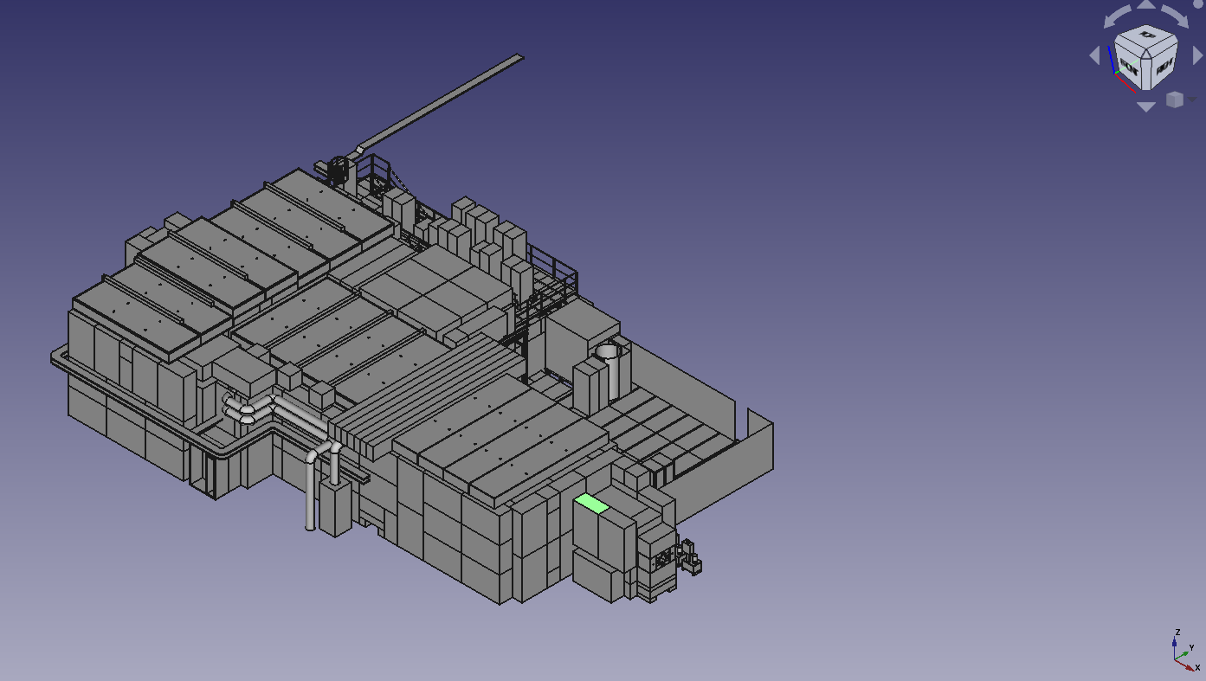
Geant4 GIF++ simulation code Source: Pfeiffer Dorothea Software developed in GEANT4-10.0 to simulate GIF++ radiation background [ref]
Software upgrade in the framework of the new DRD1 «collaboration».
Main steps:
Transition from GEANT4-10.0 to GEANT4-11.0
Description of the new bunker geometry
[ref] https://gif-irrad.web.cern.ch/documents/1-s2.0-S0168900217306113-main.pdf

Slide 3
Transition from GEANT4-10.0 to GEANT4-10.7 (1)
New GEANT4 version: geant4-10-07-patch-03 [MT]
Change of one class in the GIF++ project ()
Issue: in class GIF++UserScoreWriter,
the typedef MeshScoreMap becomes defined in G4VScoringMesh
Solutions: Geant4 upgrades to G4VScoringMesh::MeshScoreMap

Slide 4
Other Changes:
Transition from GEANT4-10.0 to GEANT4-10.7 (2)
MeshScoreMap fSMap = fScoringMesh->GetScoreMap();
G4VScoringMesh::MeshScoreMap fSMap = fScoringMesh->GetScoreMap();
std::map<G4int, G4double*> * score = msMapItr->second->GetMap();
std::map<G4int, G4StatDouble *> &score = *(msMapItr->second->GetMap());
std::map<G4int, G4double*>::iterator value = score->find(idx);
std::map<G4int, G4StatDouble *>::iterator value = score.find(idx);

Slide 5
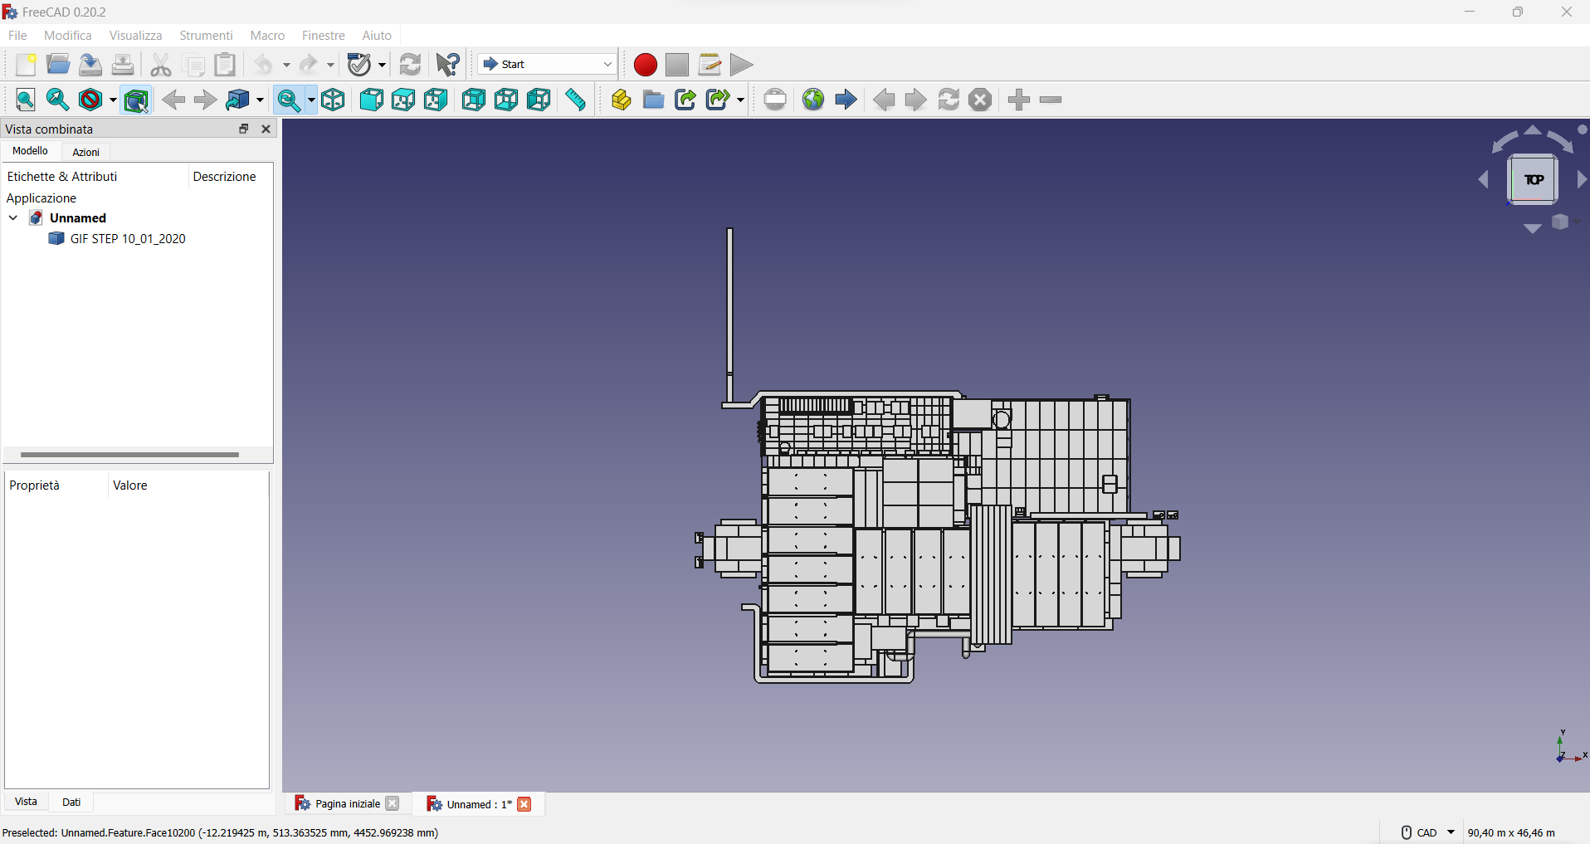
GIF++ geometry UPDATE
STEP file was opened with an open source FreeCAD to obtain the layout of the bunker
A new file GDML with FreeCAD was created and the geometry was described using a box model.
Note: The format of the GDML file is not compatible with the one used by GEANT https://gdml.web.cern.ch/GDML/
Some manipulation needed to solve the issue

Slide 6
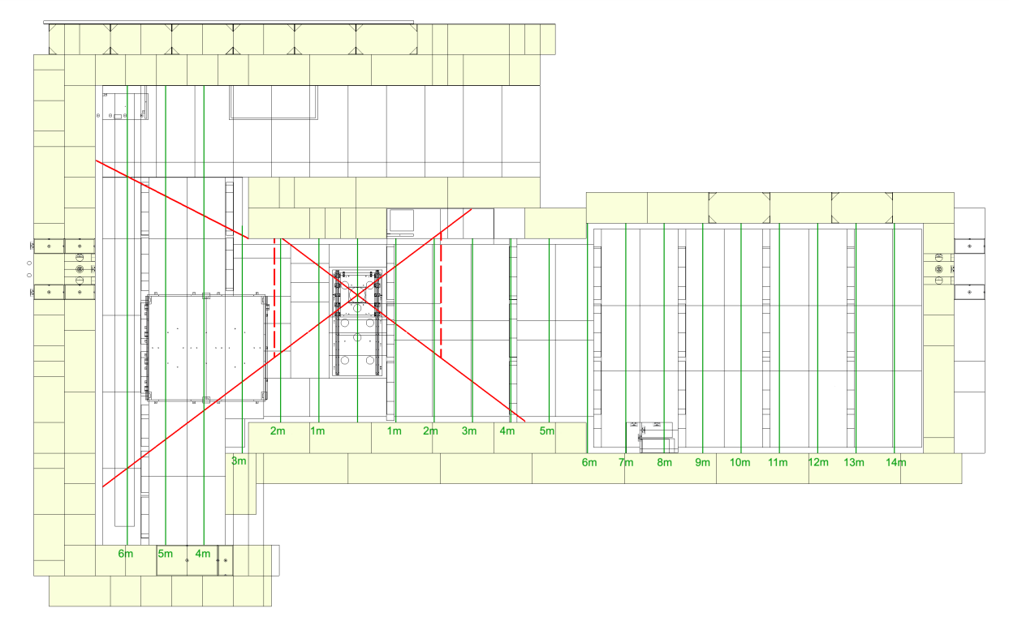
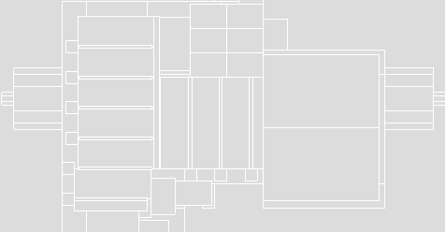
Upgrade geometry: layout
CAD Gif++ layout
GEANT gdml layout

Slide 7
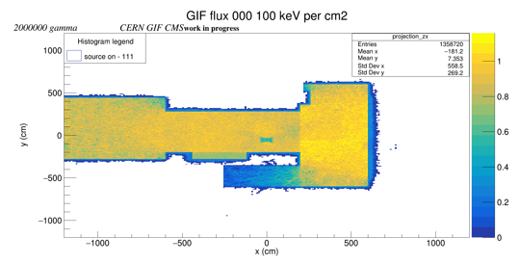
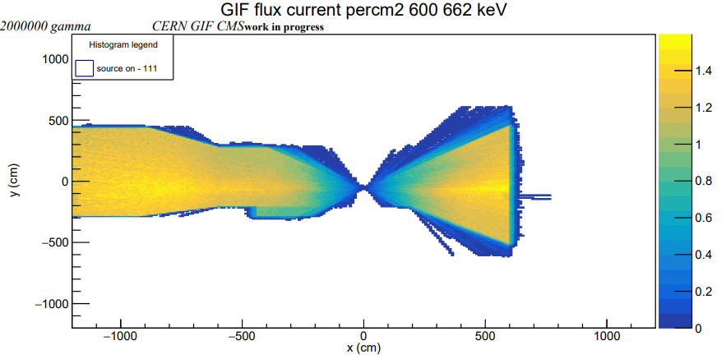
Preliminary Results
Simulated gamma: 2 10⁶
Flux in the range 600-662 keV
Flux in the range 0-100 keV

Slide 8
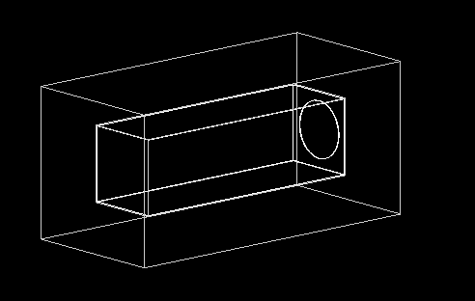
Next steps
Start simulate filters
Simulation of different detectors installed inside the GIF
Validation of the simulation by comparing the estimated dose with some measurements done in several points inside the bunker

Slide 9
Conclusion
A first simulation of the bunker succesfully done.

Slide 10
Backup

Slide 11
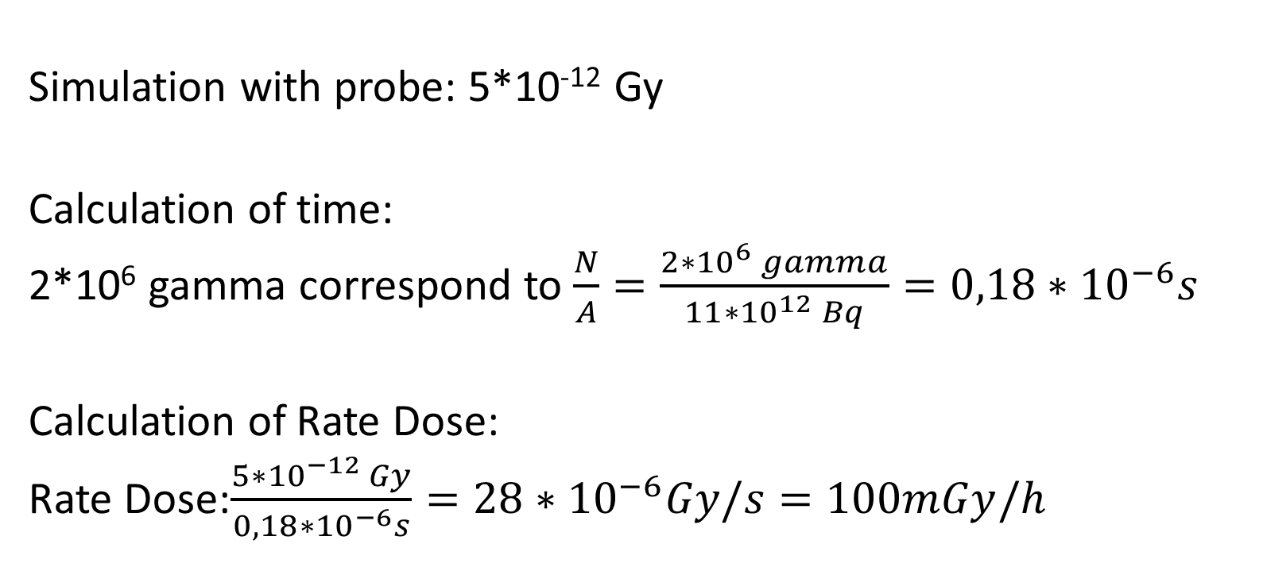
Dose calculation
Simulation with probe: 5*10⁻¹² Gy
Calculation of time:
2*10⁶ gamma correspond to $\frac{N}{A}=\frac{2∗{10}^{6} gamma}{11∗{10}^{12} Bq}=0,18∗{10}^{−6}s$
Calculation of Rate Dose:
Rate Dose:$\frac{5∗{10}^{−12 }Gy}{0,18∗{10}^{−6}s}=28∗{10}^{−6}Gy/s=100mGy/h$

Slide 12
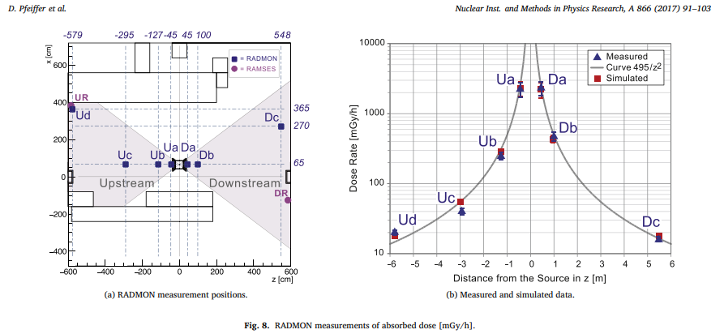
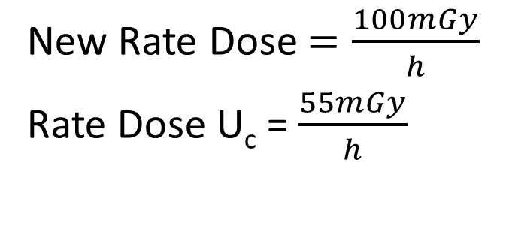
Dose comparison
New Rate Dose $=\frac{100mGy}{h}$
Rate Dose U_{c} = $\frac{55mGy}{h}$

Slide 13
Other method:
Tried to tessellate with https://github.com/christopherpoole/CADMesh every sub-volumes setting a scale for the mesh.

Slide 14
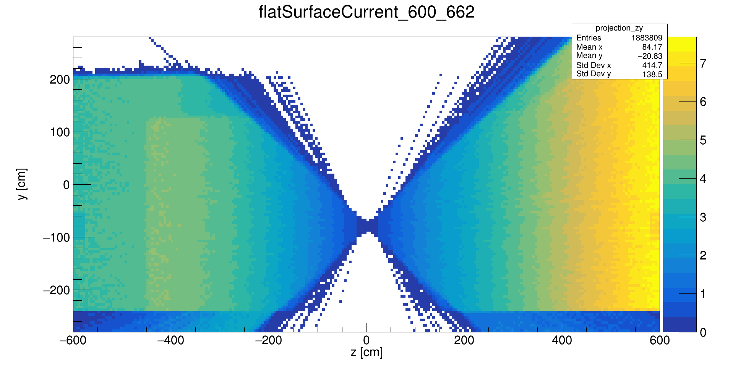
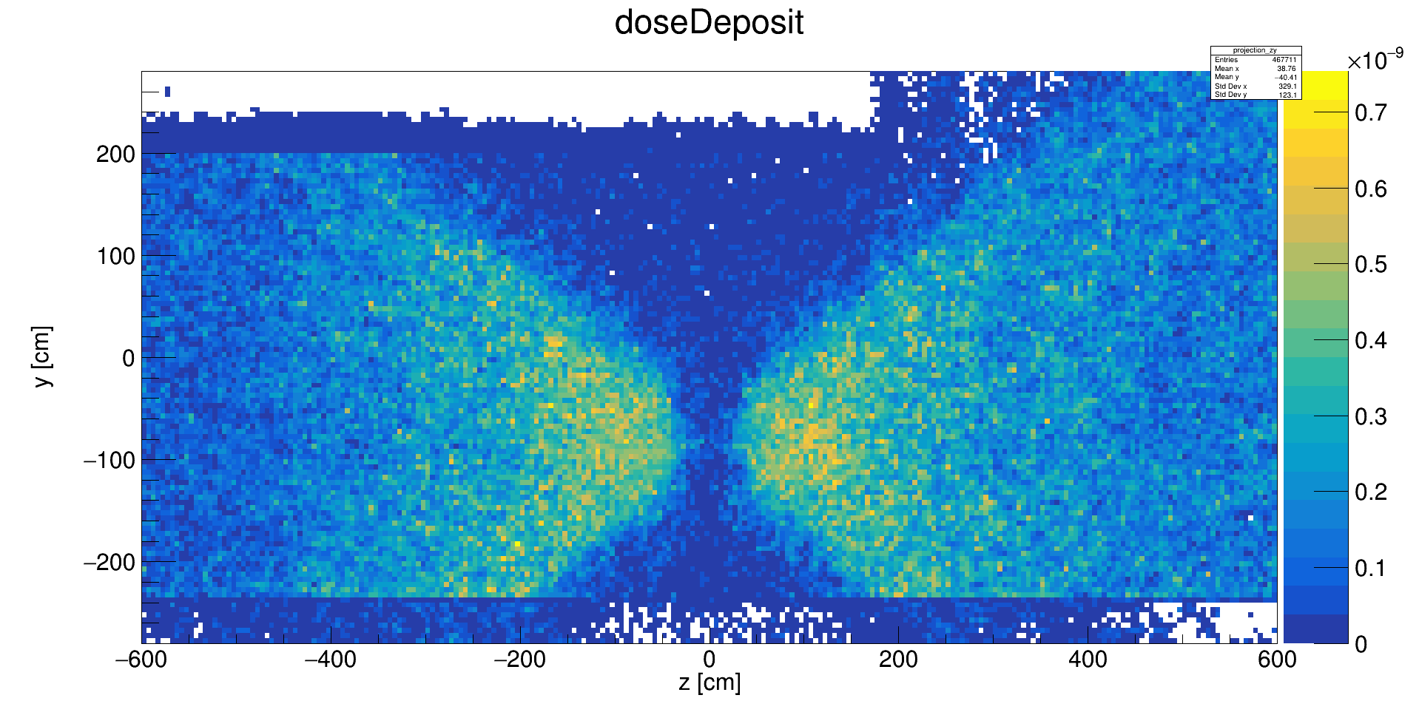
Not upgraded
COLZ flux of gamma for a volume divided into cubes of 10 cm
COLZ dose deposit of gamma for a volume divide into cubes of 10 cm
a
b

