Slide 1
1st Cost & Schedule Review Meeting Frascati 11 Dicembre 2023
Status EuPRAXIA@Sparc_LAB Technical Design Report
Andrea Ghigo on behalf of
EuPRAXIA@SPARC-LAB Collaboration
1st Cost & Schedule Review Meeting A.Ghigo Frascati 11 Dicembre 2023

Slide 2
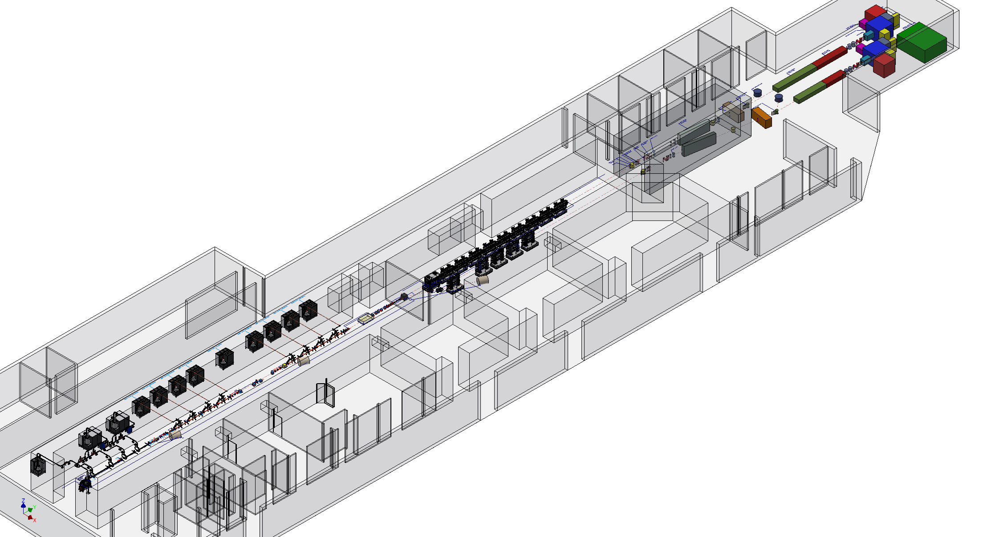
EuPRAXIA@SPARC-LAB: Machine and Building Layout
1st Cost & Schedule Review Meeting A.Ghigo Frascati 11 Dicembre 2023

Slide 3
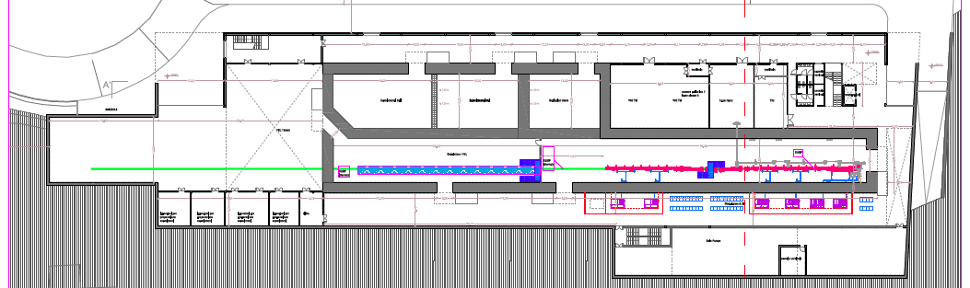
Functional description of the areas
Laser & THz clean rooms
Particle experimental halls
Photon user experimental hall
Undulators tunnel
Plant gallery
Accelerator tunnel
Klystron&modulators
Power supplies gallery
1st Cost & Schedule Review Meeting A.Ghigo Frascati 11 Dicembre 2023

Slide 4
Starting from Beam Dynamics
Courtesy of C.Vaccarezza

Slide 5
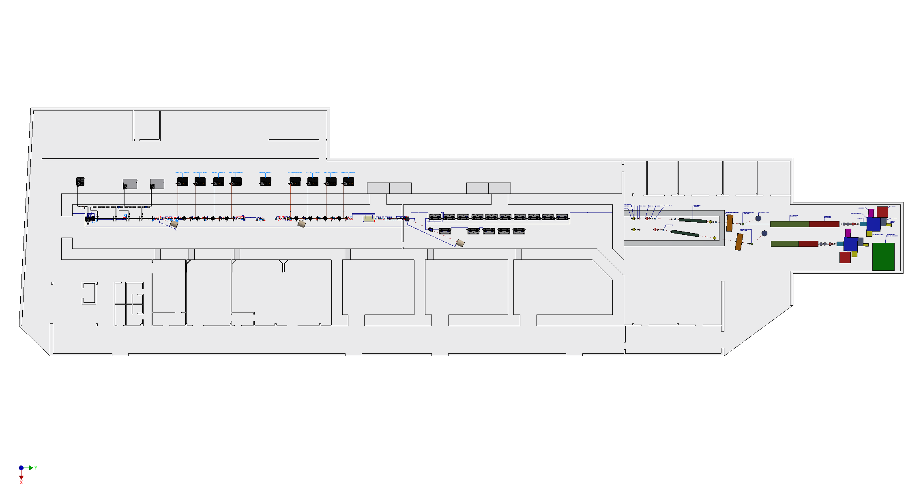
Linac, undulators and
user area layout
The components studied so far for the EuPRAXIA complex are:
the injector, the RF linac, the plasma acceleration module,
two undulator lines, two optical lines and two experimental stations
1st Cost & Schedule Review Meeting A.Ghigo Frascati 11 Dicembre 2023

Slide 6
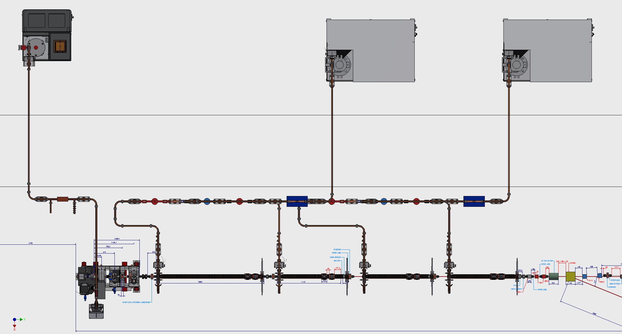
Injector 2D layout
Gun + 4 RF S-Band accelerating structure:
the first 3m long, the other 2m long
1st Cost & Schedule Review Meeting A.Ghigo Frascati 11 Dicembre 2023

Slide 7
RF Photogun
Photogun SPARC type +
X band RF linearizer
E. Di Pasquale
1st Cost & Schedule Review Meeting A.Ghigo Frascati 11 Dicembre 2023

Slide 8
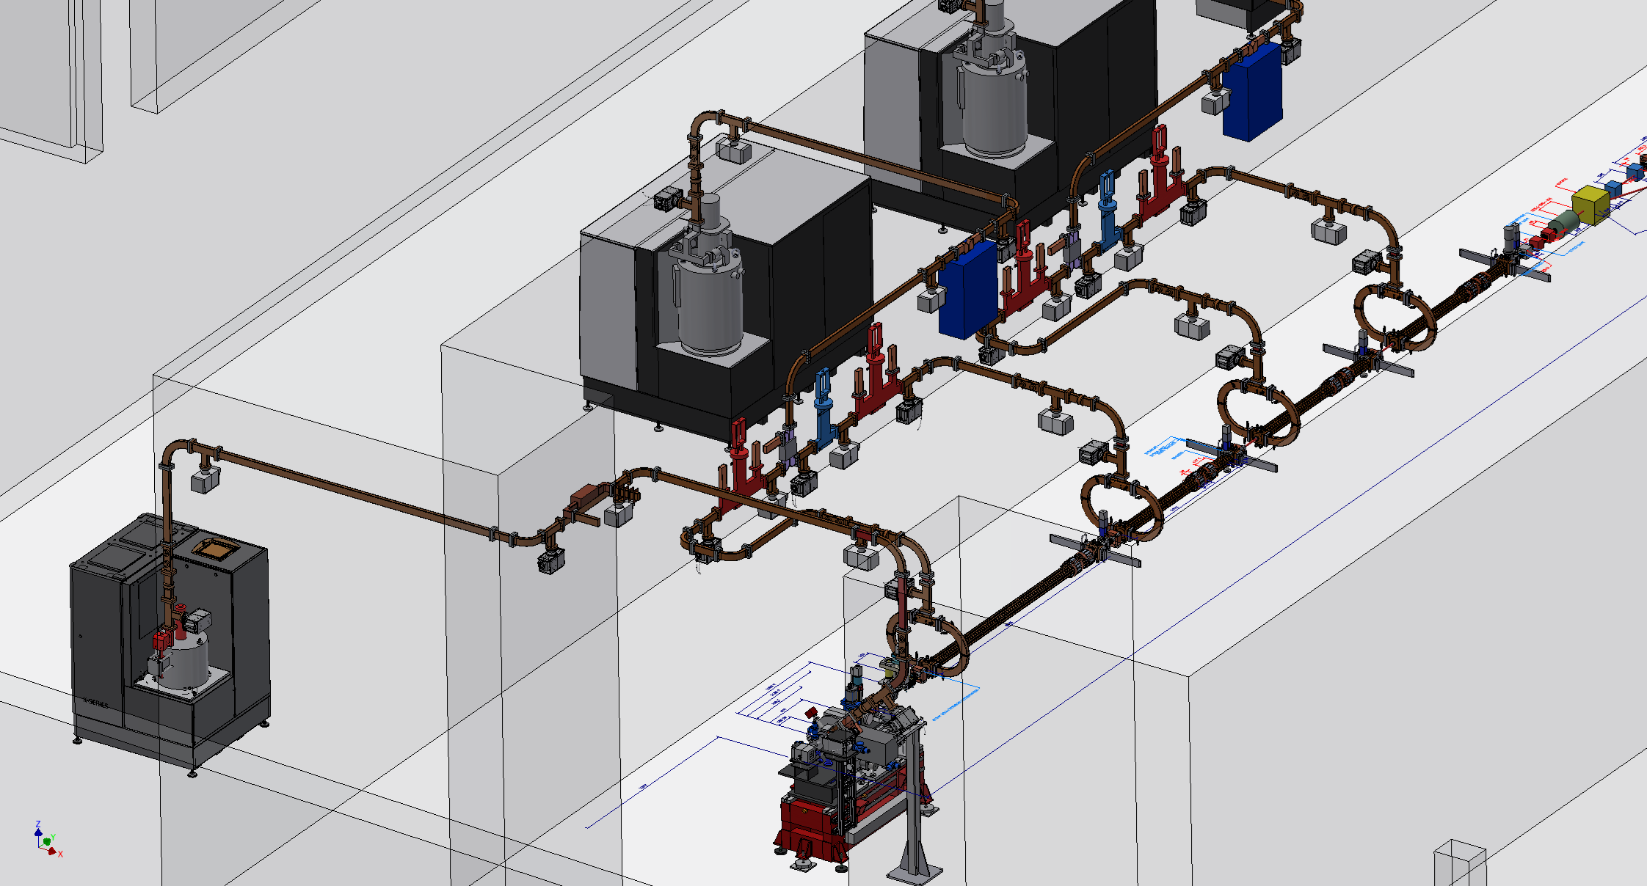
Injector & RF distribution
S-Band Injector RF power distribution
1st Cost & Schedule Review Meeting A.Ghigo Frascati 11 Dicembre 2023

Slide 9
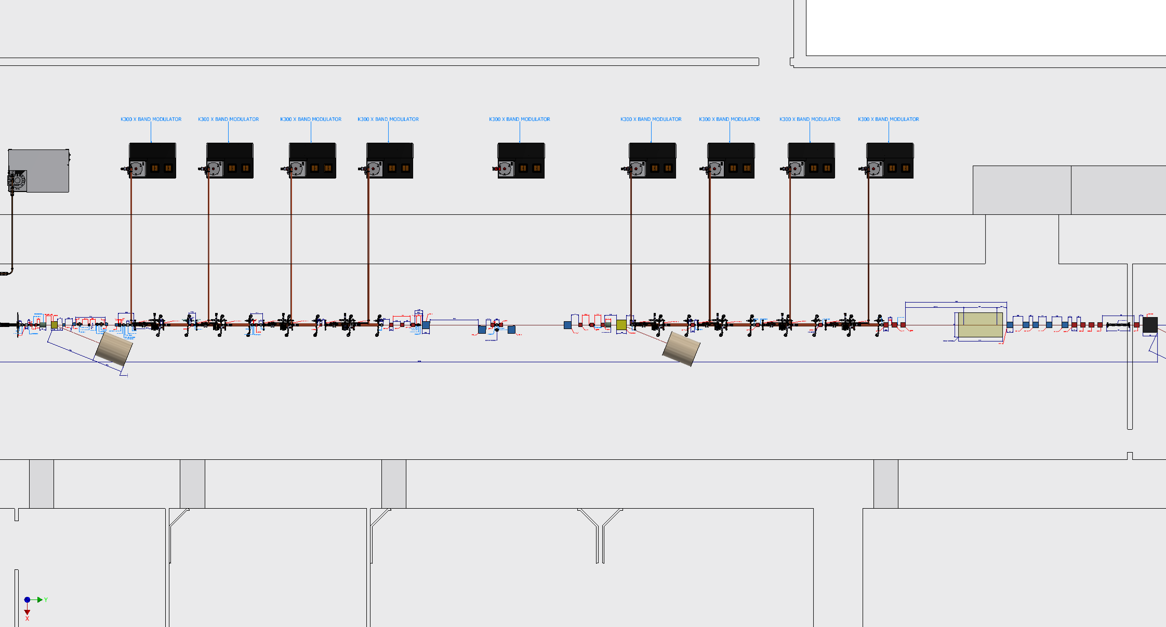
X-Band Linac 2D layout
Low energy linac: 8 X-Band accelerating structures
Bunch compressor : magnetic chicane
High energy linac: 8 X-Band accelerating structures
Plasma acceleration module
1st Cost & Schedule Review Meeting A.Ghigo Frascati 11 Dicembre 2023

Slide 10
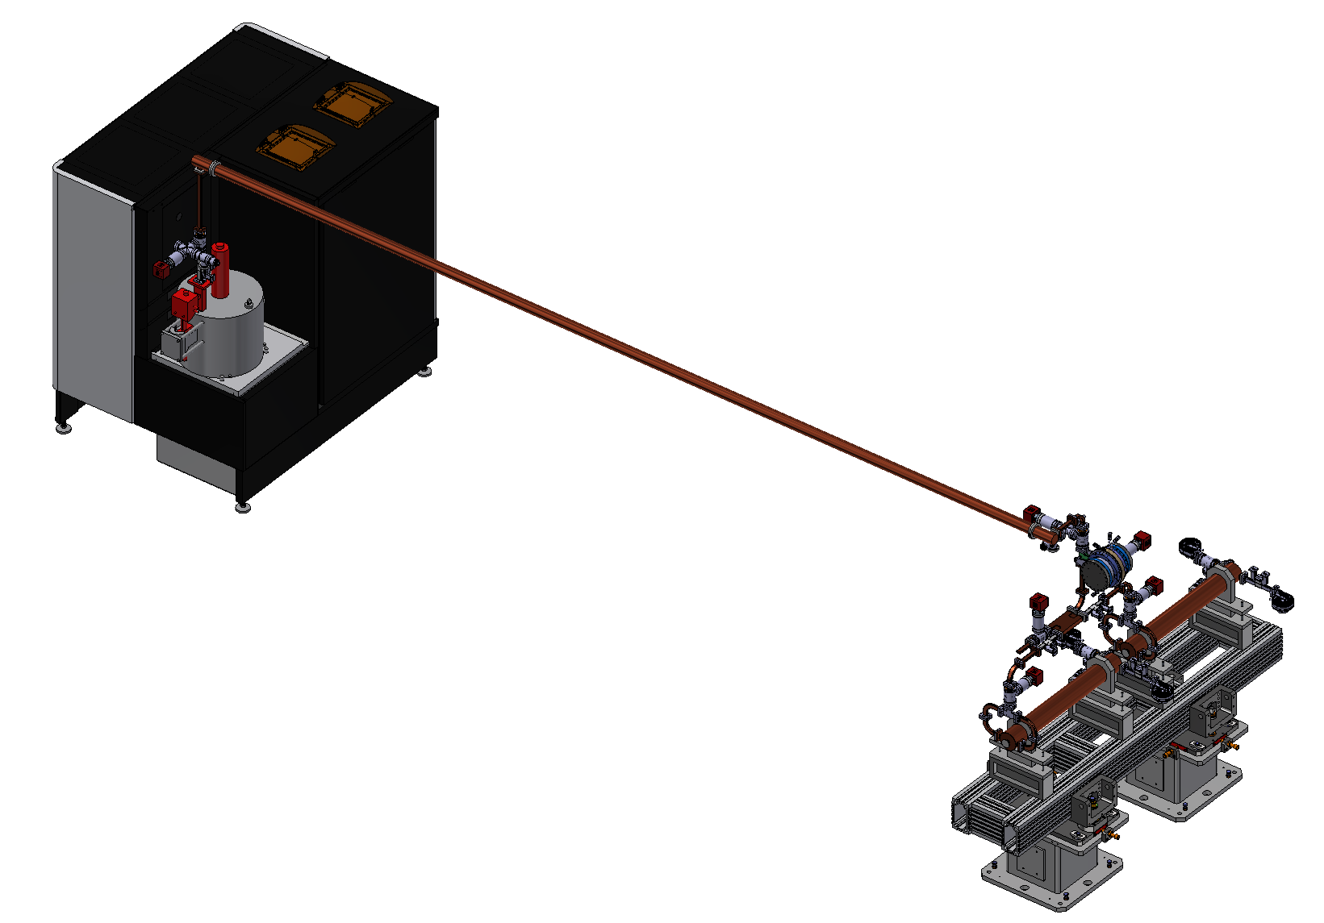
X-Band RF module
CANON 25 MW Klystron
SCANDINOVA K300 Modulator
BOC Pulse Compressor +
2 x 90cm X-band Accelerating Sections
1st Cost & Schedule Review Meeting A.Ghigo Frascati 11 Dicembre 2023

Slide 11
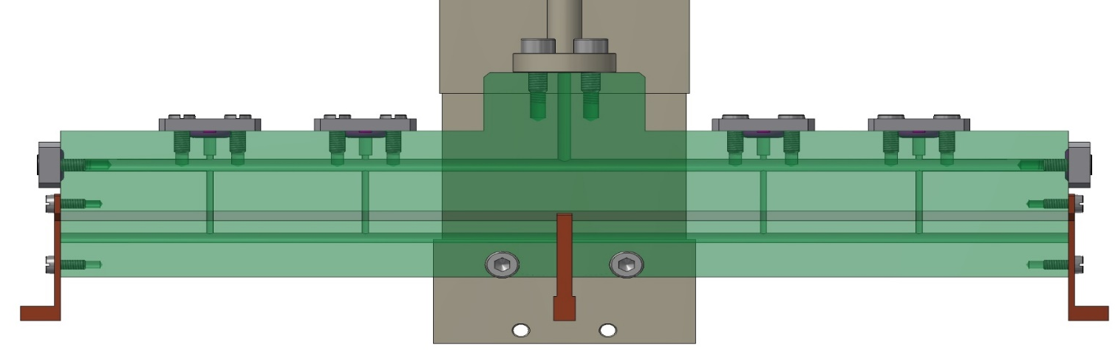
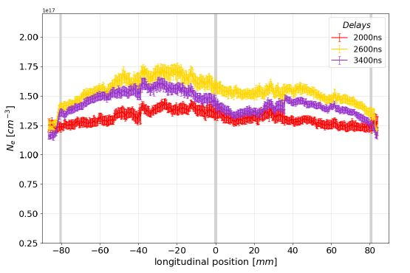
Plasma section - Plasma sources for EuPRAXIA
Plasma sources larger than 40 cm (m-scale) with HV pulses less tahn 10 kV
Longitudinal density modulation
1.5 GV/m m-scale capillary - density 10¹⁶ cm-3
6 kV
6 kV
_{e}
HV pulser
High current
HV pulser
High current
Delay generator
Discharge
trigger
control
HV generator
HV generator
Voltage/current control
1st Cost & Schedule Review Meeting A.Ghigo Frascati 11 Dicembre 2023

Slide 12
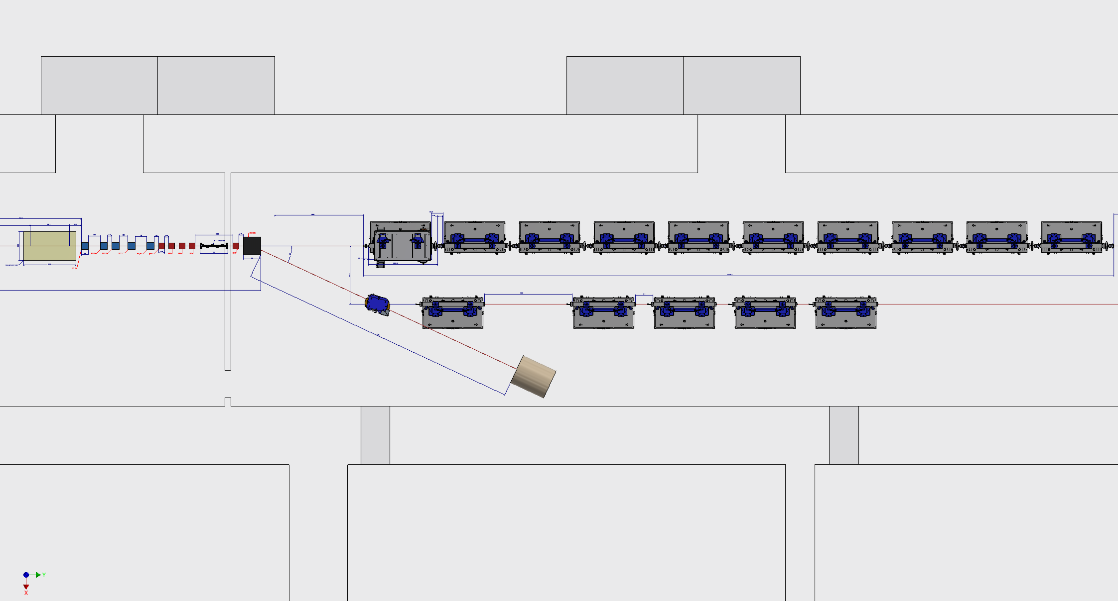
AQUA and ARIA undulators lines
AQUA: 10 APPLE-X Undulator Modules 2m long
ARIA: 5 undulator modules + dispersive section
1st Cost & Schedule Review Meeting A.Ghigo Frascati 11 Dicembre 2023

Slide 13
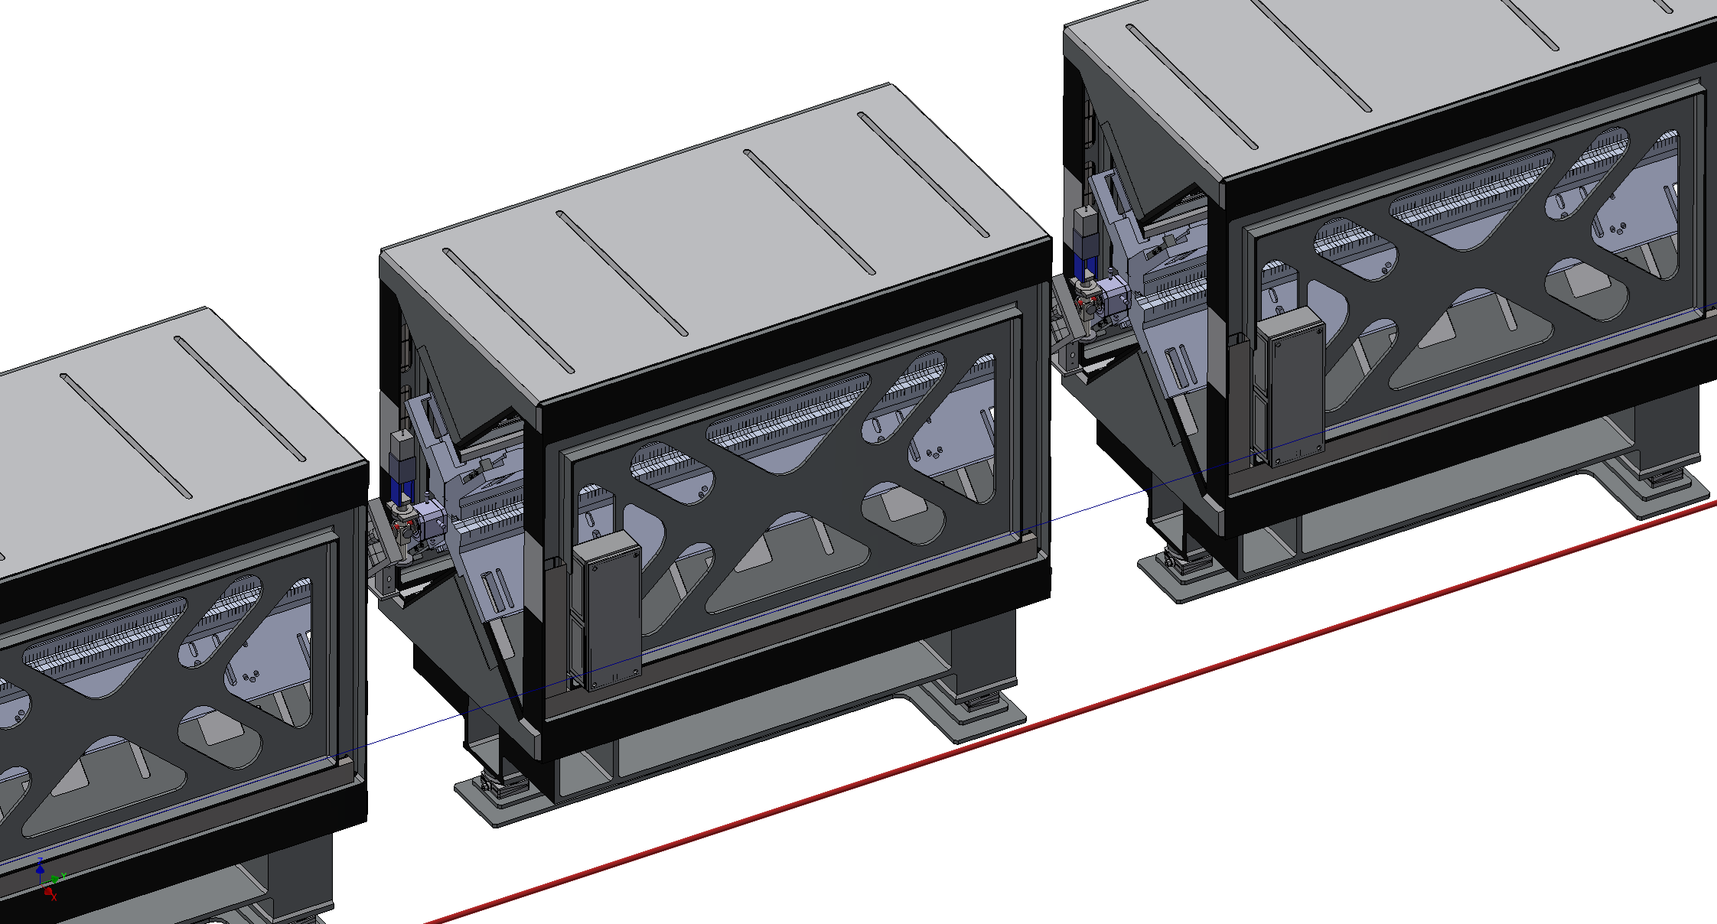
AQUA APPLE-X Undulators
Quadrupole-corrector magnet; Cavity Beam Position Monitor; view screen and pumping unit have been inserted between each module
1st Cost & Schedule Review Meeting A.Ghigo Frascati 11 Dicembre 2023

Slide 14
ARIA Planar Undulator Module
with quads & diagnostics
1st Cost & Schedule Review Meeting A.Ghigo Frascati 11 Dicembre 2023

Slide 15
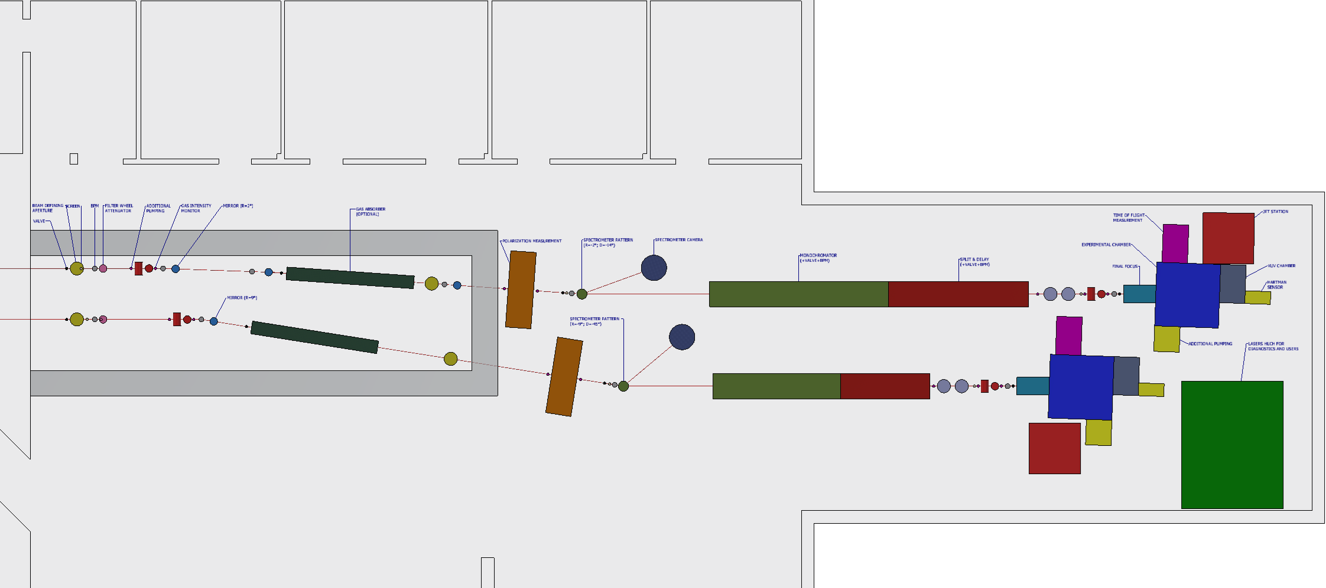
FEL Users area
We have to select the beam line components
according to the needs of the user
Beam lines:
Defining apertures
Mirror and focusing
Filter and attenuators
Monochromator
Split & delay
Diagnostic:
Beam position monitors
Intensity monitors
Spectrometer
Transverse dimension
Longitudinal dimension & time arrival
Wavefront measurement
Polarization measurement
Coherence measurement
1st Cost & Schedule Review Meeting A.Ghigo Frascati 11 Dicembre 2023

Slide 16
TDR Structure
 | Chapter | Reference person/people
1 | executive summary | ferrario
2 | eupraxia in the european context | assmann/ferrario
3 | eupraxia@sparc_lab | ferrario/ghigo
4 | scientific case | stellato
5 | experience with the LNF test facilities | pompili/cardelli/biagioni
6 | beam physics | vaccarezza/giannessi
7 | machine layout | ghigo
8 | photoinjector | chiadroni
9 | X-band linac | alesini/gallo
10 | plasma accelerating module | pompili/biagioni
11 | Free Electron Laser | giannessi/petralia
12 | photon beam lines | villa
13 | experimental endstations | stellato/villa
14 | electron and photon diagnostics | cianchi/villa
15 | laser systems | anania
16 | timing and synchronisation | bellaveglia
17 | control system | pioli
18 | vacuum system | liedl
19 | magnets and power supply | sabbatini
20 | machine protection system | pioli
21 | civil infrastructures | rotundo
22 | radiation safety and beam dump | esposito
23 | integration, implementation and commissioning strategy | del franco
24 | system engeneering | cioeta
25 | project costs , timeline and management structure | falone
1st Cost & Schedule Review Meeting A.Ghigo Frascati 11 Dicembre 2023

Slide 17
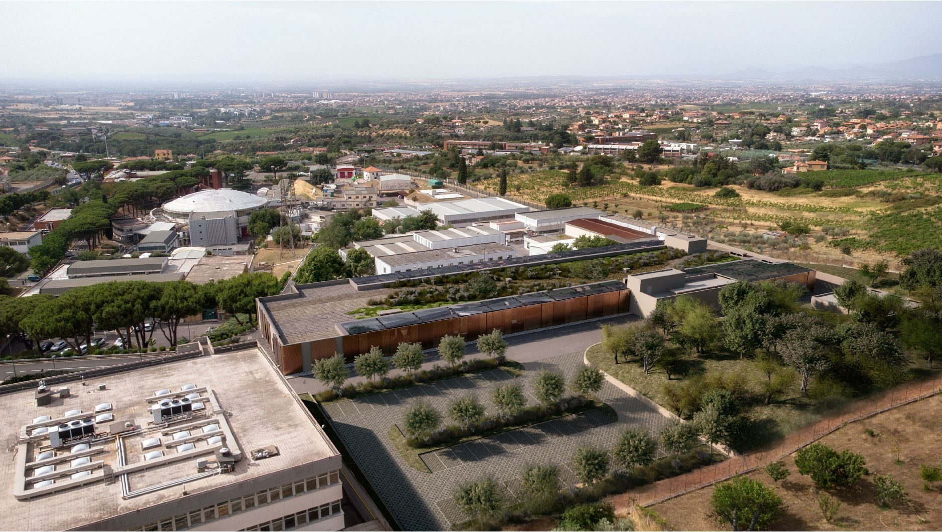
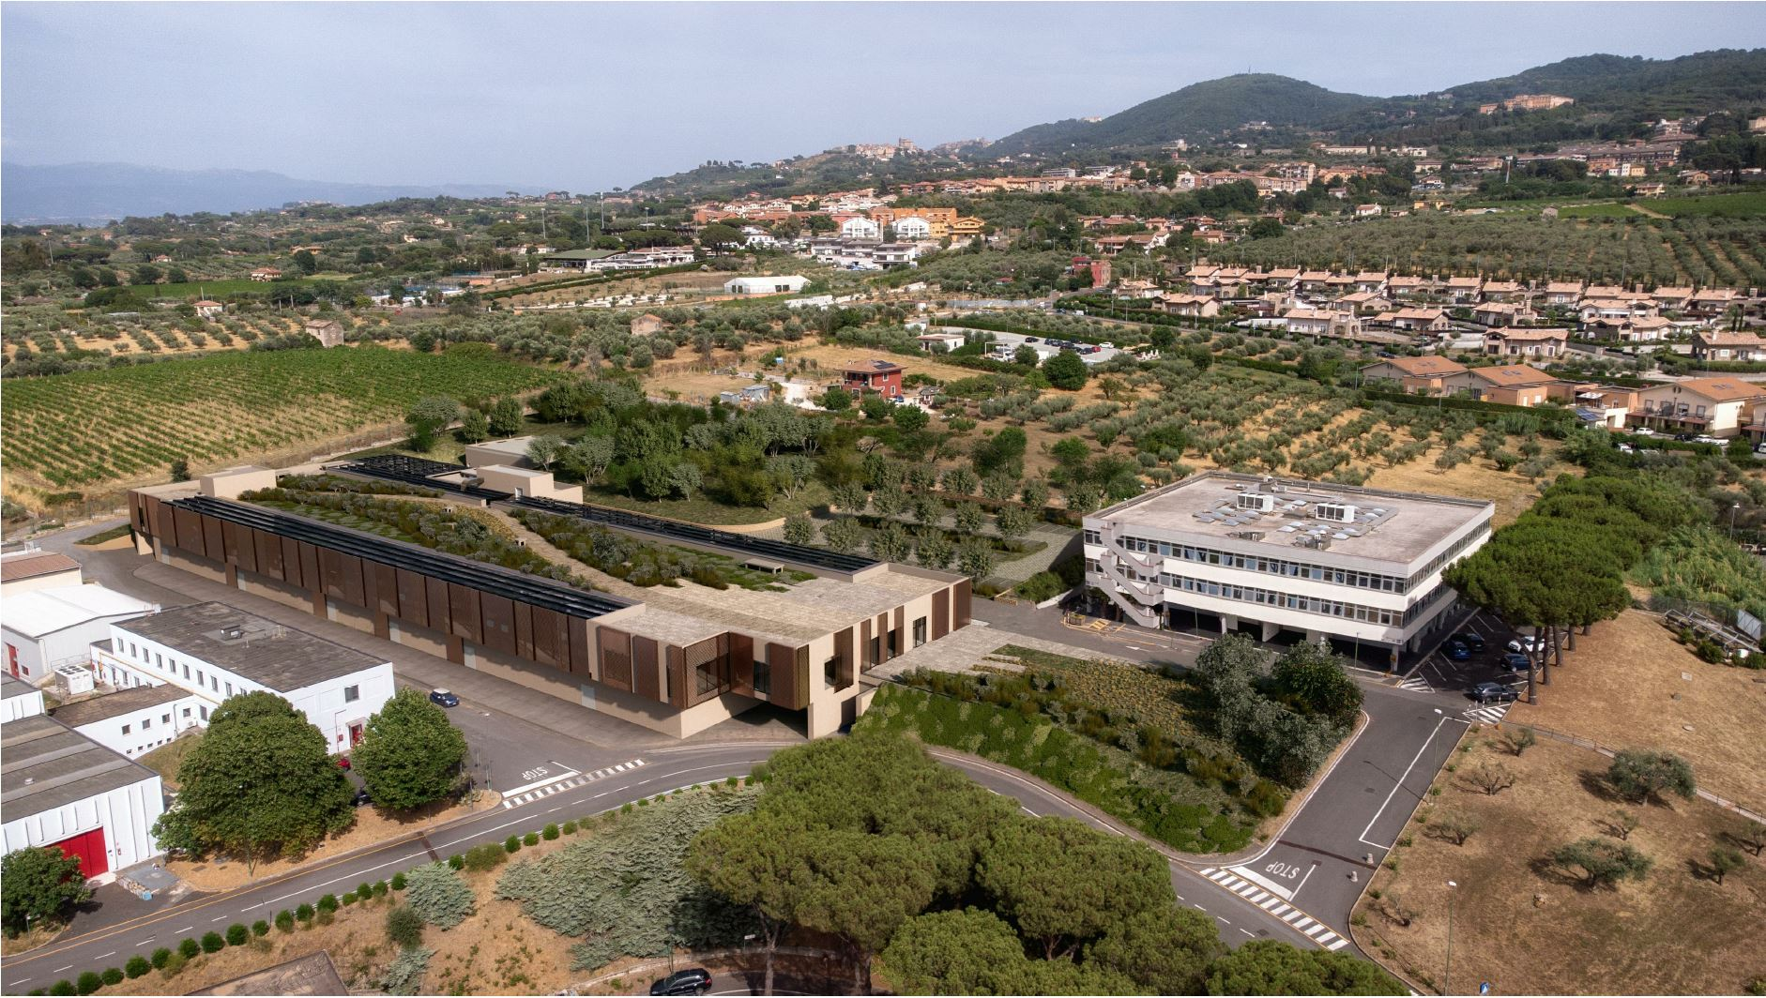
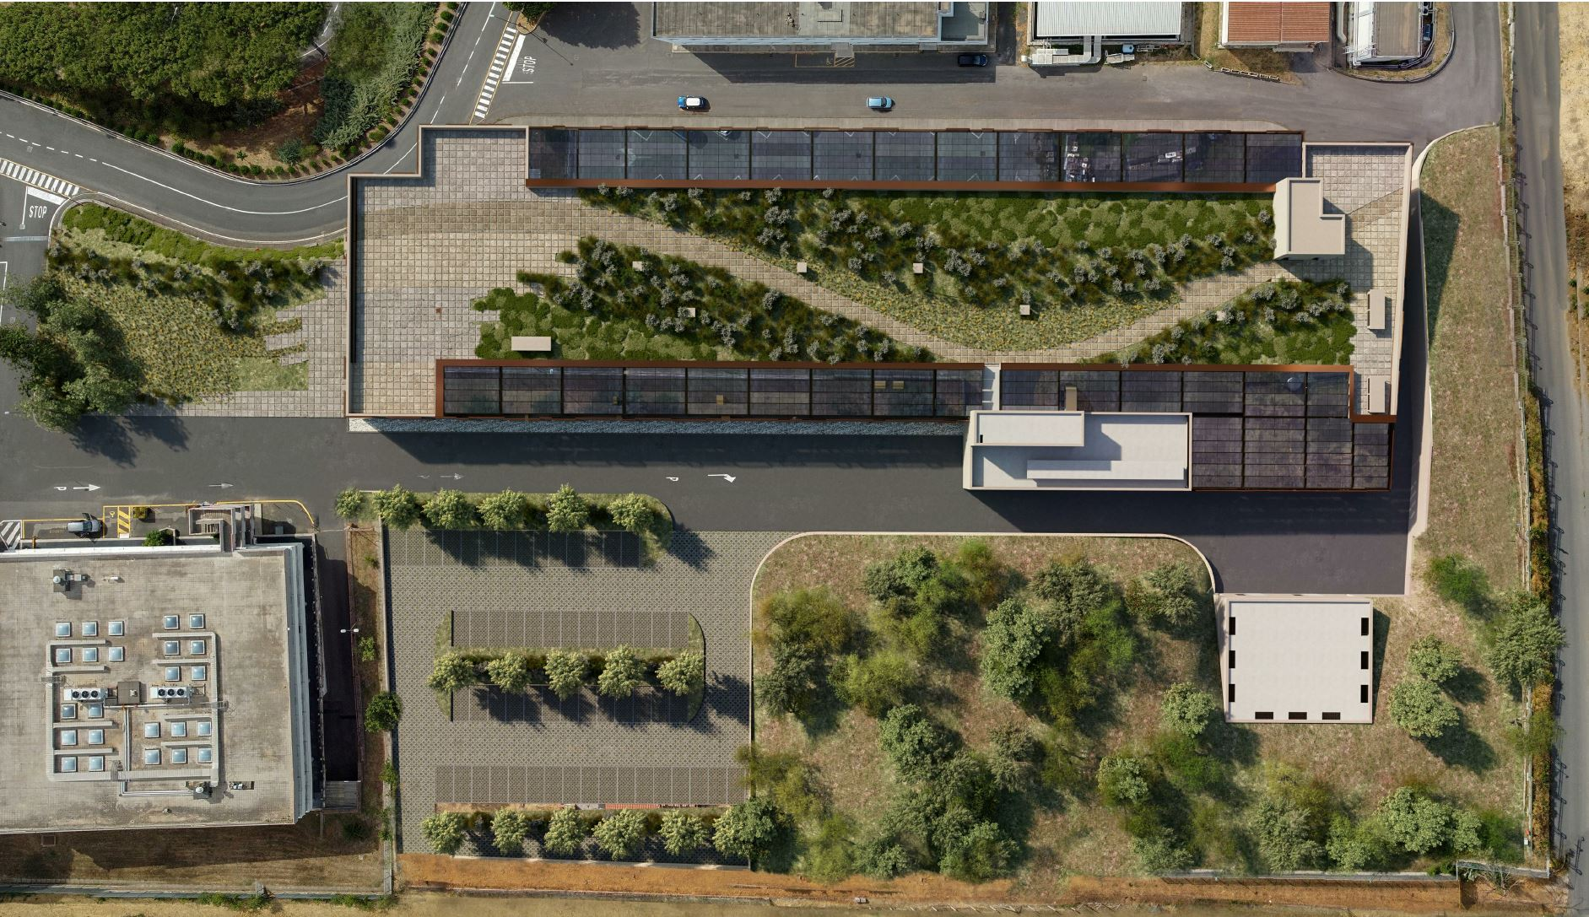
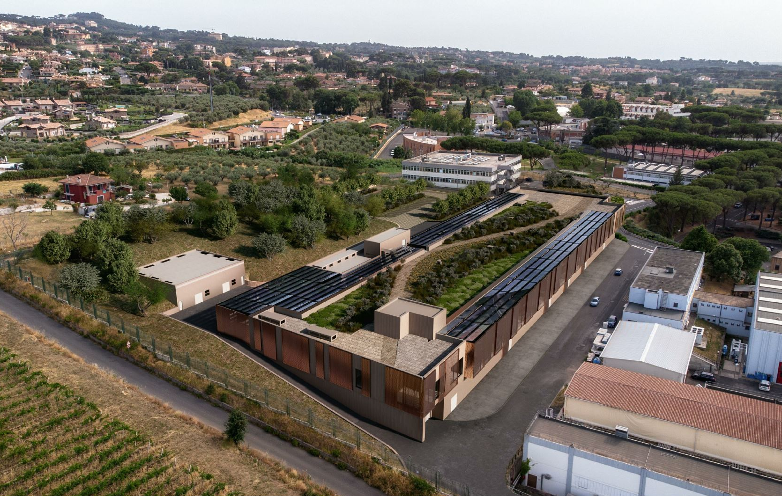
Building rendering
Courtesy MYTHOS cons., S.Incremona, U.Rotundo,
EuPRAXIA TDR Review Committee A.Ghigo Frascati 30/11-2/12 2022

Slide 18
Infrastructure Status
Progress in the design finalization and authorization process:
Final Draft has been validate
The «Conferenza dei Servizi» (Permitting authority committee) has given construction permission.
Mythos Consortium, the external designer, started the executive design, final step to start the tender for the construction
The bid for the executive project review from an external firm started
Cost updated has been presented at INFN management level (GE).
Courtesy S.Incremona, U.Rotundo
EuPRAXIA TDR Review Committee A.Ghigo Frascati 30/11-2/12 2022

Slide 19
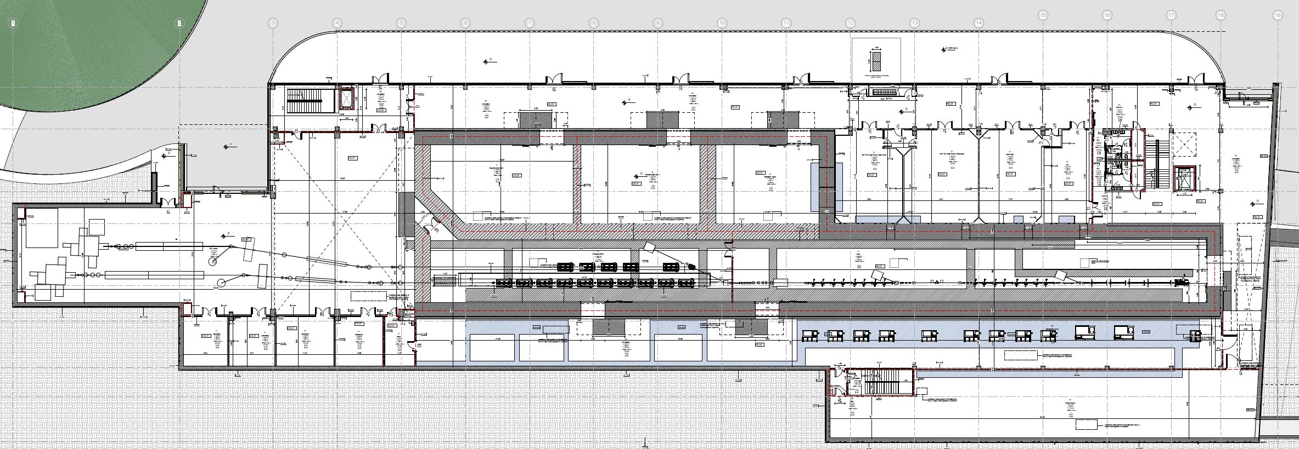
Equipments & Building CAD integration
1st Cost & Schedule Review Meeting A.Ghigo Frascati 11 Dicembre 2023

Slide 20
Accelerator & lasers Area
1st Cost & Schedule Review Meeting A.Ghigo Frascati 11 Dicembre 2023

Slide 21
Undulators & users Area
1st Cost & Schedule Review Meeting A.Ghigo Frascati 11 Dicembre 2023

Slide 22
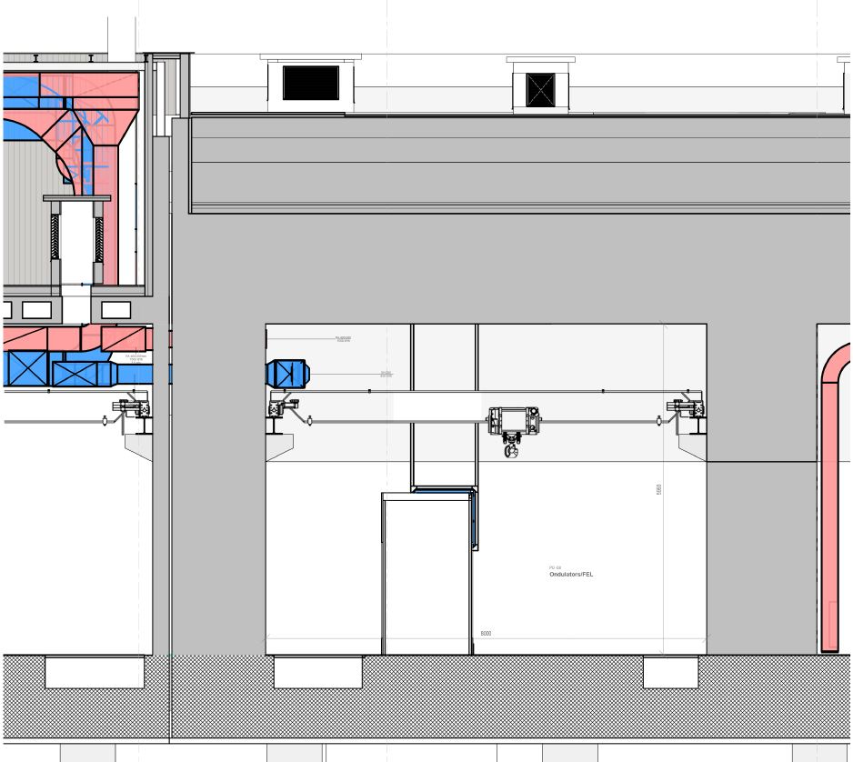
Drawing of the linac tunnel section
The final version of the definitive project took place after several iterations with the consortium of designers and revisions by our technical division
Courtesy S.Incremona, U.Rotundo and MYTHOS company
1st Cost & Schedule Review Meeting A.Ghigo Frascati 11 Dicembre 2023

Slide 23
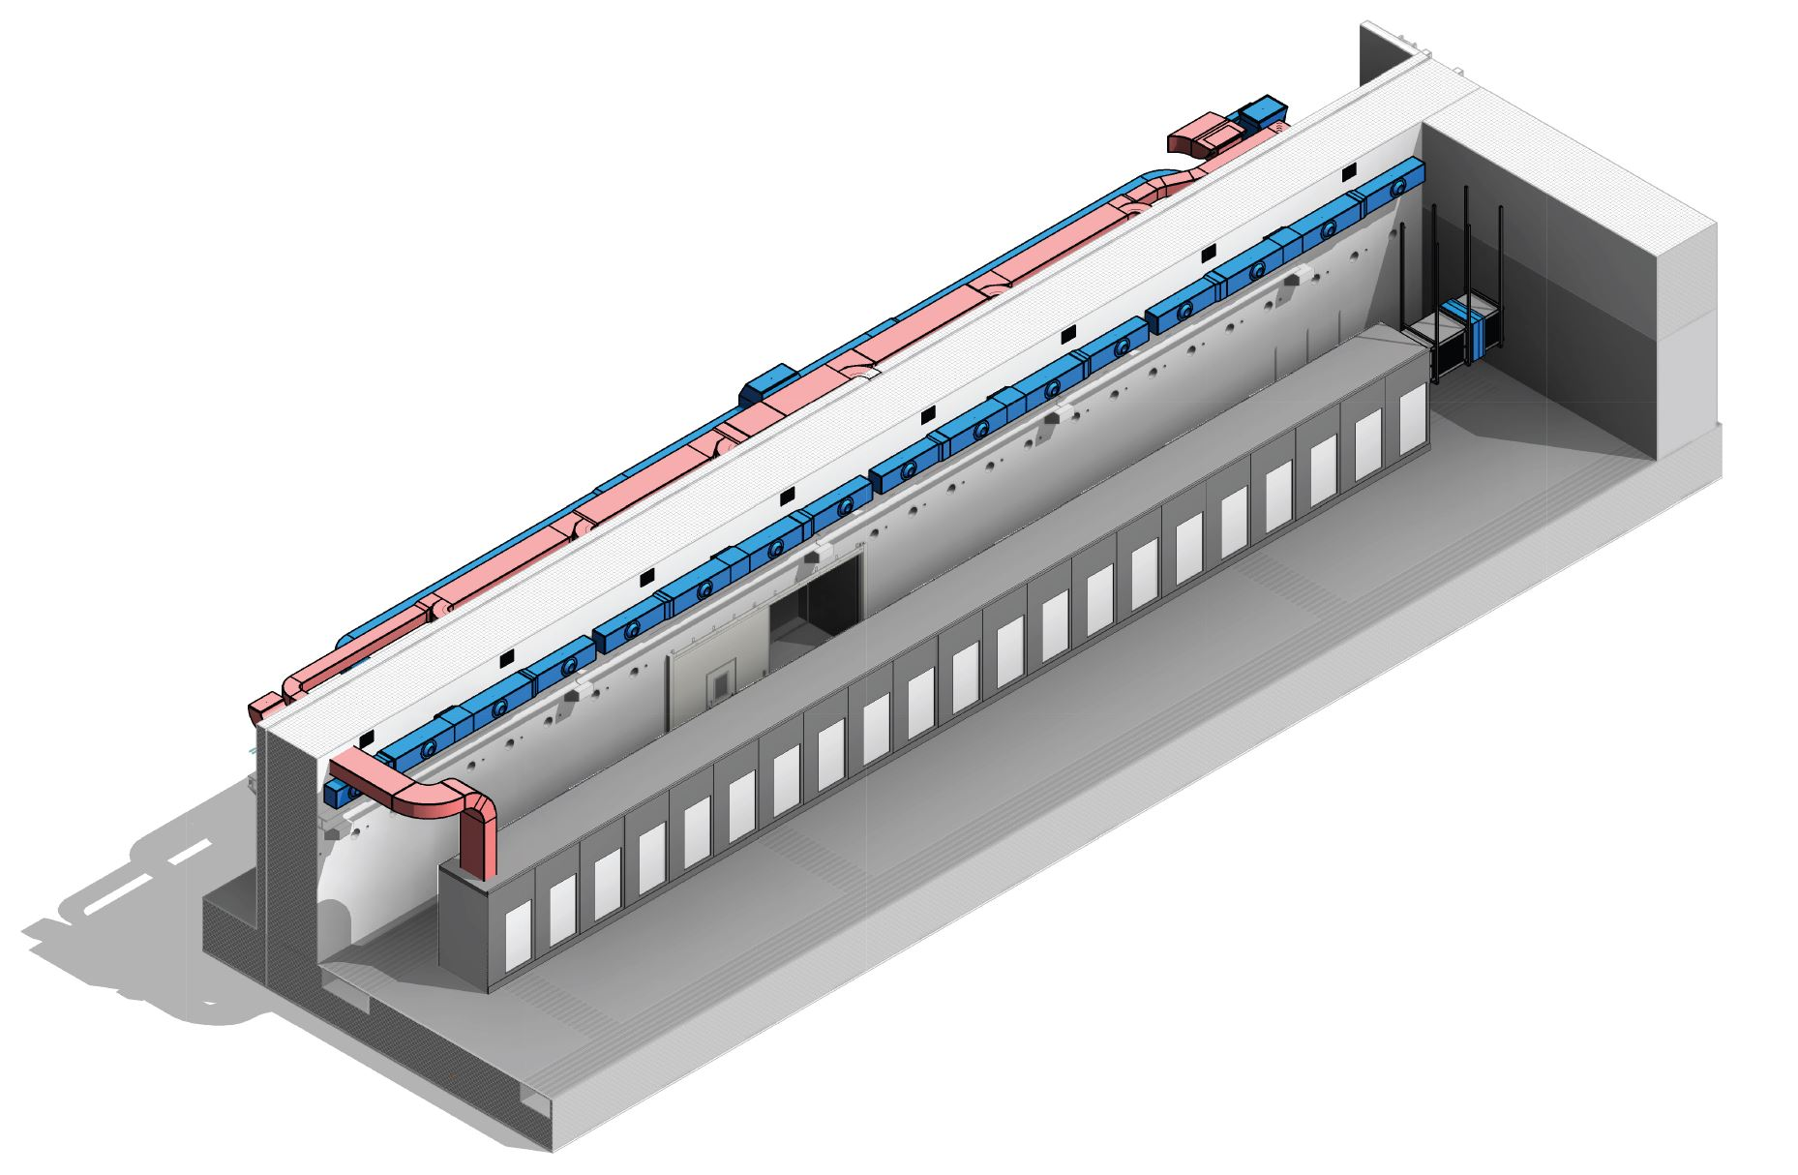
The building: Linac & undulator
areas
Undulator area
Building drawing of final draft
with air cooling distribution
Linac area
S.Incremona, S.Cantarella
1st Cost & Schedule Review Meeting A.Ghigo Frascati 11 Dicembre 2023

Slide 24
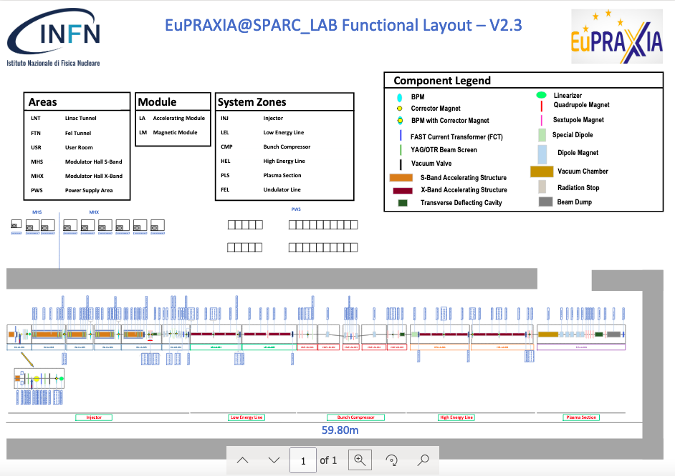
F.Cioeta
1st Cost & Schedule Review Meeting A.Ghigo Frascati 11 Dicembre 2023

Slide 25
Thanks for the attention
1st Cost & Schedule Review Meeting A.Ghigo Frascati 11 Dicembre 2023

