Slide 1
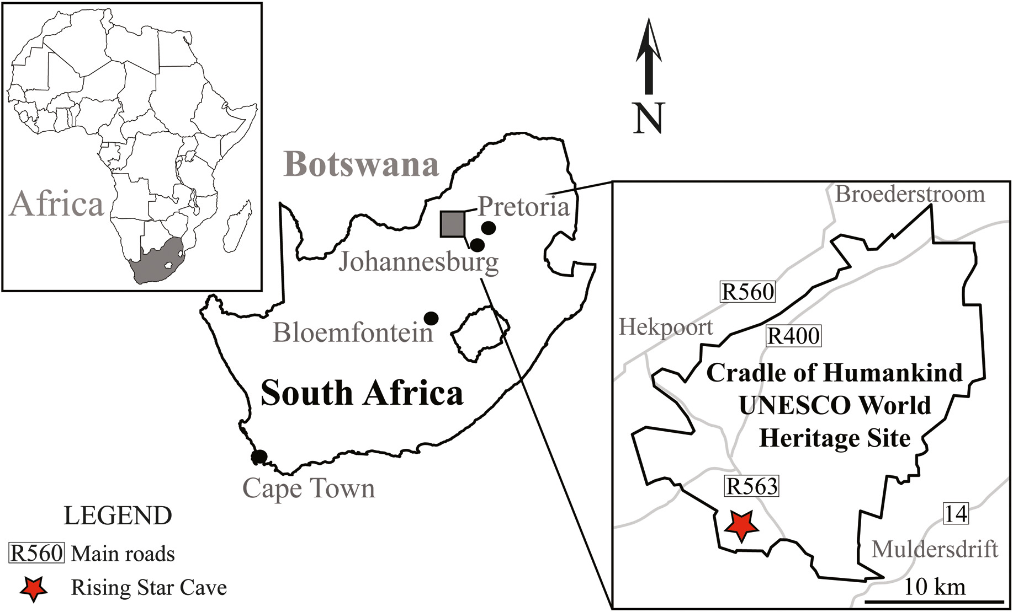
The MUSTAR project: Muography in COHWHS
M. Bruschi - INFN Bologna (ITALY)
Assemblea di Sezione – 4 Luglio 2024

Slide 2
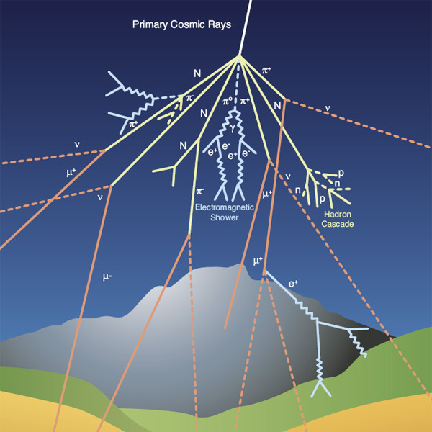
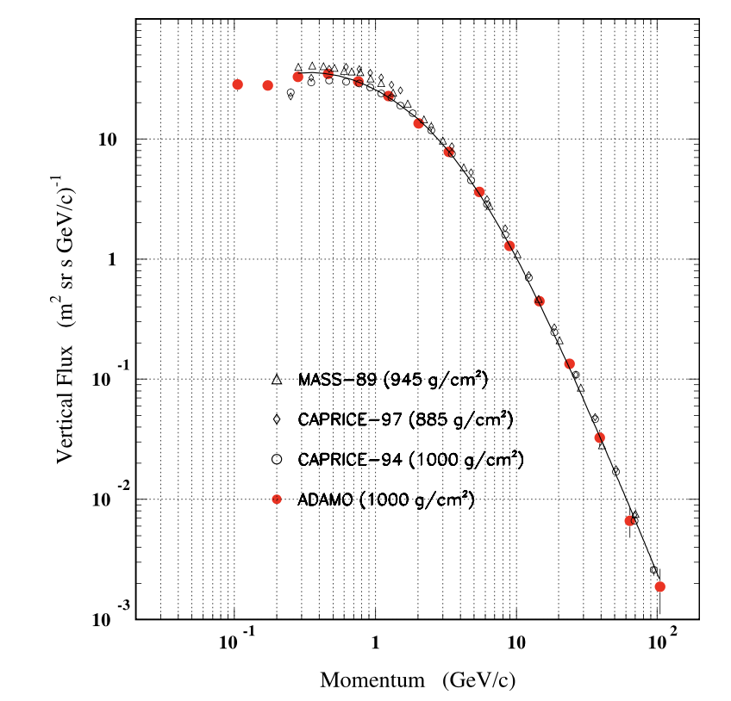
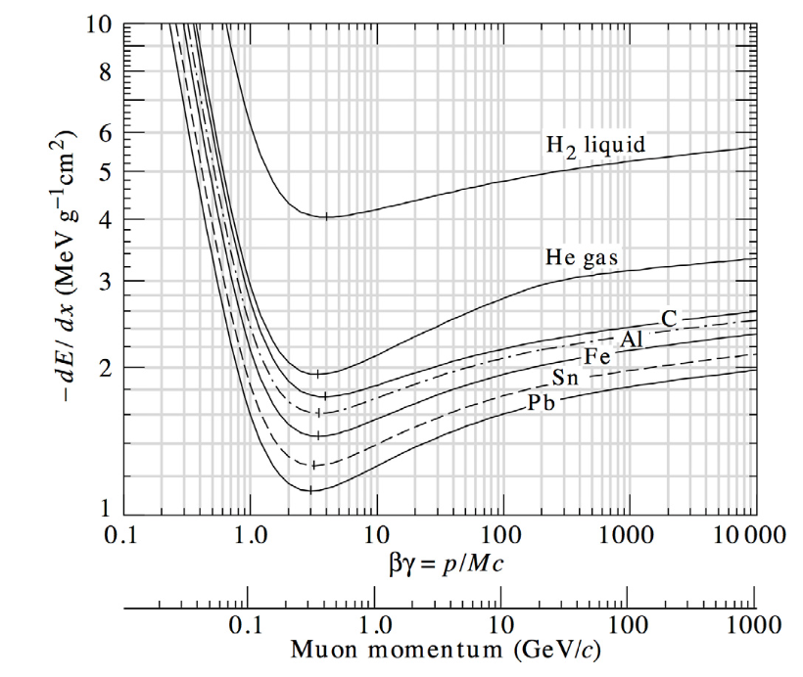
Cosmic rays cascades
Primary cosmic rays
85% protons
12% α particles
3% heavier particles
At altitudes between 15-20 km they interact in the atmosphere with nuclei initiating electromagnetic or hadronic showers
Secondary cosmic rays can survive enough to reach Earth’s surface
At the sea level, 80% of all the charged particles hitting the ground are MUONS
Typical flux of vertical muons: 1/cm²/min
The flux depends on the momentum and the zenith angle θ: I(θ)~I(θ=0) cos² θ at the sea level for muons momenta ~ 3 GeV

Slide 3
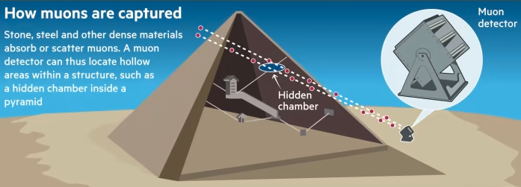
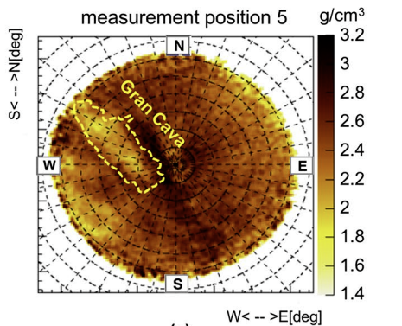
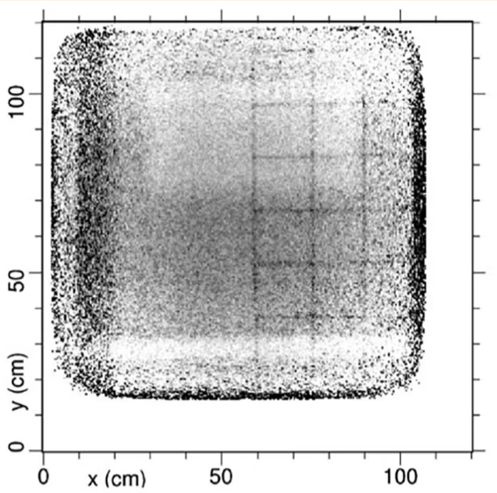
The principle of muography
Natural Imaging Agents
Unlike X-rays that require a source, muons are naturally and abundantly available.
Muons lose energy and get absorbed or deflected when passing through matter.
Capturing Shadows
Detectors placed on opposite sides of an object capture muons after they pass through.
Areas with denser material (like metals or rock) absorb more muons, casting a 'shadow' on the detector.
Creating an Image
By measuring the number of muons passing through different parts of the object, a 2D (or 3D using more detectors) image can be constructed.
Helps in revealing the internal structure without physically opening the object.
Needs comparison with MonteCarlo simulations
Example of muography inside the Temperino mine (Tuscany) by the Florence group(INFN and Uni.)
Areas of lower (hidden caves) or higher densities materials are visible
More about this in the following

Slide 4
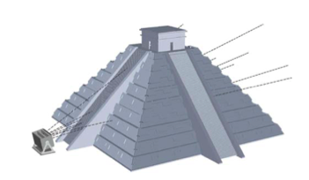
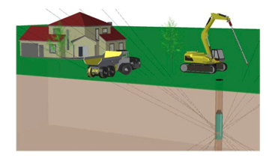
Types of Muography
Depending on the specific situation, three types of radiographic setup can be used
to map the overburden of natural or artificial cavities such as caverns or tunnels
search for hidden chambers in pyramids in Egypt and Mexico
longer data taking
A borehole can be used to host a small sized muon detector with cylindrical shape

Slide 5
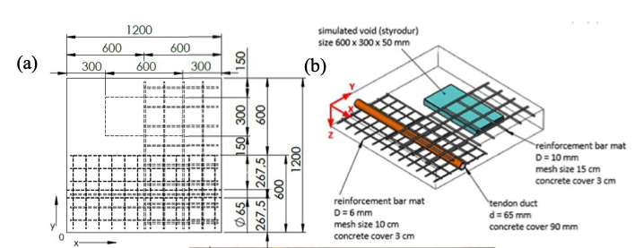
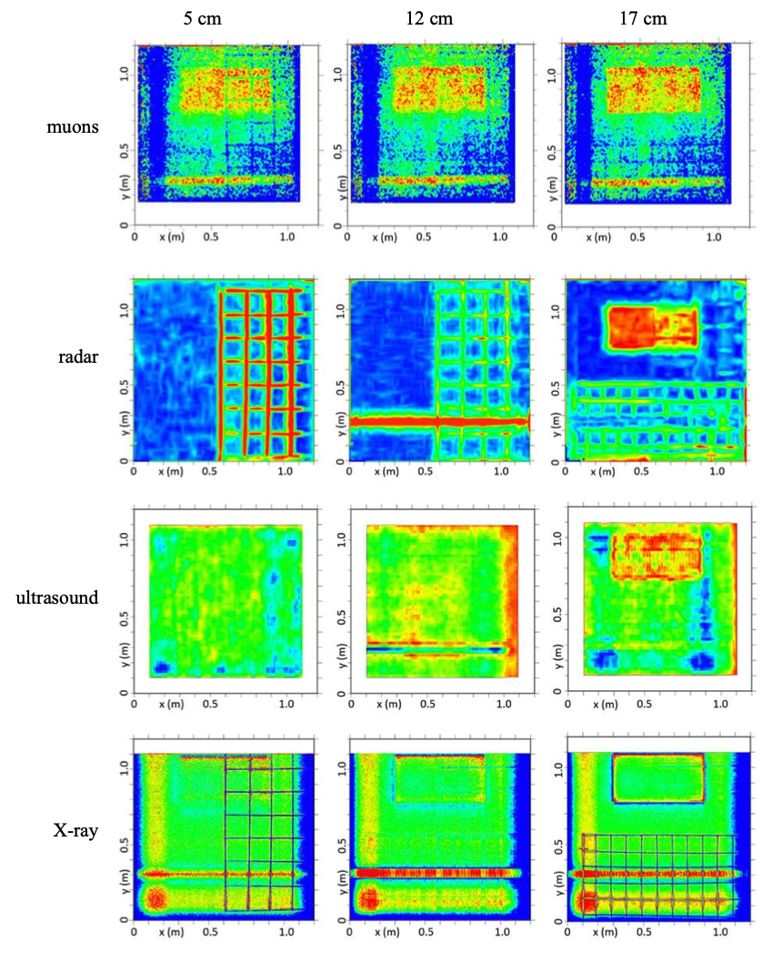
Advantages of muography wrt other techniques
Conventional Techniques & Their Boundaries:
Radar: Effective but limited to a penetration depth of about two meters. Inadequate for imaging thick walls, deep pipelines, or structures buried beyond this depth.
Ultrasound: Offers detailed insights but can be noisy and prone to echoes and self-interference, especially in dense materials, leading to unclear images.
X-rays: Provide crisp, detailed images quickly but pose significant health risks due to radiation exposure. Needs extensive paperwork for safety permits.
Not suitable for penetrating dense and extended materials
FROM: IAEA REPORT IAEA-TECDOC-2012

Slide 6
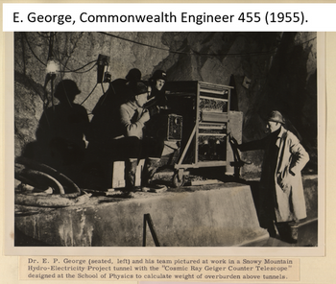
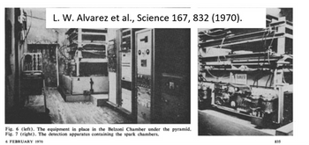
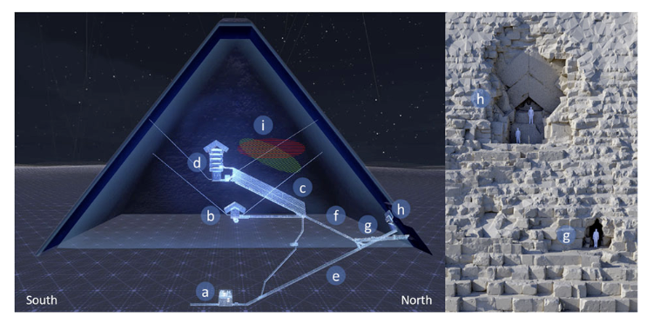
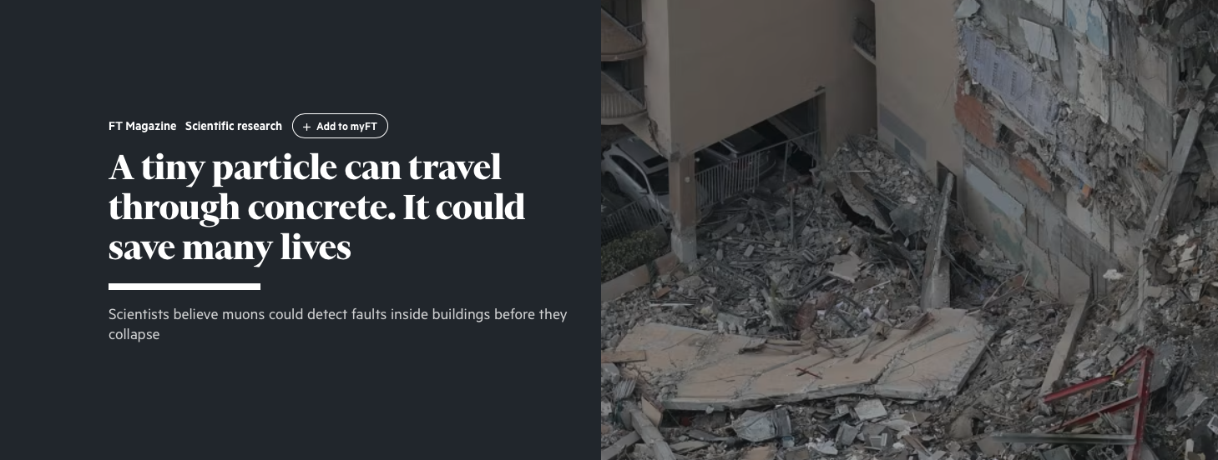
Muography applications
1955: Proposed by E. P. George to determine the thickness of snow layers on a mountain
Archaeology
from 1971: Search of unknown burial cavities in the Chephren pyramid (L. Alvarez and coll.)
Volcanology (lateral)
from 2003: Study of the internal structure of volcanoes (Tanaka and coll.)
Civil engineering and underground
imaging of concrete structures, bridges, monitoring of historical buildings, tunnel boring machines
Industrial
Process monitoring, Preventive maintenance, production optimization

Slide 7
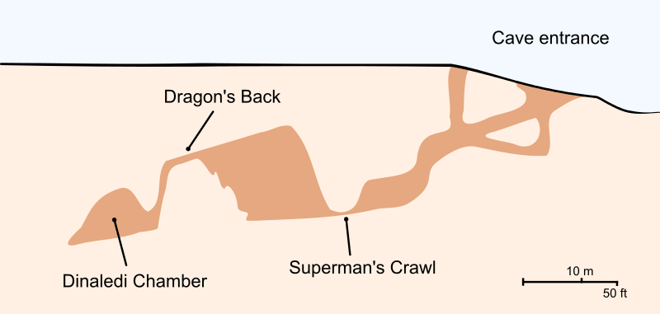
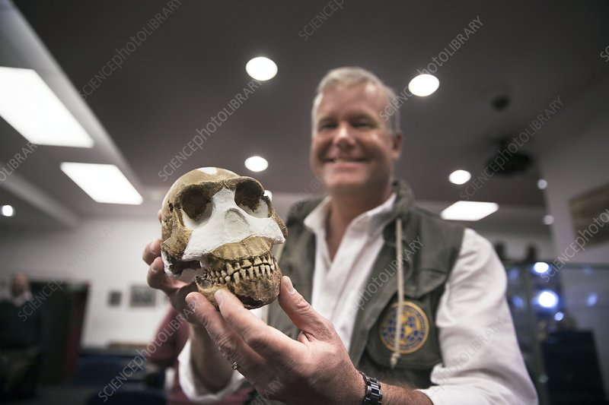
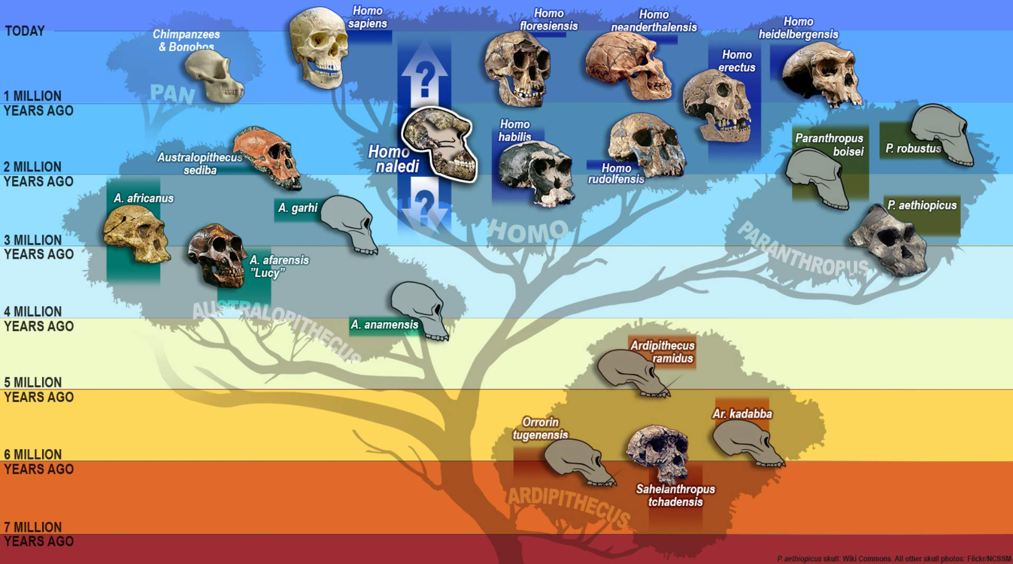
Muon Imaging in the Cradle of Humankind
Introduction:
The Cradle of Humankind UNESCO World Heritage site (COHWHS) is a region rich in karstic dolomite, featuring caves, sinkholes, and subterranean structures.
These formations preserve crucial fossil records, offering insights into human origins and paleoenvironments.
Challenges in Exploration:
Traditional methods have limitations in uncovering the full extent of these karstic systems.
Recent surveys have revealed hundreds of cave systems and fossil-bearing deposits, indicating a need for more advanced exploration methods.
Potential of Muon Imaging:
Muon Imaging presents a promising solution for discovering and exploring these subterranean spaces.
The technique uses naturally occurring muons to create detailed images of the interior of structures, capable of revealing hidden chambers and passages.

Slide 8
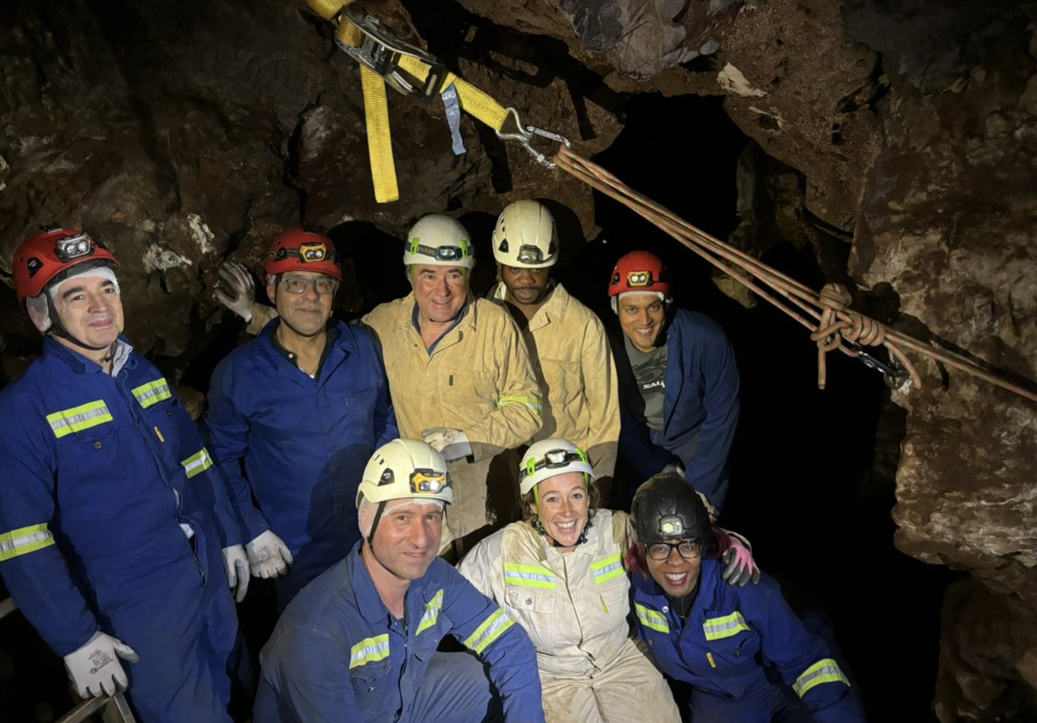
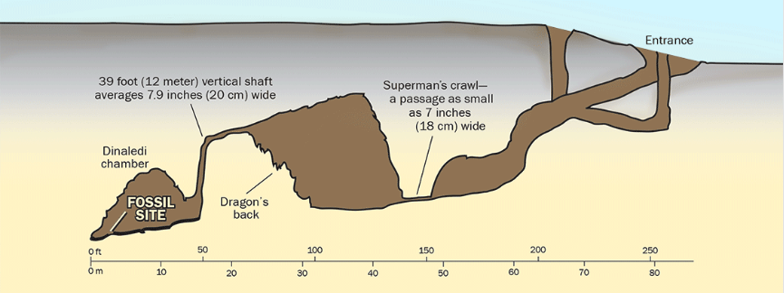
Proposed experiments with Muon Imaging in COHWHS
POC: Muography of the RS site 105
appropriate position
ideal for an initial muographic experiment
These first results will have already a big scientific impact
Exploring for alternative access points to the Rising Star subsystem
hypothesis based on the discovery of numerous remains of Naledi man in the cave system
Presently hardly accessible
The Rising Star subsystem floor sits at 30-35m depth good for MI
Positioning the detectors in different areas in the cave could be used to discover any spaces or passages that are now sealed off from the main chambers
Muon tomography to inspect blocks of fossil bearing breccias
Present imaging used conventional computed tomography or higher energy synchrotron imaging, both of which are expensive modalities and expose fossils to higher doses of radiation which may affect some studies

Slide 9
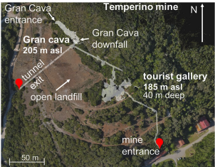
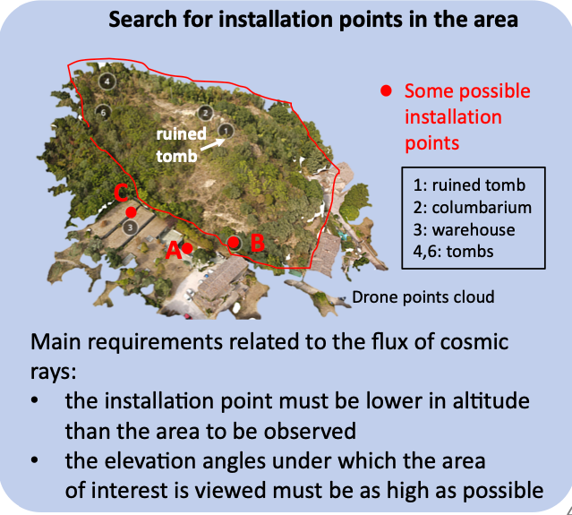
Typical measurement time
https://www.nature.com/articles/s41598-022-26393-7
Numbers received by R. d’Alessandro (thanks!)
Temperino mine (Tuscany, Italy)
In cave, 30-50 m rocky overburden, difficult access, MIMA-like detector (40x40 cm2), 4 weeks for each measurement point.
Palazzone necropolis site (Perugia, Italy)
Side protected towards the hill
used MIMA, measurement time 6-8 weeks (more inclined and greater thickness of rock to cross).
Using other types of detector
MIMONE type (64x64cm2) reduces a factor of 2.5 the measurement time
BLEMAB type (80x80cm2) reduces a factor of 4 the measurement time

Slide 10
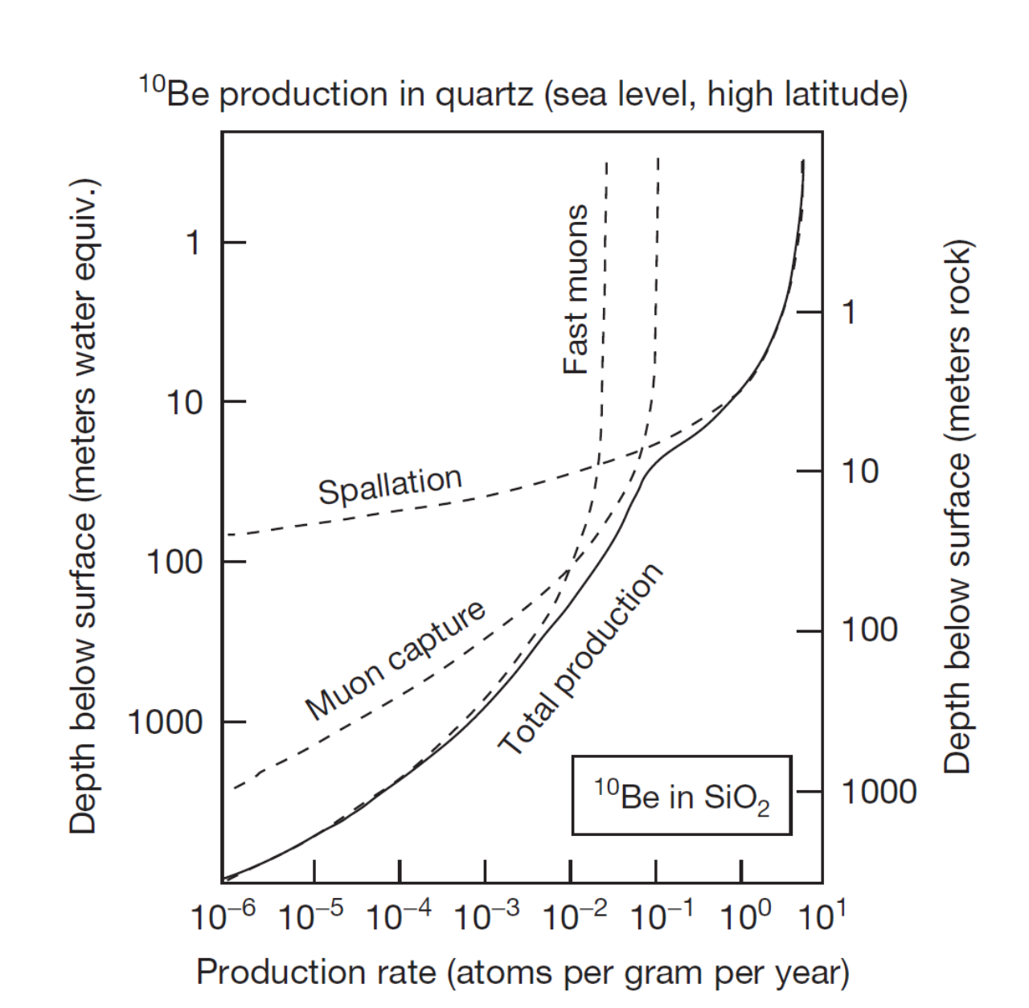
Muography and geodating
Cosmic rays products reaching the soil can produce nuclides
Spallation of high energy neutrons
¹⁶O(n,4p3n)¹⁰Be
²⁸Si(n,p2n)²⁶Al
Slow neutron capture
Slow μ⁻ capture
Fast muon interaction → BS – photons → photoneutrons (depth > 20m)
Measuring the relative abundance and the ratio of long-lived nuclides as ¹⁰Be (1.4 Myears) or ²⁶Al (0.71 Myears) is a commonly used technique for geodating
Experimental measurement of the muon/neutron fluxes (and spectra) at the surface and in cave are needed (together to MC modeling) to extract the dating
Interest of Bologna in this program (new in the INFN)
Per Grafstrom already developed interesting ideas to improve the dating of the fossils area in the COH
Measure initially proposed by Dr. T. Makhubela, Geology dpt. of Uni. of Johannesburg
Feasibility using only muon flux measurements on surface and in cave must be studied
Other groups interested
Univ of Johannesburg
INFN Bologna, Firenze
Ithemba/Wits
Precision needed for dating must be assessed and then feasibility studies must be performed

Slide 11
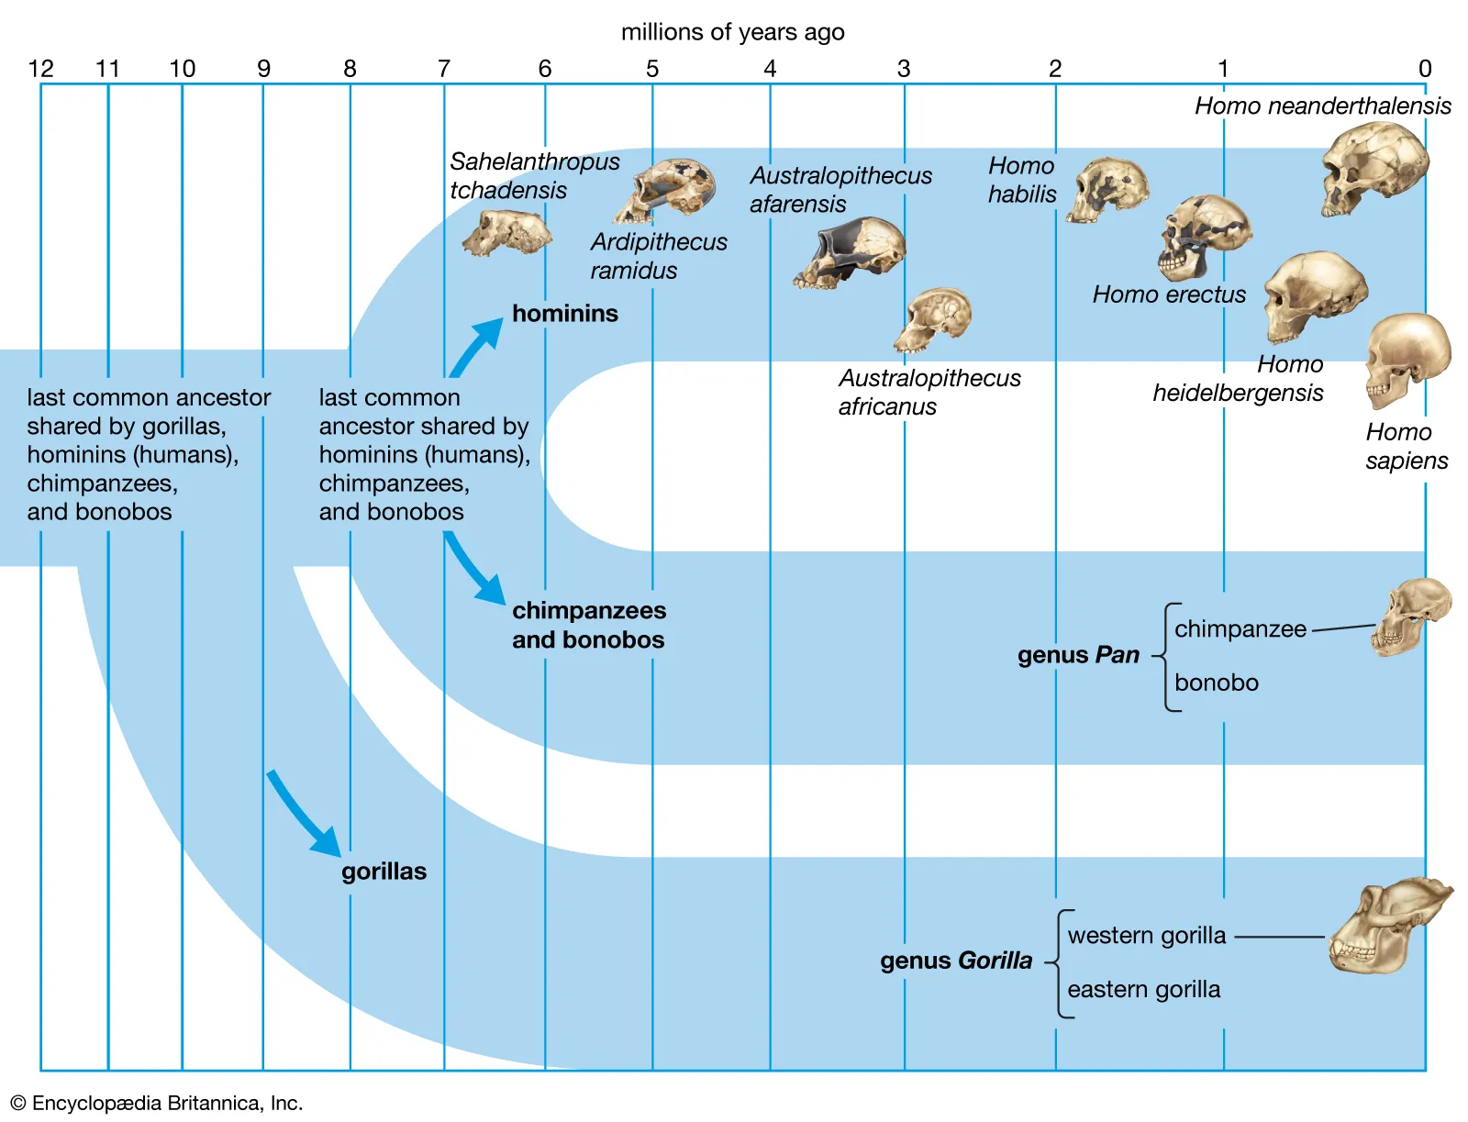
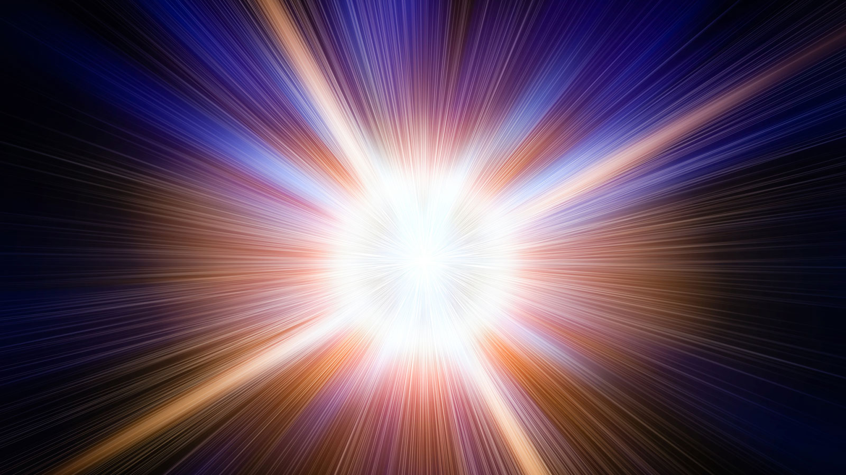
Scientific Impact of this project
The Big Bang: The Universe's Origin
Understanding the Big Bang helps scientists explore fundamental questions about the universe's origin, composition, and eventual fate.
Emergence of Humanoids: The Human Big Bang
Studying the 'human Big Bang' sheds light on human nature, social structures, and the development of civilizations.
Common points
Both events represent critical thresholds that led to vast expansions in complexity and diversity — in the universe at large and within the realm of human ancestry.
Scientific impact
Studying these pivotal moments not only enhances our understanding of the cosmos and ourselves but also underscores the interconnectedness of all things in the mosaic of existence.
Muon imaging, in its capacity to unveil hidden chambers within the Rising Star cave system, is as revolutionary to paleontology as the LHC it has been for the discovery of the Higgs Boson in particle physics!
MUon Imaging in the Rising STAR cave systems gives a unique opportunity to all of this!

Slide 12
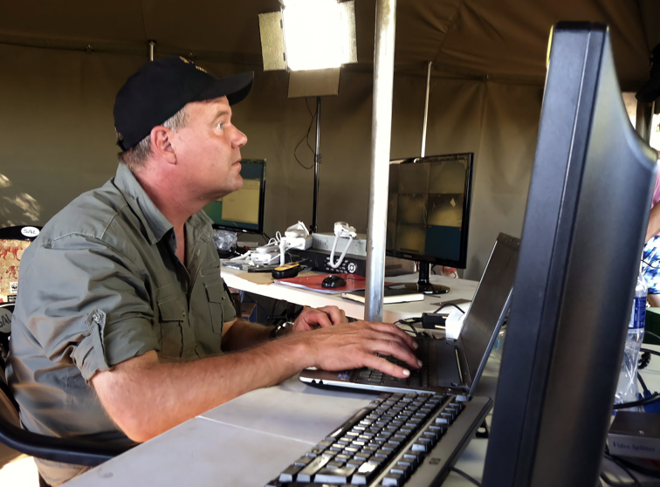
Introducing Lee Berger Renowned Paleontologist Collaborating in MUSTAR
Lee Berger is a world-famous and prizes-winner palaeontologist
His CV and carrier scientific achievements can be found here
Significant Discoveries:
In 2008, he discovered hominid remains later classified as Australopithecus sediba
Transitional stage between Australopithecus Africanus and Homo erectus
In Autumn 2013, he led an excavation at the Rising Star cave complex in the Cradle of Humankind
Recovered more than 1500 hominid fossils, representing 15 or more individuals
Fossils belong to an unknown hominid species named Homo Naledi (200-300 kY old), whose characteristics do not fit in the present scheme of human evolution
Recent Appointment:
In March 2023, Berger was appointed National Geographic Society Explorer in Residence and staff member.
etflix Series

Slide 13
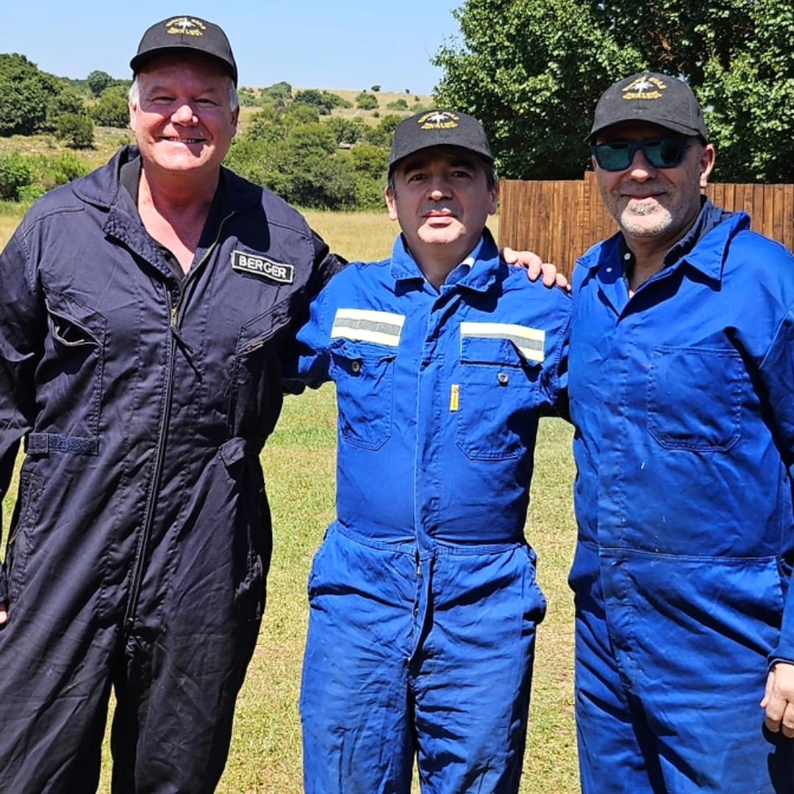
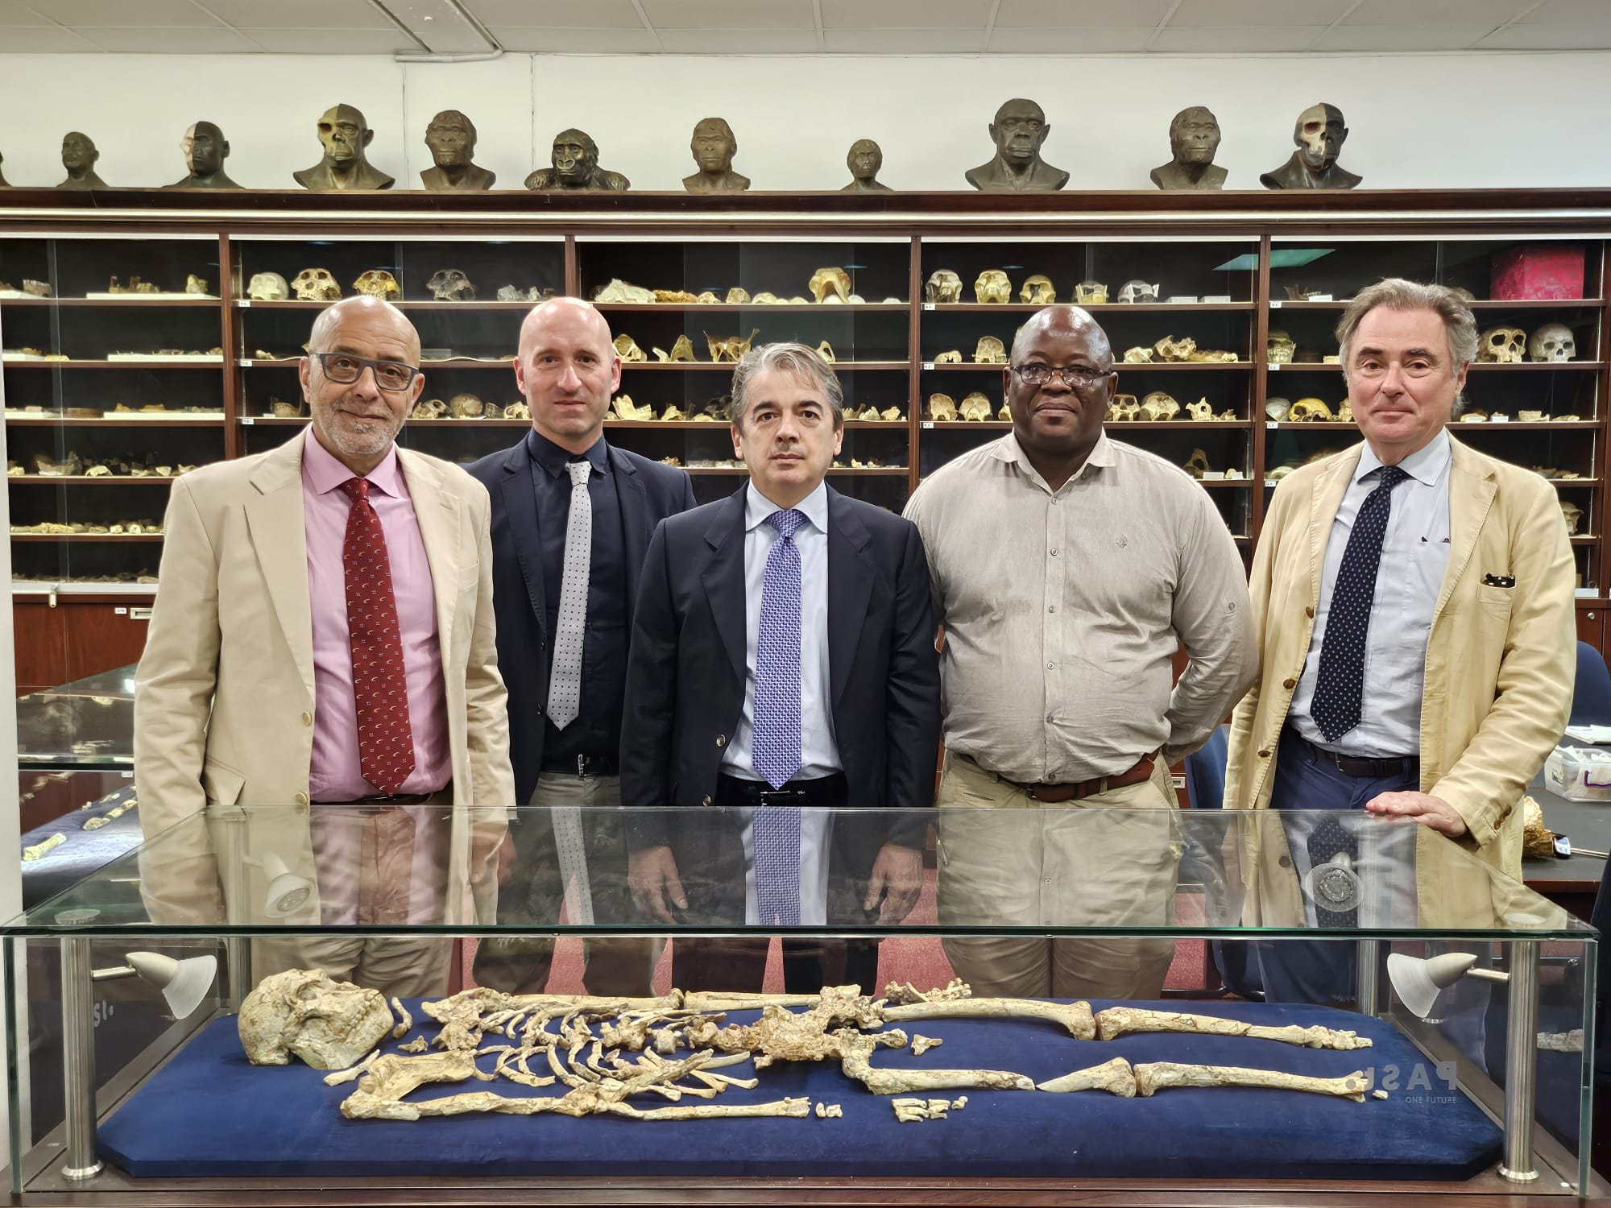
Present interested groups composition
INFN
Supported by the directors of Bologna, Firenze and LNL: E. Scapparone, G. Passaleva, F. Azaiez
Bologna
MB, B. Giacobbe, P. Grafstrom, S. Rabaglia, M. Sioli
Firenze
R. D’Alessandro, L. Bonechi, D. Borselli, C. Frosin
Big world experts in palaeontology, archaeology and anthropology express a strong interest to participate
Prof. Lee Berger (NG), Prof. John Hawks (Wisconsin Uni.), Prof. Tracy Kivell (MPI)
Regular meetings started since October 2023

Slide 14
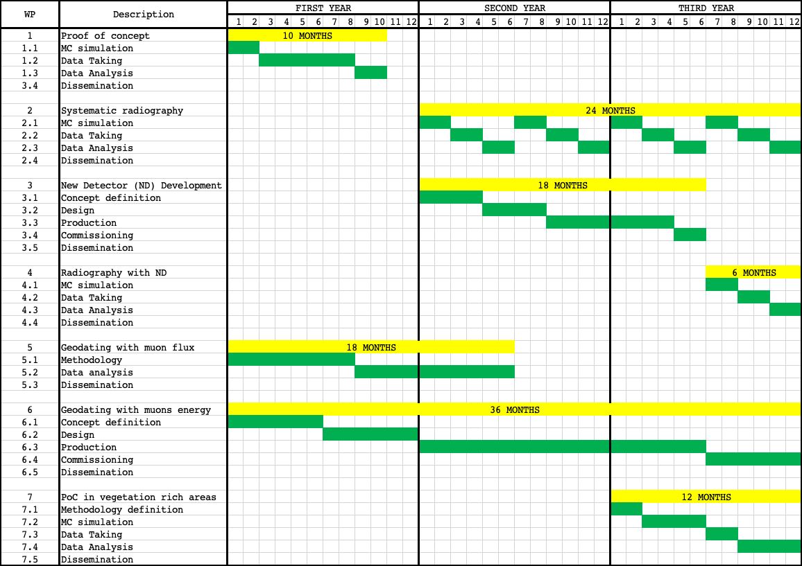
WP structure (3Y, Preliminary)

Slide 15
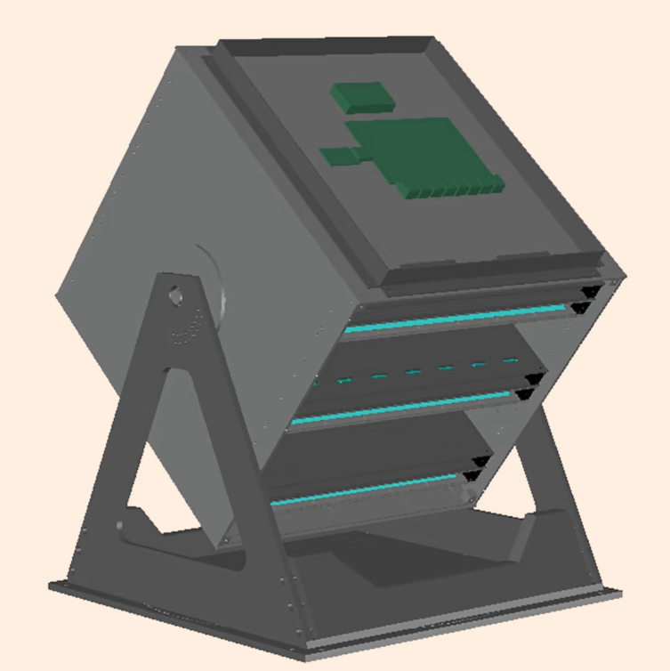
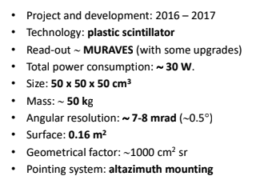
PoC funded by INFN-ENERGY
INFN in-kind
detector
Infrastructures (15k)
Detector adapting (5k)
In-situ (10k) Protective case, UPS, Cabling, Internet ....
Travel expenses (~20 k)
2 people for 2 weeks to start the activity ~ 10 k
2 people for 2 weeks to close the activity ~ 10 k
Detector transportation + Insurance (~10 k)
Dissemination (INFN): 5k
Total ~ 50 k
custom
Detector already available for shipment

Slide 16
Next steps
MoU
Lee R. Berger Foundation and National Geographic
Draft existing and submitted to INFN administration
ITHEMBA LABS
Understand whether the existing one should be updated
ERC
Synergy grant
Will be published on July 2024
Deadline November 2024

Slide 17
Useful links
A Google Doc Folder has been setup which contains the proposal plus other relevant documents
Regularly updated
https://drive.google.com/drive/folders/1aMP_zXJXw1S0-AaBuSJuKtYfldtC3-HQ

Slide 18
Backup

Slide 19
Collaboration INFN-ITHEMBA LABS
Since September 2022 there is an updated (after the 2013 one) and agreed MoU between INFN and ITHEMBA LABS
Joint research on new topics may be included in this collaboration program after mutual discussion and approval by both Parties, in line with the period of this MoU
The existence of this MoU will make easier the possibility collaboration between the two groups
possibility to have a space where to store and test the detector before the measurement starts
This project gives a great opportunity to start a fruitful collaboration between the two parts
The part concerning the geodating using muons is most likely the most promising

Slide 20
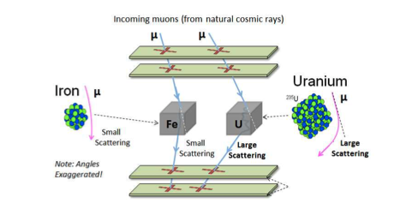
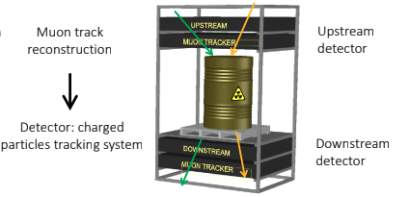
Muon Scattering Tomography
Introduction to MST:
Developed in 2003, Muon Scattering Tomography (MST) is a relatively recent technique compared to muography, offering high-precision imaging by exploiting Coulomb scattering of muons.
Utilized in fields requiring the distinction between high-Z (atomic number) and low-Z materials, such as cargo scanning for nuclear material prevention and interrogation of nuclear waste casks.
Working Principle:
MST is based on the interaction of muons with nuclei. As muons pass close to a nucleus, they experience significant electromagnetic interaction, a concept known for over a century since the experiments of Geiger, Marsden, and Rutherford.
The strength of this interaction varies with the electric charge of the nucleus, making it possible to distinguish between different materials based on the root-mean-square deflection of muons.
Applications and Advantages:
MST's intrinsic ability to discriminate materials by atomic number makes it invaluable for nuclear waste characterization, security, and material control.
Used in the development of 'muon portals' for cargo scanning and nuclear waste interrogation, enhancing safety and security in crucial sectors.

Slide 21
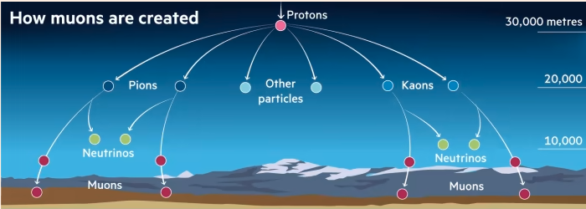
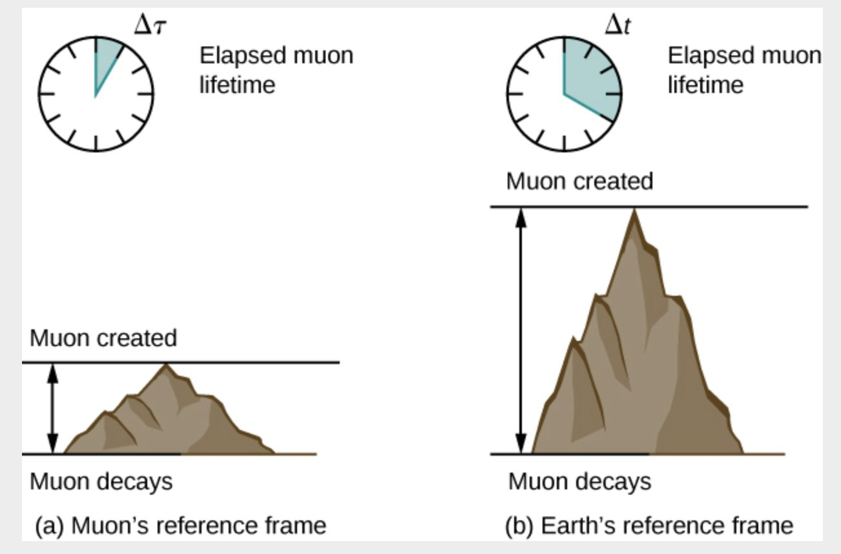
What are muons?
Muons: The Cosmic Messengers
Muons are subatomic particles similar to electrons but heavier.
Originating from cosmic rays that constantly bombard Earth from space.
Penetrating Power
Muons can penetrate through materials like rock, metal, and other dense substances.
Their ability to pass through objects makes them useful for imaging.
Remarkable Lifetime
Despite being unstable, muons have a relatively long lifetime (2.2 microseconds) at rest, allowing them to reach the Earth's surface from the upper atmosphere.
Their longevity at high speed enable them to travel significant distances (even kilometers!) before decaying, making them excellent probes for imaging.

Slide 24
