Slide 1


MIZAR ASIC
A. Di Salvo, S. Garbolino, M. Mignone, S. Zugravel,
A. Rivetti, M. E. Bertaina, Antonio Palmieri
(INFN-TO, UNITO, POLITO)
November 11th 2023 34th JEM-EUSO Collaboration Meeting

Slide 2
Take home message
MIZAR = Multi-channel Integrated Zone-sampling Analogue-memory based Readout
MIZAR ASIC in in the final design state
An order has been placed for production of 200 pieces (150 for PBR and 50 for Terzina) through CERN on 65 nm technology TSMC
Production run expected for February 2024
Delivery expected in 12 weeks (May 2024)
June and July 2024 devoted to chip characterization and verification of the requirements at INFN Torino, then distributed to the collaboration.
A second run will be precautionally booked for August 2024 in case of needed fine tuning.

Slide 3
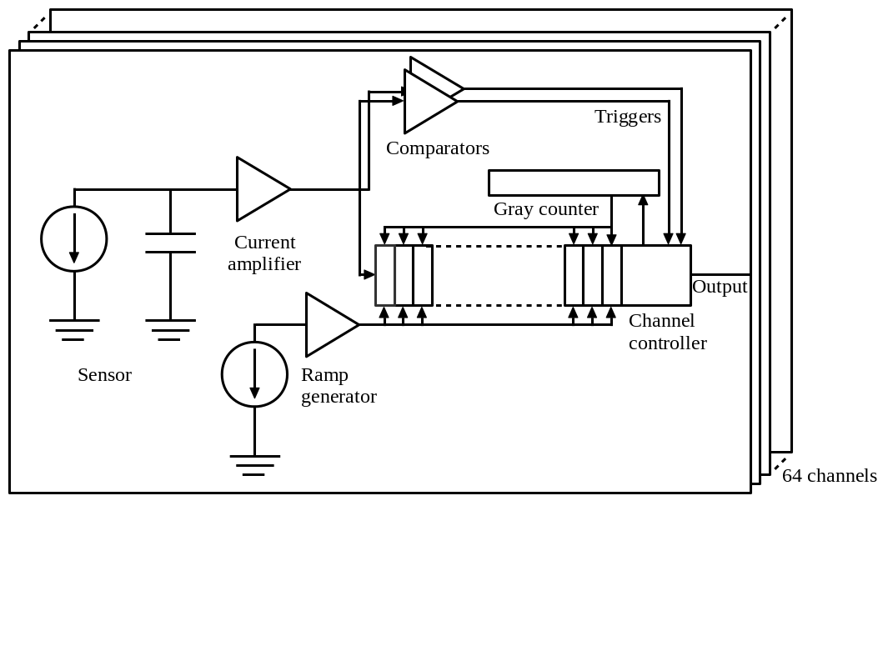
Design
● Detection of Extensive Air Showers.
● 64-channel ASIC implemented in a
commercial 65 nm CMOS technology.
● High level of configurability
● Segmentation:
- 32 cells (160 ns)
- 64 cells (320 ns)
- 256 cells (1.28 us)
● 400 MHz clock used at half rate for sampling and digitization (5 ns)
● Resolution:
8 - 12 bits
● Trigger:
- Internally generated
- Externally provided
● Mode:
- Imaging (hitmap)
Power target : <10 mW/ch

Slide 4
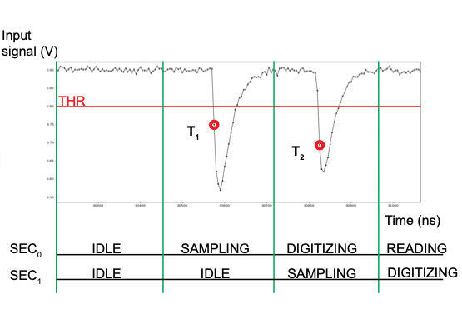
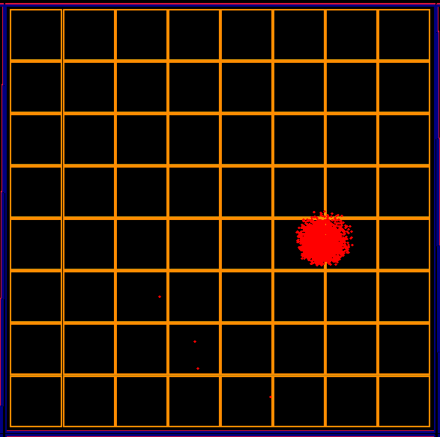
Low and High thresholds available and generation of Hit Maps
0 | 0 | 0 | 0 | 0 | 0 | 0 | 0
0 | 0 | 0 | 0 | 0 | 0 | 0 | 0
0 | 0 | 0 | 0 | 0 | 0 | 0 | 0
0 | 0 | 0 | 0 | 0 | 0 | 0 | 0
0 | 0 | 0 | 0 | 0 | 1 | 1 | 0
0 | 0 | 0 | 0 | 0 | 0 | 0 | 0
0 | 0 | 0 | 0 | 0 | 0 | 0 | 0
0 | 0 | 0 | 0 | 0 | 0 | 0 | 0
Every 20 ns
Low threshold > 5 - 7 phe
High threshold > 10 – 15 phe
Example of expected EAS (no bifocality)

Slide 5
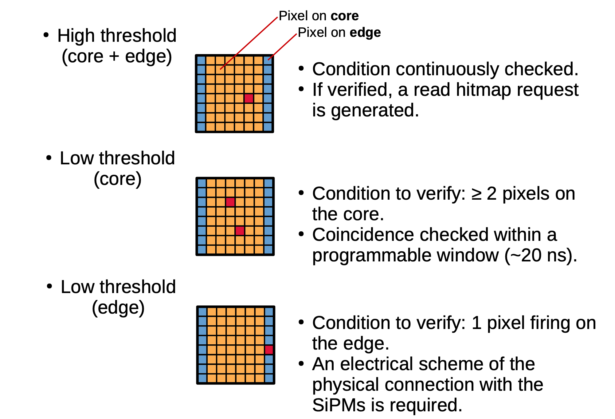
Hitmap Logic

Slide 6
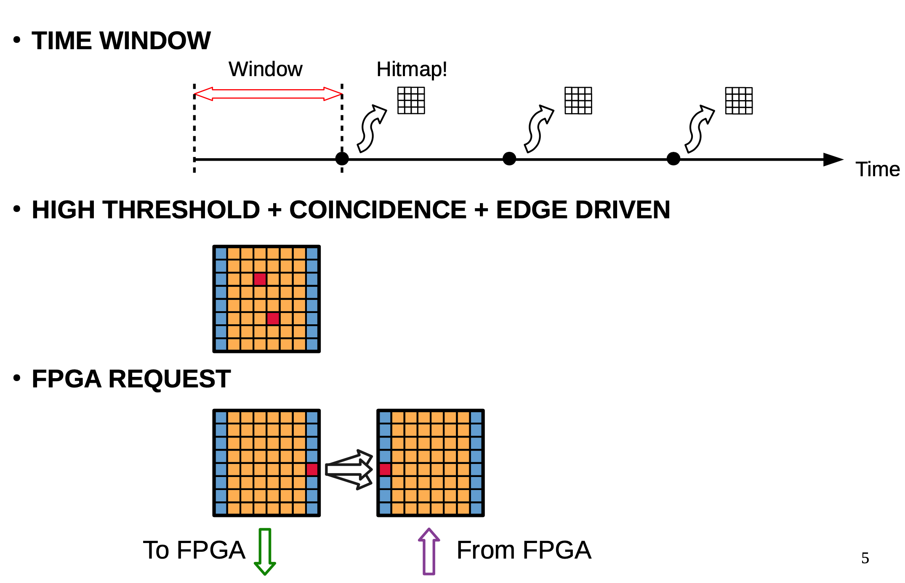
Hitmap Logic

Slide 7
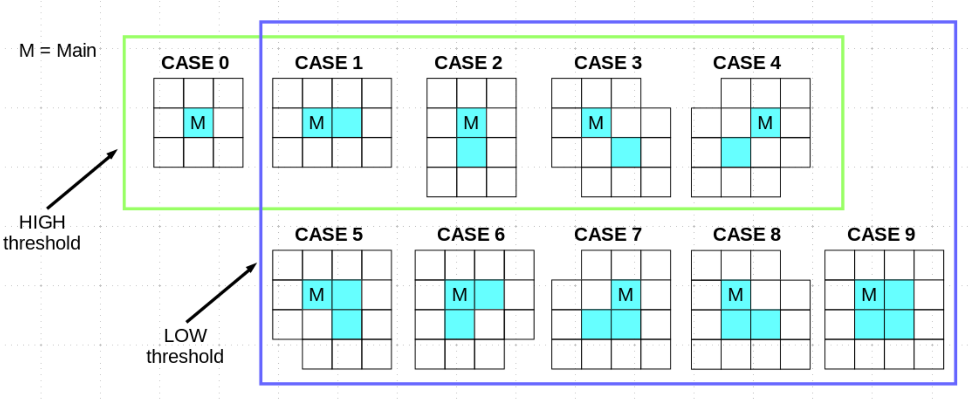
Trigger conditions for Terzina on FPGA (handled in ~150 ns)

Slide 8
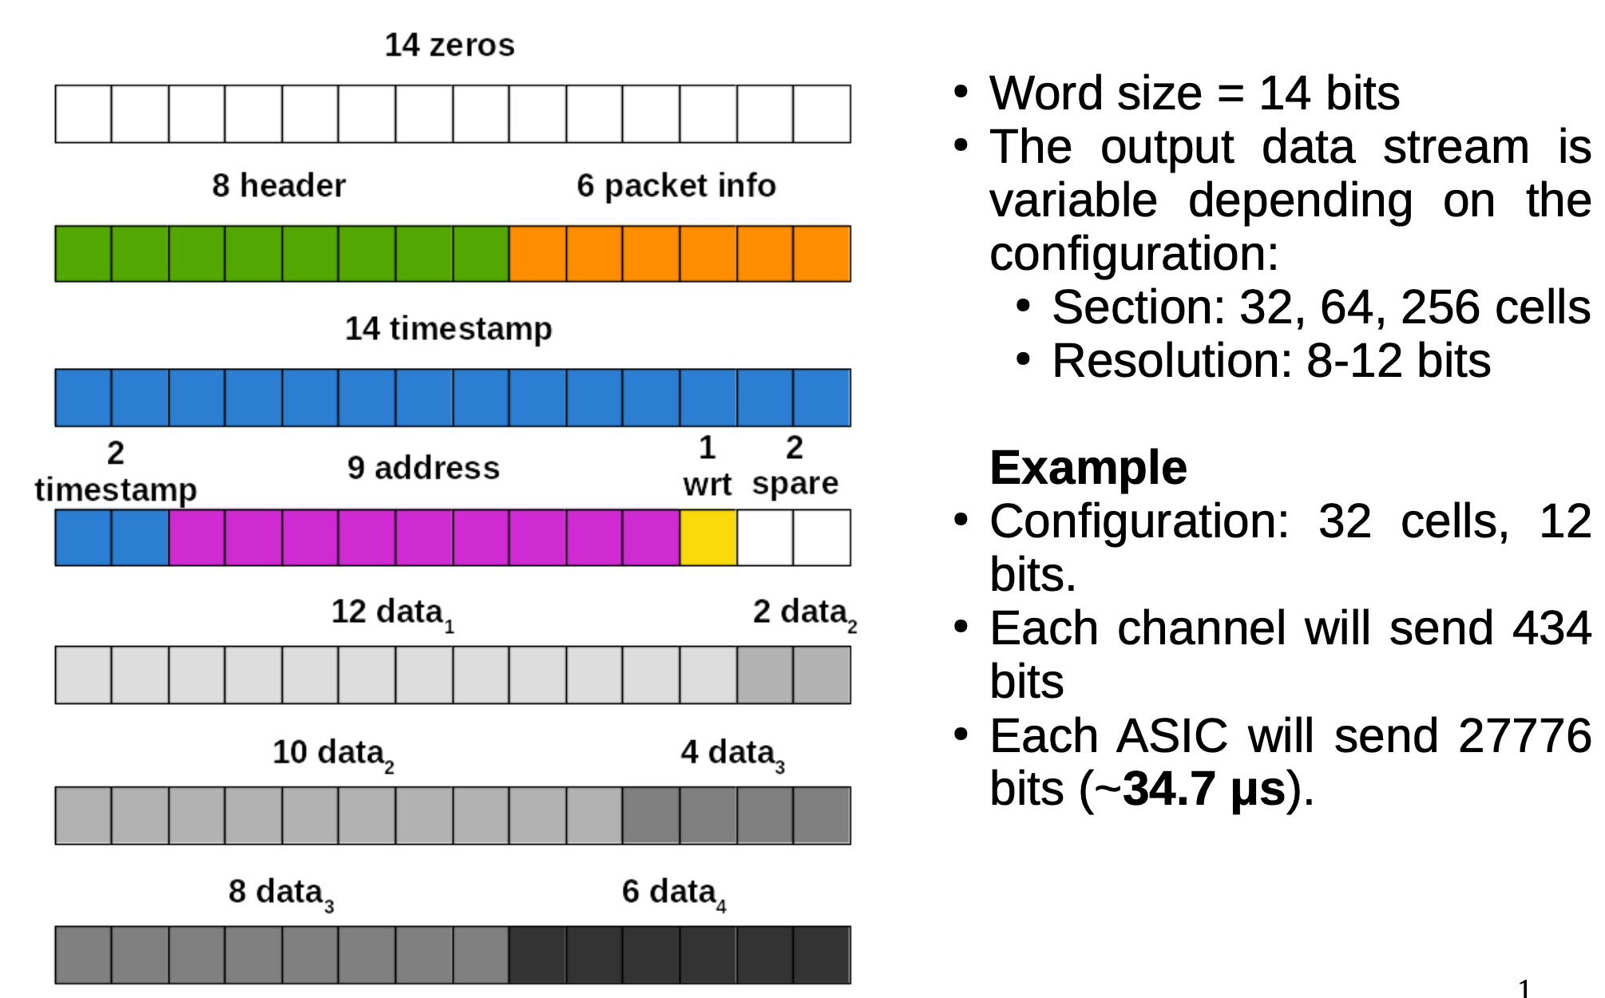
Serial Bus
The system works in Double Data Rate

Slide 9
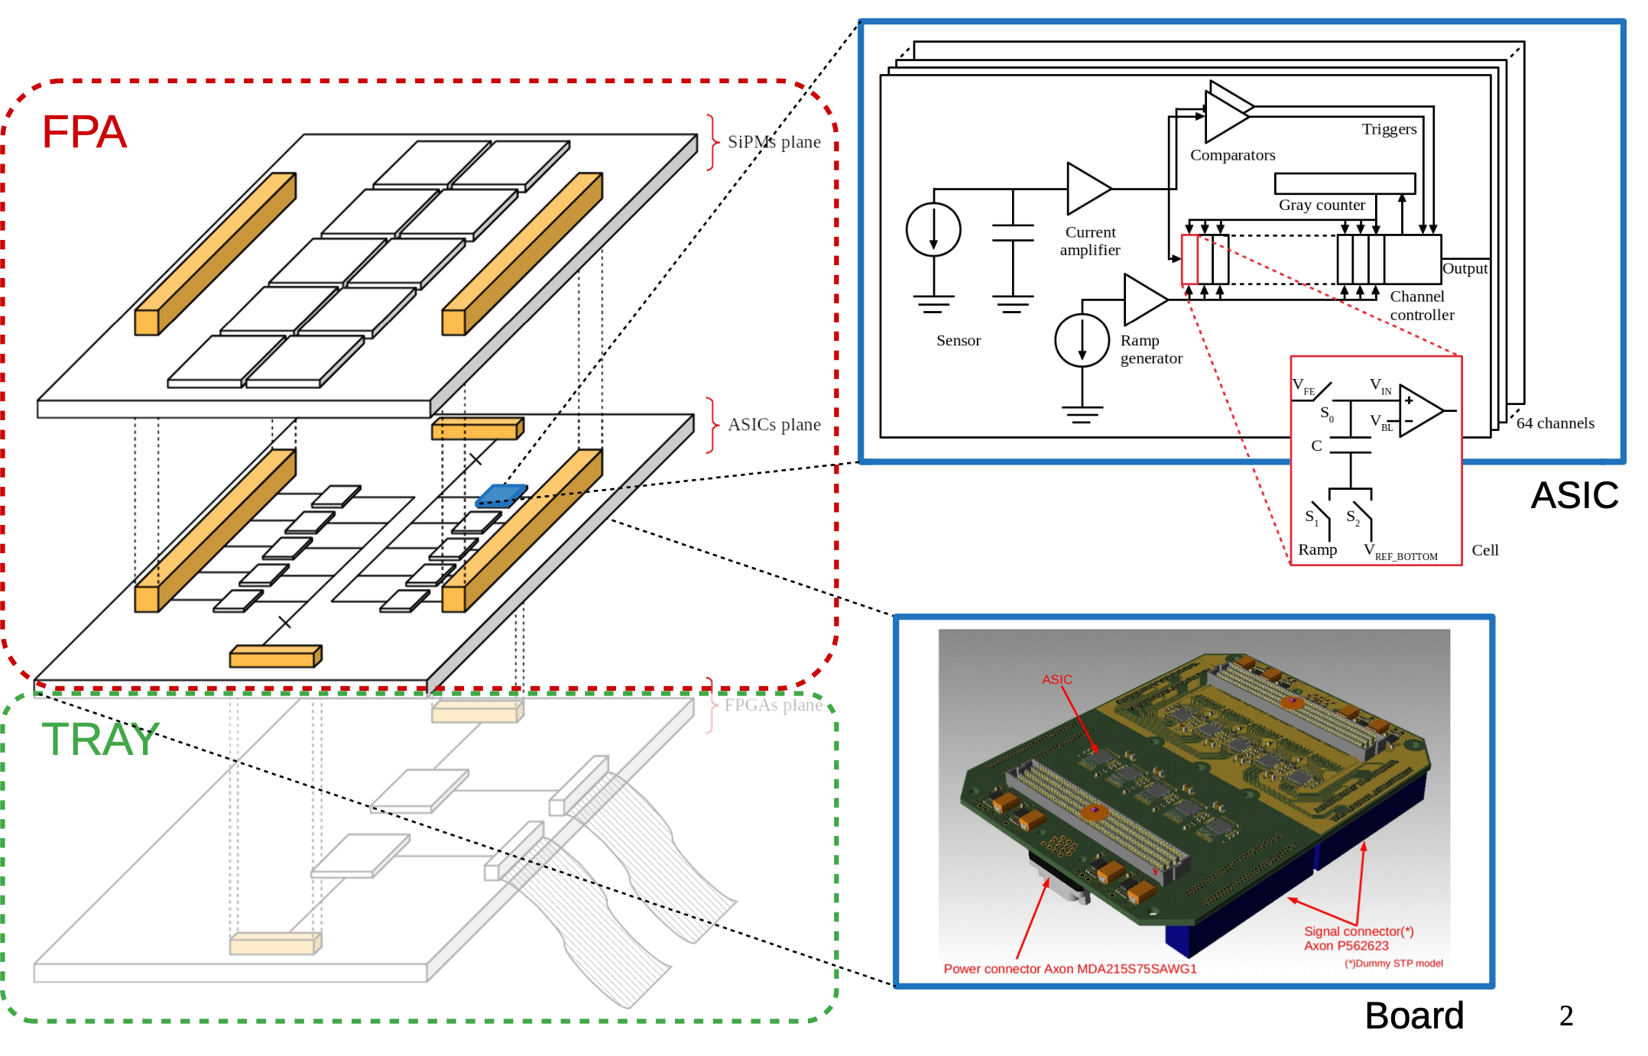
Camera and ASIC architecture
SiPM Plane
ASIC Plane
FPGA Plane

Slide 10
THANK YOU

