Slide 1
X, Gamma and charged particles
for
PBR
20/12/2023
F. Bisconti, M. Casolino, C. DeSantis,
Marcelli, L. Marcelli,
Z. Plebaniak, E. Reali

Slide 2
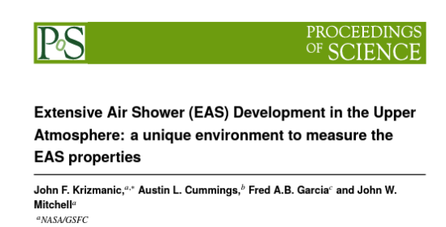
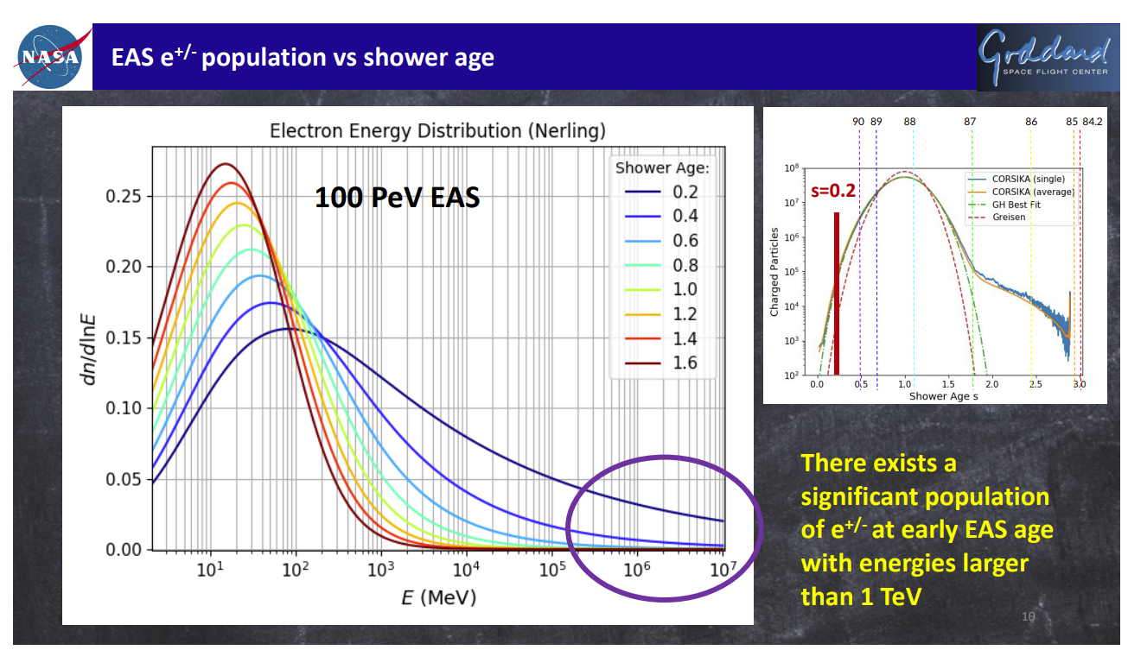
From JFK

Slide 3
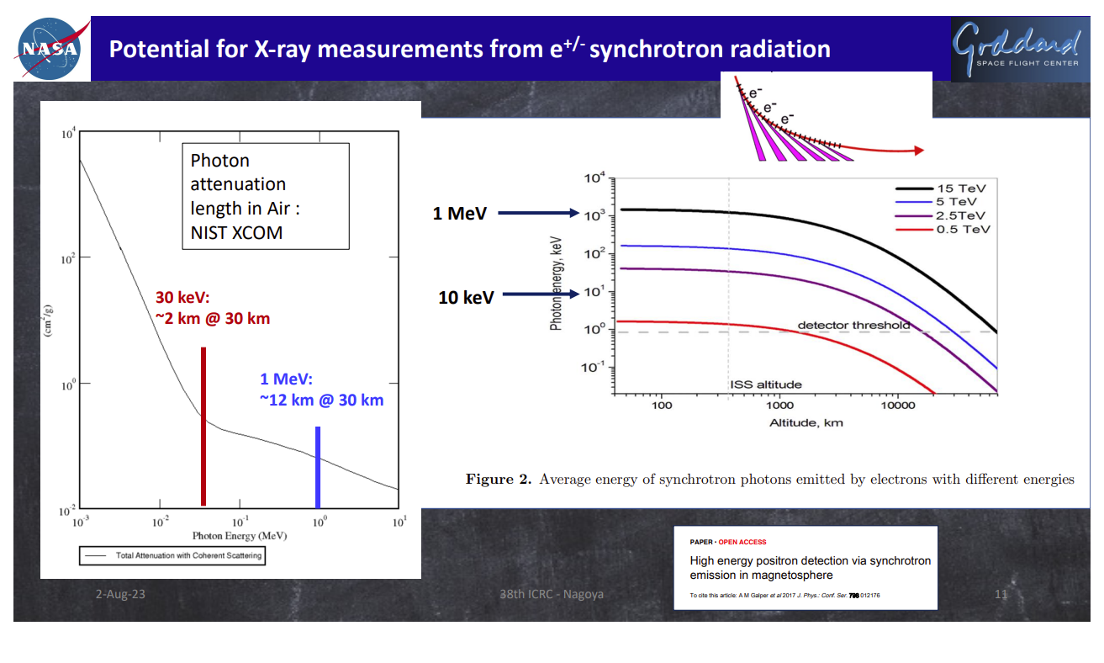
From JFK

Slide 4
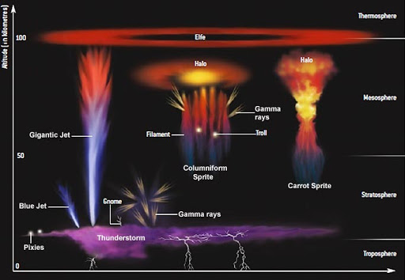
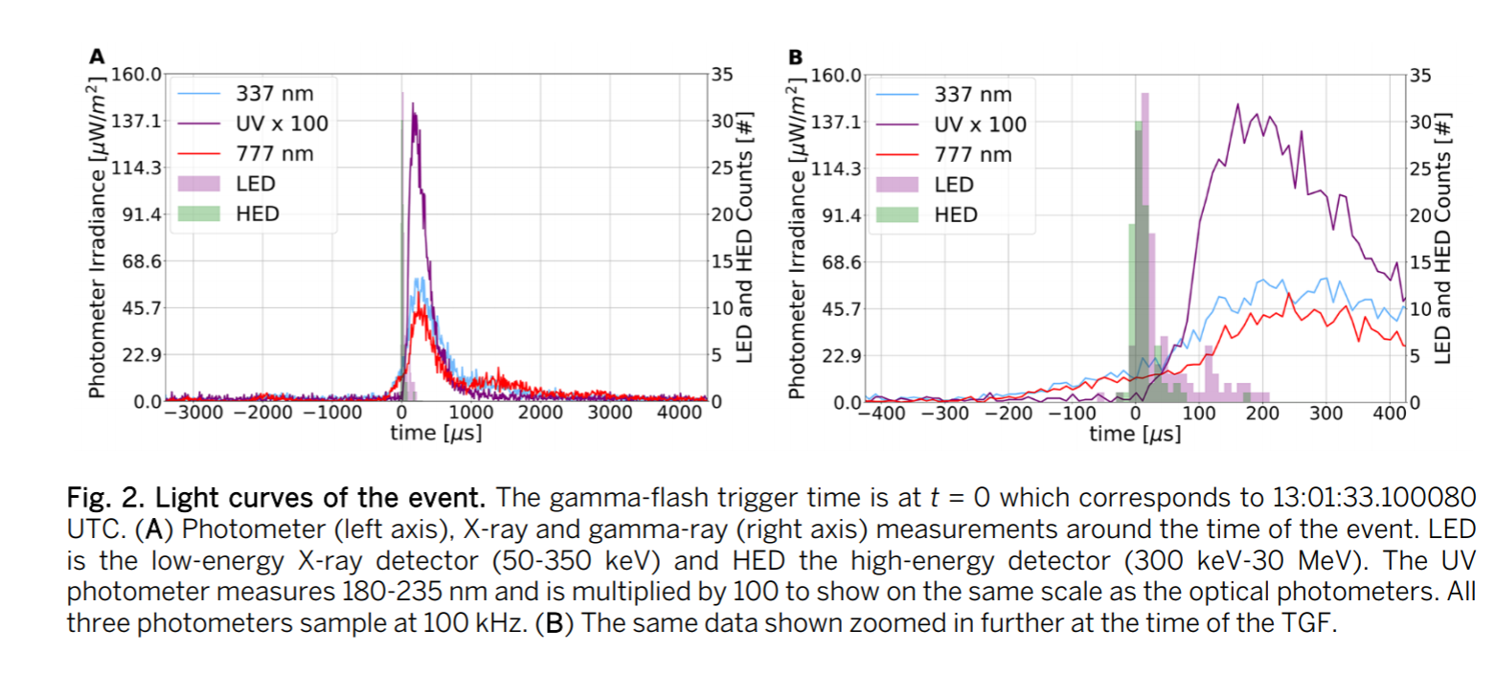
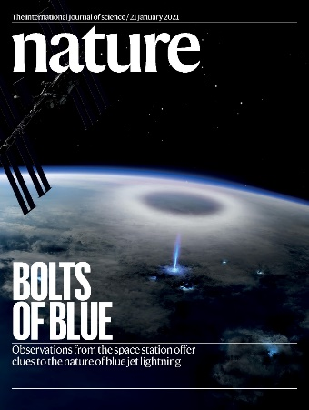
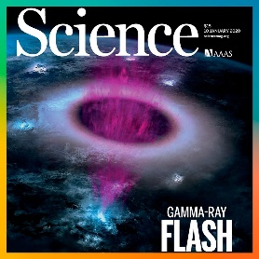
TGF, TLEs (elves)
ELVES toward the limb
ToO events, GRB, Cherenkov
Charged particles

Slide 5
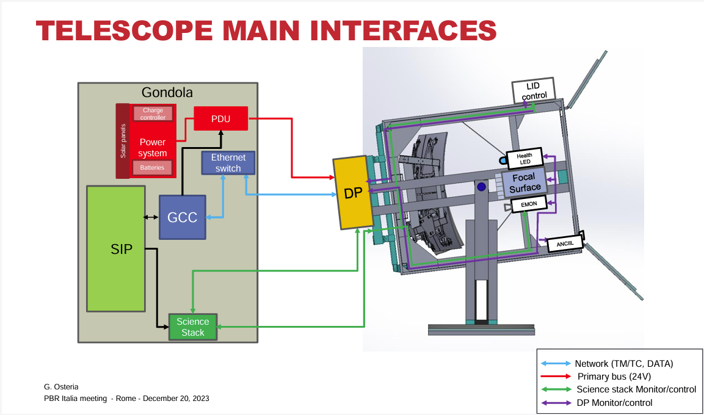
x/γ

Slide 6
E. Parizot, 16/6/2023
SBP3:
Goal:
2026
Fluorescence camera
+ Cherenkov camera
Same telescope
Tiltable, from 0°to 90°
Fluorescence: CR showers (nadir+inclined) + High-altitude CRs showers (tilted)
Cherenkov: CRs + neutrinos (tilted)
[+ anitons (nadir)]
Optics: same design, maybe larger + bifocal only for CT to be studied
A lot of simulations needed to figure out what can really be seen + the optimum pointing strategy
Auxiliary devices: IR, Radio, gamma-ray, X-ray, SQM
The future is bright!

Slide 7

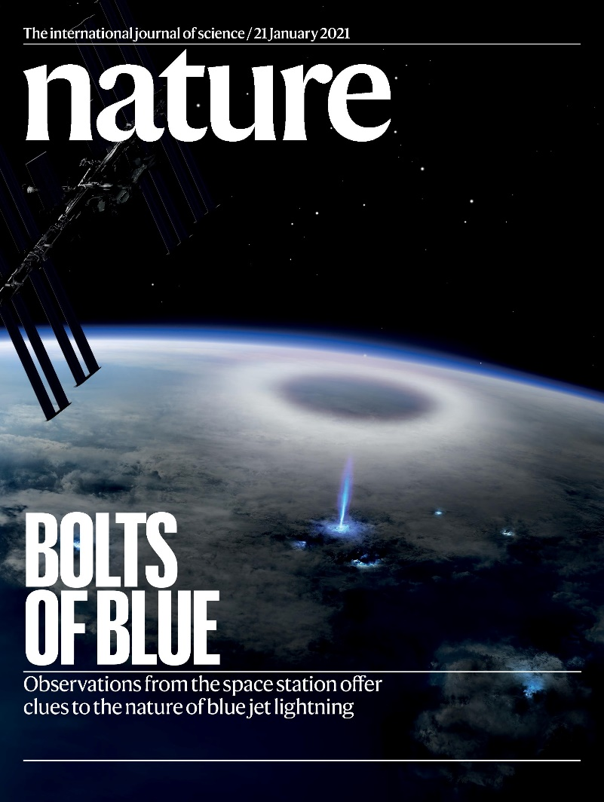
ASIM observations

Slide 8
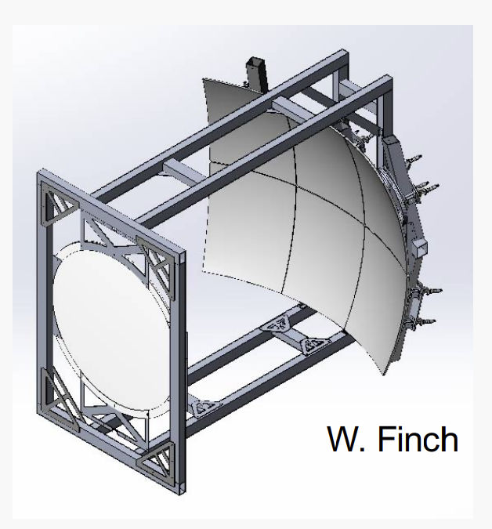
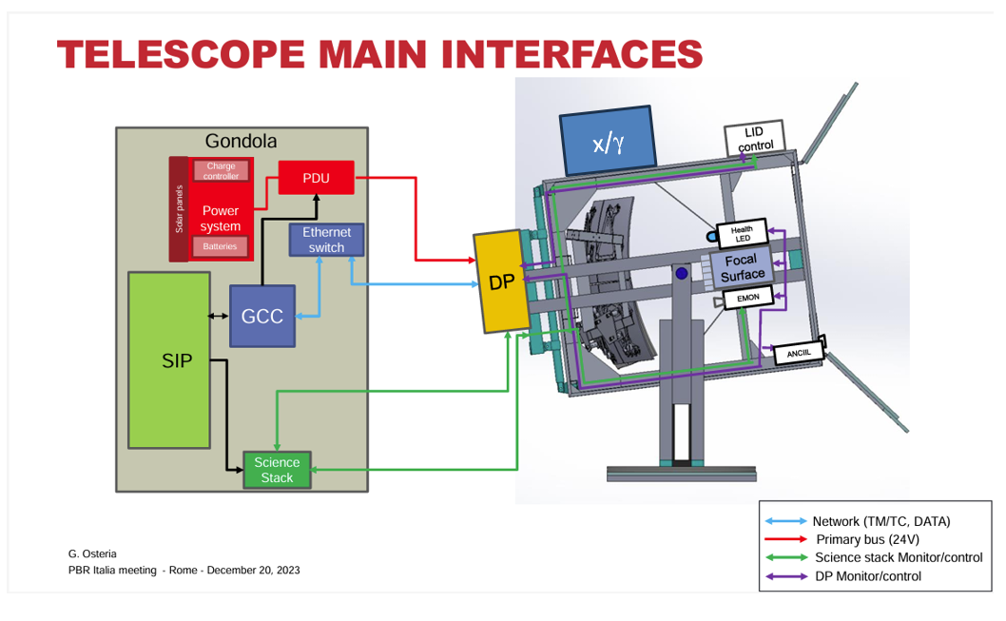
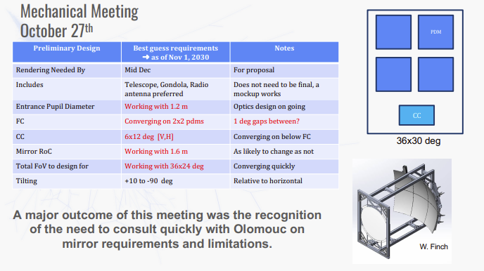
Tentative location
30kg (can be reduced)

Slide 9
Block Scheme
Low energy
/
Berillium cap
γ
low
γ
high
2cm diam
e- p
X
10 cm
Detectors
γ
e-p
e-p
e-p
Logic (AC, trigg)
10 cm *10 cm
Front-end
Mechanics
Front-end
Heater
20 cm
γ
Detectors
Data handling
Anticoincidence
Shielding
Interfaces
Front-end
Electronics

Slide 10
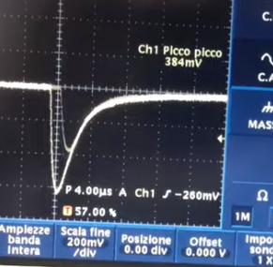
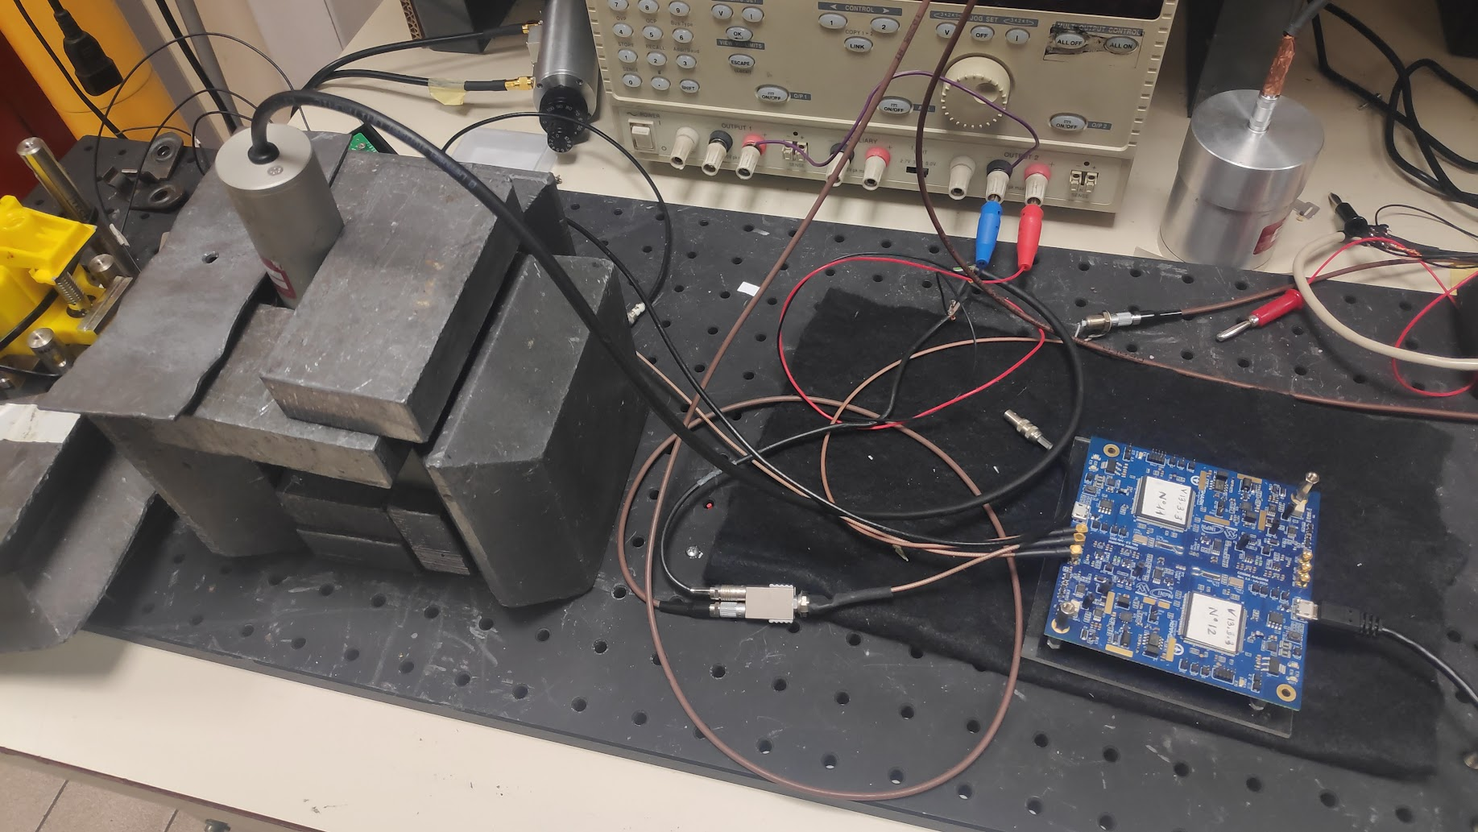
660 keV Cs137 Fukushima soil
Cosmo Ardui SiPM

Slide 11
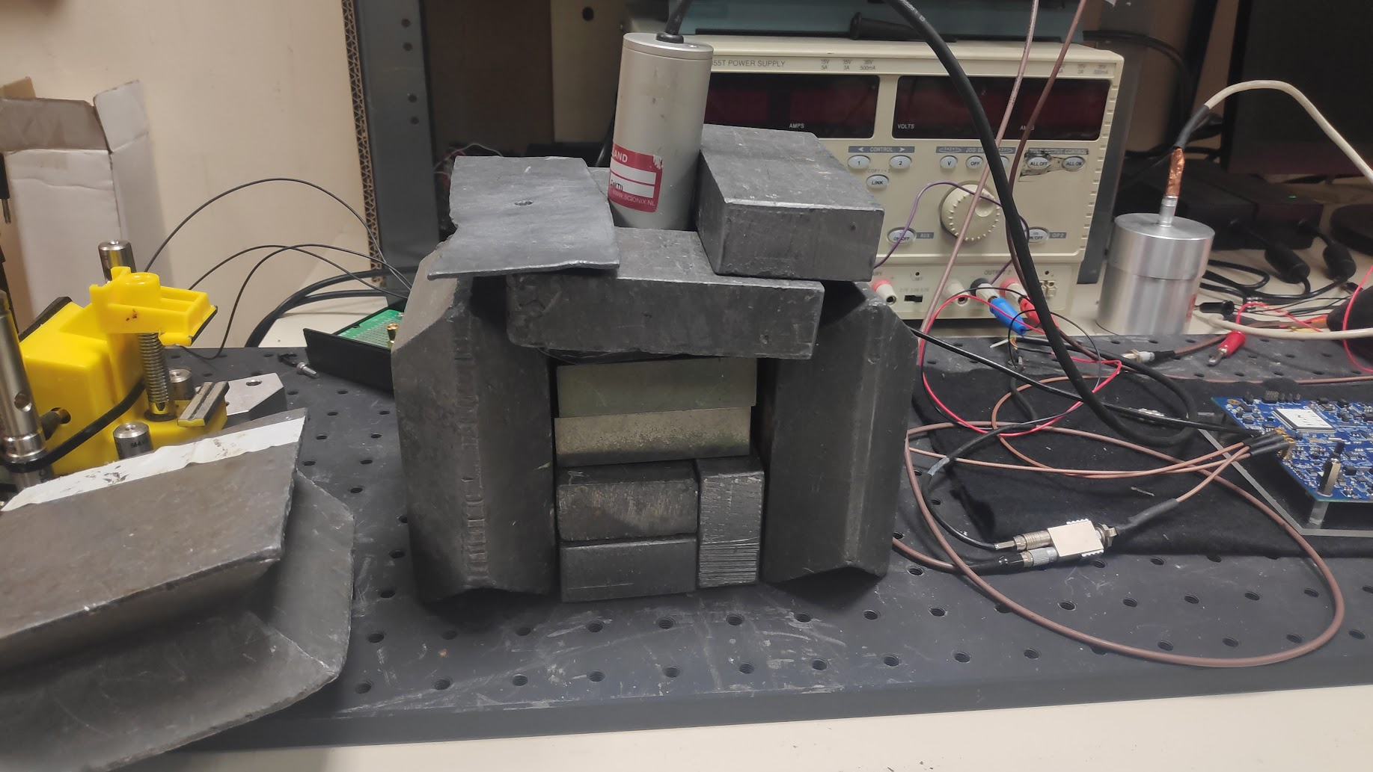

Slide 12
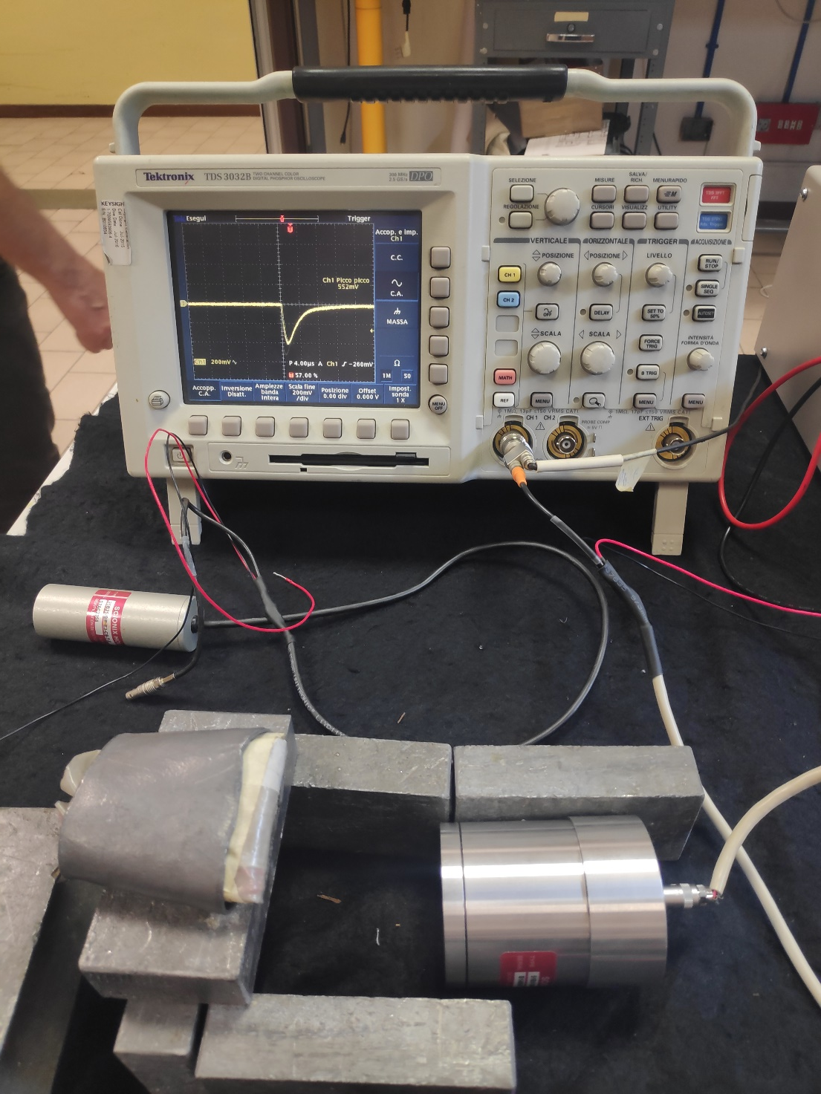
660 keV Cs137 Fukushima soil
Analog readout / shaper sample/hold

Slide 13
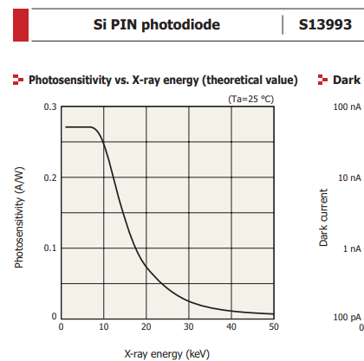
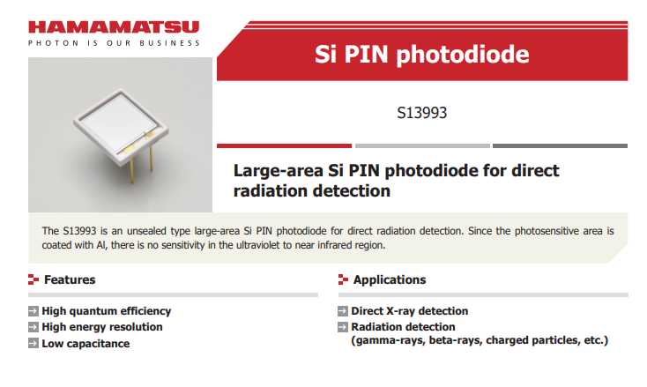
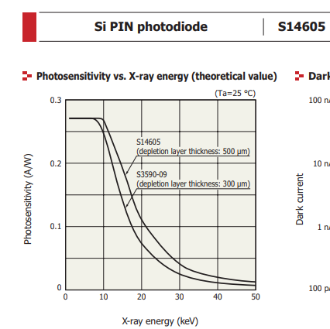
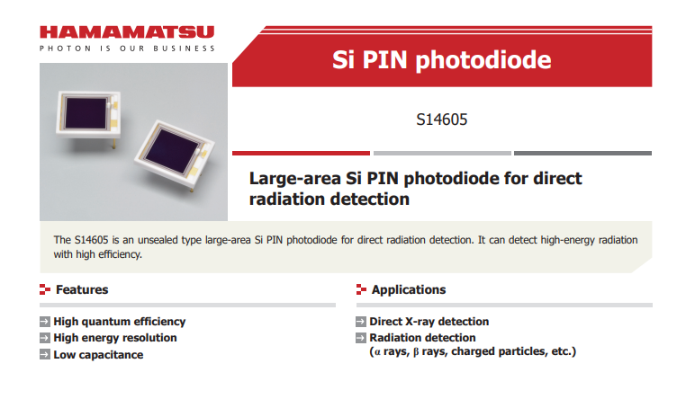
X-ray (in direct counting mode) E<10keV
Pin probably need high radiation
SiPM with crystal

Slide 14
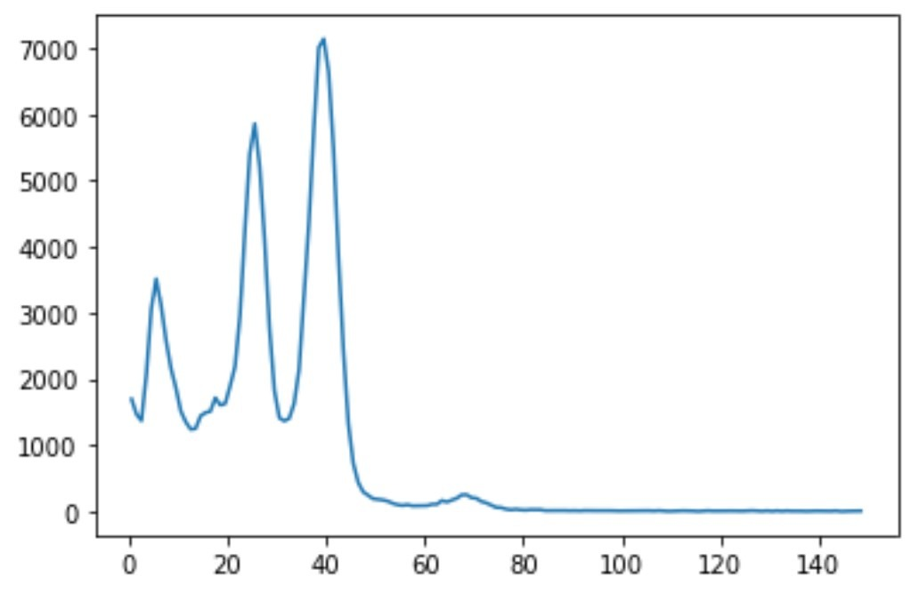
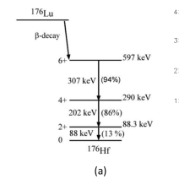
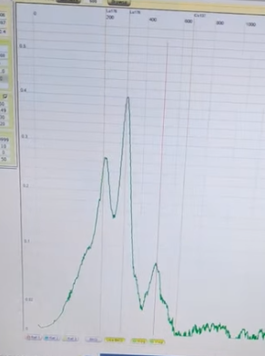
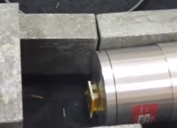
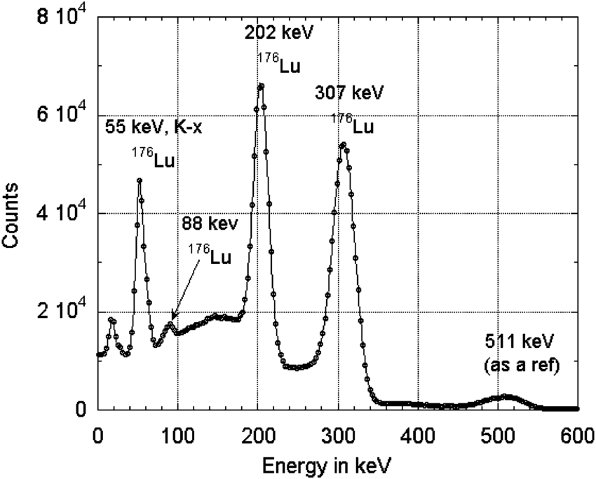
Lutetium 176 in Lyso

Slide 15
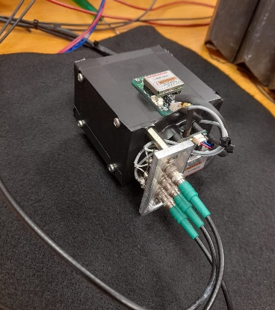
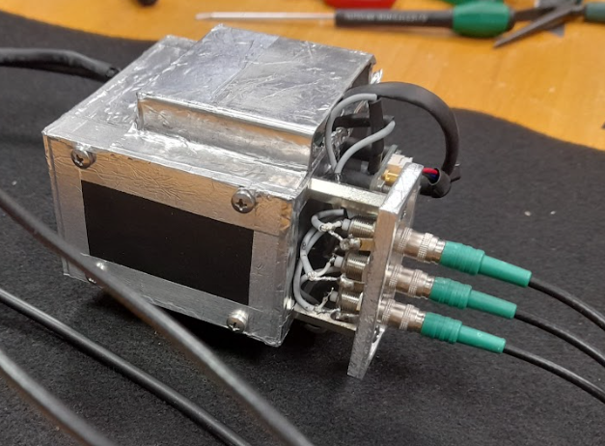
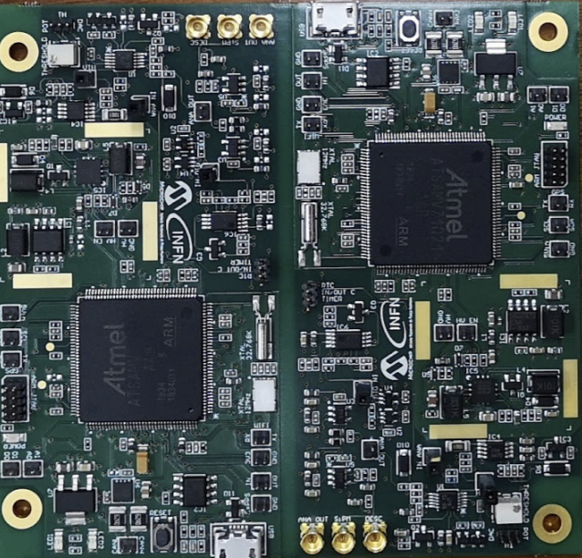
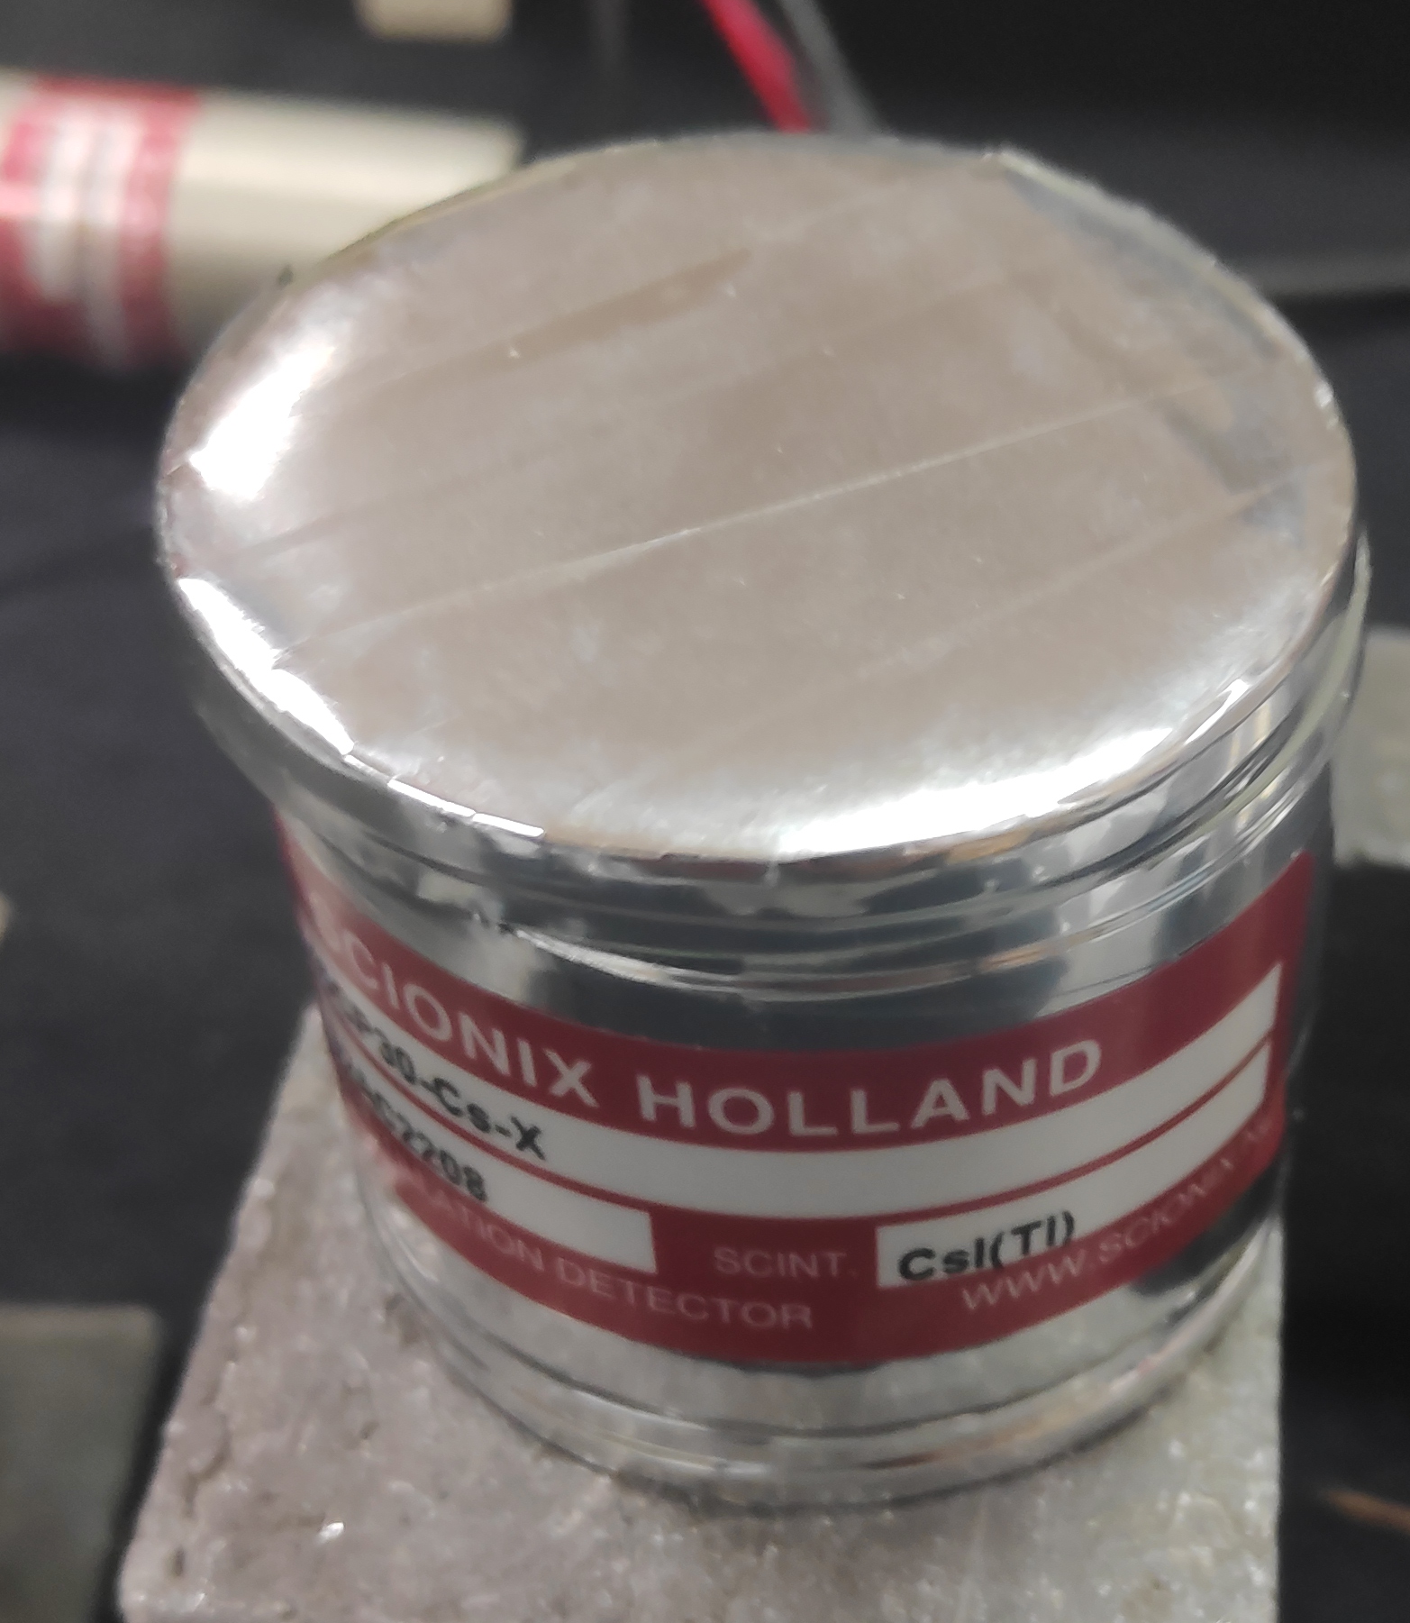
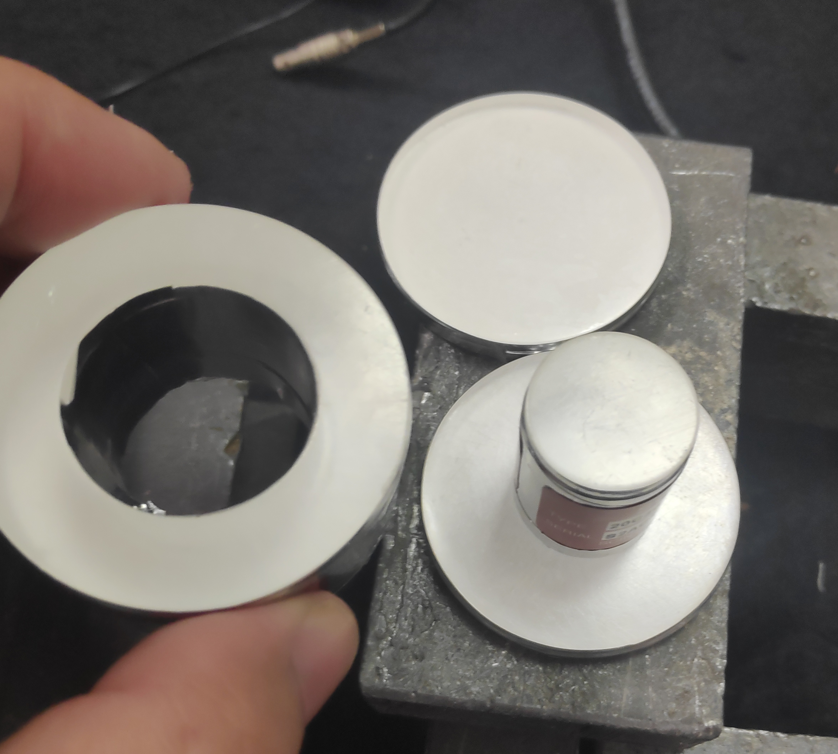
Gamma Spectrometer with anticoincidence <
CsI scintillator
SiPM
Anticoincidence
(CsI Cristal → plastic)
Analogic sum
Shaper
Sample and hold
Threshold
Reset

Slide 16
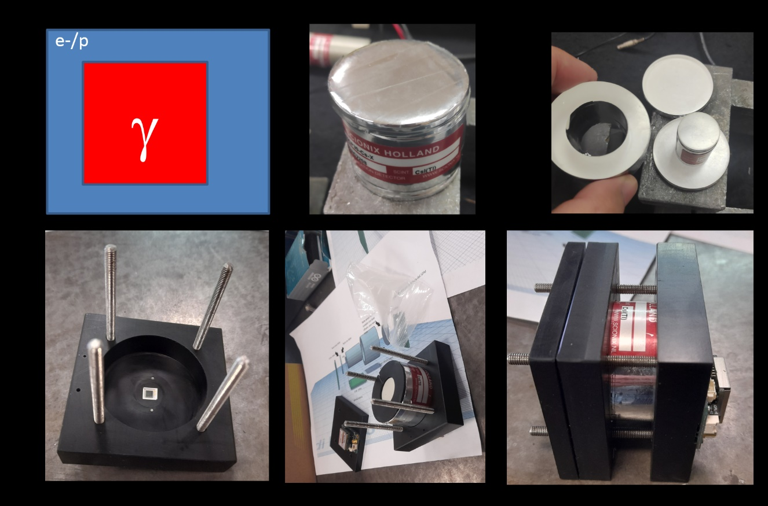
Anticoincidence system test

Slide 17
Gamma Spectrometer with anticoincidence
ASI / INFN funding
WP 4100 Aggiornamento su stato rivelatori gamma/X
26 degrees
e-/p
γ
Anticoincidence
Detector
Shielding, Lead (W)

Slide 18
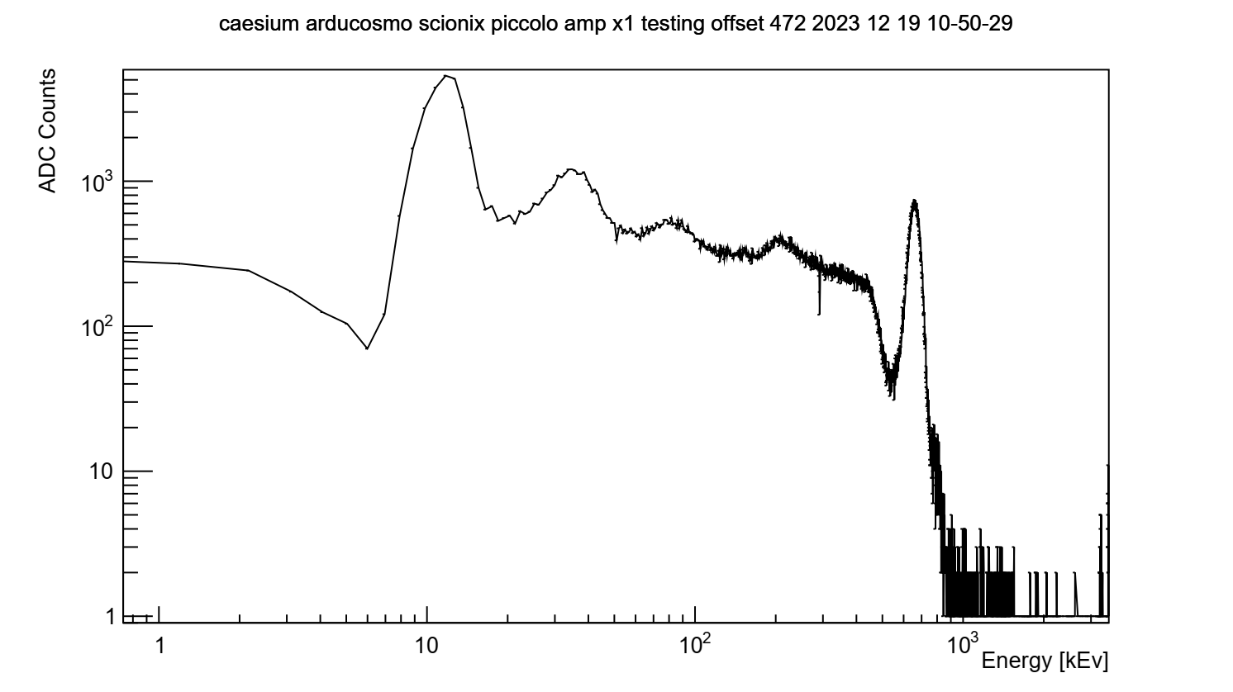
Spectrum of Cs137
30 keV
K shell
Compton
edge in CSI
E
660keV
Cs137-> Ba disex
80 keV
Piedistalli
Elettronica
280 keV
180 deg
Compton in Pb

Slide 19
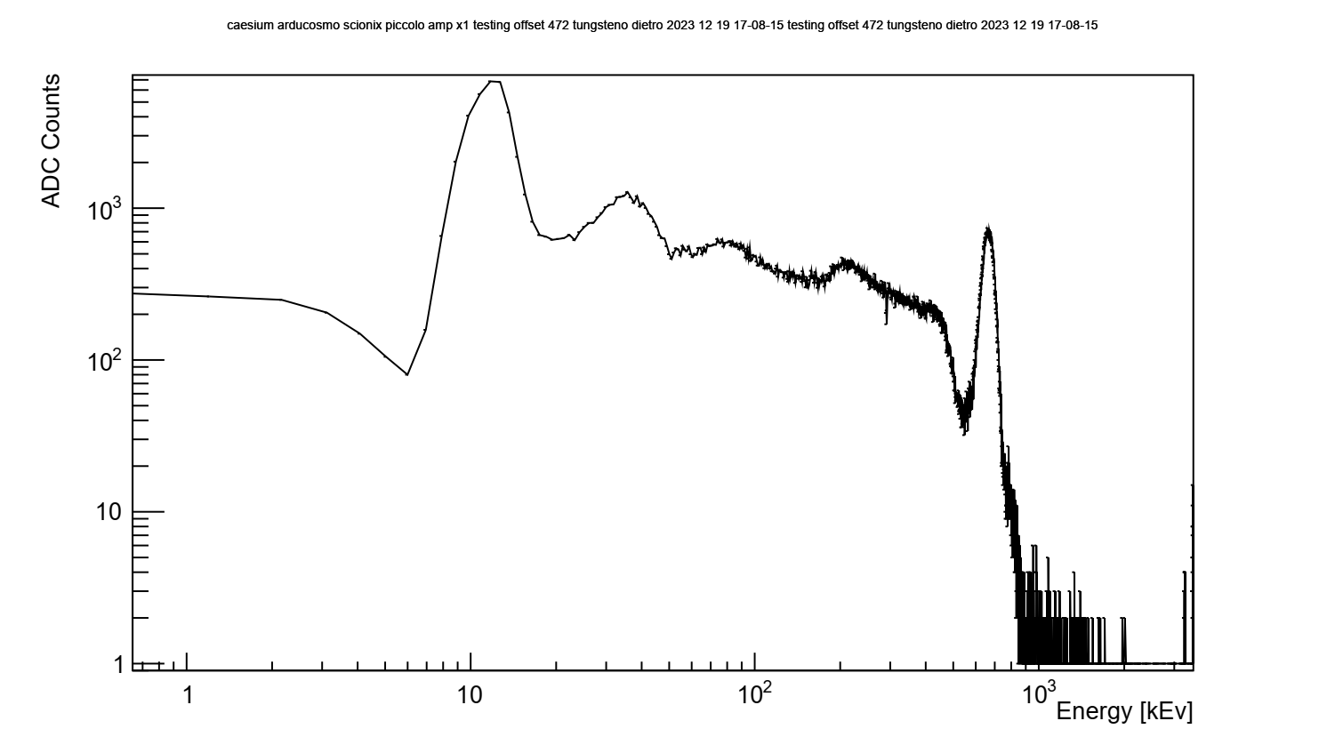

Slide 20
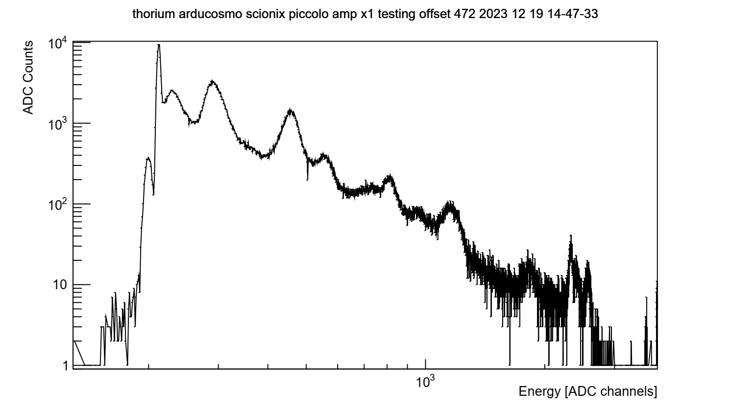
Calibration (Thorium chain)

Slide 21
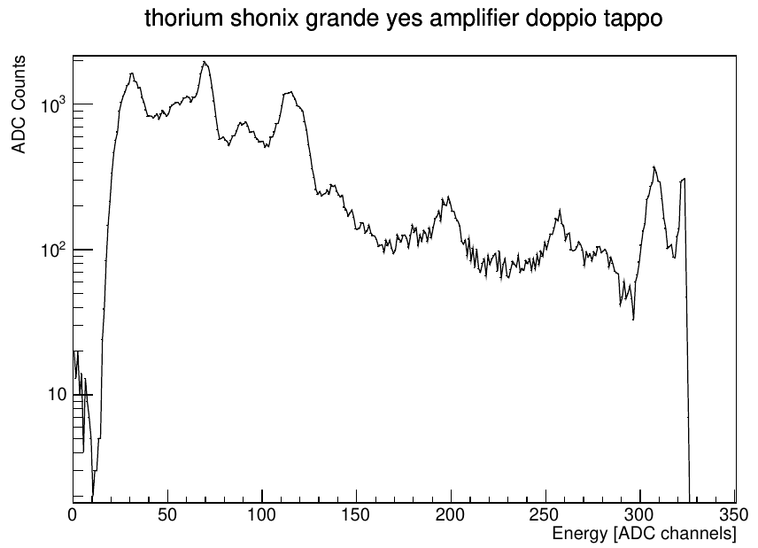
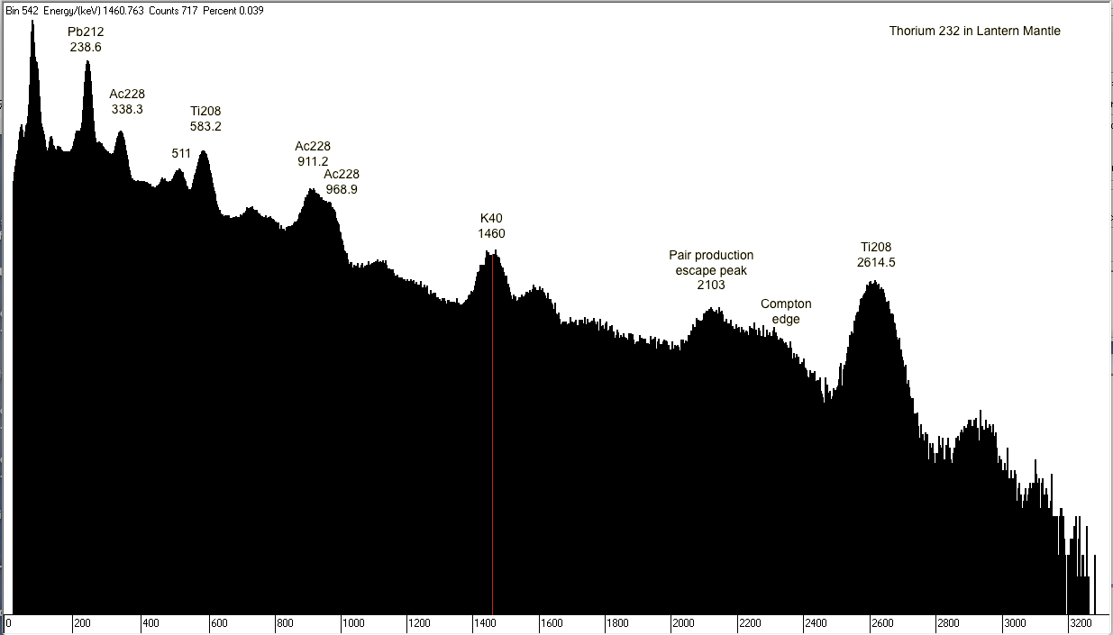
Calibration (Thorium chain)
Source: https://gammaspectacular.com/blue/th232-spectrum

Slide 22
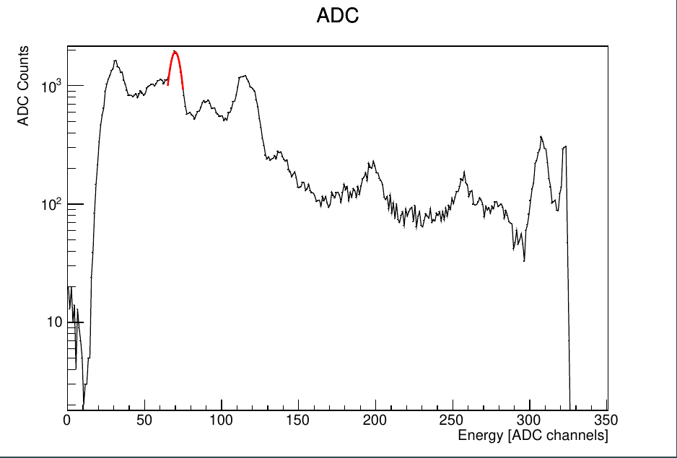
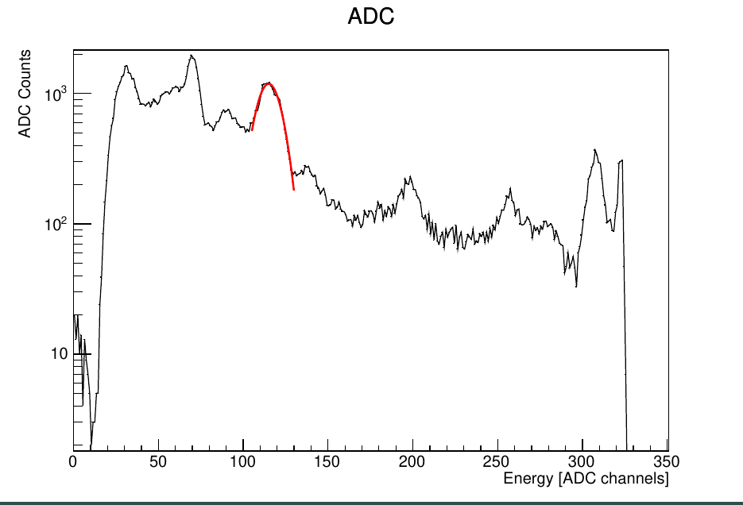
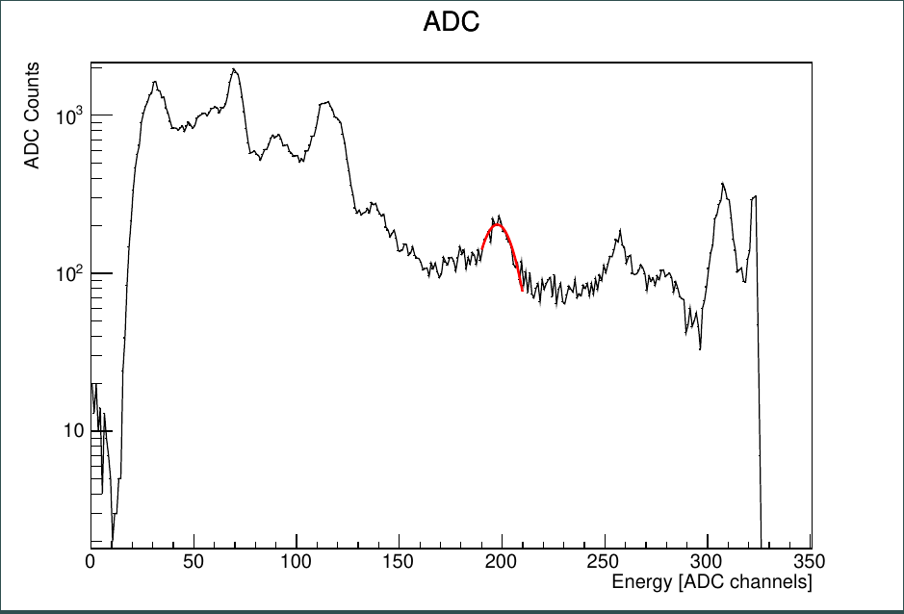
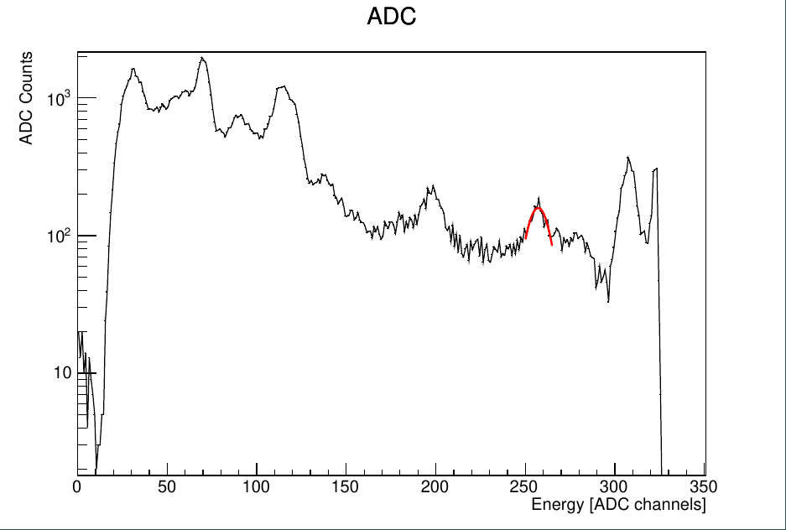
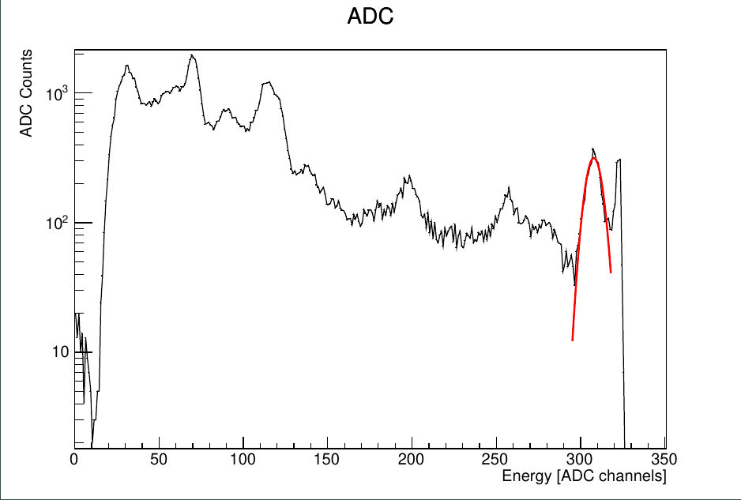
Gauss fit on the peaks – Scionix grande
Fit Peaks | Sigma
69.87456169756804 | -4.214187206155576
115.01183613902653 | -7.654448832653876
197.61497127812933 | 8.78995153215158
257.1479126267751 | 6.909449043175105
307.8117173442213 | 4.976473158076842

Slide 23
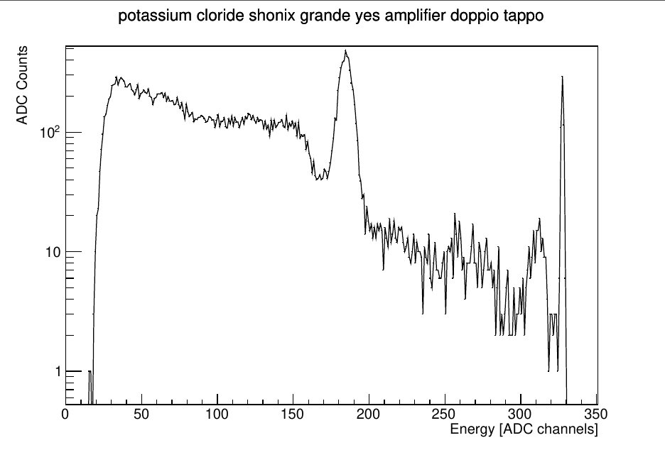
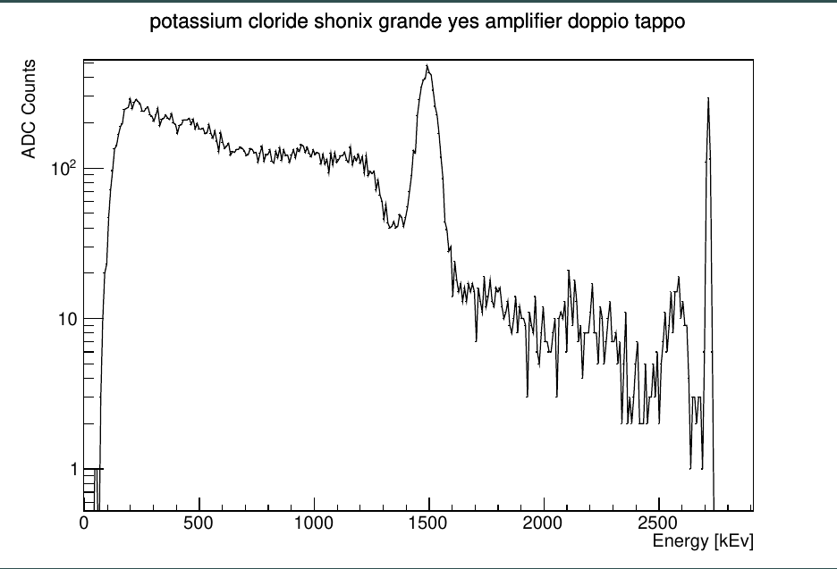
40K - KCl
Converting from ADC to kEv using the calibration we get a value near 1461 kEv
Source: https://en.wikipedia.org/wiki/Potassium_chloride

Slide 24
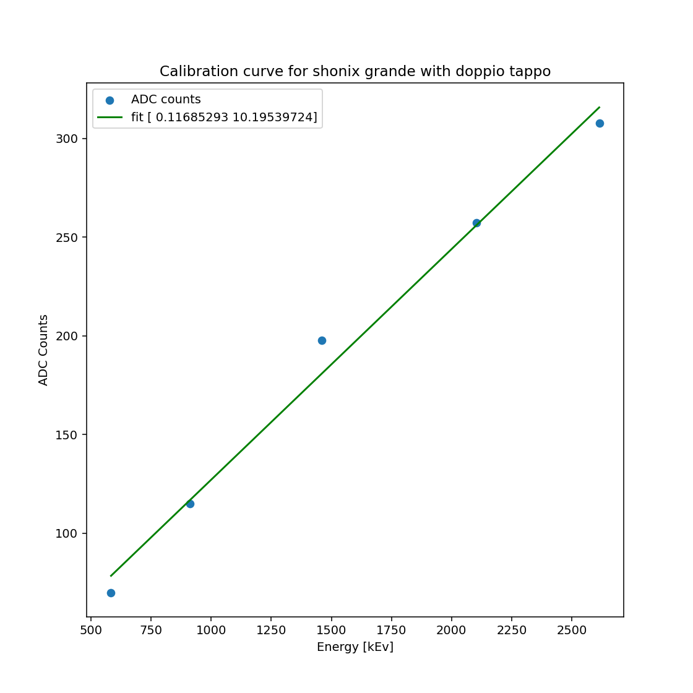
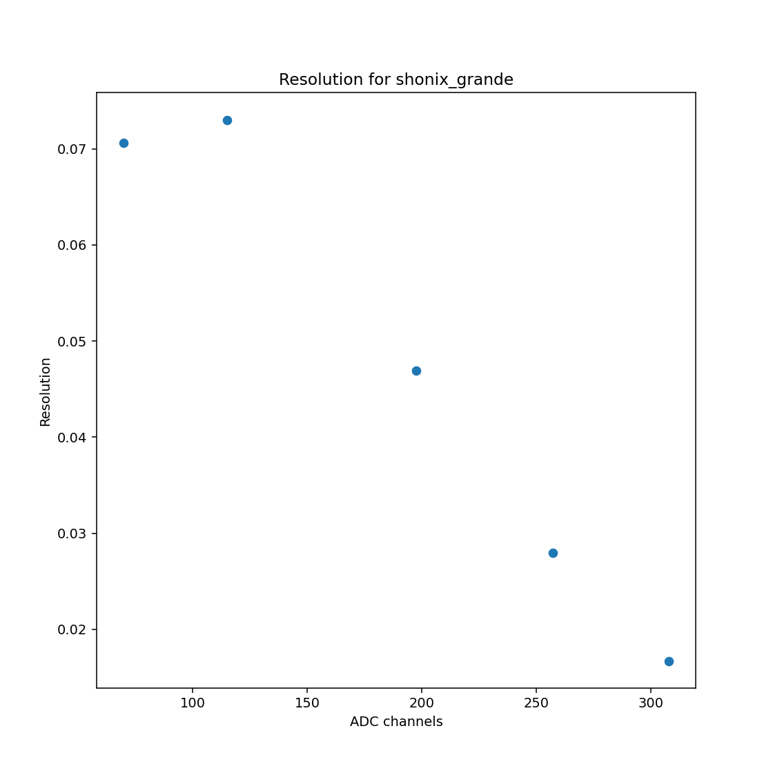
Calibration curve and resolution

Slide 25
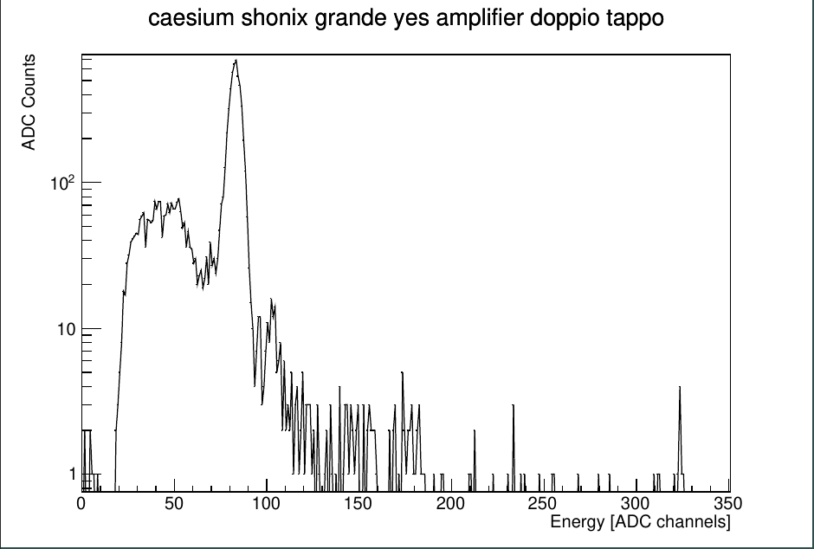
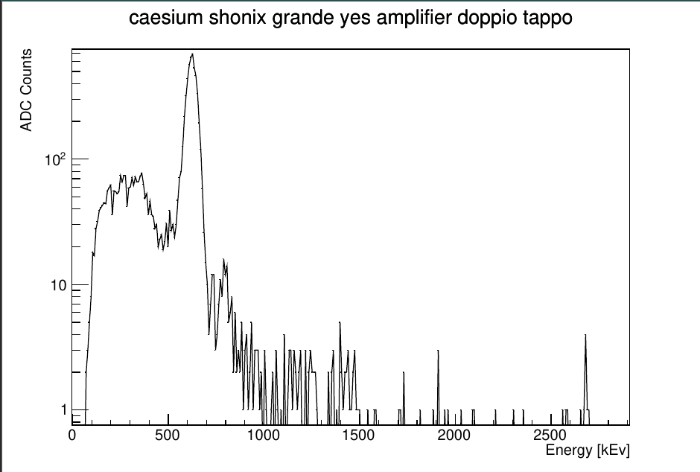
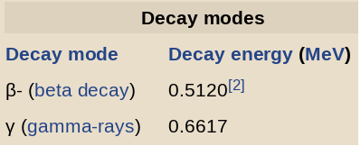
Cross-check with Cs-137
Converting from ADC to kEv using the calibration we get a value near 660 kEv
Source: https://en.wikipedia.org/wiki/Caesium-137

Slide 26
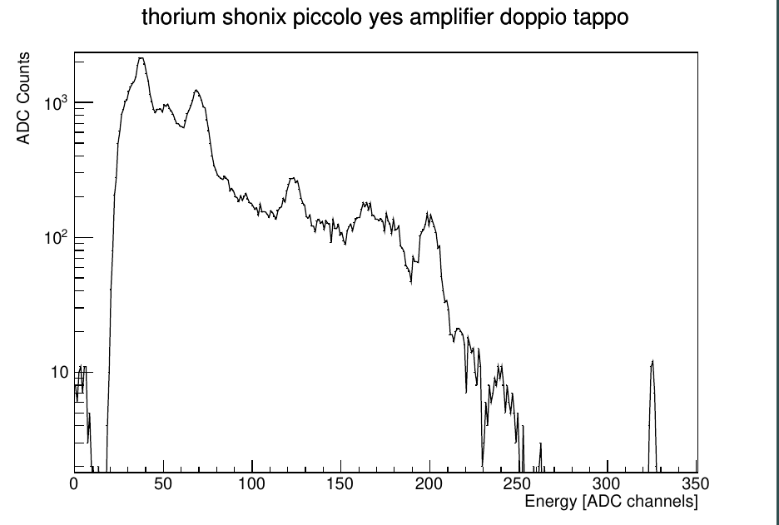
Correspondence with literature results for Scionix piccolo
Source: https://gammaspectacular.com/blue/th232-spectrum

Slide 27
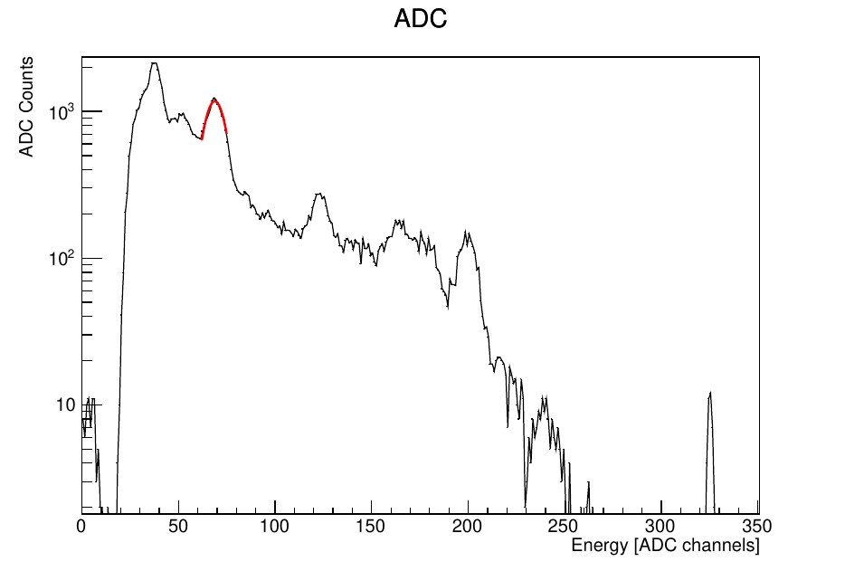



Gauss fit on the peaks – Scionix piccolo
Fit Peaks | Sigma
68.79107914042386 | 6.072847303523081
123.21536091594609 | 7.795308842960096
164.60146349903812 | 11.392989781511364
199.1809782044625 | 5.920827376930202

Slide 28


Calibration curve and resolution – Scionix piccolo

Slide 29


Proof of good calibration for Scionix piccolo: Cs-137
Converting from ADC to kEv using the calibration we get a value near 660 kEv
Source: https://en.wikipedia.org/wiki/Caesium-137

Slide 30


Thorium
Cesium

Slide 31

Charged particle
Stack of Scintillators with SIPM
Coincidence
TOF?
Charged count (Galactic, SPEs), background
Correlation with CT FT
(part of shower, ToO)

Slide 32




Block Scheme
Trigger?
Cosmo
SiPM
Detector
CPU
Readout
Gamma
X
Charged
Clock/GPS
Ethernet
(to/from Hub)
Power

Slide 33



From Giuseppe
Power
SiPM
fluo
CLOCK

Slide 34
Open points
Weight: about 30kg including cables power etc
Can be improved, most is shielding.
Power: about 30 W
Pointing direction: field of view 26 deg
Mechanics, shielding (common, individual)
Acquisition modes: histogram, self triggered (trigger scheme)
Clock synchronization
External trigger (receive) (send)

Slide 38




Caesium, small scint.

Slide 39





Thorium, small scint.

Slide 40


Calibr small scint.

Slide 41



Thorium, large scint.

Slide 42

Calibration large scint.

Slide 45
660 keV Cs137 Fukushima soil
Analog readout / shaper sample/hold

Slide 46



Cs137 from Fukushima soil

Slide 47

Thorium
Up to 3MeV
Cut at -650mV
-0.3V/MeV

Slide 48
Lutetium 176 in Lyso

Slide 50

Calibration with Thorium and Cesium
y = 8 keV/ADC + 21 keV

Slide 51
X-ray (in direct counting mode) E<10keV

Slide 52
Detectors with anticoincidence
Charged / gamma
e-/p
γ

Slide 53
Gamma Spectrometer with anticoincidence
CsI scintillator
SiPM
Anticoincidence
(CsI Cristal → plastic)
Analogic sum
Shaper
Sample and hold
Threshold
Reset

Slide 54
Rivelatori gamma

Slide 55
Thorium
Cesium

Slide 56

Charged particle
Charged count (Galactic, SPEs)
Correlation with CT FT
(part of shower, ToO)

Slide 57
Block Scheme
Trigger?
DETECTORS
CPU
FPGA
FPGA/CPU
Gamma
X
Charged
Clock/GPS
Ethernet
(to/from Hub)
Power

Slide 58
Open points
Weight: about 30kg
Power: about 30 W
Pointing direction: field of view
Mechanics, shielding
Acquisition modes: histogram, self triggered (trigger scheme, coo
Clock synchronization
External trigger

Slide 60


Slide 61


Slide 62


Slide 63


Slide 64


Slide 65


Slide 66


Slide 67

Terra

Slide 68

VOLO

Slide 69

VOLO

Slide 70

VOLO

