Slide 1

(Control) Software
F. Cafagna
INFN, Bari Department

Slide 2
What we are talking about?
In the (S)PBx jargon we talk about Control Software to specify the communication, monitor, operation and data acquisition software and middleware:
  Communication: telemetry interfaces, command handlings, status monitors, housekeeping and science data transfer and quality control …
  Monitor: housekeeping read out and analysis on board and on ground, hardware status and configurations …
  Operation: commands organization, handling, transmission and operator interfaces, operators support, hardware configurations and procedures, monitor of operations and status, operating systems configurations …
  Data acquisition: science and housekeeping read out, handling, transmission and distribution …

Slide 3
What we are talking about?
The SPB2 FT and gondola network configuration.

Slide 4
What we are talking about?
2 CPUs in hot-cold and hot-hot configurations.
10 devices to operate and monitor using two busses
4 networks to configure and monitor according to the hardware configuration.

Slide 5
What we are talking about?
2 CPUs in hot-cold and hot-hot configurations.
3 telemetry links: via GCC, PILOT (IRIDIUM) and STARLINK.
10 devices to operate and monitor using two busses
Inbound and outbound connection via PILOT and STARLINK.
4 networks to configure and monitor according to the hardware configuration.
Interface with the Gondola Control Computer for command and data handlings.

Slide 6
What we are talking about?
2 CPUs in hot-cold and hot-hot configurations.
3 telemetry links: via GCC, PILOT (IRIDIUM) and STARLINK.
10 devices to operate and monitor using two busses
Inbound and outbound connection via PILOT and STARLINK.
4 networks to configure and monitor according to the hardware configuration.
Ground Support Equipment (GSE) virtually located on any PC, via PILOT and STARLINK inboud connections
Interface with the Gondola Control Computer for command and data handlings.
2 databases setup for housekeeping and related GRAFANA servers.

Slide 7
What we are talking about?
In the SPBx jargon we talk about Control Software to specify the communication, monitor, operation and data acquisition software and middleware:
  Commands can be defined via text or XML files.
  Commands can be grouped in sequences.
  About 800 command and sequence procedures has been defined and tested for the flight operations.

Slide 8
Software working group
The software working group will coordinate the work on all task related to the above mentioned items.
As for SPB2, everybody is welcome to join it.
In SPB2 we had a representative for almost all sub-systems.
For SPBR I hope will be possible to have an interaction also with the GCC and GSE software developers.
Working group meetings will be resumed next year.

Slide 9
Outlook
For the communication task we will keep the SPB2 framework.
For the readout, but the CAN-bus, we wait for the detector requirements and specifications.
For the monitor, the InfluxDB and GRAFANA pair will be kept.
Update are needed for the Operating system:
  Migration to Debian 11;
  Migration to NetworkManager for the network configuration;
  Investigation of more advanced tools for the redundancy management.

Slide 10
Backup

Slide 11
SPB2 block scheme
To handle the complexity of the FT, its interconnection and different test and integration phases, the software must support:
  Different command format.
  Different connection protocols and hardware.
  Extensive and comprehensive configuration.
  Remote control from different PC and geographical locations.

Slide 12
The DP CPU block scheme
Software must implement the control of the FT and it subsystems.
Communication with subsystems are actuated via two links:
  CAN bus, used for device’s sensors readout (temperatures, currents, voltages), housekeeping data and slow control.
  Ethernet used for science data and slow control.

Slide 13
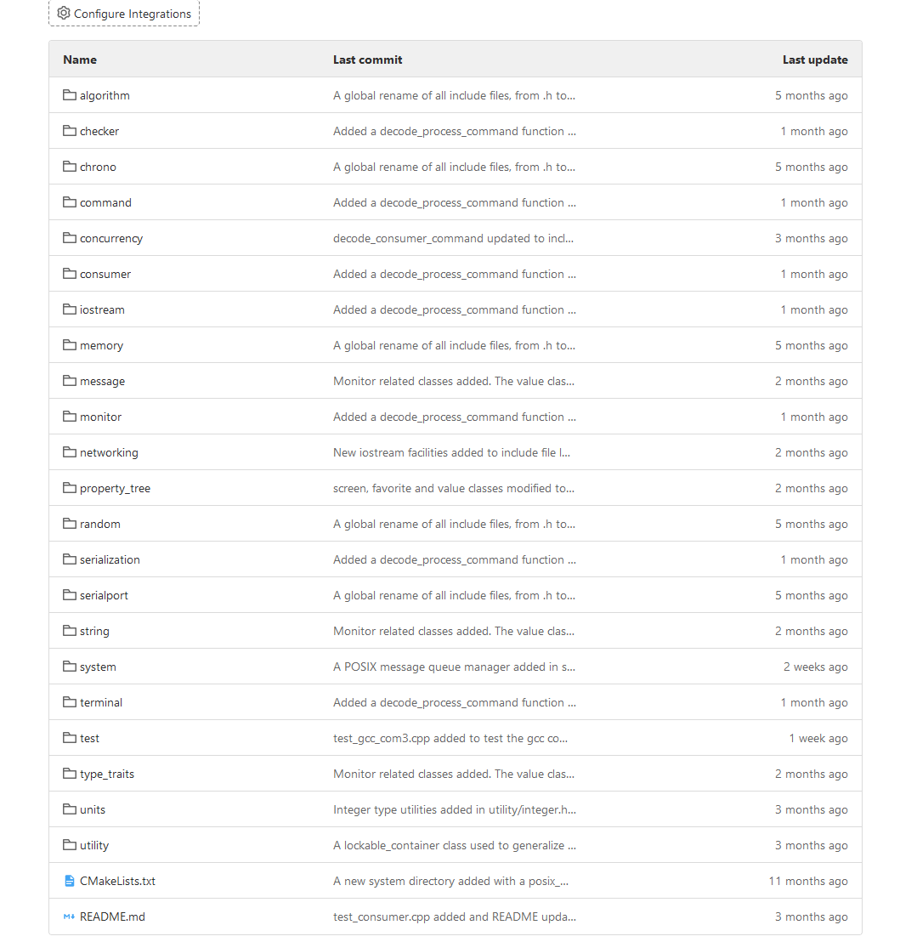
fcutils
Big effort has been put in increase the software re-usability and sharing among all the telescopes.
The repository is arranged in a collection of utilities to be used in more than one project.
For example the TCP&UDP server and client are classes of namespace and can be used just including the header file.

Slide 14
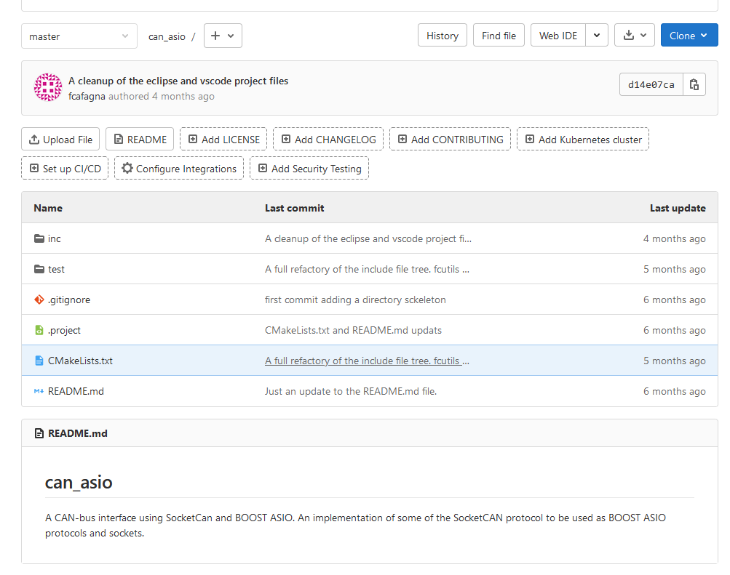
Can_asio
An interface of BOOST ASIO library and the linux socket_can module.
Communication using CAN bus are implemented using socket and the same library used for the TCP/UDP and serial communication.

Slide 15
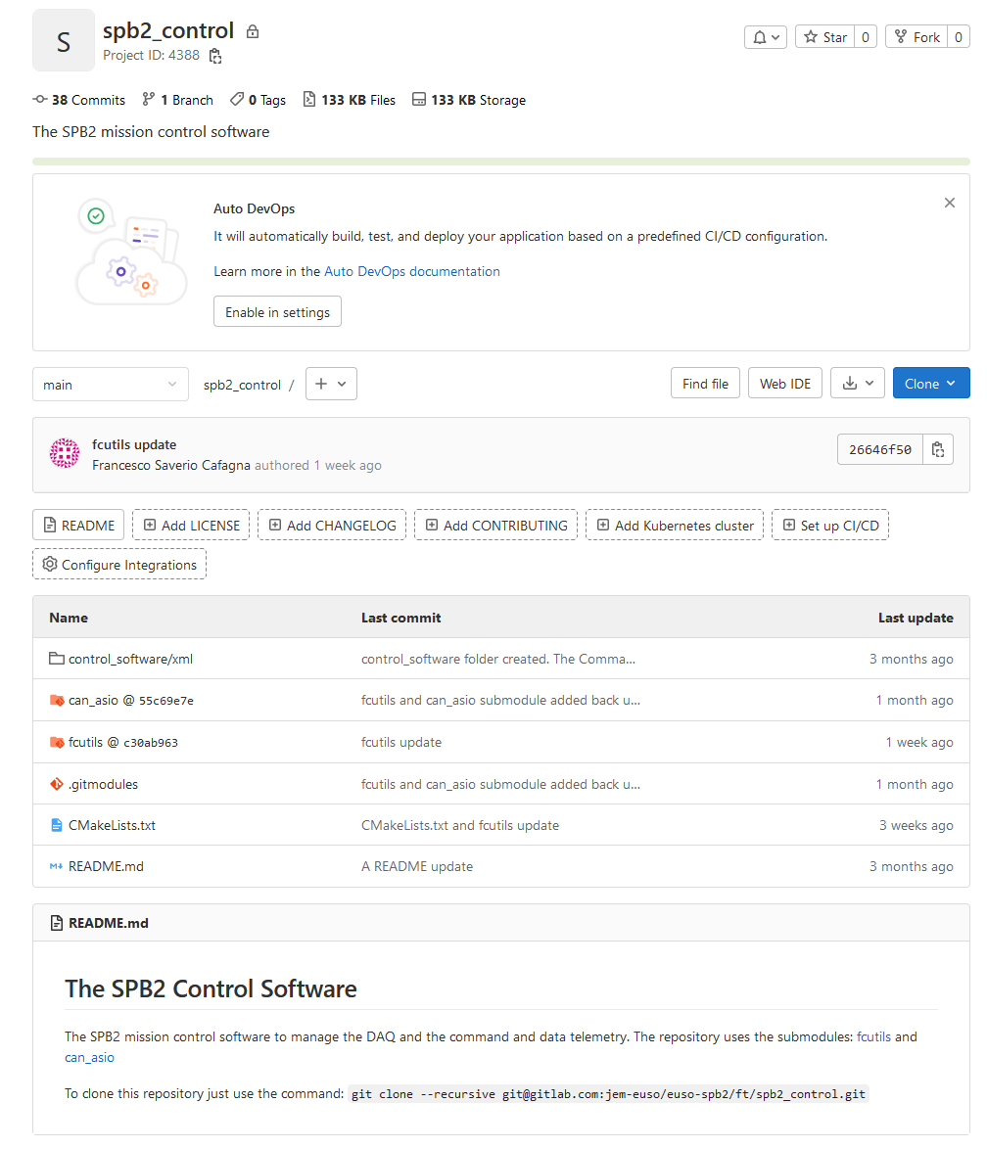
Spb2_control
The repository: spb2_control, includes all the reference repositories as submodules.
This repository is dedicated to the code in production for the flight, with focus on the XML files with the configuration and command definitions.

Slide 16
FT a straw man data flowchart

Slide 17
FT a straw man data flowchart
Raw science data merging, time ordering and Event reconstruction is implemented by the Event Builder.
Event Builder output files are readout by the Prioritizer which will look for EAS, filter data, and reorganizing them according the GCC priority naming scheme.

Slide 18
FT a straw man data flowchart
A subset of the housekeeping (HK) data will have maximum priority. To enable run time telescope monitors.
HK data will be collected via CAN and Ethernet interfaces and transferred to the TM system.

Slide 19
FT a straw man data flowchart
The control software will receive commands from GCC or support PCs (during integration) and forward it to the corresponding process.

Slide 20
Telemetry
The format and protocol of the command message upload and transmission to the DP-CPU, has been tested using a dedicated virtual machine developed by the NASA group in charge for the gondola.
Tests included both the ground section, i.e. the transmission from the operator to the mission Ground Support Equipment (GSE), and the flight section, i.e. the transmission from the Gondola Control Computer (GCC), to the DP-CPU (on both telescopes CT and FT).

Slide 21
Commands message
A common command message structure has been agreed for both telescopes.
The subsystem commands, formatted according their specification, are serialized into string and wrapped between an header and trailer.
Header and trailer are used to identify the message, to check its consistency and to encode the subsystem address.

Slide 22
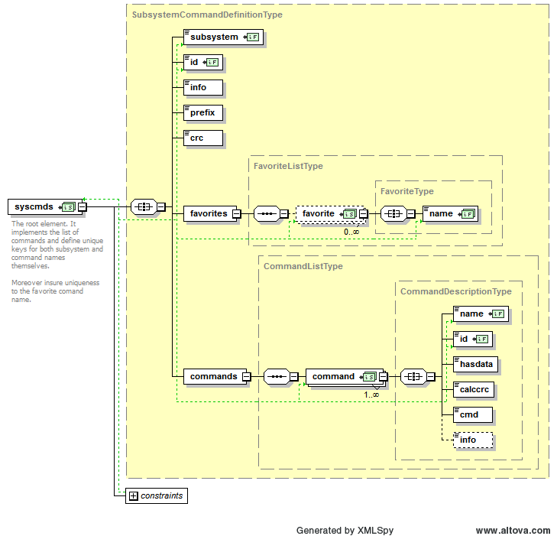
Commands message
You can think about the system as an highly configurable message passing tool.
Commands are serialized into ASCII char, to avoid telemetry problem and add an extra safety layer in the command decoding phase.
This string is then packed according to the GCC exchange format and injected into the operator command transmission chain.
On board will be received in the GCC format, unpacked and deserialized eventually.
Once serialized, commands can be collected into an ASCII file. We adopt the XML format, defining a dedicated scheme for commands.
Commands are uniquely identified via a subsystem name and a command name. These are key constraints in the XML schema to enable automatic checks in the XML file, by specialized editors and parsers.

Slide 23
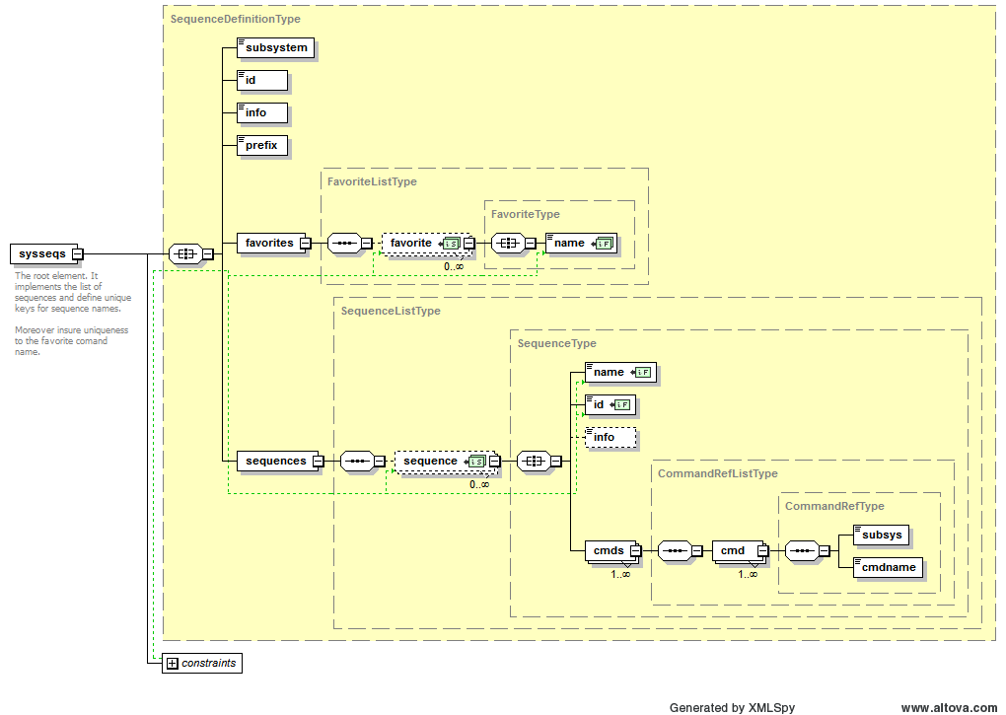
Commands message
As well as commands also sequences of commands can be defined.
As well as for commands we adopt
the XML format, defining a dedicated scheme also for command sequences.
Sequences are build up
using the command and
sequence identifiers,
i.e. a sequence can execute
other sequences.
Sequences are uniquely identified via a subsystem name and a sequence name. These are key constraints in the XML schema.

Slide 24
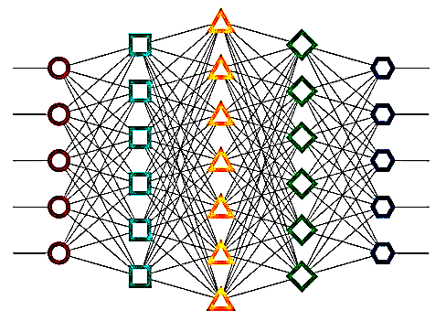
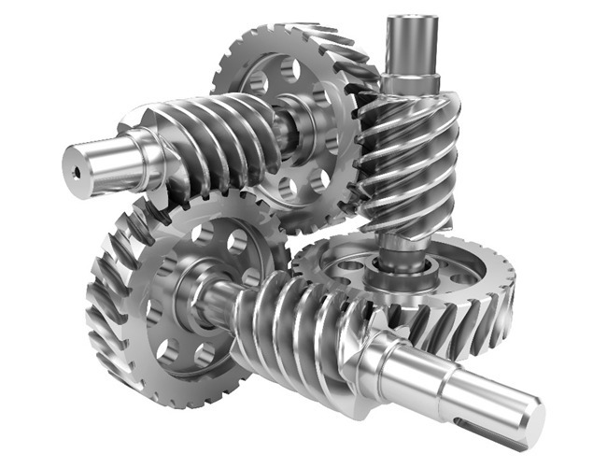
The Event Builder
CLOCK
BOARD
PDM
1
PDM
2
PDM
3
Analyzer
NEXT
Download files
HIGH
MEDIUM
Compression
event_builder
datpackets-20211129141514-0418-0.dat
datpackets-20211129141520-0428-0.dat
datpackets-….bz2
datpackets-….bz2
datpackets-20211129141532-0439-0.dat
datpackets-….bz2
datpackets-….bz2
datpackets-….bz2
PERMANENT STORAGE
datpackets-….bz2
datpackets-….bz2
datpackets-….bz2

Slide 25
The Event Builder
HEADER
CRC
Collects raw data from:
  The ClockBoard (includes GPSes info);
  The three PDMs.
Starts asynchronous spoolers to get raw data and log info from the CLKB and the Zyncs to avoid clogging their memories.
The science data packet is composed of:
  A header with its own CRC;
  CLKB part of the event with the original CRC;
  Zynq 1/2/3 data including the original CRC.
Any sub-packet can be missing and this is reported in the header.
CLOCKBOARD
CRC
PDM-1
CRC
PDM-2
CRC
PDM-3
CRC

Slide 26
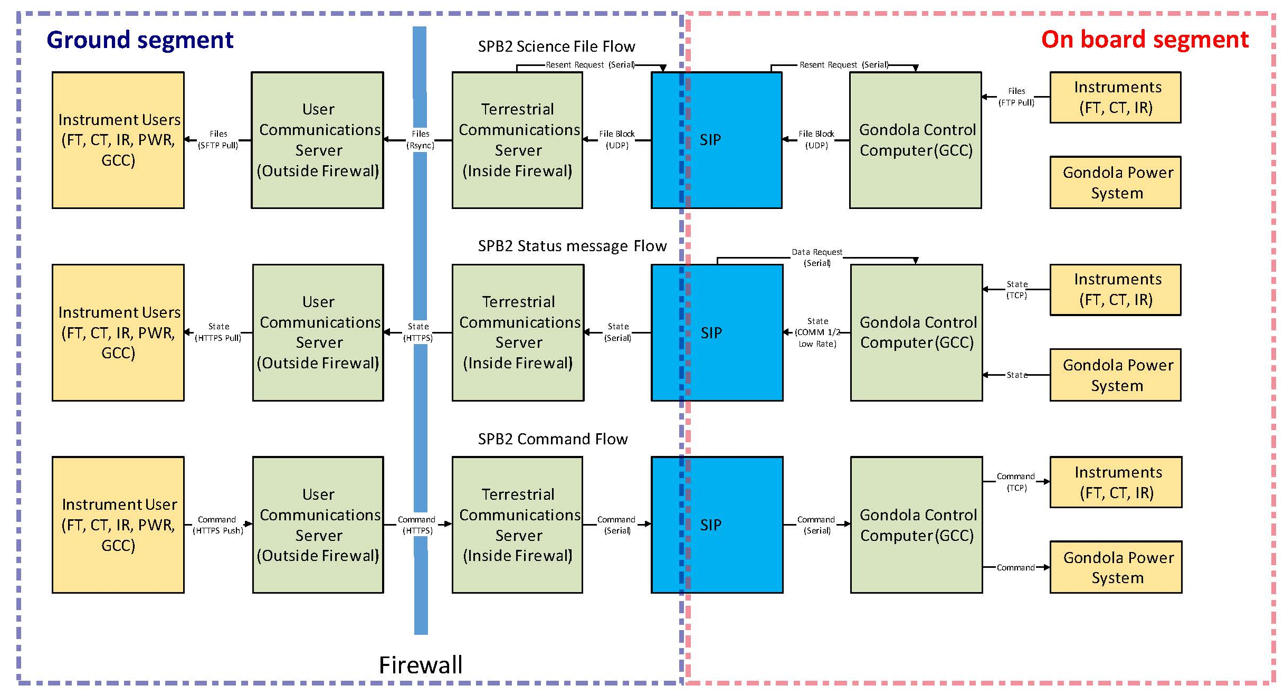
Telemetry
Block scheme of the telemetry workflow.

