Slide 1
ST update2
gtraini

Slide 2
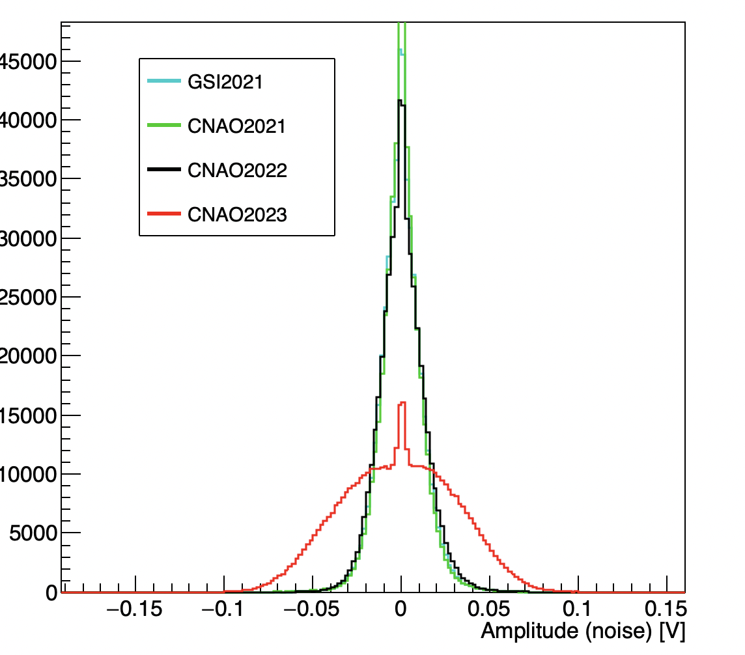
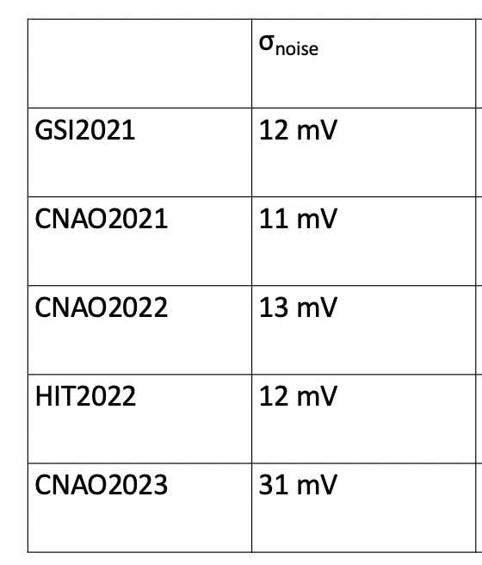
A lot of inconsistencies…
Clock syncronisation ,WaveDAQ load, noise, signal shape and amplitude, wavedream type…
I started from the most straightforward and manageable issue: noise

Slide 3
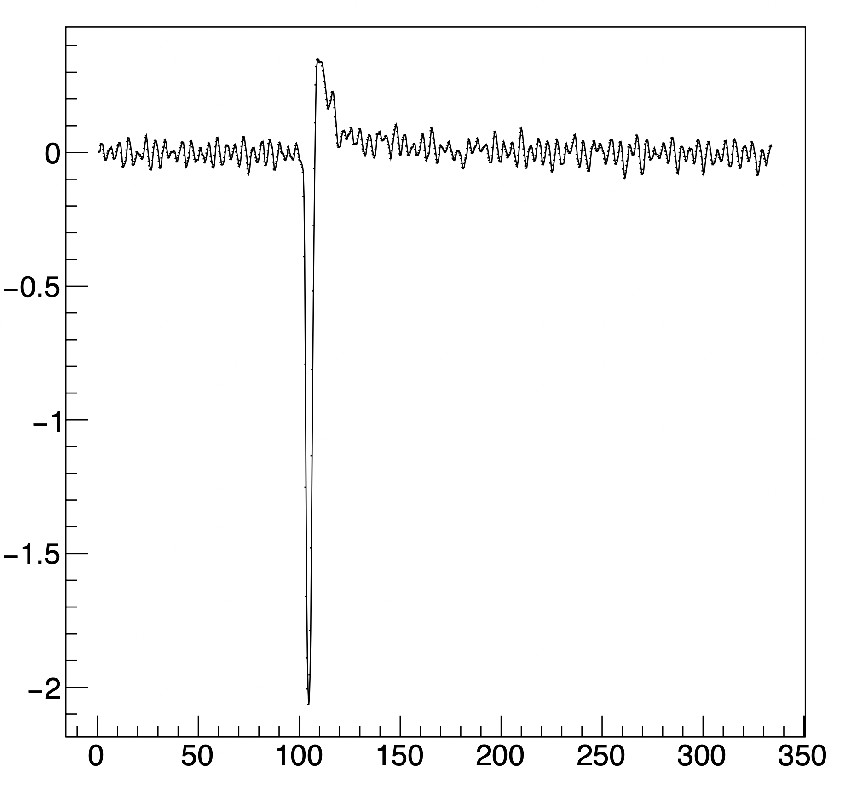
ST signal (sum)
Noise seems to have at least one component @ ~ 200 MHz
Goal: fourier analysis and filtering attempt…
Amplitude [V]
Time [ns]

Slide 4
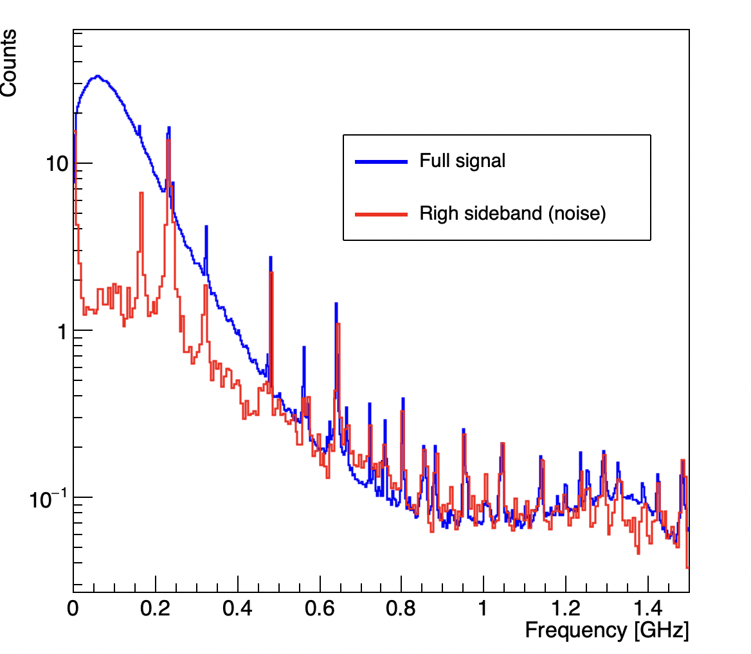
FFT
FFT implemented in shoe (ROOT libraries), still to be pushed
Clear peaks due to noise

Slide 5
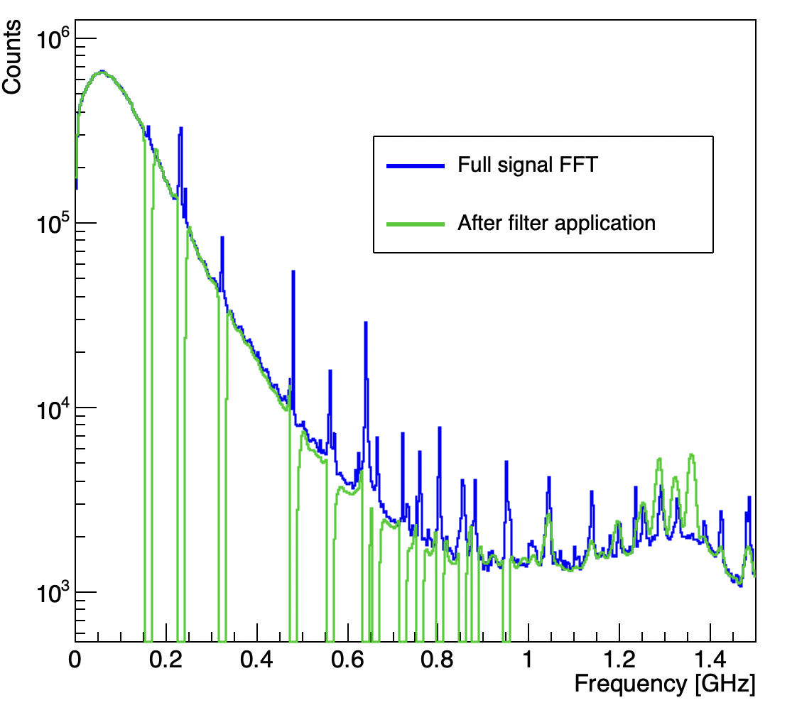
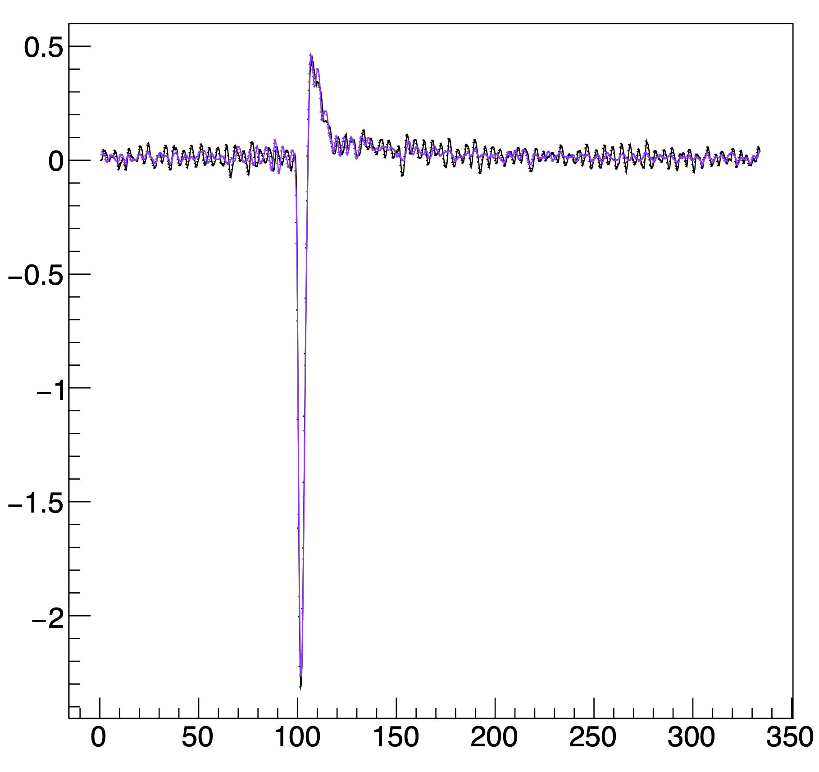
Filter
A lot of quick attempts (smoothing, high-pass, peak finder to look for noise peak…)
I show you just the best (at present) option: rough cut on single frequencies “by hand”
Process: FFT -> filter -> inverse FFT
Orig.
Inv.FFT

Slide 6
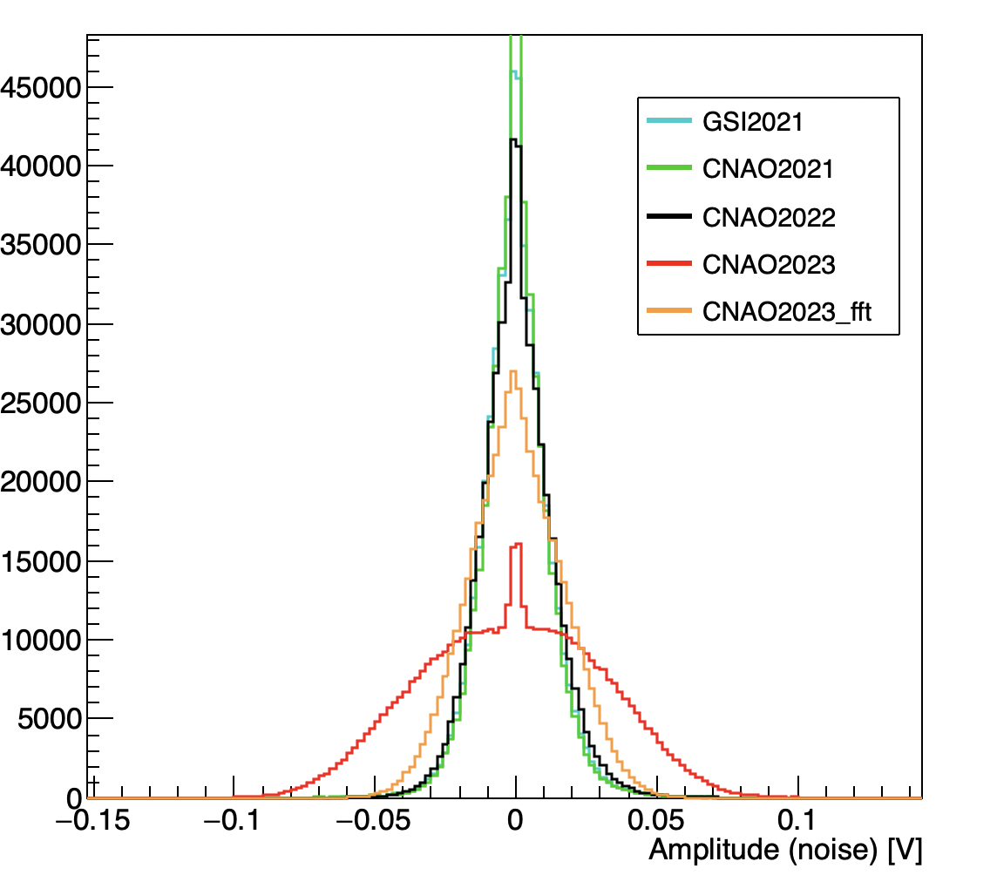
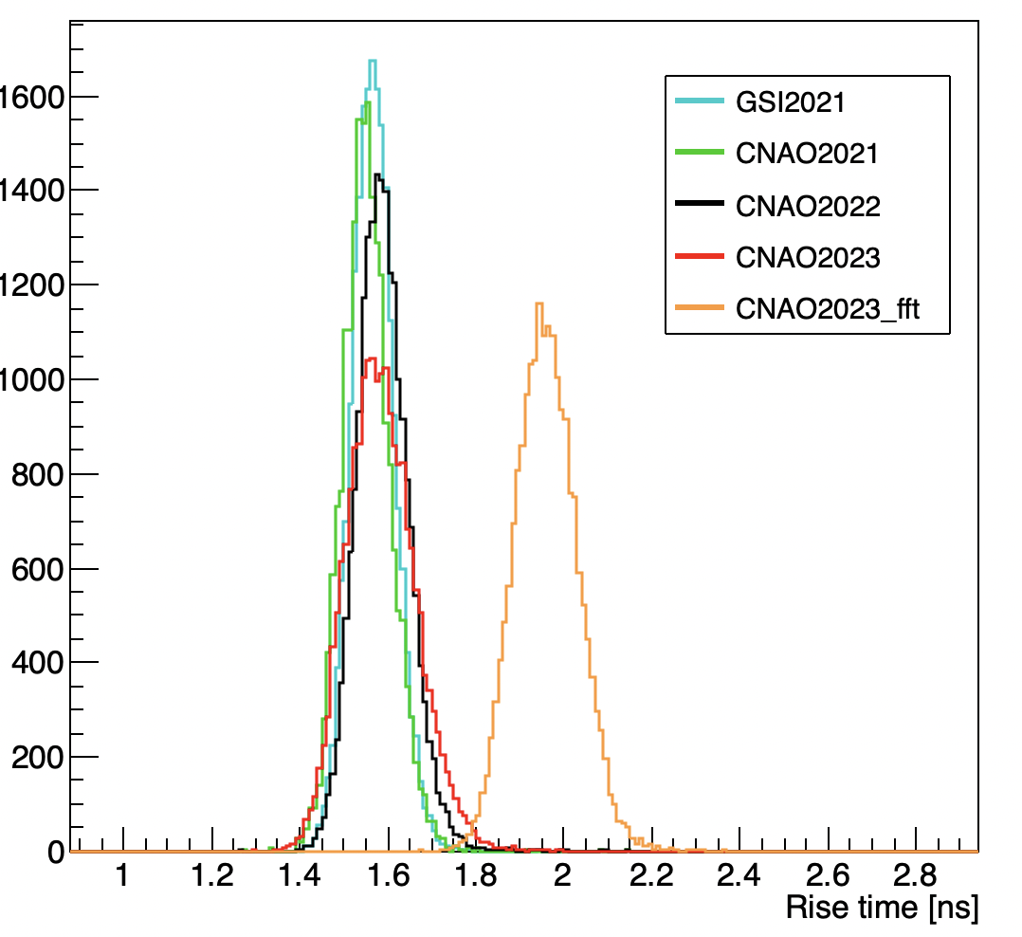
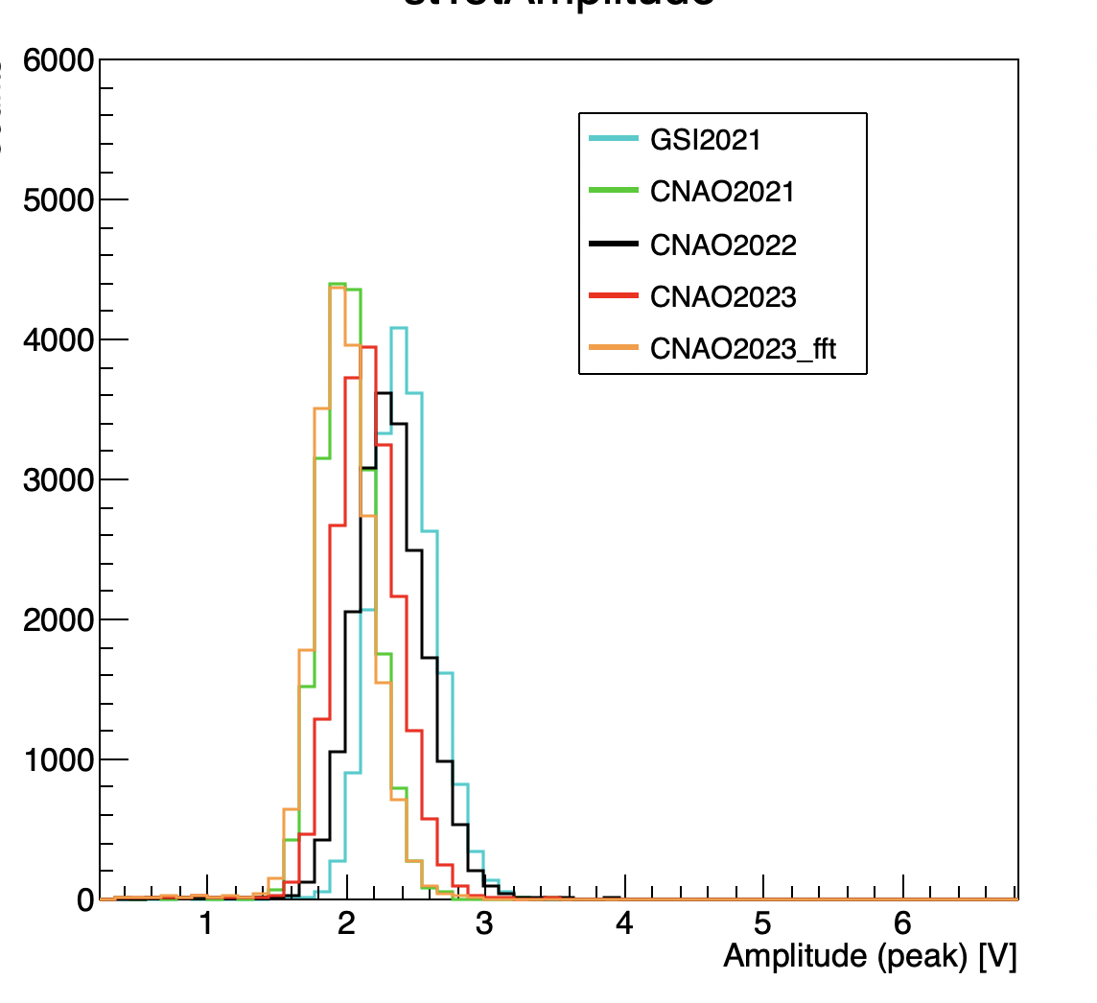
Effect on th ST
Noise reduction
Rise time enhancement
Amplitude lowering

Slide 7
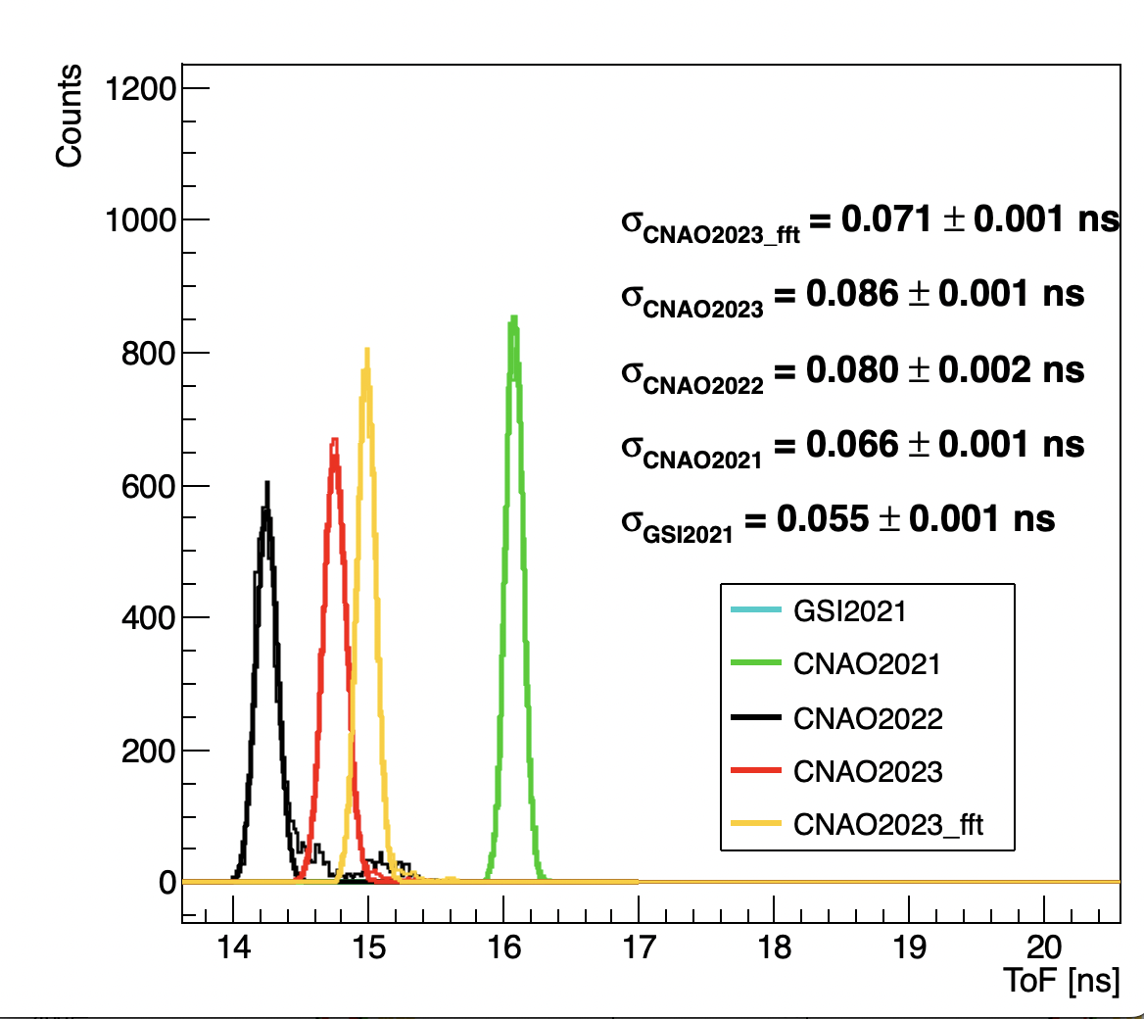
Time of flight
From 86ps to 71 ps tof resolution
Good improvement, we are closing to CNAO2021

