Slide 1
Update from RIPTIDE lab
RIPTIDE meeting 11/09/2024
Claudia Pisanti UniBO & INFN BO
Alberto Mengarelli INFN BO

Slide 2
Outline
Trigger for ASI camera
MCP status
Purchased material

Slide 3
Trigger for the ASI Camera: Set-up
Oscilloscopio
Signal from the PMT
Black box
Signal after reshaping
ASI 533 + optics
PMT
blue LED
Discriminator
Dual Timer
At 1200 Volt.
Pulsed with ARDUINO
- 1 ms ON
- 5000 ms OFF
facing the LED
To Arduino UNO
Analog PIN
Sig IN : ~50 mV
Output USB to the LAPTOP
Output USB to the LAPTOP
Threshold: 30 mV
Sig OUT : ~1.7 V
Time width from ns to ms

Slide 4
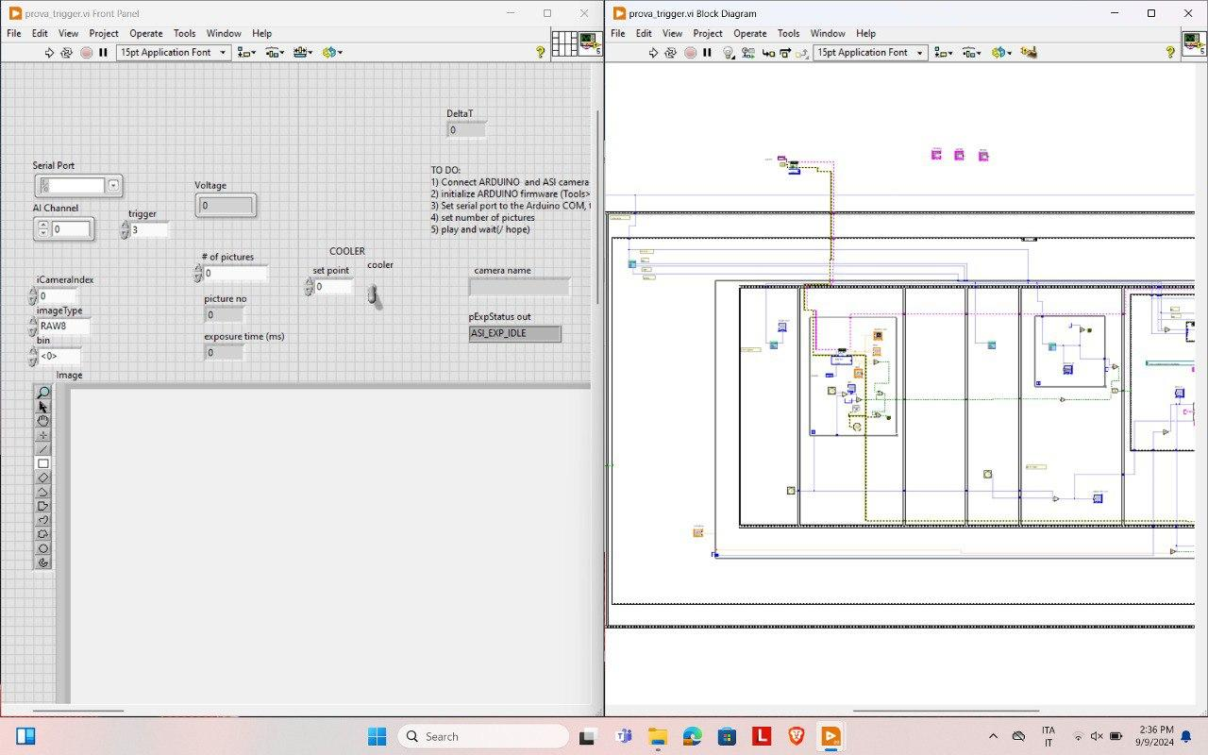
Trigger for the ASI Camera: Labview
In Labview pre-build libraries for ARDUINO and ASI-Camera
Start camera exposure
Wait for the PMT Trigger signal from ARDUINO
Stop camera exposure
Save DATA
LabView acquisition software

Slide 5
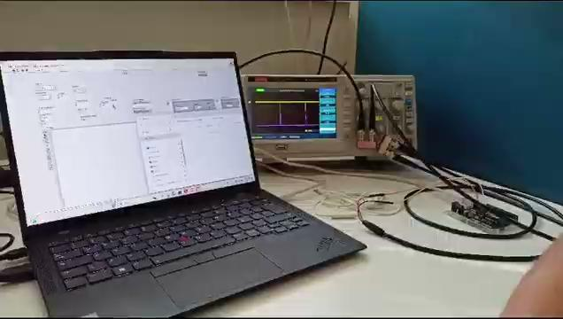
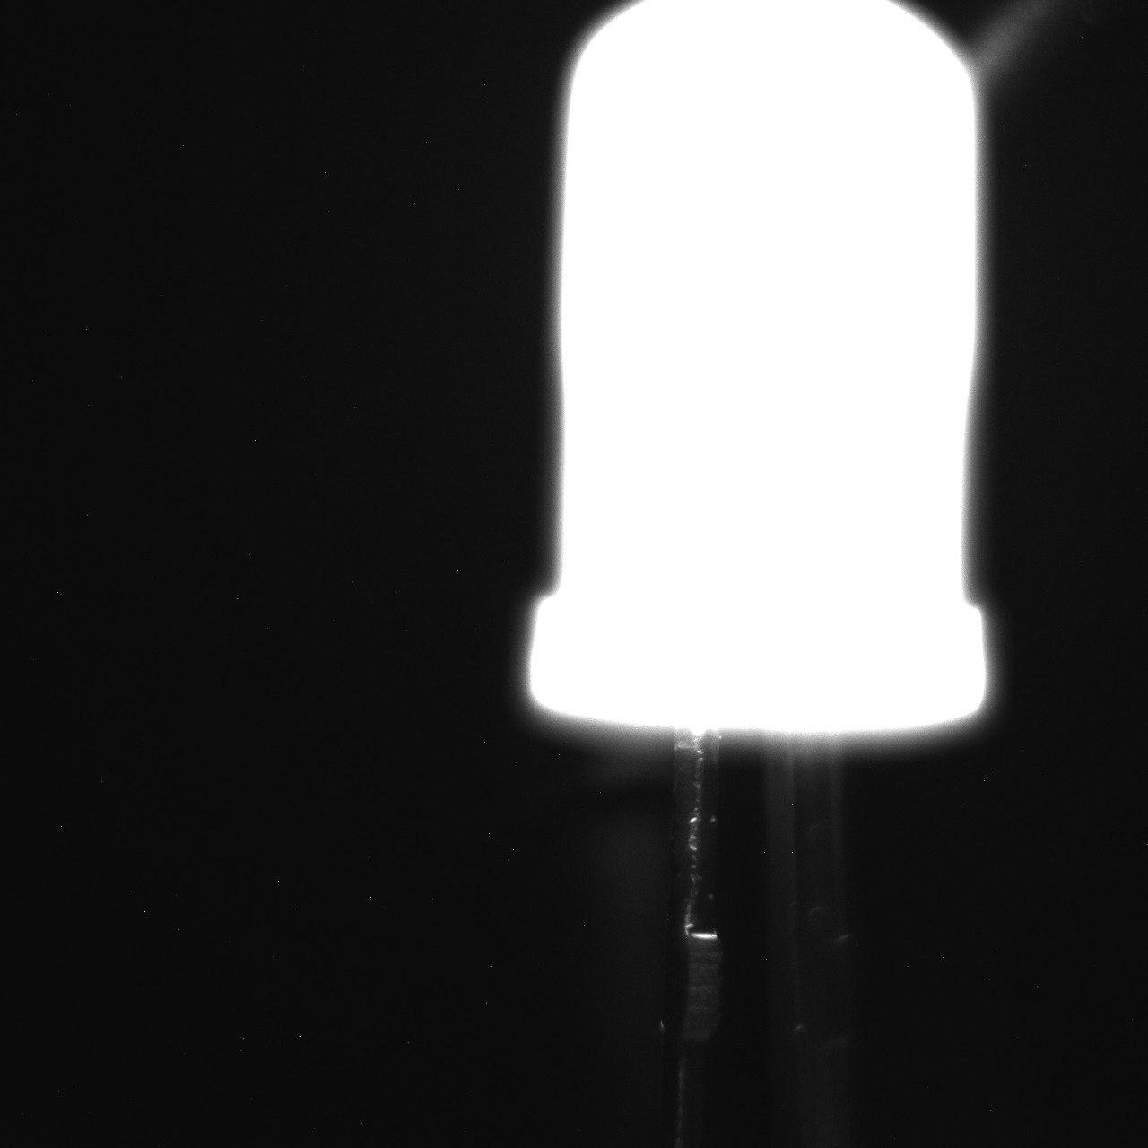
Trigger for the ASI Camera: Output
Output on the camera

Slide 6
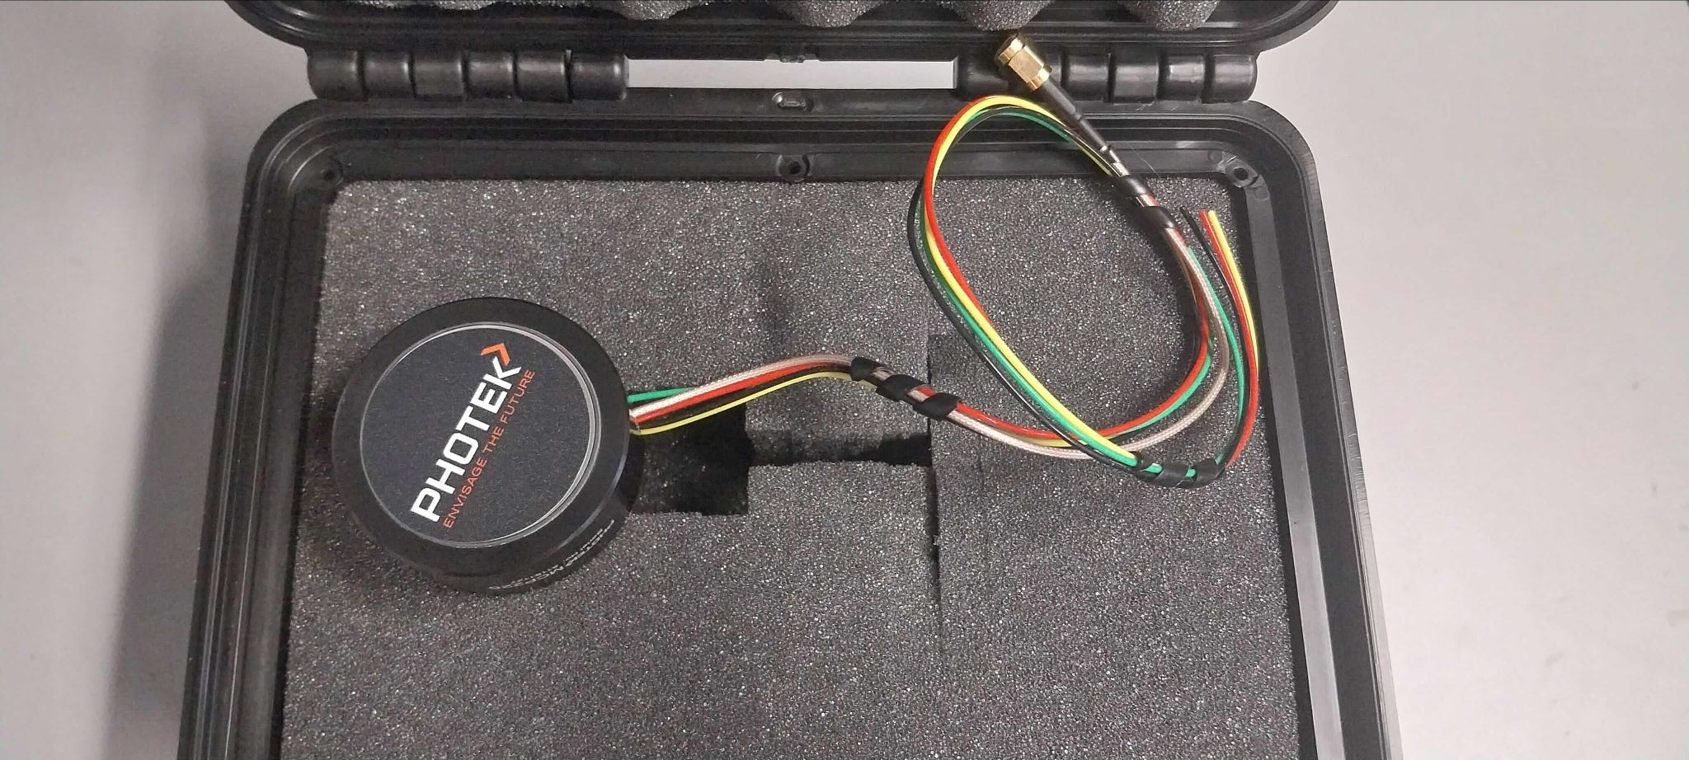
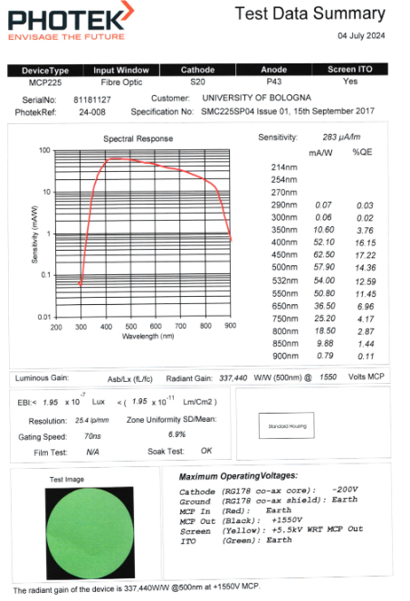
MCP Status
MCP is in out lab!
need to make it work…

Slide 7
Shopping June/July 2024
From Thorlabs:
Laser 405 nm, mounting rings and lenses, screw kit, cleaning set, mirror and holders ~ 1.5 keuro ✔
(M4 instead of M6)
From RS:
Banana-banana cables (10 red + 10 black), coaxial cable 50 m 75 Ω, connectors (micro bnc) ~ 300 euro ✔
(After 16 Oct.)

