Slide 1
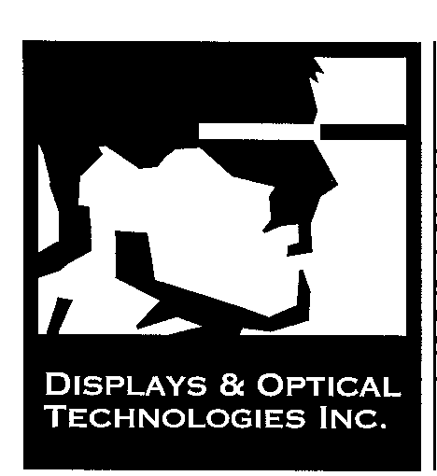

Slide 2
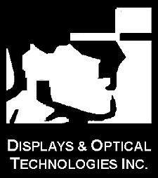
Over View
Custom Optics Manufacturer
Prototype to Production Quantity
Slumping, Annealing, Grinding and Polishing
Extremely Lightweight and Massive Optics
Custom Machining and Mounting processes.
ExPRES-PERMA lightweight mirrors
Excellent History in Gamma Ray Reflectors

Slide 3
Major Markets Served
Solar Energy
Massive mirrors for Flight Simulation
Extremely lightweight “fold” mirrors
Test and Measurement
Laser Scanning and reflection
Display System Reflectors

Slide 4
Gamma Ray pROJECTS
TREX INDUSTRIES
PHILLIPS INDUSTRIES
UCR- Solar II - Luz
VERITAS- WHIPPLE OBSERVATORY
HESS II- PROTOTYPES
UNIVERSITY OF UTAH
NASA-GREENBELT, MD

Slide 5
VERITAS - WHIPPLE oBSERVATORY

Slide 6
Luz- Solar ii Concept

Slide 7
Luz-solar ii actual mirrors

Slide 8
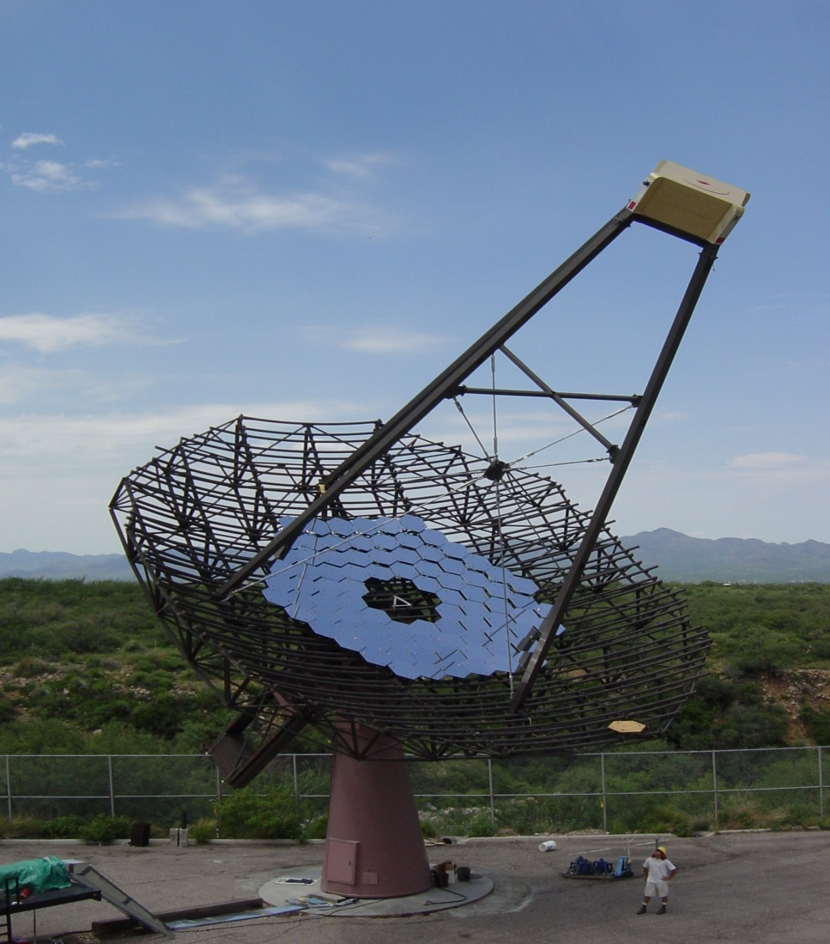
Veritas @whipple observatory

Slide 9
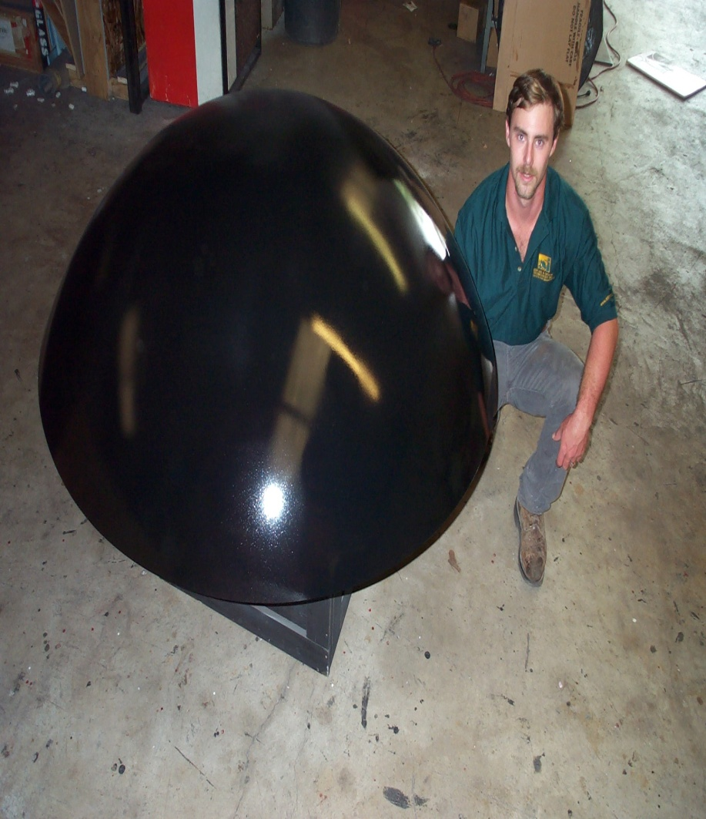
Massive optics

Slide 10
PERMA® Lightweight rigidized mirror system

Slide 11
Lightweight Simulation Mirrors

Slide 12
Summary
Lightweight Mirror Technologies
Massive Mirror Capability and Much Experience
Experienced Staff and Suppliers
Ability to ramp up for large manufacturing cycles
Ability to innovate to create lightweight, more accurate structures

